Slide 2
HI-ECN3 RP Aspects
C. Ahdida, O. Pinto, J. Coleman-Smith, P. Vojtyla, H. Vincke
CERN & ISIS collaboration workshop
01-02 June 2026

Slide 3

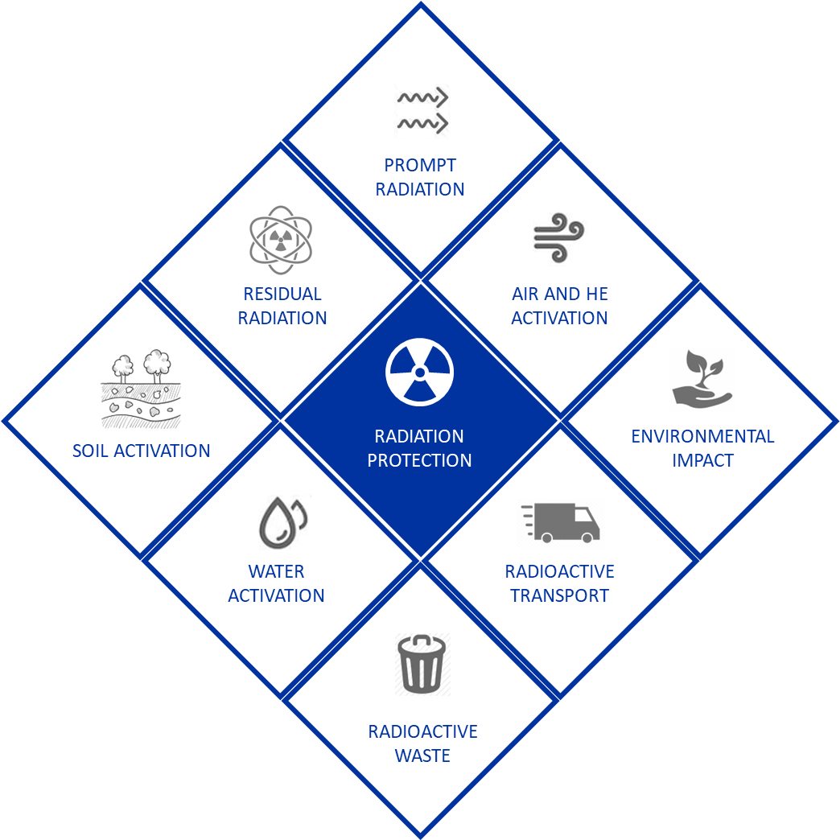
BDF/SHiP design optimization
ALARA approach
Optimization required to ensure that exposure of personnel to radiation and radiological impact on environment are
As Low As Reasonably Achievable
Wide range of RP studies
HI-ECN3 design optimization addresses all relevant radiological aspects of the facility covering its full life-cycle
RP studies are based on FLUKA MC studies
All studies will be summarized in the upcoming Technical Design Report
Few selected topics discussed today

Slide 4
Outline
Target Studies
Prototype Targets
Service Building Considerations
Tritium Diffusion Studies

Slide 5
Target Studies

Slide 6
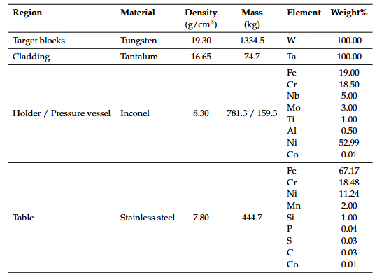
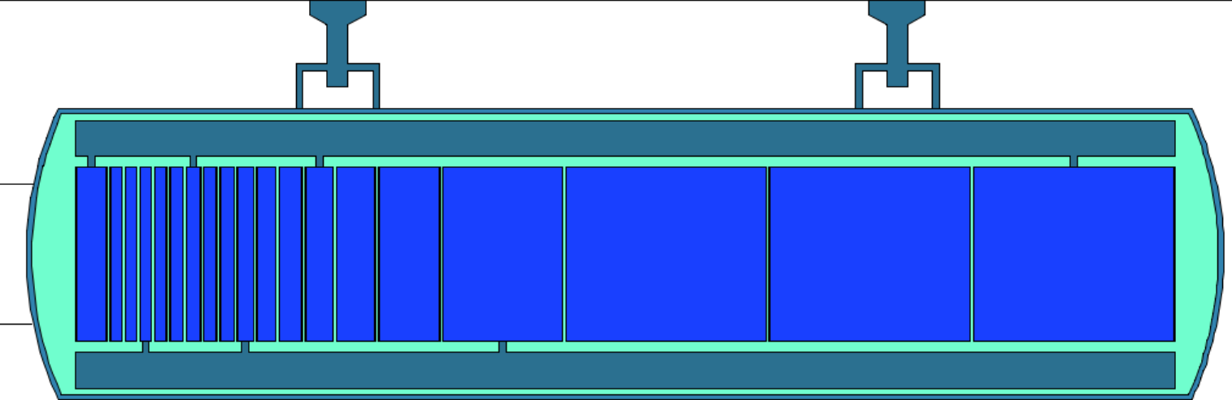
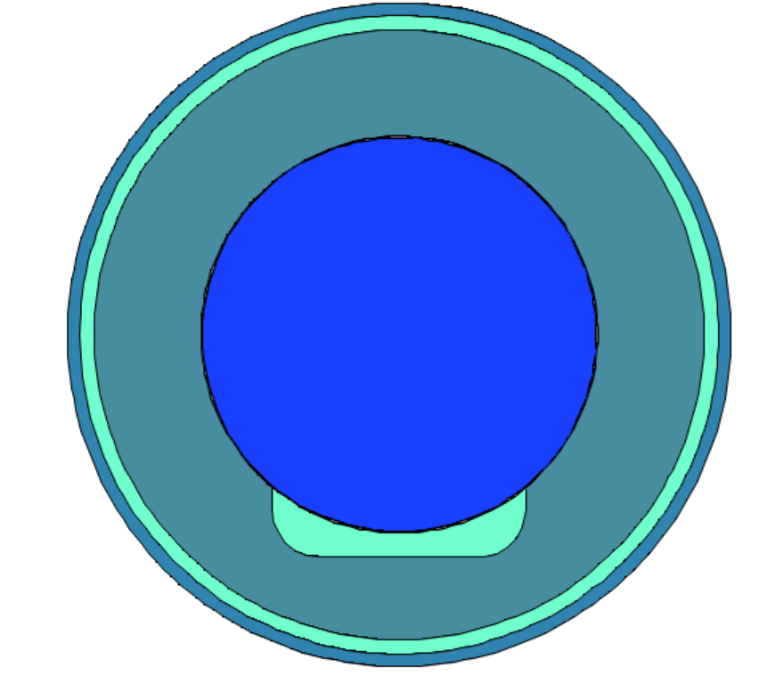
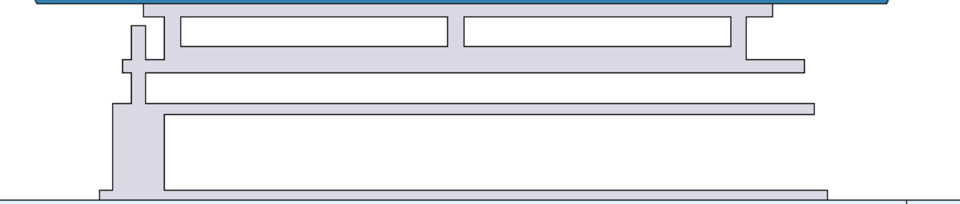
BDF Target Assembly FLUKA Model
PRELIMINARY
ST1A07710 Design
19 W blocks (L144 cm, D25 cm, 19.3 g/cm³, 1.3 tons)
With 1.5 mm Ta cladding
Target Assembly materials
171.25 cm
Inconel vessel
25 cm
Inconel holder
SS table
Tungsten
SS, 0.01% Co
Helium (only present during irradiation)
The interaction length of the target amounts to 16 λ
Tantalum
Inconel, 0.01% Co

Slide 7
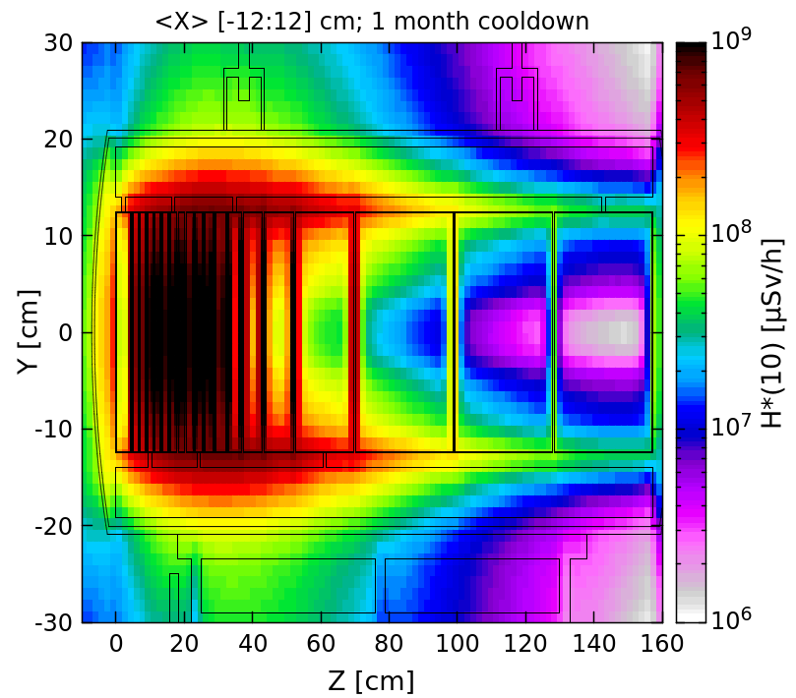
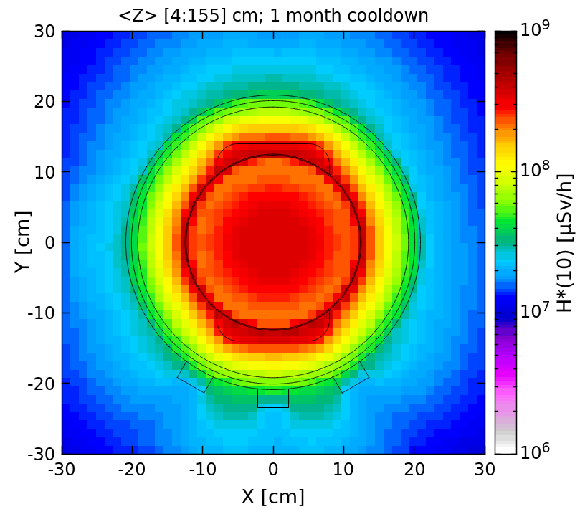
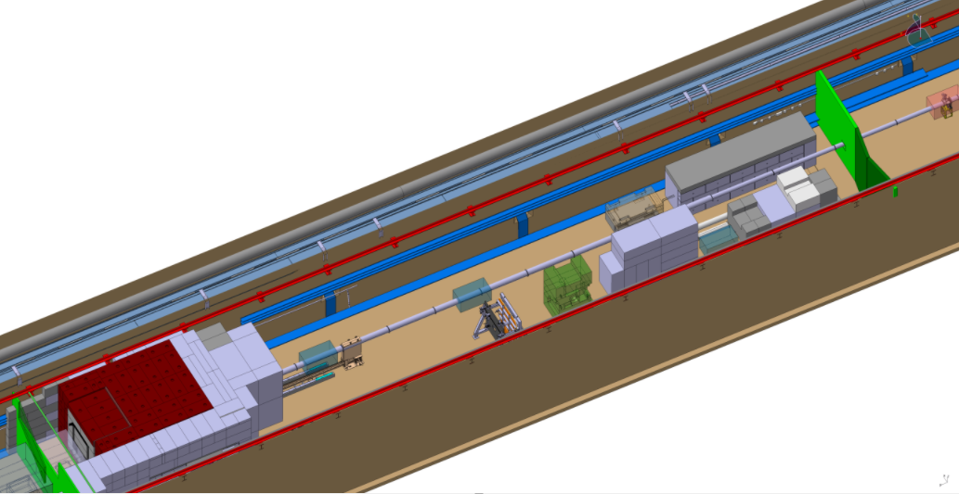
Residual Dose Rates – 1 month
PRELIMINARY STUDY
Residual dose rates of target assembly
1 month of cool-down
Top view
Cross-sectional view
The spent target will be remotely transferred into a shielded cask
The target will be stored in a dedicated intermediate storage zone in TCC8 for cooldown, prior to transport and waste packaging for disposal
Target area
Spent target intermediate storage area
Target & beam dump
Residual dose rates of target reach ~100 Sv/h at contact to the target vessel

Slide 8
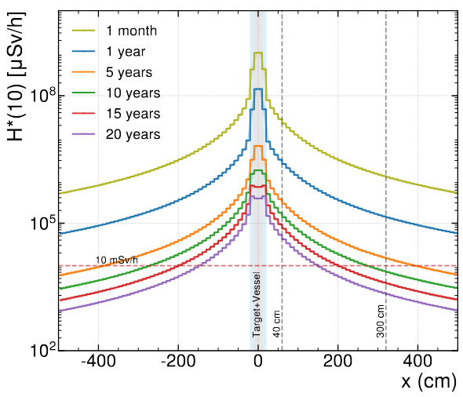
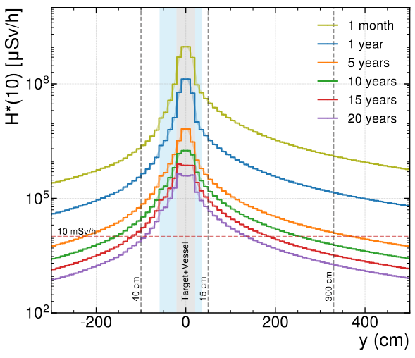
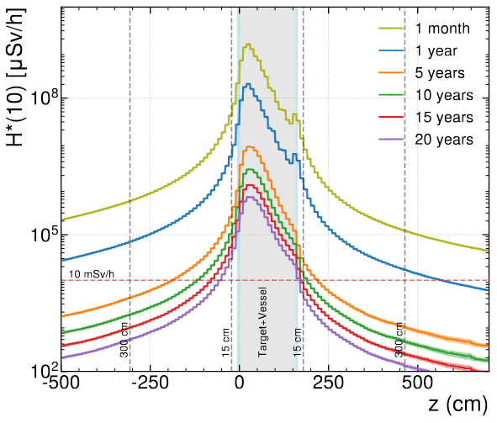
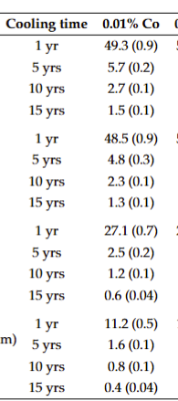
Residual Dose Rates of Target Assembly
PRELIMINARY STUDY
Residual dose rates of target assembly, no shielding
Various cool-down times
<x,y> [-20;20] cm
<z> [100] cm
y
x
z
Max. DR (mSv/h) at 3 m
Max. DR (mSv/h) at 3 m (top)
Max. DR (mSv/h) at 3 m (upstream)
No safety factor included here, statistical errors
Dose rates are < 10 mSv/h at
3 m for ≥ 5 years of cooling
Statistical uncertainties in parentheses

Slide 9
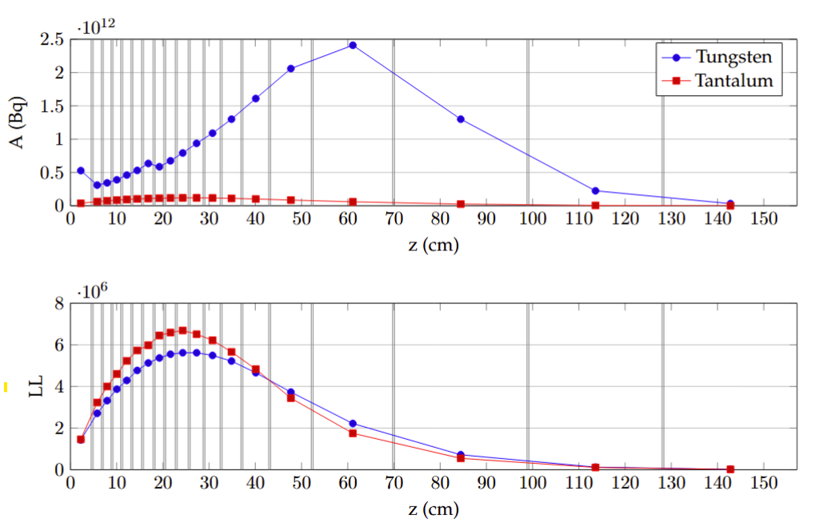
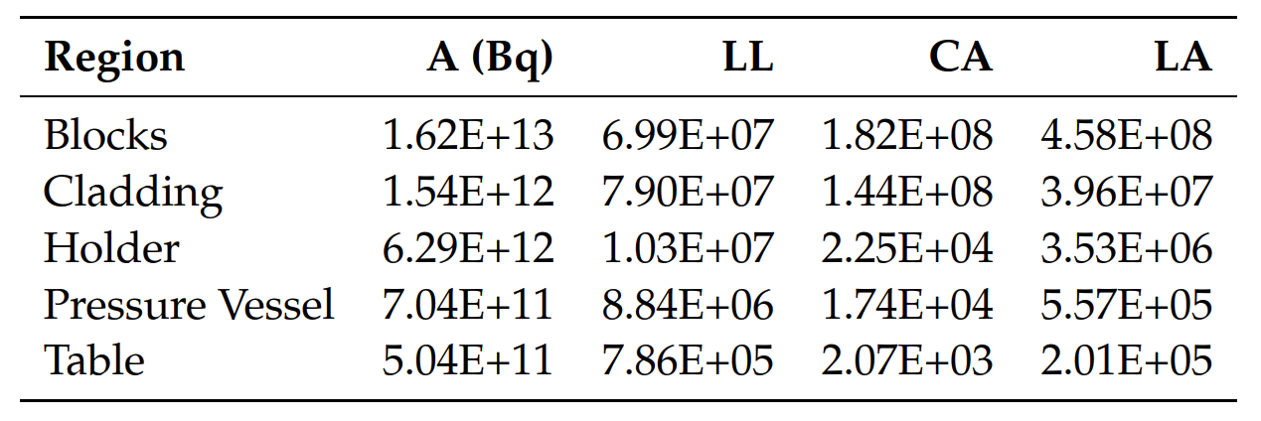
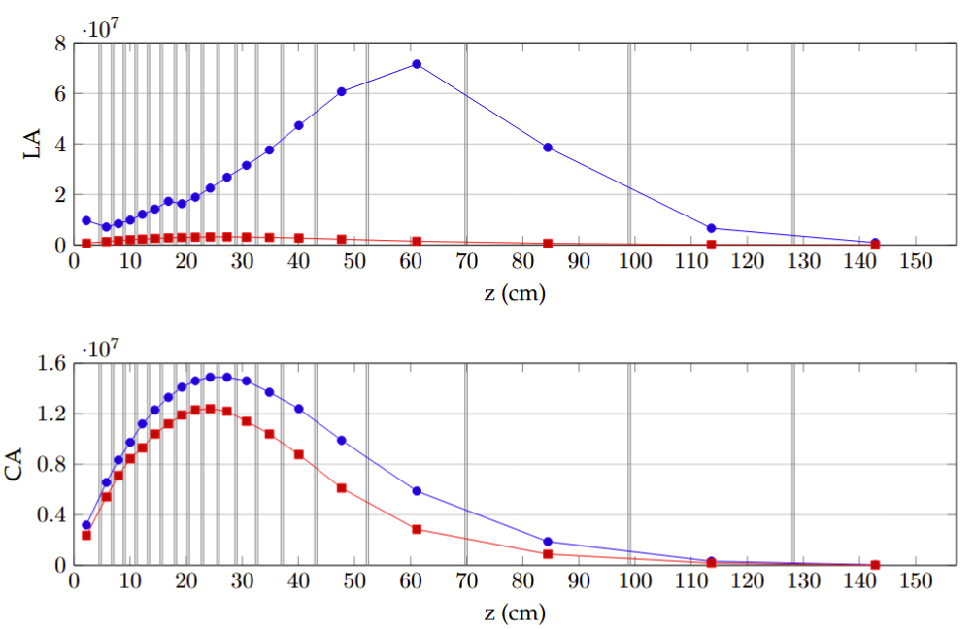
Radionuclide Inventory of Target Assembly
PRELIMINARY STUDY
Radionuclide inventory per target assembly region
10 years of cool-down
The greatest statistical uncertainty is <1.4%
LL: Clearance limit for specific activity in Bq/g
LA: Value corresponding to the absolute activity level in Bq of a material above which handling of this material is subject to mandatory licensing
CA: Guidance value for chronic occupational exposure to airborne activity in Bq/m³
The tungsten blocks dominate the overall radionuclide inventory, amounting to a total of 4.5E8 LA
In terms of specific activity, the tantalum cladding is the main contributor
The highest activity concentrations are found approximately within the first third of the target

Slide 10
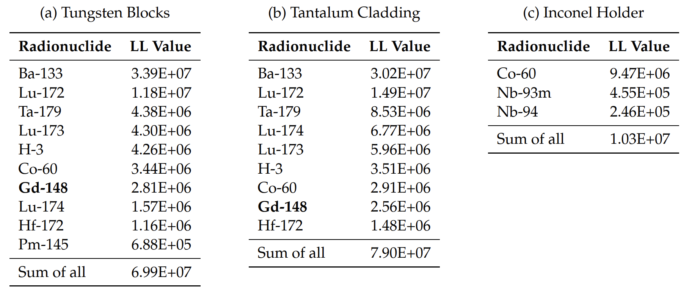
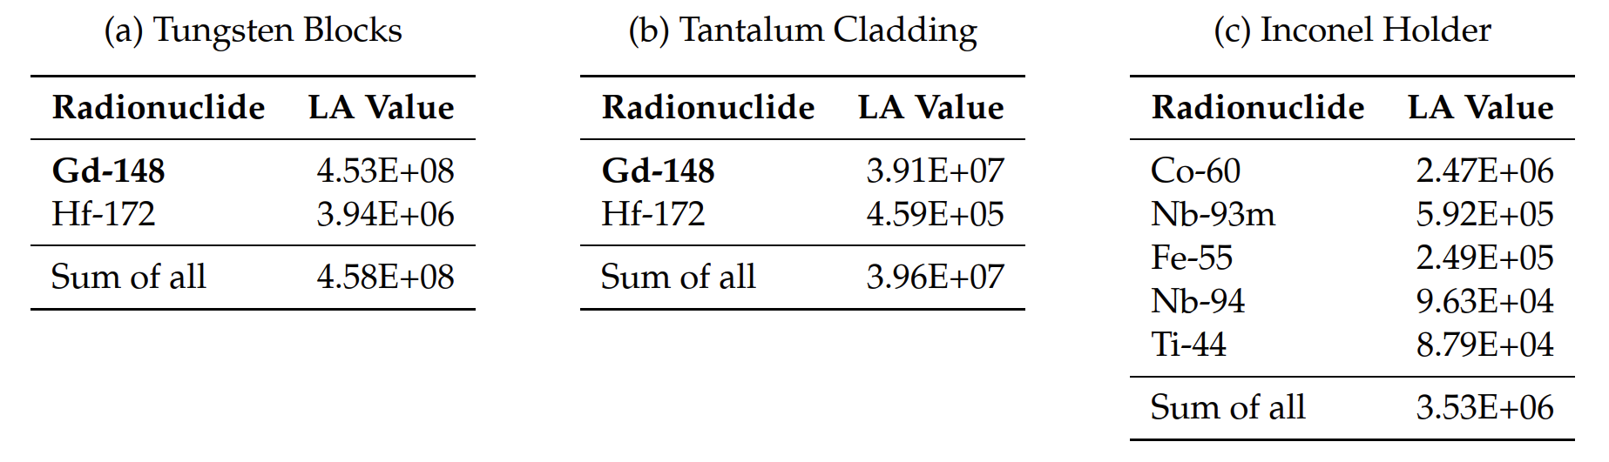
Main Contributors to LL and LA
PRELIMINARY STUDY
Main contributors to LL
10 years of cool-down
Main contributors to LA
10 years of cool-down
Statistical uncertainties are below 1.4%
The total H-3 content in the target assembly amounts to 14.74 ± 0.01 Bq
In terms of alpha emitters, the most dominant radionuclide is Gd-148 (74.6 years half-life) with a total of 98.47 ± 0.29 GBq after 10 years. Other alpha-emitters amount to 5.34 ± 0.01 MBq
Comparison to transport classification limits, showing that a transport under LSA-II classification is possible for 5 years of cooling (IP2 certified container

Slide 11
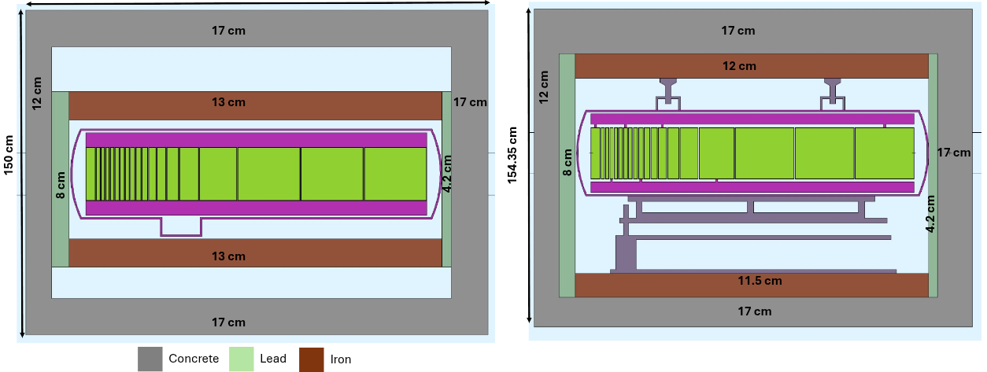
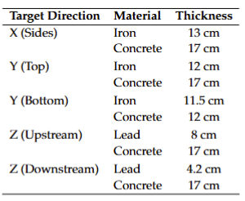
Preliminary Packaging Proposal
Assumed shielding configuration
4.2 cm
4.2 cm
Including:
KC-T12 container with 12 cm concrete on all sides
Min. 5 cm concrete filling on all sides except the bottom
Additional lead shielding for top and bottom
Additional iron shielding for sides
The waste assembly is defined as the target assembly plus the lead/iron mold
Further filling of free space with sand but excluded for simulations (conservative)
Target length limited to 155 cm
Upstream target side
Bottom target side

Slide 12
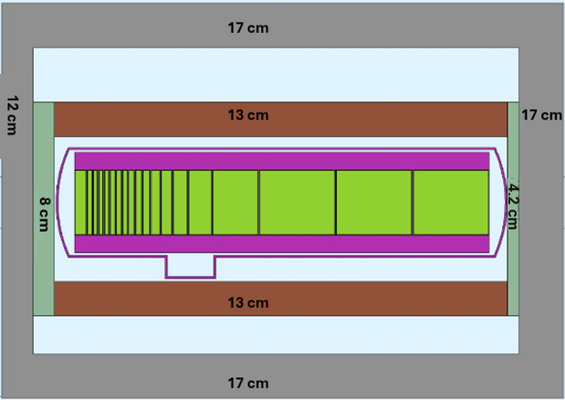
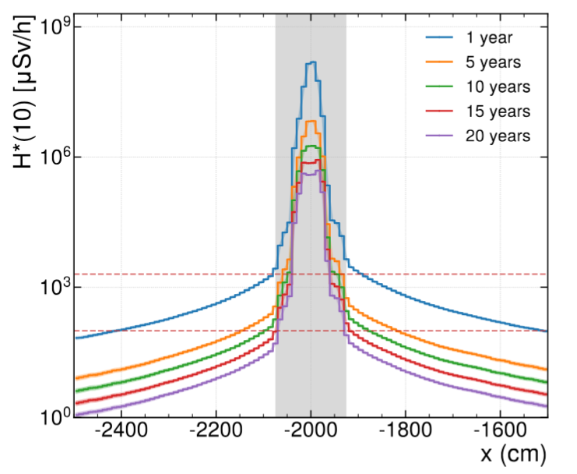
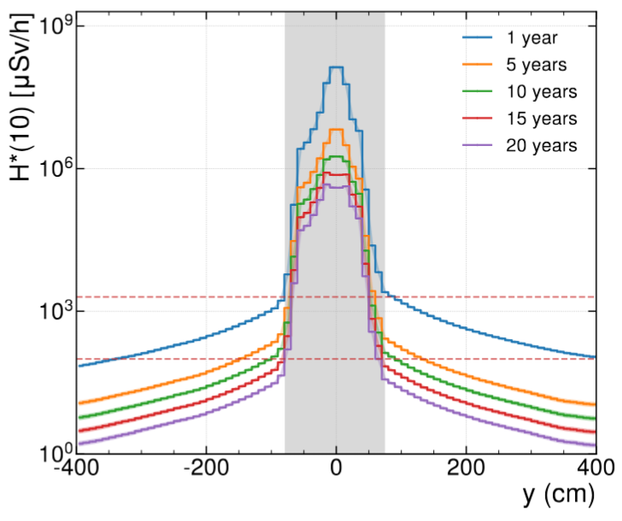
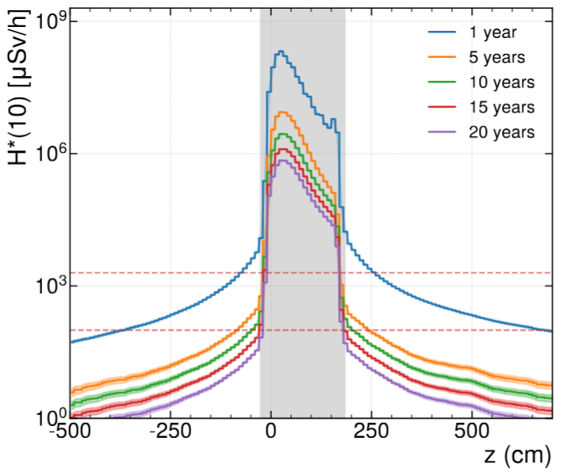
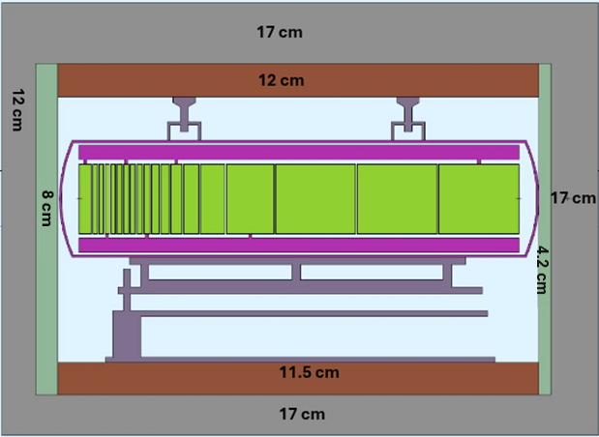
Residual Dose Rates of KC-T12 Package
PRELIMINARY STUDY
Residual dose rates of KC-T12 package, with safety factor 3
Various cool-down times
<x,y> [-20;20] cm
<z> [100] cm
x
z
2 mSv/h
2 mSv/h
2 mSv/h
y
0.1 mSv/h
0.1 mSv/h
0.1 mSv/h
Max. DR (mSv/h) for 5 yrs cooling
Max. DR (mSv/h) for 5 yrs cooling (top)
Max. DR (mSv/h) for 5 yrs cooling (downstream)
Safety factor 3; stat. errors
Well within 2 mSv/h at contact and 0.1 mSv/h at 2 m (≥10 yrs)
Contact: 1.11 (0.06) mSv/h
2 m: 0.09 (0.02) mSv/h
Contact: 0.54 (0.04)mSv/h
2 m: 0.06 (0.02) mSv/h
Contact: 1.42 (0.07) mSv/h
2 m: 0.11 (0.02) mSv/h
Max. DR (mSv/h) for 10 yrs cooling
Max. DR (mSv/h) for 10 yrs cooling (top)
Max. DR (mSv/h) for 10 yrs cooling (downstream)
Contact: 0.55 (0.03) mSv/h
2 m: 0.05 (0.01) mSv/h
Contact: 0.27 (0.02)mSv/h
2 m: 0.03 (0.01) mSv/h
Contact: 0.73 (0.04) mSv/h
2 m: 0.06 (0.01) mSv/h
Statistical uncertainties in parentheses

Slide 13
Service Building Considerations

Slide 14
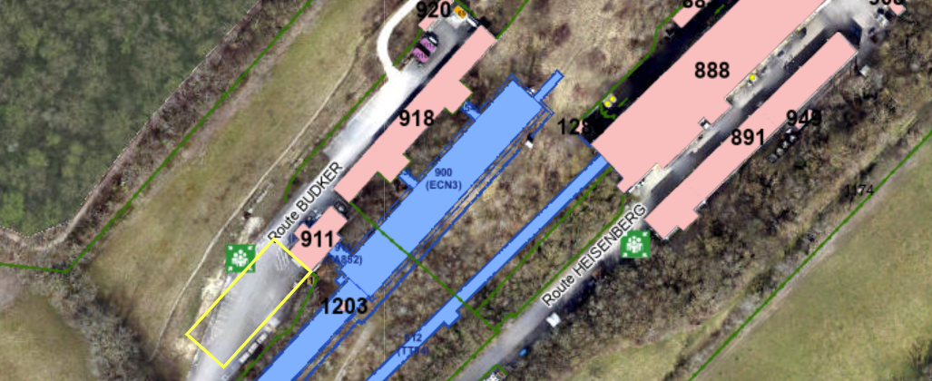
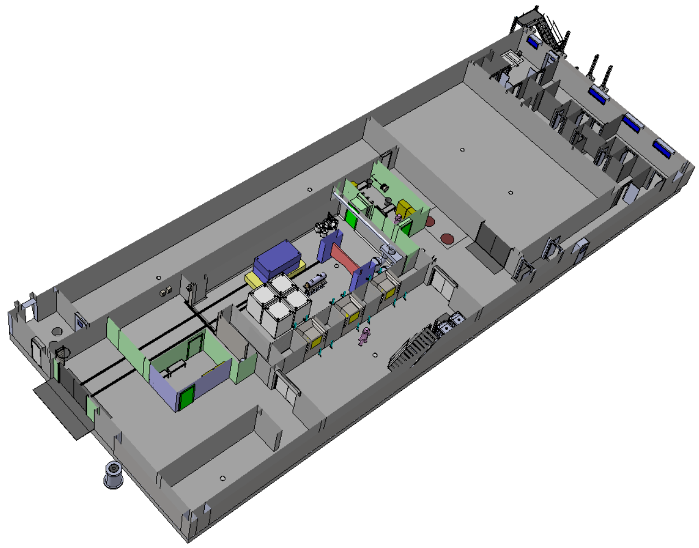
Service Building 754
CERN fence
754
CERN Prévessin site
CV rooms
Personnel airlock
  CV rooms
  for He-cooling system of BDF target with filters* and ventilation system of B754 and target area
Material airlock
*HEPA filters and heat exchanger in underground target area
Telemanipulator area
B911
  Handling hall + buffer area for equipment transfer via airlock zone to service cell, temporary storage
  Service cell for safe packaging and disposal of radioactive equipment (e.g. BDF target), as mandated by host state authorities
Service Cell
Hotcell
Handling hall + Buffer area
EDMS 3406737
Claudia AHDIDA et al. HI-ECN3 RP Aspects
29.01.2026
14

Slide 15
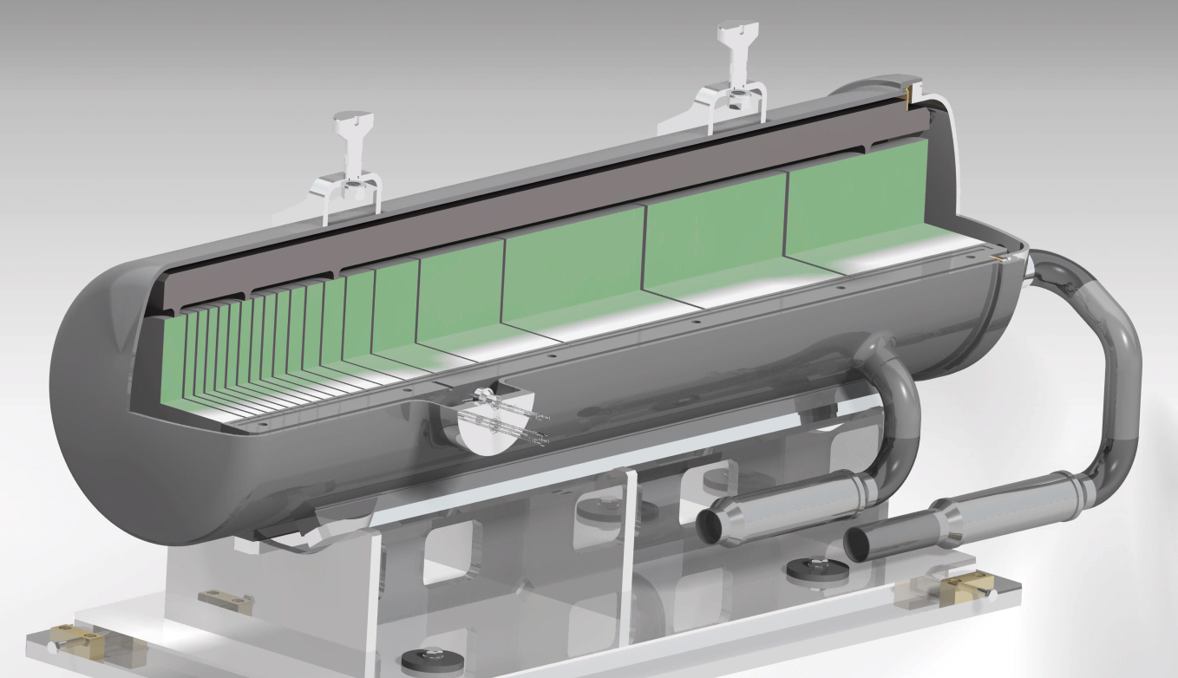
Contamination risks during Target Cutting
SS316LN holder
Resuspended activity in comparison to Swiss Licensing (LA), Surface Contamination (CS) and Air Activity Concentration (CA) Limits, 6 months cool-down*
Inconel vessel
Sum of SS316LN holder + Inconel vessel
Total LA: | 6.0E+05
Total CS: | 3.3E+04
Total CA: | 3.0E+05
Total beta/gamma SurfAct, Bq/cm²: | 1.1E+06
Most contributing radionuclides:
Co-60, Fe-55, Mn-54, Co-58, Sc-46
no alpha emitters
Cutting process still to be defined in detail, ; current assumption: four cuts, each 1 cm thick
  22 kg of StainlessSteel holder
  3.5 kg of Inconel vessel
Radionuclide inventory of SS holder and Inconel evaluated based on FLUKA + ActiWiz studies
  Assumed Service Cell dimensions:
  Internal surface: 1.3E6 cm²
  Volume: 1.2E9 cm³
Neglecting potential contamination of BDF target (W, Ta)
Inconel vessel only
Total LA: | 3.9E+05
Total CS: | 1.8E+04
Total CA: | 1.9E+05
Total beta/gamma SurfAct, Bq/cm²: | 9.9E+05
→ Type A work sector classification needed
(> 10’000 LA)
CS: Guidance value for surface contamination
CA: Guidance value for chronic occupational exposure to airborne activity. Same as Derived Air Concentration (DAC) in ISO17873 norm
LA: Value corresponding to the absolute activity level of a material above which handling of this material is subject to mandatory licensing
EDMS 3406737
Claudia AHDIDA et al. HI-ECN3 RP Aspects
29.01.2026
15

Slide 16
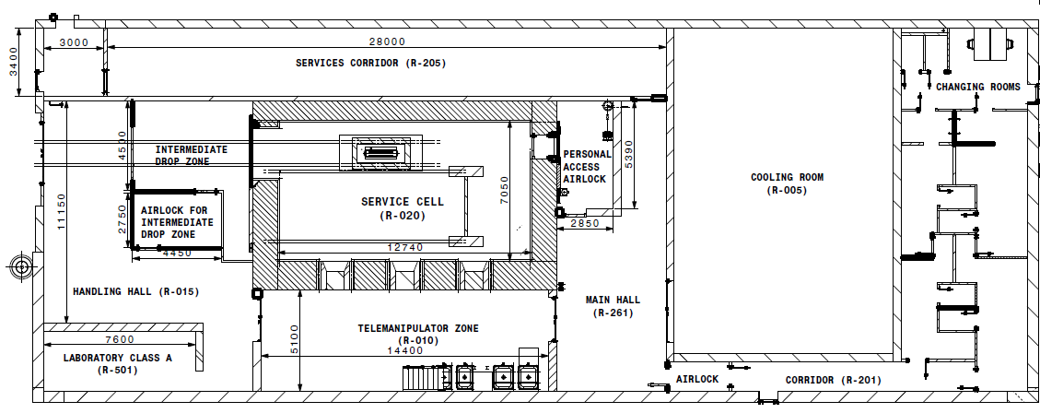
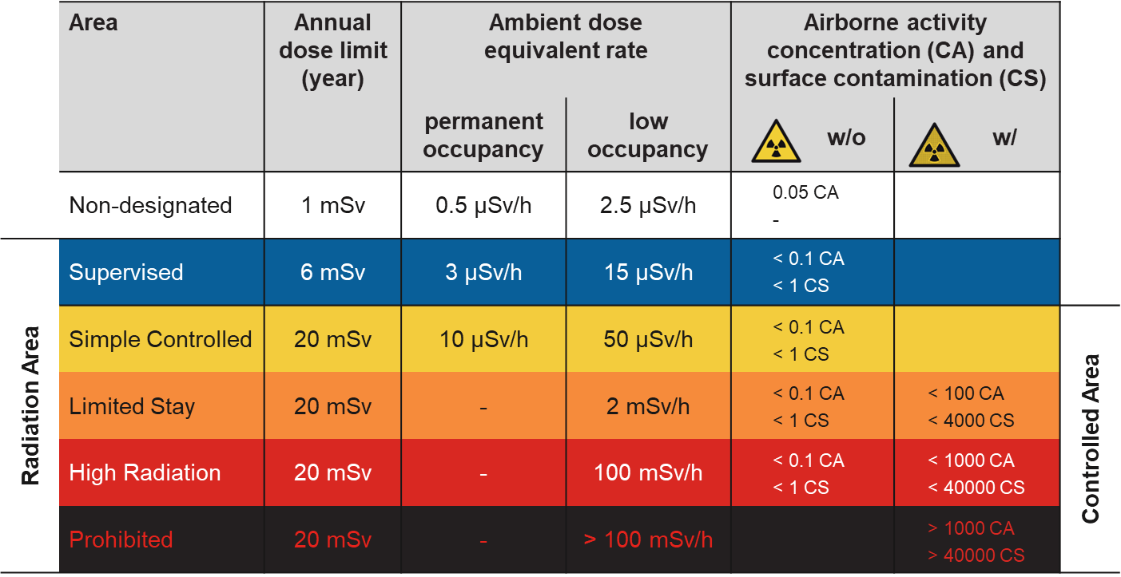
*C. Ahdida, Revised HI-ECN3 service building area classification, EDMS 3237086 v.2
Radiological Classification of B754
Work sector classification
A
Simple Controlled or Limited Stay Radiation Area with Contamination Risk
Supervised Radiation Area
Work sector | Maximum Activity
Normal | LA
Type C | 1E+02 LA
Type B | 1E+04 LA
Type A | Depending on authorization
Resuspended activity for BDF target container cutting of ~6×10⁵ LA
B911
Area classification
Class A working areas will in addition have a Controlled Radiation Area classification with contamination risk
(Limited Stay or High Radiation Area, or temporarily even be a Prohibited Area)
EDMS 3406737
Claudia AHDIDA et al. HI-ECN3 RP Aspects
29.01.2026
16

Slide 17
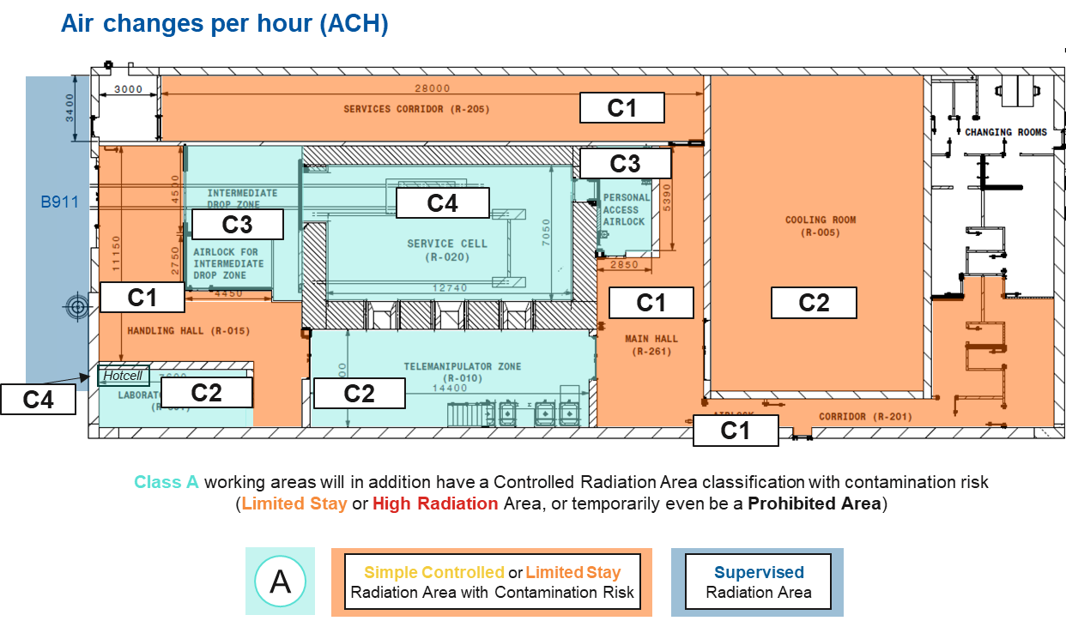
ISO 17873 Classification
The proposed classification based on ISO 17873
Service Cell and hot cell with highest Containment Class 4 (ISO 17873)
Telemanipulator zone and laboratory inline with similar areas in ISOLDE / MEDICIS
Classes in-line with recommendations by external consultants
HEPA + charcoal filters
EDMS 3406737
Claudia AHDIDA et al. HI-ECN3 RP Aspects
29.01.2026
17

Slide 18
2025 Prototype Targets –
Contamination Measurements

Slide 19
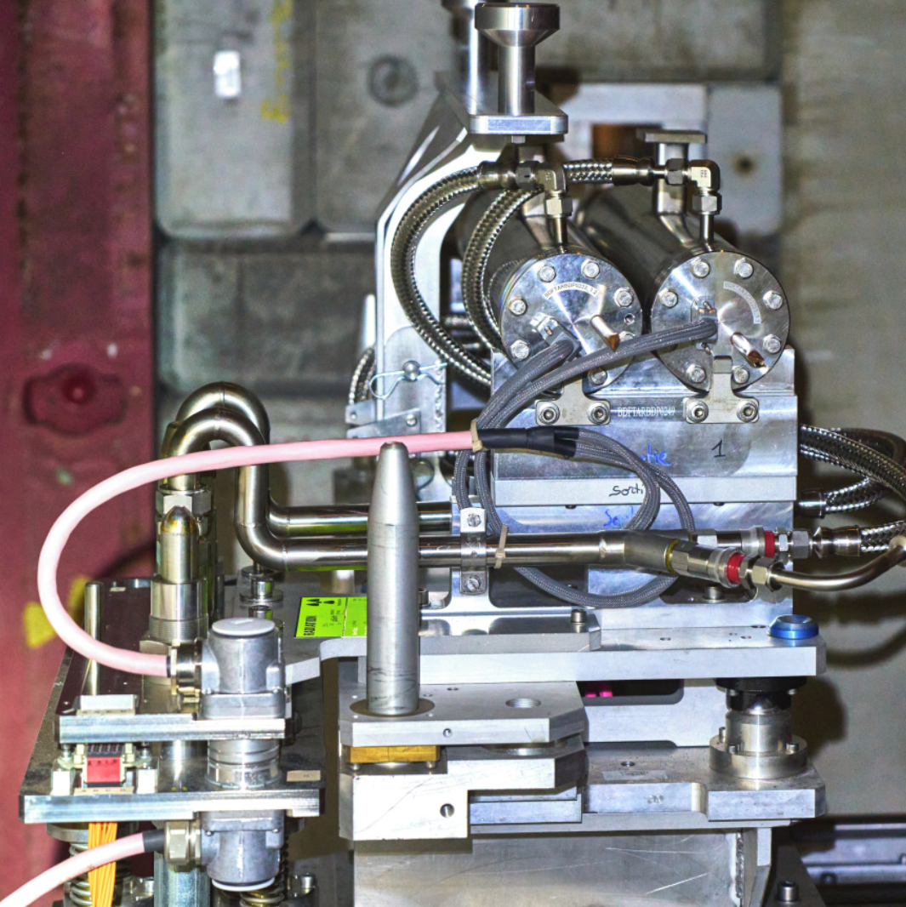
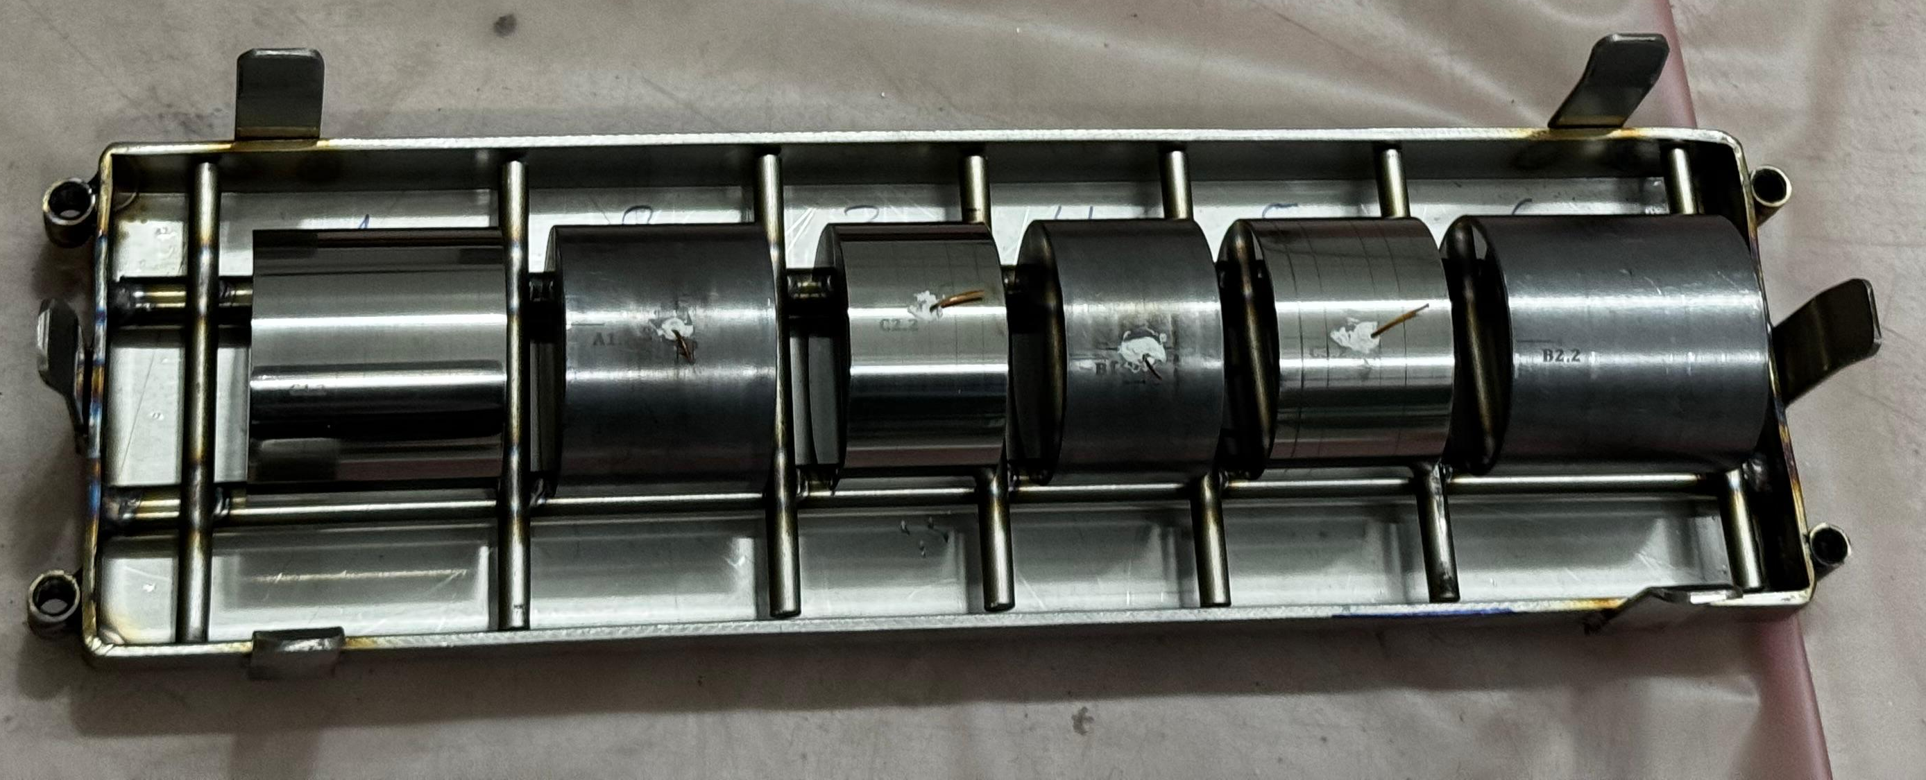
2025 Prototype Targets
Test stand in TCC2
Irradiation conditions
 | Target 1 | Target 2
 | Integrated POT | Integrated POT
Day 1 (24/09/2025) | 1.6E+13 | -
Day 2 (01/10/2025) | - | 6.8E+13
Day 3 (29/10/2025) | 9.7E+12 | 2.5E+13
Total | 2.563E+13 | 9.326E+13
Information from M. Parkin
Open target vessel after irradiation
Two BDF prototype targets were tests with beam in TCC2
The targets were surrounding by a static He environment with water cooling only for the outside of the target vessel
Contamination measurements were performed and analysed on 16.01.2026, 79 days after irradiation

Slide 20
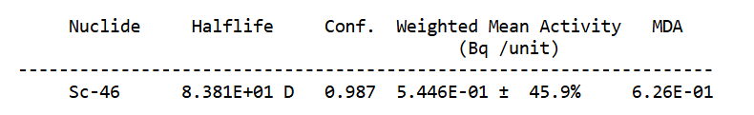
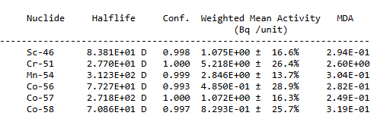
2025 Contamination Measurements
Contamination measurements were performed on all target blocks without any relevant detectable activity with a hand-held device
Two wipe tests were taken inside the target vessels with a surface area larger than100 cm²
The results reported from gamma spectroscopy are as follows:
30.01.2026, 93 days cooling
Target 1 vessel
Target 2 vessel
0.5 Bq → 0.005 Bq/cm² (1.7E-3 CS)
12 Bq → 0.1 Bq/cm2 (5E-3 CS)
All measured radionuclides can be produced in SS316LN vessel
CS: Guidance value for surface contamination
If the classification of the material to be transported is exempted, the contamination on the material shall remain below 0.4 Bq/cm² for beta/gamma emitters, and below 0.04 Bq/cm² for alpha emitters.

Slide 21
2026 Prototype Target –
Contamination Measurements

Slide 22
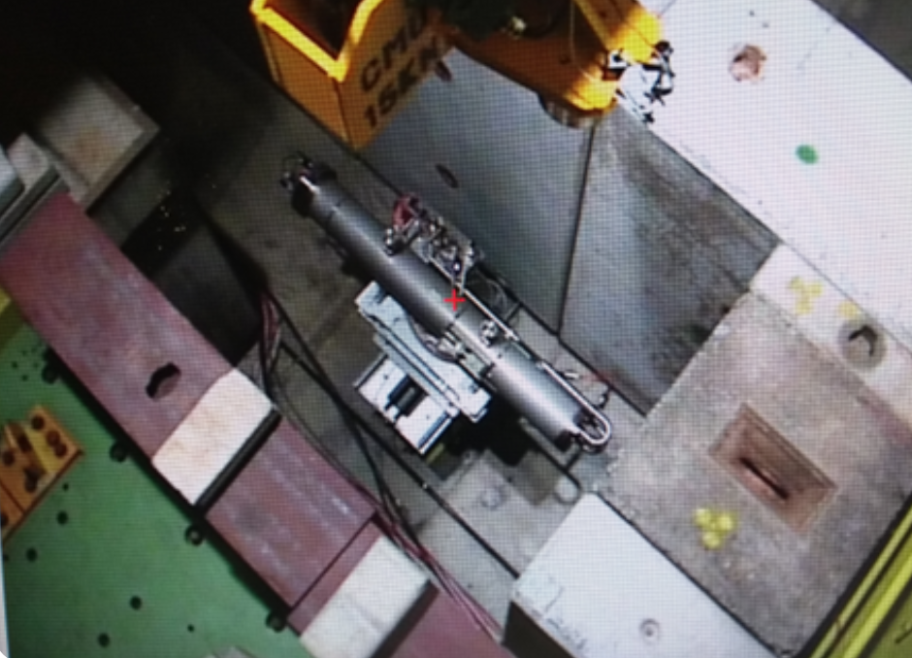
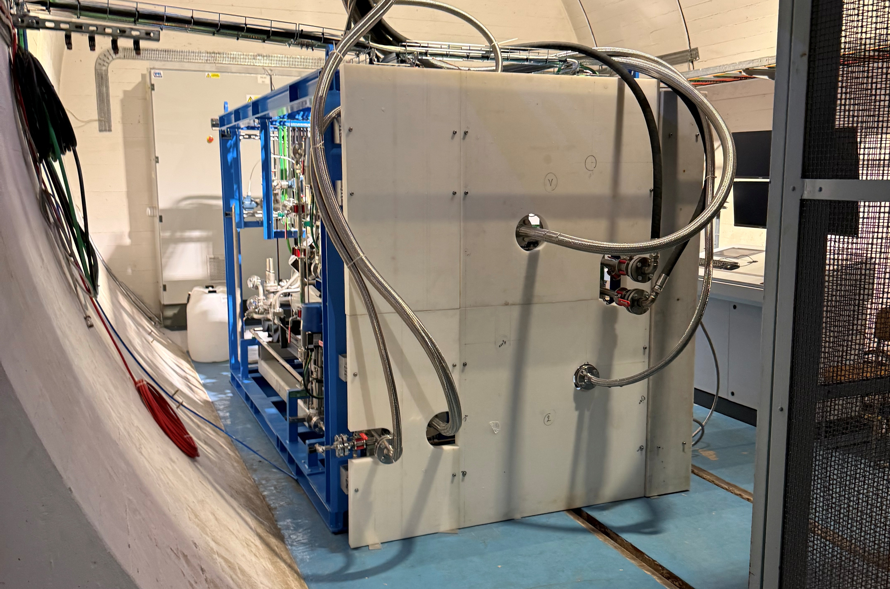
2026 Prototype Target
2026 Prototype Target
Irradiation conditions (to date)
 | Integrated POT | Avg. intensity (p/s) | Hours of irradiation
Day 1 (10/03/2026) | 8.899E+13
Day 2 (18/03/2026) | 9.59E+14 | 8.64E+10 | 3.08
Day 3 (08/04/2026) | 6.96E+14 | 1.93E+11 | 1.00
Day 4 (22/04/2026) | 8.89E+14
Day 5 (06/05/2026) | 1.02E+15 | 8.68E+10 | 3.25
Day 6 (24/06/2026) | (planned)
He cooling skid
Information from M. Parkin
In 2026, a prototype target is actively cooled with helium (up to 16 bar, ~10 g/s He)
Skid technologies identical to final target
Tests ongoing with last irradiation planned for 24/06/2026
Removal of target during the Long Shutdown 3

Slide 23
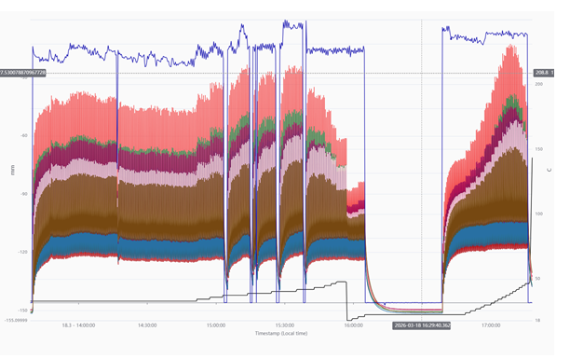
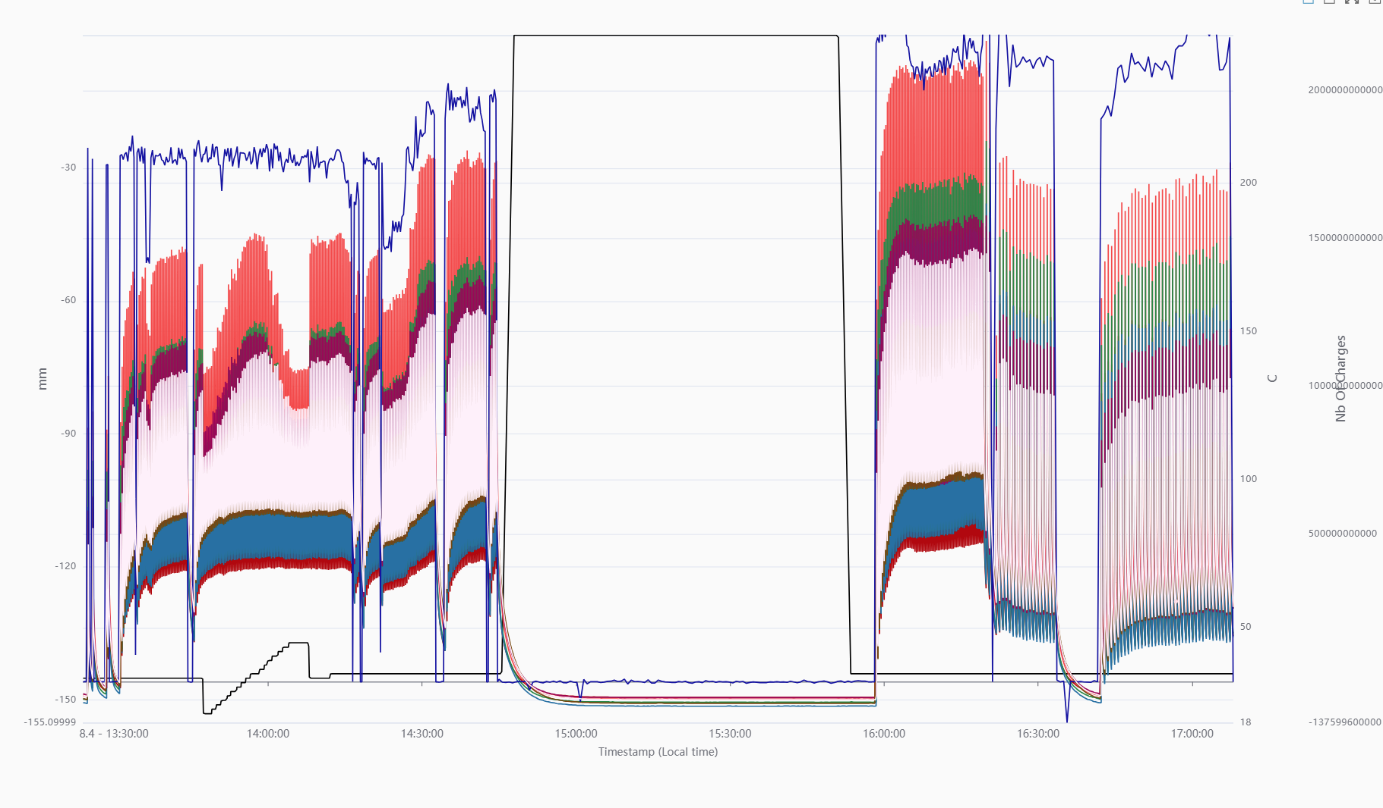
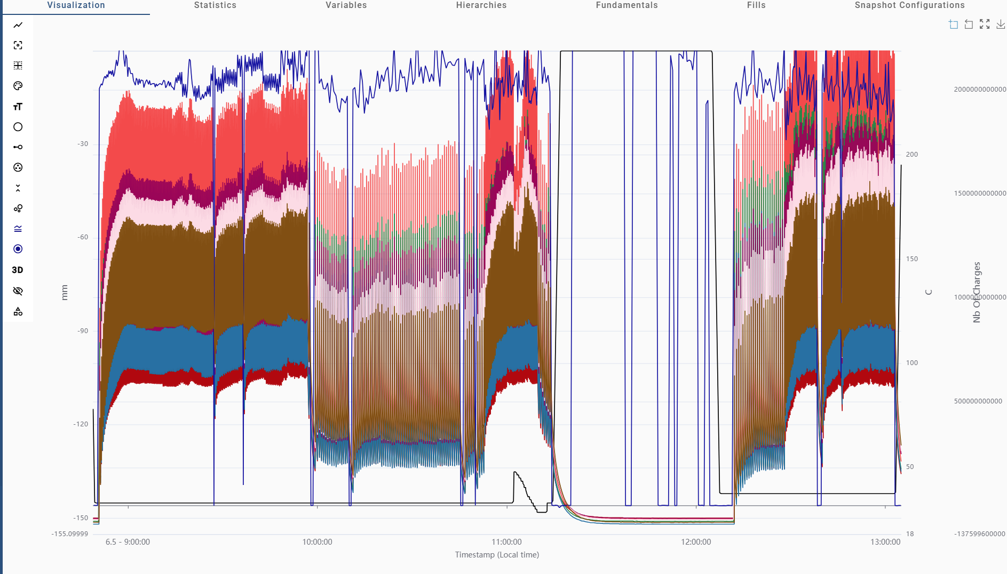
Beam conditions
Day 2 (18/03)
Day 3 (08/04)
Day 5 (06/05)
2 time periods
Time start time end total POT
13:39 16:05 7.315 E+14
16:39 17:18 2.271E+14
Avg. intensity (p/s) 8.64E+10
Hours of irradiation 3.08
3 time periods
Time start time end total POT
13:24 14:45 4.21278E+14
15:58 16:33 1.92952E+14
16:43 17:08 8.22499E+13
2 time periods
Time start time end total POT
08:49 11:13 7.43843E+14
12:12 13:03 2.71876E+14
Avg. intensity (p/s) 1.93E+11
Hours of irradiation 1
Avg. intensity (p/s) 8.68E+10
Hours of irradiation 3.25

Slide 24

2026 Contamination Measurements
Once 2026 beam operation finishes, contamination measurements will be performed on the target blocks and vessel as well as critical He cooling system elements (e.g. heat exchanger, HEPA filters)
Future checks for alpha contamination are also foreseen
Target tests are currently still ongoing, however three He-samples were taken shortly after beam operation for Days 2, 3 and 5
The He-samples were contained in a bottle and analyzed via gamma spec
Swagelok 304L-HDF4-400
Internal volume: 400 cm³ ± 5%
Min. wall thickness: 2.4 mm
Material: 304L
He cooling pressure: 13.1 bar
He cooling temperature: 23.5 C
He in cooling circuit: 149 mol, 0.6 kg
(assuming 0.28 m³, 280 l)
He in bottle: 0.22 mol, 0.89 g (assuming 420 cm³)
0.15% of total He
Information from F. Dragoni

Slide 25
He sample analysis – Day 2 and 3
Preliminary
 |  |  |  |  |  | Decay + shielding attenuation¹ corrected
 |  |  |  |  |  |  |  |  |  |  | Extrapolated to total He circuit
 |  |  |  |  |  |  |  |  |  |  |  |  | Extrapolated to BDF² + fully saturated³
End of beam operation | Gamma spec. Started | Cooling t (h) | Isotope | Half-life (h) | Activity (Bq) | Activity (Bq) | CA* (Bq/m³) | Multiple of CA | LA (Bq) | Multiple of LA | Activity (Bq) | Multiple of LA | Activity (Bq) | Multiple of LA | Multiple of CA
18/03/2026 17:00 | 20/03/2026 10:34 | 41.3 | I-123 | 13.27 | 0.94 | 2.0E+01 | 8E+04 | 4.8E-02 | 5.0E+07 | 3.9E-07 | 1.3E+04 | 2.7E-04 | 5.8E+06 | 1.2E-01 | 3.1E+00
18/03/2026 17:00 | 20/03/2026 10:34 | 41.3 | Xe-125 | 16.9 | 2.32 | 2.4E+01 | 3E+05 | 1.6E-02 | 3.0E+08 | 8.1E-08 | 1.6E+04 | 5.5E-05 | 8.9E+06 | 3.0E-02 | 1.0E+00
08/04/2026 17:07 | 09/04/2026 09:08 | 16.0 | I-123 | 13.27 | 2.897 | 1.6E+01 | 8E+04 | 3.9E-02 | 5.0E+07 | 3.3E-07 | 1.1E+04 | 2.2E-04 | 6.2E+06 | 1.2E-01 | 1.1E+00
08/04/2026 17:07 | 09/04/2026 09:08 | 16.0 | Xe-125 | 16.9 | 4.081 | 1.5E+01 | 3E+05 | 9.8E-03 | 3.0E+08 | 5.0E-08 | 1.0E+04 | 3.4E-05 | 7.3E+06 | 2.4E-02 | 2.8E-01
*Under atmospheric pressure
¹Attenuation in 2.4 mm iron
²Rescaling to BDF/SHiP intensity (4E13 p / 7.2 s)
Only the relatively short-lived radionuclides I-123 and Xe-125 were identified
Both radionuclides must have been produced in the target, either in the tantalum cladding or the tungsten core material of the target blocks
The measured activities are very low, well below Swiss airborne activity concentration and authorization limits, also when taking radioactive decay, attenuation within the sampling vessel and the total volume of the He cooling circuit into account
Extrapolation to future BDF beam intensity (4E13 p⁺ / 7.2 s) and radionuclide saturation, would result roughly in 6E6 Bq of I-123 and ~ 9E6 Bq of Xe-125 in the total circuit, which would still remain below 1 LA. It would be above 1 CA, however when taking ODH risks into account (max. He concentration of 1.4% by vol.) the airborne activity can also be considered to be well below 1 CA for an occupational exposure scenario
³Considering full saturation in BDF/SHiP operation
CA: Guidance value for chronic occupational exposure to airborne activity. Exposure to an airborne activity concentration of 1 CA for 40 hours
LA: Value corresponding to the absolute activity level of a material above which handling of this material is subject to mandatory licensing

Slide 26
H-3 Diffusion Studies

Slide 27
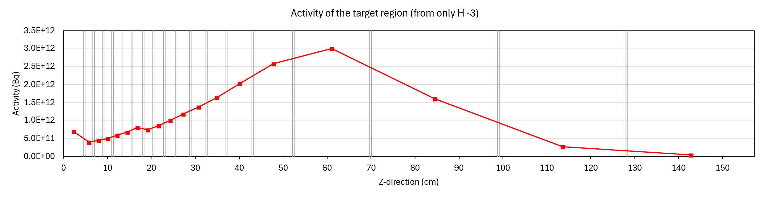
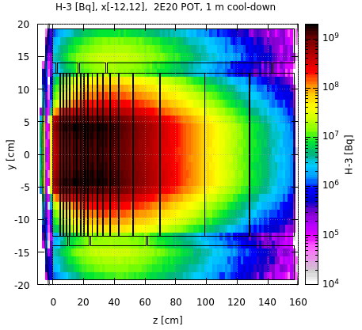
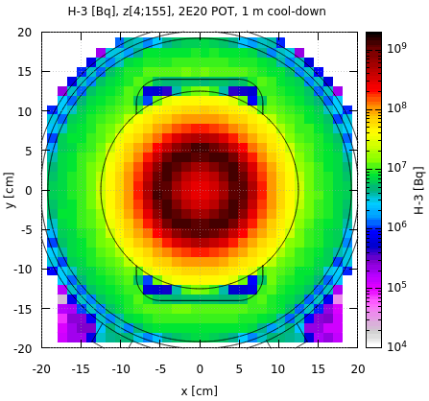
BDF tungsten target H-3 content
Preliminary
Total PoT 2×10²⁰ (5 yrs) + 1 month cool-down
Total PoT 2×10²⁰ (5 yrs) + 1 month cool-down
H-3 activity (Bq)
Total H-3 Activity Production (Bq)
W target | 2.47E+13
He cooling | 4.6E+09
→ 0.02% wrt. W target
Inhomogeneous H-3 production in the W target due to target dimensions and irradiation profile
Several orders of magnitude lower H-3 production in He than in the W target
Main contribution of H-3 in He cooling circuit due to diffusion
Quantification of H-3 diffusion and related radiological risks
  Conservative assumption that all H-3 produced in tungsten permeates to helium
  Evaluation of H-3 diffusion via SOLIDUSS assuming all H-3 reaching the target surface will desorb to helium
x[-12;12]
z[4;155]

Slide 28
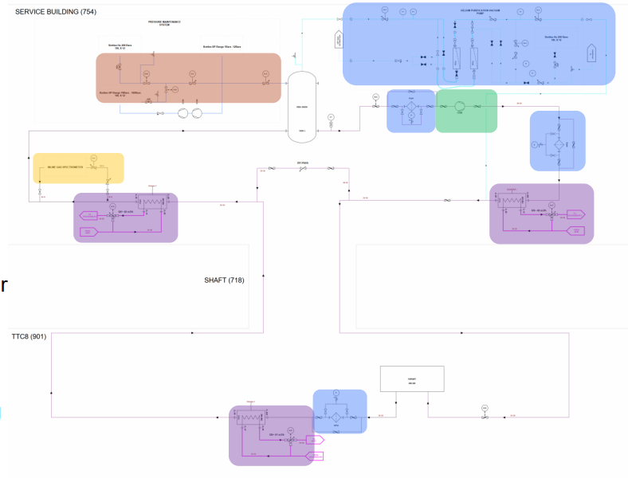
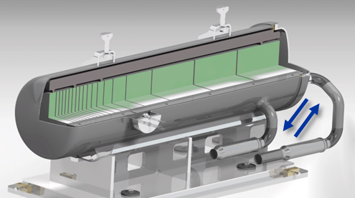
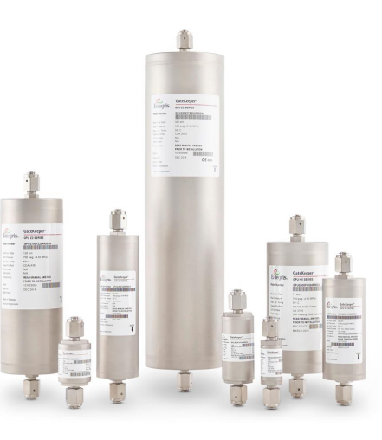



H-3 content in He cooling
Preliminary
He-cooling circuit
Conservative H-3 diffusion
High-efficiency air filters (HEPA grade) and heat exchanger (200 °C to 30 °C) are in underground target area
The cooling pipes go from target area to above-ground Service Building
BDF target
Total H-3 production in 5 years of 24.7 TBq → conservatively assuming all H-3 diffuses to He
8 m³ He at 14.5 bar (avg.)
He cooling, 14.5 bar, 30° C → 200° C
He purification
H-3 content
He purification via chemical getters (Entegris®) permanently trapping impurities via chemical absorption
2% of overall flow rate circulated through them
  Achieved purity: H₂O, O₂ , CO, CO₂ , H₂ (<100 pptV each), Sulfur compounds (< ppbV)), acting equally on HT, T₂ and HTO
A conservative steady state H-3 concentration of 465 pptV was estimated
$$C_{SS}=\frac{P_{T}}{\dot{N}}+ C_{min}$$
$C_{SS}$ Steady state concentration (pptV)
$P_{T}$ Production rate of H-3 (mol/s)
$\dot{N}$Filtration rate of H-3 (mol/s)
A total of 2.3 GBq of H-3 content with a partial H-3 pressure of 6.7E-4 Pa could be present in the circuit

Slide 29
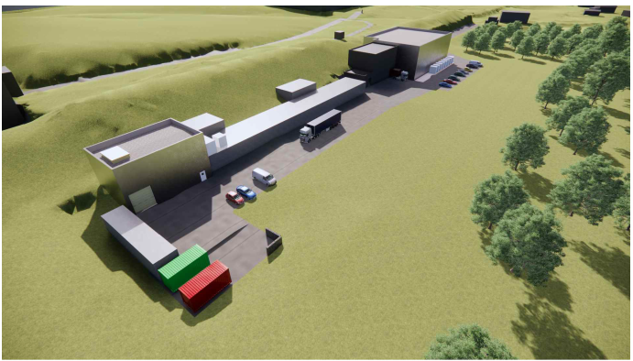
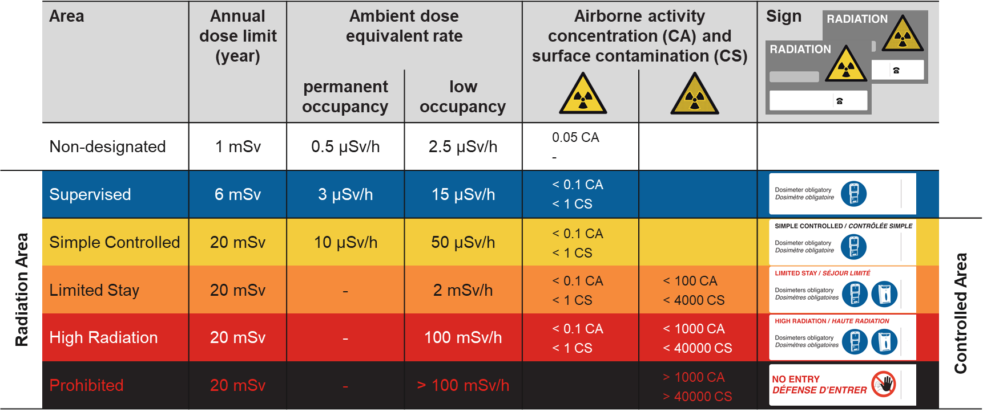
(Accidental) He release
Preliminary
Assumption of (accidentally) releasing at once the total He (8 m³, 14.5 bar) volume of the cooling system containing 2.3 GBq of H-3 would have the following radiological impact:
  Environmental impact:
    Site-specific dose coefficients for short-term release of HTO (most conservative) are available: 3.11E-18 Sv/Bq (see backup slide)
    A given H-3 release would result in a potential committed effective dose to members of the public of 0.01 uSv → fulfills CERN’s dose optimization objective for the public of <10 uSv/year
  Facility impact:
    A release of the total He (116 m³ at 1 atm) would create an unacceptable ODH risk in the EN-CV rooms (530 m³, 1116 m³)
    ~0.4 CA¹ for any accidental releases inside w/o ODH risk (He concentration <1.4% by vol.) → within the given area classification limit
He
He
    It shall be noted that potential contributions from other volatile radionuclides are not considered here
¹CA: Guidance value for chronic occupational exposure to airborne activity. Exposure to an airborne activity concentration of 1 CA for 40 hours

Slide 30
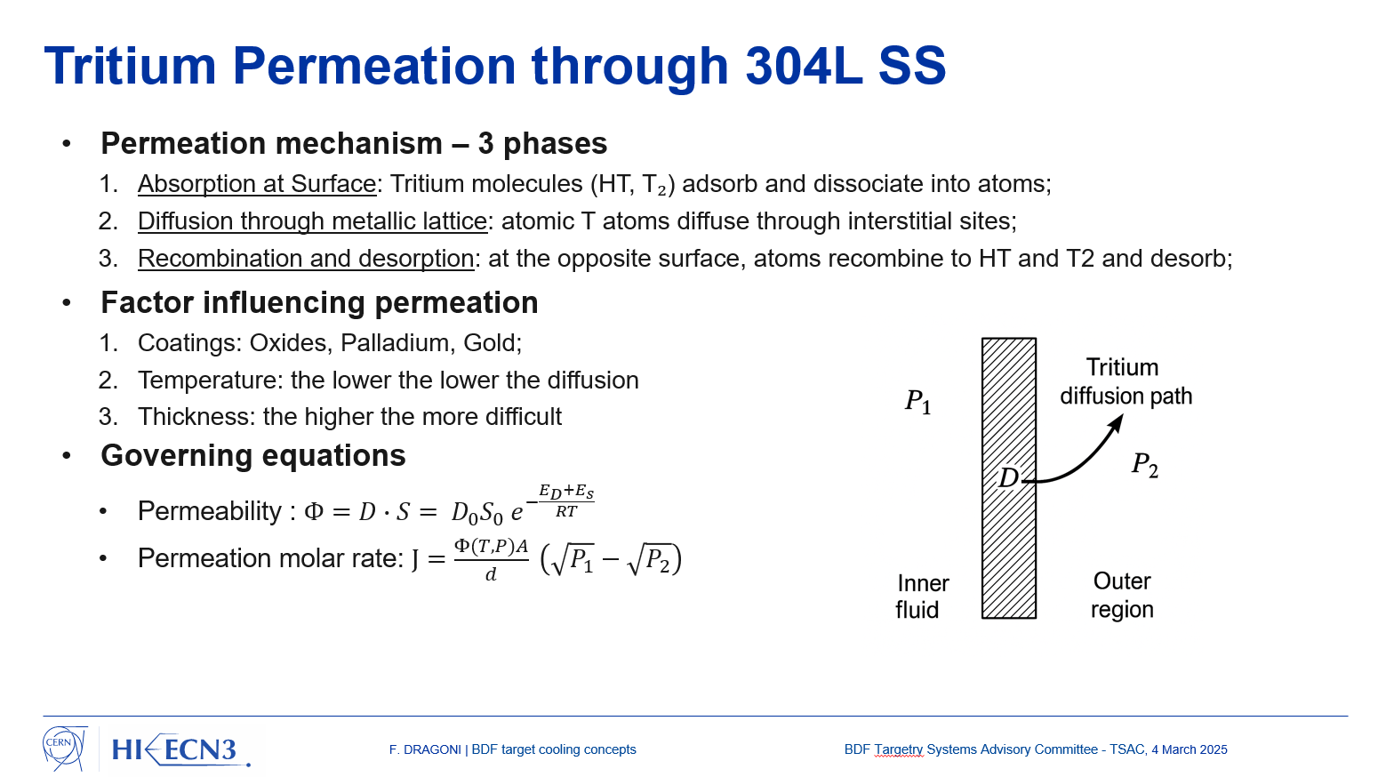
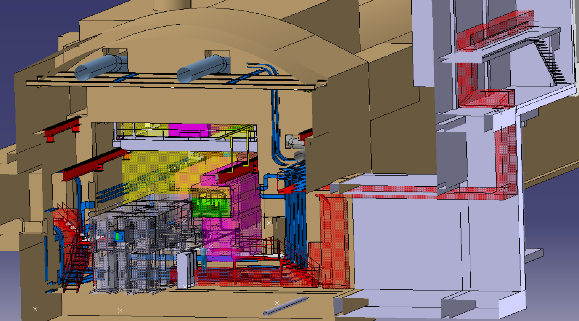
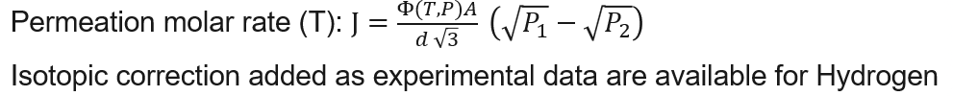
H-3 permeation through SS304L
Preliminary
H-3 may permeate through the SS304L pipes (3 mm thick)
Conservative H-3 permeation rates* including isotopic correction were evaluated for the given He temperatures
F. Dragoni, BDF target cooling concepts
  Cold He (30°C):
    1.4 ∙ 10⁻¹⁵ mol/s, which would result in 47 MBq/year
      The environmental impact with a dose of 0.1 nSv/y is negligible
      The facility impact is negligible given air volumes and ventilation
  Hot He (200°C):
    1.6 ∙ 10⁻¹¹ mol/s, which results in 0.1 TBq/83 operational days
      The environmental impact with a dose of 0.4 uSv/y is acceptable particularly in view of the conservative assumptions
      No facility impact as hot area not accessible during operation and dynamically confined
H-3
H. G. Nelson, J E. Stein, Gas-phase hydrogen permeation through alpha iron, 4130 steel, and 304 stainless steel from less than 100 C to near 600 C, NASA 1973
* Based on 24.7 TBq/year H-3 production in the BDF target leading to 465 pptV

Slide 31

H-3 leakage
Preliminary
Furthermore, leaks from the He cooling system may contribute to H-3 releases
The maximum He leakage from all 50 flanged joints was evaluated resulting in 0.28 g/year
This corresponds to a H-3 release of 35 kBq/year
      The environmental impact with a dose of
      << nSv/y is negligible
      The facility impact is negligible even if released in a single room without considering ventilation
F. Dragoni, BDF target cooling concepts

Slide 32









H-3 diffusion parameters
Preliminary
Estimation of H-3 diffusion into He with SOLIDUSS [1]
Target temperatures from Ansys calculations (M. Parkin) with most extreme temperatures investigated for diffusion
Diffusion parameters (A, Q) from [2]
W Target Temperatures in °C
Arrhenius equation
 | Bulk | Surface
Max after pulse | 392 | 349
Target avg. after pulse | 243 | 203
Max, time avg. | 387 | 327
Target avg., time avg. | 234 | 193
$$A$$
[cm² s⁻¹] frequency factor
1 beam pulse of 1 s every 7 s
Required input
$$D=A\exp\left(−\frac{Q}{RT}\right)$$
$$Q$$
[J mol⁻¹] diffusion activation energy
Temperatures investigated
$$T$$
[K] absolute temperature
$$R$$
[J K⁻¹ mol⁻¹] gas constant
Reference [2]
F. Reiter, G. Gervasini, K. S. Forcey, A Compilation of Tritium-material Interaction Parameters in Fusion Reactor Materials, Commission of the European Communities, 1993
$A=$ 4.1E-3 cm² s⁻¹,
$Q=$38E3 J mol⁻¹
$→D=$ 4.3E-6 cm² s⁻¹ @ 665 K (392 C)
Reference [1]
F. Ogallar Ruiz, Evaluation and criticality assessment of radiological source terms to be used for fire risk studies at accelerator facilities, CERN-THESIS-2021-293

Slide 33




H-3 diffusion parameters
Preliminary
Estimation of H-3 diffusion into He with SOLIDUSS [1]
Target temperatures from Ansys calculations (M. Parkin) with most extreme temperatures investigated for diffusion
Diffusion parameters (A, Q) from [2]
W Target Temperatures in °C
Arrhenius equation
 | Bulk | Surface
Max after pulse | 392 | 349
Target avg. after pulse | 243 | 203
Max, time avg. | 387 | 327
Target avg., time avg. | 234 | 193
$$A$$
[cm² s⁻¹] frequency factor
1 beam pulse of 1 s every 7 s
Required input
$$D=A\exp\left(−\frac{Q}{RT}\right)$$
$$Q$$
[J mol⁻¹] diffusion activation energy
Temperatures investigated
$$T$$
[K] absolute temperature
$$R$$
[J K⁻¹ mol⁻¹] gas constant
H-transport properties dashboard
Rémi Delaporte-Mathurin
Tungsten, H-3
$A=$ 4.1E-3 cm² s⁻¹,
$Q=$38E3 J mol⁻¹
$→D=$ 4.3E-6 cm² s⁻¹ @ 665 K (392 C)
Reference [1]
F. Ogallar Ruiz, Evaluation and criticality assessment of radiological source terms to be used for fire risk studies at accelerator facilities, CERN-THESIS-2021-293
665 K

Slide 34
H-3 diffusion estimation
Preliminary
Total PoT 2×10²⁰ (5 yrs) + 1 month cool-down
Operational periods for the BDF target
Assumptions
  5 operational periods of 83.3 days with maximum intensity (tot. 2×10²⁰ POT) at fixed high temperature (no T gradient)
  Cool-down periods at 22 °C in between
  Diffusion taken into account for all periods (operation, shutdown) with respective H-3 production right at start of each operational period (conservative)
  Radioactive decay considered (minor effect)
  All radionuclides reaching the target surface diffuse to He (conservative)
Findings
  Total H-3 diffusion in 5 years BDF operation ranges from 21 – 24 TBq (85 – 99 %) depending on the operational T assumed
  Open question: how much of H-3 reaching surface will diffuse to He
1
2
3
4
5
Operational period – high temperature
83 d
83 d
83 d
83 d
83 d
Shutdown period – low temperature
282 d
282 d
282 d
282 d
time
H-3 diffusion (t, T)
 | 392 °C | 234 °C | 193 °C | 22 °C
Diffusion per 83.3 d | 94% | 73% | 62% | -
Diffusion per 282 d | - | - | - | 8%
H-3 diffusion for BDF (operational T)
 | 392 °C | 234 °C | 193 °C
Diffusion per 5 years | 99% | 92% | 85%
Diffused H-3 (Bq) | 2.4E13 | 2.3E13 | 2.1E13
For all the same shutdown T of
22 °C s assumed

Slide 35





H-3 diffusion estimation – basic validation
Preliminary
Analytical formula for uniform radionuclide distribution [1]
Fraction of atoms Reaching an object’s Surface (FRS)
H-3 diffusion (t, T)
 |  | 392 °C | 234 °C | 193 °C | 22 °C
SOLIDUSS | Diffusion per 83.3 d | 94% | 73% | 62% | -
 | Diffusion per 282 d | - | - | - | 8%
Analytical formula | Diffusion per 83.3 d | 100% | 73% | 54% | -
 | Diffusion per 282 d | - | - | - | 6%
$$S$$
Surface of object
$$FRS≈erf\left(\frac{S}{V}\sqrt{Dt_{T}}\right)$$
$$V$$
Volume of object
$$D$$
Diffusion coefficient of interest
$$t_{T}$$
Total diffusion time
Relatively good agreement is observed between the SOLIDUSS predictions and the analytical formula, despite the expected differences arising from the strongly inhomogeneous distribution of H-3 within the BDF target
Reference [1]
F. Ogallar Ruiz, Evaluation and criticality assessment of radiological source terms to be used for fire risk studies at accelerator facilities, CERN-THESIS-2021-293

Slide 36
Thank you for your attention
Claudia AHDIDA et al. HI-ECN3 RP Aspects
01/06/2026

Slide 37



Main Requirements for Waste Disposal
FA-MA (ILLW) classification known requirements:
  KC-T12 container is the only large container that PSI currently accepts for large radioactive waste
  A bigger Swiss container exists for nuclear waste, but currently not for industry or research sector. As this may take long time and has cost implications (factor 2), we need to count on KC-T12
  KC-T12 is a concrete container of limited size and weight in which the waste is cemented
  Main dose rate limits
    < 10 mSv/h at 3 m from the target waste assembly
    < 2 mSv/h at contact of the package
  LSA-II or LSA-III classification limit (ADR - Carriage of Dangerous Goods by Road) to be respected¹
  $\sum_{i=1}^{n}{\frac{Ai (Bq)/g}{{10}^{−4}×A2i (Bq)/g}<1} \sum_{i=1}^{n}{\frac{Ai (Bq)/g}{2×{10}^{−3}×A2i (Bq)/g}<1}$
  Alpha-emitters specific activity limit to be respected on the
  conditioned waste to avoid alpha-toxic waste classification
  $\sum_{i=1}^{n}{A_{i} <20 kBq/g}$
Available weight:
15.63 tons minus the weight of the cement filling
Max. available height:
1.68 cm (1.73 m – 5 cm top cement) minus required shielding
Max. available width:
1.16 m (1.26 m – 10 cm side cement) minus required shielding
Container shielding:
12 cm concrete
LSA-II
LSA-III
1. The BDF target assembly is not considered as a combustible solid according IAEA SSG-26 Rev.1 §522.2, and thus the limit of 100 A2 for LSA-II and LSA-III classifications is not applicable

Slide 38


Alpha Emitters
PRELIMINARY STUDY
Specific activity of alpha emitters of conditioned waste
10 years cooldown
Gd-148: 99 GBq
Other RN α-emitters: <5.34 MBq
Total mass of waste: 7162 kg
  W Blocks: 1334 kg
  Ta Cladding: 74 kg
  Inconel Holder: 781 kg
  Inconel Pressure Vessel: 159 kg
  Steel Table: 444 kg
  Empty KC-T12: 4370 kg
  Mold: 0 (safety margin)
  Cementation: 0 (safety margin)
  Sand: 0 (safety margin)
$$\sum{A_{i} ≤15.1 kBq/g}$$
The alpha-emitters specific activity was calculated for the conditioned waste without accounting for the additional mold, cementation and sand filling that would account for a safety margin
The resulting specific activity is below the limit to avoid alpha-toxic waste classification that is
$\sum_{i=1}^{n}{A_{i} <20 kBq/g}$

Slide 39
Underpressure Cascade Proposal
Pressure values relative to atmospheric pressure
The proposed underpressure cascade follows:
  OUMR (Class A lab)
  ISO 17873
  Ventilation WG recommendations
  Two external consultants
  and is consistent with ISOLDE / MEDICIS approach
Service Cell and hot cell with highest Containment Class 4 (ISO 17873)
0 Pa
-20 Pa
-40 Pa 1st / 2nd floor
-120 Pa
-120 Pa
B911
-230 Pa
-70 Pa
-60 Pa
-20 Pa
Hotcell
-60 Pa
-20 Pa
0 Pa
-230 Pa
-60 Pa
+30 Pa
Class A working areas will in addition have a Controlled Radiation Area classification with contamination risk
(Limited Stay or High Radiation Area, or temporarily even be a Prohibited Area)
A
Simple Controlled or Limited Stay Radiation Area with Contamination Risk
Supervised Radiation Area
EDMS 3406737
Claudia AHDIDA et al. HI-ECN3 RP Aspects
29.01.2026
39

Slide 40
RP Air Monitoring
A
Simple Controlled or Limited Stay Radiation Area with Contamination Risk
Supervised Radiation Area
b911
Class A areas w/ Ventilation Aerosol Monitors (VAM, iCAM by Mirion)
The Target Area and cooling room w/ Air Monitoring Station (AMS)
The exhaust stack shall extend at least 2 m above roof level
B911
4 Aerosol monitors (β/γ)
1 Gaseous air activity conc.
1 Punctual bubbler
Inline gas activity monitor + gamma spec
Notes:
1 Mirrion ICAM per exhaust (~20 kCHF/ICAM). continuous alpha beta monitors. Beta as from a few tens or a hundred keV , calibrated for Sr90
Proper aersol sampling in a long (ideally 8 aerolic diameters after last bend) straight section in exhaust duct
ABPM air monitors in accessible area of next to hot / service cell
BAI 9109-4 Moniteur de mesure bêta des gaz radioactifs - Berthold Technologies GmbH & Co.KG

