Slide 1
Update on ISIS Targets: Analysis and Operating Experience
Dan Wilcox, High Power Targets Group, Rutherford Appleton Laboratory
ICANS XXV, Malmö, Sweden
13th - 17th April 2026

Slide 2

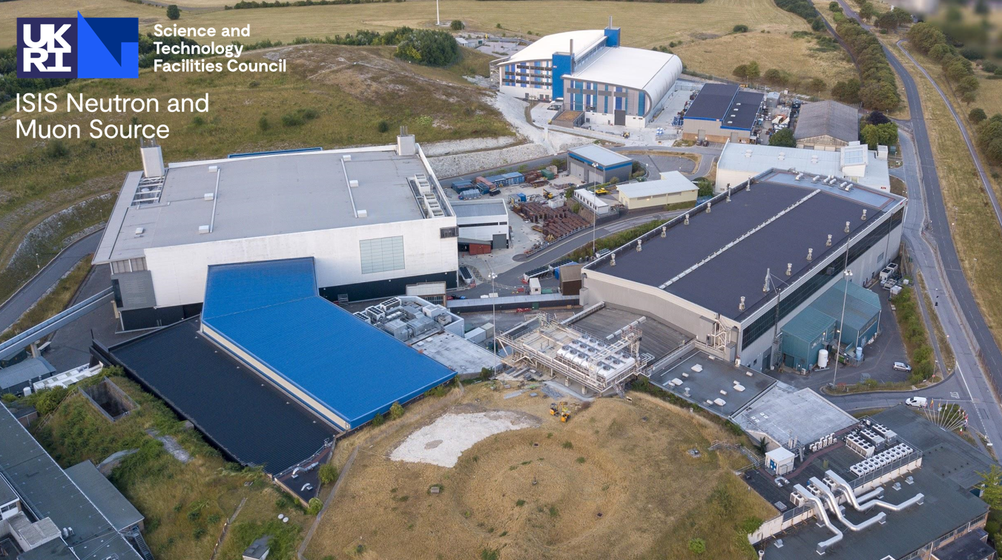
Contents
Introduction to ISIS targets
TS2 target lifetime
  Latest simulation approach
  Multi-plate target design
TS1 Project operating experience
  Simulation vs reality
  In-situ measurement of radiation damage
Summary
TS2
TS1
Synchrotron
Linac
An aerial photograph of the ISIS facility

Slide 3
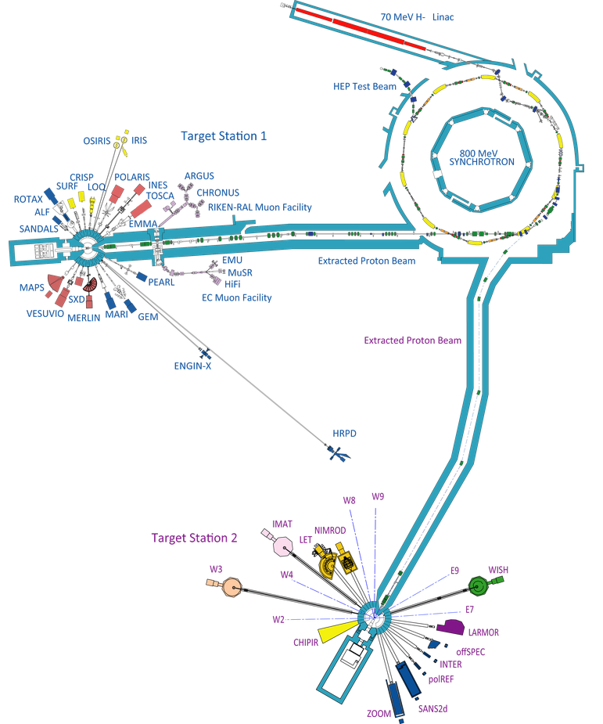
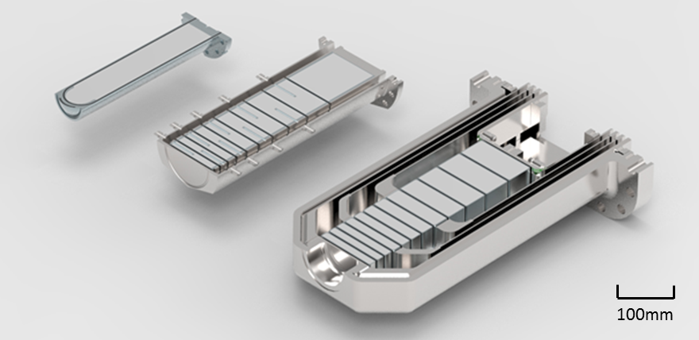
Current ISIS Targets
Synchrotron
192kW, 50Hz, 800MeV protons
Target Station 1
160kW, quasi-50Hz (receives 4/5 beam pulses)
Ta-clad W target, 10 plates (formerly 12)
Proven reliability over many years
New design of target, moderator and reflector installed late 2022, now in operation
TS2
TS1 Project
Previous TS1
Target Station 2
32kW, 10Hz (receives 1/5 beam pulses)
Ta-clad W target, solid rod
High neutronic efficiency, short target lifetimes

Slide 4
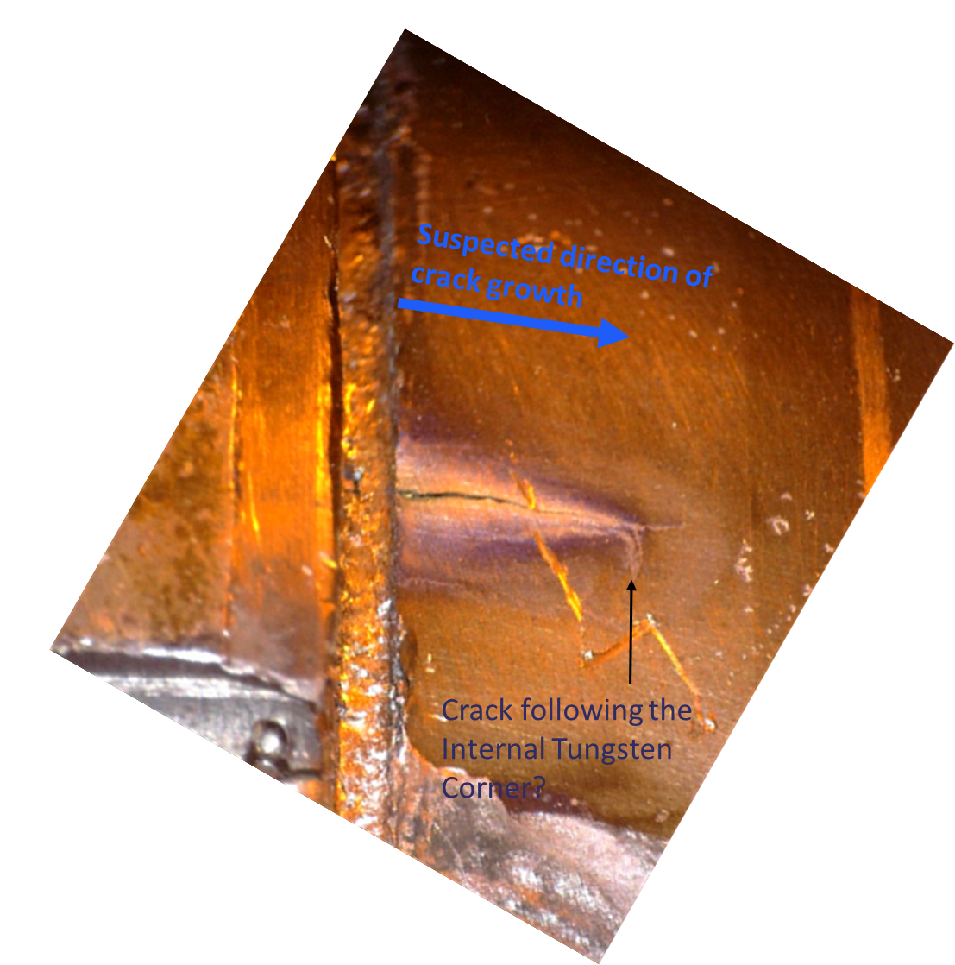
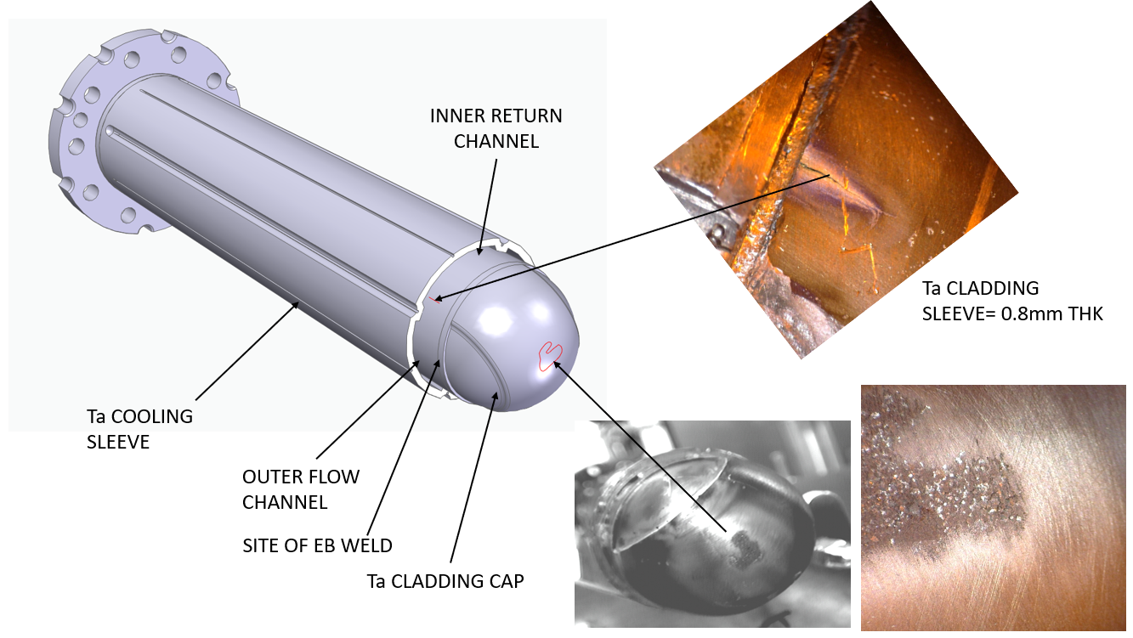
PIE Evidence – TS2 Target #4
Visible crack in tantalum cladding – consistent with measurements of tungsten in cooling water
Surface damage but no visible cracks at target nose
Videos of end cap removal suggest significant ductility is retained in tantalum
See talk by Stephen Gallimore, 16th April 13:30

Slide 5
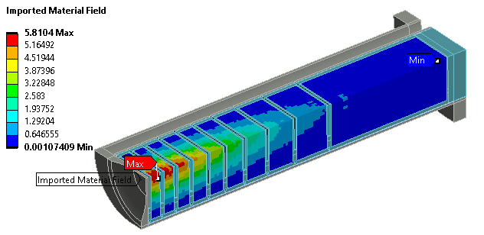
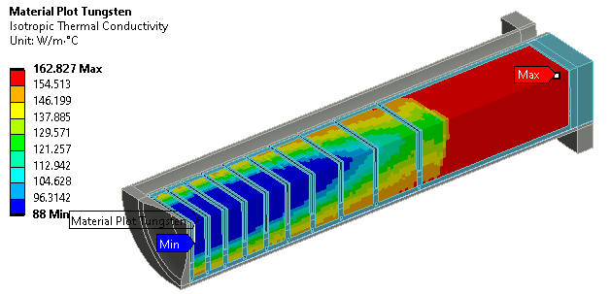
Simulating Radiation Damage
DPA after 1 year operation
Radiation damage is now included in all ISIS target simulations
DPA map calculated from accumulated beam on target then imported from FLUKA/MCNPX
Each material property can be a function of DPA
Major changes in irradiated tungsten:
UTS: 560 -> 300 MPa after 1.3 DPA
k: 175 -> 88 W/(m.K) after ~2 DPA
Effect on tungsten conductivity
No further change up to 27 DPA
References
J. Habainy et al., “Thermal diffusivity of tungsten irradiated with protons up to 5.8 dpa,” Journal of Nuclear Materials, vol. 509, pp. 152-157, 2018.
J. Habainy et al., “Mechanical properties of tungsten irradiated with high-energy protons and spallation neutrons,” Journal of Nuclear Materials, 2019.
Y. Dai, "Thermal diffusivity of tungsten irradiated by protons in spallation environment up to 26.5 dpa", Presentation at HPTW 2023, Thursday Nov 9th 2023
A. Reza et al. (2020). Thermal diffusivity degradation and point defect density in self-ion implanted tungsten. Acta Materialia, 193, 270-279.
See talk by Lina Quintieri, 16th April 14:10

Slide 6

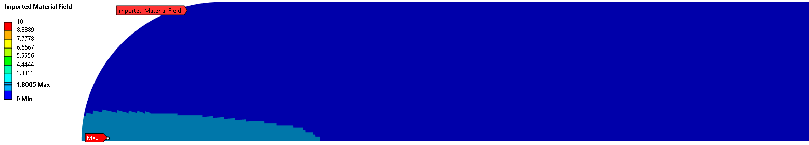
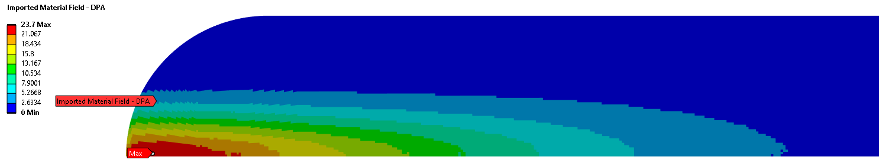
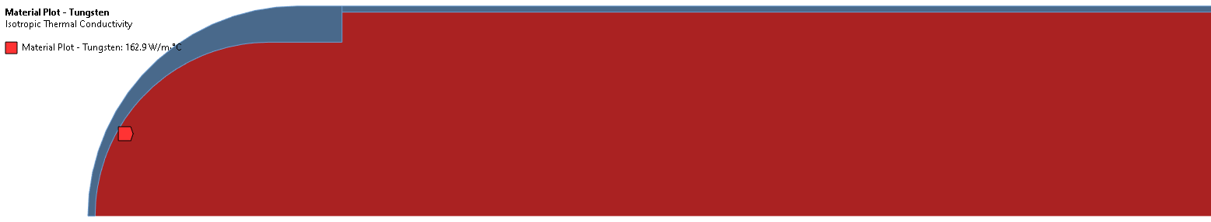
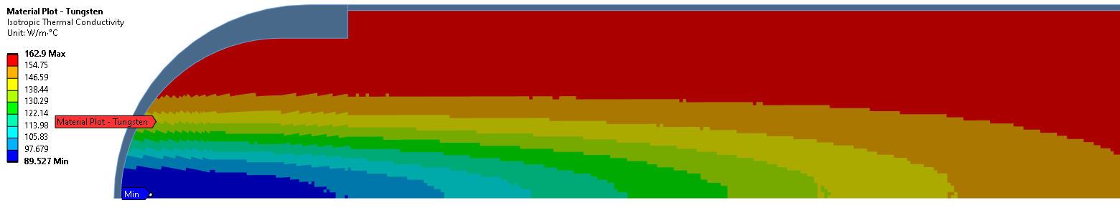
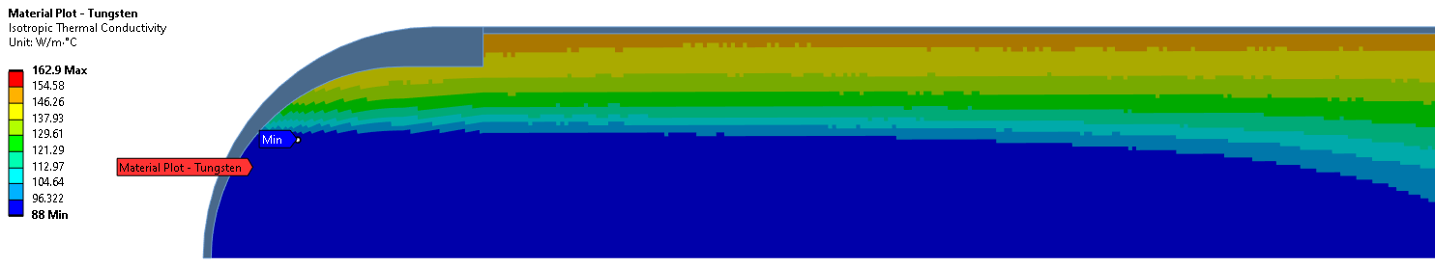
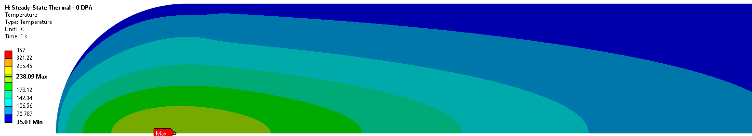
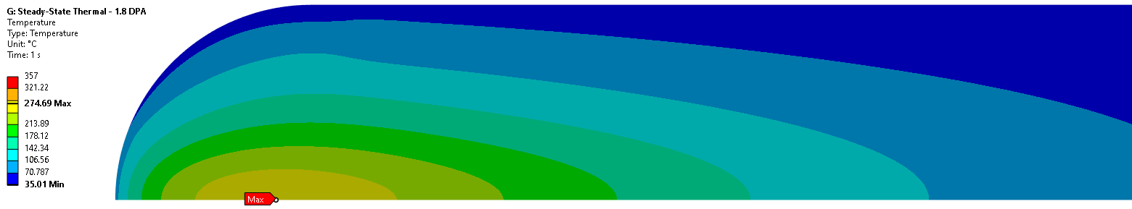
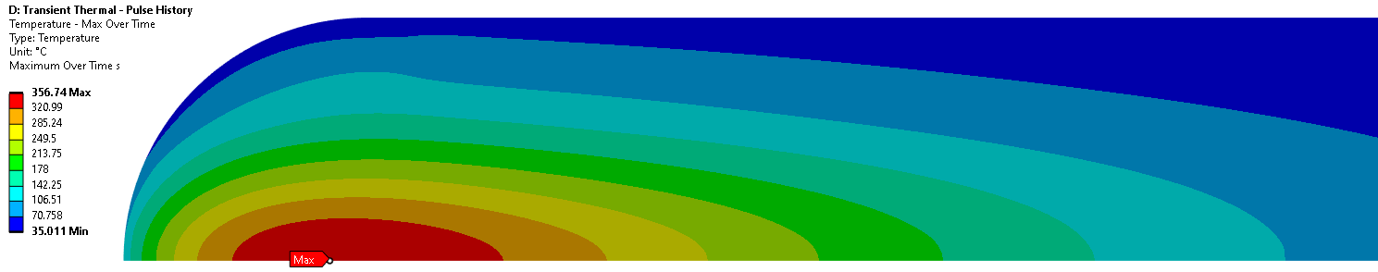
Evolution of Damage in TS2 Target
Tungsten thermal conductivity degrades as a function of dose, then saturates above 2 DPA
Initial condition
After ~2 months operation
TS2 W#10 target at end-of-life
Peak DPA = 0
Peak DPA = 1.8
Peak DPA = 23.7
k = 163 W/m-K
k = 90-163 W/m-K
k = 88-163 W/m-K
Peak Temp = 238 °C
Peak Temp = 287 °C
Peak Temp = 357 °C

Slide 7
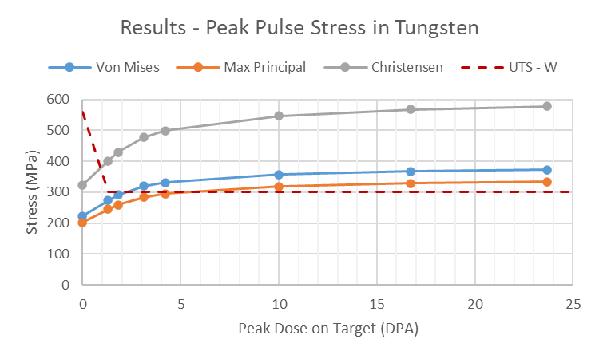
Evolution of Damage in TS2 Target
Tungsten safety factor is initially large but drops rapidly.
Tantalum may slightly exceed yield stress but remains below UTS. Limited data at high DPA.
Measured water activation begins some time after safety factors exceeded
Activity started to rise from around 150mAh (12.3 DPA) on TS2 W#10 target.
Very rapid rise from 250mAh (20.5 DPA).
Ultimately replaced at 290mAh (23.7 DPA)
TS2 #4 reached 19.2 DPA, then studied in PIE
Design Limit

Slide 8
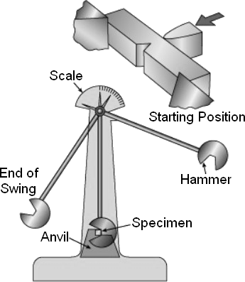
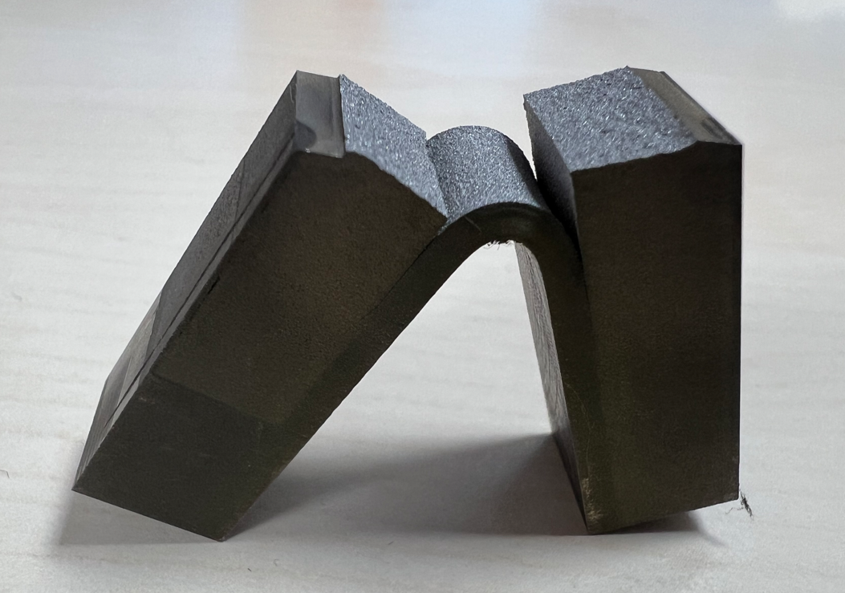
Crack Propagation at Ta/W Interface
Simulations show possible cracking in tungsten core – what happens next?
  Testing by SNS Second Target Station team [1] found that: “Tungsten cracks caused delamination damage then cladding failed in fatigue”
  Charpy impact tests on ISIS clad samples [2] also showed that the HIPed interface debonds rather than propagates through Ta
[1]
Charpy Impact Test Setup
[2]
[1] “Current Status of the STS Target Segment Manufacturing Development & Evaluation”, Justin Mach, IWSMT-15, March 2023

Slide 9
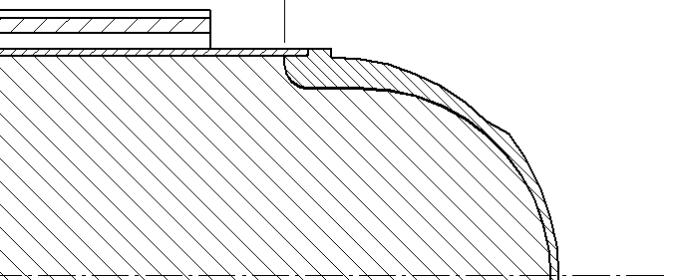
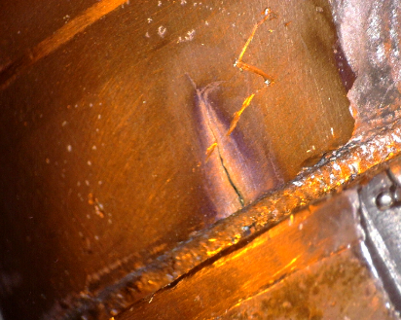
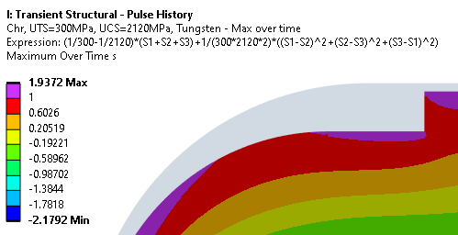

Simulation of TS2 Target #4
Simulated at the actual end-of-life dose on TS2 W#4 target: Peak DPA = 19.2
Crack is not at the first location we would expect from simulations (nose), but is at the second location (shoulder)
Suspected direction of crack growth
Location of observed crack:
Purple = Christensen failure criterion exceeded
    Slide 9

Slide 10
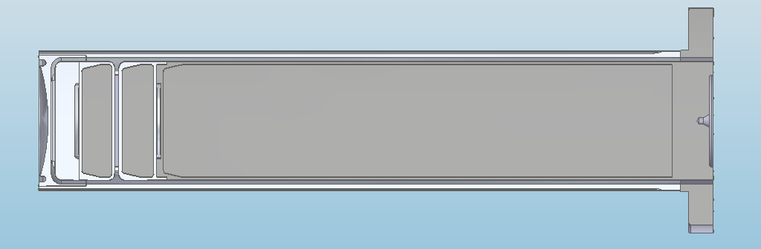
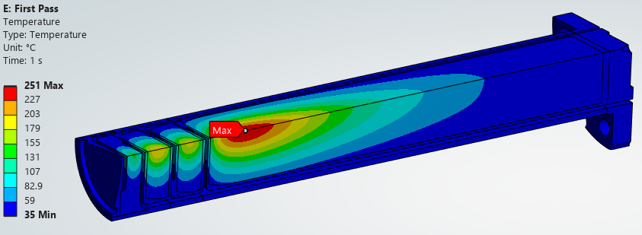
Multiplate TS2 Variant – Mk5 Proposal
Thicker Ta “cross flow guide”
2x Ta-clad W plates, + 1x Ta-clad W rod
Split monolithic target rod to improve cooling
Plate thicknesses optimised based on irradiated material properties
Brings operating conditions more in line with TS1 targets
Design review expected mid-2026
Results summary with irradiated tungsten properties:
Geometry | Temperature (°C) | Heat Flux (MW/m^2) | Von Mises Stress Ta (MPa) | Christensen Criterion W ()
TS1 Project | 253 | 2.3 | 106 | 0.68
TS2 Mk2 | 377 | 2.6 | 241 | 1.70
TS2 Mk5 | 273 | 2.4 | 110 | 0.85
Limit | N/A | 3 | 160 | 1

Slide 11
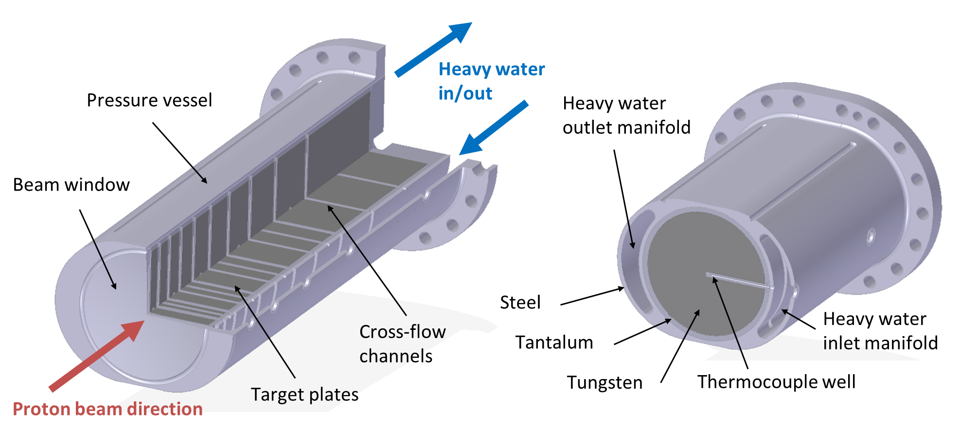
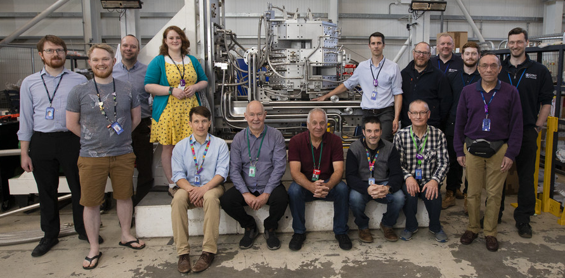
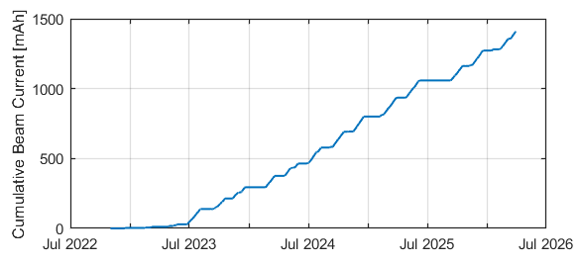
TS1 Project Target Experience
First beam in November 2022
Now operating at up to 164 µA
Accumulated mAh = 1409 so far
Thermocouples in each plate, and cooling water inlet and outlet
Cumulative beam current on first TS1 Project target
Note: Previous TS1 targets have lasted 2000-4000 mAh

Slide 12
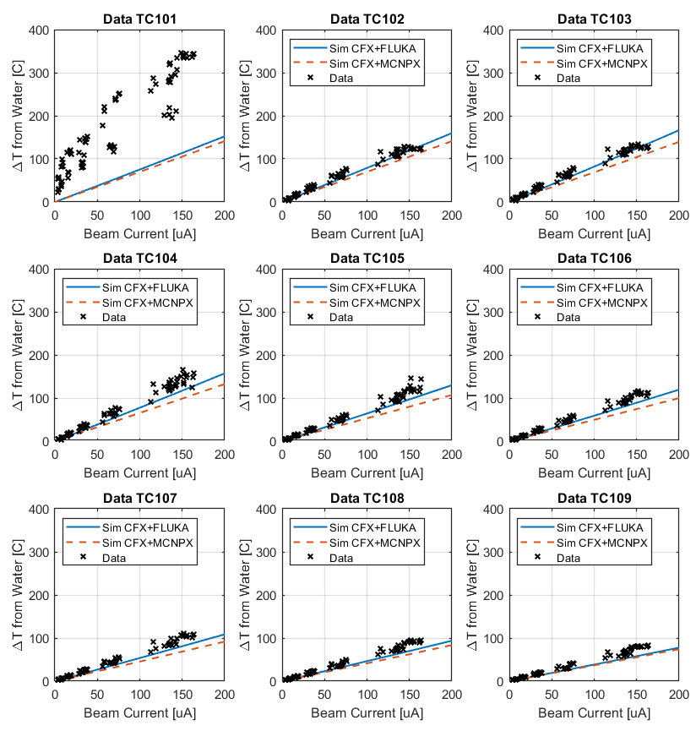
Steady State Temperatures
Temperature simulations close but consistently slightly high
  Possible effect of beam focus
Plate 1 temperature clearly anomalous
  Thought to be due to poor thermal contact around thermocouple
  For more details see: D. Wilcox et al., “Simulated and measured performance of the ISIS TS-1 Project target”, Journal of Neutron Research, vol. 26, pp. 47–58, 2024.
Data from Nov 2022 – Mar 2026

Slide 13
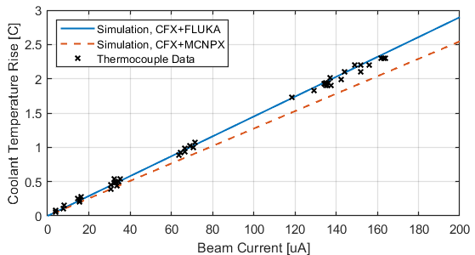

Power Deposition in Target
Calculated from temperature rise in cooling water:$Q = \dot{M}{ C}_{P} ∆T$
Water circuit ΔT is small, but appears to be as expected – validating Monte Carlo estimate of heat deposition
Data from Nov 2022 – Mar 2026

Slide 14
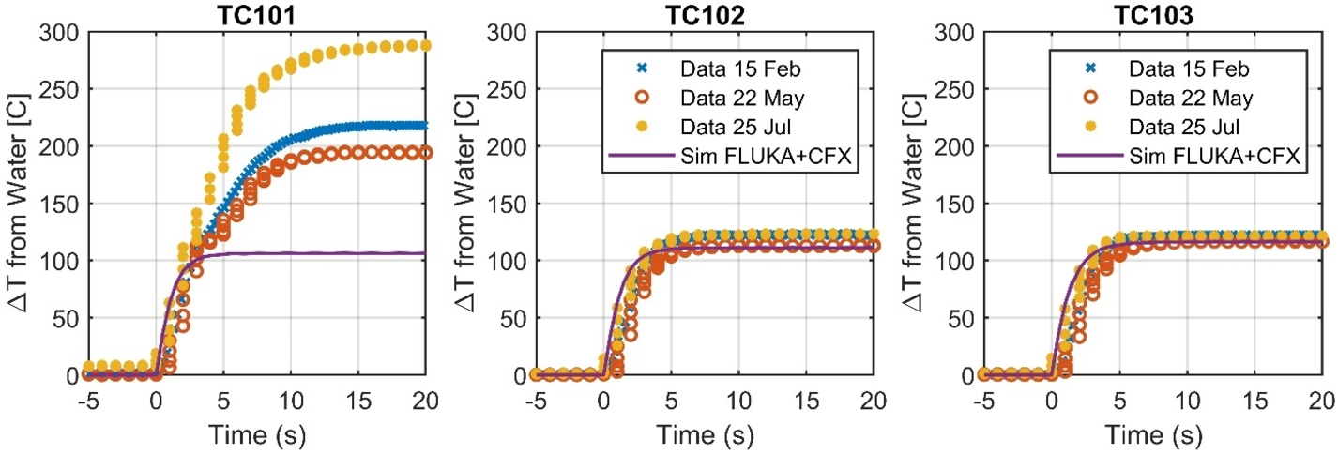
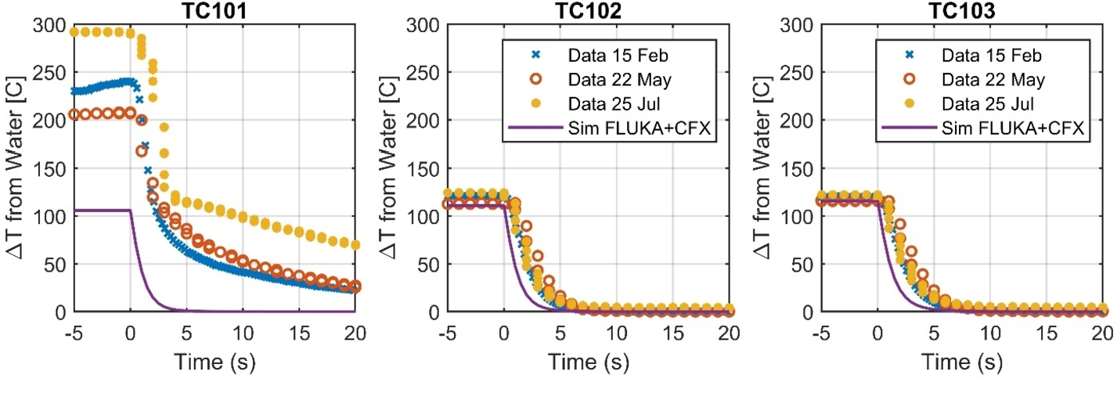
Transient Temperatures
Heating Rates:
Very low cooling rate on plate 1 at low temperatures
Broadly good agreement apart from plate 1 (anomalous sensor)
Initial heating rate gives an independent validation of heat deposition
Rapid cooling rate indicates water system is functioning as expected
Cooling Rates:

Slide 15
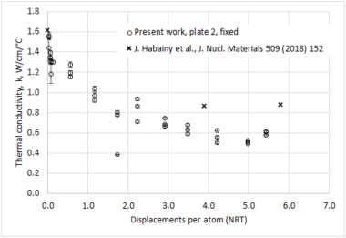
In-Situ Measurement of Conductivity Loss
Potential factors affecting thermocouple temperature:
Cause | Possible Effect (%)
Beam focus (spot size) | 50
Beam profile (gaussian or parabolic centre?) | 40
Tungsten radiation damage | 30
Monte Carlo code used (MCNPX vs FLUKA) | 15
Beam centre position | 15
D2O Flowrate variation within trip range | 10
Expected effects of thermal conductivity loss in tungsten:
  Increase in steady-state plate temperatures
  Decrease in cooling rate after beam off
TS1 plates are thin, effect of conductivity is relatively small (~40°C)
Beam profile and focus effects are potentially larger, particularly for 1). Beam profile monitor currently not working.
See recent publication by David Findlay et al. for an investigation of 2):
  https://doi.org/10.1016/j.nima.2026.171555
  “Measurements of decreasing tungsten thermal conductivity in an operating spallation neutron target”

Slide 16
Summary
Continually updating our simulation approach, and can now include radiation damage to materials in detail
We are improving our understanding of TS2 failure modes via new irradiated material data, better simulations, and ongoing PIE
TS2 Mk5 targets redesign will hopefully bring thermomechanical performance more in line with TS1 targets
Continuing to monitoring TS1 Project target performance. Validation of simulations against real data is generally as expected

Slide 17
Thank you for your attention.
Any questions?

Slide 18
Backup Slides

Slide 19
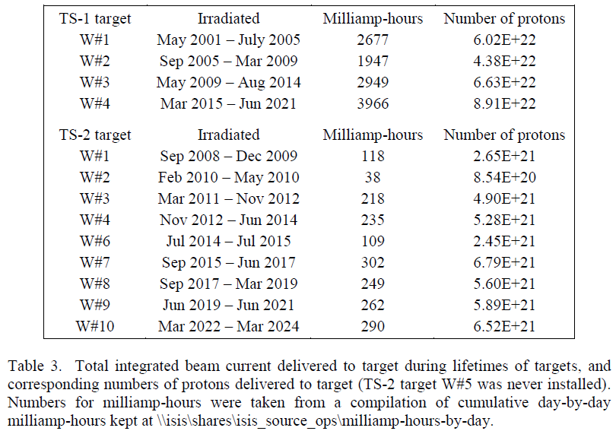
ISIS Target Lifetime History
TS-1 Target | Lifetime (mAh) | Peak DPA | Cause of Replacement
W#1 | 2677 | 24.7 | Thermocouples reached end of life
W#2 | 1947 | 18.0
W#3 | 2949 | 27.2
W#4 | 3966 | 36.6
Project #1 | 1409 so far |  | In Operation
TS-2 Target | Lifetime (mAh) | Peak DPA | Cause of Replacement
W#1 Mk1 | 118 | 9.7 | Oxidation of front face Ta
W#2 Mk1 | 38 | 3.1
W#3 Mk2 | 218 | 17.8 | Cooling water activation Isotope analysis indicates tungsten
W#4 Mk2A | 235 | 19.2
W#6 Mk2A | 109 | 8.9
W#7 Mk2A | 302 | 24.7
W#8 Mk2B | 249 | 20.4
W#9 Mk2B | 262 | 21.5
W#10 Mk3 | 290 | 23.7
W#11 Mk3A | 271 so far |  | In Operation
Table and DPA estimates courtesy of David Findlay, ISIS
Used for first TS2 target PIE
Peak damage per run year ~6 DPA on TS1, 12 DPA on TS2

Slide 20
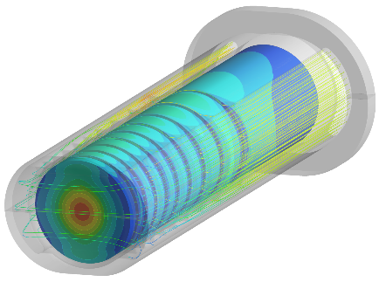
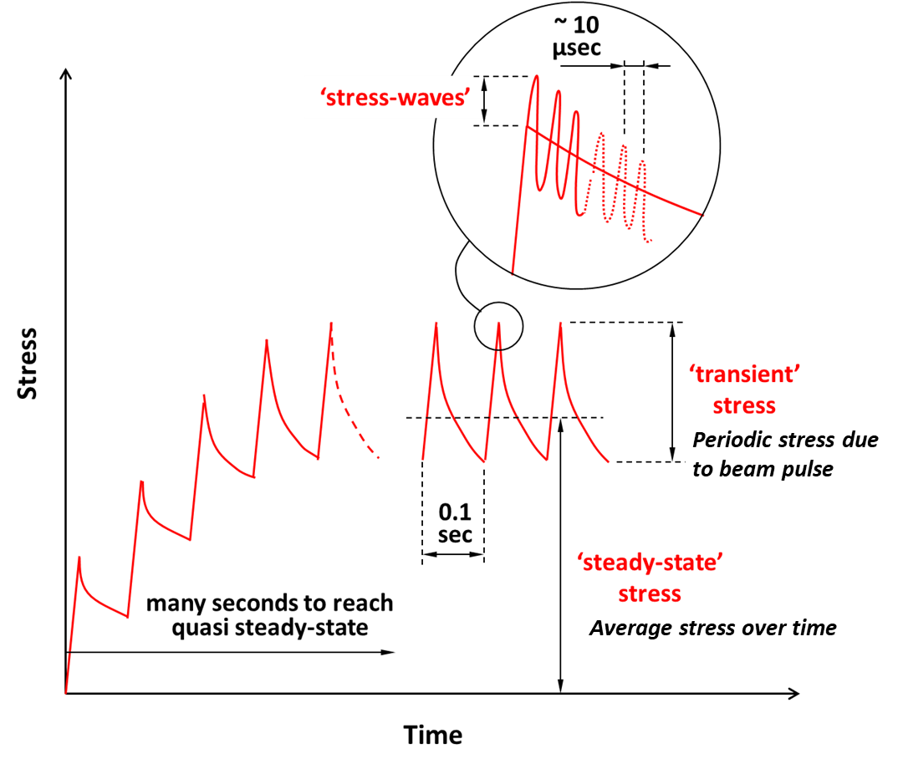
Target Simulation Approach
Ta cladding attached to W core via Hot Isostatic Press (HIP). Residual stress simulated with 500°C “lock-in” temperature [1] [2]:
Tensile in Ta, induces yielding but not failure. Detrimental to fatigue life.
Compressive in W – initially beneficial for fatigue life
  Does radiation damage act to relieve this residual stress? Currently unproven.
Proton beam heating adds thermal stress, which is higher in TS2
Short pulse facility (~400ns), so stress waves are inevitable
Much worse in TS2 due to smaller beam spot
Fatigue due to beam pulses (many, small stress) and beam trips (few, large stress)
References
[1] D. Wilcox, P. Loveridge, T. Davenne, L. Jones and D. Jenkins, "Stress levels and failure modes of tantalum-clad tungsten targets at ISIS," Journal of Nuclear Materials, vol. 506, pp. 76-82, 2018.
[2] D. Wilcox, P. Loveridge, S. Kabra, T. L. Lee, J. Moor and D. Jenkins, "Measurement of residual strain in tantalum-clad tungsten after hot isostatic pressing," Journal of Neutron Research, vol. 22, no. 2-3, pp. 287-297, 2020.

Slide 21
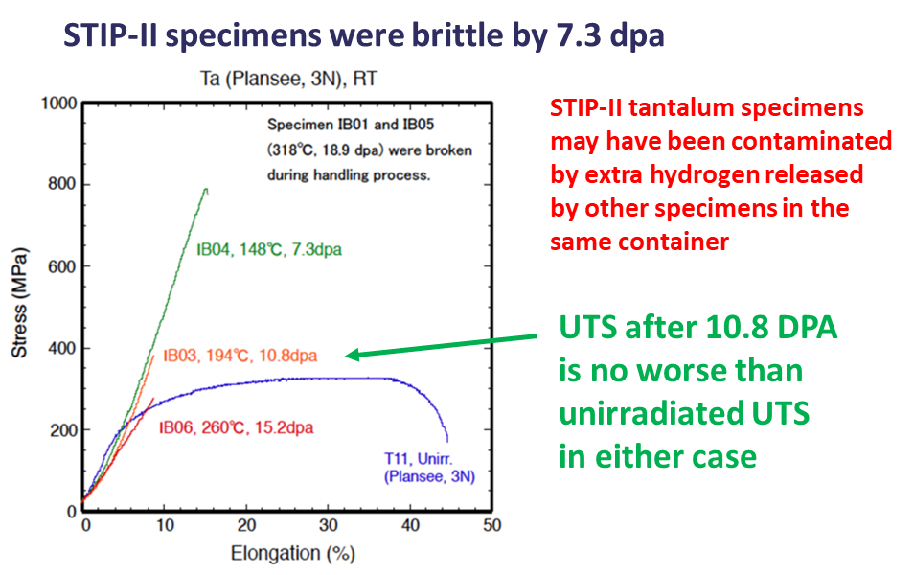
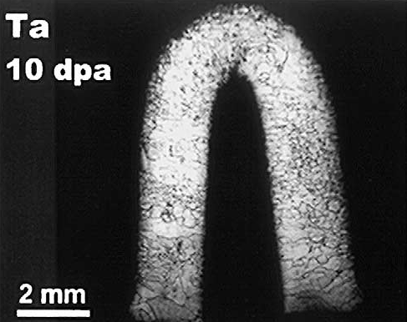
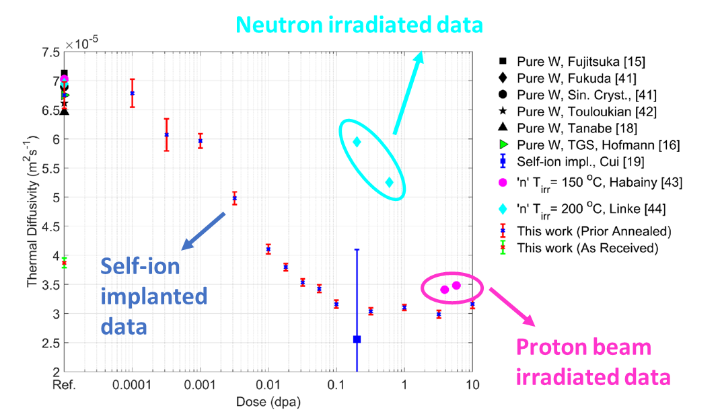
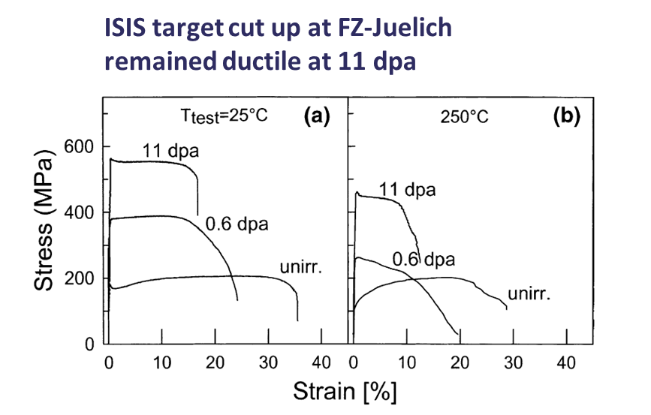
Summary of Irradiated Material Properties
Tungsten
Brittle at room temp. even before irradiation
UTS: 560 -> 300 MPa after 1.3 DPA
k: 175 -> 88 W/(m.K) after ~2 DPA
UCS: 1170 -> 2120 after 23.3 DPA, no saturation
UCS/UTS: 2.1 -> 7.1 (brittle -> very brittle)
Tantalum
Initially: High ductility, very high fatigue endurance limit
Large variation in reported ductility after 10 DPA
Less irradiated data overall
No further change up to 27 DPA
References
J. Habainy et al., “Thermal diffusivity of tungsten irradiated with protons up to 5.8 dpa,” Journal of Nuclear Materials, vol. 509, pp. 152-157, 2018.
J. Habainy et al., “Mechanical properties of tungsten irradiated with high-energy protons and spallation neutrons,” Journal of Nuclear Materials, 2019.
Y. Dai, "Recent spallation materials researches performed at PSI", Presentation at HPTW 2023, Monday Nov 6th 2023
Y. Dai, "Thermal diffusivity of tungsten irradiated by protons in spallation environment up to 26.5 dpa", Presentation at HPTW 2023, Thursday Nov 9th 2023
A. Reza et al. (2020). Thermal diffusivity degradation and point defect density in self-ion implanted tungsten. Acta Materialia, 193, 270-279.

Slide 22
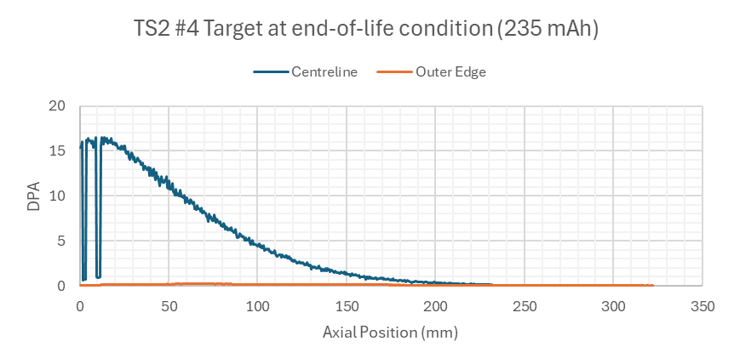
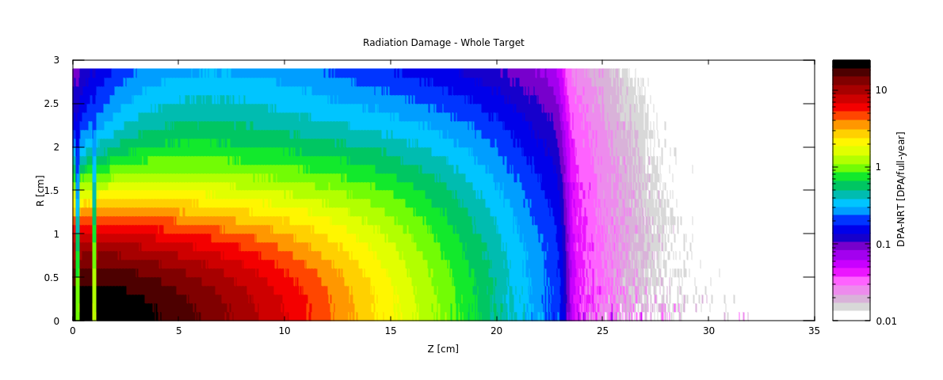
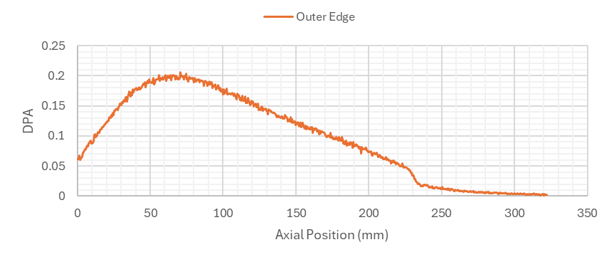
Simulation of TS2 Target #4 – Received Dose
What was the condition of TS2 target #4 when PIE was carried out?
~16 DPA at centreline (survived), 0.18 DPA at crack location in Ta
Scale to accumulated mAh on real target
DPA-NRT after 1 full year of 40uA operation:
Location of observed crack:

Slide 23
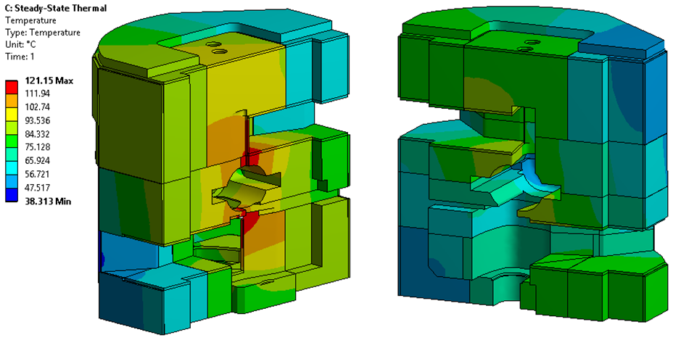
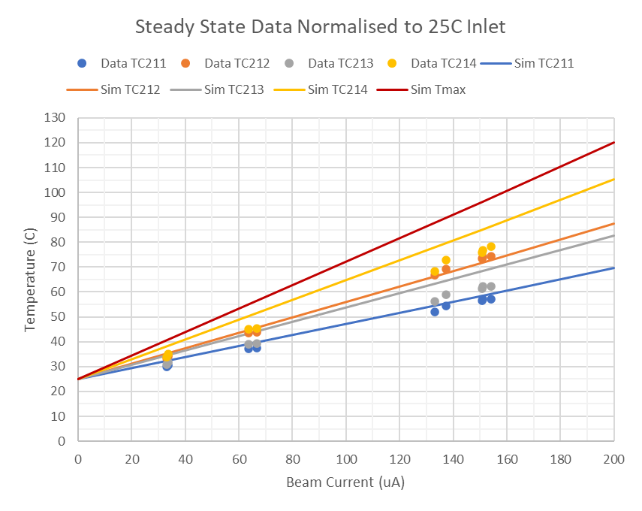
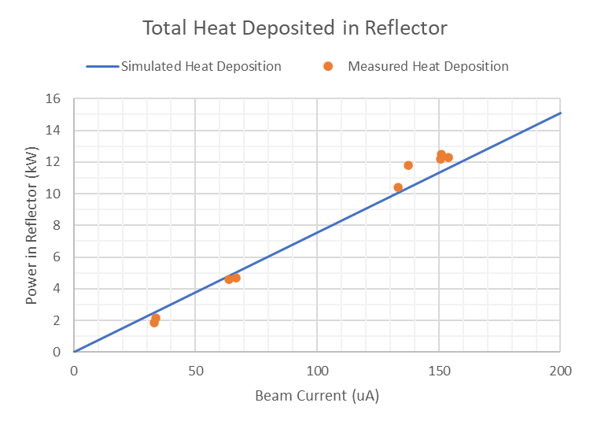
TS1 Project Reflector – Measured Data
Total heat deposition estimated from coolant ΔT
Four thermocouples are directly in contact with Be
Peak temperature estimated from simulation only

