Slide 1
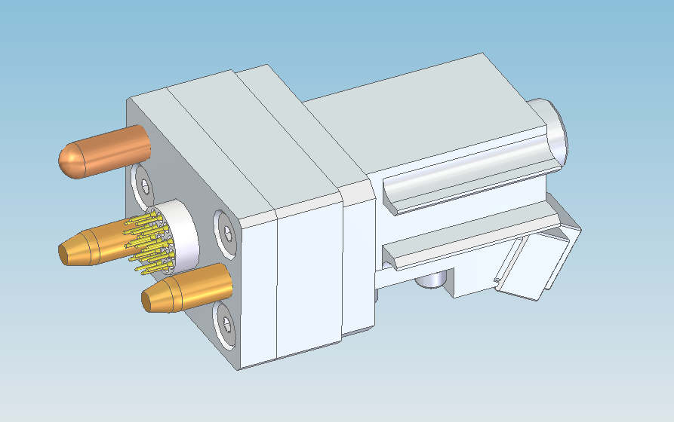
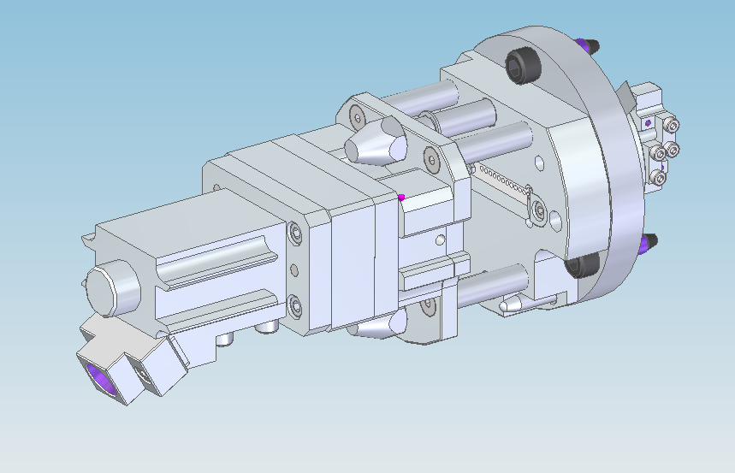
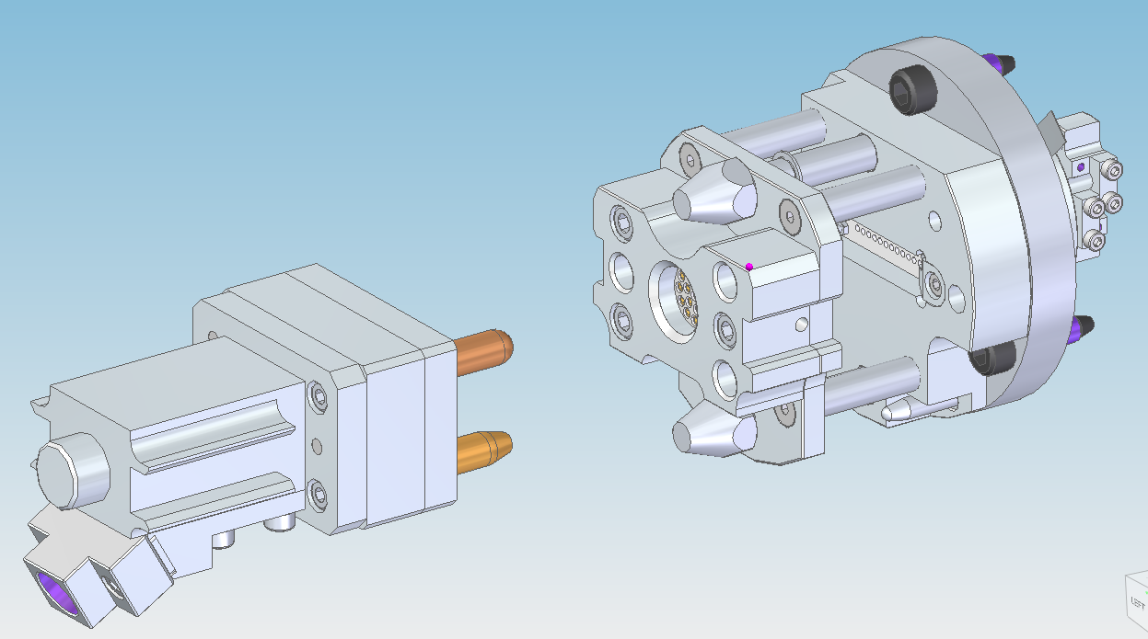
ISIS TRaM REMOTE THERMOCOUPLE PLUG ASSY
ALLECTRA DOOR FLANGE. WELDABLE D-SUB SOCKET
VOID VESSEL He SIDE
AIR SIDE
CERAMIC 19 PIN BURNDY PLUG.
CABLE CLAMP FOR LOOM
3 POINT LOCATION PINS
SACRIFICIAL CONNECTOR, D-SUB PLUG TO DOOR FLANGE. CERAMIC BURNDY SOCKET TO REMOTE PLUG
REMOTE HANDLING PLUG. CONSISTS OF A BURNDY CERAMIC PLUG. DISCONNECTED TWICE A YEAR FOR MODERATOR CHANGE.
CERAMIC 25 WAY D-SUB PLUG
CERAMIC 19 PIN BURNDY SOCKET.
CABLE CLAMP FOR MODERATOR THERMOCOUPLES

Slide 2
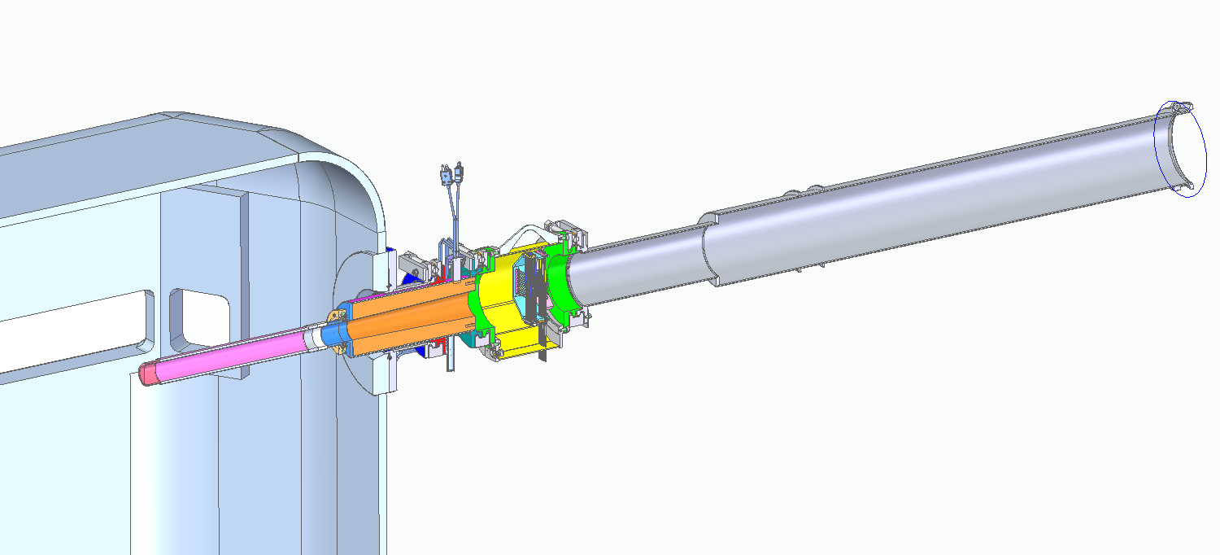
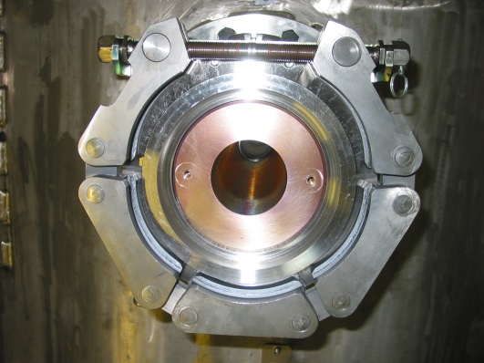
Assembly breaks down into 3 component parts
EPB Tube + Beam Profile Monitor + EPB Window Assembly
The seals are assembled to the replacement components
using location tabs.
The clamps are replaced with each window change.
Alu / Stain Friction Joint
Alu PBW
Proton Beam Window Clamp
Monitor Clamp
EPB Vac
Proton Beam
EPB Tube
Void Vessel
He
EPB Tube Clamp
Copper collimator
Copper Collimator
Profile Monitor
Clamp support hooks

Slide 3
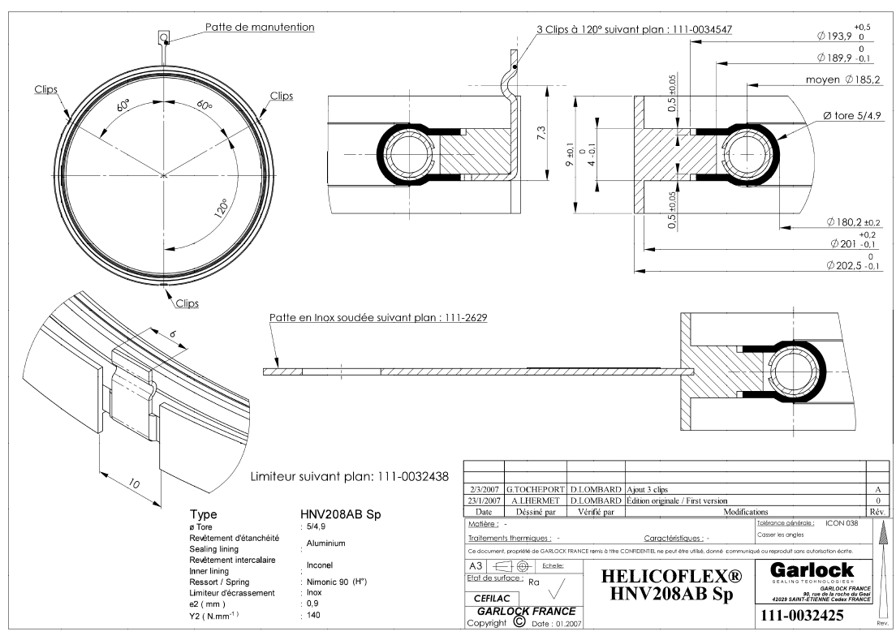
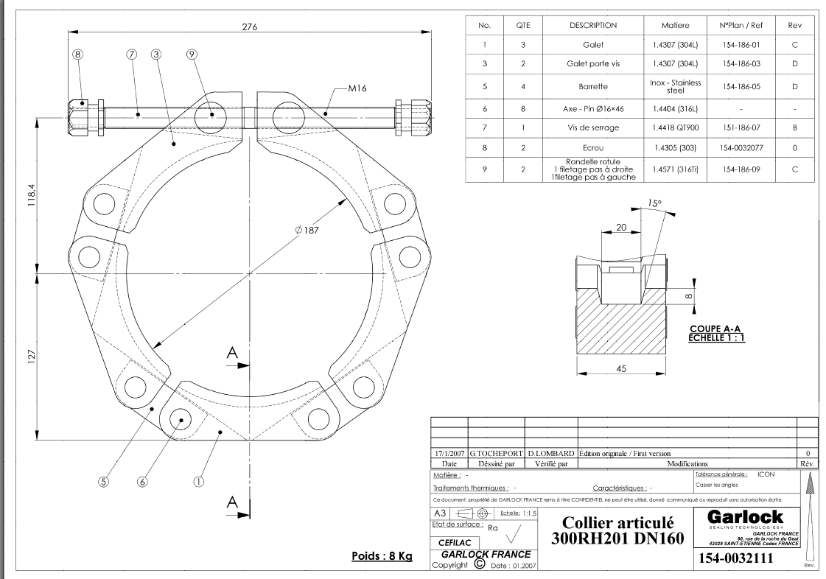
Note the orientation of the clamp. The direction of the thread to tighten can reverse due to orientation of the clamp. We have sheared nuts off due to tightening rather than releasing.
Clamps and seals are obtained from Technectics.
We have managed to reseal helicon flex seals after initial clamping. We normally replace.
We apply a small amount of copper slip grease to the clamp thread. We have had some of the smaller clamps seize. The thread had to be cut to release.

Slide 4
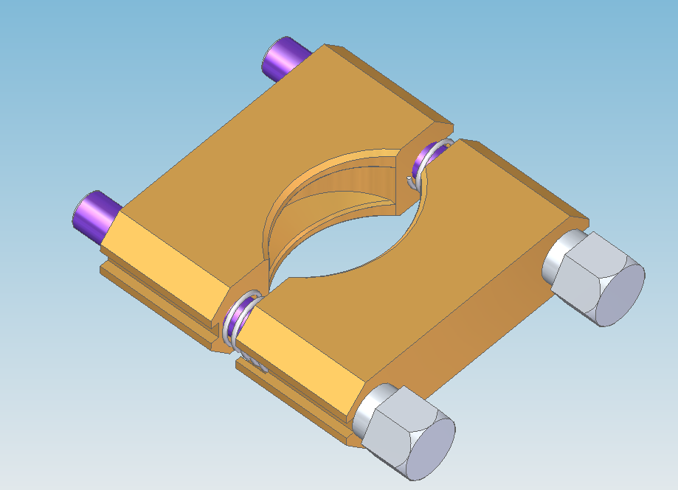
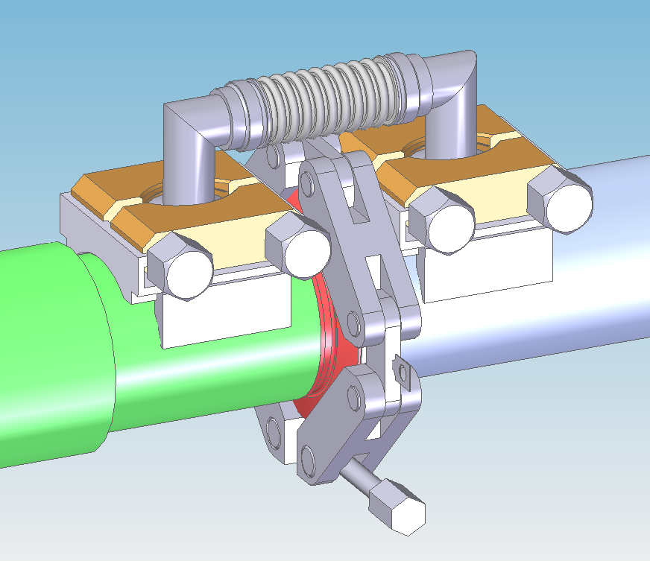
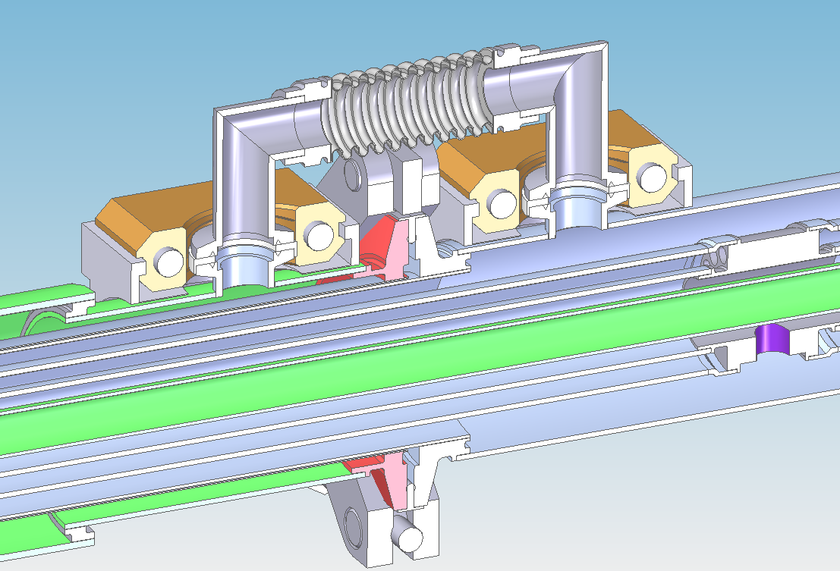
ISIS CRYO TRANSFERLINE CONNECTIONS
ALU \ BRONZE
JAWS
STFC DESIGNED
REMOTE HANDLING
KF16 VAC CLAMP
BLANKET VACUUM LINK PIPE
STAINLESS
COMPRESSION SPRINGS
STANLESS 304 CLAMP
SCREWS
MODERATOR
COLDBOX
ALU 1030
KNIFE EDGE
Kf16 VAC SEALS
8 BAR CRYO CONNECTION
TECHNECTIC HELICOFLEX SEAL
HN-208-ABK-75.20-88.50-2.80-ARGENT.
QUICK DISCONNECT COLLAR 300 RH87SP CLAMP
VAC CLAMP SUPPORT CRADLE

