Slide 1
Target Systems Vacuum Vessel and Feedthrough Design
ISIS/CERN collaboration progress workshop
1rst - 2nd June 2026
Gemma HUMPHREYS - Jean-Louis GRENARD – CERN – SY-STI-TSP
On Behalf of the HI-ECN3 Project Team

Slide 2
Contents
Facility Overview
Contents and functions
Objective and requirements for the study
Design Development
Installation and Alignment
Failures
Vacuum system
Feedthroughs
Manufacturing
Vacuum Vessel Seal
Prototype Plans
Opening Sequence

Slide 3
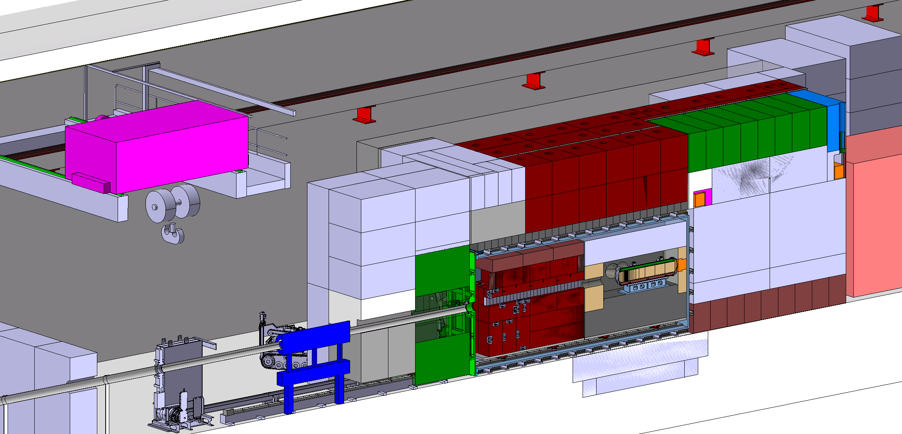
Target Station & Target system
Target System
Copper Proximity Shielding
Trolley assembly
Vacuum vessel
Magnetised Hadron Stopper
Target bunker (iron & concrete)
5m
SHiP
Experiment
9m
P+

Slide 4
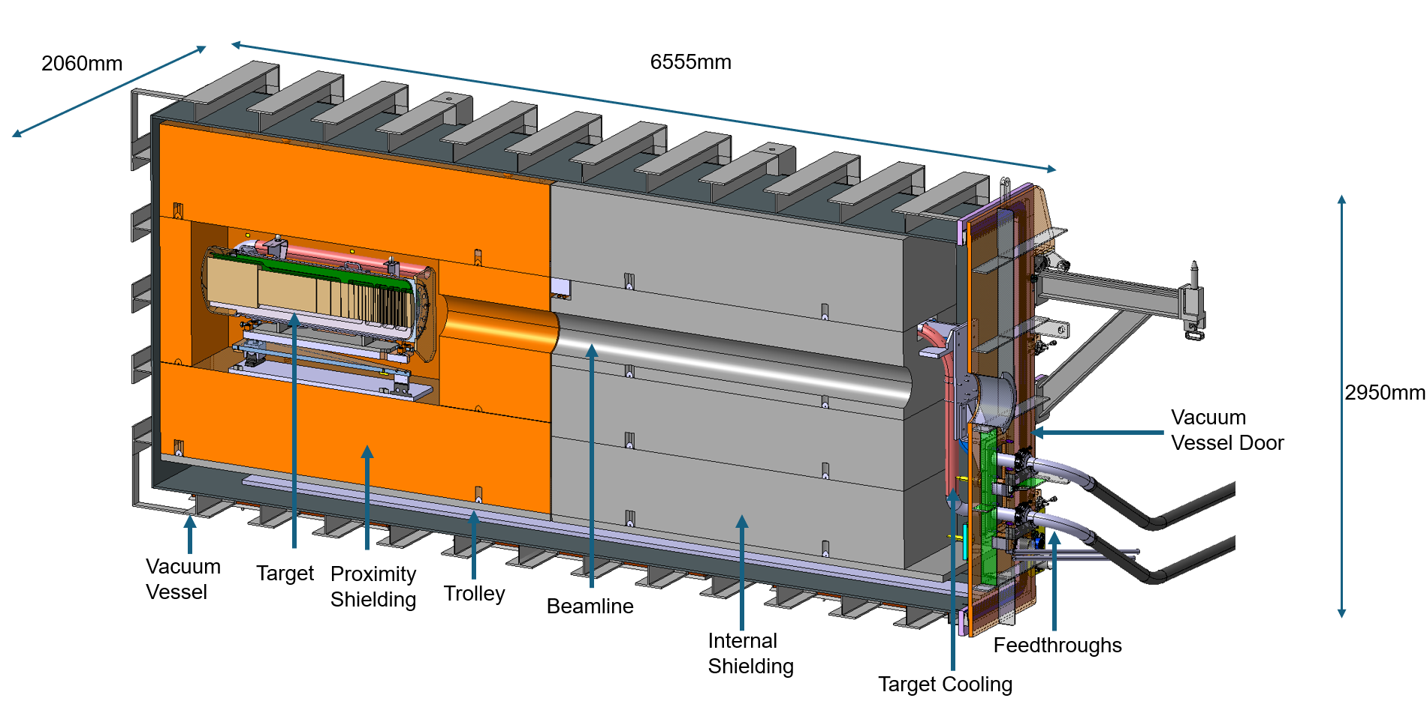
Contents and Functions
Primary Functions:
Minimise activation of the surrounding air and corrosion risks through maintaining vacuum level of 10⁻³ mbar
House the target, related proximity shielding and relevant cooling components
Maintain target alignment with the beamline
Auxiliary Functions:
Contain a system to ease the removal of the target and shielding
Provide structural integrity
Integrate with the safety systems
Allow for integration of coolant pipes into the vessel
Retention vessel if coolant leakage occurs
Internal Vacuum Vessel Systems Cross Section
Internal load: ~150 tonnes
Empty Weight: ~13 tonnes
Prompt Dose Rate: ~1.6E11 uSv/h
Internal Volume: ~30m³

Slide 5

Objective of Preliminary Design Study - Streicher
16-week mechanical design contract for the preliminary design of the vacuum vessel system
  Expertise in the field of competence (design, manufacturing / construction, installation)
Further develop the CERN concept with design and structural calculations
Develop the vacuum system
Understand risks associated with vacuum vessel
Develop the opening sequence and any tooling required
Provide standards and regulations to be followed
Provide qualification criteria for welds and vacuum acceptance
Generate an estimate of the cost for the final production of the vacuum vessel
Price enquiry and specification: https://edms.cern.ch/document/3315586/1

Slide 6
Requirements
Fit in a defined envelope within target station shielding
Comply with material restrictions
  Low Cobalt content
  No magnetic properties
Fit all required components within the vessel
Locate all possible failure points on one part of the vessel
Handle if a water leak was to occur in the vessel
  Drainage options
  How to dry vessel

Slide 7
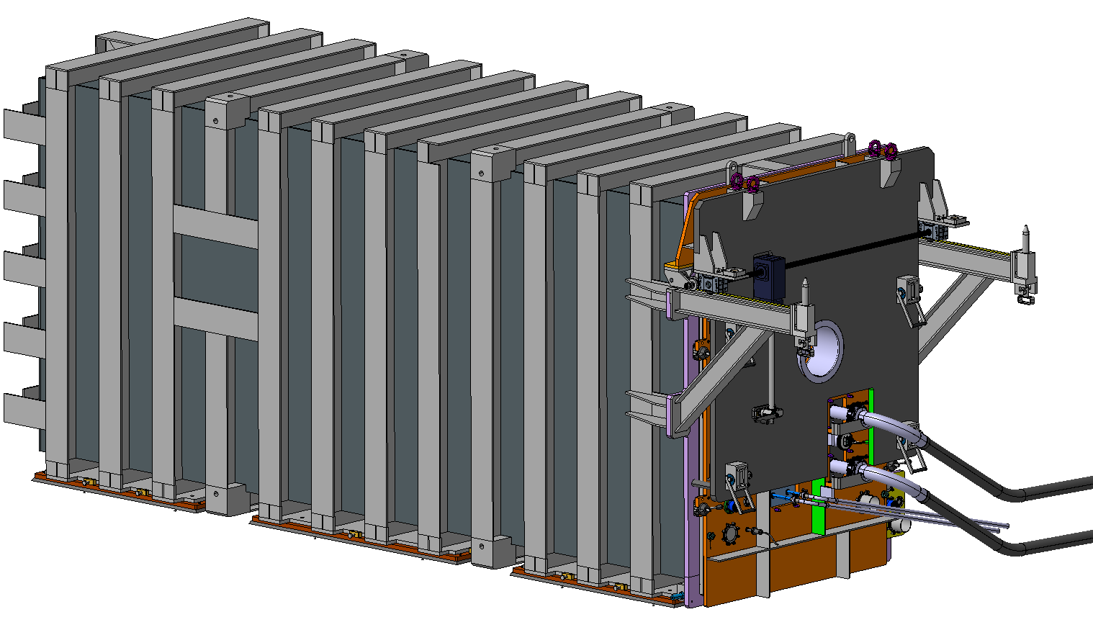
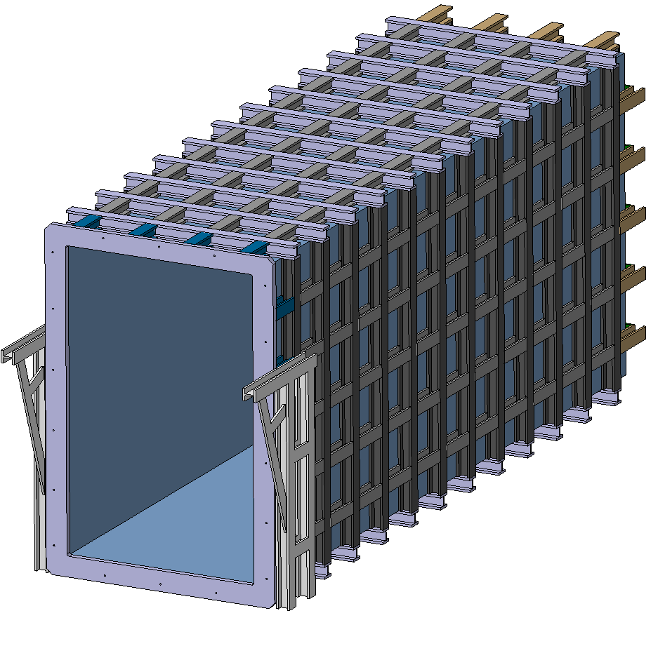
Design Change from Previous Year
2050mm
2060mm
6555mm
6579mm
Guide Rails
2950mm
2941mm
TSAC1
Internal volume: 28.96m³
Weight: 25 Tonnes
TSAC2
Internal volume: 26.52m³
Weight: 13 Tonnes
Full Structural assessment
Method of installation and alignment
Door installation and opening
Developed shielded lifting tool
Vacuum pumping system
Drainage connections

Slide 8
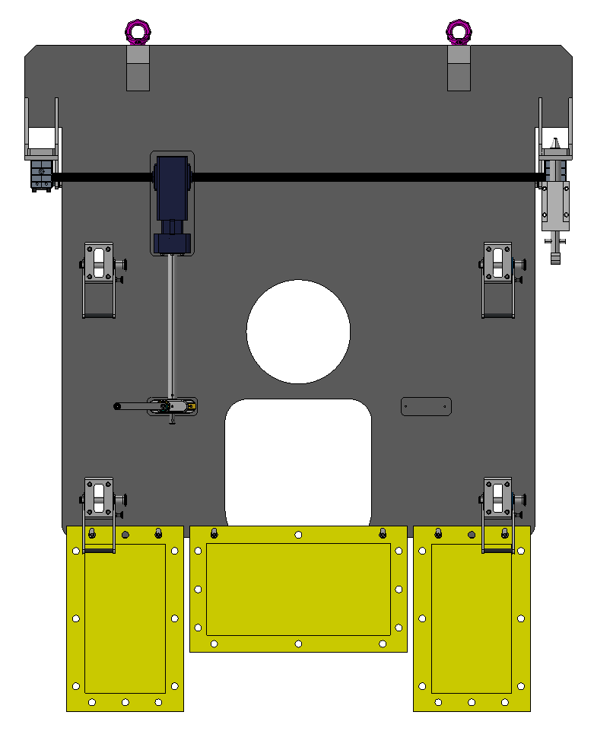
Shielded Lifting Tool
Shielded Lifting Tool
5cm thick carbon steel tool
Moved into place to provide some shielding when door is being opened
Utilises manual crank to move towards the door
  Design adaptation to include robotic handling
Locking pins secure tool to door
Lead blankets for specific operations
Rollers
Connection to vessel door
Manual crank
Cut-outs for feedthroughs
Lead Blankets

Slide 9
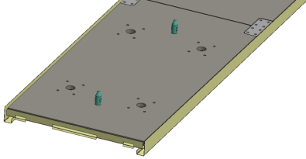
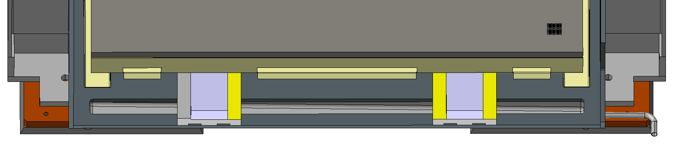
Water Leak Scenario
Water Collection
Gutter System
Drainage Pipe
Step
Action
Chamber State
Notes
1
Leak detection (pressure rise
-
> chiller
Under Vacuum
Leak detection system in
stops)
cooling system
2
Dry the cooling loop (collect water to
Atmosphere/under vacuum
To prevent larger leaks and allow
chiller, seal inlet/outlet)
evacuation
3
Pump drainage (water pump via
Under Vacuum
Only done for large leaks (>few
drainage network)
litres
)
4
Vacuum drying residual water left in tank
Under Vacuum
Usage of vacuum pumping
system

Slide 10
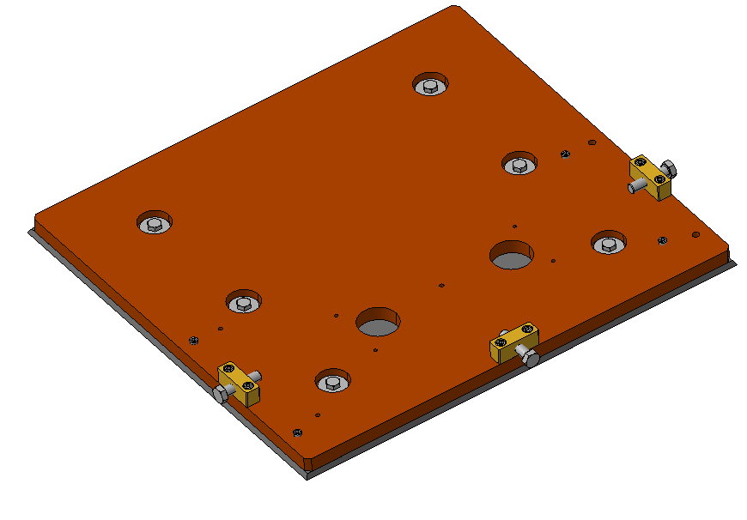
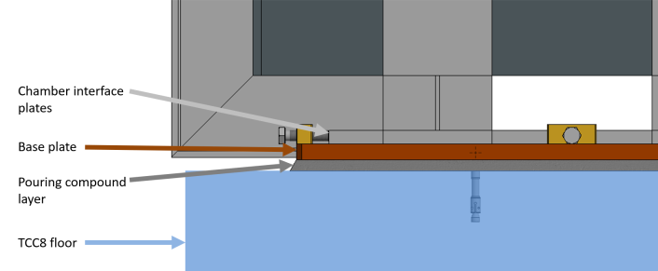
Installation and Alignment
Ground Anchor Bolts
Laser Tracker Interface
Levelling Bolts
Drilling and installing anchor bolts into TCC8
Base plates installed and vertical alignment performed with set screws and laser trackers (0.2 - 0.3mm accuracy)
Base plates grouted with high-compressive strength cement-based compound
Vacuum chamber installed onto base plates
Chamber positioned with chamber alignment bolts (±20mm)
Chamber fixed to base plates
Size of base plates ~1m² to remain within the 30 tonnes/m² average overall weight limit in TCC8
Base Plate Design
Levelling Bolts
Chamber Alignment Bolts
Openings for Concrete Pouring

Slide 11
Failure Reduction and Recovery
Cooling pipes have welded connections to flanges
  Reduced chances of leakage
All components mounted onto the vacuum vessel door
  One replaceable component if there were to be failures
Weld inspection
  All welds on the pipes check with x-ray and die penetrant testing
  Pressure tests performed
Pressure relief valve + burst disk – used in case of a helium leak from target cooling
  Redundancy on overpressure scenarios
Event of failure inside of vessel:
  Send a robot inside
  Mount a shielded cabin onto the rails and put inside to carry out maintenance

Slide 12
Failure Impacts to Surroundings
Leak in the water or helium cooling within vacuum vessel
Large vacuum leak in vessel
Without proton beam window
With proton beam window
Contamination spreads out of vacuum vessel into upstream beamline
Loss of upstream beamline vacuum
Contamination remains within the vacuum vessel
Upstream beamline remains under vacuum
Could foresee a fast vacuum valve and/ or proton beam window

Slide 13
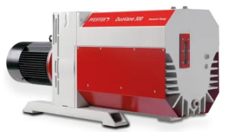
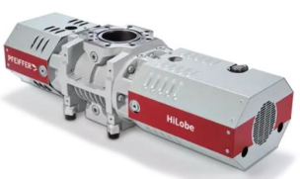
Vacuum System
Rotary Oil Pump + Roots Booster |  | Dry (screw) Pump + Roots Booster |  | 2 Dry Multi-Stage Roots Pumps + Roots Booster
Ultimate pressure lower than dry pump | Possible oil pollution in primary pump with radioactive dust – preventable with soft start pumping | No possible contamination of chamber with oil | Worse vacuum performance | No possible contamination of chamber with oil | Worse vacuum performance
No contamination of chamber from oil vapors |  |  | More complex construction and servicing | No annual servicing | More complex construction and servicing
Annual oil change on site |  | Annual oil change, belt replacement, full cleaning on site |  | Major service at supplier premises every 4 years
Major service at supplier premises every 10 years |  | Major service at supplier premises every 4 years
Final selection still to be fully validated by BE-EA

Slide 14
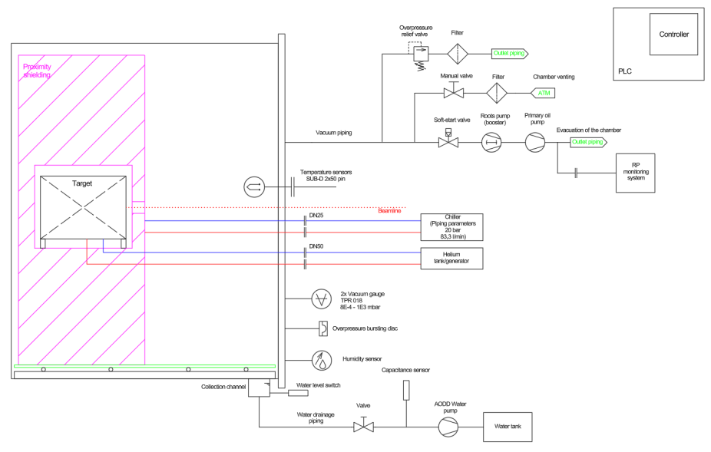
Vacuum Vessel Preliminary P&ID
Outlets both have filters and are connected to the ventilation system
Filters and outlets could be grouped together
Proposed systems to be checked for compatibility with CERN NA primary vacuum infrastructure
Water drainage connected to contaminated water network

Slide 15
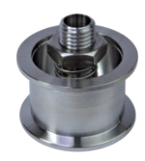
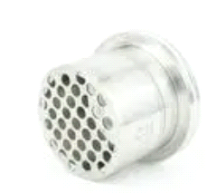
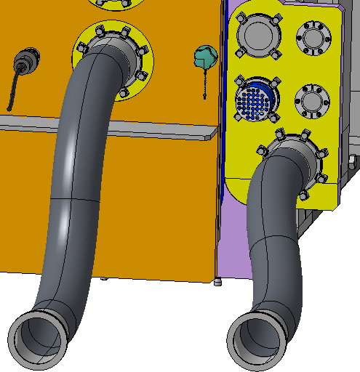
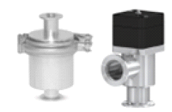
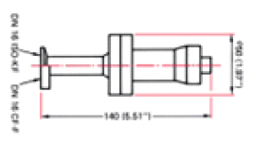
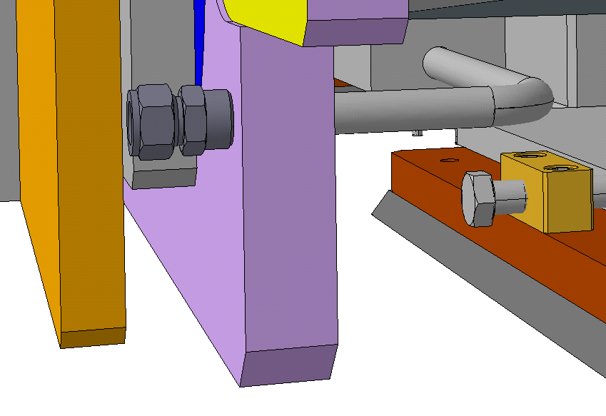
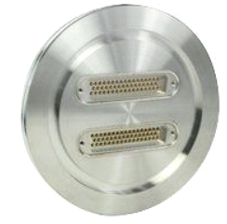
Vacuum Vessel Feedthroughs
Action
No.
Function
Connection
Placement
Type of gasket
Component description
Additional info
needed
type
before
Action description
door
removal
Relief pressure =
±
0,15
Overpressure relief valve should be outside radiation zone.
Pressure relief
DN40 ISO
-
bar(g). Flow rate max =
There is O
-
1
Vacuum piping
FKM/EPDM
NO
ring in the body of the valve
–
degradation would
valve
KF
210 l/min. Added particle
cause lose of sealing. No piping connected on the outlet
–
filter on the outlet
only particle filter.
Bursting pressure = 0,45
–
Can be connected on the door or on the main flange, no
Pressure burst
DN63 ISO
-
2
K
Door/Flange
Metallic
0,48 bar(g). Flow rate >
NO
maintenance needed (metallic sealing). No piping
disc
/ ISO
-
CF
500 l/s. Free volume of
connected.
the chamber = 7500 l
EPDM if it is
located on the
-
mbar to be
reached
Vacuum system can be connected to the main flange
–
then
3
Vacuum system
DN100
Door/Flange
door. Metallic if it
10
3
YES/NO
there would be no action needed. If connected to the door
–
is located on the
then piping
must
be dismounted before door opening.
flange
DN40 ISO
4
Venting
-
Vacuum piping
FKM/EPDM
Manual valve with LOTO
NO
No action needed, outside of the radiation zone.
KF
function + Particle Filter
DN16 ISO
2
×
Pirani measuring tube.
5
Vacuum gauge
-
Door
Metallic
Measuring range: 8E
-
KF / ISO
4
–
YES
Disconnection of communication cables.
-
CF
1000 mbar
6
Level limit switch
Door/Flange
To be determined
/ humidity sensor
3/4"
Water collection channel
7
Drainage system
Swagelok
Flange
Metallic
connected to a swagelok
NO
No action needed.
tube fitting
fitting on the main flange
DN100
8
Thermocouples
ISO
-
Door
Metallic
SUB
-
D (2 x 50 Pins)
Yes
Unplug thermocouples from door
K/ISO
-
CF

Slide 16
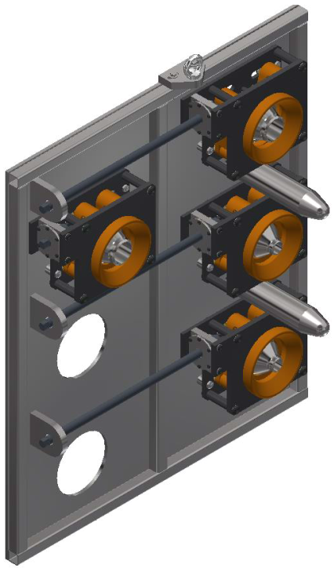
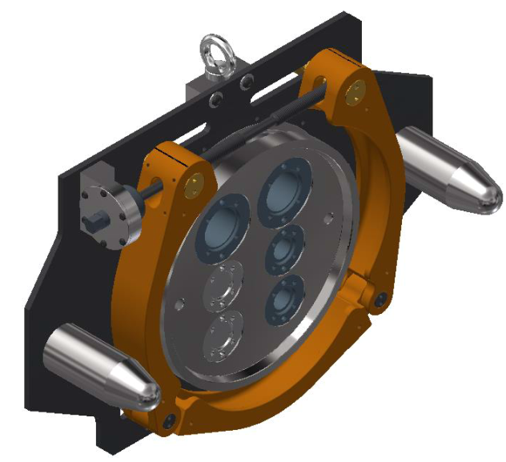
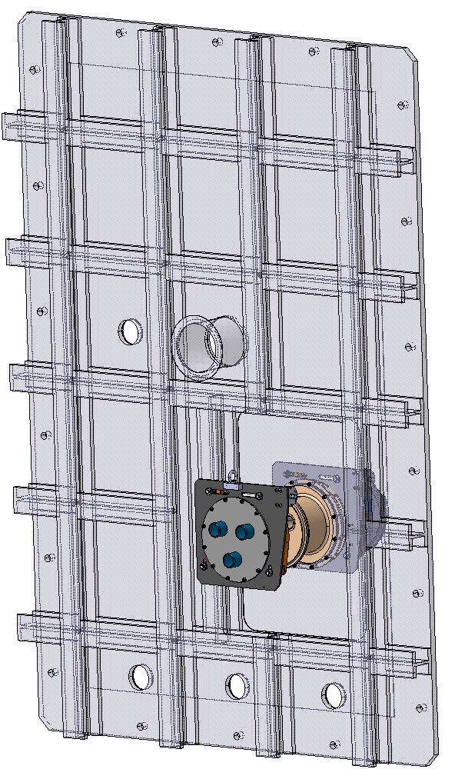
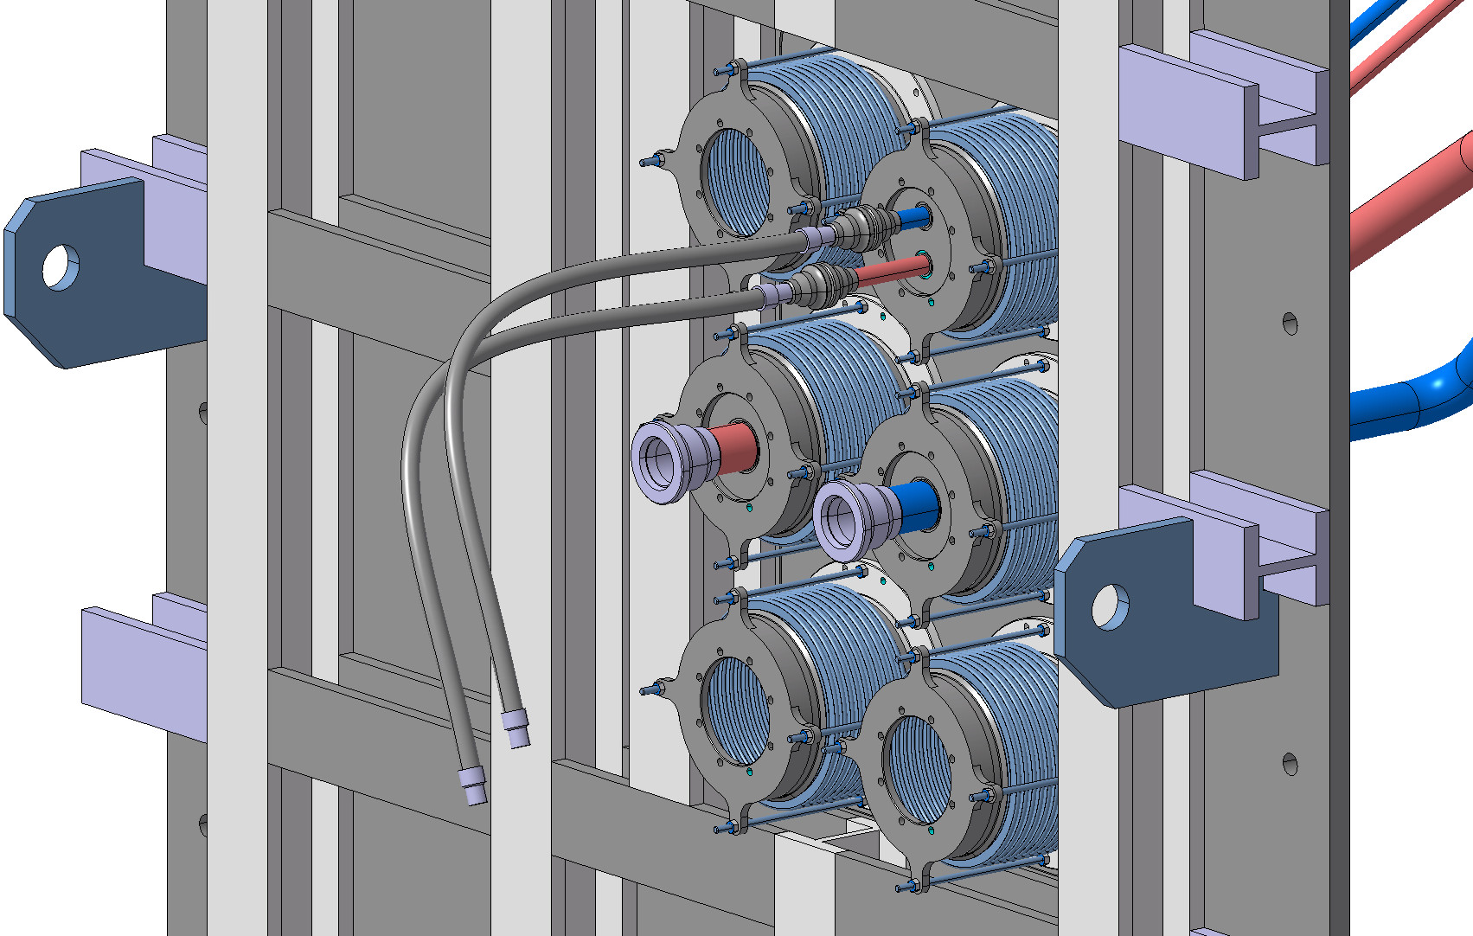
Incorporation of Cooling Feedthroughs
Proximity Shielding water cooling
Extra feedthroughs for instrumentation
Target Helium Cooling
Bellows connected to vacuum vessel door
Assessing to include remote flange connection
Design study ran with Destec to incorporate remote flange connections onto the vessel door
Multiple configurations assessed
Sealing both the pipes and the vacuum proved challenging with added weight of heavy connectors
Complexity outweighed the benefits
Integrated dose: 1-5 kGy/year in this area
Residual dose: ~500-800µSv/h compatible with human intervention

Slide 17
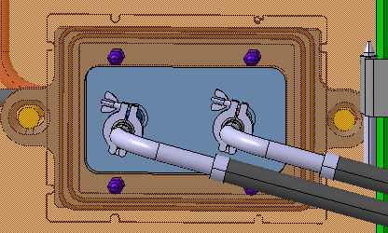
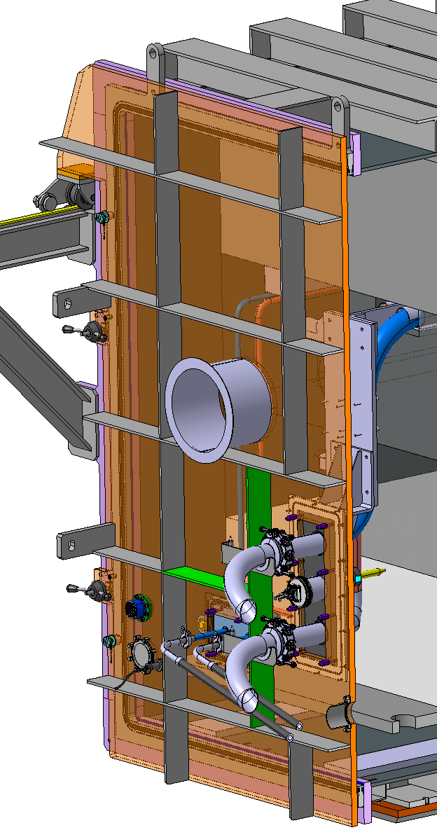
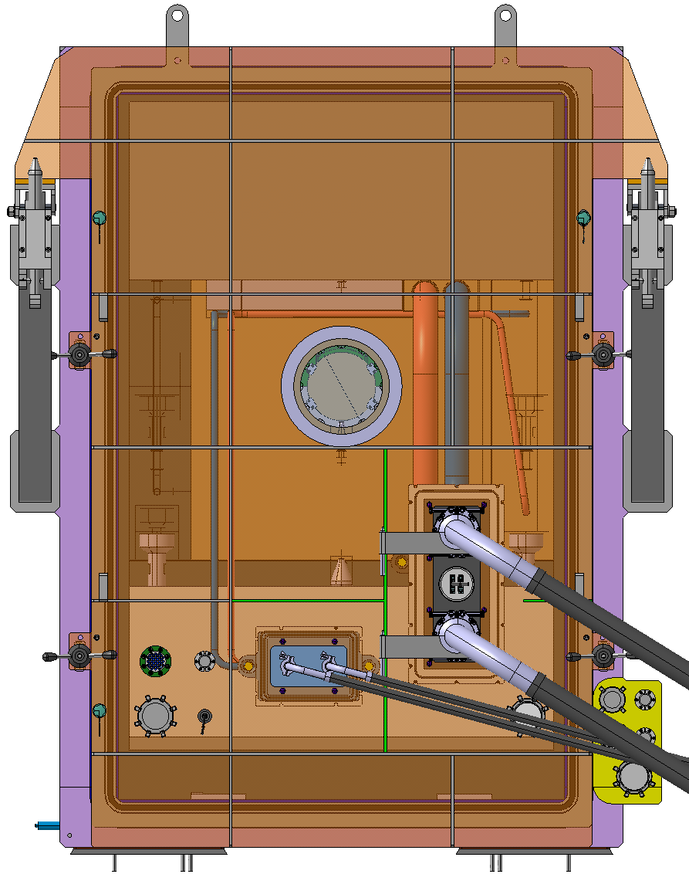
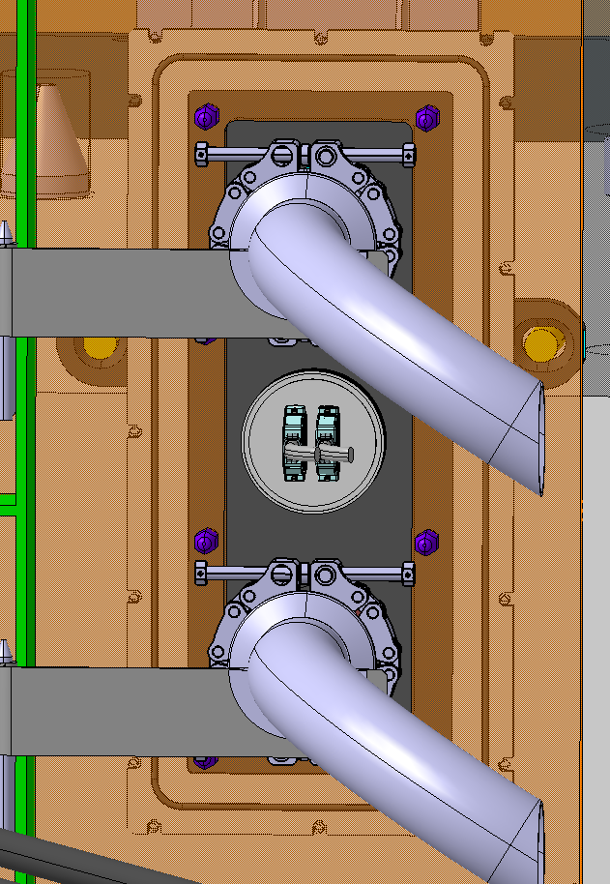
Vacuum Vessel Cooling Feedthroughs
2026 design under development
Water Cooling
Support structure for pipes
2x Helium cooling pipes DN80
Thermocouples
2 x Water cooling pipes DN25
Remote chain clamp
Helium Cooling
Design courtesy of C.Mucher

Slide 18
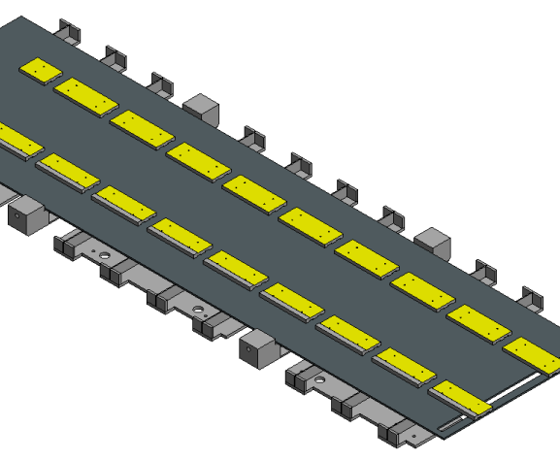
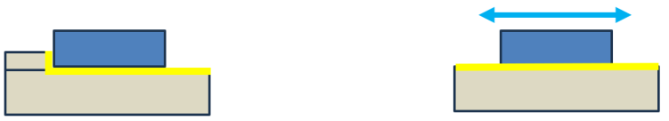
Manufacturing
Base of vacuum vessel is produced and reinforcements welded
Interface rails machined precisely and welded to the base
  Previous experience with similar sized vessel achieved ±0.2mm accuracy
Rest of vacuum vessel welded around the base
Sand blasting finish
Weld inspection
  Penetrant testing
  Ultrasonic testing
Leak test
  Performed before shipped and upon installation
Interface Rails
Lip to ensure alignment when installing trolley rails
See L.Jorat talk for more information on vacuum vessel rails

Slide 19
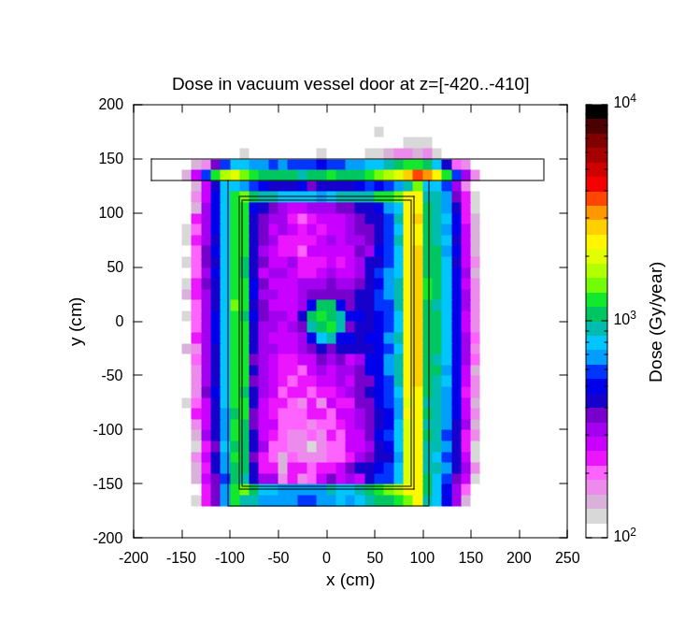
Vacuum Vessel Seal
Vessel door, helium cooling and water cooling all require elastomer sealing
Investigations into the radiation effect to seals ongoing
Seals to be replaced every time the vacuum vessel is opened – once every 5 years
Radiation to materials level in seal locations reaches up to 3kGy/year
Seals must withstand at least 15 kGy total

Slide 20
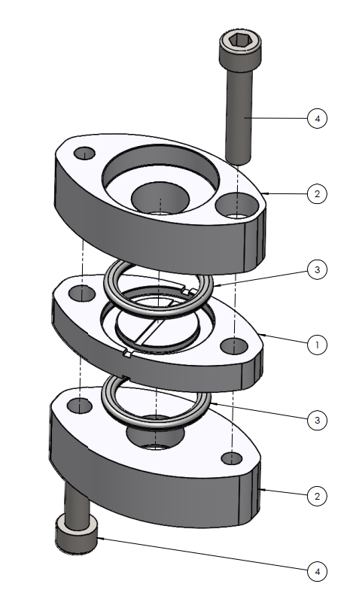
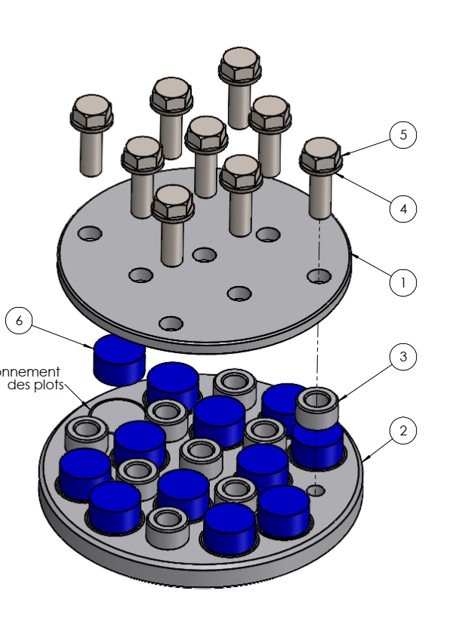
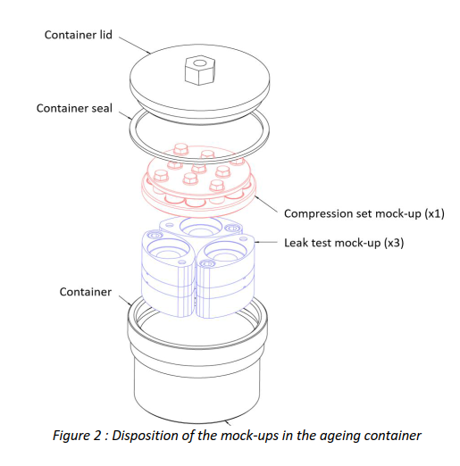
Elastomers for Vacuum Vessel Seals – Overview
Motivation | Develop know-how in testing elastomers at CERN Assess radiation effects on elastomer materials
Materials | 3 silicone rubbers,1 EPDM Cylindrical samples and O-rings
Irradiation | 37 - 201 days of irradiation at nTOF NEAR (neutron-dominated field) 5 dose points between ~170 - 940 kGy 1-, 2-, and 3-month irradiations finished in 2025 5- and 7-month irradiations ongoing (until end of August 2026)
Pre- & post-irradiation tests | Leak tightness Residual deformation after 10% compression Surface aspect (microscopy)
Compression Assembly
O-ring Assembly
Slides courtesy of D. Zemkova

Slide 21
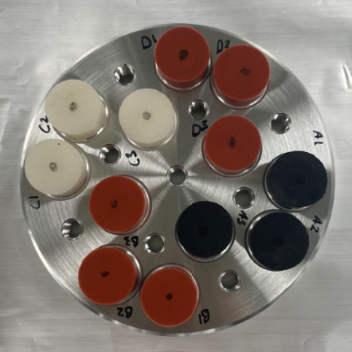
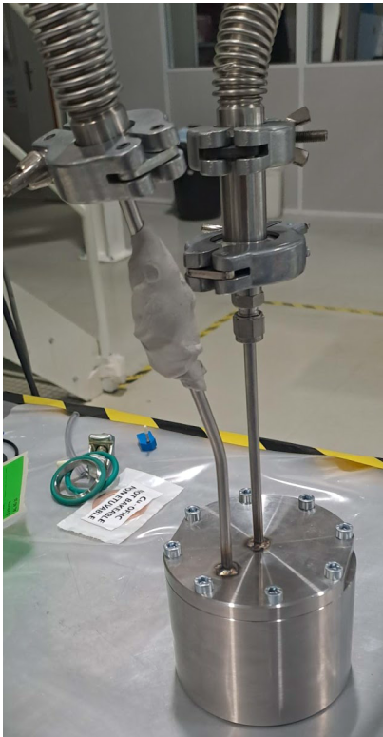
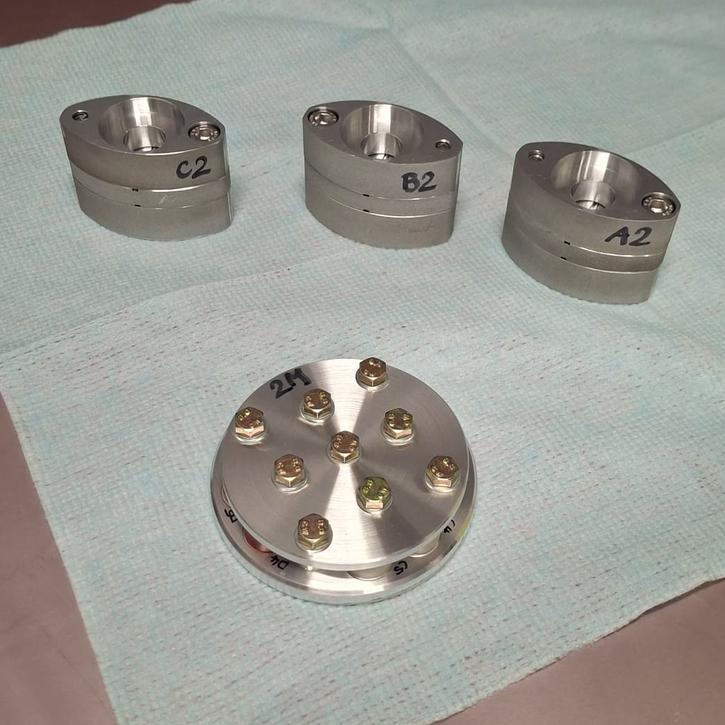
Elastomers for Vacuum Vessel Seals – Project status
Materials & tools | Samples provided by an external company Compression assemblies and tools provided by an external company and CERN
Sample preparation | Pre-irradiation tests done at CERN and the external company Irradiation assemblies prepared at CERN
Tests | Tests on 2025 samples scheduled in May 2026 Tests on 2026 samples in Autumn/Winter 2026
Results | Preliminary results to be presented in June 2026 Final results to be published in collaboration with the external company
Helium Leak Testing
Slides courtesy of D. Zemkova

Slide 22
Prototype Plans
Feedthrough Connections
  Mock-up to assess the bolting of the flange to the door and chain clamp operations
  Assess robotic compatibility with chain clamps
  Ensure pipes can be well managed during disconnection/connection process
  Check spacing of pipes is compatible with robotic intervention
Vacuum vessel seal irradiation testing
No prototyping for the vacuum vessel
  Product proven to work in industry already

Slide 23
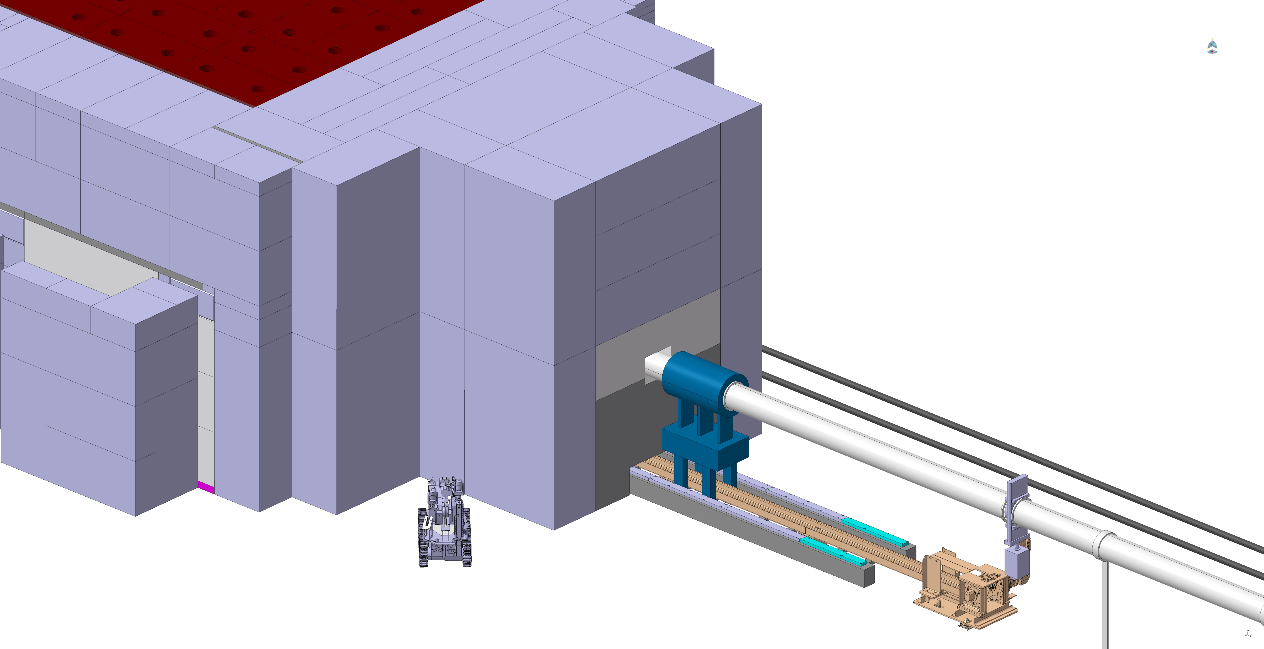
Vacuum Vessel Opening Sequence
21 mSv/h, 4 hours cooldown time
Courtesy of C. Mucher

Slide 24
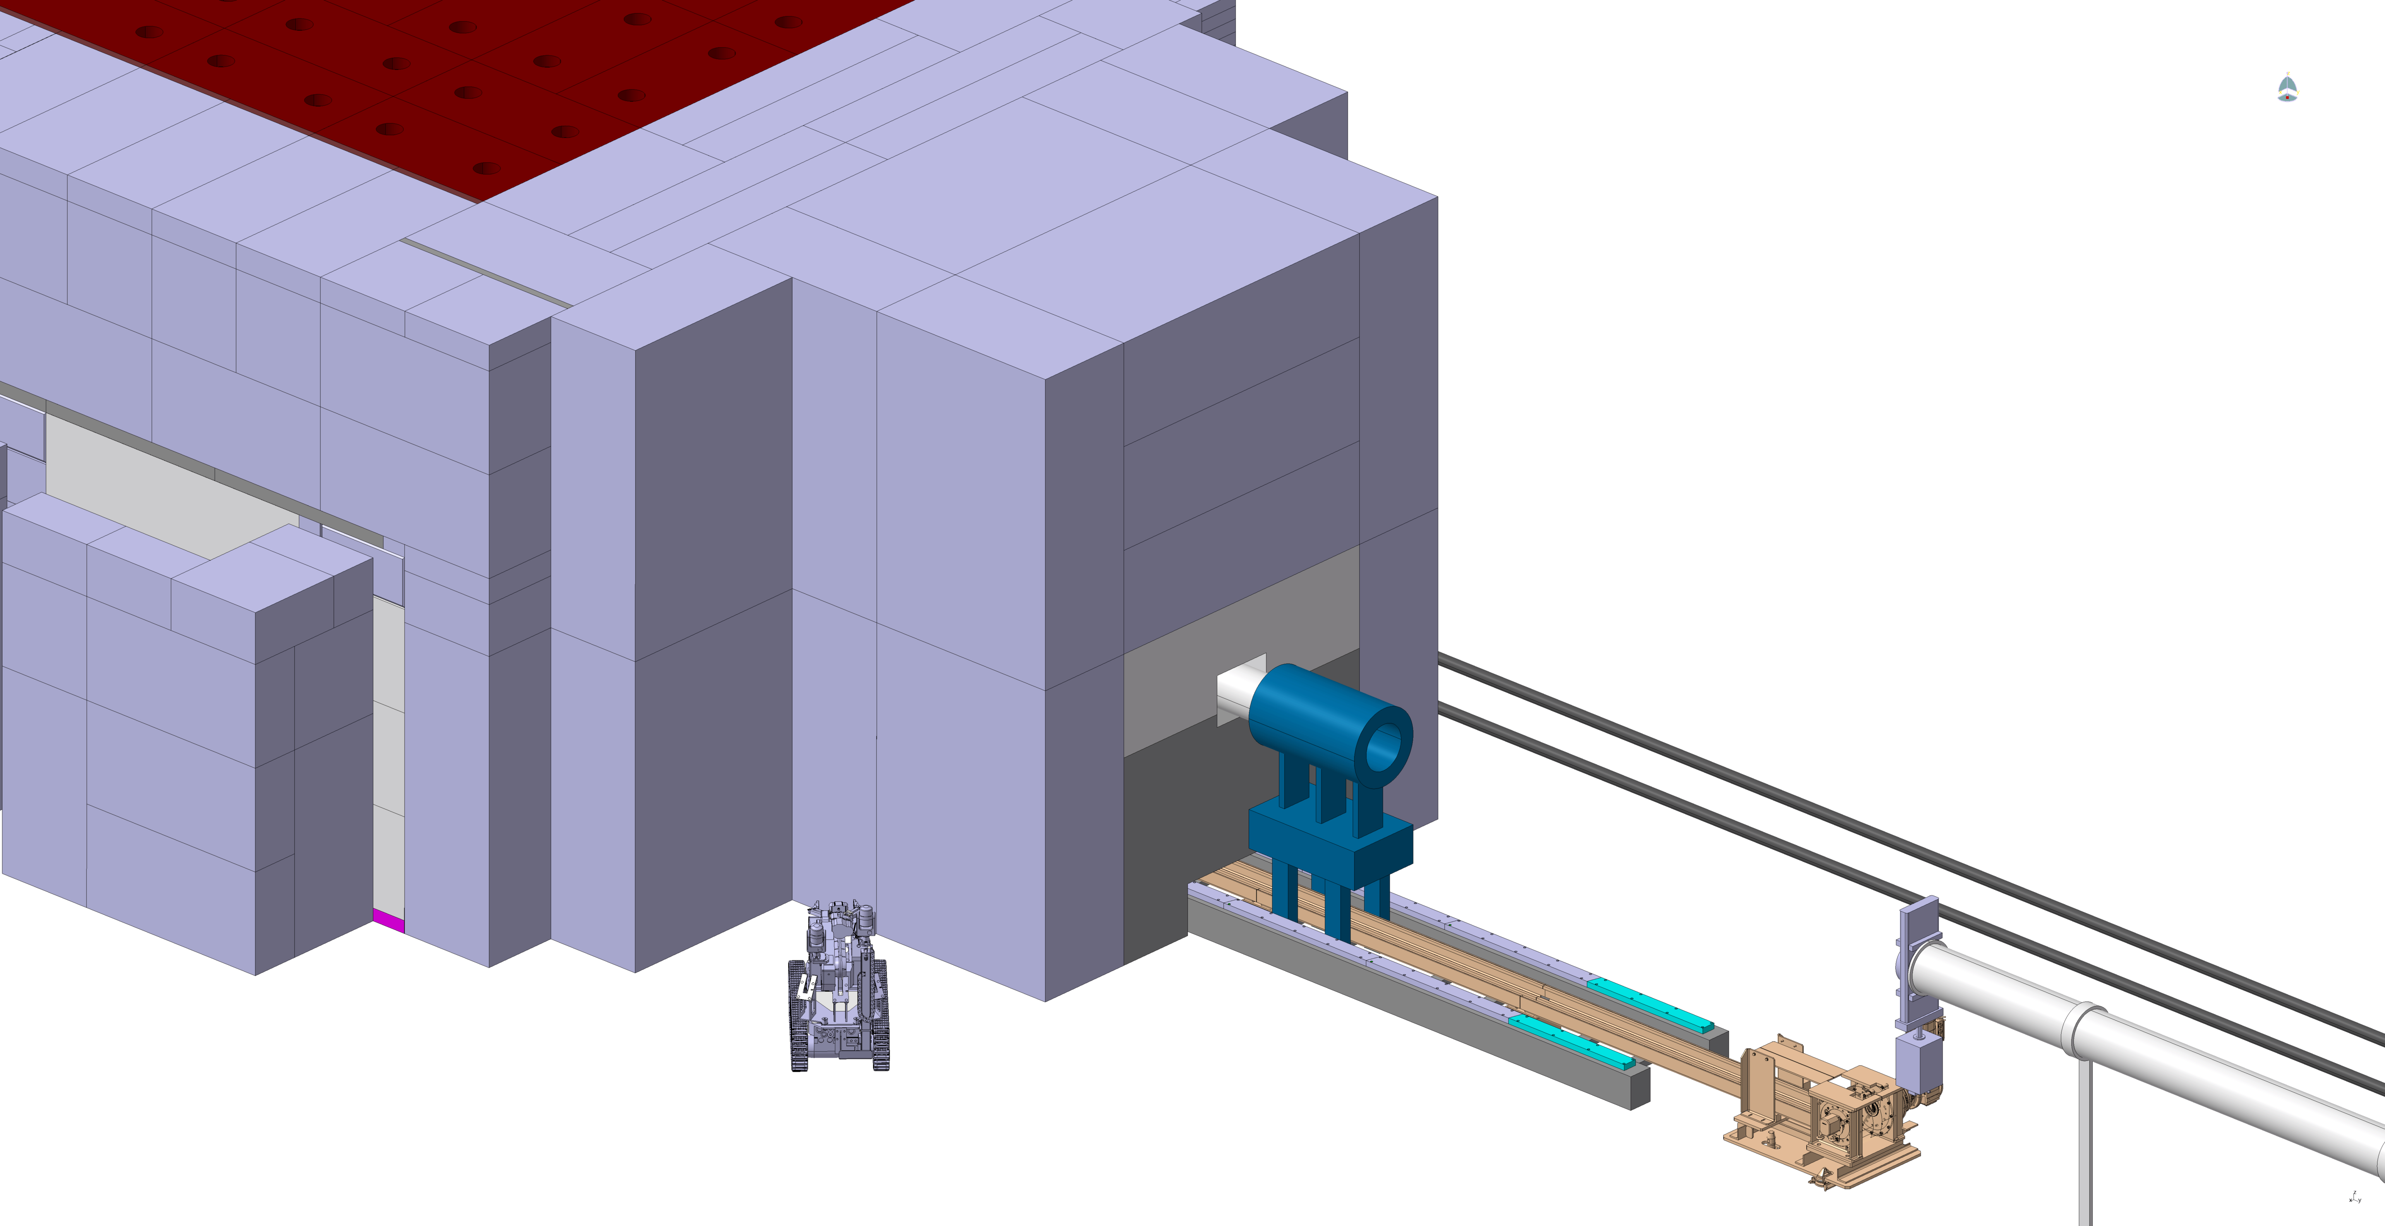
Beam Line Removal

Slide 25
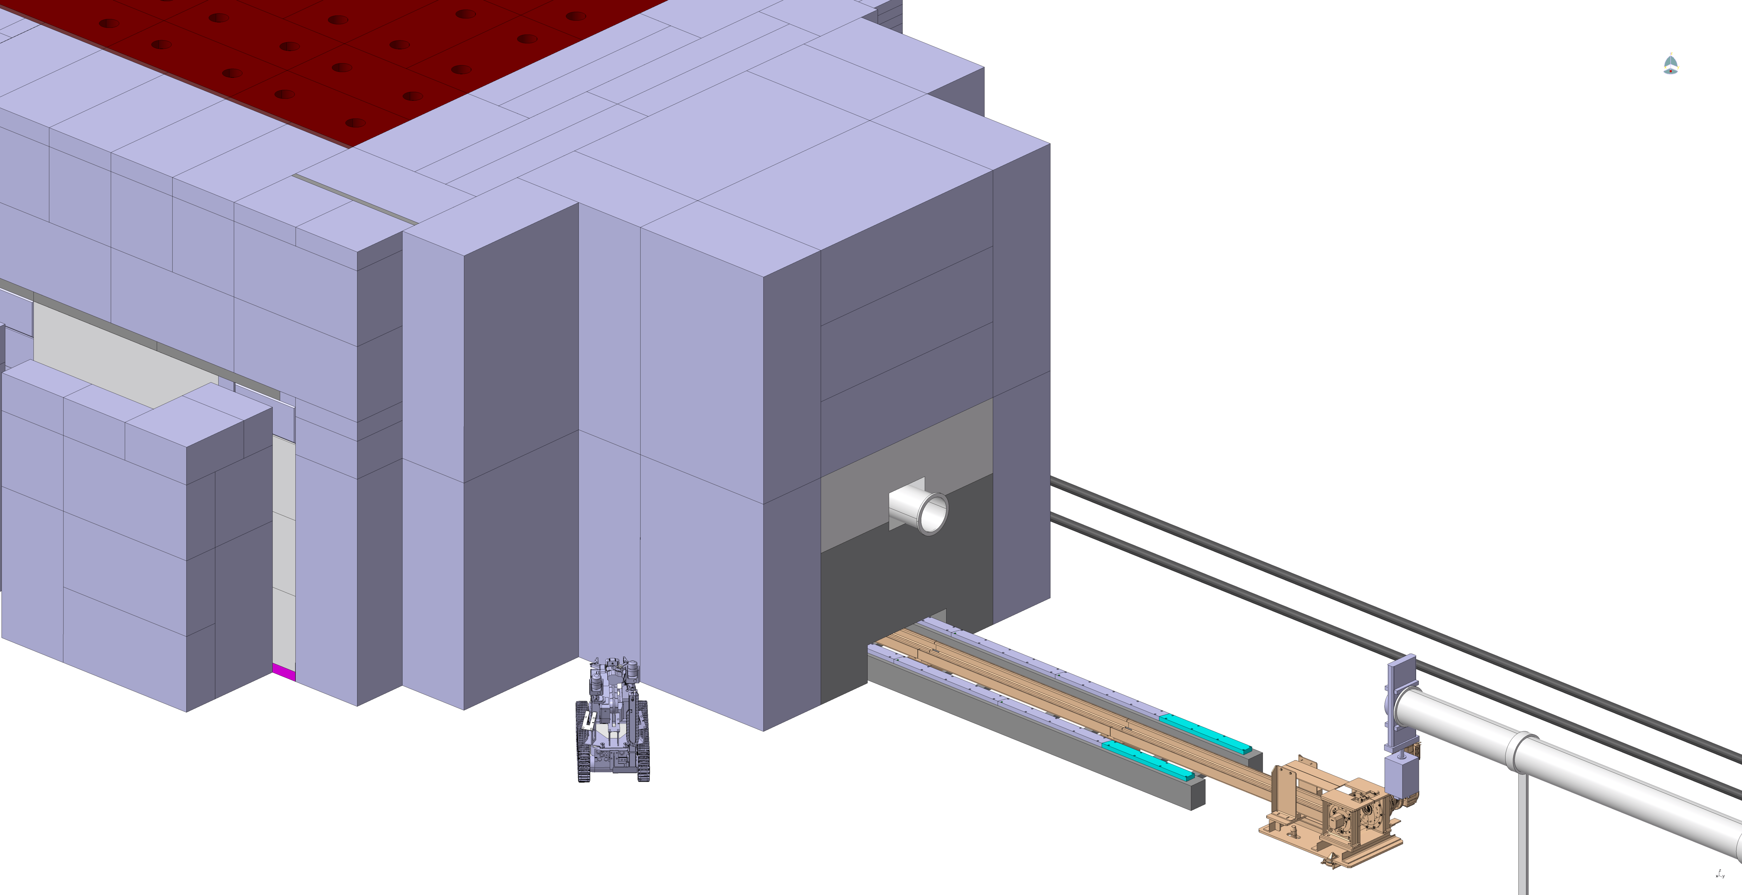
Beam Instrumentation Package Removal

Slide 26
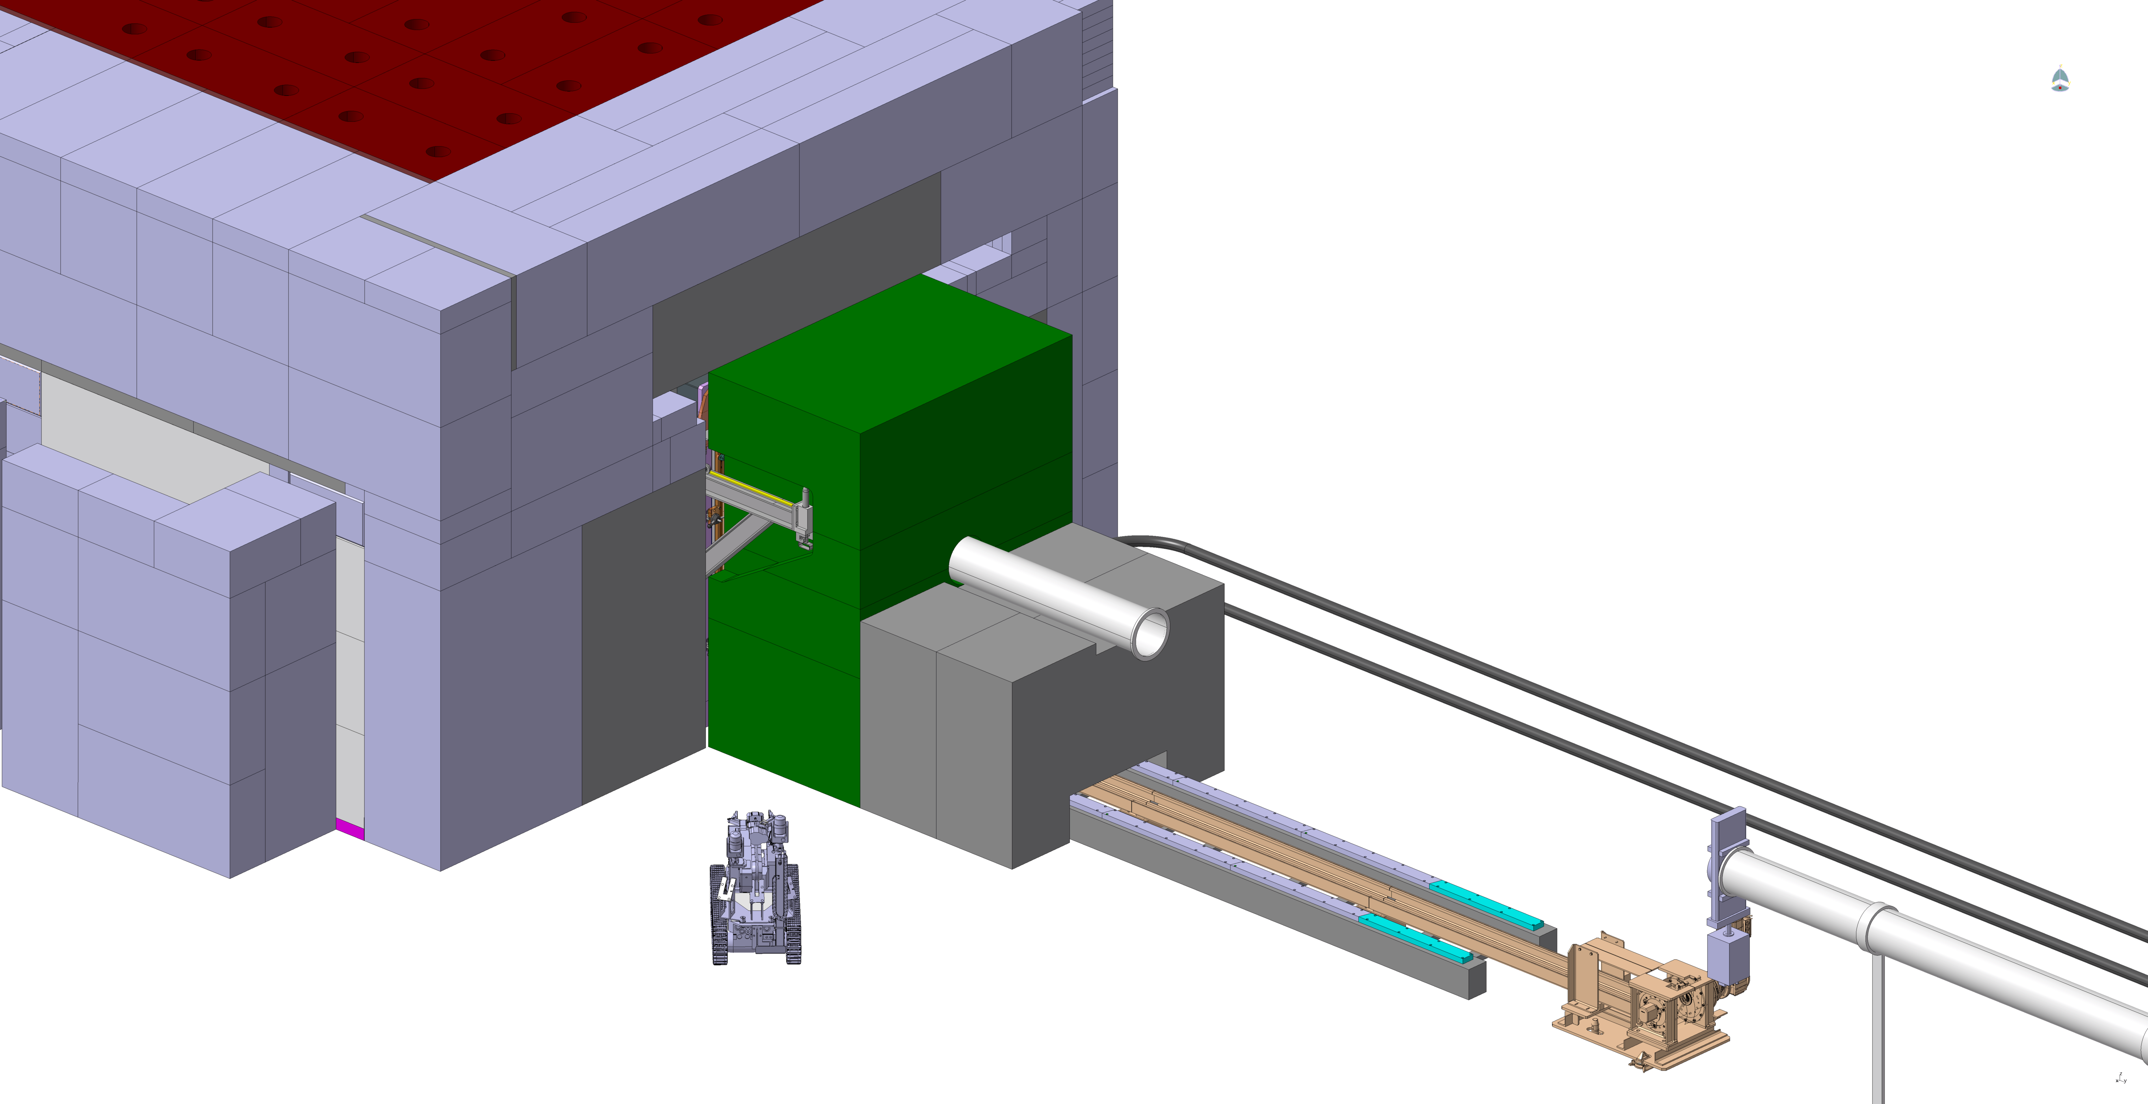
Collimator/Mask Shielding Removal

Slide 27
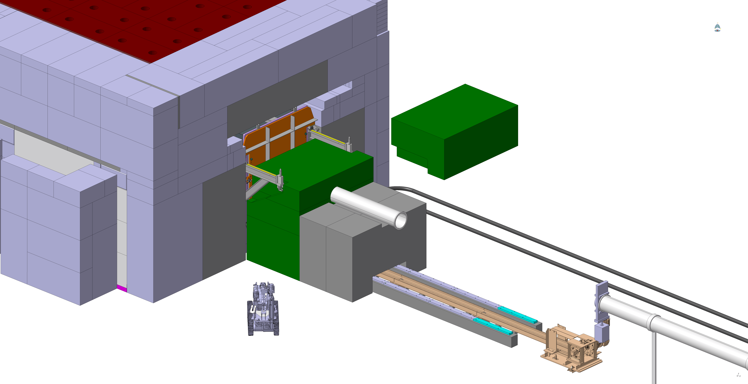
Colllimator/Mask Removal

Slide 28
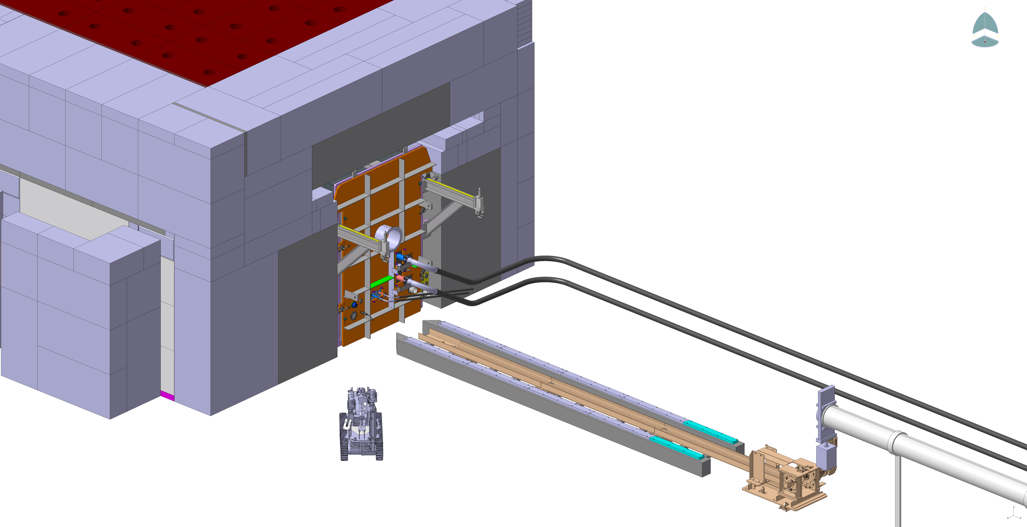
Beam Pipe Removal

Slide 29
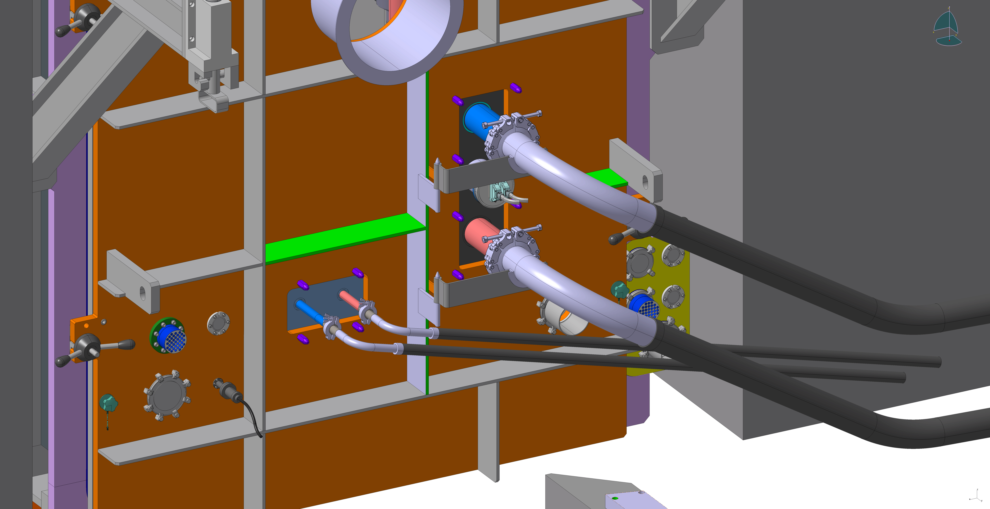
Feedthrough Disconnection

Slide 30

Chain Clamp Removal

Slide 31
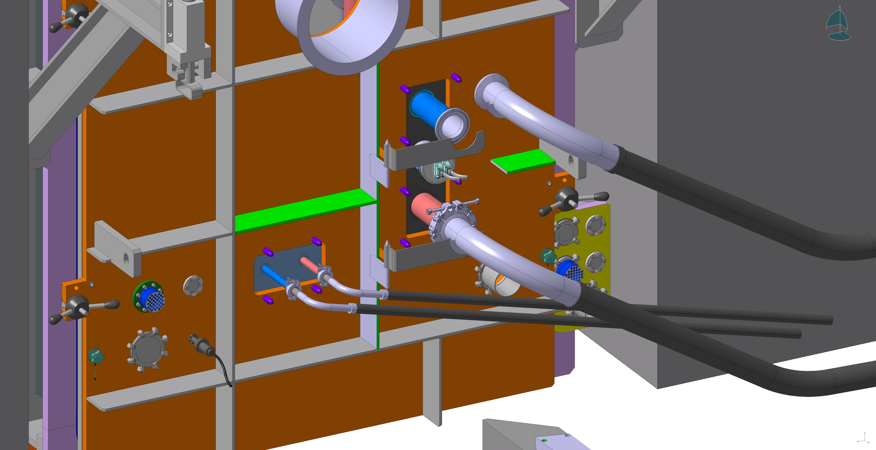
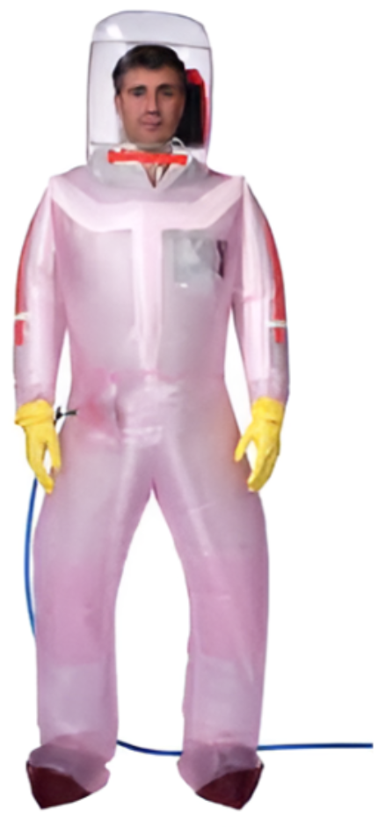
Pipe Removal
Contamination risk during disconnection

Slide 32
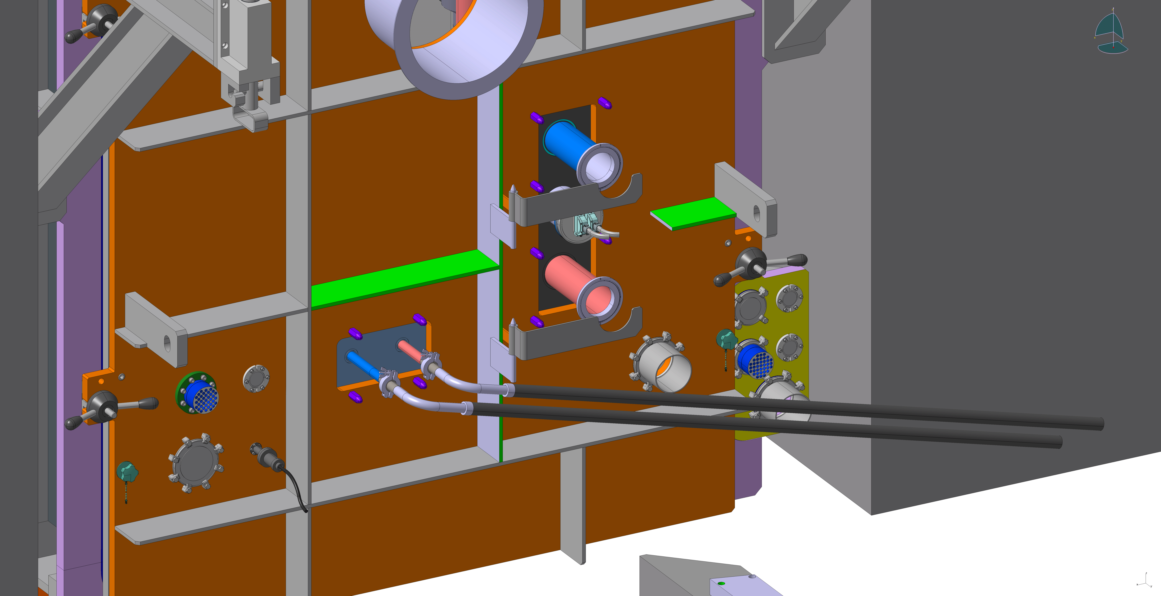
Second Pipe Removed

Slide 33

Pipe Support Removal

Slide 34
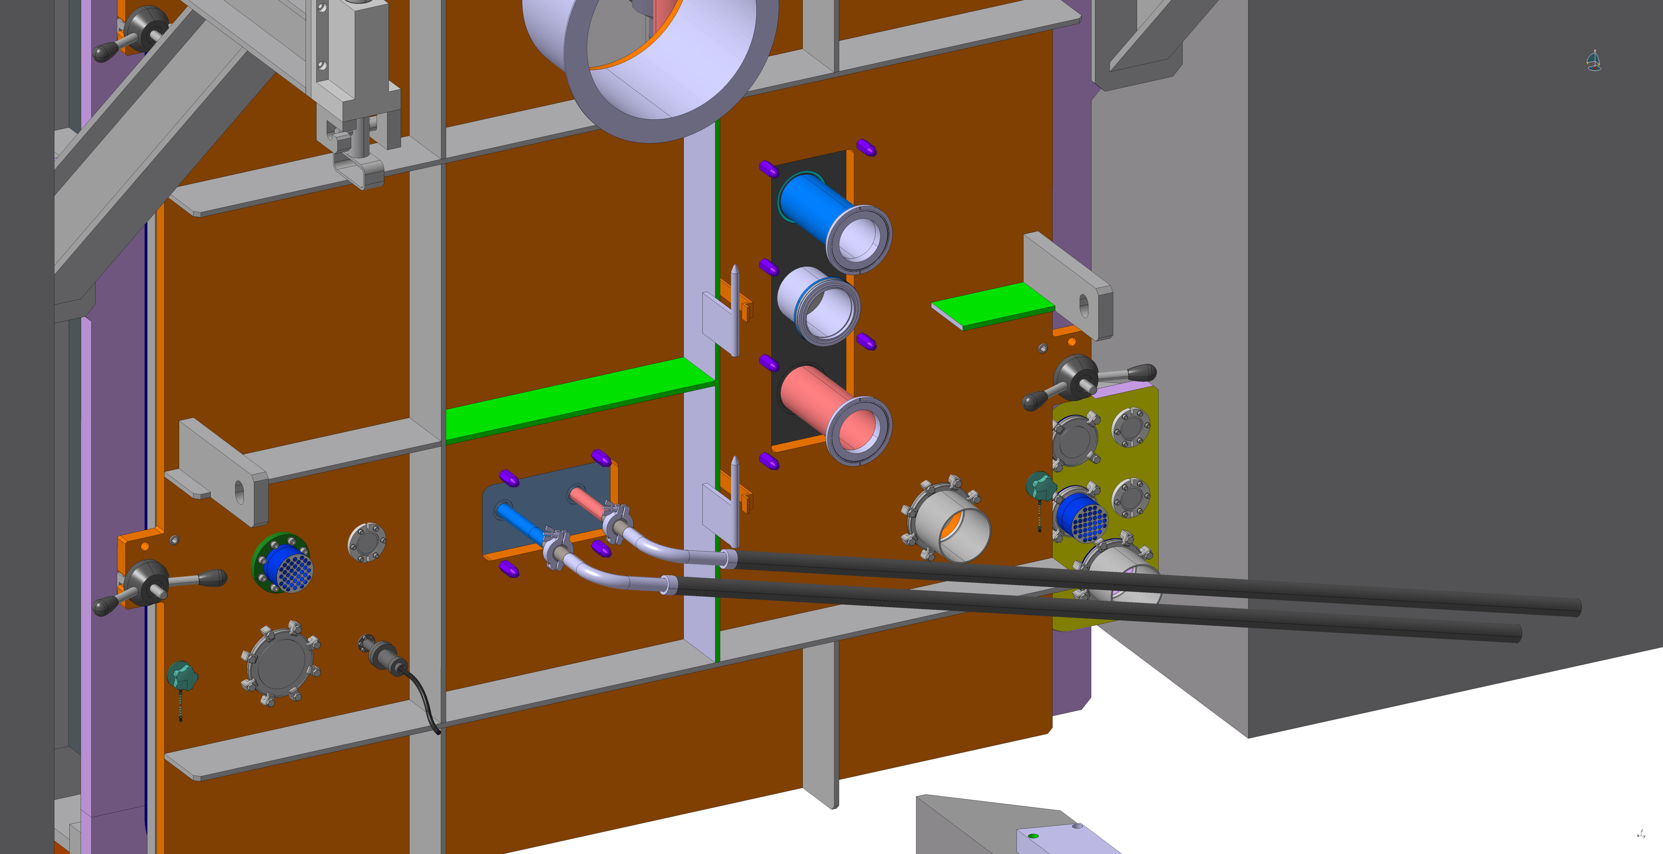
Thermocouple Removal

Slide 35
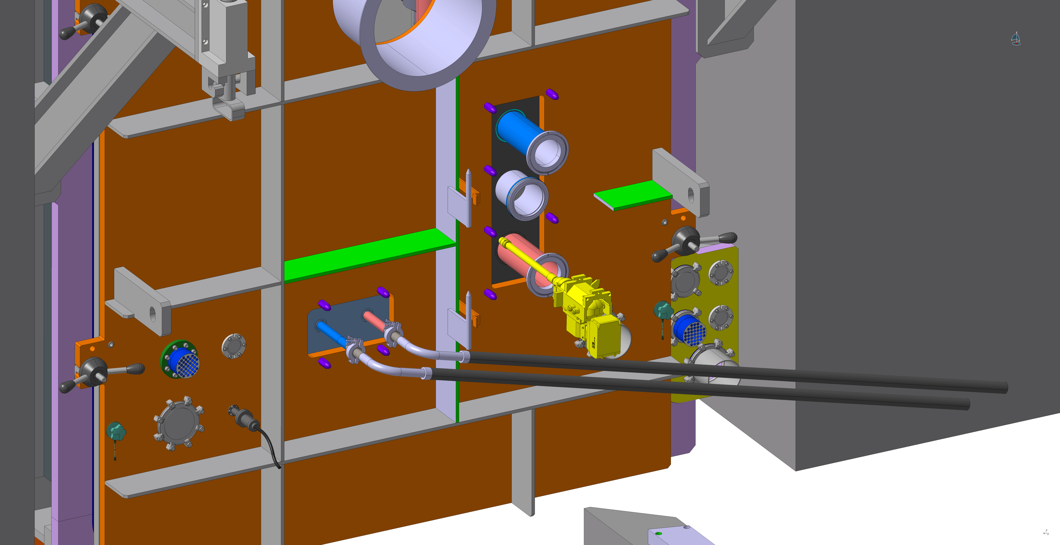
Flange Bolt Unscrew

Slide 36
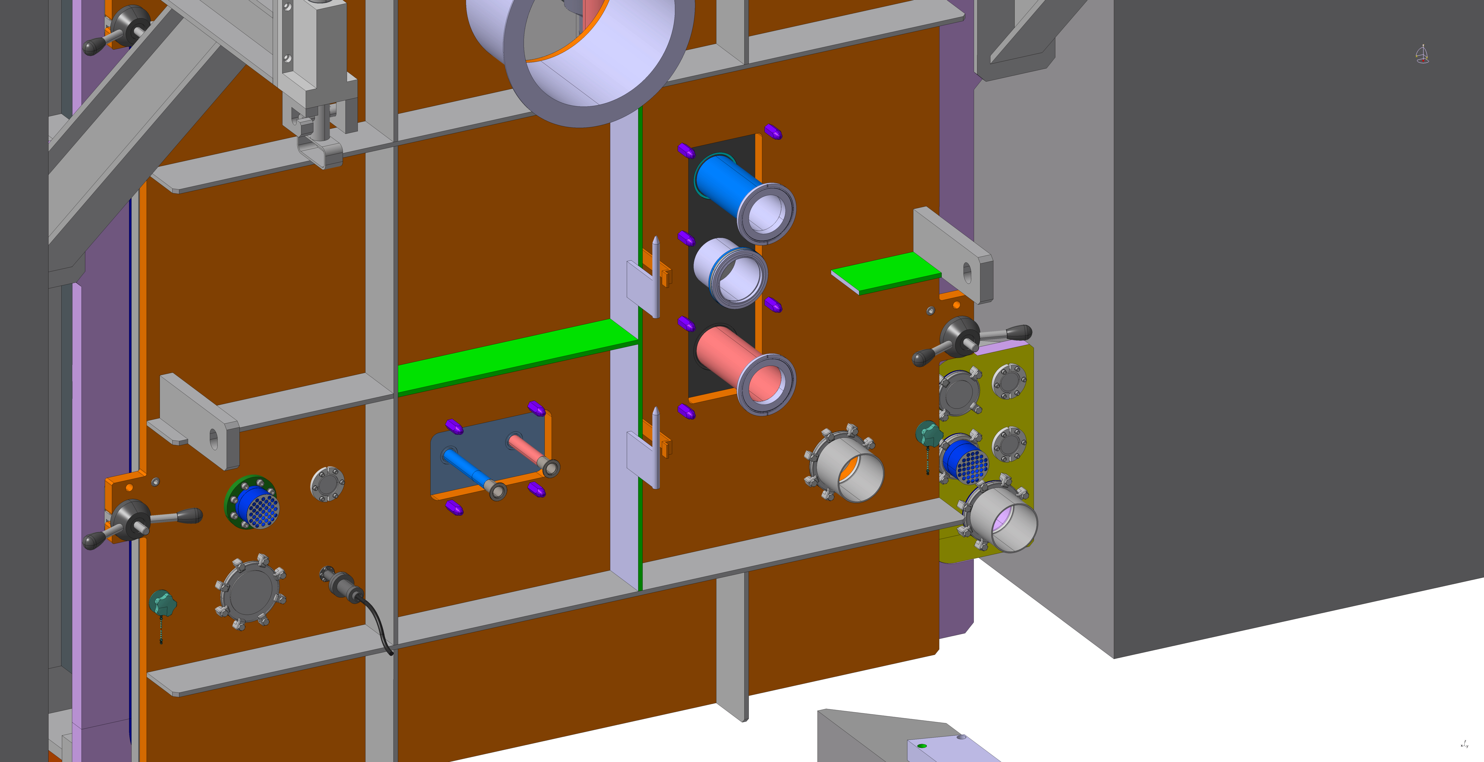
Water Pipes Disconnected and Removed

Slide 37

Door Unbolted

Slide 38
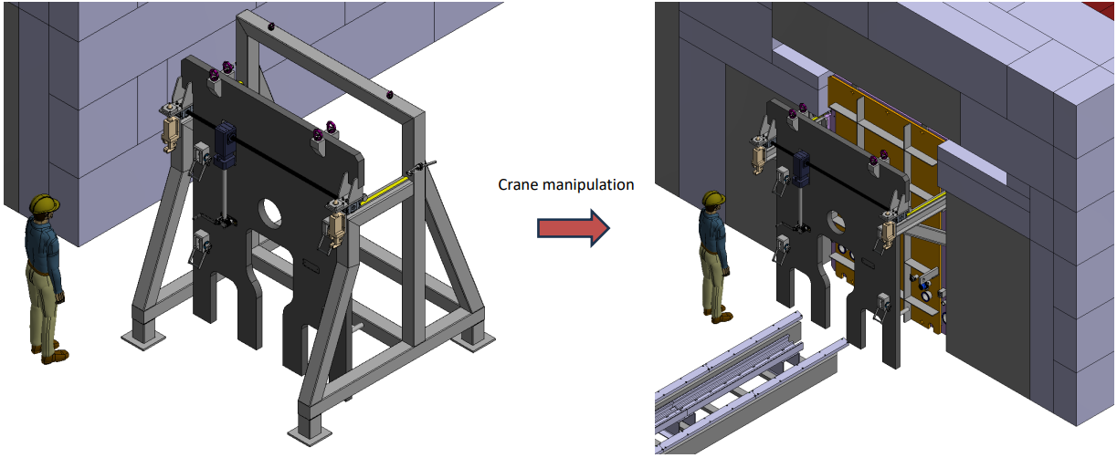
Lifting Tool Transported to Chamber Guide Rails
Courtesy of Streicher

Slide 39

Manipulation of Lifting Tool to Chamber Door
Can also be performed by robotics

Slide 40

Connection of Lifting Tool to Door

Slide 41

Manipulation of Lifting Tool + Door to End Stop

Slide 42

Transporting Lifting Tool + Door to Storage Frame

Slide 43



Separating Door from Lifting Tool
Clamp door to storage frame
Lift levers to separate tool from door
Crank tool away from door

Slide 44
Conclusions
Preliminary design of vacuum vessel completed (see additional documentation)
  Awaiting final report
Risk analysis ran in parallel by Streicher (see additional documentation)
  Fundamental risks of vacuum chamber
  Basic control requirements
  Identification of residual hazards
Second contract for the detailed final design and manufacture of the vacuum vessel and its associated system in 2027
Feedthrough design ongoing
  Prototype to be developed for the connection/disconnection

Slide 46


