Slide 1


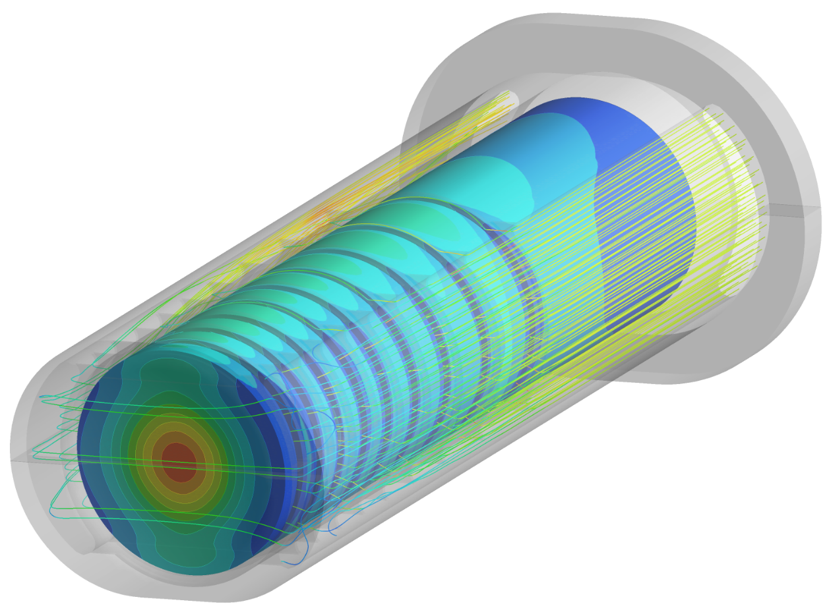
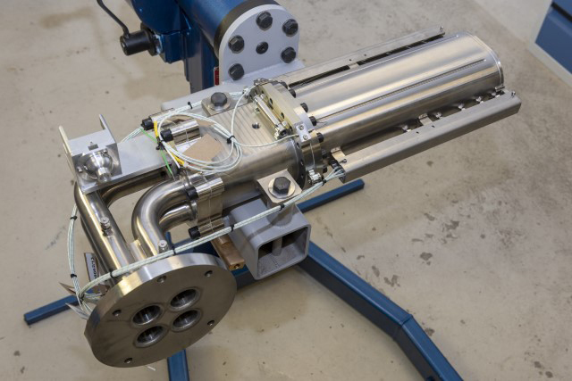

Simulated
and Measured Performance of ISIS TS1 Project Target
Dan Wilcox
High Power Targets Group, Rutherford Appleton Laboratory, UK
30th October 2023
ICANS XXIV, Dongguan, China

Slide 2
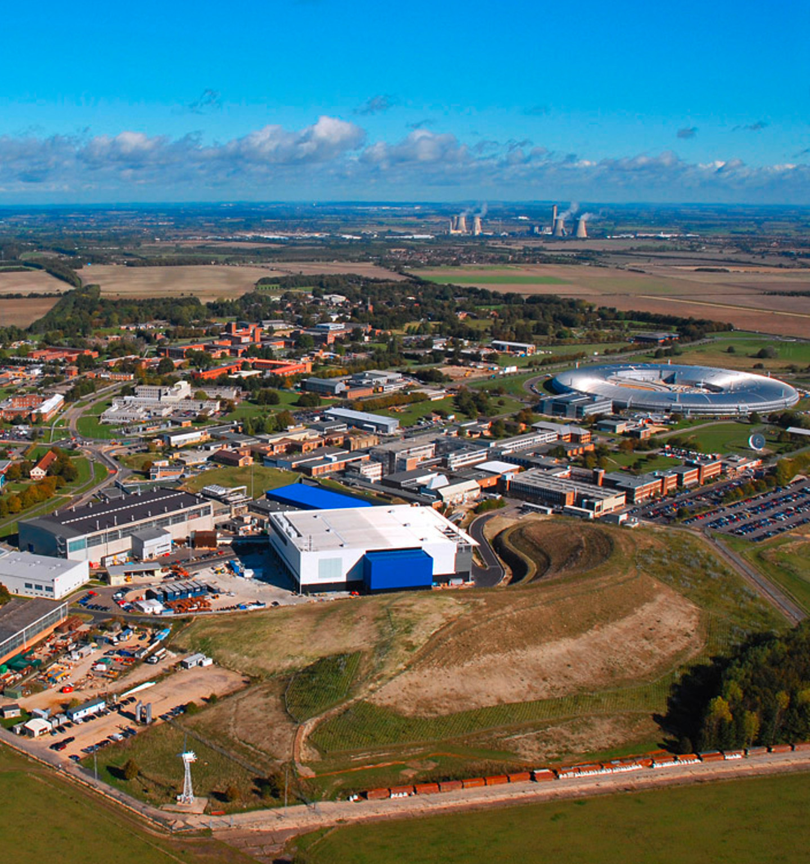
Overview
TS1 Project target design
FEA validation
Plate 1 temperature anomaly
Measurement of radiation damage?
Conclusions

Slide 3
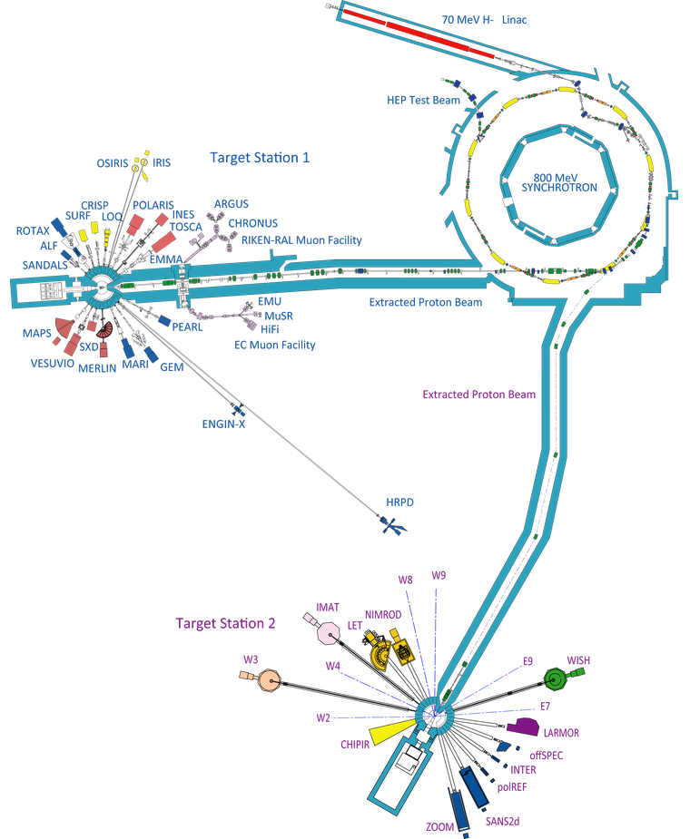
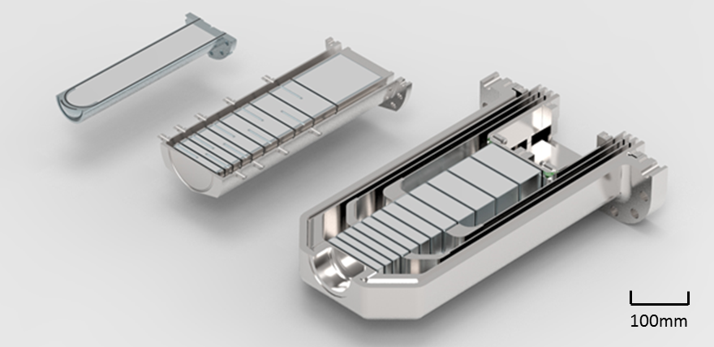
ISIS Overview
Synchrotron
192kW, pulsed at 50Hz
Target Station 1
Receives 4/5 beam pulses (160kW)
Ta-clad W target, 10 plates (formerly 12)
Proven reliability over many years
New design of target, moderator and reflector installed late 2022, during the “TS1 Project”*
TS2
TS1 Project
Previous TS1
*See talks by Ste Gallimore:
“Summary of lessons learned from the TS1 project implementation”, Wednesday 1st
“TS1 Project with-beam commissioning”, Thursday 2nd
Target Station 2
Receives 1/5 beam pulses (32kW)
Ta-clad W target, solid rod
High neutronic efficiency, short target lifetimes

Slide 4
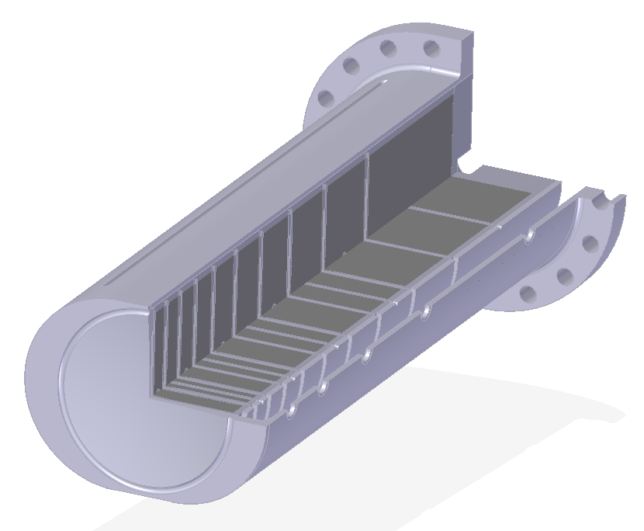
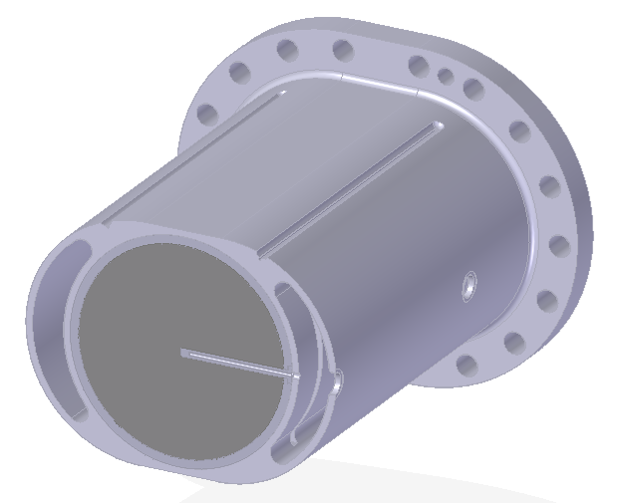
Detailed TS1 Target Design
Heavy water in/out
Pressure vessel
Heavy water
outlet manifold
Beam window
Steel
Heavy water inlet manifold
Cross-flow channels
Tantalum
Tungsten
Thermocouple well
Target plates
Proton beam direction

Slide 5
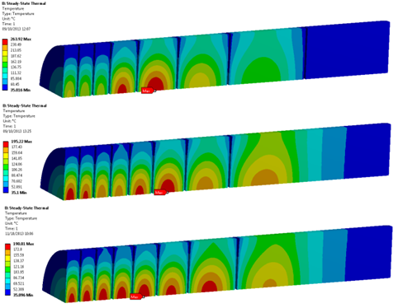
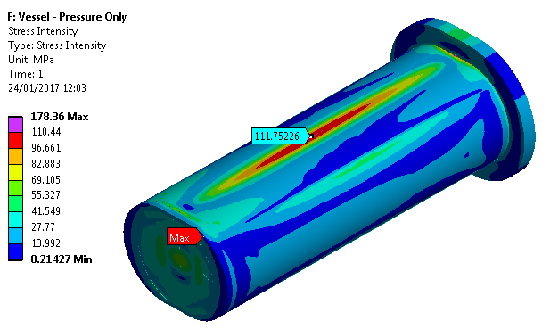
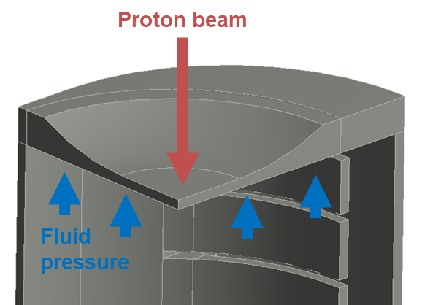
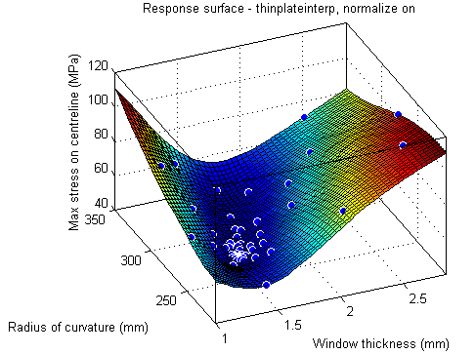

FEA for Target Optimisation
Pressure vessel design assurance to PD5500
Minimising number of target plates
Beam window optimisation
Conjugate fluid/thermal analysis

Slide 6
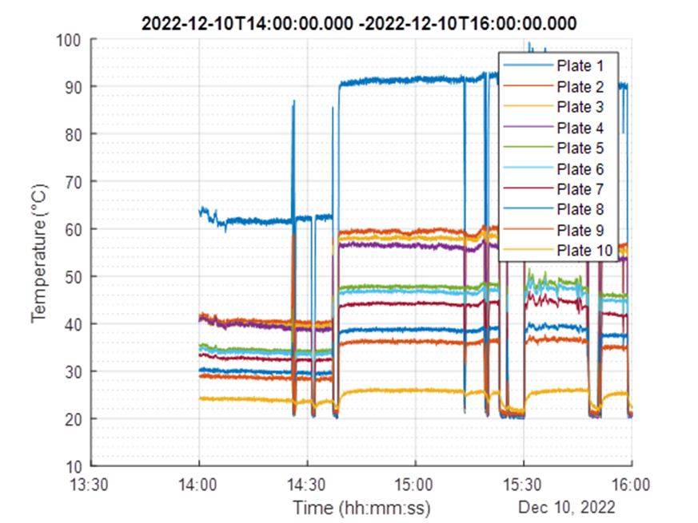
First Beam – Unexpected Results
Run on 10th Dec 2022 at 1/8th and 1/4 nominal beam power
Higher than expected temperature readings on plate 1
  Simulations indicate temperatures in plates 1-4 should be very similar
1/4 Power
1/8 Power

Slide 7
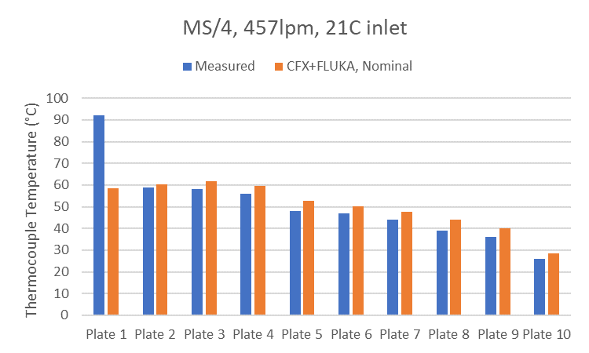
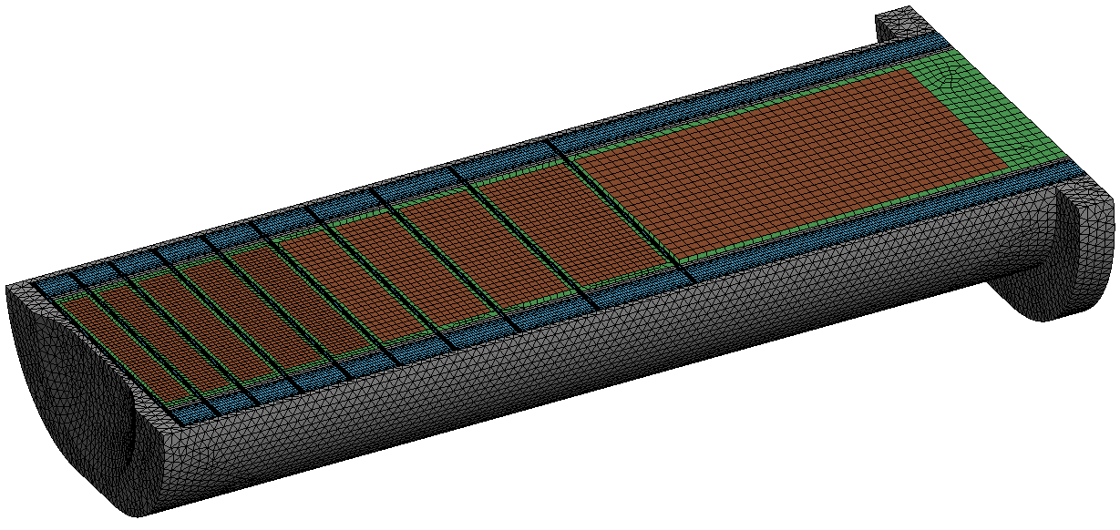
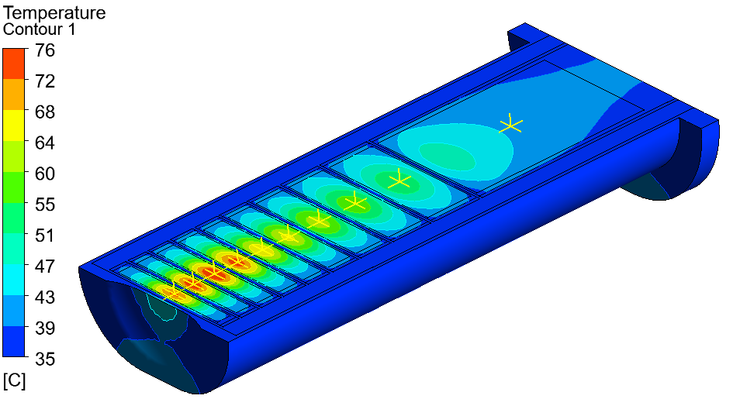
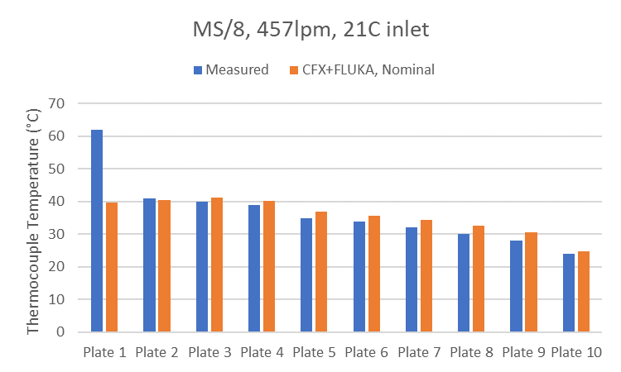
FEA Validation
Target simulated in ANSYS CFX, conjugate fluid/thermal analysis
  Heat deposition calculated by ISIS Neutronics Group
Results extracted at thermocouple measurement locations

Slide 8
Possible Causes
Bad thermocouple reading
Simulation error
Off-normal proton beam
Off-normal cooling flow
Heat transfer from beam window to plate 1
Blockage in front channel
Water or air bubble around thermocouple?
Bad contact at bonded interfaces
Thermocouples tested, no issues
Good agreement on all other plates
Plates 2, 3 and 4 are about the same size and position as plate 1, and behave normally
Channel flow is too high. No knock-on effect from plate 1 on plate 2
Notes:
Thermocouples tested in detail, convinced this is not the issue.
Much happier with the FEA now it has been shown to work for all the other similar plates. This also rules out lots of other possible issues with the cooling or the proton beam which would effect all of the plates at once.
Remaining – blocked channel, or some localised problem close to the TC.

Slide 9
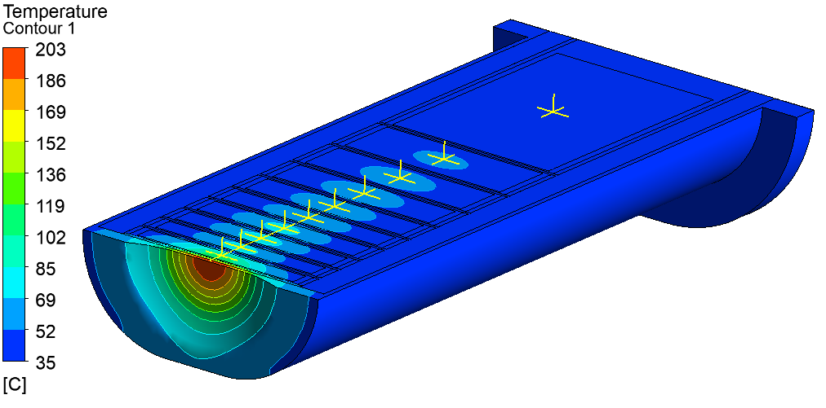
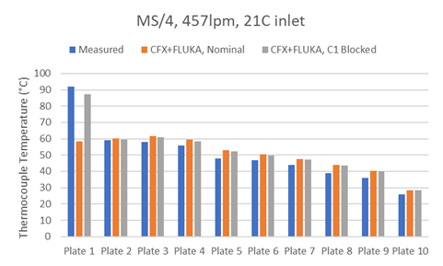
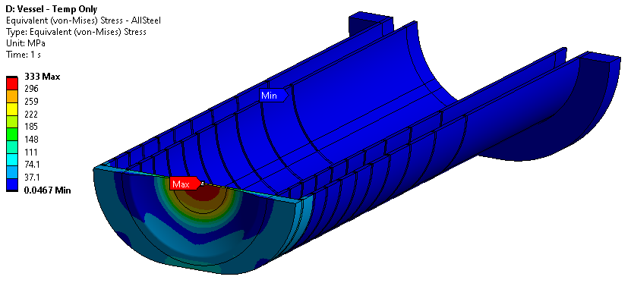
Blocked Channel Case
PD5500 limit in Stainless 316L = 345MPa
Stress at 25% power = 333MPa
Stress at 50% power = 655MPa
Tested in ANSYS; front channel replaced with stationary water
100% block could produce this effect

Slide 10
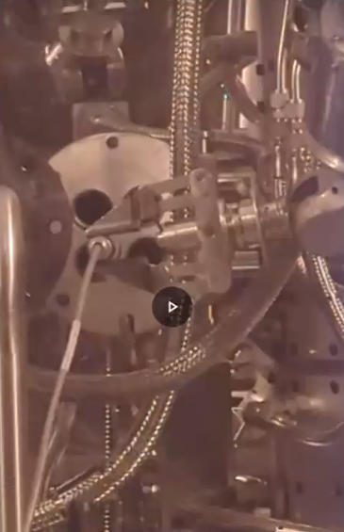
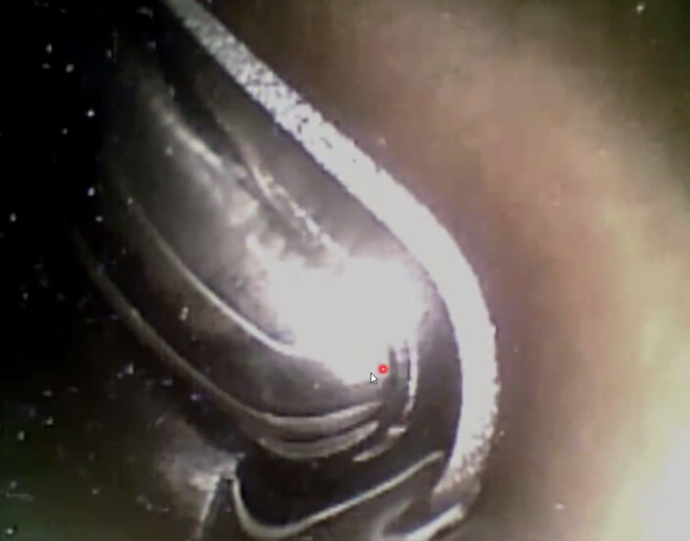
Possible Causes
Bad thermocouple reading
Simulation error
Off-normal proton beam
Off-normal cooling flow
Heat transfer from beam window to plate 1
Blockage in front channel
Water or air bubble around thermocouple?
Bad contact at bonded interfaces
Nothing seen on fiberscope inspection
- Ok to increase beam power!

Slide 11
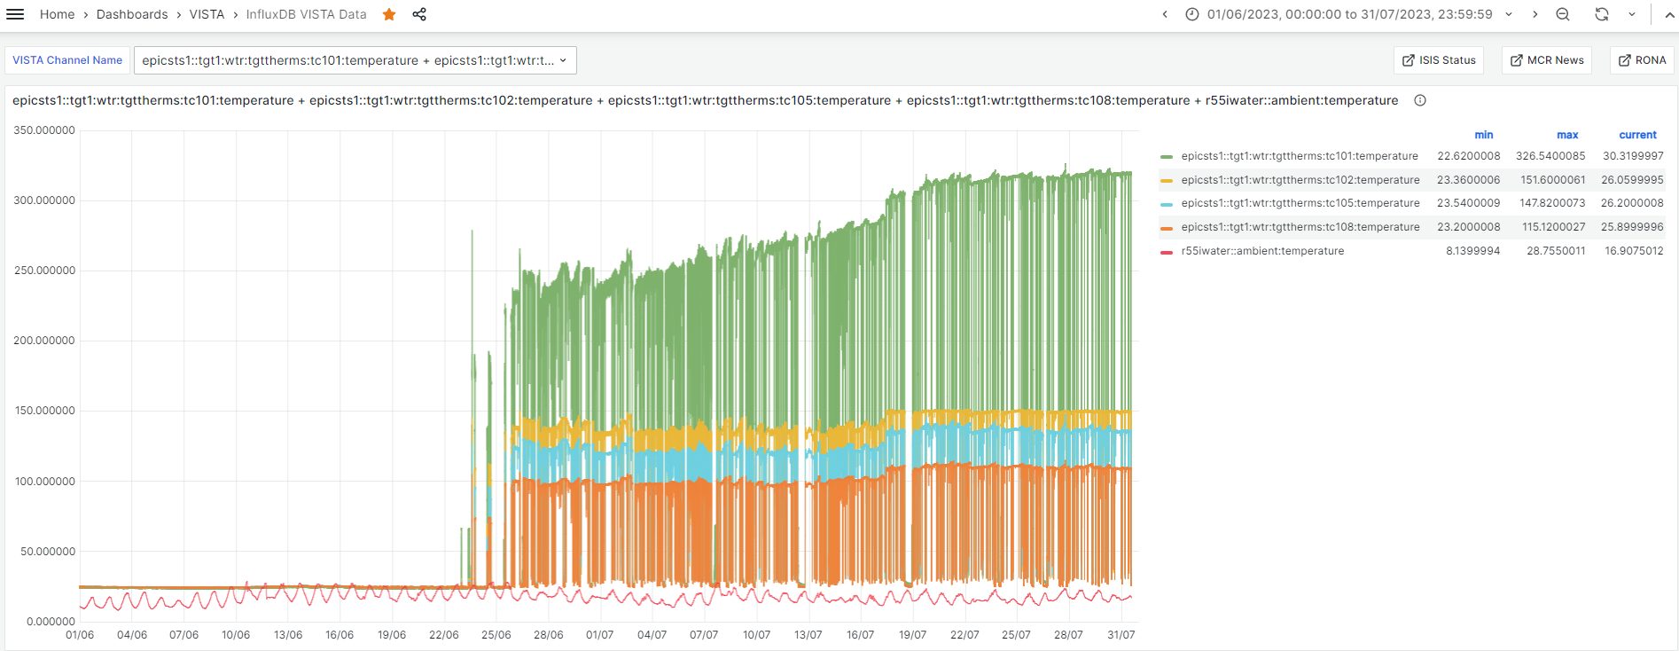
Continuing Temperature Increases
Gradual increase of ~50°C on TC101 during June-July 2023, not seen on other TCs
TC101
TC102
TC105
TC108
Not much change in ambient water temperature over these months
All plates show a slight temperature increase around 17th July – change in beam current or focus?

Slide 12
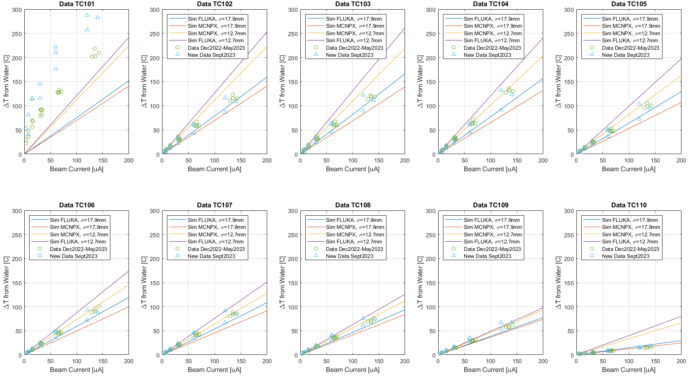
More Validation: Steady State Temperatures

Slide 13
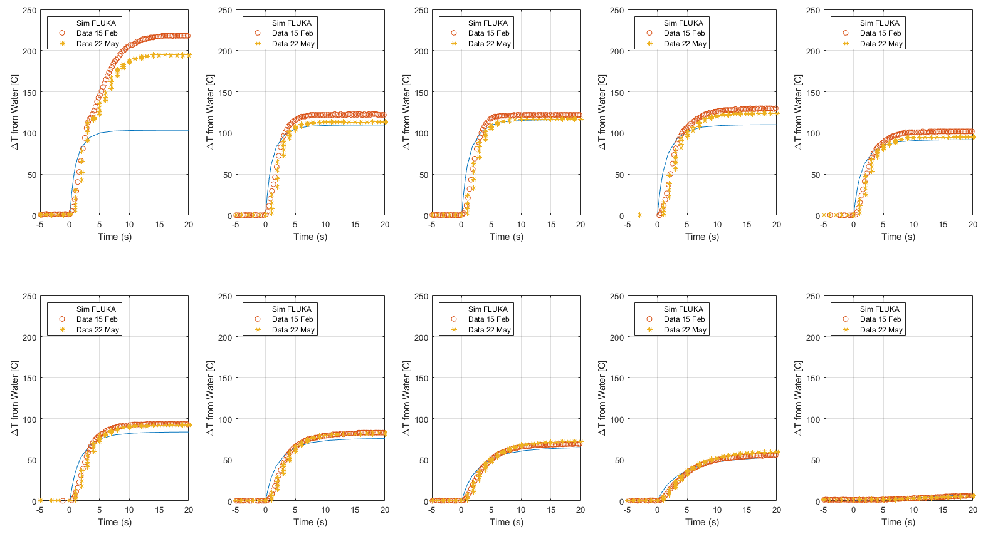
More Validation: Transient Heating at 140uA
Delayed TC response time? ~0.75s delay expected

Slide 14
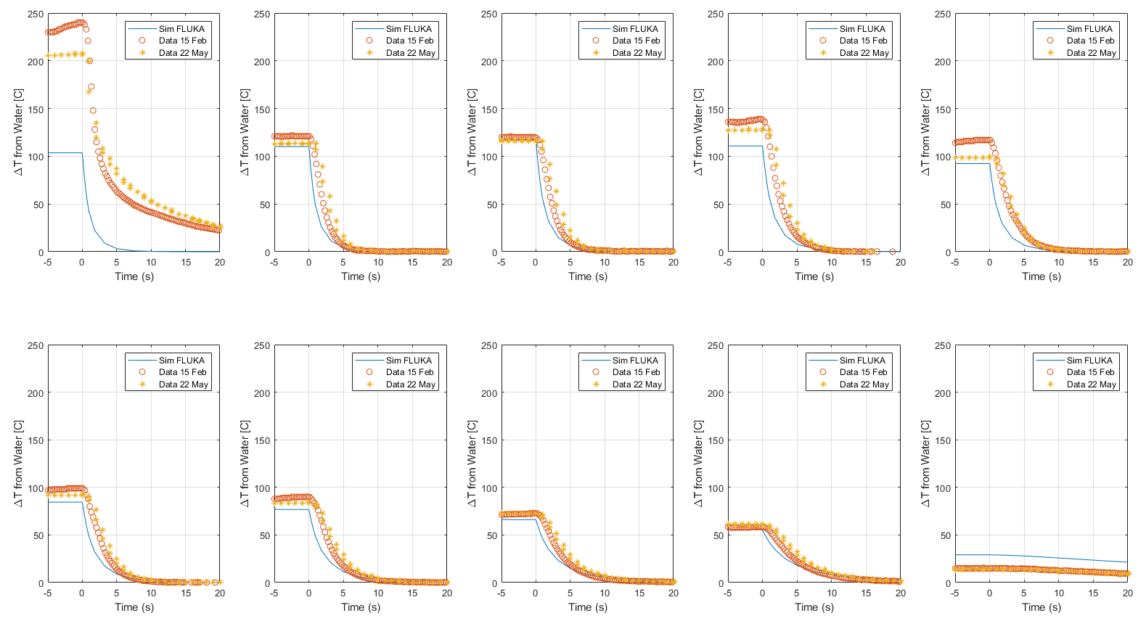
More Validation: Transient Cooling at 140uA

Slide 15
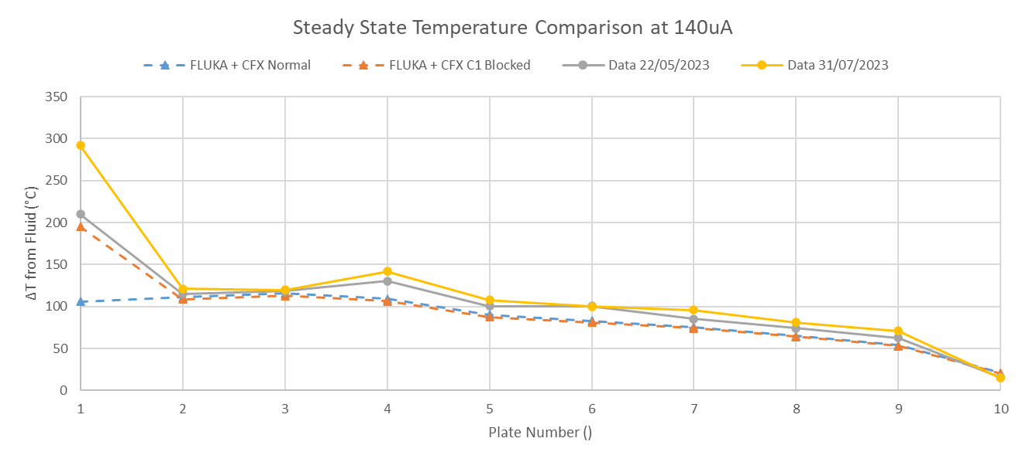
Blocked Front Channel Case
Temperature now too high to be explained by a channel blockage
Must be a bad thermal interface or other very localised effect
This temperature cannot be explained by a 100% channel blockage

Slide 16
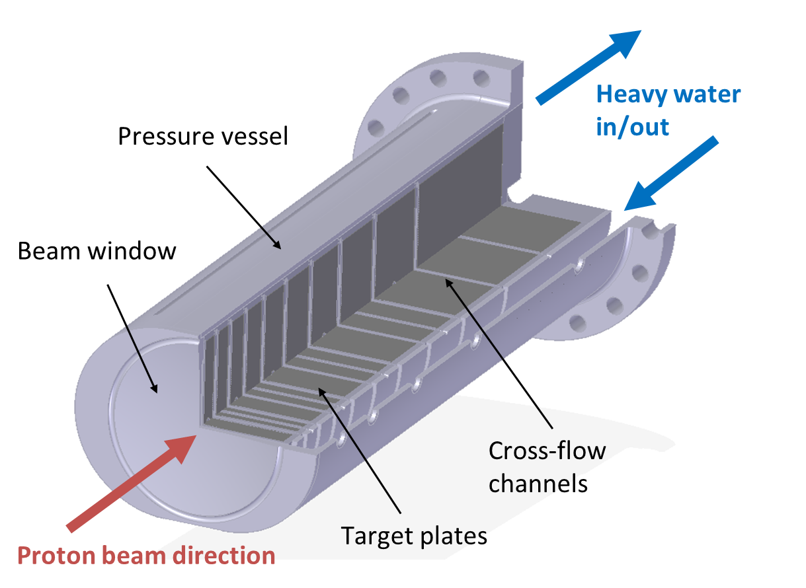
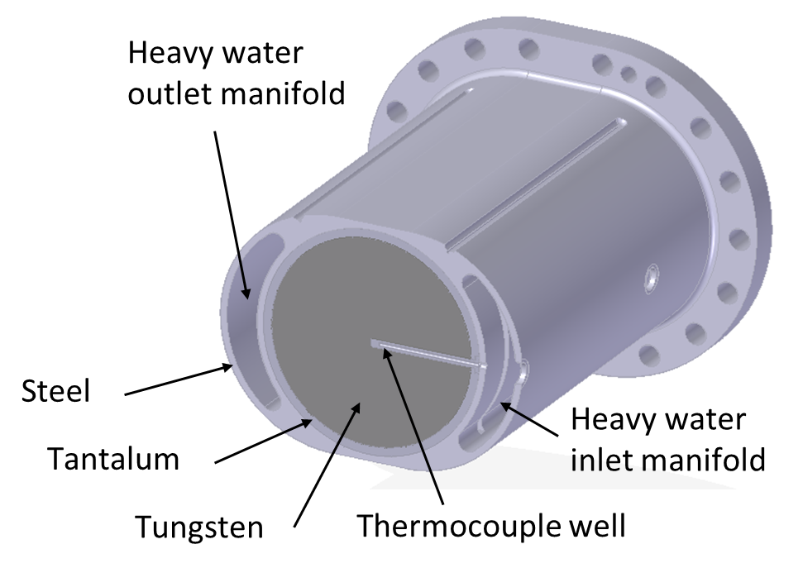
Possible Causes
Bad thermocouple reading
Simulation error
Off-normal proton beam
Off-normal cooling flow
Heat transfer from beam window to plate 1
Blockage in front channel
Water or air bubble around thermocouple?
Bad contact at bonded interfaces

Slide 17
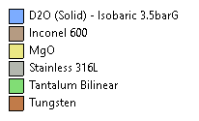
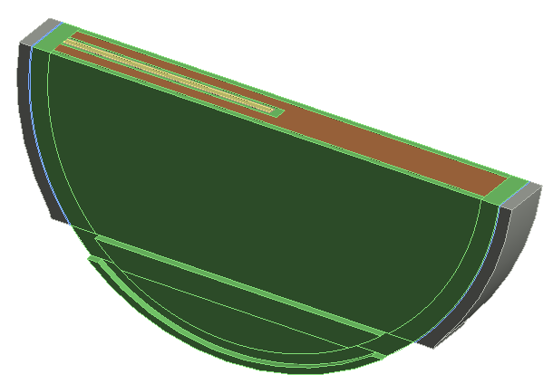

Detailed Thermocouple Well Simulations
Plate 1 only, full TC details (1.8mm dia, Inconel 600 sheath), simplified cooling (constant HTC)
Interface locations:
Plate-Clad
Well-Plate
TC-Well
Thermal resistance can be added to the model at any of these locations

Slide 18
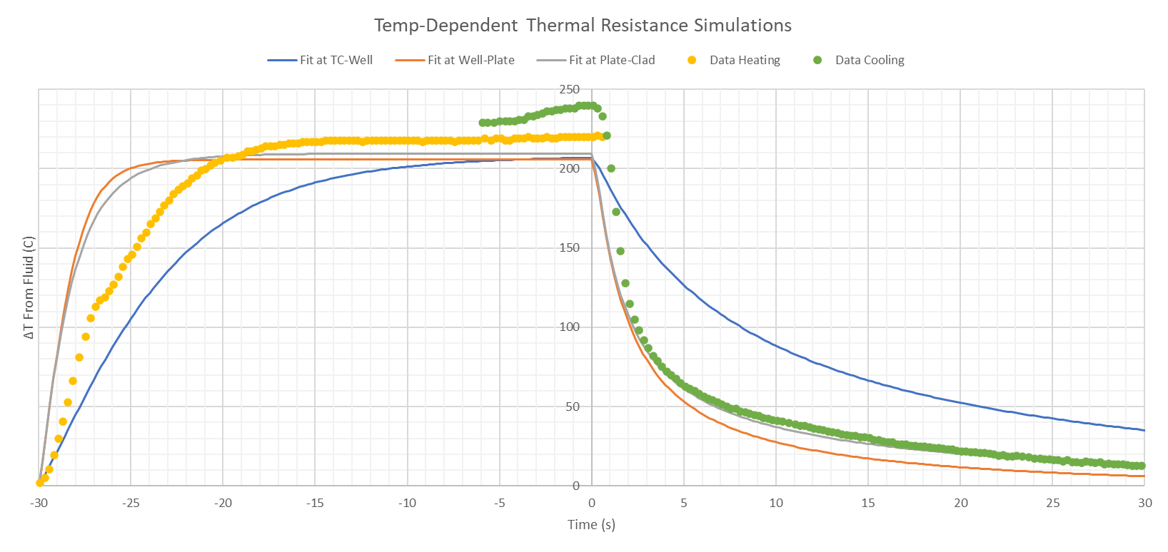
Test On Transient Data – Plate 1
Compare transient response using various thermal resistance models to transient data from 15th Feb 2023 at ~140uA
Some variation in steady state temperature
Unexplained temperature rise of ~10°C just before cooling starts
Delayed TC response time? ~0.75s delay expected
Unexplained shoulder in heating data

Slide 19
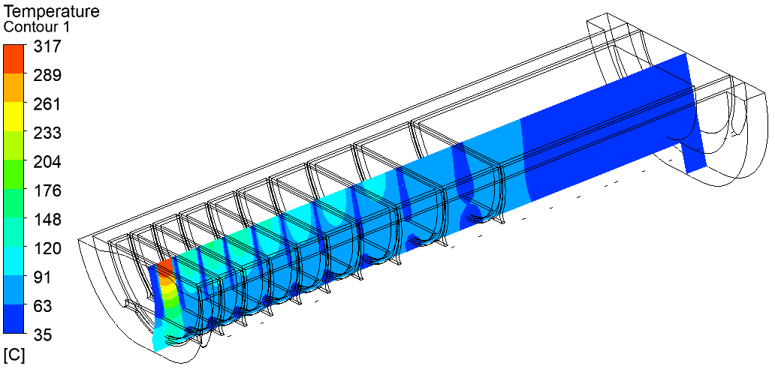
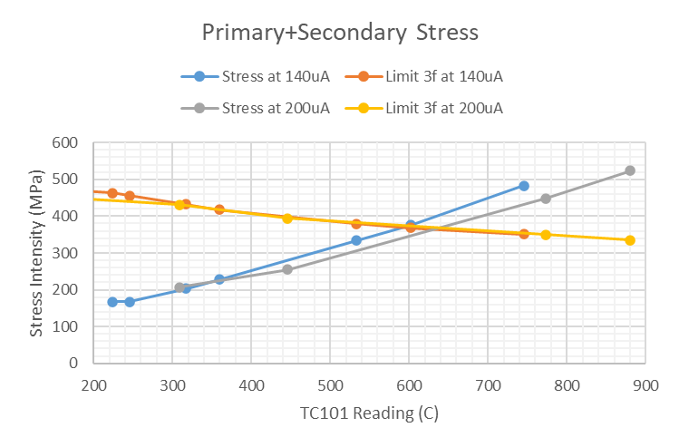
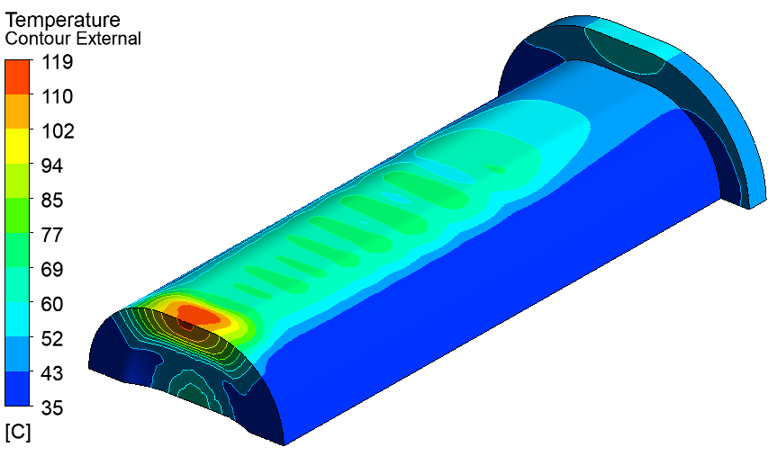
Is it safe to keep operating?
Simulation of worst case plausible effect (bad thermal contact to cladding):
PD5500 Limit Exceeded
We are here
High temperature localised to centre of plate 1

Slide 20
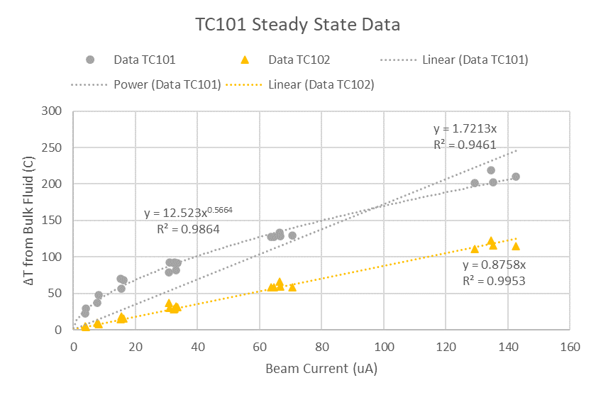
Transient Anomalies
Consistent “wiggle” in transient data at around 140C
  about the boiling point of D2O at ~3barG
However, no change in steady state behaviour at the same temperature
Plots c/o David Findlay

Slide 21

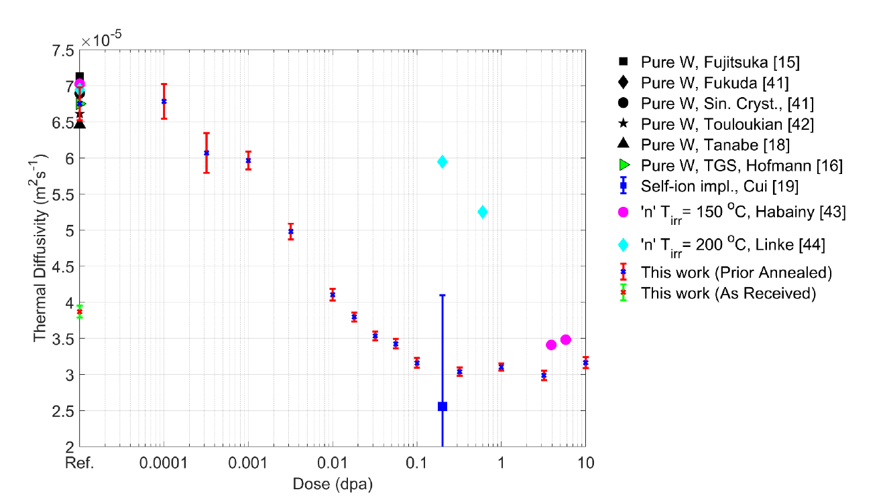
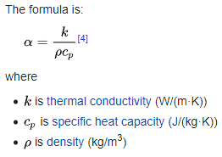
Radiation-Induced Thermal Conductivity Loss
Thermal conductivity loss looks significant, even at relatively low doses
  Effect should be fully saturated after ~1yr operation of TS1 Project target
    Not yet know if effect will occur suddenly, as for self-ion damage, or more slowly, as for neutron damage
Neutron irradiated data
+ Higher irradiation temperature
– Higher Re and He production
Self-ion implanted data
Proton beam irradiated data
References:
Thermal diffusivity of tungsten irradiated with protons up to 5.8 dpa – J. Habainy et al., Journal of Nuclear Materials, 2018
Thermal diffusivity degradation and point defect density in self-ion implanted tungsten – A. Reza et al., Acta Materialia, 2020

Slide 22
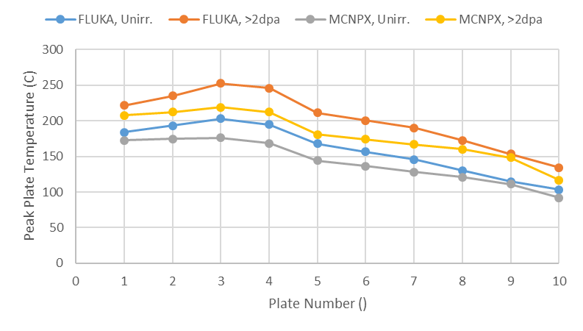
In-Situ Measurement of Conductivity Loss
Thermocouples may allow thermal conductivity loss to be measured in-situ on a working TS1 Project target
  But effect is small compared to uncertainties due to Monte Carlo code, beam focus, etc.

Slide 23
Conclusions
FEA was essential to design the new ISIS TS1 target – and to understand unexpected sensor readings without hands-on access
Combining simulations, experiments and operating data gave confidence to increase power
  Lots of possible causes ruled out – including all of the potentially dangerous ones
  But still no clear explanation for plate 1 anomaly
New TS1 Target has now run at close to full power with no ill effects
  9/10 plates performing as expected, validating the FEA approach
Future work:
  Ongoing simulation and monitoring – “Digital Twin”?
  Look for evidence of in-situ radiation damage
  Design and analysis for ISIS-II studies

Slide 24




