Slide 1
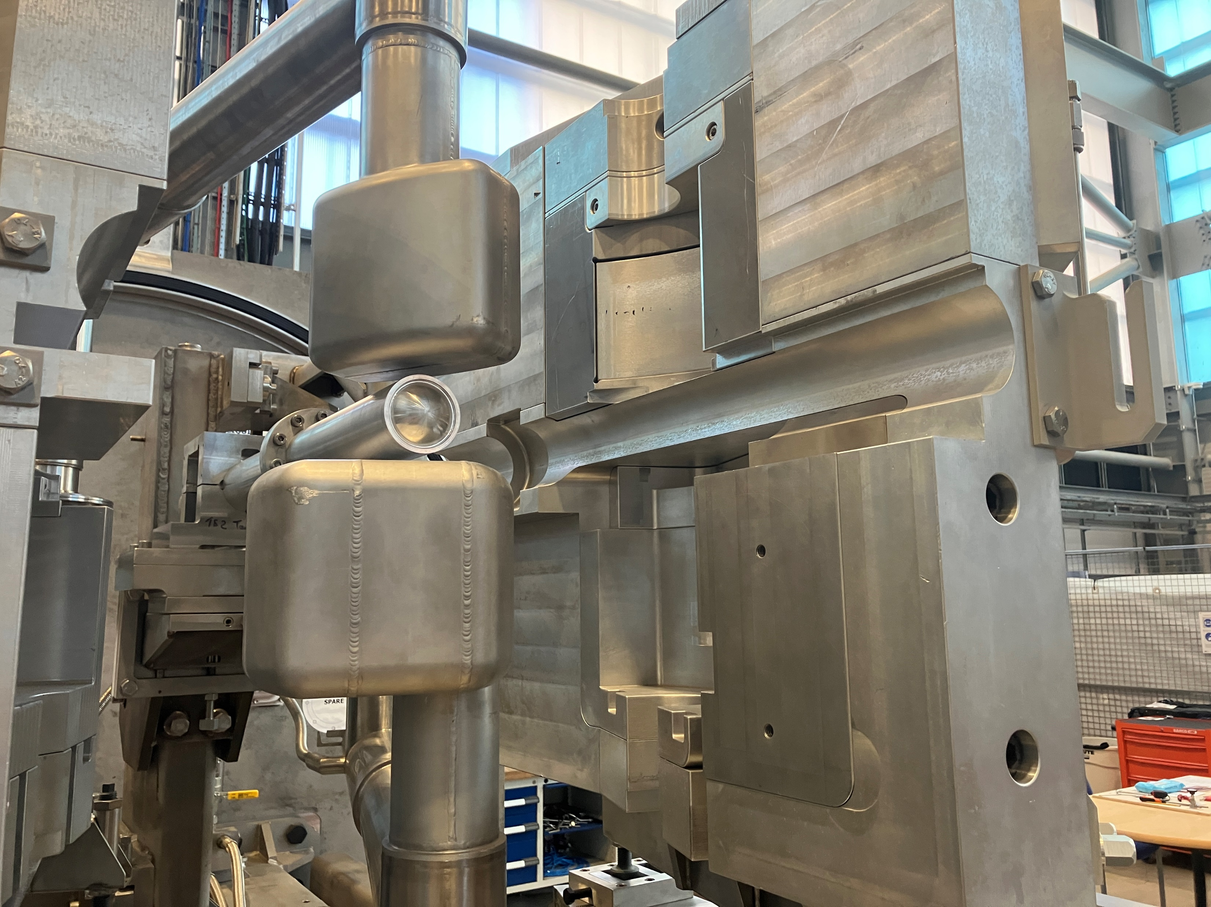
Target & Cryogenic Moderator Thermocouples & Instrumentation
General Overview
Raj Gupta
June 2026

Slide 2
Target & Cryogenic Moderators Thermocouples
Type K to measure Target and Cooling water temperature
Above Liquid Nitrogen temperature COTS Converter
Type E to measure Cryogenic Moderators temperature
Below liquid Nitrogen temperature, mV measurement Converter

Slide 3
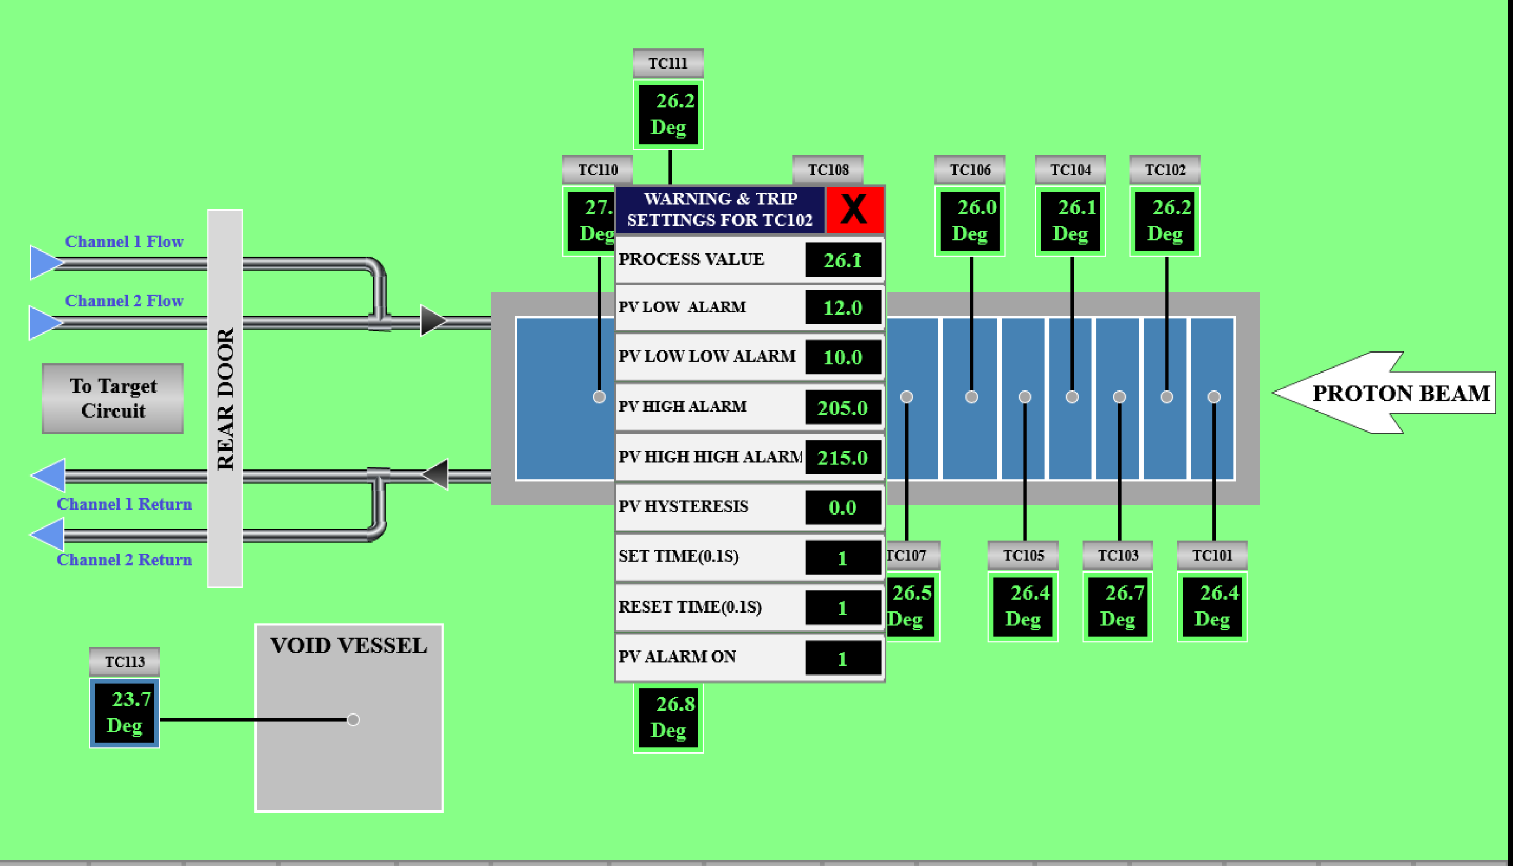
Target Thermocouples

Slide 4
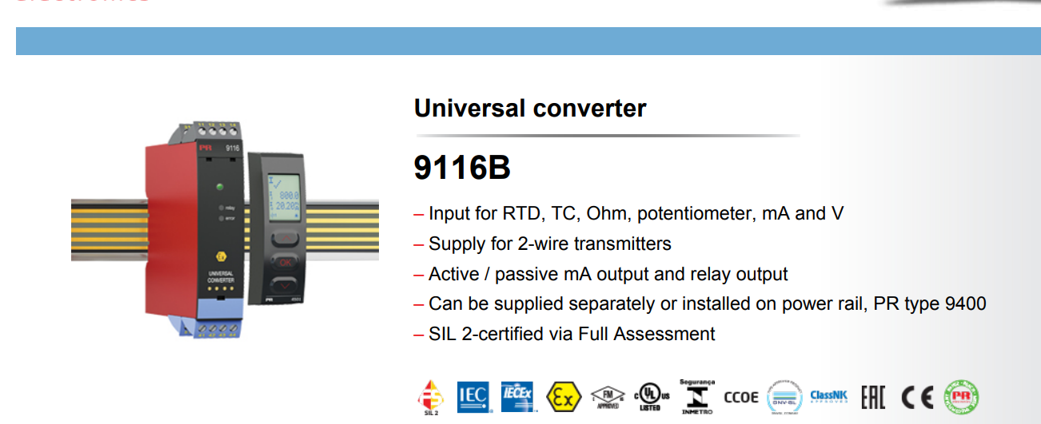
Target Thermocouple Instrumentation

Slide 5
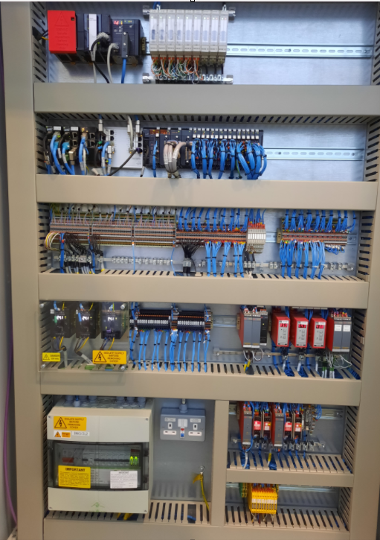
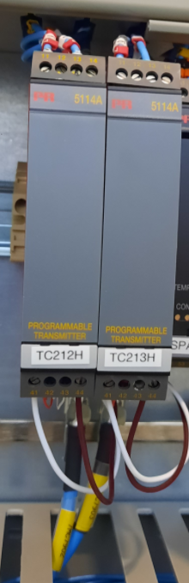
Hydrogen Moderator Temperature Measurement

Slide 6
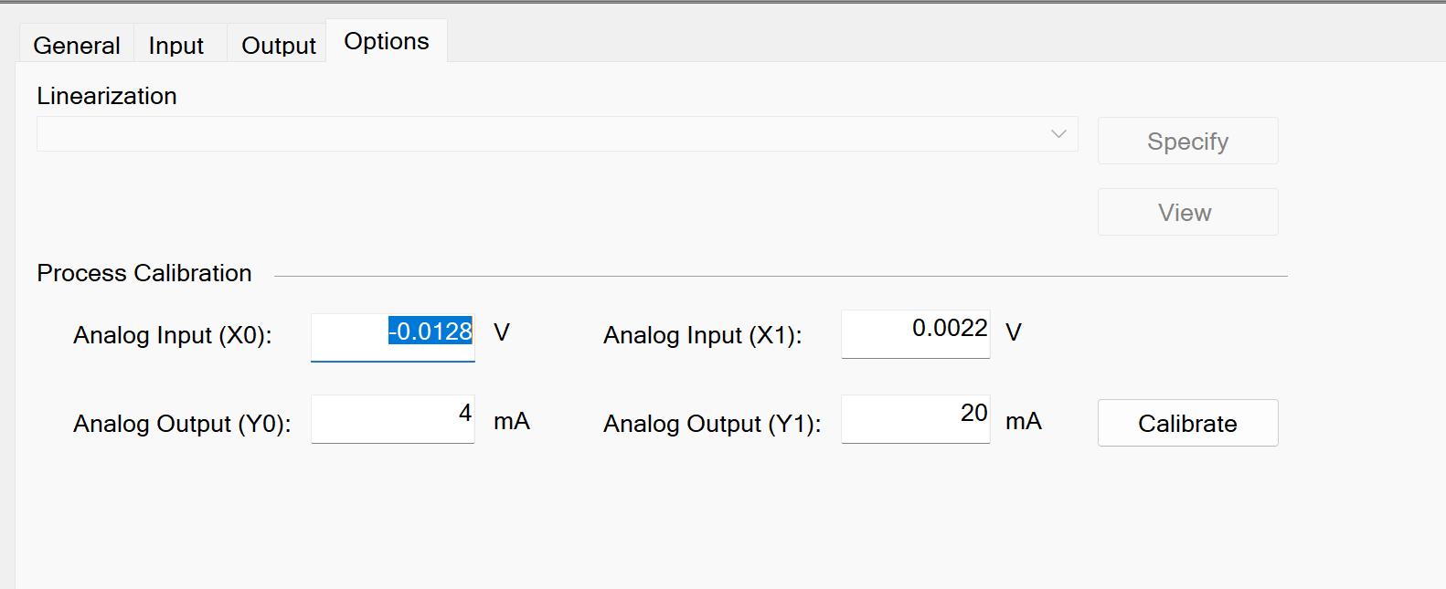
PR5114 CH1

Slide 7
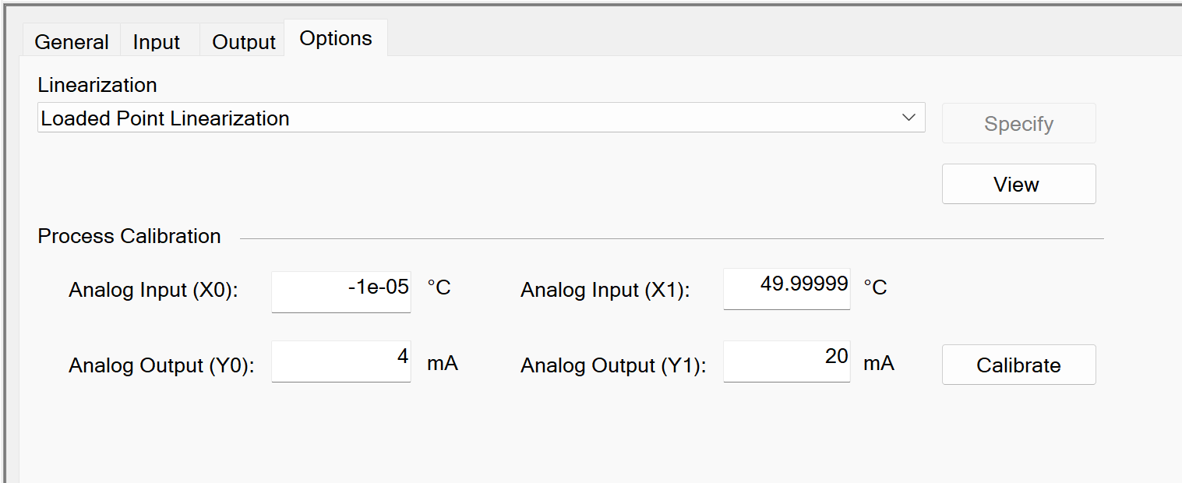
PR5114 CH2

Slide 8
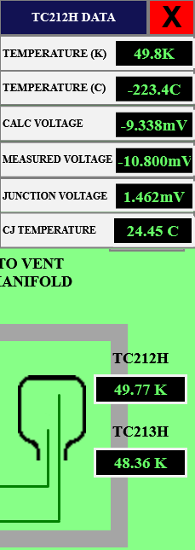
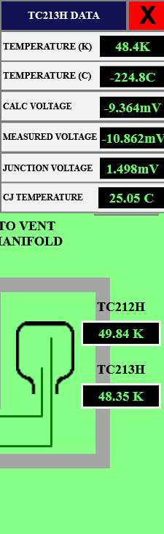
Hydrogen Moderator
Thermocouple Measurement

Slide 9
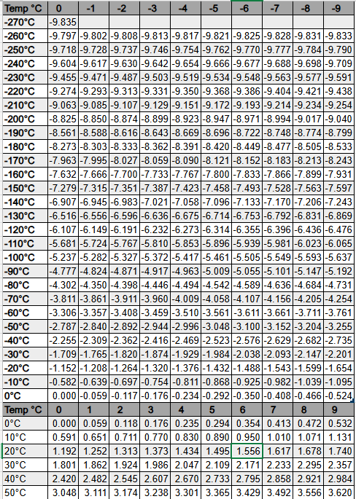
Type E Temperature Vs mV

Slide 10
Issue We Encountered
Inaccuracy introduced by temperature gradient at unintended Junction due to door feed through
01
Inaccurate measurement of the junction temperature at the Converter terminals (PR5114)
02

Slide 11
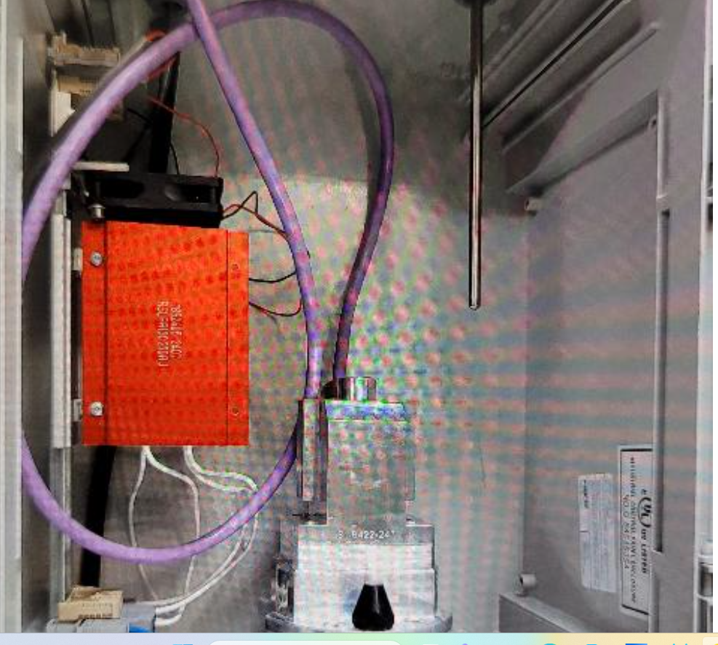
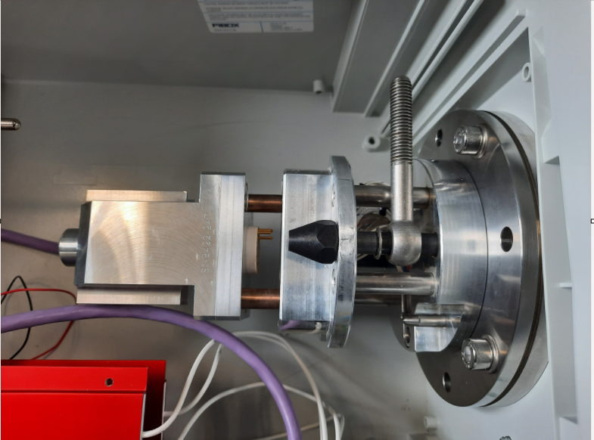
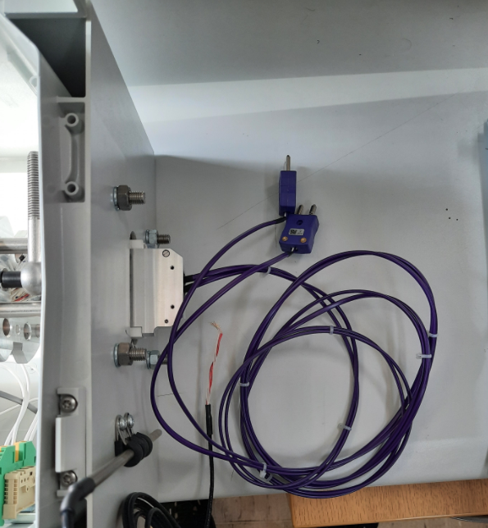
Measure the inaccuracy caused by temperature gradient at unintended Junction

Slide 12
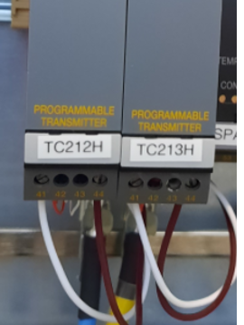
Optimize/Find the best place to measure the Junction Temperature

Slide 13
Thank You

