Slide 1



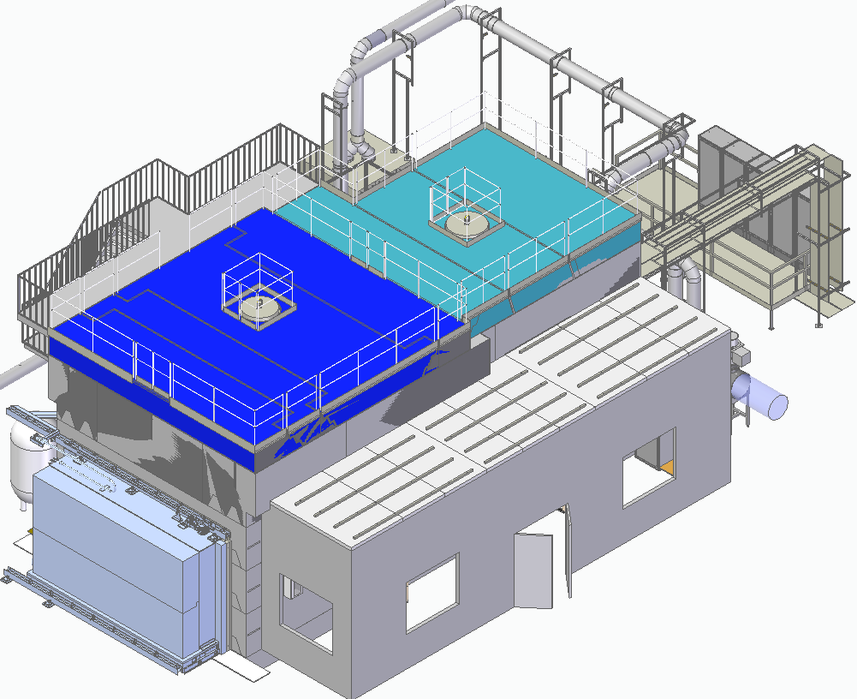
Remote Retrieval
and Handling Facility
Project overview
Mark Shaw
24th April 2026
ISIS-RRHF-WM-Rv-0015
Notes:
The abstract pattern can be removed or repositioned if required. Be careful to ‘Send to Back’ so that it does not obscure any important information.

Slide 2
Purpose
To provide an overview of the project requirements and progress
Notes:
To replace photo with one of your own. 1) Send the geometric shape overlay to the back – Right-Click > Send to Back > Send to Back. 2) Replace image – use the guides provided to correctly position it. 3) Send your image to the back so that the geometric overlay re-appears over the image. Please remove or amend the image credit if you are using a different image to the one provided.

Slide 3
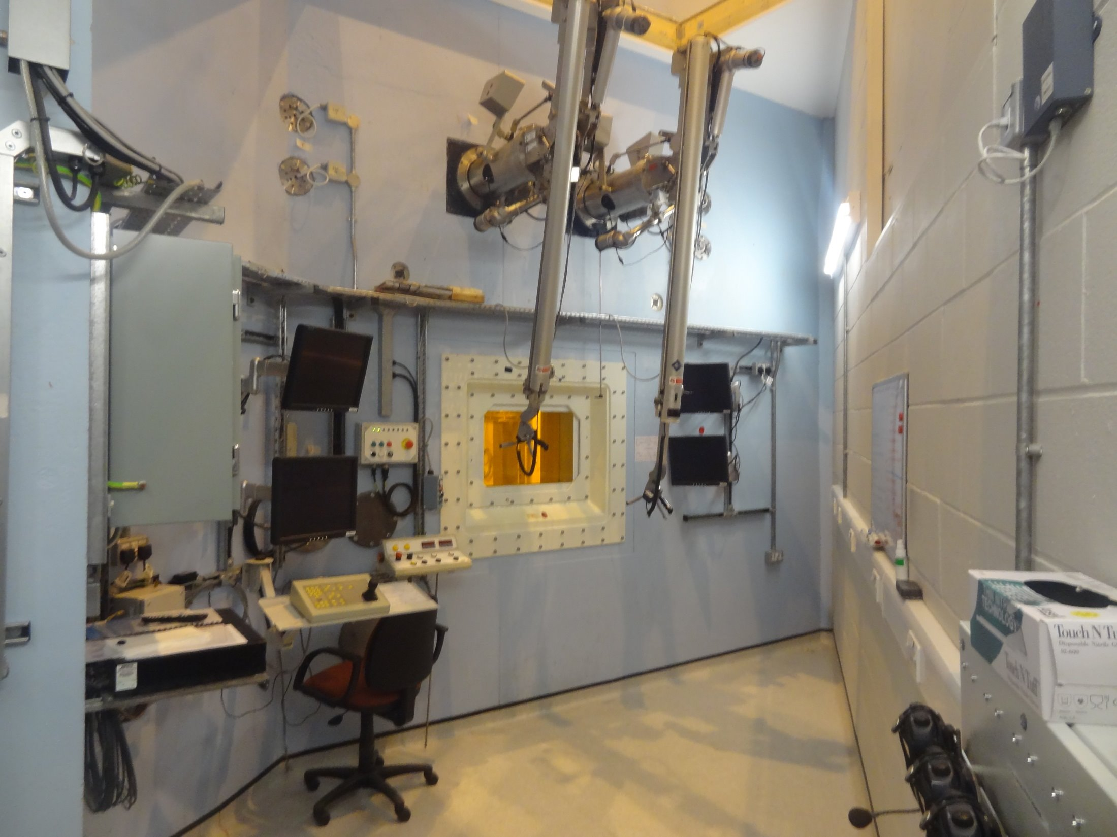
What
Radiation shielded remote handling facility;
  1450 mm concrete shielding
  Designed for remote handling
  Physical size. 14 x 12 m footprint
  Leak tight
Similar to the existing TS1 and TS2 remote handling cells used for servicing the TRaM
To be owned by the Radioactive Waste Team

Slide 4
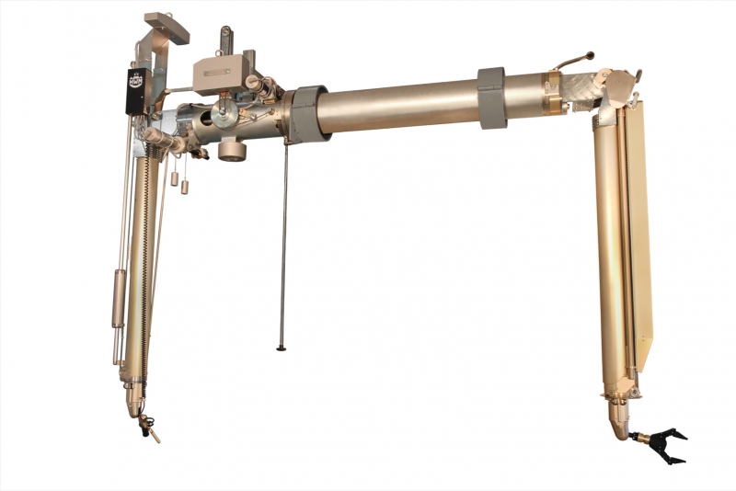
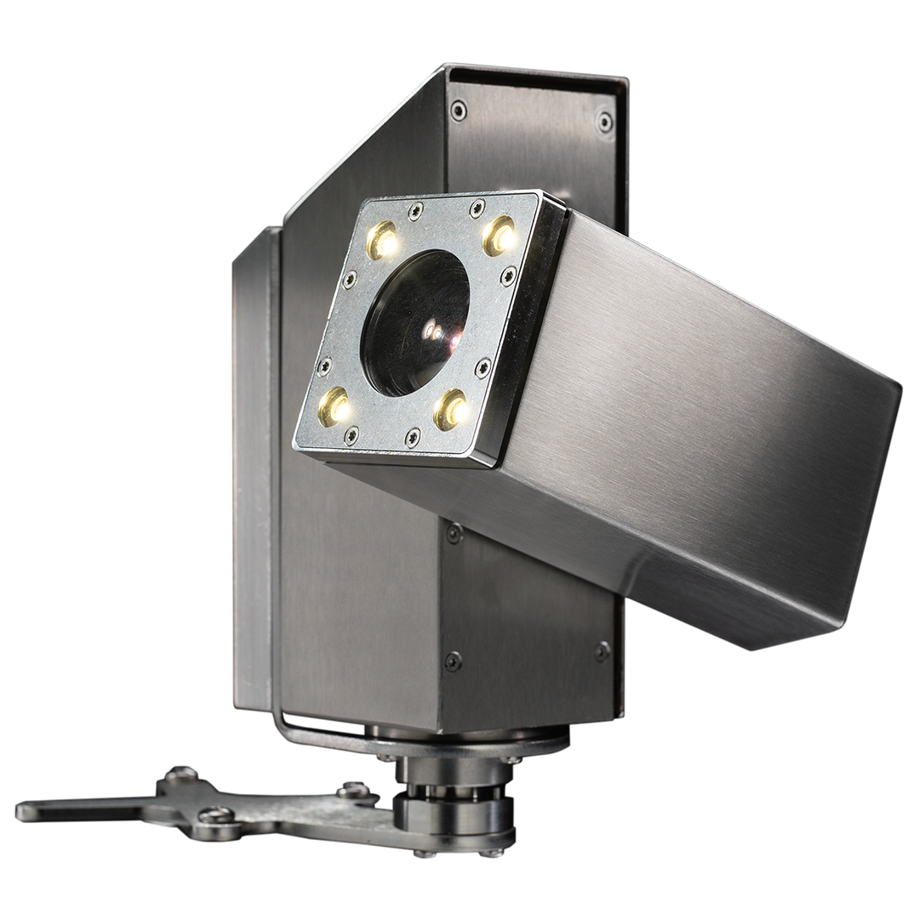
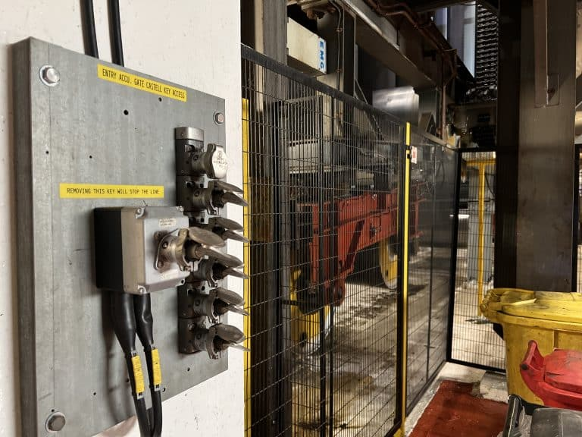
Capability
Designed to accommodate wide range of operations, flasks and tooling.
  Remote handling capability
    4 x Walischmiller A100 through-wall-manipulators
    2 x in-cell cranes (6 tonne and 1 tonne)
    Radiation tolerance PTZ cameras
    Radiation shield windows
  Hazard management
    Radiation monitoring
    Safety interlocks
    Active ventilation extraction system
    Minimised contamination traps, and designed for decontamination
  Future proofing
    Spare capacity for cabling and services
    Designed to accommodate a wide range of processes

Slide 5
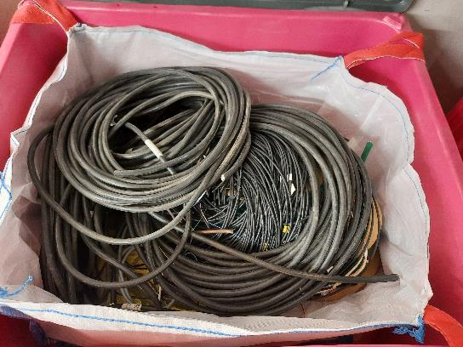
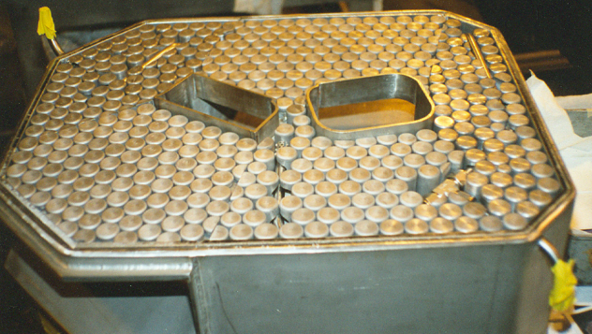
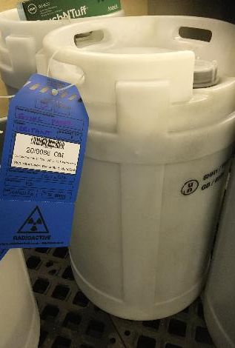
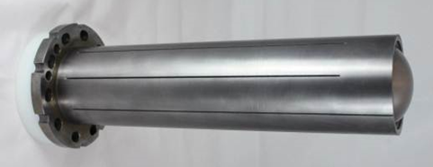
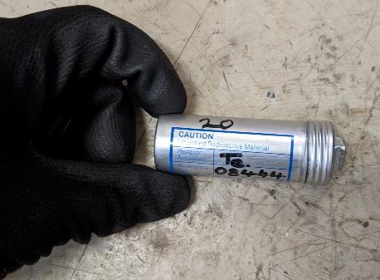
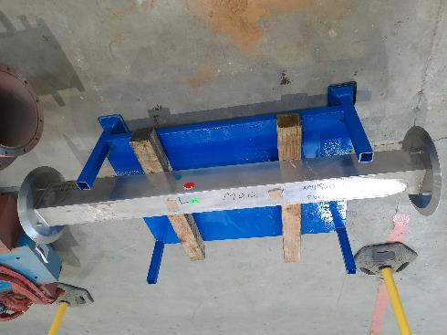
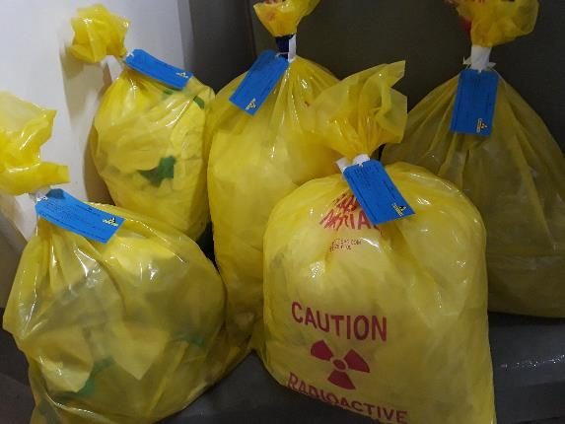
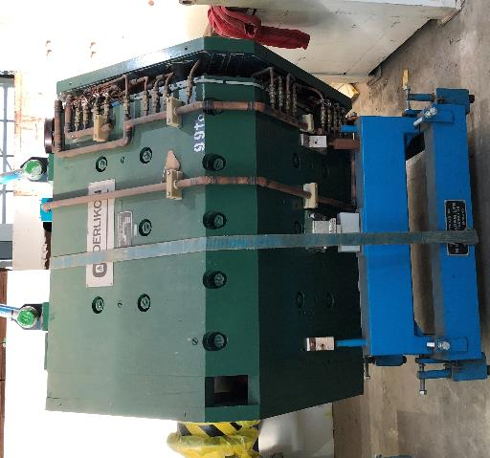
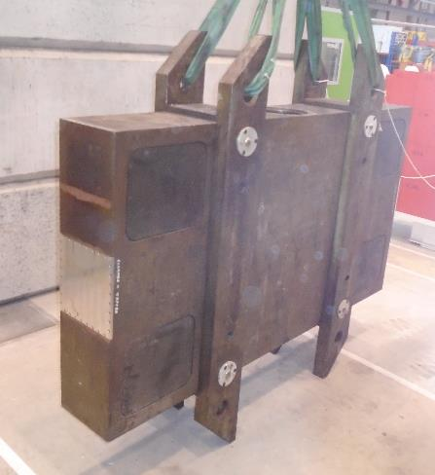
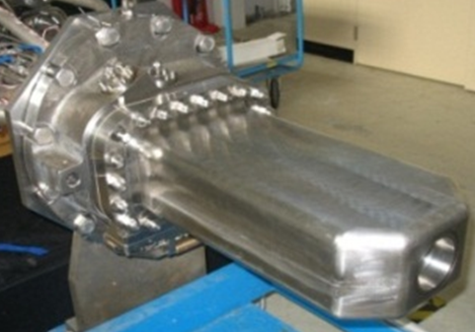
Why
Waste preparation for disposal by sampling, sorting, segregation, and size reduction
Waste Category | Current Volume | Disposal Cost
LA-LLW | 1,140 t | ~ £2.2 M
LLW | 100 t | ~ £1.5 M
ILW | 70 t | ~ £ 70 M
Notes:
Predominantly the facility is required to deal with the significant volume of radioactive waste materials which have been accumulated at ISIS.
As is shown in the images here, we have a wide range of materials to deal with, such as neutron targets, collimators, beryllium refctors etc., ranging greatly in size and activity. The mean dose rate considered for this waste is 70 mSv/h at 1m.
A hot cell is required to allow sampling, sorting, segregation, and size reduction of materials in preparation for disposal.
To dispose of the intermediate-level waste in its current state would cost around £70M and would take up a significant volume of space at the waste storage facility.
The hot cell will allow the size reduction of materials before packing them and could reduce the ILW disposal cost by approximately £50M.
EA permit requirements. Not complying risks enforcement action (cessation of operations)
Planning for future wastes

Slide 6
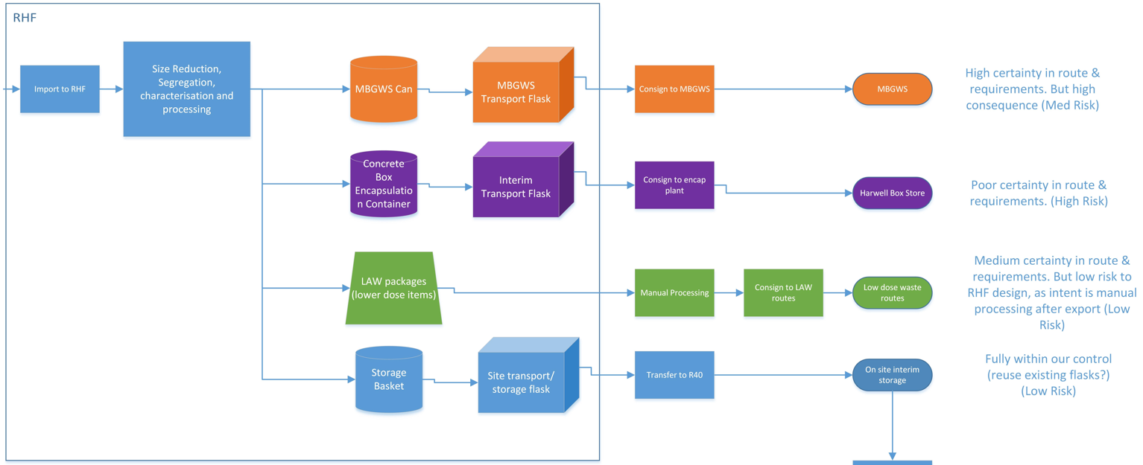


Disposal Routes

Slide 7
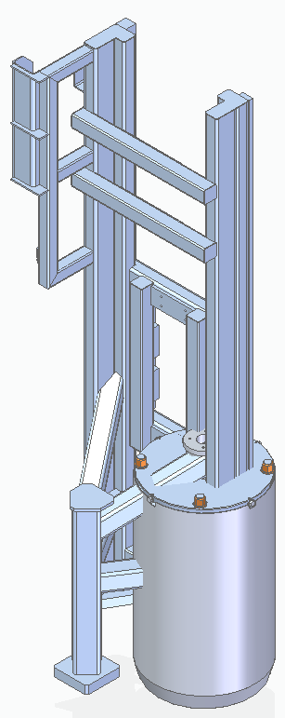
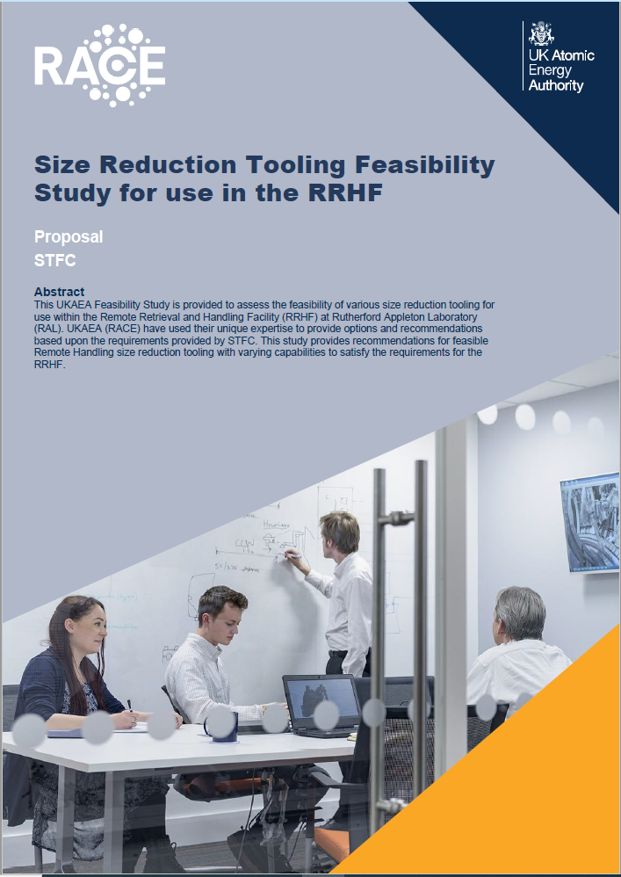
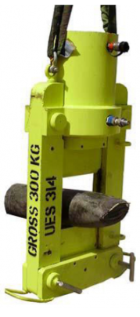
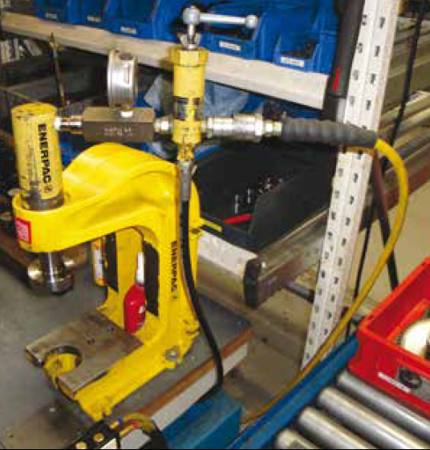
In-cell tooling
Predominantly for size reduction but also for segregation

Slide 8
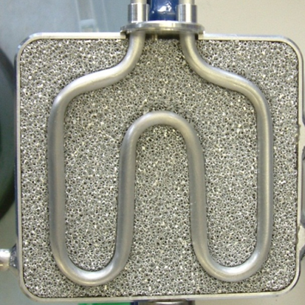
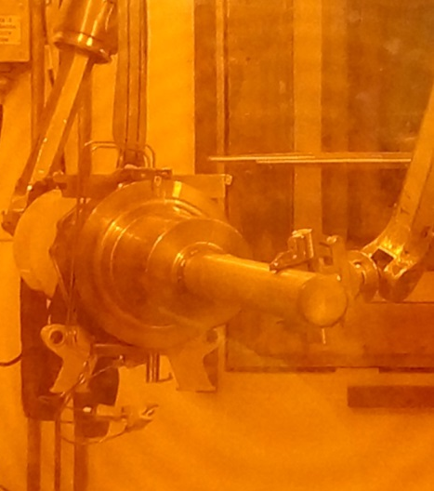
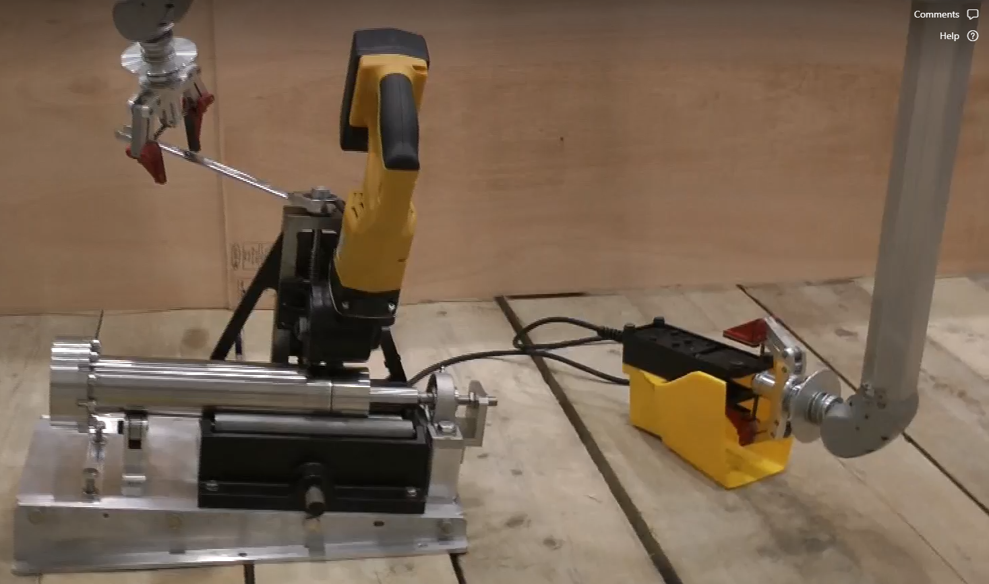
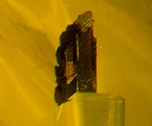
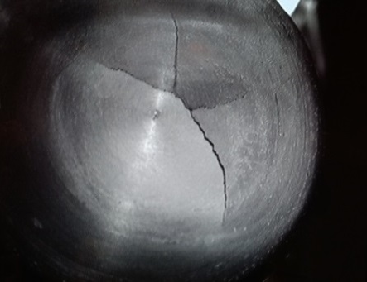
Why
PIE, to increase the ISIS facility operational longevity and robustness.
(sample preparation and visual examination)
Methane moderator carbon build up
TS2 beam entry window (failed in service)
TS2 neutron targets. Understanding failure modes and potential for extending service life.
Notes:
The facility will also greatly improve the Post Irradiation Examination capabilities at ISIS.
PIE is of strategic importance and will help to increase the ISIS facility operational longevity and robustness.
PIE will predominantly focus on visual examination and preparation of samples to send to specialist facilities for detailed analysis.
The images on this slide show a sample of the components we are particularly interested in.
Neutron moderators. Assessing the carbon build-up within the methane moderators. Seperatly, assessing the root cause which led to the rupture and failure of a moderator in 2009 shortly after first use. Both tasks will require cutting of the outer stainless steel cans, resulting in loose and airborne radioactive contamination.
An aluminium 5083 proton beam window which failed unexpectedly in service resulting in a lengthy and complicated replacement. This will involve preparing samples for analysis at a specialist PIE facility.
Neutron targets, specifically the targets used on the second target station, with the goal of extending usable life to ~5 years, and minimising the risk of contamination to the target cooling water.

Slide 9
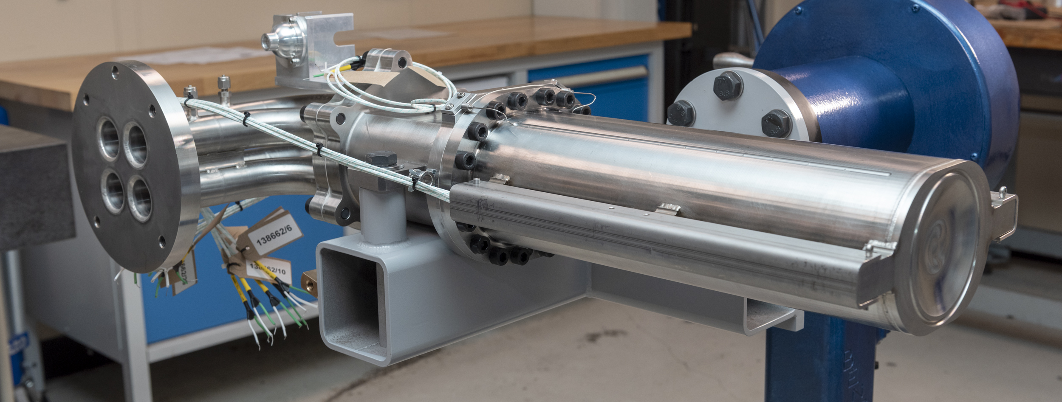
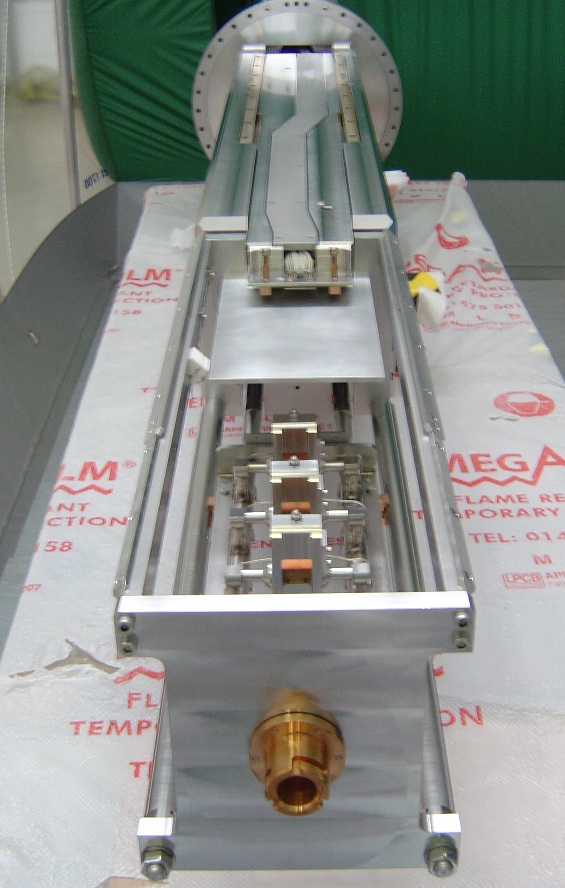
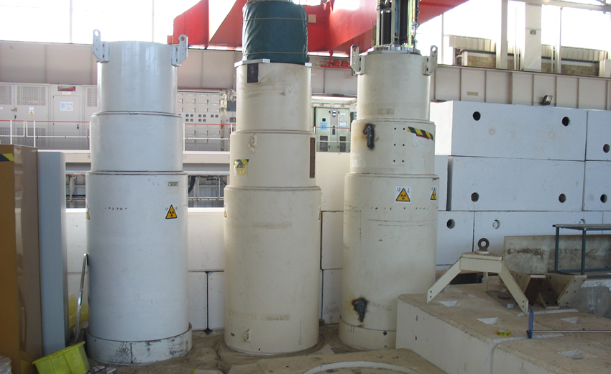
Why
Maintenance of radioactive components
Notes:
Another objective is to deliver a facility which will allow us to maintain some of the target station components which have become highly radioactive, reducing the generation of radioactive waste, resulting in lower costs and moving towards a more sustainable future.
Both PIE and maintenance activities pose a significantly more challenging radiation hazard than sorting and repacking waste materials. As an example, the neutron targets generally have a dose rate of between 5 and 10 SV/h after 5 years of cooling, which is much more than the 70 mSv/h of the general waste items.
Here are some examples of the equipment we are particularly interested in maintaining.
First is the Muon Target assembly. The three small graphite targets and the profile monitor assembly require routine replacement. They are designed for ease of replacement using through-wall-manipulators.
For the neutron targets, the thermocouples will eventually fail. The latest neutron target has been designed to allow the thermocouples to be replaced. Currently, these targets are being consigned to the Sellafield mixed beta gamma waste store, at a cost of more than £200k each, excludig the cost of transport, flasks, and manufacture of replacement target assemblies.

Slide 10
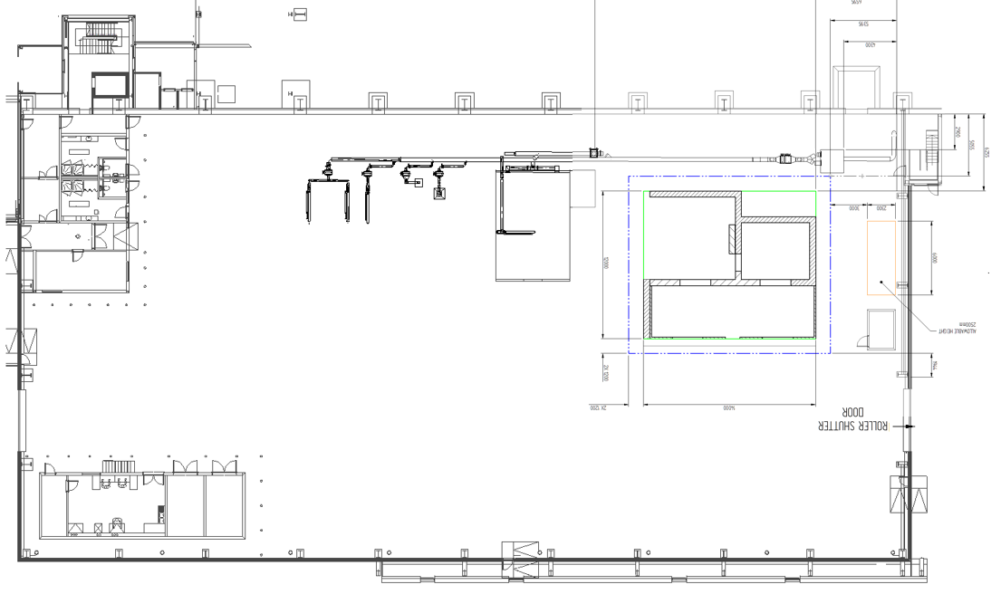
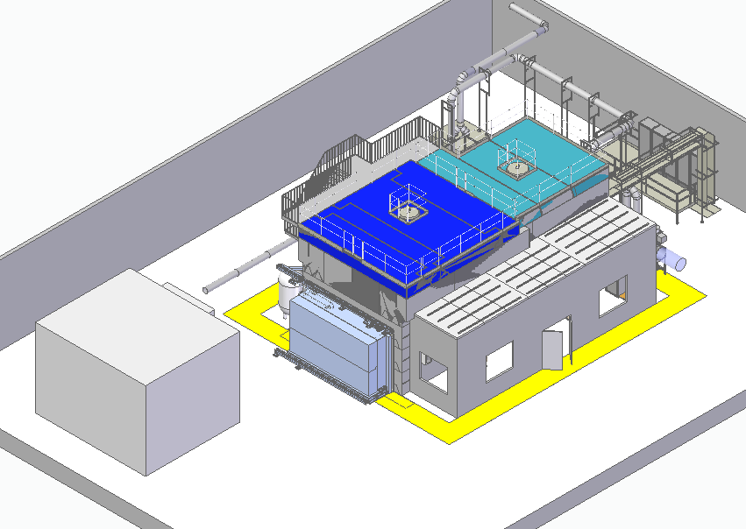
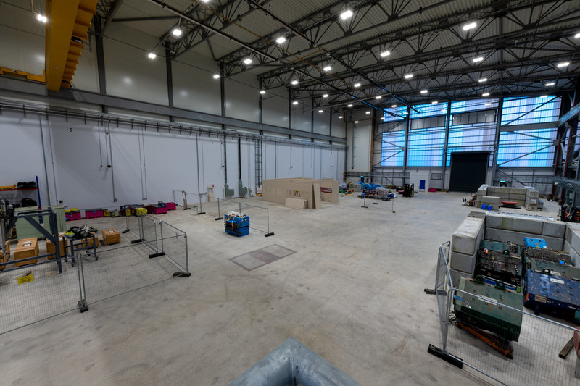
Build location

Slide 11
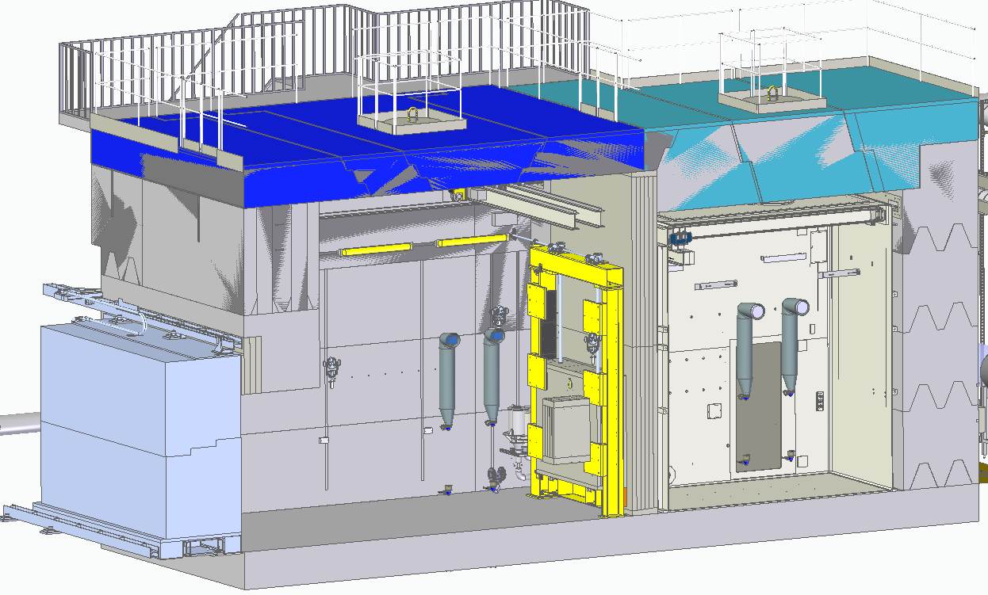
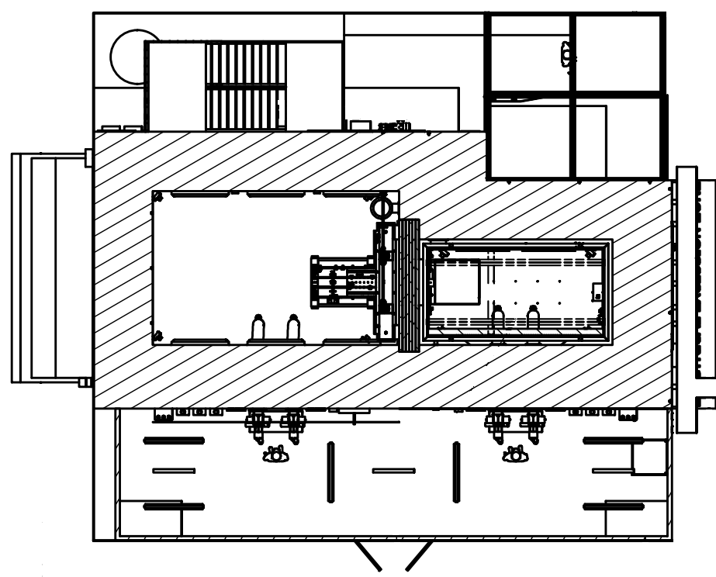
Facility overview
De-lidding cell
Active cell
Manipulator room
Notes:
2 cells
De-lidding cell for loading and unloading flasks
Active cell for invasive works
De-lidding cell 5.6 x 3.5
Active cell 4 x 2
Class four containment in accordance with ISO 10648-2:1994
Over head cranes
Through wall manipulators
Shield windows
CCTV

Slide 12
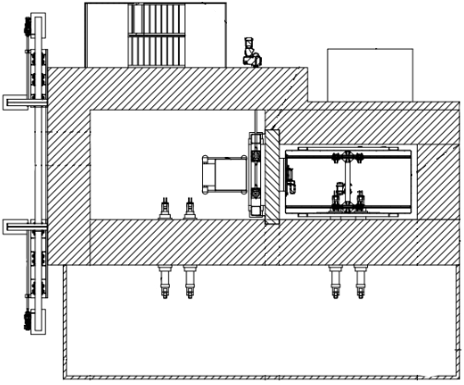
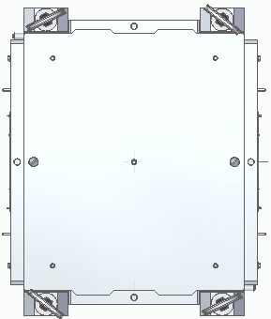
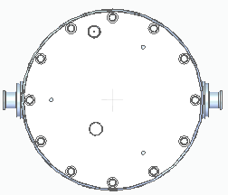

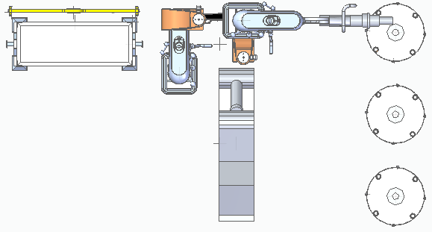
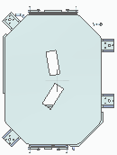

High level operational overview
Image © STFC John Dawson
Import
Export
Notes:
The diagrams on this slide show the intended method of operating the RRHF.
Flasks will be brought into the de-lidding cell at ground level on a powered tug or lifted in through removable roof panels (we have a range of flasks with different transport and loading requirements).
Operators will enter the de-lidding cell and prepare the flask for opening (removing transport bolts and installing lifting equipment).
Operators will leave the de-lidding cell, the shield door is closed and operations are continued remotely from the manipulator room.
The flask contents will be retrieved and moved into the active cell using in-cell cranes and through-wall-manipulators.
All invasive works will be performed in the active cell which will be a class 4 containment.
Tooling will be imported and exported from the active cell when required.
Materials are loaded into waste export cans.
Waste export cans will be moved from the active cell into the de-lidding cell by overhead crane and loaded into flasks.
The shield door is opened, and an operator enters the de-lidding cell, prepares the flask and removes it using the powered tug or overhead crane.
Invasive works will inevitably generate airborne contamination which will need to be contained and dealt with in the active cell. Personnel entry into the active cell will only occur when absolutely necessary and under controlled conditions.
Personnel entry into the de-lidding cell will be required for normal operation.
Operated remotely with through-wall-manipulators and over head cranes – challenge of doing varied work / tasks

Slide 13
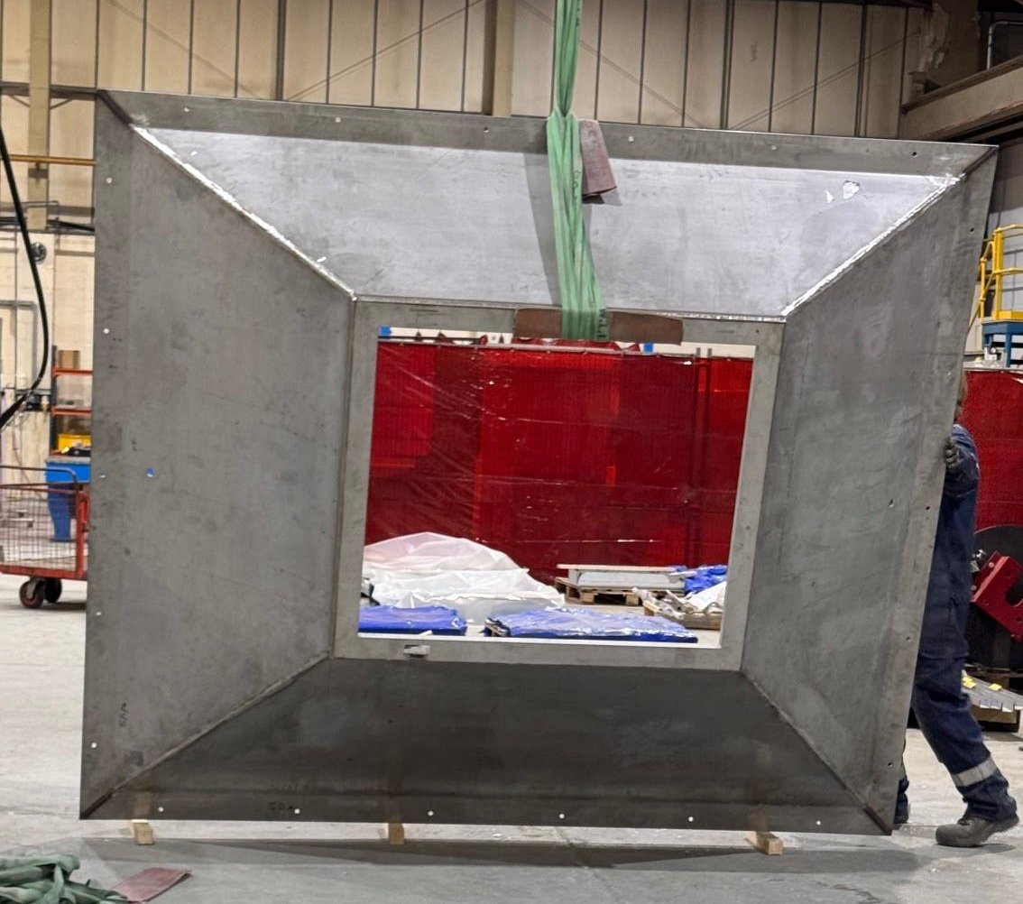
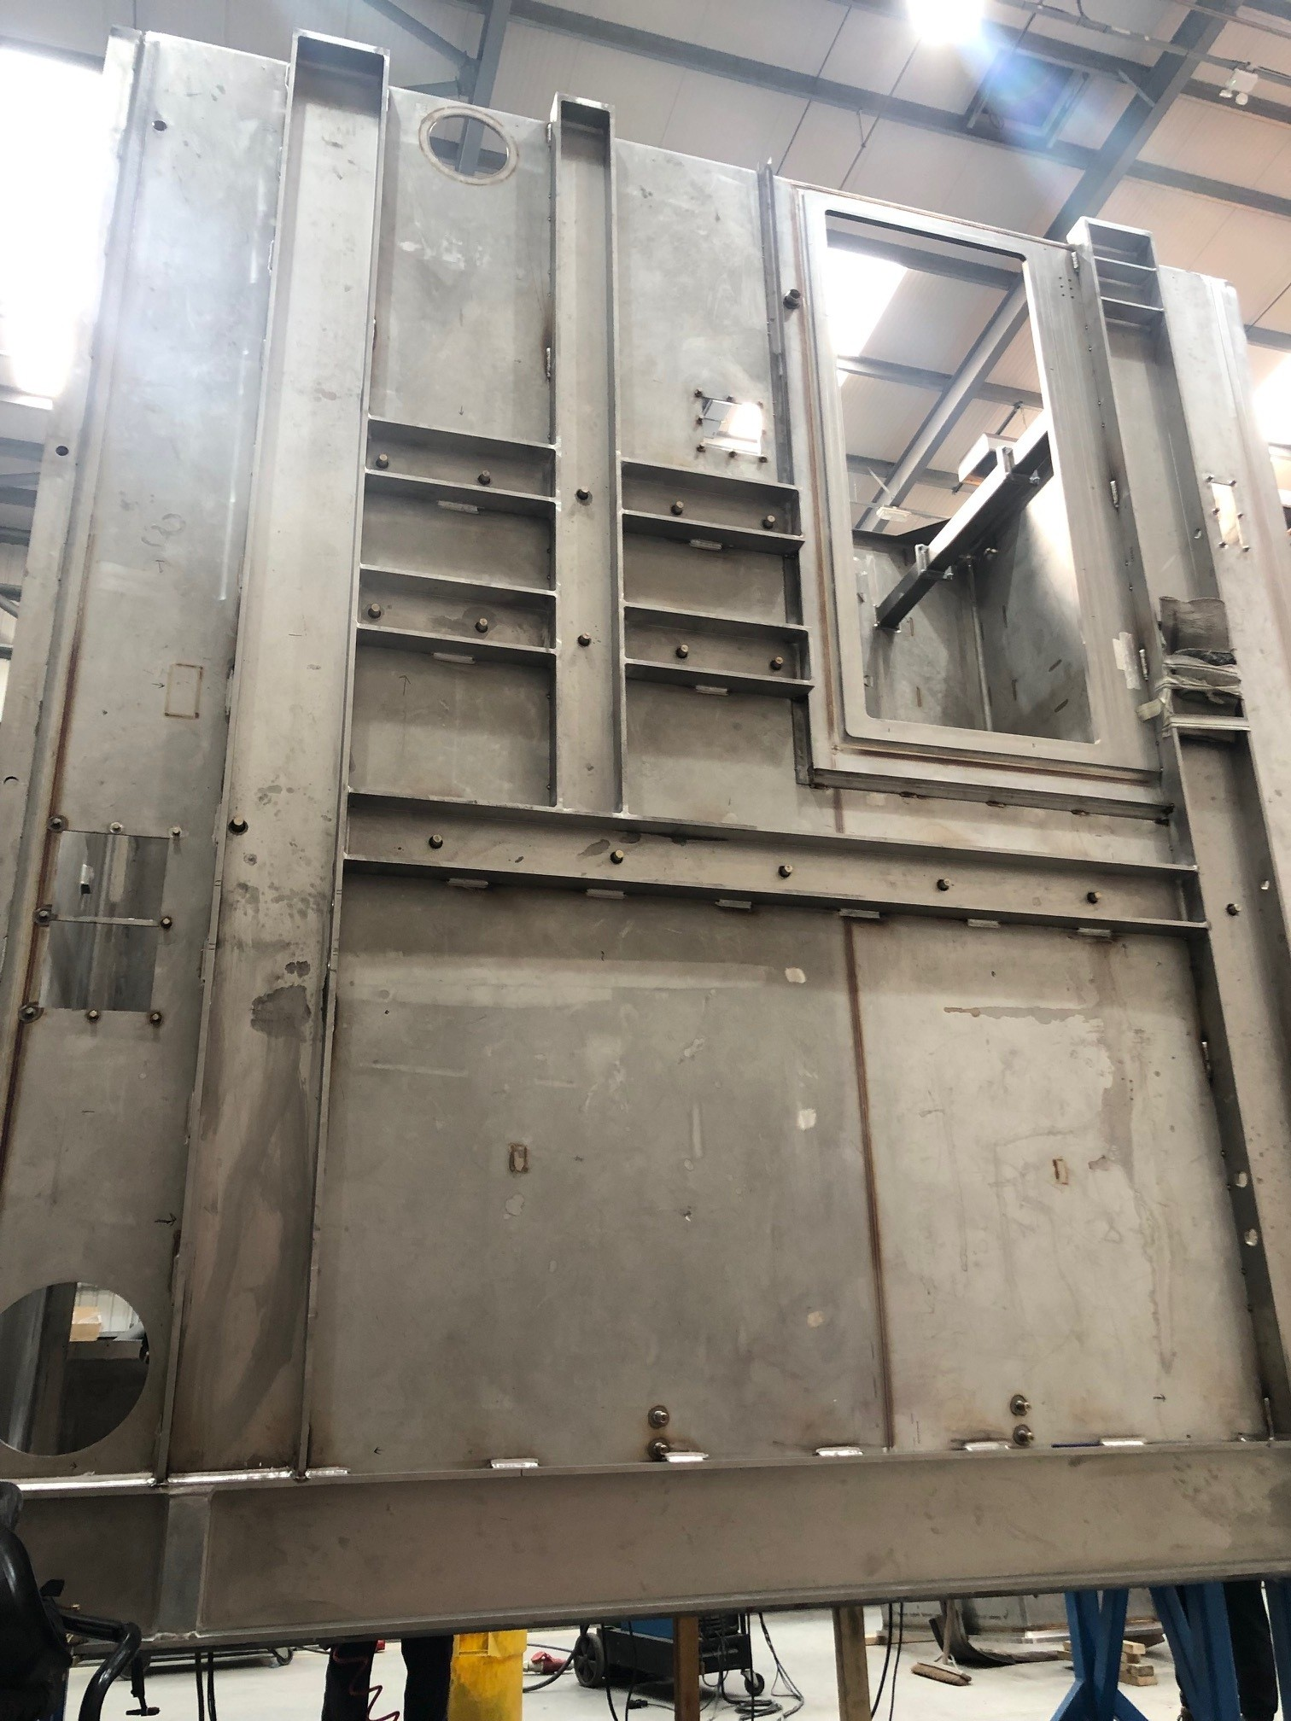
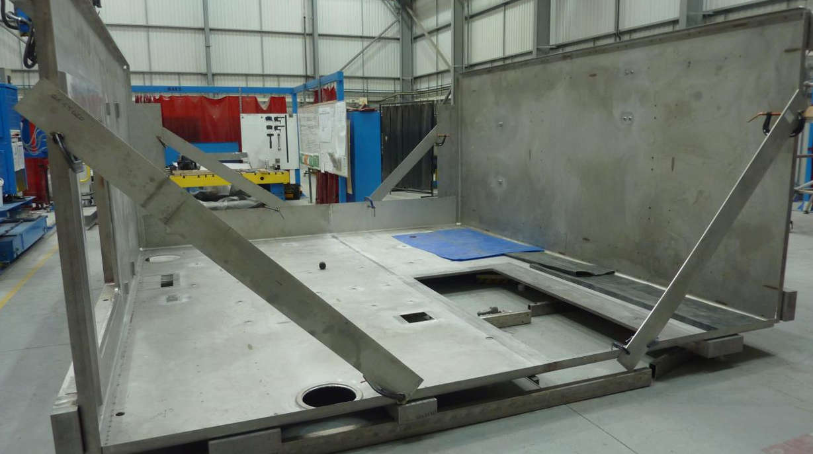
RRHF manufacture
Active cell containment

Slide 14
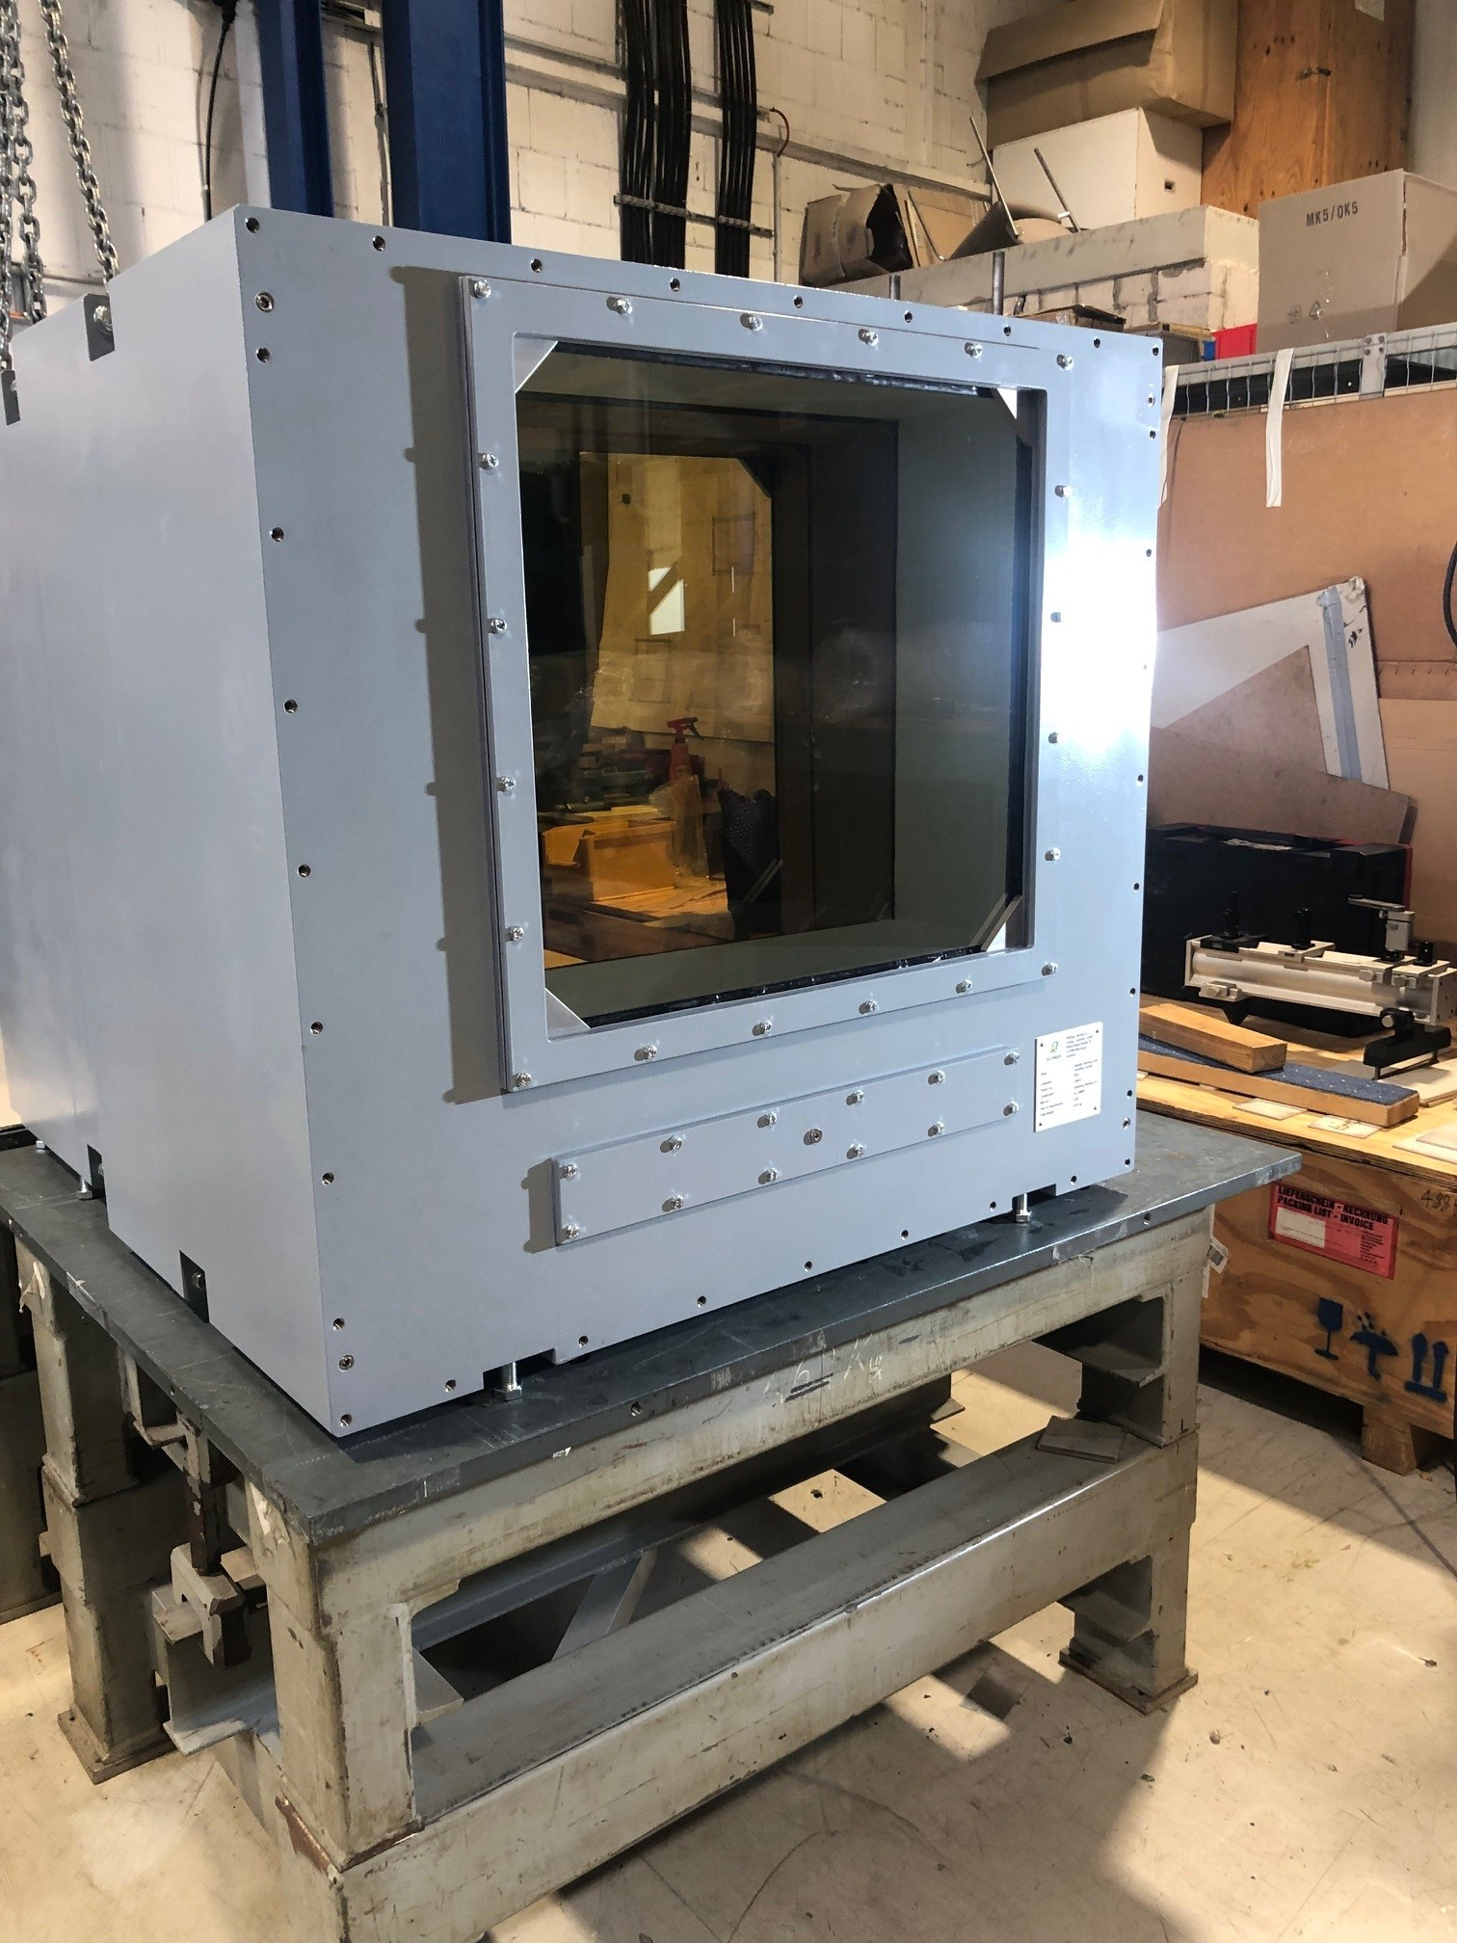
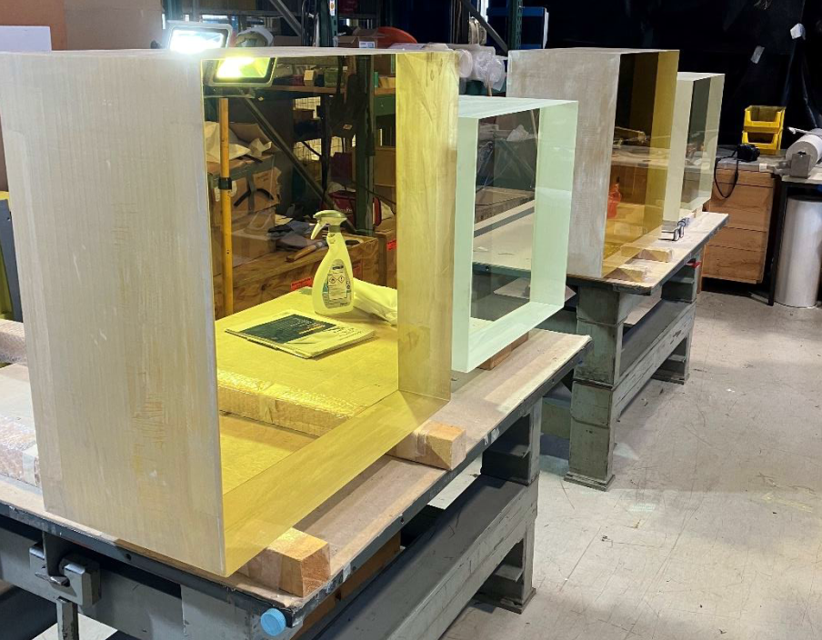
RRHF manufacture
Shield windows
Image © STFC John Dawson

Slide 15
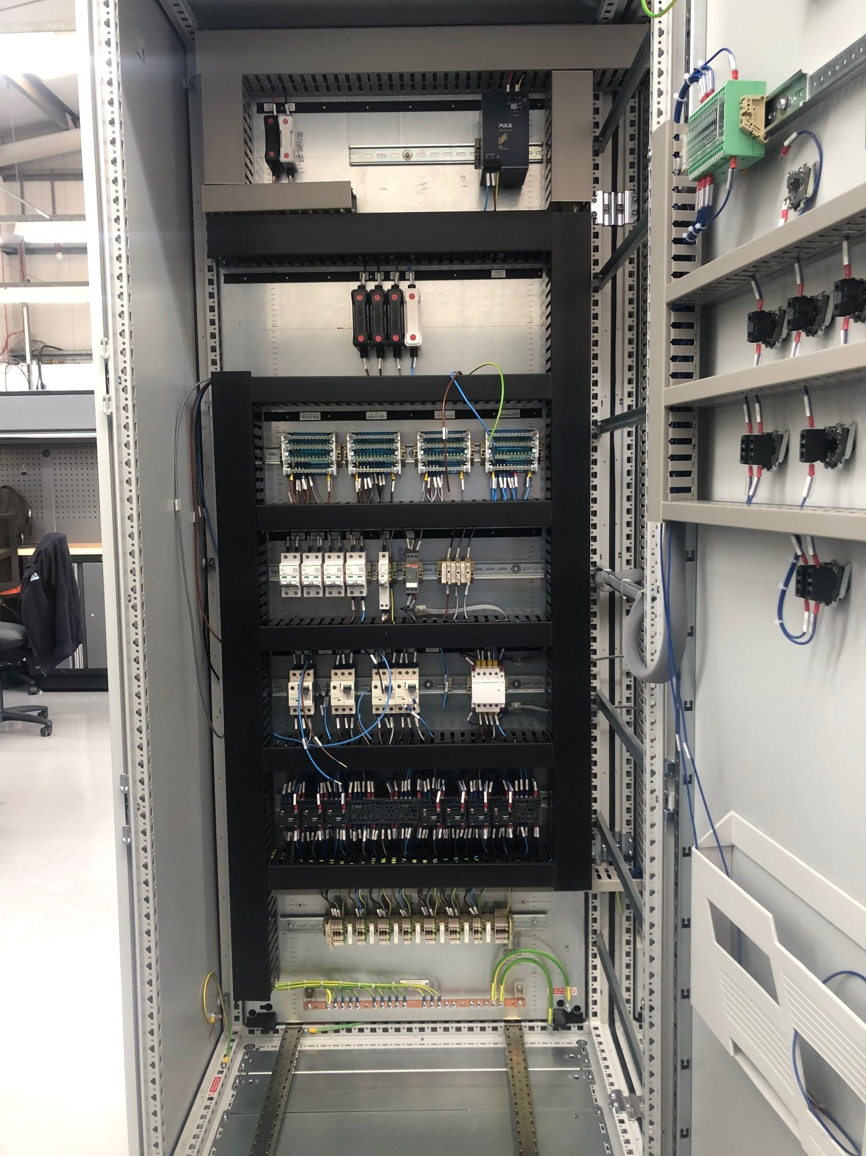
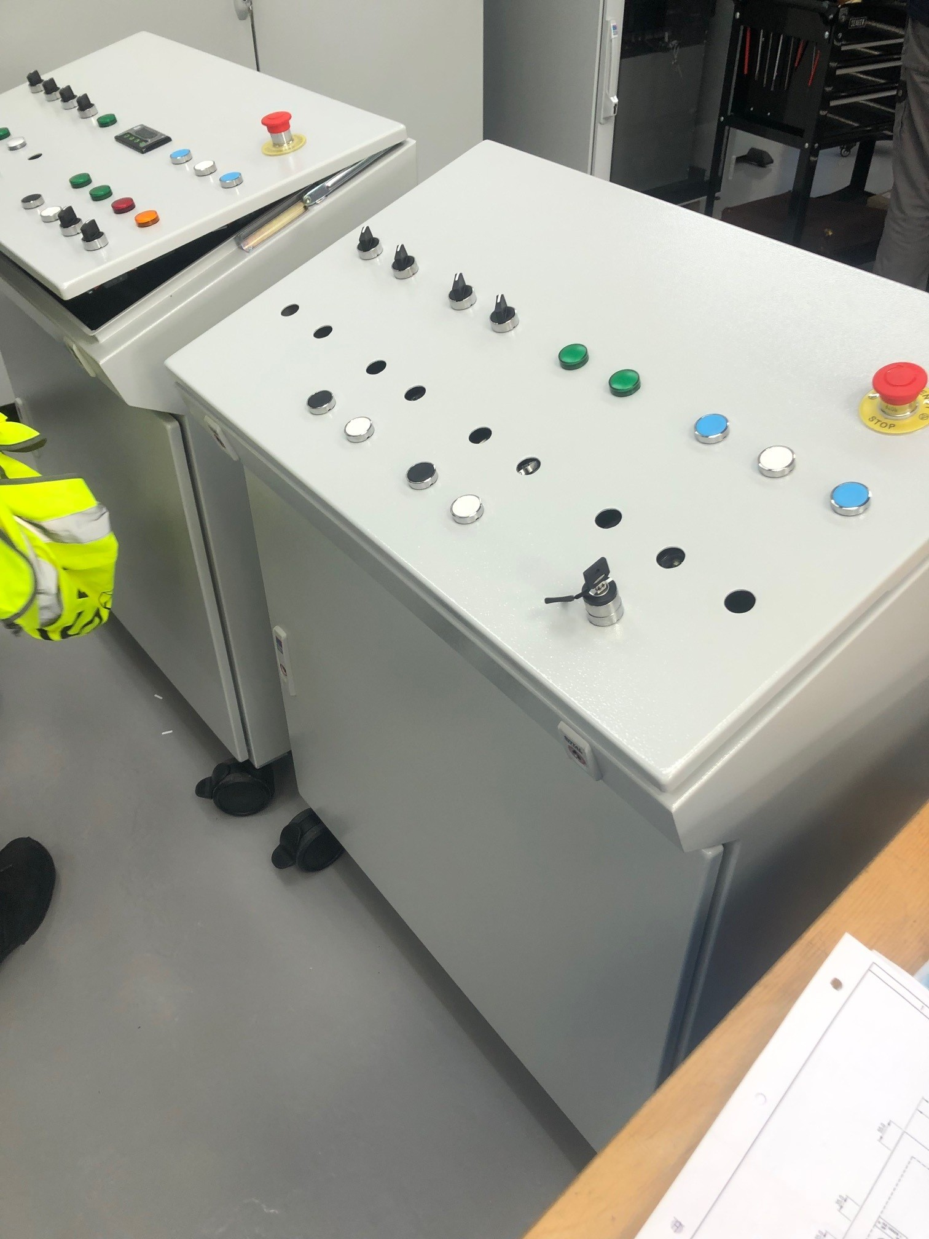
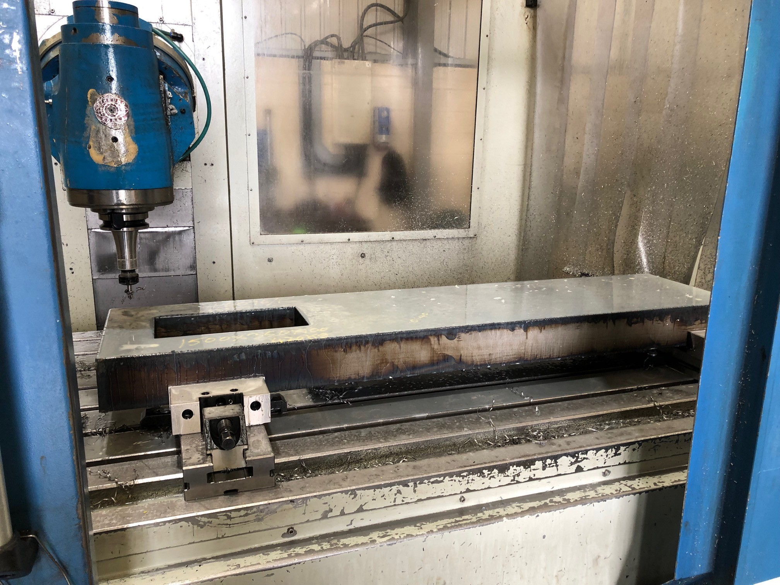
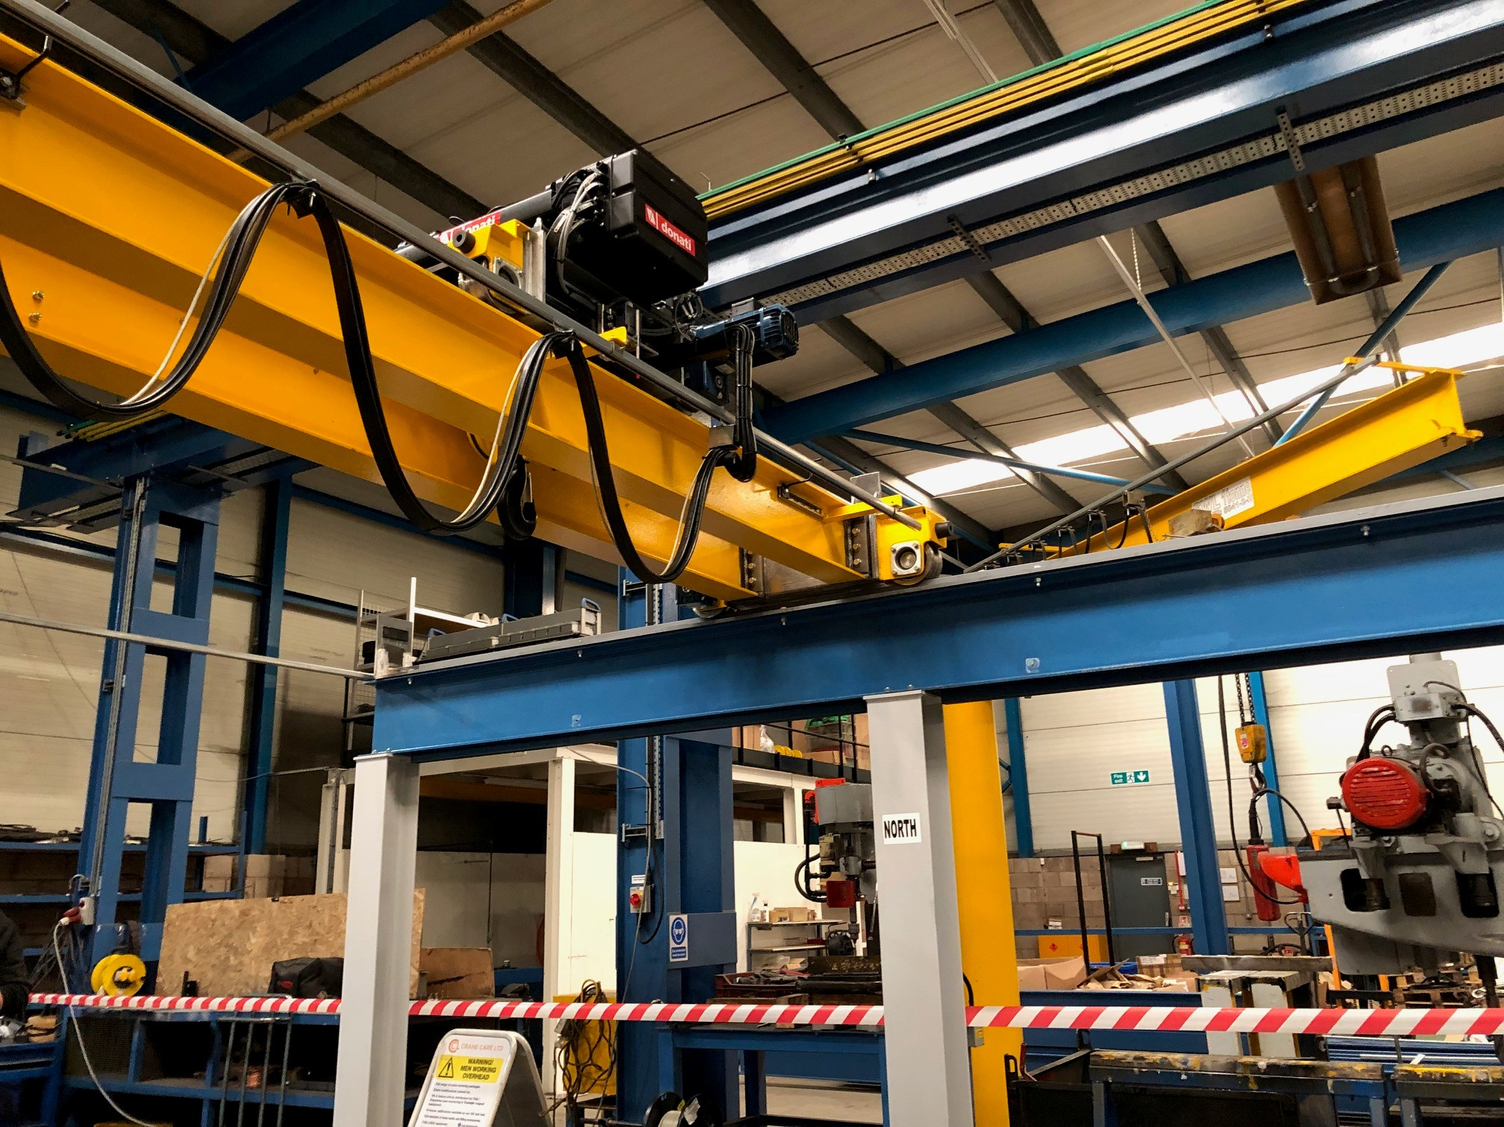
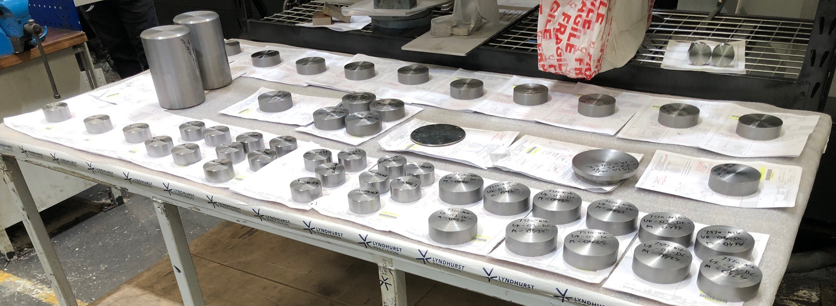
RRHF manufacture
Image © STFC John Dawson

Slide 16
Timeline
Task | Duration months | 2021 |  | 2022 |  | 2023 |  | 2024 |  | 2025 |  | 2026 |  | 2027
Pre-procurement | 20
Procurement | 16
Design | 14
Manufacture | 18
Trial assembly and FAT | 6
Installation | 6
Commissioning | 9
Completion and handover | 0

Slide 17



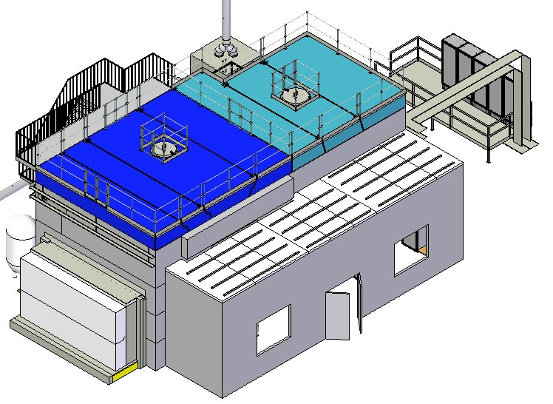
Notes:
The abstract pattern can be removed or repositioned if required. Be careful to ‘Send to Back’ so that it does not obscure any important information.

Slide 18




isis.stfc.ac.uk
STFC
Notes:
The abstract pattern can be removed or repositioned if required. Be careful to ‘Send to Back’ so that it does not obscure any important information.

