Slide 1
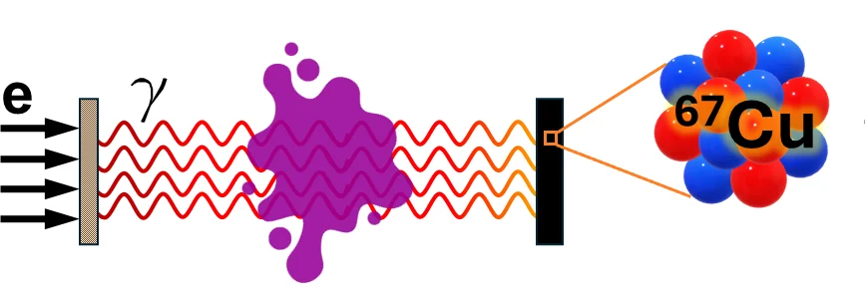
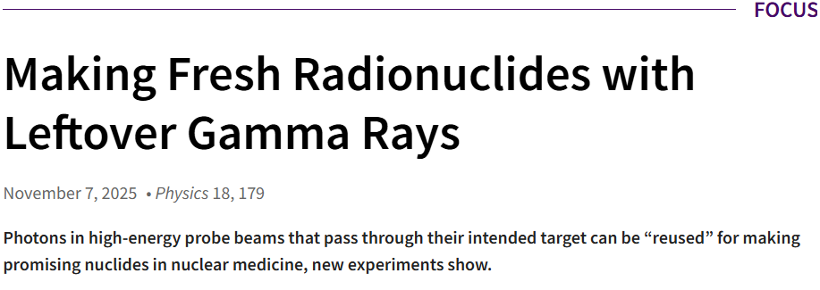
York at MAMI: isotope production as a second output
Demonstrated the principle at MAMI, Mainz:
parasitic bremsstrahlung from MAMI was used to produce and assay ⁶⁷Cu from zinc targets, without making isotope production the primary experiment.
APS Physics Focus
Accelerator infrastructure built for precision physics can also enable applied nuclear measurements.

Slide 2
Discussion proposal
Can we test a compact, removable converter--target station at MESA for electron driven medical isotope production?
MESA e⁻ beam
→
bremsstrahlung converter
→
activation target
→
off-line assay
What York can bring
activation targets | HPGe assay | yield/cross section measurements | converter/target chamber

