Slide 1
Thoughts on Neutrino Detectors for NuStorm
Neil McCauley
University of Liverpool

Slide 2
Physics Goals
Measure exclusive neutrino cross sections at the 1% level
  Support the long baseline programme (DUNE, HK).
  Measure electron neutrino cross sections
  Measure cross sections with multi particle final states + full kinematics
  Constrain the elements of neutrino-nucleus scattering models
Search for Sterile neutrinos
  Or improve measurements following positive results at Fermilab SBL programme
  Multiple baselines
  Excellent neutrino energy reconstruction

Slide 3
Reminder: Oscillation experiments
The idea is simple: compare the rates at near and far detector
We measure the results of the neutrino interactions, but oscillations affect the neutrinos themselves.
  The spectrum is different at near and far detectors
  Neutrino cross sections are essential to understand the effect on the measurements
  We have to estimate neutrino energy or a proxy for it
    CCQE
    Calorimetric
Neutrino energy reconstruction at T2K

Slide 4
Breaking apart cross sections
Cross section models are combinations of several parts
  Free nucleons
    CCQE, Resonant, DIS
  Initial states, including state correlations
  Final state interactions
Measurements that can decouple these will help build better models

Slide 5
Detector Requirements
We need to reconstruct the products of the neutrino interactions. Our detector is also our target.
Keep in mind the physics goals and beam composition
Detectors should provide
  Charge Identification - Magnetise
  Momentum Reconstruction – Curvature/Path length
  Particle Identification - muons/electrons/pions/protons/photons
  Reconstruction of multiple particles – most interactions will produce at least 2
    Requirement for any kind of calorimetric neutrino energy reconstruction
  Detection of protons and neutrons at low threshold – nuclear effects
  Variety of nuclear targets
    Minimum of Ar and H₂O. Also C (HK and DUNE ND comparisons). Strong case for H & D if possible.

Slide 6
Detector Systems
Meeting all requirements with a single detector looks challenging.
Take inspiration from HK + DUNE ND systems + experience from T2K, Minerva, MiniBooNe, MicroBooNe etc.
For oscillation measurement multiple detectors with multiple baselines are essential.
General point, I assume beam timing is sufficient to remove cosmic backgrounds, but some minimal overhead, is likely desirable.

Slide 7
Reminder DUNE ND System

Slide 8
Reminder HK ND/ND280 Upgrade
T2K

Slide 9
Reminder HK intermediate detector

Slide 10
Detector 1 – Liquid Argon TPC
Two concepts to consider, single phase and dual phase
Single Phase – wire detection – think ProtoDune SP, MicroBooNe, SBND, DUNE
  Ar target
  Excellent track reconstruction
  Should be a proven technology in time for nuStorm
  No magnetic field, relatively high proton threshold, neutron detection?

Slide 11
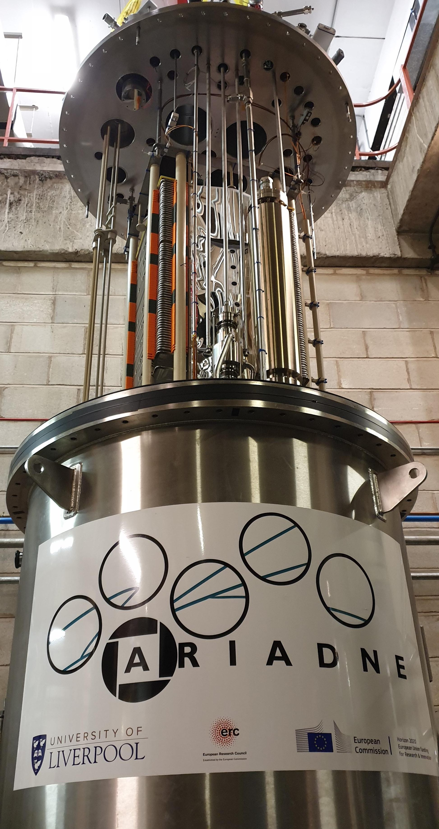
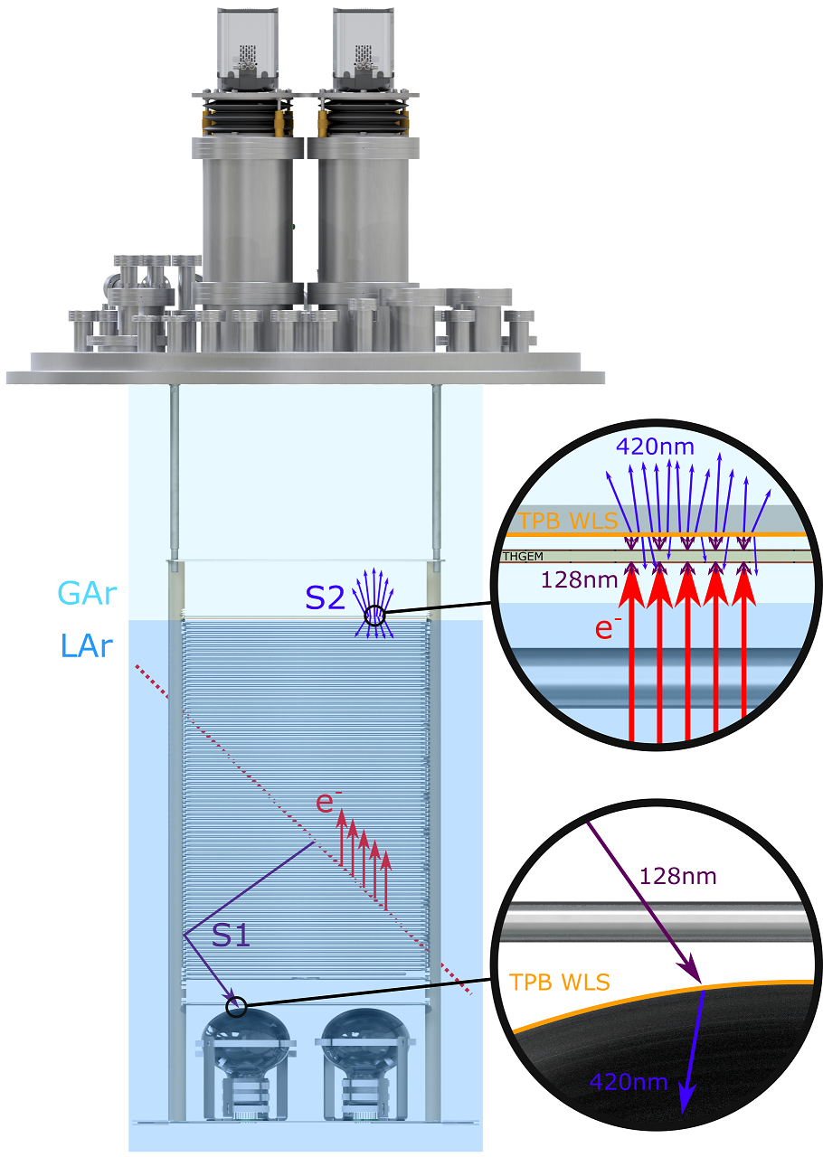
Dual Phase Options
Multiple read out options for dual phase, optical readout is one interesting option
Ariadne:
  Fast optical imaging
  High resolution (~mm pixels) Low threshold (~100 keV)
  Small number of channels compared to wires
  Use image intensifiers and cameras to measure secondary scintillation light from THGEM holes
    Use TPX3Cam fast cameras for readout
      Accurate calorimetry
      Accurate timing (1.6 ns) for full 3D reconstruction
      Zero suppressed readout

Slide 12

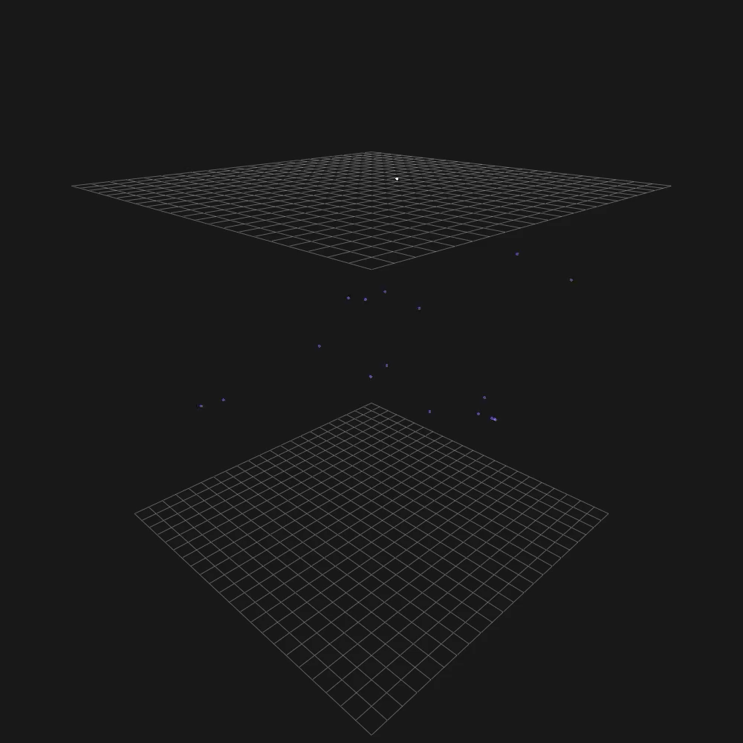
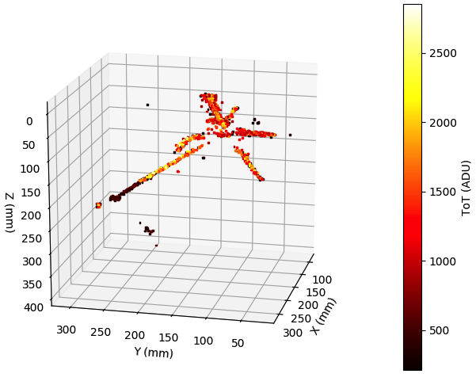
Gallery and video of Cosmics interacting in LAr
THGEM field 29kV/cm
Resolution 1.1mm/pixel
Continuous streaming, 10 msec slice
Stopping muon candidate
Antiproton candidate

Slide 13
Detector 2 ND280UP/ Sand inspired
Tracking detectors have led current cross section measurement programmes and can continue to do so in the liquid argon era.
  Especially for alternative nuclei.
Super FGD style detectors are currently leading way here.
  Scintillating cubes read out by wavelength shifting fibres.
  C target. Can investigate using hollow cubes filled with water and WBLS for water target.
    Alternatively use water layers
    WAGASCI concept
    Would desire a fully plastic scintillator region as well.
  Good proton detection and some neutron detection as well

Slide 14
Fitting this into the rest of the detector
Surround the sFGD with TPC
  Lack of high angle tracks in ND280 has been a major issue
    Need to extrapolate models to unmeasured parts of phase space and match far detector acceptance
    Major part of ND280 upgrade
  TPC will have excellent momentum resolution for charged tracks and excellent PID (with some exceptions)
  Surround this with ECAL
    Similar to but more sophisticated than ND280
    Gamma catcher at front (no lead) – Detector low energy (c. 50 MeV) photons
    HCAL at rear- (thicker lead or iron) pions to shower to improve PID
    Overall can catch everything that leaves the interaction and patch PID inefficiencies in TPC
  Time of Flight
    Could be part of electronics for sFGD and ECAL or dedicated detector.
    Sense of tracks must be known to reduce backgrounds
    Further PID
  Magnet to surround entire detector
    Yoke could form part of HCAL, but must be designed in
    Momentum in TPC and track sign

Slide 15
Cartoon of such a detector
Magnet
ECAL
TOF
TPC
sFGD
sFGD –H₂O

Slide 16
Extra Options
HPTPC
  Similar to detector 2 but replace sFGD and TPC with a high pressure TPC
  Third detector option for DUNE
  Advantage of lower proton threshold
    Allows improved measurements of various nuclear effects
  Fewer pile up concerns than other detectors
  Gas mixture changes allow measurement on different nuclei
    Oxygen may be a problem
    Theoretical opportunity for H and D measurements.
      Additional safety factors to overcome
  Current research on such detectors is active in the UK

Slide 17
Extra Options
Water Cherenkov
  Well understood technology – provides a water taget
  Better matched to energies slightly lower than nustorm
  Issues with amount of overburden.
  Muon momentum reconstruction is problematic
    Need to range out in detector, but such a large detector will have pile up and overburden problems

Slide 18
Extra Options
Emulsion detectors
Very fine scale tracking
  Have to backup emulsion with additional detectors to find vertex
  Need to photograph and scan emulsion
    Speed of this process has been increasing
Potentially the cleanest way to detect ν_{τ} if this become an important physics goal
Most recent example is Ninja at JPARC

Slide 19
Extra Options
Magnetised Iron Spectrometer
  Most likely to act a companion to another technology to provide muon momentum reconstruction
    Emulsion, Water Cherenkov
  Does not provide 4π measurement
Baby MIND at JPARC is a prime example
  Spectrometer for WAGASCI and Ninja
Baby Mind @ JPARC

Slide 20
Oscillation Detection
For an idealised oscillation experiment you would prefer the same target in near and far detectors
  Not achieved in LarTPC and tracker plan
Moveable detectors are part of HK and DUNE ND plans
  Use off axis angle to change the neutrino spectrum and improve physics extraction through the extra controls.
For oscillations the same idea can be used to control L
  For example imagine putting one of the detectors in rail track inside a tunnel.
  Excellent cancelation of systematics for high precision sterile neutrino experiment.

Slide 21
Summary
I’ve discussed my personal thoughts on possible detectors for nustorm
  Detector choices will have been missed or glossed over.
Extraction of the full potential of the beam will require multiple detectors
We should aim to collect detailed cross section data on at least Ar and O
A serious consideration of H and D targets should be made to get to bare nucleon cross sections
A Liquid Argon TPC and an improved magnetised tracker are two clear detector choices that can be made.
Additional detector technologies are available and should also be pursed

