Slide 1

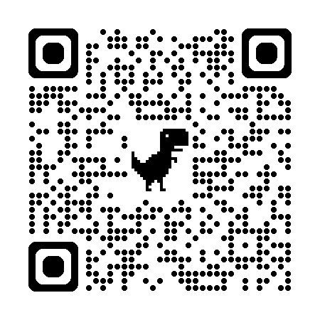
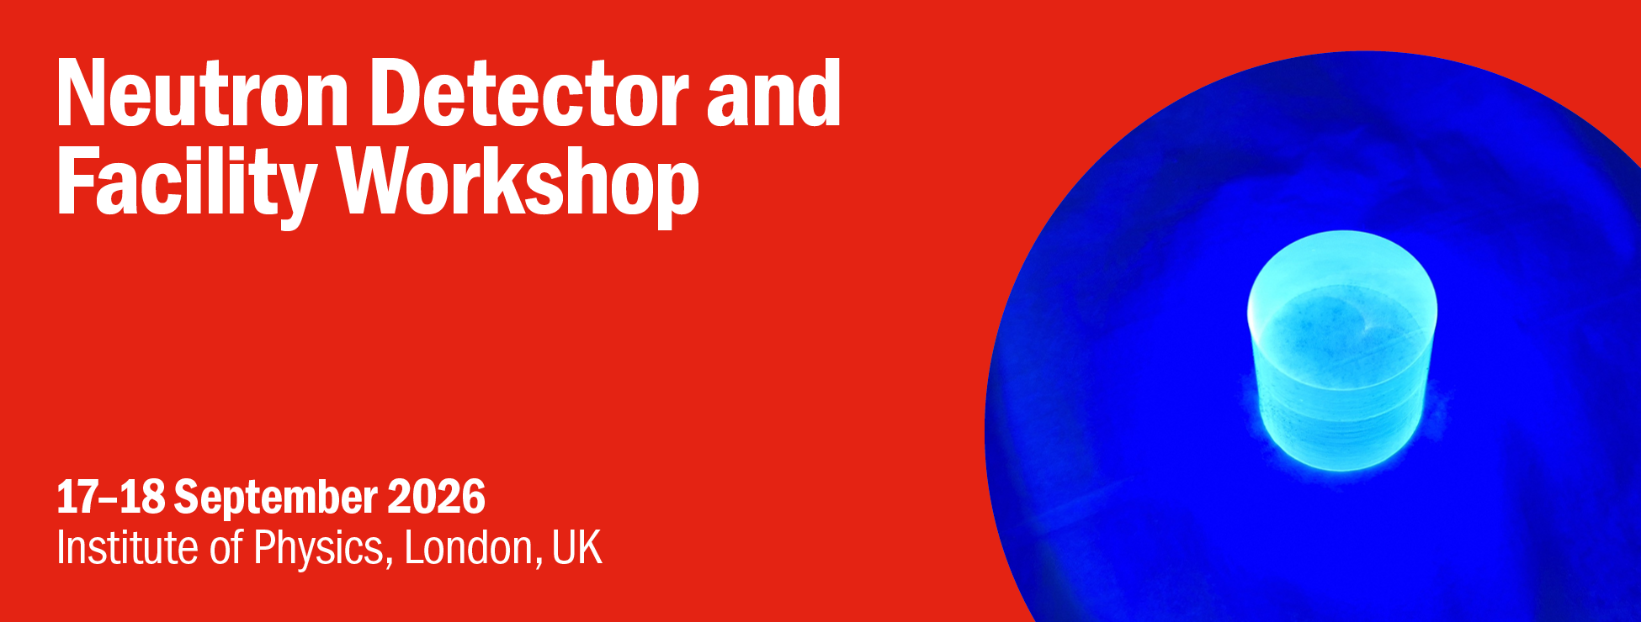
Indico link

Slide 2
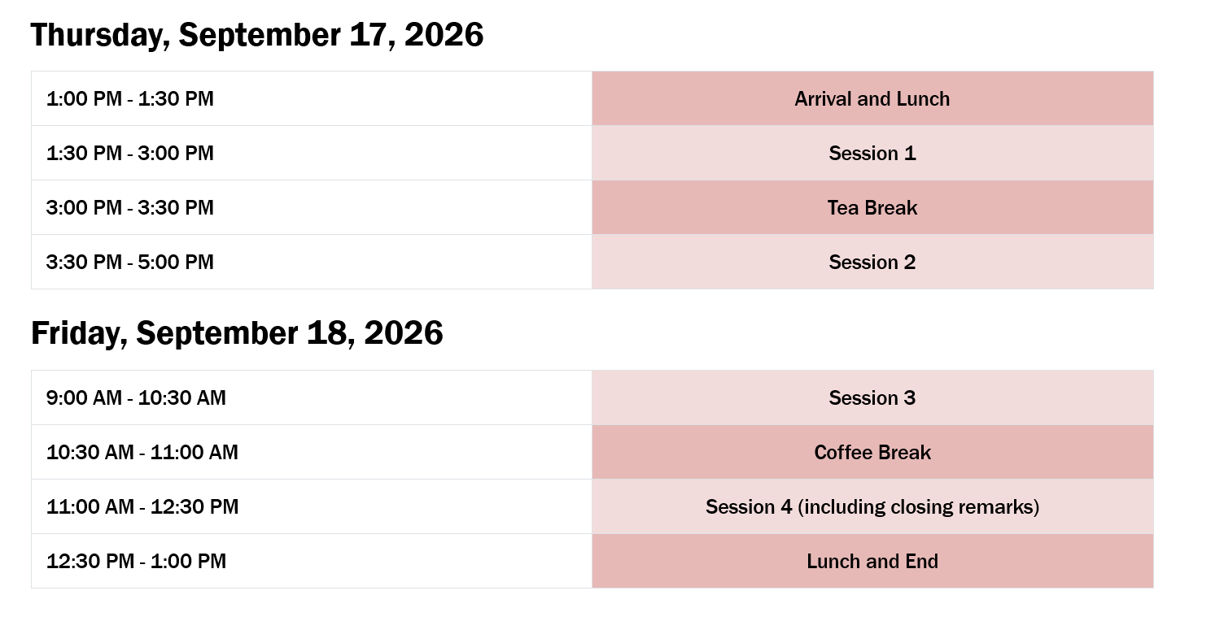
7:00 – 9:00 PM Conference meal

Slide 3
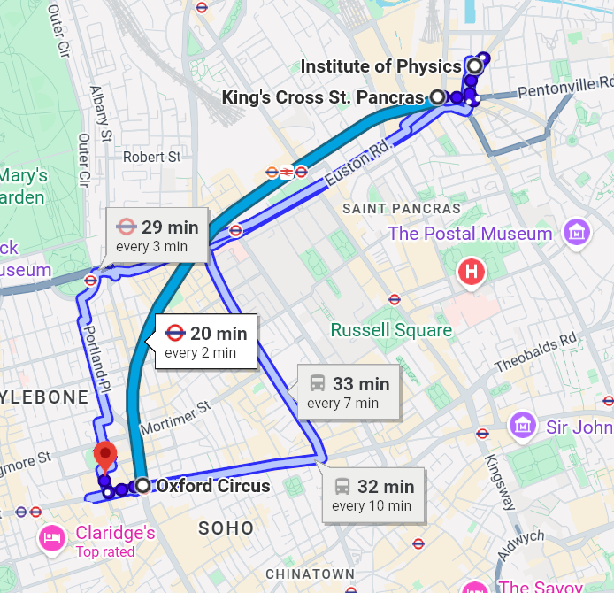
Meal at the Market Halls Oxford Street
Tables booked from 19:00 – 21:00
20 min underground ride from Kings Cross on the Victoria Line

