Slide 1
Neutron detection work in the Applied Radiation Technology group at UKAEA
Gemma Wilson
Neutron Detector and Facility Workshop, 17-18th September 2026, IOP

Slide 2
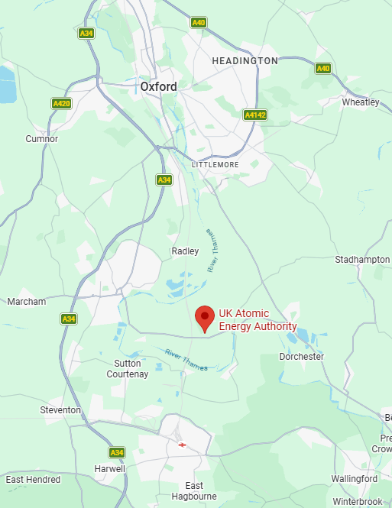
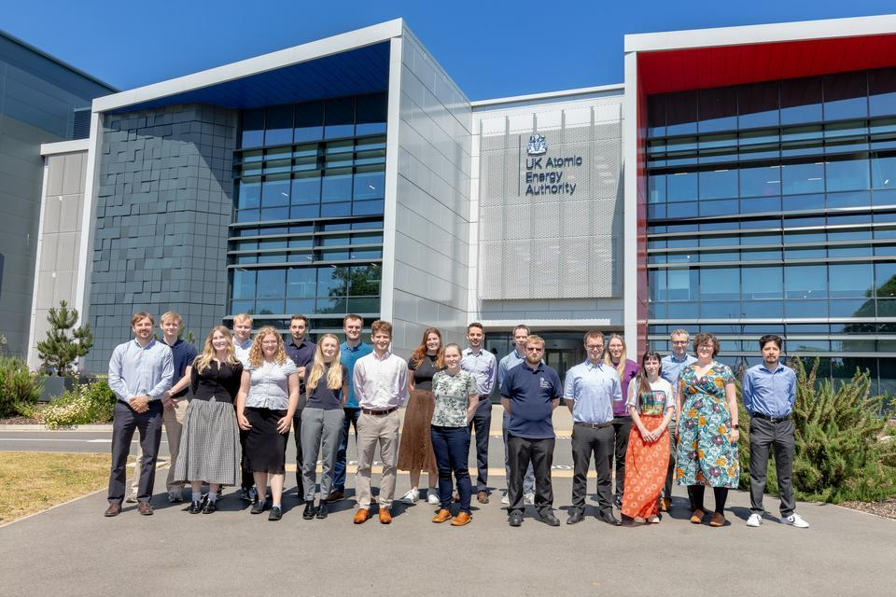
The Applied Radiation Technology Group
A group of experts in the simulation and measurement of radiation environments sits in the Applied Radiation Technology group in the Technology Division (1 of 7 UKAEA divisions).
~17 staff on applied neutronics (Computational Team) and Validation & Verification (V&V Team), and ~8 staff working on radiometrics (Experimental Team), operating the RADLab onsite.
Computational
Experimental
Validation
&
Verification

Slide 3
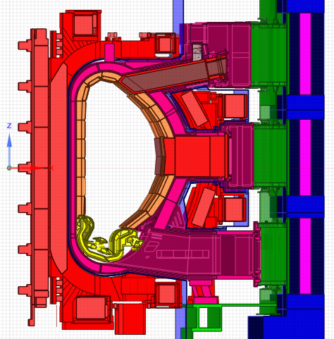
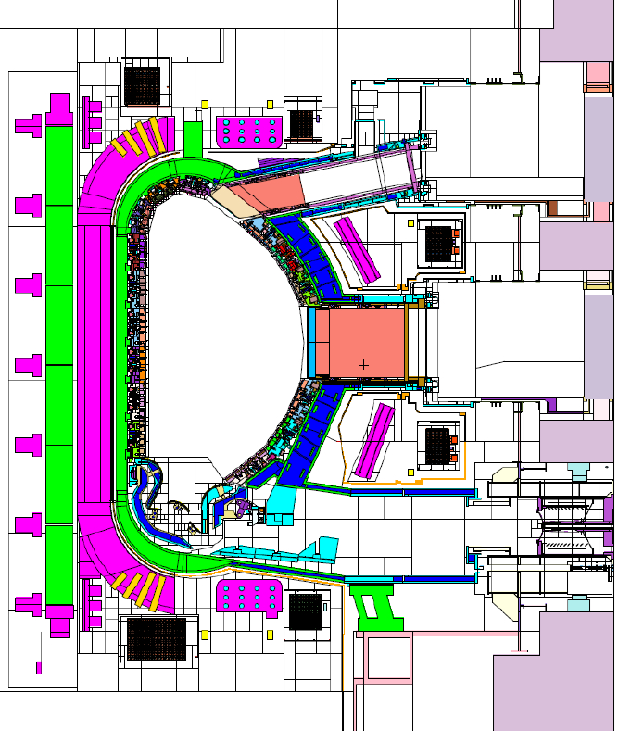
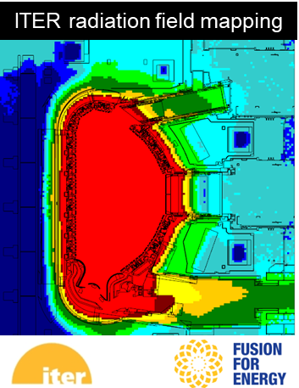
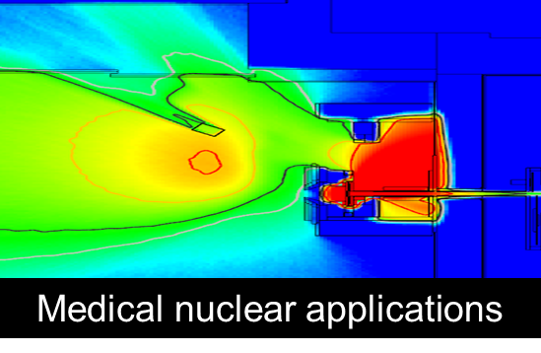
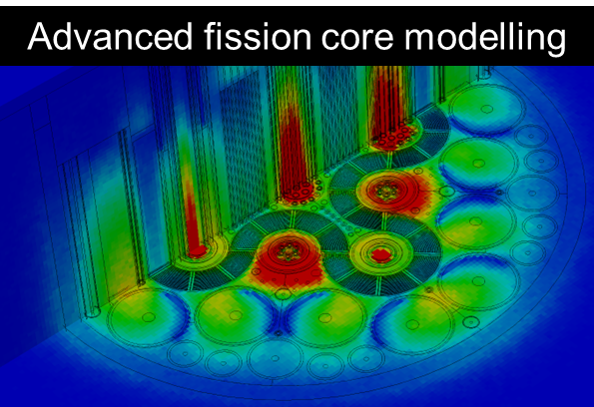
Computational:
Neutronics and nuclear data
Monte Carlo
radiation transport
CAD model
Nuclear Analysis
Nuclear responses:
Particle flux
Dose rates
Nuclear heating
Tritium production
Material damage
Gas production
Material activation
Radiological waste
Detector responses
Shutdown dose rates
MCNP, OpenMC

Slide 4
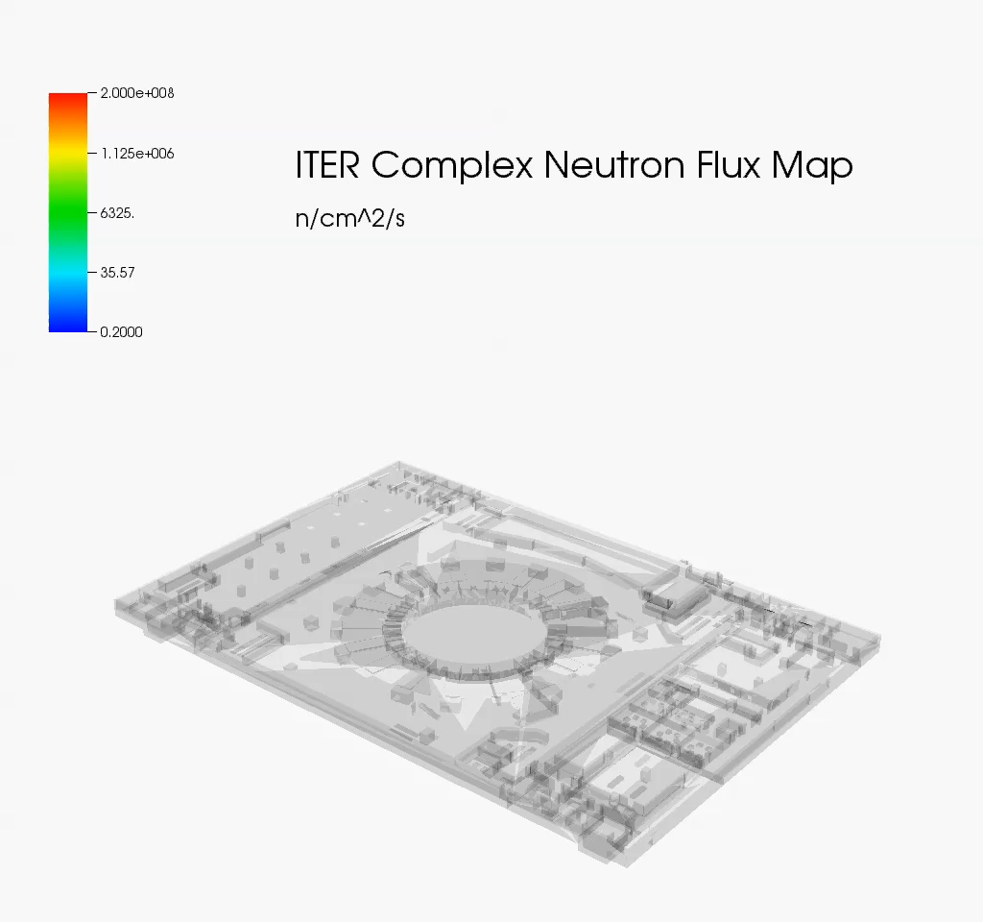
3D neutron flux maps: ITER Complex

Slide 5
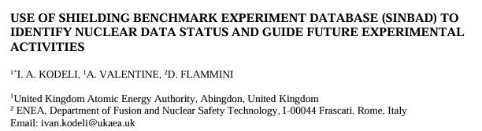
Neutronics and nuclear data
Neutronics analysis is vital when planning a facility:
  Safety concerns
  Engineering constraints
  Tritium breeding capability of a fusion machine
  Activation and shut down dose rates
Data libraries used often have gaps – a lot of neutron data is acquired because of the fission industry and not necessarily fusion relevant. How do we validate these models?

Slide 6
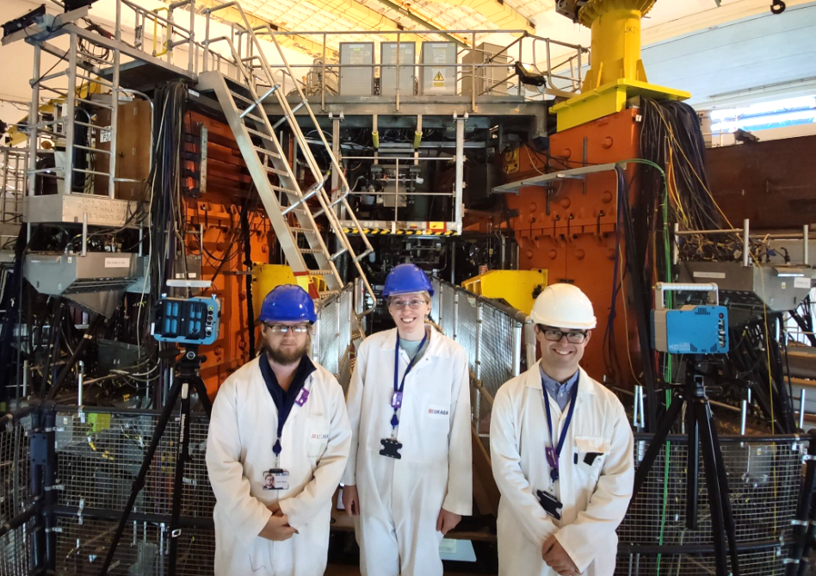
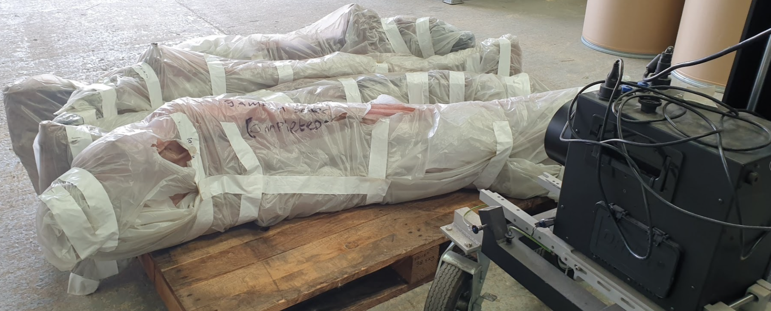
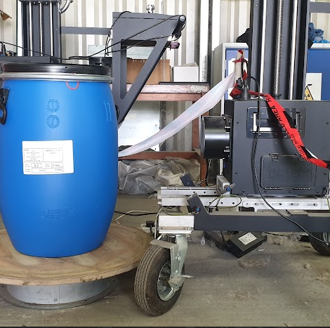
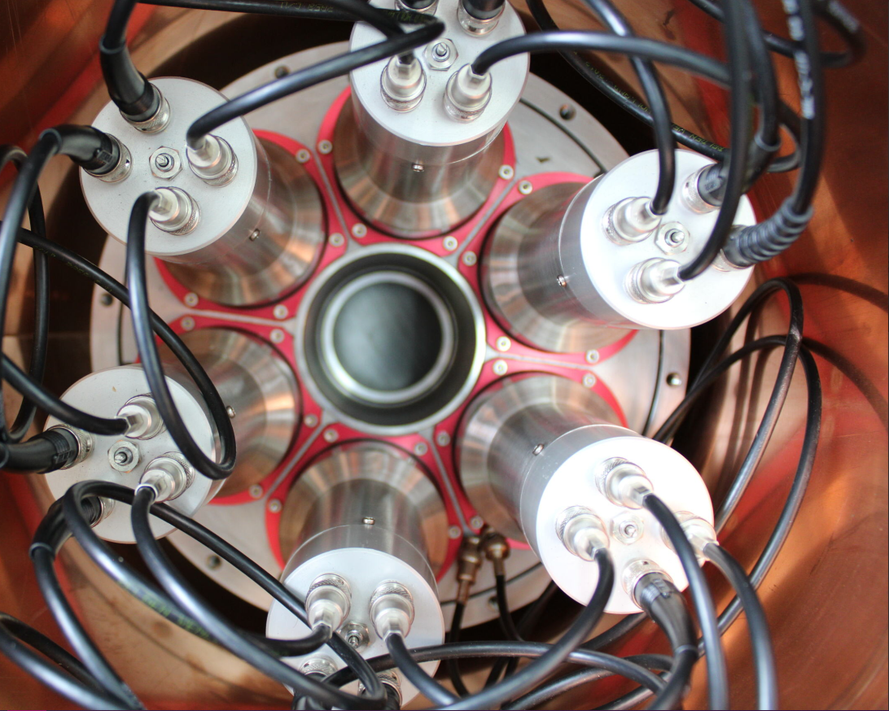
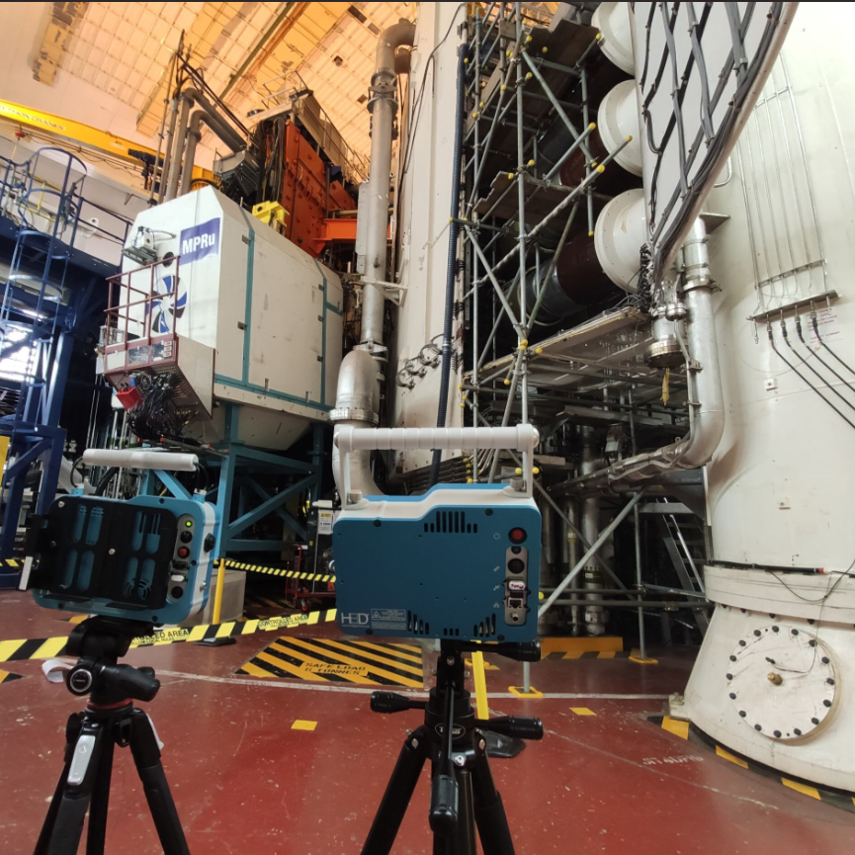
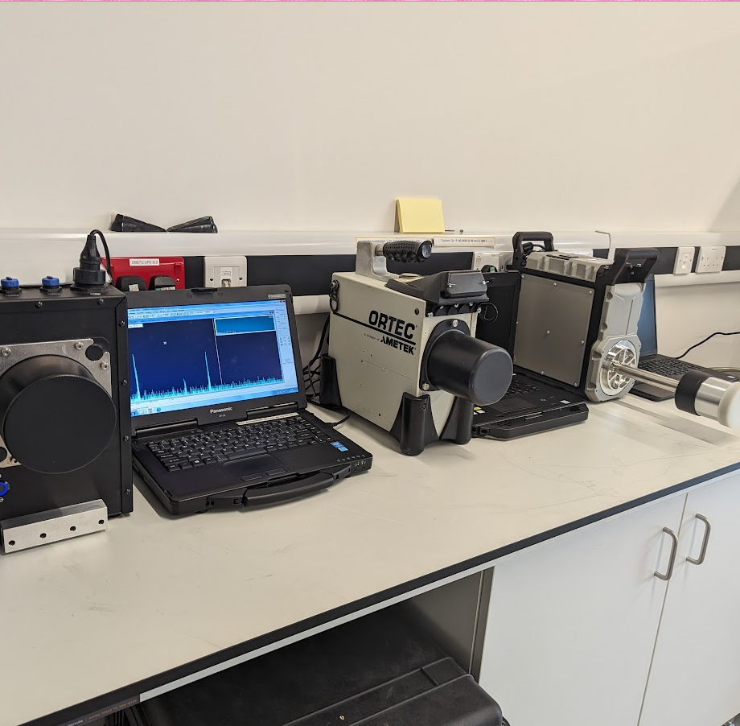


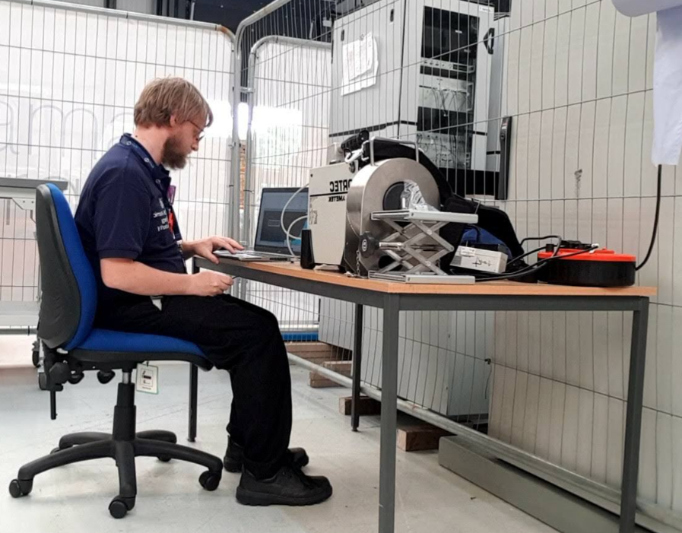

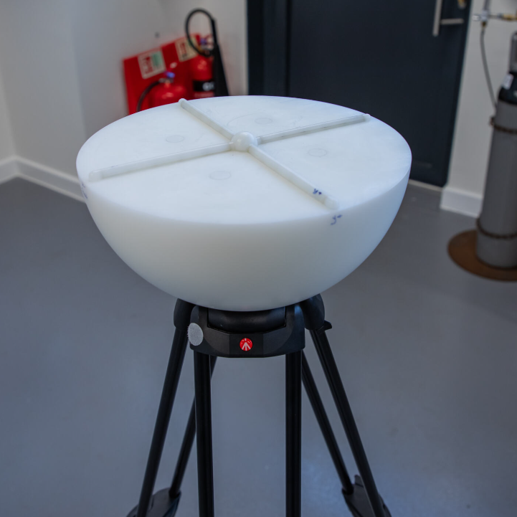


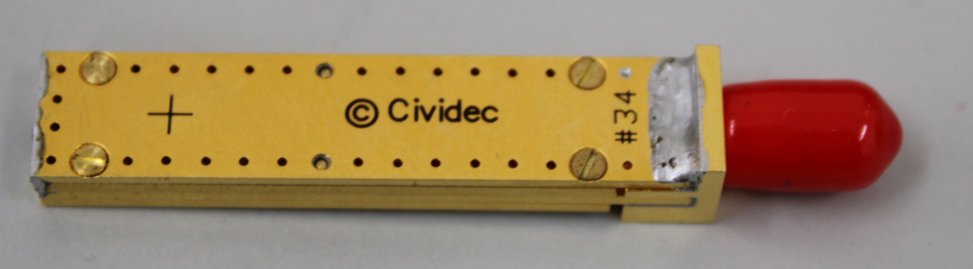
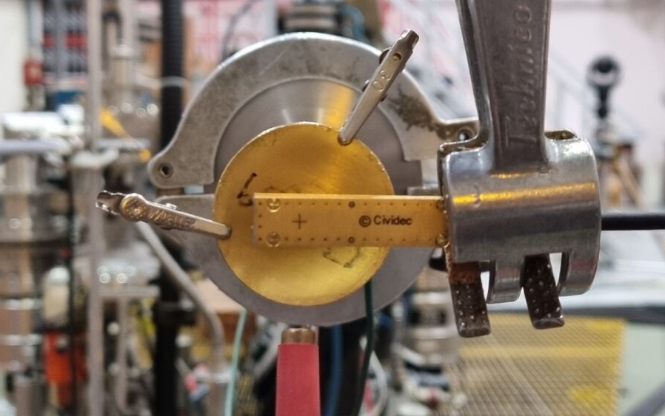
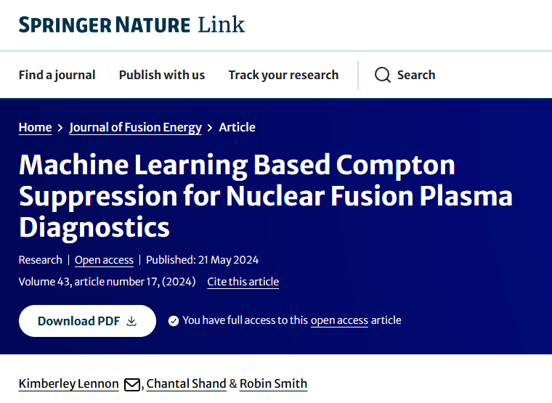
Experimental
MAST-U
JDR
Waste Assay Services
Mega
Amp
Spherical
Tokamak
Upgrade
JET
Decommissioning and
Repurposing
RADLab
Radiological Assay and Detection Lab
Gamma Diagnostic R&D
Research Support Services
Remote Applications in Challenging Environments
Neutron Diagnostic R&D
AI for Nuclear Physics
Notes:
provide measurement services, training, and collaborate in five core areas.
The RADLab core areas are:
Waste assay services - for item clearance from radiological areas across site and JDR decommissioning support,
Research support services – measuring stuff at MRF and private fusion
Gamma diagnostic R&D – research work includes improving gamma spectroscopy systems
AI for detector noise reductions (recently published work!)
Neutron diagnostic R&D - in-house development of systems and experimental testing/validation of radiation tolerant equipment,

Slide 7
ART Subgroups
V&V is a crossover of computational and experimental work
  It’s especially critical in fusion!
Fusion environments are complex
  Lots of different physics in different regimes
  Extremes (temperature, magnetic fields, radiation)
  Fusion environments don’t exist outside of fusion facilities
Computational
Experimental
Validation
&
Verification
Modelling facilities is critical, but developing simulations with incomplete models and data is not useful

Slide 8
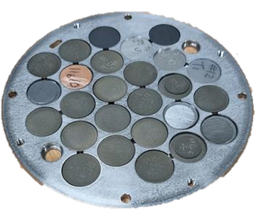
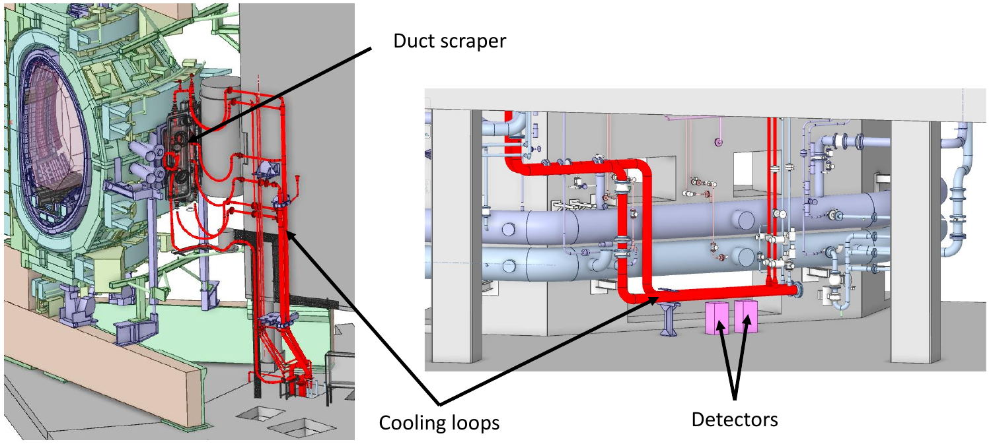
Validation & Verification
Work includes:
Verifying output from fusion machines
Measuring activated materials against simulation
  Tungsten and concrete benchmarks measured at the Frascati Neutron Generator
Validate fluid activation analysis codes and benchmark against data (See Gee Bartram’s talk)
Measurement of activity in materials irradiated by JET (activation foils, ITER materials samples), shutdown dose rates in the JET Torus Hall to validate codes and techniques

Slide 9
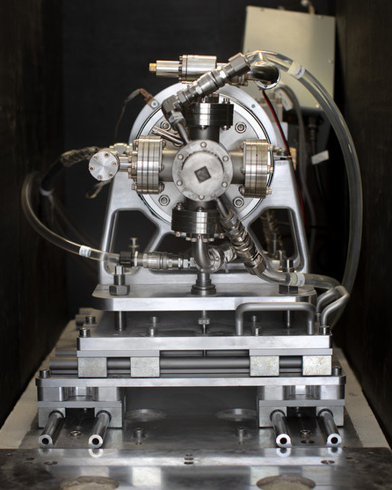
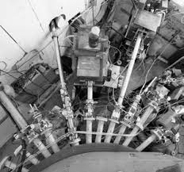
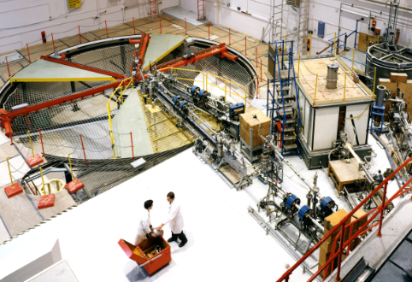
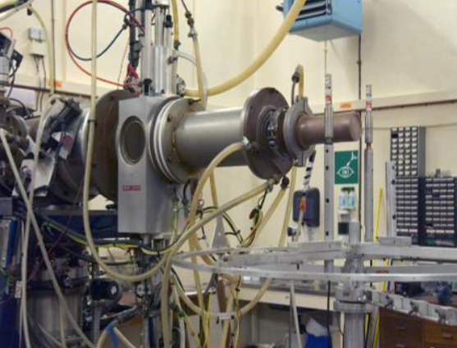
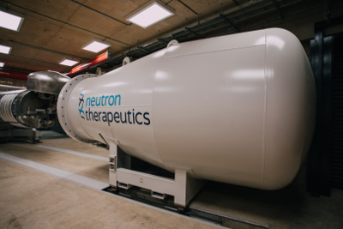


Where to qualify?
For R&D of novel diagnostics and for demonstrating the effectiveness of shielding for existing diagnostics qualification is required.
The level of qualification is dependent on the application i.e. safety systems will require a higher confidence level.
Neutron Irradiation Laboratory for Electronics (NILE)
DD and DT neutron generator
MC40 Cyclotron
Can produce deuterons up to 20 MeV. Targets can be used to get neutrons of desired energy ranges.
Van de Graaff accelerator
Produces neutrons between 8-17 MeV
High Flux Accelerator-Driven Neutron Facility
(HF-ADNeF)
Protons onto a lithium target. ~1 MeV neutrons, 10¹³ n/s
ASP Facility
14 MeV DT neutrons, 10¹¹ n/s

Slide 10
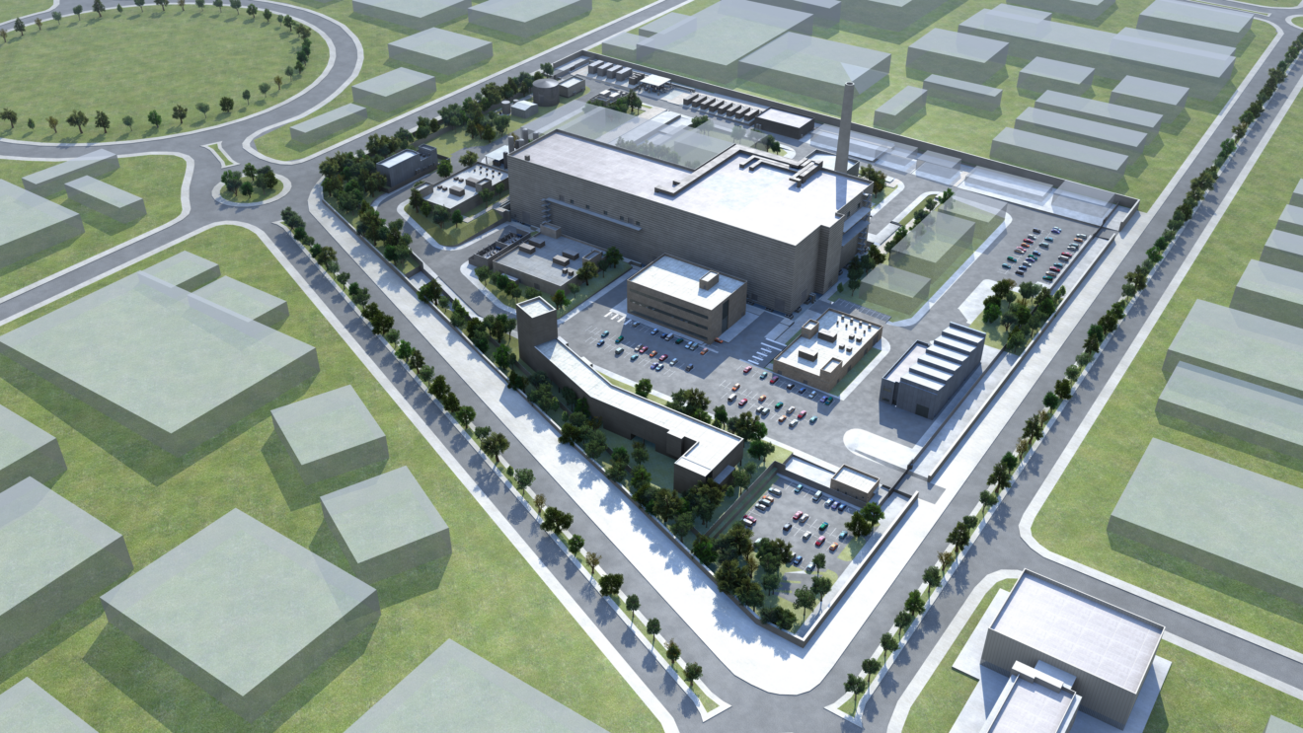
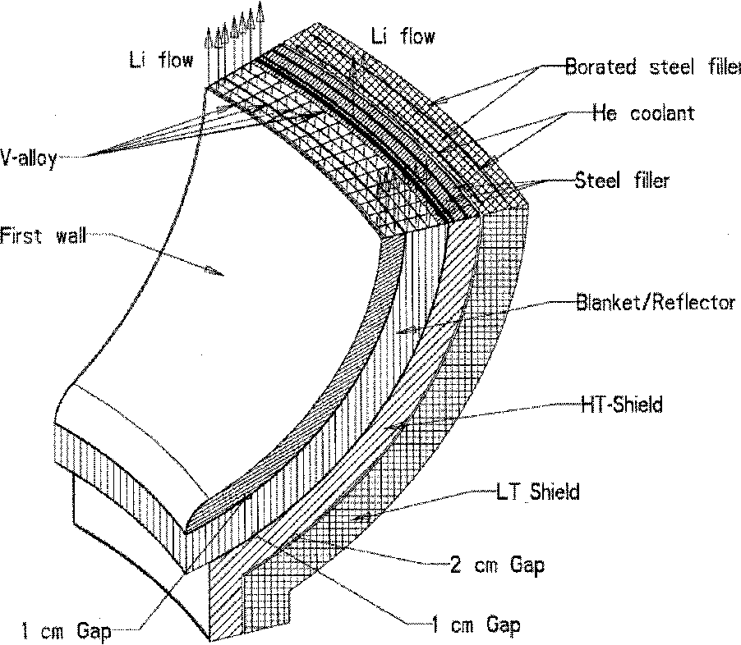

Future Facilities
IFMIF-DONES
International Fusion Materials Irradiation Facility​ DEMO Oriented Neutron Source
LIBRTI
Lithium Breeding Tritium Innovation
Breeder blankets are complex components that are critical to the success of fusion.
Many concepts exist, with not many places to qualify at the engineering scale.
For testing materials in fusion relevant irradiation conditions.
Currently in design, planned construction in Granada, Spain.
Flux in the high flux test module ~10¹⁴ n/cm²/s
14 MeV neutrons
Capacity for large mock-ups to experimentally test key questions that remain about the tritium fuel cycle.
Also provides an environment to qualify diagnostics.

Slide 11
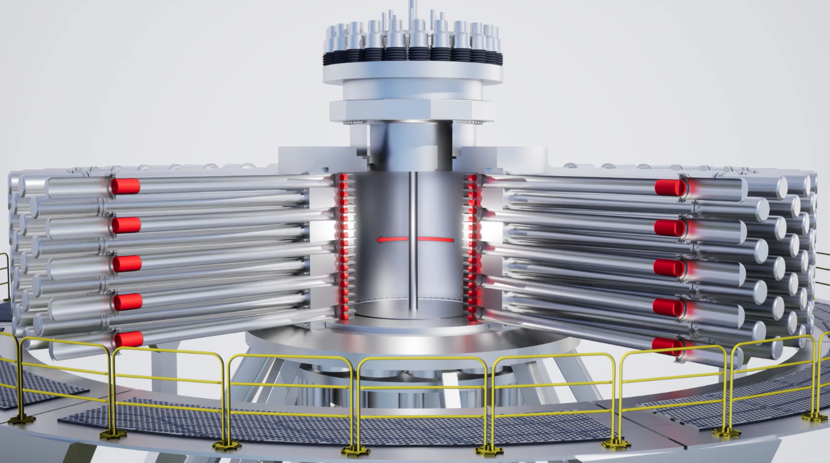
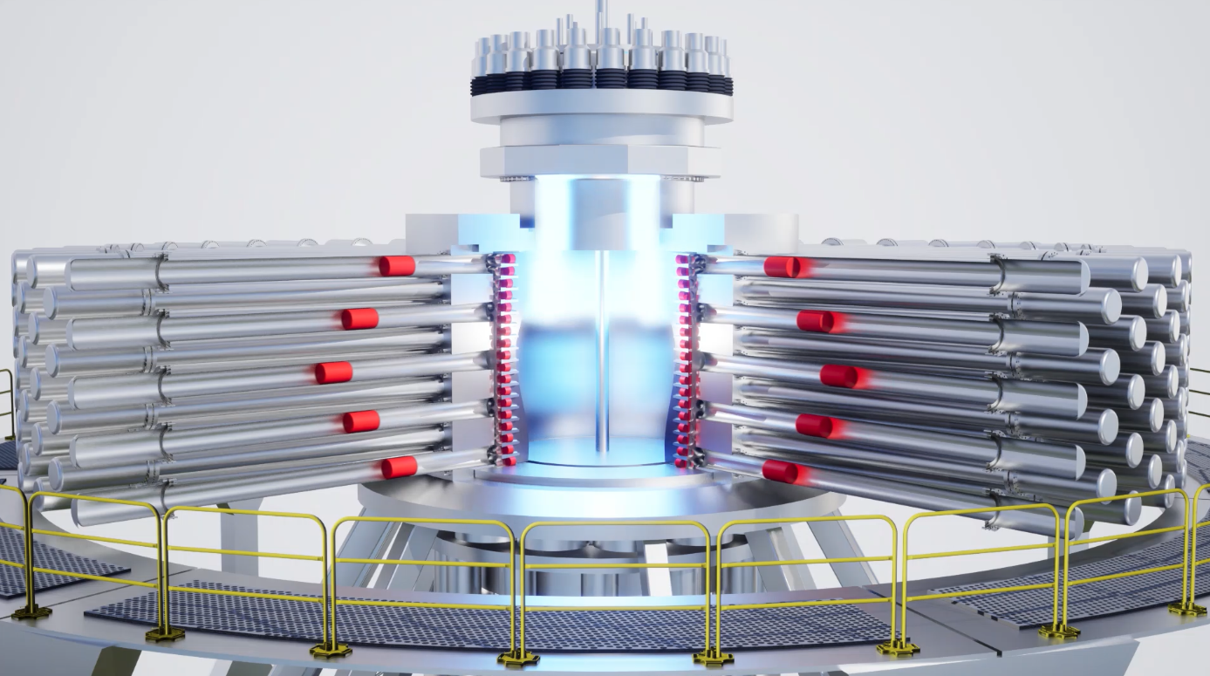
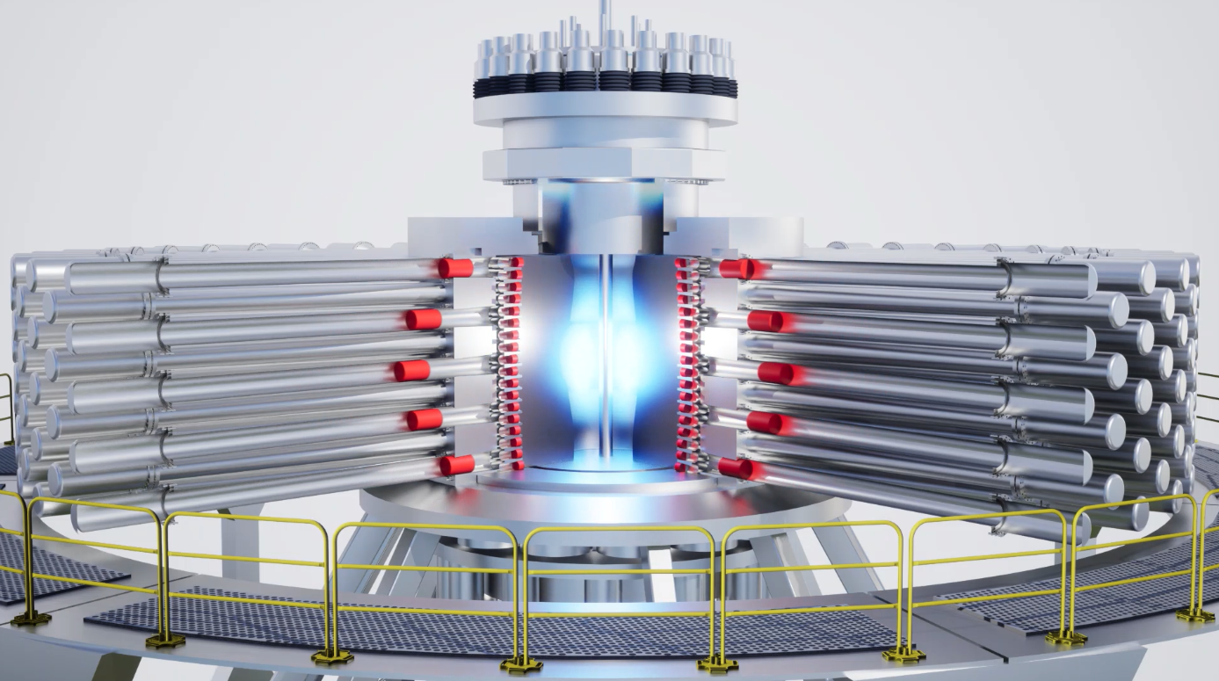
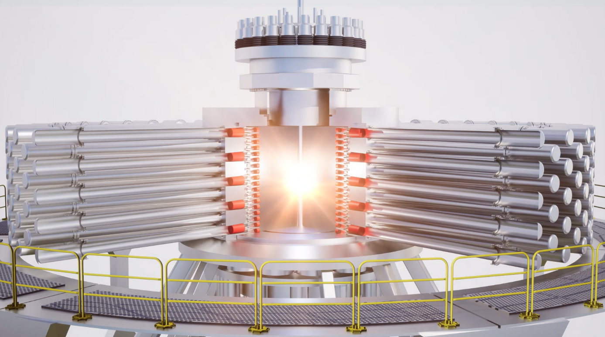
General Fusion
Founded in 2002 in Vancouver, with early experiments conducted in a garage.
Adoption of a magnetized target approach:
  Form a liquid metal blanket inside a vacuum vessel
  Magnetized plasma is injected into the liquid metal cavity
  Plasma is compressed with liquid metal using mechanical drivers
  Fusion conditions are created in the highly compressed plasma, using a combination of magnetic and inertial confinement
Liquid metal
Plasma injector
Pistons

Slide 12
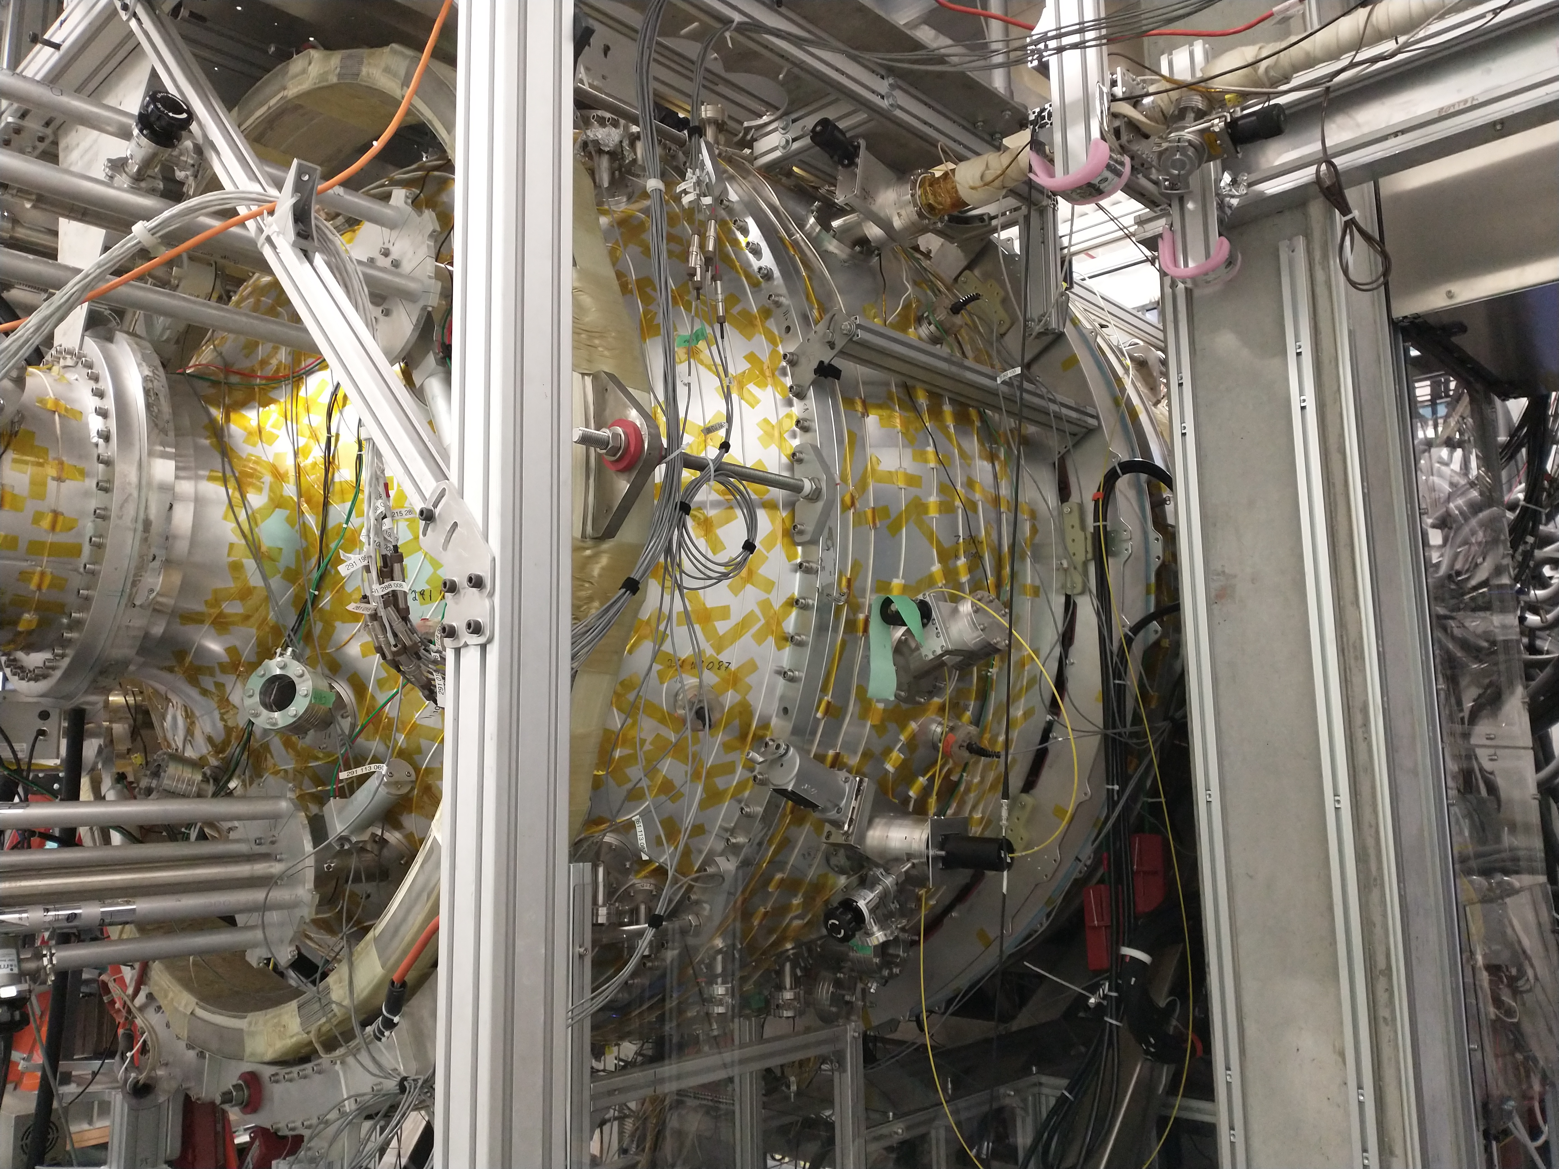
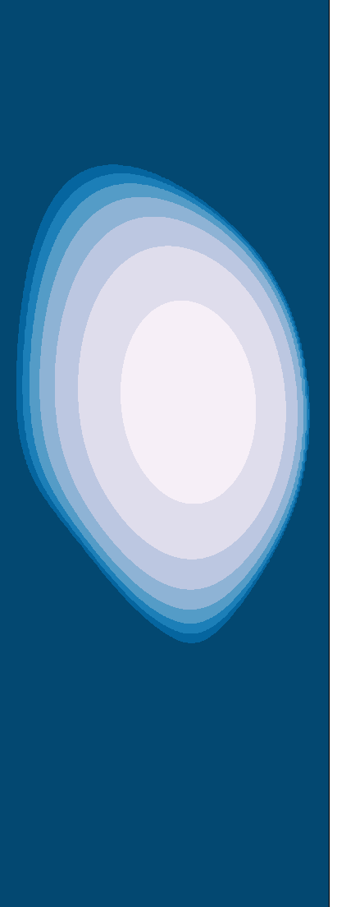
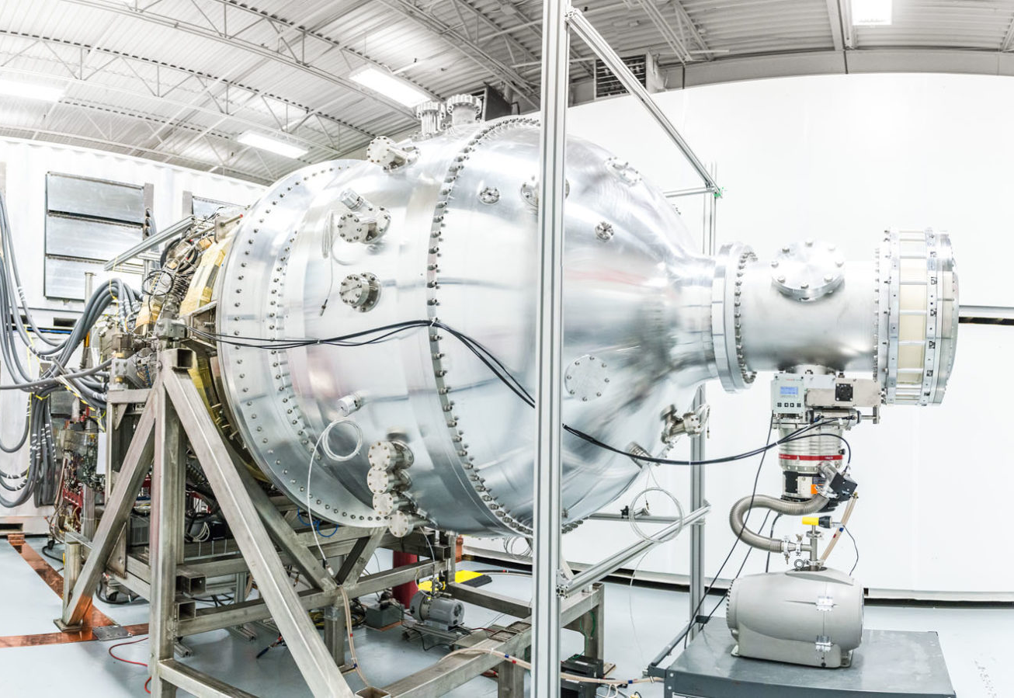
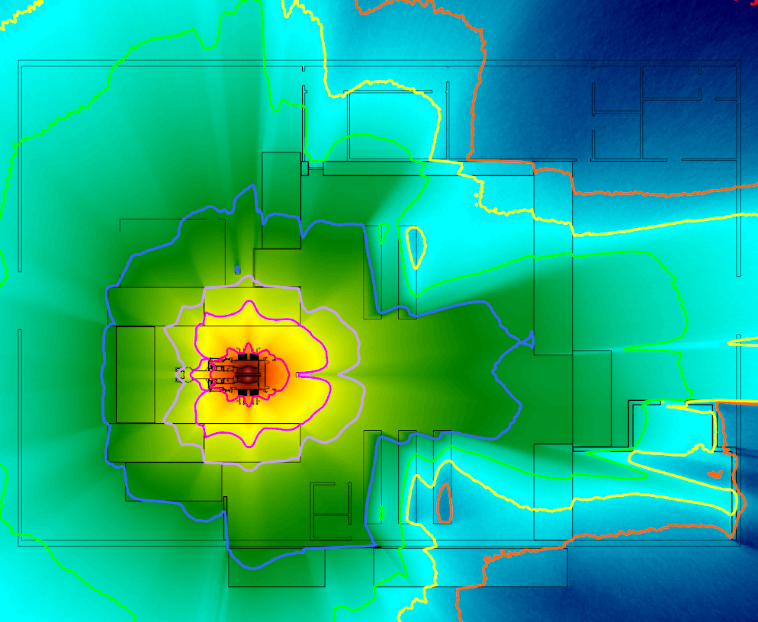
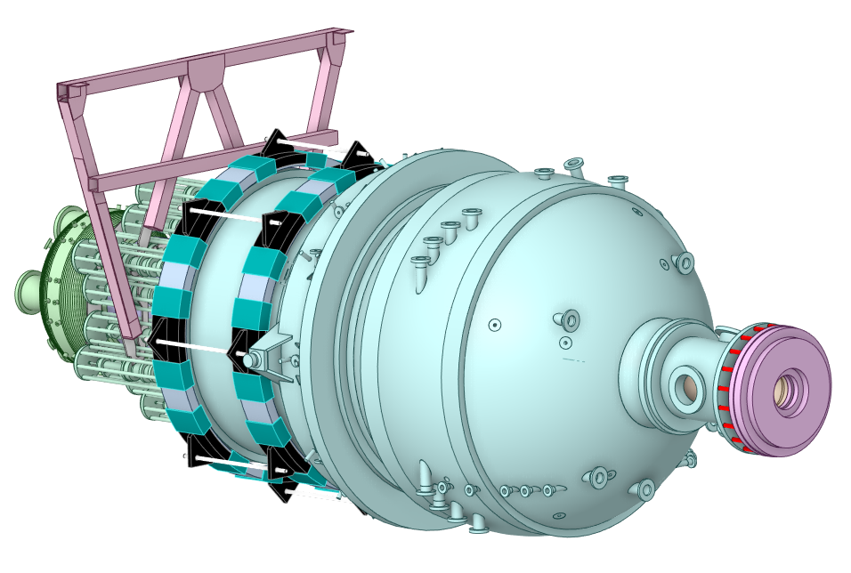
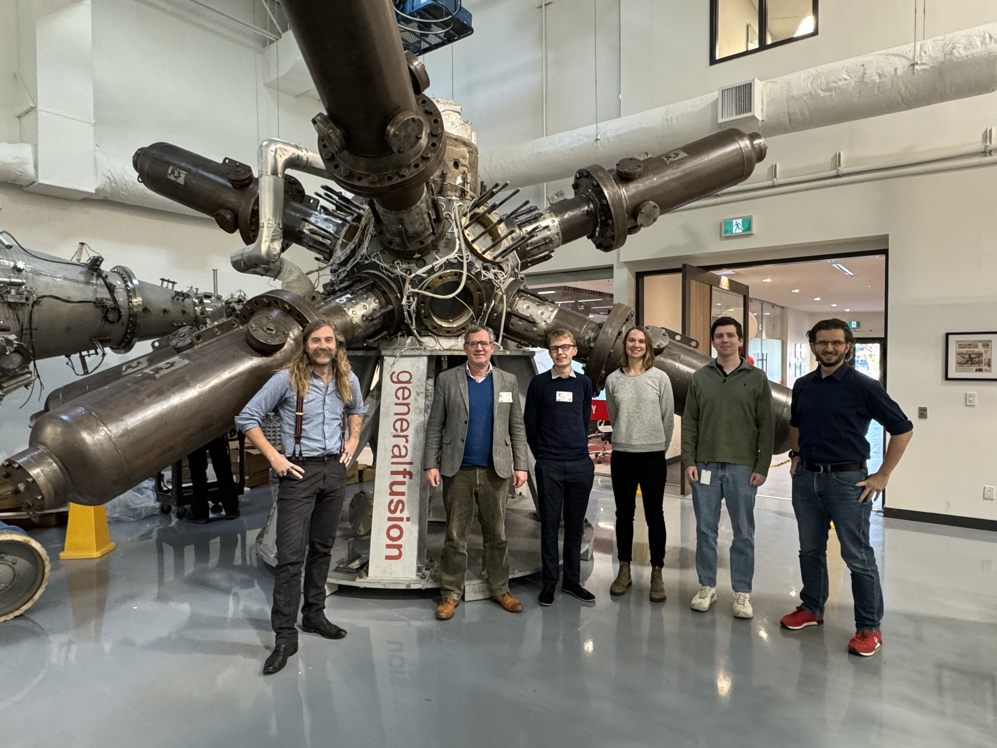
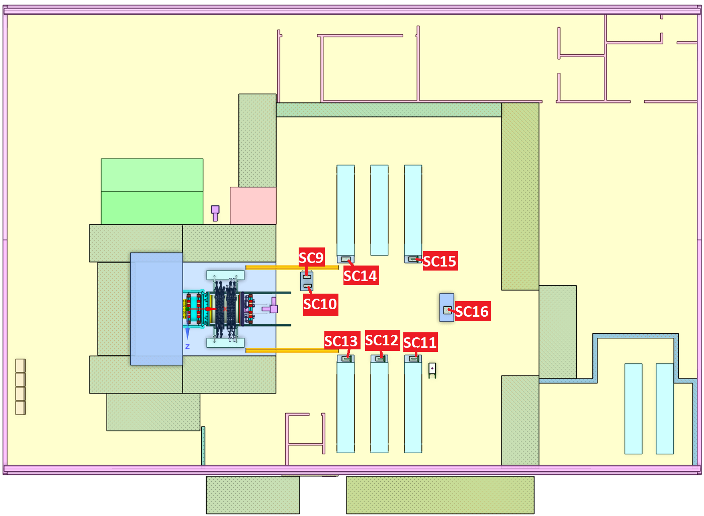
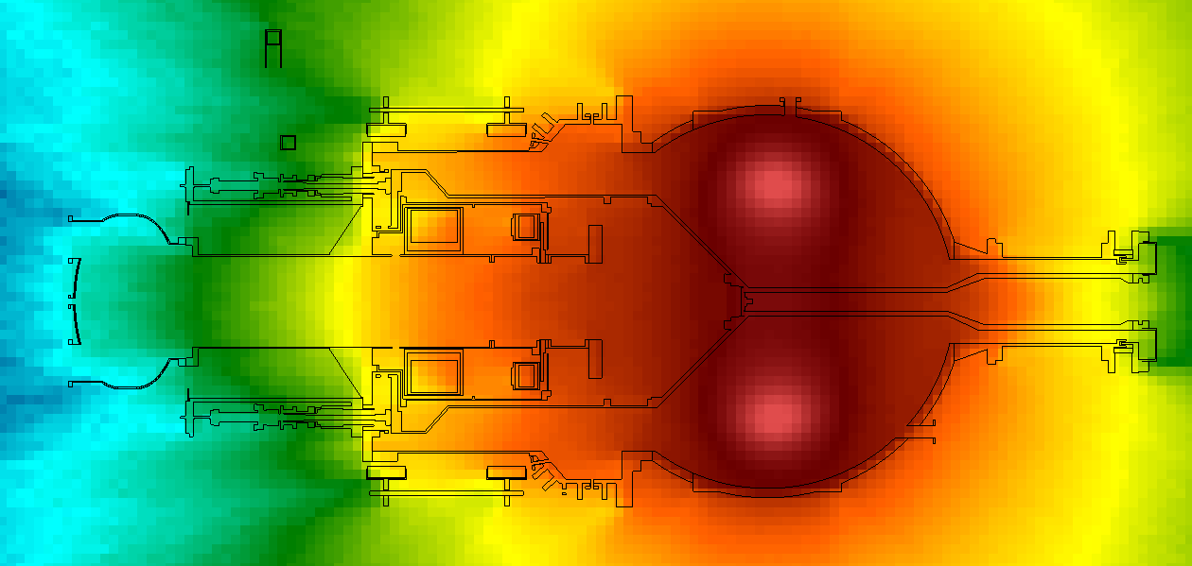
Modelling support & verify outputs
Prompt dose fields
Diagnostic responses
Neutronics modelling of past operational devices (PI3)
Modelling and diagnostic support for present device (LM26)
UKAEA visit November 2023
Ion temperature inference from neutron counting in Maxwellian Deuterium plasmas: https://www.tandfonline.com/doi/full/10.1080/15361055.2026.2613327
Notes:
Fusion Technologies world leading neutronics team have been contracted by General Fusion (private fusion company looking at MTF), to support their radiation modelling and later verify the outputs from their latest fusion experiments. Our team aim to “count” the number of neutrons produced from their latest fusion device.
Team members recently visited their site in Vancouver as part of the contract; this is strengthening our collaborations and highlights UKAEA’s support.
With the completion of this works, our leading neutronics team will have verified fusion reaction outputs from: MCF (JET, MAST, etc,), ICF (First light fusion) and MTF (General Fusion), showing the value in UKAEA concept agnostic skills for realisation of fusion.
Impact of neutronics work on licencing, determination of dose rates and waste inventories, verification of neutron diagnostic responses, determination of ion temperature

Slide 13
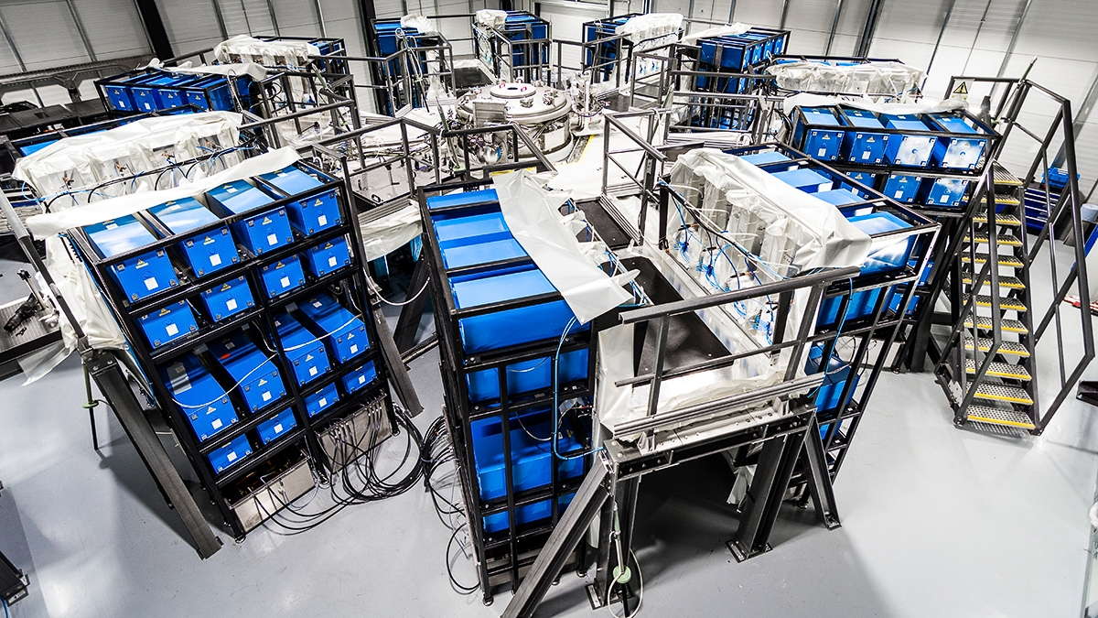
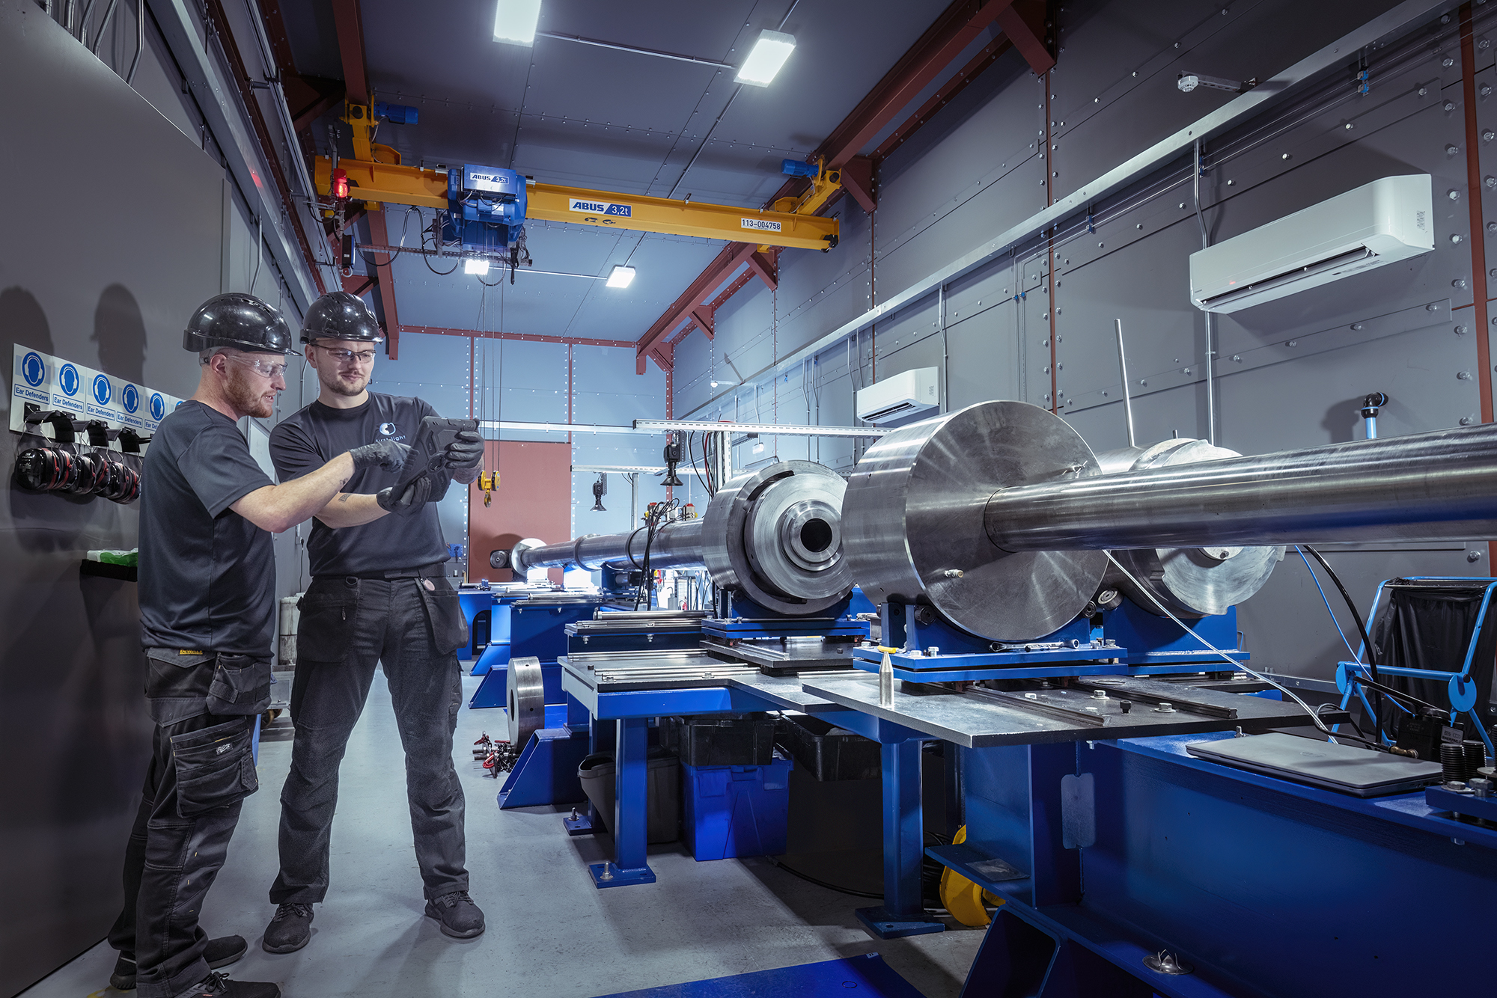

First Light Fusion
Founded in 2011, as a spinout from the University of Oxford.
Look to achieve fusion conditions from inertial confinement, using high velocity projectile impacts with their unique deuteron target design.
Two principal research devices have been designed, built and operated:
  Gas Gun device, known as BFG (big friendly gun).
  Pulsed power device, known as Machine 3.
Research strategy published in 2025 describing focus towards commercial reactor, FLARE
We have had a secondment at FLF supporting their nuclear analysis.
Machine 3
BFG

Slide 14
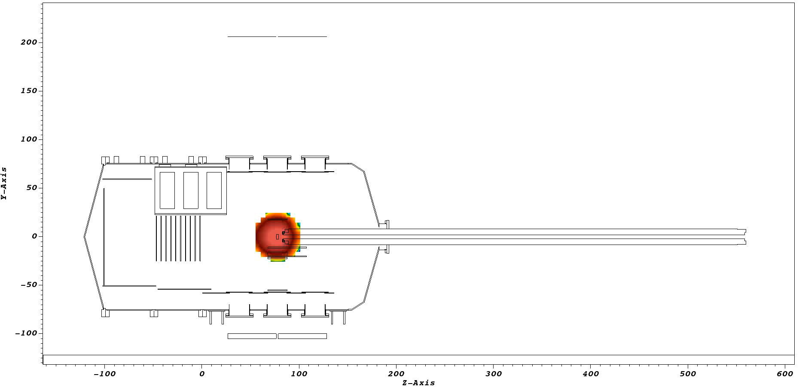
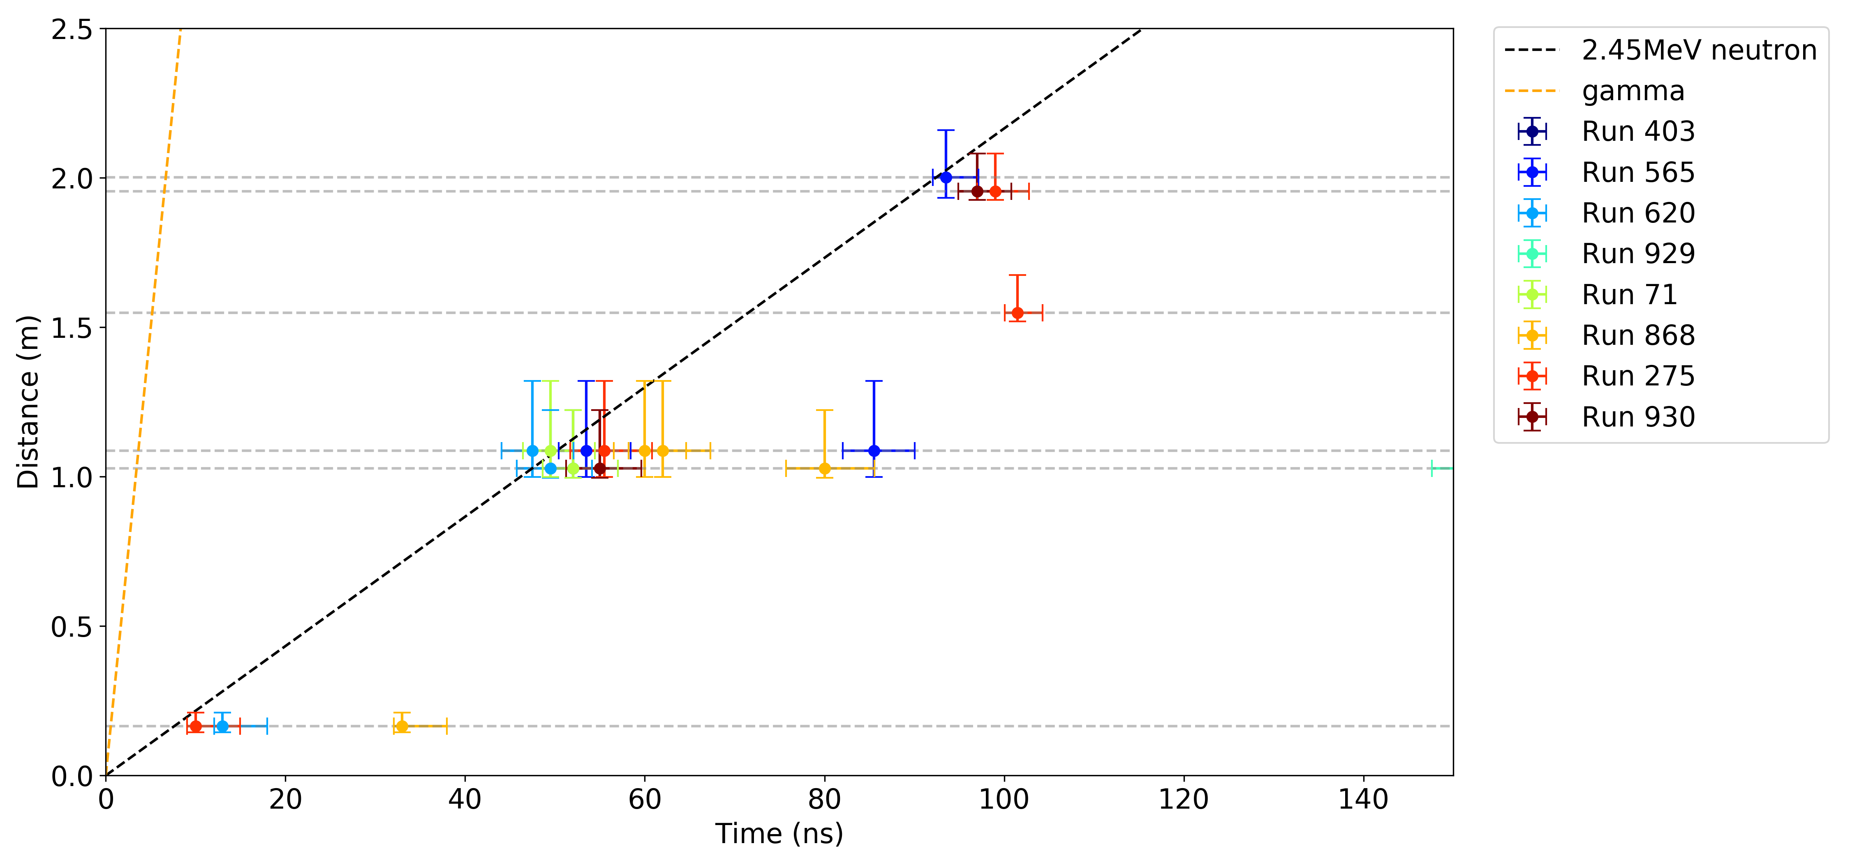
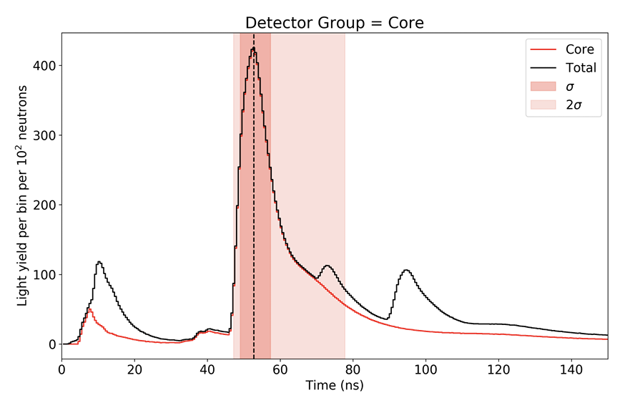
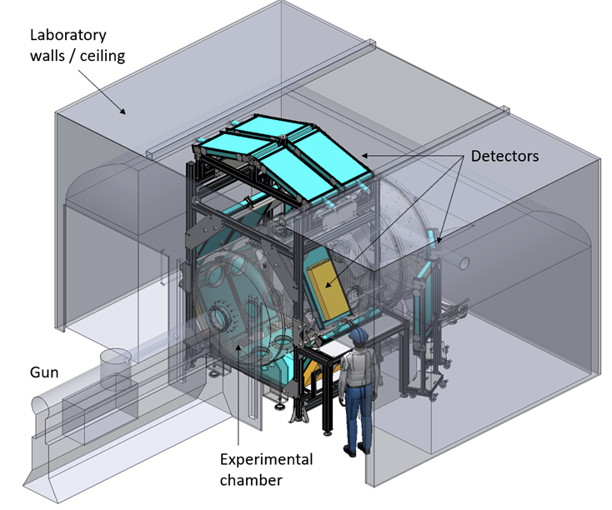
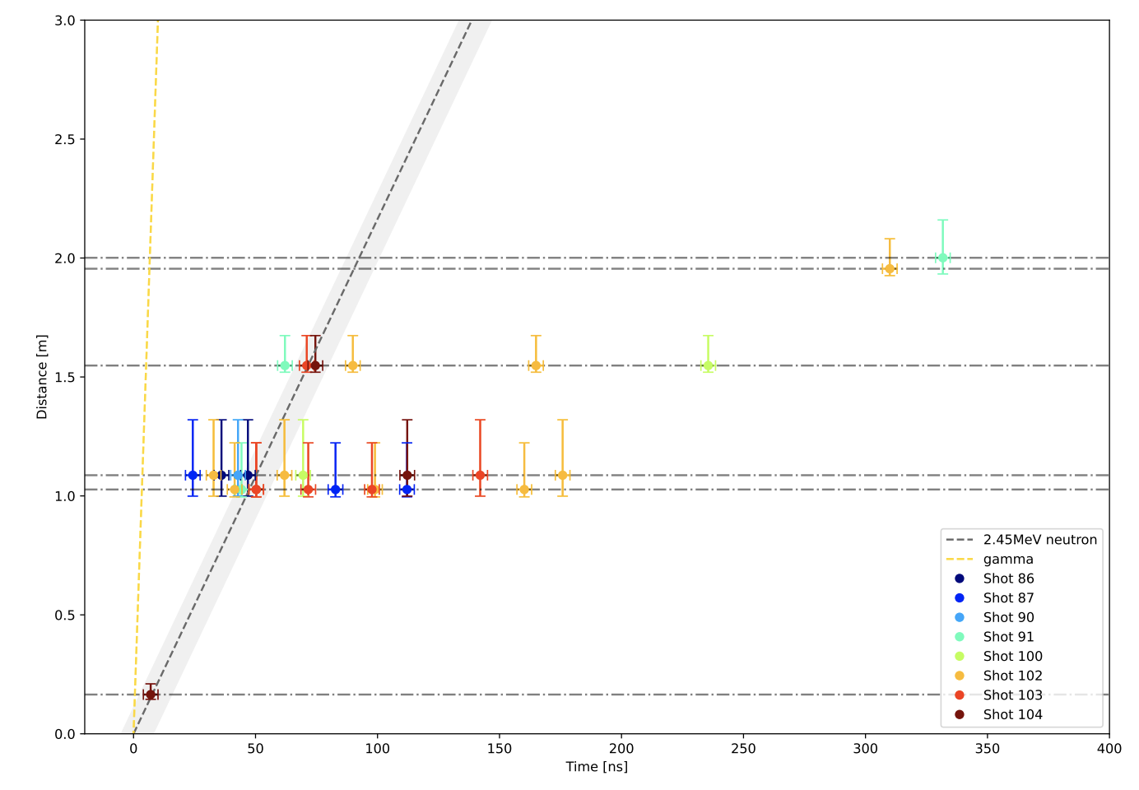
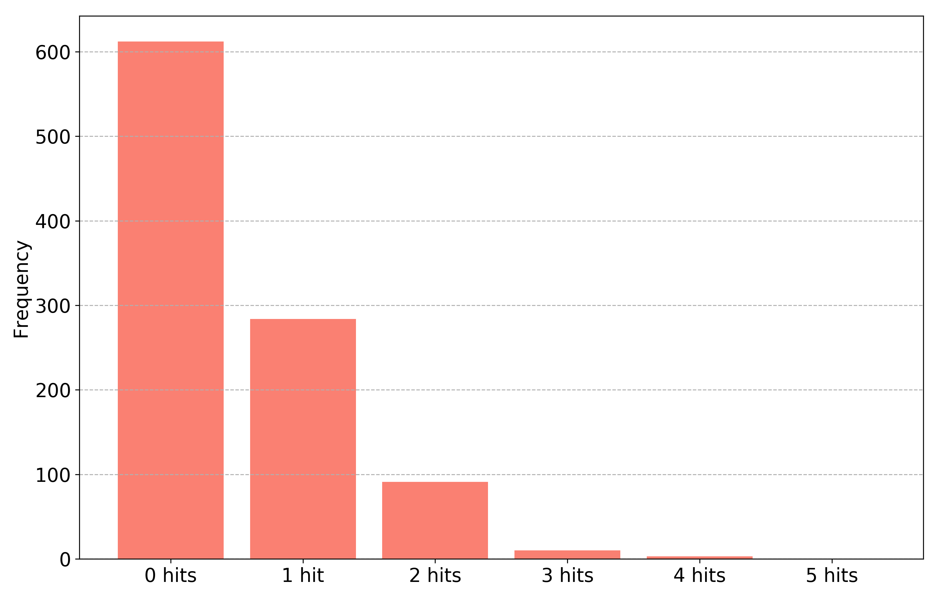
First Light Fusion: Neutronics
Modelling
Measurement
Initial neutronics simulations to predict nuclear environment
Simulated (top) and experimental (below) time of flight distributions
He-3 (below) and Scintillator (top) predicted responses
Used to inform selection of diagnostics
Independent expert review of FLF results
https://www.ukaea.org/case-studies/first-light-fusion-appoint-ukaea-to-validate-fusion-experiments/
14

Slide 15
The LIBRTI Facility
LIthium BReeding Tritium Innovation

Slide 16
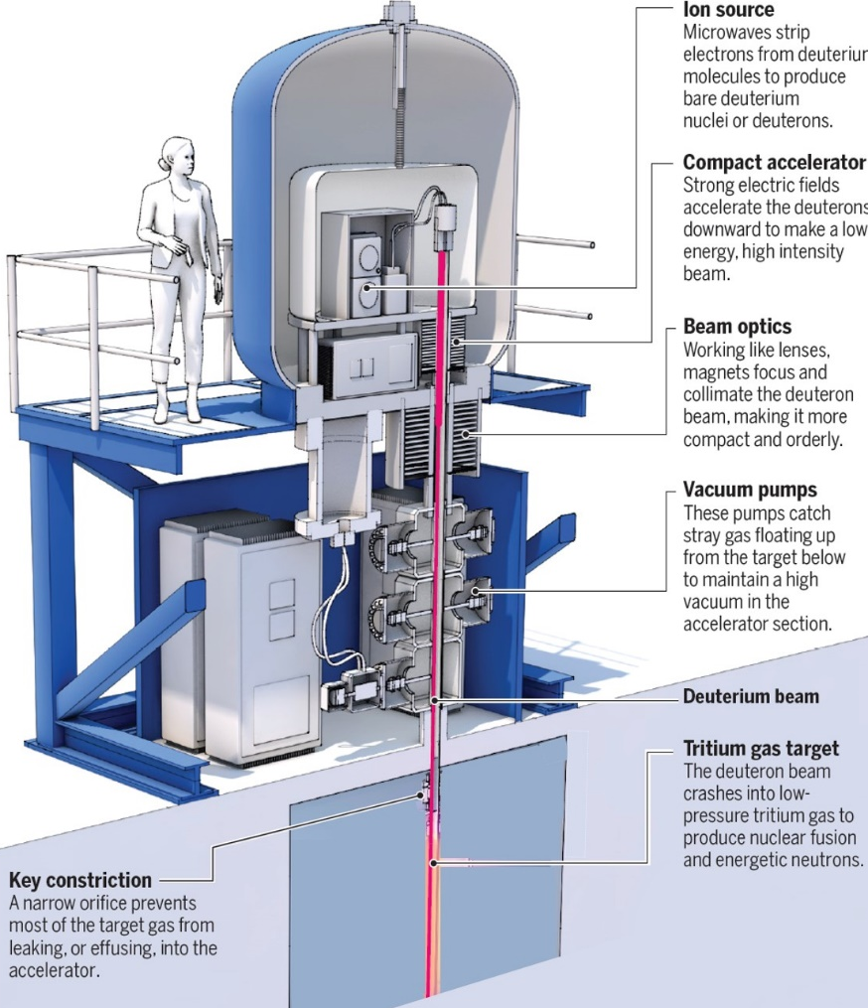


LIBRTI – LIthium BReeding Tritium Innovation
A unique testbed for benefit to fusion powerplant design & construction
Science July 2024, Vol 385
125 kW system
75 mA deuteron beam injection
~300 keV deuterons
Up to 10¹³ n/s total
10¹⁰-10¹¹ peak n/cm²/s flux
DT-neutron output
Predict and reproducibly achieve Tritium production
Science simulation underpinned by experiments
water

Slide 17
The purpose of LIBRTI
Irradiating tonne-scale materials with fusion-relevant neutrons for decision-grade evidence
Make the UK the global hub for advancing tritium breeding technology
fusion breeding
Advancing fusion breeding technologies through a world-leading demonstrator facility with predictive multi-physics capability
technologies
world-
leading
multi-physics
capability
Build UK breeder-technology supply chain capability and capacity
Develop a validated multi-physics platform that offers predictive capability and informs technology design

Slide 18

LIBRTI Facility
Experimental zone around neutron source
~10x15x5 m³
Instead of water, the neutron source will be surrounded by breeder material
Tritium bred within the material will be extracted and measured
Data acquired will be used to validate a digital twin of the facility, using a multi-physics approach
Working towards 500+ hours operational availability/yr

Slide 19


The SHINE neutron source profile
beam

Slide 20
Why are we measuring neutrons?
Safety case
Experiment
Neutrons OUT
Dosimetry
Radiation regulations
Activation
Key metric in quantification of results
Digital
Source monitoring
Characterisation
Validation
Make an MCNP neutron source term
Matching experimental data to simulated results
Ensuring the source is consistent
Notes:
Characterisation is the bootstrap for the source monitors in the room. It’s the ‘worst case’ for the safety monitors – source is more bare. Digital measure for source term

Slide 21
The need for characterisation
Factory Acceptance Testing – does it work as anticipated?
Recharacterise after major maintenance – is everything performing as it should?
A key performance indicator of a breeder is the tritium breeding ratio
Directly related to neutron flux
Tritium Breeding Ratio = Tritium produced
(TBR)
Tritium consumed
Knowing the source output as a function of time is key
Use characterisation to cross-calibrate diagnostics around the neutron source
Better handle on errors and how it affects the measured TBR

Slide 22
The need to do it a bit differently
300-keV D
Many other DT facilities are ²H beam on solid TiT target
Use Associated Alpha Detection, foils, fast/thermal neutron detection
  Can also measure their reaction products (eg medical isotopes) – trickier with ³H
We have:
Volume source, high source strength
The need for multiple measurements (to change beam/target settings, etc)
Don’t want to activate too much
1.38 m

Slide 23



The Passive Neutron Spectrometer
The Passive Neutron Spectrometer is a 30-cm diameter sphere of HDPE with pairs of TLDs (⁶LiF, ⁷LiF) placed at different depths.
Neutrons lose energy as they are moderated through the plastic, and TLDs will have a response dependent on the depth in the plastic
The neutron flux as a function of neutron energy is unfolded
Ross Worrall et al., Fus. Eng. Des. 161 (2020) https://doi.org/10.1016/j.fusengdes.2020.112038
HDPE
HDPE spacers
30 cm
TLD pairs
Figures from Ross Worrall

Slide 24


The Passive Neutron Spectrometer
Light curve extracted for TLDs – after processing, this gives dose as a function of depth
Neutron energy related to the depth of the TLD
Need a response function – i.e. the sensitivity of the TLDs to neutrons as a function of energy
Essentially, unfolding requires solving simultaneous equations:
Measured
values
Neutron flux
$$Z_{0}=\int_{0}^{∞}{R_{i}\left(E\right)φ\left(E\right)dE_{i}}$$
φ(E) across the PNS
TLD response
Neutron energy (from the TLD depth)
Dose as a function of depth
Figures from Ross Worrall

Slide 25

Using TLDs with LIBRTI
Use TLDs to measure absorbed dose as a function of (ρ,φ,z)
Start with the SHINE source and build a TLD geometry that can reproduce the SHINE spectrum as the solution
Strongly vary the source and ensure that the solution can still be reproduced
Need to use enough TLDs to obtain the required information
  Number and geometry needs to be optimised
  30 cm of HDPE is enough to thermalise 14-MeV neutrons
[ PRELIMINARY ]

Slide 26


Extra detectors
Keen to also use ‘live’ measurement methods during the characterisation, e.g. diamond detectors
Detectors in the room during experiments will include fission chambers
Activation foils will be put next to the source for cross checking
  These will need to be analysed immediately after irradiation, so number will be limited
  TLDs are stable after irradiation – can be stored for up to a year
See talk by Gee Bartram
Diamond detectors
Fission chambers

Slide 27
Requirements for detectors
For fusion-relevant experiments, and fusion power plants

Slide 28


Neutron spectra in tokamaks
The plasma will produce monoenergetic neutrons either 14 MeV (DT) or 2.5 MeV (DD)
14 MeV fusion neutrons lose energy by elastic and in-elastic scattering events with material in the device surrounding the plasma
Hence even at the first wall there will be a large range of neutron energies
  Measurement of neutrons directly relates to fusion power
  Plasma and fuel parameters can be derived from neutrons
    fuel ratio (nT/nD)
    fast ion temperature and alpha energy distribution
    alpha particle density profile
    fast ion related MHD instabilities

Slide 29







Fusion neutron diagnostics
PADC detector
PNS
Bonner Spheres
Low dose / personal dosimetry
Neutron camera
Activation foils
Fission chamber

Slide 30

Environment gets more intense
  Temperatures ranging from 100-450 degrees (at diagnostics locations - tritium breeding module environments particularly challenging).
  JET: Approximately 50-100 degrees
  Magnetic fields ranging from 1-10 Tesla
  JET: ~3 Tesla
  Neutron flux 10¹²-10¹⁶ n/cm²/s
  JET: 10⁹-10¹⁰ n/cm²/s
  Also, gamma radiation, vibrations, dust, etc.
  JET: less intense, diagnostics more easily accessed, shorter operations
Ethos:
Move diagnostics further away – while minimising lines of sight
Shield – while minimising perturbation of the field
Redesign – takes time and requires qualification
Use as little as possible – diagnostics on power plants will be minimal, aiming at control (not science)
Challenge:
We don’t know the exact environments or requirements for future machines but may be required to provide solutions quickly to inform design/planning.

Slide 31
Current R&D work
Radiation tolerant detectors
Adapting known low-energy neutron detectors into high-energy neutron detectors
Solutions for long distance between detectors and electronics
Neutron signals in a high gamma environment

Slide 32
Summary
Wide range of varied work in the Applied Radiation Technology group, including measuring and simulating neutrons and their environment
Currently working towards the LIBRTI facility, including:
  Full characterisation of the source
  Neutron monitors around the source:
    providing energy and flux information as a function of time
    Also information as a snapshot in time (activation foils)
Starting to develop more in terms of neutron detection R&D
This work is part of the UKAEA’s Lithium Breeding Tritium Innovation (LIBRTI) programme, funded by the Department of Energy Security and Net Zero, as announced by the UK Government in October 2023.

Slide 33



UK Fusion Investment Prospectus

