Slide 2
Developments in Portable Neutron Measurement and Radiometric Analysis Capabilities at Sellafield
Presenter: Henry Watkinson
MPhys MInstP
Radiometric Physicist
Co-contributors:
Dr. Jon Wright Charly Preston
Sam Hodgkinson Michael Turner
Brandon Smith

Slide 3
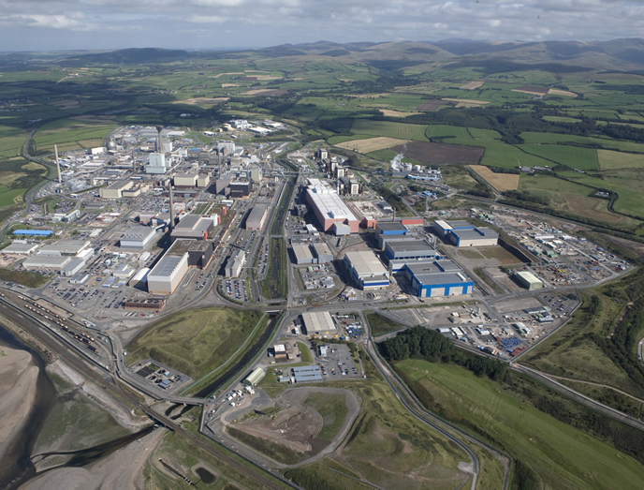
Requirements for Portable Neutron Measurements
Understanding nuclear material inventory in-situ
  Criticality safety requirements
  Hazard/risk reduction priorities
  Waste characterisation
Initial Decommissioning
  Sellafield facilities involved in fuel reprocessing are contaminated with ‘fissile’ material
  Understanding inventory informs dismantling
Waste sentencing
  Done in-situ on contaminated objects or on final waste packages to inform waste routes

Slide 4
Portable Neutron Measurement Solutions

Slide 5
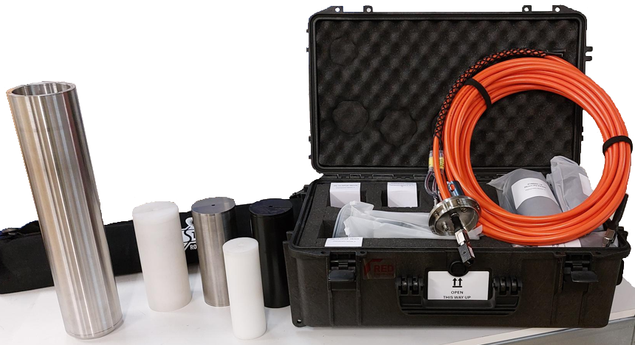
Portable Neutron Measurement Solutions – I
Detector Deployment Package (DDP)
  Made in collaboration with RED Engineering and Cavendish Nuclear
  Made for either Kromek TN-15 for neutron measurement, Cube927E CZT for gamma spectrometry, or gamma dose probe
  Cadmium-lined container to prevent thermal neutron ingress
  Polythene inserts moderate epithermal/fast neutrons that pass through the cadmium liner into the package for detection
  10mm thick tungsten or lead
  inserts for high dose rates up
  to ~200 mSv/hr
  3 cm diameter polythene with 1 cm
  shielding, or 5 cm diameter polythene
  (no shielding)

Slide 6
Portable Neutron Measurement Solutions – II
Polyurethane insert used first, then moderator
  PU foam less dense and low H so does not moderate – estimates background
  Significant gamma bleedthrough at high gamma dose
Designed for deploying horizontally in port channels below a tank
Cavendish Nuclear carried out analysis using their PSIM+ software following deployment
Analysis identified distribution and quantified approximate Pu mass present for informing decommissioning

Slide 7
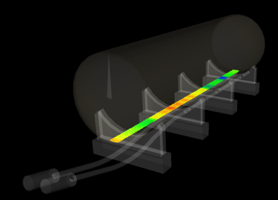

Slide 8
Portable Neutron Measurement Solutions – III
Limitations/challenges
  Dose rate limitations, also requires other corrections at higher dead time
  Polyurethane foam cannot support weight of detector and other internal equipment
  Heavy – package up to ~20 kg (tungsten configuration)
  Design restricted to TN-15/CZT/dose meter sizes
  Disassembly and reassembly to swap components
Other developments
  In-house benchmarking and analysis capability
  Use for other scenarios – vertical deployments and other cells

Slide 9
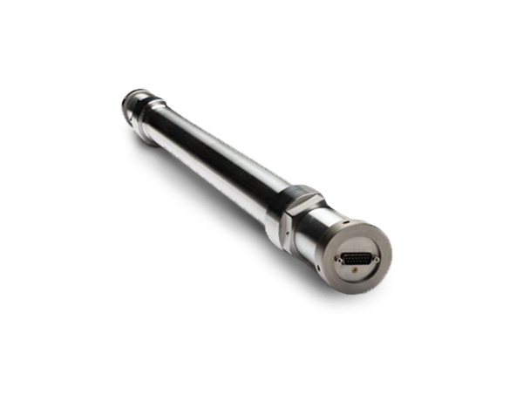
Portable Neutron Measurement Solutions – IV
Arktis S670 fast neutron detectors
  Helium gas scintillators
  Fluorescence in gas from recoil He-4 nuclei following elastic scattering, proportional to deposited energy
Used to measure fast neutrons
  Generally better for in-situ measurements
    Waste packages contain significant amounts of highly moderating plastic content
Two measurement scenarios
  In-situ mass assessment of cell/room
  Measurement of waste packages
Neutron Detectors – Arktis Radiation Detectors

Slide 10
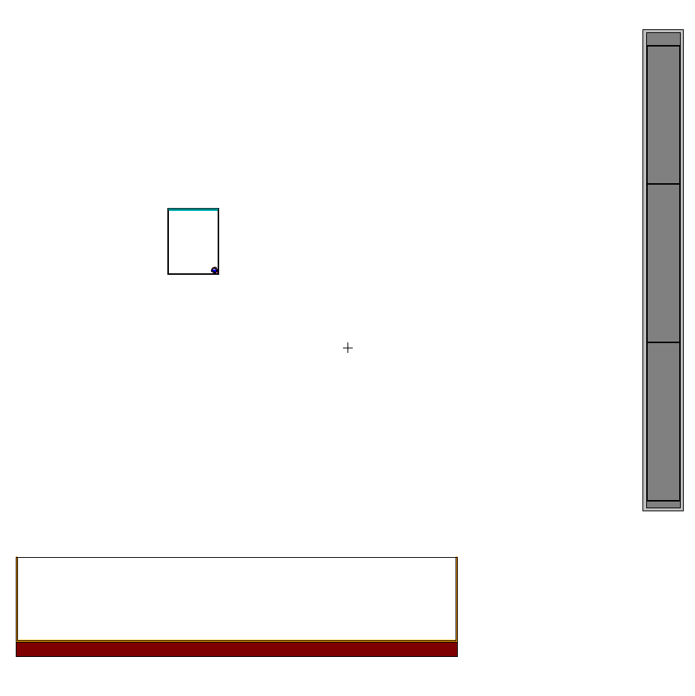
Portable Neutron Measurement Solutions – V
MCNP benchmarking
  Using MT=2 (elastic scattering) in f4 tallies
  Provides reaction rate per neutron emitted
  Then use a conversion factor between counts and reactions (cross-section fairly low)
Measurements inside both free space and mock-up geometries gives somewhat consistent correction factor
  Between 0.5 and 0.7 counts/scatter, varies by segment
Dependent on energy cut-off
  Channel cut-off chosen to remove gamma background, interferes up to channel ~150 (high Co-60 background), goes from [0,255]

Slide 11
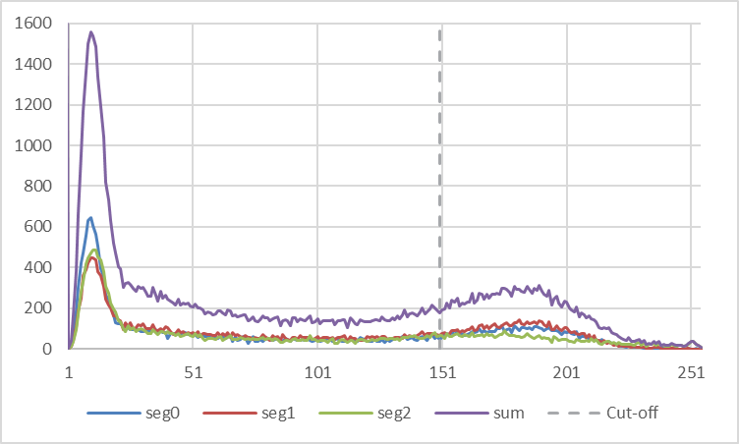

Slide 12
Portable Neutron Measurement Solutions – VI
Testing and trial completed so far, found to be suitable for measurement of waste drums in practicable amounts of time (~1 hour each)
Paired HRGS for further characterisation of material when deployed
Provides a portable solution able to measure at ‘10s of grams’ level
Limitations/Challenges
  Pressurised detector ~190 atmospheres
  Significantly lower efficiency with significant moderator material (dense plastic blocks not suitable for measuring)
  So far calibrations are with MCNP of waste with empirical benchmarks, unsure how much the correction factors for actual / measured correlate, e.g. with moderator
Other development
  Tie-in with new radiometric analysis capability

Slide 13
Analysis Capability Development

Slide 14
Analysis Capability Development – I
FINDER
  Fissile INventory DEtection and Reconstruction
Uses empirically measured reference efficiencies by solid angle and distance
MCNP models generated calculate transmission and build-up factors
  Use point cloud
Response matrix set generated for each detector and cloud point
  For detector measurement point i and potential source position j
Points are clustered by similar response before MLEM solve
  Ensures the MLEM solve is physically plausible and not just the most mathematically plausible (speckling)

Slide 15
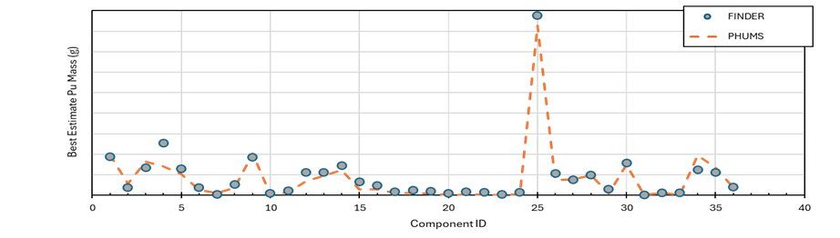
Analysis Capability Development – II
Uses ‘perturbations’ of count rates and responses as well as multiple runs to determine best estimates and uncertainties
Best estimate masses comparable to substantiated techniques
Identifies locations and quantities of material to inform decommissioning and waste routes

Slide 16
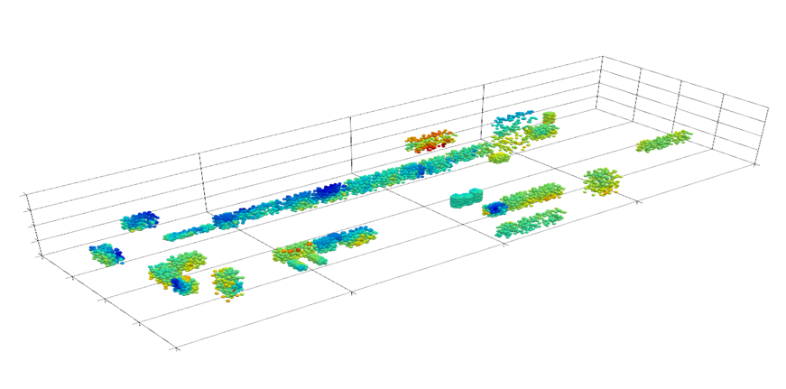

Slide 17
Analysis Capability Development – III
Limitations/Challenges
  Simplifications – response matrix made with f5 point tallies, can account for material and energy cut-off, requires additional ‘solid angle’ calculations
  UoL and internal testing – detection window only effective and consistent to 90° ‘cone’ from each segment, requires corrections beyond this
  Long deployment time – single detector used to measure in array of several, tightly spaced points for resolution – setup time for changing and measuring each position
  Need good enough measurement positions to gain resolution – around shielding, different sides, etc. (not unique to FINDER, across all MLEM)
    can improve solves by deliberately reducing resolution (e.g. using section of a box instead of point cloud constrained within)
Future developments
  Applications for other systems – DDP, also dose-rate based flux measurements, allows for determining effectiveness of clean-outs

Slide 18
Summary

Slide 19
Summary
Three key internal developments
  Detector Deployment Package
  Arktis Fast Neutron Detector Measurement Systems
  FINDER
Successful measurements with DDP, trial point for other two
DDP and FINDER allow us to do measurements of material in-situ, as well as quantify and localise source terms for informing decommissioning and disposal
Arktis system also tested as viable method for measuring waste packages with high fissile presence
Keen to hear other solutions/developments/innovations/difficulties for neutron detection

Slide 20
Thank You
Questions

