Slide 1
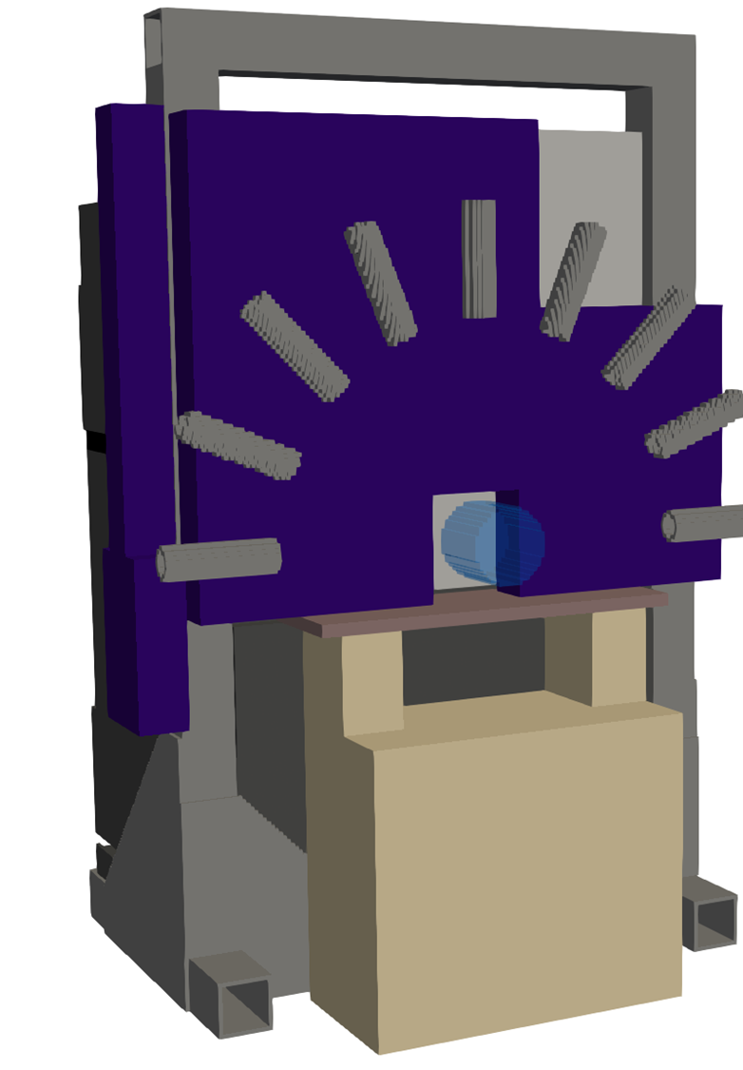

On-line prompt-gamma dosimetry for BNCT at HF-ADNeF
Max Conroy
Neutron Detector and Facility Workshop
18/09/26
Contact: m.j.conroy@pgr.bham.ac.uk

Slide 2
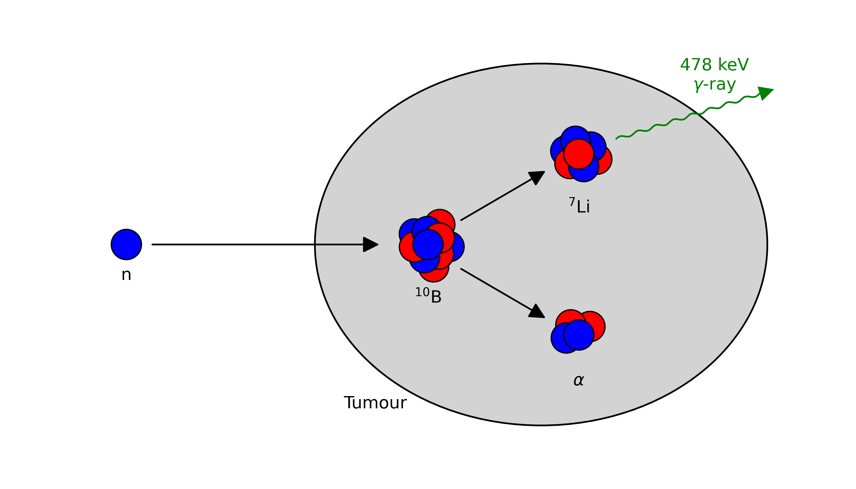
Boron Neutron Capture Therapy
A binary cancer therapy: utilises both biological and physical targeting.
Patient is injected with boron-loaded pharmaceutical, then irradiated with an epithermal neutron beam.
Neutron capture cross section (thermal)
for ¹⁰B: 3840 barns. Significantly higher
than normal tissue.
Ionising particles are produced from
the ¹⁰B(n,α)⁷Li reaction: high LET, short range.
Dosimetry is a remaining challenge for BNCT.​
Notes:
Introduce BNCT. Need to research a bit more about the benefits of it etc.

Slide 3
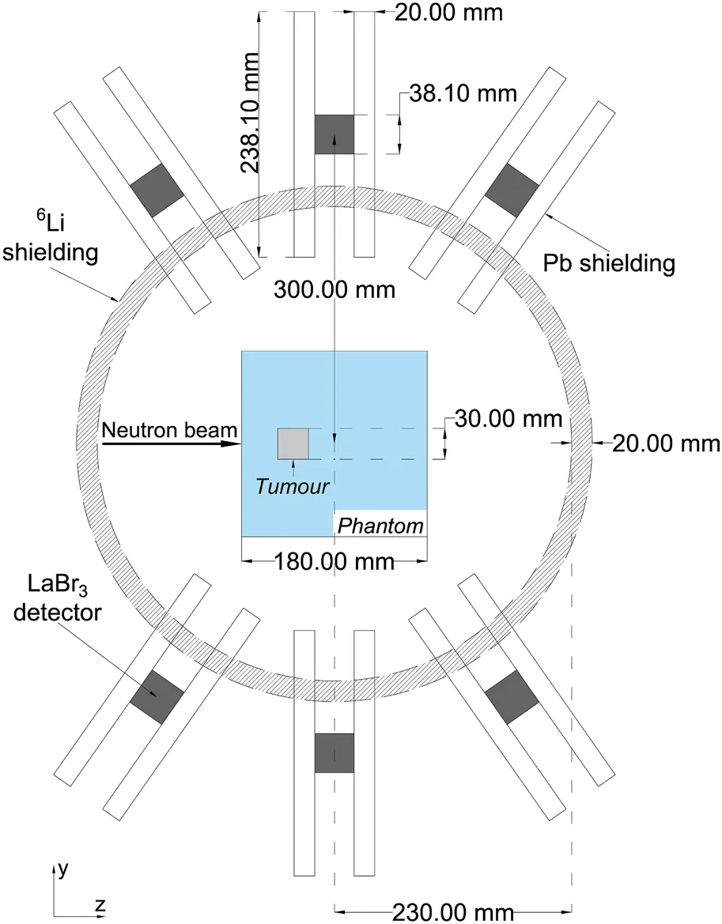
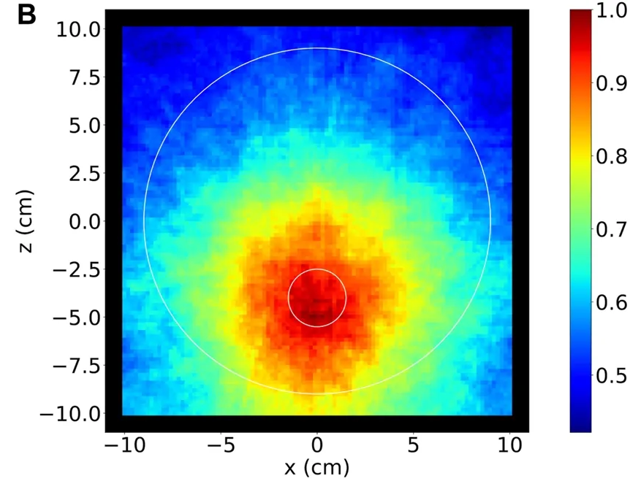
BNCT prompt-gamma dosimetry
The prompt 478 keV gamma ray from ⁷Li can be used for dosimetry.
Previous PhD
student’s work
investigated using a
Compton camera.
What next?
1) Nutter K, et. al. A feasibility study using an array of LaBr3(Ce) scintillation detectors as a Compton camera for prompt gamma imaging during BNCT. Front Phys. 2024 Feb 21;12
Notes:
Here, I just want to highlight previous work by D Minsky and Kiran. Include a plot from each and explain what they have been able to do.
WHY ARE WE DOING THIS THEN? Well for one we have HF-ADNeF, an accelerator DESIGNED FOR BNCT, but with no clinical guard-rails – we don’t work with patients so we have a lot more freedom to try things.
Also, we are using OpenMC, which is potentially well suited for BNCT.

Slide 4
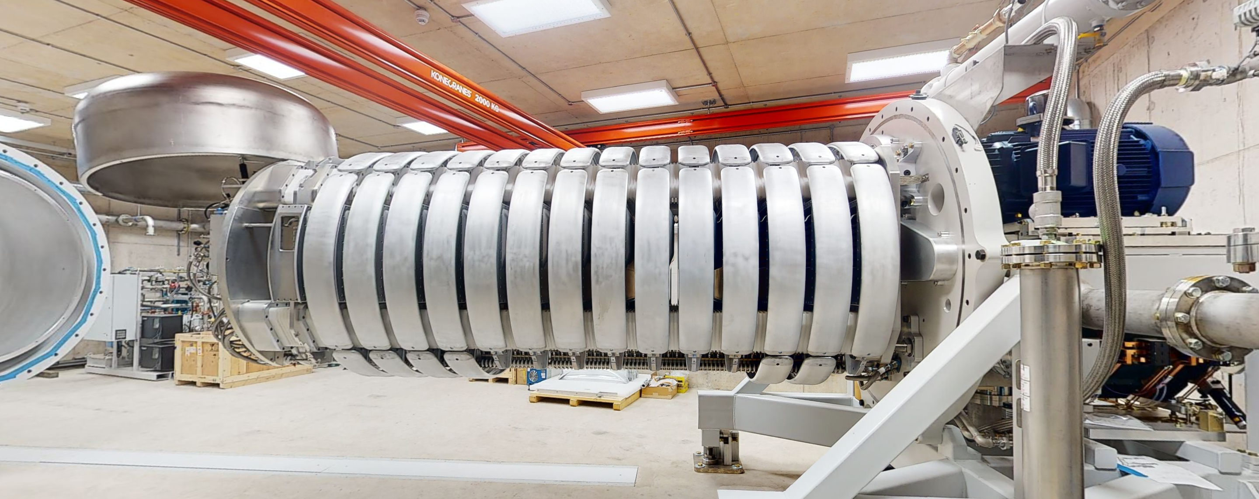
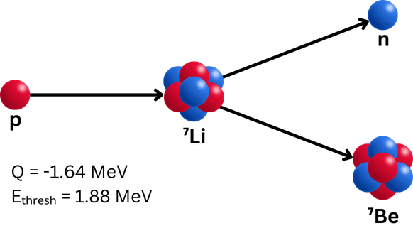
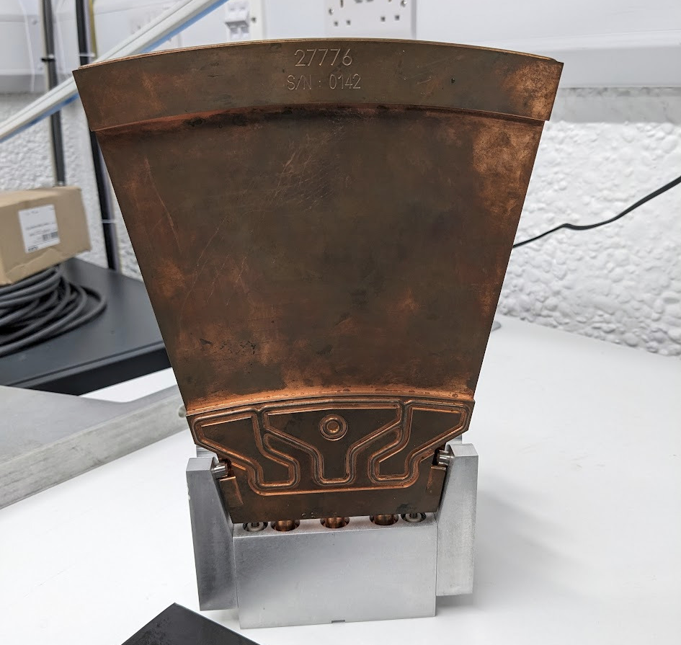
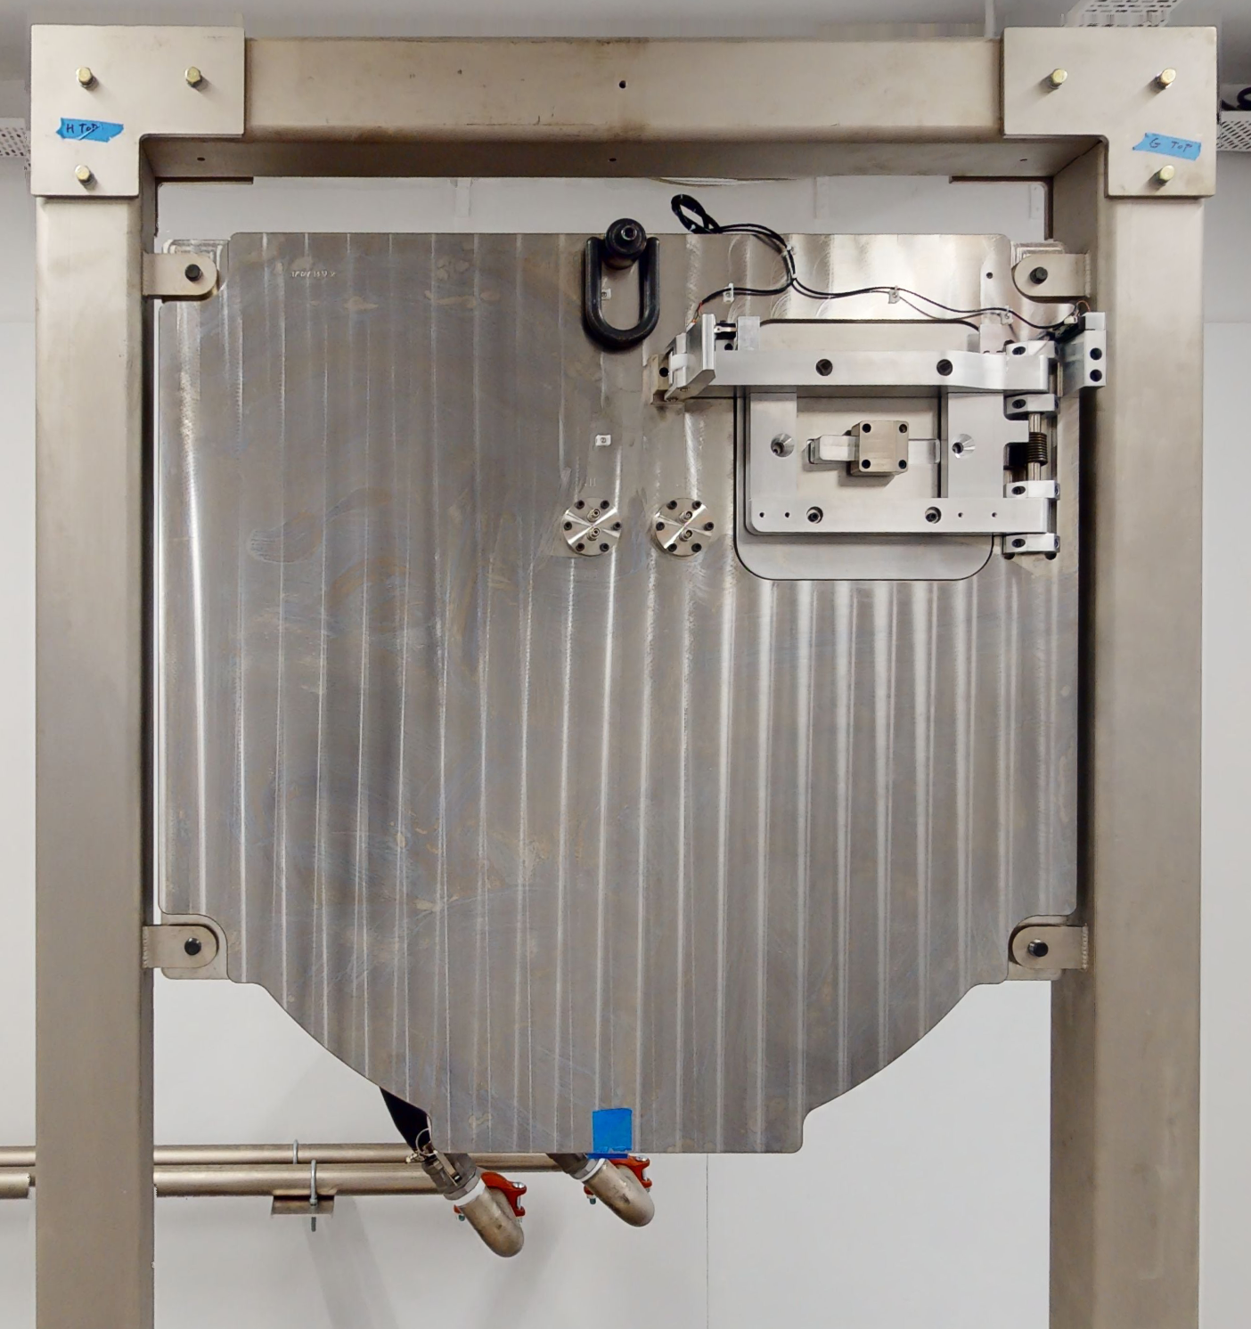
High Flux Accelerator-Driven Neutron Facility
Proton beam (>30 mA) incident upon lithium target, formed of 16 rotating water-cooled petals.
Neutron fluxes up to 10¹² n cm² s⁻¹.
1
~1 m
~13 cm
Aim: demonstrate prompt-gamma dosimetry is possible at HF-ADNeF.​
2
3
Notes:
Quick explanation of HF-ADNeF – Jack will have already explained this.

Slide 5
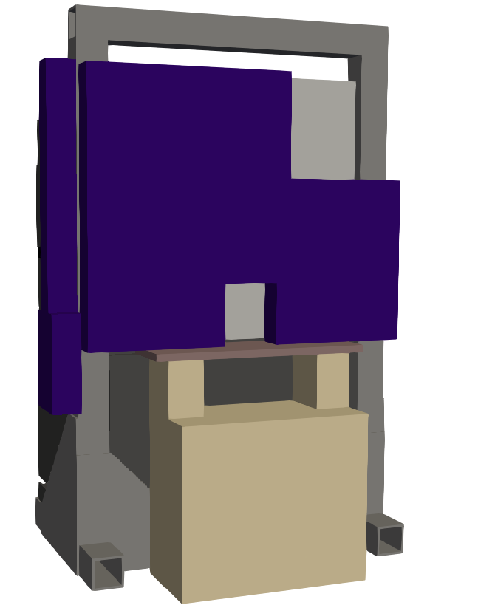
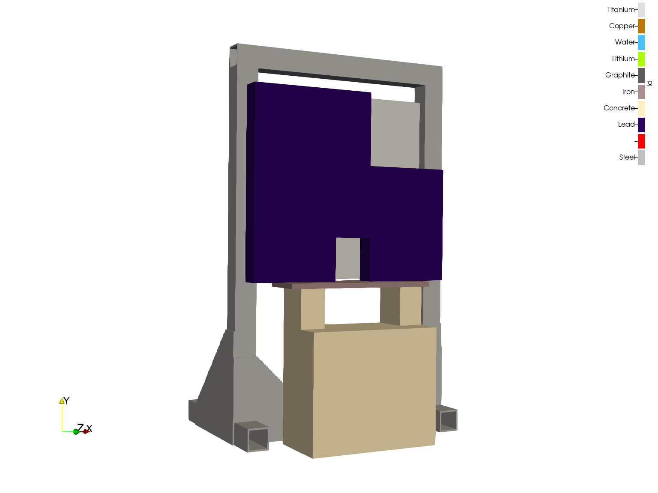
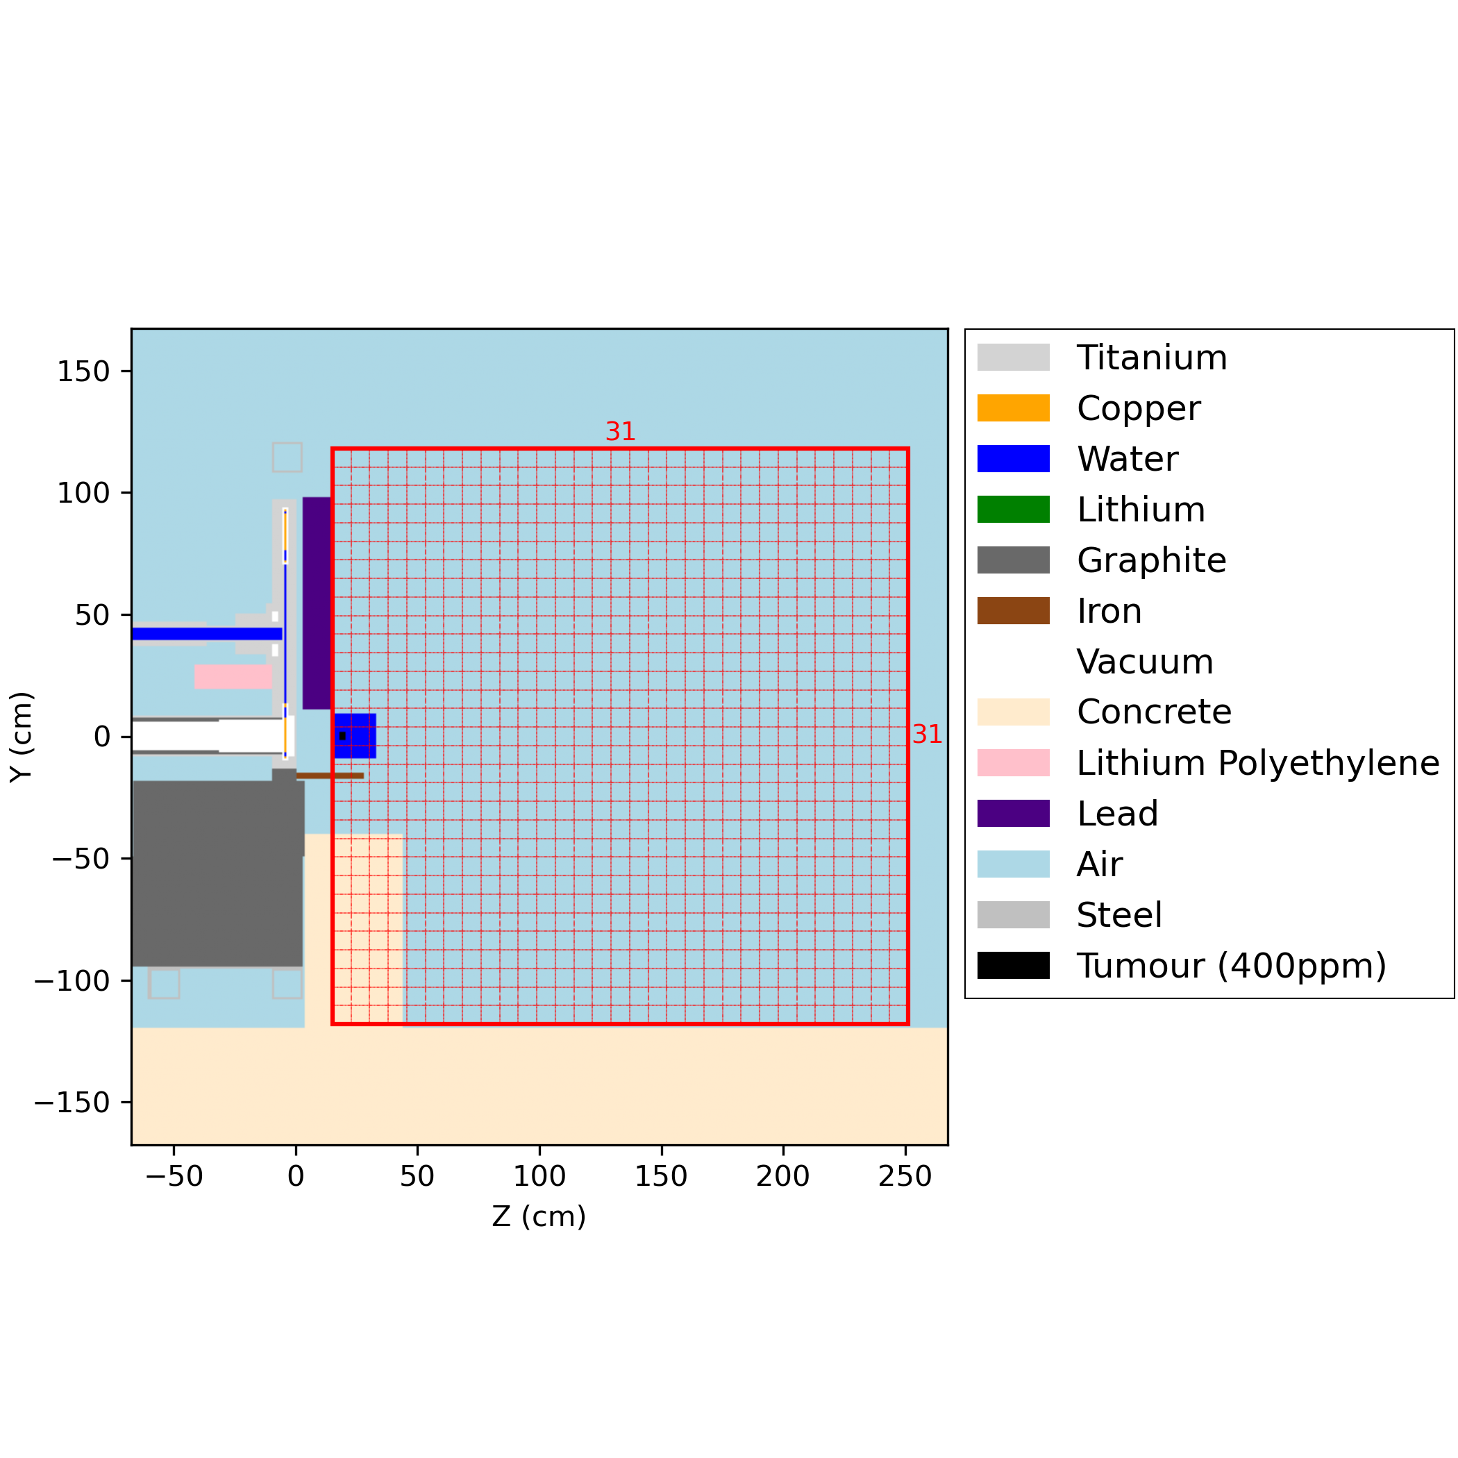

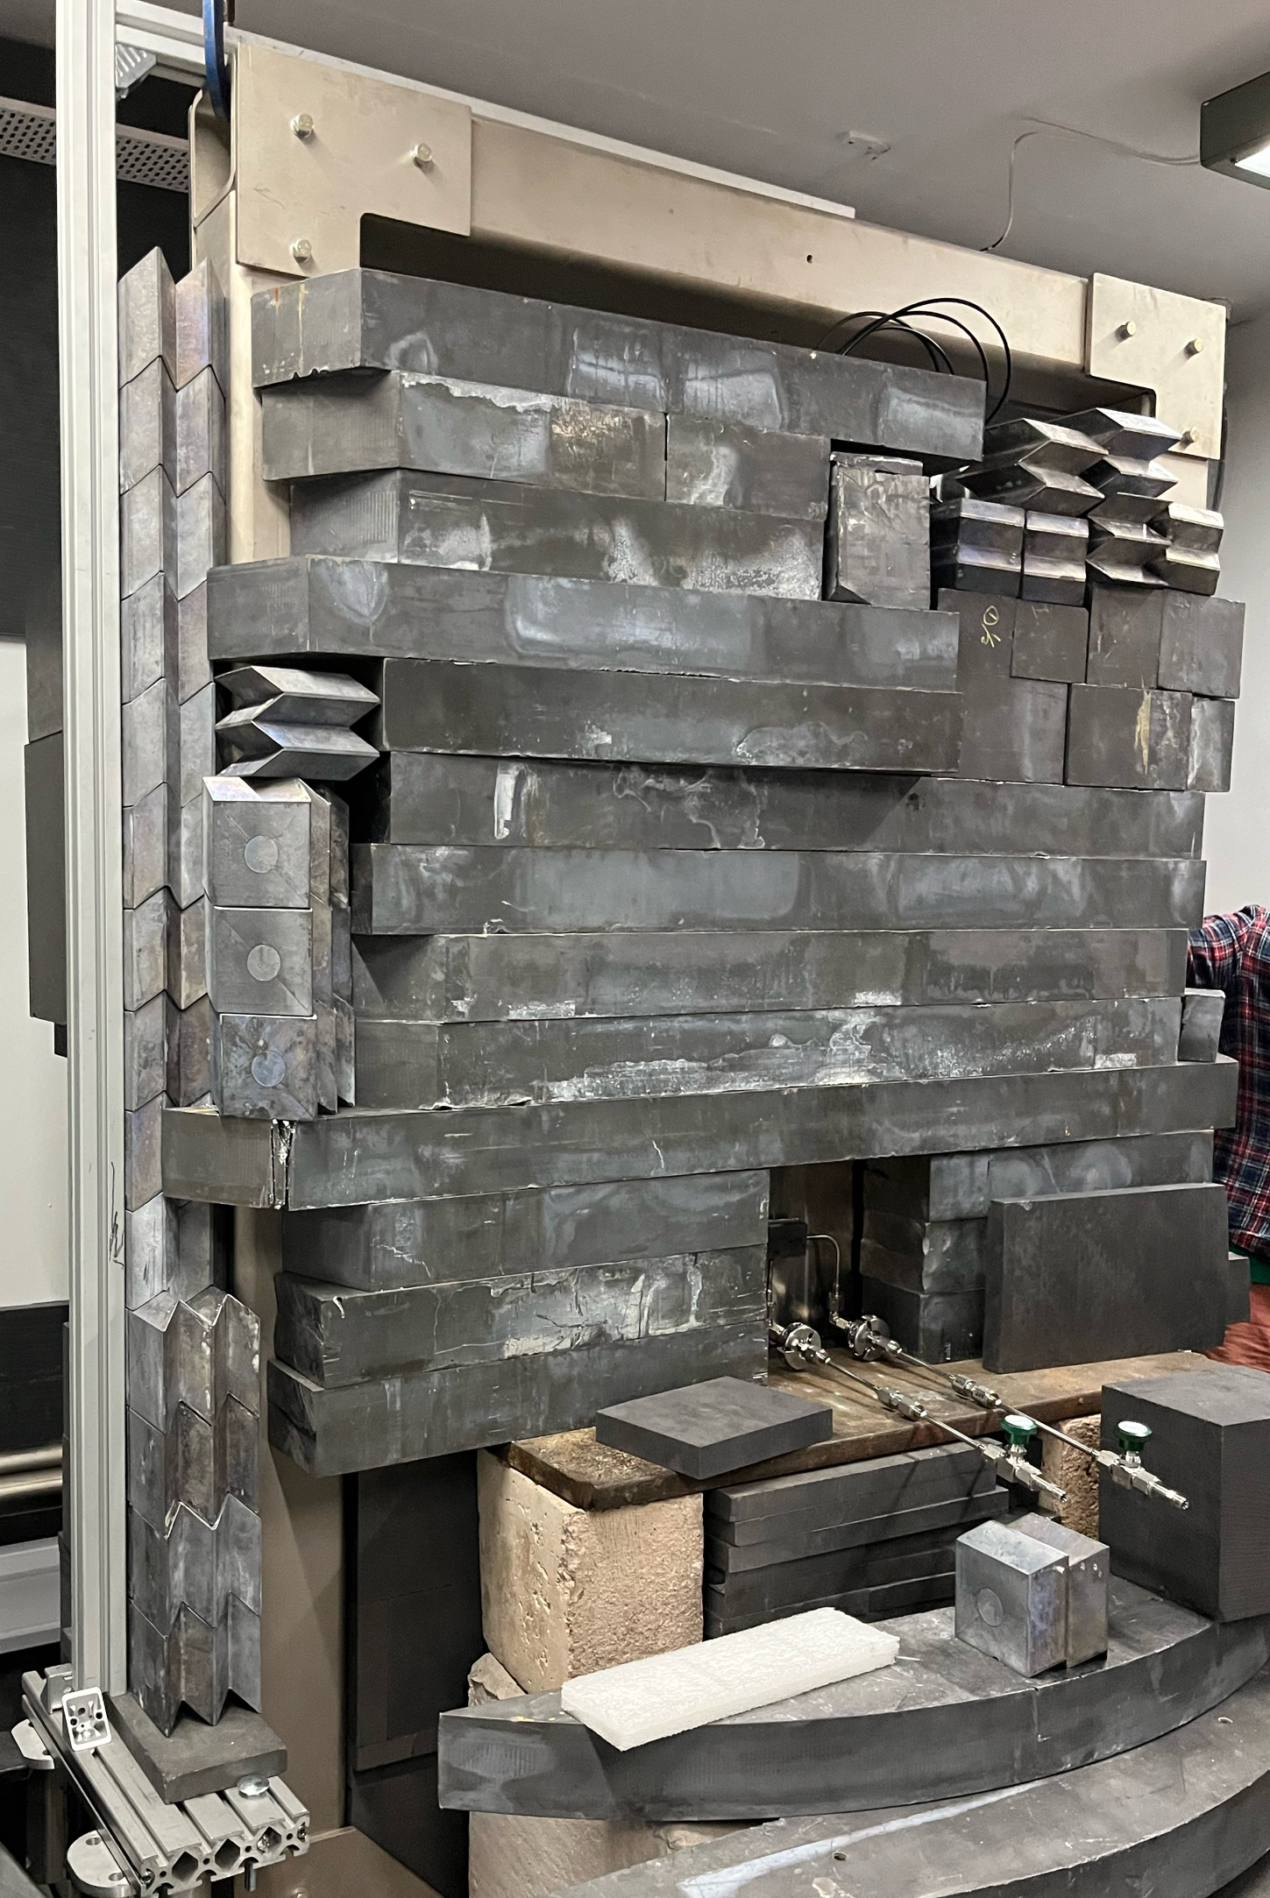
OpenMC Simulation
Created a custom neutron source
term for OpenMC simulations.
Neutron spectra produced by source term:
Pairs with a 3D facility model for accurate neutron transport.
Notes:
Explain the OpenMC simulation, show different neutron spectra as well as validation.

Slide 6
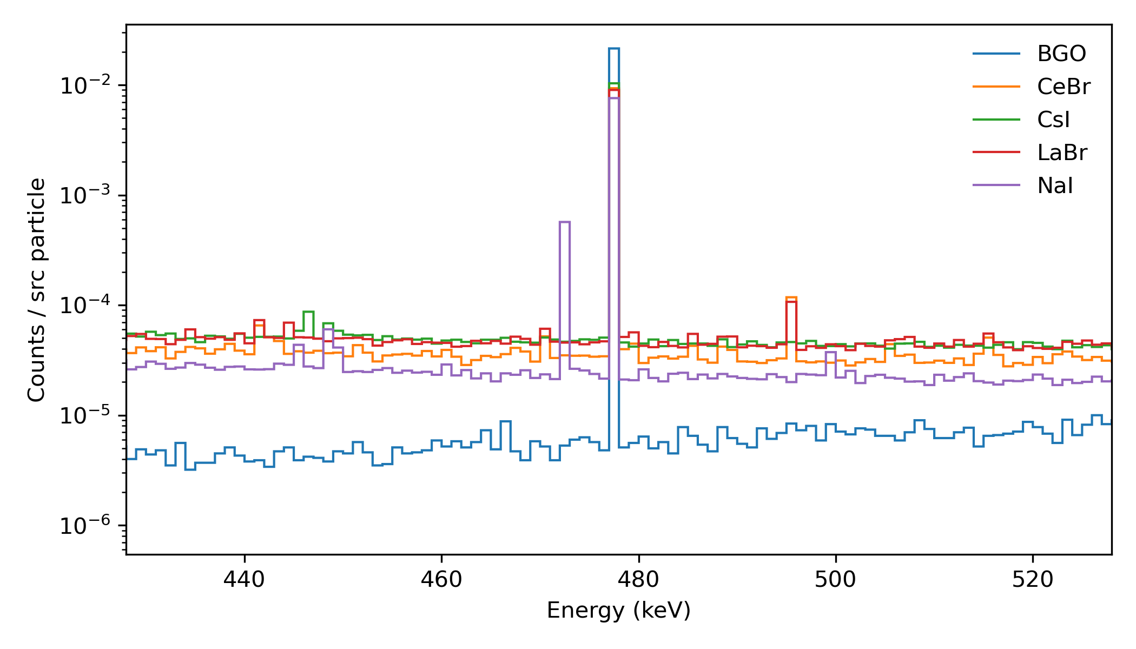
Stage 1: Detector choice
For this study, CeBr₃ scintillators have been simulated.
Clean energy spectrum
around 478 keV
(according to ENDF/B-VIII.1).
No internal radiation.
Fast response time (<20 ns).
Count rates > 500 MHz.
Simulated detector response to thermal neutron irradiation
Notes:
Show a plot of the OpenMC detector responses. Highlight issue with NaI (refer to ND conference last week) and mention ENDF vs JEFF.
Be brief here – explain choice of CsI – Joey's work and SPARC.
Ultimately, choice of CsI is because OpenMC will simulate it correctly, whereas for LaBr OpenMC will not simulate the intrinsic background.

Slide 7
Stage 2: Flux mapping
Implemented a 3D mesh tally of flux through the
HF-ADNeF target room.
Notes:
Explain what this plot is of: 3x3x3 inch cubes of the space in front of the HF-ADNeF target. Split up to measure the flux through.

Slide 8
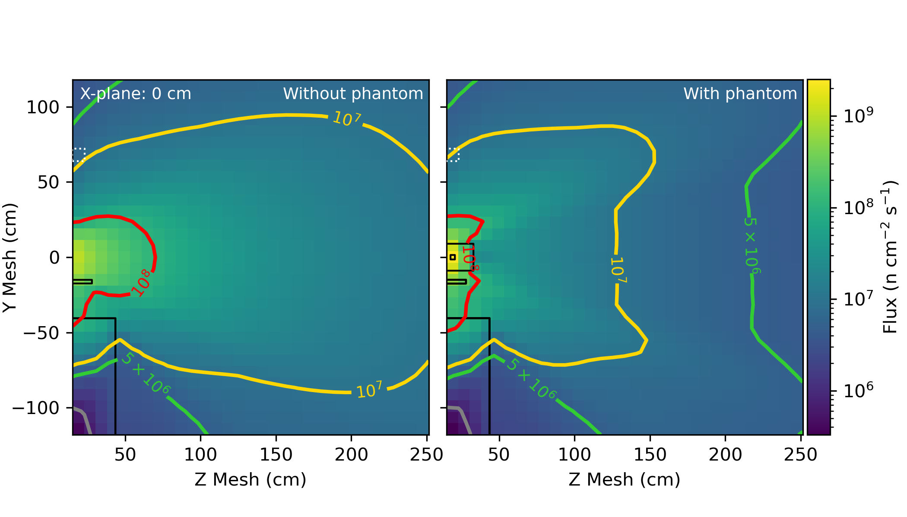
Stage 2: Flux mapping
E_{p} = 1.912 MeV
I_{p} = 30 mA
Notes:
Explain what this plot is of: results of simulation on previous slide
Contour lines added for clarity. From this (and next slide) decide that 10^7 is lowest feasible neutron flux...

Slide 9
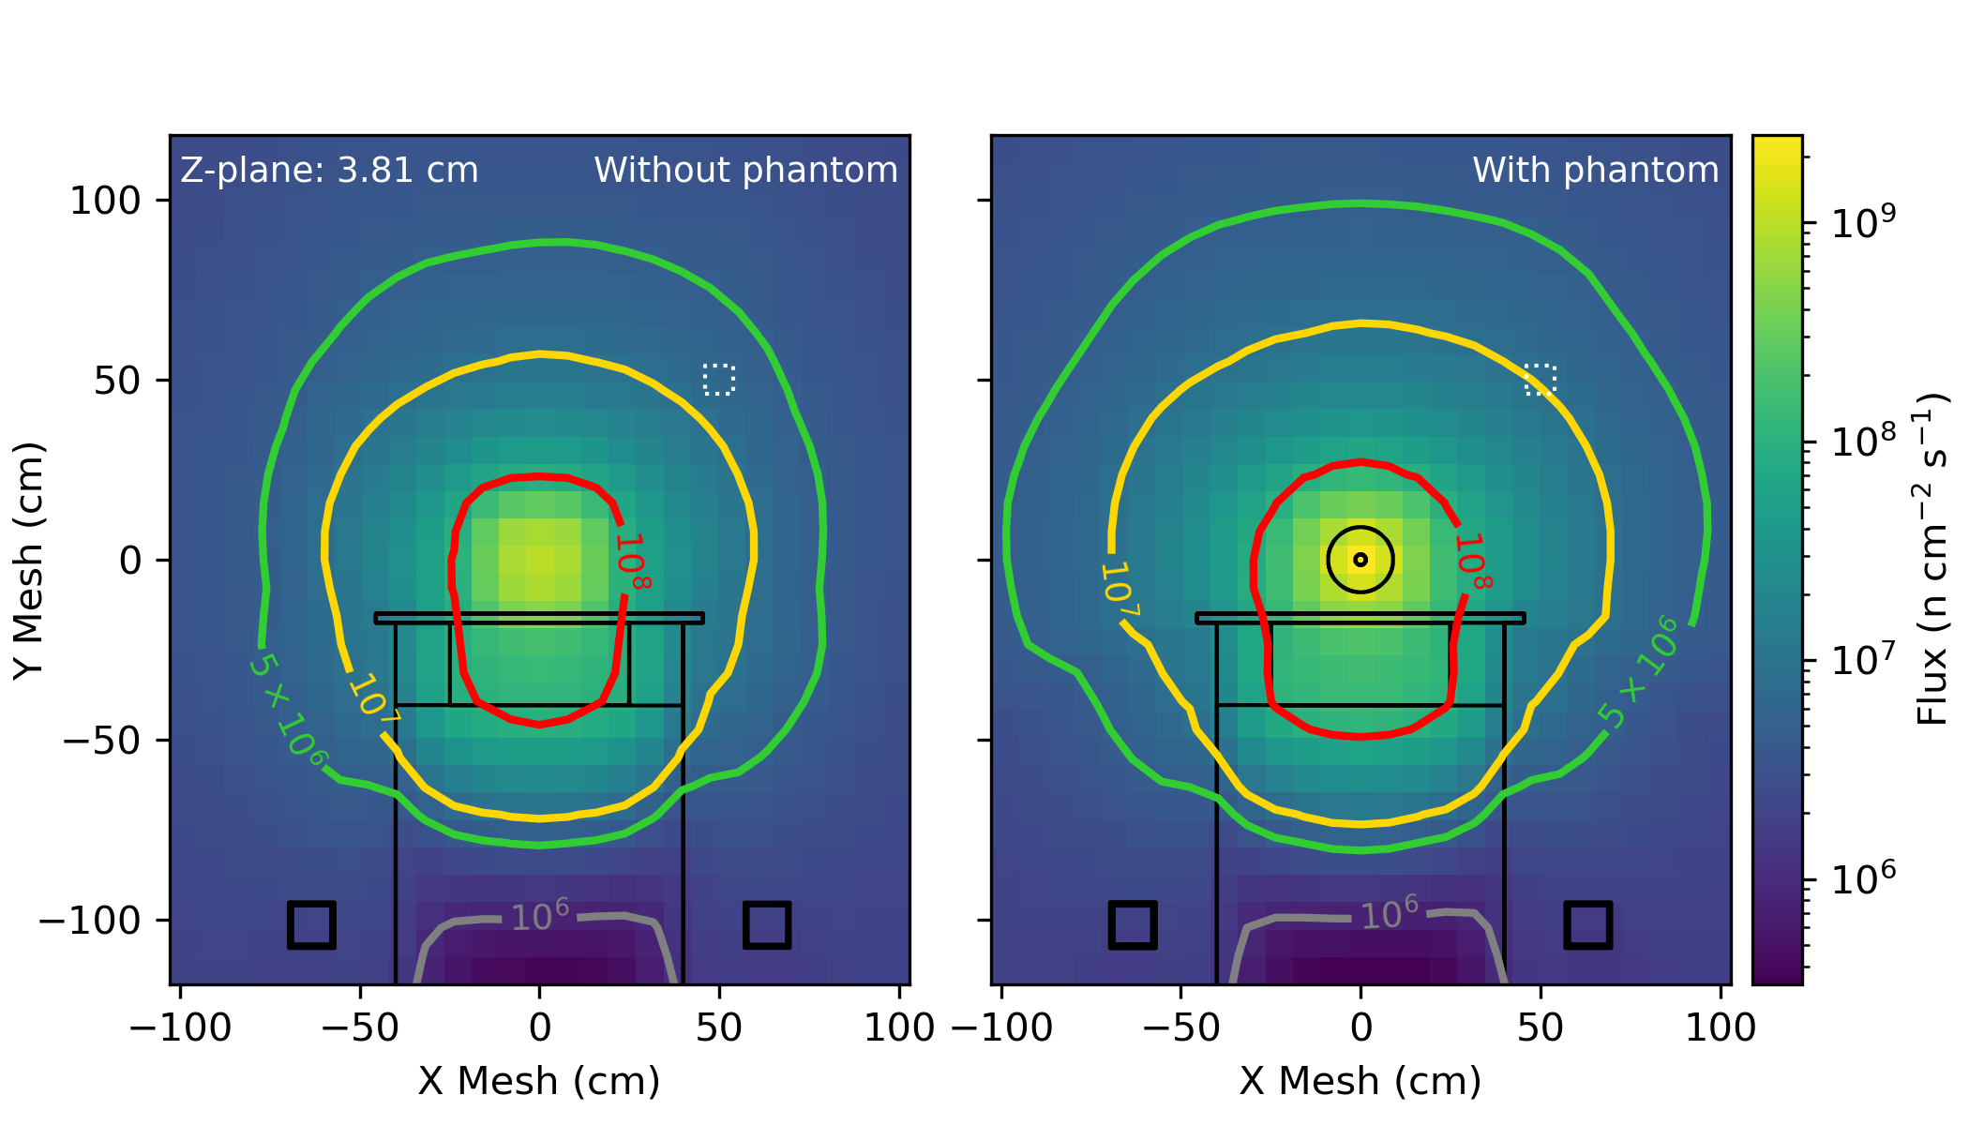
Stage 2: Flux mapping
E_{p} = 1.912 MeV
I_{p} = 30 mA
Proposed detector position: r = 68 cm
Notes:
From this (and previous slide) decide that 10^7 is lowest feasible neutron flux...
Therefore choose a radius of 68 cm to place detector at.

Slide 10
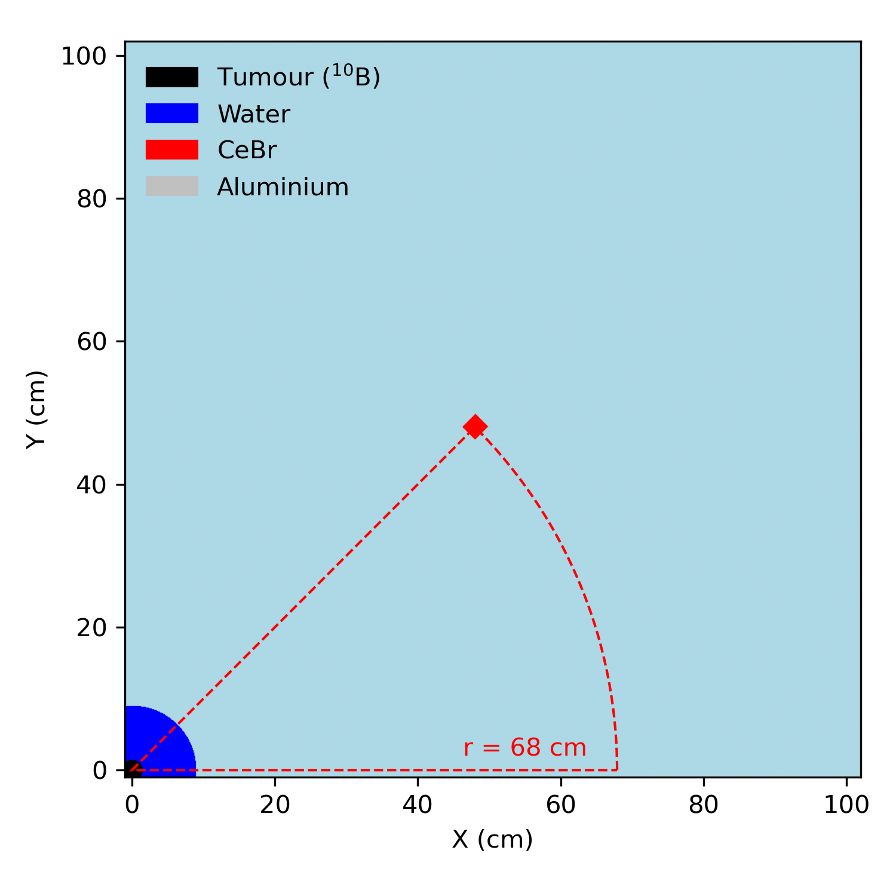
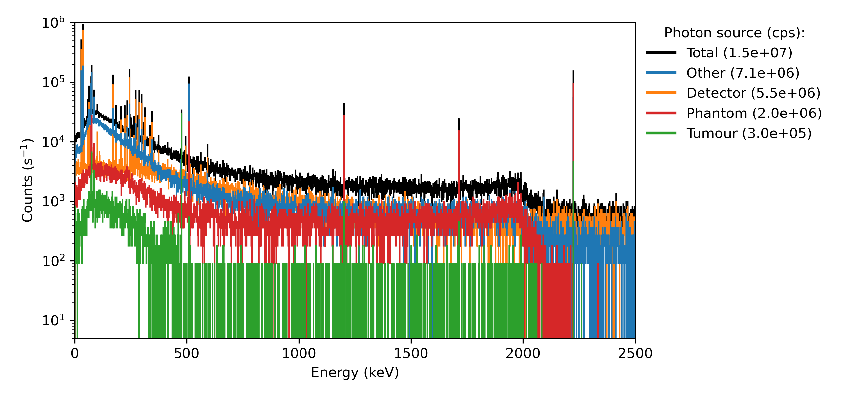
Stage 3: Shielding
No shielding
I_{p} = 30 mA
Lead X-rays
511 keV
SNR = 0.0398
478 keV
Escape peaks
2.2 MeV (²H)
Despite a good signal-to-noise ratio, the total count rate is too high.
Shielding is therefore necessary.
14 iterations later...
Notes:
Explain count rates in detector without shielding.

Slide 11
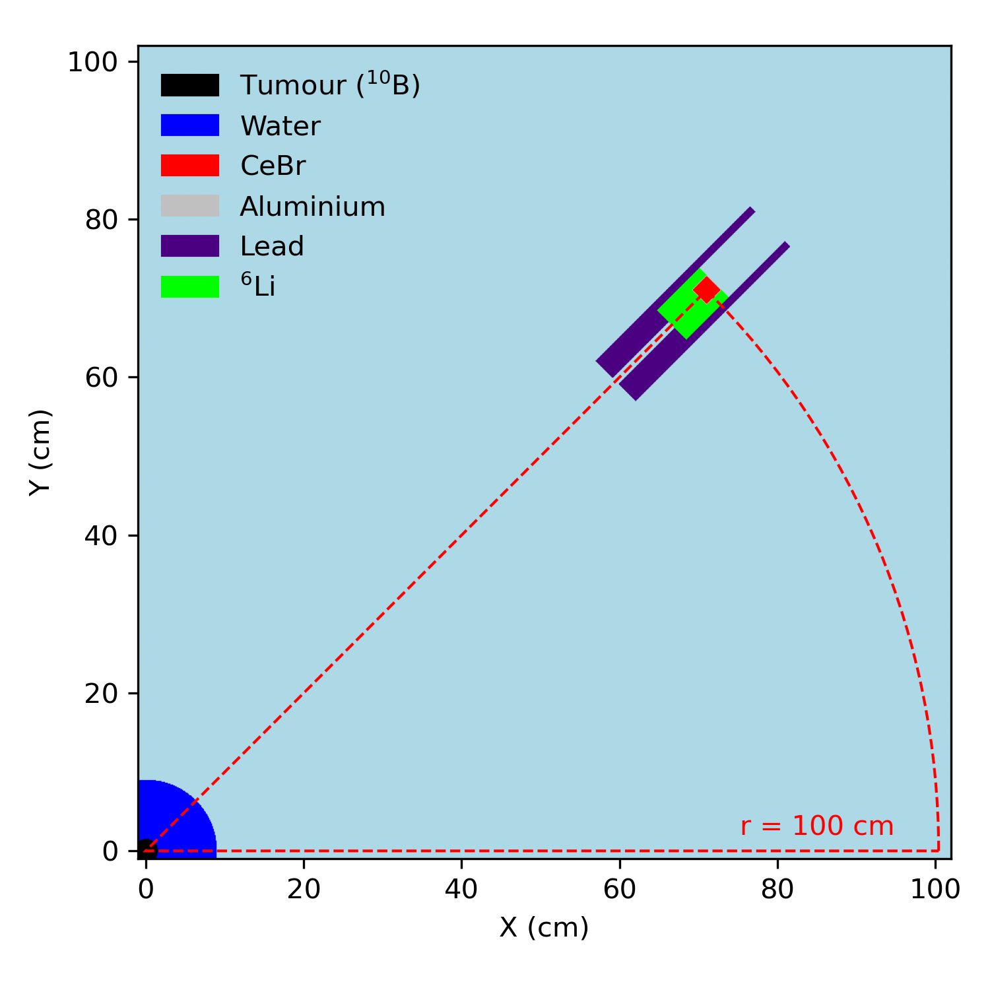
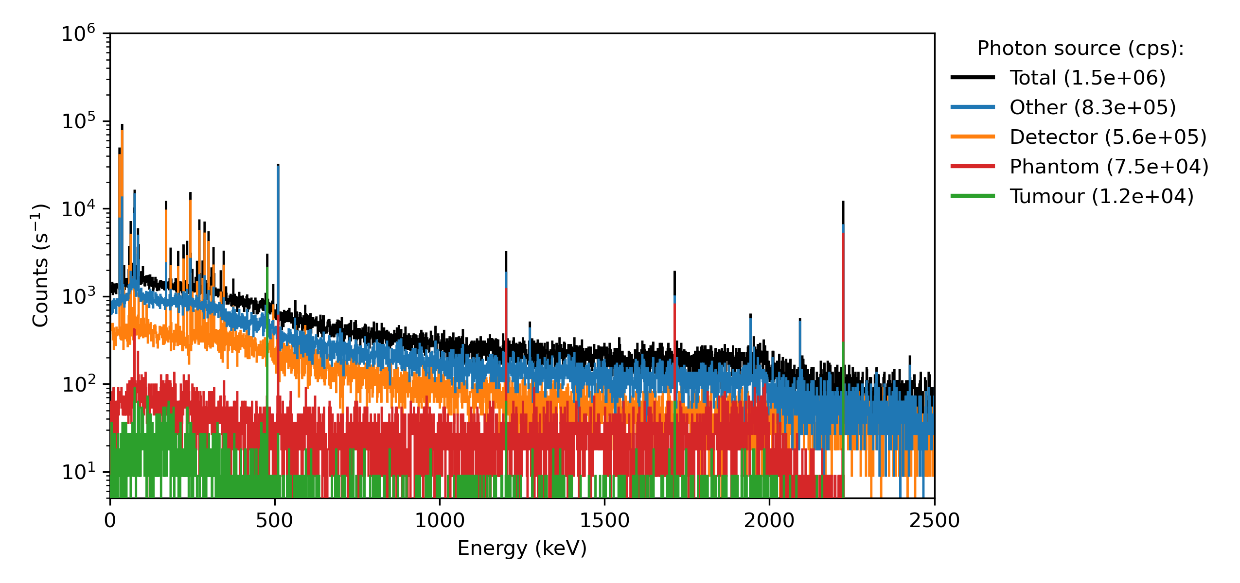
Stage 3: Shielding
Lead and ⁶Li metal
I_{p} = 30 mA
SNR = 0.0143
​
Achieved a 10x count rate reduction.
The neutron flux at HF-ADNeF can feasibly be reduced by reducing I_{p} from 30 mA --> 10 mA).
This suggests that experimentally implementing this design could be possible.
Detector moved to 100 cm from Z-axis.
Notes:
Describe shielding – has lead to an order-of-megnitude decrease...

Slide 12
Discussion
OpenMC simulations suggest that with adequate shielding, it may be possible to place CeBr₃ detectors in the HF-ADNeF target room, keeping the count rate in the detector below 500 MHz.
Current limitations: nuclear data libraries, simulation of charged particles.
Future work: include multiple detectors in simulation for imaging.
An experimental investigation looks promising.​

Slide 13


Thank you to...
Dr Tony Price¹, Prof. Carl Wheldon¹, Dr Luigi Capponi², Dr Robert Mills²,
Prof. Stuart Green^{2,3}
¹School of Physics and Astronomy, University of Birmingham, UK
²United Kingdom National Nuclear Laboratory, UK
³Queen Elizabeth Hospital Birmingham, University Hospitals Birmingham NHS Foundation Trust, UK
This work was partially funded by the Hawkesworth fund, University of Birmingham and UKNNL’s Medical Radionuclide Science core science theme. The simulations described in this presentation were performed using the University of Birmingham's BlueBEAR HPC service.

Slide 14
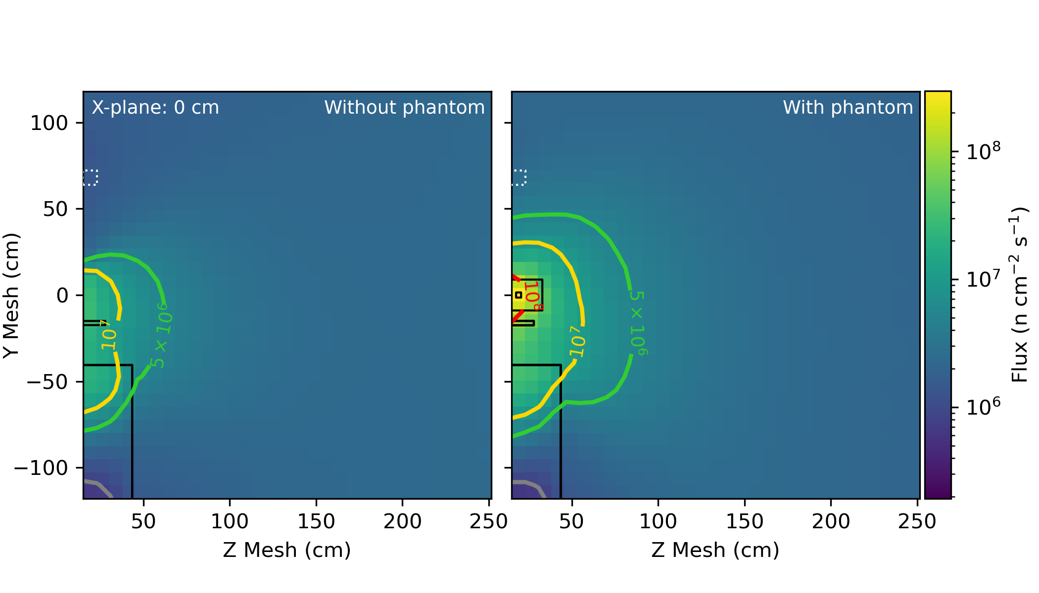
Photon flux
I_{p} = 30 mA
Notes:
Explain what this plot is of: results of simulation on previous slide
Contour lines added for clarity. From this (and next slide) decide that 10^7 is lowest feasible neutron flux...

Slide 15
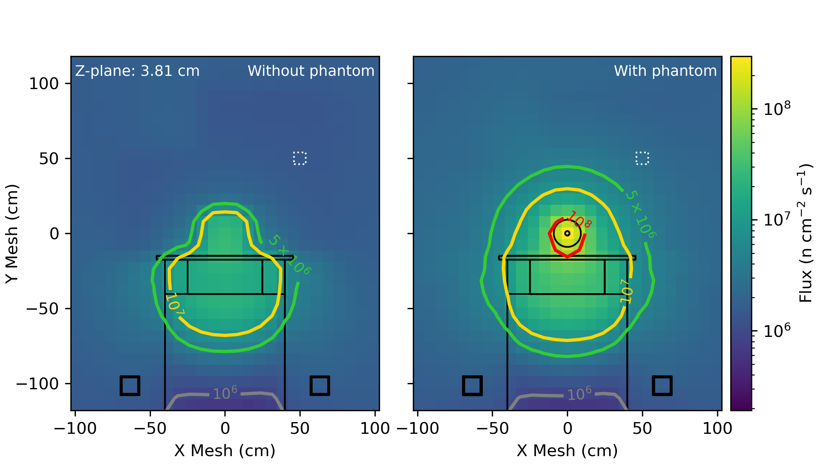
Photon flux
I_{p} = 30 mA
Notes:
From this (and previous slide) decide that 10^7 is lowest feasible neutron flux...
Therefore choose a radius of 68 cm to place detector at.

Slide 16
Discussion
Verbose word dump at the moment: this will be refined into clear bullet points.
OpenMC simulations suggest that with adequate shielding, it may be possible to place CeBr detectors in the HF-ADNeF target room, keeping the count rate in the detector below 500 MHz.
A limitation of this study: no simulation of recoil in detectors: we are low enough in energy that no alpha/protons are being produced, so likely a small contribution.
Could be possible to do this experimentally in the future.

Slide 17
Stage 1: Detector choice
472 keV gamma ray from 23Na
Notes:
Show a plot of the OpenMC detector responses. Highlight issue with NaI (refer to ND conference last week) and mention ENDF vs JEFF.
Be brief here – explain choice of CsI – Joey's work and SPARC.
Ultimately, choice of CsI is because OpenMC will simulate it correctly, whereas for LaBr OpenMC will not simulate the intrinsic background.

Slide 18
Stage 1: Detector choice
This slide will contain a plot of the pulse-height spectra from various crystal types when placed next to a boron target, irradiated with neutrons.
Also maybe show a plot without the boron to demonstrate the background.
This will show that NaI is not suitable as it has a background peak at 472 keV.
Also reference to SPARC experiment where they state LaBr can be used up to 500 MHz: Fugazza SL, Marcer G, Nocente M, Ciurlino A, Croci G, Rosa MD, et al. Feasibility study of gamma-ray spectroscopy for the determination of the fusion power at the SPARC tokamak. Fusion Engineering and Design. 2026 Jan 1;222:115403
Notes:
Show a plot of the OpenMC detector responses. Highlight issue with NaI (refer to ND conference last week) and mention ENDF vs JEFF.
Be brief here – explain choice of CsI – Joey's work and SPARC.
Ultimately, choice of CsI is because OpenMC will simulate it correctly, whereas for LaBr OpenMC will not simulate the intrinsic background.

Slide 19
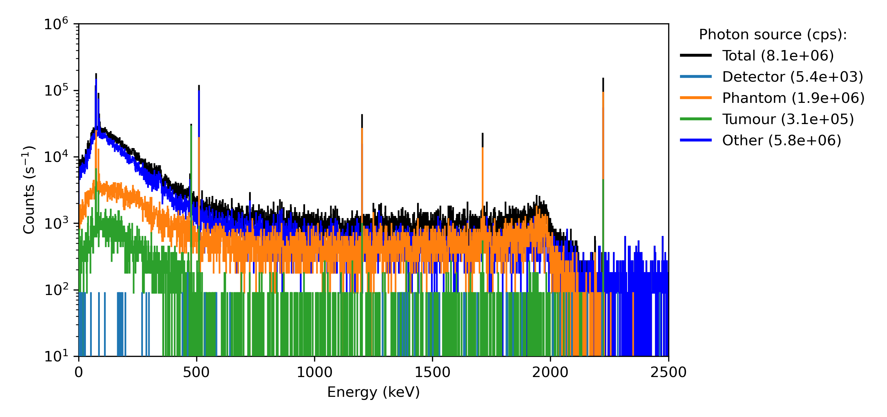
Stage 3: Shielding
No shielding
I_{p} = 30 mA
Lead X-rays
511 keV
SNR = 0.0398
478 keV
Escape peaks
2.2 MeV (²H)
Despite a good signal-to-noise ratio, the total count rate is too high.
Shielding is therefore necessary.
14 iterations later...
Notes:
Explain count rates in detector without shielding.

Slide 20
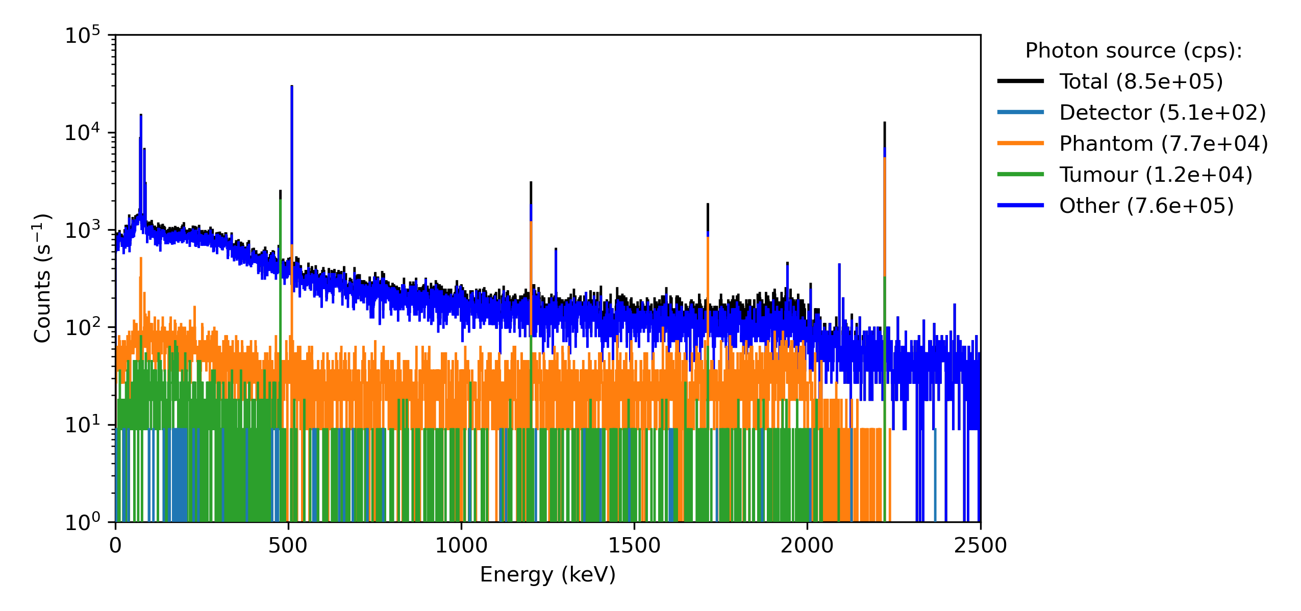
Stage 3: Shielding
Lead and ⁶Li metal
I_{p} = 30 mA
SNR = 0.0143
The flux at HF-ADNeF can feasibly be halved (I_{p} = 30 mA --> 15 mA)
The addition of beam-shaping assemblies (BSAs) would further reduce flux.
So, implementing this design could be possible experimentally.
Detector moved to 100 cm from Z-axis.
Notes:
Describe shielding – has lead to an order-of-megnitude decrease...

Slide 21
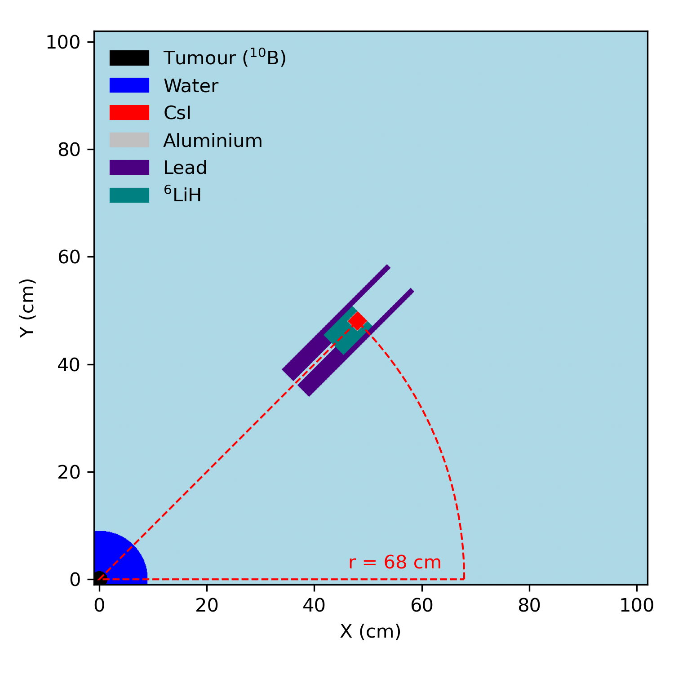
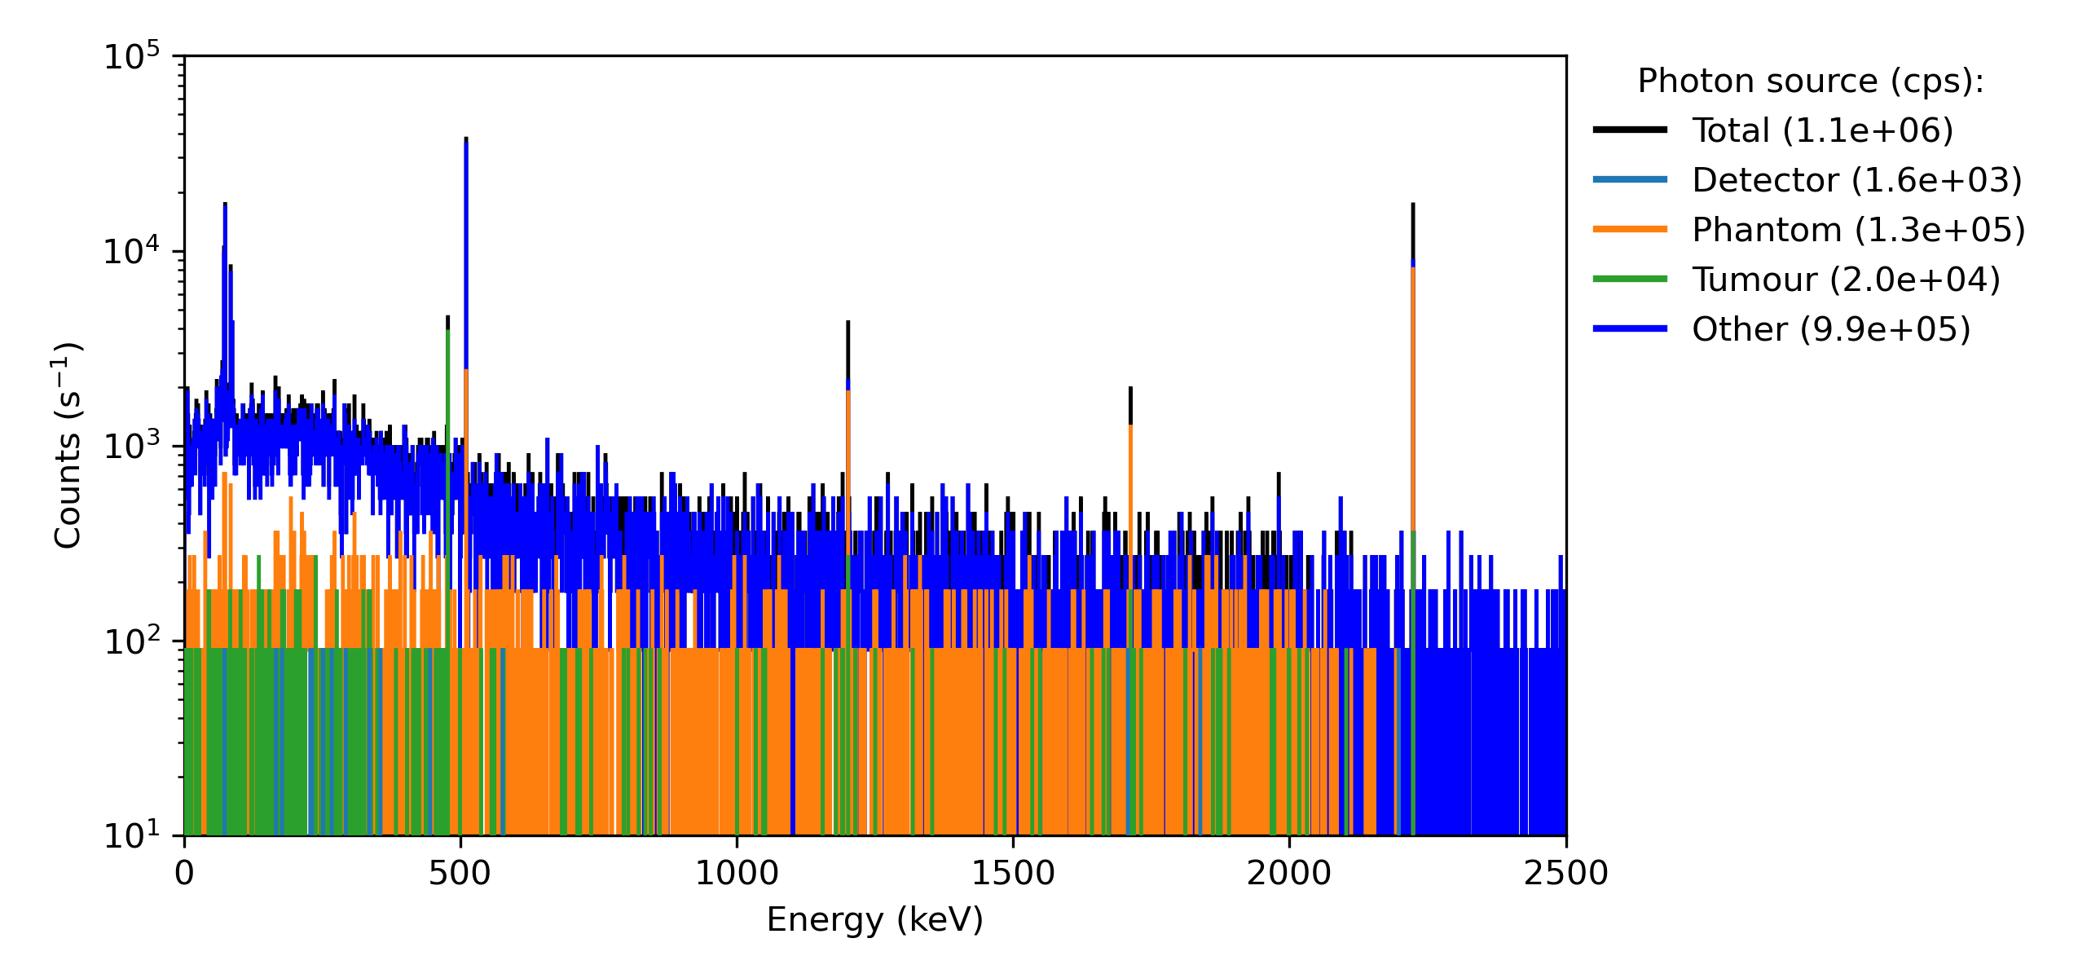
Stage 3: Shielding
Lead and lithium-6 hydride
SNR = 0.0185
Count rate is
Notes:
Explain count rates in detector without shielding.

Slide 22
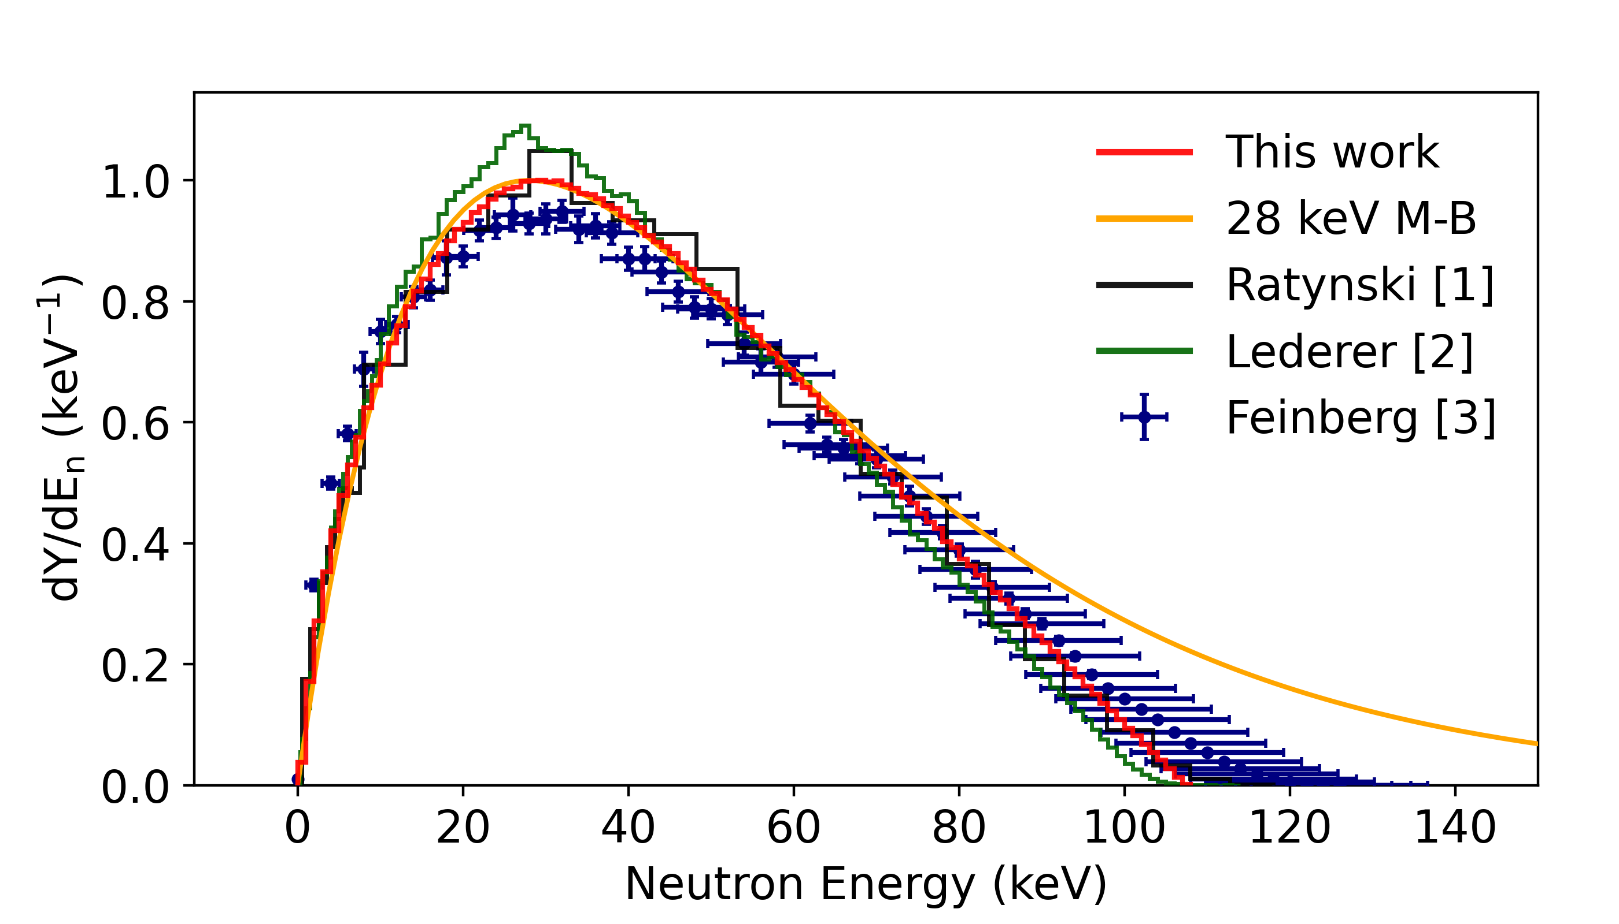
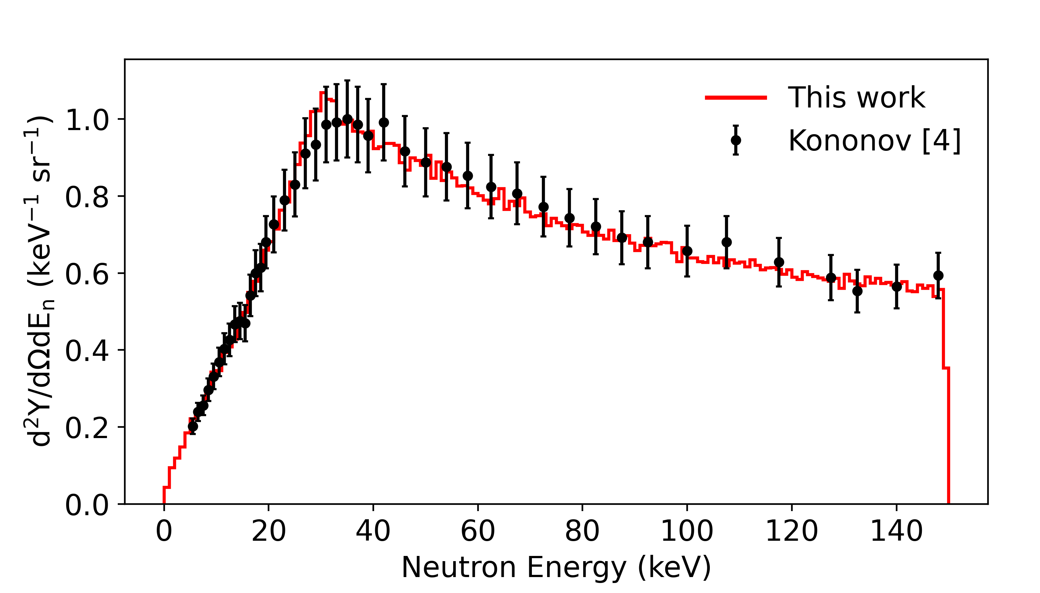
OpenMC Simulation
Validation possible at certain energies, using existing data:
Created a custom neutron source term for OpenMC simulations.
Total yield at
1.912 MeV:
Neutron spectra produced by source term:
0-degree yield at
1.94 MeV:
1) W. Ratynski, F. Käppeler, Neutron capture cross section of 197Au: A standard for stellar nucleosynthesis, 1988
2) C. Lederer et. al., Definition of a standard neutron field with the 7Li(p,n)7Be reaction, 2012
3) G. Feinberg et. al., Quasistellar neutrons from the 7Li(p,n)7Be reaction with an energy-broadened proton beam, 2012
4) V.N. Kononov, Absolte yield and spectrum of neutrons from the 7Li(p,n)7Be reaction, 1977
Notes:
Explain the OpenMC simulation, show different neutron spectra as well as validation.

Slide 23
OpenMC Simulation
Expand this slide with a recent image of HF-ADNeF, or merge with previous slide for conciseness.
Notes:
These neutrons are then transported through an accurate 3D model of the facility. This has been modelled natively in OpenMC, and is as accurate as possible.

