Slide 1
Enabling Better Science: Recent Scintillator and Micro-Pattern Gas Detector Developments at ISIS
Giacomo Mauri, G. Jeff Sykora¹, Davide Raspino¹, Sarah E. Mann¹, Erik M. Schooneveld¹, Nigel J. Rhodes¹
Neutron Detector and Facility Workshop – Institute of Physics London
17-09-2026

Slide 2
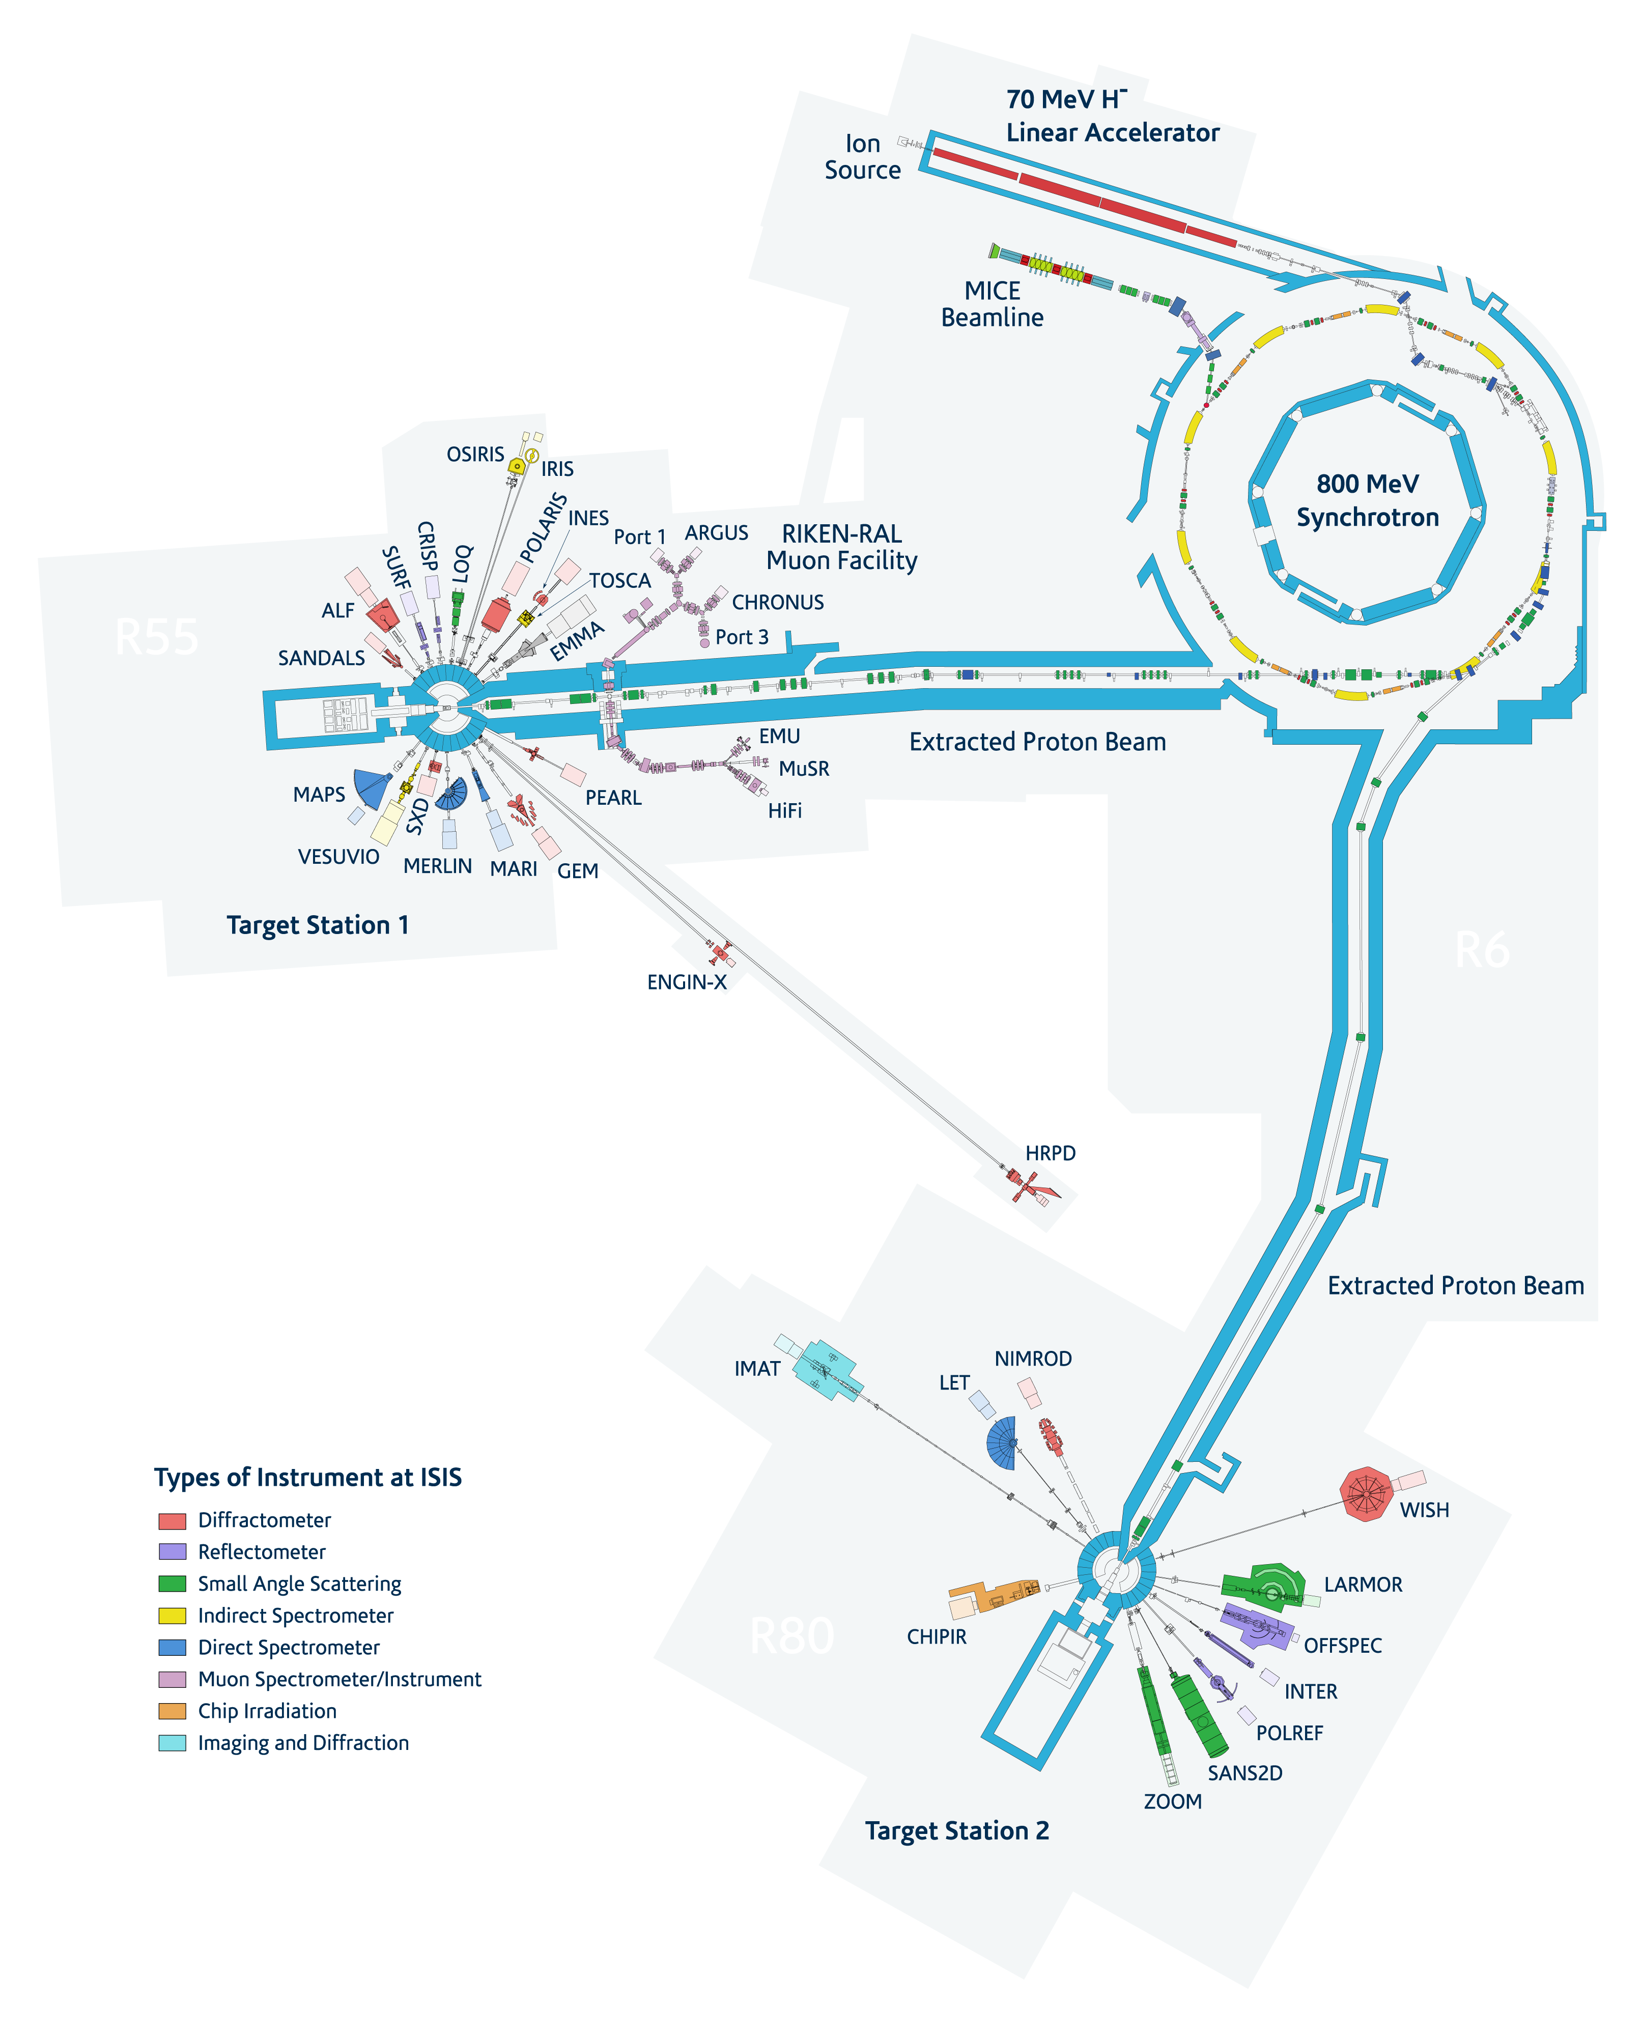

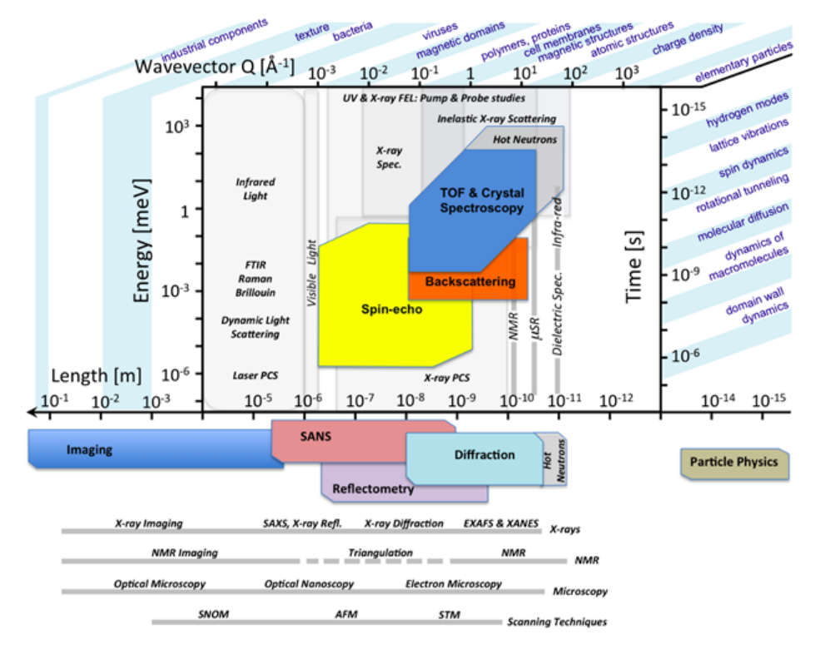
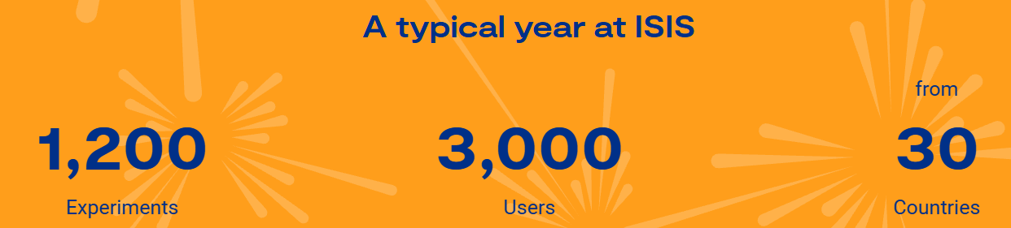
ISIS neutron and muon facility
Spallation neutron and muon source with two target stations and a suite of 35 instruments

Slide 3

ISIS neutron and muon facility
Keeping the facility at the forefront of neutron and muon scattering: Delivering Scientific and Societal Impact
75M£ programme to deliver
2 cutting-edge instruments *
5 major upgrades
Over the next 10 years
Instrument | Technique
HRPD-X | High resolution powder diffraction
Wish-II * | Disordered material neutron diffraction
SANDALS-2 | Inelastic neutron scattering
Mushroom * | Single crystal, thin film and powder diffraction
Osiris+ | High-resolution spectrometer
Tosca+ | indirect geometry spectrometer
SuperMuSR | Muon spectrometer

Slide 4
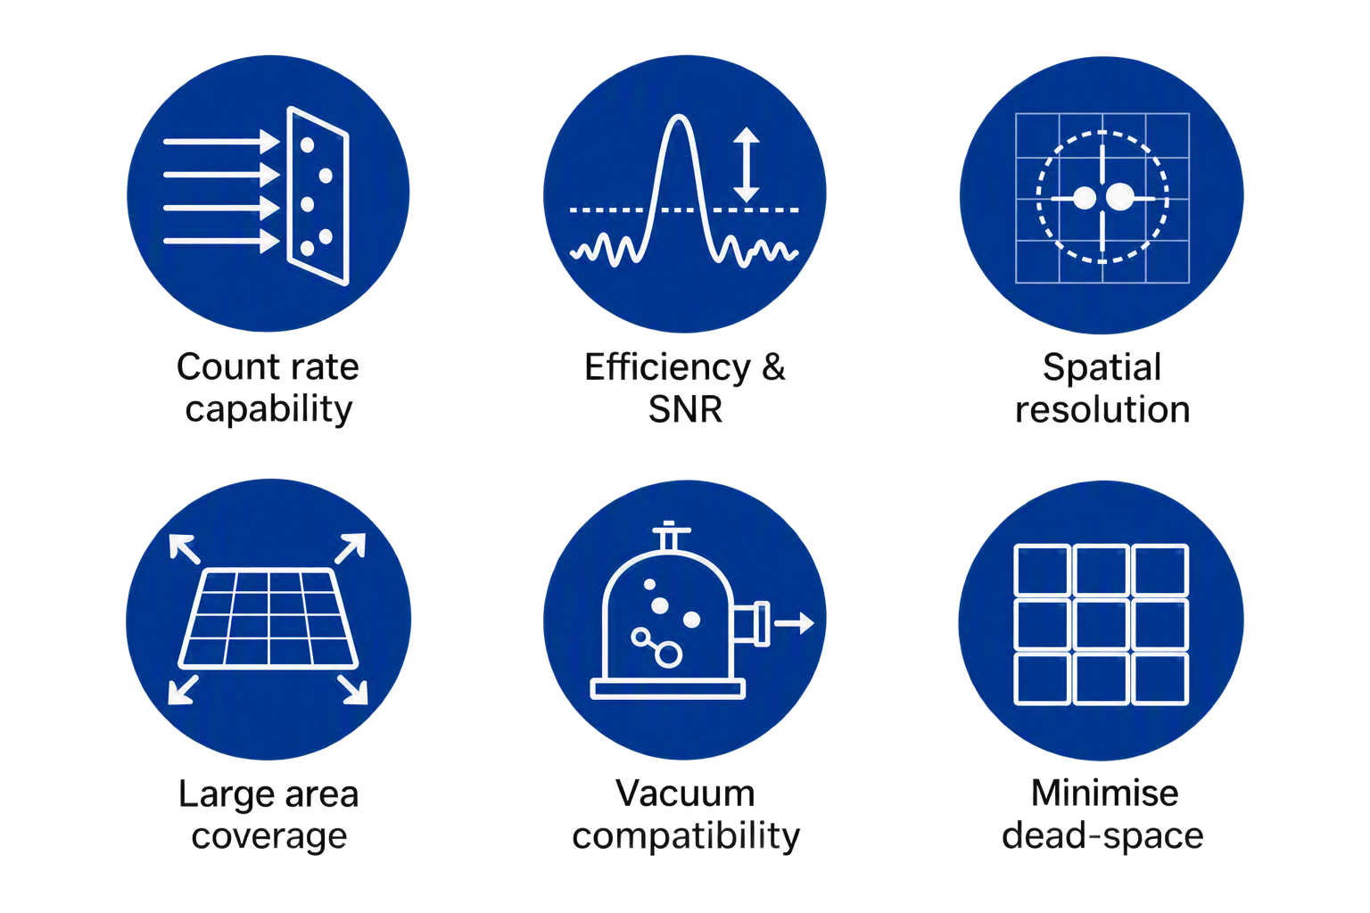
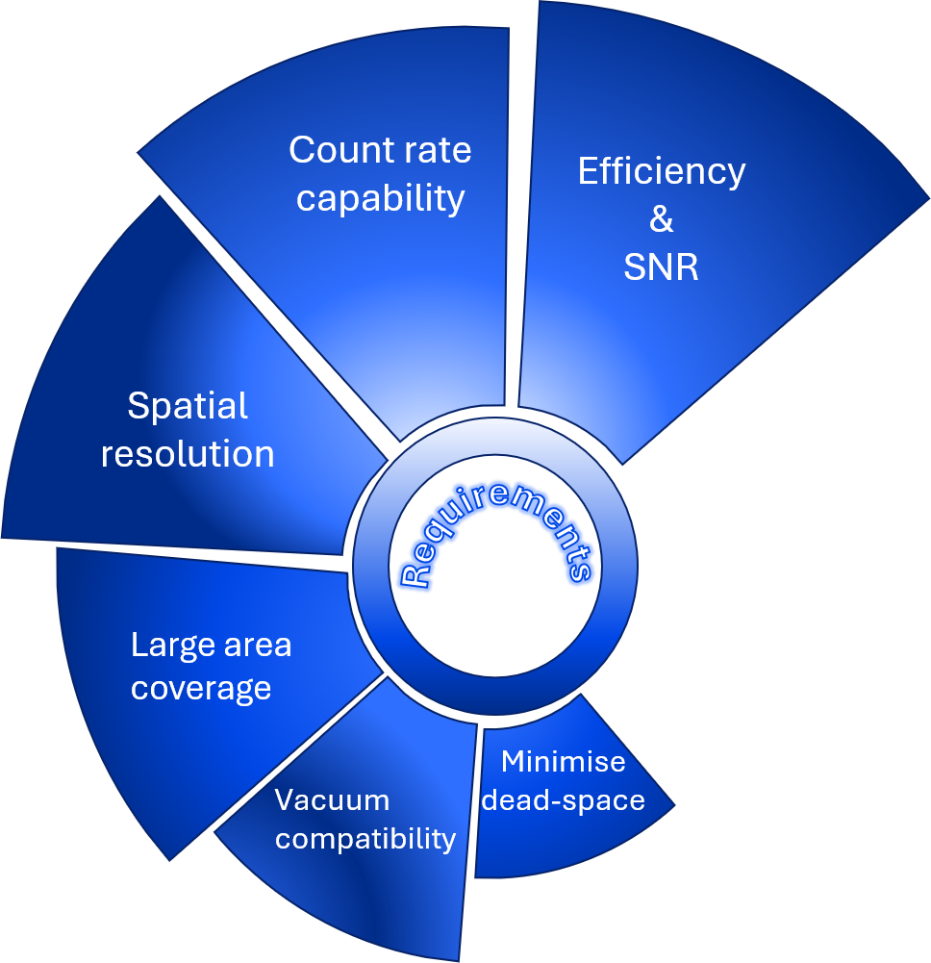
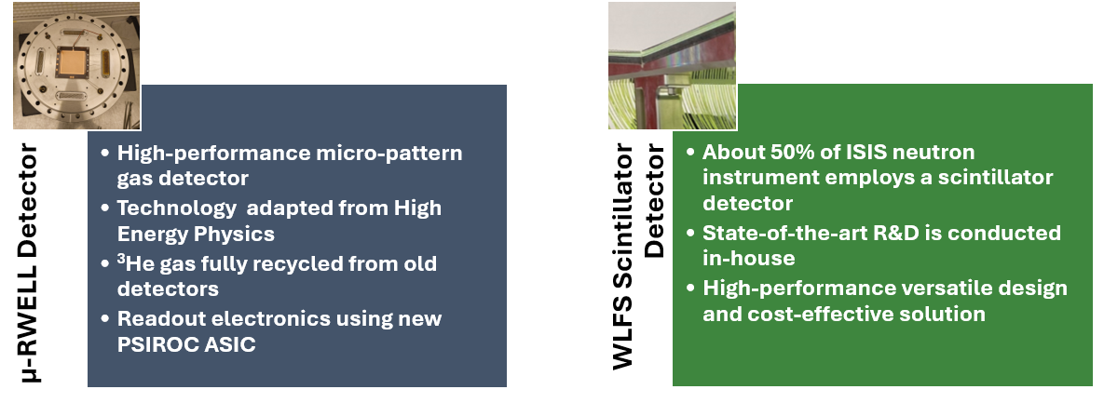
Neutron detector development
Neutron detector development necessary to meet the requirements of the instruments
Scintillator- and gaseous-based neutron detectors have been developed at ISIS for over 30 years. Ongoing R&D is focused on improving performance and meeting increasingly demanding instrument requirements

Slide 5
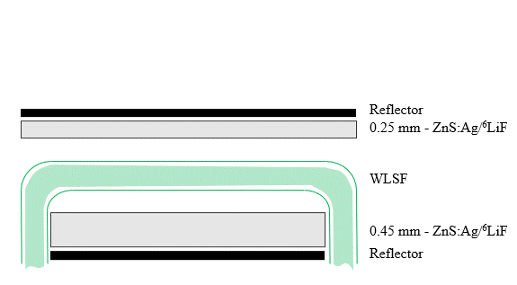
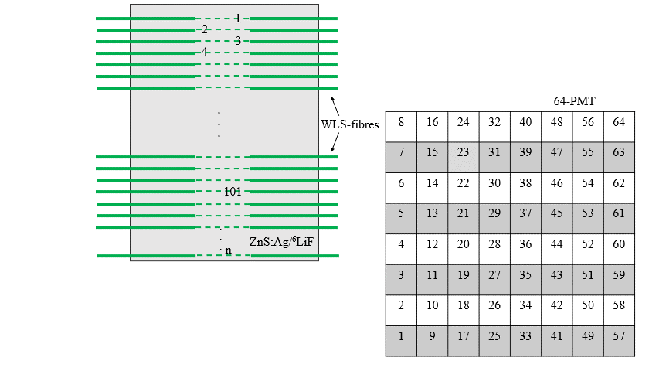
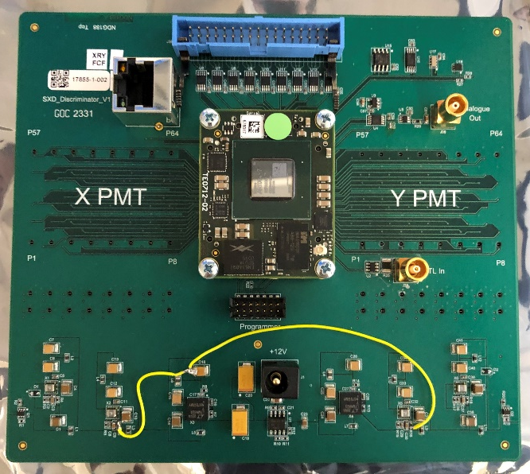
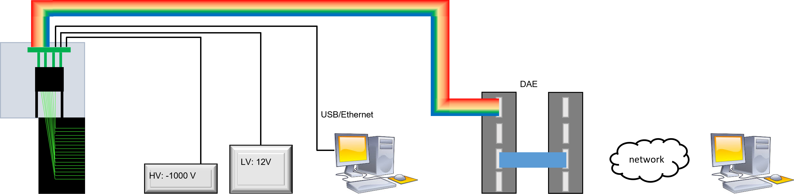
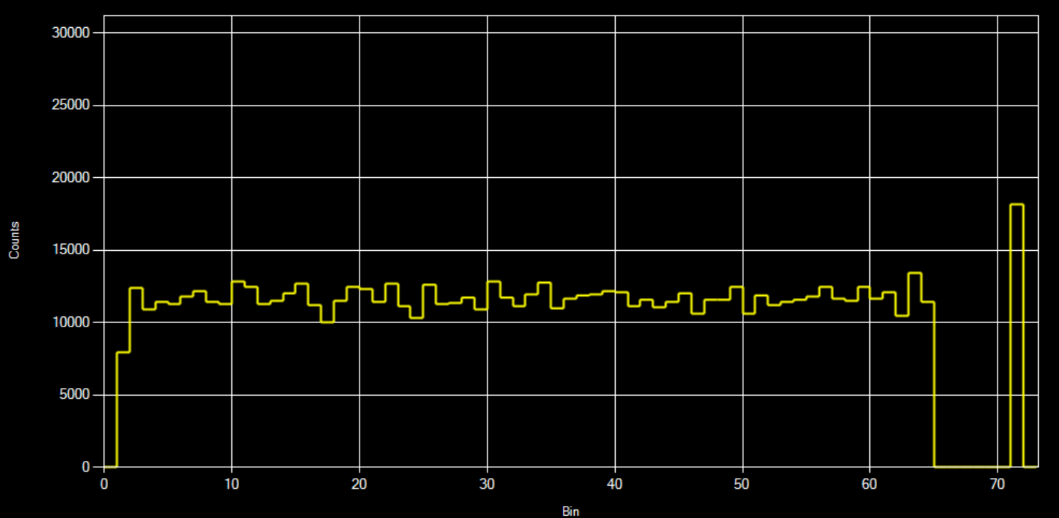
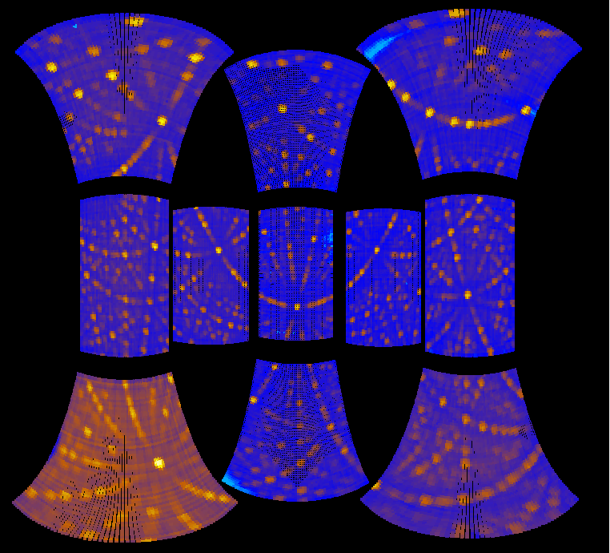
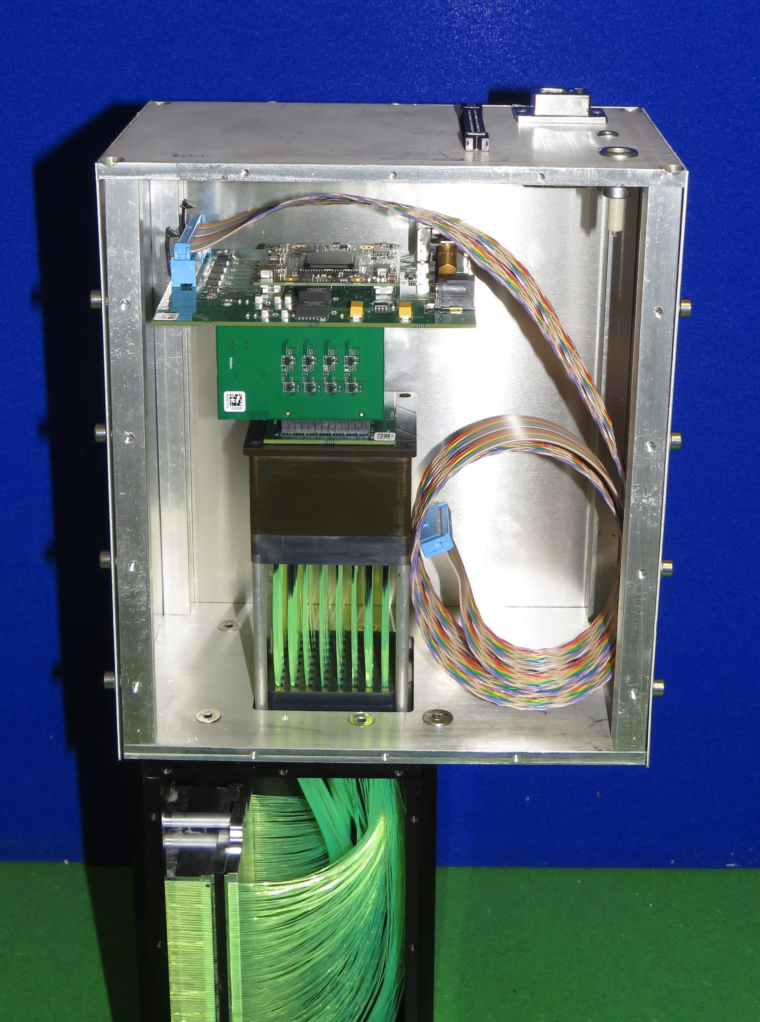
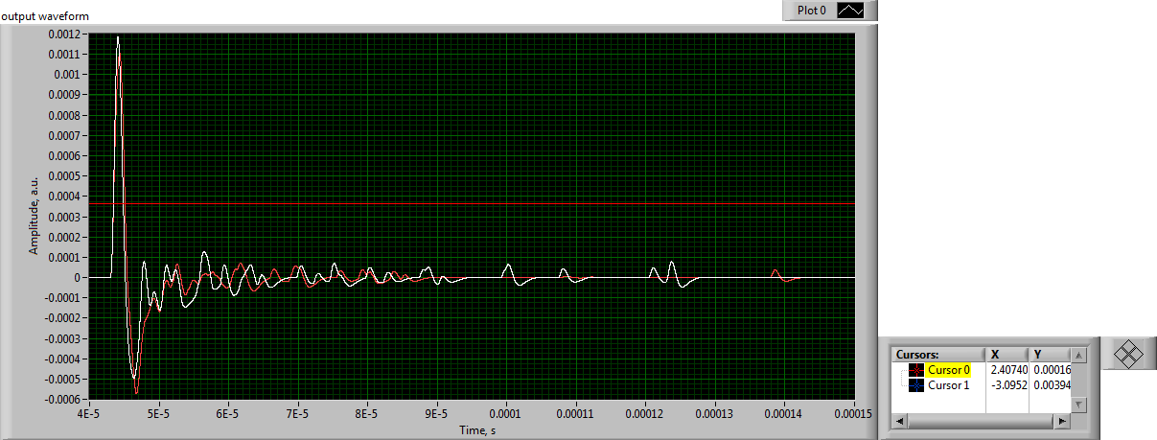
WLSF Scintillator detectors – basic concept
Scintillator/WLSF
PMT
Front-End Electronics
PreAmps+ FPGA Discriminator board
Data Acquisition
$${}_{3}^{6}{Li}+{}_{0}^{1}{n→{}_{1}^{3}H+ {}_{2}^{4}{α ; Q=4.78 MeV}}$$
Scintillator: 2:1 ZnS:Ag to ⁶LiF ratio
Fibre: Kuraray Y-11, 300 ppm dye concentration, diameter 0.5 mm
Reflector: Al foil
Data transfer:
Directly from FPGA to the pc via
USB/Ethernet.
Via ISIS DAE saved on the network.
Three-stage integrator and single differentiator: convert single photon density into digitised analogue signal

Slide 6
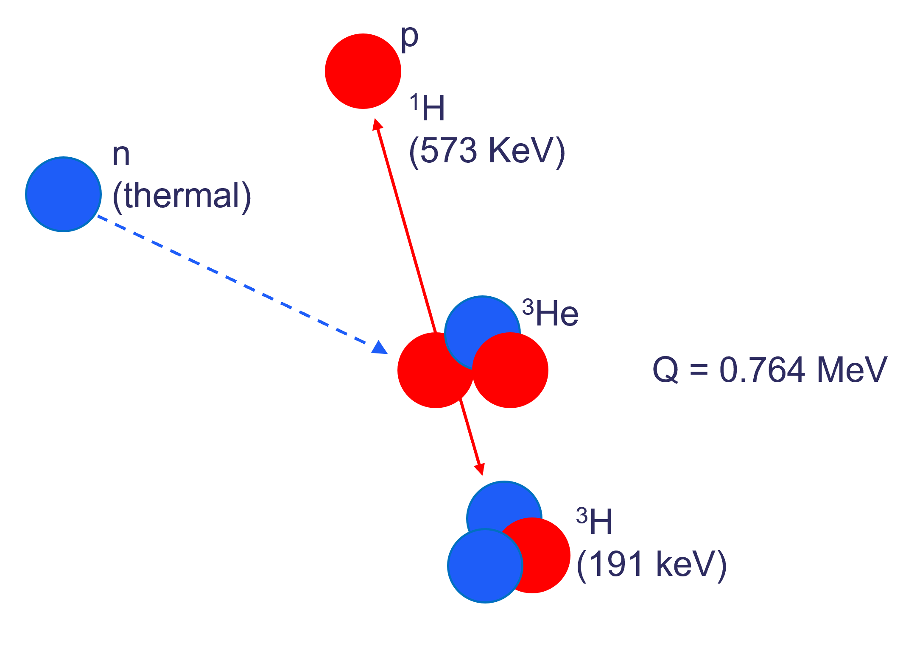
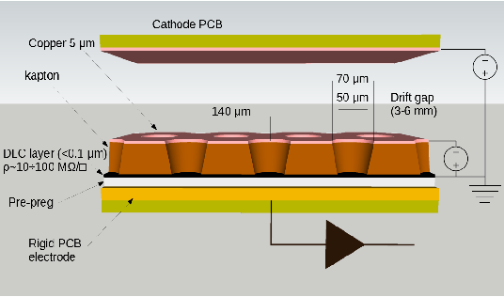
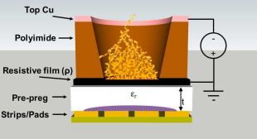
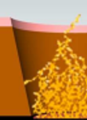
µRWELL detector – basic concept
Micro-Pattern Gas Detection technology developed for High-Energy physics at CERN.
Adapted for neutrons at ISIS in 2022*. It was shown that µ-RWELLs can operate in ³He-CF₄ (up to 6 bar CF₄)
*Davide Raspino
n

Slide 7
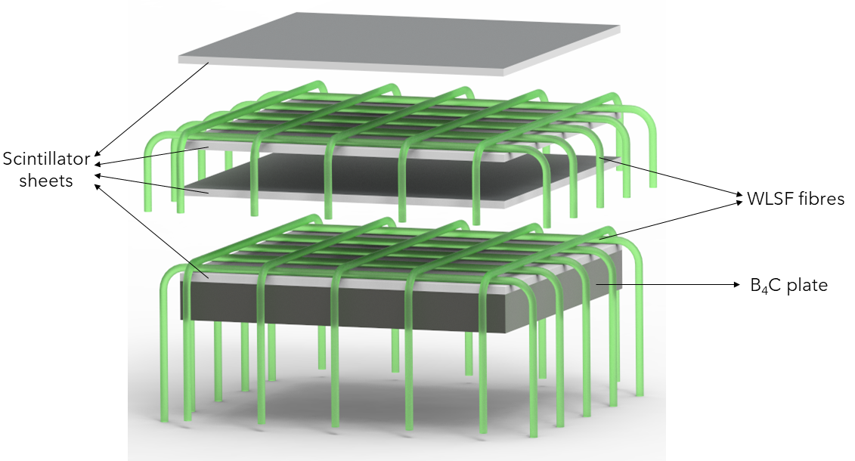
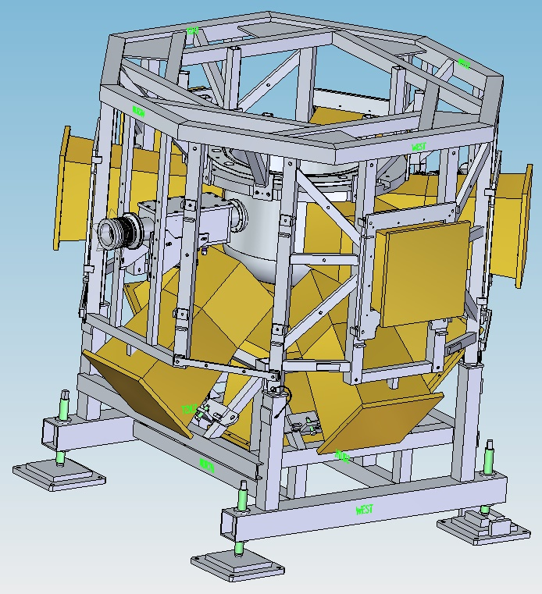
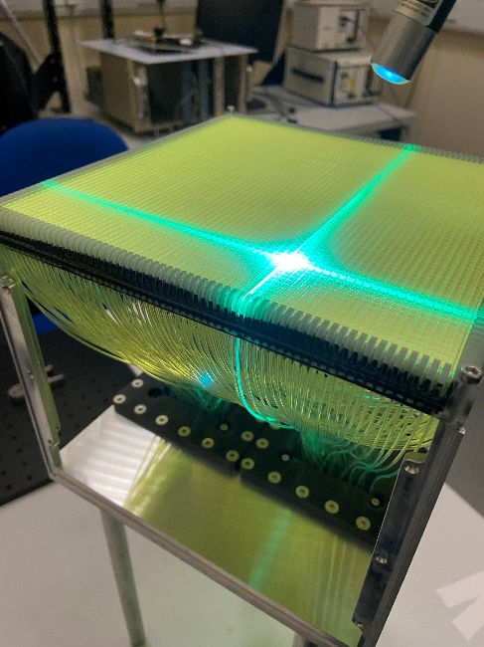
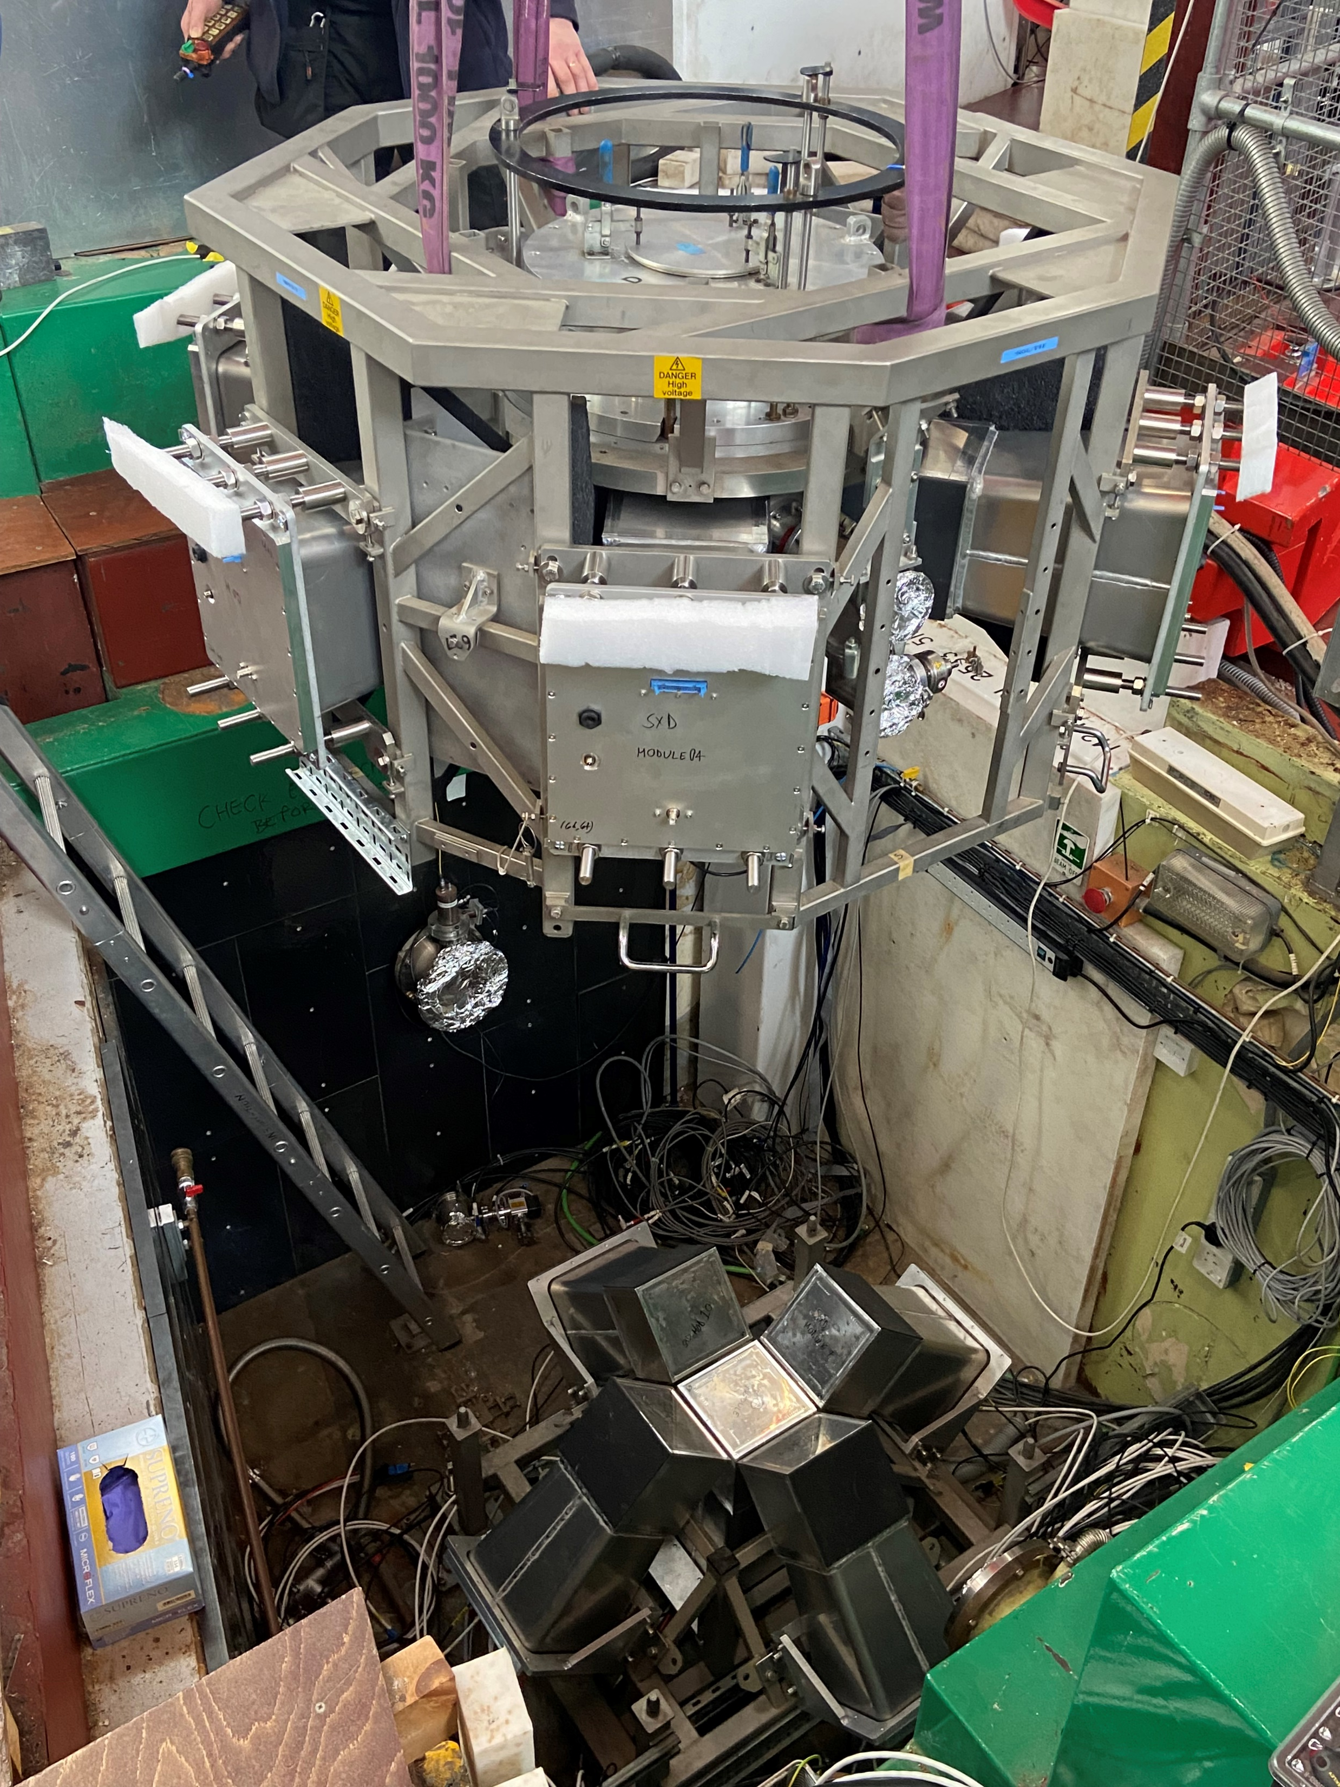
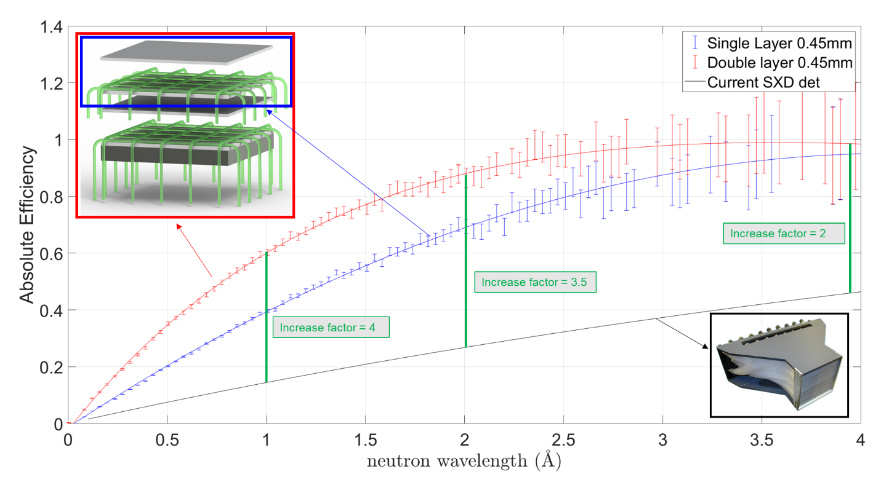
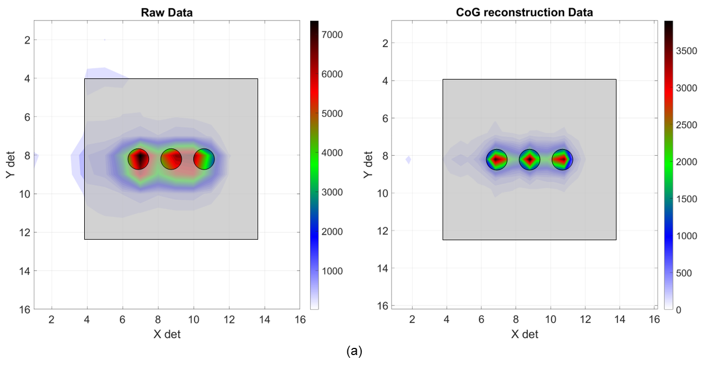
WLSF scintillator detector - latest developments
Double-layer design
SXD – Single crystal diffractometer
Scintillator geometry | Double layer
Efficiency at 1.8A | 80%
Area coverage | 0.44 m²
Pixel size | 3 mm x 3 mm
Number of pixels per module | 4096
PMT channels per module | 128
Samples | <1mm³ unit-cell10000-30000 Å³
Increase position resolution using CoG algorithm. Able to resolve 3 holes of 2 mm Ø at 6 mm distance

Slide 8
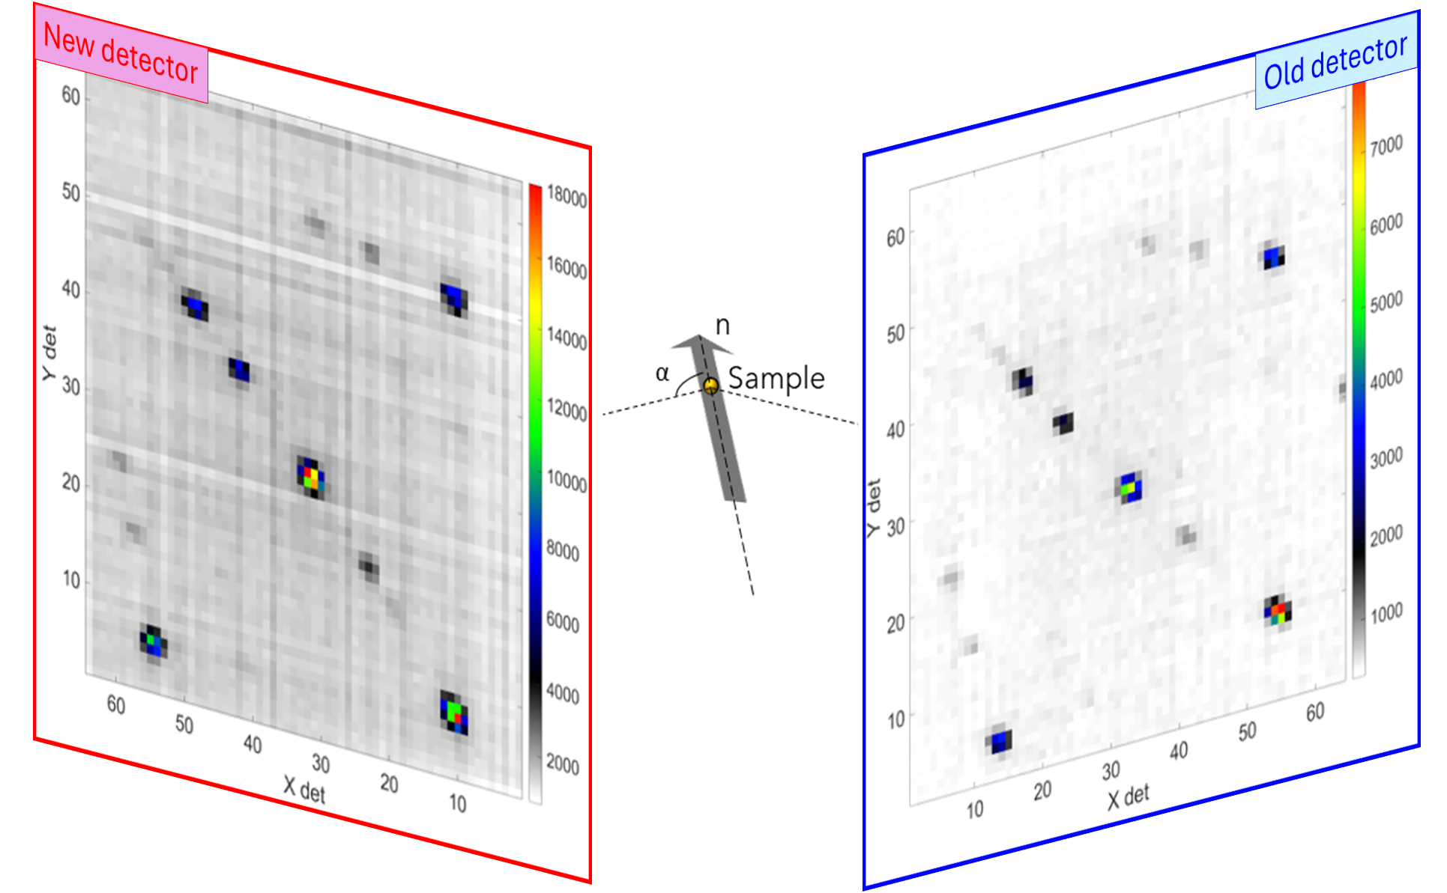
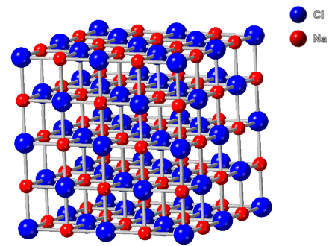
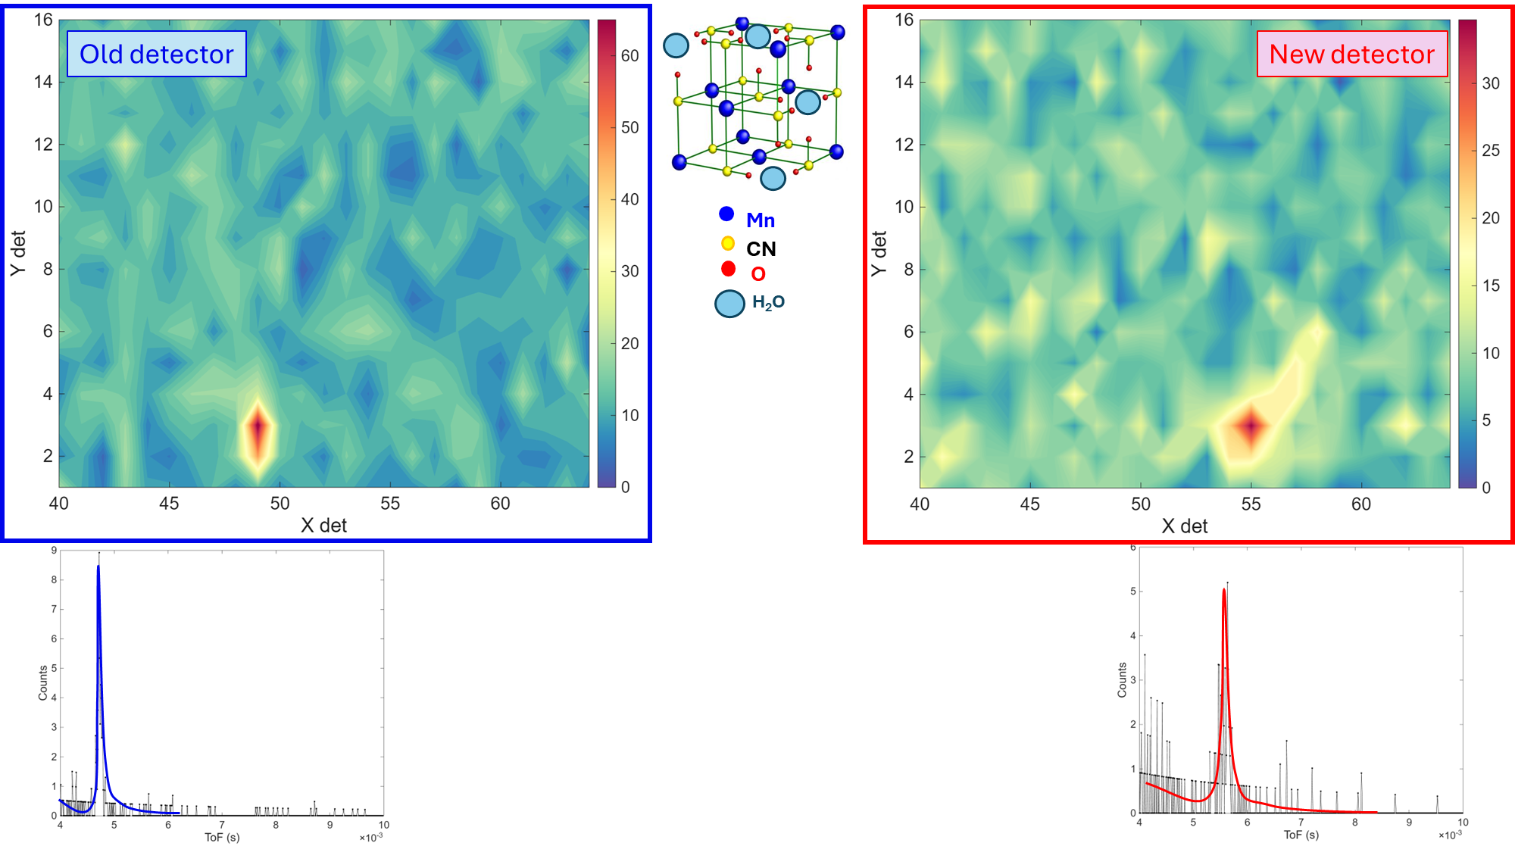
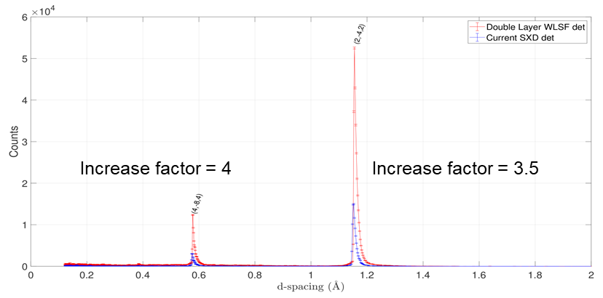
WLSF scintillator detector - latest developments
NaCl
Manganese analogue of Prussian Blue: Mn₃[Mn(CN)₆]₂(H₂O)₆.x(H₂O)
Bragg reflections intensities of the centre Bragg peak
Increase by over a factor 3 with the new detector
Able to measure Bragg peak:
x50 smaller sample
45% of measuring time
In H₂O instead of D₂O

Slide 9
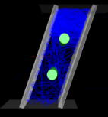
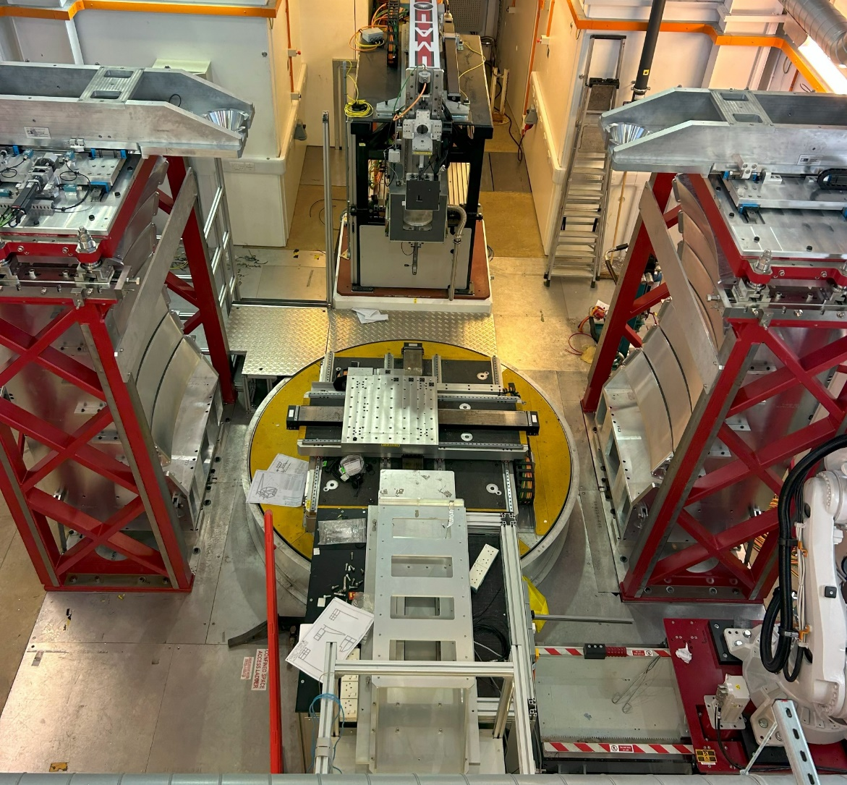
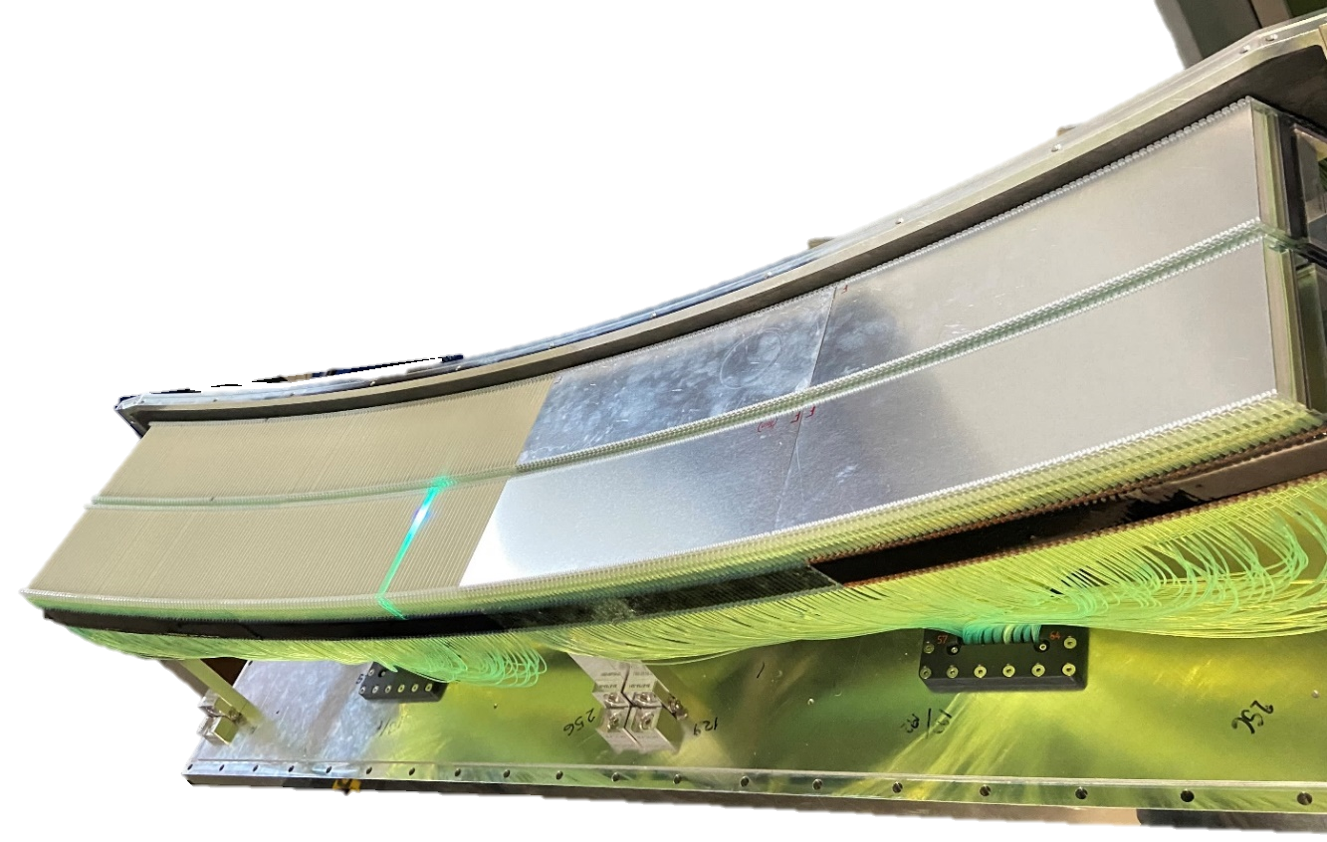
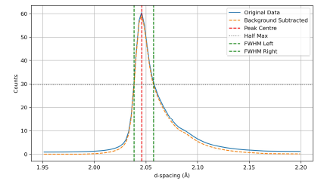
WLSF scintillator detector - latest developments
Tomographic driven diffraction with texture analysis
Scintillator geometry | Venetian
Efficiency at 1.8A | 65%
Total coverage | 2.8 m²
Pixel size | 4 mm x 100 mm
Number of pixels per module | 512 x 2
Curvature geometry | L₂ = 2m
Resolution | Δd/d<0.01
Successful commissioning and installation of 14 modules
Uniformity ±10%
Fe powder
Δd/d = 0.0092

Slide 10
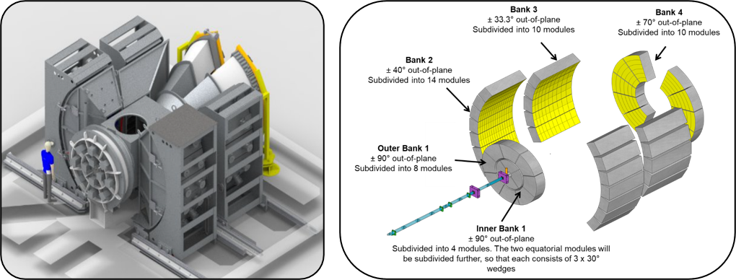
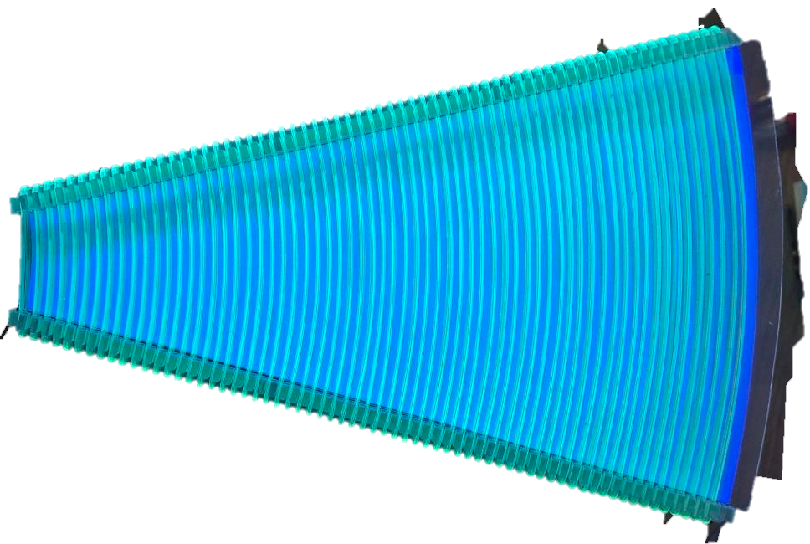
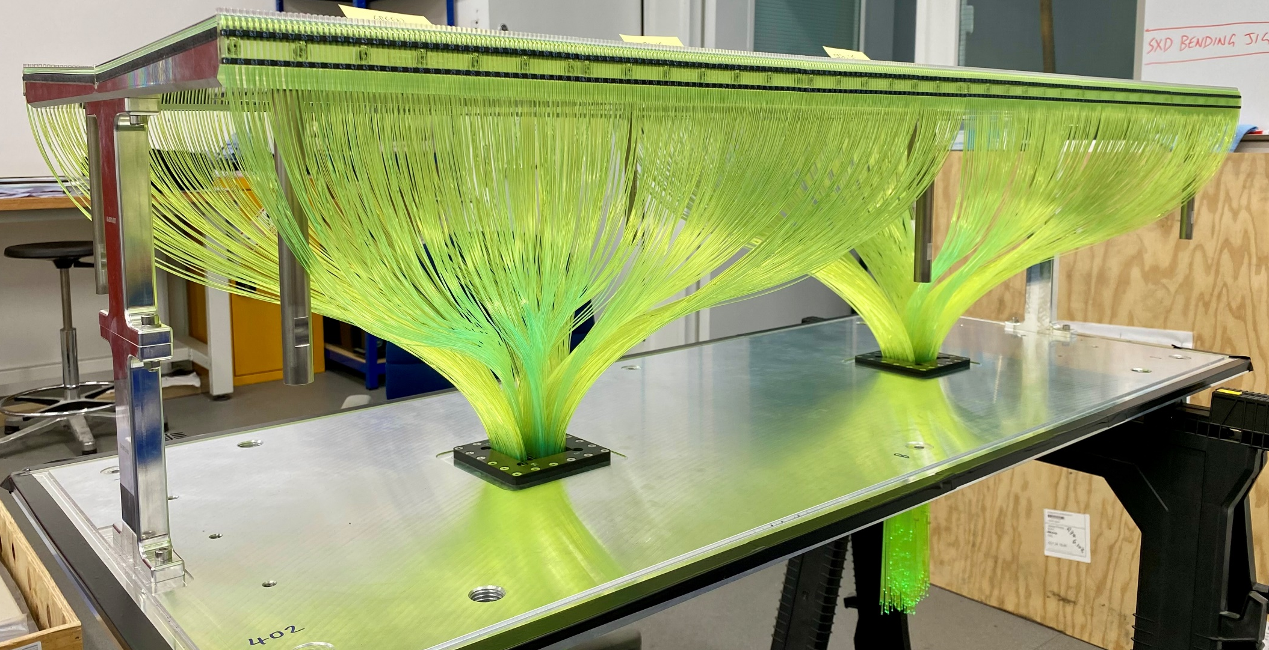
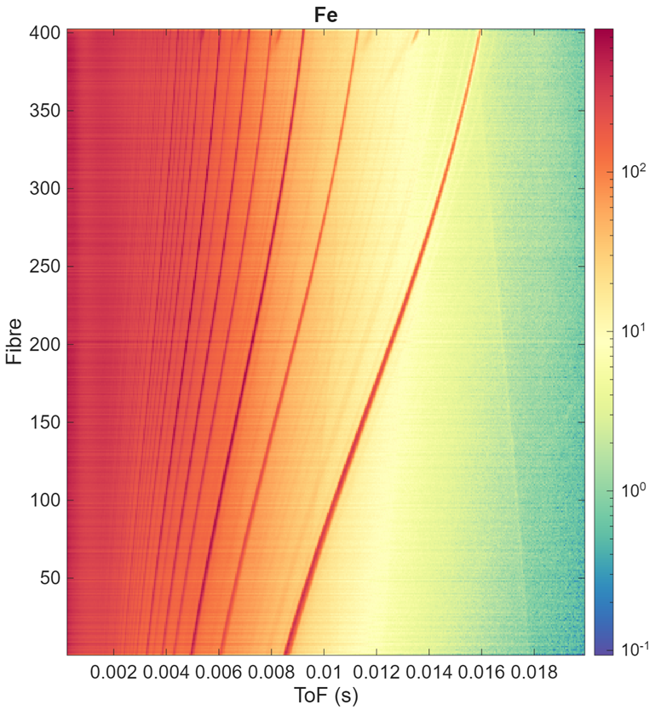
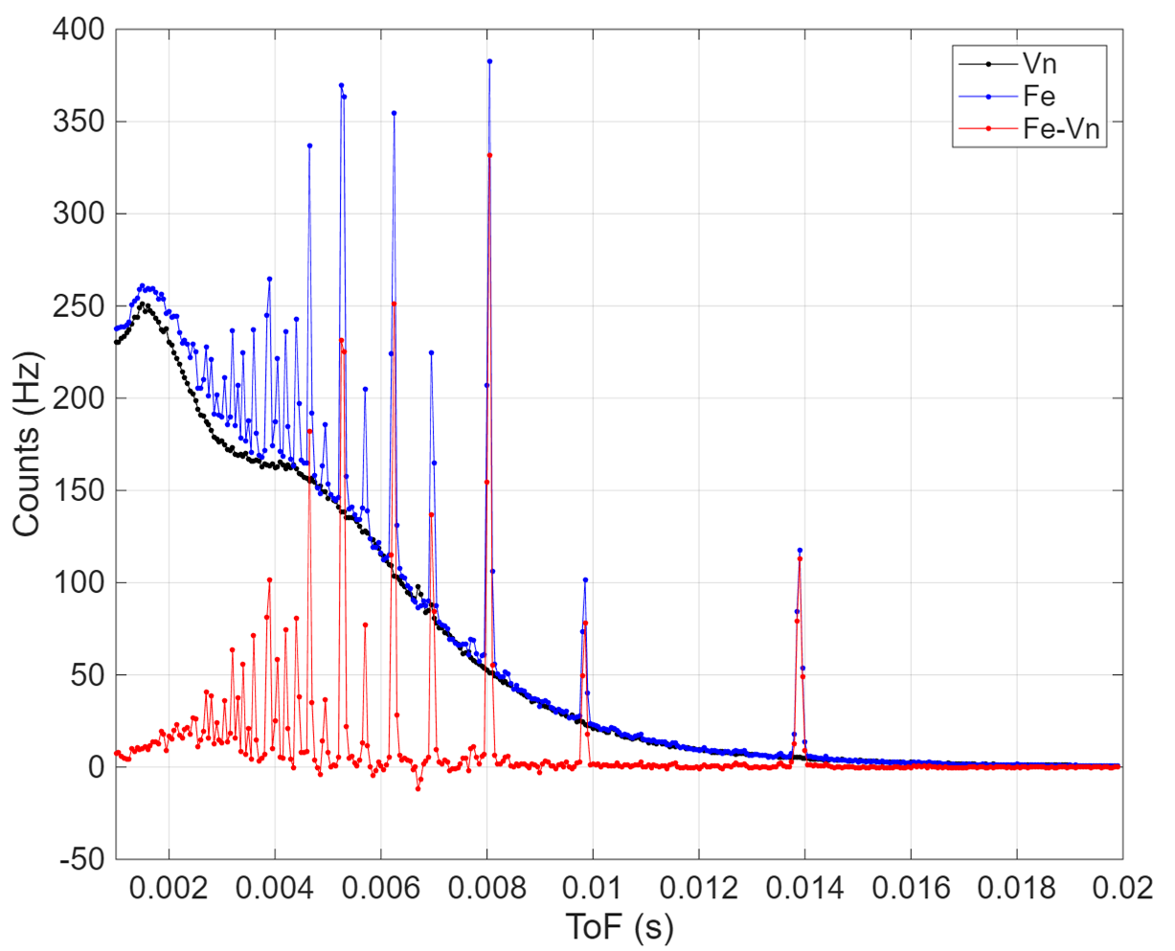
WLSF scintillator detector - latest developments
HRPD-X
4 detector banks for large-area coverage 17.5 m²
5 different types of detectors
  3 types of annular detector (back-scattering and forward-scattering)
  2 types of ‘curved’ detector (90° and low angle)
Double layer geometry, efficiency 75% at 1.8 Å
Pixel size 3 mm x varying
Δd/d = 4x10⁻⁴
PICTURE
First 90 ° detector
MEASUREMENT
First wedge detector

Slide 11
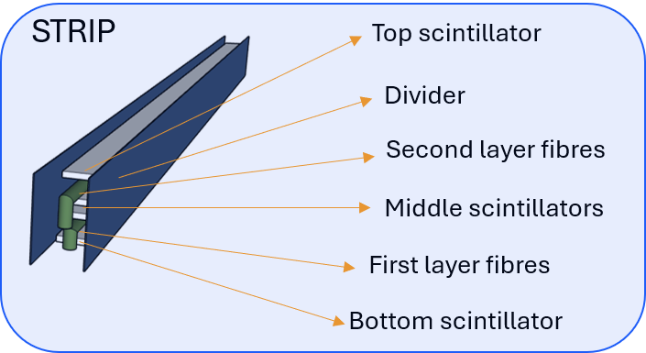
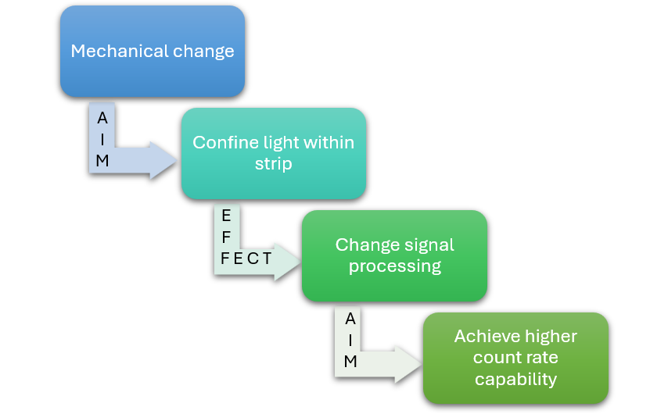
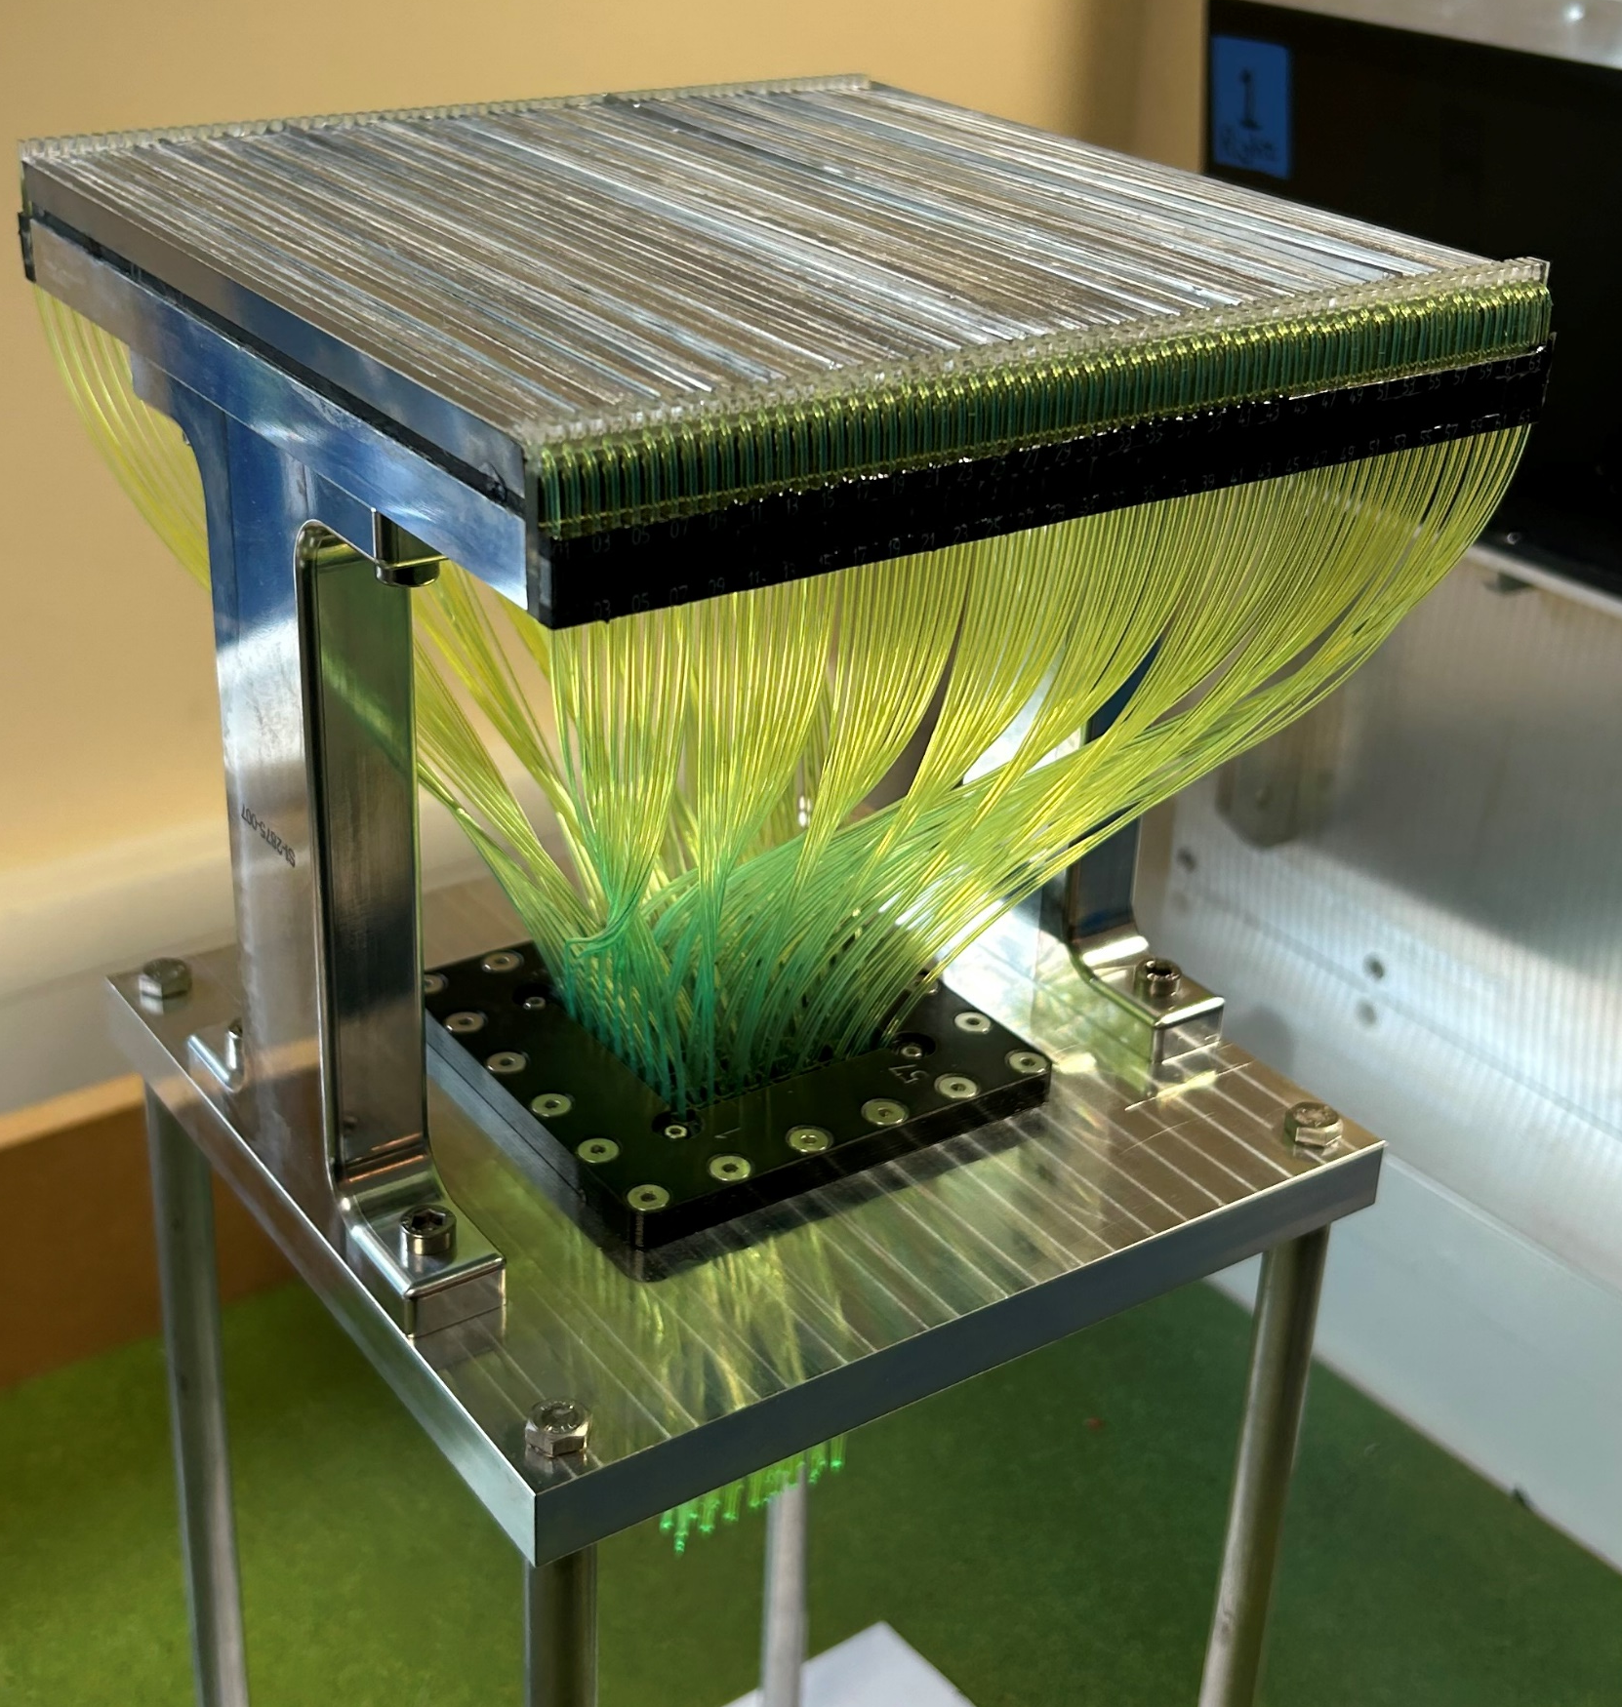
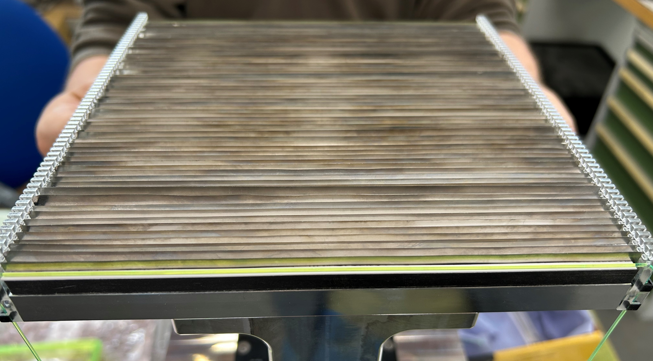
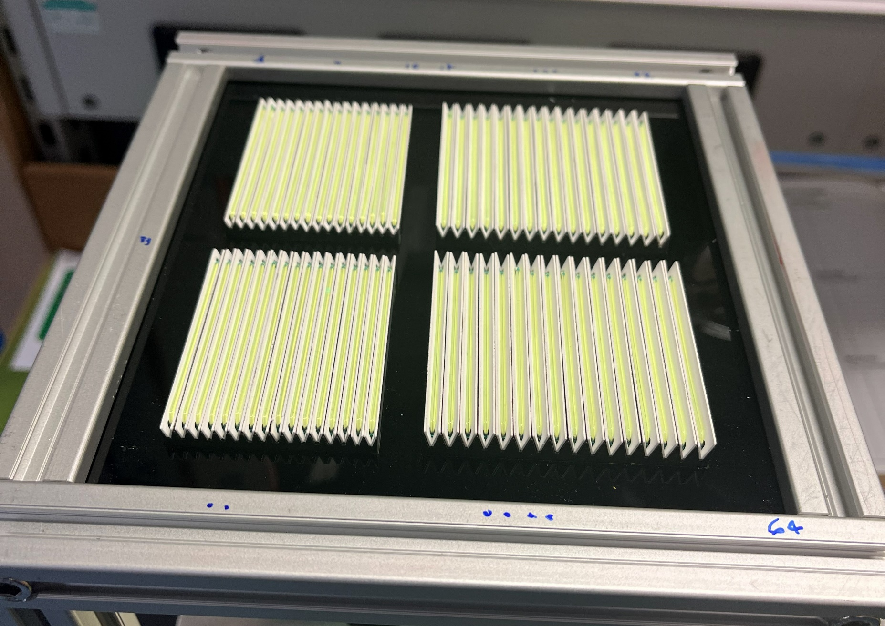
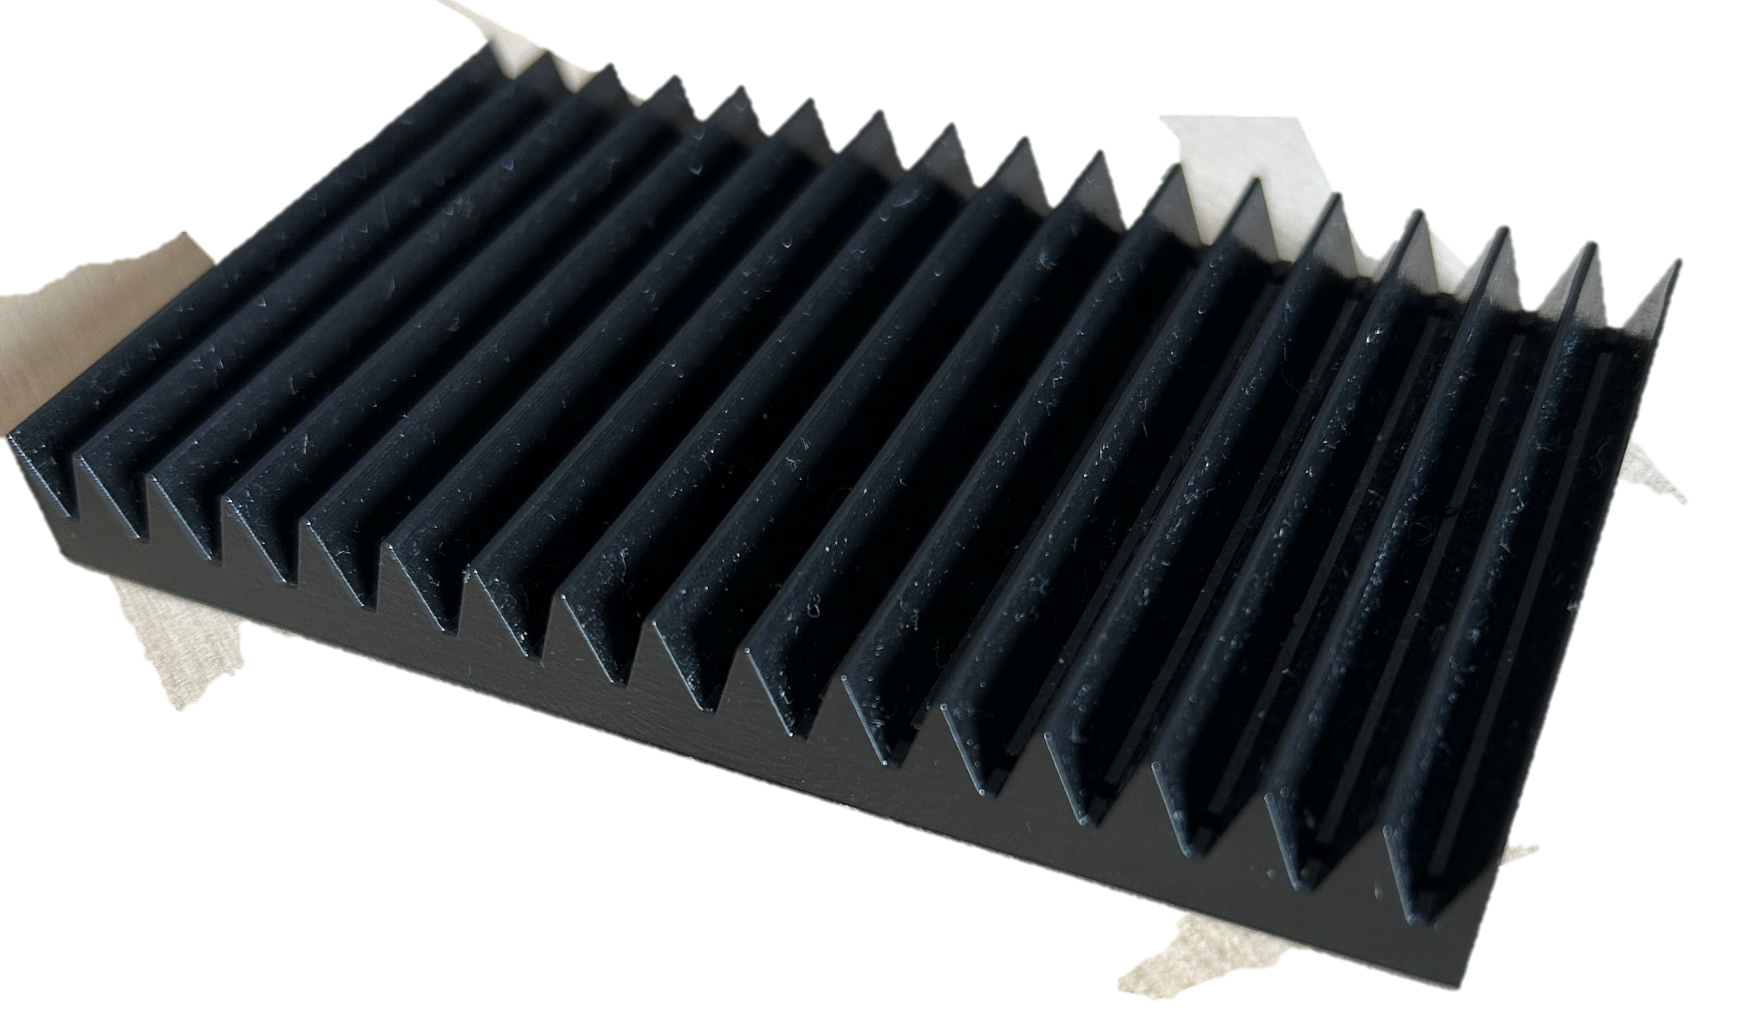
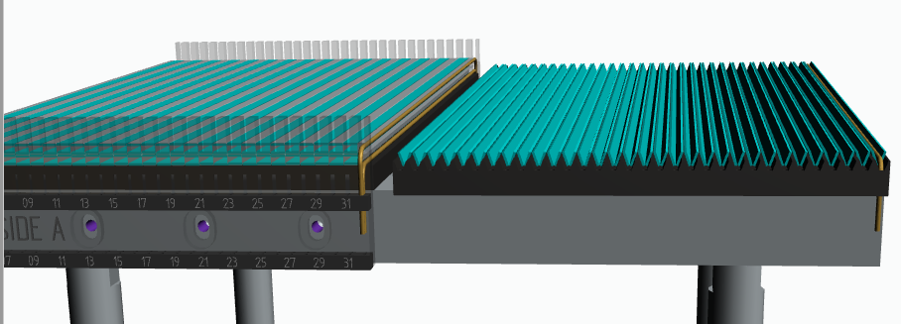
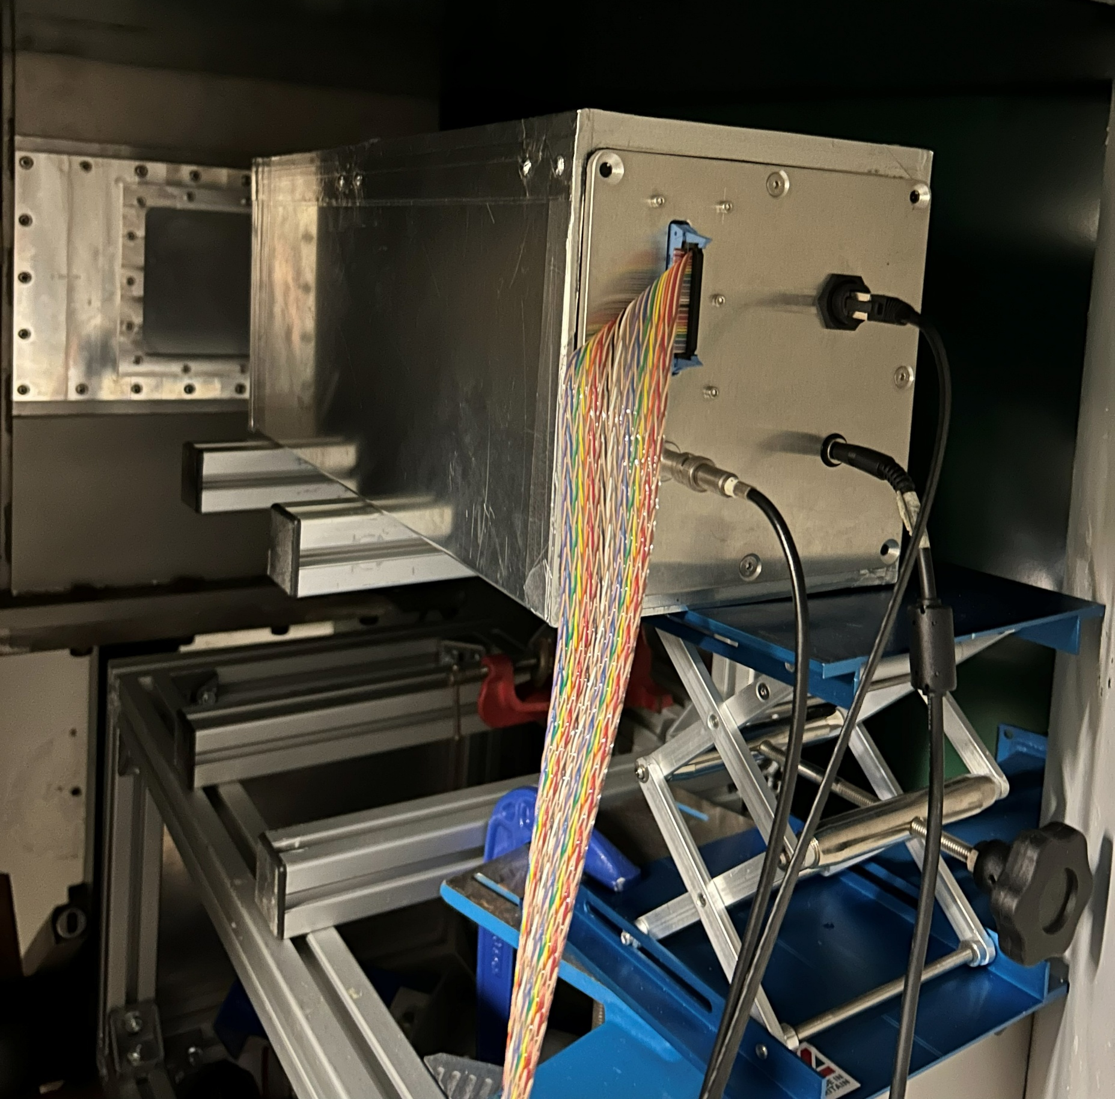
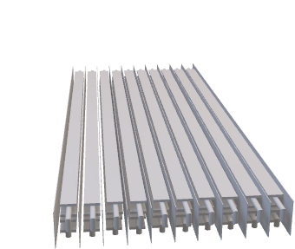

WLSF scintillator detector - latest developments
HiRIS (High-Rate Individual Strip)
Tilted geometry
Implications:
Same efficiency as using 4 layers
Same increase in rate capability
Easier to build
Cost reduction
$$c=b∙\frac{1}{\sin{θ}}$$
b
θ
c
c
a
a
Factor increase in path length
b

Slide 12
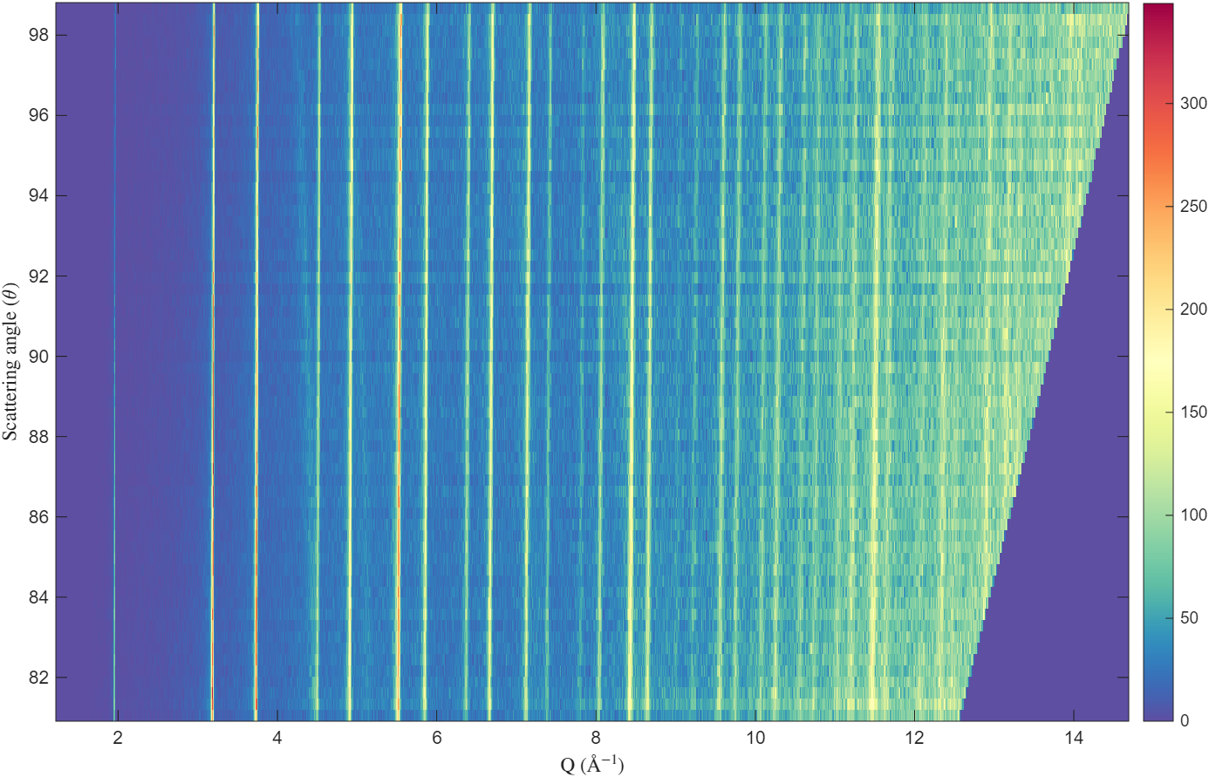
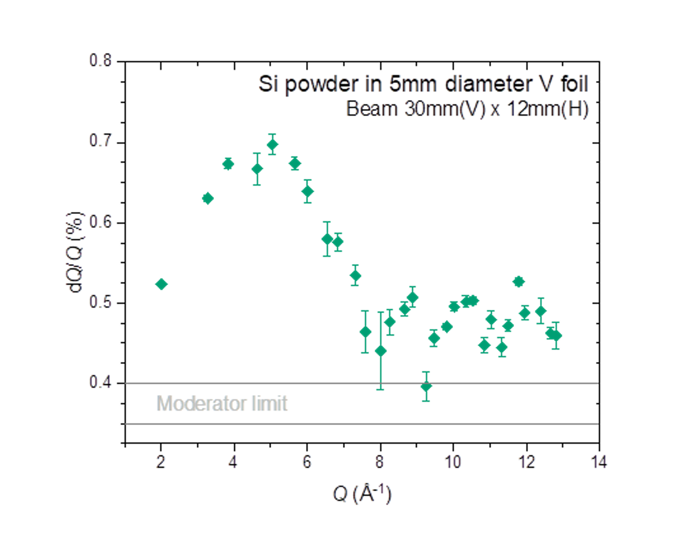
WLSF scintillator detector - latest developments
Performance
Uniformity below ±8% (or ±3% with variable LLD calculation)
TbE show potential double counting effects ~0.9%
Gamma sensitivity ~1.8·10⁻⁶
Count rate ~300kHz
Count rate variation <0.09%/°C
ΔQ/Q <1%

Slide 13
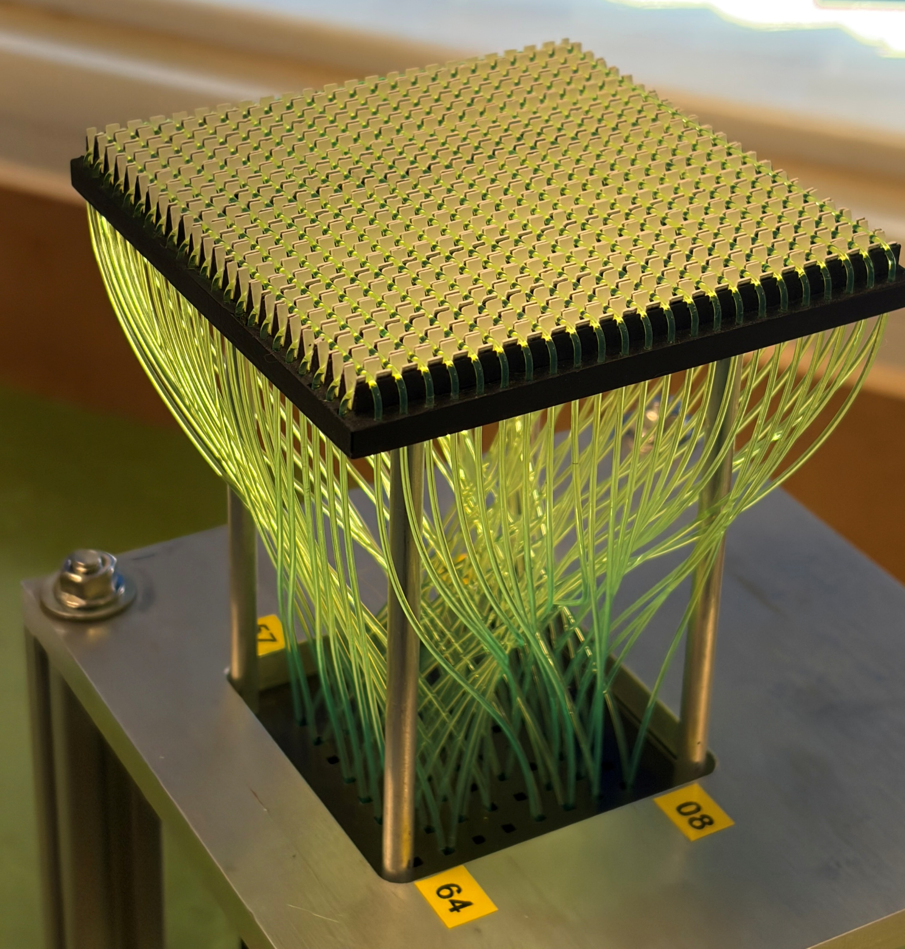
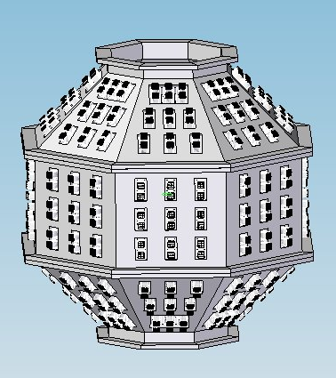






WLSF scintillator detector - latest developments
Large area coverage 12.5 m²
Minimise dead-space between modules
Vacuum compatibility
Efficiency >75% at 1.8 Å
Pixel size 4 mm x 4 mm
d-spacing range 0.5-100 Å
NaCaAlF
15% less efficient than ³He tubes
Similar SNR
Silicon
Shape and profile of the reflection is consistent with the ³He tubes

Slide 14





µRWELL detector – latest development
MUSHROOM
Concept:
Collect more scattered neutrons.
Concentrate them onto a compact detector system.
Use detectors capable of handling the much higher local rates.
Detector Performance:
~80% efficiency at 4.3 Å
~3 mm spatial resolution
Local peak rates approaching 1–2 MHz per pixel during elastic peaks

Slide 15










Conclusion
Enhancements in performance and continued research on these detector technologies, will further extend the capabilities of the science programme, paving the way for future instrument upgrades at ISIS.
Group leader
Jeffrey Sykora
Section leader & electronics
Erik Schooneveld
Scintillator detectors
Giacomo Mauri
Sarah Mann
Gas detectors
Davide Raspino
Imaging and muon detectors
Daniel Pooley
Beam monitors
Quintino Mutamba
Technicians
Stefan Howarth
Graham Smith
Endeavour consultant
Nigel Rhodes
Students
Reailtin Eve Emilia Giorgio Henry Ben Gabriel Annabelle + more
Electronics section
Thank you for your attention!

Slide 16
backup

Slide 17



Slide 18


WLSF scintillator detector - latest developments
Number of counts similar between SF (standard firmware) and MF (multiplex firmware)
Uniformity below ±8% (or ±3% with variable LLD calculation)
TbE show potential double counting effects ~0.9%
Gamma sensitivity ~1.8·10⁻⁶

Slide 19
WLSF scintillator detector - latest developments
Number of counts similar between SF (standard firmware) and MF (multiplex firmware)
Uniformity below ±8% (or ±3% with variable LLD calculation)
TbE show potential double counting effects >0.9%
Gamma sensitivity ~1.8·10⁻⁶
Count rate ~300kHz

Slide 20
WLSF scintillator detector - latest developments
Number of counts similar between SF (standard firmware) and MF (multiplex firmware)
Uniformity below ±8% (or ±3% with variable LLD calculation)
TbE show potential double counting effects >0.9%
Gamma sensitivity ~1.8·10⁻⁶
Count rate ~300kHz
Count rate variation <0.09%/°C

