Slide 1
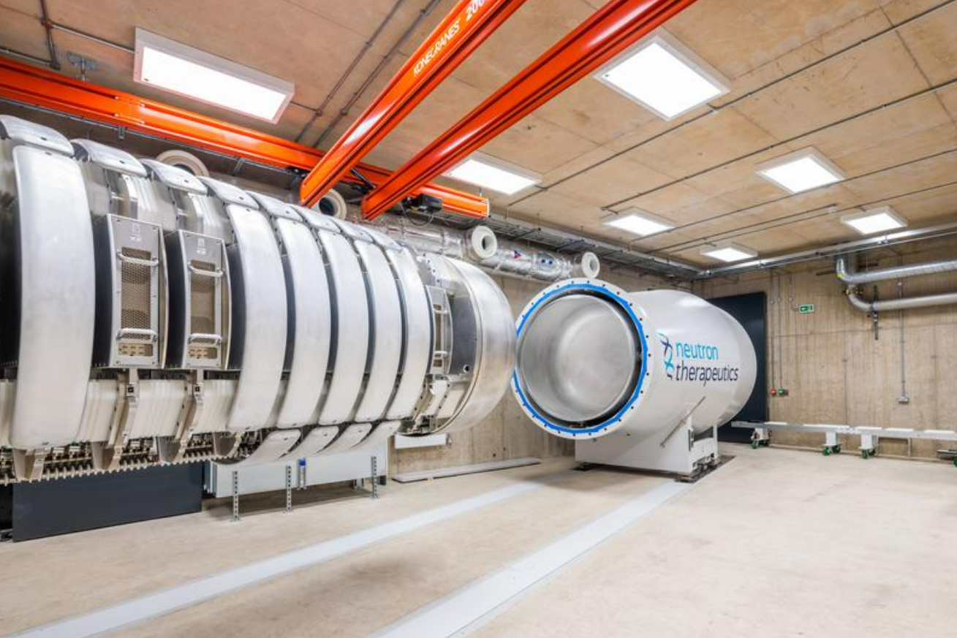


Towards establishing a high-energy $d−Li$ neutron production capability at HF-ADNeF
John Murphy

Slide 2
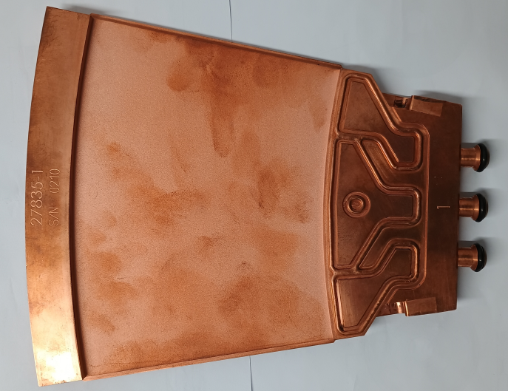

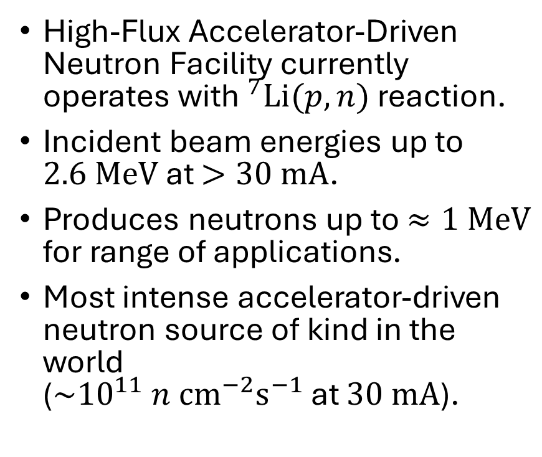
Overview of HF-ADNeF currently
High-Flux Accelerator-Driven Neutron Facility currently operates with$^{7}Li(p,n)$ reaction.
Incident beam energies up to $2.6 MeV$ at $>30 mA$.
Produces neutrons up to $≈1 MeV$ for range of applications.
Most intense accelerator-driven neutron source of kind in the world ($\sim {10}^{11} n {cm}^{−2}s^{−1}$ at $30 mA$).
[1]

Slide 3
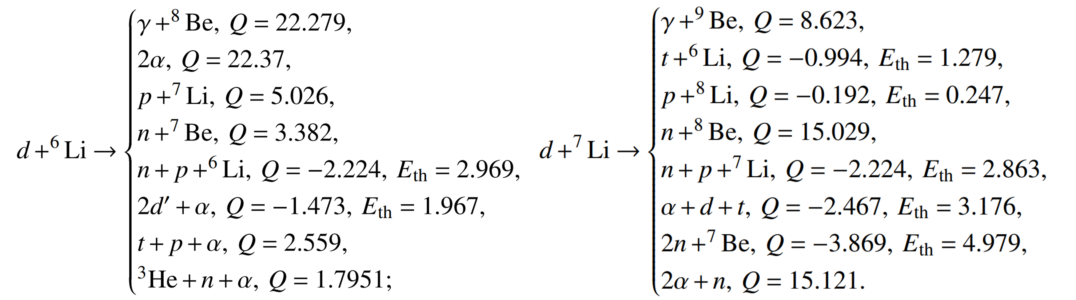
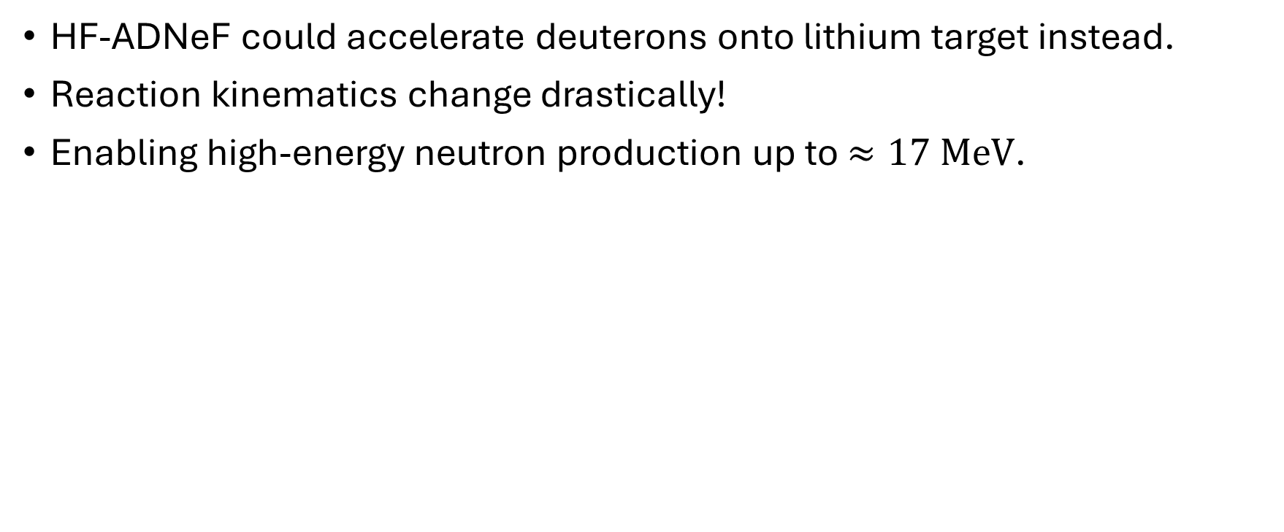

The $Li(d,xn)$ reaction
HF-ADNeF could accelerate deuterons onto lithium target instead.
Reaction kinematics change drastically!
Enabling high-energy neutron production up to $≈17 MeV$.
[2]

Slide 4
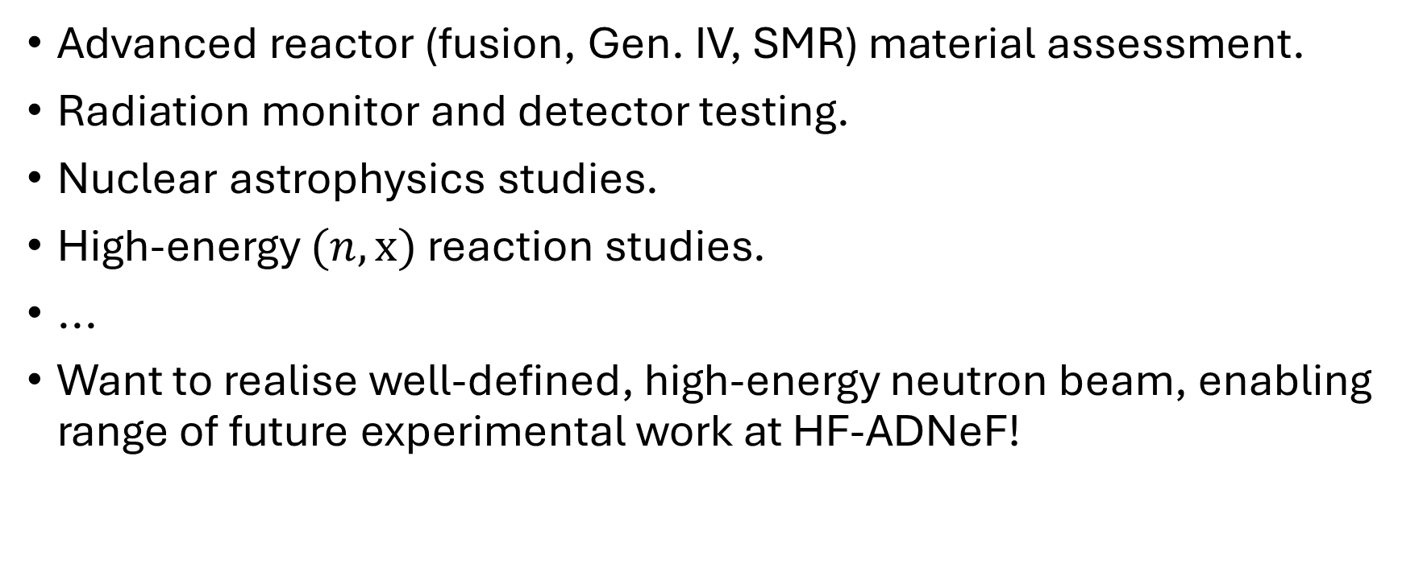
Applications
Advanced reactor (fusion, Gen. IV, SMR) material assessment.
Radiation monitor and detector testing.
Nuclear astrophysics studies.
High-energy $(n,x)$ reaction studies.
...
Want to realise well-defined, high-energy neutron beam, enabling range of future experimental work at HF-ADNeF!
Notes:
Put isotope production higher (with the applied stuff)

Slide 5
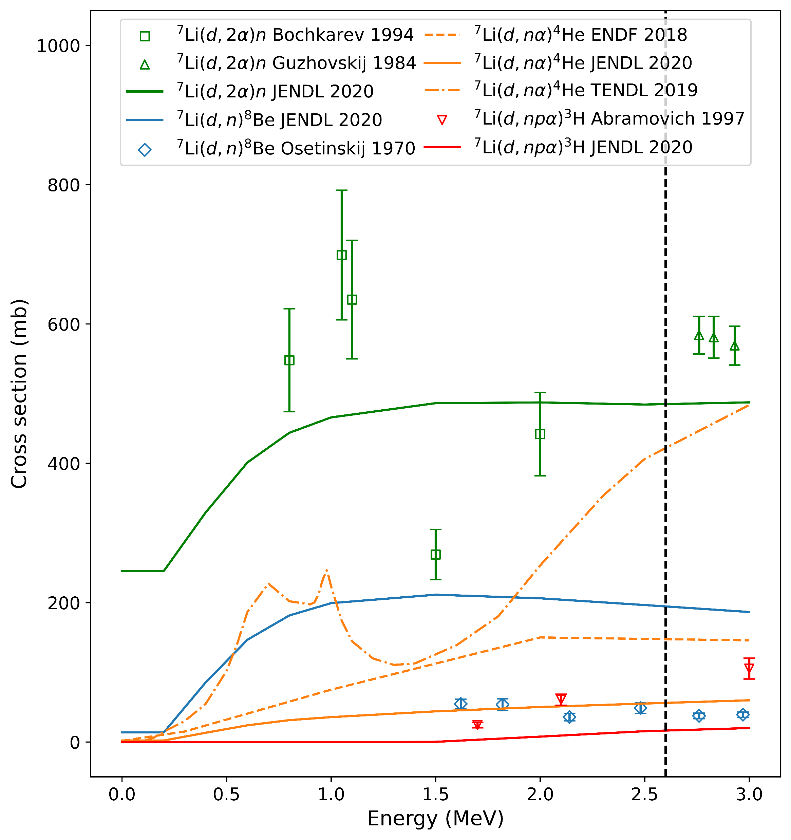
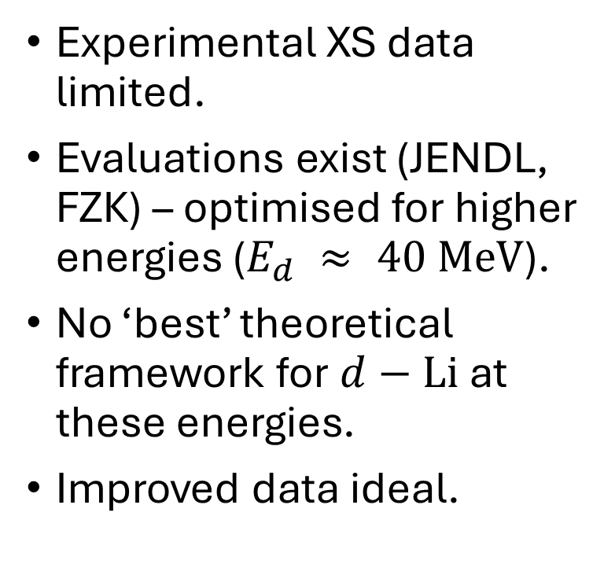
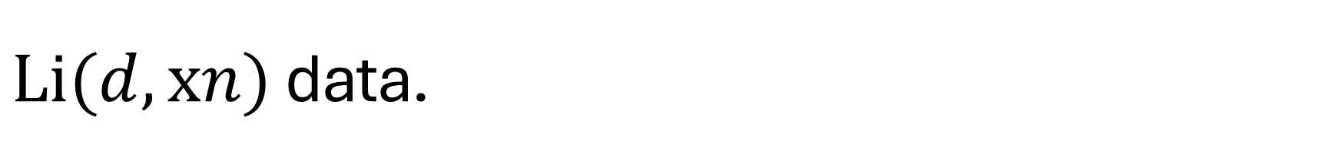
$Li(d,xn)$ data.
[3-9]
Experimental XS data limited.
Evaluations exist (JENDL, FZK) – optimised for higher energies ($E_{d} ≈ 40 MeV$).
No ‘best’ theoretical framework for $d−Li$ at these energies.
Improved data ideal.

Slide 6
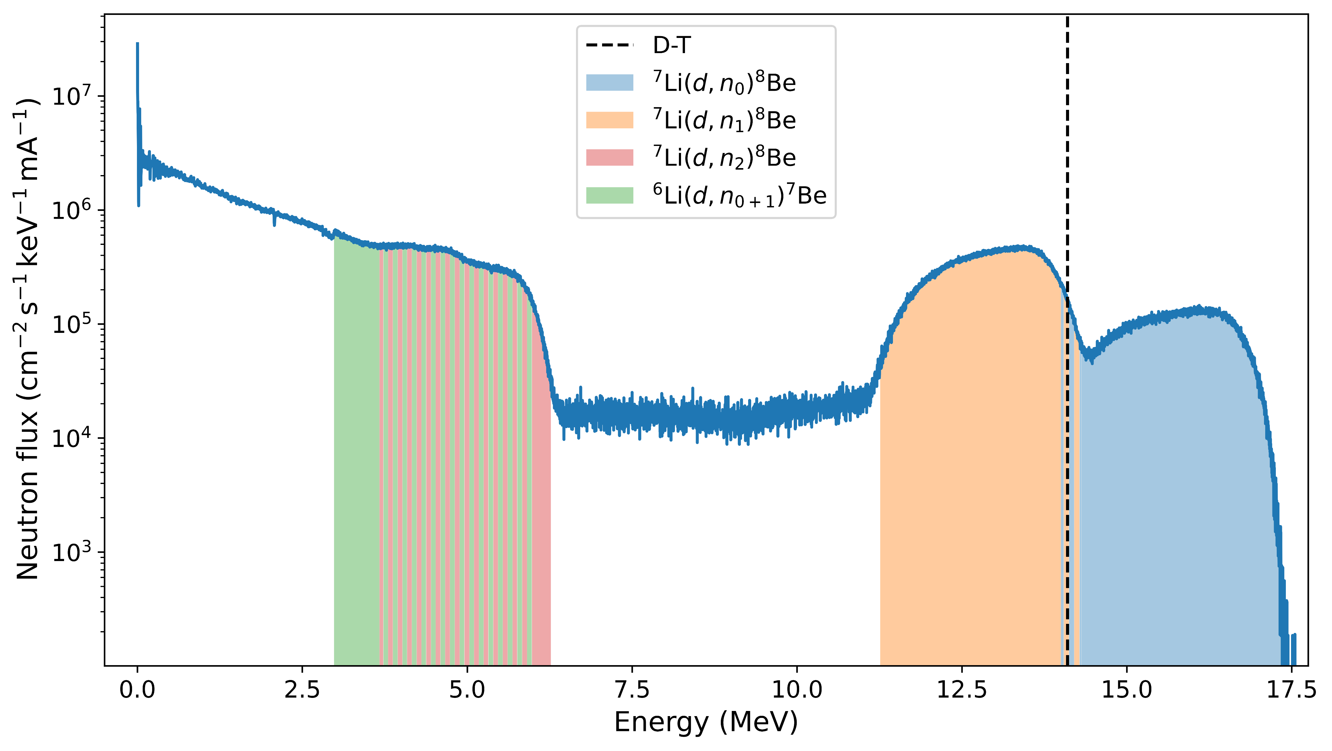
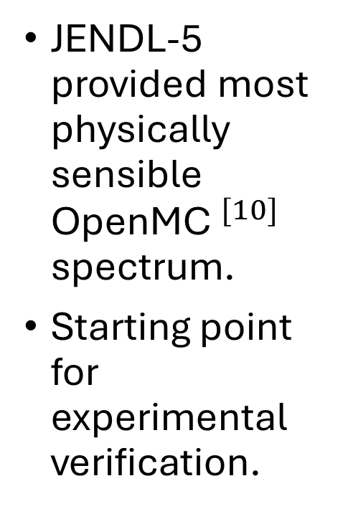
Spectrum predictions
JENDL-5 provided most physically sensible OpenMC$^{[10]}$ spectrum.
Starting point for experimental verification.

Slide 7
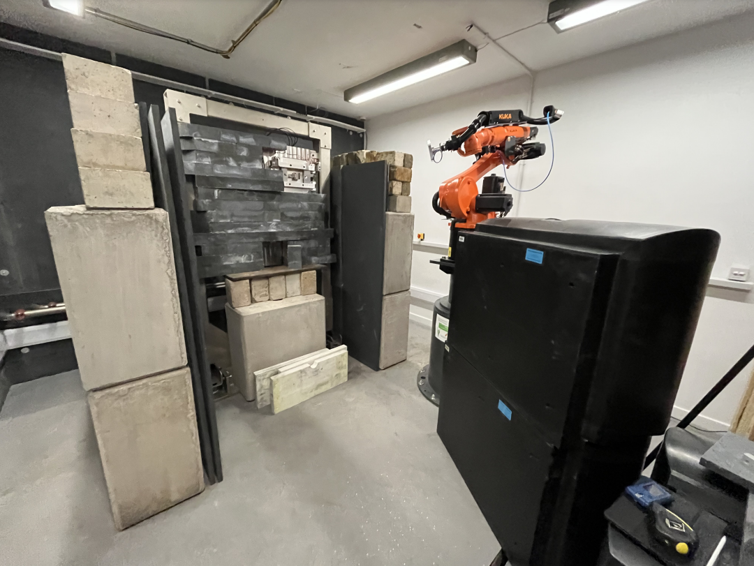

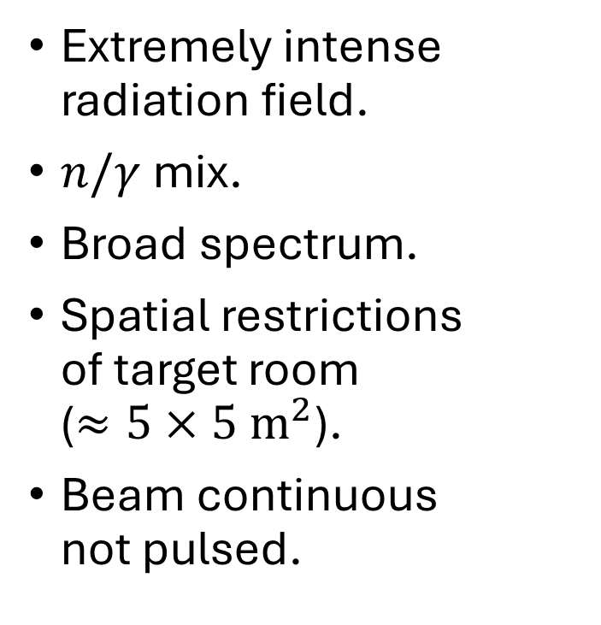
Verification challenges
Extremely intense radiation field.
$n/γ$ mix.
Broad spectrum.
Spatial restrictions of target room ($≈5×5 m^{2}$).
Beam continuous not pulsed.
$$d$$

Slide 8
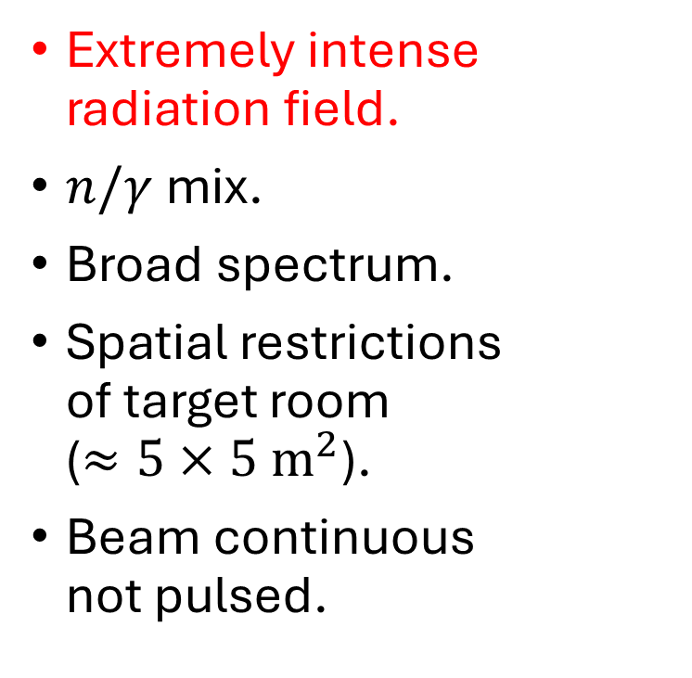
Verification requirements
Extremely intense radiation field.
$n/γ$ mix.
Broad spectrum.
Spatial restrictions of target room ($≈5×5 m^{2}$).
Beam continuous not pulsed.
Detectors/electronics should be sufficiently rad-hard.

Slide 9
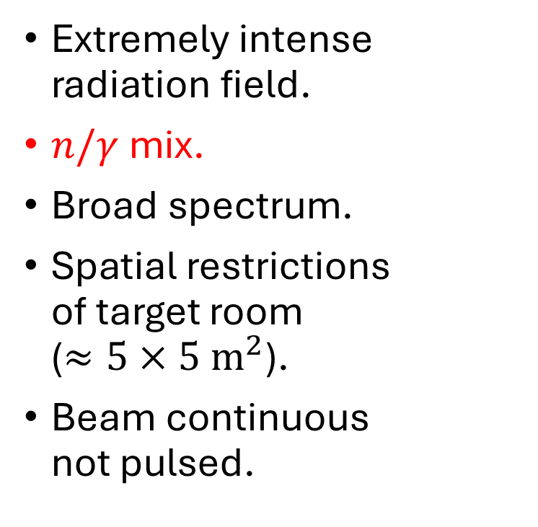
Verification requirements
Extremely intense radiation field.
$n/γ$ mix.
Broad spectrum.
Spatial restrictions of target room ($≈5×5 m^{2}$).
Beam continuous not pulsed.
Detectors/electronics should be sufficiently rad-hard.
Responses to each should be well understood.

Slide 10
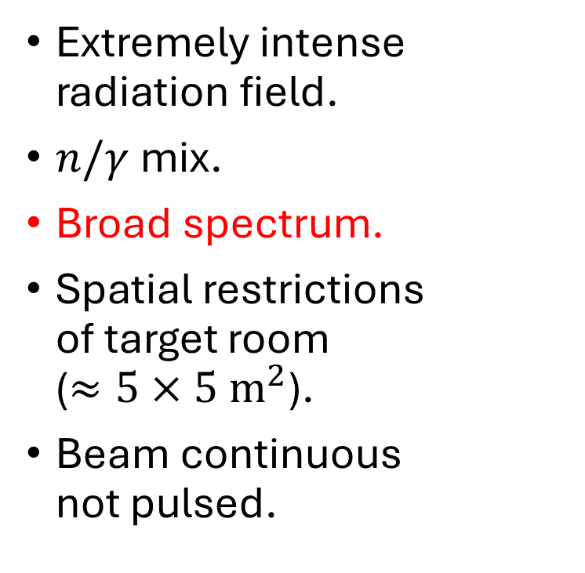
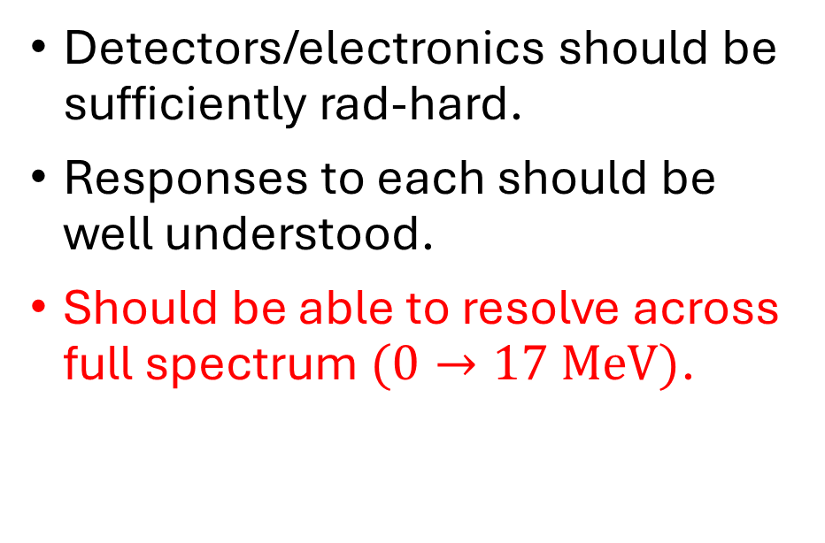
Verification requirements
Extremely intense radiation field.
$n/γ$ mix.
Broad spectrum.
Spatial restrictions of target room ($≈5×5 m^{2}$).
Beam continuous not pulsed.
Detectors/electronics should be sufficiently rad-hard.
Responses to each should be well understood.
Should be able to resolve across full spectrum $(0→17 MeV)$.

Slide 11
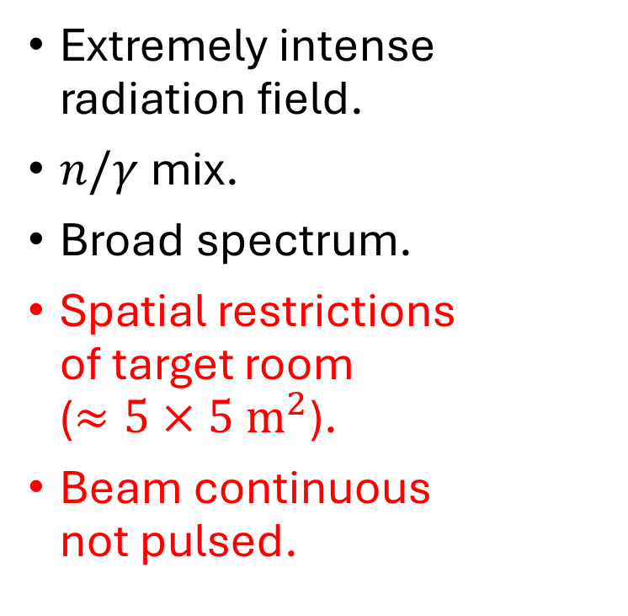
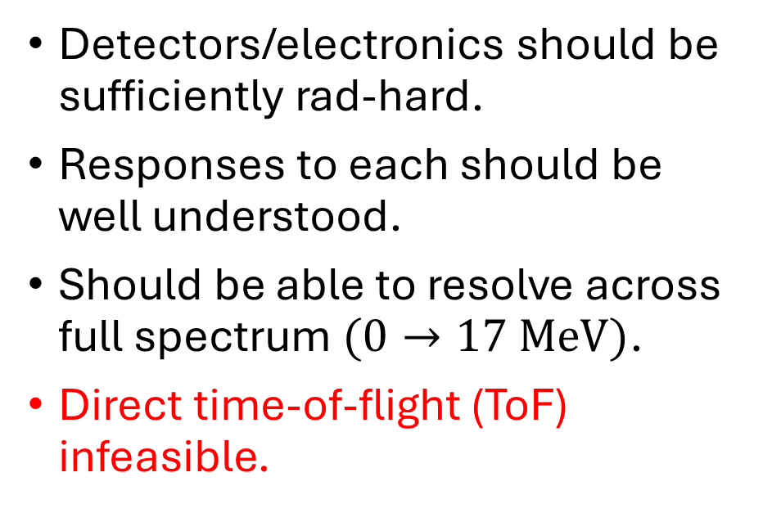
Verification requirements
Extremely intense radiation field.
$n/γ$ mix.
Broad spectrum.
Spatial restrictions of target room ($≈5×5 m^{2}$).
Beam continuous not pulsed.
Detectors/electronics should be sufficiently rad-hard.
Responses to each should be well understood.
Should be able to resolve across full spectrum $(0→17 MeV)$.
Direct time-of-flight (ToF) infeasible.

Slide 12
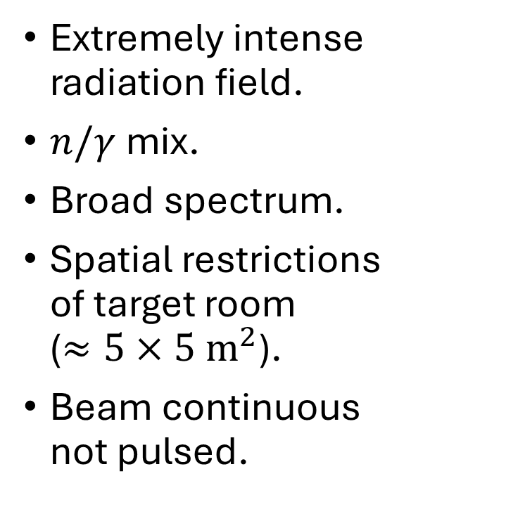
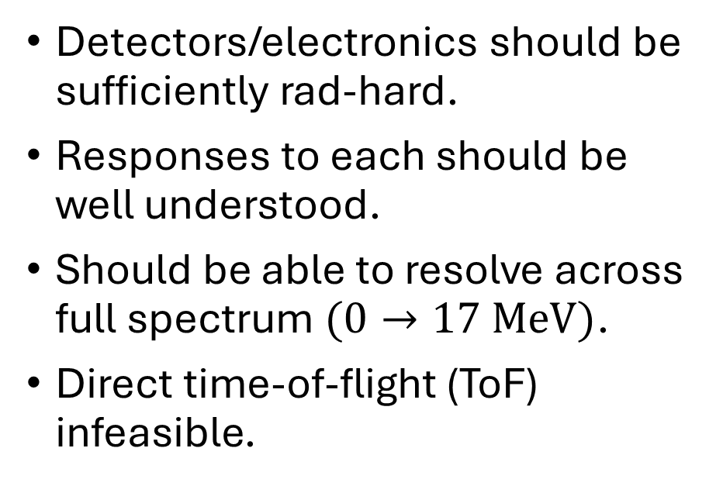
Verification requirements
Extremely intense radiation field.
$n/γ$ mix.
Broad spectrum.
Spatial restrictions of target room ($≈5×5 m^{2}$).
Beam continuous not pulsed.
Detectors/electronics should be sufficiently rad-hard.
Responses to each should be well understood.
Should be able to resolve across full spectrum $(0→17 MeV)$.
Direct time-of-flight (ToF) infeasible.
Need ‘Swiss Army knife’ approach!

Slide 13
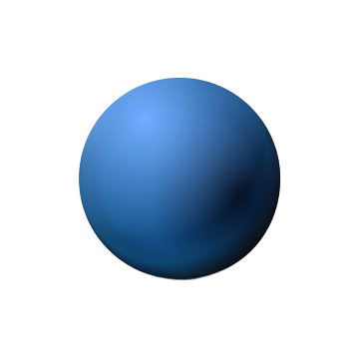
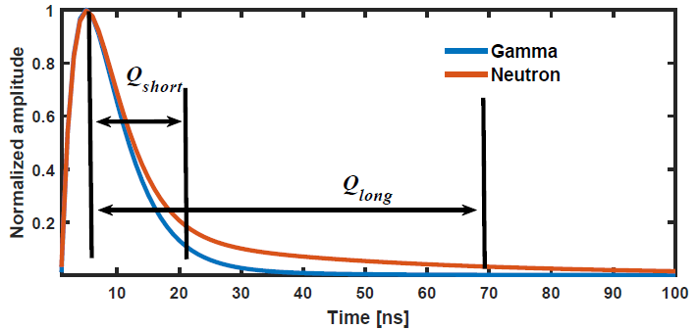



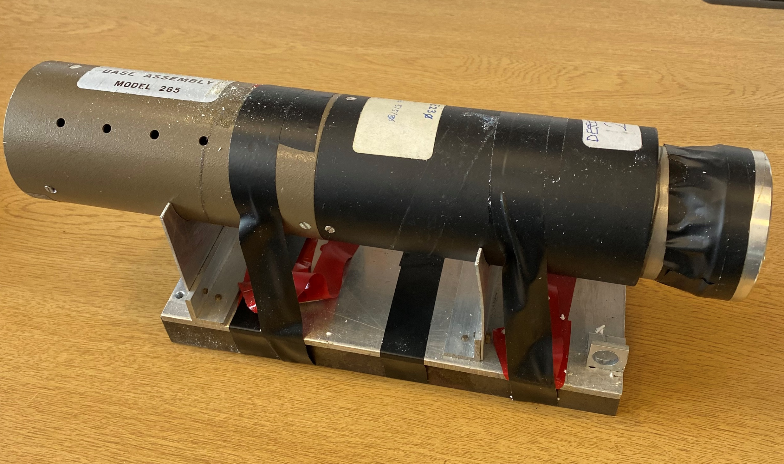
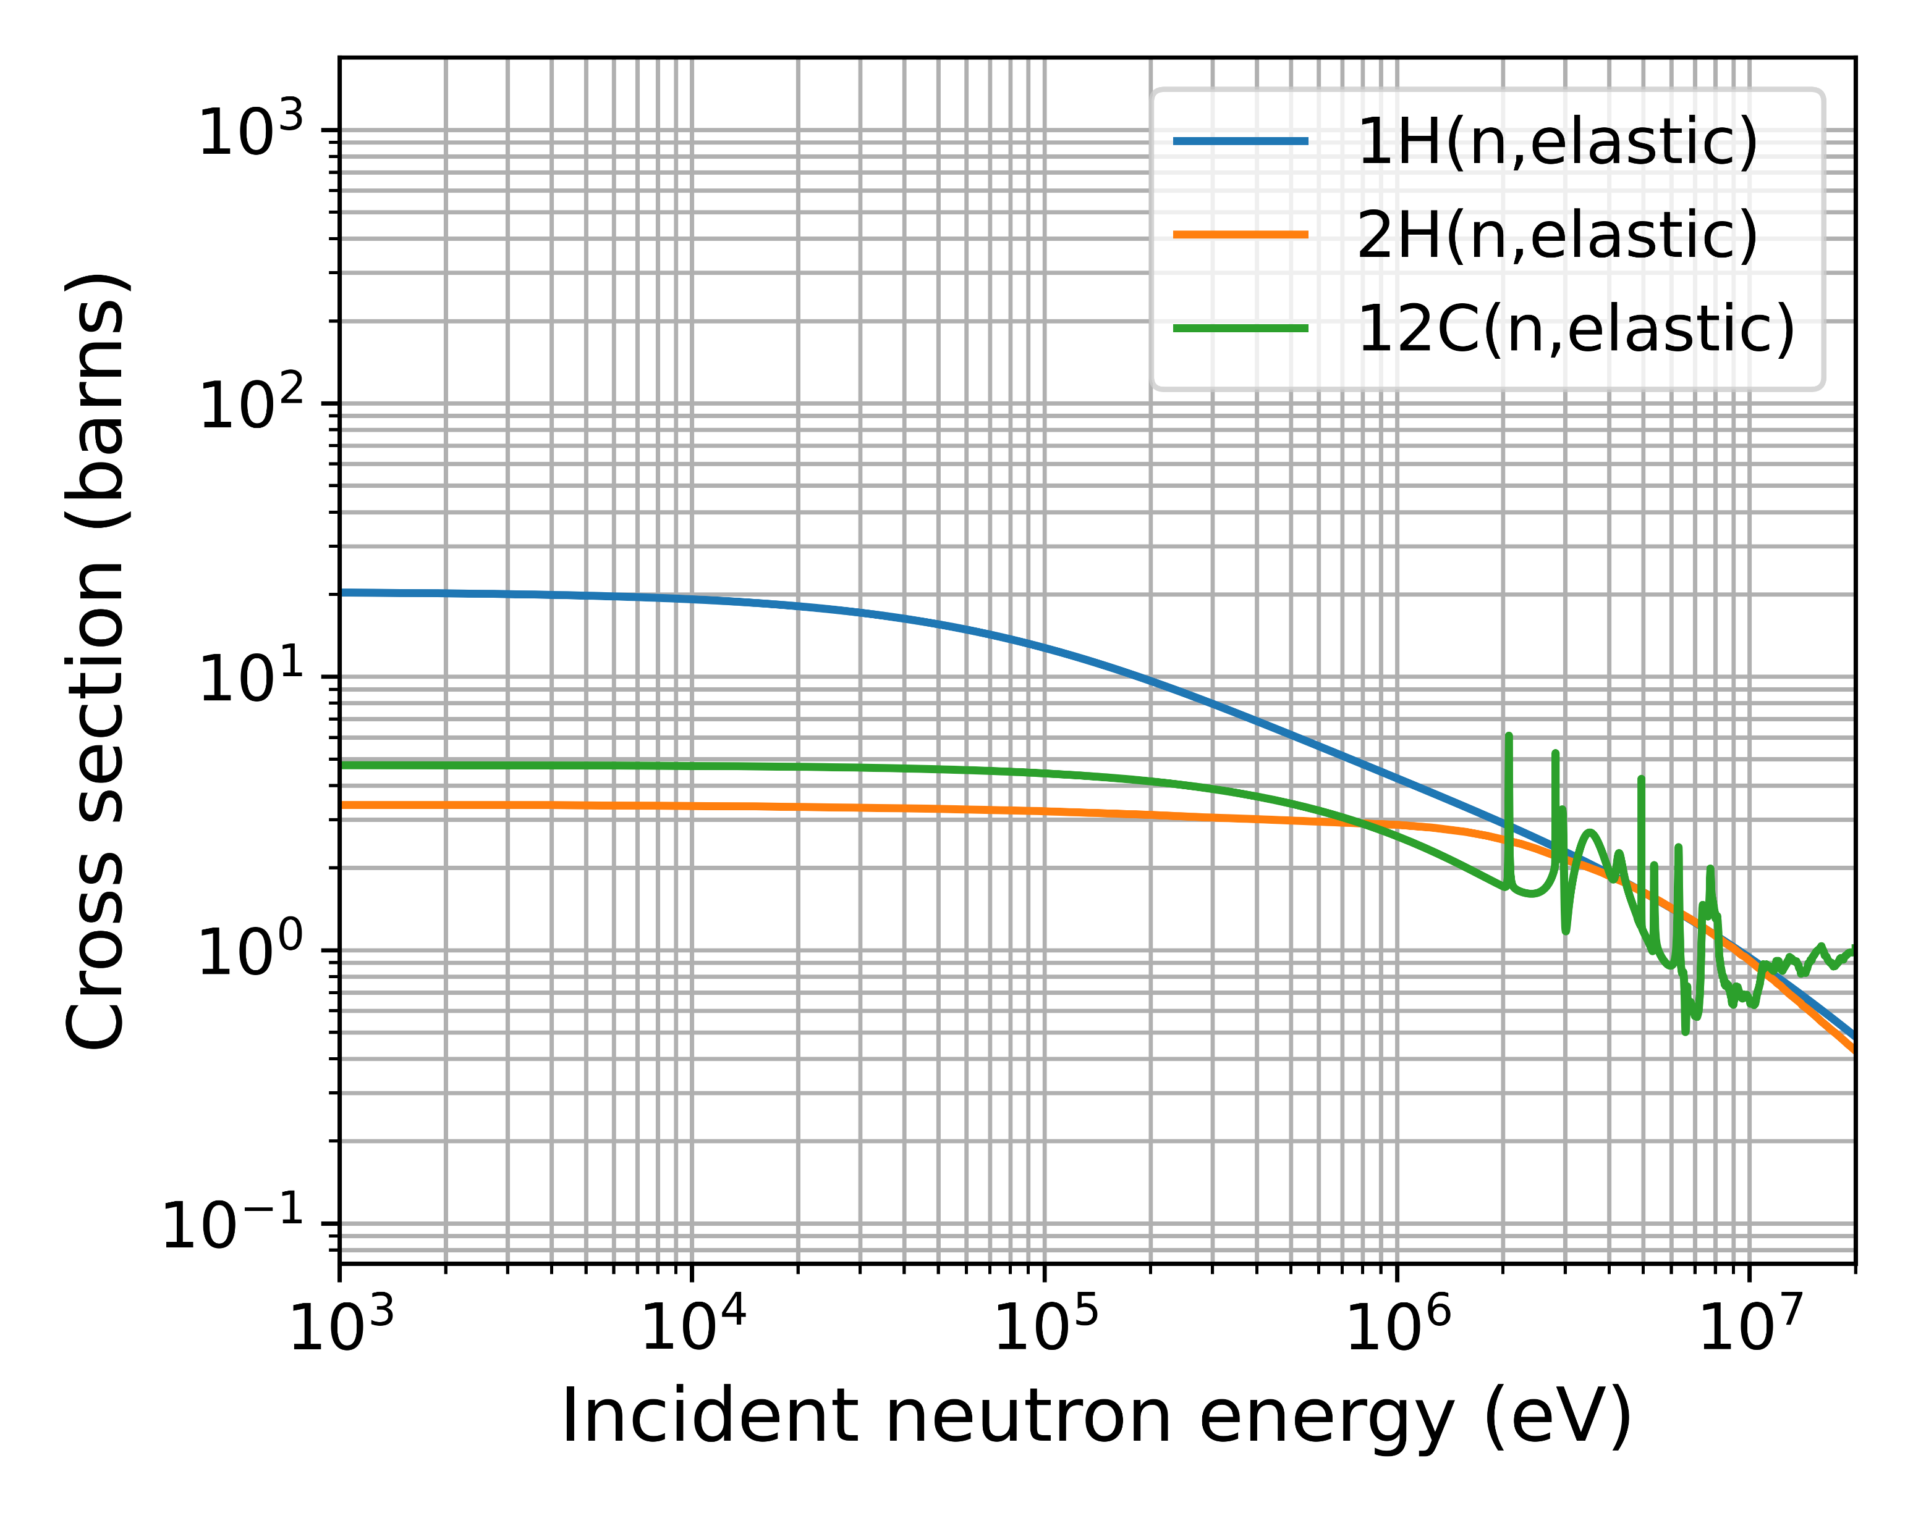
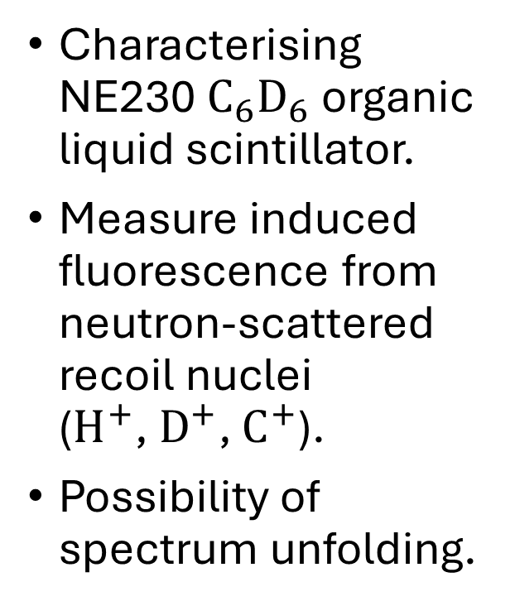




Ongoing work – NE230
$$n$$
$$γ$$
$$e^{−}$$
Characterising NE230 $C_{6}D_{6}$ organic liquid scintillator.
Measure induced fluorescence from neutron-scattered recoil nuclei ($H^{+}$, $D^{+}$, $C^{+}$).
Possibility of spectrum unfolding.
$$D^{+}$$
Liu et al. 2024 $^{[11]}$

Slide 14
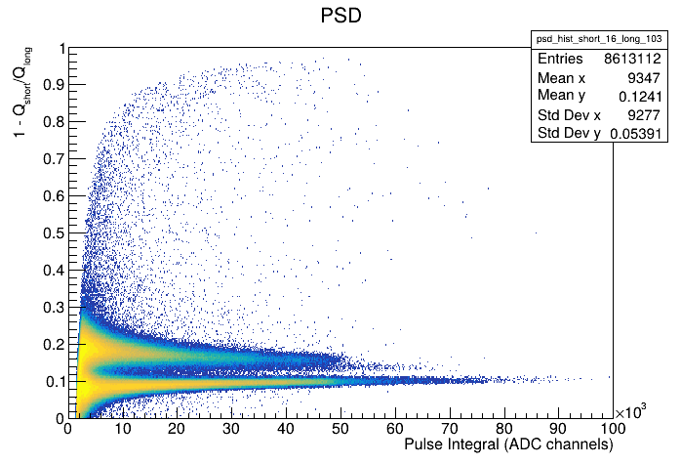

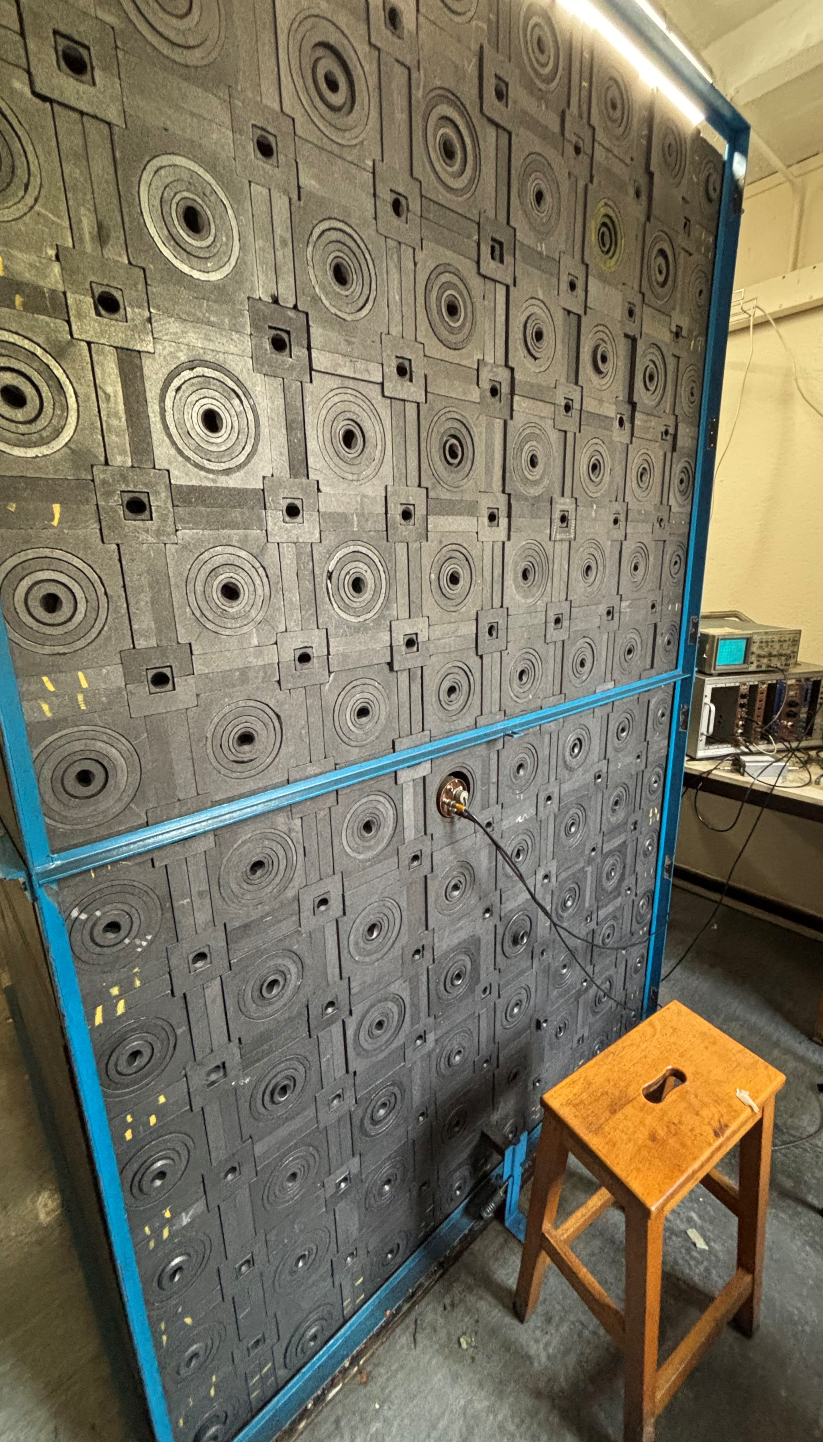
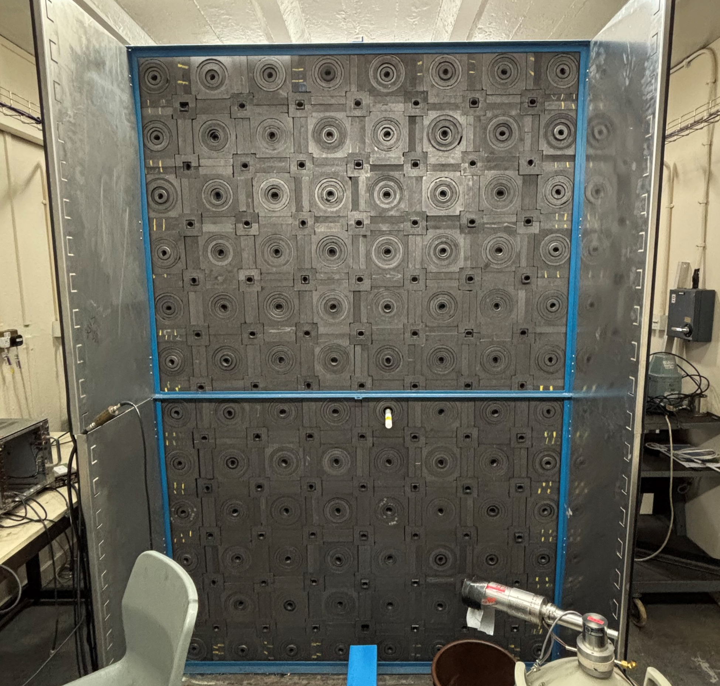
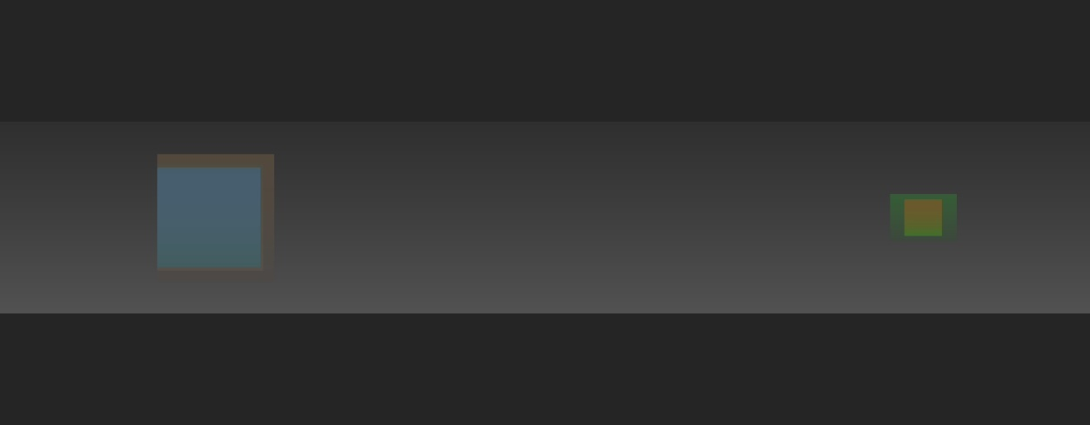
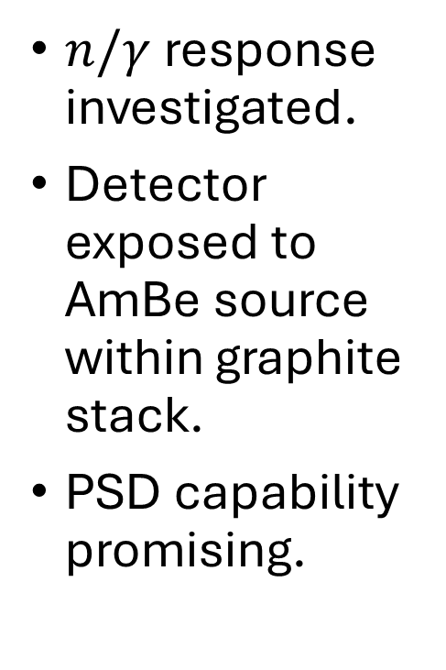


NE230 – PSD
$n/γ$ response investigated.
Detector exposed to AmBe source within graphite stack.
PSD capability promising.
Graphite
$$n$$
$$γ$$
AmBe
NE230

Slide 15
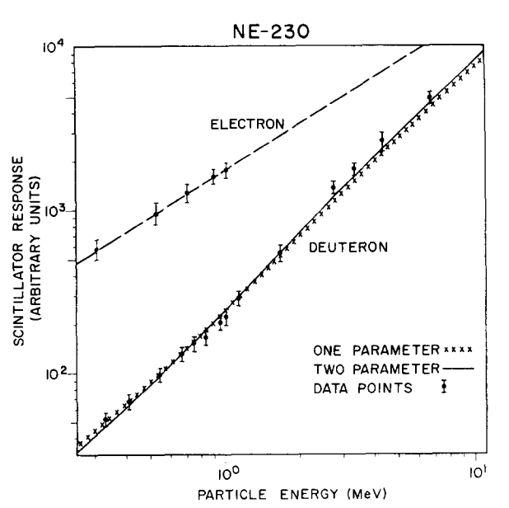
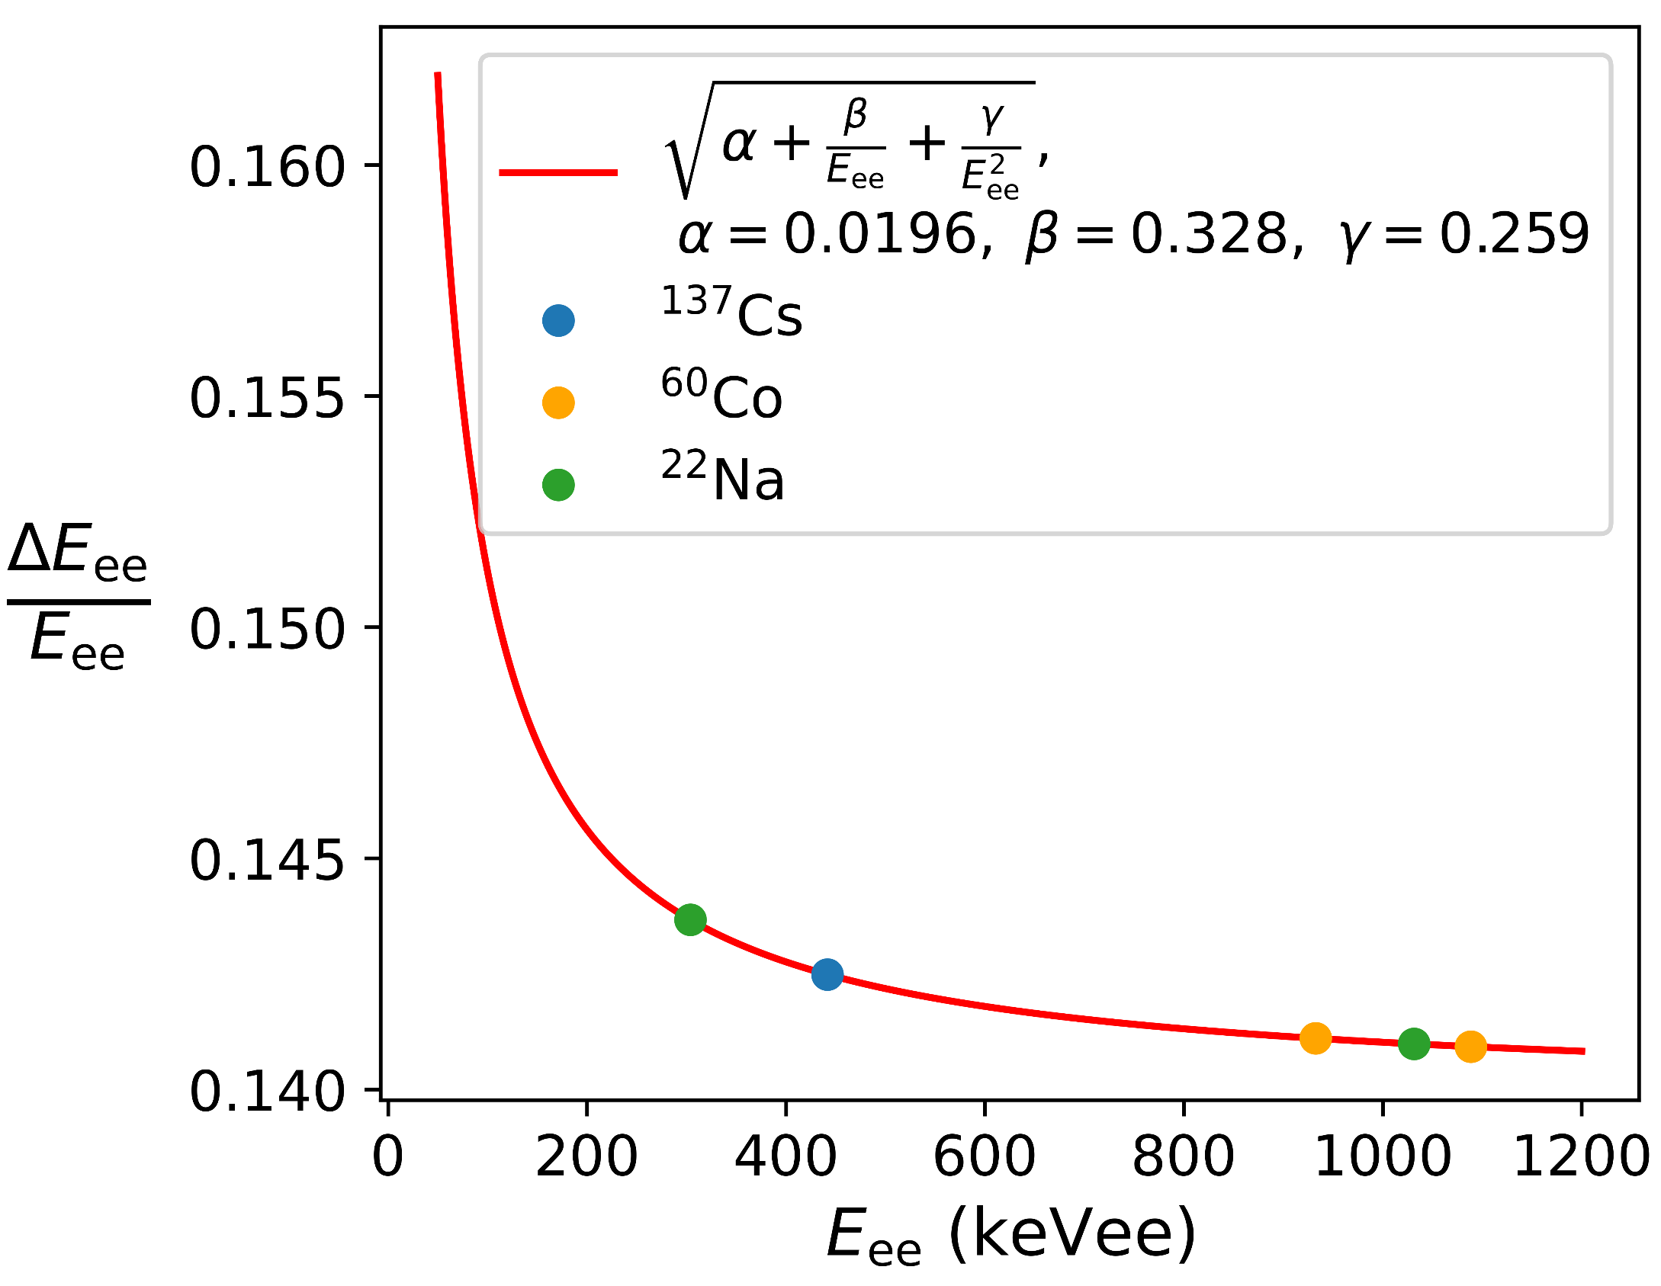

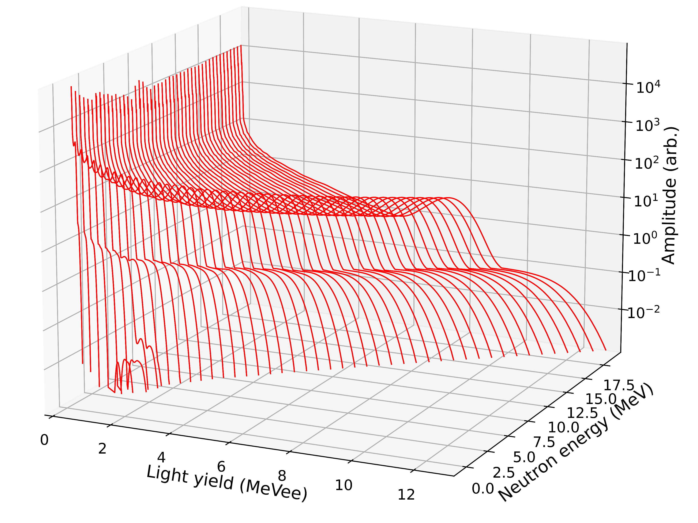
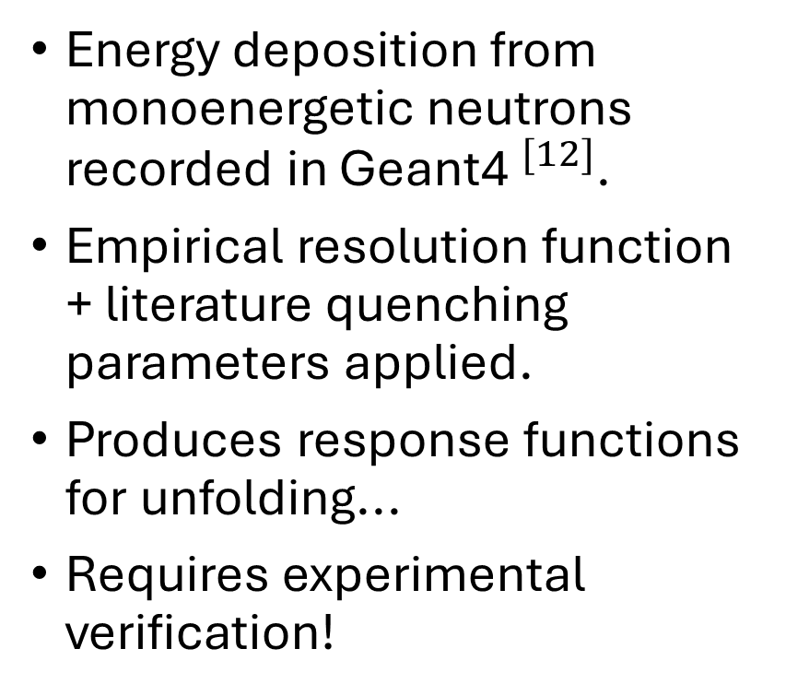
NE230 – response
Craun et al. 1970
Energy deposition from monoenergetic neutrons recorded in Geant4$^{[12]}$.
Empirical resolution function + literature quenching parameters applied.
Produces response functions for unfolding...
Requires experimental verification!
PRELIMINARY

Slide 16

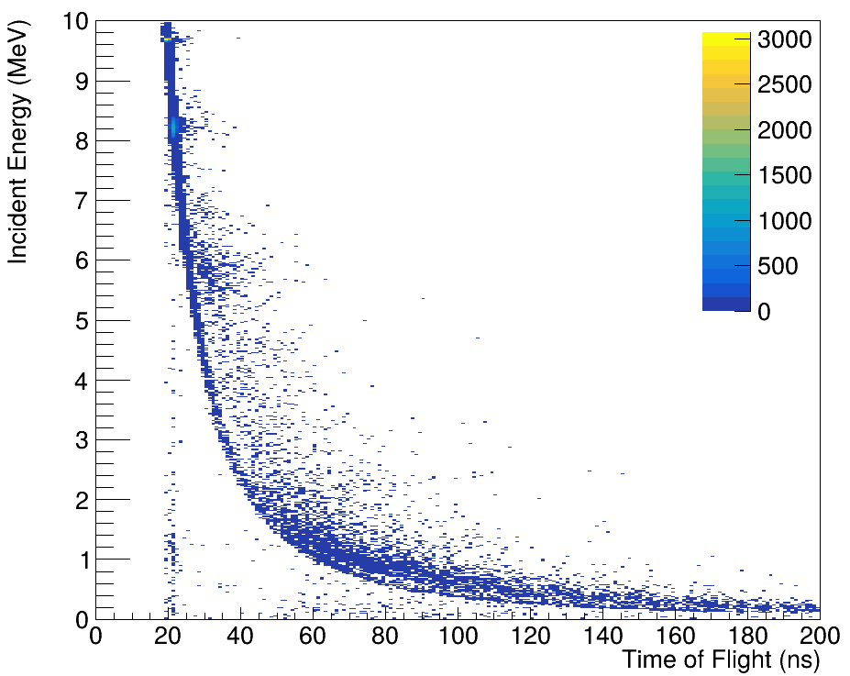
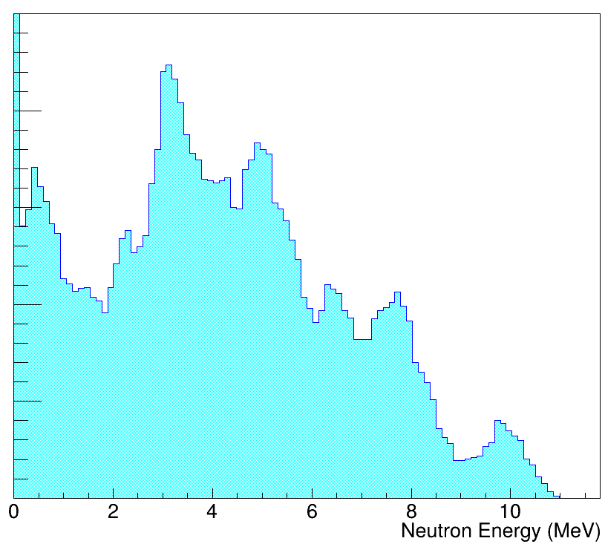

Indirect ToF?
A
$$≈1.5 m$$
Scatterer (S) and absorber (A).
ToF determines neutron energy.
Feasibility study with AmBe-graphite setup in progress.
Separates spectrum into quasi-monoenergetic groups.
Responses experimentally determined.
S
AmBe

Slide 17
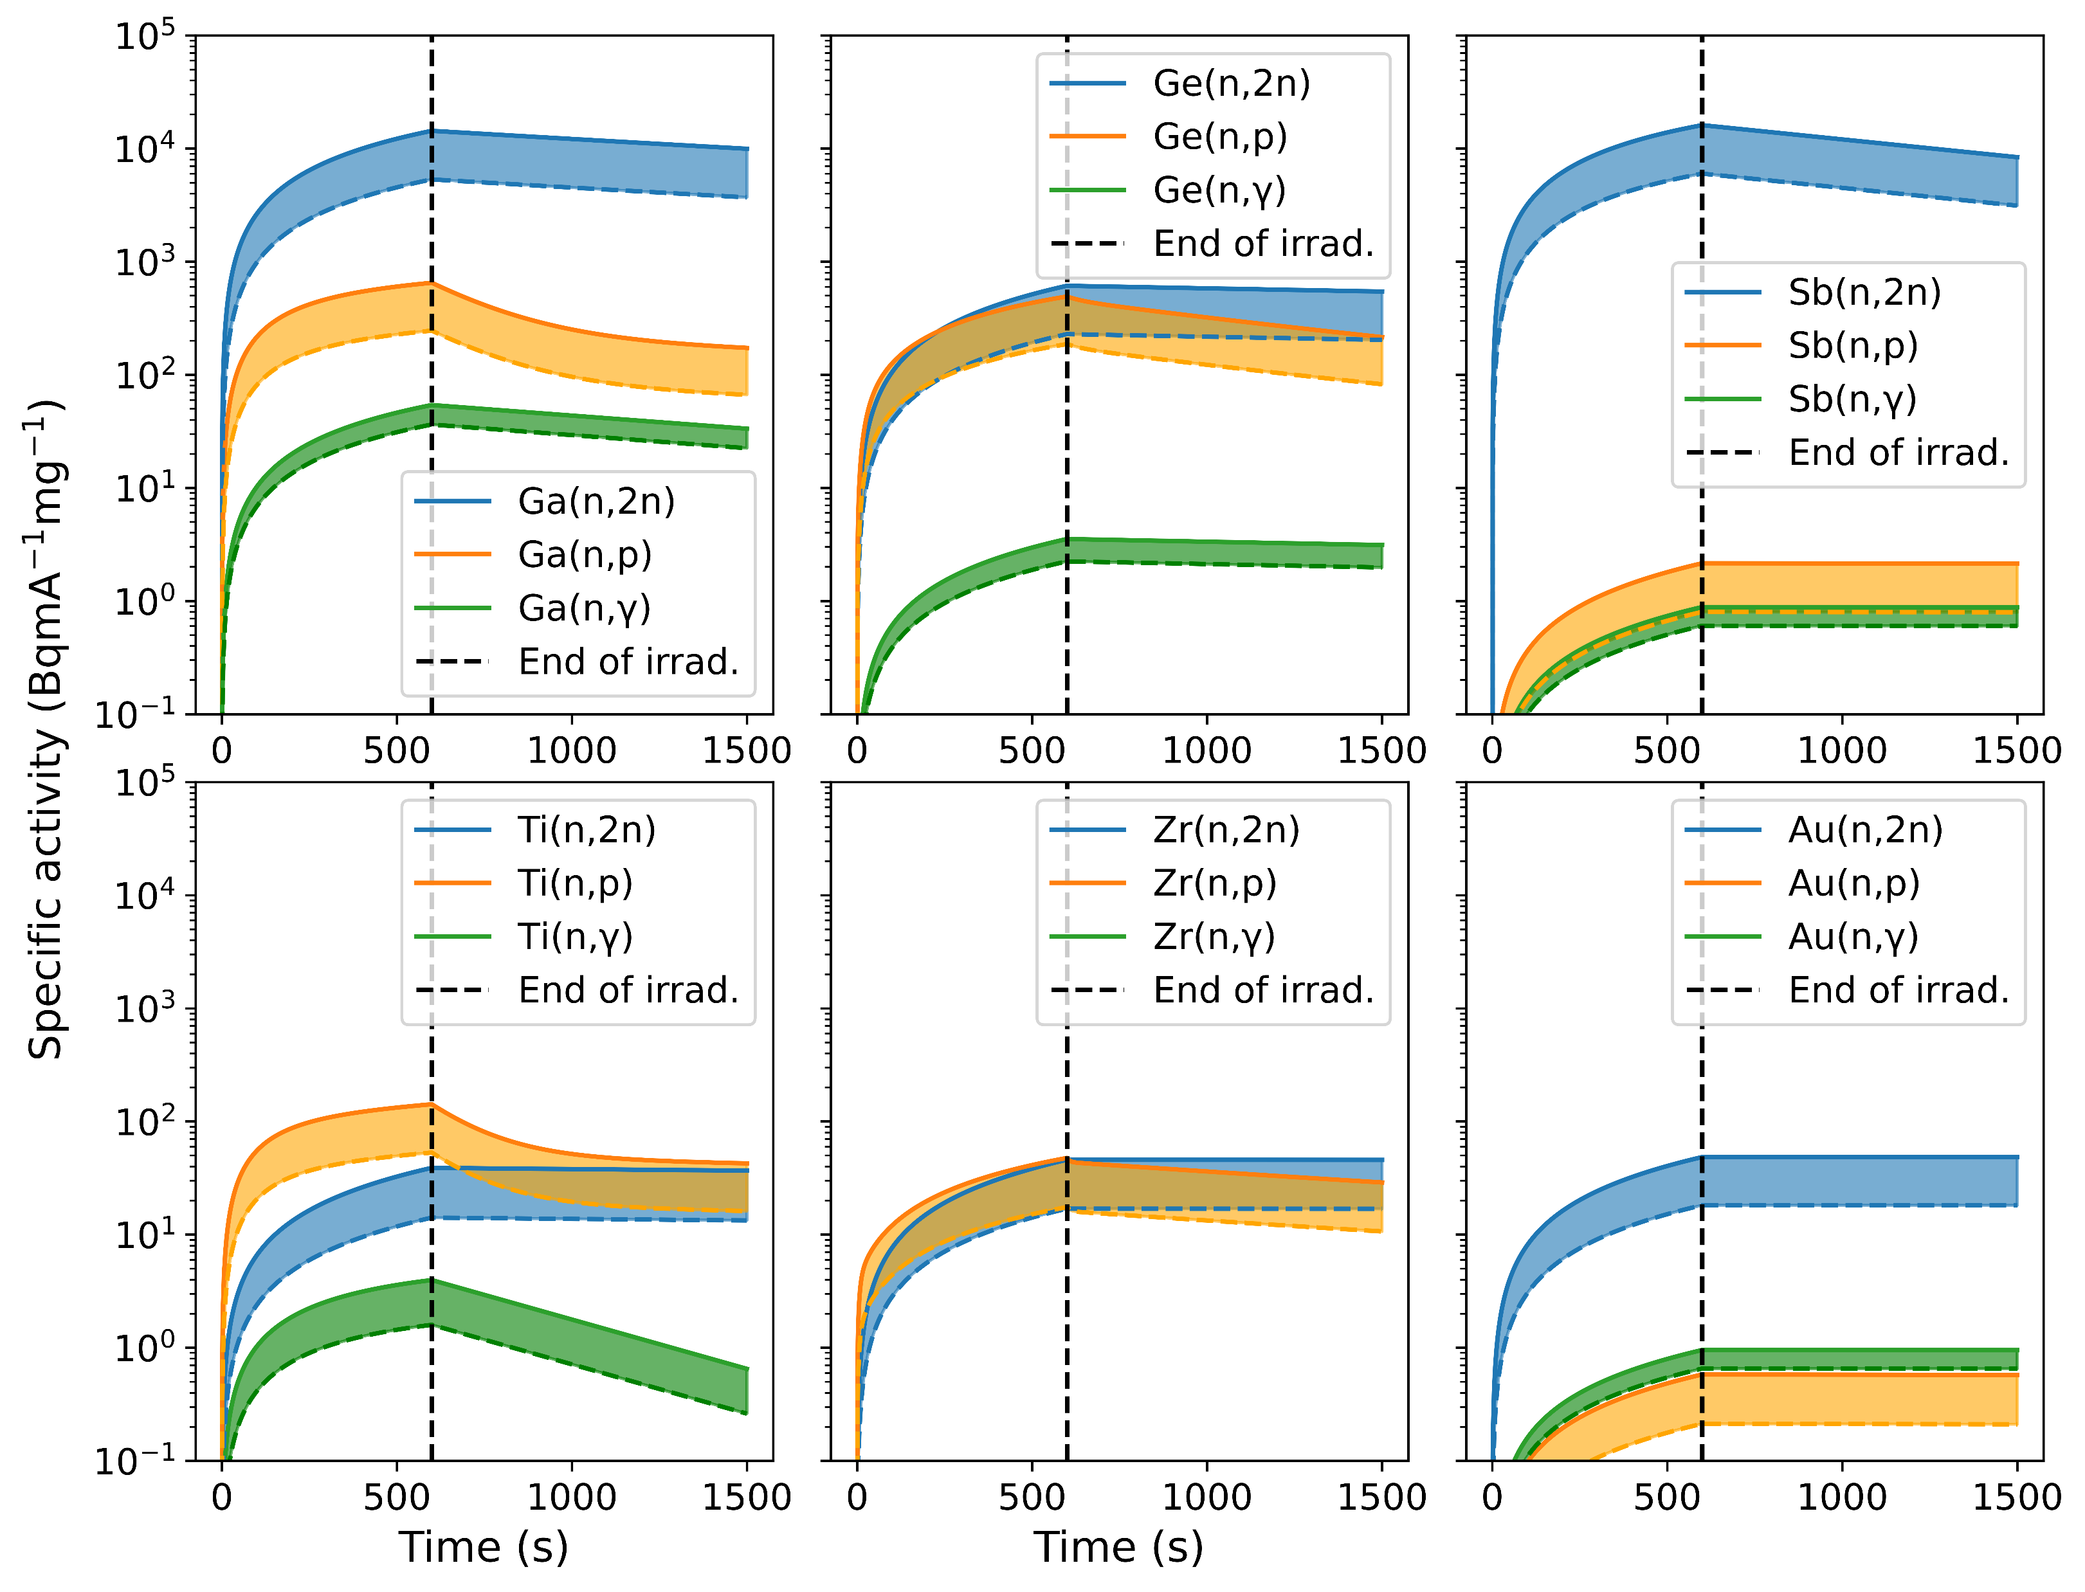
Plans and outlook
Continue detector characterisation.
Initial experimental testing in next few months??? ☺
First involving activation foils (C/E ratios).
If positive, move to online detector tests.
Employ other techniques?

Slide 18
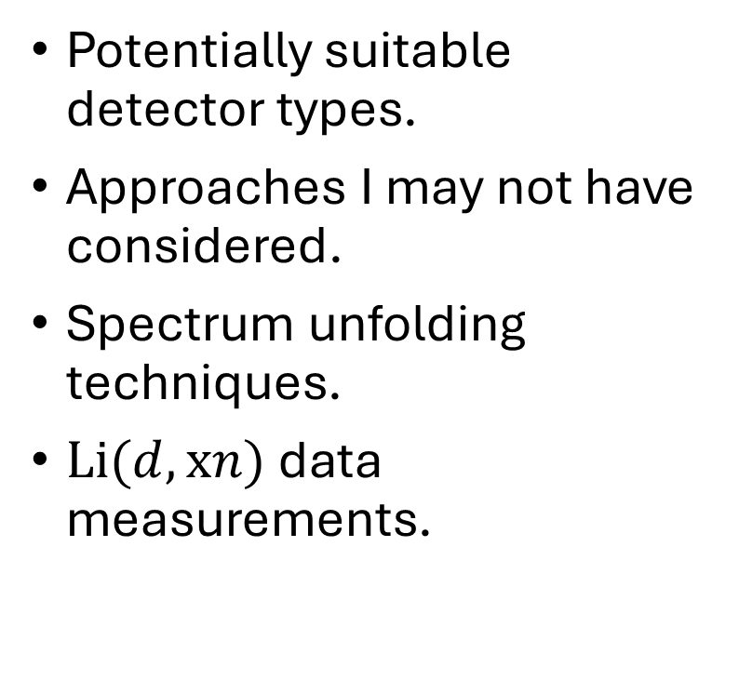
Please talk to me about…
Potentially suitable detector types.
Approaches I may not have considered.
Spectrum unfolding techniques.
$Li(d,xn)$ data measurements.

Slide 19
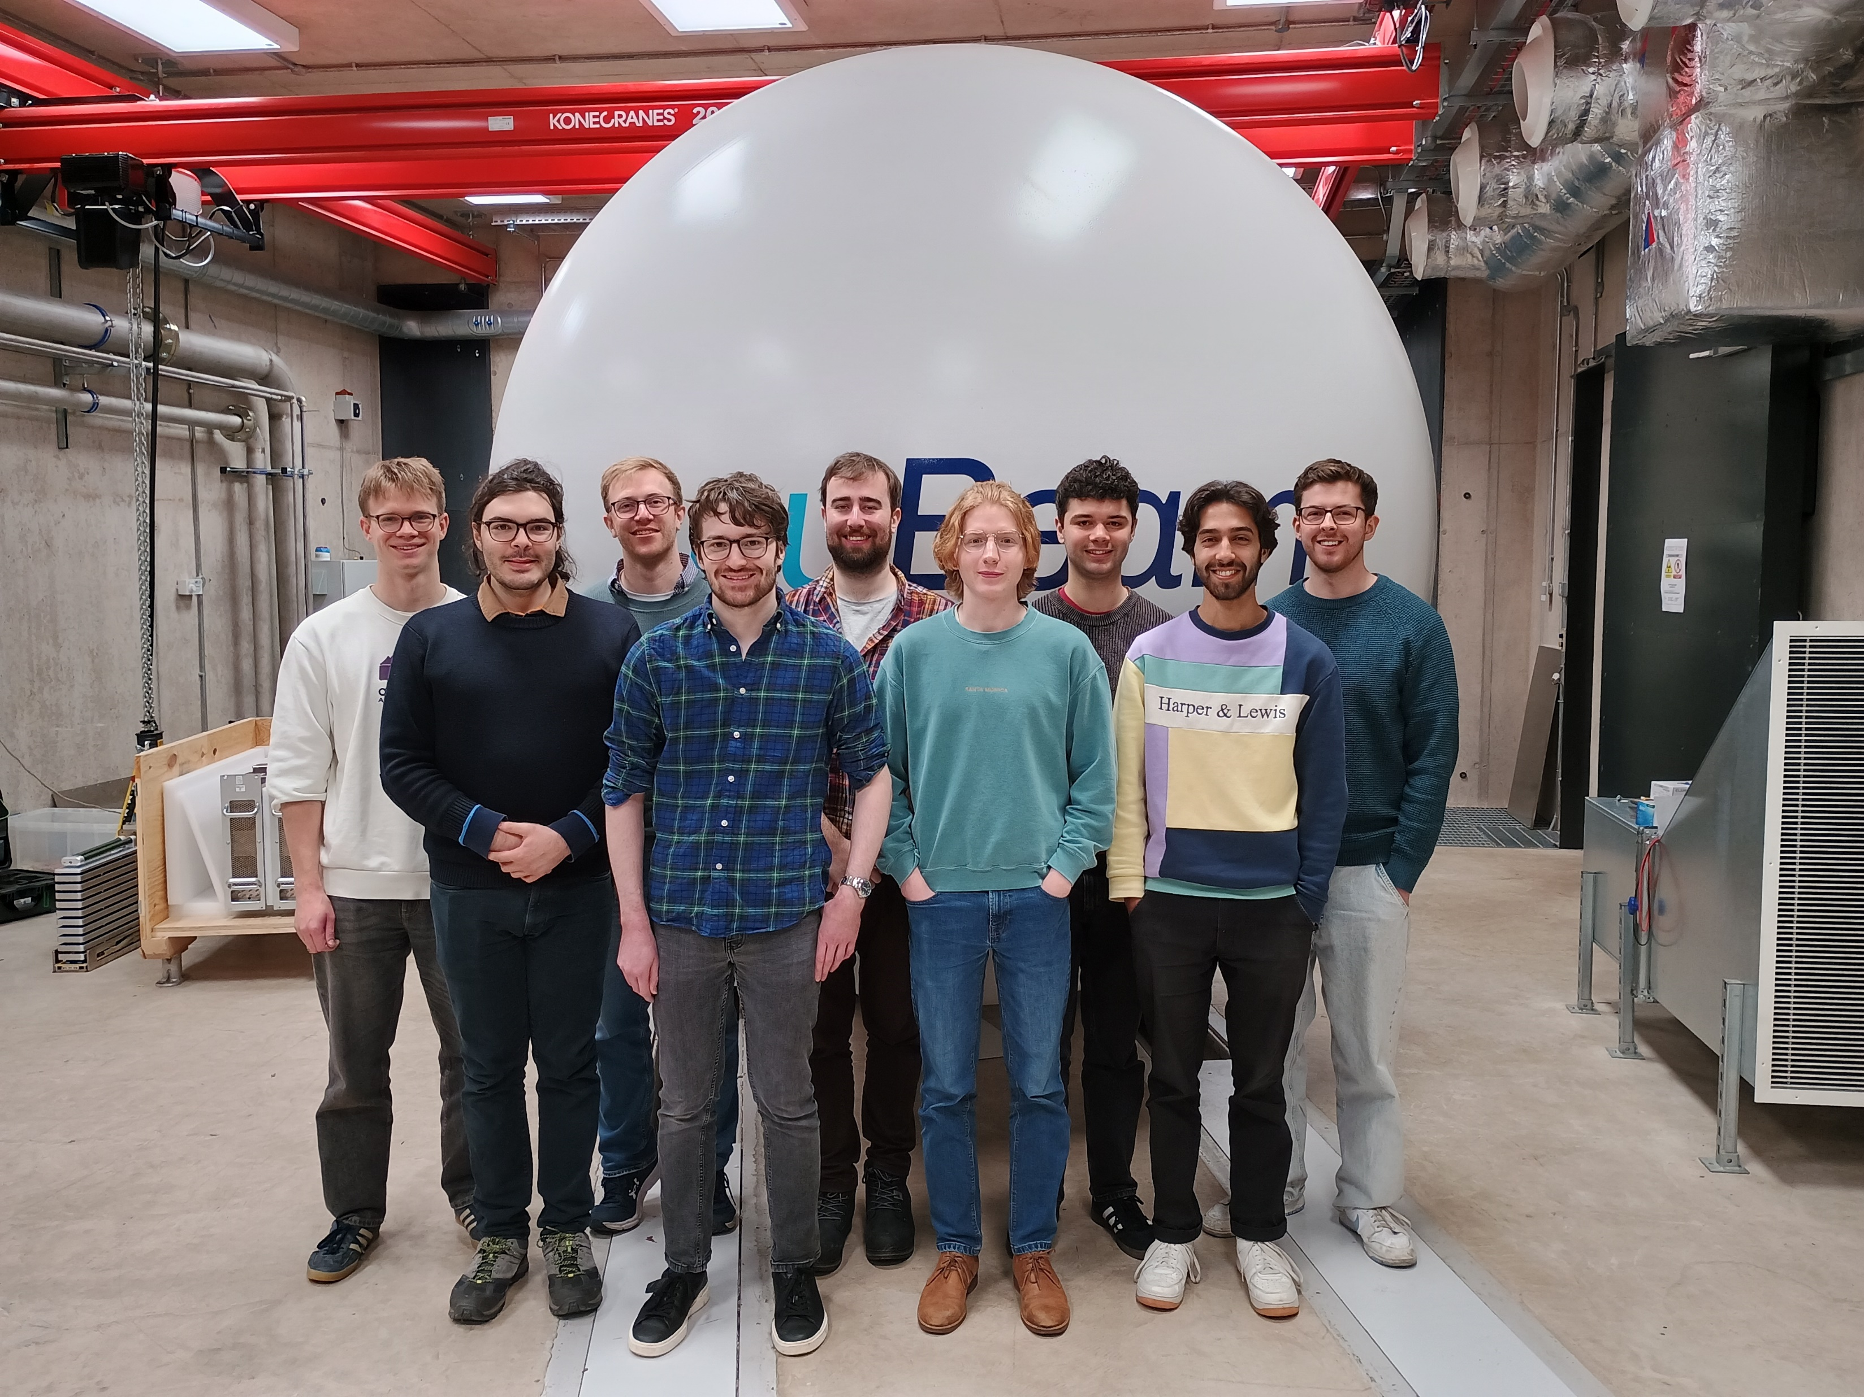

Acknowledgments
University of Birmingham:
  Dr. Jack Bishop.
  Prof. Carl Wheldon.
  Prof. Tzany Kokalova.
AWE:
  Dr Simon Rice.

Slide 20
Thank you very much for your attention!
Any questions?
References:
[1] – C. Wheldon et al. (2024), ‘A Birmingham Laboratory Portrait’, Nuclear Physics News, 34(4), pp. 4–8.
[2] – M.V. Egorov et al. (2021), ‘Deuteron inelastic scattering on 6Li and 7Li nuclei within the three-body cluster model’, Chinese Phys. C 45 014108.
[3] – A.J. Koning et al. (2019), ‘TENDL: Complete Nuclear Data Library for Innovative Nuclear Science and Technology’, Nuclear Data Sheets 155 (2019) 1.
[4] – Nakayama, S. et al. (2021), ‘JENDL/DEU-2020: deuteron nuclear data library for design studies of accelerator-based neutron sources’, Journal of Nuclear Science and Technology, 58(7), pp. 805–821.
[5] – D.A. Brown et al. (2018), ‘ENDF/B-VIII.0: The 8th Major Release of the Nuclear Reaction Data Library with CIELO-project Cross Sections, New Standards and Thermal Scattering Data’, Nuclear Data Sheets, 148: pp. 1-142 (2018).
[6] – Bochkarev, O.V. et al. (1994), ‘Neutrons from the ⁷Li + d reaction in the deuteron energy range 0.7–12.1 MeV’, (Technical Report IAE-5784/2), International Atomic Energy Agency.
[7] – Guzhovskij, B.Ya. et al. (1984), ‘Energy dependences of total cross sections of neutron formation in reactions ⁶,⁷Li + ²,³H.’, Prikladnaya Yadernaya Spektroskopiya, 13, 135.
[8] – Osetinskij, G.M. et al. (1970), ‘The investigation of the ⁷Li(d,n)⁸Be reaction’, (JINR-P15-5143), Joint Institute for Nuclear Research.
[9] – Abramovich, S.N. et al. (1997), ‘Measurements of cross sections for the reactions ⁶,⁷Li(d,t) with radiochemical methods.’ In Nuclear Data for Science and Technology (Vol. 1, p. 632). Trieste.
[10] – P.K. Romano et al. (2015), ‘OpenMC: A State-of-the-Art Monte Carlo Code for Research and Development’, Ann. Nucl. Energy, 82, 90–97 (2015).
[11] – X. Liu et al. (2024). ‘An Optimized SVR Algorithm for Pulse Pile-Up Correction in Pulse Shape Discrimination.’ Sensors, 24(23), 7545.
[12] – S. Agostinelli et al. (2003), 'GEANT4—a simulation toolkit', Nuclear Instruments and Methods in Physics Research Section A, 506(3), pp. 250–303.

