Slide 1

Challenges in the Calibration, Operation, Quality Control and Reliability of a Processing Facility Active Neutron Generator Assay System for Intermediate Level Waste at Dounreay
Paul Tait MChem, PhD
Senior Radiometric Specialist
Nuclear Restoration Services (Dounreay)
Paul Mullarkey
Senior Radiometric Specialist
Nuclear Restoration Services (Dounreay)
James Doherty MPhys, CPhys
Radiometrics Team Leader
Nuclear Restoration Services (Dounreay)
Alan Simpson
Senior Physicist
Pajarito Scientific Corporation (Alpha Safety)

Slide 2
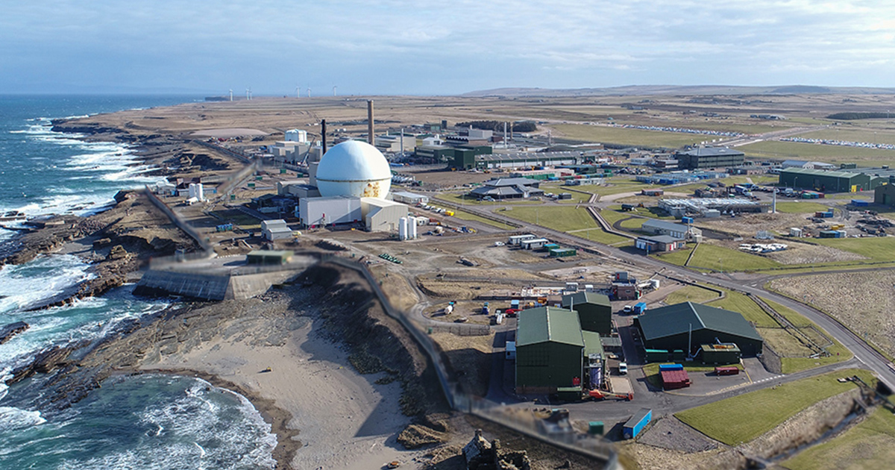
The Dounreay Site
Operated by Nuclear Restoration Services, an NDA group company

Slide 3
The UK Centre of Fast Reactor Research
Built in 1955 and in operation since 1959
Materials Test Reactor, Dounreay Fast Reactor and Prototype Fast Reactor
Fuel Cycle Area (U and Pu recovery, raffinate cementation; and commercial reprocessing)
Legacy Waste Disposal Facilities – where higher activity wastes were deposited

Slide 4
Decommissioning
Dounreay is a Delivery Unit of NRS
The Fuel Cycle Area decommissioning programme produces RHILW with accountable fissile material – arising from operations and stocks, some spent fuel or nuclear material which, following a Best Practicable Means assessment justifying their management as waste, being reclassified as waste.
These will be subject to assay on the FCA’s Active Neutron Generator Assay System
The Shaft and Silo decommissioning programme includes the retrieval and processing of its legacy solid wastes. The design of the retrieval and processing facility includes passive/active neutron generator assay systems, which has been procured. Active commissioning is scheduled to begin in FY35/36.

Slide 5
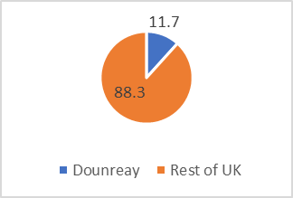
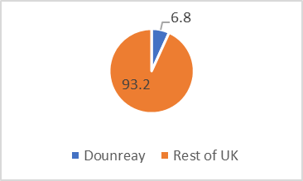
The Lifetime Plan and Radioactive Waste Management
Our Lifetime Plan includes near and medium-term blocks which extend up to 2036. There are a number of blocks beyond that are harder to predict and subject to uncertainty.
FCA’s RHILW processing facility is predicted to be required up until 2064.
Context of our Radioactive Waste Inventory:
Volume:
Final Packages
Within
UK

Slide 6
NDA7

Slide 7
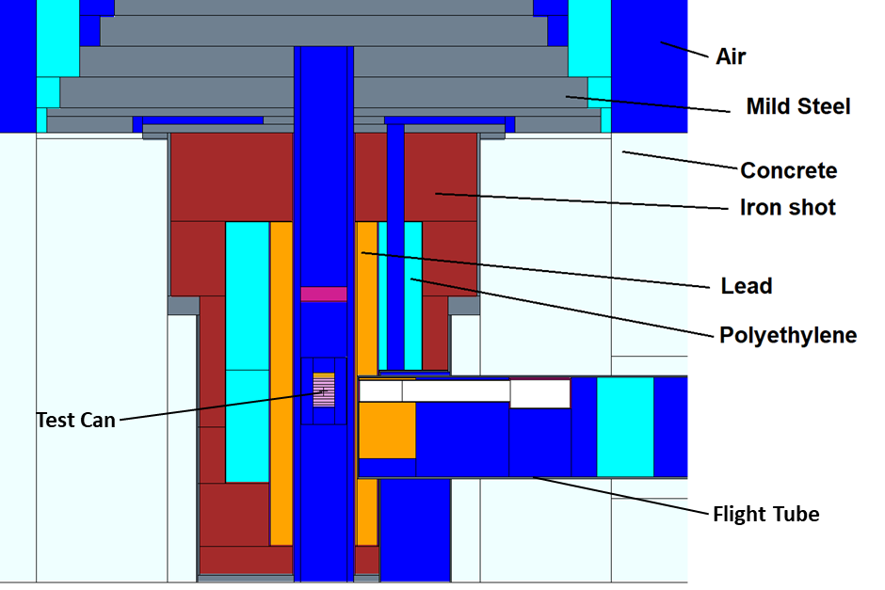
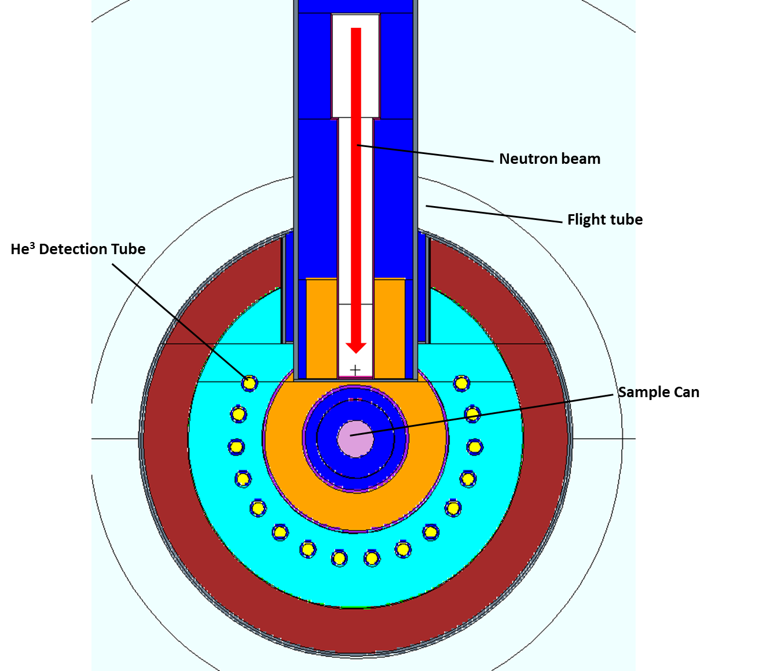
Background and System Description
NDA7 is the FCA’s Passive/Active Neutron Counting system for Remote-Handled Intermediate Level Waste (RHILW).
Uses a SODERN MEN 16NG D-T Neutron Generator as a neutron source.
Neutrons detected by an array of 16 He3 tubes.
NDA7 was upgraded from a Californium Shuffler system in 2021.
Commissioned and entered service in November 2022.
Waste cans measuring 90mm in diameter, 229mm (9”) or 660mm (26”0 in length are raised into the assay chamber for measurement via a hoist
Figure 1. NDA7 – Side View

Slide 8
Passive and Active Calibrations
4 calibrations for Passive Assay (Pu240 measurement) and 4 for Active Assay (U235 measurement) were developed by the manufacturer using Monte-Carlo N-Particle Transport Code (MCNP) modelling.
Calibrations range from effectively neutron transparent, to significantly neutron moderating based on volume of hydrogenous material (plastics, paper, wood) within the waste matrix.
Calibration | Moderator Content (Hydrogen Density in g/cm³) | Description
C1 | 0.0000 | Metals only.
C2 | 0.0065 | Plastics/wood/paper present but less than 10% of waste can volume.
C3 | 0.0135 | Low plastic (More than 10% but less than 25% of can by volume)
C4 | 0.0235 | High plastic (More than 25% of can by volume)
Notes:
Basically operators eye-ball the can contents to select calibration

Slide 9
NDA7 System Performance
System performance is confirmed via a QC check at the start of each working day using a combined, verified Pu/U mixed standard.
The system cannot be used for waste assay unless the following QC checks have passed in the previous 24hrs:
  Background counts are below a certain threshold.
  A Passive and Active QC check against defined limits has been passed.
Passive QC checks have remained stable over 3 years of operation.
Active QC checks have varied significantly, with a general downward trend since the system was commissioned.

Slide 10
Active QC Check Measurement – Historical Data
Notes:
First recal July 2025, can see on graph
Lightning strike December 2024

Slide 11
Active QC Check Measurement – Historical Data

Slide 12
Issues and Possible Causes
Core issue – NDA7 Active measurement displays general downward trend with occasional step-changes/instability.
Potential consequences – Underestimation of U235 (and hence total Uranium) mass in waste packages by up to ~30%.
Immediate action – System was removed from service until an investigation could be carried out.
Short-term solution – Develop in-house ability to recalibrate Active Assay using certified U235 standards instead of MCNP.
Long-term solution – Strategic review of RHILW assay options.

Slide 13
Short Term:
Standard Production and Recalibration

Slide 14
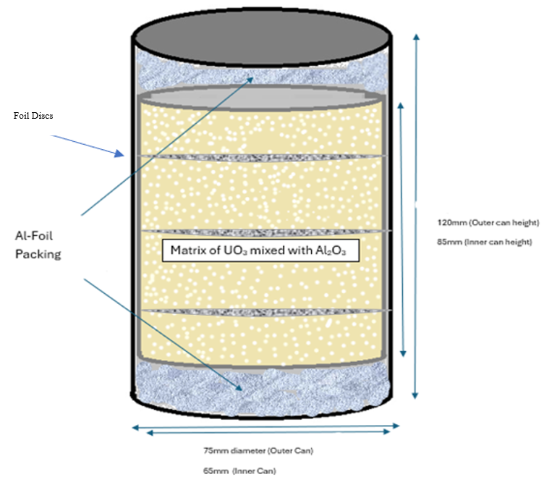
Recalibration – Manufacture of new U235 Standards
Existing Uranium material with well-characterized isotopics was used to manufacture new U235 standards with the following masses of U235 present.
Plastic Polyoxymethylene (POM) liners of increasing thickness were used to simulate increased volumes of hydrogenous content within the waste matrix.
Each standard was measured with an Al liner, and 3 different POM liner thicknesses to build up 4 calibrations for each waste matrix type.
Notes:
Old standards were around 30 yo
Same base standards in different POM liners
Cylindrical Al liner cradle for the POM liner – same for each.
Al cradle only
POM liner least thick
POM liner medium thick
POM liner thickest

Slide 15
Recalibration – New Active Calibration Equations
Notes:
Validated using MCNP

Slide 16
Recalibration – Comparison with MCNP

Slide 17
Effect on Total Measurement Uncertainty
Due to recalibration, additional uncertainty terms must be considered in the uncertainty budget.
  Effect of (expected) continuing downward trend in Measured U235eff (9.16%)
  Uncertainty inherent to U standard preparation method (4.18%)
  Uncertainty in composition of UO₃ material used (7.88%)
Uncertainties associated with MCNP modelling have been removed from the overall budget.
  Uncertainties associated with MCNP model itself (11.4%)
  Uncertainty associated with benchmarking MCNP model against previous verified 5g UO₃ standard (15.9%)

Slide 18

Long Term:
Technical and Strategic Review

Slide 19
Technical Review: Phase 1
Comparative performance analysis of NDA7 pre- and post-update. Summarized findings from a site visit.
Actions and recommendations including testing activities were identified to address quality issues with the goal of improving the long-term reliability, performance, and stability.

Slide 20
Strategic Review: Phase 2
1. Cost-Benefit Analysis and implementation programme for all identified options.
2. A radioactive source management strategy: suitability of our existing sources, cost and risk with each option.
3. Address broader issues relating to limited availability of Cf-252.
4. Immediate and long-term solutions for characterisation of nuclear material across the UK and internationally to include good practice standards, IAEA considerations [15] and active neutron innovations.
5. Review of hardware and software to understand risks associated with long-term maintenance and obsolescence.
6. Practicable contingency options to manage the risks associated with periods of downtime.
7. Identify and quantify performance metrics: detection limits, self-shielding issues etc.
8. Improving technical knowledge and understanding through academic partnership to enable NRS to fulfil our intelligent customer function to the maximum extent possible.

Slide 21
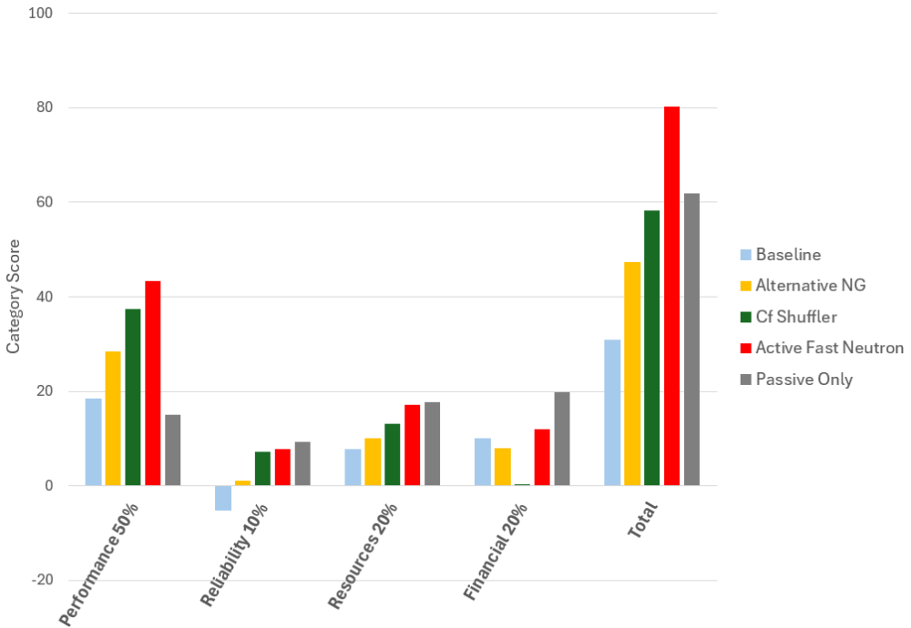
Strategic Options Assessment Outcome: Phase 2
Required “Detection Capability” is:
For Active Mode: U235 Mass 0.5g
For Passive Mode: Total Pu Mass 0.06g (for ‘O’ Grade Pu)
NDA7 Technical Specification defines required Detection Limits based on normal background conditions of 80 mg U235eff (active mode) and 30 mg Pu (passive mode).
The resulting “Measurement Range” is:
Uranium-235: 80 mg to 10g U3O8 (70V Enrichment) (dependent on matrix)
Total Plutonium: 30 mg to 10g PuO2 (‘O’ Grade)
PSC considers TMUs between 10% and 25% acceptable in typical measurement range of NDA7. For more challenging waste matrices, uncertainties of up to 50% are acceptable.
Notes:
Outcome of holistic weighted assessment – fast neutron.
Note active LoD is inversely proportional to ngen flux – and was determined at generator start of life, flux now lower

Slide 22
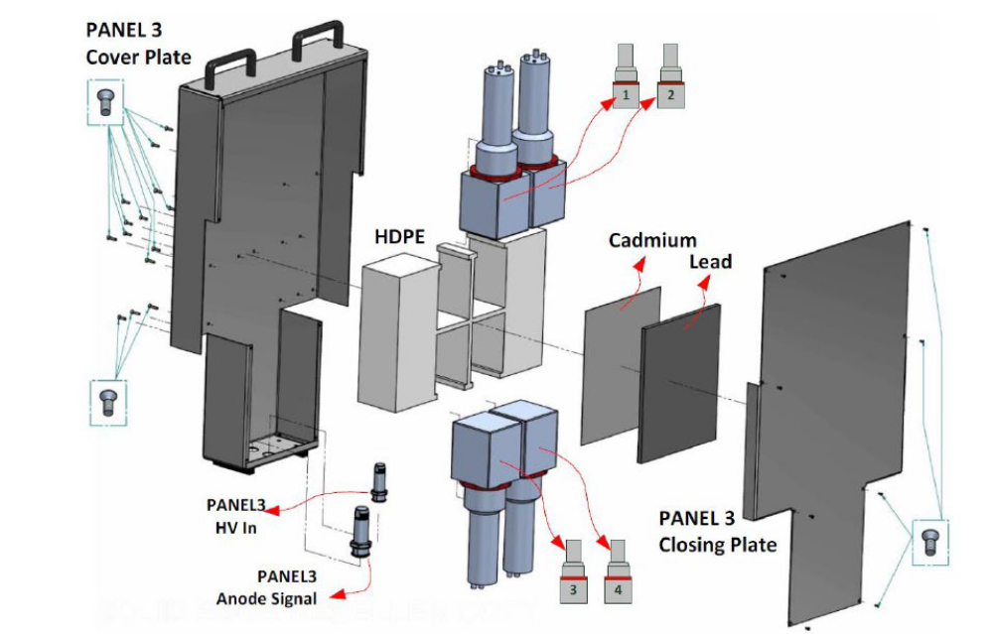
Fast Neutron Collar – AmLi Interrogation
Dounreay has two AmLi sources available.
PSC identified issues to address:
Detector sensitivity to gamma rays
Adoption of technology for characterisation of waste
  Model and experimentally test the FNC concept for the RHILW application and determine its optimum design as an NDA7 upgrade
Notes:
Shows the components of a detector panel, which is lined with an (optional) cadmium and lead liner.
The cadmium liner ensures that thermalized neutrons (< ~0.5 eV) outside of the assay region are effectively captured by the liner and are unable to induce subsequent thermal-neutron induced fissions.
E.g. EJ-309 organic scintillators
Extremely short gate width – e.g. 40 ns cf 50 micro s
Pulse shape discrimination methods have been developed that allow the gamma interactions to be identified and removed from the signal during the analysis. This approach does have some limitations in cases where the detectors are exposed to very high gamma radiation such that the gamma signal overwhelms the weaker neutron signal. However, the 3” thick lead shield in the NDA7 system, will block the vast majority of gamma rays emitted by the RHILW containers. NEEDS DEMONSTRATED.
The neutron / gamma discrimination works reliably for the EJ-309 at dose rates of 60 uGy/hr or higher (tests performed by CAENsys). Typical high-activity RHILW package (containing up to 35,000 MBq Cs-137), will generate dose rates on the outer surface of the 3” lead shield of < 10 uGy/hr. Thus, measurement of RHILW is well within the capability of the existing FNC systems.
For modelling and experimentally testing: Practical considerations include cross-talk between detectors (neutrons that interact in more than one detector), pulse pile up, the effect of background cosmic spallation in the lead shield and any gamma dose rate limitations. Carefully positioned, HDPE moderator and cadmium will be required between / around the fast neutron detectors to achieve optimum interrogation flux in the epi-thermal and thermal energy regions while limiting ‘self-shielding’.
If asked: Alan prefers AmLi – better discrimination, one clear peak easier to see than an AmBe (more wobblies at low energy)

Slide 23
Outlook

Slide 24
Conclusions
Successes
  NRS have developed in-house ability to recalibrate NDA7 RHILW Assay System using new certified UO₃ standards instead of MCNP.
  Four new calibration equations for four waste matrix types created.
  Revised and slightly improved Total Measurement Uncertainty.
Caveats
  Underlying cause of Active calibration drift and instability still not fully understood, suspected multiple compounding issues.
  Active calibration expected to continue to drift/decrease, at which point the system will need to be re-benchmarked using a new set of measurements.
Future outlook
  NRS continue to monitor and investigate NDA7 performance and have the ability to re-calibrate the system, producing new Active calibration equations as & when necessary.
  We will upgrade NDA7 to a Fast Neutron Collar system within the next 5 to 10 years
  We will shortly be seeking an academic partner to support modelling and experimental testing

