Slide 1





Deuterated Liquid Scintillator for Low-Energy Neutron Measurements in Nuclear Astrophysics
Rhys Bonnell
University of Edinburgh
https://www.erc-nuclear.uk​

Slide 2
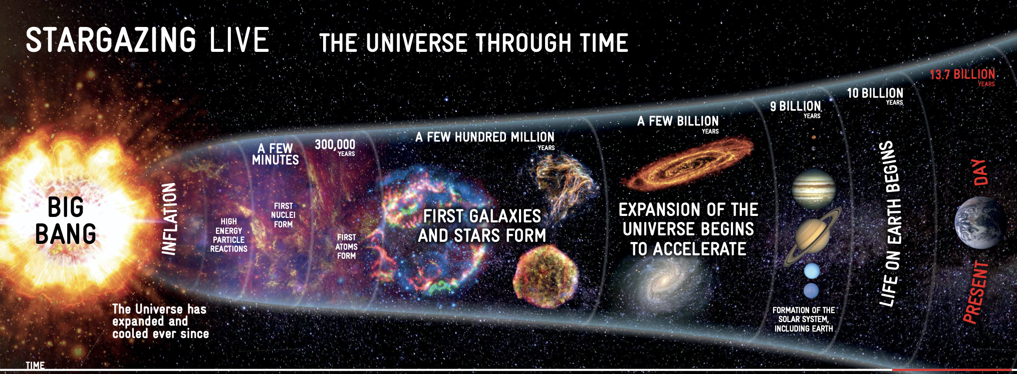
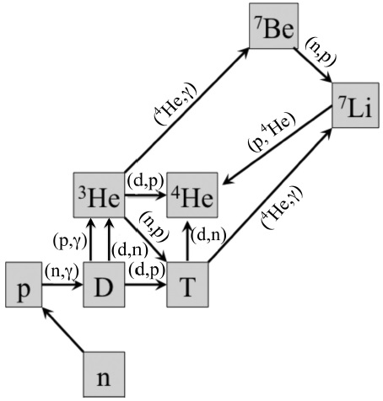
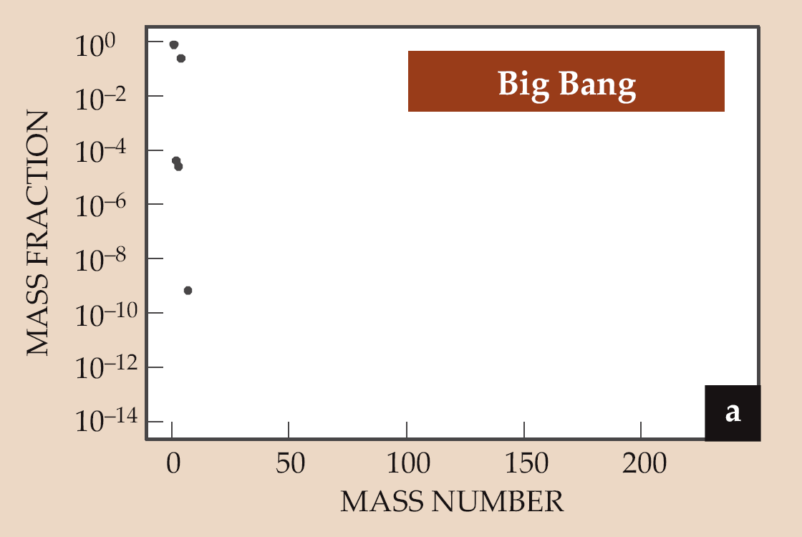

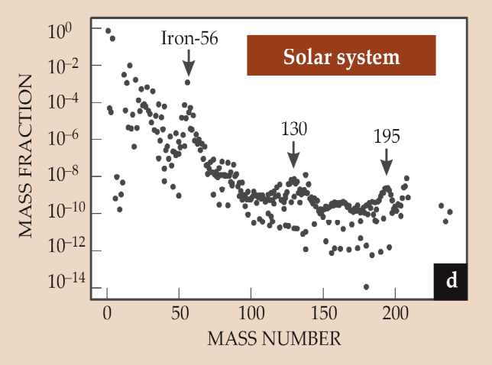
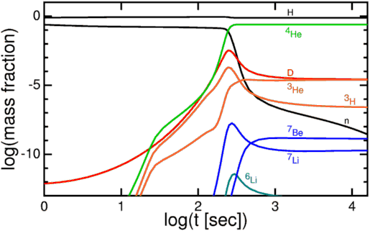
Skype meeting | 17 July 2014
The Chemical Evolution of the Universe (in a Nutshell)
Big Bang Nucleosynthesis
3-20 min after BB
how do we breakout from BBN to synthesise CNO elements and beyond?

Slide 3
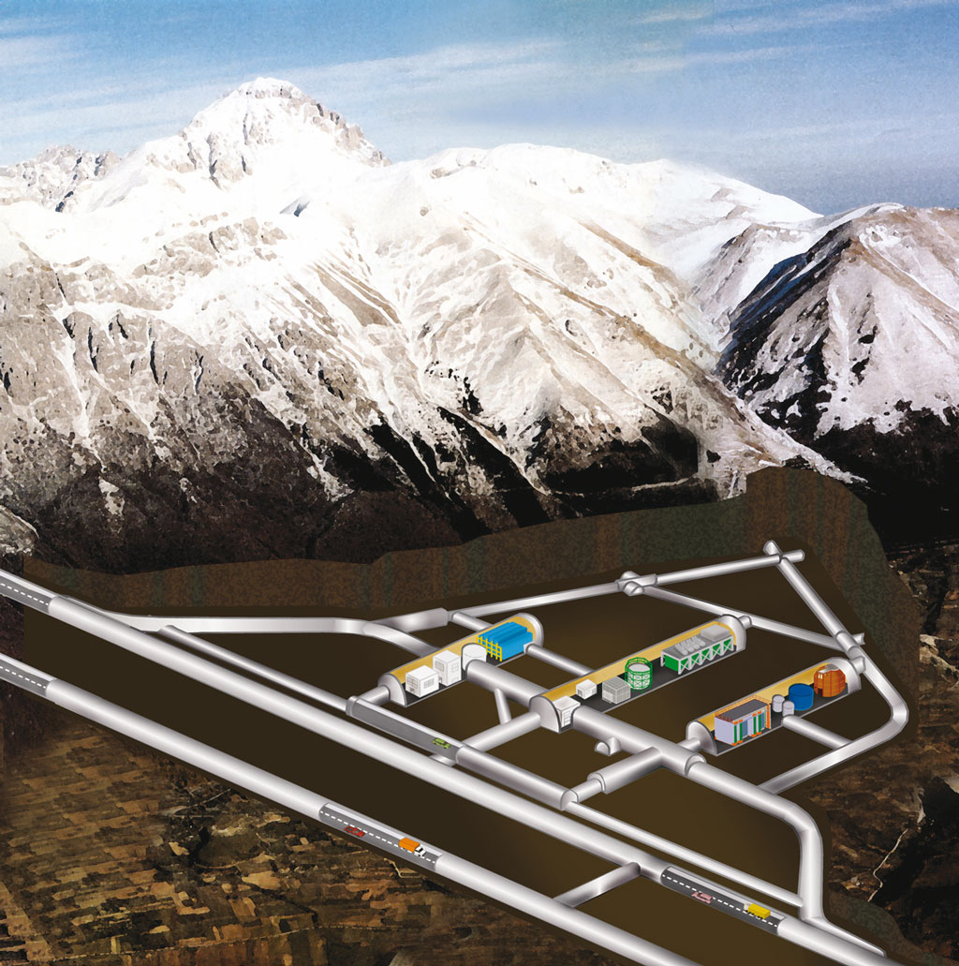
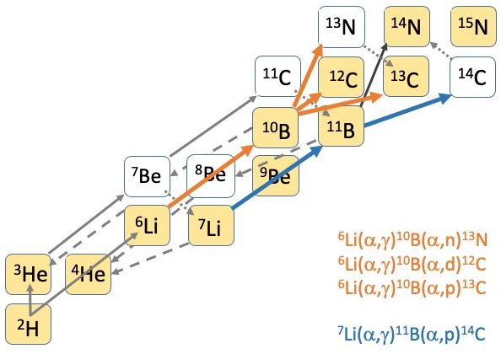
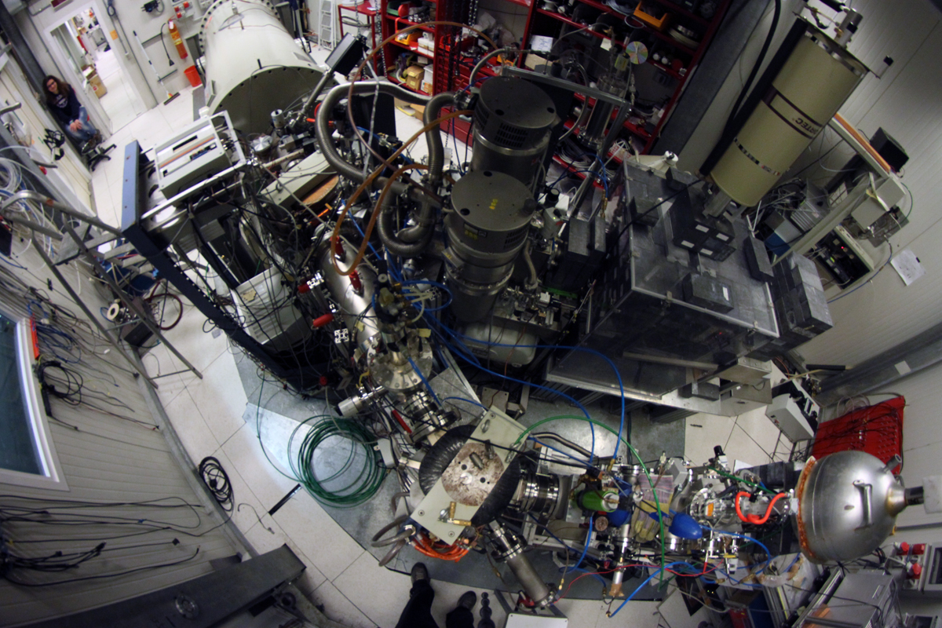
Measurements at LUNA
Cosmic ray attenuation: μ → 10⁻⁶
n → 10⁻³
~ 1400 m
(3800 m.w.e.)
Goal:
Measure α+¹⁰B reactions down to lowest feasible energies
LUNA 1
50 kV
(1991-2001)
LUNA400
400 kV
(2000 → present)
Z
Bellotti IBF
(2023 → present)
3
LUNA400 Facility:
400keV accelerator
H⁺ and He⁺ beams
I = 200 – 300 uA
ΔE = 100 eV
N

Slide 4
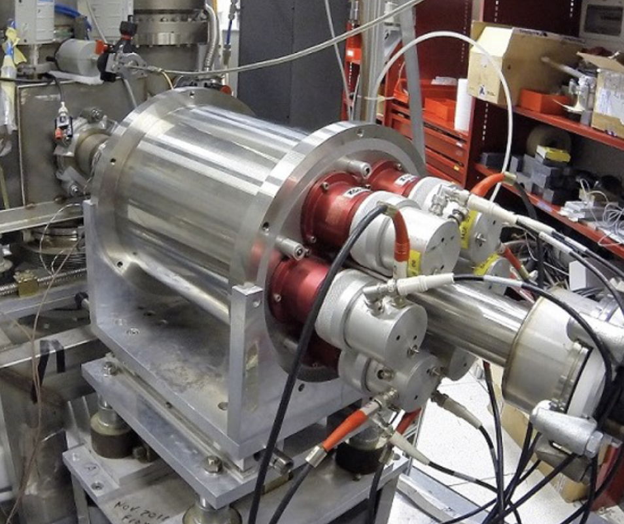
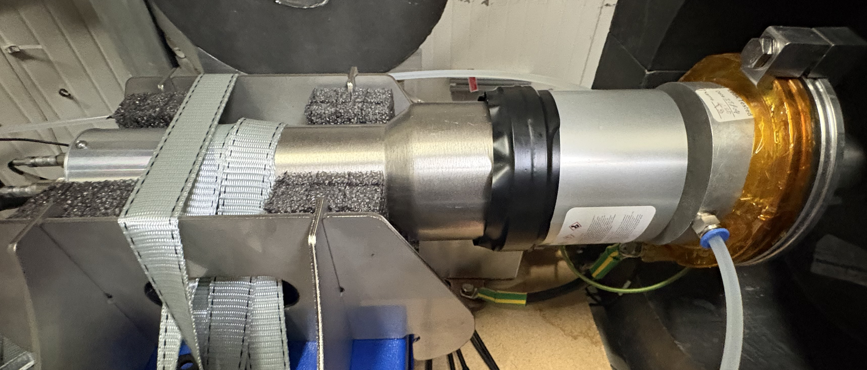
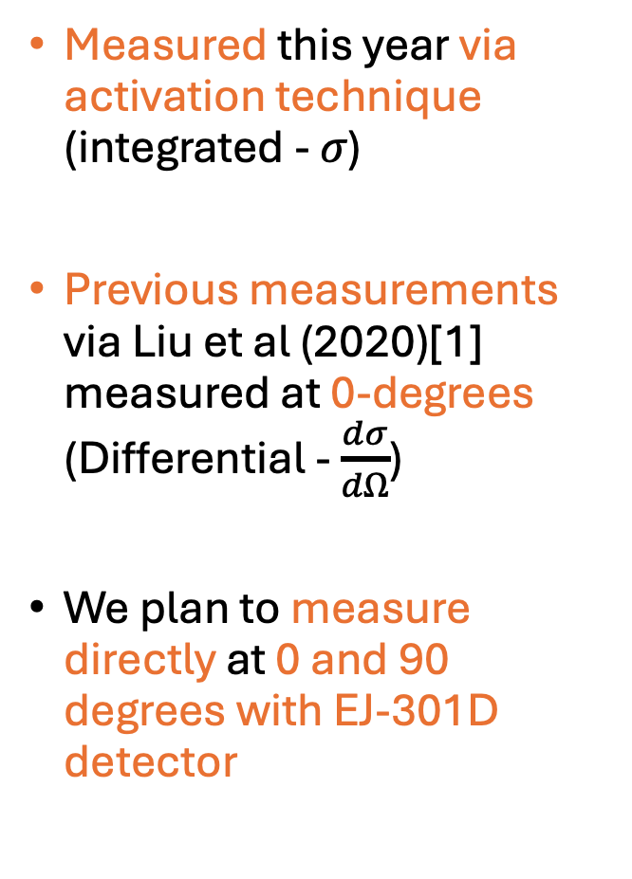
¹⁰B(α,n)¹³N reaction measurement
¹⁰B(α,n)¹³N
Q = 1.054 MeV
11680 keV
Measured this year via activation technique (integrated - 𝜎)
Previous measurements via Liu et al (2020)[1] measured at 0-degrees (Differential - $\frac{dσ}{dΩ}$)
We plan to measure directly at 0 and 90 degrees with EJ-301D detector
BGO 6
BGO 1
10B+a
11510 keV
BGO 5
BGO 2
13N+n
β+
511keV
511keV
S_{α} = 11.612 MeV
13C (+n)
BGO 4
BGO 3
14N
LUNA BGO no shielding
EJ-301D
Target Holder
[1] Q. LIU et al. PHYSICAL REVIEW C 101, 025808 (2020)

Slide 5
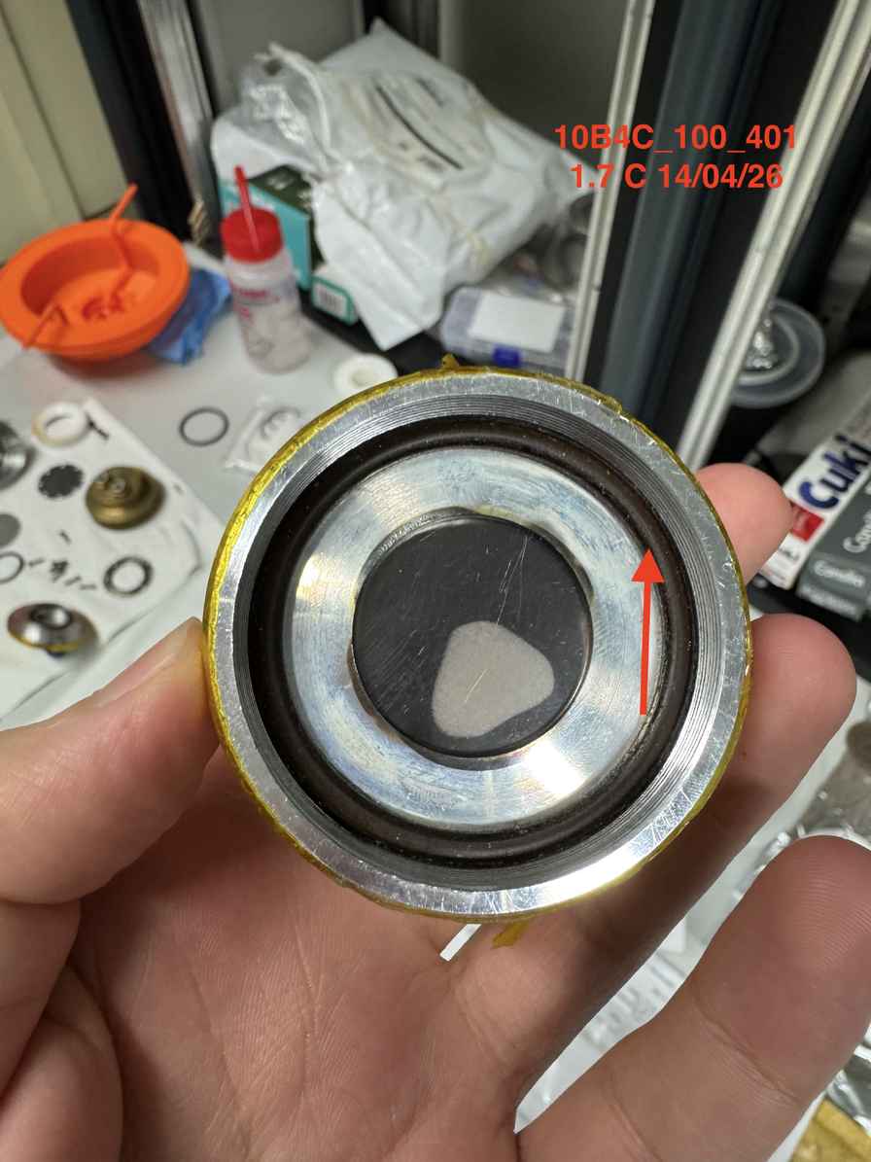
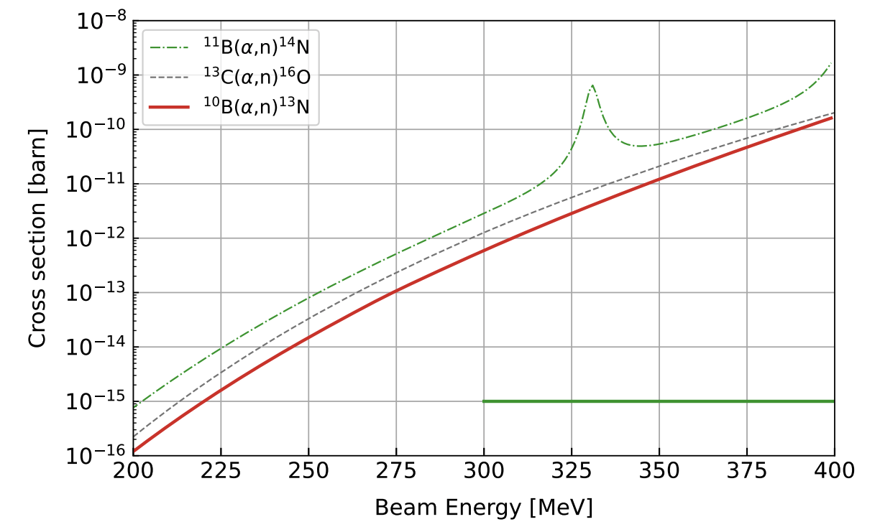
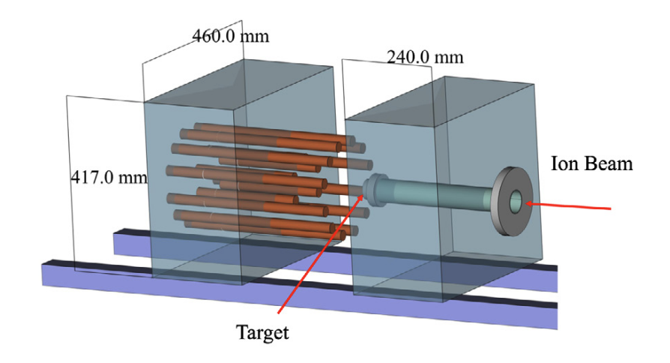
What issues do we face with direct neutron detection?
¹⁰B₄​C Target
Solid targets of enriched Boron-10 (¹⁰B₄​C ) on tantalum
Targets contain ¹¹B and ¹³C
These generate neutrons through (α,n) reactions of varying energies
  ¹¹B(α,n)¹⁴N: Q-Value = 158 keV
  ¹³C(α,n)¹⁶O: Q-Value = 2215 keV
  ¹⁰B(α,n)¹³N: Q-Value = 1059 keV
Moderated ³He Counters can be, and are, used for (α,n) reaction due to high efficiency but no energy information
¹³C(α,n)¹⁶O – ³He counter set up at LUNA
Csedreki et al Nuclear Inst. and Methods in Physics Research, A 994 (2021) 165081

Slide 6
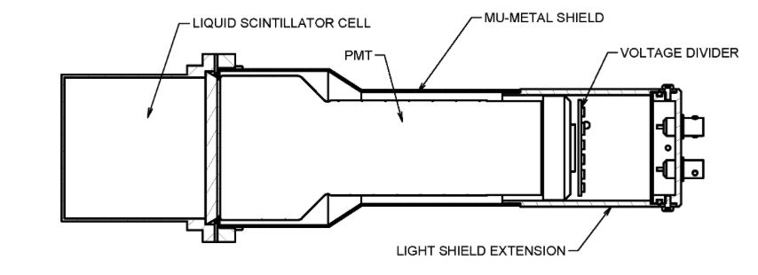
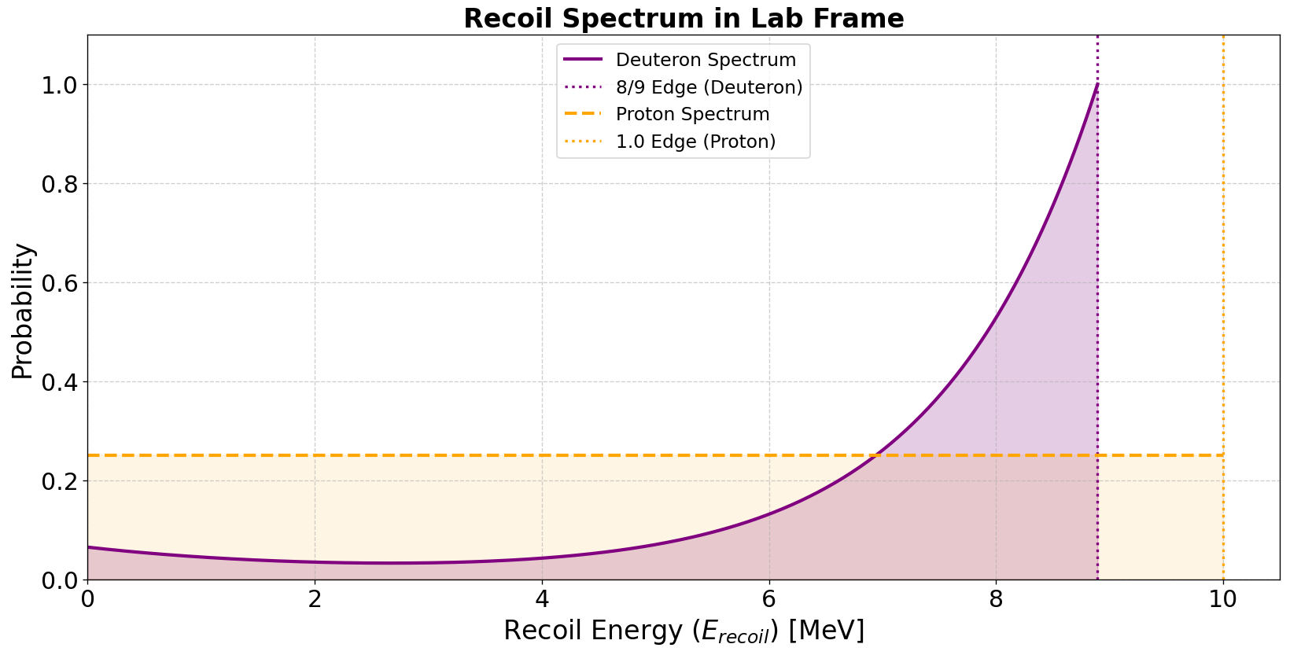
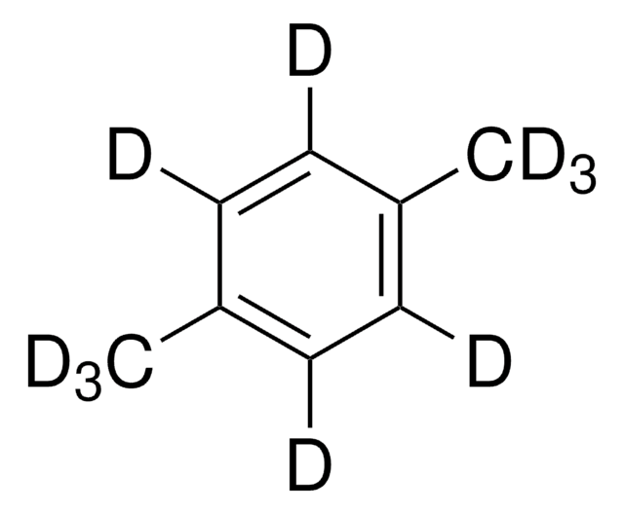
What is EJ-301D?
Liquid Scintillator
  p-Xylene-d10: 85-96%
  Naphthalene-d8: 5-15%
  C:D ratio => 1:1.2
EJ-301D
https://eljentechnology.com/products/liquid-scintillators/liquid-scintillator-cells
p-Xylene-d10

Slide 7
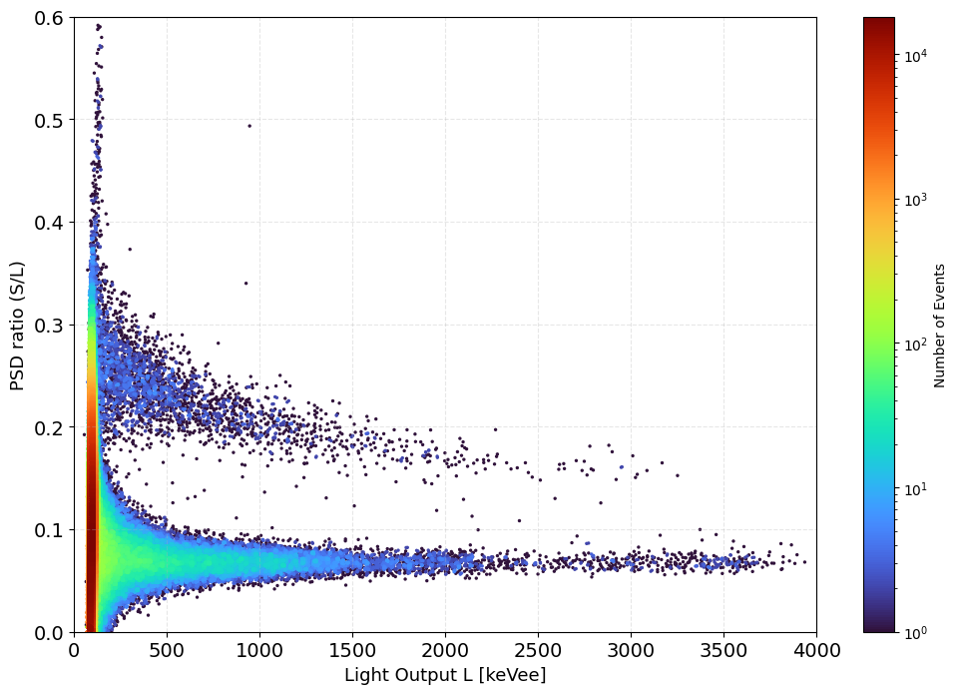
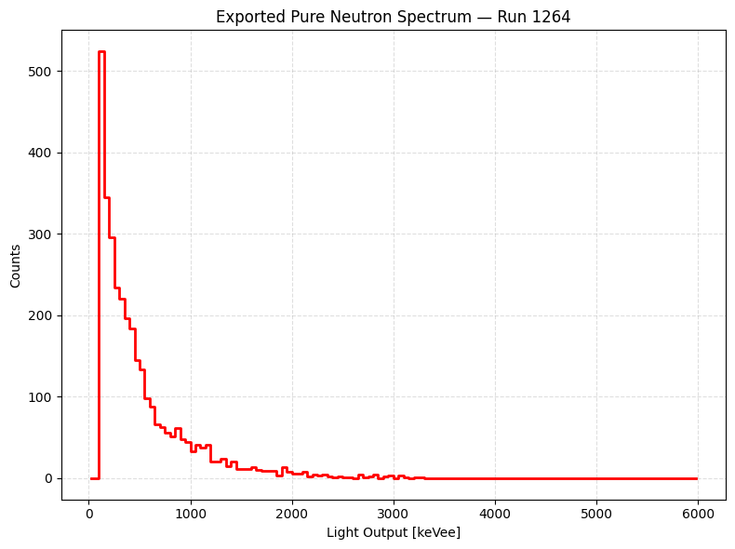
Pulse Shape Discrimination
PSD of AmBe Source
Neutron Light Output For AmBe Source
Neutrons
Gammas

Slide 8
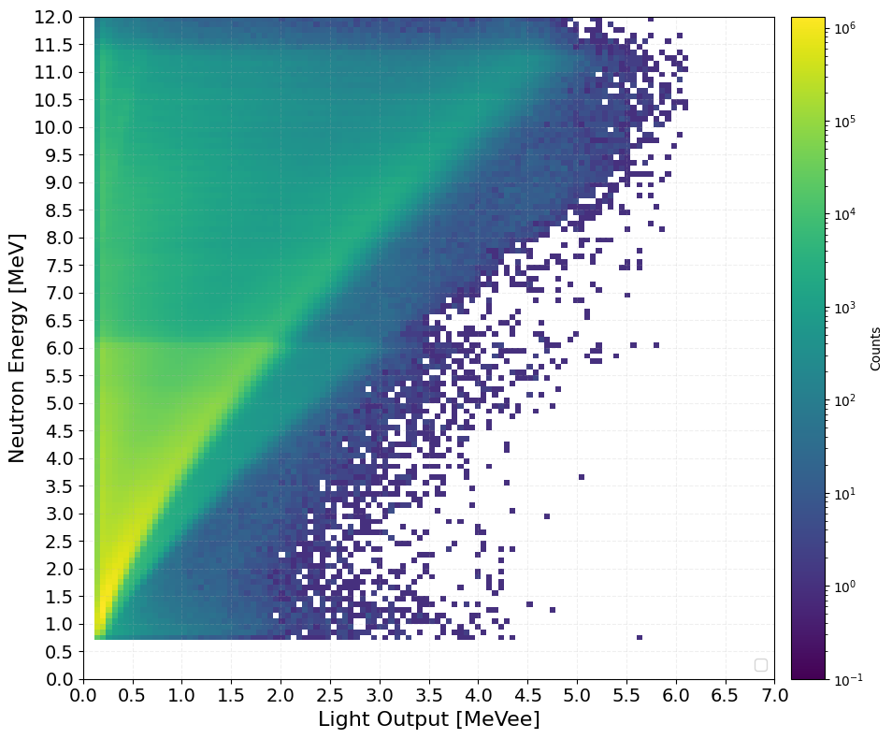
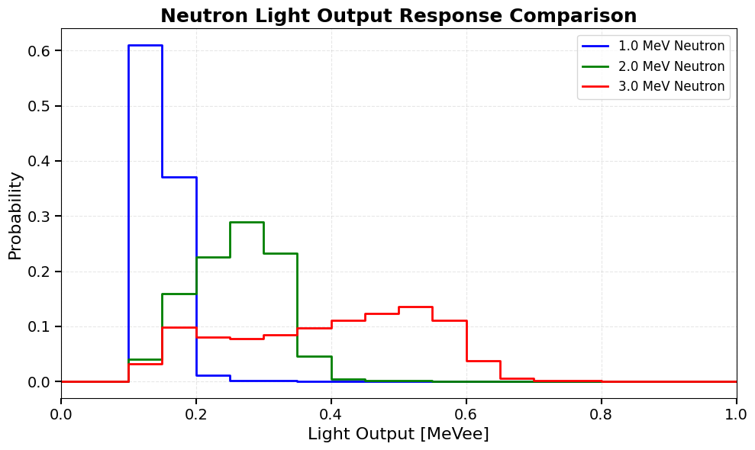
Detector Response Matrix (DRM)
The DRM maps the light output to neutron energy
Obtained experimentally (Time of Flight using AmBe source, accelerator-based fast neutron production) or via simulations (e.g. MCNP…)
DRM Courtesy of University of Notre Dame

Slide 9
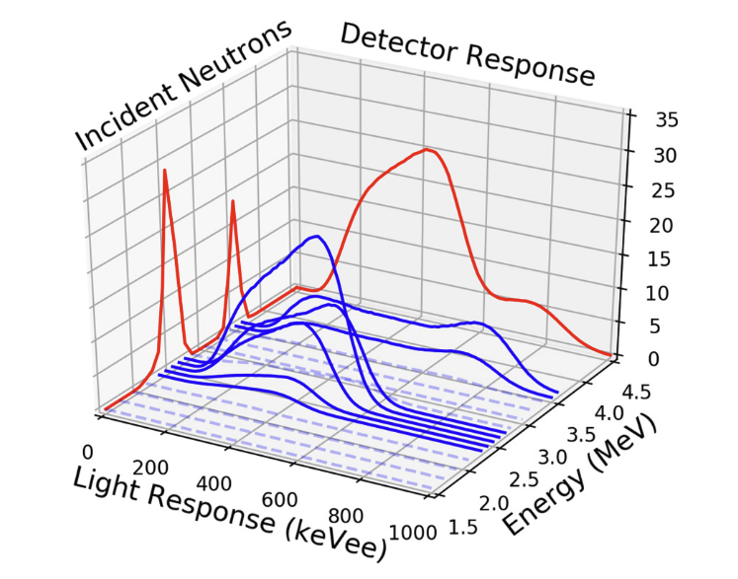
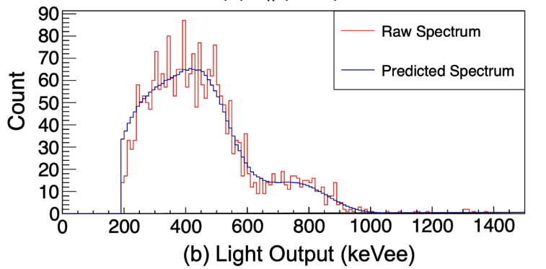
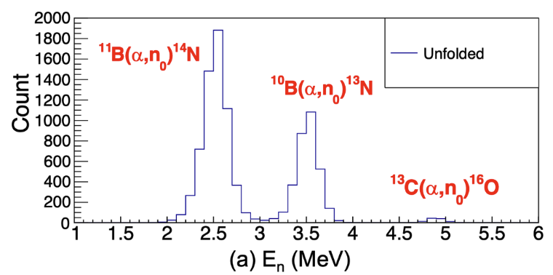

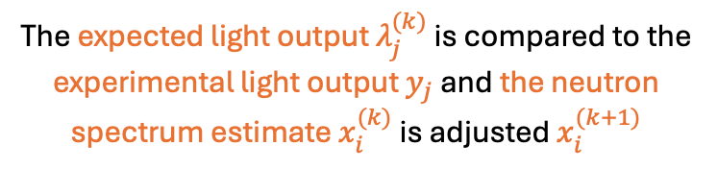

Maximum Likelihood Expectation Maximization (MLEM)
Liu et al. PRC 101, 025808 (2020)
M. Febbraro et al. NIM A989 164824 (2021)
Kanj et al. Radiation Measurements 176 107206(2024)
Becchetti et al. NIM A820 (2016) 112 and refs therein
From Liu et al. PRC 101, 025808 (2020)
From Liu et al. PRC 101, 025808 (2020)
$E_{α}=2.5$ MeV
From Liu et al. PRC 101, 025808 (2020)
The expected light output $λ_{j}^{(k)}$ is compared to the experimental light output $y_{j}$ and the neutron spectrum estimate $x_{i}^{(k)}$ is adjusted $x_{i}^{(k+1)}$

Slide 10
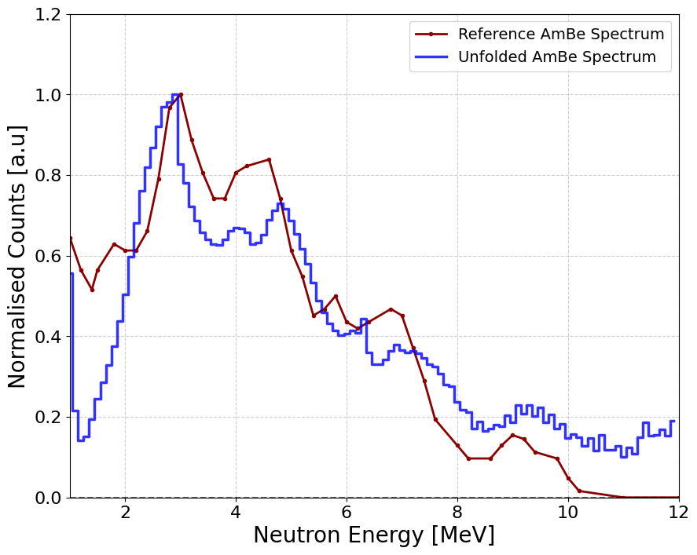
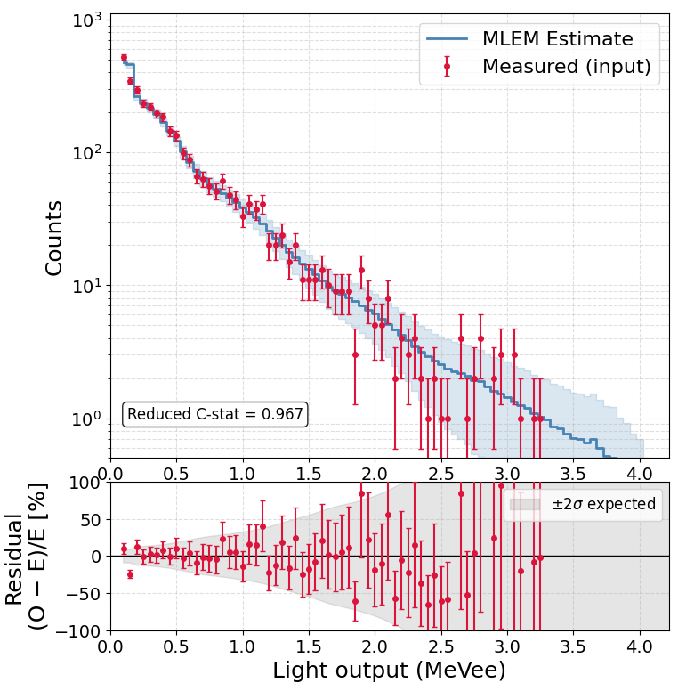
AmBe Results
Data Acquired over 1 hour with AmBe Source – low stats
https://r2e.web.cern.ch/about-radiation/test-facilities/ambe
PRELIMINARY

Slide 11
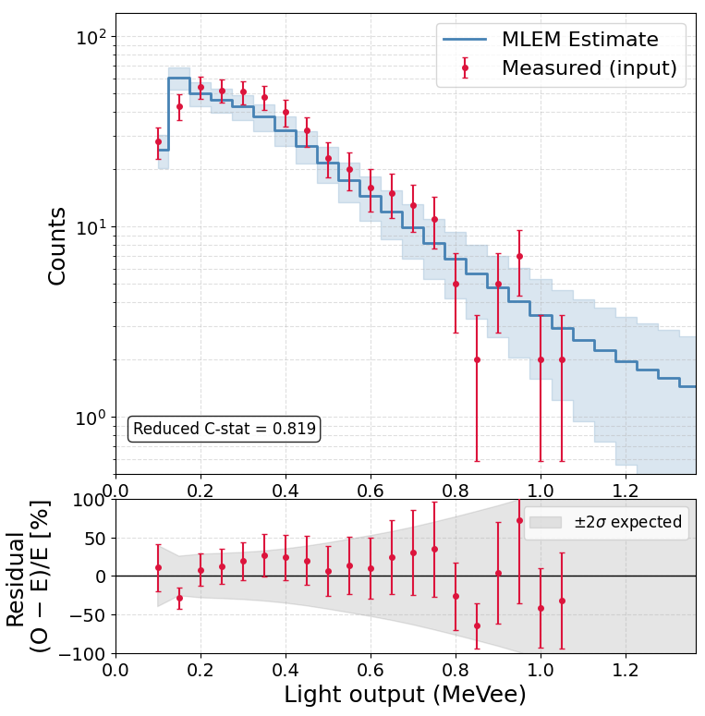
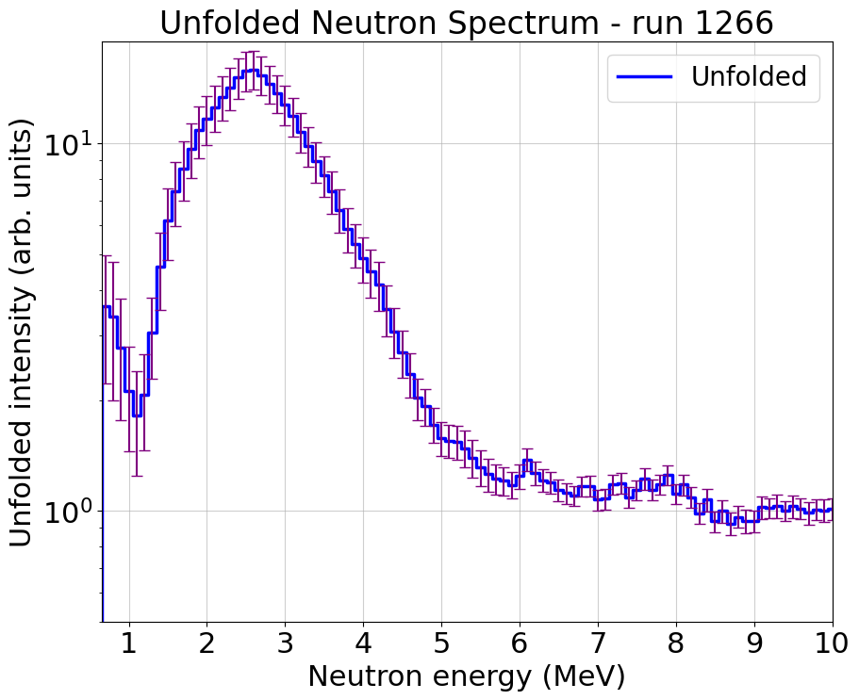
Fast Neutron Background
Taken for 20.6 hours
LUNA400 accelerator hall
Longer measurement time needed
Not efficiency corrected
PRELIMINARY

Slide 12
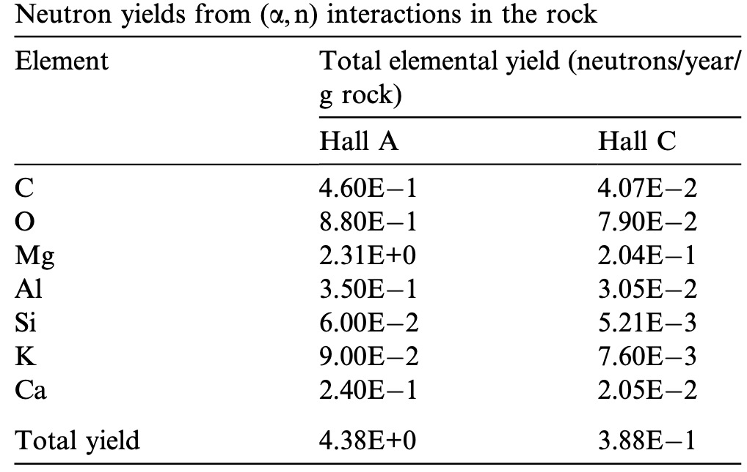
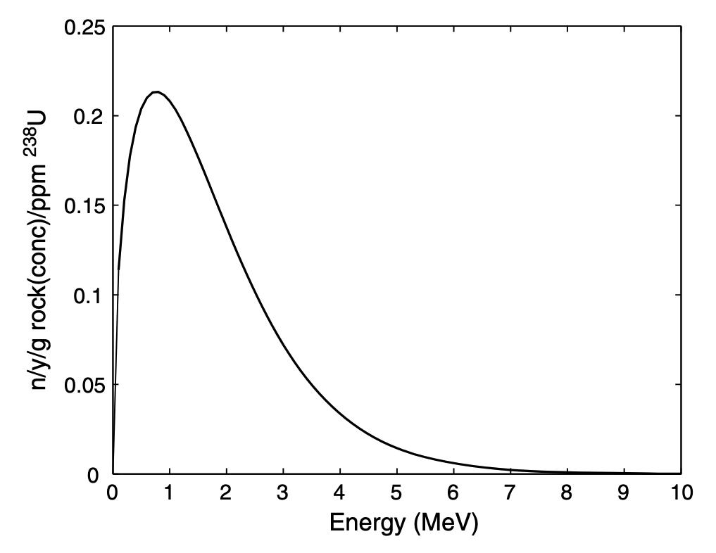
What reactions are dominant?
Half of the total (α,n) neutron production is from Mg, which only makes up 6% of the rock [2]
Sources: ²⁵Mg(a,n)²⁸Si (Q-Value = 2.65 MeV) + many other (a,n) reactions and neutrons from ²³⁸U and ²³²Th
Or potential Alpha Contamination in detector
PRELIMINARY
[2]
[2]
[2] H. Wulandari et al. / Astroparticle Physics 22 (2004) 313–322

Slide 13
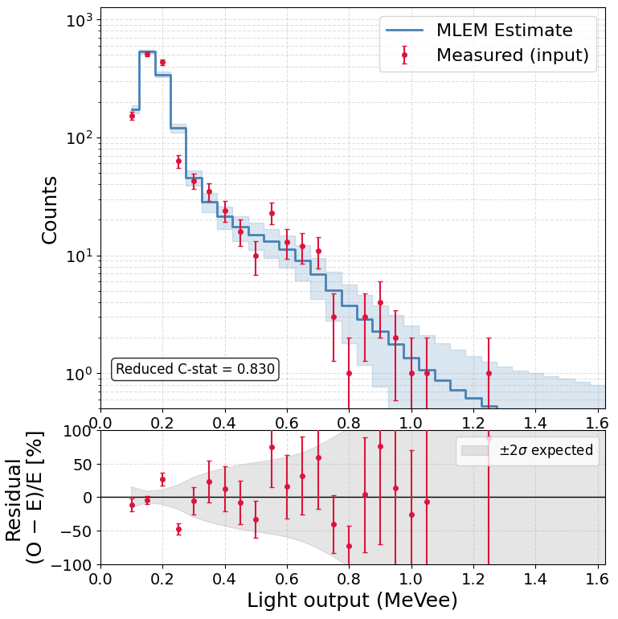
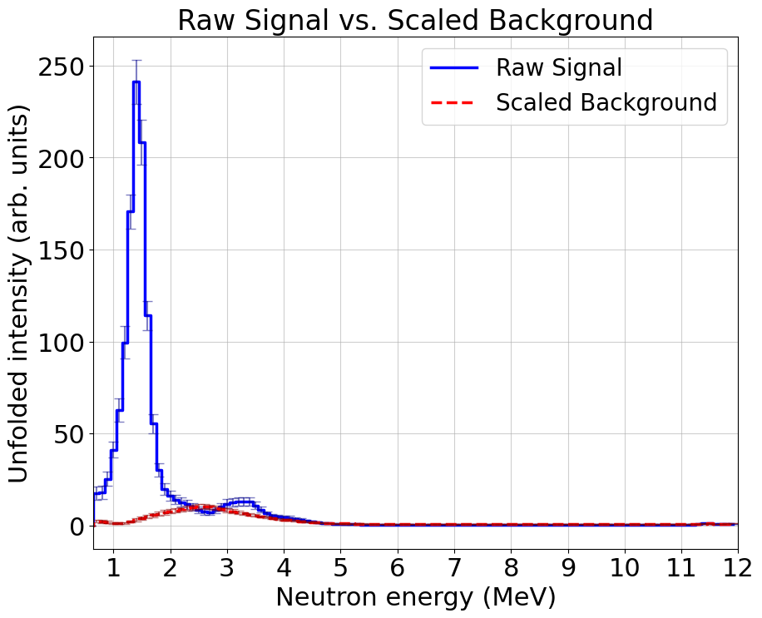
¹⁰B(α,n)¹³N Result
⁴He⁺ = 400 keV on a ¹⁰B₄C target
Expected ¹⁰B(α,n)¹³N = 1.35 MeV
Not efficiency corrected
¹⁰B(α,n)¹³N
PRELIMINARY
¹³C(α,n)¹⁶O ?

Slide 14
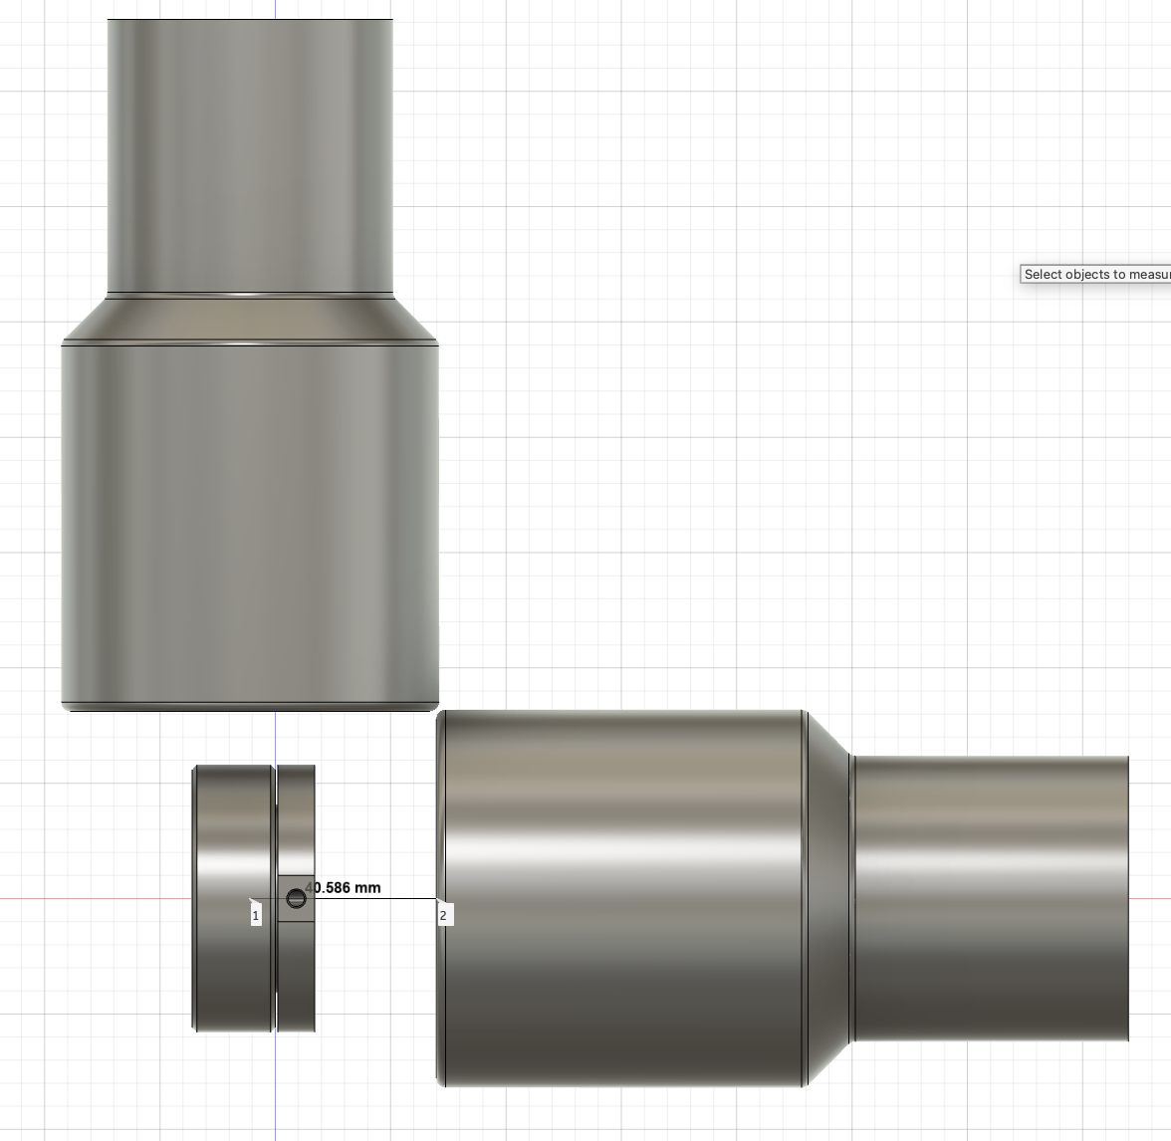
The future use of the EJ-301D Scintillator
Planned LUNA-setup
October 2026 LUNA
  ¹⁰B(α,n)¹³N Measurement at LUNA
  (0 and 90 degrees)
  Further Background measurements
Ongoing at Edinburgh - Time of Flight set up for neutron energy tagging
  Improvement to DRM via improved resolution
    Detector specific DRM
  Testing of new unfolding procedures
    Event by Event and Bayesian Neural Network
EJ-301D
EJ-301D

Slide 15







Special Thank to M. Febbraro
PI: Prof. Marialuisa Aliotta
R. Bonnell, P. Black, S. Baltaci,
A. Compagnucci, L. Dalla Vedova,
T. Davinson
THE LUNA COLLABORATION
http://luna.lngs.infn.it
Contact: R.Bonnell@sms.ed.ac.uk
M. Wiescher, J. deBoer, V. Picciotto,
K. Manukyan, M. Sorensen
+ local staff and students
https://www.erc-nuclear.uk

Slide 16
Extra Slides

Slide 17
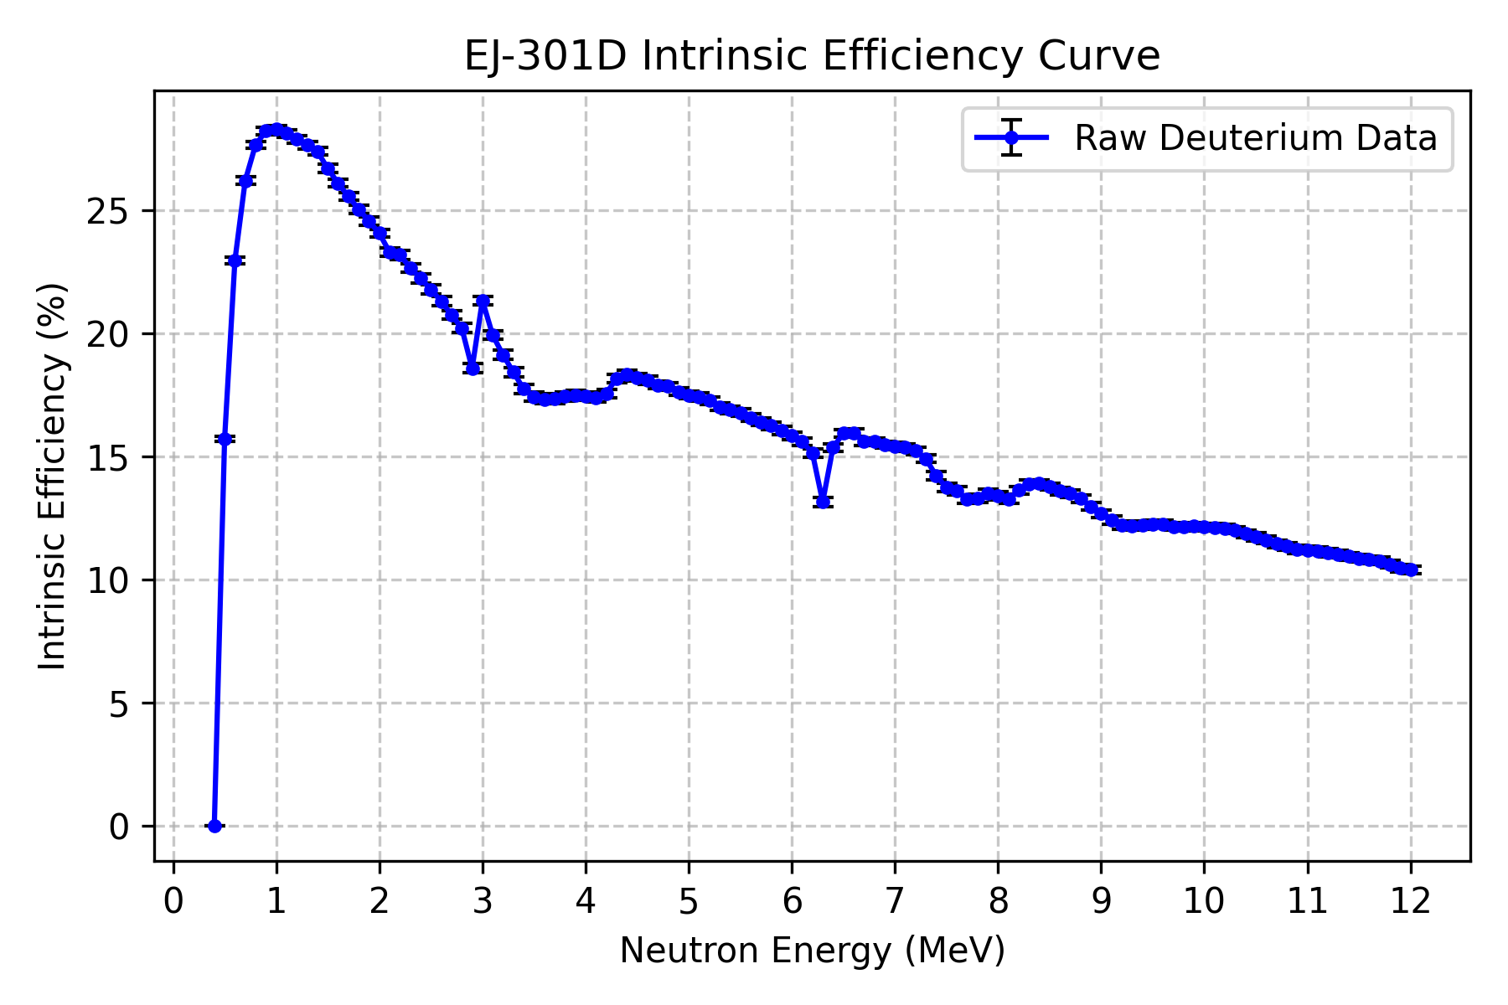
EJ-301D Efficiency
Computed using Monte Carlo N-Particle (MCNP) code
Derived from the kinetic energy transferred exclusively to deuterium nuclei
Applied a low-energy cutoff (≈100 keVee) mapping to the experimental light output limits
Incorporated neutron scattering and absorption by carbon atoms to reflect true in-volume physics

Slide 18

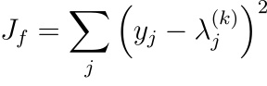
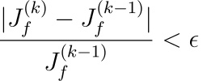
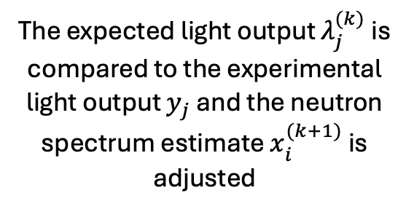
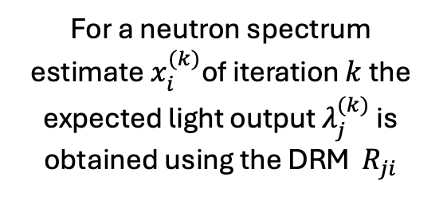
Light Output to neutron energy through Maximum Likelihood Expectation Maximization
For a neutron spectrum estimate $x_{i}^{(k)}$of iteration $k$ the expected light output $λ_{j}^{(k)}$ is obtained using the DRM $R_{ji}$
To prevent over fitting to noise the residual is calculated
The expected light output $λ_{j}^{(k)}$ is compared to the experimental light output $y_{j}$ and the neutron spectrum estimate $x_{i}^{(k+1)}$ is adjusted
Criteria not met
Monte Carlo sampling done to obtain neutron spectra error
If either criteria is met the fitting is stopped and the resulting neutron spectra is outputted
Criteria met

