Slide 1



Big Data at the Large Hadron Collider
Dr Katy Ellis, RAL

Slide 2



LHC Computing
Computing is a really important part of particle physics
Everybody uses computers to do lots of different tasks (not just Zoom, email and watching YouTube)
Without computers we would not be able to handle the huge amount of data from LHC experiments

Slide 3

How big is big data?
Big! And growing all the time.
Data saved by LHC experiments is already at ExaByte scale. That’s 1,000,000,000,000,000,000 (10¹⁸) Bytes!
Or ~230,000 years of video-calls!
x1000
x1000
x1000
x1000
x1000
x1000
1 Byte (B)
1 kilobyte (kB)
1 MegaByte (MB)
1 GigaByte (GB)
1 TeraByte (TB)
1 PetaByte (PB)
1 ExaByte (EB)
Notes:
https://ischoolonline.berkeley.edu/blog/big-data-infographic/
https://www.backblaze.com/blog/what-is-an-exabyte/

Slide 4

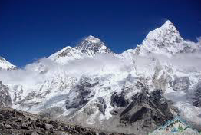
How big is big data?
The CMS experiment outputs so much data that we can only afford to keep 0.0025% of it!
If the data we keep were stored on MacBooks the stack would be 12.5km high!*
*Mount Everest is 8.8km high
x1000
x1000
x1000
x1000
x1000
x1000
1 Byte (B)
1 kilobyte (kB)
1 MegaByte (MB)
1 GigaByte (GB)
1 TeraByte (TB)
1 PetaByte (PB)
1 ExaByte (EB)
Notes:
200PB on 250GB MacBooks is 800,000 MacBooks, at 1.56cm thickness is 12480m

Slide 5
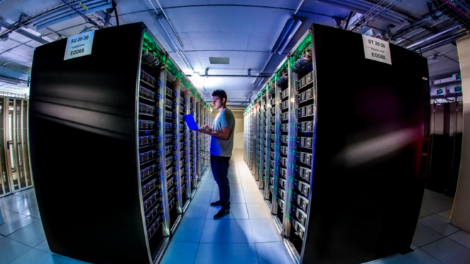
Grid sites
Data is stored and processed at each site

Slide 6
LHC Computing
LHC computing is spread throughout the world in many different countries
  At Universities and National Labs (like RAL)
This is called “The Grid”
All the sites are connected together
  There’s a constant stream of data moving between sites
Data centres worldwide provide computing and storage resource accessible by all LHC physicists

Slide 7
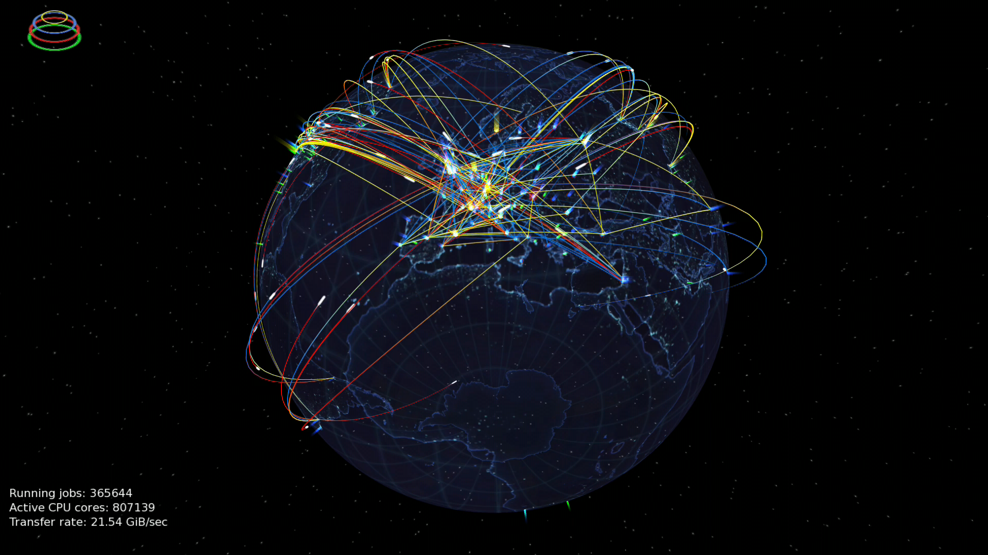
“The Grid”
170 computing sites in 40 countries
Each site hosts thousands of computers and data storage

Slide 8

Distributed computing

Slide 9


Using “The Grid”
12,000 LHC scientists across the world have access
They do not need not know where their computing jobs will run or where the data is stored
Submit to the grid and receive results on completion!
Notes:
https://wlcg.web.cern.ch

Slide 10
What do these ‘jobs’ do?
Create theoretical data based on physics models
  ‘Simulate’ the data to make it look like it came from a real detector
  Reconstruct it just like the experimental data
‘Process’ the data from the experiment
  Do ‘reconstruction’ of tracks from particle hits
  Identify particles based on how they move and appear in the detector
Perform comparison!
(‘Physics analysis’)

Slide 11
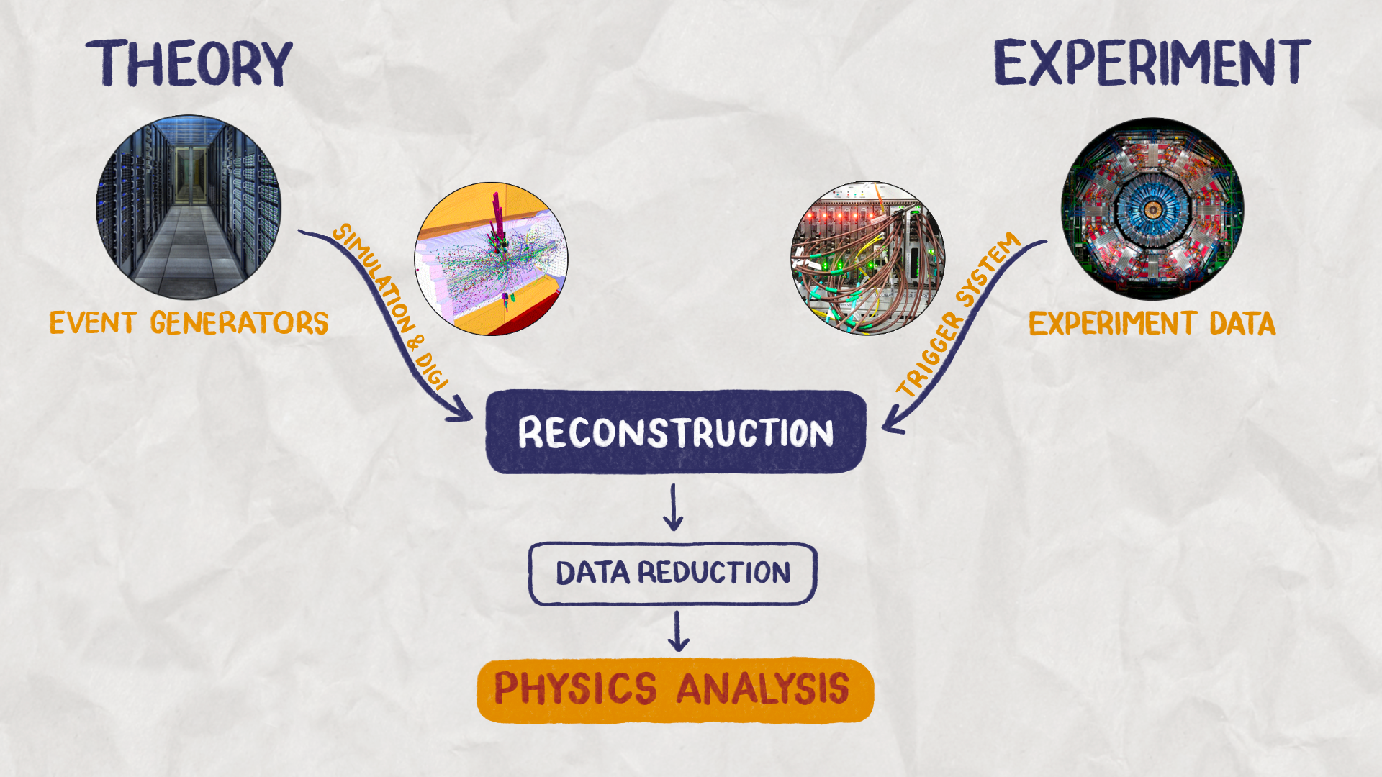

How to do particle physics

Slide 12
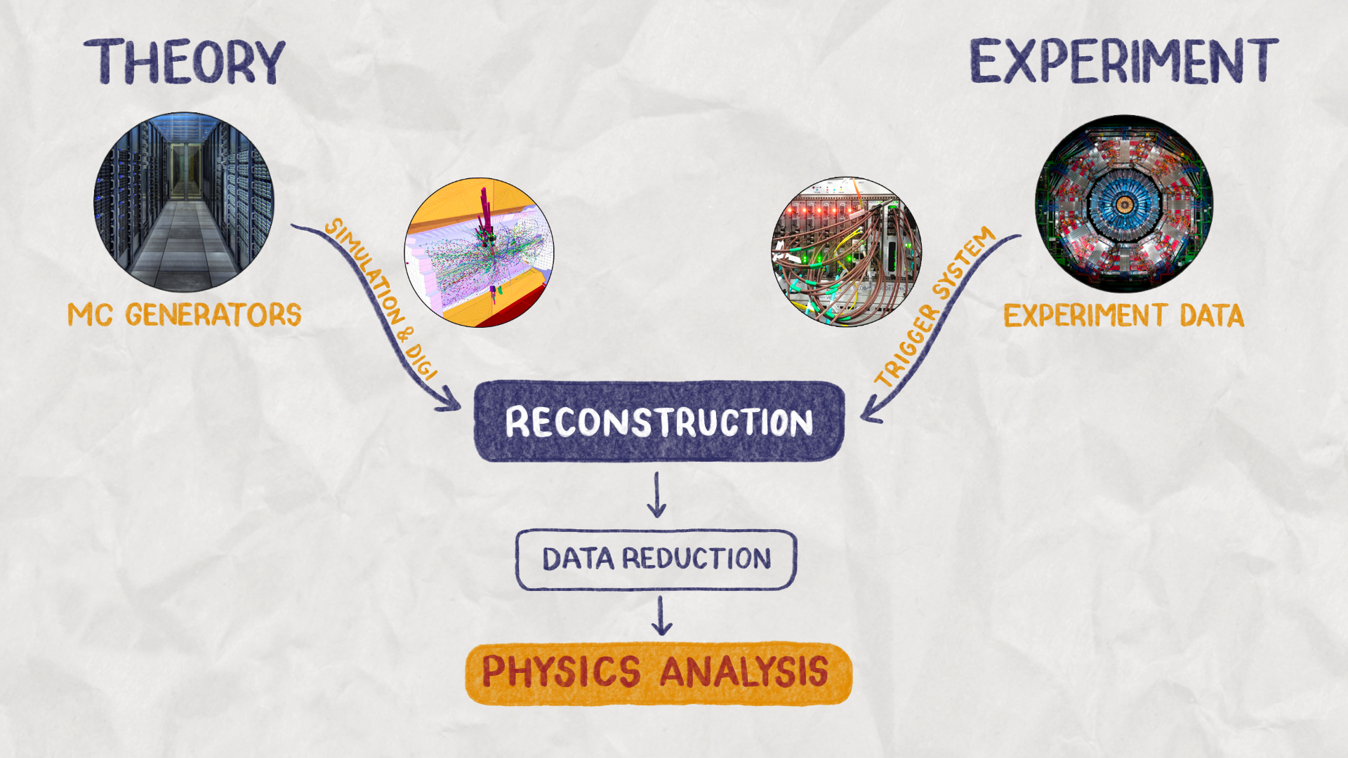
Computing!

Slide 13
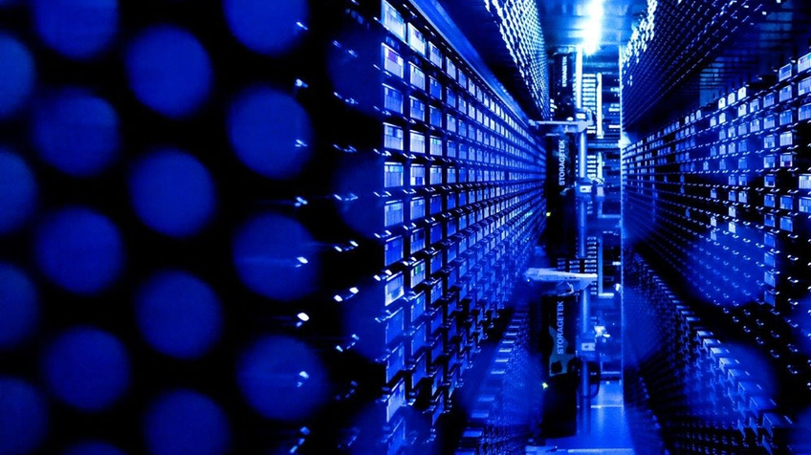
Data must be stored on disk, or even on tape!

Slide 14
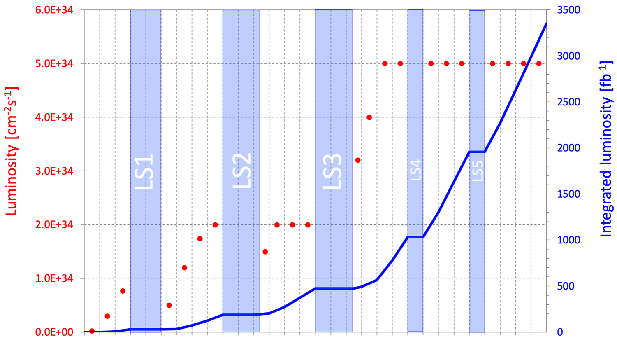
Why do we need so much data?
To discover ‘new’ science we need to find and study things that are extremely rare
  The more data we have, the better the chance to find something new
LS = Long Shutdown
Run 1
Run 2
Run 3
Run 4
Run 5
Run 6
Dataset size ~doubling in every 3 years of running!
HL-LHC
Despite data reduction as illustrated in next slide
2009
Now
Time

Slide 15
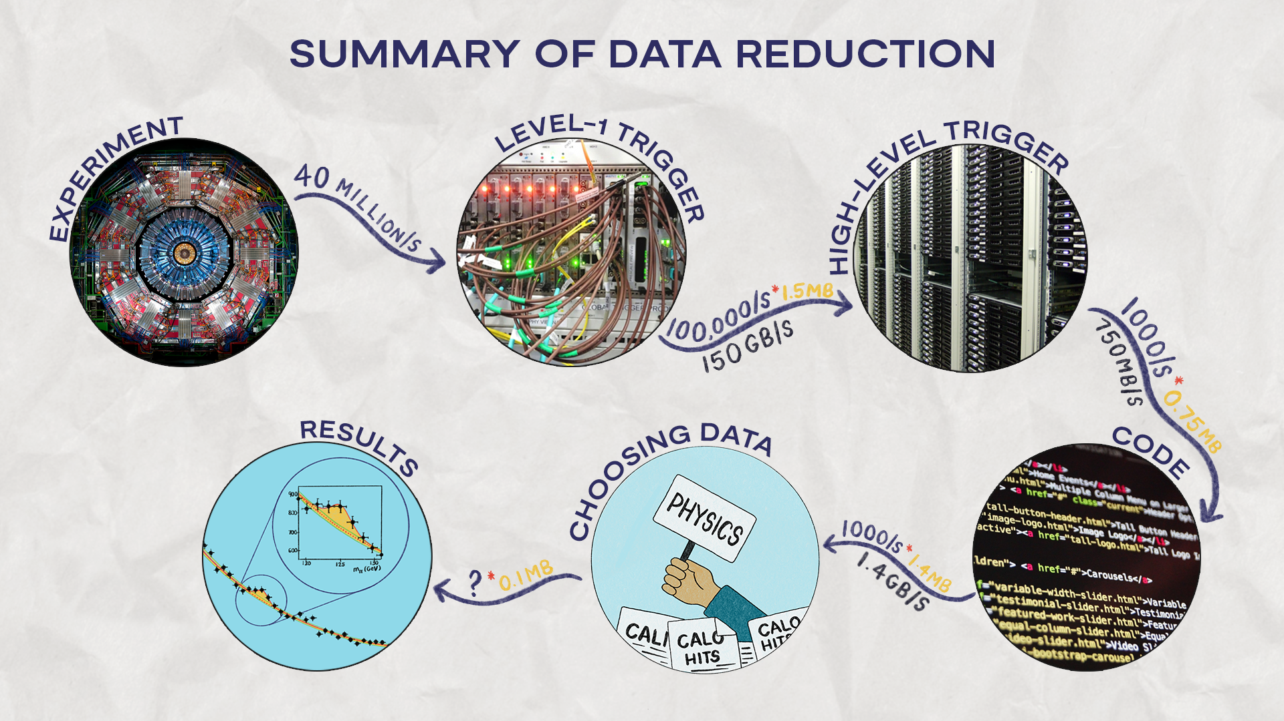
Data reduction
Notes:
Choosing data = sophisticated selection procedures, using e.g. ML
HLT – does reconstruction. What’s the new trigger rate?

Slide 16
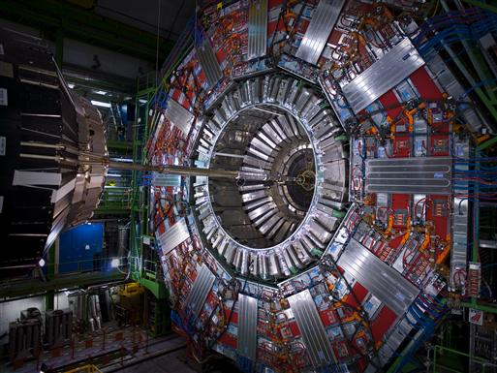
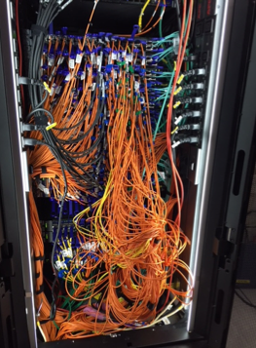
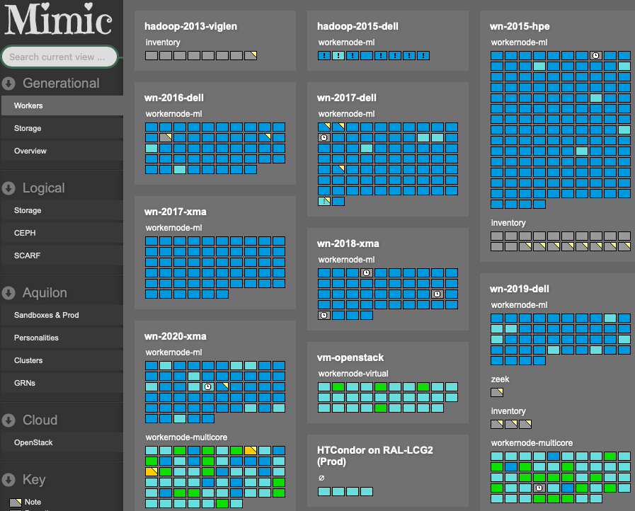
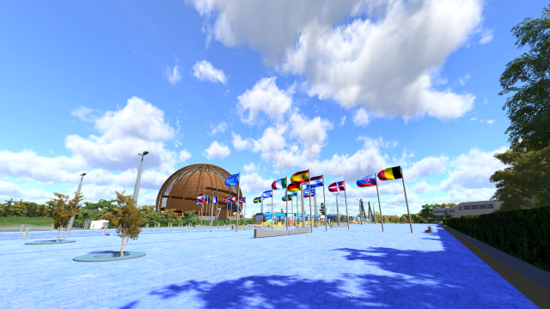
What do I do?
Work on computing for the CMS experiment (at RAL)
Look for problems at Tier 1 data centre
  Computing jobs
  File transfers
Try to make improvements by talking to my colleagues at RAL and in the CMS experiment
Travel to CERN and other places to work more closely with colleagues

Slide 17
Running the Tier 1 data centre at RAL
What do we need?
  Data storage
    To keep the data safe and ready for use
  Computers (CPU)
    To process the data and create simulations
  Network
    To move the data between sites
For LHC at RAL we have:
  70PB of disk storage
  Plus 150PB of tape storage
  65k CPU
  200GigaBit/s network connection (e.g. to CERN)
All of this runs 24/7/365!

Slide 18
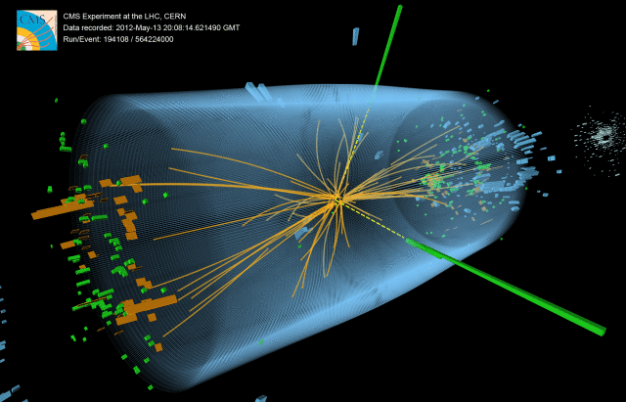
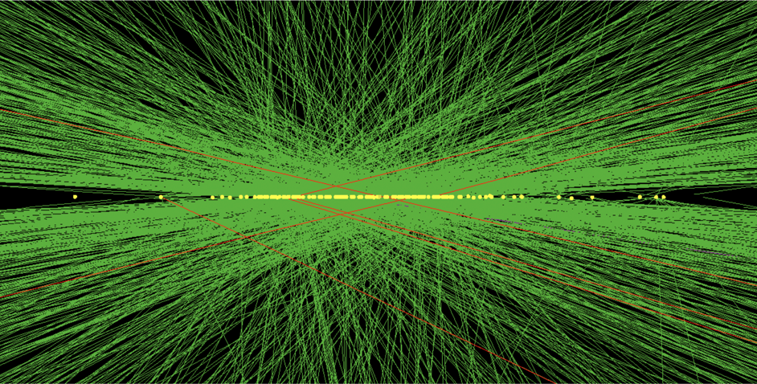
Future challenges?
More events and larger events require:
  Increased storage
  Increased computing power
Run 1
Run 4 simulation
Notes:
Remember that there are 40 Million of these ‘snapshots’ per second!

Slide 19

What can we do?
Find new ways to do computing
Inspiration required!
New hardware?
  Can GPUs speed up our reconstruction code?
New computational methods?
  Can we use Machine Learning to improve performance?
Notes:
UK was second in the challenge.

Slide 20
Summary
Particle physics cannot exist without computing
Equally, modern computing strongly influenced by the grid?!
Grid sites around the world store and process data
Stored data from LHC experiments is already over 1 Exobyte and will rapidly increase through the lifetime of the LHC
Computer processing needs will increase with the data size and complexity

Slide 21
Credits
Thanks to Divya Sekar at RAL for assistance with images and animations

Slide 22






Science and Technology Facilities Council
@STFC_matters
Science and Technology Facilities Council
Notes:
The abstract pattern can be removed or repositioned if required. Be careful to ‘Send to Back’ so that it does not obscure any important information.

