Slide 1
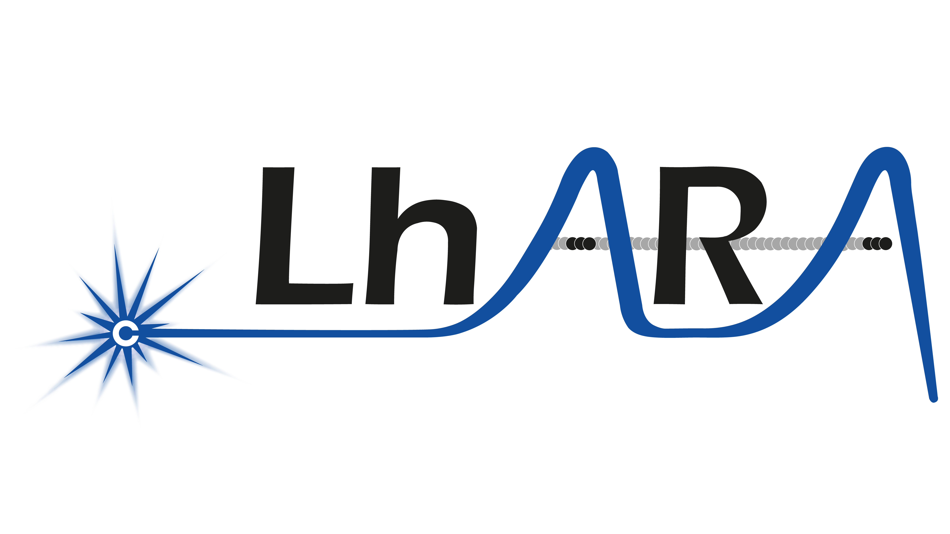

Slide 2
What is LhARA? – as previously seen
A novel, hybrid, approach:
Laser-driven, high-flux proton/ion source
  Overcome instantaneous dose-rate limitation
    Capture at >10 MeV
  Delivers protons or ions in very short pulses
    Bunches as short as 10—40 ns
  Triggerable; arbitrary pulse structure
Novel “electron-plasma-lens” capture & focusing
  Strong focusing (short focal length) without the use of high-field solenoid
Fast, flexible, fixed-field post acceleration
  Variable energy
    Protons: 15—127 MeV
    Ions: 5—34 MeV/u
Front. Phys., 29 September 2020; DOI: 10.3389/fphy.2020.567738

Slide 3
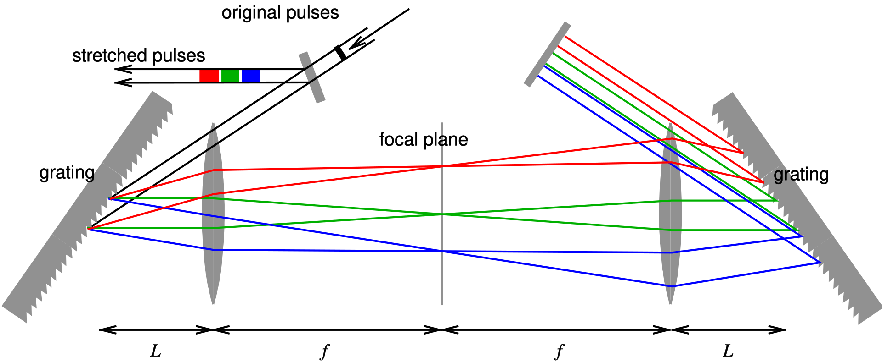
What is LhARA #2 - Why
Nobel Prize in Physics in 2018 was awarded to Donna Strickland and Gérard Mourou for work on Chirped Pulse Amplification (CPA)
CPA allows us to produce protons directly, at high energy.
OK – why should we care?

Slide 4
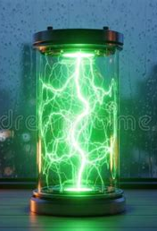
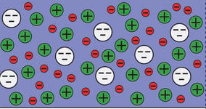
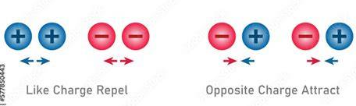
Why we should care
Notes:
Looks nothing like the illustration. What it does have is balanced mix of positive and negative charge which is completely useless as a proton beam.
We apply an electric field to separate the positive from the negative and ‘draw off’ our desired protons. Simple.
Unfortunately the act of separating the charges means our slow moving protons are now exposed not only to the electric field that

Slide 5
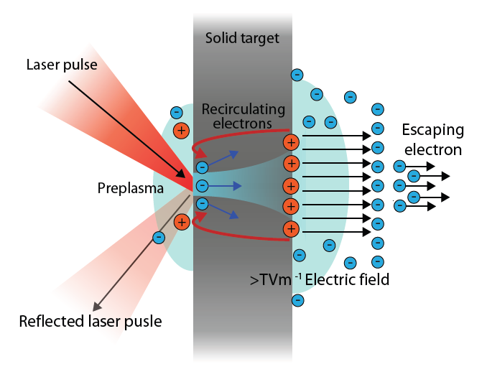
Source
Laser energy absorbed
electrons propagate through the target
Generates strong fields at target rear
Drives acceleration of high energy protons

Slide 6
Source
A combination of simulation
2-stage simulation using accurate “pre-plasma” profile
Study proton production as a function of angle of incidence, spot size, proton-layer thickness
PhysRevLett.90.185002

Slide 7
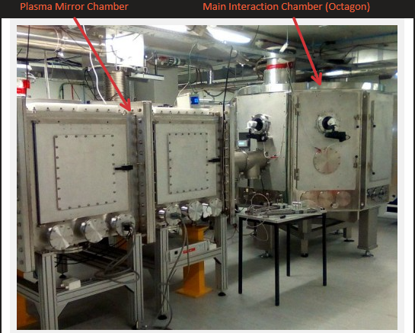
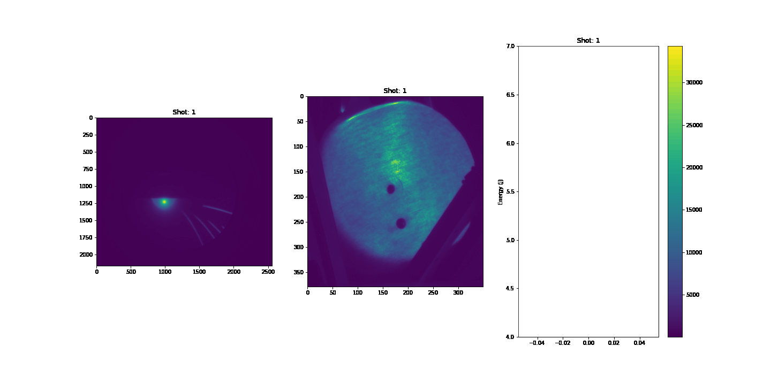
Experiments at SCAPA
Endpoint energy
R. Gray
Shot number

Slide 8
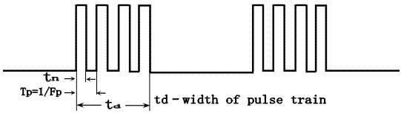
Radiotherapy in general and with the broadest of possible brushstrokes
All* radiotherapy is delivered in very short pulses.
X-rays - mostly use a linac pulses at nanosecond lengths.
Cyclotron - also produces trains of nanosecond pulses
VHEE - either linac (or possibly wakefield in future) – pulsed
  * Ok, maybe not ALL, but most, or at least many
Imager credit, Stackoverflow - Arduino

Slide 9
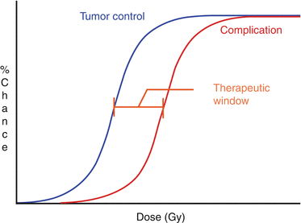
So – what is different about LhARA
LhARA aspires to deliver the ‘whole’ dose required in ‘one’ shot

Slide 10
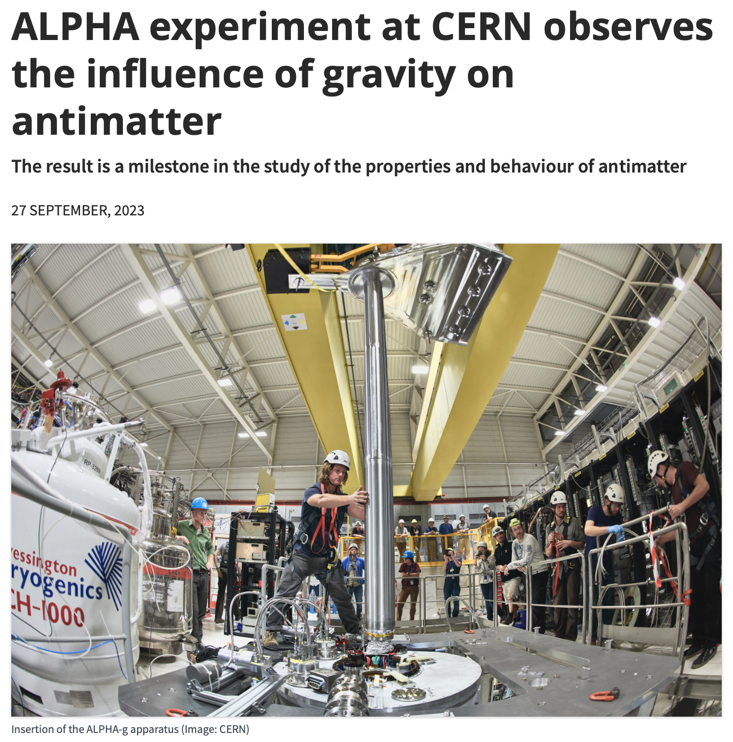
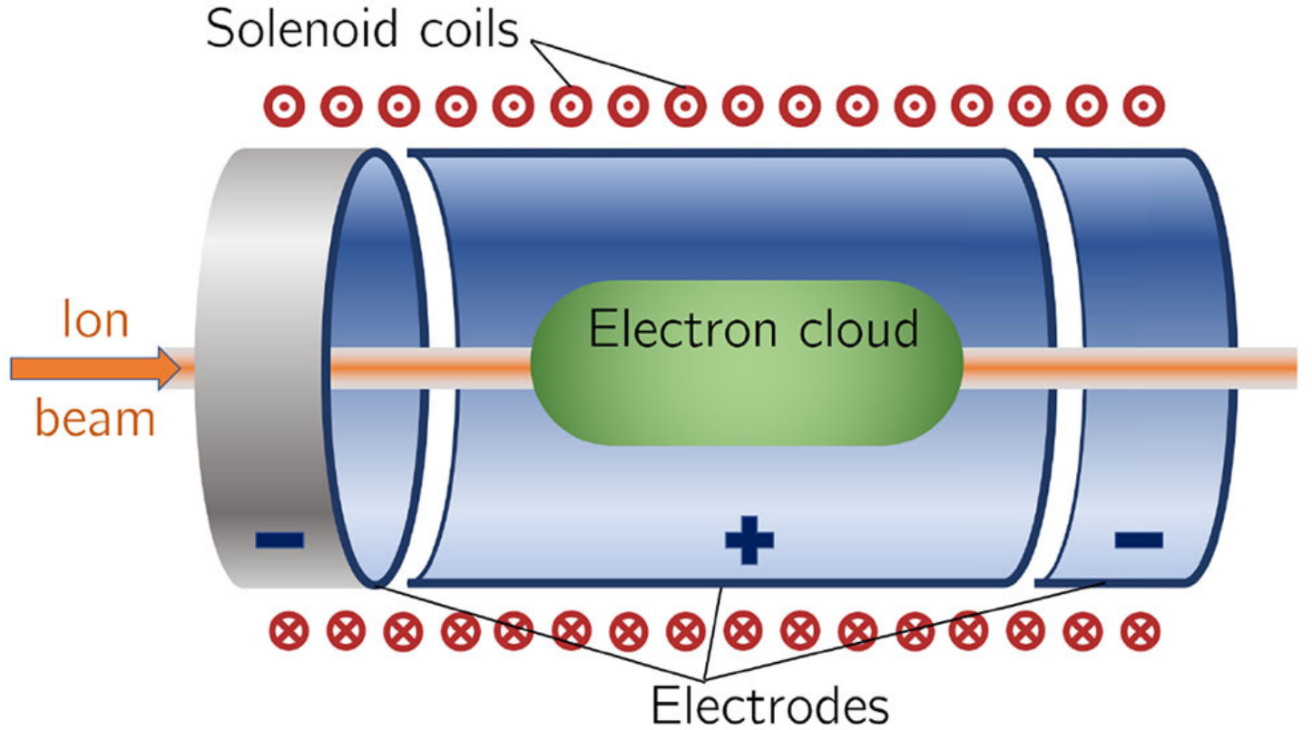
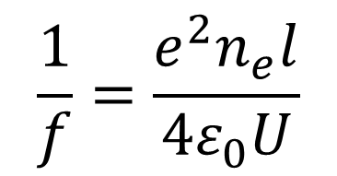
Capture
$$\frac{1}{f}=\frac{e^{2}n_{e}l}{4ε_{0}U}$$

Slide 11
Capture
Rucksasakchai et al

Slide 12
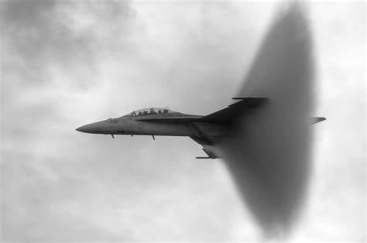
Ion Acoustic
Exploits the ‘shockwave’ generated when ions deposit their energy.
Totally parasitic
Intrinsically linked to the treatment effect
Immediate read out
..and Air Fluorescence
Exploits the interaction of the protons beam
with nitrogen in the air
Totally parasitic
Intrinsically linked to the measurement required
Immediate read out

Slide 13
Rapid, flexible acceleration for stage 2
Fixed-field alternating-gradient accelerator (FFA):
  Compact, flexible solution: Multiple ion species
    Variable energy extraction
    High repetition rate
      Rapid acceleration
    Large acceptance
Front. Phys., 29 September 2020; DOI: 10.3389/fphy.2020.567738

Slide 14
End Station
When LhARA is operational we will require:
Feed the beast @ 10Hz – huge logistical challenge.
Diagnostics – what do we need to measure?
  What new diagnostics are emerging?
What communities do we need to serve?
What will those communities need?
  Incubators, CO₂, class II cabinets

Slide 15
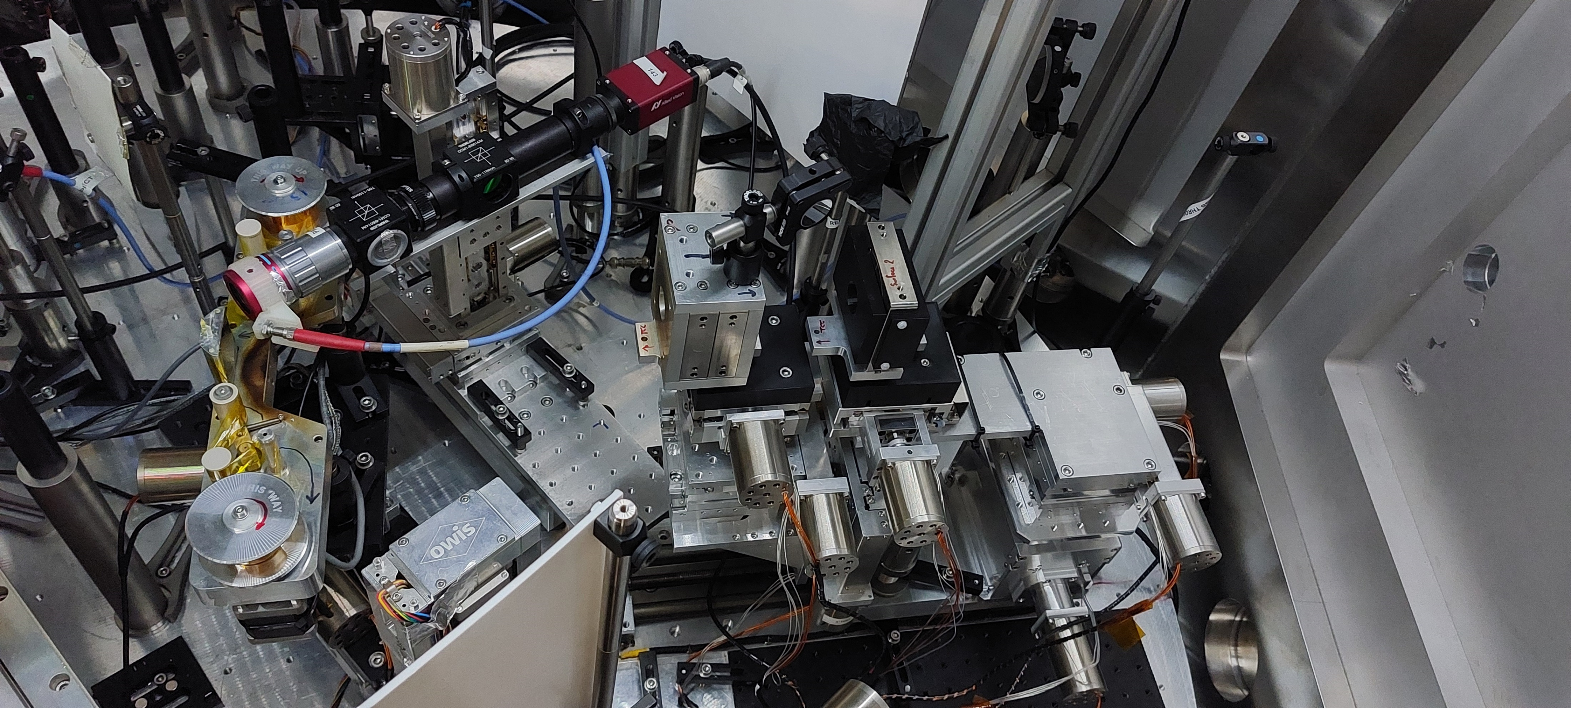
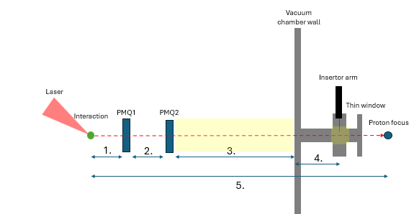
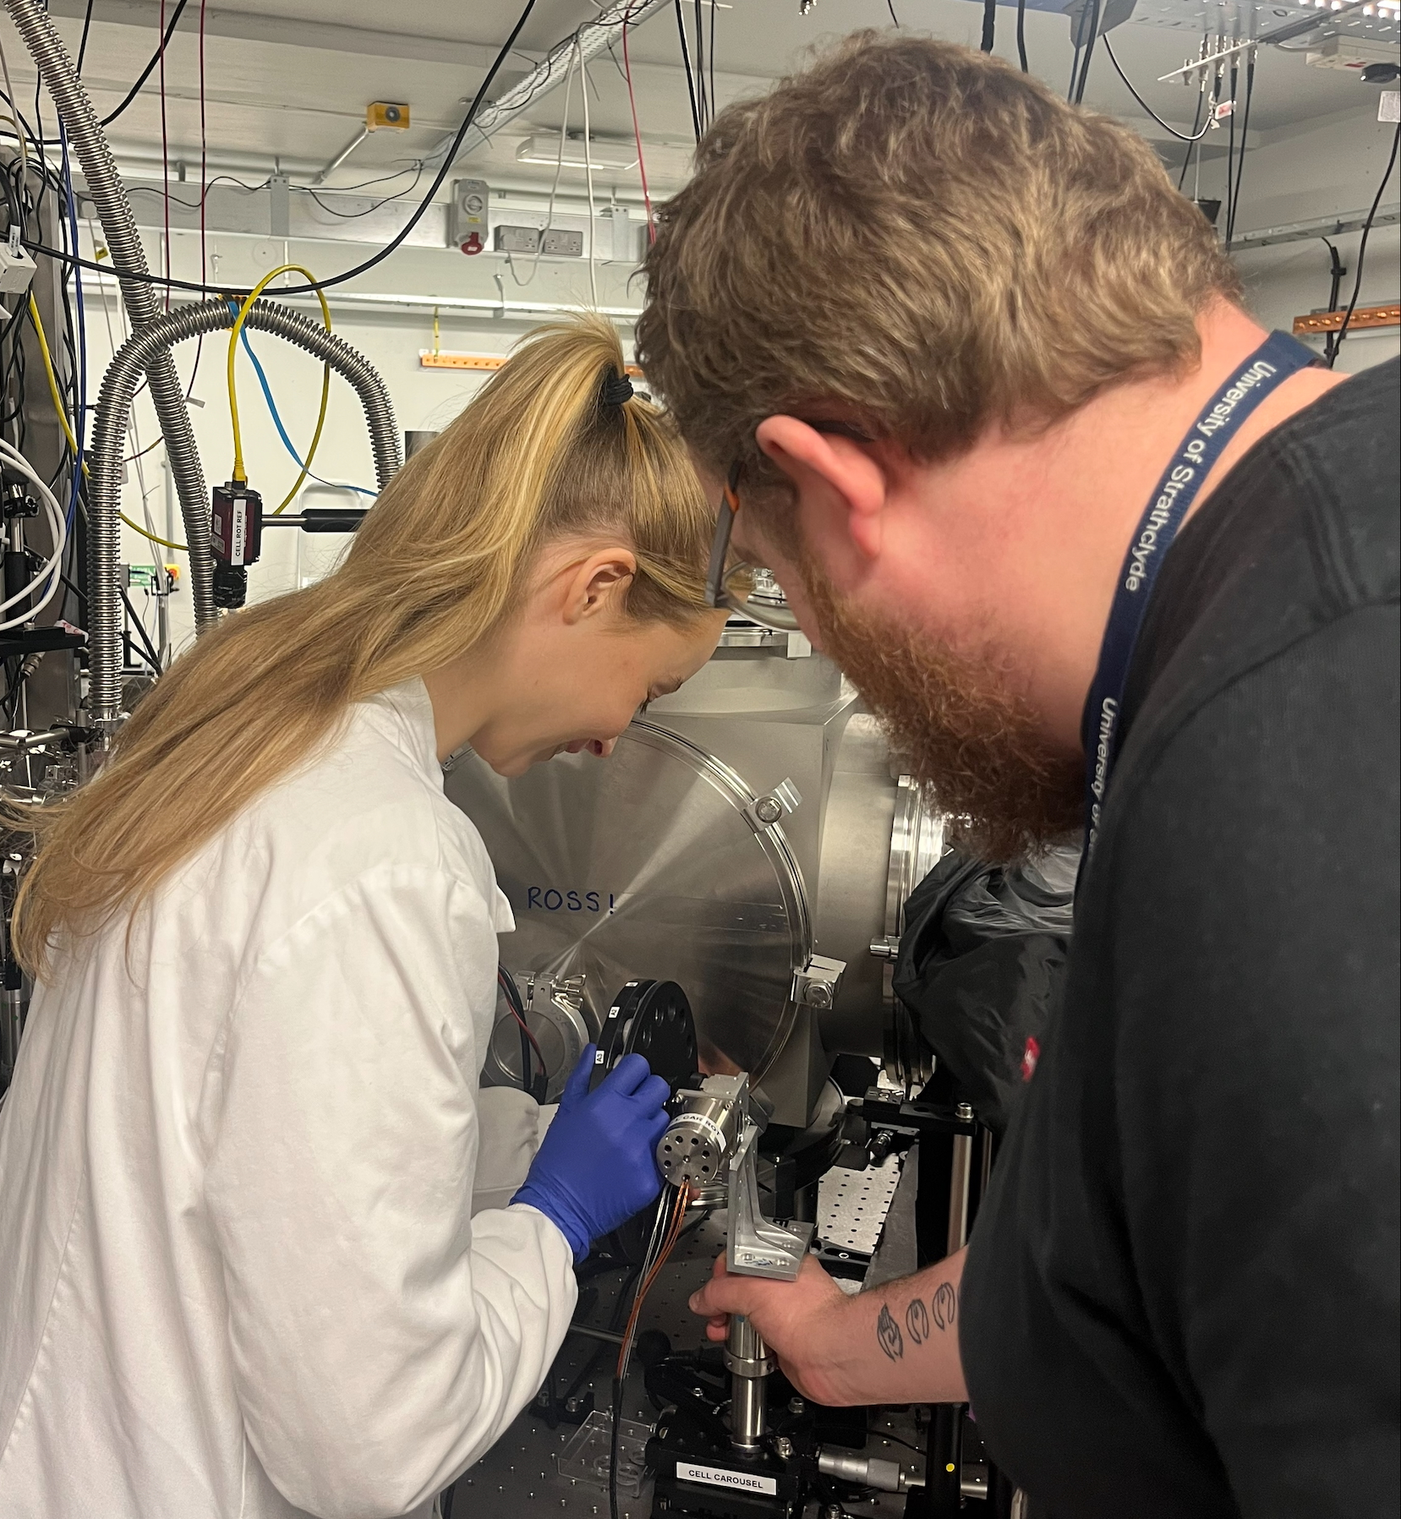
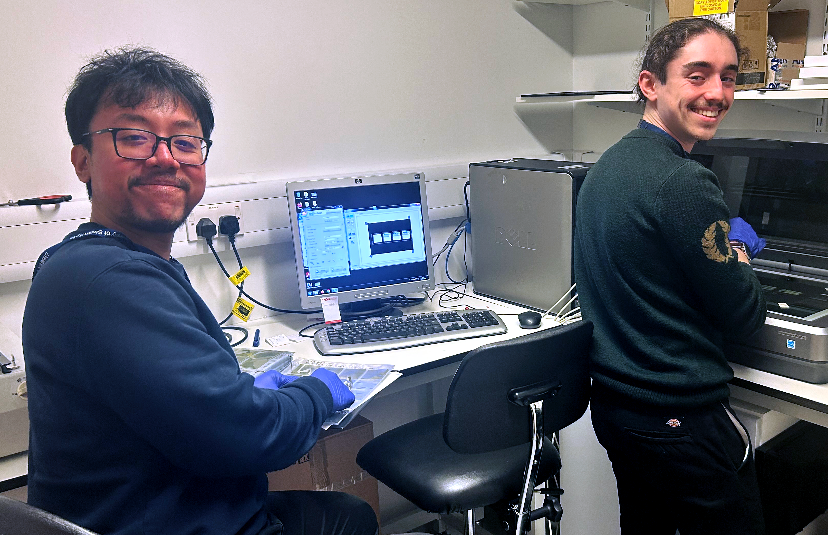
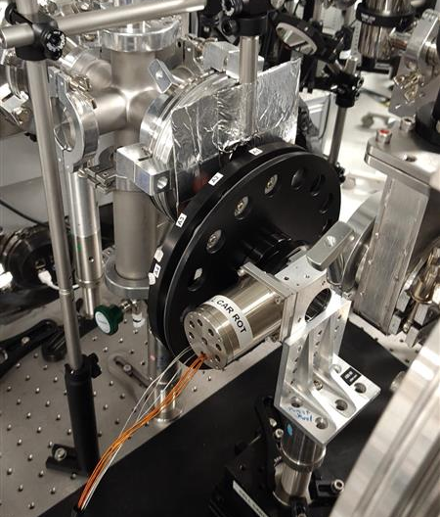
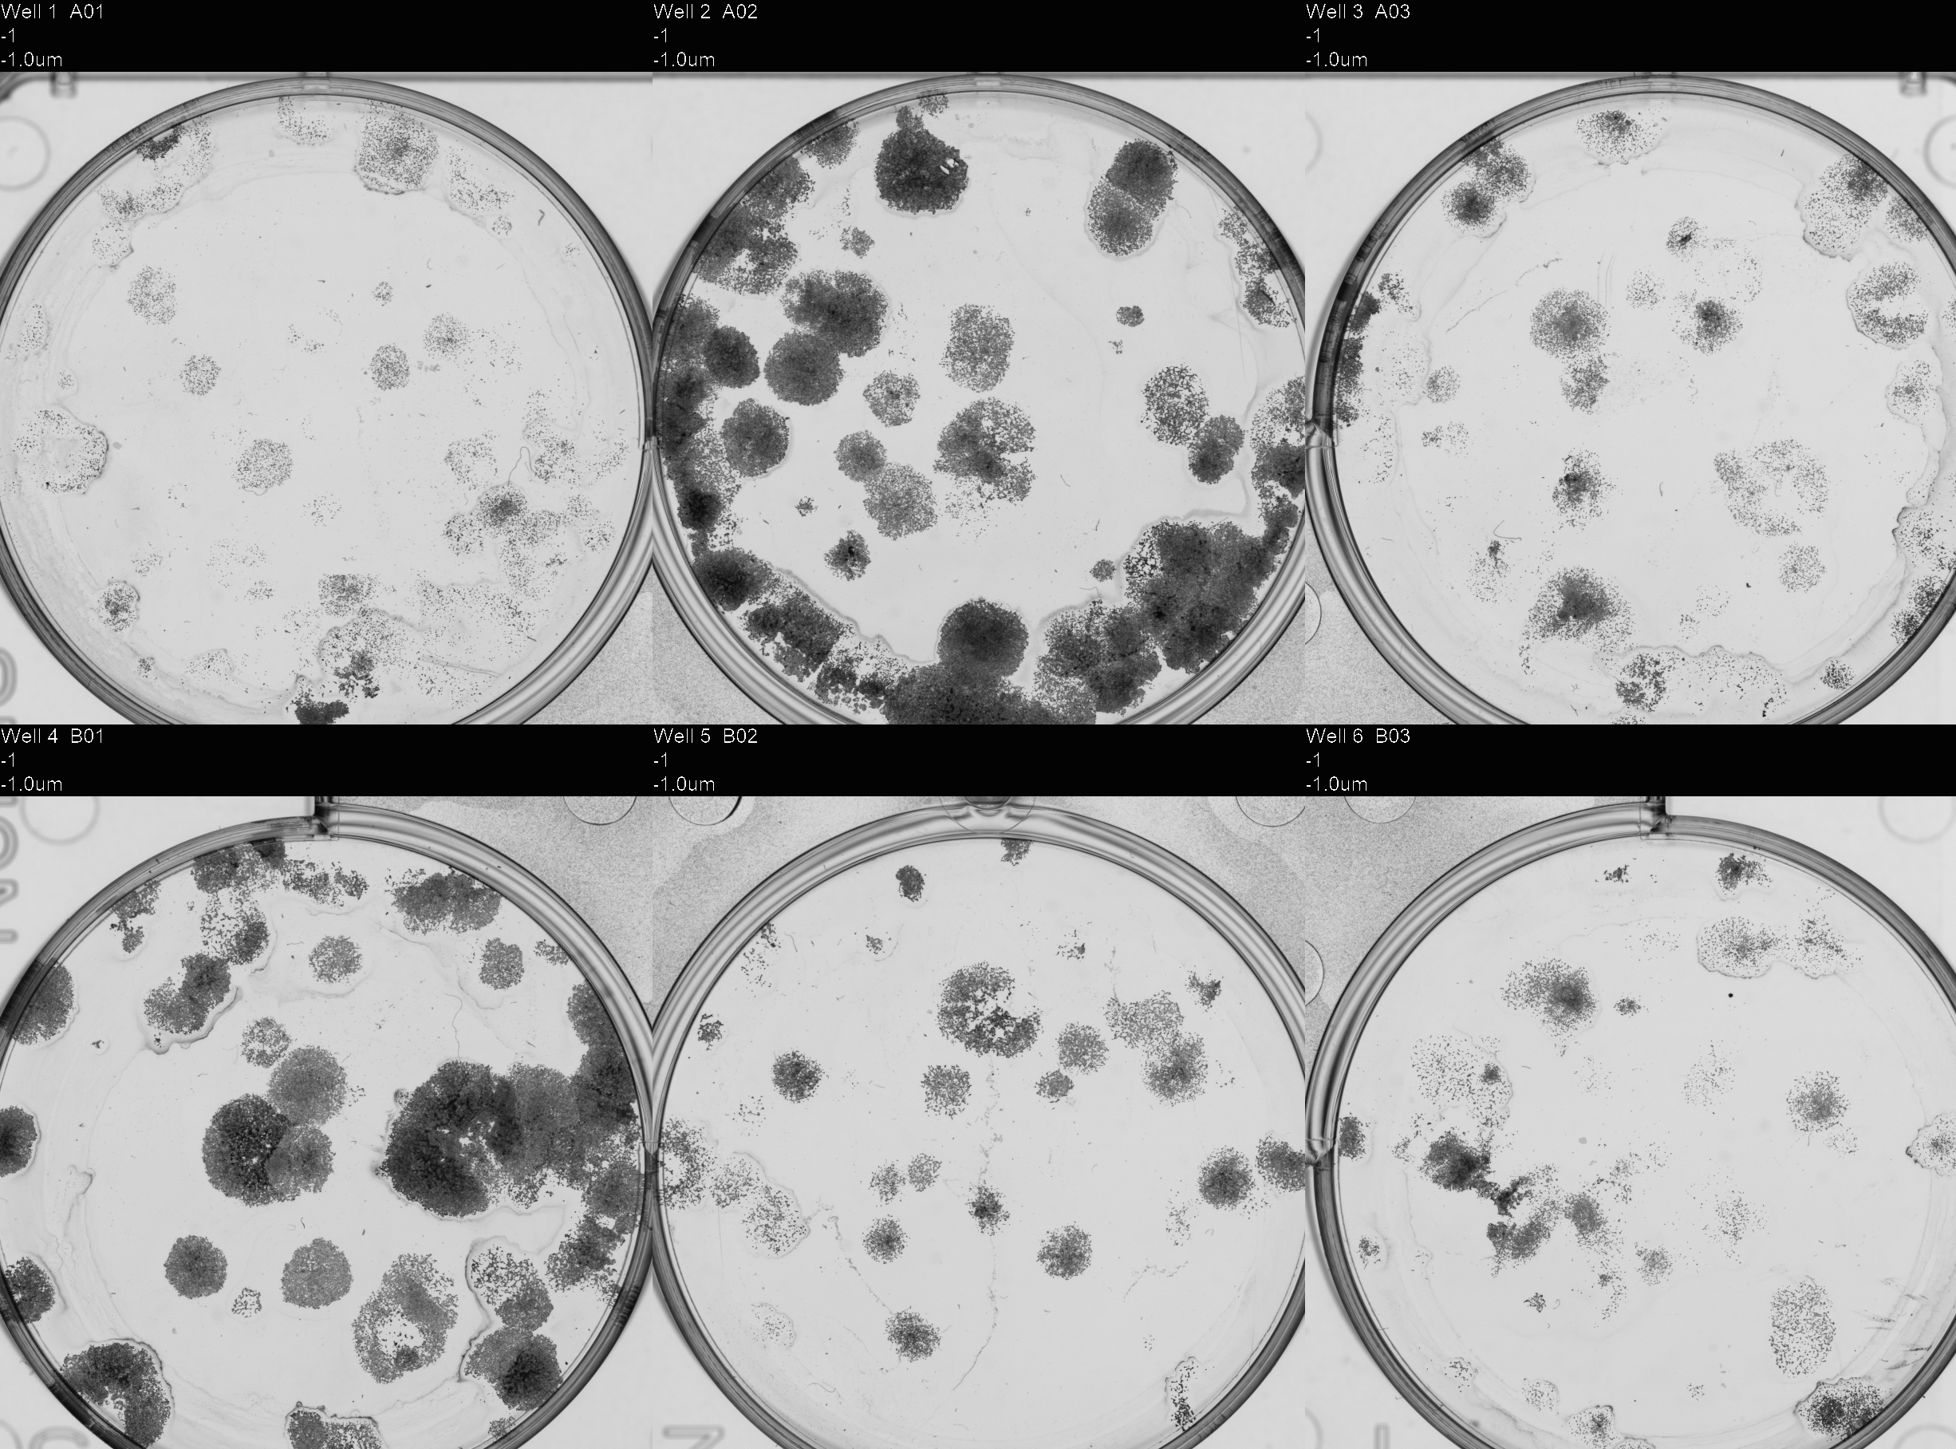
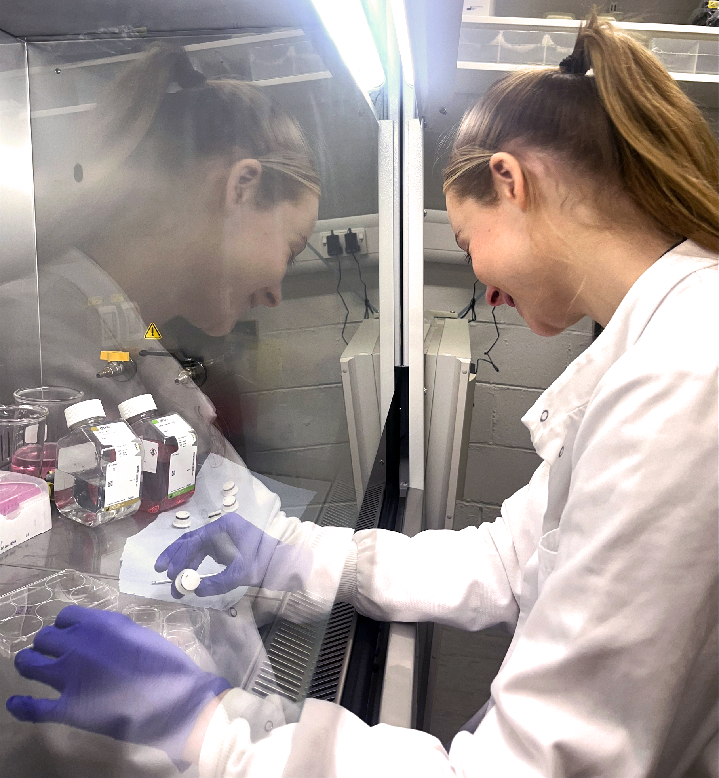
PoPLaR at SCAPA (Strathclyde) [Nov26]
Capture with 2 PMQs
RCF stack for dose estimation
McGarrigle
Fernandez-
Rodriguez
First irradiations:
  Cell survival rates
  Compare to cyclotron
  Promising results!
McGarrigle

Slide 16
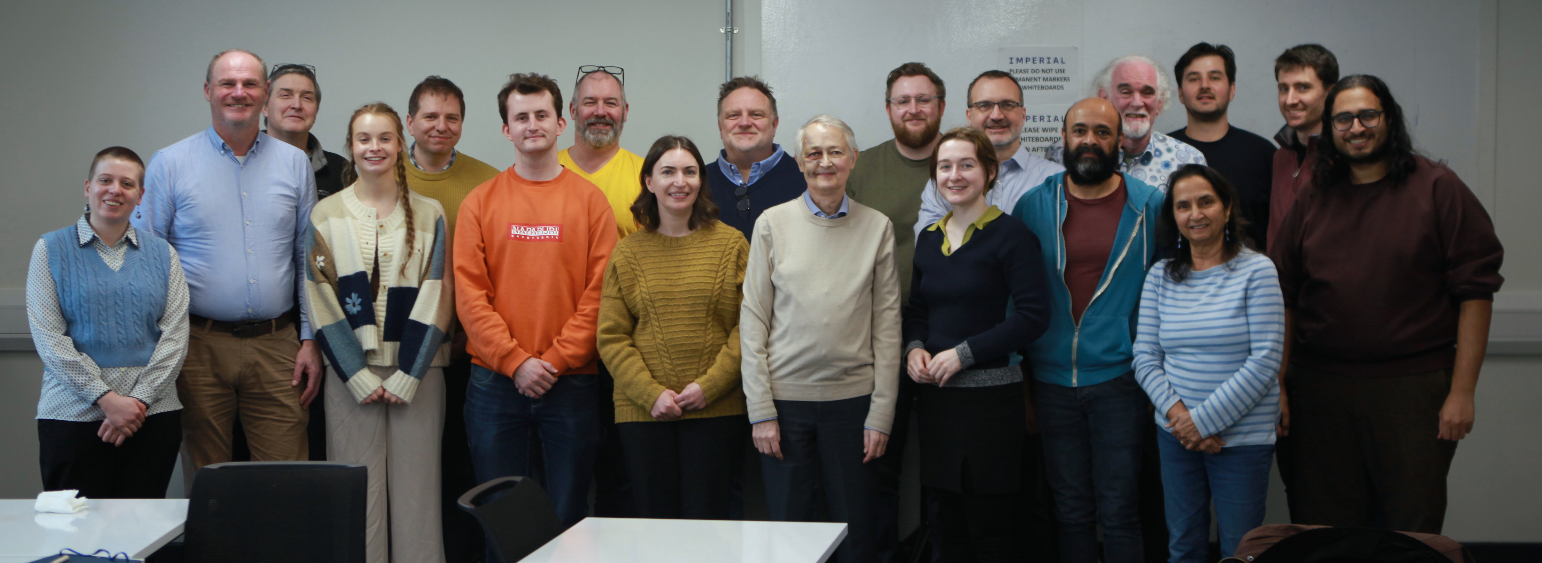
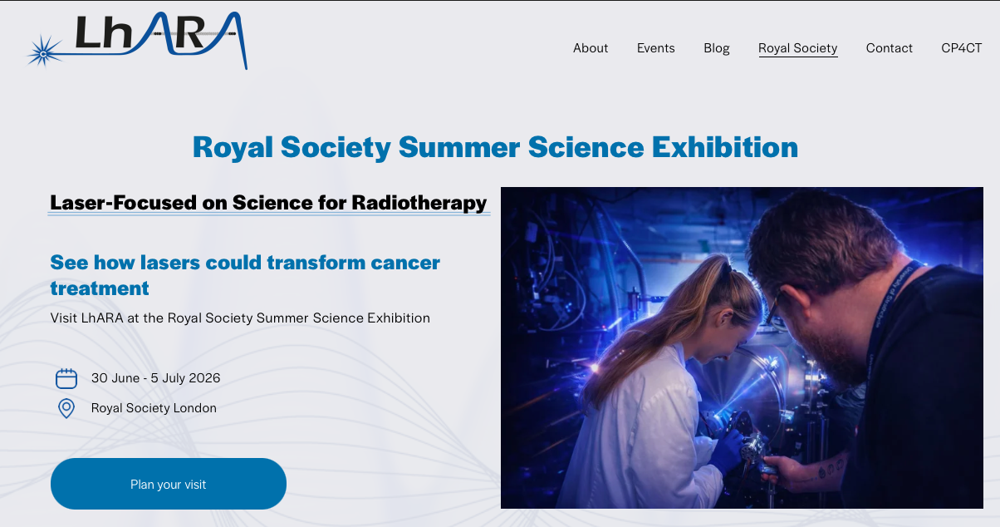
We are going to …
“Summer Science Exhibits on Tour”
Runs between Summer Science Exhibitions
Pitching a schools-engagement project to run in parallel

Slide 17
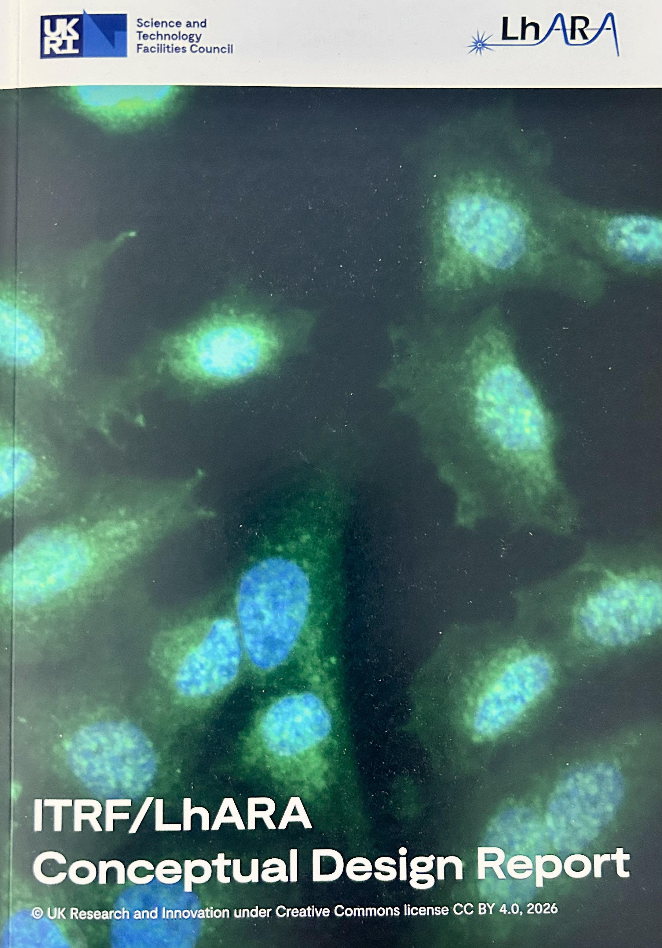
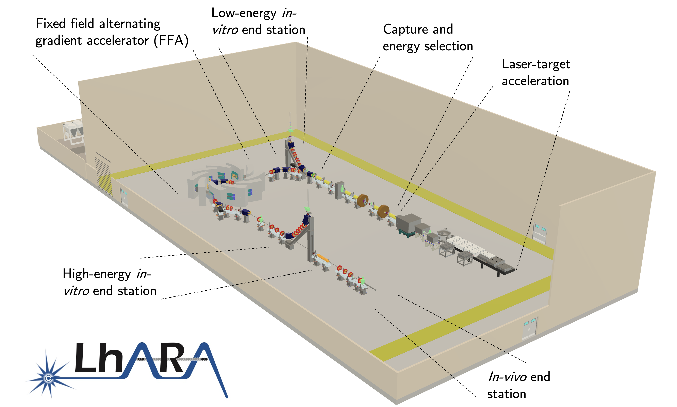
Progress highlights
Conceptual Design Report
  Foundation for future
DOI: 10.5286/stfctr.2026007

