Slide 1
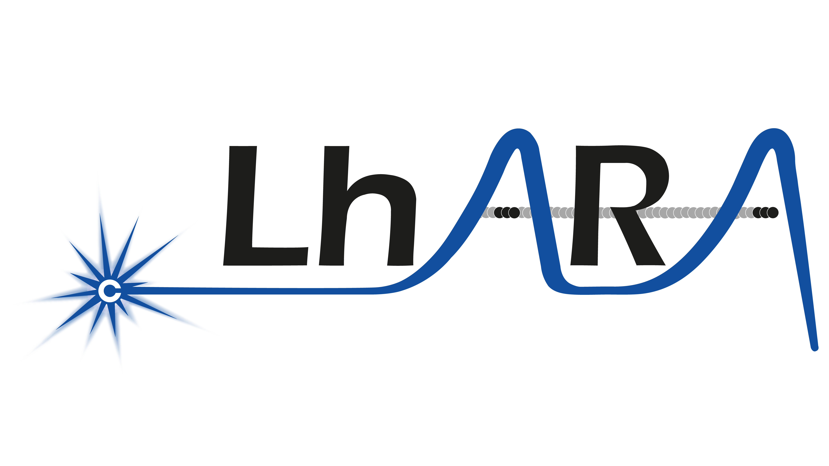
The Laser-hybrid Accelerator for Radiobiological Applications
… and the LhARA initiative

Slide 2
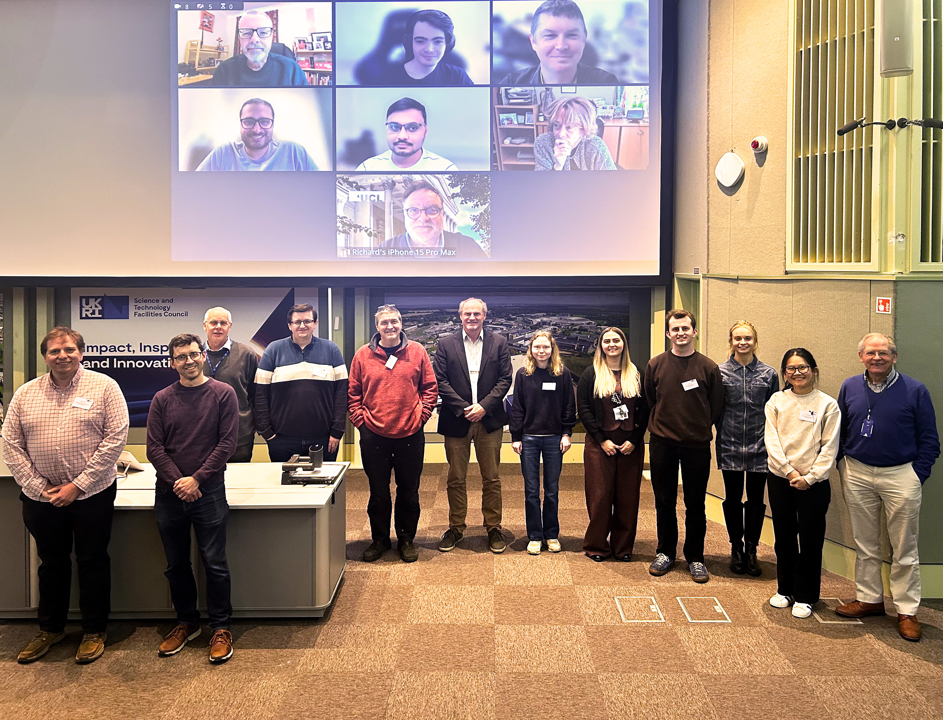
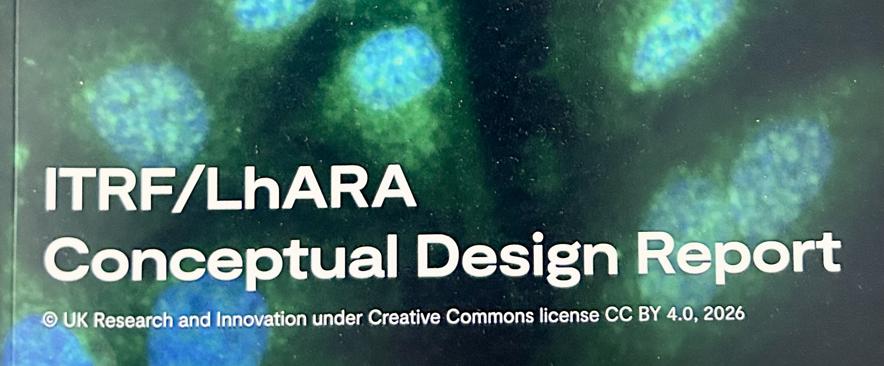
Acknowledgements
DOI: 10.5286/stfctr.2026007

Slide 3
Radiotherapy; the challenge
Cancer: second most common cause of death globally
Radiotherapy:
Indicated in half of all cancer patients
Contributions to 40% of cures
Significant growth in global demand anticipated:
14.1 million new cases in 2012 ⇢ 24.6 million by 2030
8.2 million cancer deaths in 2012 ⇢ 13.0 million by 2030
Atun, Lancet Oncol. 2015 Sep;16(10):1153-86

Slide 4
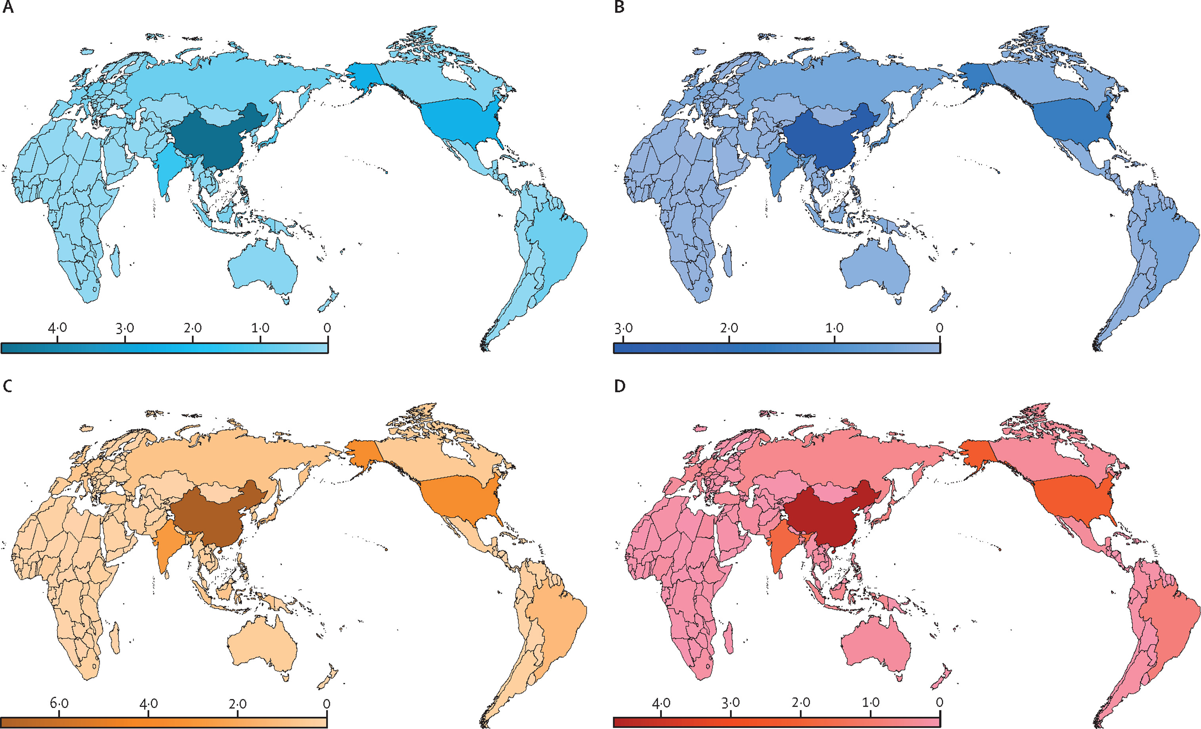
Radiotherapy; the challenge
Cancer incidence in 2022 in (millions).
Patients needing radiotherapy in 2022 (millions).
The Lancet Global Health 2024 12e1945-e1953DOI: (10.1016/S2214-109X(24)00355-3)
Cancer incidence in 2025 (millions).
Patients needing radiotherapy in 2025 (millions).

Slide 5
Radiotherapy; the challenge
Scale-up in provision essential:
Opportunity: save 26.9 million lives in low/middle income countries by 2035
Provision on this scale requires:
Development of new techniques; and
Cost-effective system integration
Atun, Lancet Oncol. 2015 Sep;16(10):1153-86

Slide 6
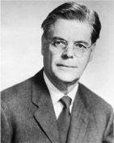
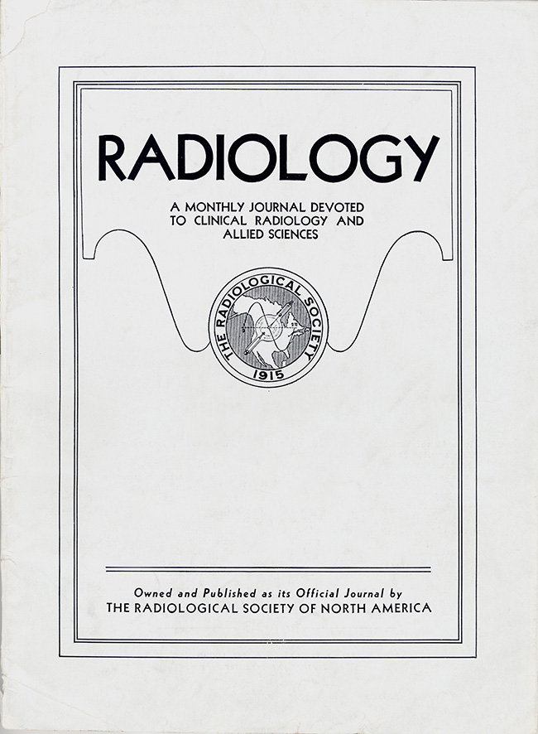
Hadron beams for radiation therapy
Radiology 47:48a7–91 (1946)
Robert R. Wilson
Wilson, then at Harvard designing 150 MeV cyclotron:
Identified benefits and properties of proton beams for RT
Pointed out potential of ions (carbon) and electrons

Slide 7
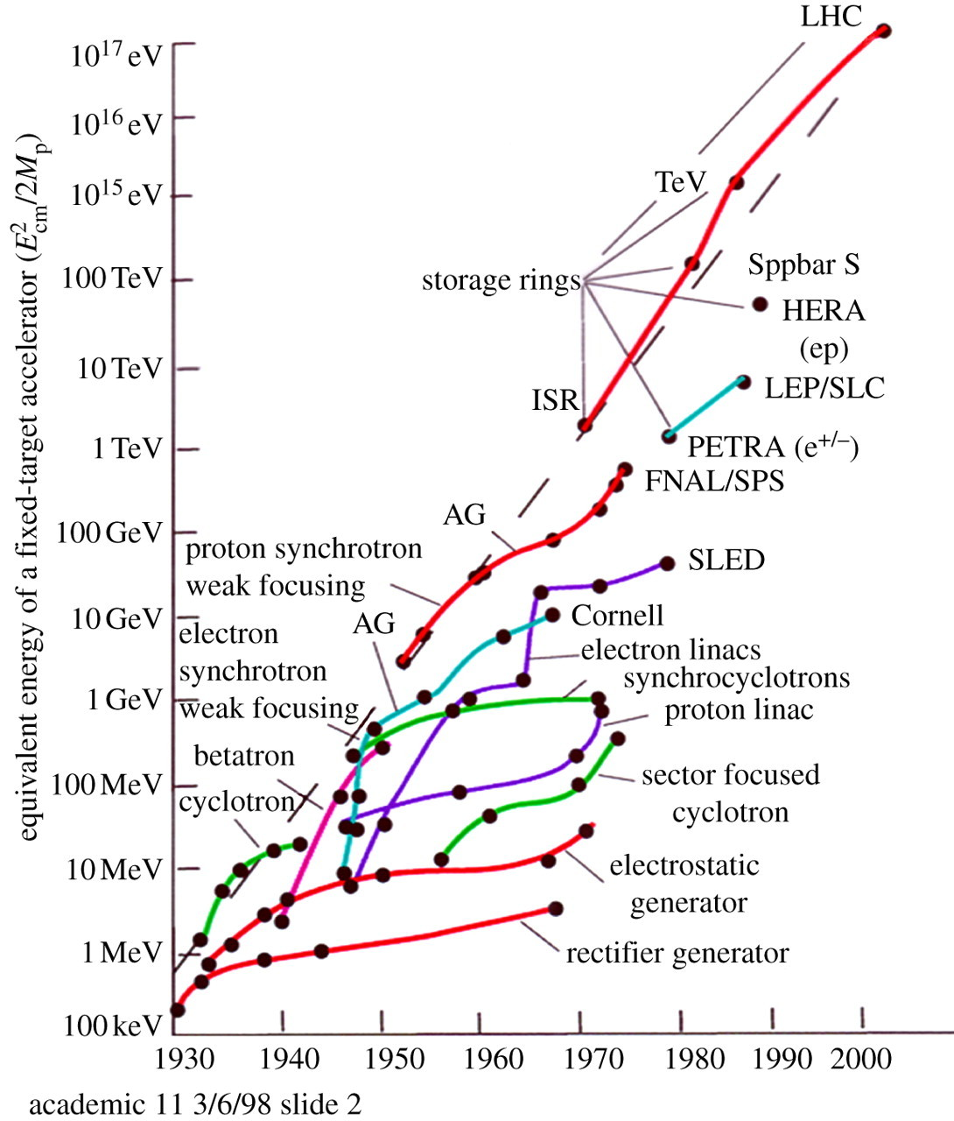
Evolving state of the art
Cancer therapy
(Mass Gen Hosp)
1974
Clinical studies (pituitary gland);
1954
Biological studies; 1948
Synchrotron
Goward, Barnes; 1946
Cyclotron
Laurence; 1932

Slide 8
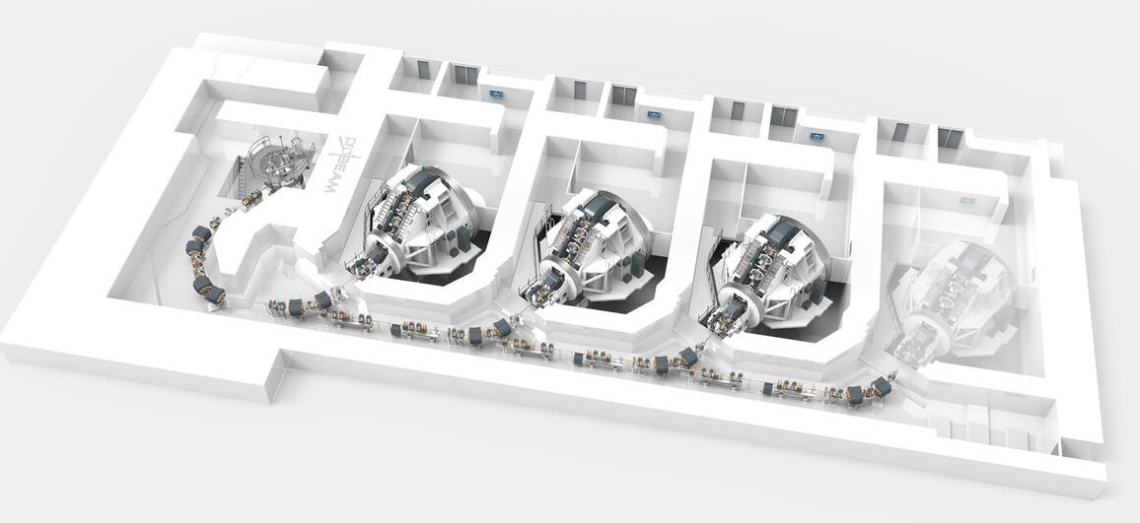
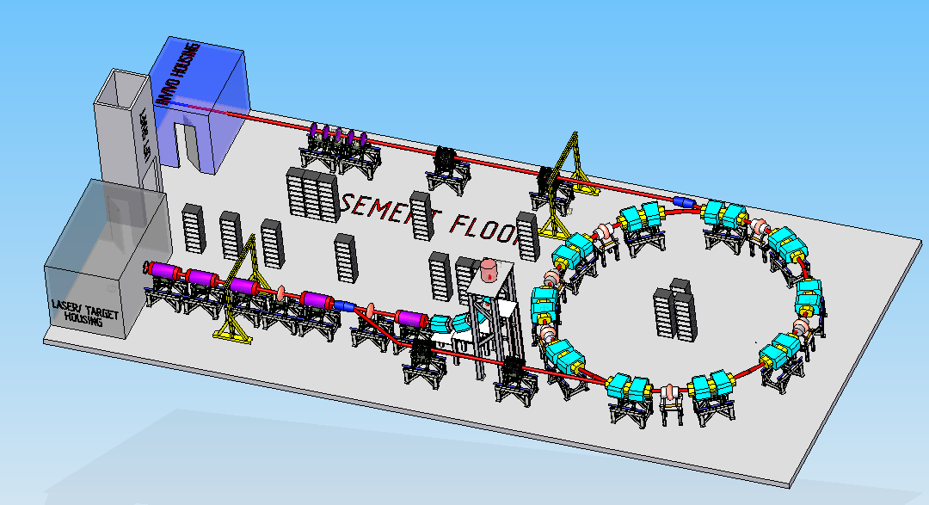
Particle beam therapy today
Cyclotron based:
Limitations:
Energy modulation
Instantaneous dose rate
Synchrotron based:
Limitiations:
Complexity
Instantaneous dose rate
⇒ reduce footprint, cost and complexity
‘PBT for the many’!
Christie Hospital, Manchester
⇒ increase flexibility
optimise treatments
MedAustron, Austria
8

Slide 9
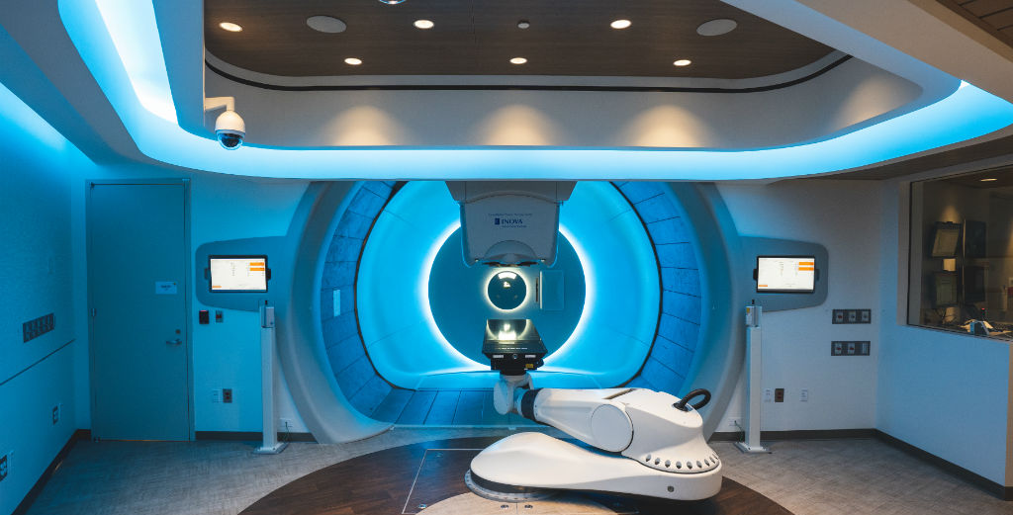
Particle beam therapy today
⇒ Increase automation, monitor motion
‘shoot on demand’!
⇒ increase throughput reduce cost/treatment

Slide 10

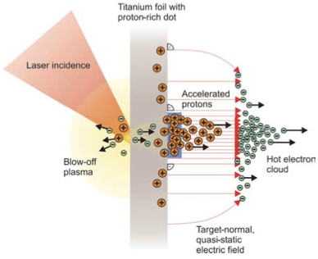
The LhARA initiative:
Deliver a systematic and definitive radiation biology programme
Prove the feasibility of laser-driven hybrid acceleration
Spin into curiosity-driven science
Lay the foundations for the transformation of ion beam therapy
automated, patient-specific proton and ion beam therapy
10

Slide 11
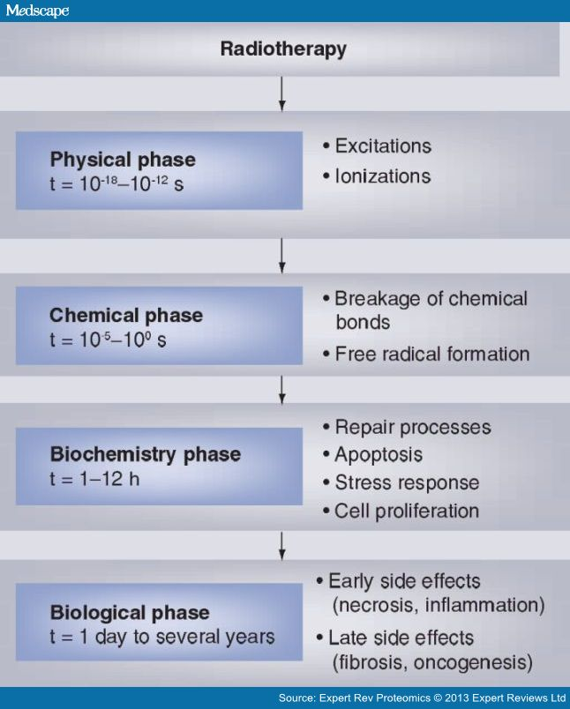
Radiobiology in new regimens
Time
domain
Space
domain
The ideally flexible beam facility can deliver it all!
⇒ substantial opportunity for a step-change in understanding!
Multidisciplinary approach essential
Ion
species
Energy
In combination and with chemo/immuno therapies

Slide 13
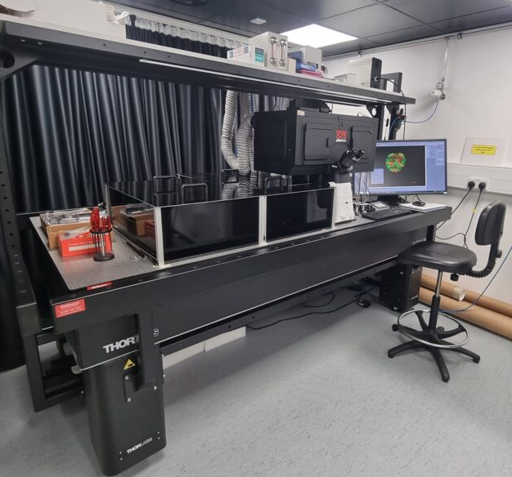
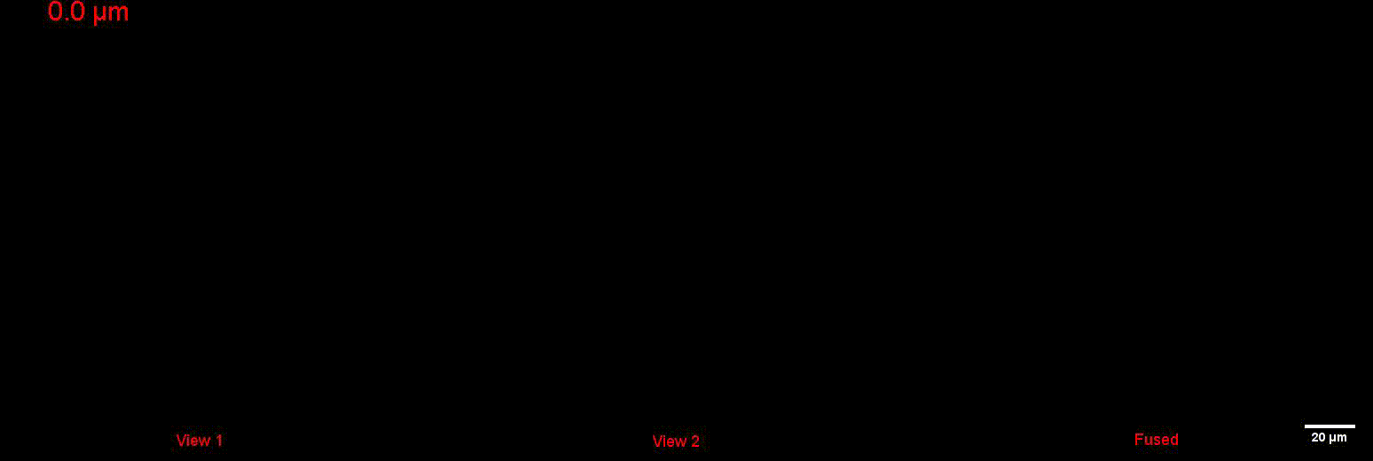
Dual-view Oblique Plane Microscopy
https://mach3cancer.org/news/

Slide 14
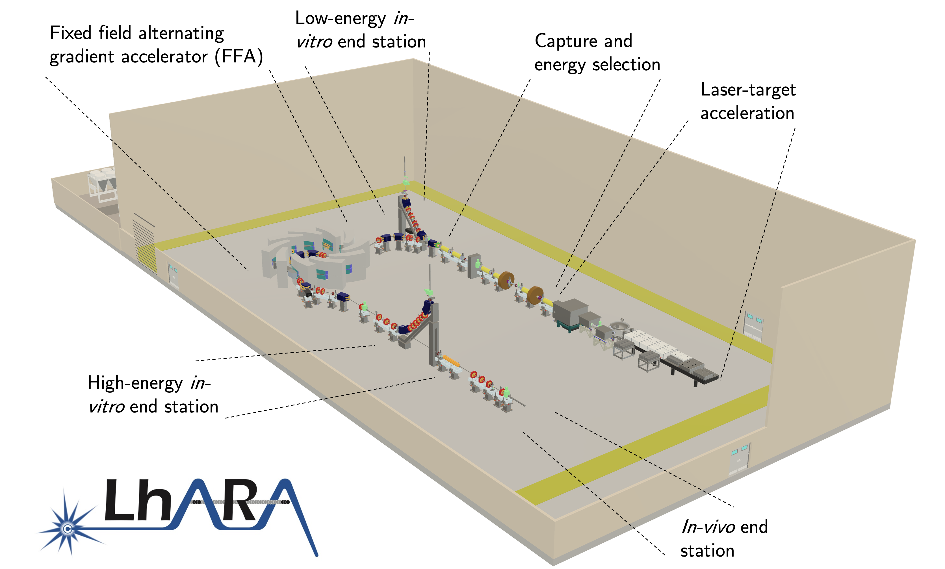
Specifications
A novel, hybrid, approach:
Laser-driven, high-flux proton/ion source
Overcome instantaneous dose-rate limitation
Capture at >10 MeV
Delivers protons or ions in very short pulses
Bunches as short as 10—40 ns
Triggerable; arbitrary pulse structure
Novel “electron-plasma-lens” capture & focusing
Strong focusing (short focal length) without the use of high-field solenoid
Fast, flexible, fixed-field post acceleration
Variable energy
Protons: 15—127 MeV
Ions: 5—34 MeV/u
DOI: 10.5286/stfctr.2026007

Slide 15
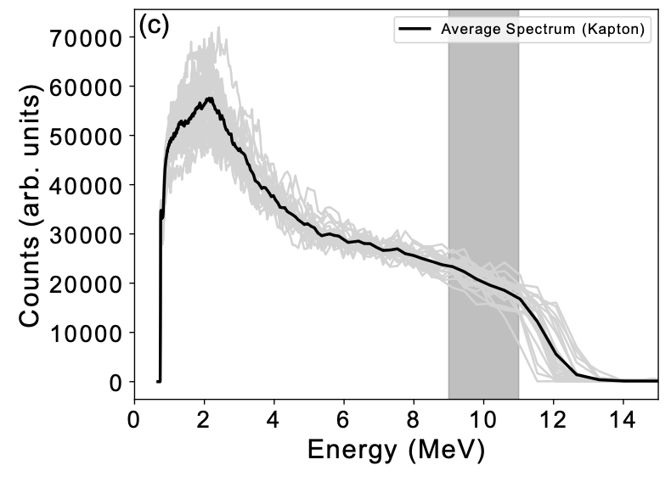
Source
R&D objectives:
Tests: building to LhARA specification
Diagnostics and target development
High-rep rate, automation/longevity studies
Numerical modelling 3D simulation codes
SCAPA

Slide 16
Plasma (Gabor) lens
Electron plasma:
Created through ionisation of CO₂ by “seed” electrons
Confined in
Penning-Malmberg trap

Slide 17
Plasma lens; status
Plasma-trap beam line at University of Swansea

Slide 18
Rapid, flexible acceleration for stage 2
Fixed-field alternating-gradient accelerator (FFA):
Compact, flexible solution:
Multiple ion species
Variable energy extraction
High repetition rate
Rapid acceleration
Large acceptance
LhARA FFA
10 cells
2 MA loaded RF cavities
Front. Phys., 29 September 2020; DOI: 10.3389/fphy.2020.567738

Slide 19
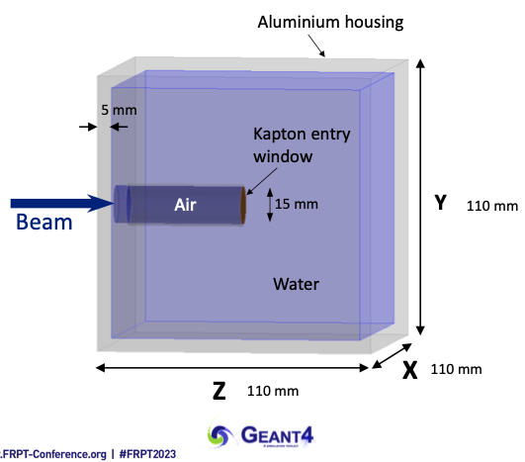
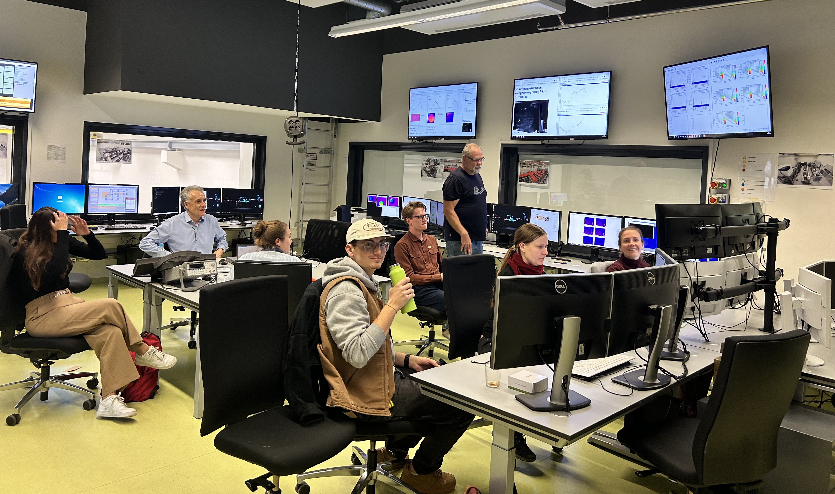


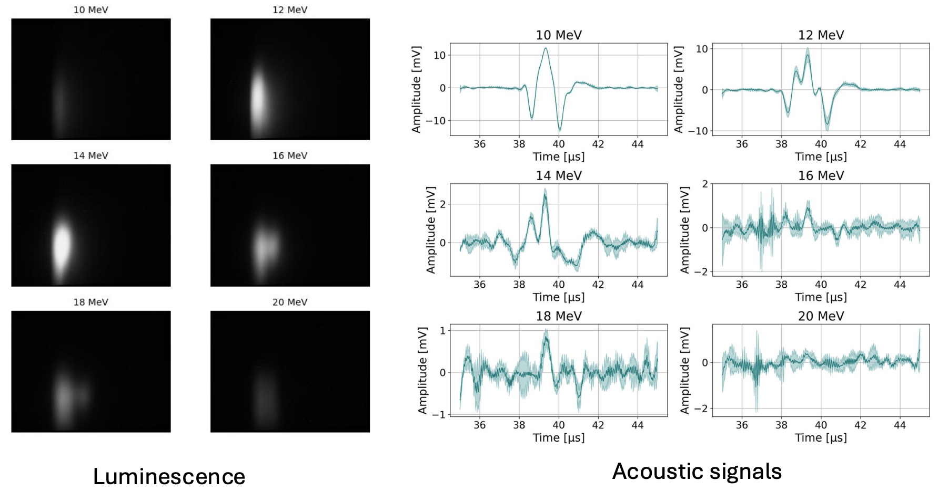
Dose mapping in real time: ion-acoustic imaging
LION @ CALA

Slide 20

Three pillars
Science:
radiobiology
LhARA, the project
Co-creation;
science for growth

Slide 21
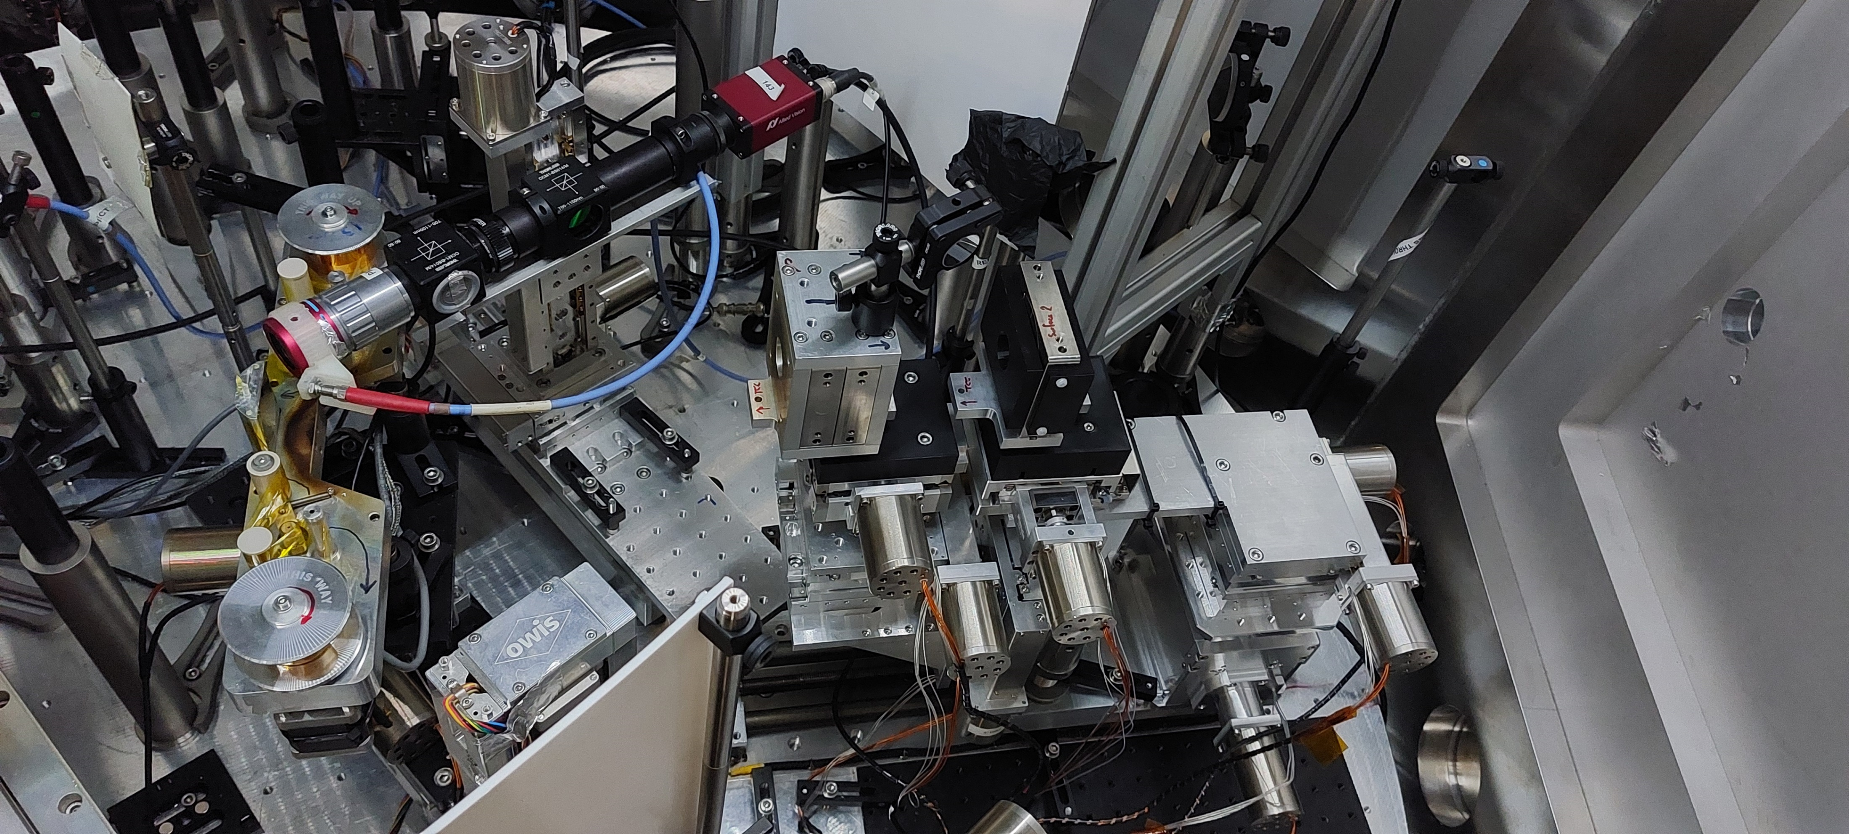
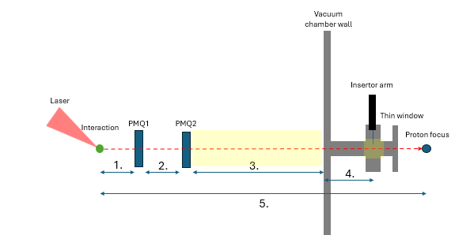
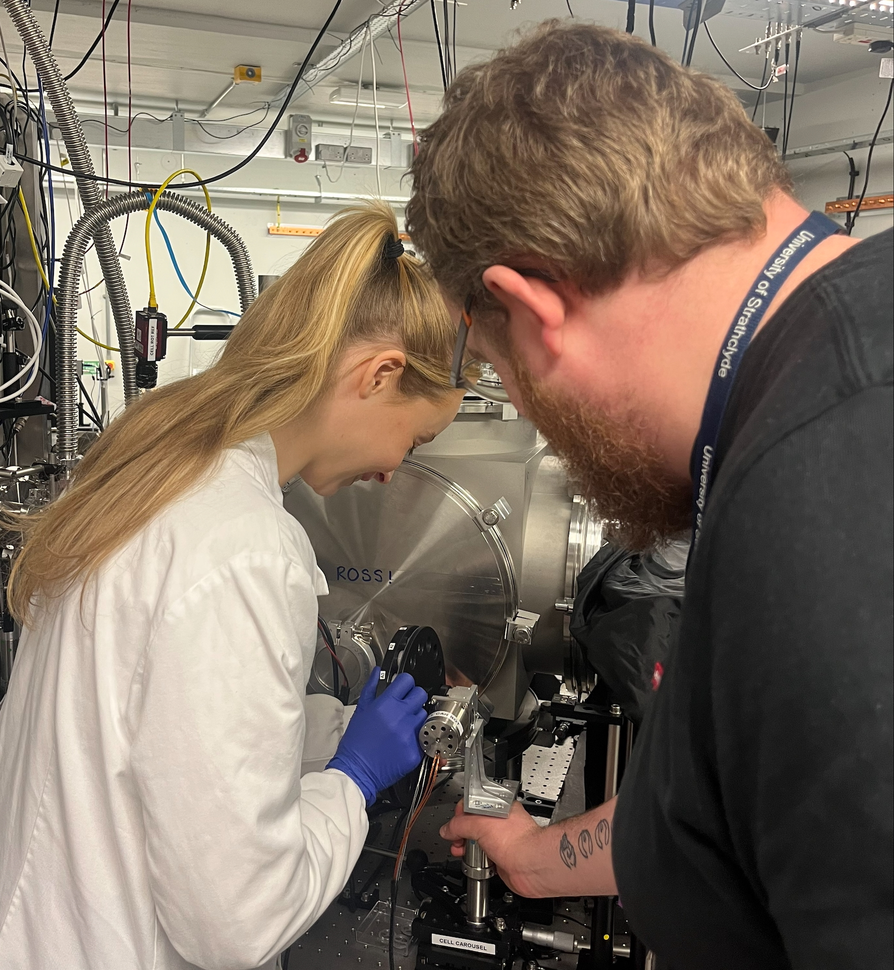
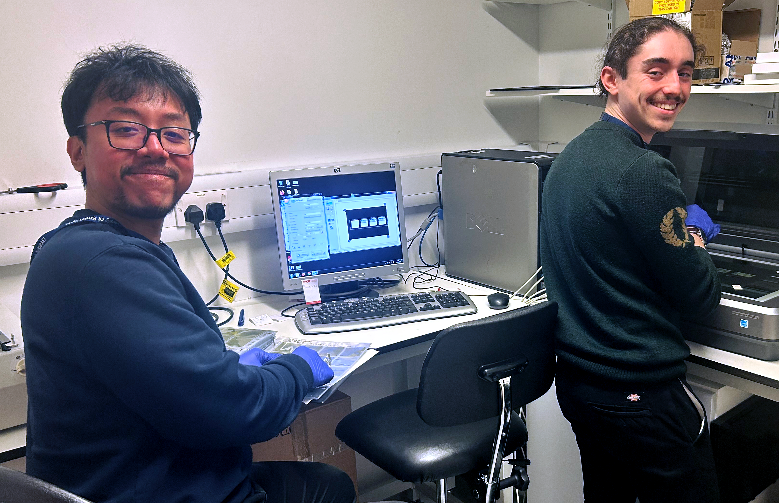
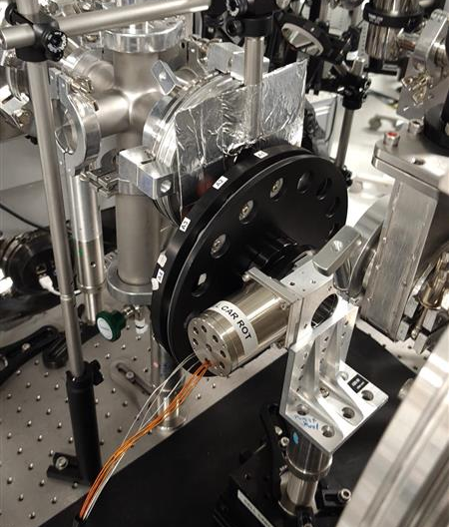
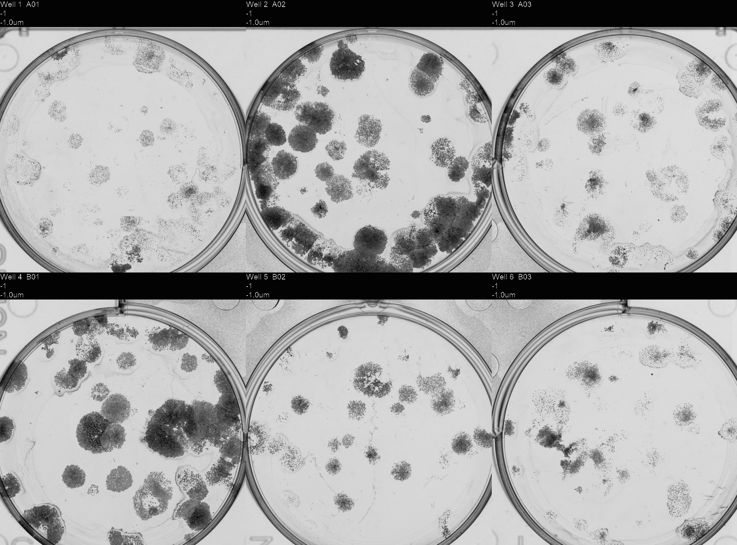
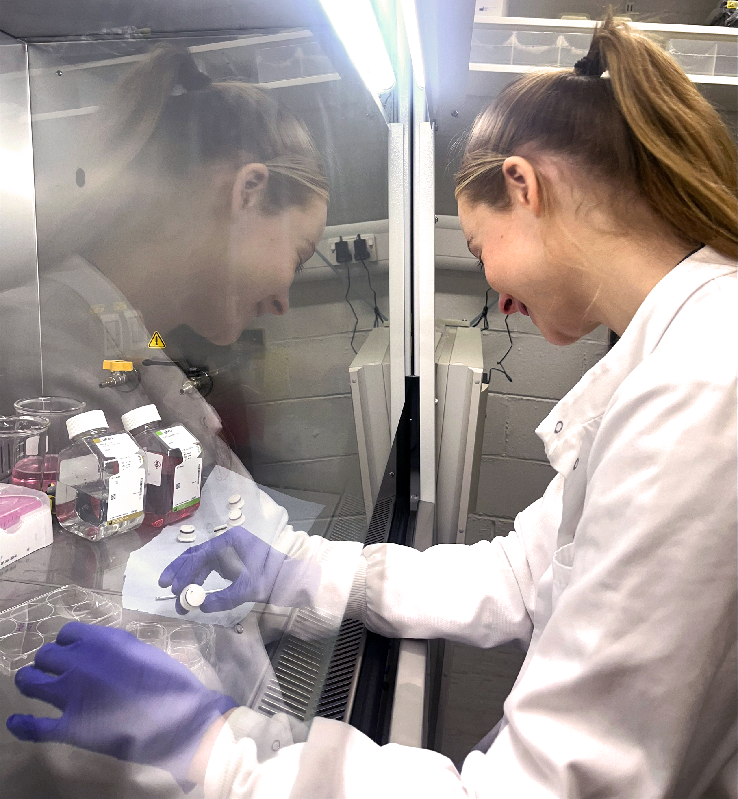
PoPLaR at SCAPA (Strathclyde) [Nov26]
Capture with 2 PMQs
RCF stack for dose estimation
First irradiations:
Cell survival rates
Compare to cyclotron
Promising results!

Slide 22
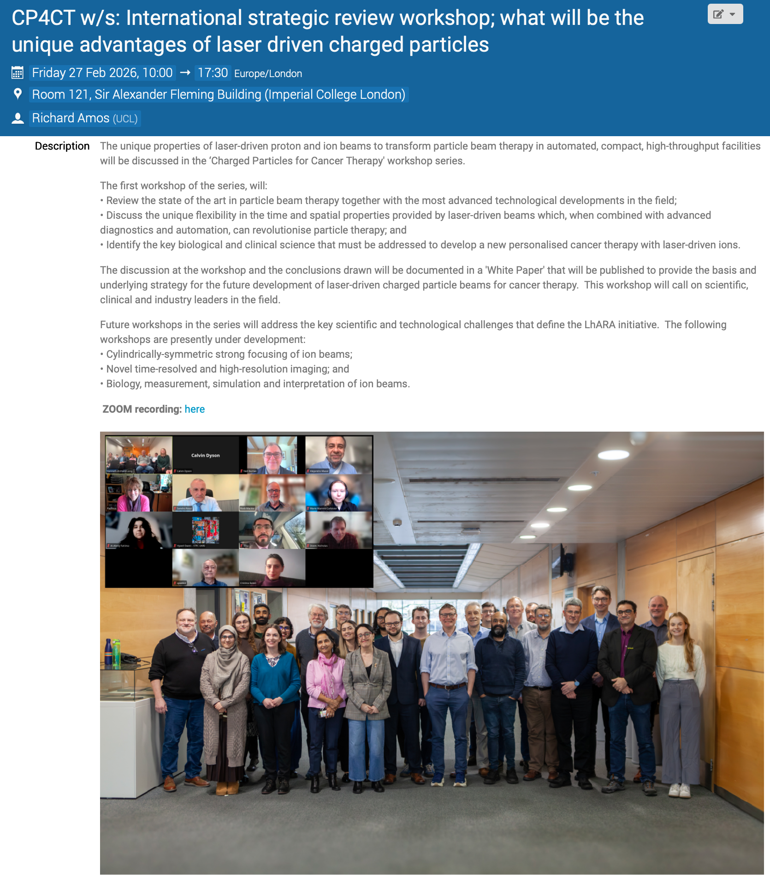
Peer-group meeting series
First of series: 27Feb26
Success!
70 registrants; UK, Europe (France), the Americas
Coming up:
Cylindrically-symmetric strong focusing of ion beams;
Planned for week of 07Sep26
Novel time-resolved, high-resolution imaging;
Biology, measurement, simulation and interpretation of ion beams
https://indico.stfc.ac.uk/event/1703/

Slide 23
The LhARA initiative
Preparation
Proposals:
Establish R&D
R&D:
Stage 1
Project:
Stage 2
Project:
Stage 3
Ambition:
EU: MCSA
UKRI: TBD
IS-8+ Bucket 2
...
Business case
Radiobiology
Laser/accel.
Science,
Industrial partnership
End station
Interpretation
Staged build & operation of laser-hybrid source serving low-energy in-vitro end station
Staged build & operation of boosted beam serving high-energy in-vitro and in-vivo end stations
LhARA facility: radiobiology
Co-creation of laser-hybrid system for the clinic
2026/27
2028 …
2030 …
2035 …
2040 ..

Slide 24
Opportunity, through the LhARA initiative:
Deliver a systematic and definitive radiation biology programme
Prove the feasibility of laser-driven hybrid acceleration
Spin into curiosity-driven science
Lay the foundations for the transformation of ion beam therapy
automated, patient-specific proton and ion beam therapy

