Slide 1
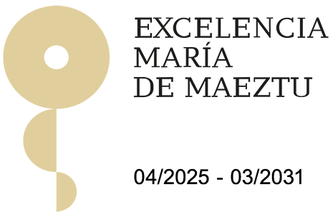
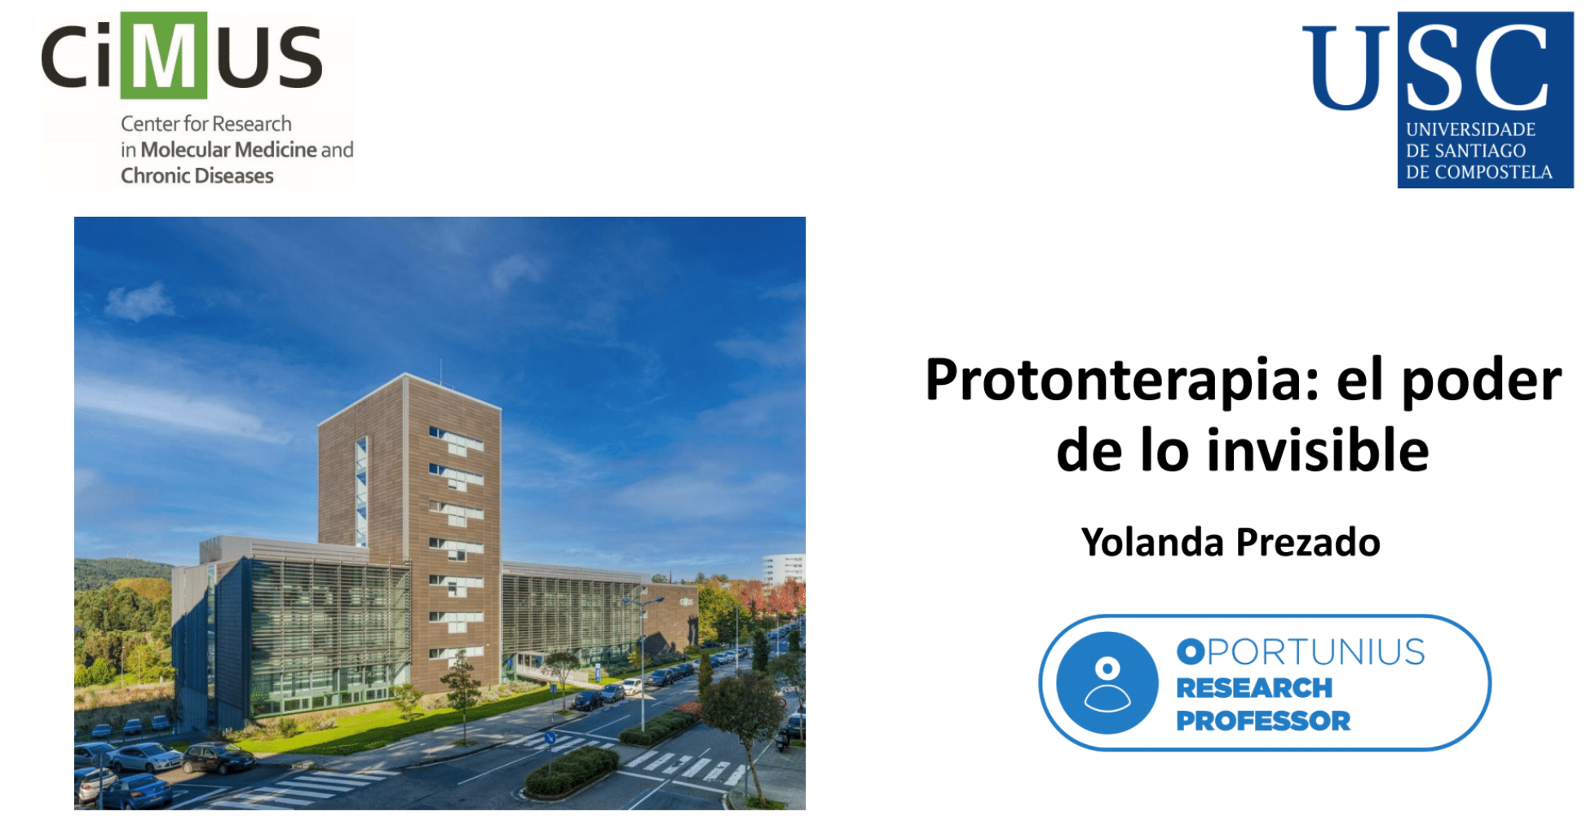

LhARA: a platform enabling the radiotherapy of tomorrow
Yolanda Prezado
Poner lo del prpgramaOportunius

Slide 2
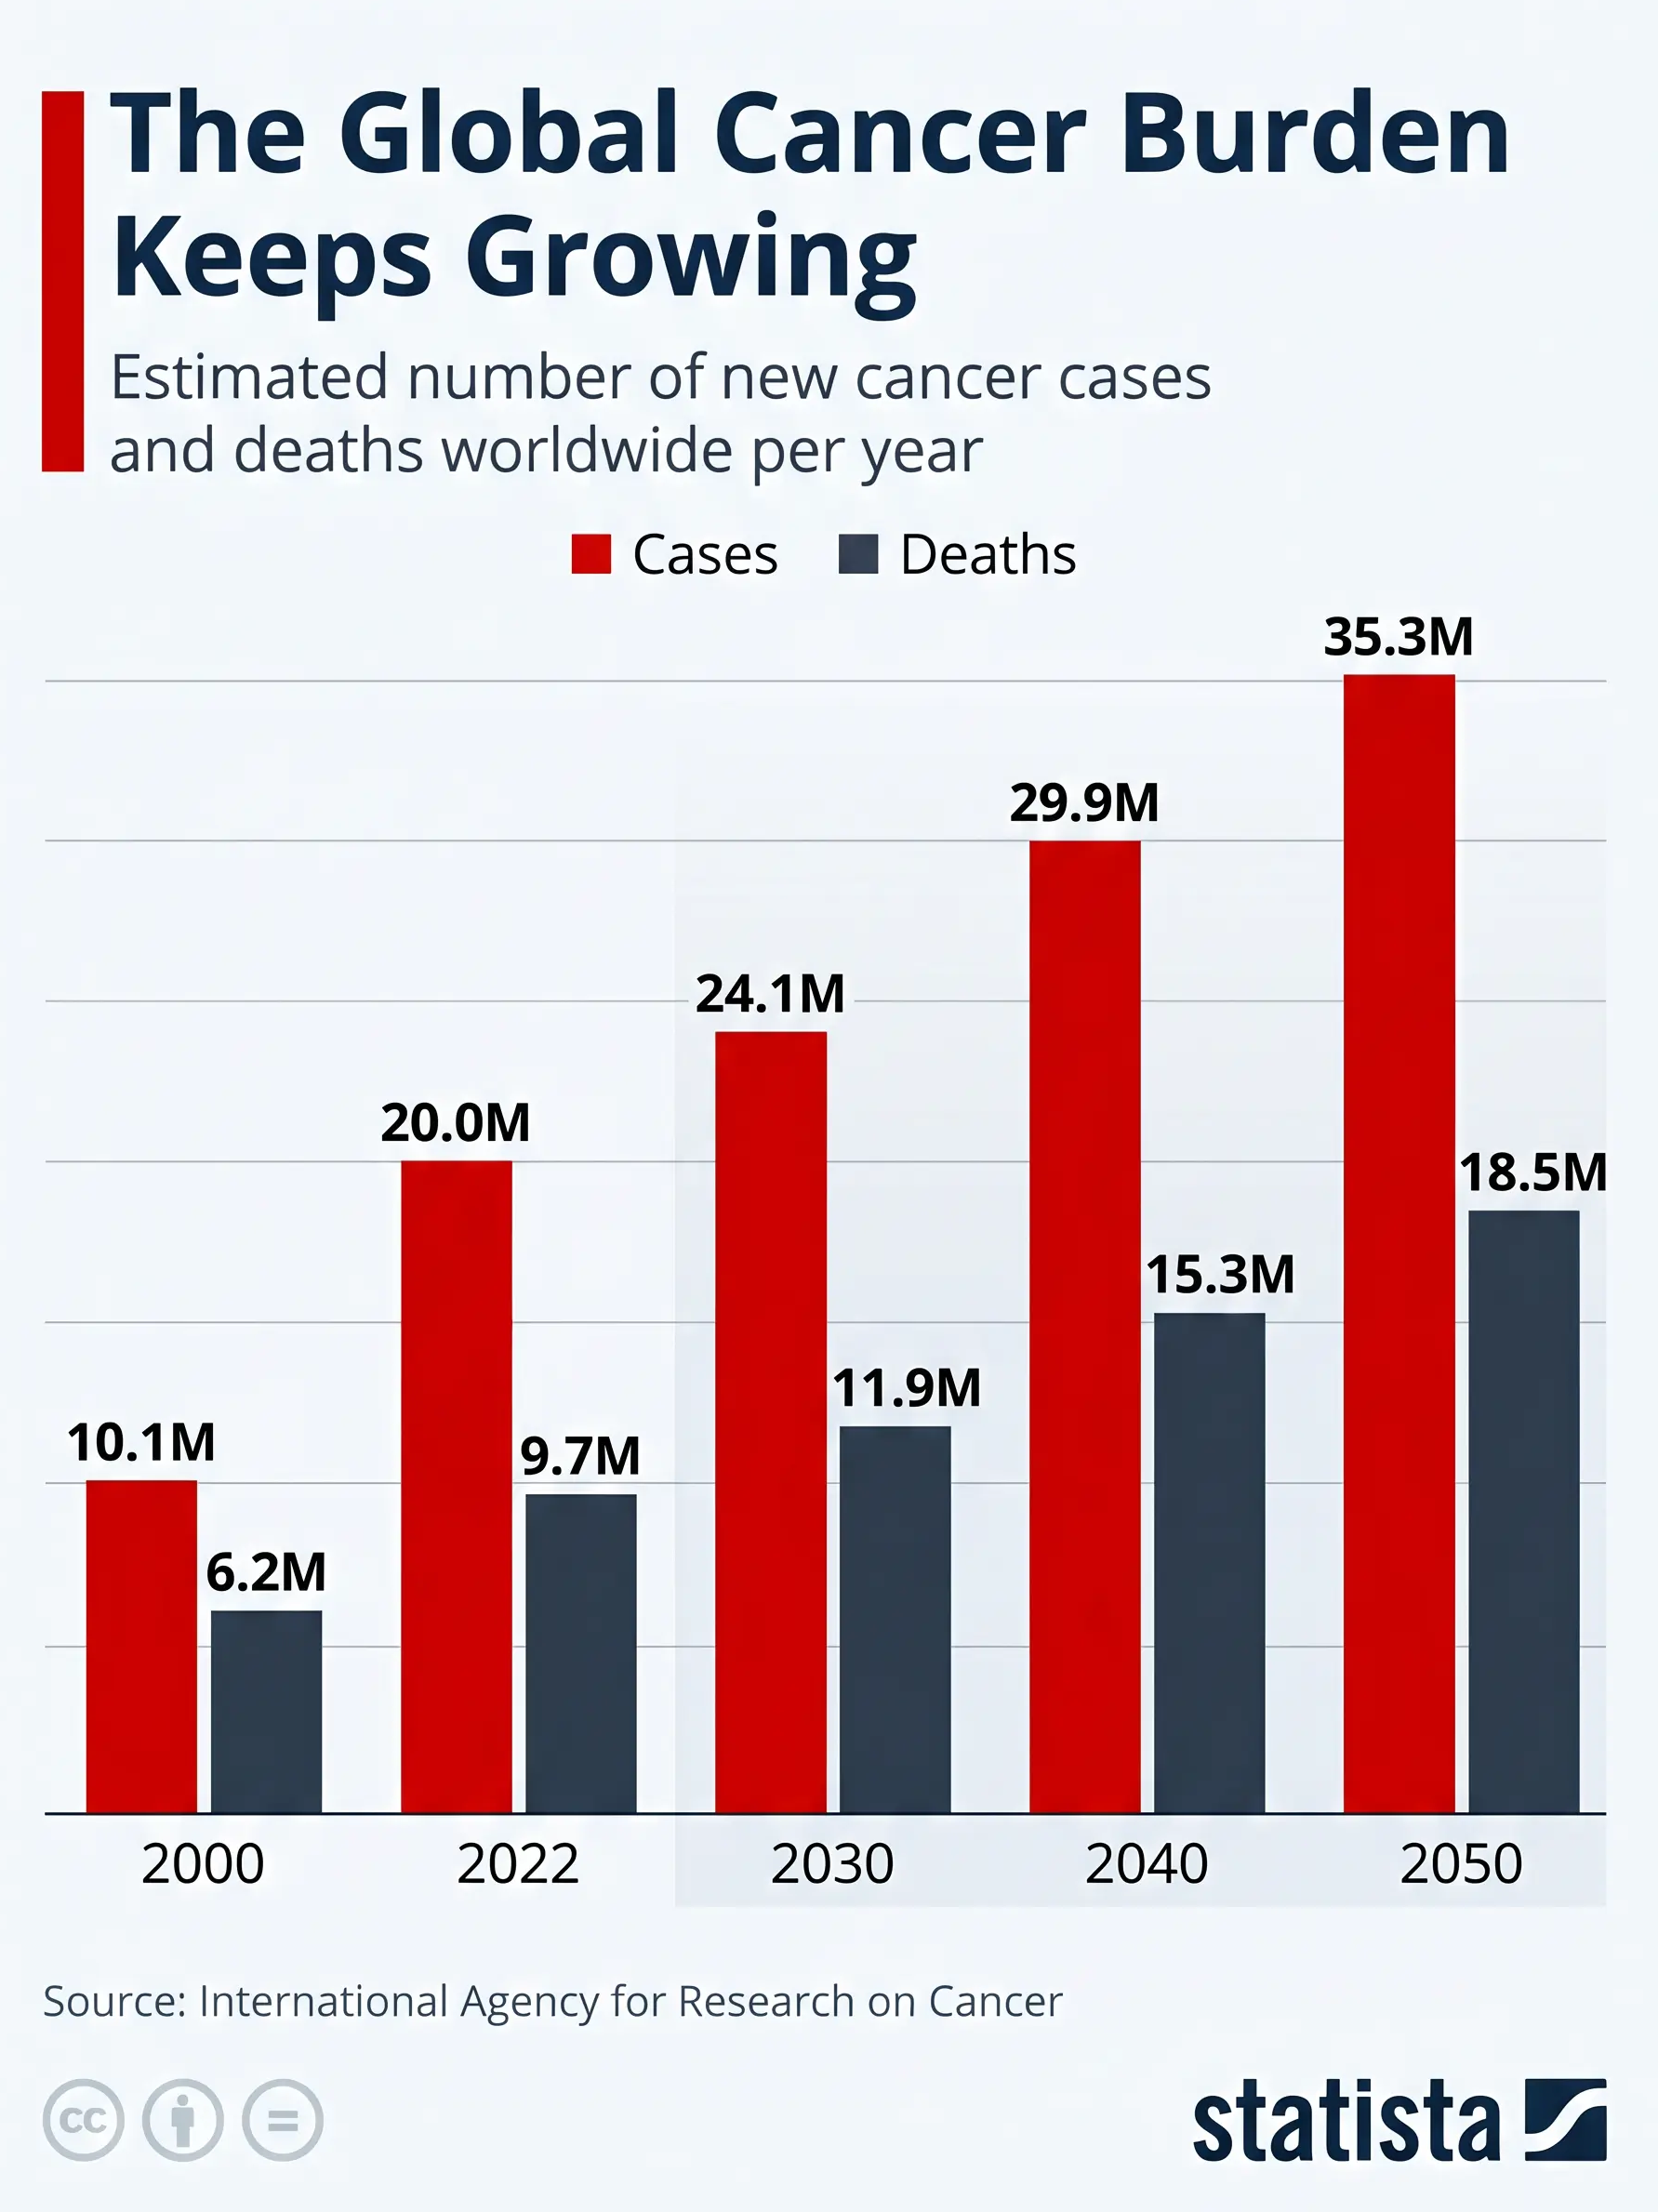

Slide 3
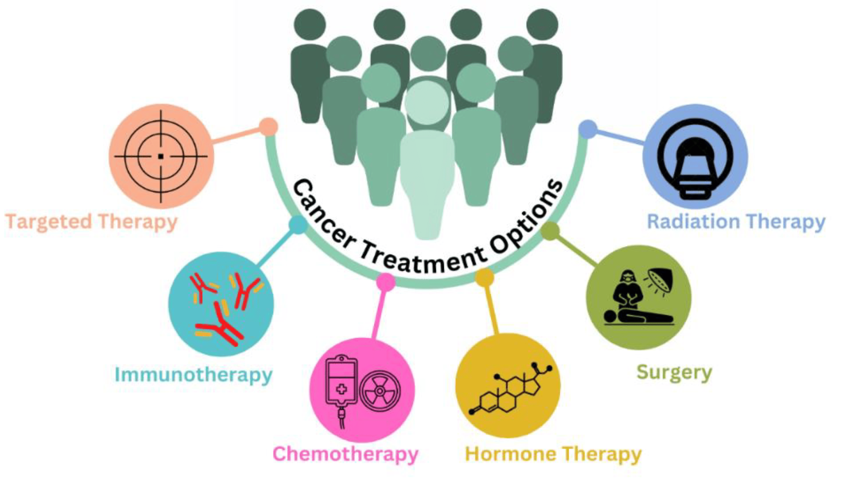
Radiotherapy
Radiotherapy contributes to 50% of all cancer cures worldwide, while also improving the quality of life of many other patients.
After surgery, radiotherapy is the most effective treatment.
The three Cs of radiotherapy:
Curative (it contributes to 50% of all cancer cures), Conservative (it enables the preservation of organs), Cheap (Cost-effective) (it accounts for only 5% of the total cost of cancer treatment).

Slide 4
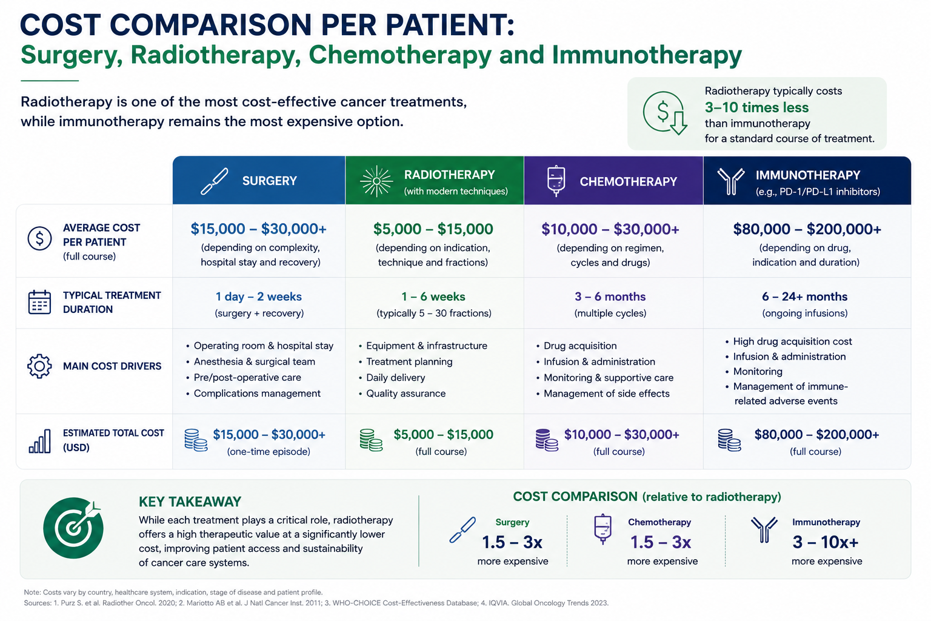

Slide 5
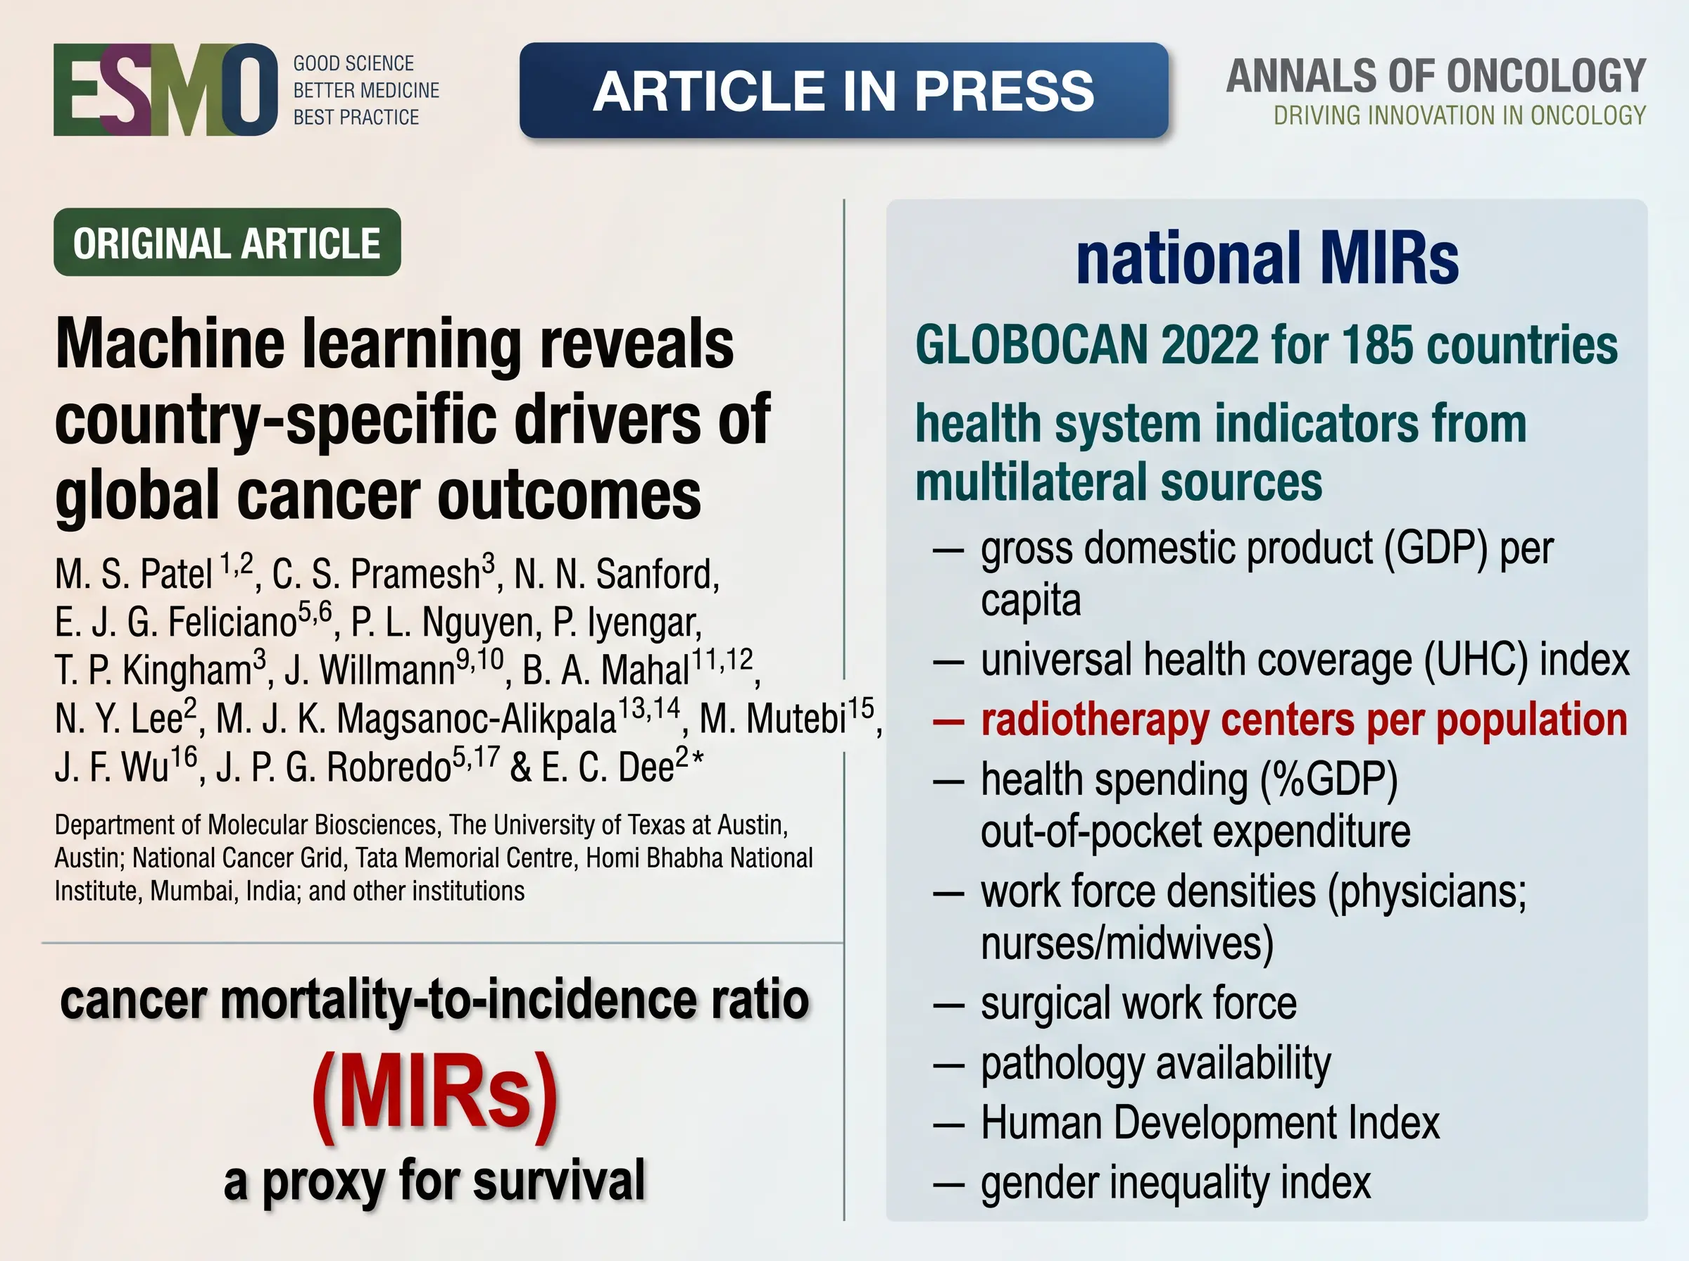


Slide 6
Notes:
Los SHAP contributors son las variables o características que más contribuyen a la predicción de un modelo de inteligencia artificial o machine learning, según el método SHAP (SHapley Additive exPlanations).

Slide 7
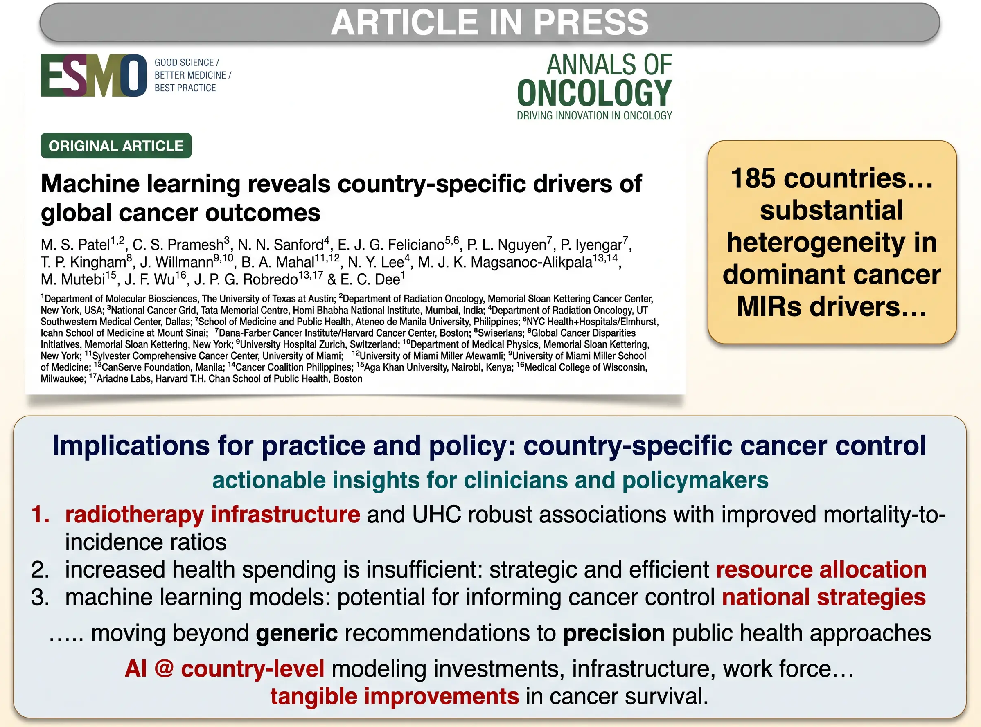

Slide 8
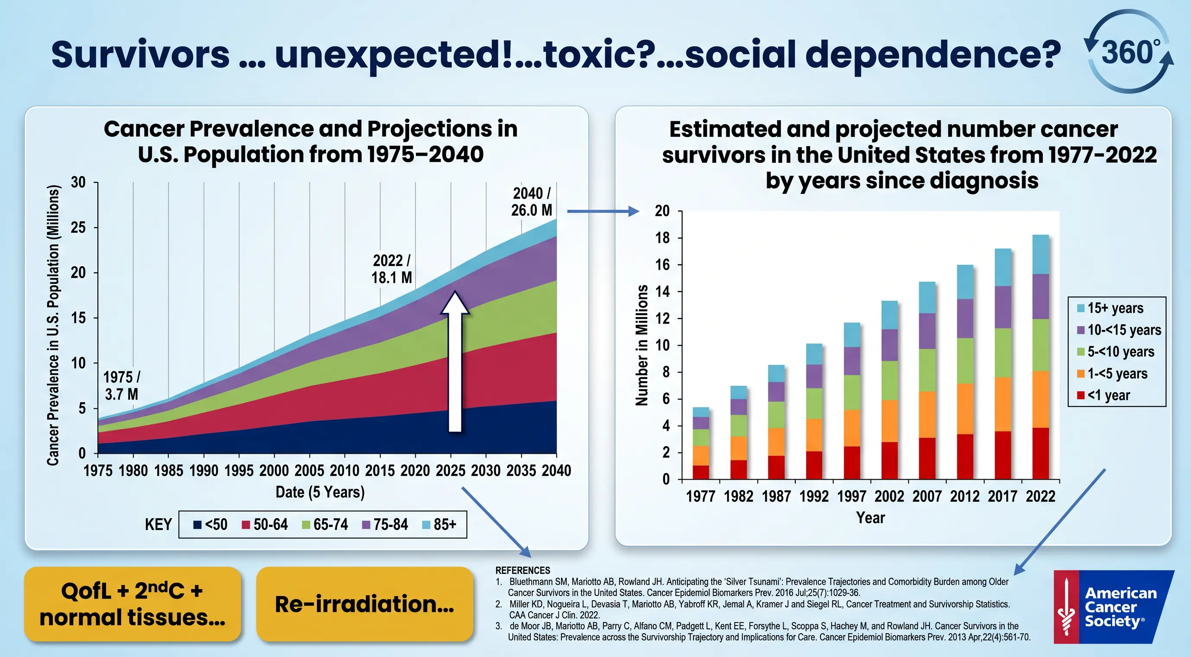

Slide 9
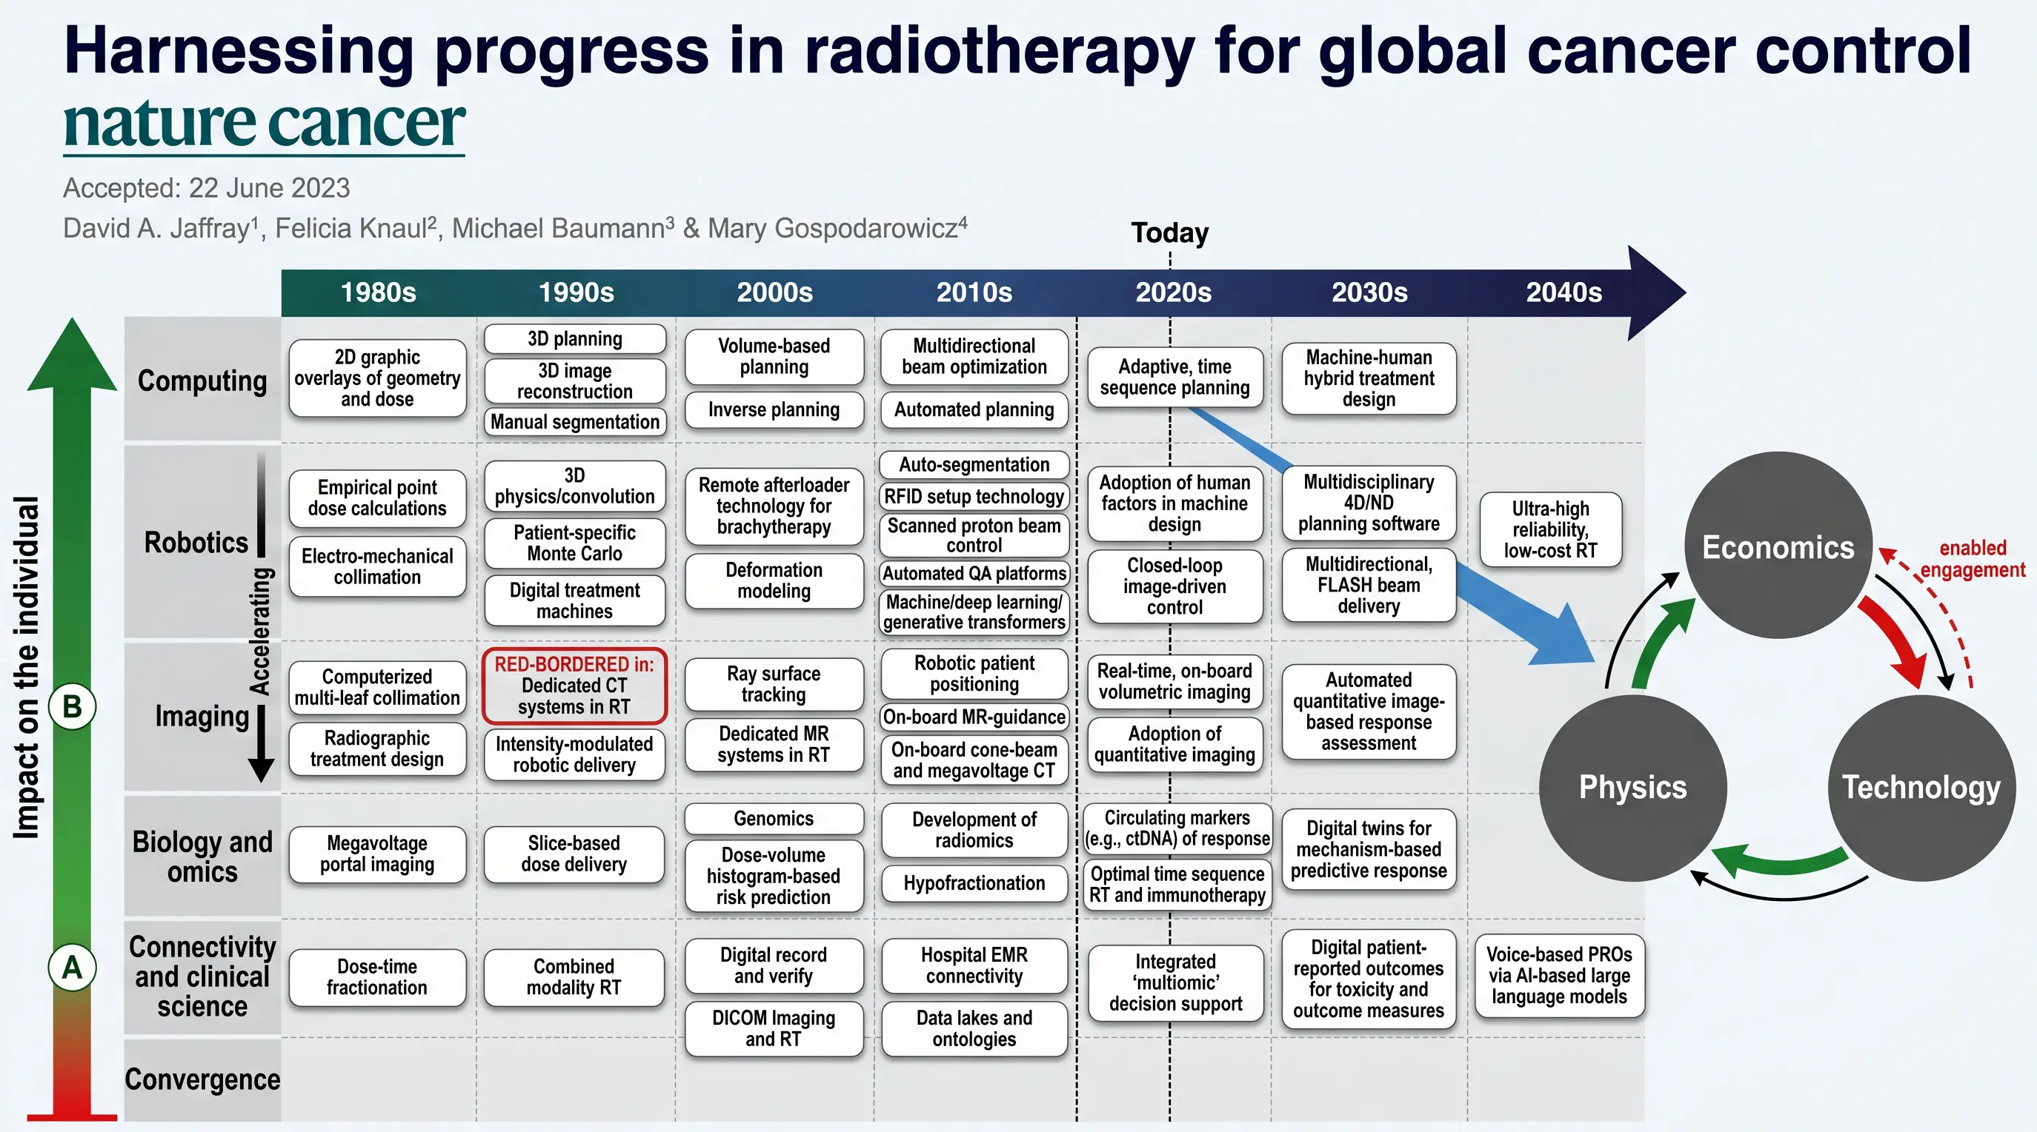

Slide 11
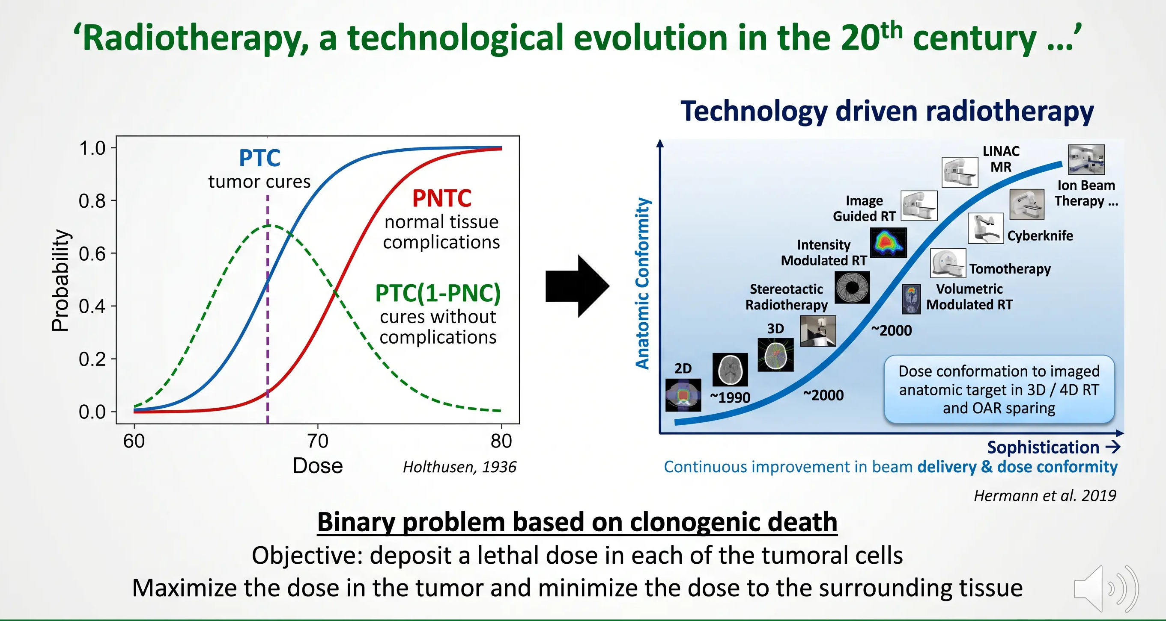

Slide 12
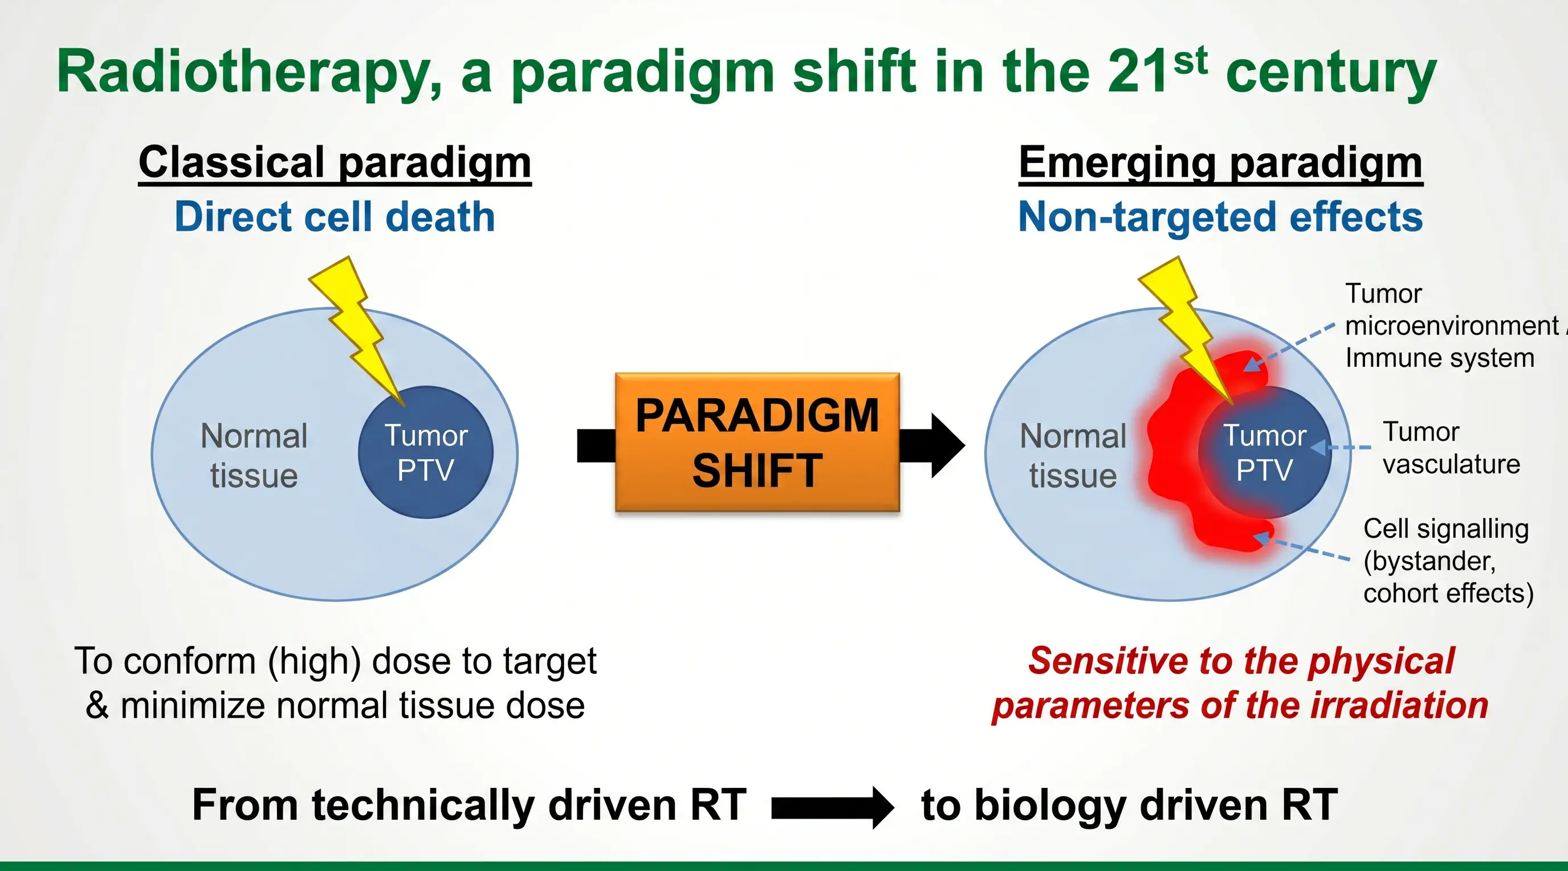

Slide 13
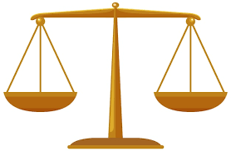
Radiation beyond clonogenic cell death and DNA damage
Impact on
Cell biochemistry
Tumor and normal tissue metabolism
Vascular system
Immunomodulatory & systemic effects
Cell signalizing: bystander effects
Influence factors
Oxygenation
Patient genetics
Patient health condition
Microbiome
Etc.

Slide 14
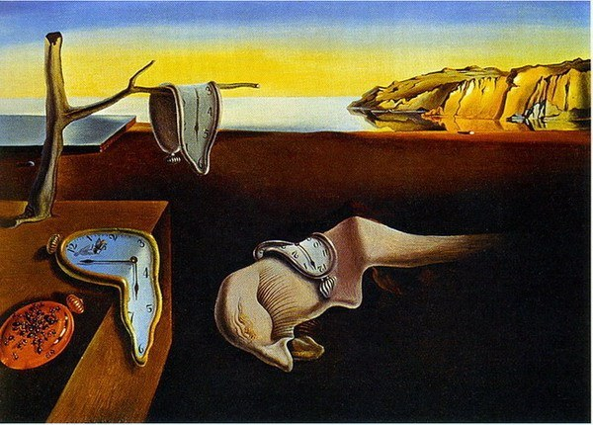
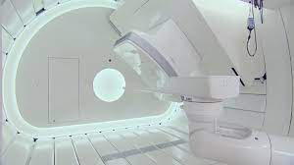
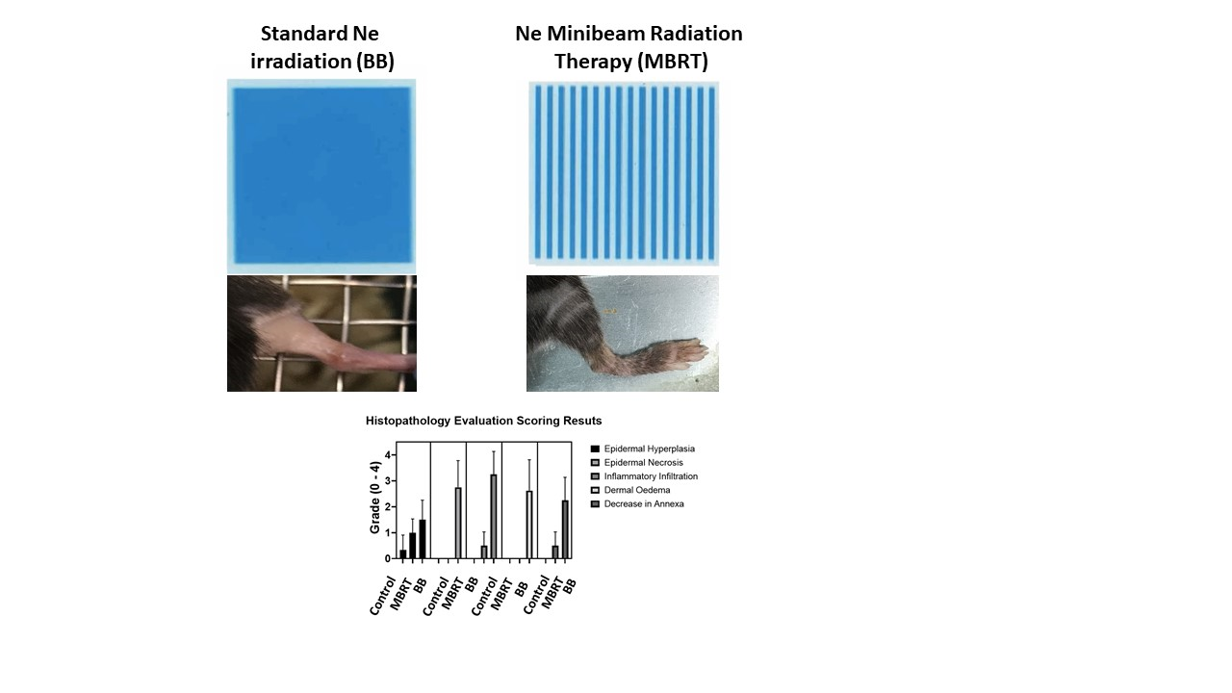
Radiotherapy: a paradigm shift in the 21th century
TIME
PARTICLES
SPACE
DOSE PER FRACTION

Slide 15
Radiotherapy: a paradigm shift in the 21th century
TIME
PARTICLES
SPACE
DOSE PER FRACTION

Slide 16
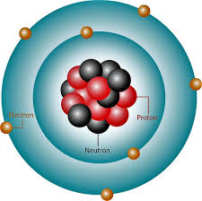
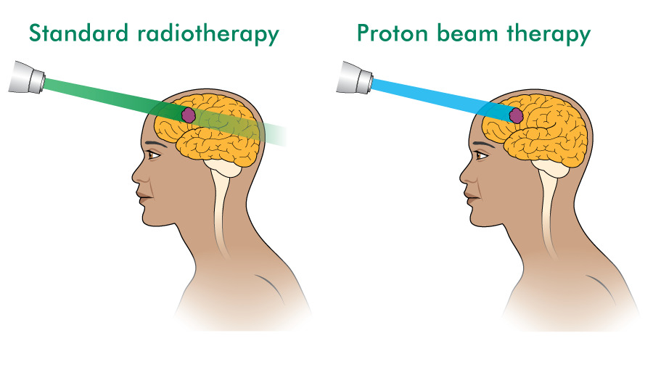
Protons versus photons
Physical advantages
Biological advantages

Slide 17
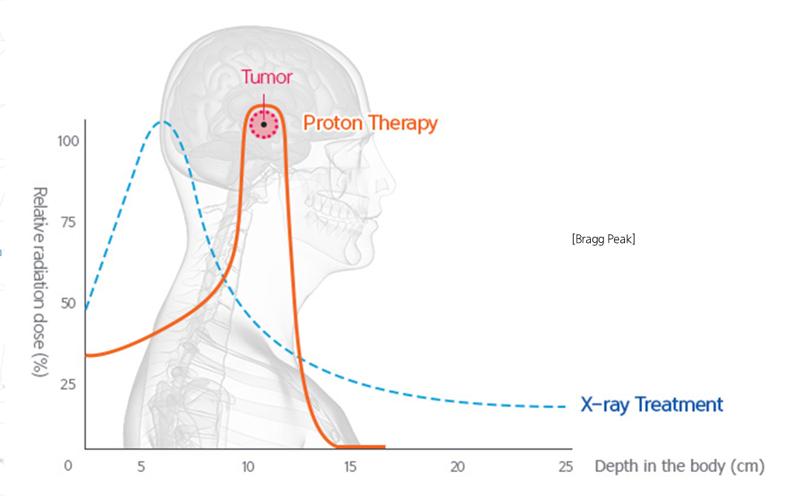
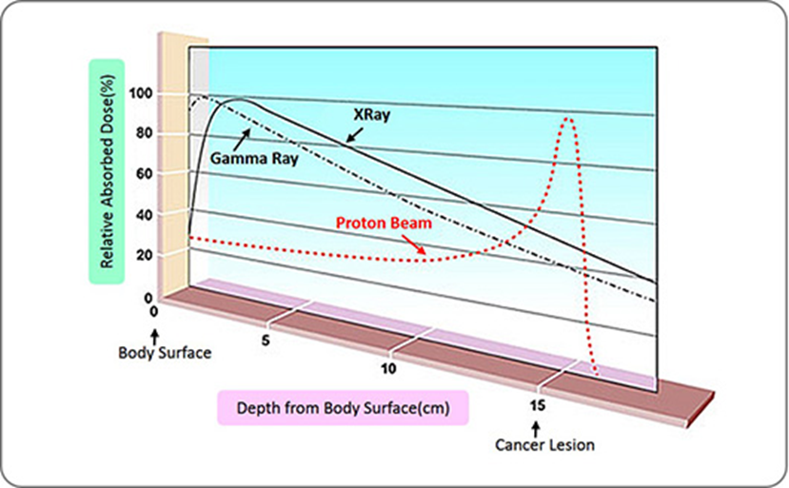
Photons versus protons: physical advantages

Slide 18
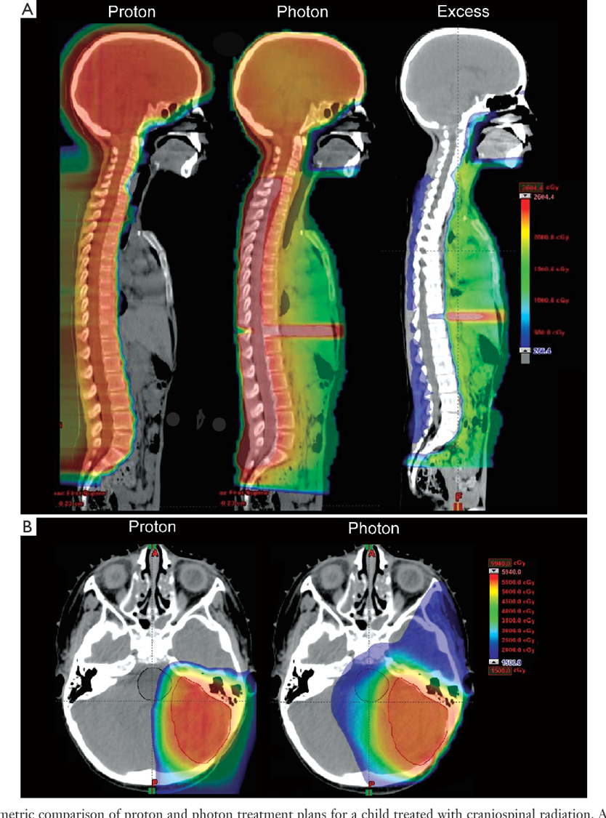
Photons versus protons: physical advantages

Slide 19
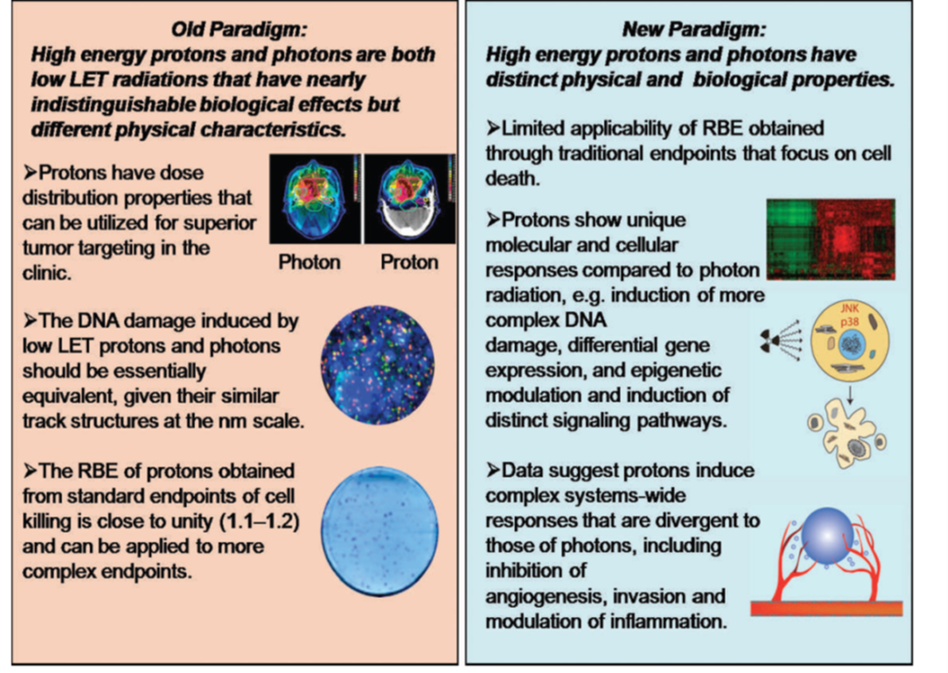
Different radiobiology
Protons offer
more effective inhibition of angiogenesis
different modulation of inflammation
more effective activation of immune system
S. Guirdani et al 2013

Slide 20
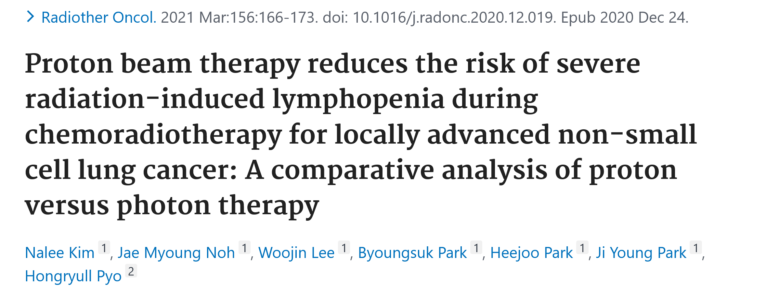
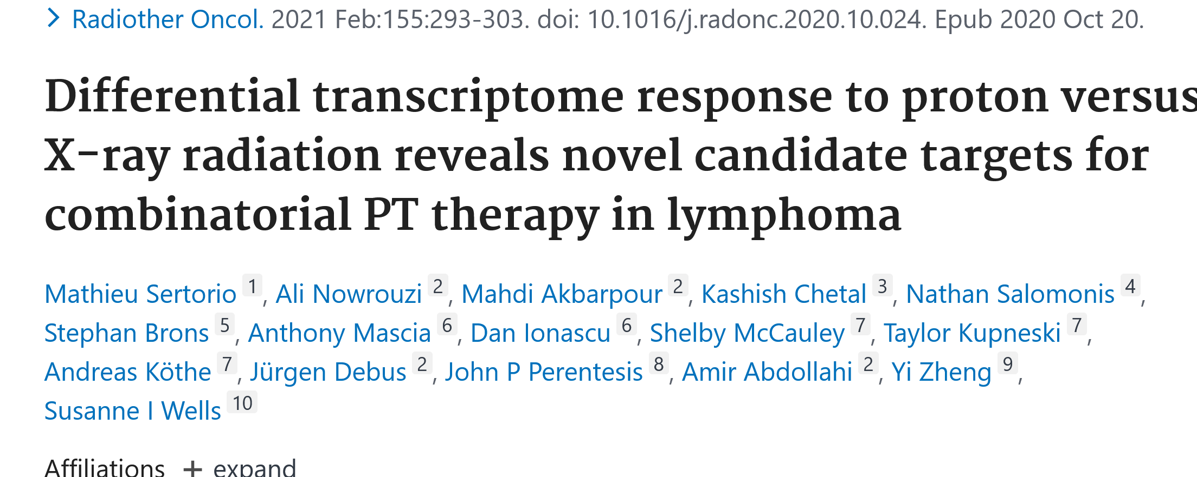
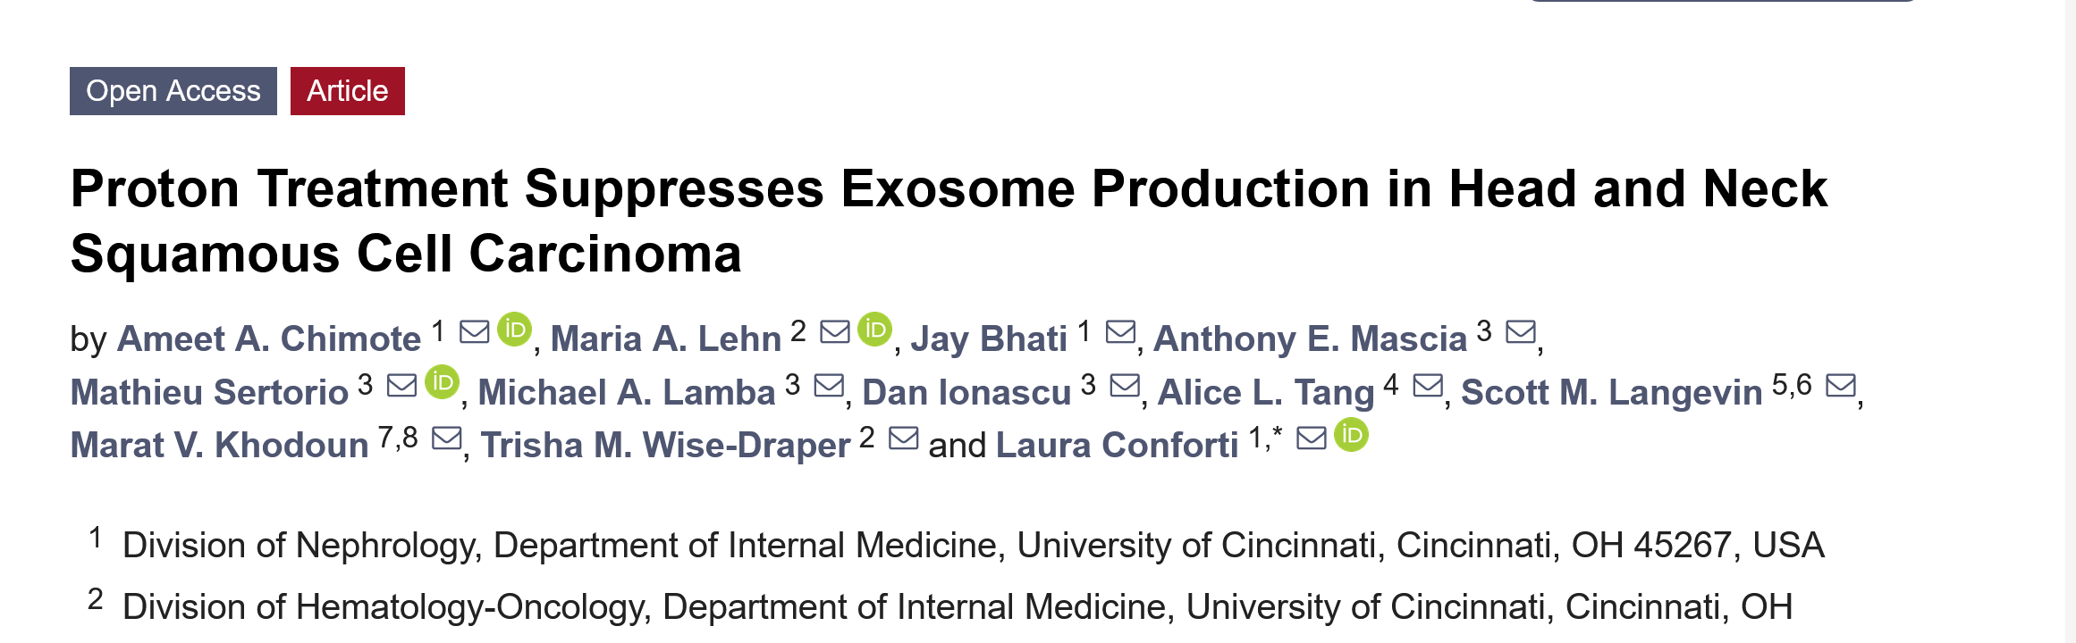
Proton radiobiology: beyond classical RBE

Slide 21
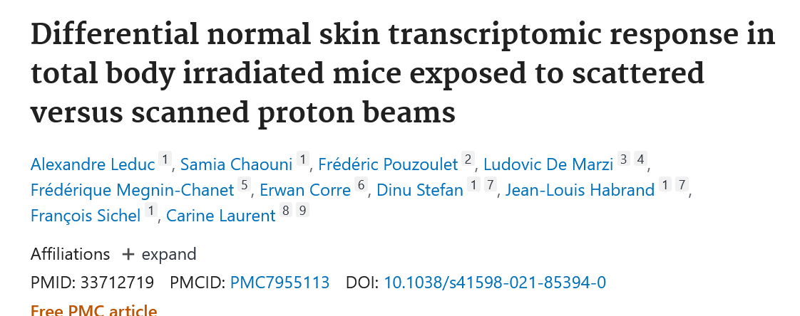
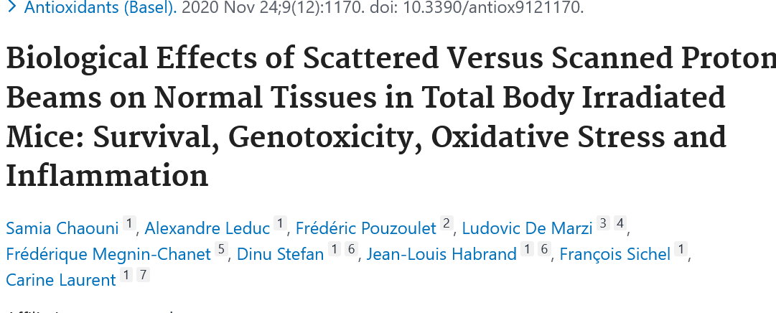
From passive to active beam scanning in proton therapy
From passive to active beam scanning in proton therapy
The way of delivering dose in PT could influence late side effects.
Notes:
Buscar mejores figuras

Slide 22
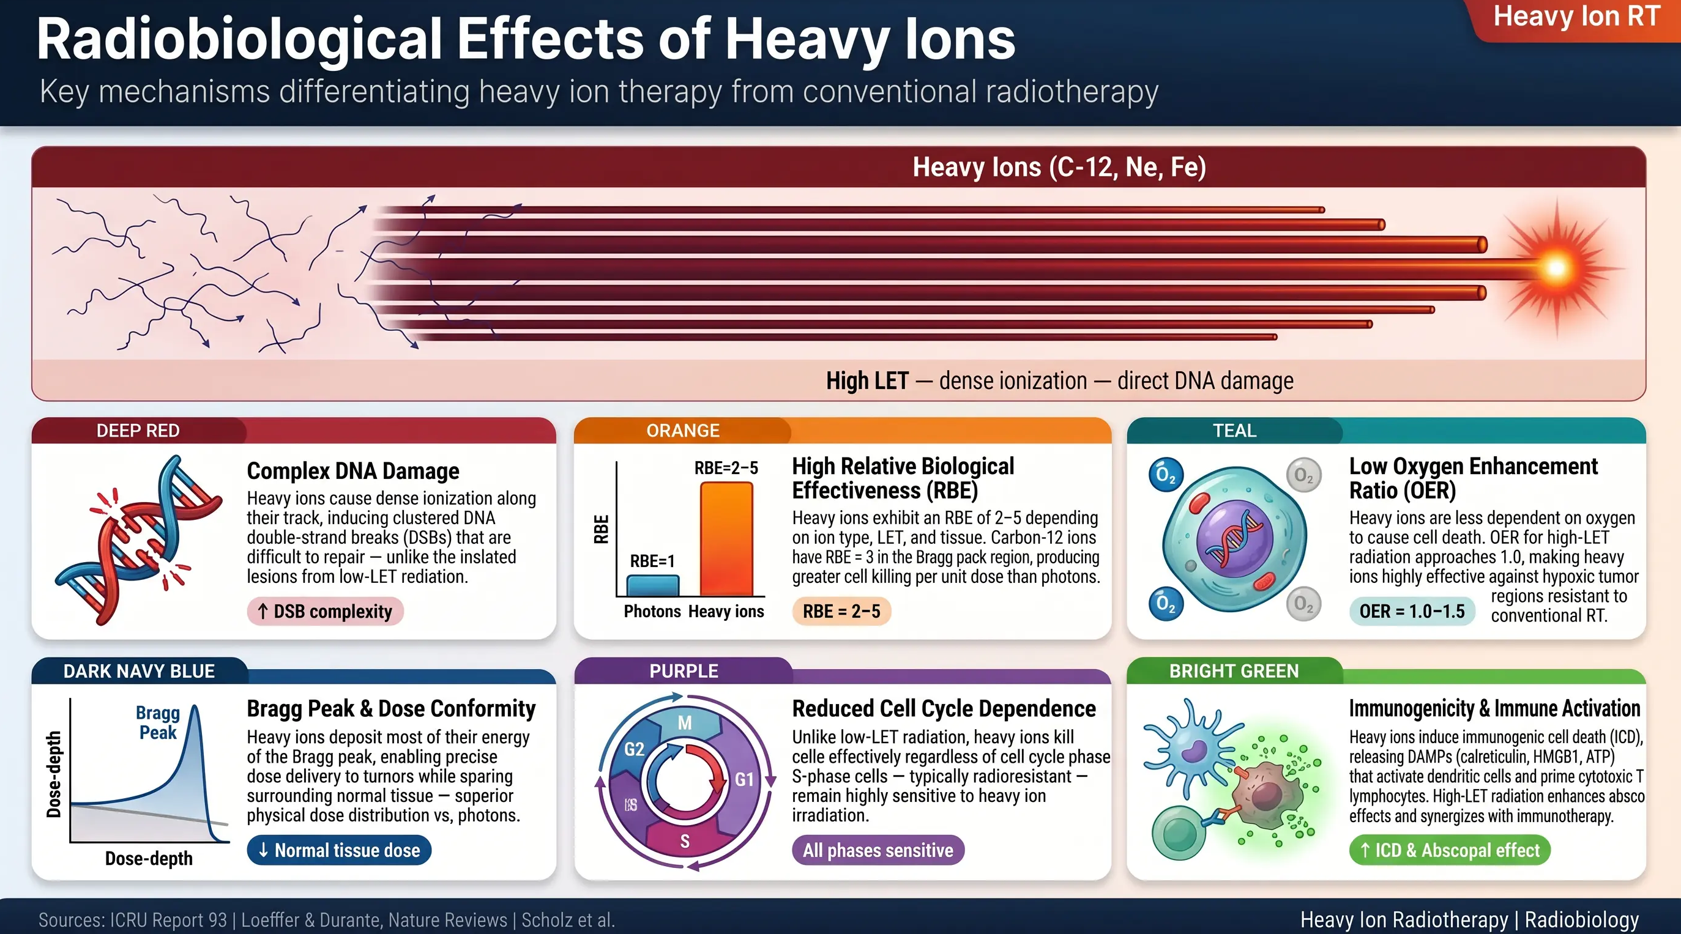

Slide 23
Radiotherapy: a paradigm shift in the 21th century
TIME
PARTICLES
SPACE
DOSE PER FRACTION

Slide 24
Radiotherapy: a paradigm shift in the 21th century
TIME
PARTICLES
SPACE
DOSE PER FRACTION

Slide 25

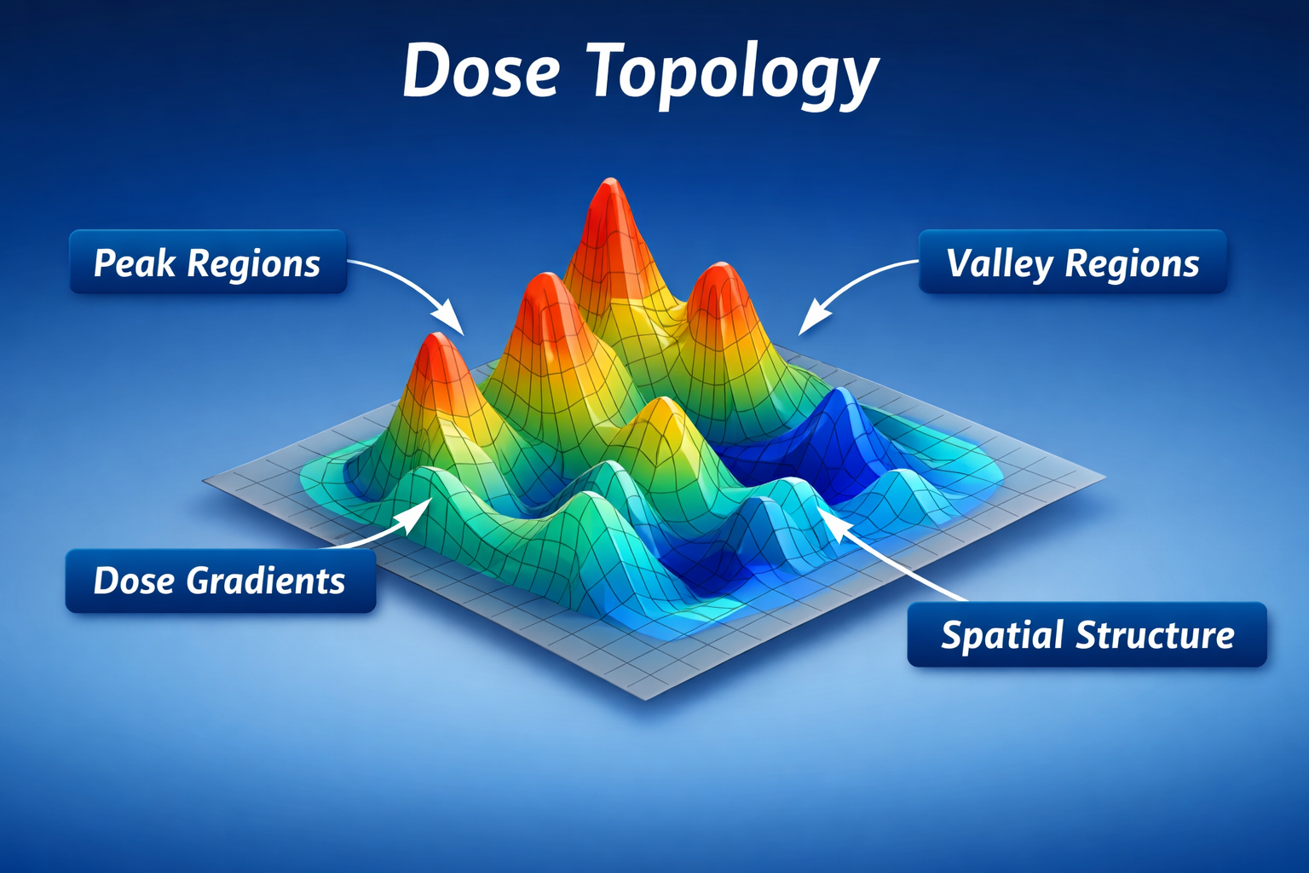
Rethinking RT: It’s not just the dose, it’s how it’s delivered

Slide 26
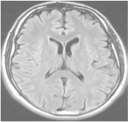
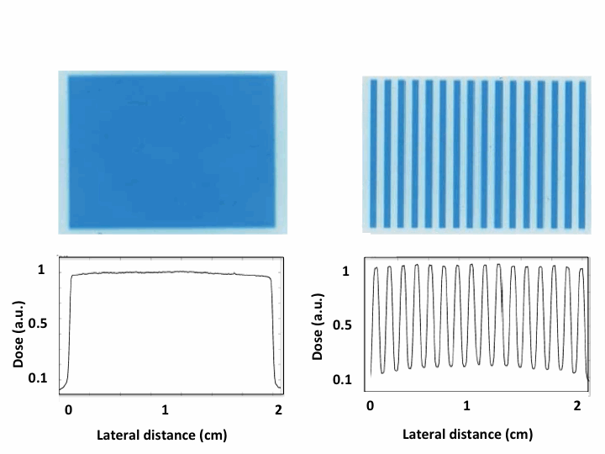
Spatially Fractionated Radiation Therapy (SFRT)
large fields (≥ 1 cm)
laterally homogeneous dose distributions
field composed of smaller beamlets
laterally heterogeneous dose distributions (peaks and valleys)
➜ increase of normal tissue tolerance
Standard RT
≥ 1 cm
beamlet
peak valley
SFRT

Slide 27
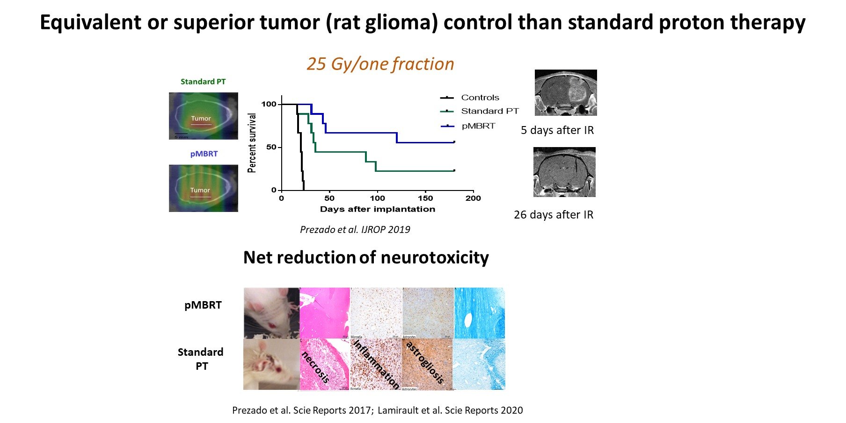
pMBRT increases the therapeutic index for high-grade gliomas
demyelination

Slide 28
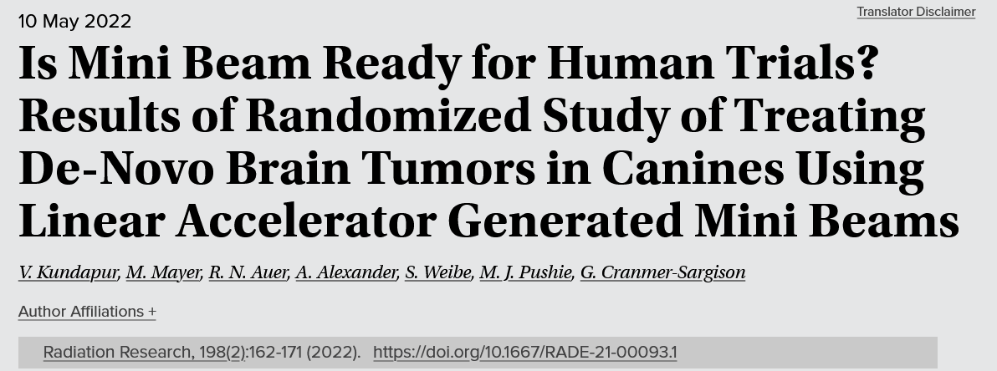
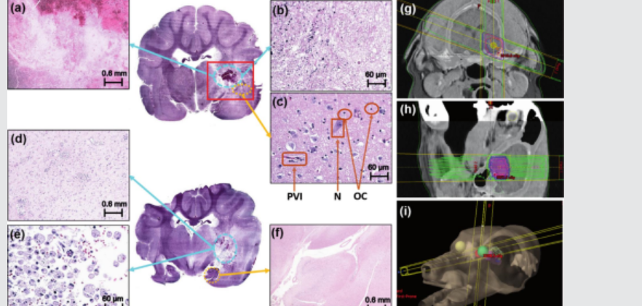
First pet treated…
N=8 dogs in MBRT ( 26 Gy mean dose)
N=8 dogs in conv RT arm (9 Gy in 3 fractions)
-71% complete pathological remission in MBRT versus 0% in Conv RT
-Sparing of normal tissue in the study arm, compared to Conv RT
SFRT: TYPES

Slide 29
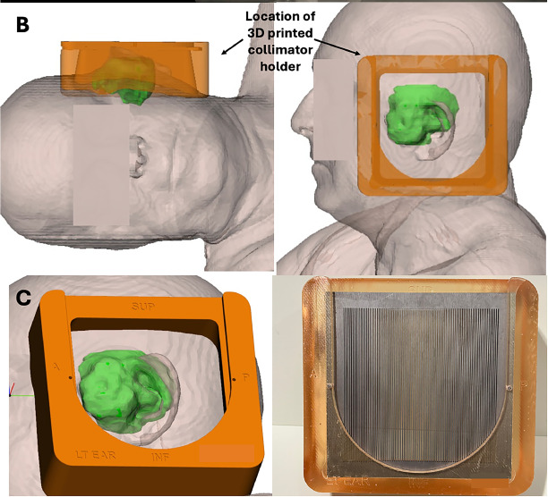
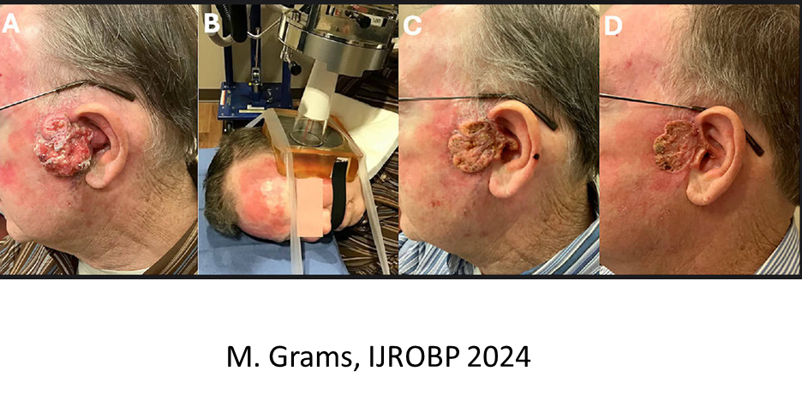
MBRT: first patients

Slide 30
Radiobiology: what we know and don’t
Differential effect tumor versus normal tissue
Normal tissues | Tumor
Vascular effects
Prompt repair | Damage
Immune system
Reduced inflammation | Immune infltration/activation
Cell signalling/abscopal
Positive “bystander”-like effects | Cytotoxic “bystander”-like effects
Cell migration, hyperplasia and proliferation | Different biochemistry
Prezado, Exp. Rew Mol Medicine 2022

Slide 31
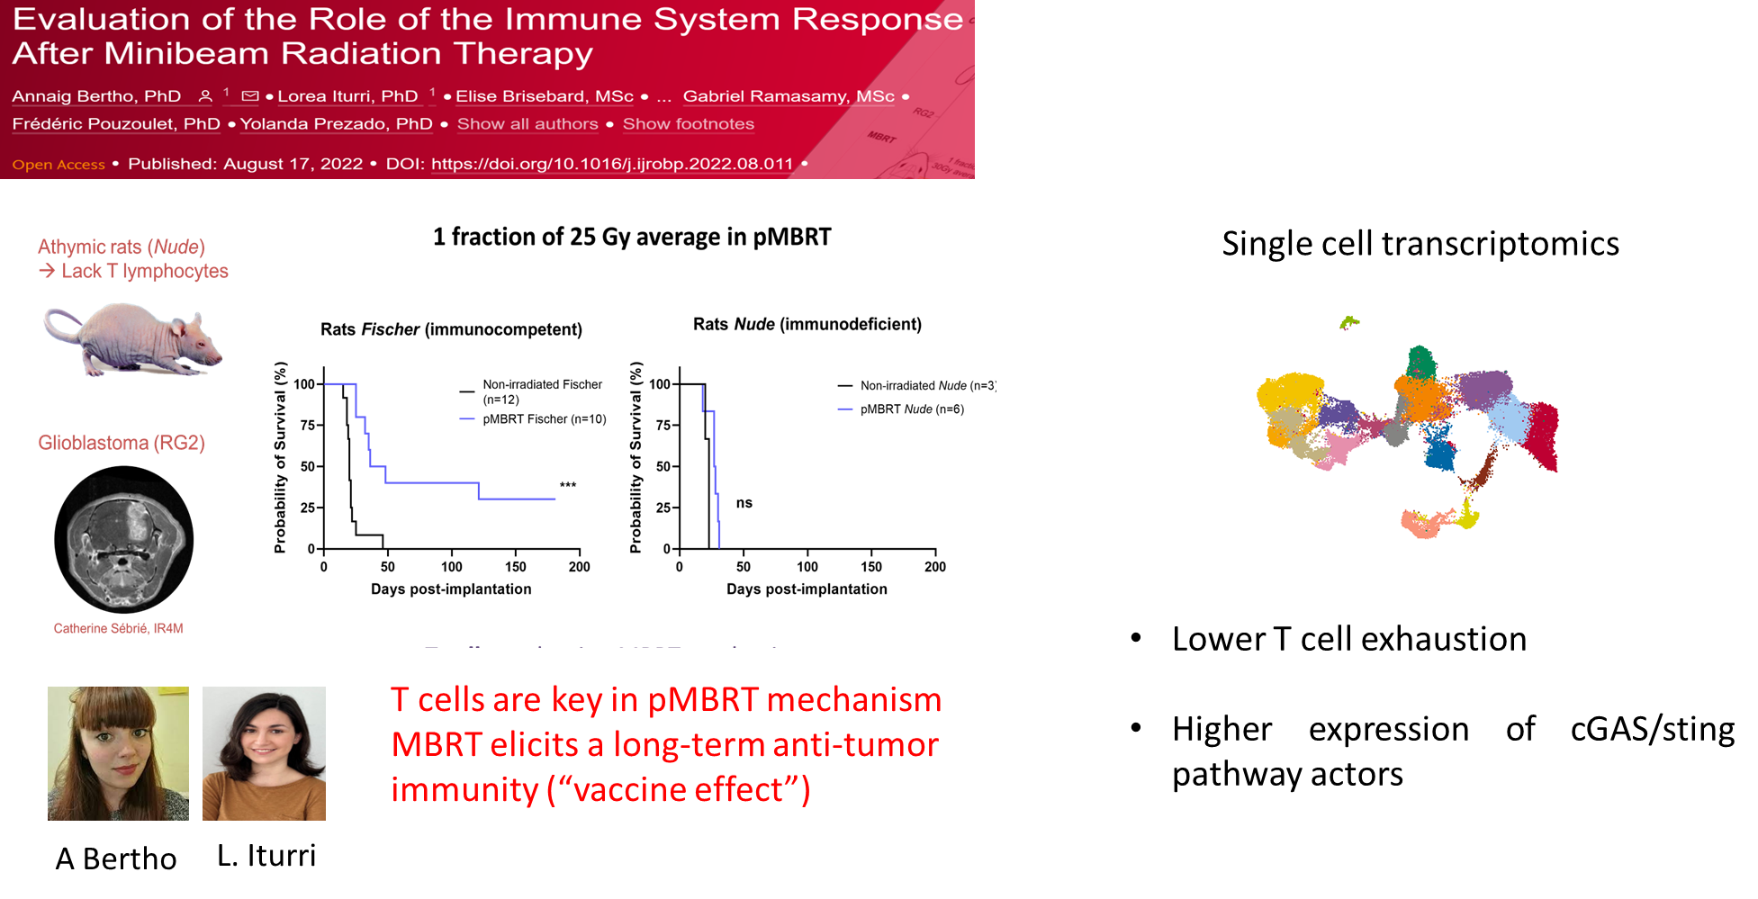
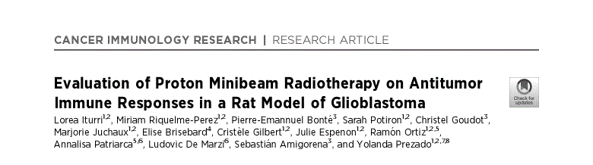
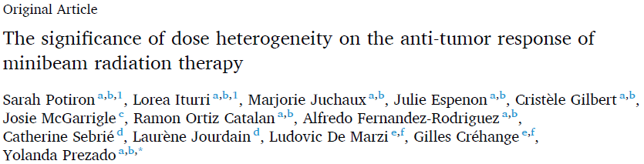
SFRT leads to an effective immune antitumor response
Increase of T cell infiltration
notably cytotoxic T cells, T helpers
Lower T cell exhaustion
Increase of B cell infiltration
In situ vaccination
Reduced number of immunosupressive cells
MBRT rewires macrophages states towards antitumoral phenotype
Potiron et al. submitted to Nat Comm.

Slide 32
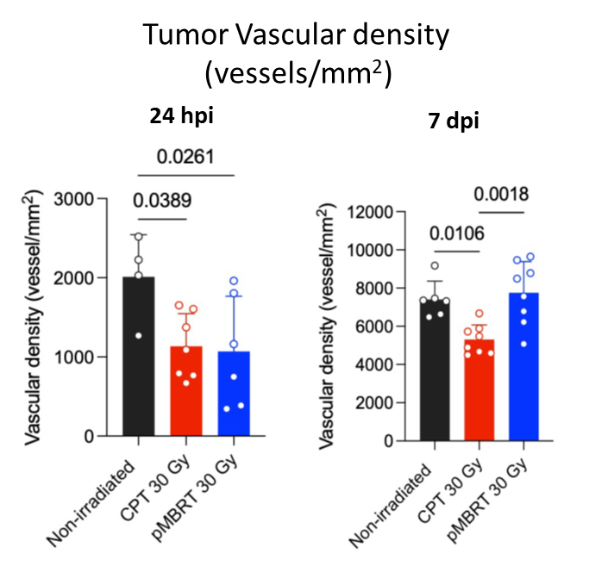
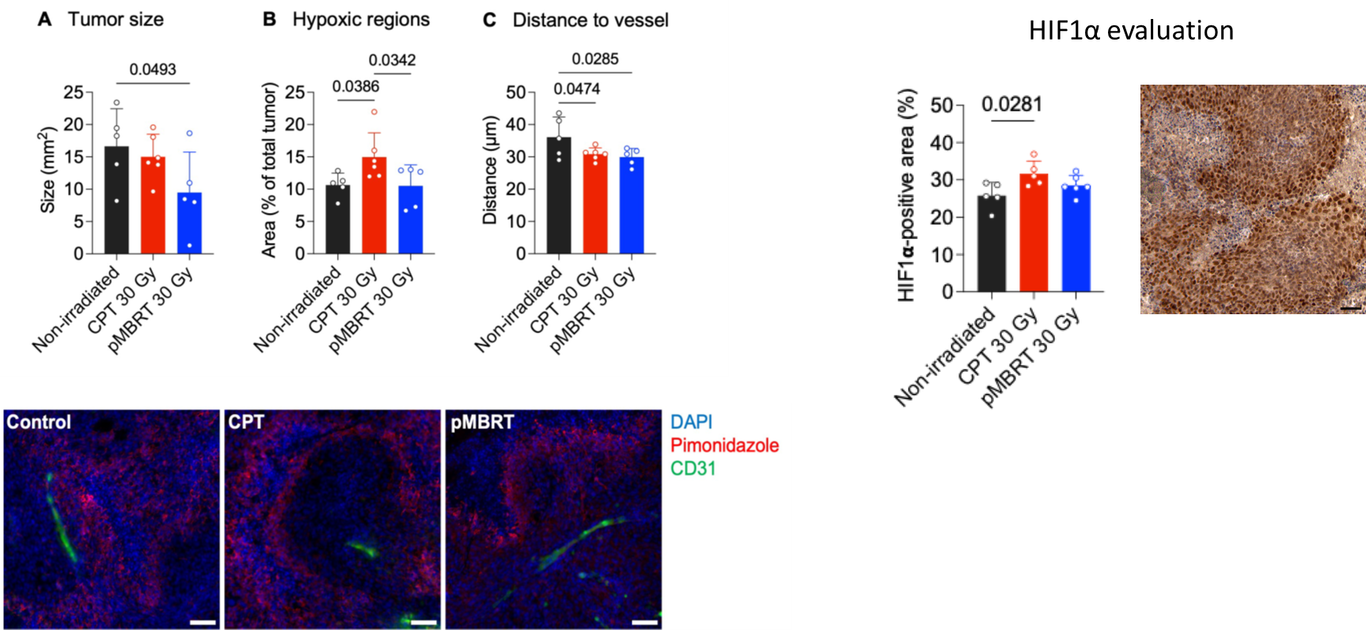
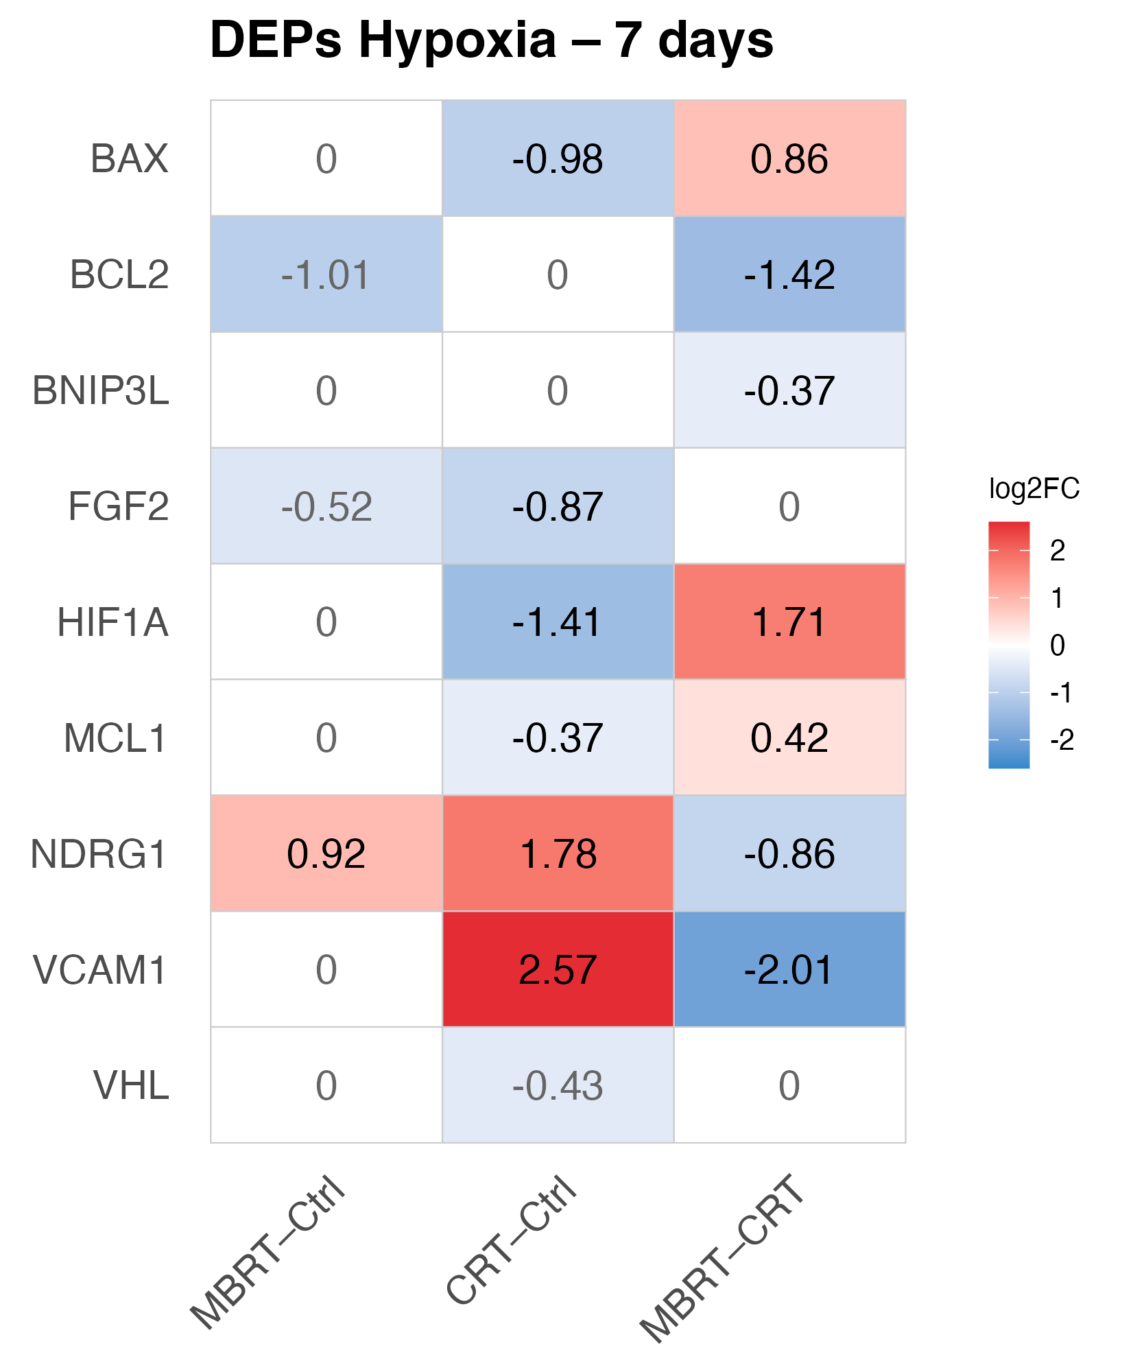
SFRT leads to vascular renormalization and limits the development of hypoxia
MBRT preserves adaptive hypoxia signaling and limits inflammation.

Slide 33
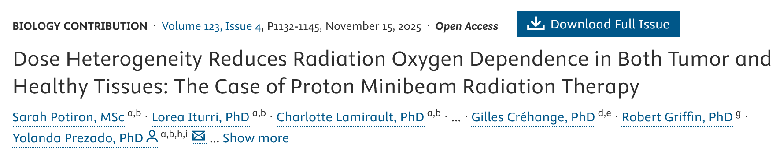
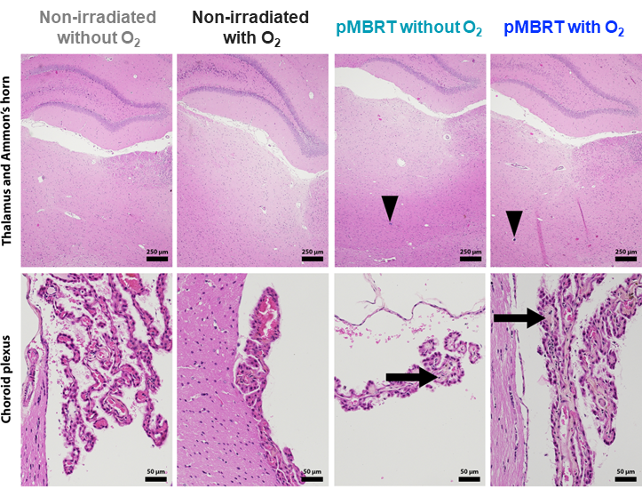
SFRT reduces oxygen dependence

Slide 34
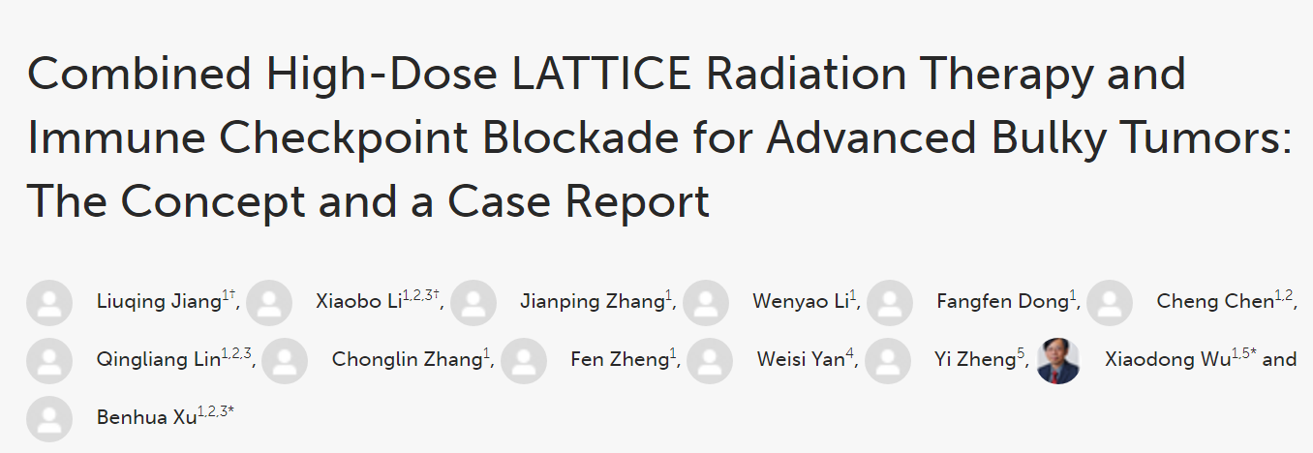
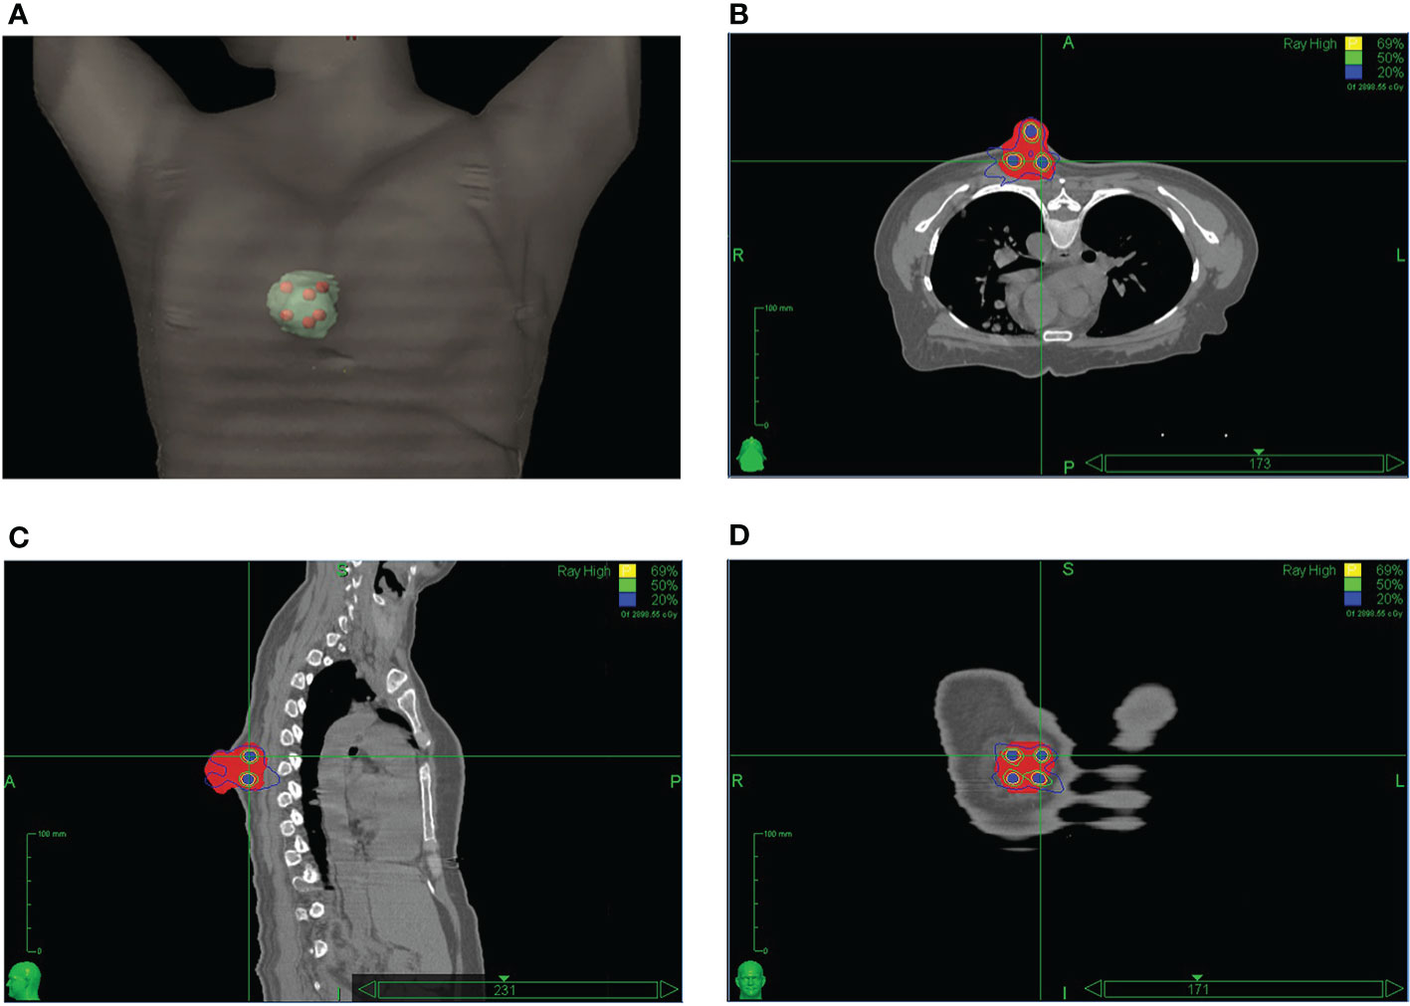
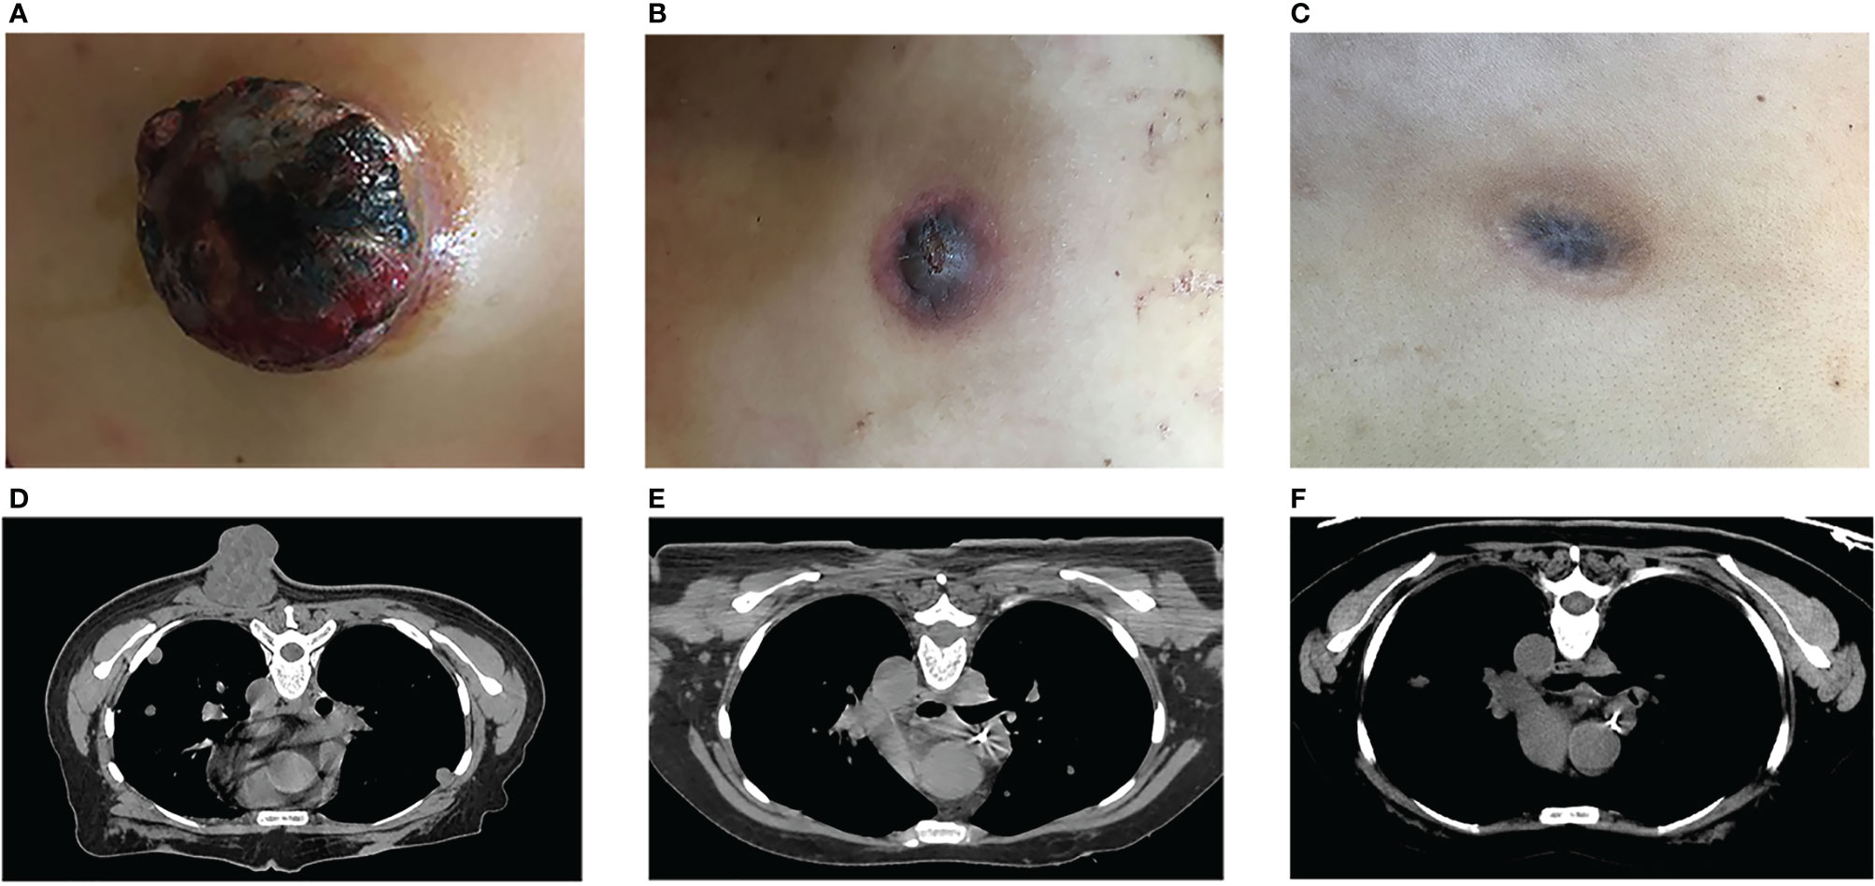
SFRT and immunotherapy
Case report: non-small cell lung cancer (NSCLC) with multiple metastases. Palliative radiation treatments with combined chemotherapies and immunotherapies to multiple lesions.
Treatment of the fast-growing posterior chest wall mass with HDLRT (20 Gy) + the on-going anti-PD-1 treatment→complete local response
All other lesions achieved only partial response, including the ones treated with SBRT of 20 Gy single fraction
High dose is not enough, spatial fractionation needed.
RADIOBIOLOGY

Slide 35


SFRT and immunotherapy (CAR-T)
TK-Luc human lymphoma
RRGS (Rat Rag1^{-/-} γc^{-/-} hSIRPα⁺)
lack all T, B and NK cells
Model for humanized rats
Ménoret et al. Transplantation 2020
MBRT and NOT broad beam irradiations enhance CAR-T efficacy
CAR-T delays tumor growth but does not eradicate it contrary to MBRT+CAR-T
S. Amigorena
L. Iturri
Iturri et al. submitted to Blood Advances
Notes:
Mejorar la grafica!

Slide 36
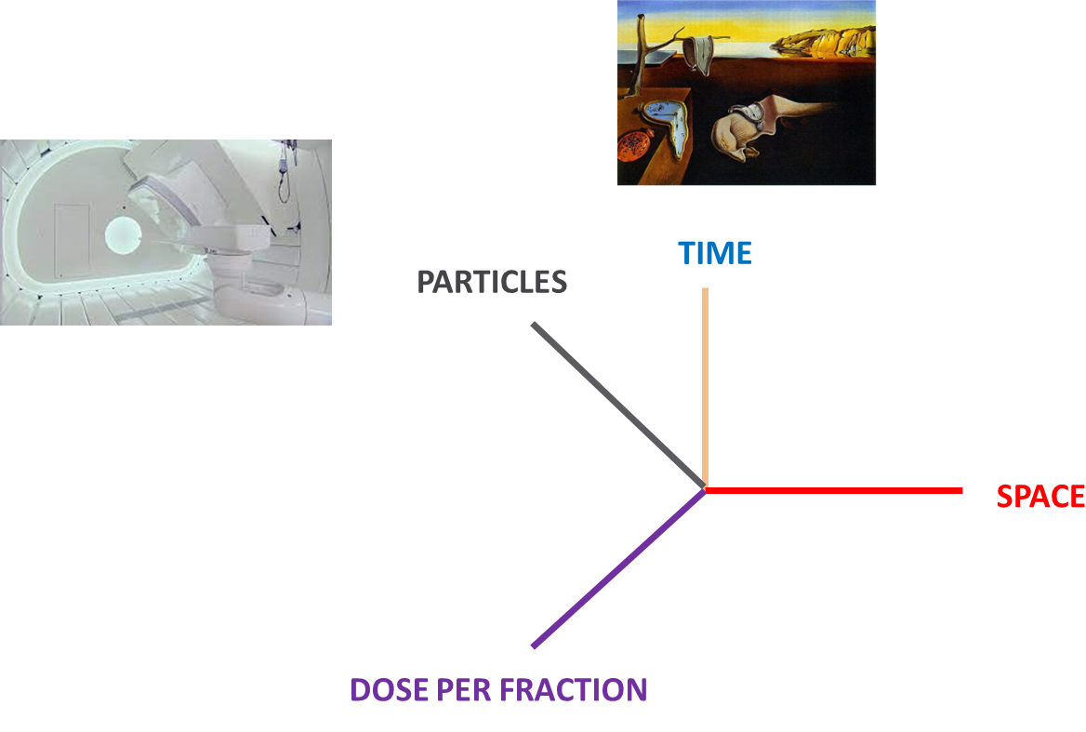

Radiotherapy: a paradigm shift in the 21th century
PULSAR
FLASH
“Pulsed” radiobiology

Slide 37
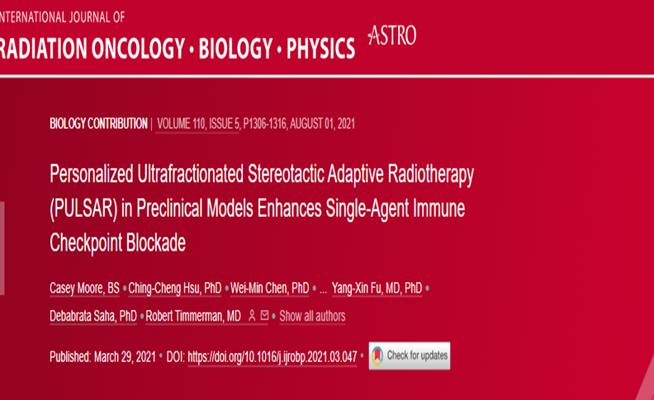
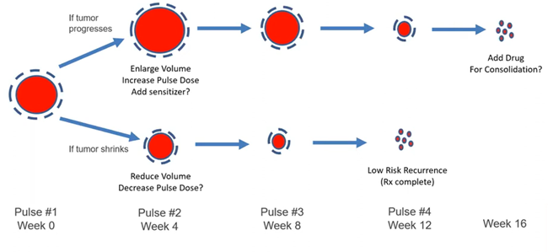
PULSAR: Personalised ultrafractionated stereotactic adaptative RT
PULSAR aims to deliver tumoricidal doses in a pulsed mode with long intervals (for a period of weeks or months).
Three advantages of PULSAR
Split course treatments are less toxic
Long intervals between pulses facilitate adaptation
Long intervals between pulses may foster adaptative immunity
Notes:
Traditional fractionated radiotherapy upholds two fundamental principles: daily fractionation and fixed treatment duration. These two principles leverage the disparities in radiobiological behaviors between malignant tumors and healthy tissues, striking a delicate equilibrium between tumor re-sensitization, regrowth, reoxygenation, resistance development, and the benefits of normal tissue repair
Extended intervals: substantial recovery of normal tissues and afford the tumor and tumor microenvironment ample time to undergo significant changes.
PULSAR provides the flexibility to adapt to the evolving characteristics of tumor, encompassing changes in size, shape, and biomarker expression.

Slide 38
Radiotherapy: a paradigm shift in the 21th century
PULSAR
FLASH
“Pulsed” radiobiology

Slide 39
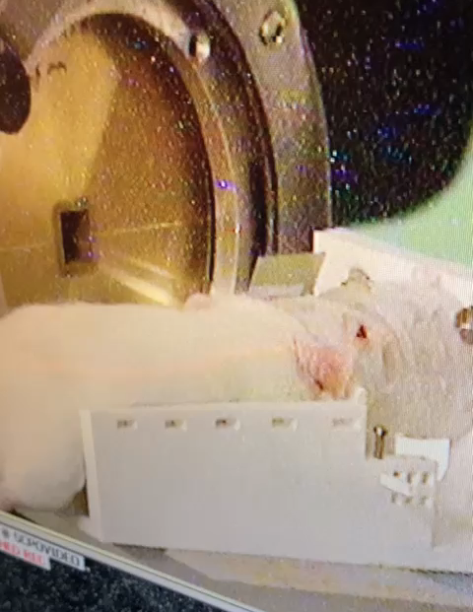
FLASH radiation therapy (FLASH-RT)
Ultra-fast delivery of radiation
> 40 Gy/s
High dose given in milliseconds
Protective effect in healthy tissue: FLASH effect
Neurocognitive sparing of memory Montay-Gruel 2017
Reduction in pulmonary fibrosis Favaudon 2014
Skin, intestine, muscle Diffenderfer 2020 & Cunningham 2021 & Tinganelli 2022
R. Ortiz (NARA)

Slide 40
Proton FLASH (pFLASH)
Skin | Gut | Brain | Heart
PBS FLASH reduced skin and soft tissue toxicities (Cunningham et al., 2021) pFLASH reduced skin toxicities, PBS pFLASH reduced acute and late skin toxicities, similar tumor control (Sorensen et al., 2022) Single-dose pFLASH reduced skin toxicities, fractionation abrogated FLASH effect in the skin (Sorensen et al., 2022) Single dose PBS pFLASH reduced skin toxicities, fractionation compromised FLASH sparing effect (Mascia et al., 2023) SOBP pFLASH reduced acute and late skin toxicities (Kristensen et al., 2024) pFLASH reduced ear thickness and inflammation at 33 Gy (Rudigkeit et al., 2024) pFLASH reduced skin toxicities (Zhang et al., 2024) pFLASH reduced skin toxicities, stem cell depletion, inflammation, and late toxicities (Velalopoulou et al., 2024) | pFLASH decreased acute and late toxicities (Diffenderfer et al., 2020) Entrance and SOBP pFLASH preserved crypts, similar tumor control (Kim et al., 2021) Partial abdominal pFLASH did not spare intestinal tissue (Zhang et al., 2023) pFLASH reduced acute and late abdominal toxicities, through IFN-I signaling (Lim et al., 2024) Increased acute lethality, no tissue sparing effect (Bell et al., 2024) | 5 Gy pFLASH reduced impairment of cognitive function in neonatal rats (Williams et al., 2022) pFLASH spares memory and induces similar neuroinflammation and tumor infiltration by lymphocytes (Iturri et al., 2022) pFLASH reduced neurotoxicities, spared memory, increased lymphocyte tumor infiltration Oxygen supplementation in anesthesia gas abrogated FLASH sparing effect but did not affect immune cell tumor infiltration (Iturri, Bertho, et al., 2023) | pFLASH reduced inflammation, decreased fibrosis, and preserved cardiac function (Kim et al. 2024)
Notes:
Studies on pFLASH were conducted in the skin, the gut, the brain and the heart. Most of the studies succeed in demonstrating the pFLASH-sparing effect in these healthy tissues. However, some studies failed to generate a sparing effect with protons in the skin and gut. Globally, similar results were observed in eFLASH.
And, similarly to what has been observed with electron FLASH, the FLASH-sparing effect was also abrogated when the anesthesia gas was supplemented with oxygen.

Slide 41



BUT negative results on FLASH as well…

Slide 42


Slide 43


Slide 44


Slide 45



Pulsed radiobiology: new untested regimes in the femtochemistry domain

Slide 46
Radiation beyond clonogenic cell death and DNA damage
Influence factors
Oxygenation
Patient genetics
Patient health condition
Microbiome
Etc.
Irradiation mode

Slide 47


Slide 48


Slide 49


Slide 50



Laser Hybrid Accelerator for radiobiology applications
G. Aymar et al. Frontiers in Physics
Notes:
Nanorain

Slide 51


Slide 52


Slide 53

New Approaches in Radiotherapy team
CIMUS

Slide 54

Thank you very much for your attention!
yolanda.prezado@usc.es
54

