Slide 1
2026/09/17
Radon Control and Measurement at SNOLAB for Current and Next-Generation Rare-event Search Experiments
Dr Nasim Fatemighomi (she/her)
SNOLAB Research Scientist
Queen’s University adjunct Professor
Rutherford Appleton Laboratory, September 2026

Slide 2
Outline
Introduction
  Neutrinoless double beta decay and dark matter
  Sources of background
Why controlling radon is important
Techniques applied to measure radon ex-situ at SNOLAB
Radon removal techniques
Techniques to create low radon environment
Summary
Notes:
Outline:

Slide 3
Introduction

Slide 4


Universe looks like this
… and not like this
https://webbtelescope.org/news/first-images/gallery
Notes:
The Big bang should have created equal amount of matter and anti-matter in the universe so why in today’s Universe there is a more matter than anti-matter in the universe. In other words why our universe likes this? Made of galaxies, stars, planetns and life which all made of matter, rather than the matter and antimatters from big bang annihilate each each other and create and empty Universe? So what is the physics mechanism behind matter anti-matter symmetry?

Slide 5
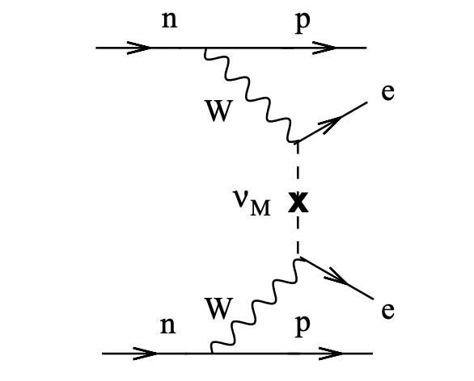
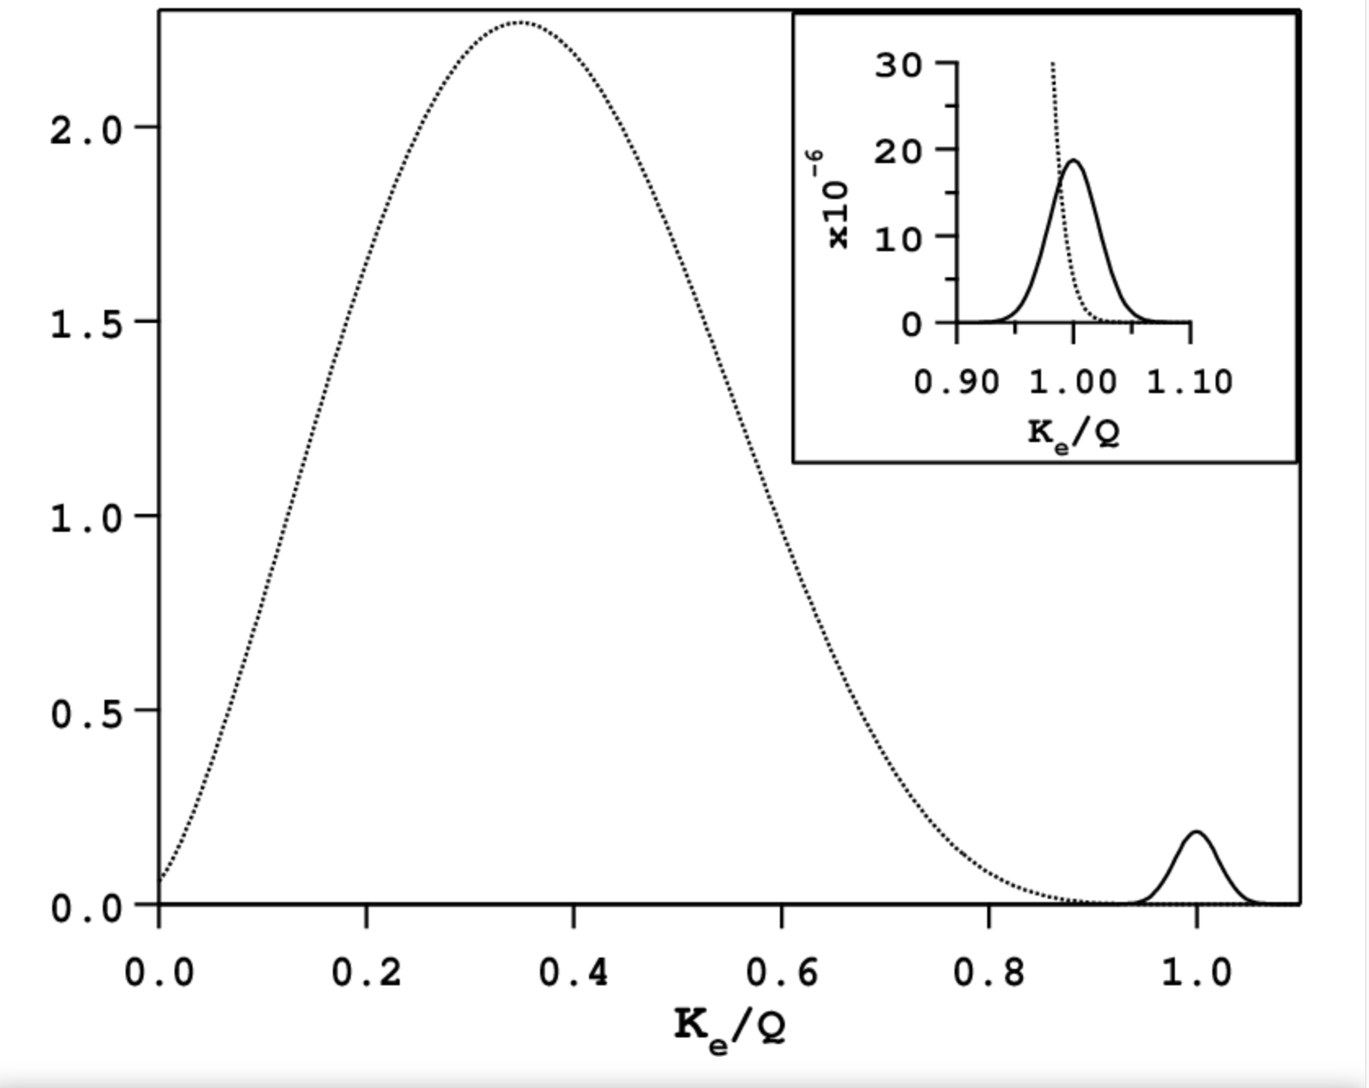
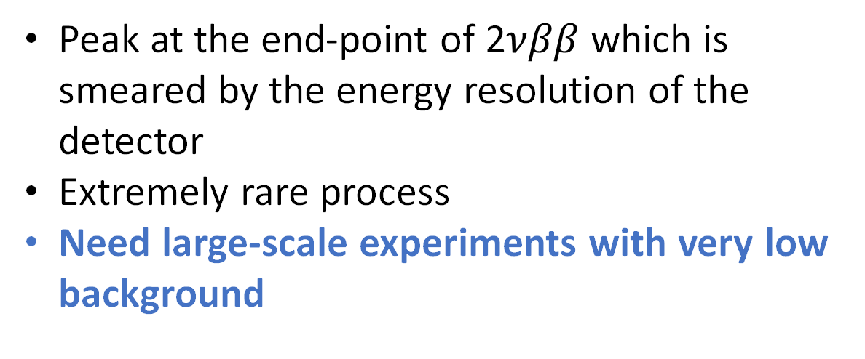
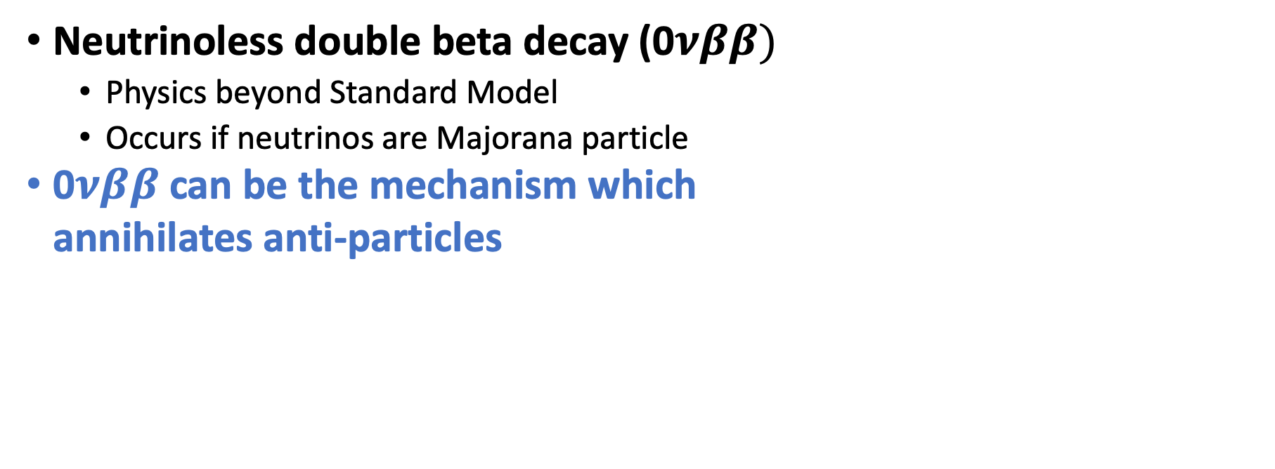
Can Neutrino-less Double Beta Decay (0$νββ)$be the answer?
Neutrinoless double beta decay (0$νββ)$
  Physics beyond Standard Model
  Occurs if neutrinos are Majorana particle
0$νββ$can be the mechanism which
annihilates anti-particles
Peak at the end-point of 2$νββ$ which is smeared by the energy resolution of the detector
Extremely rare process
Need large-scale experiments with very low background

Slide 6
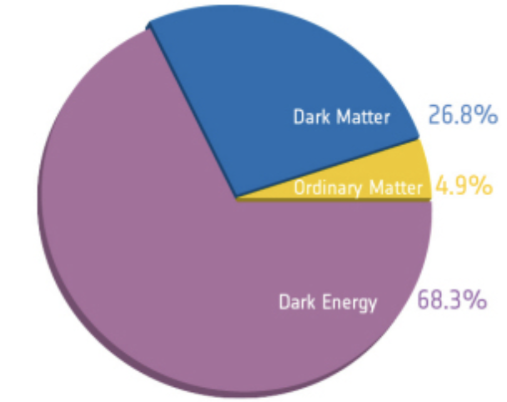
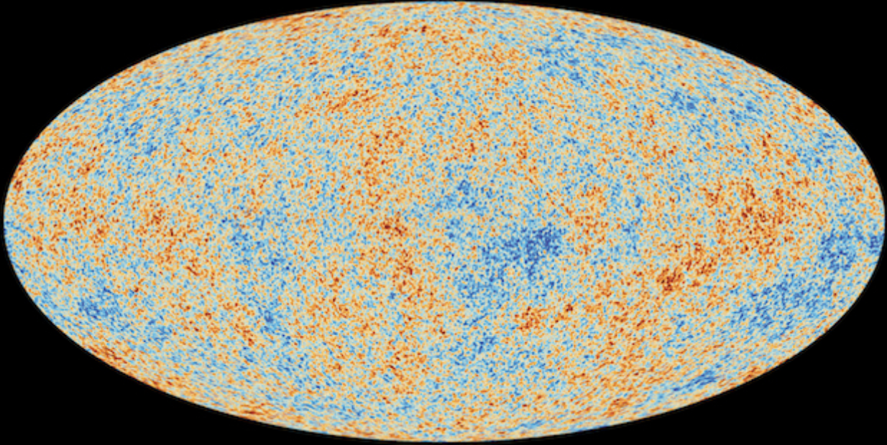
Evidence of Dark Matter (CMB)
CMB data most convincing evidence of dark matter
Look at the tiny variation of temperature of the universe 400000 years after the Big Bang
Can precisely calculate what
the Universe is composed of
GeV to TeV scale dark matter particles are predicted in several beyond standard model theories

Slide 7
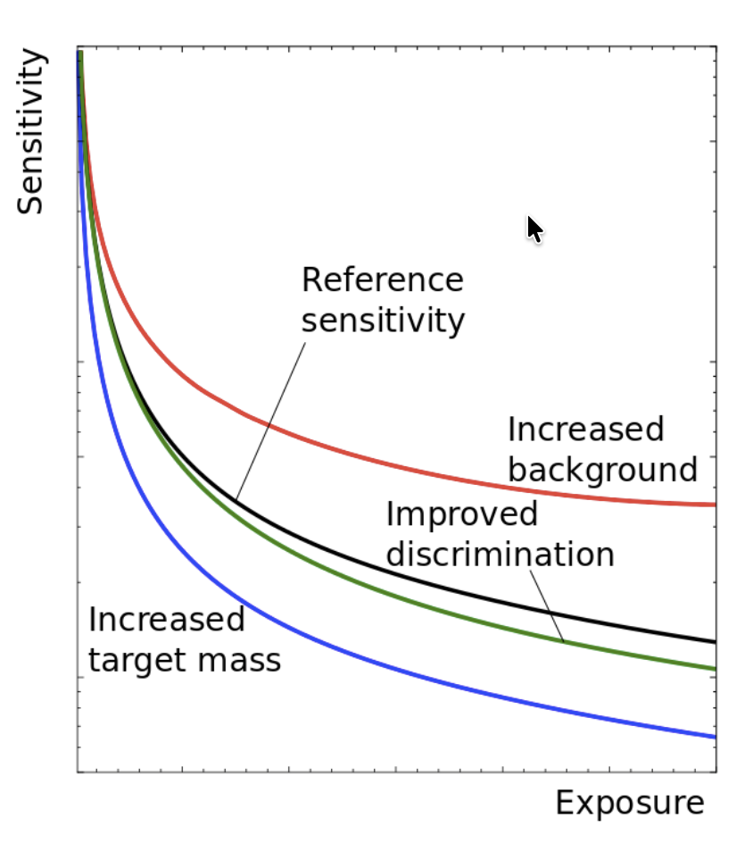
Effect of background
An Dark Matter Experiment
In a low background experiment,
higher exposure gives
better cross section sensitivity
A detector with an order of magnitude higher background, reaches its maximum sensitivity sooner
Longer measurements do not improve the sensitivity
Next generation of xenon and argon experiments aim for 1 event or less in 10 years!
https://ar5iv.labs.arxiv.org/html/1509.08767

Slide 8
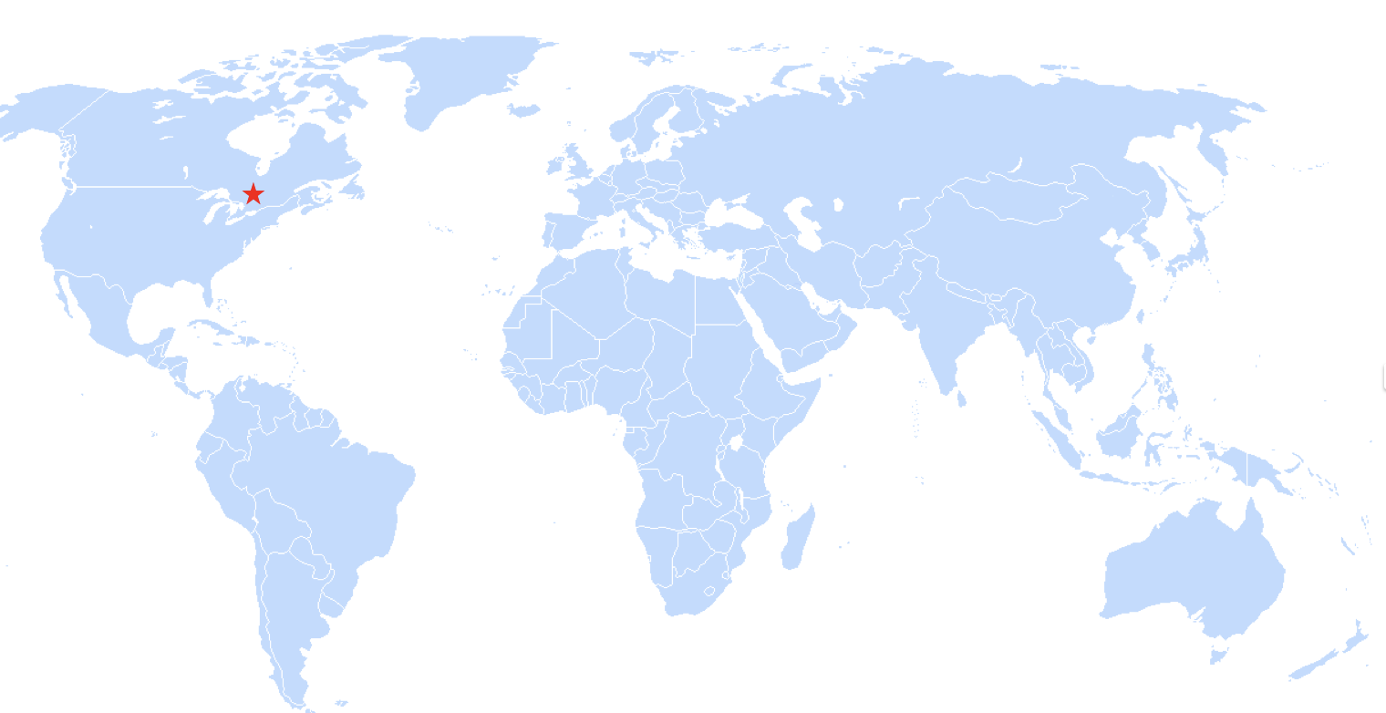
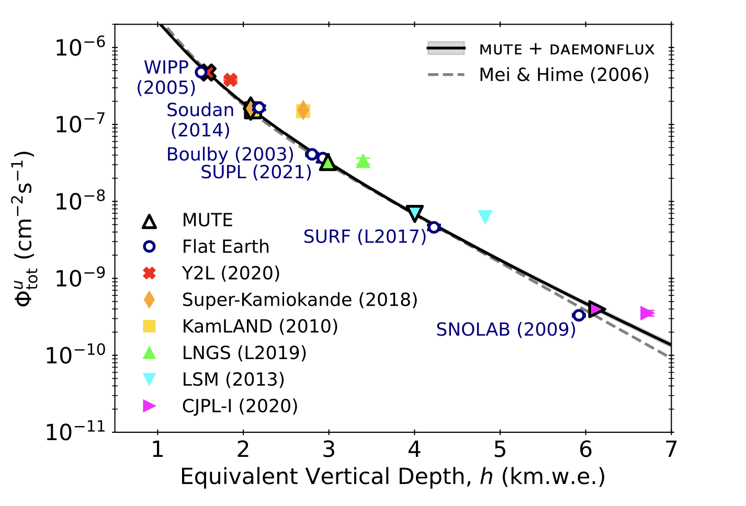
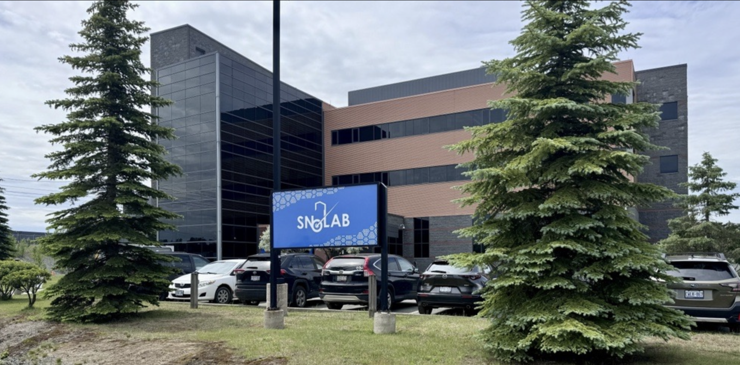
SNOLAB Underground Facility
SNOLAB hosts neutrino and dark matter experiments
Located 2 km underground in the active Vale Creighton nickel near Sudbury, Ontario, Canada
arXiv:2406.10339

Slide 9
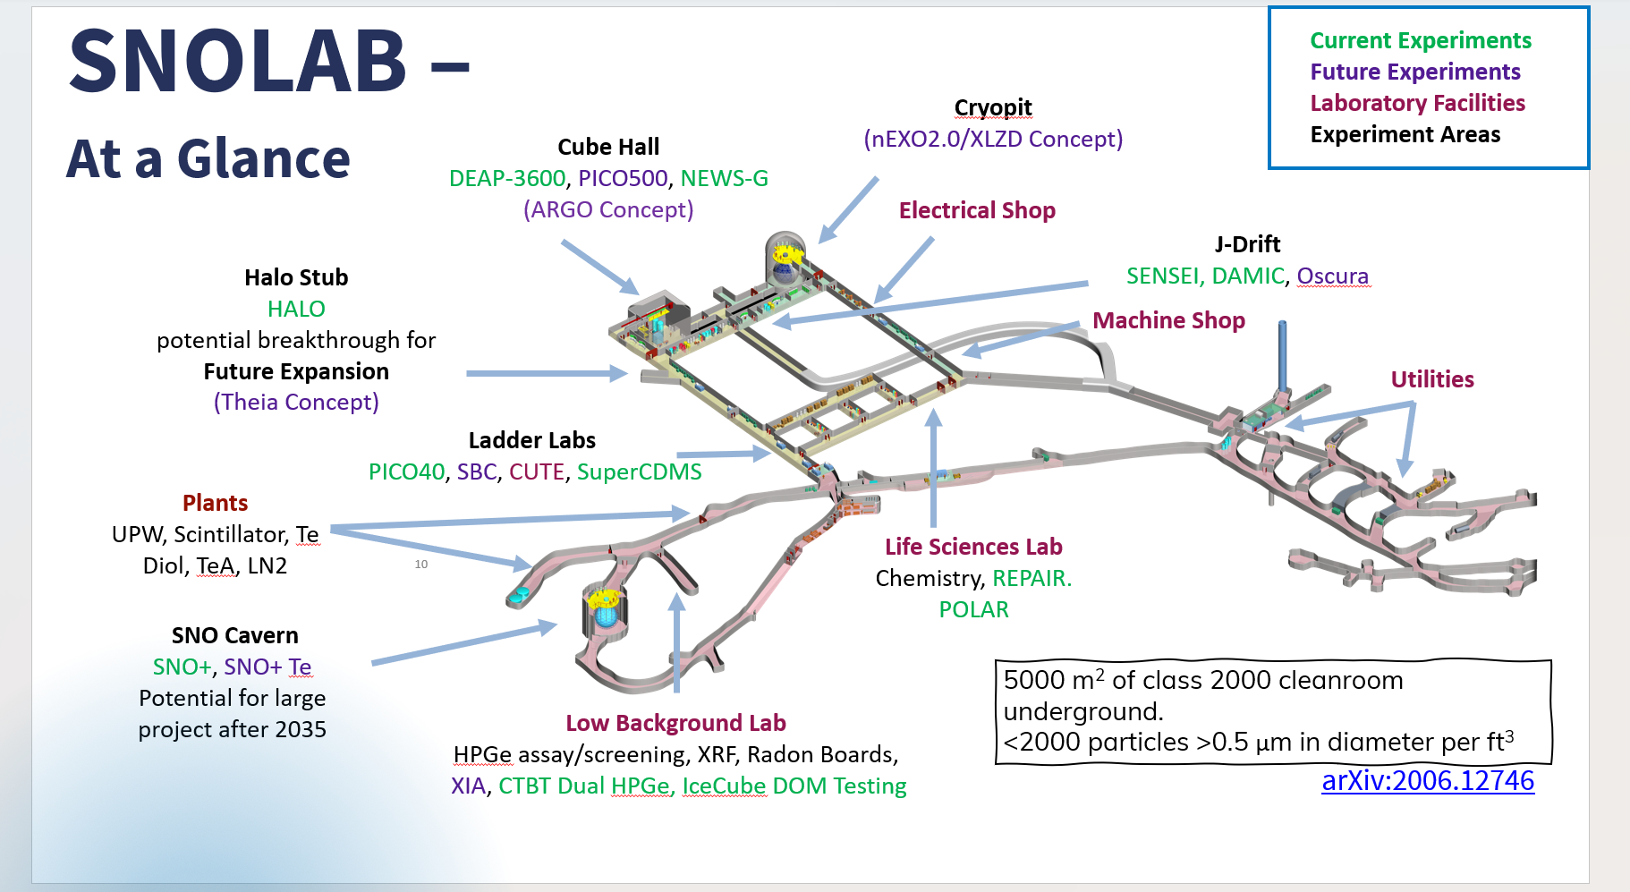
Notes:
Merge slide 4 and 5

Slide 10
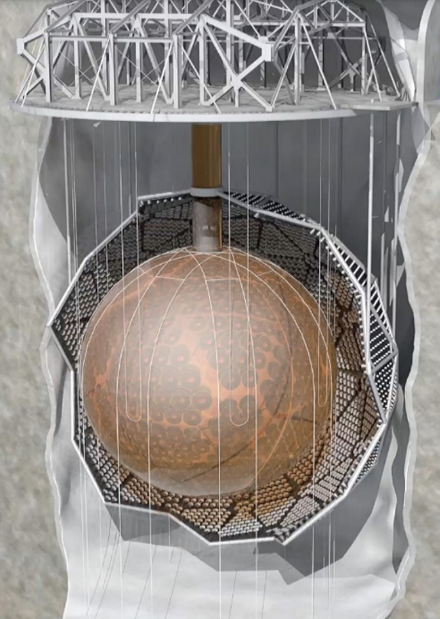
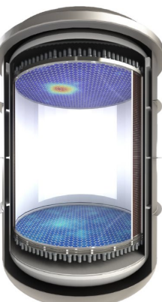
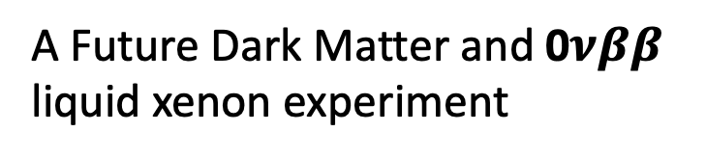
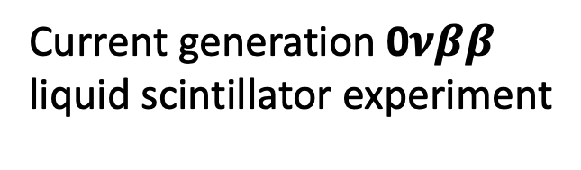
Example of Large-Scale Detectors
SNO+
XLZD (SNOLAB or Boulby?)
~ 3 m
12 m
Current generation 0$νββ$
liquid scintillator experiment
A Future Dark Matter and 0$νββ$
liquid xenon experiment

Slide 11
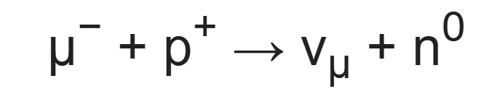
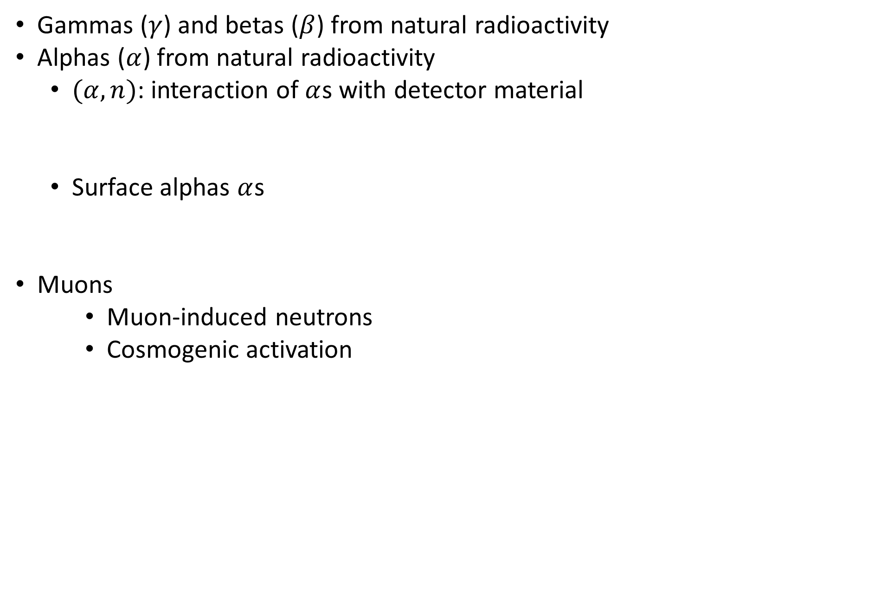




Background sources
Gammas ($γ$) and betas ($β$) from natural radioactivity
Alphas ($α$) from natural radioactivity
  $(α, n)$: interaction of $α$s with detector material
  Surface alphas $α$s
Muons
    Muon-induced neutrons
    Cosmogenic activation
¹³C
$$n$$
$$α$$
Detector Medium
Detector Wall
¹⁶O
$$α$$
$$α$$
Notes:
For these experiments to be successful, they need to control and mitigate background , these are gamma and betas from natural radioactivity, alphas from natural radioactivity which can create neutrions by interacting with detector material. Can create surface alpha background which can have similar recoil energy as a dark matter candidate. Or muons. The focus of my talk today is radon induced background which can create gamma and betas from natural radioactivity and alphas from natural radioactivity.

Slide 13
Long-lived isotope:
²²⁶Ra, ²²²Rn and short-lived progeny
Longer-lived ²²²Rn progeny

Slide 14
Long-lived isotope:
²²⁶Ra, ²²²Rn and short-lived progeny
Longer-lived ²²²Rn progeny
Complex processing can cause radioactive disequilibrium
Must study each sub-chain separately

Slide 15
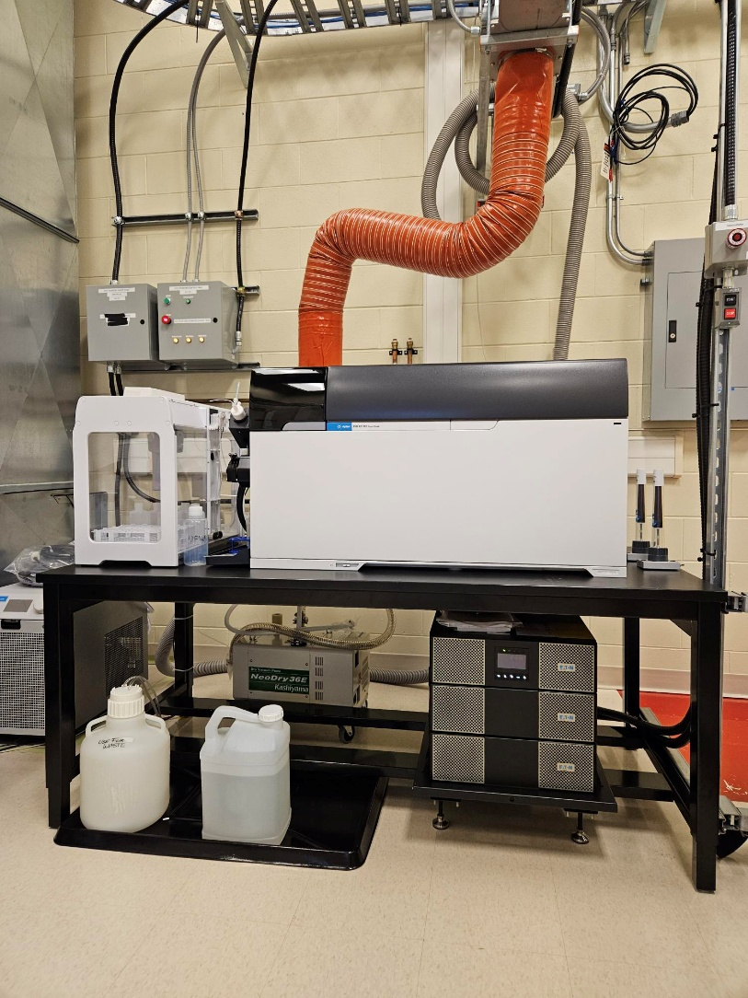
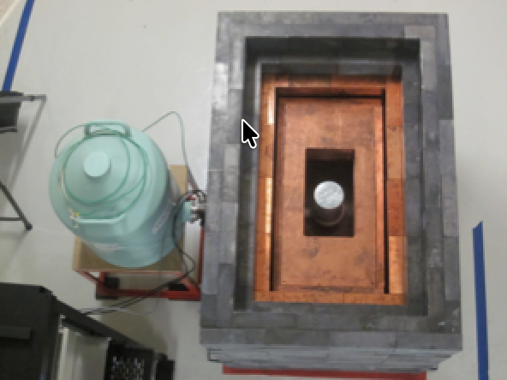
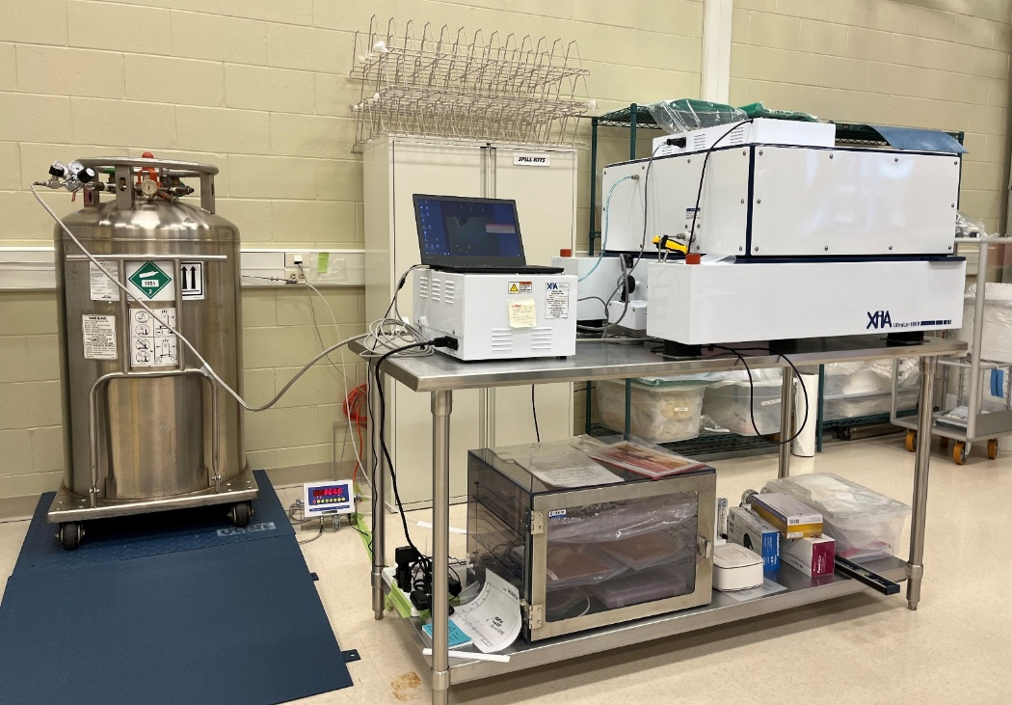
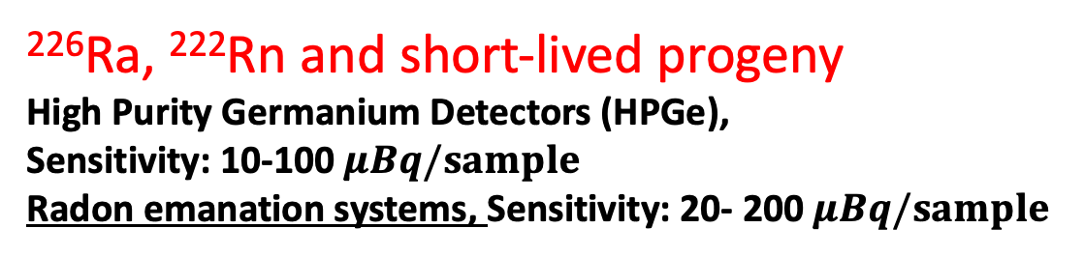
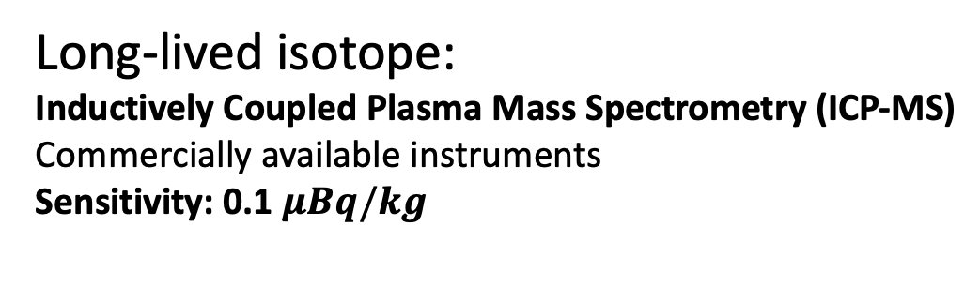
Long-lived isotope:
Inductively Coupled Plasma Mass Spectrometry (ICP-MS)
Commercially available instruments
Sensitivity: 0.1 $μBq/kg$
²²⁶Ra, ²²²Rn and short-lived progeny
High Purity Germanium Detectors (HPGe),
Sensitivity: 10-100 $μBq/sample$
Radon emanation systems, Sensitivity: 20- 200 $μBq/sample$
ICP-MS at SNOLAB
Longer-lived ²²²Rn progeny
Alpha spectroscopy – such as XIA UltraLo-1800 alpha counter
Sensitivity: ~ 1 mBq/kg
A VdA HPGe detector at SNOLAB
XIA UltraLo-1800 at SNOLAB

Slide 16
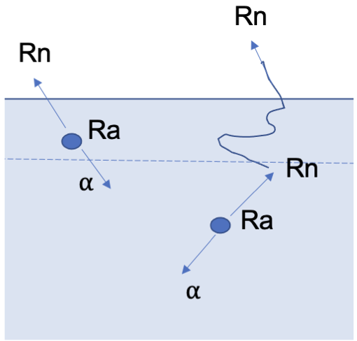
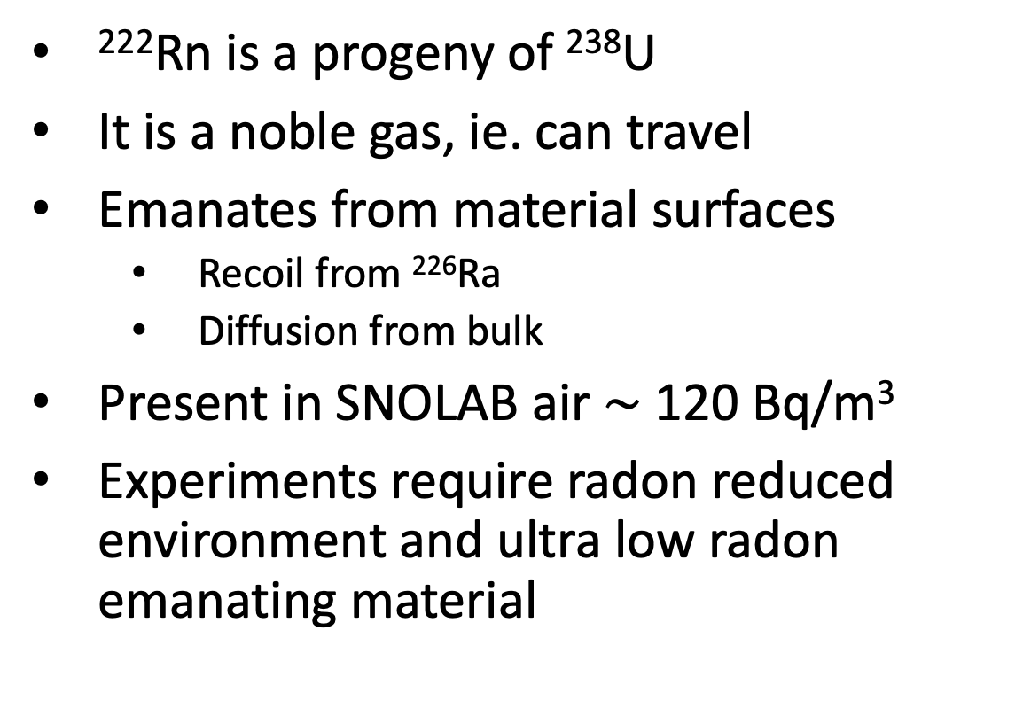
Radon Emanation Measurement
²²²Rn is a progeny of ²³⁸U
It is a noble gas, ie. can travel
Emanates from material surfaces
  Recoil from ²²⁶Ra
  Diffusion from bulk
Present in SNOLAB air $\sim$ 120 Bq/m³
Experiments require radon reduced environment and ultra low radon emanating material

Slide 17
Mitigation strategy
Strict material selection by performing radon emanation measurements
Regular monitoring of Rn levels
Rn removal from liquid and gas
Controlling radon ingress in the detector
Preventing surface contamination
Cleaning and removal of surfaces to remove ²¹⁰Pb

Slide 18
Radon Assay Systems at SNOLAB

Slide 19
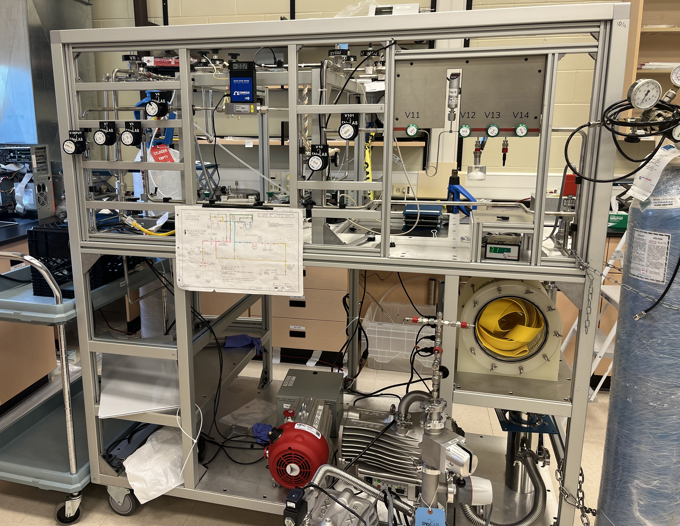
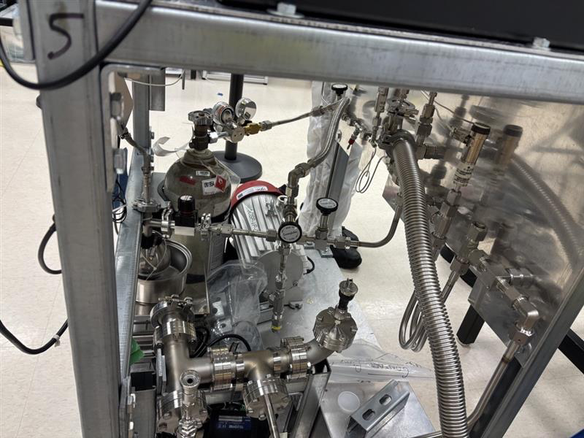
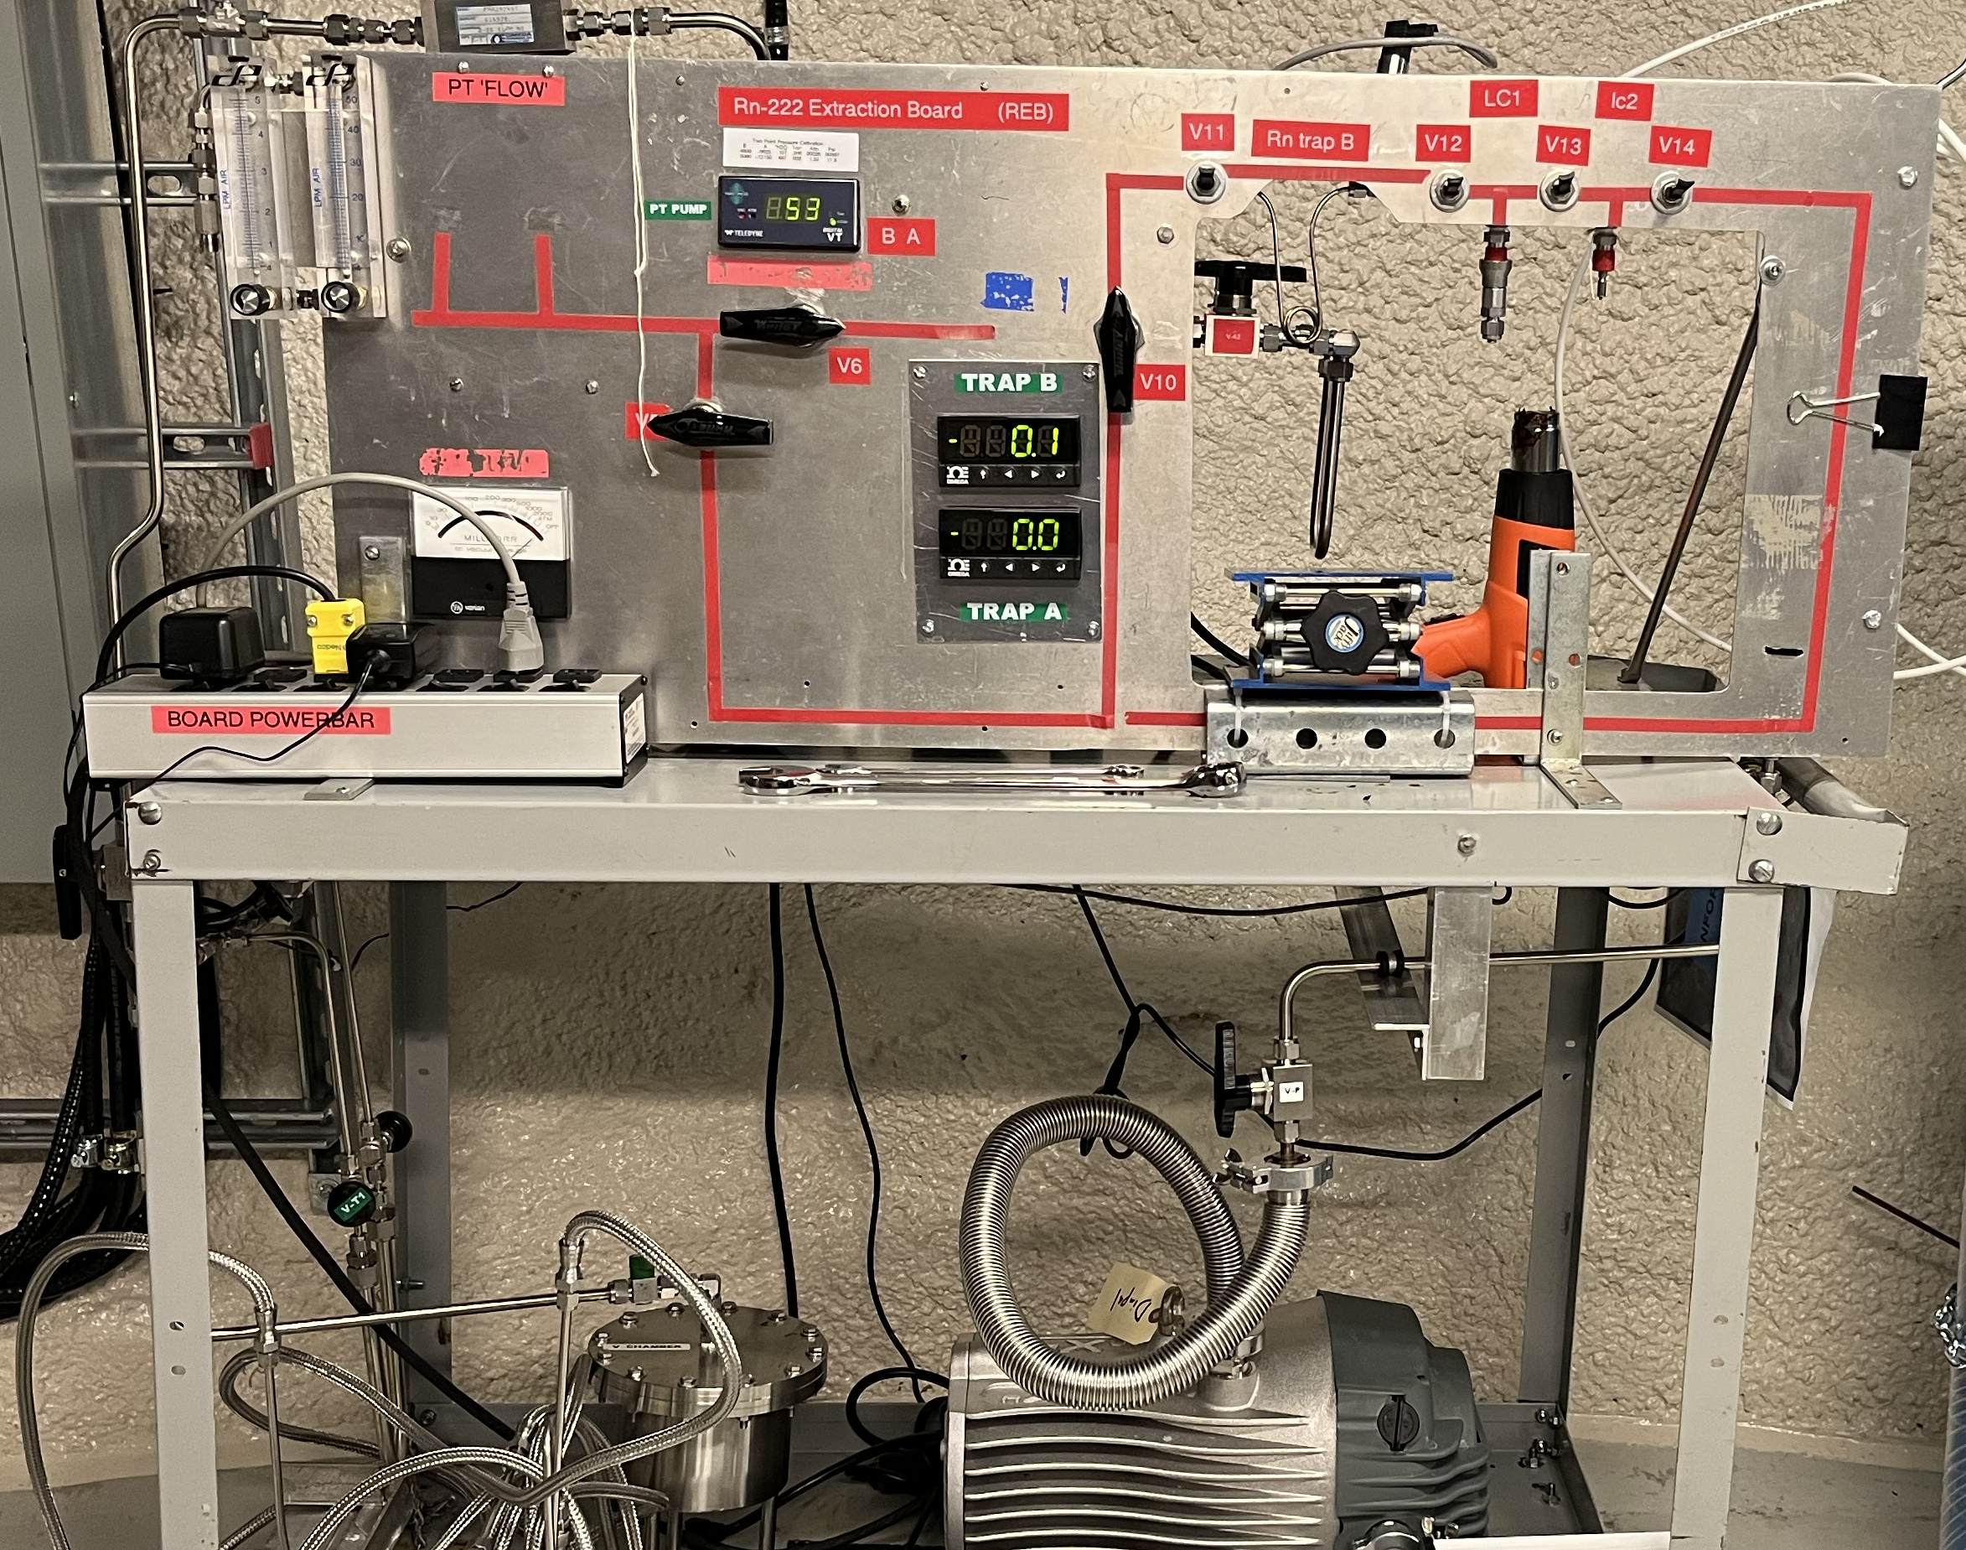
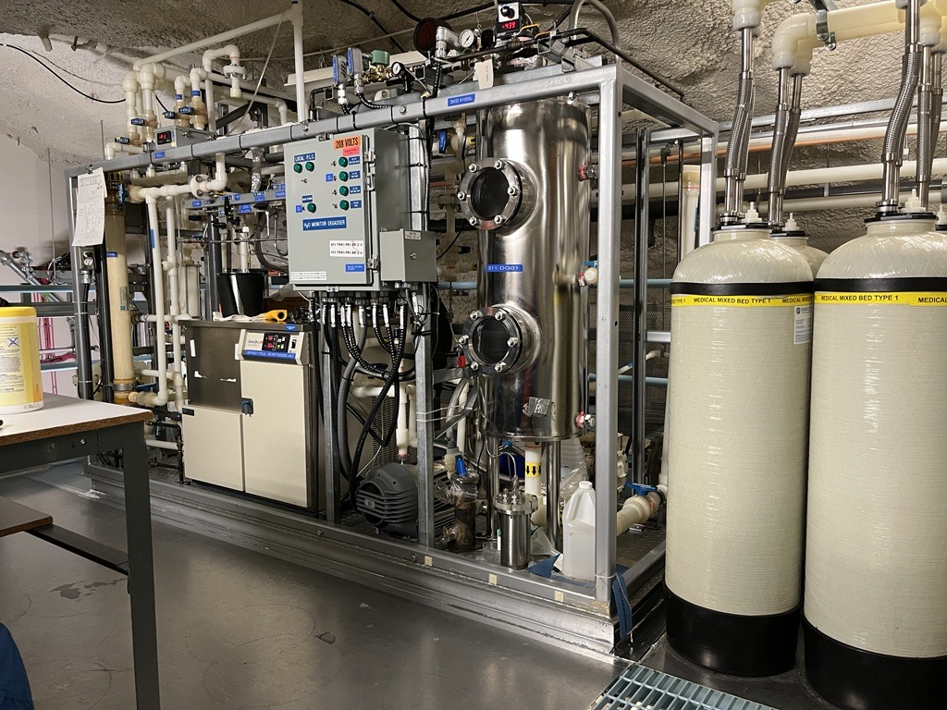
Radon Assay
²²²Rn assay refers to the measurement of emanation rate from a material surface and ²²²Rn concentration in gas or water samples.

Slide 20
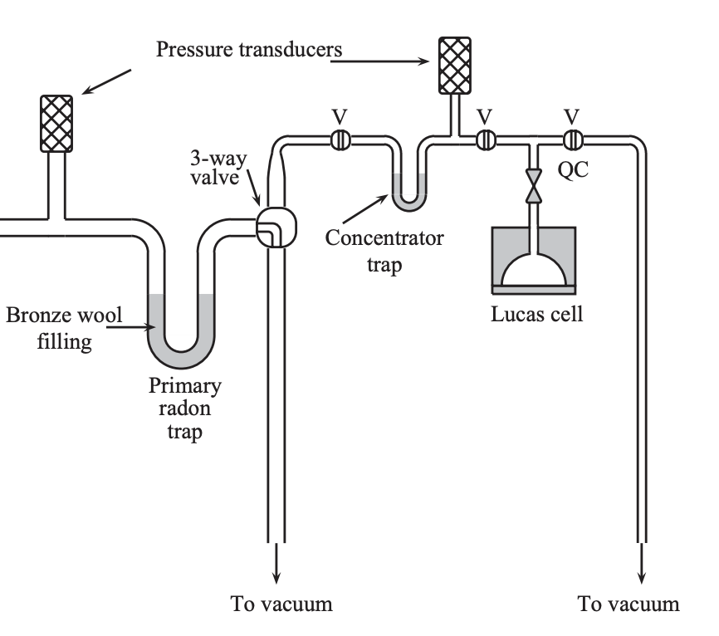
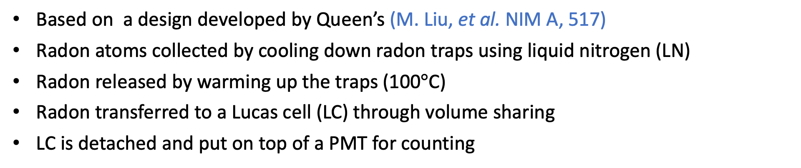
Radon Trapping Technique
Based on a design developed by Queen’s (M. Liu, et al. NIM A, 517)
Radon atoms collected by cooling down radon traps using liquid nitrogen (LN)
Radon released by warming up the traps (100$°$C)
Radon transferred to a Lucas cell (LC) through volume sharing
LC is detached and put on top of a PMT for counting
Emanation Chamber
(under vacuum)
Notes:
Bigger figures, remove white space, make the text more readable

Slide 21
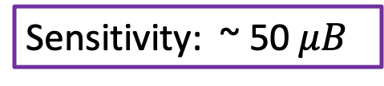
SNOLAB Radon Emanation System
Sensitivity: ~ 50 $μB$
Emanation
Chamber
Vacuum Pump
Plan to increase the emanation chambers
Notes:
Make the picture bigger, cover the whole slide, and put the information in text boxes ,

Slide 22
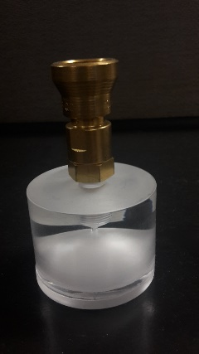
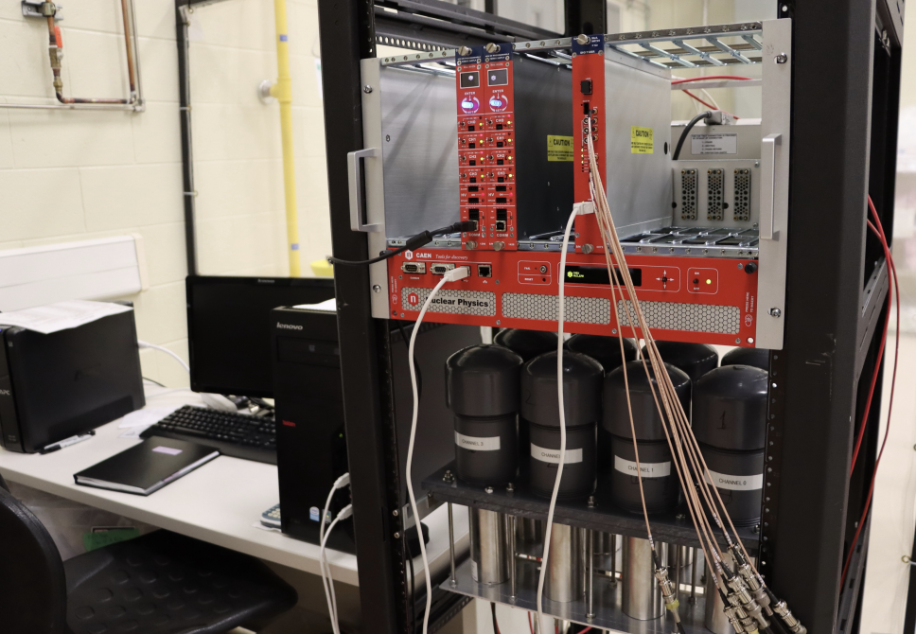
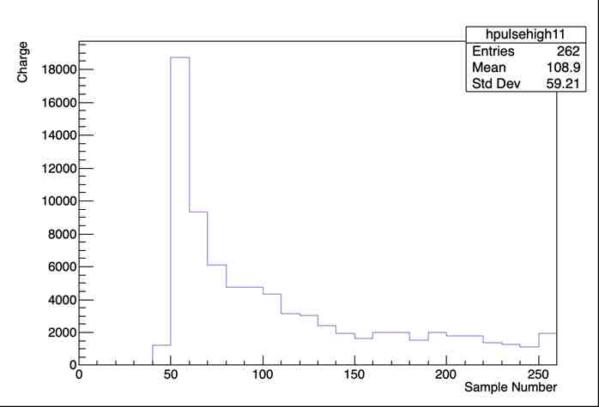
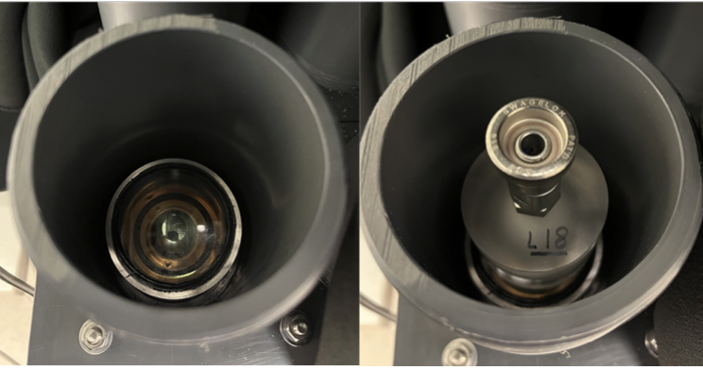
LC Counting System
Portable Lucas cells (LCs) with ZnS(Ag) coating
ZnS(Ag) scintillates with α particles → ideal for radon detection
Sixteen LC channels available
2” diameter
2” diameter PMTs and CAEN electronics
4 μs window
Notes:
Justify why LC compare to other type of like electorstatic chamber, cheap to produce, if you want to count 16 assays at the time you need to make 16 electrostatic chamber.. Which makes it expensive. I think this type of detector is unique to SNOLAB and while we should investigate other type of technology, high efficiency compare with electrostic chambers… I think we should push impoving this as well… talk about justin , keegan etc work … less sensitive to moisture and other impurities compare to electrostic and proportional counters. Less affected by noise during radon correction.

Slide 23
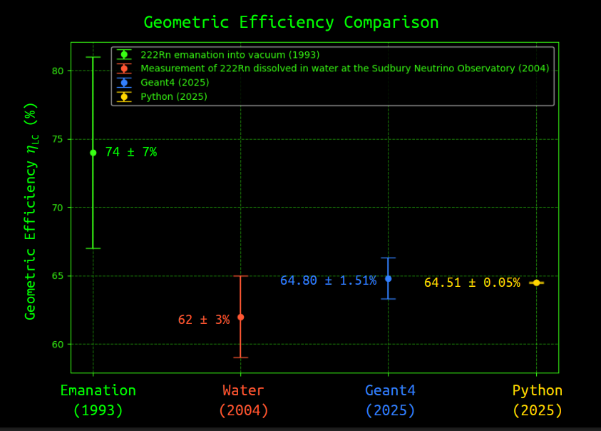
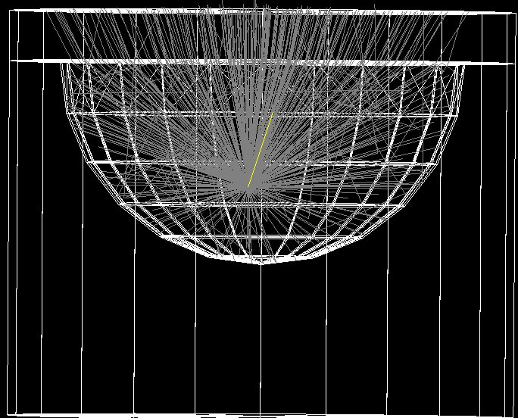
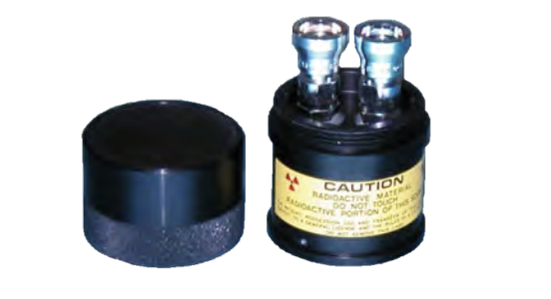
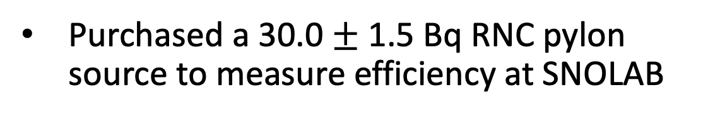
LC Efficiency
  I. Blevis, et al. NIM A, 517
GEANT4 simulation
SNOLAB
recent simulation
(Preliminary)
  M. Liu, et al. NIM A, 329
Courtesy of J. Suys
Purchased a 30.0 $±$ 1.5 Bq RNC pylon source to measure efficiency at SNOLAB
Notes:
Put Justin’s plot here, how to make the error in data smaller.
Tension between the two measurment

Slide 24
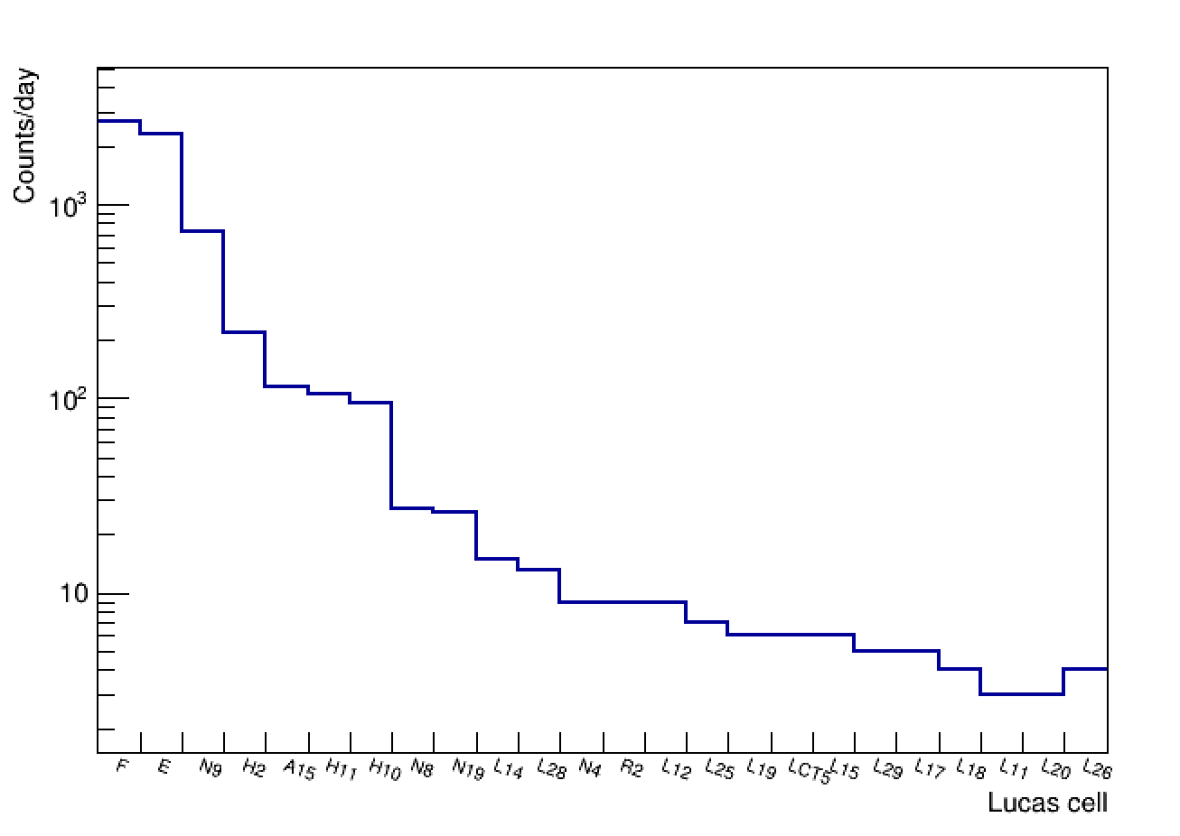
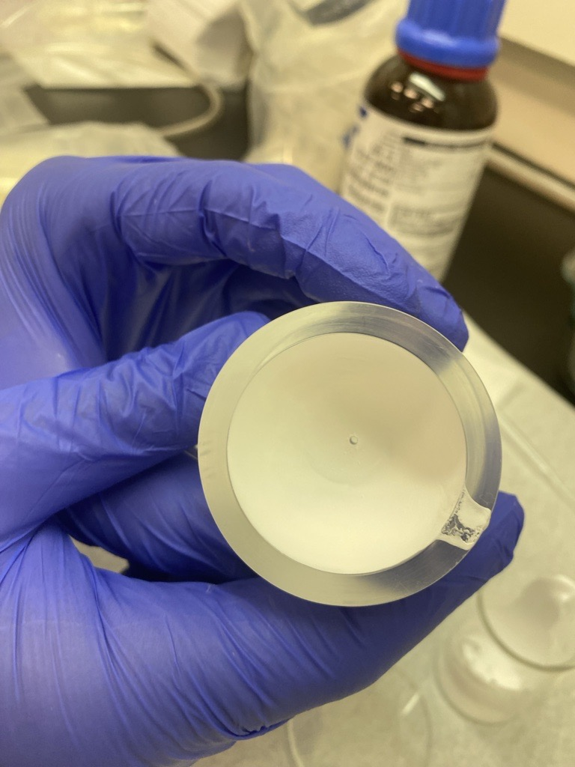
LC Background
New LCs have background of 3 to 5 alpha counts day
LC ²¹⁰Po background increases with ²¹⁰Pb build up
The background is from ZnS(Ag)
Every few years we make new LCs
Increasing age
New LC made at SNOLAB
Coated with commercial ZnS(Ag)
Notes:
Background cells build over time
Reduce the background, think about conclusion, ages

Slide 25
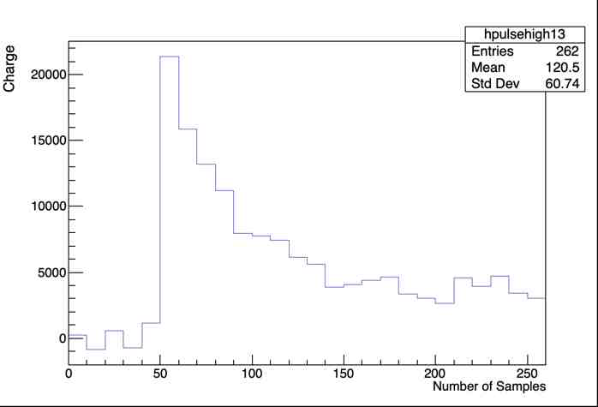
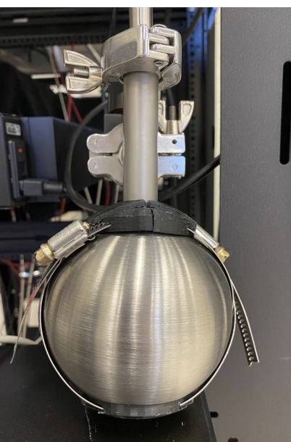
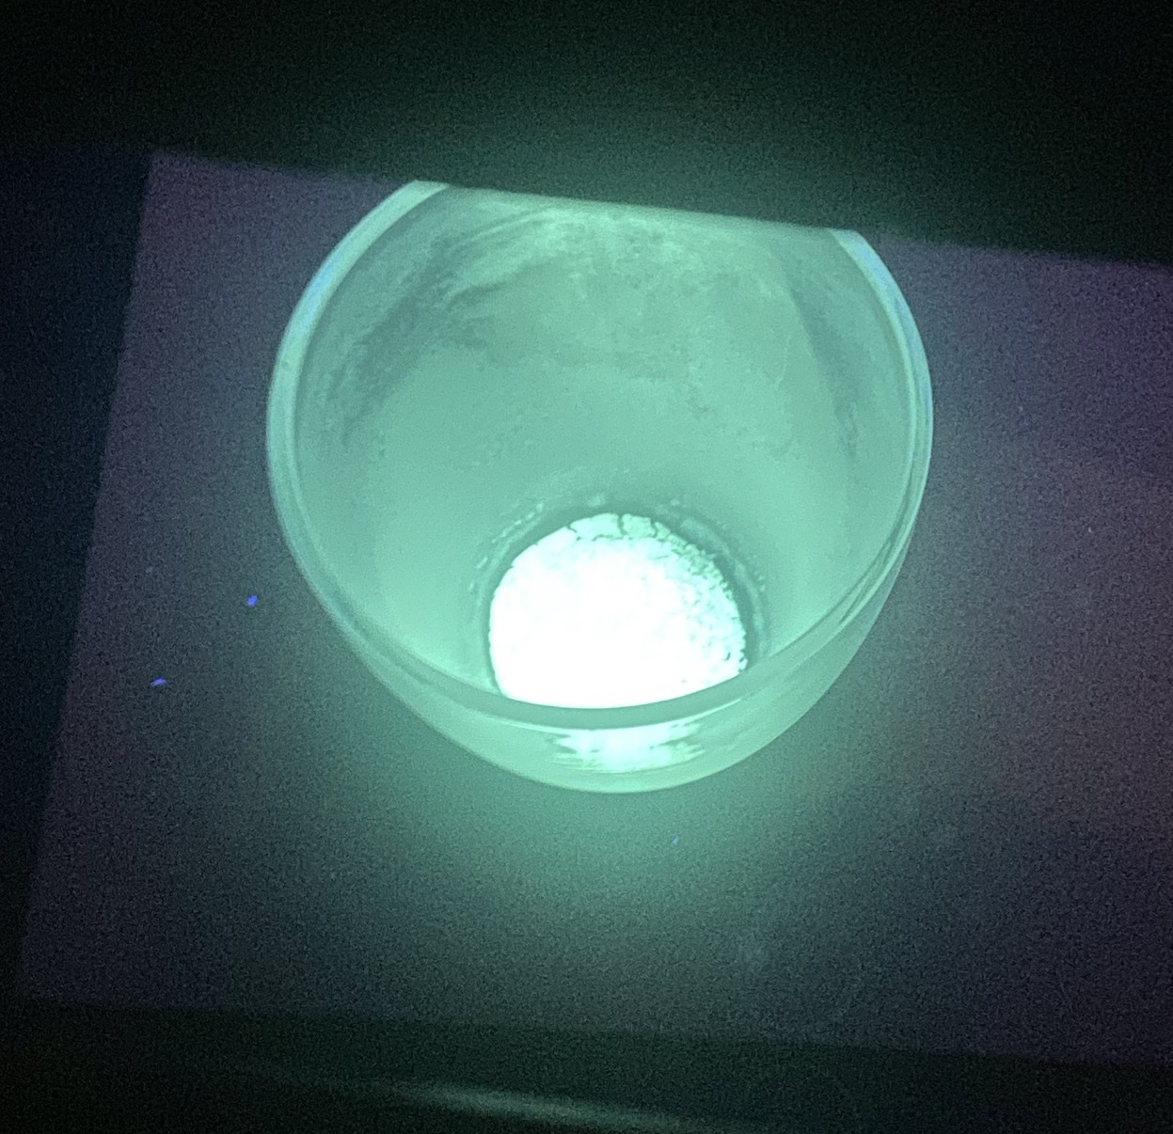
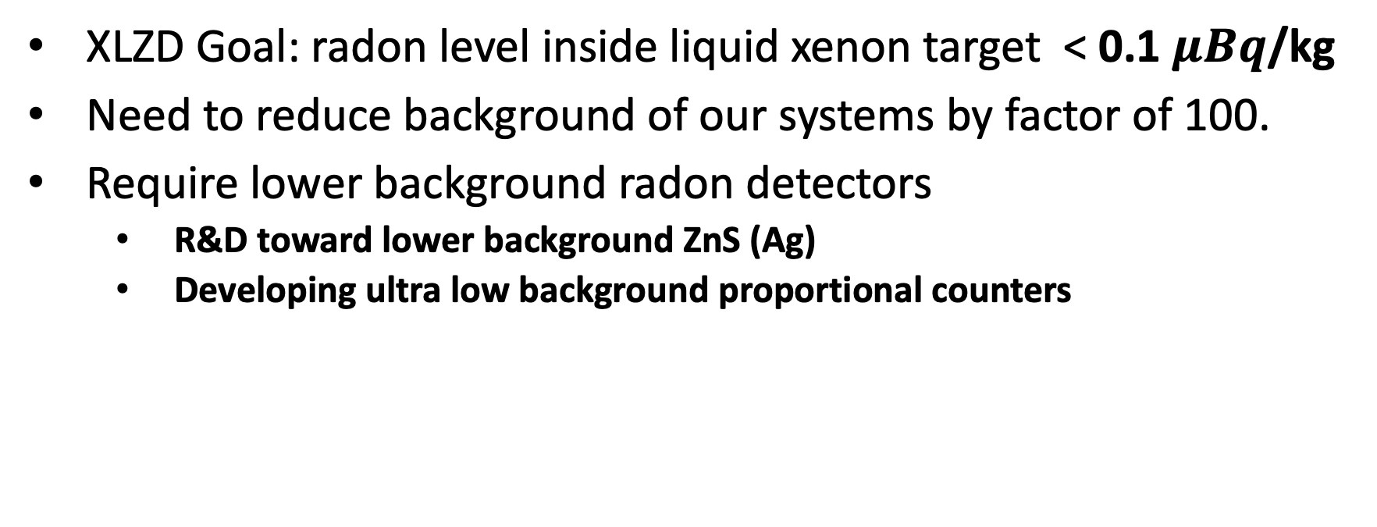
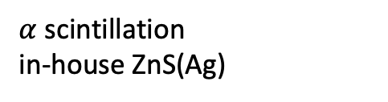
Ongoing Research and Development
XLZD Goal: radon level inside liquid xenon target < 0.1 $μBq$/kg
Need to reduce background of our systems by factor of 100.
Require lower background radon detectors
  R&D toward lower background ZnS (Ag)
  Developing ultra low background proportional counters
Spherical Proportional
Counter (a la NEWs-G)
In-house ZnS(Ag)
$α$ scintillation
in-house ZnS(Ag)

Slide 26
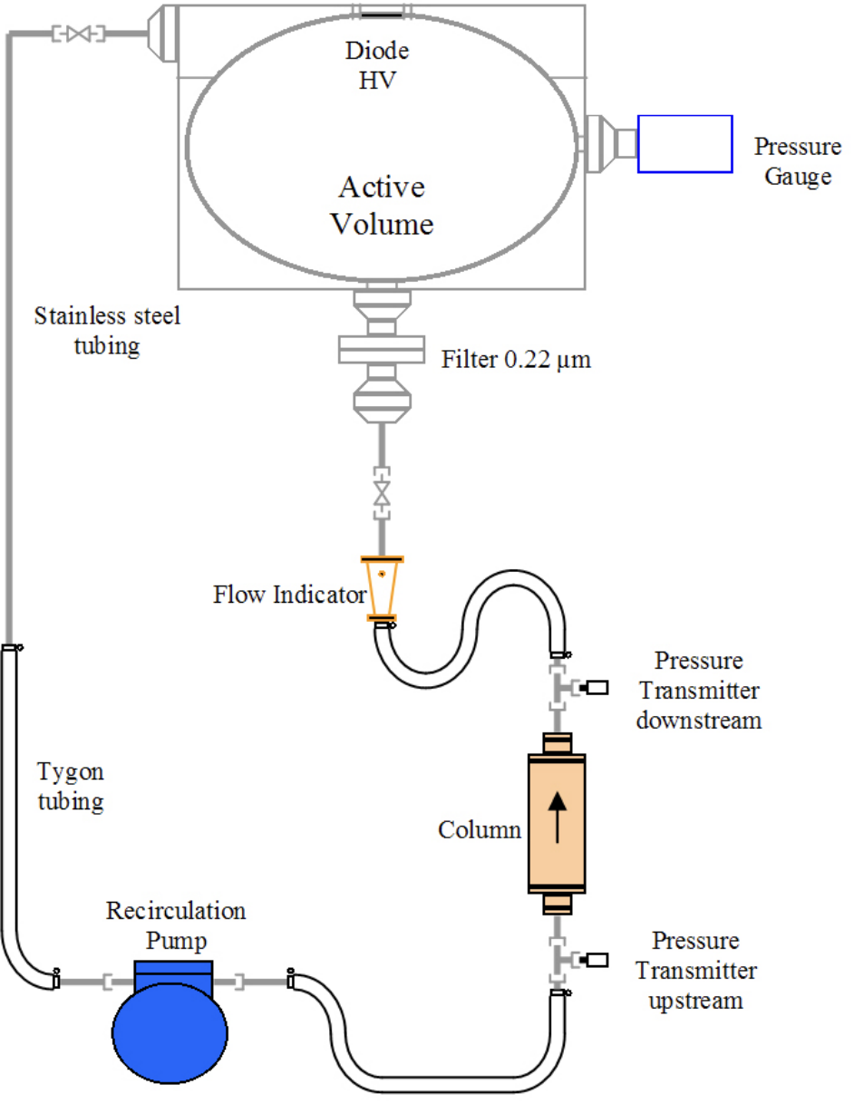
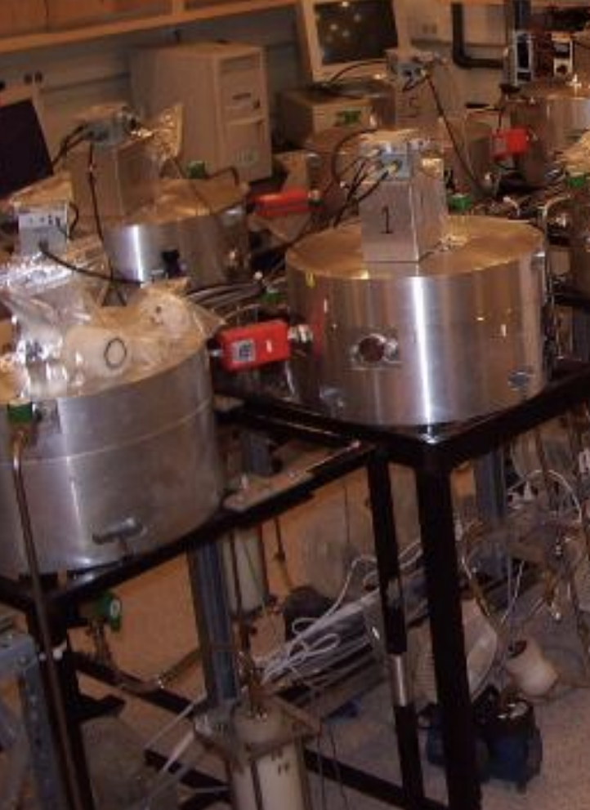
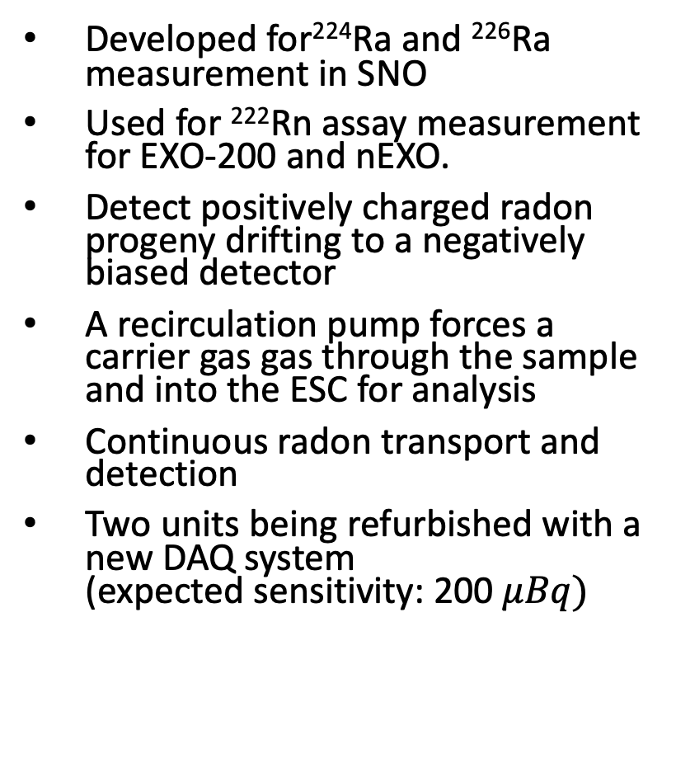
Recirculation Technique using Electrostatic Chambers
Developed for²²⁴Ra and ²²⁶Ra measurement in SNO
Used for ²²²Rn assay measurement for EXO-200 and nEXO.
Detect positively charged radon progeny drifting to a negatively biased detector
A recirculation pump forces a carrier gas gas through the sample and into the ESC for analysis
Continuous radon transport and detection
Two units being refurbished with a new DAQ system
(expected sensitivity: 200 $μBq)$

Slide 27
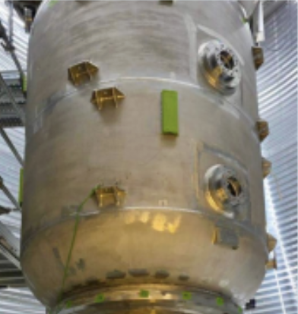

Measurement of radon concentration in gas
N₂ is widely used as a cover gas to prevent Rn ingress in the detector
For large-volume systems, N₂ is used as a carrier gas to sweep out emanated Rn
SNO+ Cover Gas System
PICO-500 Dark Matter Experiment Steel Shell

Slide 28


The UG Mobile System
Designed for vacuum radon emanation measurement
Was adopted to perform N₂ gas assays
Cover Gas system
filled with N₂
vapor trap
Notes:
. The commercial trap contained a helically wound titanium coil filled with a coolant called R290/R1150 (a blend of propane and ethylene) a

Slide 29



Primary Trap Limitation for Gas Assays
Radon traps use porous materials to enhance trapping
Bronze wool highly efficient under high vacuum
Gas assay efficiency decreases with longer duration or >1 SLPM flow
Limited extracted gas volume constrains sensitivity (> 3.3 mBq/m³)
Need for traps with more porous material
S.M.A. Hussain MSc thesis (2022)

Slide 30




Activated Charcoal Trap
Activated charcoal traps used for gas purification
  G. Heusser, et al. Appl. Radiat. Isot., 52 (2000)
Gas assays require both trapping & efficient radon release
Developed a portable activated charcoal trap to enhance radon trapping
  Nasim Fatemighomi et al: Nucl.Instrum.Meth.A 1076 (2025)
Used low background Calgon OVC 4 × 8 (coconut-based)
In-house nitric acid etching to remove ²³⁸U background
Radon emanation: 18$±$3 mBq/kg at room temperature
100μm
22 g trap

Slide 31



Trap Efficiency Test Set-up
N₂ flow through the source introduces radon atoms to trap
Charcoal cooled with LN₂–alcohol mix to trap radon
Radon released from charcoal trap by heating
Released radon were extracted using the radon board

Slide 32


Charcoal versus Bronze Traps
Unlike bronze wool trap, charcoal trap is 100% efficient after one hour of assay duration
The trap is also 100% efficient for flow rate of up to 5 SLPM
N₂ assay sensitivity $>$90$μ$Bq/m³
This sensitivity is sufficient for external systems at SNOLAB (need to reevaluate for XLZD)
Plan to develop lower background traps
The method developed to test this charcoal trap can be used to test other radon traps

Slide 33

Water Radon Assay System
Designed and built by the SNO collaboration (DOI: 10.1016/j.nima.2003.10.103)
Operated by SNOLAB and SNO+ to monitor ²²²Rn level of SNO+ cavity UPW
and SNOLAB UPW plant
For double beta decay physics knowing level of external ²¹⁴Bi is important
The SNO+ experiment
Degassser
Trap B
Water trap
Trap A
Water shielding
(7000 tonnes UPW)

Slide 34


Degasser
Water trap (-60 C)
Radon extraction board
H₂O from SNO+ cavity/UPW plant
(19 SLPM)
Water return to cavity

Slide 35



V203: Between Acrylic Vessel and PMTs
Results are consistent with SNO times
SNOLAB UPW plant radon level is ( 294$± 84$) Rn atoms/L

Slide 36
Radon Removal Techniques

Slide 37


Removal of Rn from liquid/gas
Cryogenic Distillation
Physical Adsorption
Condenser
Boiled-off
liquid/gas
Liquid/gas
Rn
Heater
Using Raoult’s law:
the concentration (Rn) in the gas
equals the vapor pressure times its mole fraction
Application: Liquid Xenon
Making a trap with
silver exchanged zeolite
Room temperature
Application: Liquid Argon, boil-off N₂
Making a cryogenic trap from activated charcoal
Application: Liquid Argon, boil-off N₂

Slide 38

Silver Exchanged Zeolite for Rn Removal
Demonstrates 10–100 times higher adsorption efficiency than activated charcoal at room temperature
Planned usage at SNOLAB radon removal from N₂ cover gas systems
Currently testing Ag-13X at room temperature at SNOLAB
Efficiency measurements of a radon trap is ongoing using surface board setup
Collaboration with Queen’s argon and xenon astroparticle group to develop a radon trap for argon and xenon systems
17 g adsorbent at room temperature
Nitrogen
S. Heinitz, et al. Nature: Sci Rep 13, 6811 (2023)
Notes:
Time that radon breakthrough the trap, ideal trap is lets everything through but radon

Slide 39

Silver Zeolite for Rn Removal (Argon-Xenon (?))
Rn breakthrough is longer when carrier gas is argon
No published data with Xe
  Maybe because zeolite also traps Xe?
Need to work with the company to see if we can optimize the material to not to trap Xe.
Xe experiments currently use distillation technique for radon removal.
17 g adsorbent at room temperature
S. Heinitz, et al. Nature: Sci Rep 13, 6811 (2023)

Slide 40
Controlling Radon Ingress in the Experiments

Slide 41

Radon Reduced air
arXiv:1708.08535
Can use columns of activated charcoal (or silver exchanged zeolite) to create a low radon concentration environment
SuperCDMS achieved <0.1 Bq/m³
Such systems will be needed for future large-scale projects

Slide 42


N₂ Cover Gas Systems
SNOLAB provides boil-off N₂ to experiments
by surface LN Dewar's, UG LN plant and N₂ bottles
SNOLAB UG LN plant Boil-off had radon level of $\sim 2$ mBq/m³
Can achieve lower concentration if we use a zeolite trap

Slide 43



SNO+ unique N₂ Cover Gas system
Designed and fabricated at Queen’s University
Sealed system which adjusts for pressure fluctuation (up to 9%) in the lab
Main components:
  Three flexible bags
  Failsafe (pressure relief system)
  Universal interface
Current activity $\sim$0.1 Bq/m³
Meets the requirements for double beta decay physics
For solar neutrino physics, radon levels can be further reduced using zeolite traps

Slide 44
Summary
SNOLAB’s rare-event experiments probe fundamental questions in particle physics
Controlling ²²²Rn-induced backgrounds is critical to achieving physics goals
SNOLAB continues to strengthen its radon mitigation program by:
  Building and operating low-background radon assay systems
  R&D toward making low background radon counting systems
  Developing advanced radon removal techniques
  Creating radon reduced environments with boil-off N₂
  Maintaining existing radon systems

Slide 45
Back up

Slide 46



Radon Calibration Source for Trap testing
A calibrating source was made using Nora Xp 5319
rubber floor tile
10cm
Fit is based on²²⁶Ra-supported emanation
and ²²²Rn outgassing from porous rubber tiles
14 x 10 cm² floor tiles
Calibration Can

Slide 47



Procedure and the current challenge
ZnS is made using a two-stage selective precipitation
To activate with Ag: add 100 ppm of Ag and recrystalise using NaCl/kCl as flux at temperature of 950$°$ C
In addition to ZnS(Ag), ZnO is also observed (confirmed with Raman spectroscopy)
This occurs because the annealing process is performed in an open-air furnace, leading to oxidation.
The presence of ZnO reduces the α-particle detection efficiency.
SNOLAB plans to purchase an oxygen-free tube furnace to mitigate this issue.
ZnO scintillation
Notes:
Here talk about both making new LC and to make ZnS

Slide 48


More LC related research (improving efficiency)
The design of the LC needs to be revisited
Use a transparent scintillator on the window (PEN)
Make a spherical LC, take advantage of light being
reflected from ZnS surface
Requires GEANT4 simulation
Possible graduate student project
Silicon photo multiplier

Slide 49
Trap Efficiency Test Set-up
N₂ flow through the source introduces radon atoms to trap
Charcoal cooled with LN₂–alcohol mix to trap radon
Radon released from charcoal trap by heating
Released radon were extracted using the radon board

