Slide 1

Architecting Intelligence : AI-Driven Decision Support for High-Energy Physics Project Management
Sandeep Rao-Gopalam
STFC PPD – Project Office
Ai4PPD (PPD Ai Group)
Contains speculative AI imagery to illustrate evolution of the project’s data journey

Slide 2
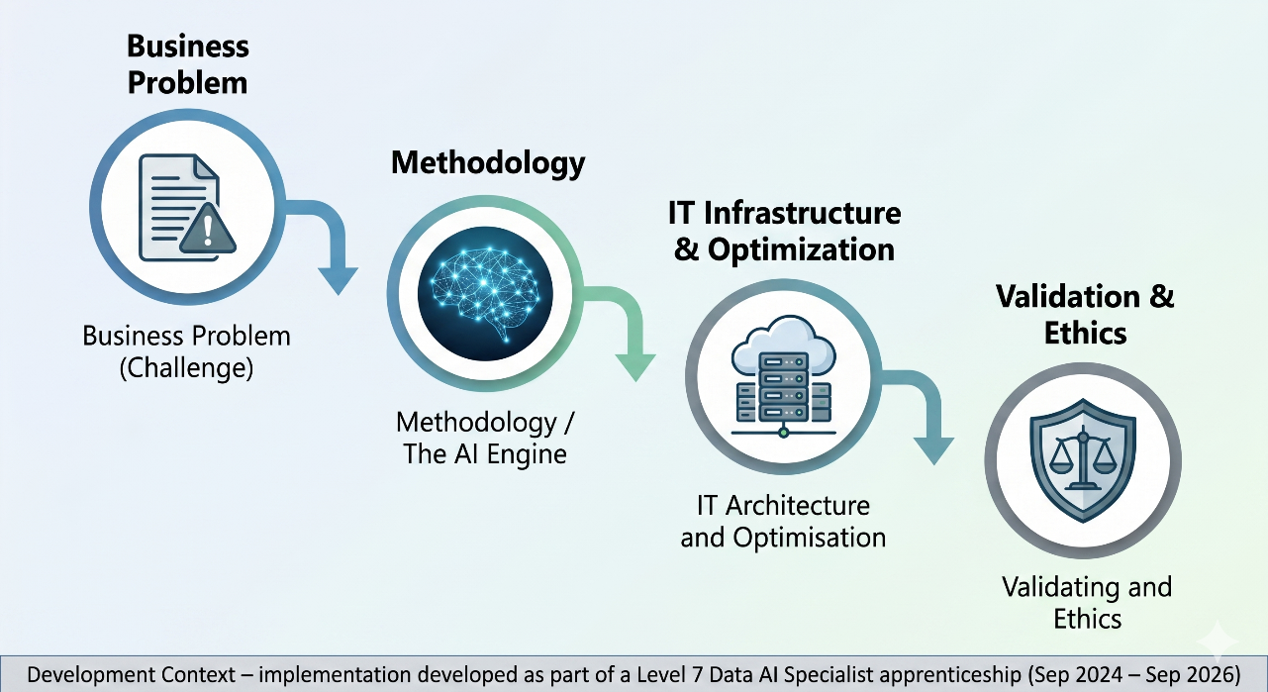





Slide 3
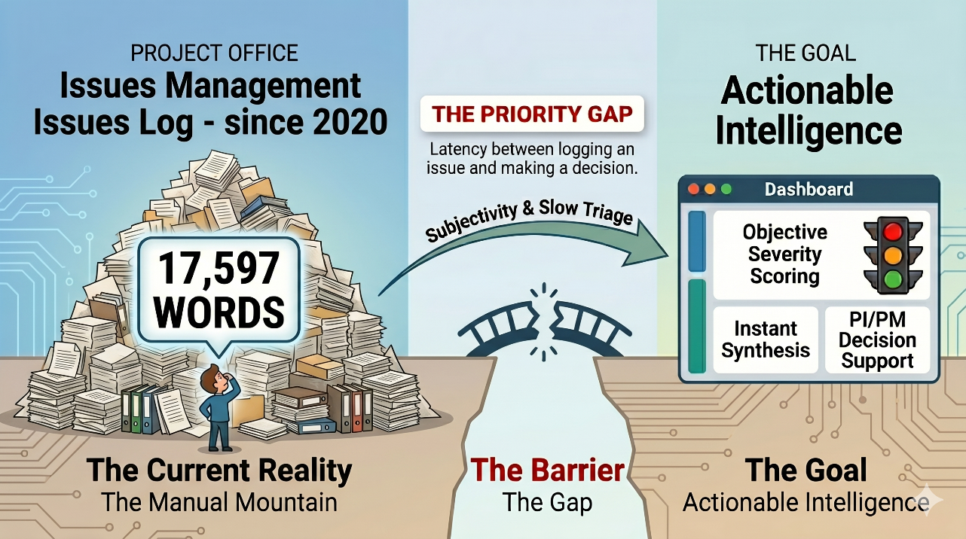



Slide 4
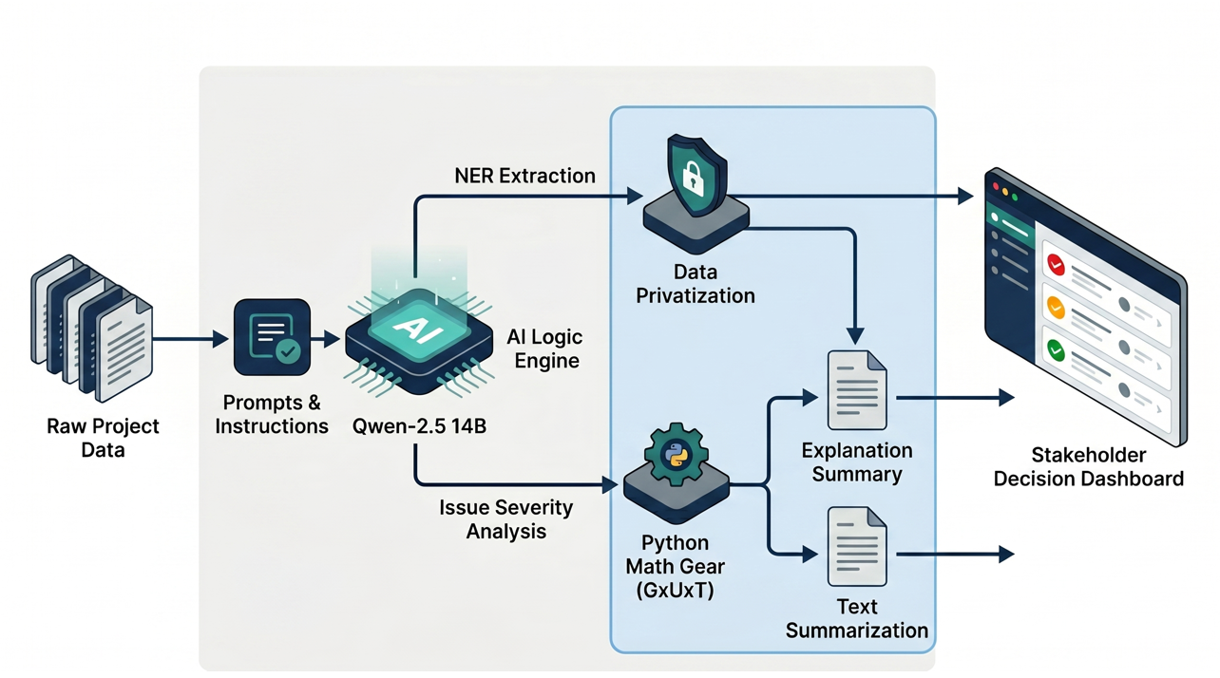
















Slide 5
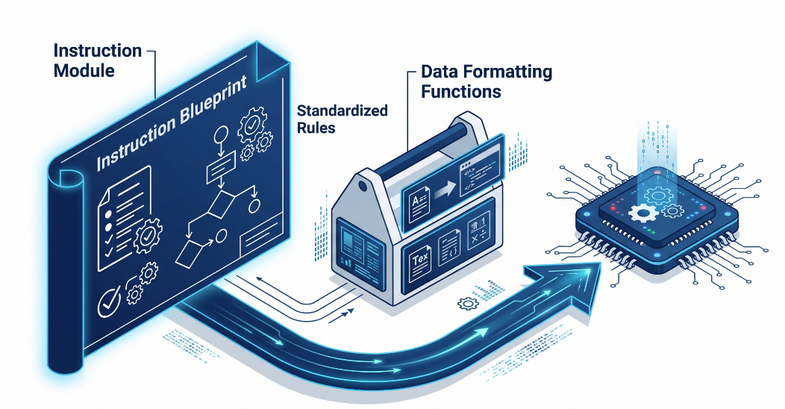
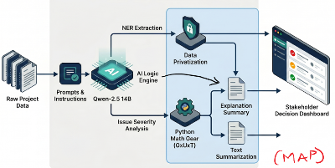














Slide 6
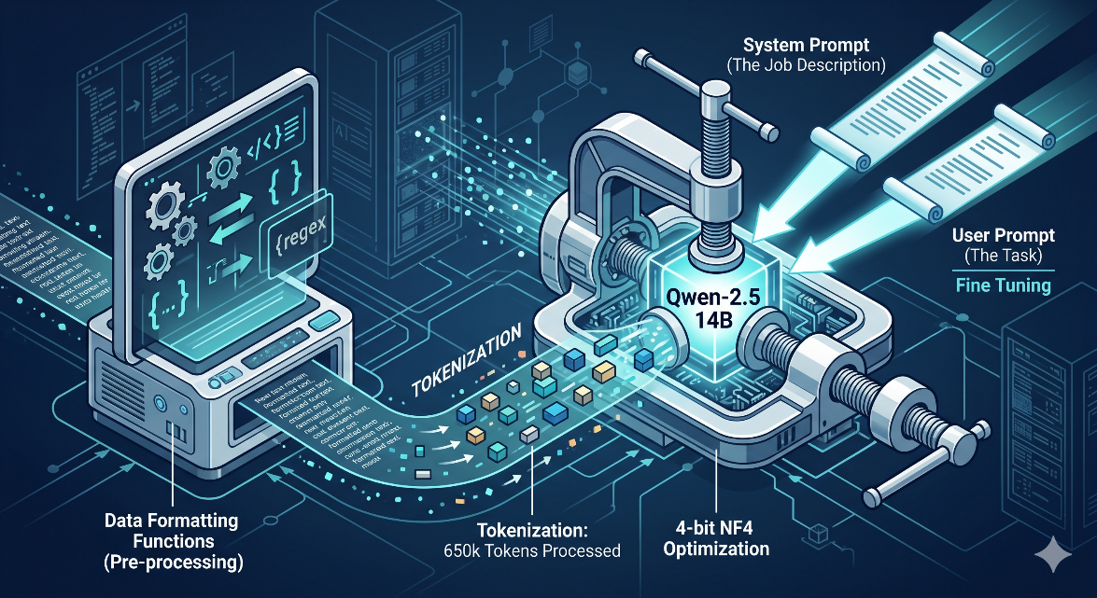





Slide 7
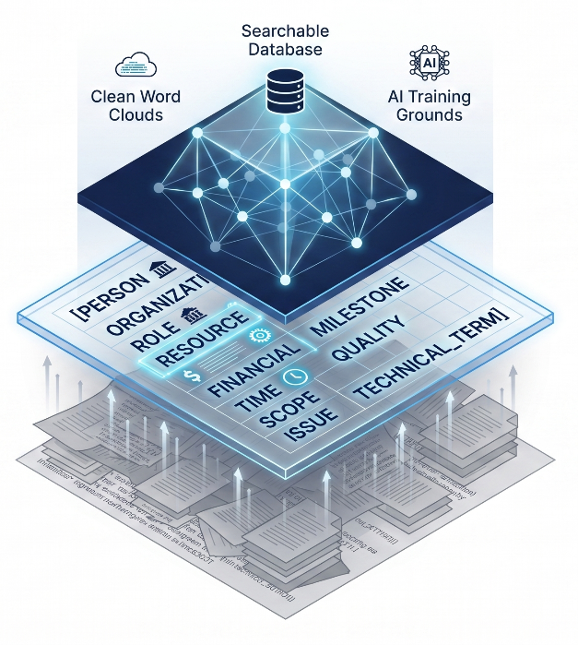

































Slide 8
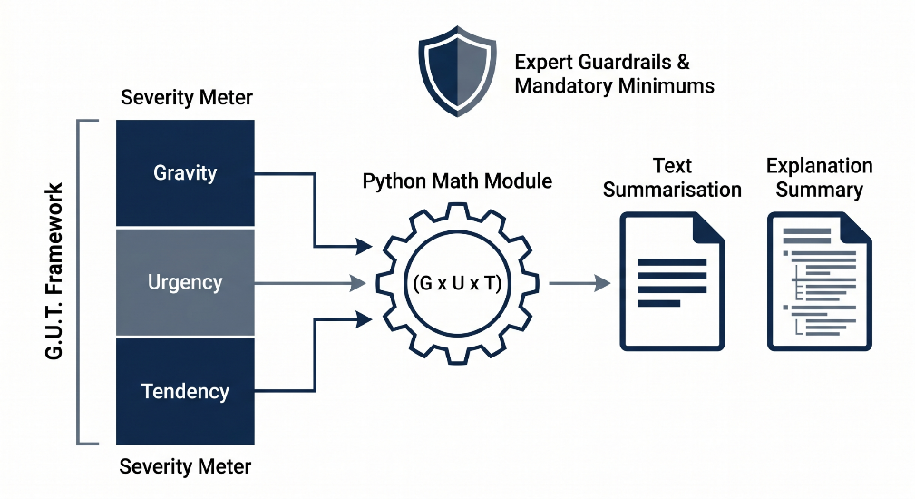







Slide 9
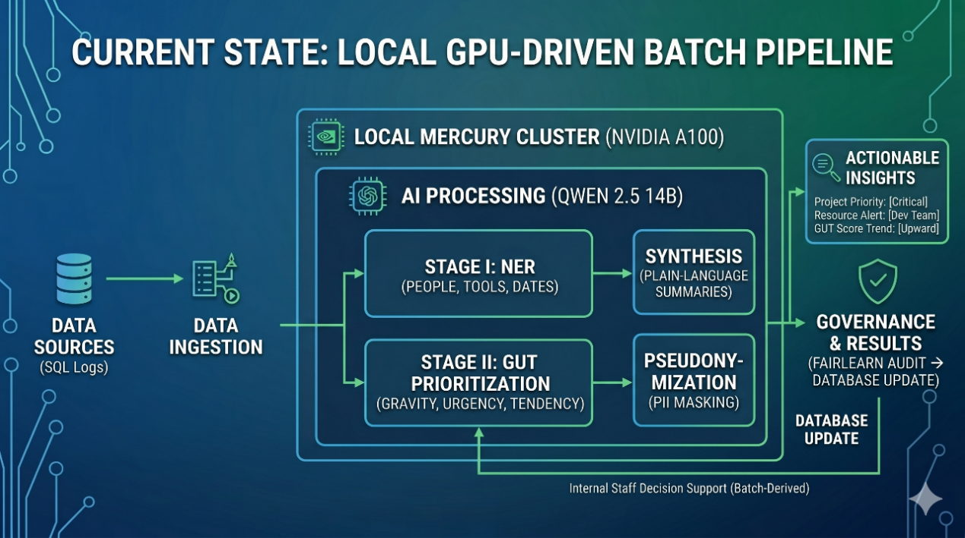


Slide 10
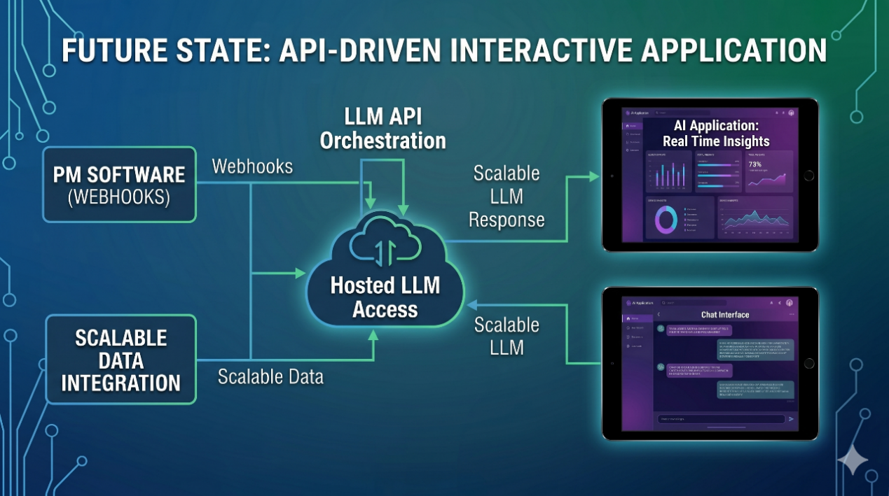

https://alpaca.pp.rl.ac.uk/
https://vicuna.pp.rl.ac.uk/
Managed by Ai4PPD group

Slide 11
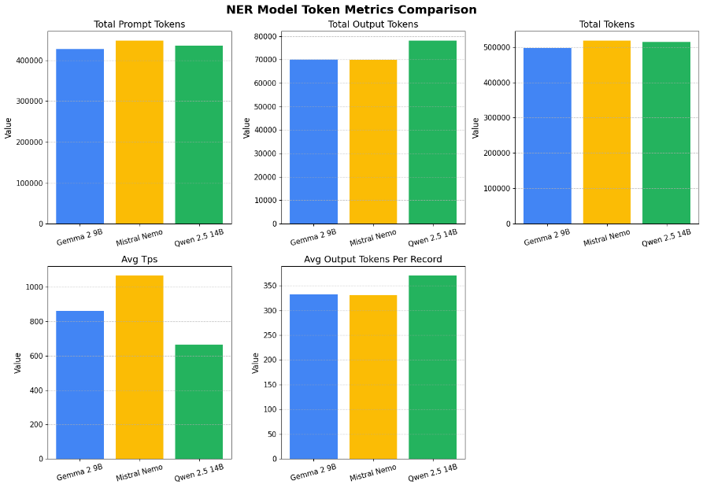

















Slide 12
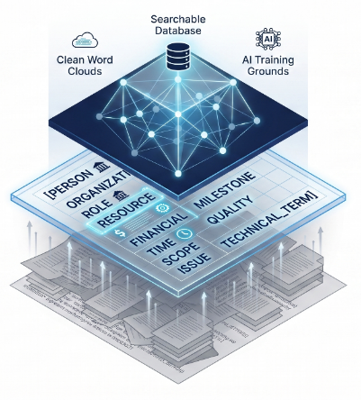
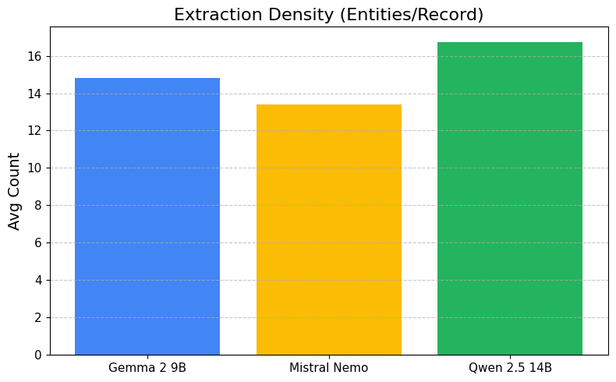





Slide 13
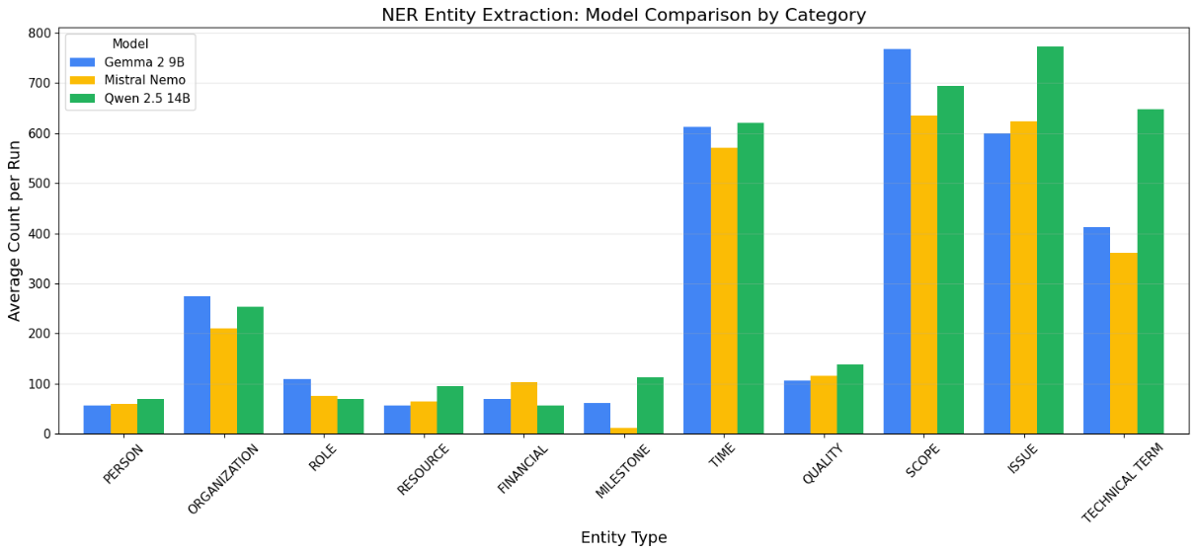





Slide 14
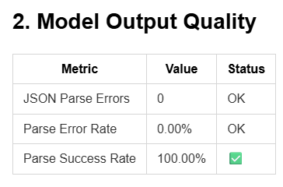
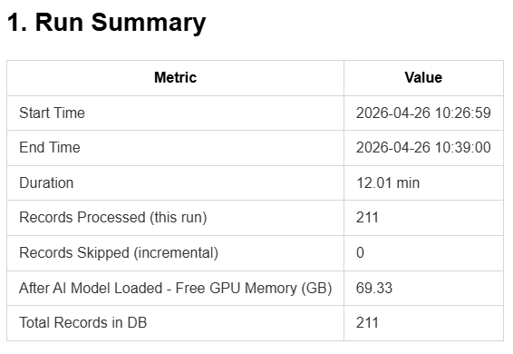
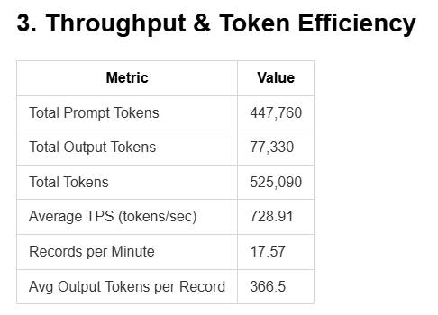
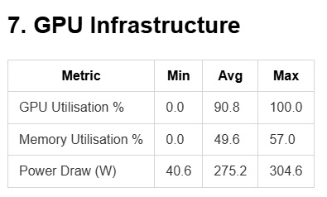






Slide 15
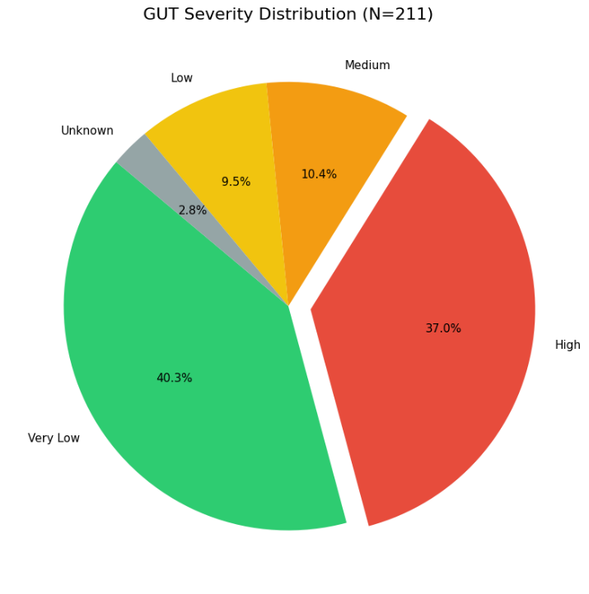


Slide 16
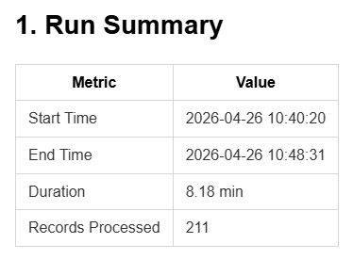
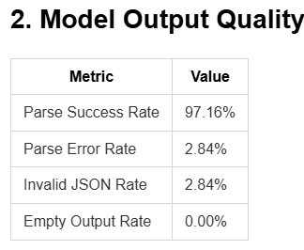
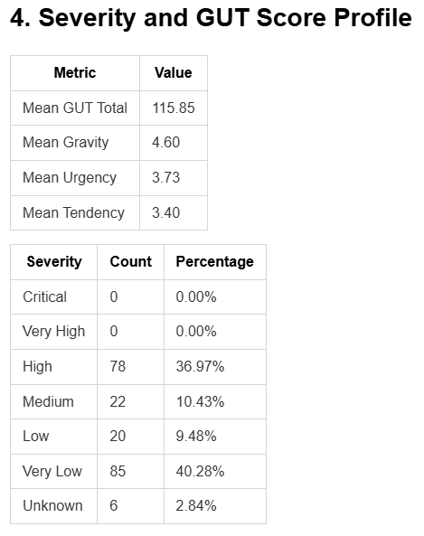
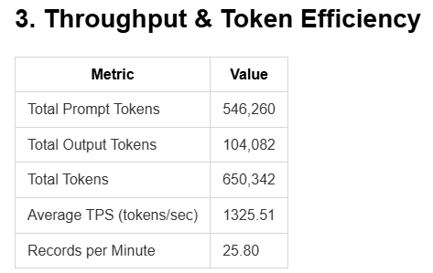









Slide 17
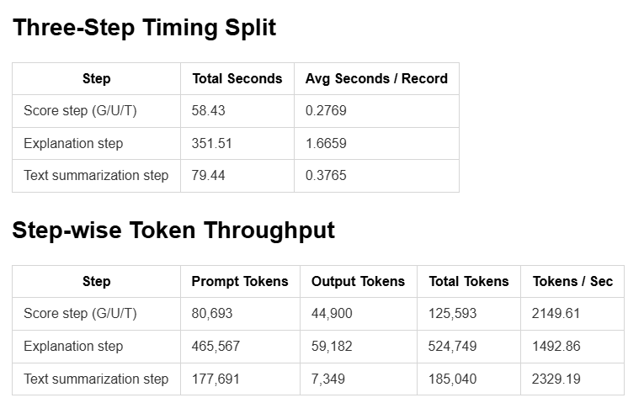




Slide 18
AI Ethics
Technical Excellence is baseless if the entire system is biased
How do we know if AI is favouring on one project than the other, during the analysis?
How do we know if AI is hallucinating?
Is the AI design system
Fair | - Accountable
Transparent | - Have data protection
Safe | - Impact on Society
- Impact on Environment

Slide 19
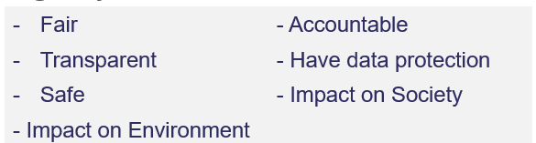
AI Ethics – Measures (Test)
Ensuring Human in the Loop
Fairlearn (Open-source Python Library) – assessing the fairness of AI and ML systems.
Data and AI Ethics Framework (Gov.uk)
  https://www.gov.uk/government/publications/data-ethics-framework/data-and-ai-ethics-framework
  Data and AI Ethics Self-Assessment Tool

Slide 20
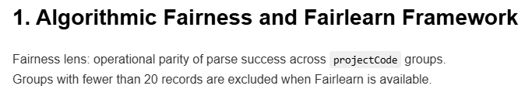
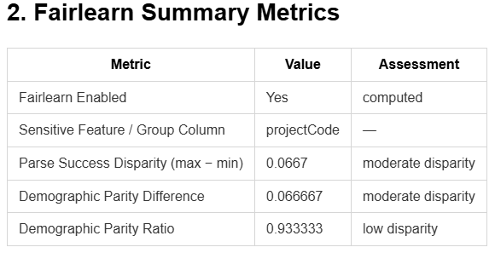
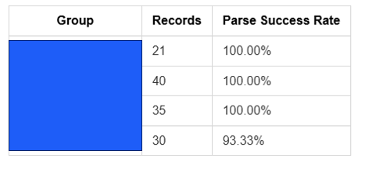
AI Ethics – Measures Output (Test)

Slide 21
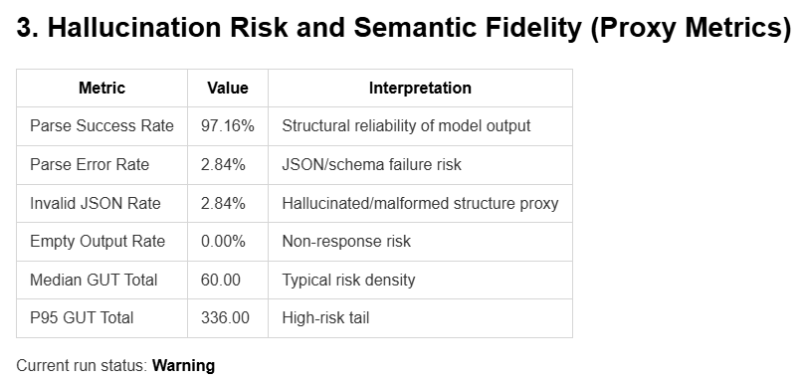
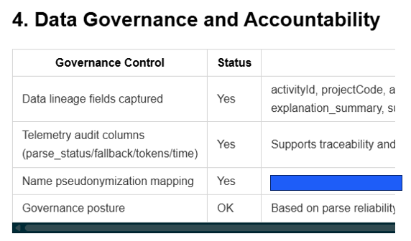
AI Ethics – Measures (Test)

Slide 22
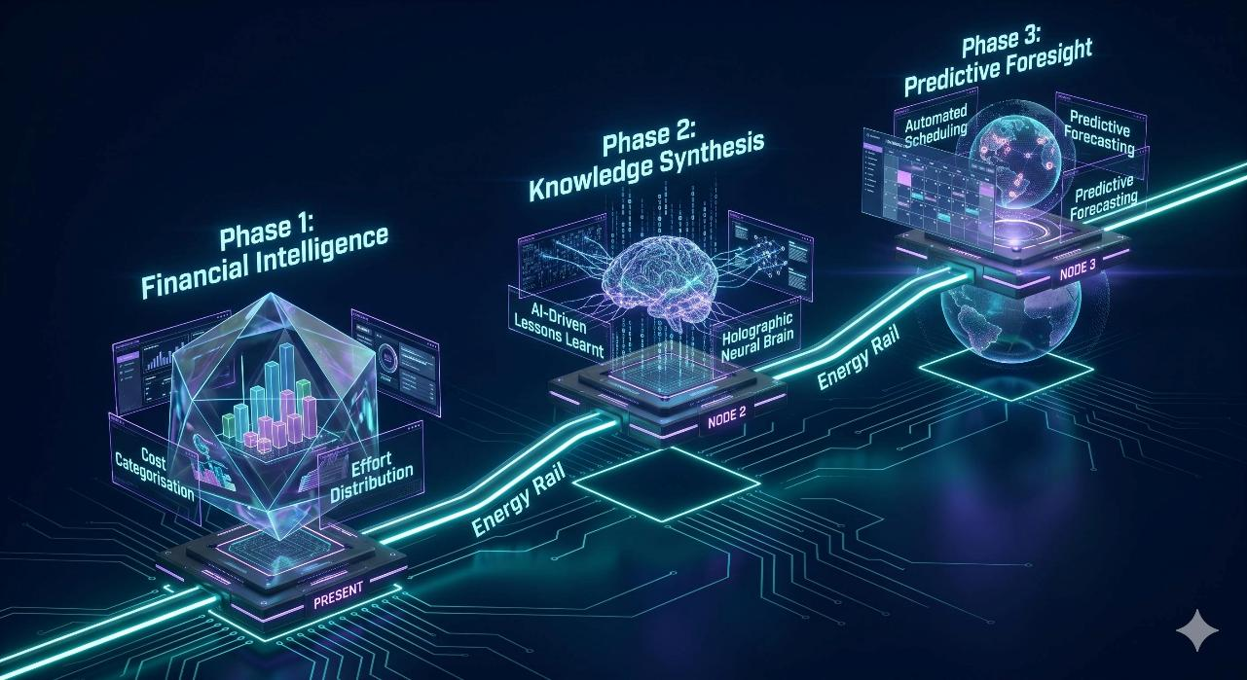




Slide 23
Thank you for your time
AI Image credits – Google Gemini Nano Banana
Facebook: Science and Technology Facilities Council
Twitter:@STFC_matters
YouTube: Science and Technology Facilities Council

