Slide 1
Applying for access to ISIS
Emma Gozzard
User Programme Manager & User Office Group Leader
UKRI-STFC ISIS Neutron and Muon Source

Slide 2
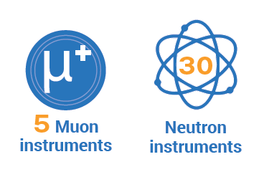
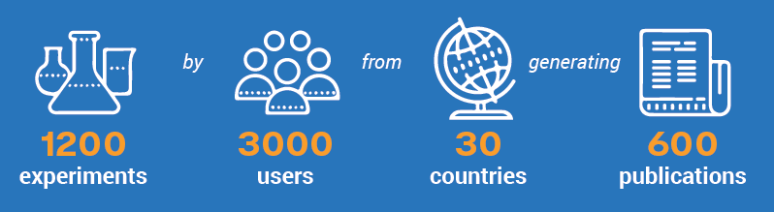


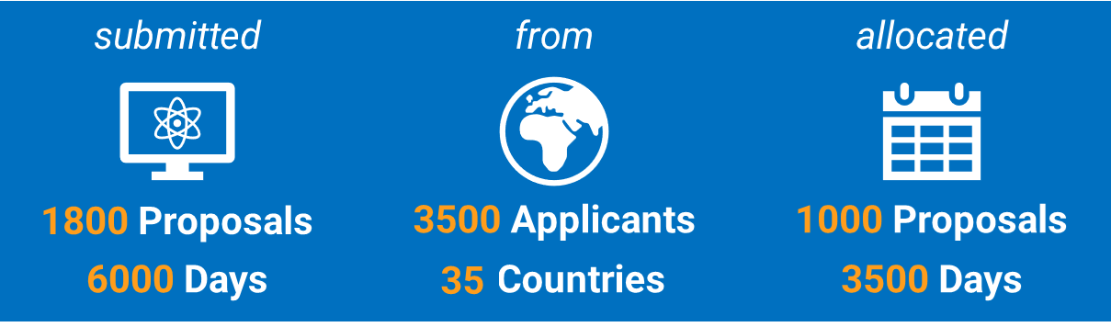



User Programme
Direct
Rapid
Xpress
Partnerships
Industrial/Commercial

Slide 3
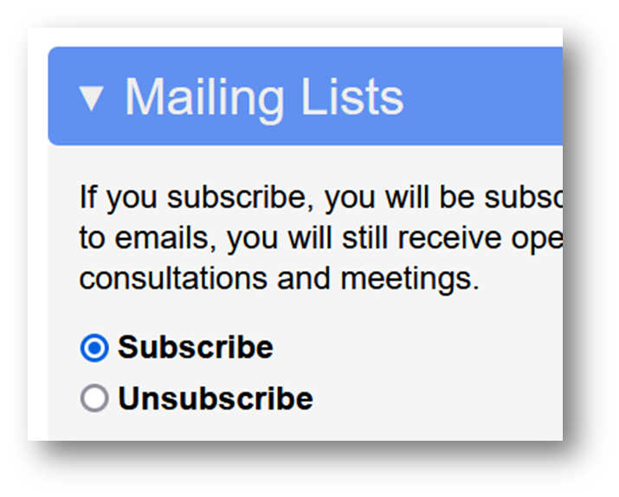
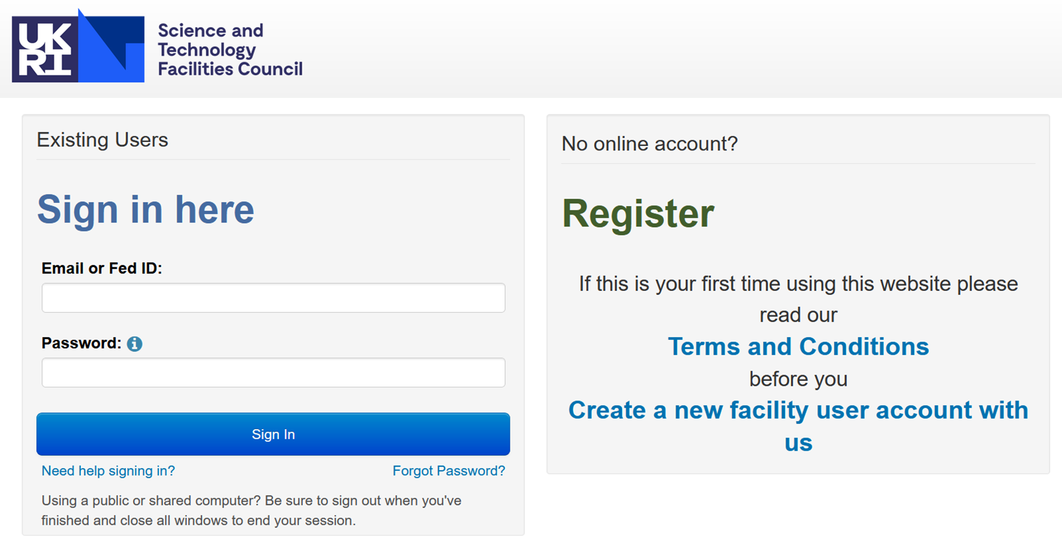

Applying for beamtime
https://users.facilities.rl.ac.uk
ISIS Facility user account

Slide 4
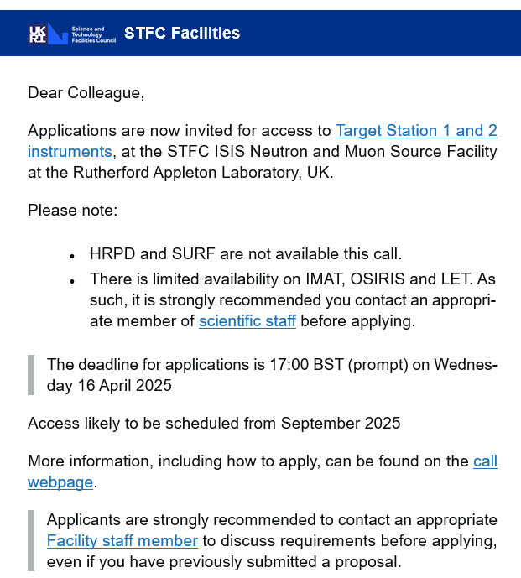
Applying for beamtime
ISIS Facility user account
Access call notifications
and user communication

Slide 5
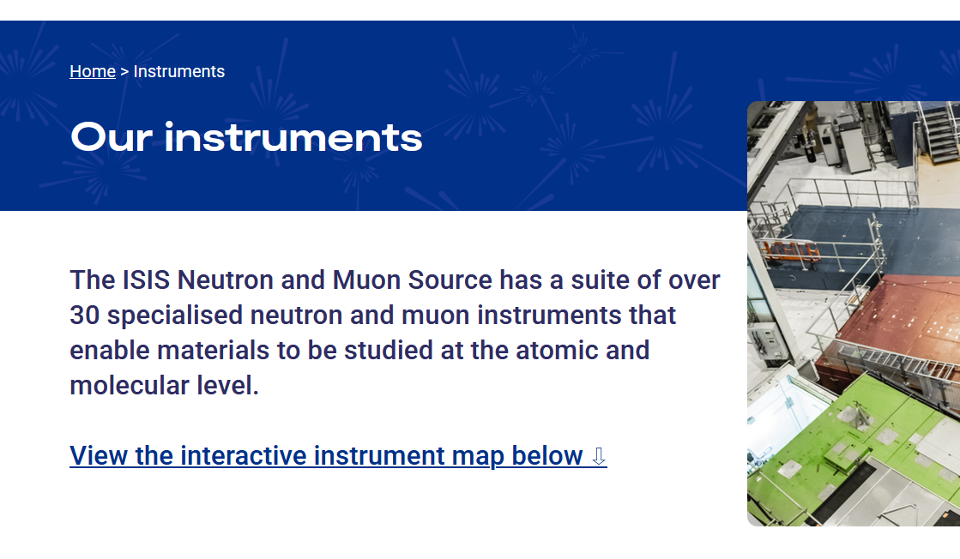
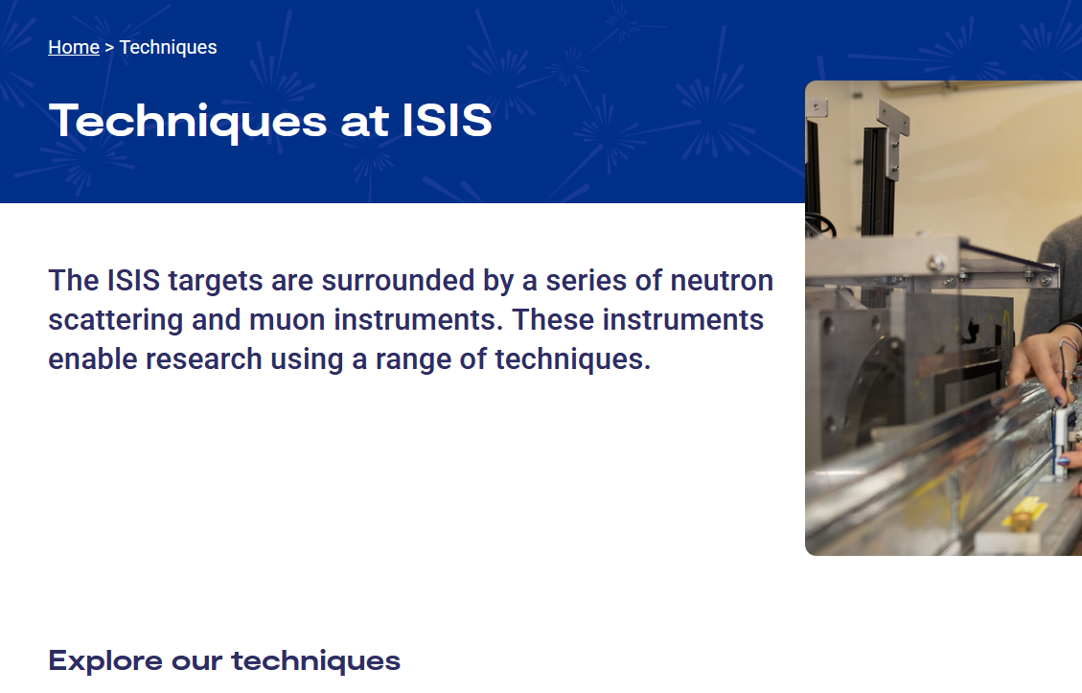
Applying for beamtime
ISIS Facility user account
Access call notifications
and user communication
Engaging with the Facility
prior to submission
https://isis.stfc.ac.uk/instruments/
https://isis.sis.stfc.ac.uk/techniques/

Slide 6
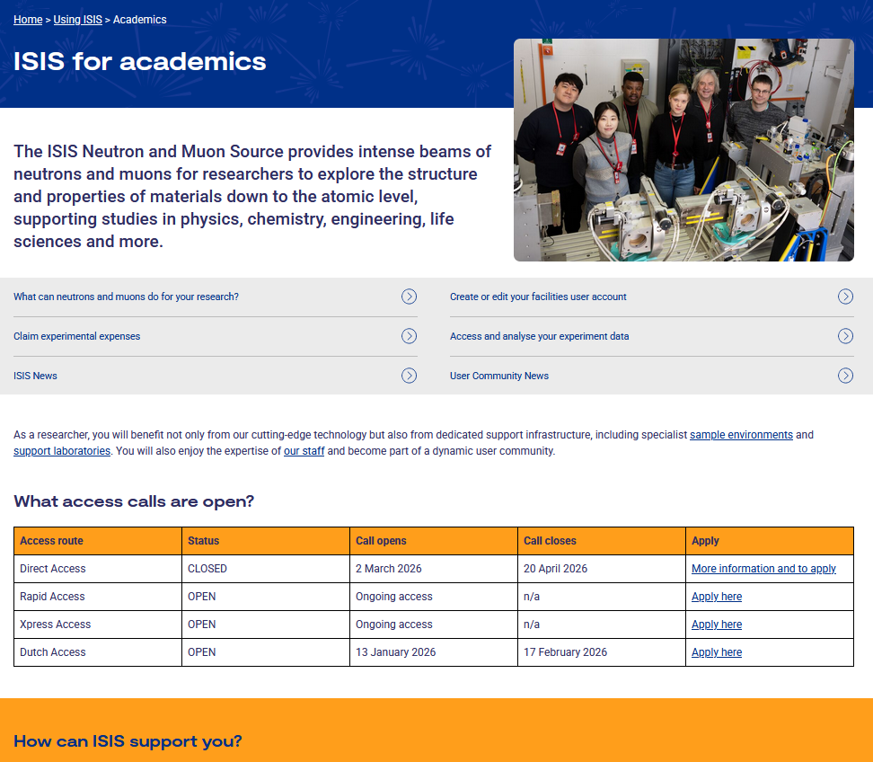

Applying for beamtime
ISIS Facility user account
Access call notifications
and user communication
Engaging with the Facility
prior to submission
Website information
https://isis.stfc.ac.uk/using-isis/

Slide 7
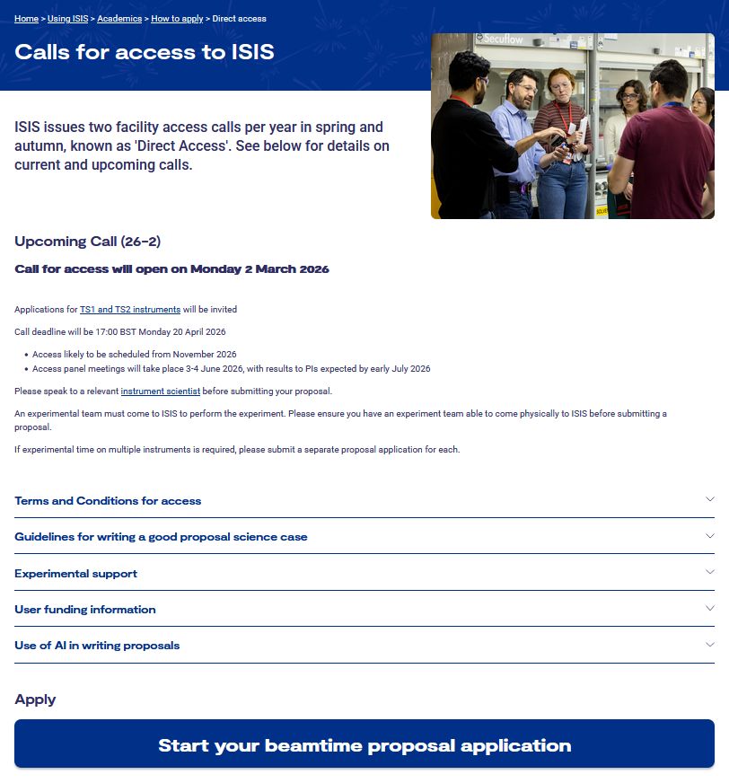
Applying for beamtime
ISIS Facility user account
Access call notifications
and user communication
Engaging with the Facility
prior to submission
Website information
Direct Access
https://isis.stfc.ac.uk/using-isis/academics/how-to-apply/direct-access/

Slide 8
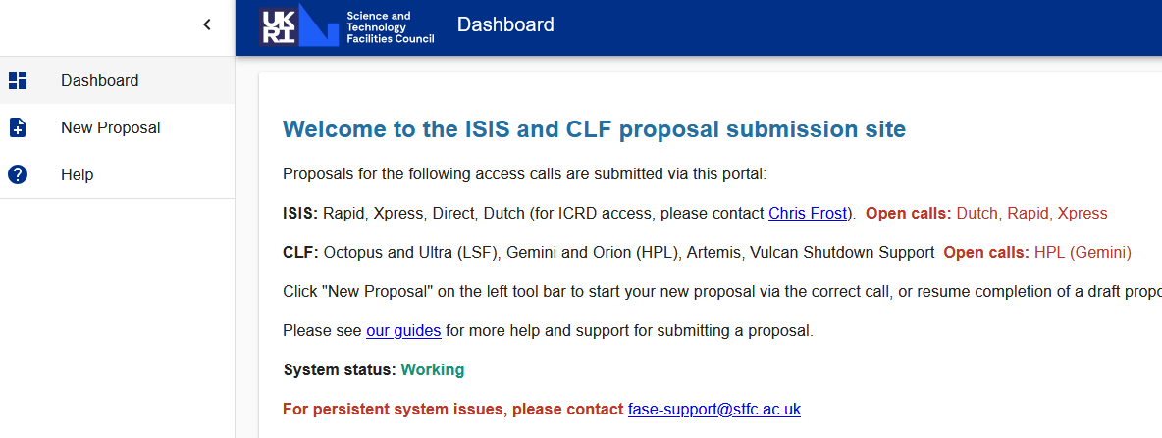
Submitting a proposal
ISIS Facility user account
Access call notifications
and user communication
Engaging with the Facility
prior to submission
Website information
Direct Access
Proposal submission system

Slide 9
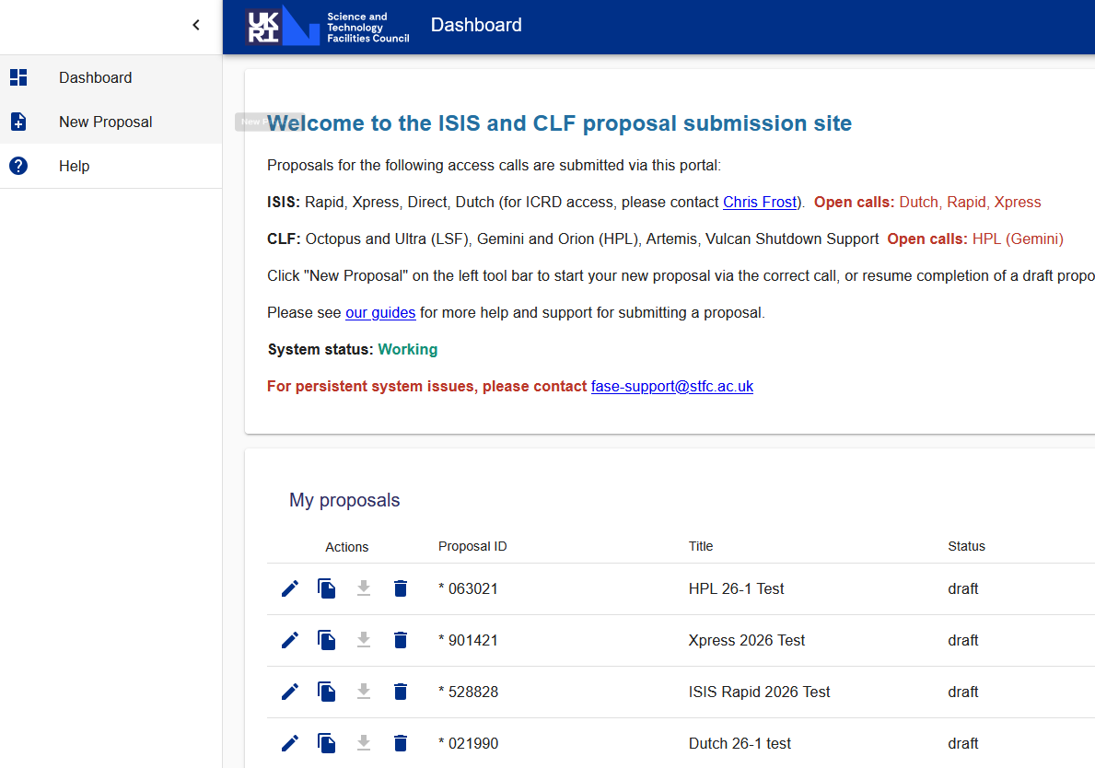
Submitting a proposal
Dashboard
https://proposal.facilities.rl.ac.uk/

Slide 10
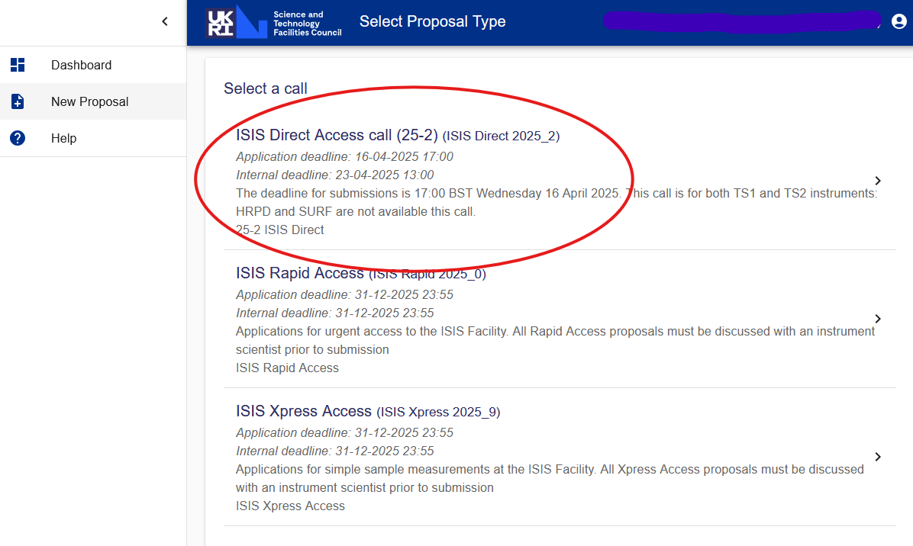
Submitting a proposal
Dashboard
Call selection

Slide 11
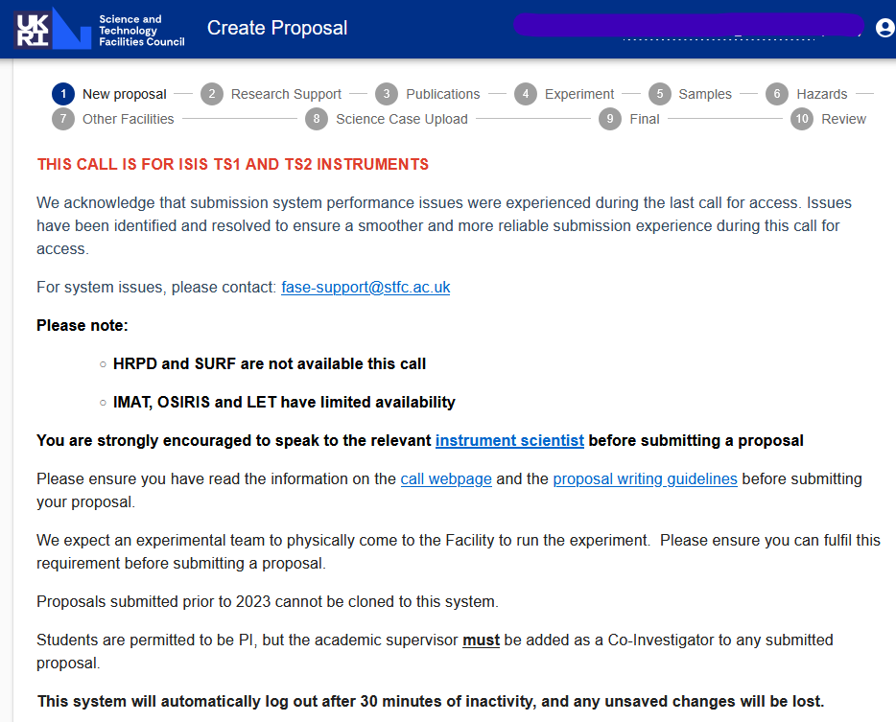
Submitting a proposal
Dashboard
Call selection
Questionnaire

Slide 12
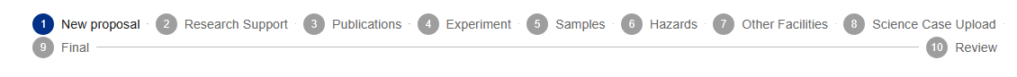
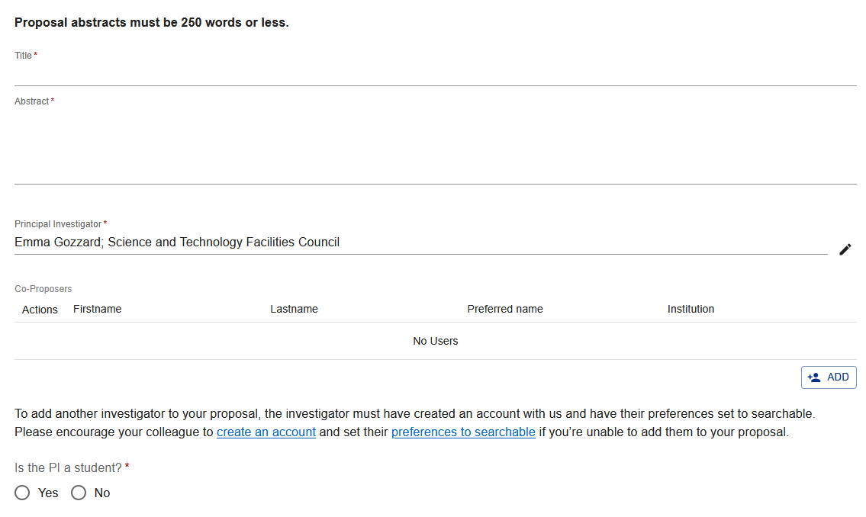
Submitting a proposal
Dashboard
Call selection
Questionnaire
  Topics

Slide 13
Submitting a proposal
Questionnaire topics
Research Support: Grants, Industry links, PhD students
Publications: Your own, recent ISIS experiments, relevant to science case
Experiment: Instrument and time request, sample environment
Samples: Add sample information
Hazards: Basic hazard information
Other facilities: Deuterated materials, Diamond Light Source
Science case: 2 pages, Background and Context, Proposed Experiment, Summary of previous beamtime or characterisation, Justification of beamtime request, Experimental Plan
T&Cs, Review and Submission (proposal can be edited until call closure)

Slide 14
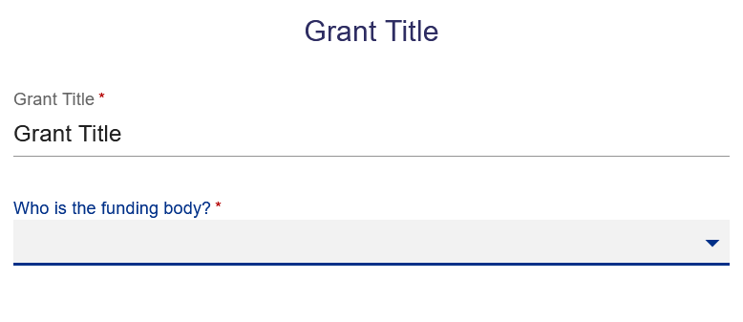
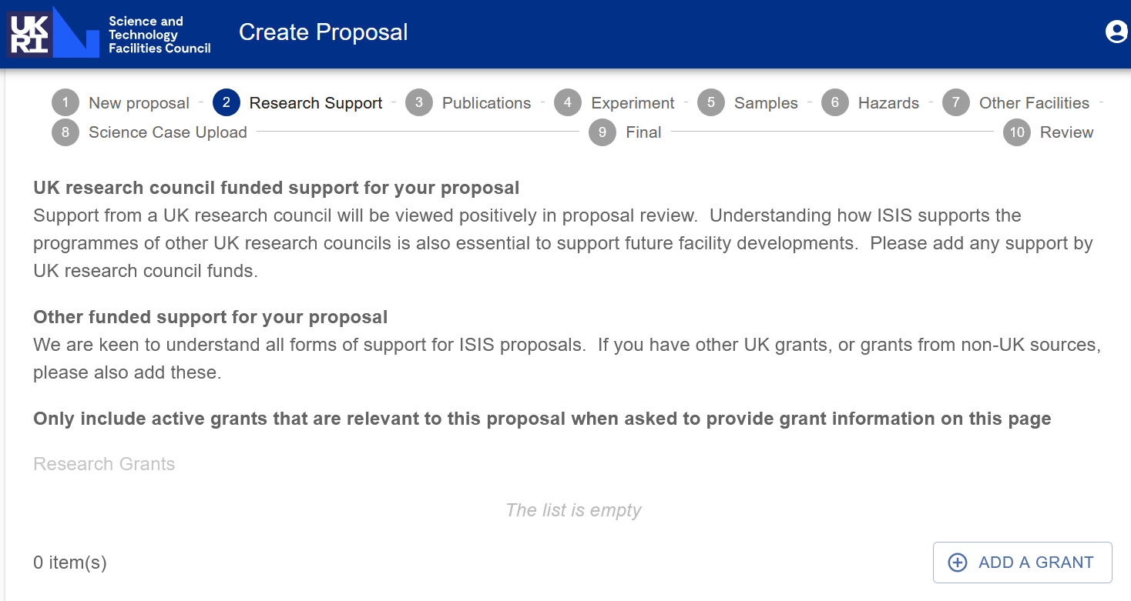
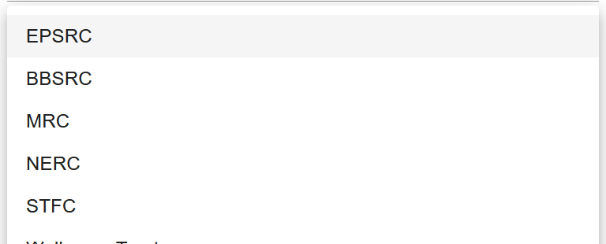
Submitting a proposal
Questionnaire topics
Research Support: Grants, Industry links, PhD students
Publications: Your own, recent ISIS experiments, relevant to science case
Experiment: Instrument and time request, sample environment
Samples: Add sample information
Hazards: Basic hazard information
Other facilities: Deuterated materials, Diamond Light Source
Science case: 2 pages, Background and Context, Proposed Experiment, Summary of previous beamtime or characterisation, Justification of beamtime request, Experimental Plan
T&Cs, Review and Submission (proposal can be edited until call closure)

Slide 15
Submitting a proposal
Questionnaire topics
Research Support: Grants, Industry links, PhD students
Publications: Your own, recent ISIS experiments, relevant to science case
Experiment: Instrument and time request, sample environment
Samples: Add sample information
Hazards: Basic hazard information
Other facilities: Deuterated materials, Diamond Light Source
Science case: 2 pages, Background and Context, Proposed Experiment, Summary of previous beamtime or characterisation, Justification of beamtime request, Experimental Plan
T&Cs, Review and Submission (proposal can be edited until call closure)

Slide 16
Post submission
Call closes
Technical feasibility
Scientific review
Peer Review Access Panels
Decision notification to PIs
Approx. 8 weeks

Slide 17


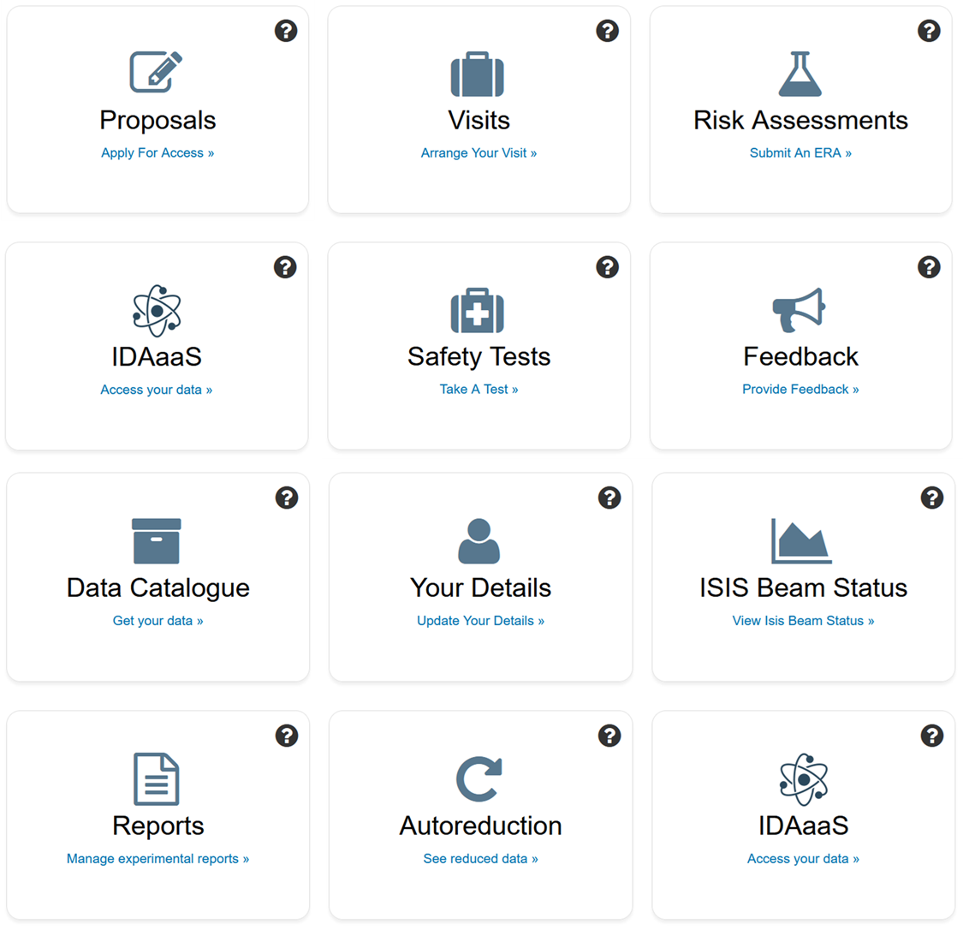

Help and queries
ISIS Staff & User Office
Your user account
https://users.facilities.rl.ac.uk/auth/Menu.aspx
https://isis.stfc.ac.uk/instruments/
isisuo@stfc.ac.uk
ISIS website
https://isis.stfc.ac.uk/using-isis/

Slide 18

Thank you for listening!
Time for questions

