Slide 1



Muon applications
Peter Baker
ISIS Muon Group scientist
Notes:
The abstract pattern can be removed or repositioned if required. Be careful to ‘Send to Back’ so that it does not obscure any important information.

Slide 2
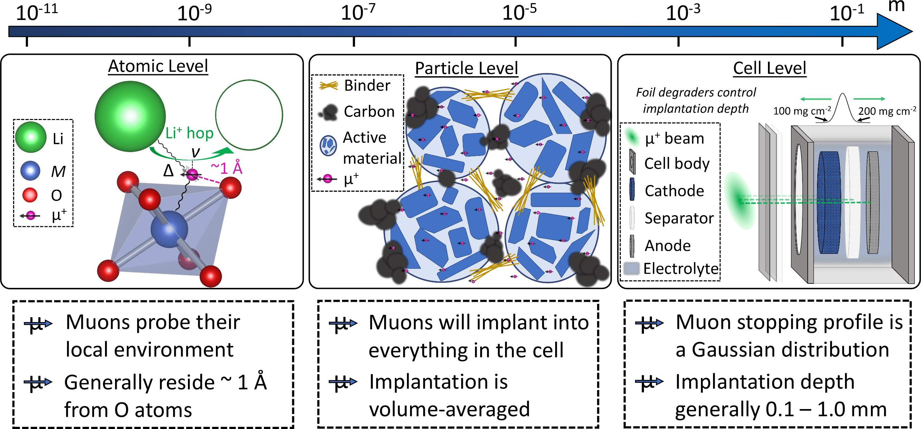
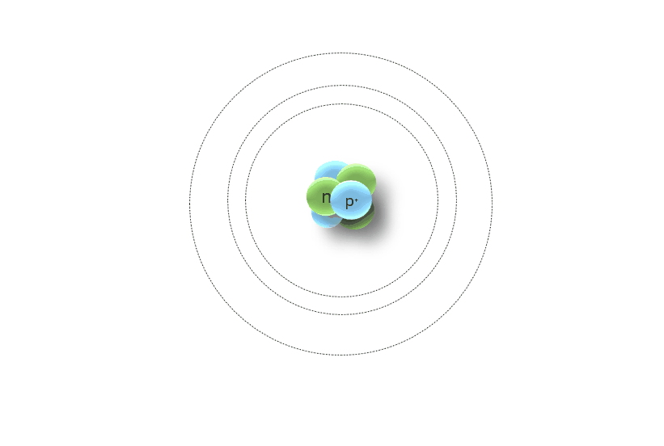
Two ways to use muons
Positive muons to study magnetic fields inside materials
Negative muons to study the elemental composition of materials
Positive muons implanted into the sample
Spin polarization changes in response to static and dynamic magnetic fields
A bit like Nuclear Magnetic Resonance
Negative muons implanted into the sample
X-rays emitted specific to the nucleus capturing each muon
A bit like X-Ray Fluorescence

Slide 3



Ionic motion
Batteries, supercapacitors, hydrogen fuel cells and storage

Slide 4
What information do you get from muons?

Slide 5

Which ions can you study?
Nucleus | Moment | Abundance (%) | Chance of success | Ionic radius (pm)
¹H | +4.84 | 99.9885 | Have to separate µ⁺, µ⁺e⁻ and H⁺ motion | 0.0008 or 110
⁷Li | +4.20 | 92.41 | Excellent and well-studied | 90
¹⁹F | +2.63 | 100 | Not promising due to F-μ bonds | 119
²³Na | +2.86 | 100 | Excellent and some existing work | 116
²⁵Mg | -0.86 | 10.13 | Works but with a small signal | 86
²⁷Al | +3.64 | 100 | Promising | 67.5
⁴³Ca | -1.49 | 0.135 | Terrible unless enriched | 114
⁵¹V | +5.15 | 99.76 | Promising | 68-93
⁶⁷Zn | +0.875 | 4.1 | Not promising | 88
¹²⁷I | +2.81 | 100 | Excellent | 206
Also consider:
Do nuclei move faster than muons?
Is the environment magnetic too?
Does NMR work?
If not, why not?

Slide 6
What information do you get from muons?
How often ions with a magnetic moment move past
Measures the atomic-level ionic self diffusion rate
Knowing pathways allows comparison with bulk diffusion
Change with temperature is governed by energy barriers to motion
Field distributions inside the sample
Probe of local structural changes – as distances between atoms change, so does the field distribution

Slide 7
Ex-situ ion diffusion measurements – Li deficient NCA
Primary use of muons is to measure local ionic motion
Works in paramagnetic materials
Material doesn’t have to be in a cell
Ion must have a nuclear magnetic moment, e.g. Li, Na, K, Mg, I
Measure the hopping rate as a function of temperature
Extract energy barrier(s)
Find hopping rate ~MHz and derive local diffusivity for available pathways
T.E. Ashton et al., J. Mater. Chem. A 2020, 8, 11545

Slide 8
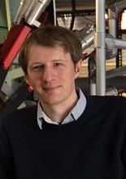
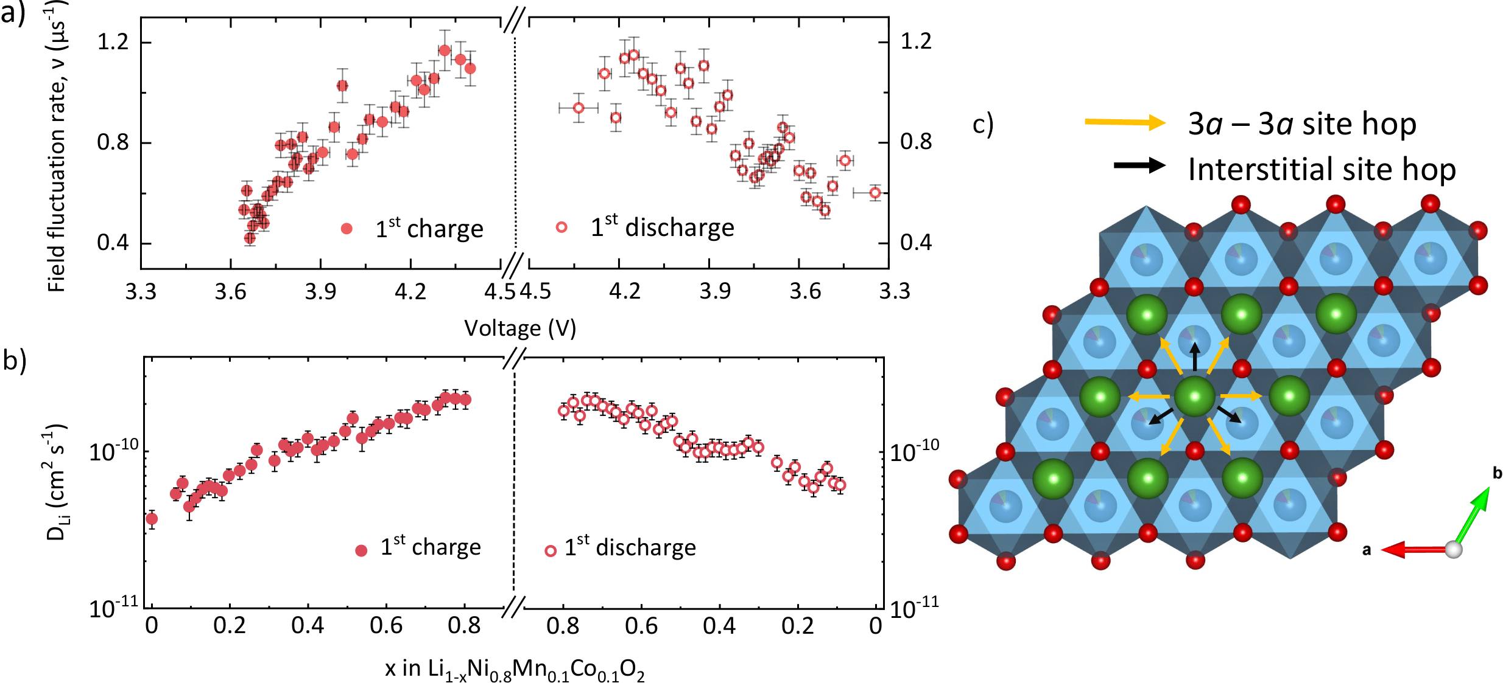
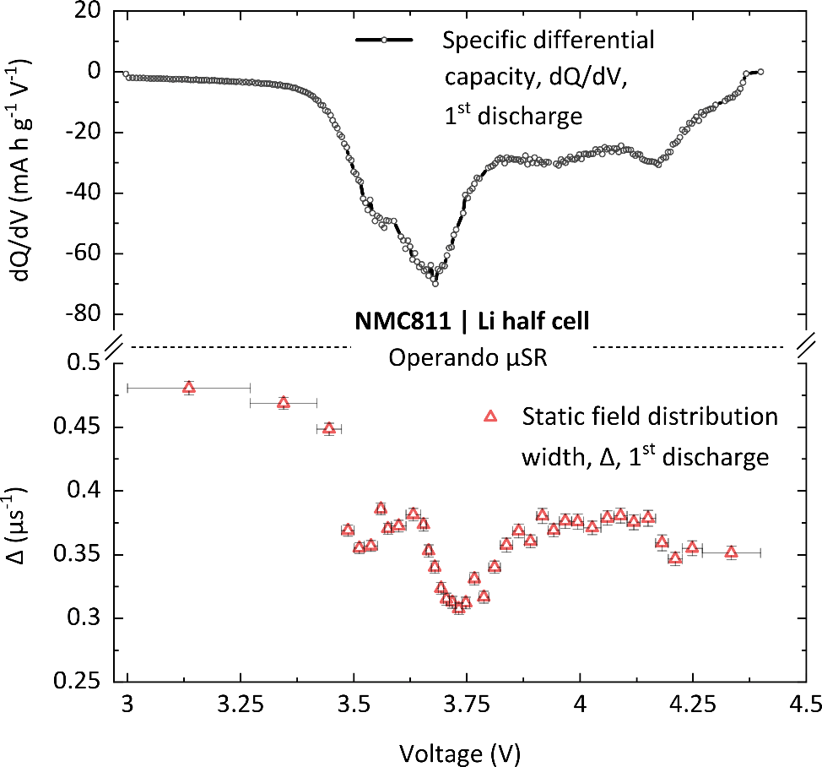

Li⁺ Diffusion in NMC811 during cycling
Li⁺ hopping rate
Changes in local structure
$DLi=$ $\sum_{i=1}^{n}{\frac{1}{N_{i}}}Z_{ν,i}s_{i}^{2}ν_{Li}$
Li⁺ diffusion coefficient

Slide 9

Chemical reactions
Catalysis, kinetics, supercritical water

Slide 10
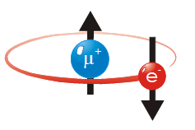
Muonium Chemistry
Positive muons can capture electrons to form a light hydrogen isotope: Muonium (Mu)
Mu can undergo the same reactions as a H-atom …
Addition: Mu + R₂C=CH₂ R₂ĊCH₂Mu
Abstraction: Mu + RX MuX + R·
Radical Combin.: Mu + ·OH MuOH
E- transfer: Mu + X^{n+} µ⁺ + X^{(n-1)+}

Slide 11
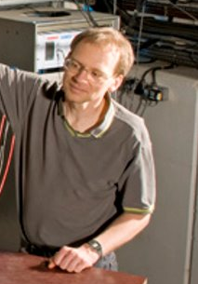

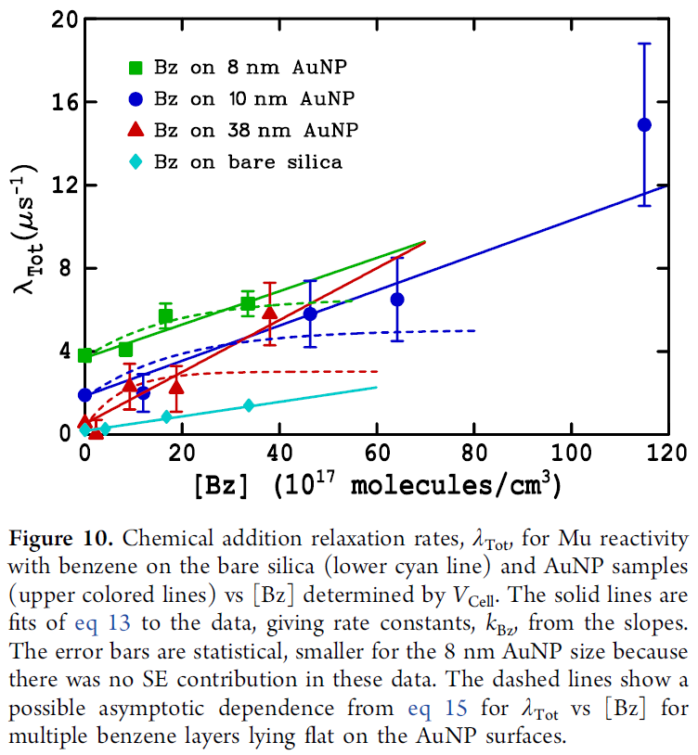
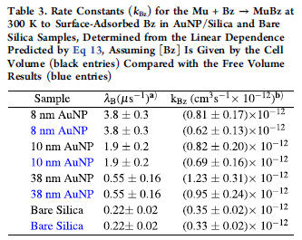
Determine rate constants, k_{Mu} …
Change Benzene conc. and measure λ_{Tot}
Determine k_{Mu}
From k_{Mu} …
2 – 3-fold catalytic effect from benzene on metal surface

Slide 12

Semiconductors
Solar, power electronics, computing

Slide 13

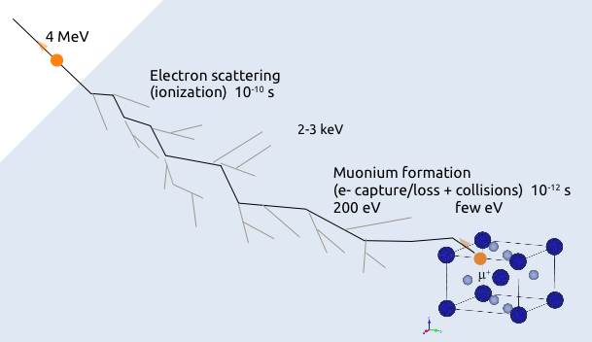
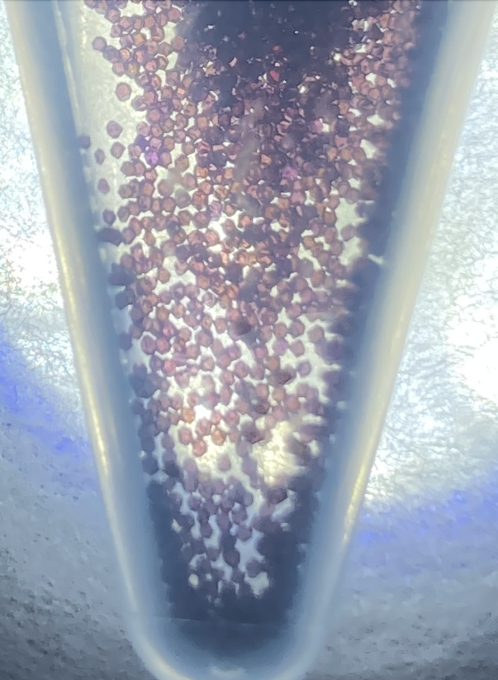
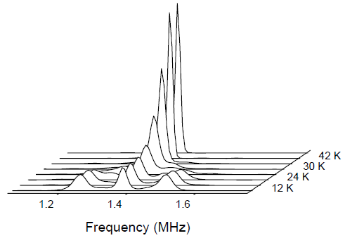
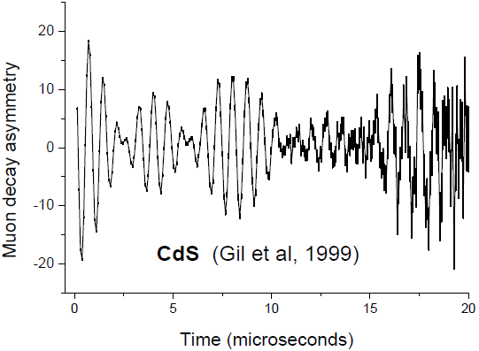
What muons can tell you about semiconductors
Generally studying muonium in the semiconductor
Hydrogen defect analogue
Where it forms in the material
What dynamics it experiences
Investigating paramagnetic centres
e.g. NV centres in diamond
Charge carrier dynamics
Thermal effects
Light induced effects

Slide 14
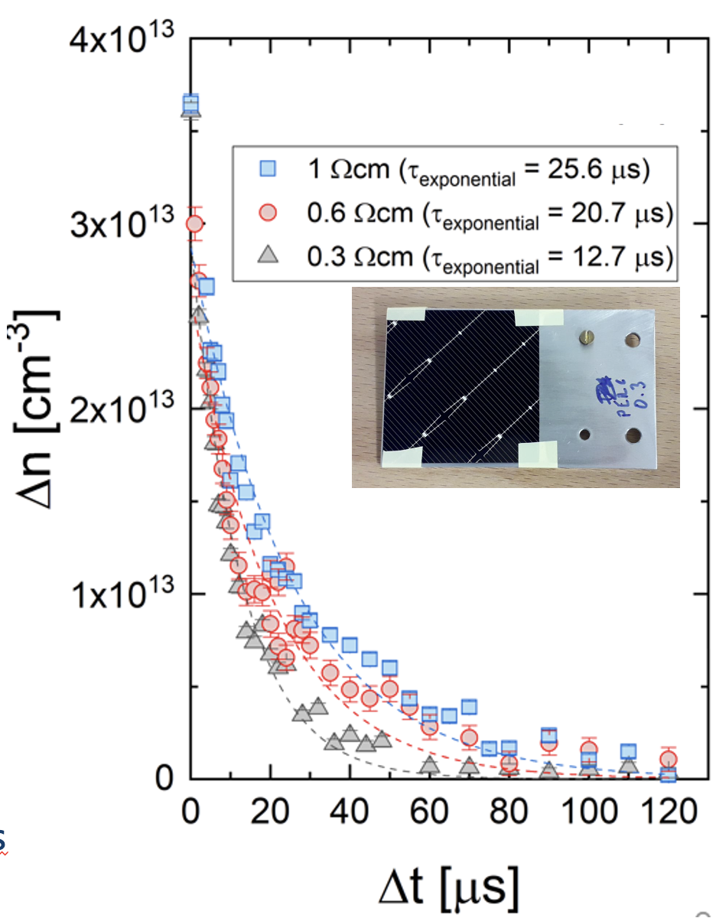
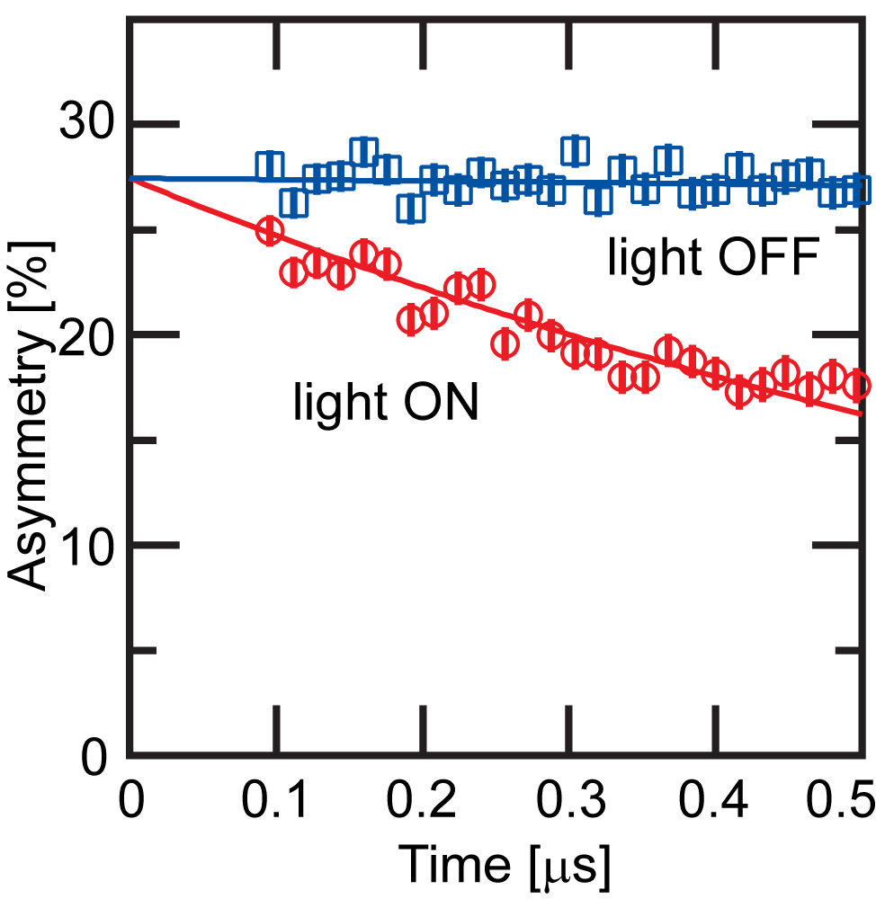
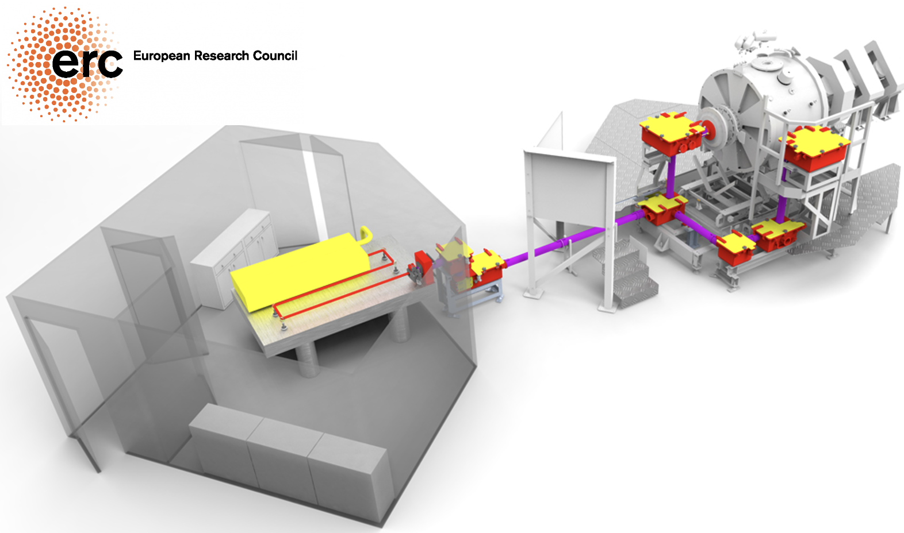
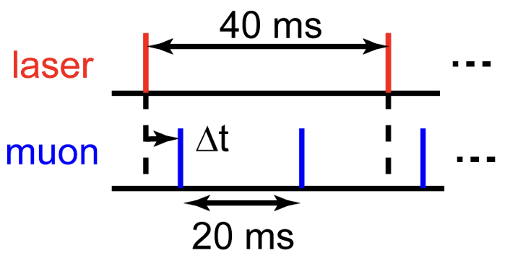
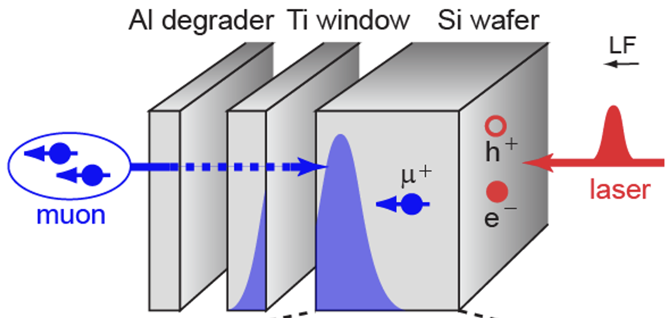
Charge carrier kinetics in semiconductors
Carrier-Mu interaction depolarises muon signal
Relaxation rate tells carrier density
HIFI Laser for optically generating carriers in semiconductors
By changing the pulse delay, one can measure carrier lifetime spectrum
Even in completed solar cells
Depth-dependent measurements enable carrier kinetics study within a wafer
Applicable to many semiconductors. So far: Si, Ge, SiC, GaAs
General-purpose setup for light-pump muon-probe experiments
Review of Scientific Instruments 87, 125111 (2016).
Phys. Rev. Lett. 119, 226601 (2017).
Appl. Phys. Lett. 115, 112101 (2019).
Appl. Phys. Lett. 118, 252105 (2021).
Journal of Applied Physics 132, 065704 (2022).
Journal of Applied Physics 136, 055707 (2024).

Slide 15

Elemental composition
Batteries, fertilizers, cultural heritage

Slide 16

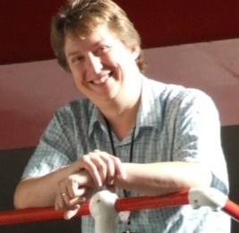
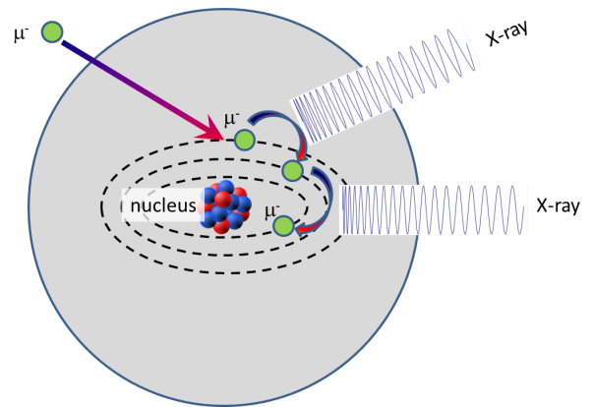
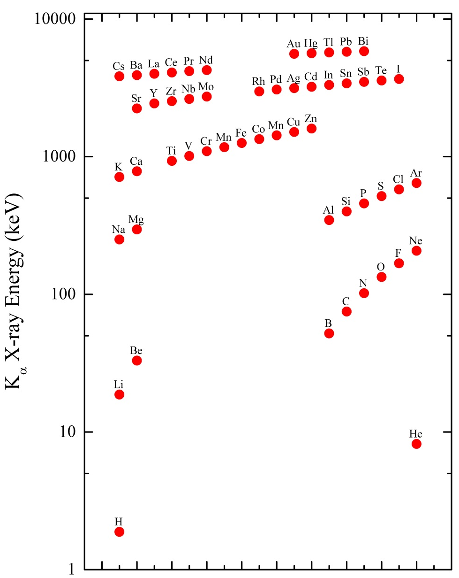
How negative muons determine elemental composition
High Energy X-rays emitted – XRF turbocharged
Energy depends on the atom which captures the muon
0.1-10MeV – mass of the muon is 200x that of the electron so higher energy
Can measure as a function of depth up to ~ 1cm
Proof of concept imaging studies in progress

Slide 17
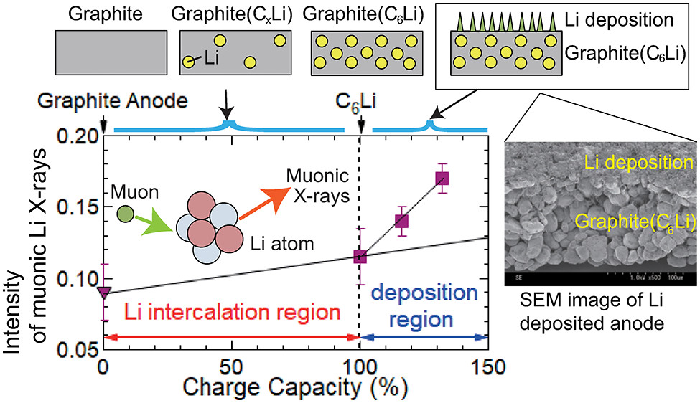
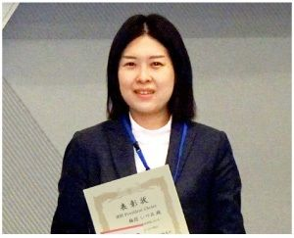
Li plating on graphite anodes
Negative muon study of a pouch cell
Can use muon beam energy to tune the layer that the muons stop in
Atomic Coulomb capture from metallic Li ~50x more than for atomic Li
Very sensitive to Li plating
I. Umegaki et al., Anal. Chem. 2020, 92, 8194

Slide 18
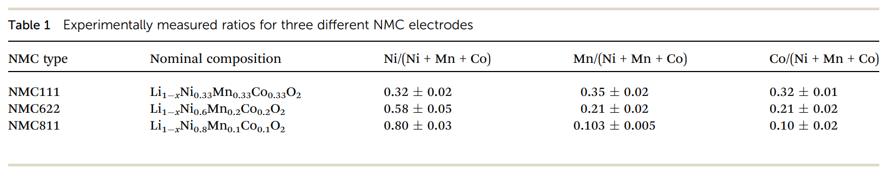
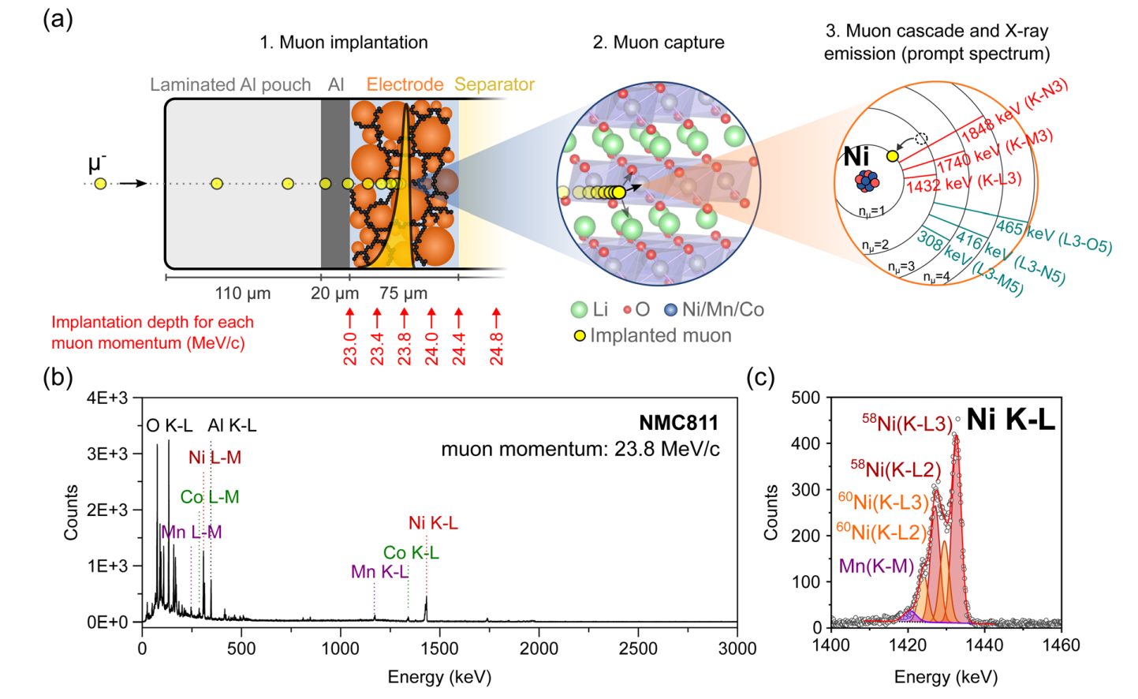
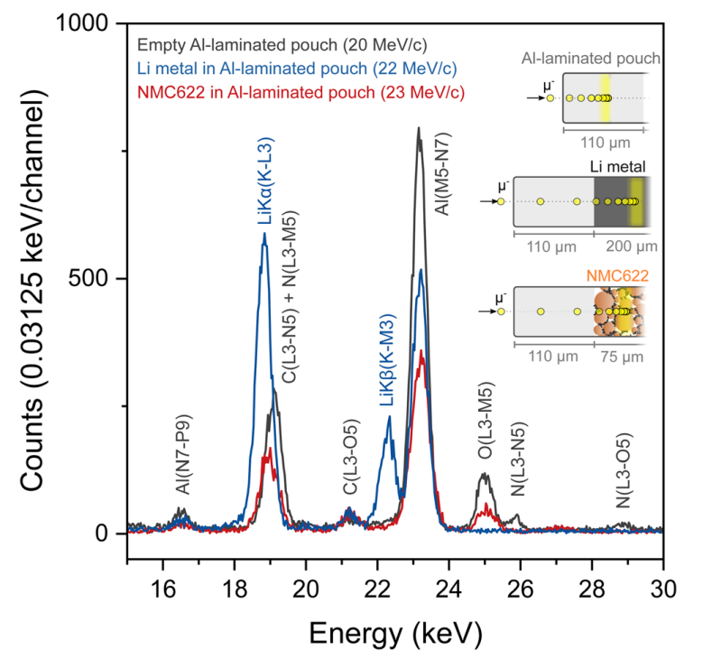
Composition within pouch cells
E. Querel et al., J. Mater. Chem. A, 2025, 13, 2275

Slide 19
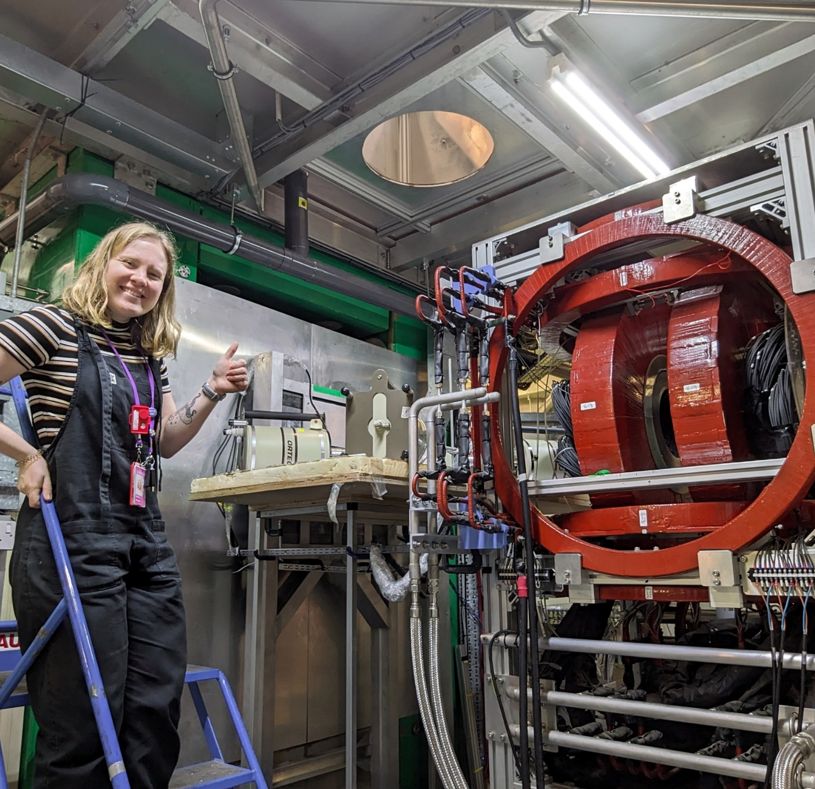
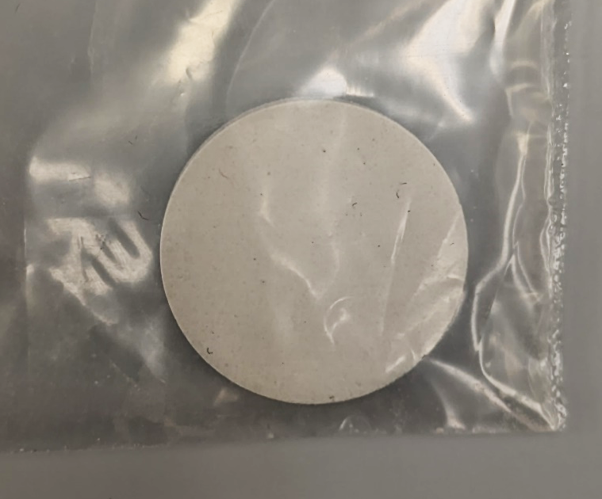
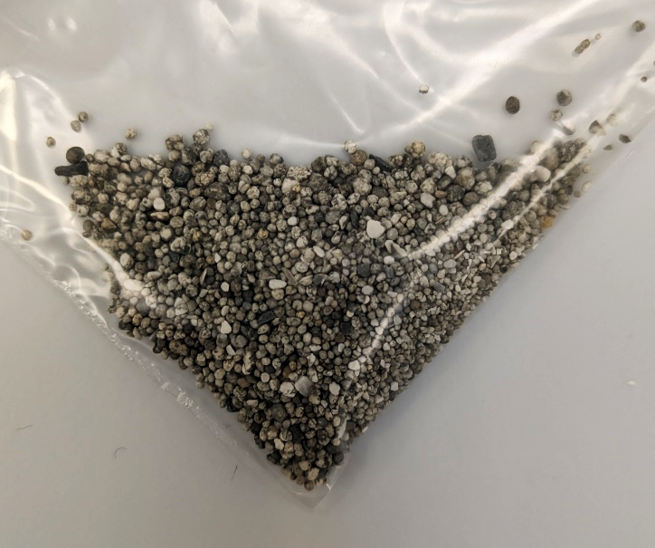
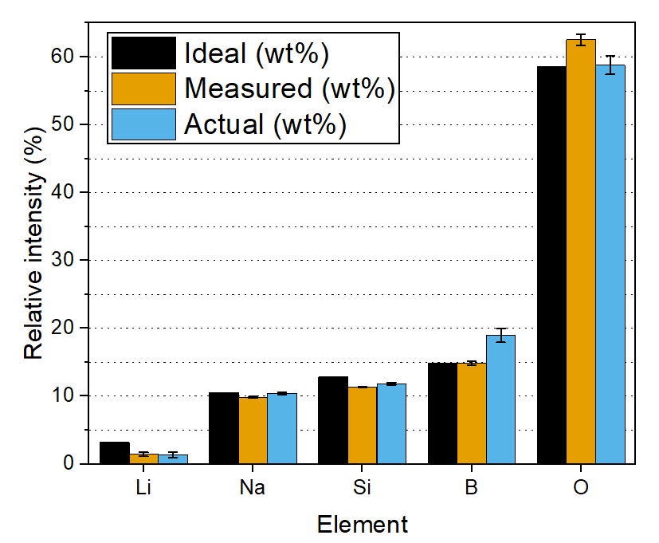

Elemental analysis of ‘kryptonite’
M. Rhodes et al., in preparation
Jadarite (LiNaSiB₃O₇(OH)) – (Fluorine deficient) Kryptonite!
Potential Li and B ore
Only 1 known reserve
Formation and structure poorly understood
Measurements use energy-sensitive Ge detectors
Fit peaks to determine amplitudes and positions to give the Measured wt%
Correct for muon capture probably for different elements determined using standards to give the Actual wt%
Technique is effective in determining the composition of Li-containing ores
Synthetic
Natural
20 mm

Slide 20
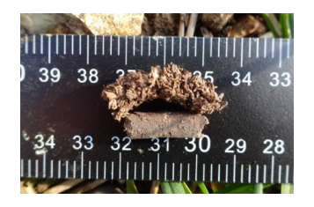
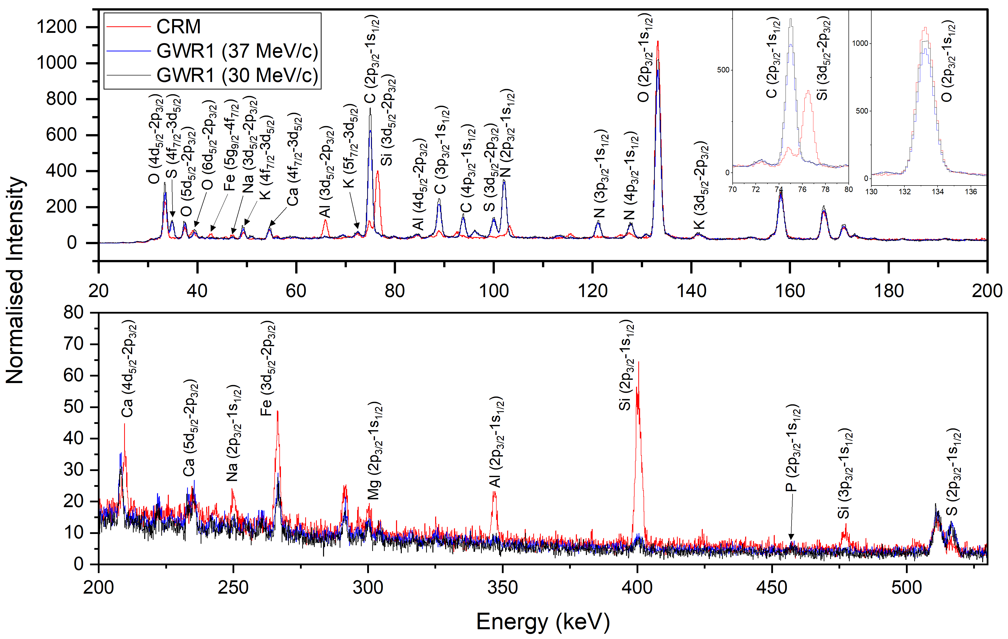
Green fertilizer composition
Swollen pellet -> Dry pellet exposed to moisture
Compare batches of fertilizer derived from waste materials to commercial reference materials
Understand consequences of variable feedstock on composition as a function of depth within pellets at different moisture contents
Non-destructive depth-dependence capability allows pellets to be studied in a representative form
Dry pellet

Slide 21
Conclusions
Muons are used across a wide range of clean energy materials
Ionic motion in battery and fuel cell materials from ex-situ to in-operando
Reaction kinetics in catalysts
Charge carrier dynamics and defects in semiconductors
Non-destructive elemental composition beneath the surface
Muons also used extensively in magnetism and superconductivity
Materials for quantum technologies
Superconductors for quantum technologies and fusion applications
Please get in touch if you think muons might be helpful for understanding materials you’re working on
Review articles –
I. McClelland et al., Annu. Rev. Mater. Res: https://doi.org/10.1146/annurev-matsci-110519-110507
G.E. Pérez et al., J. Mater. Chem. A: https://doi.org/10.1039/D2TA07235A
isis_energy_cleangrowth@stfc.ac.uk

