Slide 1
Neutron Imaging and Engineering Diffraction
Sylvia Britto
Instrument Scientist, IMAT
Webinar: Material Studies for Clean Energy
12th Feb, 2026

Slide 2
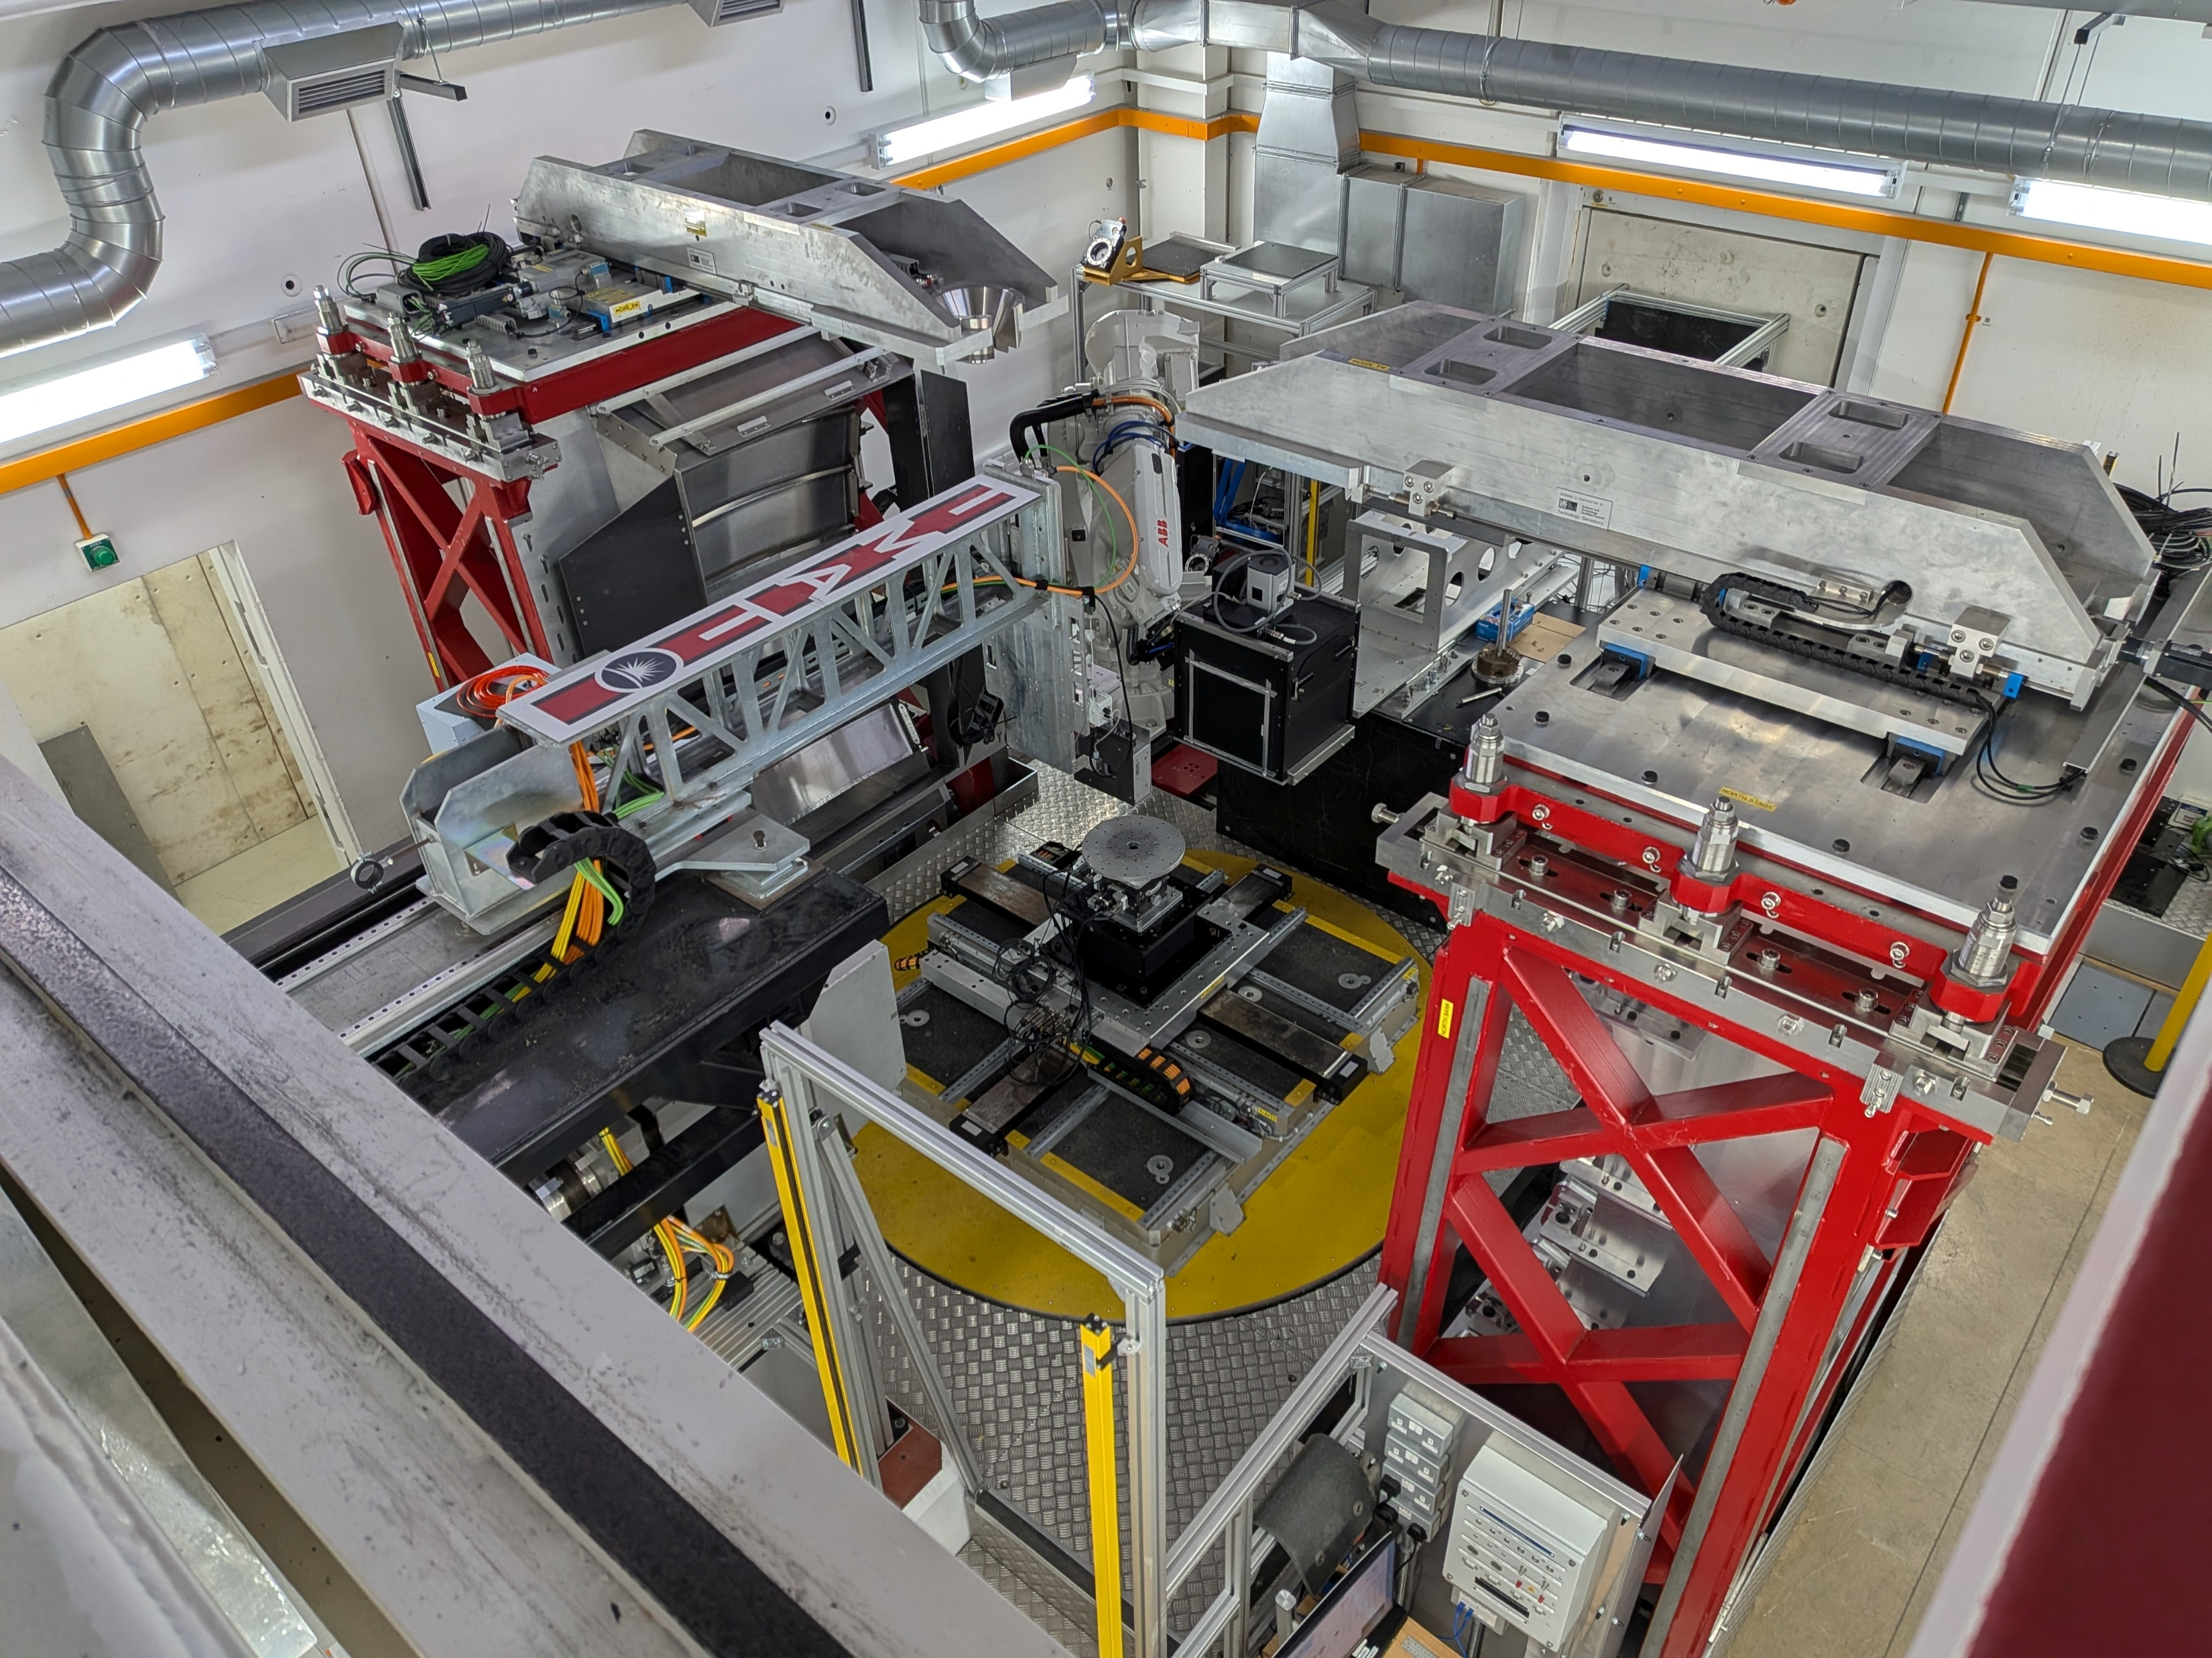
Neutron Imaging and Diffraction on IMAT
Spatial resolution
60 μm (3D)
120 μm (Bragg edge)
Flux (max)
4*10⁷ n/cm²/s
Max Field of View
20 x 20 cm²
3 x 3 cm² (Bragg edge)
Radiography (2D imaging)
Tomography (3D imaging)
2 - <10 hours
TOF (Bragg edge) imaging
Δλ/λ ~0.6 at 4Å
Diffraction
Diffraction detectors
Imaging camera
beam
Sample stack

Slide 3
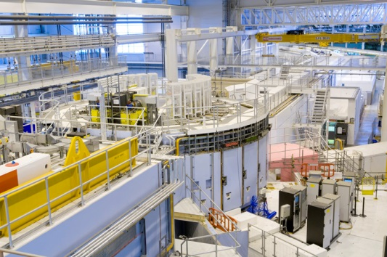
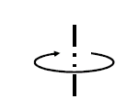
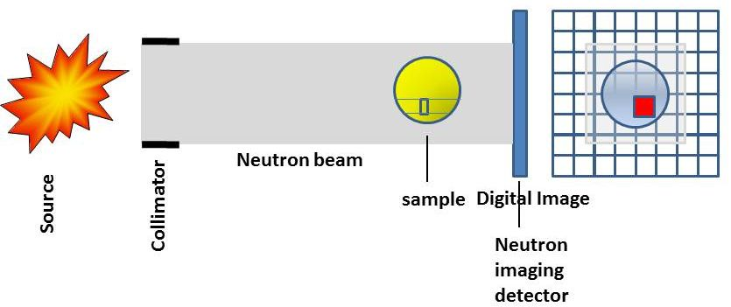




Neutron Imaging
L₁
Sample
Neutron Imaging
Detector
Neutron pulses (e.g. 10 Hz)
polychromatic
“white” beam
Transmission
Total cross section: $σT ($λ)
rotation
$I=Io exp \left\{−N∗σT∗t\right\}$
Attenuation coeff. μ
$\text{}=−ln\left(\frac{I}{Io}\right)\frac{1}{t}=$ $N∗σT$
$σ_{T}=$ $σ\left(capture\right)+σ\left(Bragg\right)+…$

Slide 4
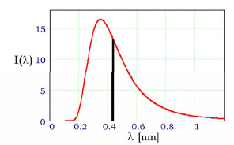
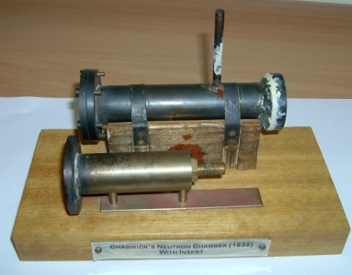
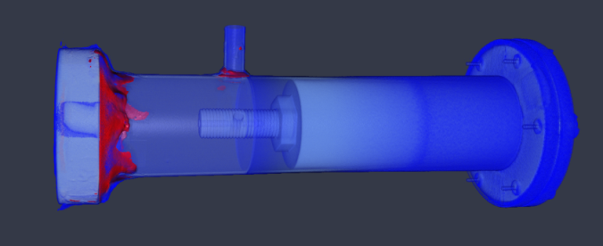
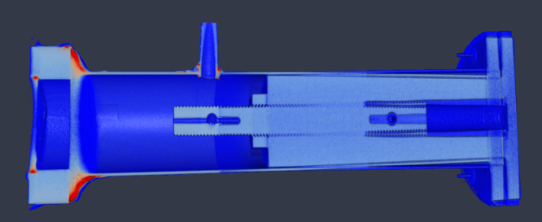
White beam tomography
rotation
Recording the 3D image:
Collect projections: #projections = #pixel * π / 2.
Apply normalisation (flat field; dark field); filters; determine centre of rotation;
Reconstruct slices using: filtered back projection or iterative algorithms
4) Visualization and analysis tools ImageJ / Avizo / VGStudio / etc
Chadwick’s neutron chamber replica

Slide 5
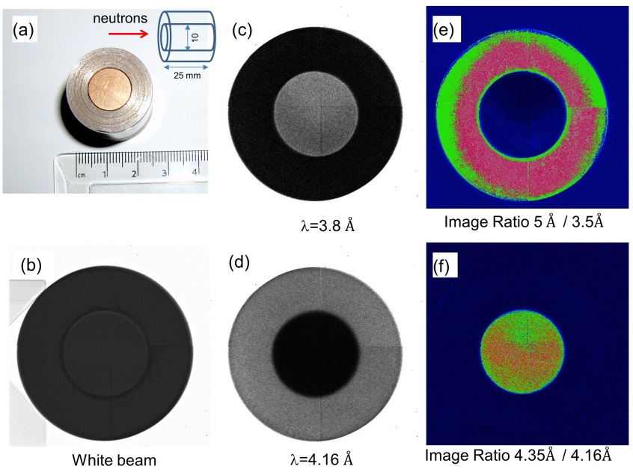
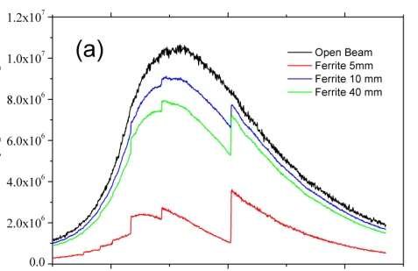
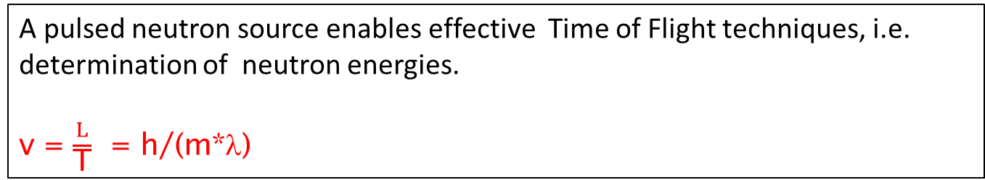
Energy-resolved neutron radiography on IMAT
A pulsed neutron source enables effective Time of Flight techniques, i.e. determination of neutron energies.
v = $\frac{L}{\text{T}}$ = h/(m*λ)
Detector at 57 m
sample
10 Hz
3000 energy slices

Slide 6

What’s in a pixel?
Energy-dispersive (TOF) imaging /Bragg Edge Mapping
Start
λ
λ
λ
Max Field of
View
3 x 3 cm²
$−ln\left(\frac{I}{Io}\right)\frac{1}{t}=$ $N∗σT($λ) $=$ μ(λ)
intensity
Resonance peaks show which atoms/isotopes present
Bragg edges show crystal structure – how those atoms are arranged
Height → Texture
Height → Concentration
Width → Temperature
Position → Strain
Wavelength, TOF

Slide 7
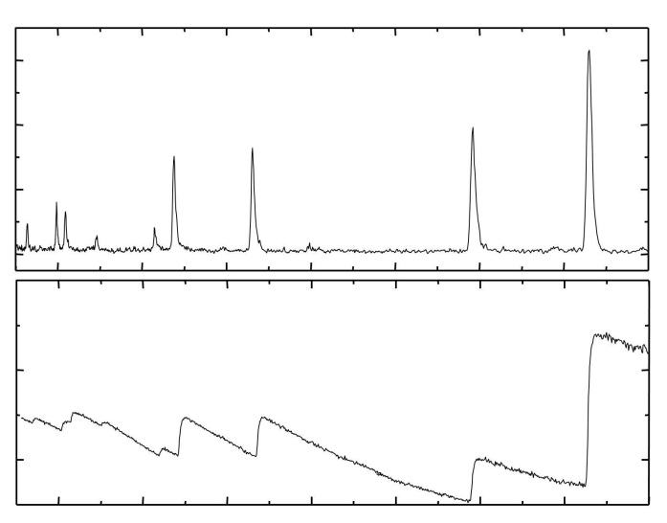
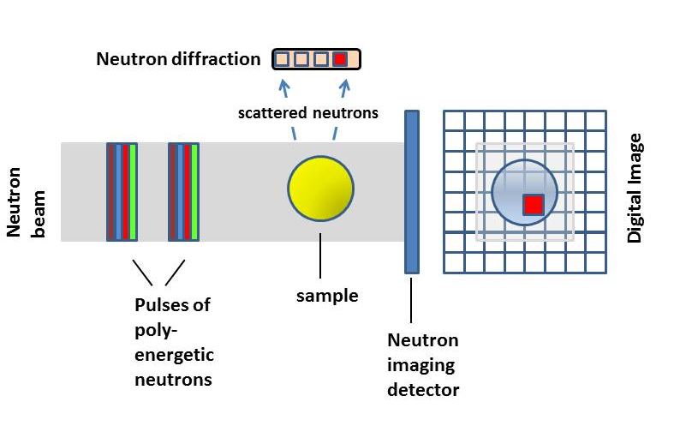
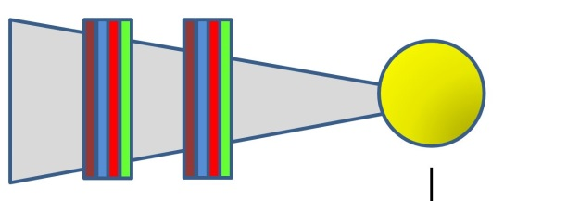
Spatially resolved Diffraction/transmission analysis
Bragg Peaks
Bragg Edges
d-spacing
Diffraction / transmission analysis:
positions → residual strains
heights → phase composition
rel. heights → texture
widths → microstrain/particle size

Slide 8
Clean Energy Applications of Neutron Imaging
Energy storage
Fuel Cells and Batteries
Cultural Heritage
Neutron Imaging in Life Sciences

Slide 9
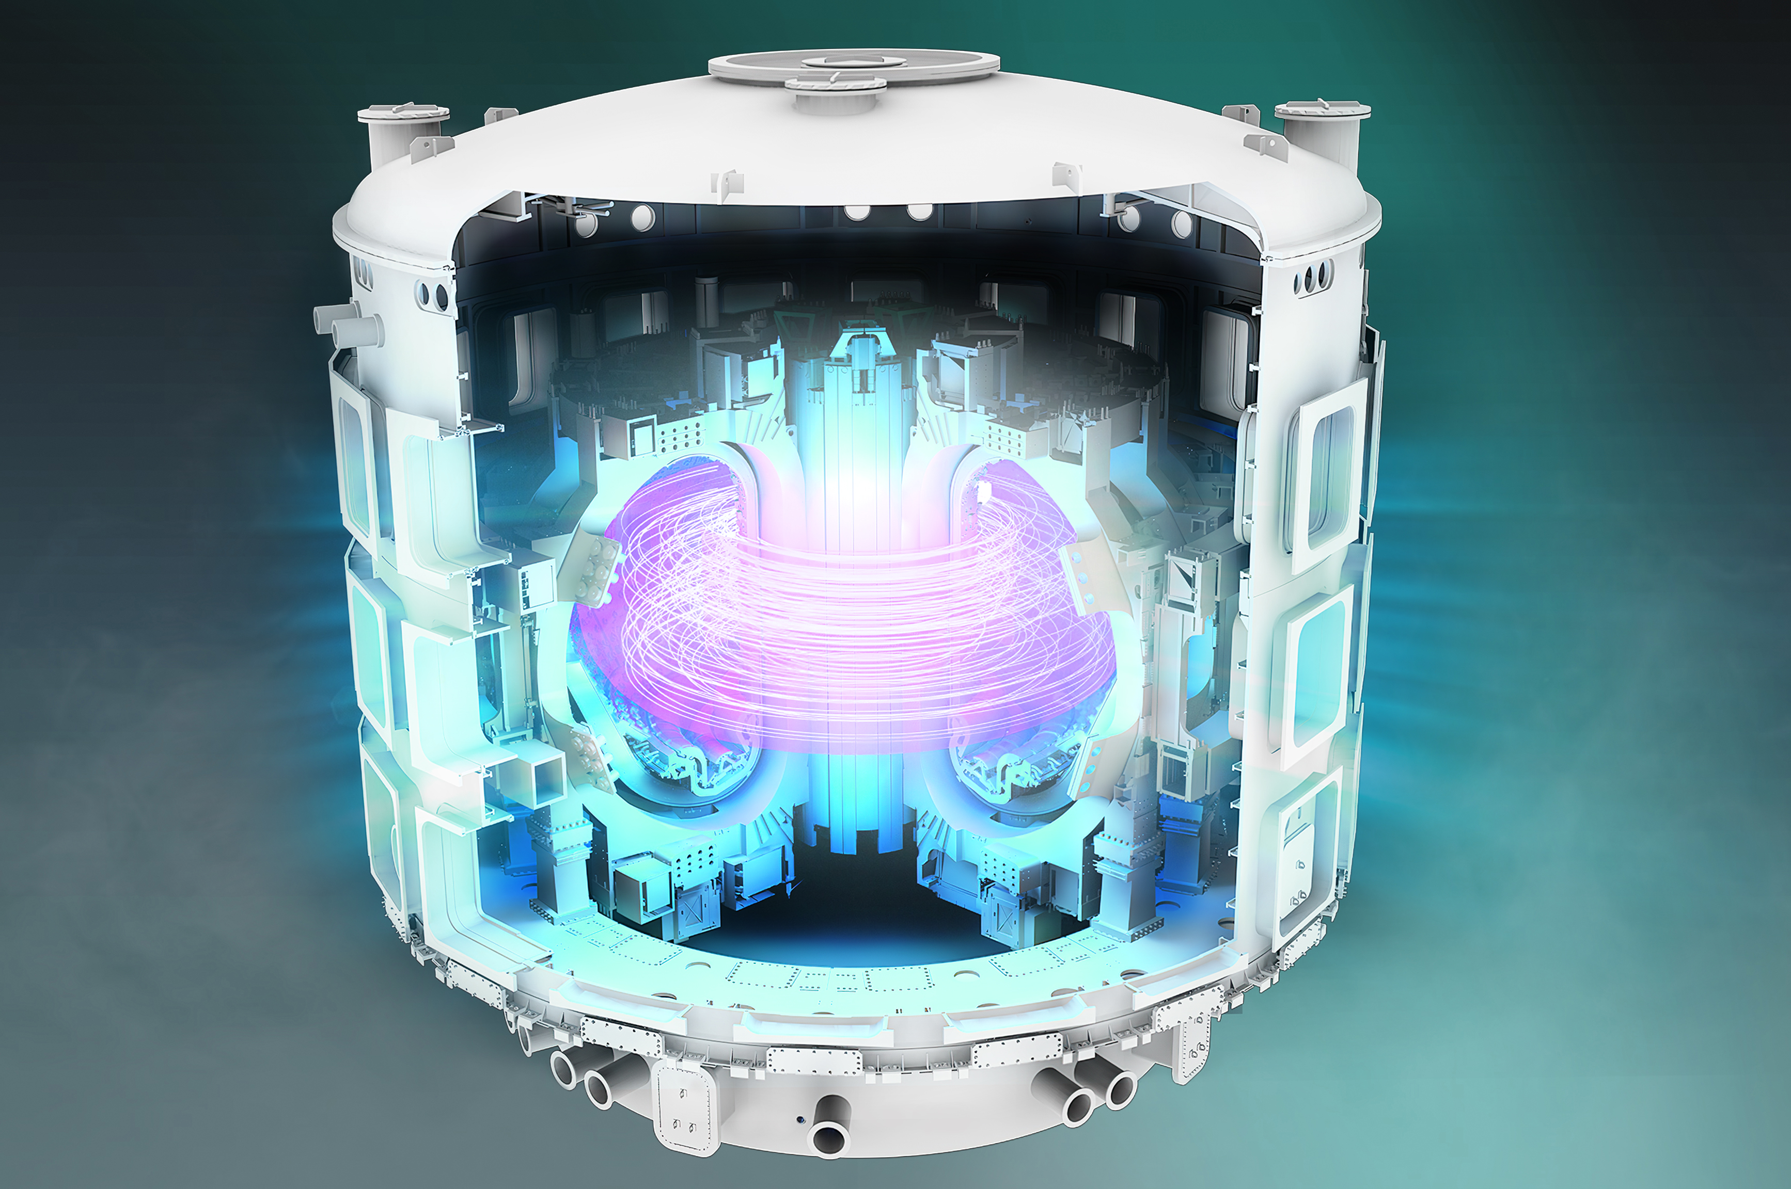
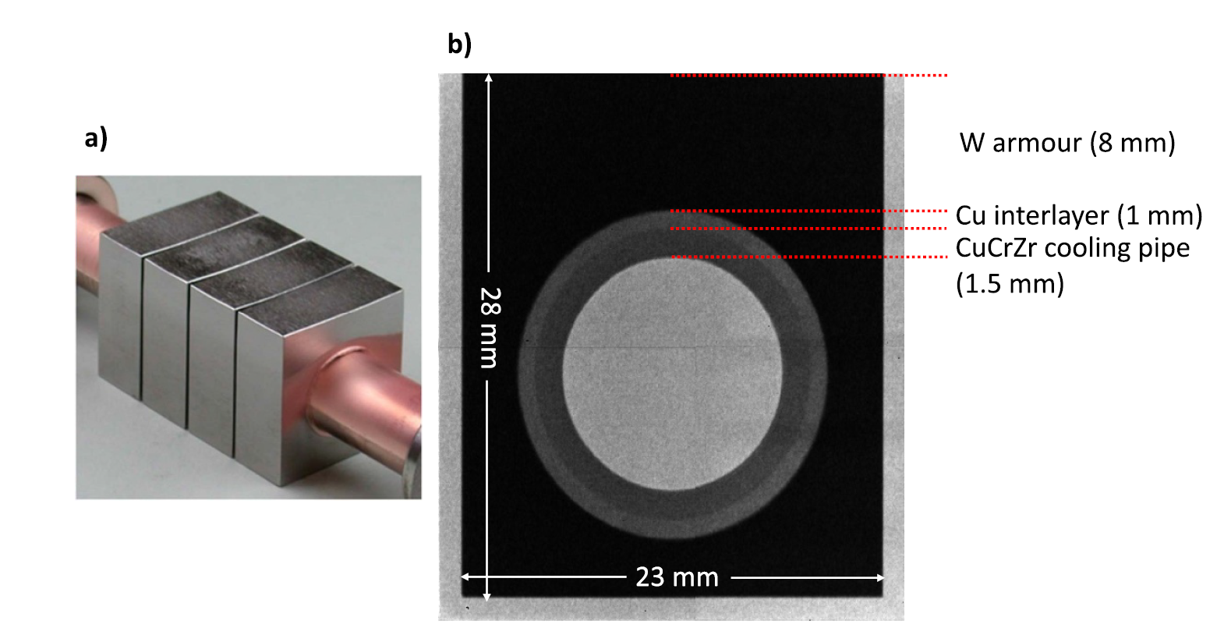
Assessing manufacturing quality of components: Fusion divertor tungsten monoblock
Neutron imaging useful to non-destructively characterize defects and voids in dense plasma facing components
in nuclear fusion reactors.
https://www.iter.org/machine/
T. Minniti et al, Nucl. Fusion 65, 2025, 026041

Slide 10
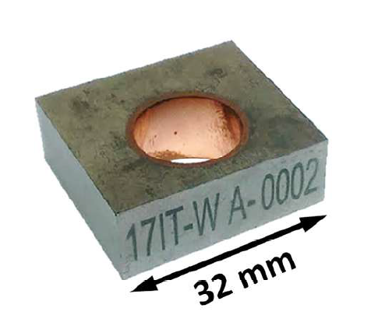
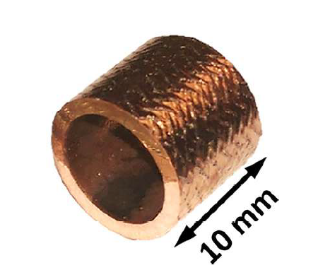

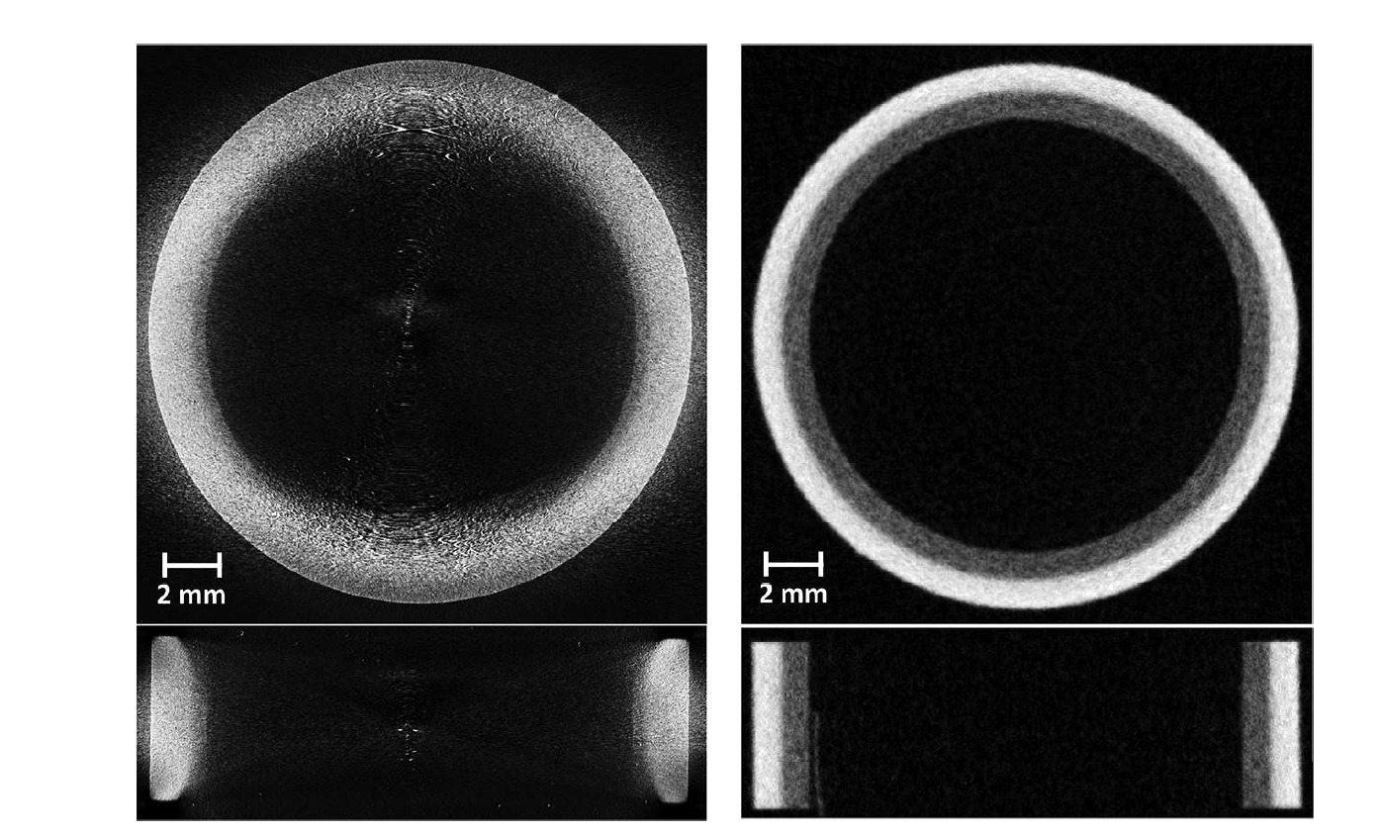
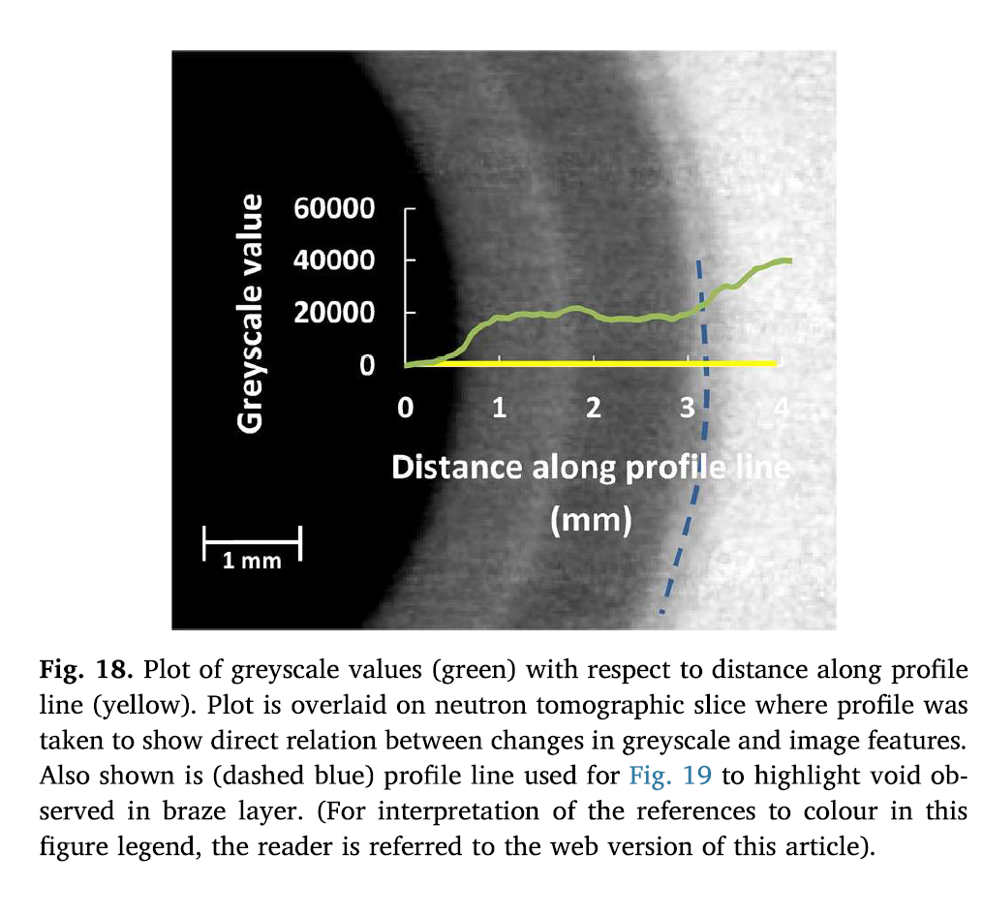
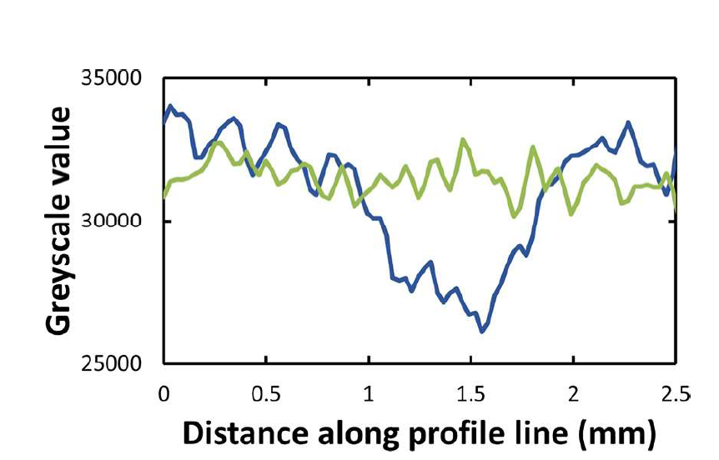
Assessing manufacturing quality of fusion divertor tungsten monoblock
X-ray Tomography
Neutron Tomography
L. L. Evans et al, Fusion Energy and Design, 134, 2018, 97-108

Slide 11
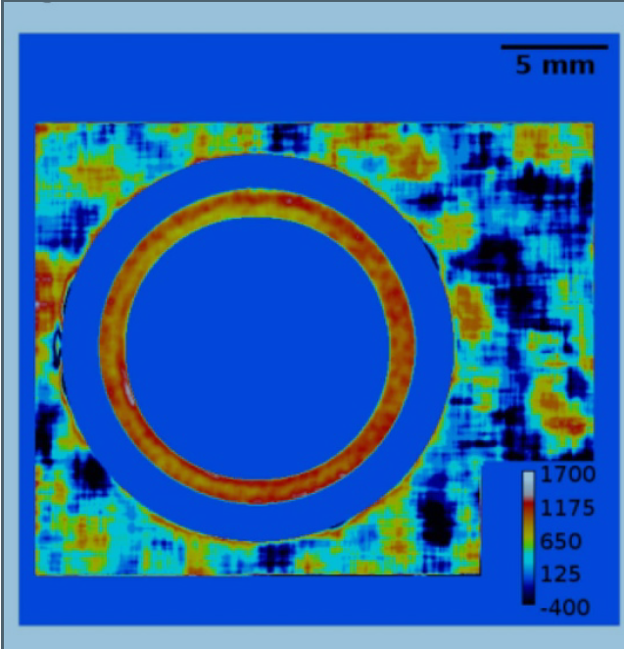
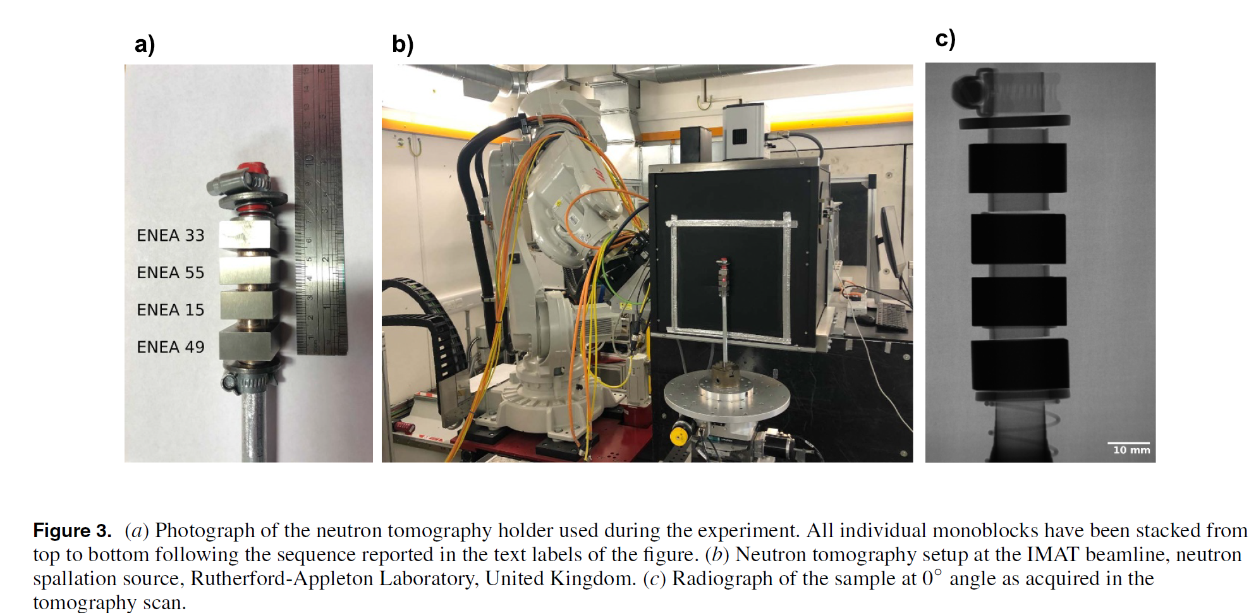
Assessing manufacturing quality of fusion divertor tungsten monoblock
Strain map derived from Bragg edge imaging
T. Minniti et al, Nucl. Fusion 65, 2025, 026041

Slide 12

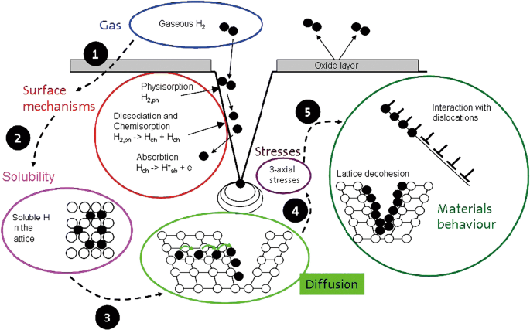
Hydrogen embrittlement
Neutron imaging useful to non-destructively quantify spatial distribution of hydrogen in engineering alloys.
San Francisco Bay Bridge, 2013
Can cause catastrophic mechanical failure in H carrying pipelines, high pressure storage tanks, refuelling stations
Review of Hydrogen Embrittlement in Metals: Hydrogen Diffusion, Hydrogen Characterization, Hydrogen Embrittlement Mechanism
and Prevention, X. Li et al, Acta Metallurgica Sinica, 33, 2020, 759-773.

Slide 13
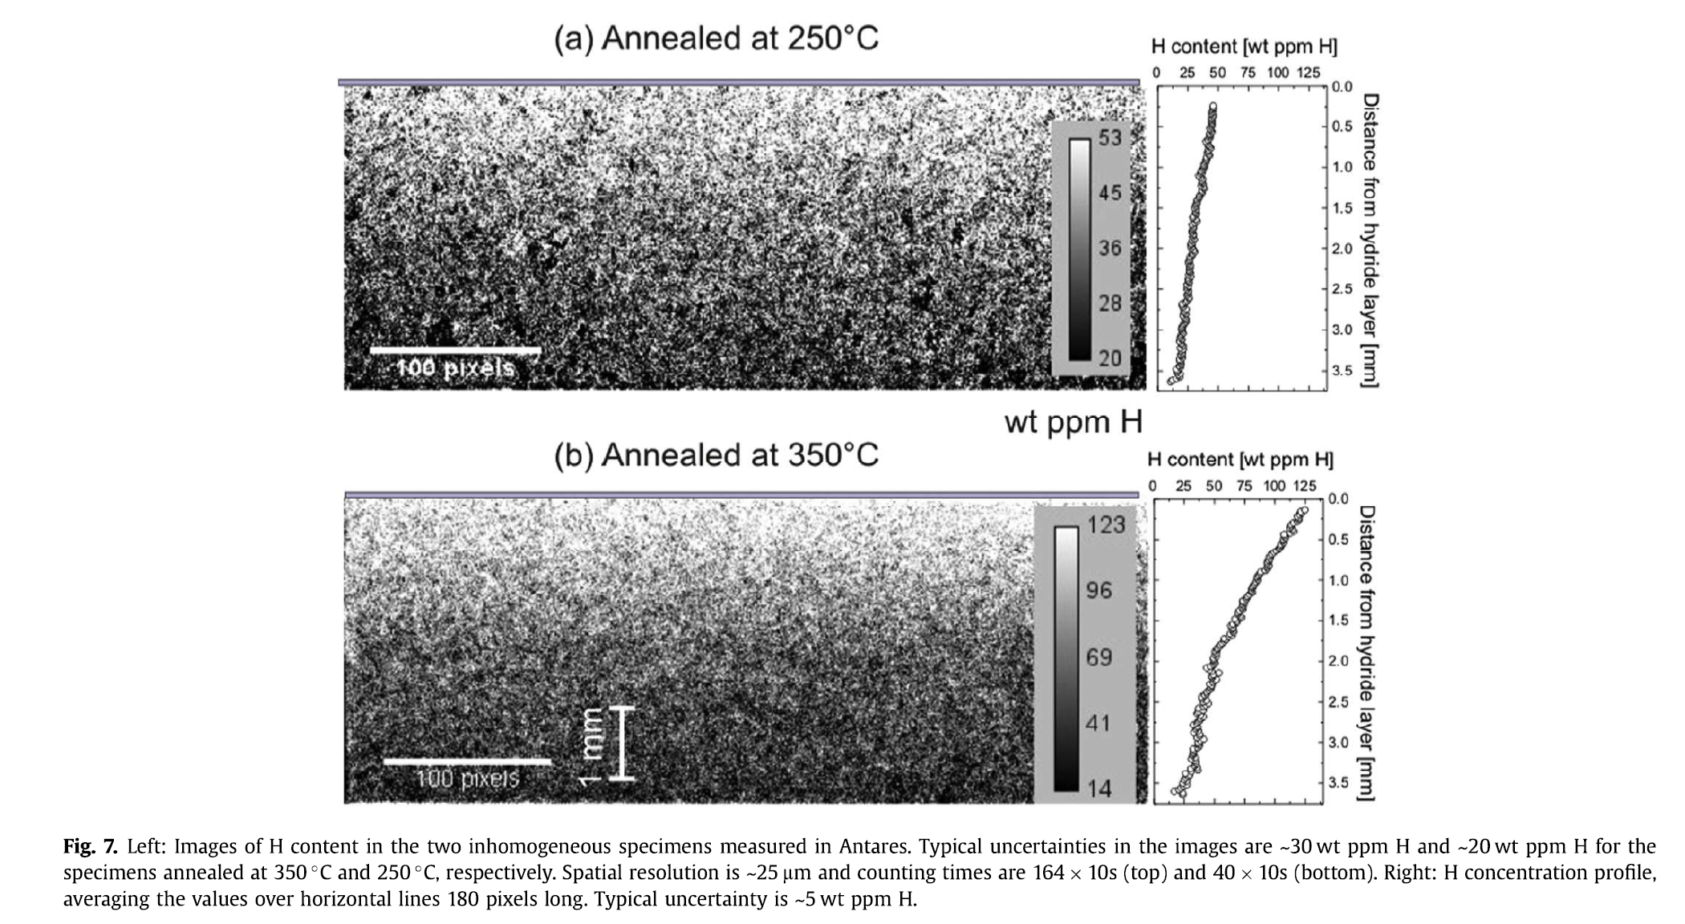
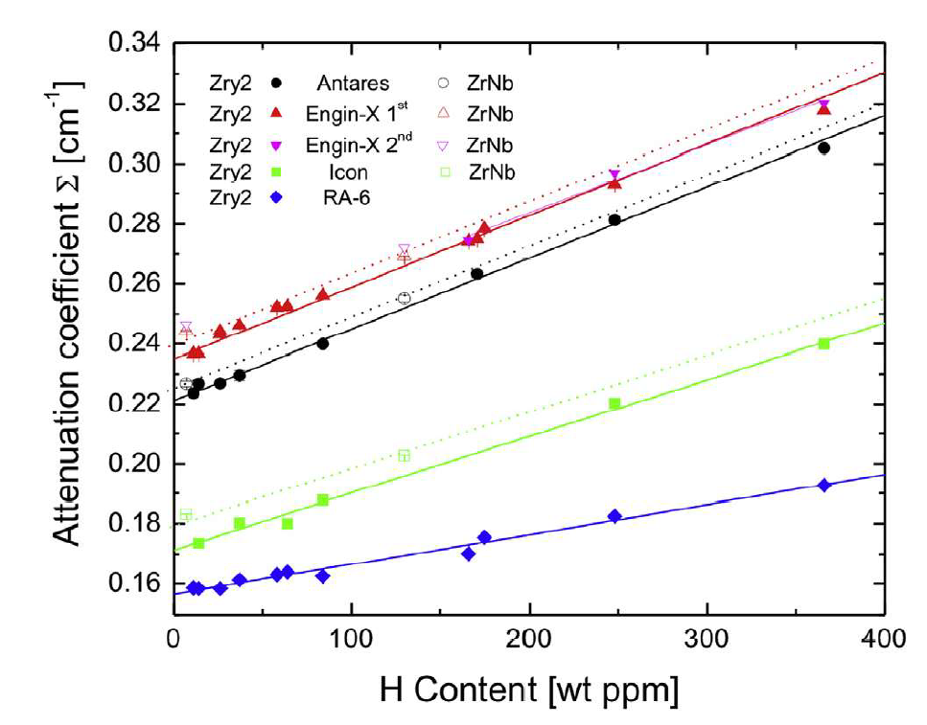
Hydrogen embrittlement in alloys
Standards containing known amounts of H are used to calculate attenuation coefficients.
From this H content in unknown samples can be determined.
N. L. Buitrago et al, J. Nucl. Mater. 503, 2018, 98-109

Slide 14

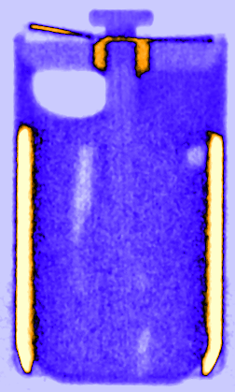
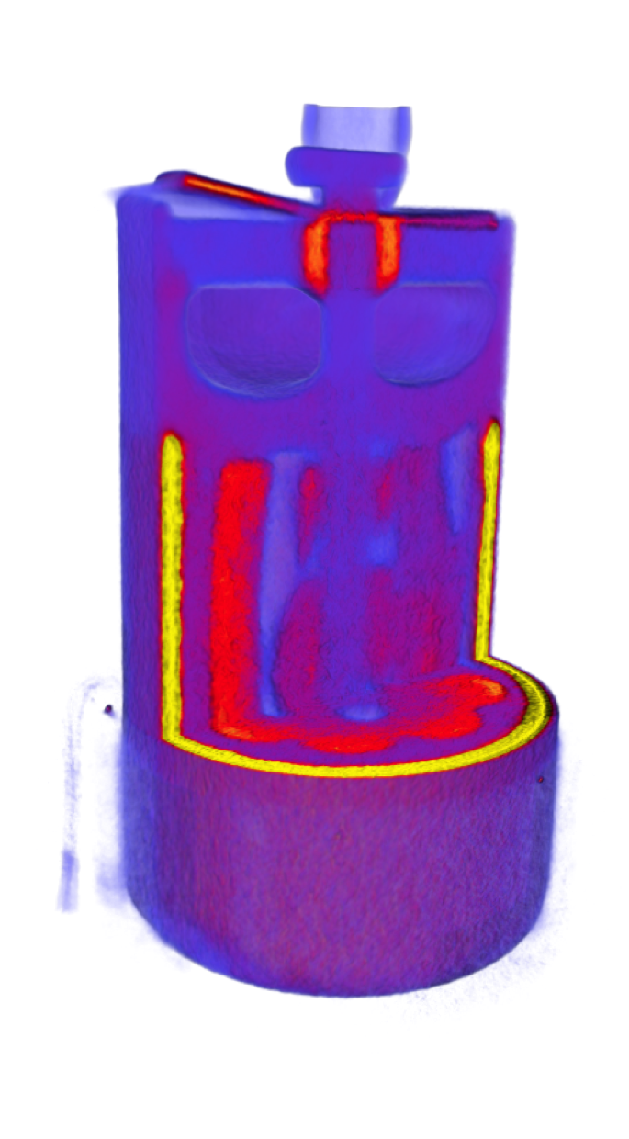
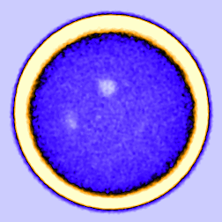
Energy Storage: Li Diffusion in Li/SOCl₂ batteries
Neutron imaging can be used to visualize lithium ion diffusion and dynamics in Li-ion batteries.
LS14250 - Saft
Li metal / thionyl
Lithium diffusion in Li/SOCl2 batteries
positive tab
SO₂ gas
reservoir
< … discharging … >
SOCl₂
cathode
15mm
R. Ziesche, J. Electrochem. Soc. 167 (2020)
Li anode
R. F. Zeische et al, J. Electrochem. Soc. 167, 2020, 130545
15mm
R. F. Ziesche, J. B. Robinson, M. D. R. Kok, H. Markotter, W. Kockelmann, N. Kardjilov, I. Manke, D. J. L. Brett and P. R. Shearing, 4D Neutron and X-ray Tomography Studies of High Energy Density Primary Batteries: Part 1. Dynamic Studies of LiSOCl₂ during Discharge, J. Electrochem. Soc. 167, 130545, 2020.

Slide 15
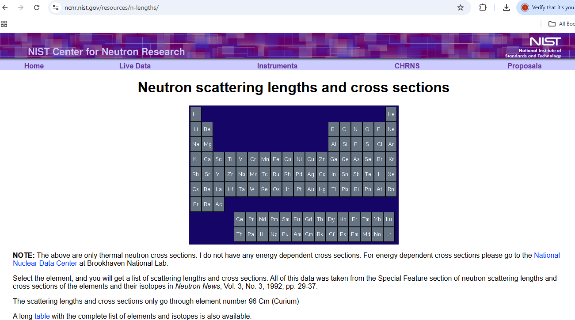
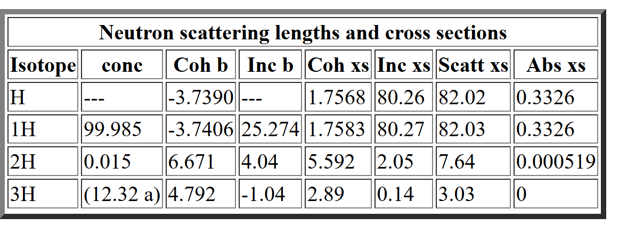
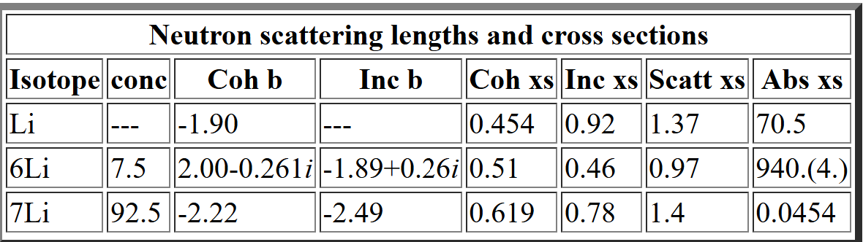
Isotope Selectivity

Slide 16
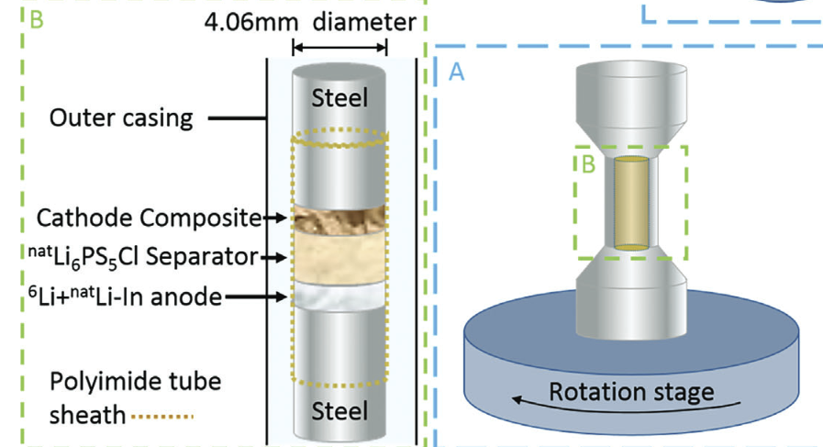
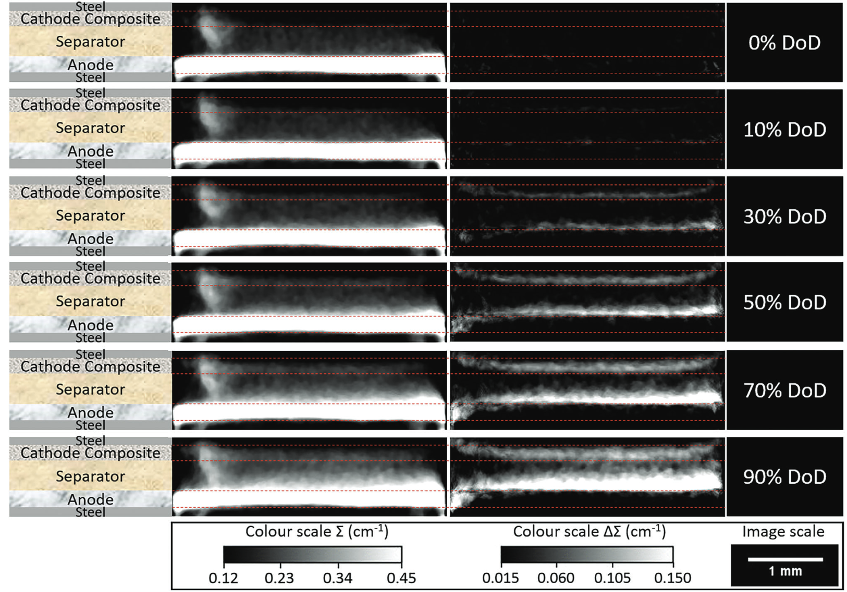
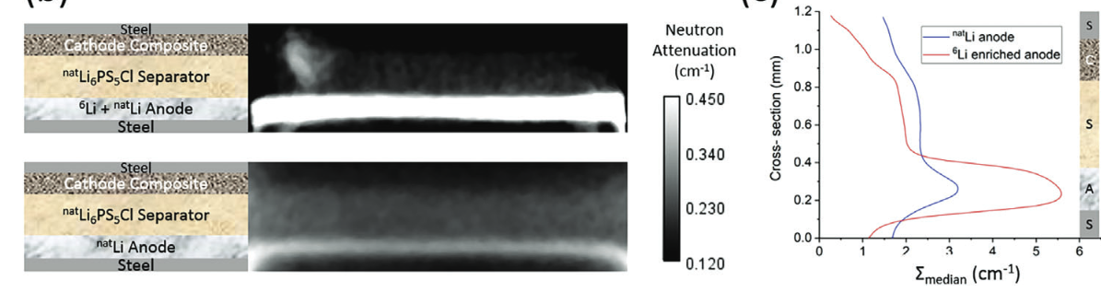
Visualizing Lithium ion transport in solid state Li-S batteries
@NeXT, ILL
R. Bradbury et al, Adv. Funct. Mater. 33, 2023, 2302619

Slide 17
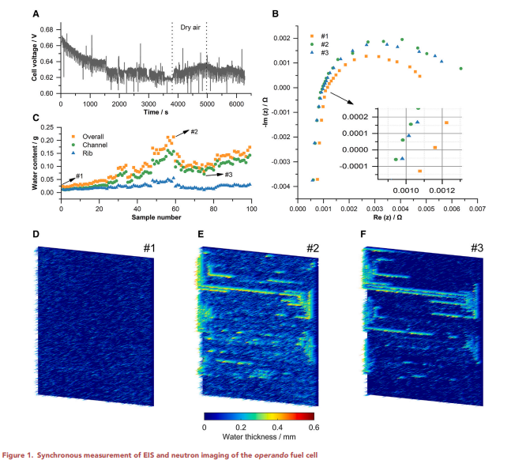
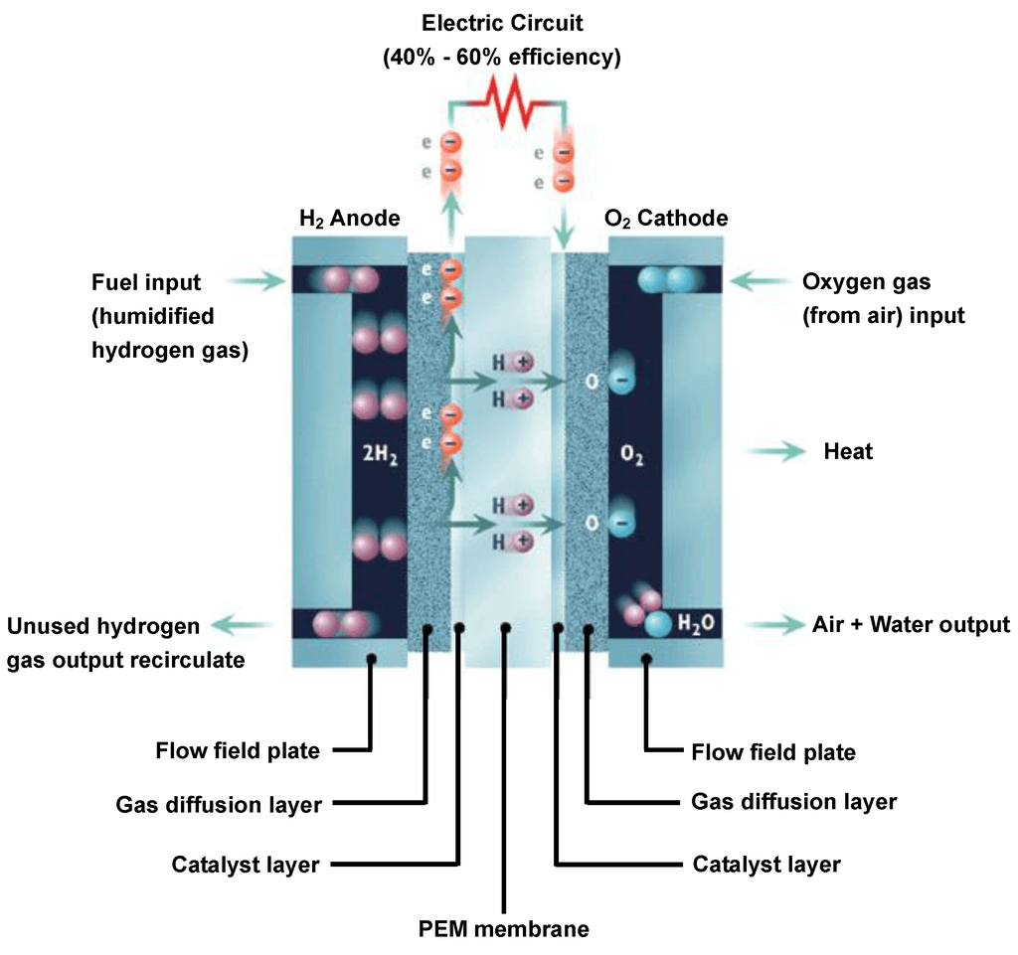
Neutron Imaging of Fuel Cells
Neutron imaging can be used to study water management in operating fuel cells.
S. Zhou et al, Cell Reports Physical Science, 5, 2024, 102208

Slide 18
Thank you
IMAT Contacts
Sylvia Britto sylvia.britto@stfc.ac.uk
Ranggi Ramadhan ranggi.ramadhan@stfc.ac.uk
Winfried Kockelmann winfried.kockelmann@stfc.ac.uk
Engin-X Contacts
Joe Kelleher joe.Kelleher@stfc.ac.uk
Tung-Lik Lee tung-lik.lee@stfc.ac.uk

