Slide 1

Neutron spectroscopy
Svemir Rudic
ISIS Molecular Spectroscopy Group scientist

Slide 2
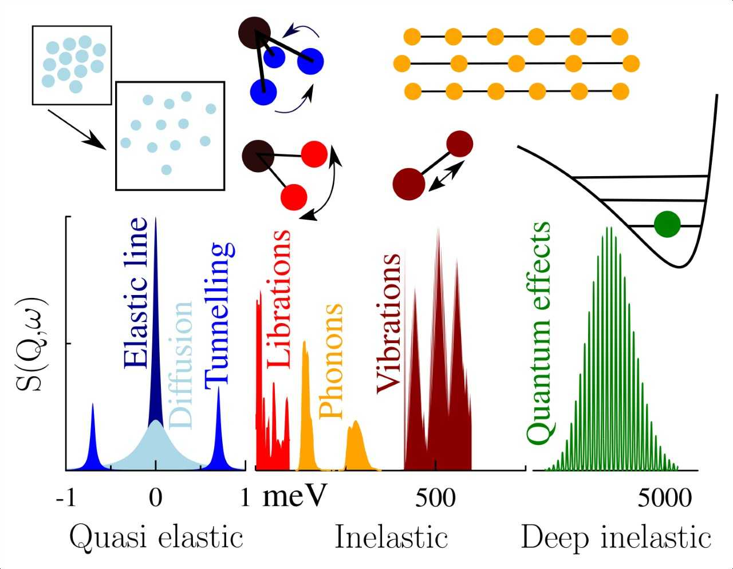
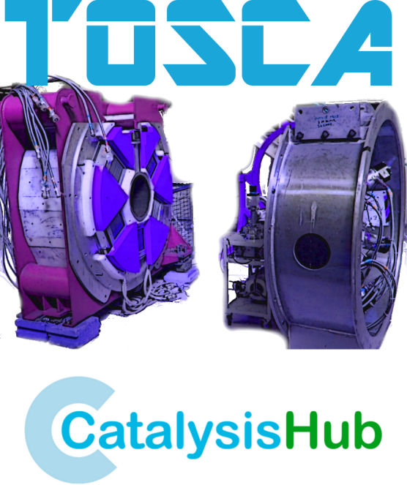
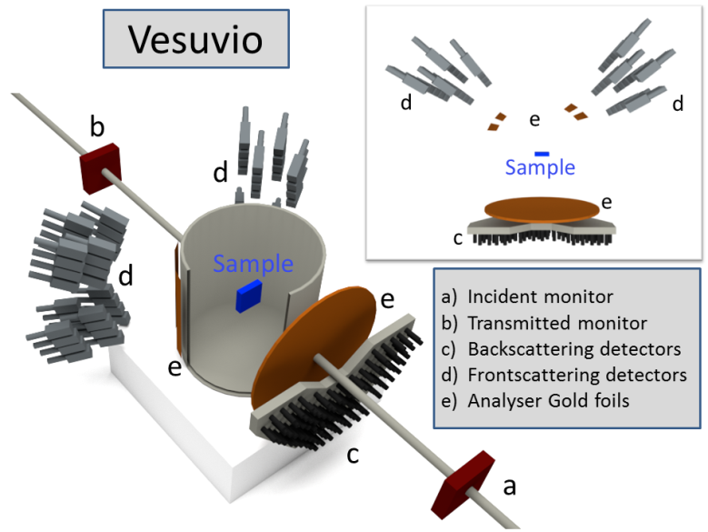
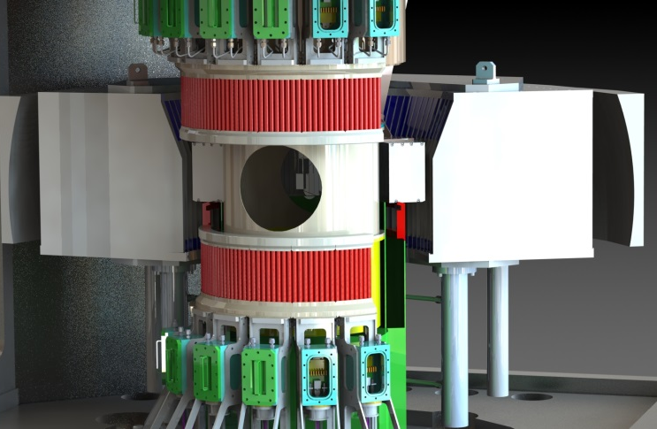
LOW
energy
High
energy
OSIRIS/IRIS

Slide 3
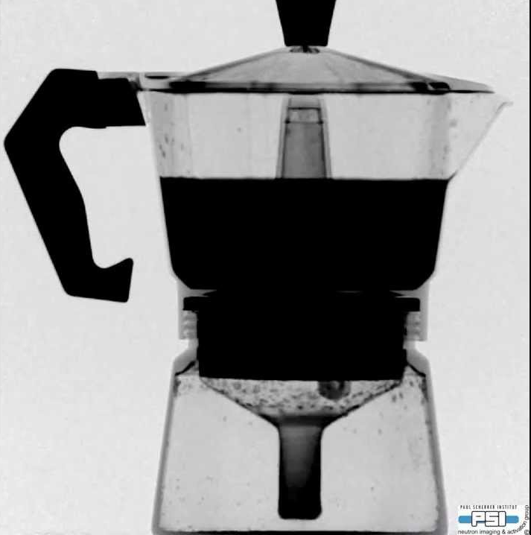
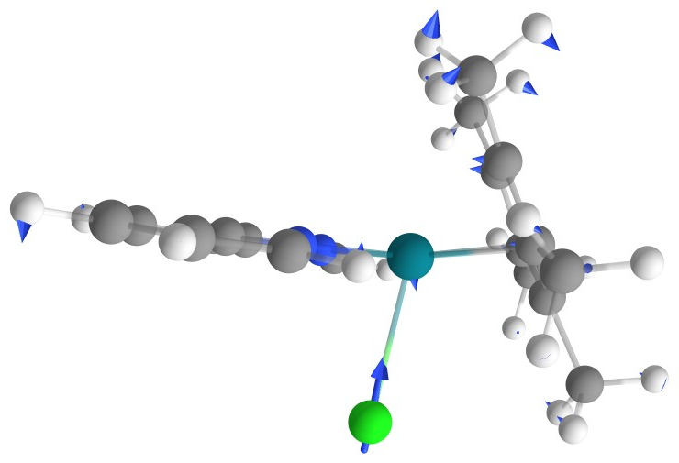
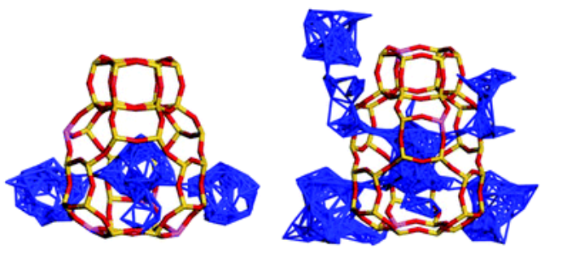
Why neutrons for dynamics?
H
D
O
Fe
X-ray
Neutrons
Selective deuteration
distinguish different molecular groups
The perfect tool for self correlation of Hydrogen!
All modes are active unlike IR/Raman

Slide 4
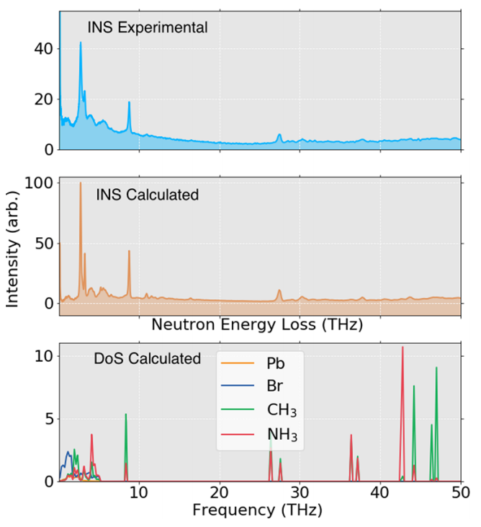
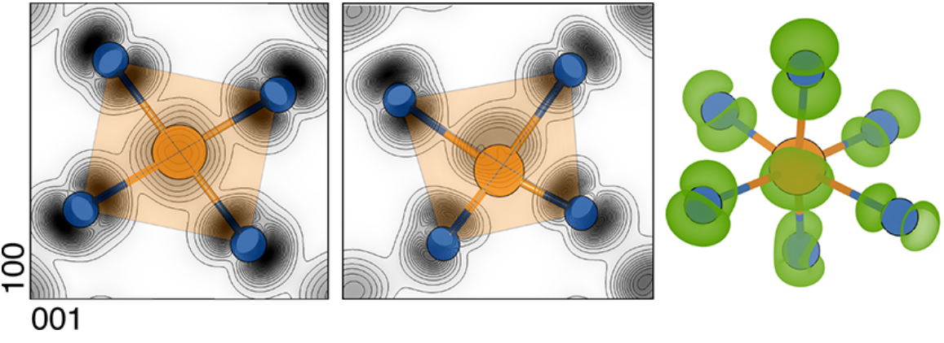

Identifying peaks on Tosca
Density functional theory can be used to calculate vibrational modes
Data can then be weighted by neutron cross sections
Combinations and overtones can be added
Gives atomic insight
abins

Slide 5
Examples of TOSCA INS studies
A. Michalchuk et al., Chem. Commun. 57, 11213 (2021)
I. Vazquez-Fernandez et al., J. Phys. Chem. C 125, 24463 (2021)

Slide 6
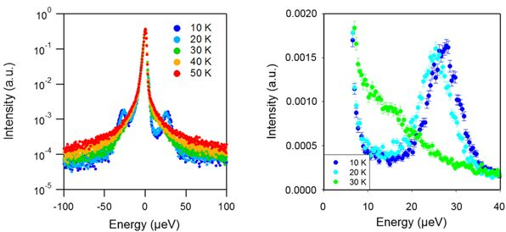
Basic principles of quasi elastic scattering
Similar to TOSCA, but lower energy and multiple detector angles (Q)
Uncertainty in E_{i} defines the lowest accessible timescale/energy
Broadening beyond instrumental resolution increasing motion (diffusion, low frequency bending of polymers, local confined motion)
Fickian diffusion has a linear relation between FWHM and Q
Many other models describe hopping etc.
Peaks indicate tunnelling

Slide 7
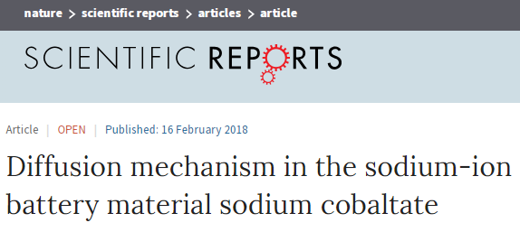
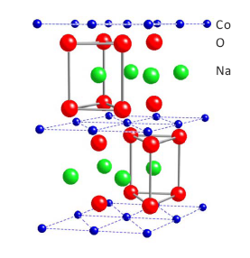
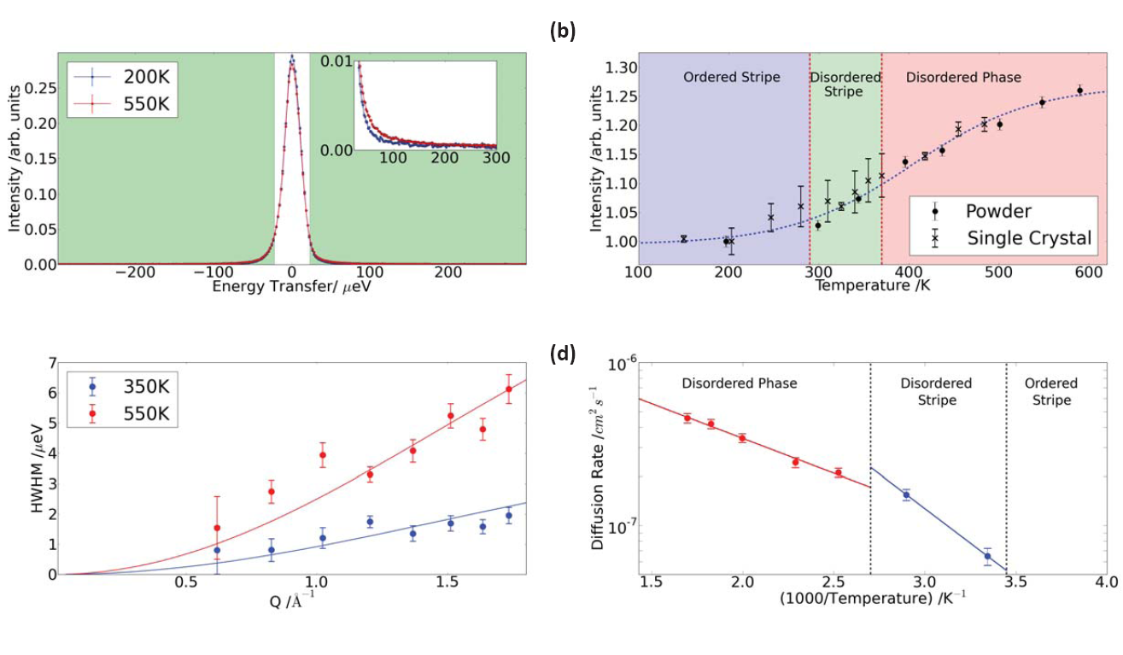
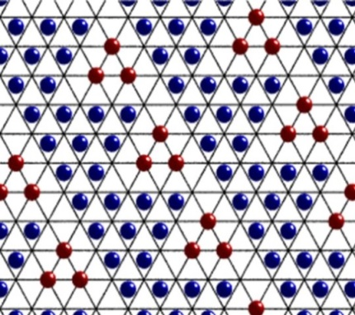
The scarcity of Li, has sparked interest in Na
Replacing Li with Na!
Lorentzian fitting
Jump diffusion model fitting
Diffusion coefficients are extracted as a function of T
T.J. Willis et al., Scientific Reports 8, 3210 (2018).

Slide 8
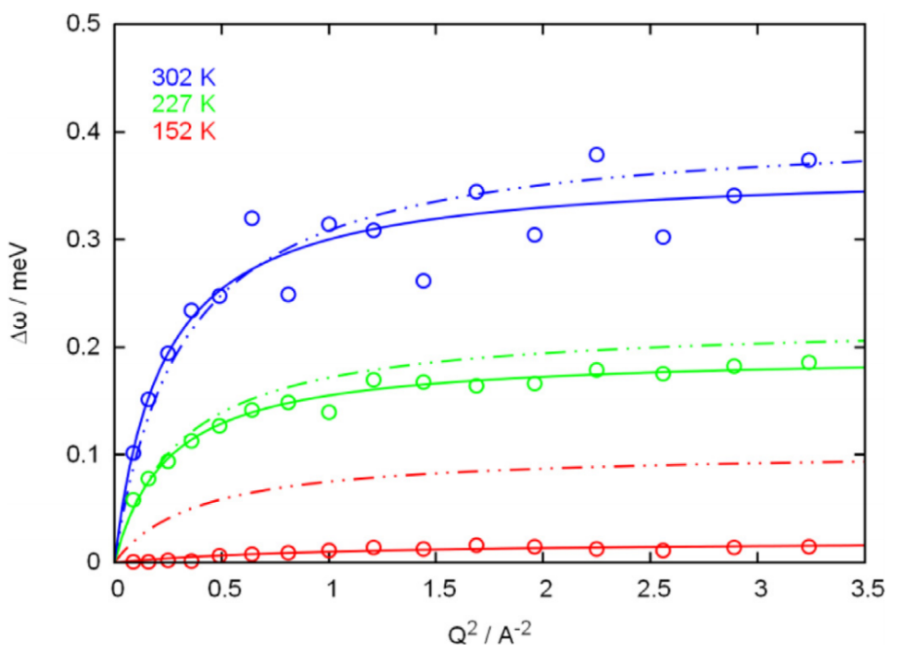
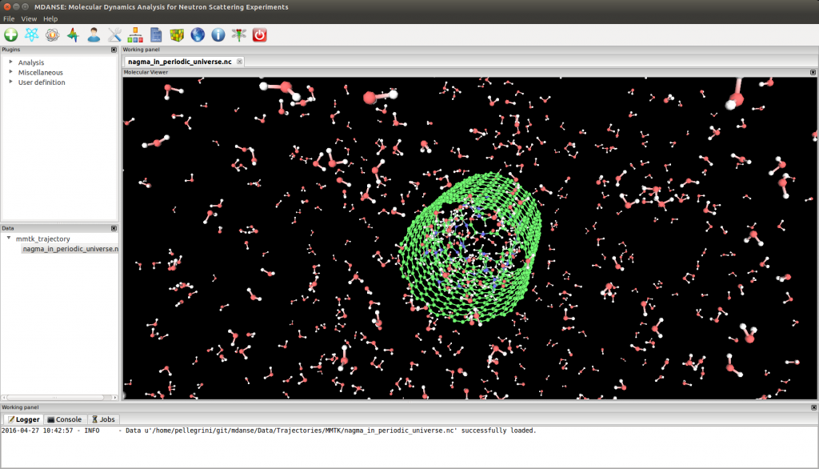
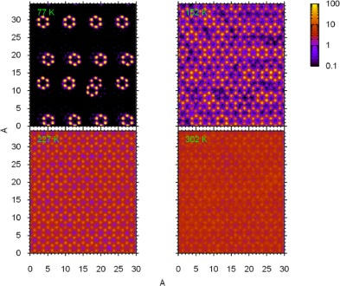
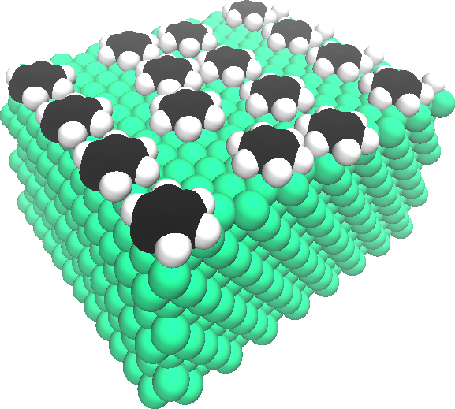
Molecular dynamics (MD) with qens
MD can probe diffusive/long time regimes as in QENS
Ab Initio and empirical force-fields may be compared directly to QENS via MDANSE
QENS can even be used to parameterise MD models
I. Silverwood and J. Armstrong, Surface Science 674, 13 (2018).

Slide 9
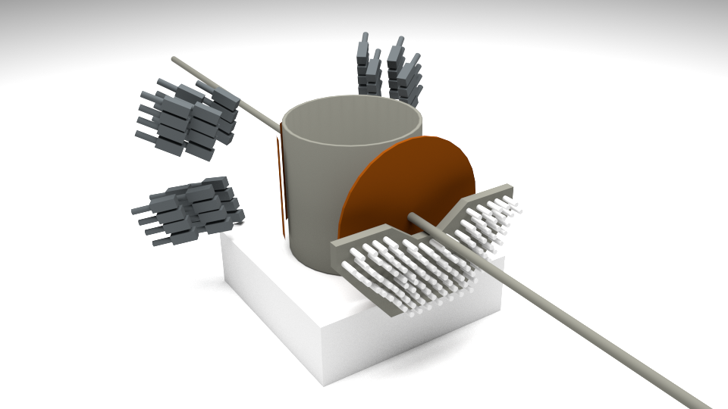
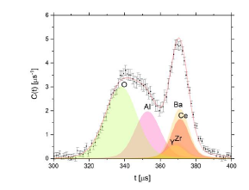
VESUVIO is a unique instrument in the world!
1. Neutron Compton scattering (NCS)
Unlike other instruments, it looks at materials one atom at a time..
Can we do any better?

Slide 10
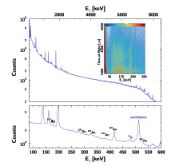

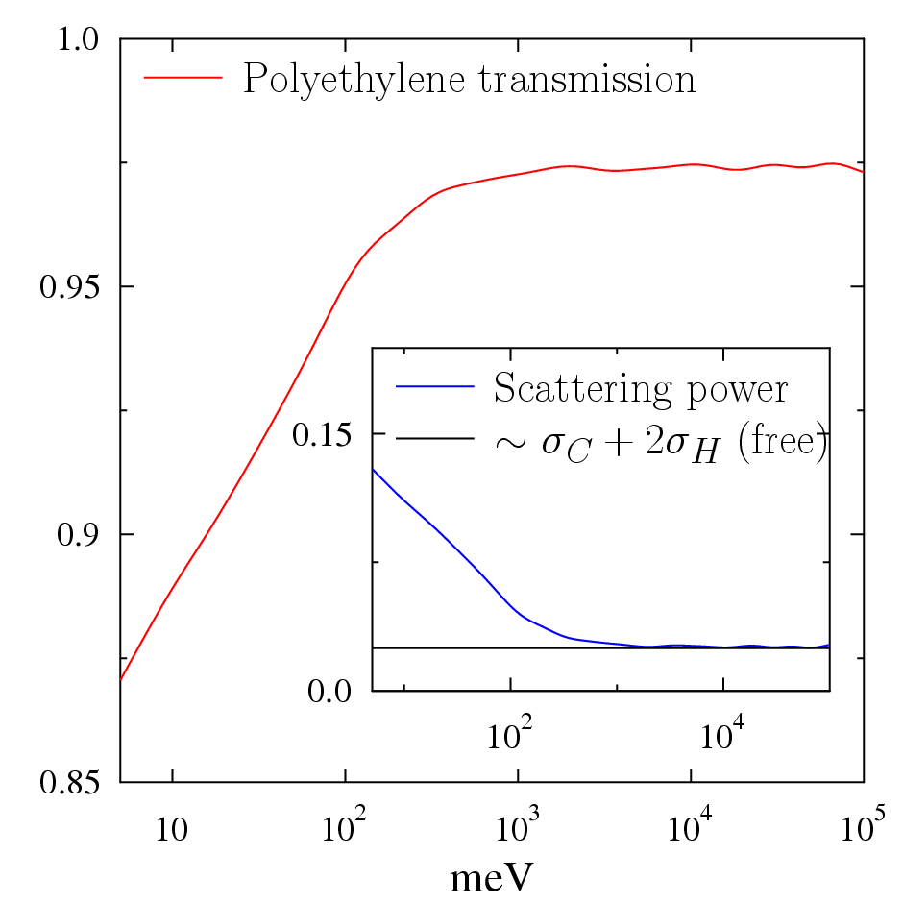
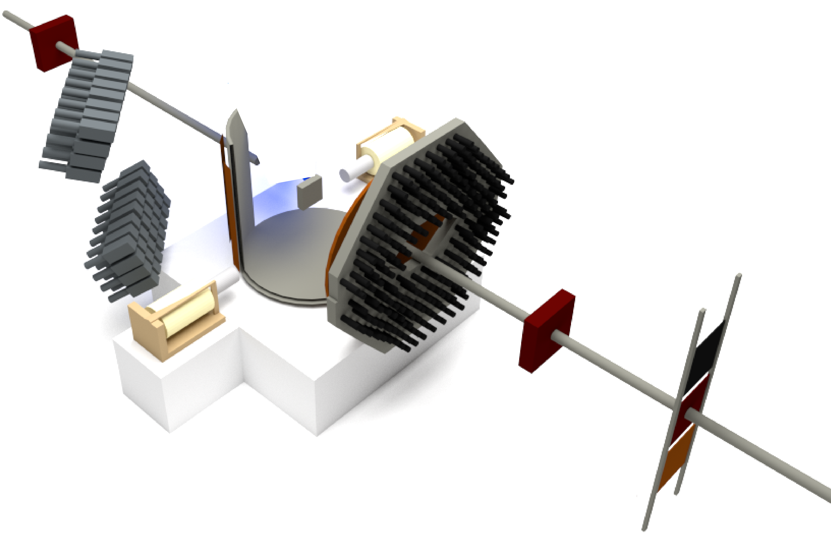
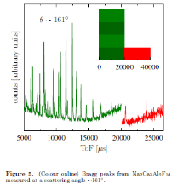
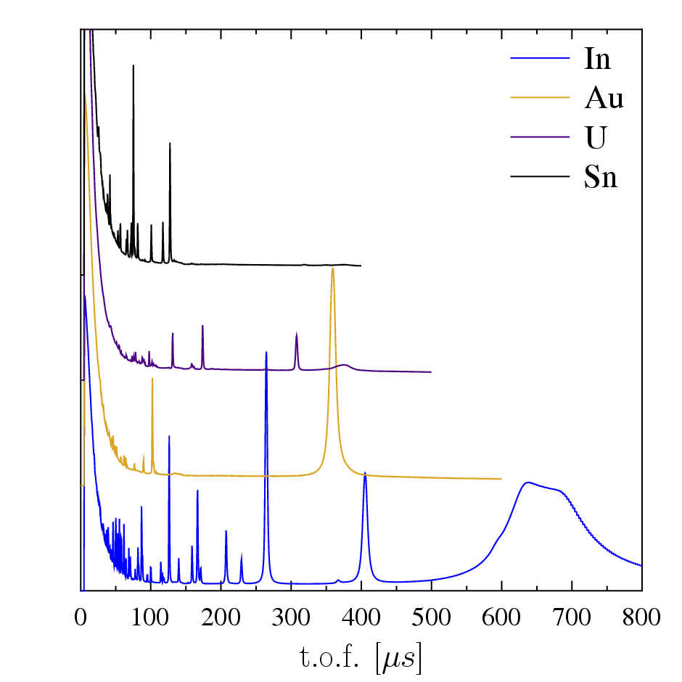
4 new techniques on VESUVIO and made them integral part of the user programme
5. PGAA and multi-dimensional
PGAA
3. Neutron transmission
2. High-resolution
wide d-spacing range
neutron diffraction
4. resonant neutron
absorption Dopplerimetry
VESUVIO+:
50 k£ budget and 4 years!

Slide 11
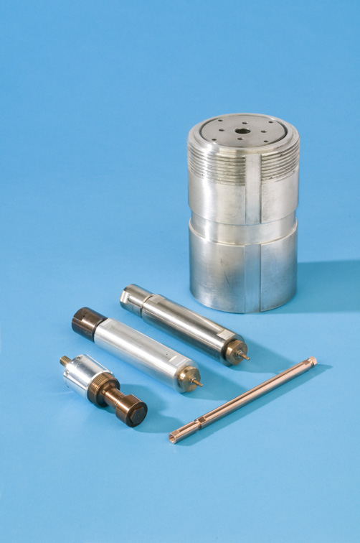
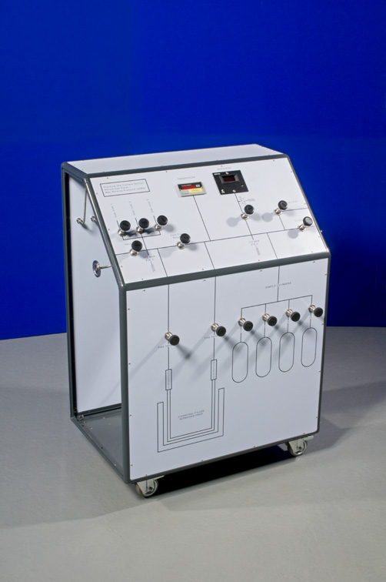
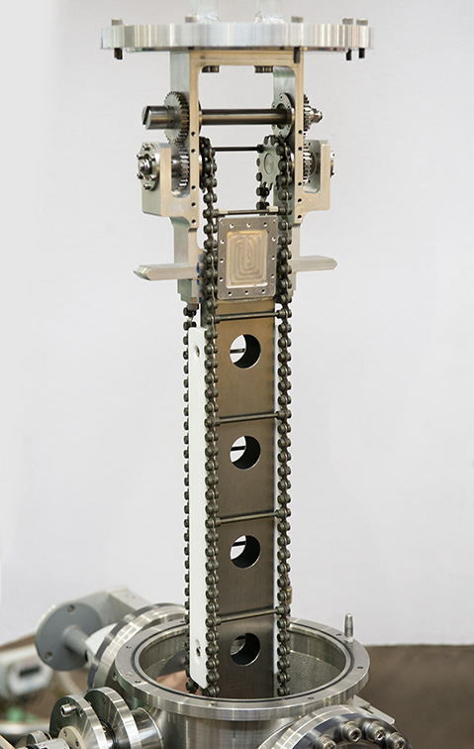
sample environment
Sample Changers
TOSCA (36 samples)
IRIS (3 samples)
High pressure cells
(Up to 7 Kbar)
Gas Panel
(Many gases available)
High P phase changes
Gas absorption vs pressure
Studies of entire class of
material

Slide 12
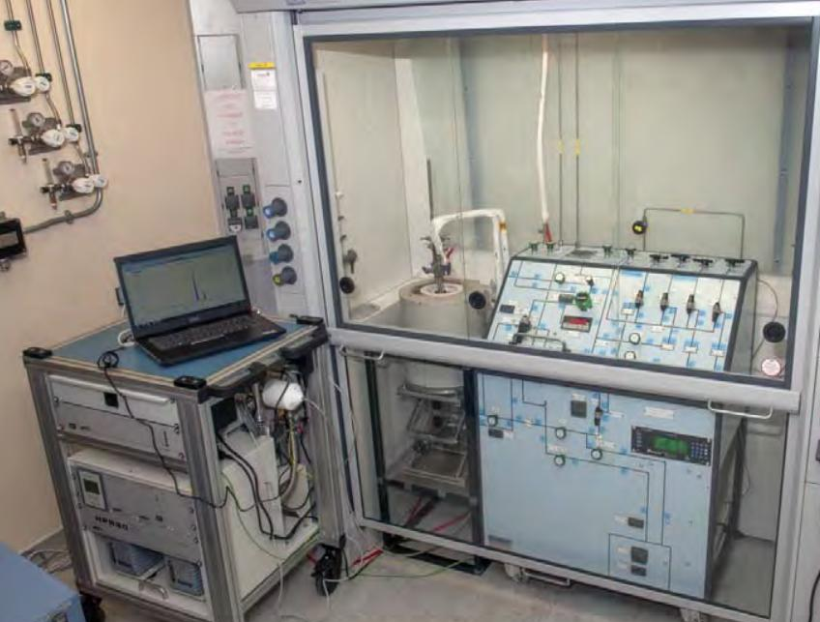
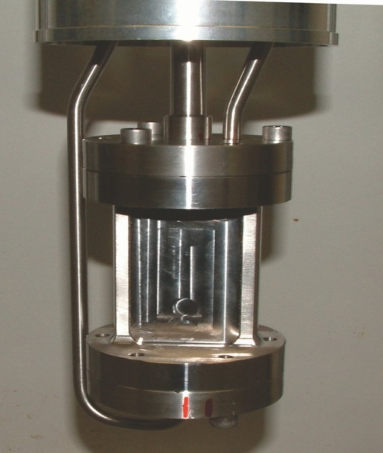
Catalysis rig
Catalytic reactions at the target station, which can be put straight onto TOSCA
furnace
Gas manifold
Mass spec
Study reactions under different conditions
Flow through
Reaction cells

Slide 13
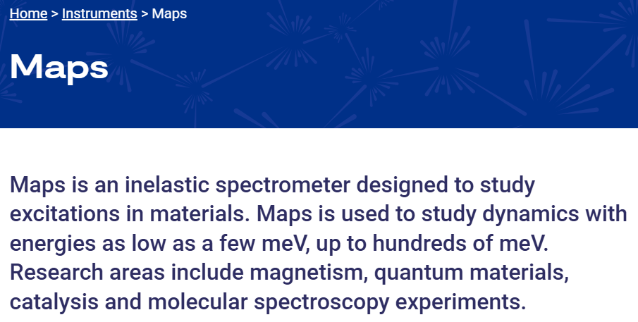
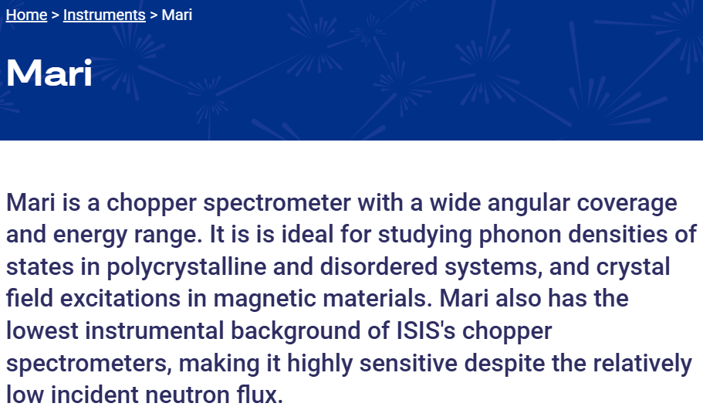
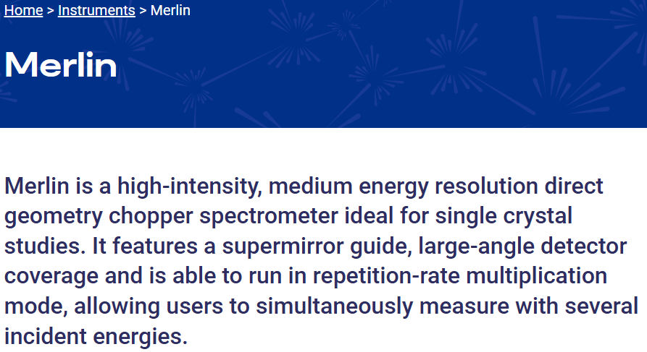
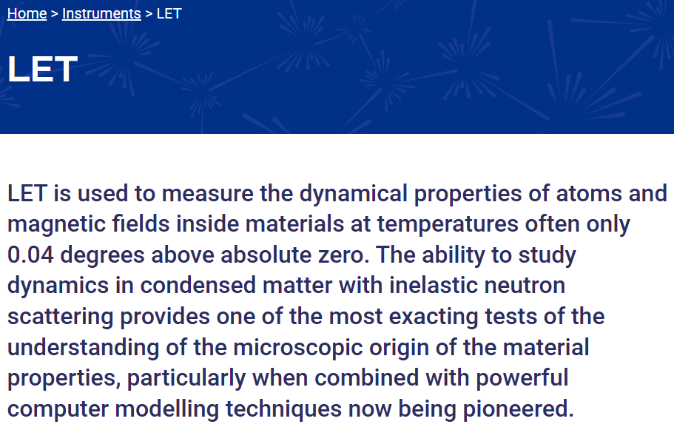
Excitations Group
https://isis.sis.stfc.ac.uk/instruments/let/

Slide 14
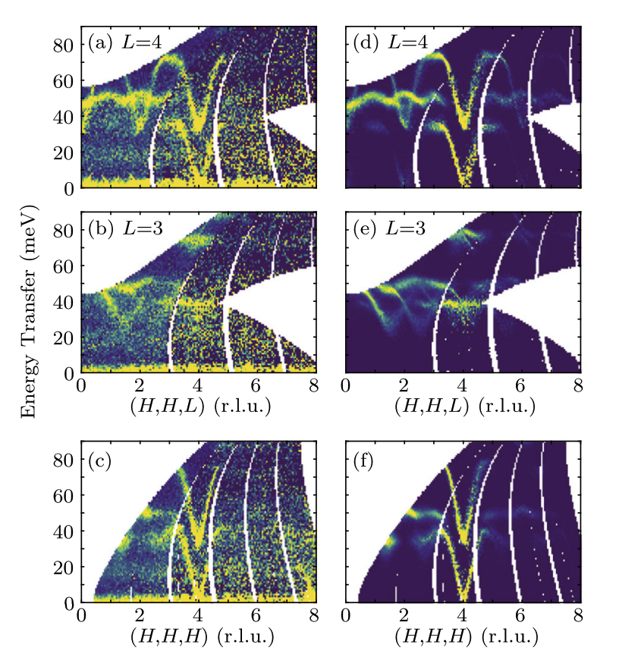
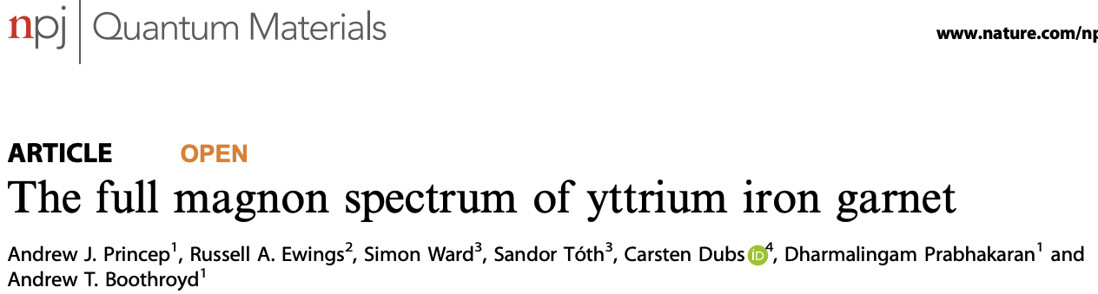
Why bother?
pS timescale is that of atomic or magnetic vibrations.
Information about the interatomic bonding or magnetic interactions.
What is driving a phase transition?
How does heat travel through this material?
What are the important magnetic excitations in this spintronic?

Slide 15
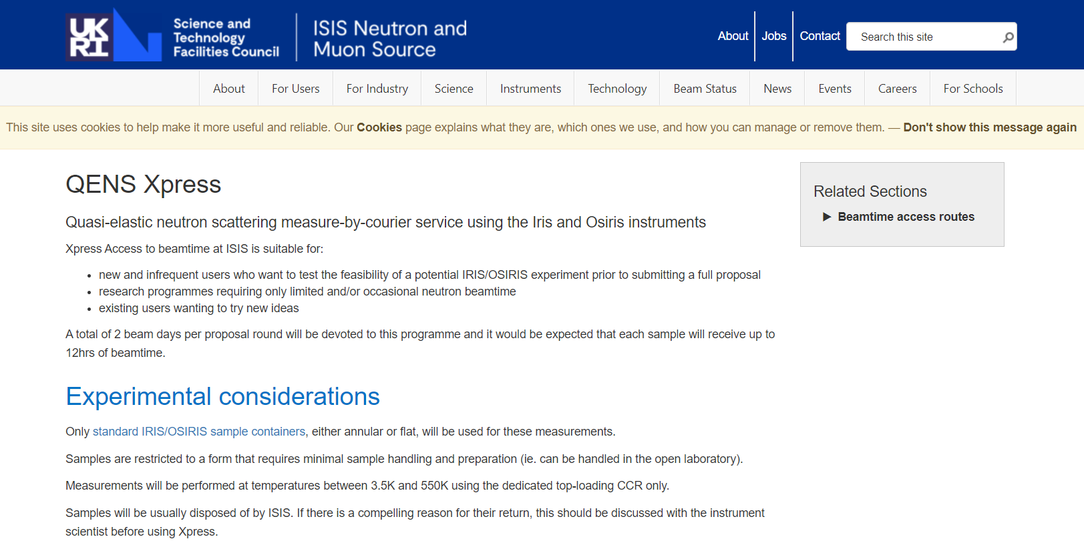
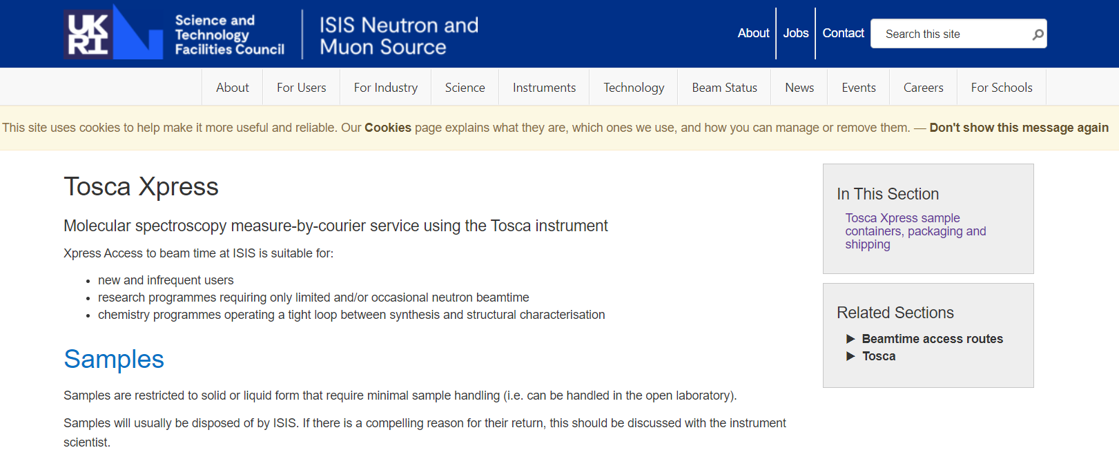
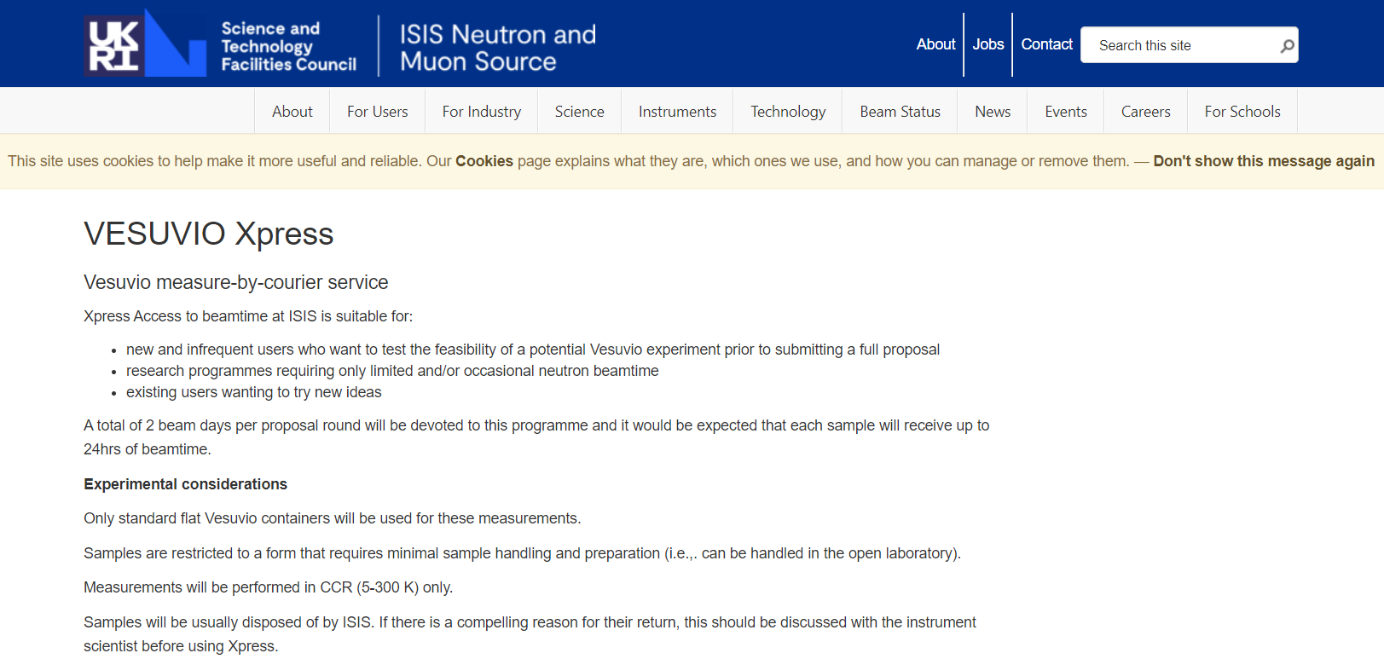
Xpress Access

Slide 16
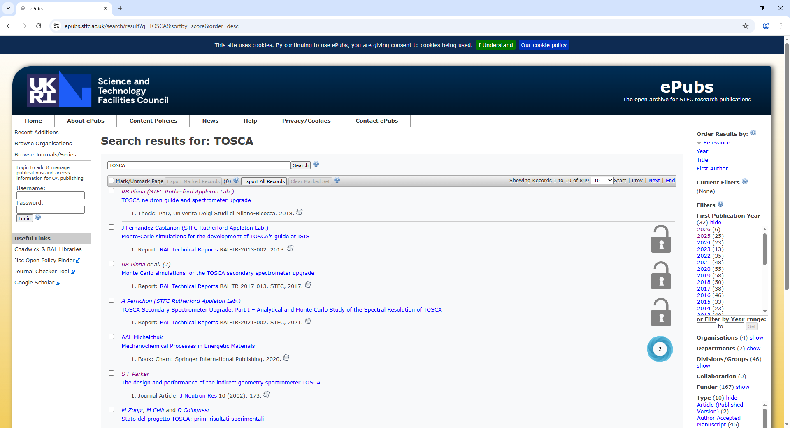
STFC ePubs – the open archive for STFC research publications

Slide 17
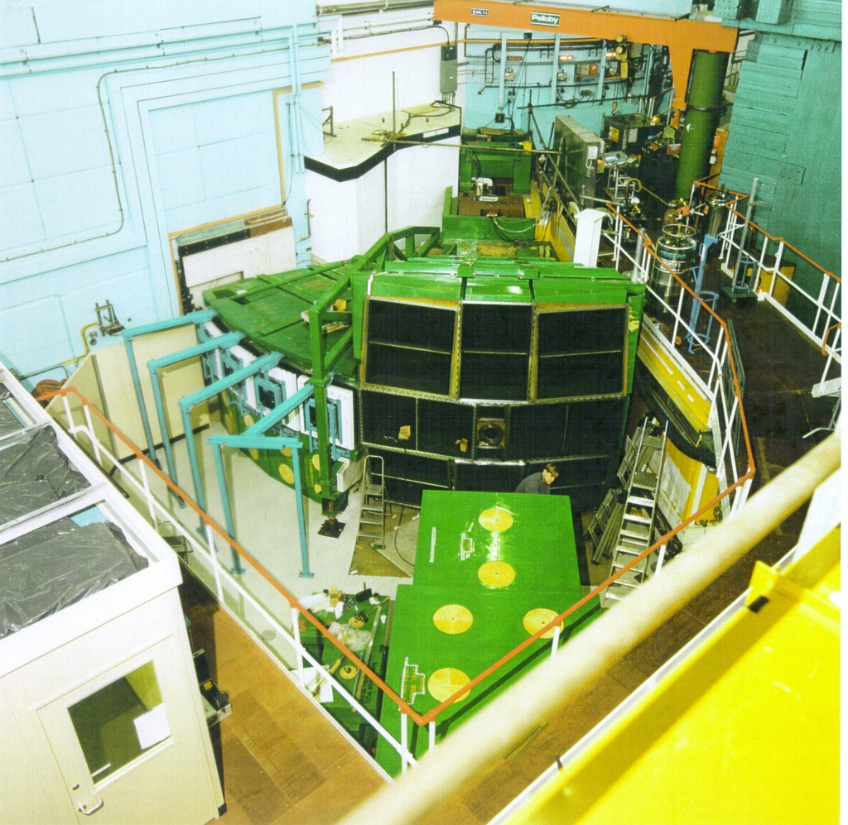
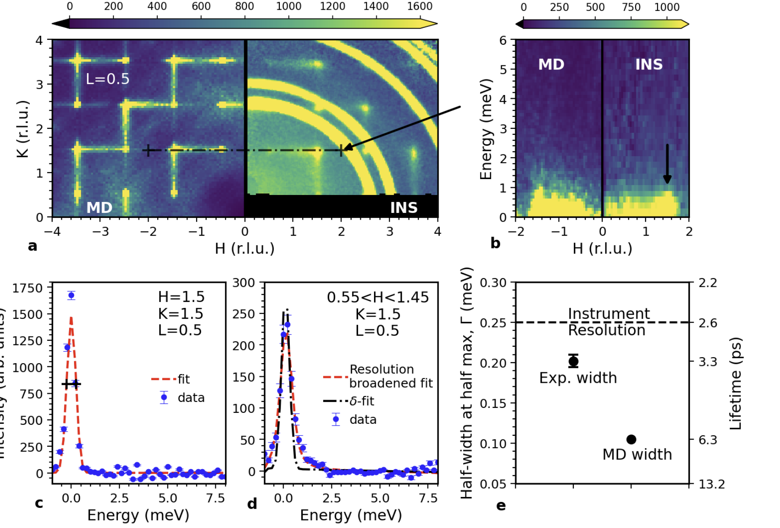
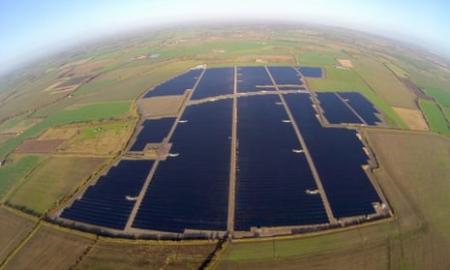
Overall summary
Neutron spectroscopy provides a view of the atomic dynamics.
These dynamics are integral to the materials performance in a wide range of areas.
This means there are a lot of applications gaining fundamental understanding of technological materials i.e. solar cells.
If you wish to apply for time, do drop me an email
OR david.voneshen@stfc.ac.uk

Slide 18

Thanks for listening

