Slide 1
Neutron diffraction applications
Tom Wood
Webinar: Materials studies for clean energy: how neutron and muon techniques can help
12th February 2026

Slide 2
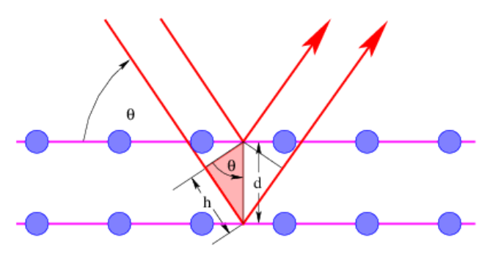
What is neutron diffraction?
The principle is exactly the same as X-ray diffraction, but run slightly differently
Radiation (n or hν)
Sample
Differences are:
Neutrons scatter differently to X-rays
ISIS operates on time-of-flight
  ToF directly proportional to d-spacing
  Not so constrained by angle
Image from Physics LibreTexts

Slide 3
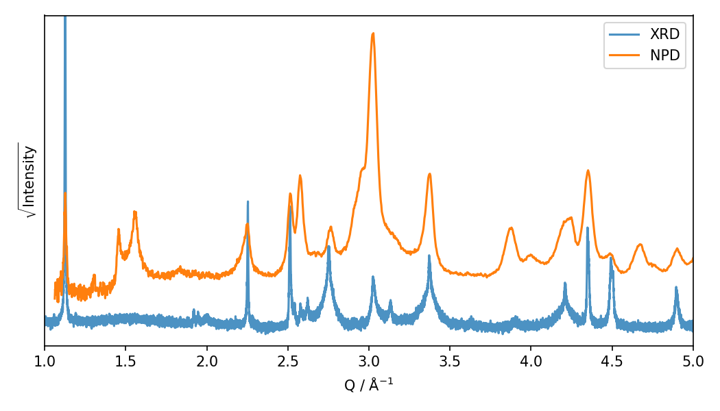
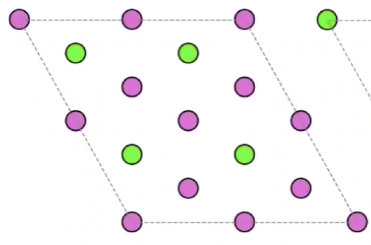
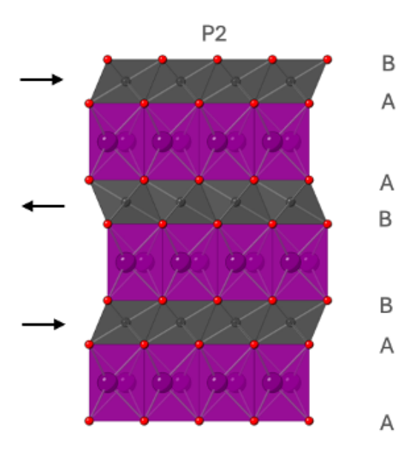
Neutrons scatter differently to X-rays
An example from battery materials: a straightforward measurement
Na_{2/3}Mn_{2/3}Ni_{1/3}O₂
Images courtesy of Dr Andy Bridger

Slide 4
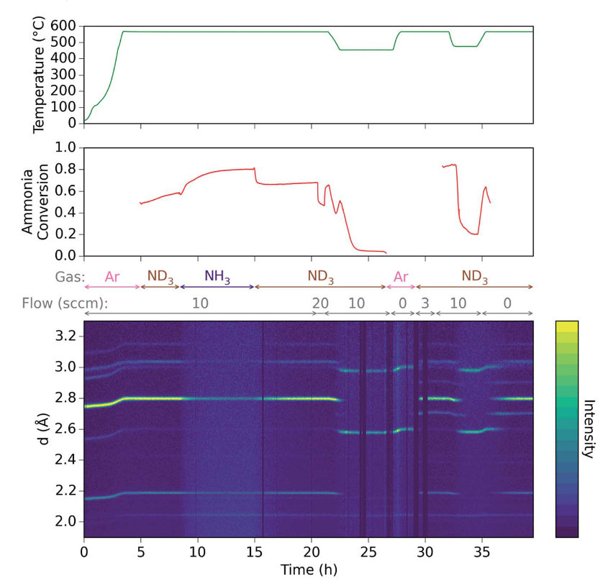
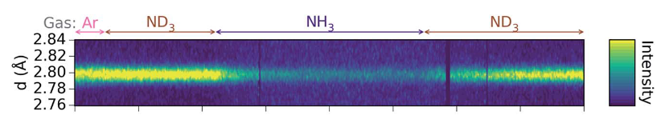
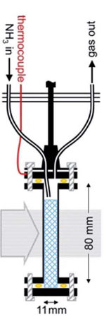
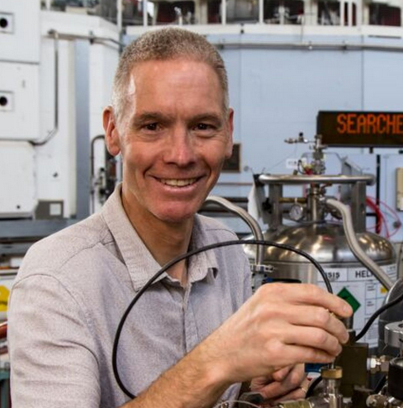
Neutrons are penetrating
Images taken from:
Phys. Chem. Chem. Phys. 2018, 20, 22689.
Faraday Discuss. 2016, 188, 525
Which means we can use complex sample environment
Ammonia decomposition catalysts in-situ
ron.smith@stfc.ac.uk

Slide 5
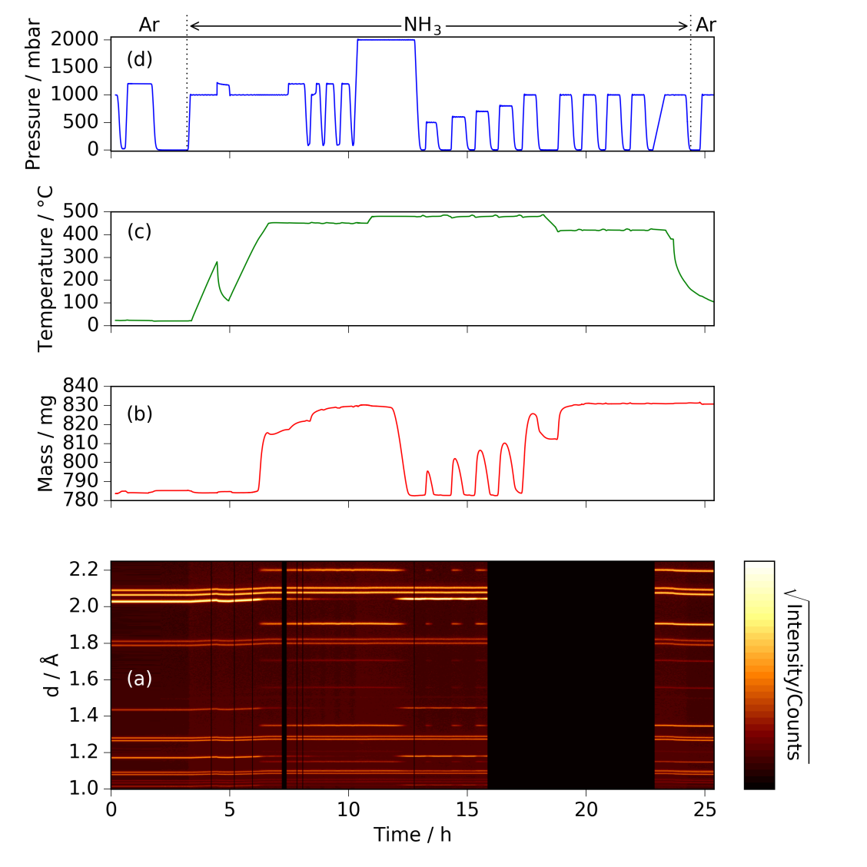
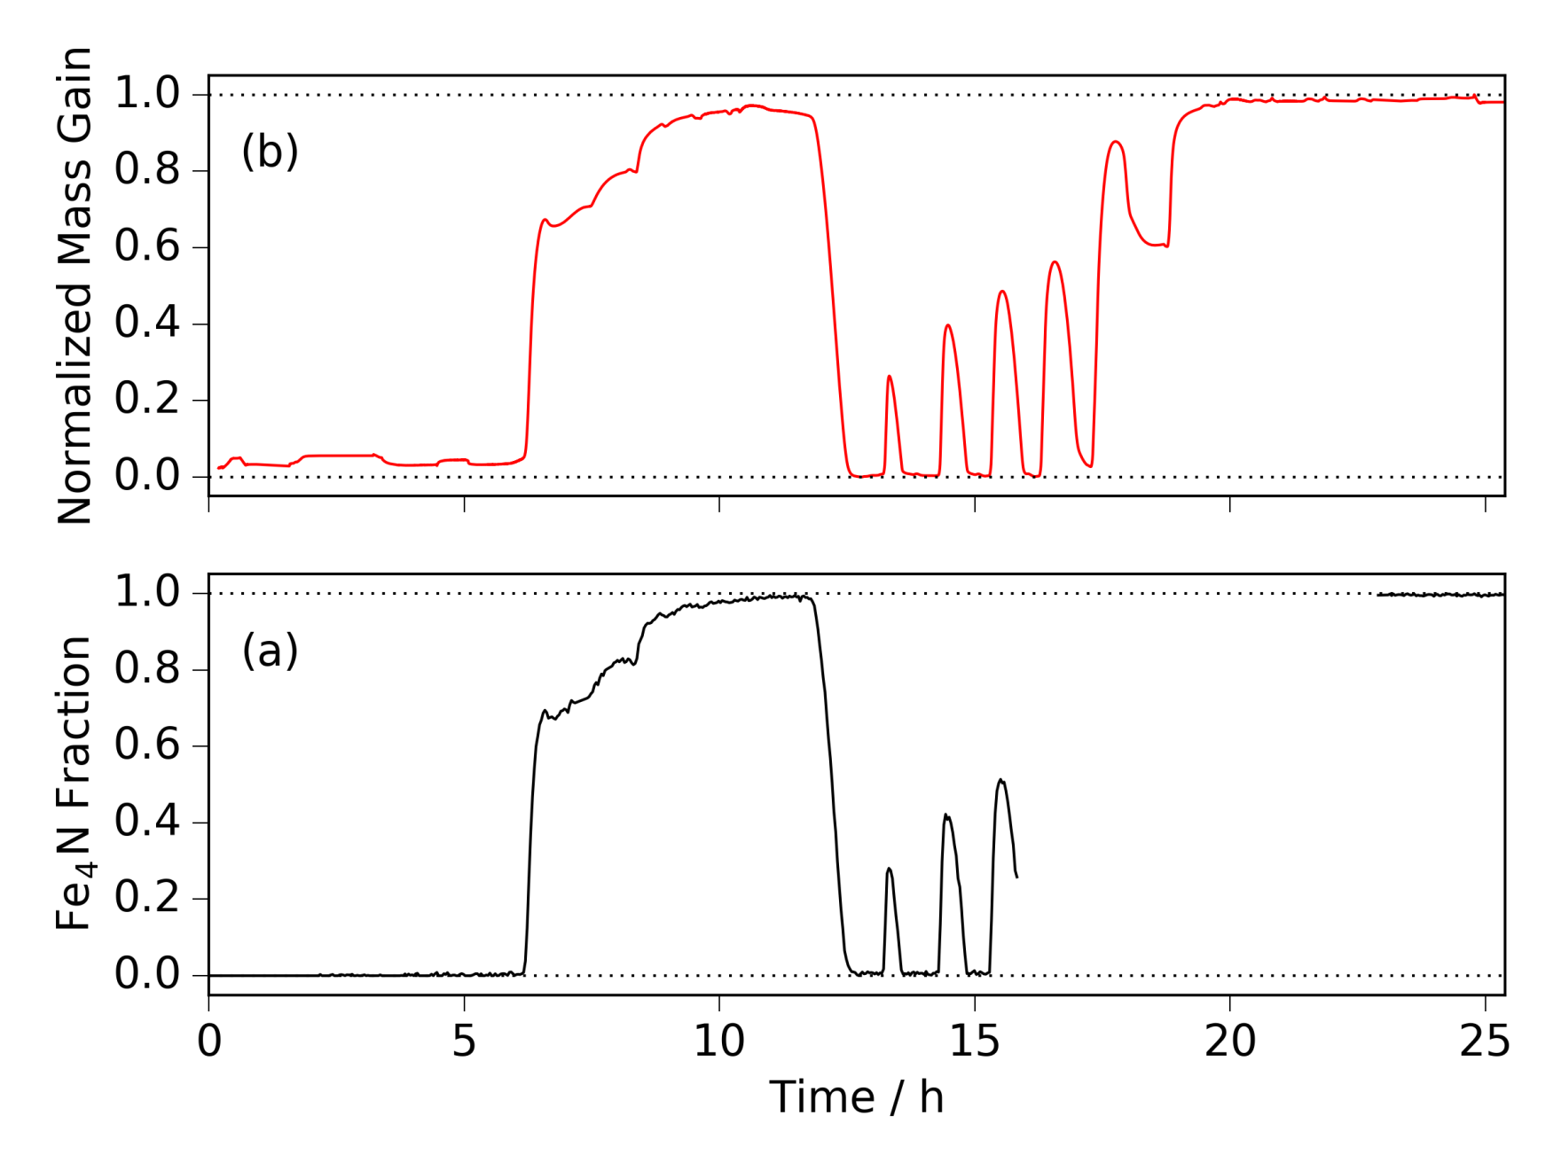
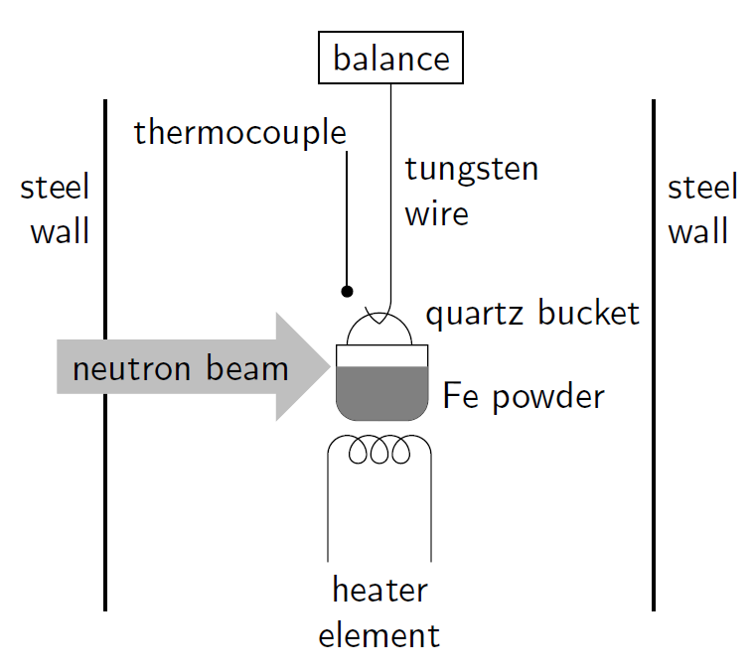
Neutrons are penetrating
Iron nitriding in situ

Slide 6
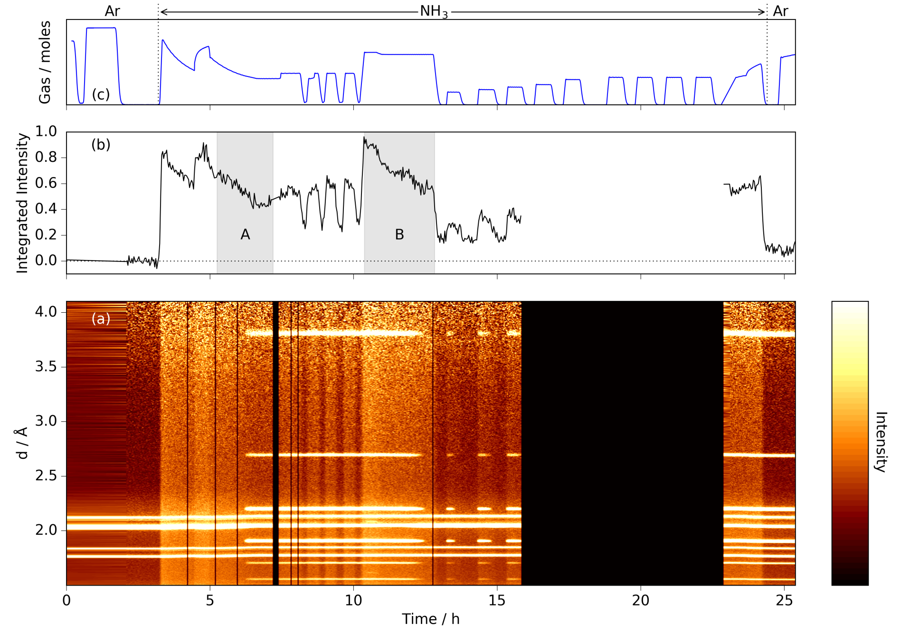
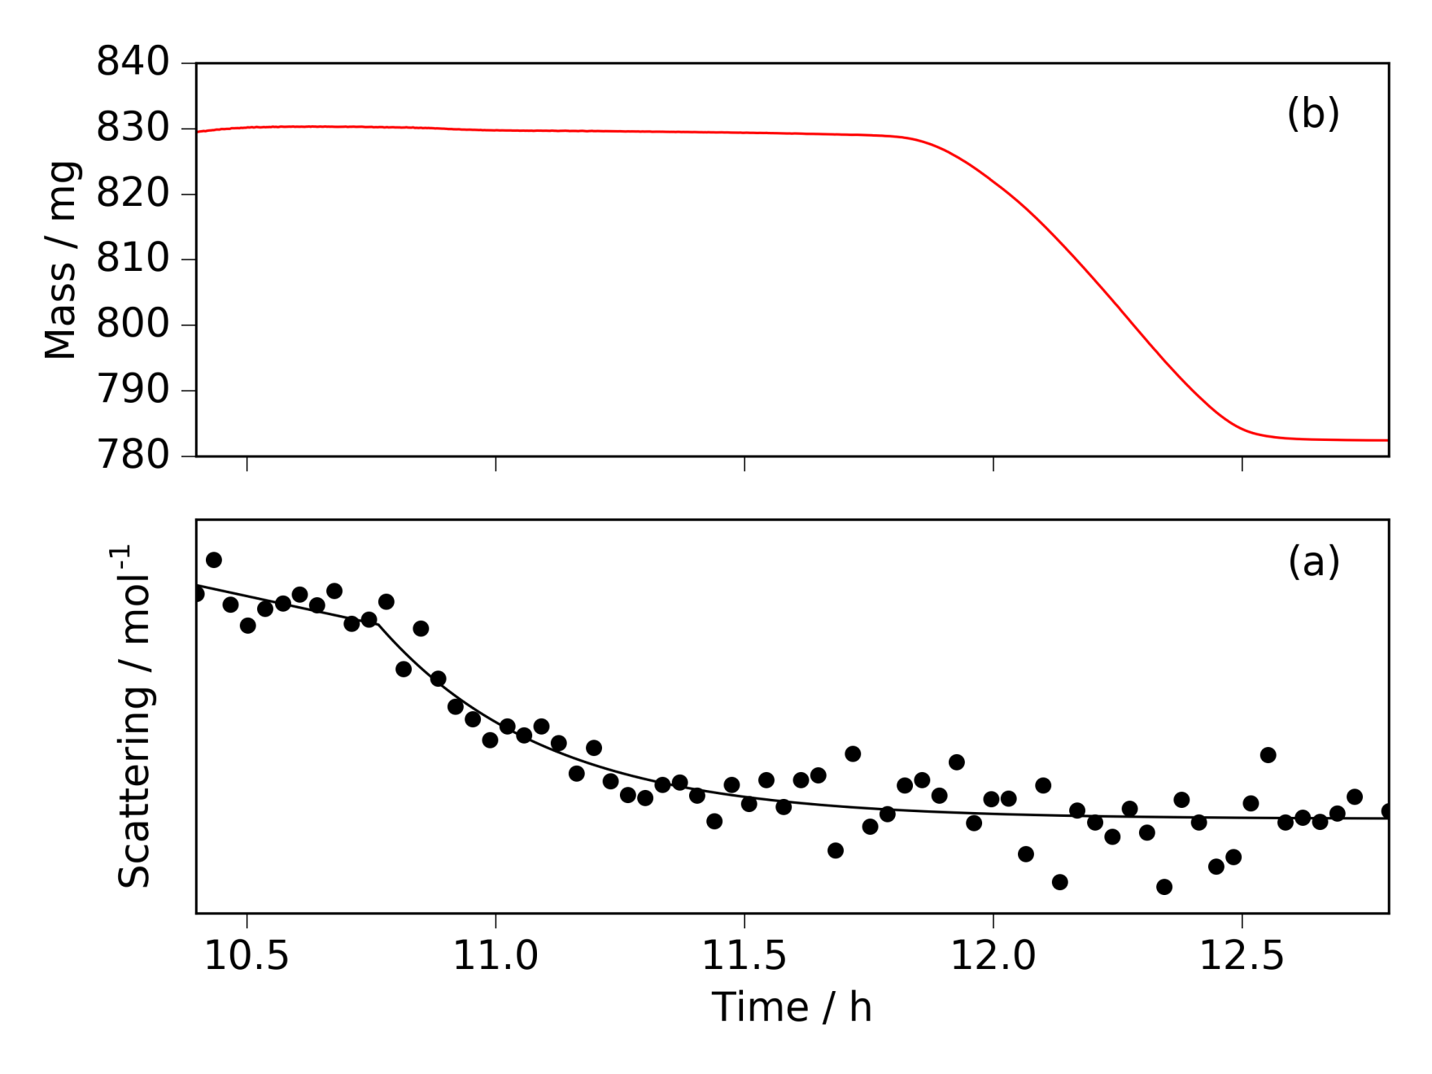
Neutrons are penetrating
Iron nitriding in situ
Fe₄N
Fe

Slide 7
SANS: looking at larger spacings
Small angles equals larger distances (1 to 100 nm)
Radiation (n or hν)
Sample

Slide 8

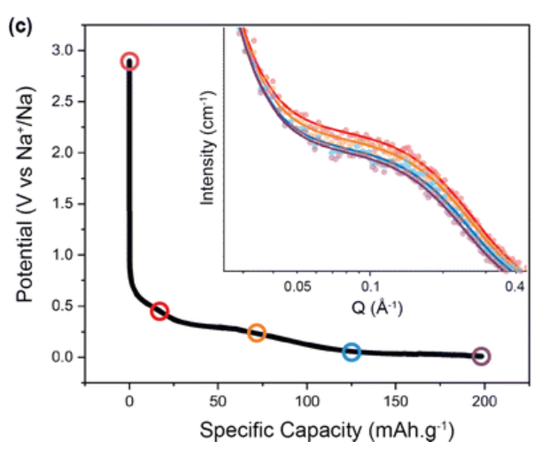
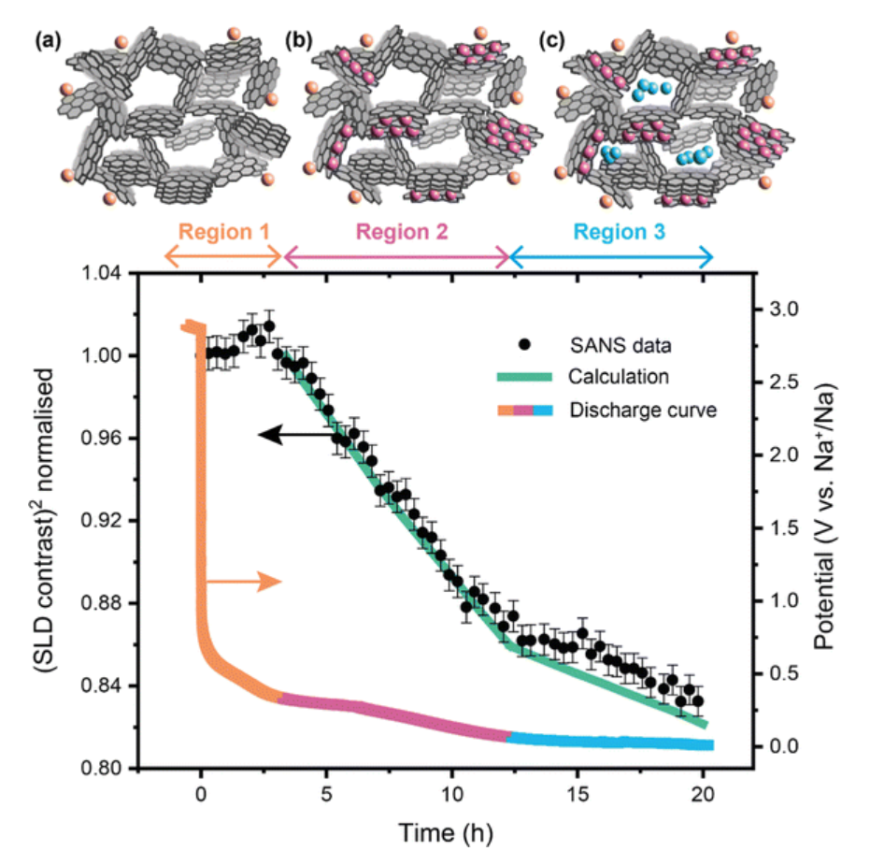
SANS: looking at larger spacings
gabriel.perez@stfc.ac.uk
Hard carbon anodes for sodium batteries
Measurements on an in operando sodium half-cell.
https://doi.org/10.1039/D3TA04739C

Slide 9
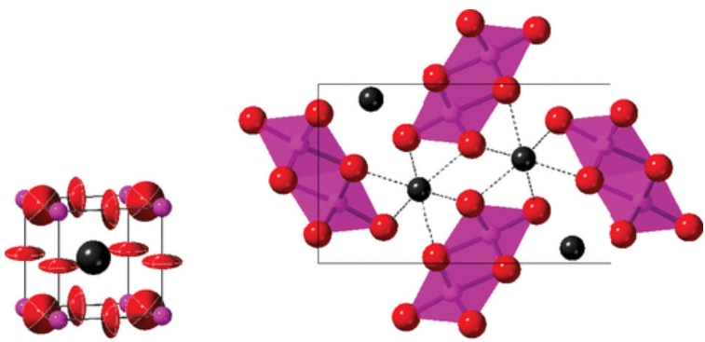
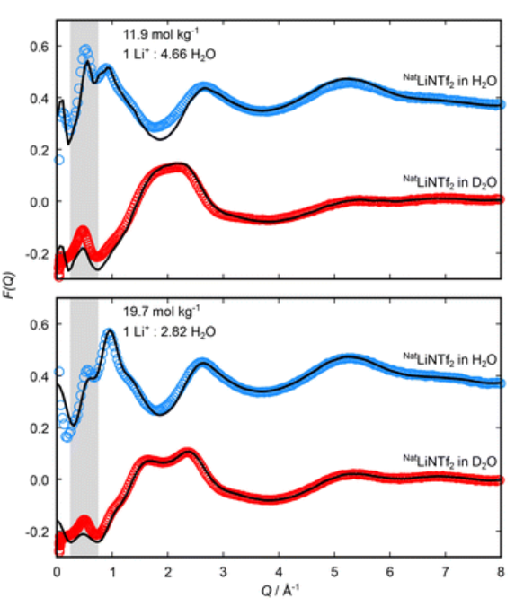
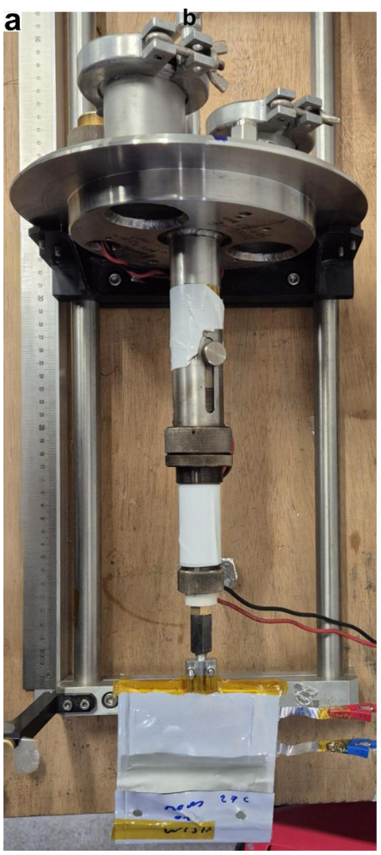
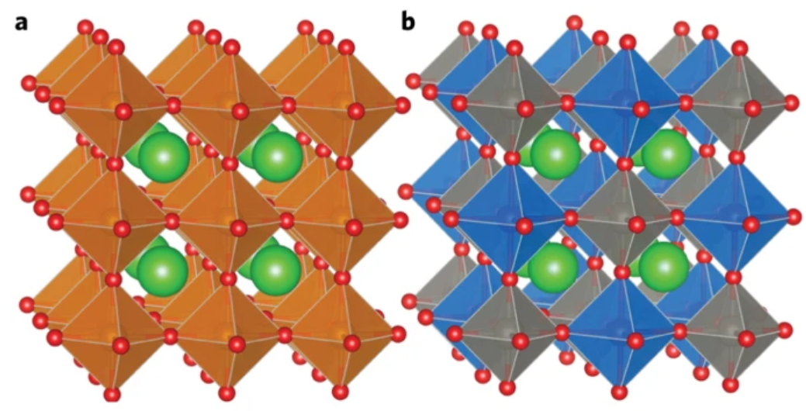
Non-exhaustive list of other energy areas
In operando pouch cells
From: “Advancing Battery Diagnostics through Operando Neutron Diffraction of Unmodified Non-deuterated Li-ion Single-layer Pouch Cells
Solar cell materials
J. Phys. Chem. C 2019, 123, 14934
Solid oxide fuel cells
Nat. Energy 2017, 2, 16214
Electrolyte structure
EES Batteries 2025, 1, 1797

Slide 10
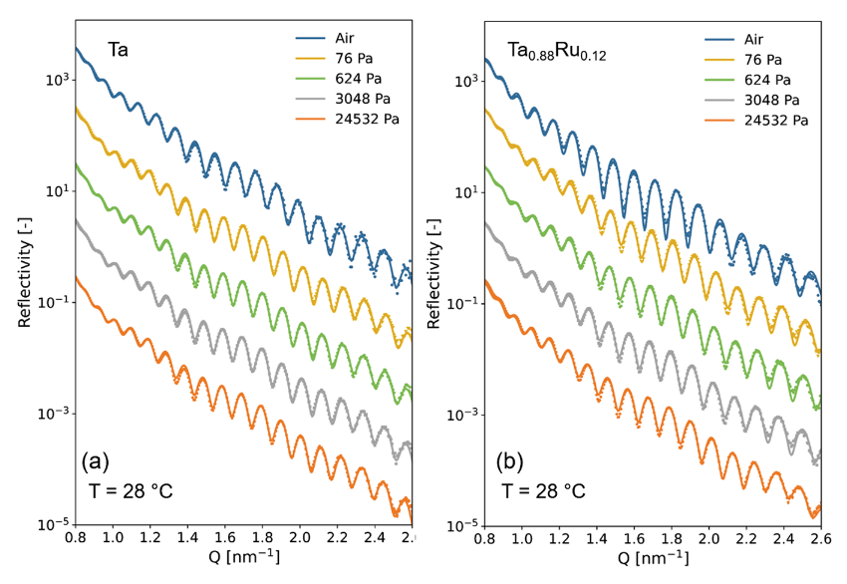
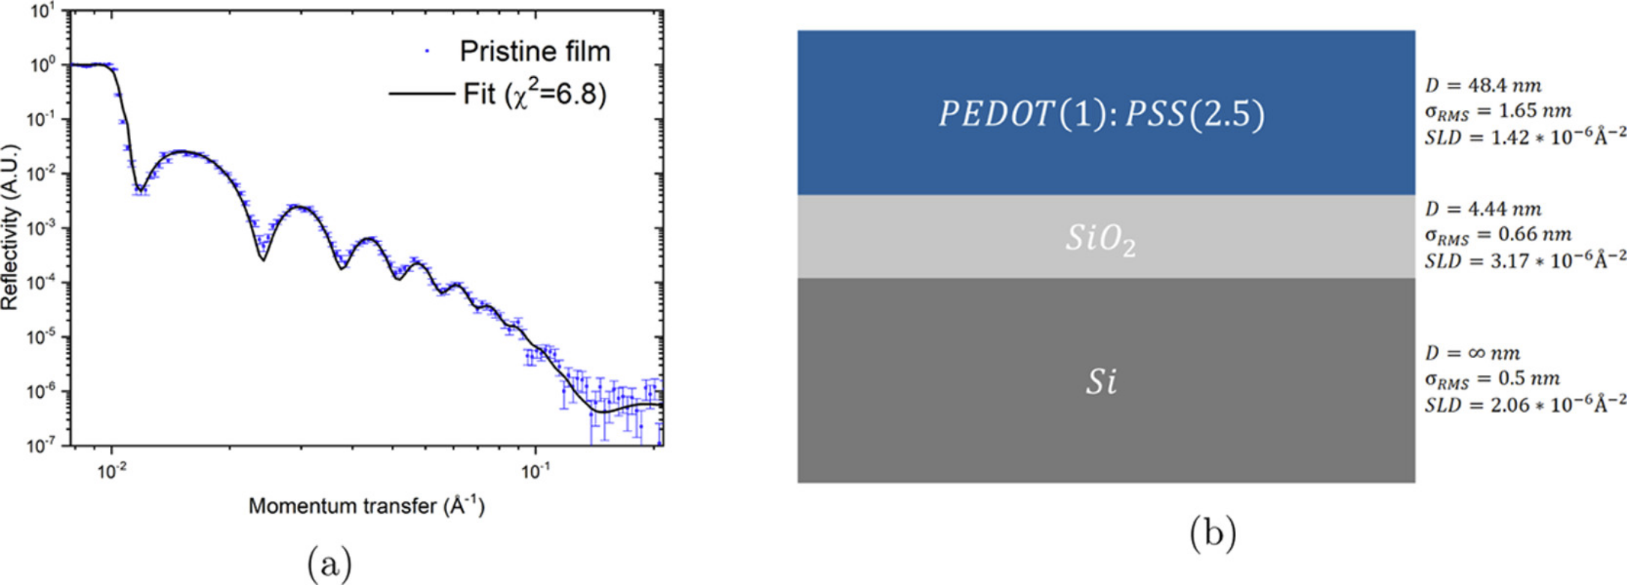
Addendum: A quick mention of reflectometry (not diffraction)
Hydrogen sensors
ACS Appl. Mater. Interfaces 2023, 15, 8033
Image from Physics LibreTexts
Organic electrode structures
ACS Appl. Mater. Interfaces 2019, 11, 13803

