Slide 1
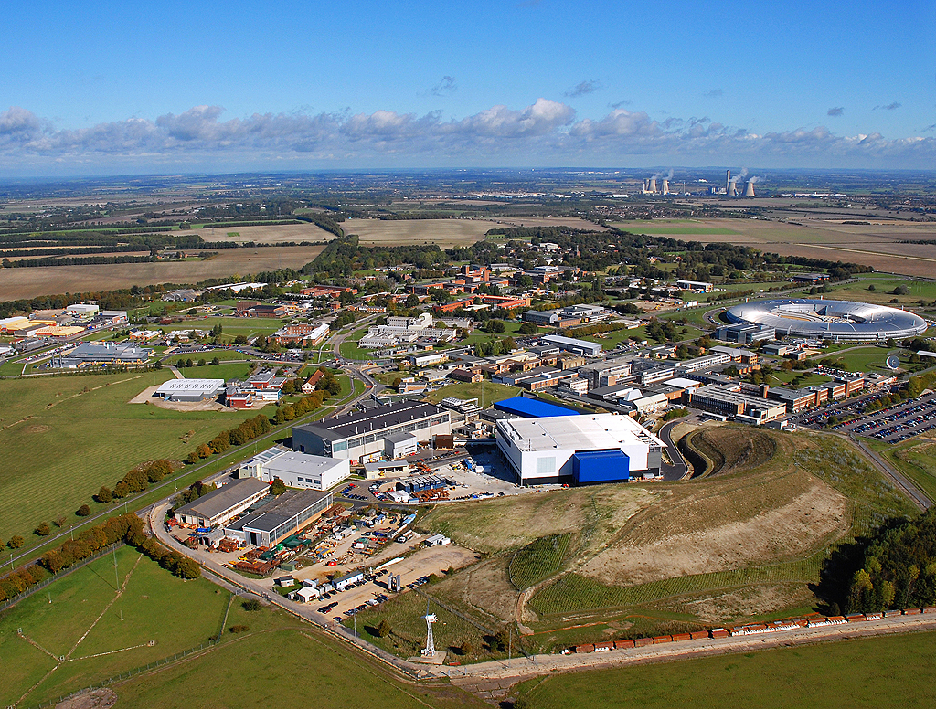

Neutrons and Muons
for
Energy Materials Research

Slide 2
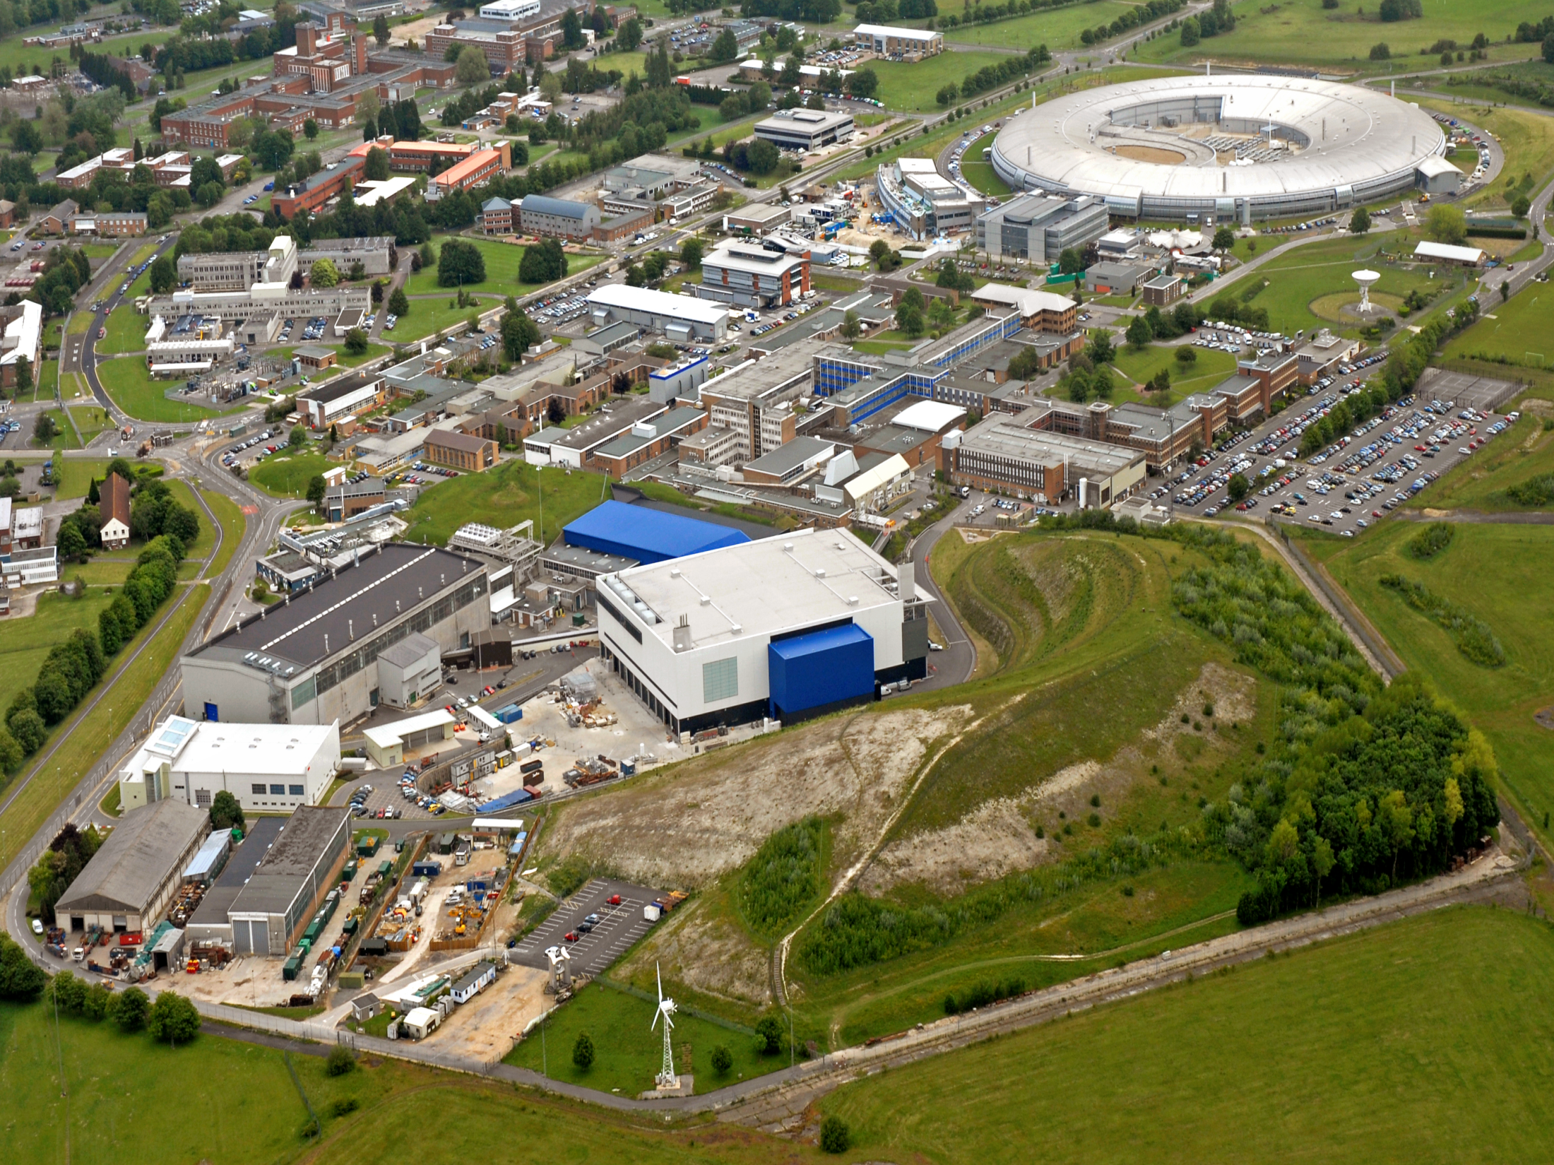

Slide 3
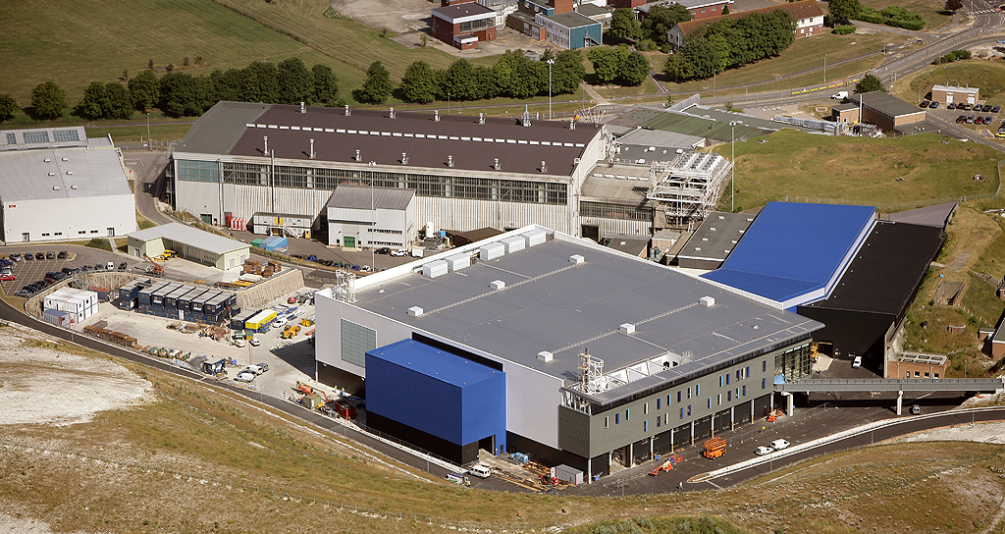
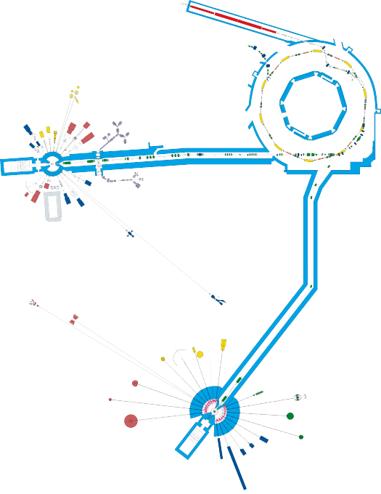
The ISIS Pulsed Neutron and Muon Source
A World Centre for Science with Neutrons and Muons

Slide 4
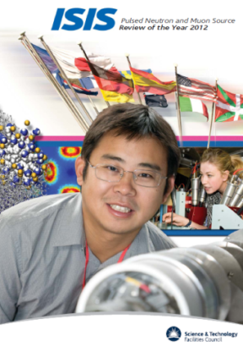
ISIS Users
~1200 individual users/year (70% UK, 40% students)
~3500 user visits
~1500 other visitors
> 700 different experiments/year
~400 publications per year (~130 in high impact journals)
150 days accelerator operation
32 instruments (1 Italy, 3 Japan)
>1000 different items of sample environment
6 Tbytes data/year

Slide 5
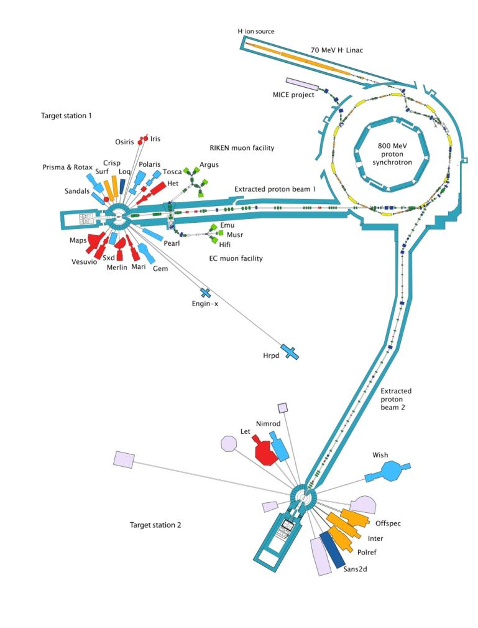
Structure (& morphology)
powder diffractometers
liquid diffractometers
small angle scattering
reflectometers
imaging/tomography
Dynamics
neutron spectrometers (inelastic & quasi-elastic)
muon spectrometers
Others
support laboratories
Bioscience dedicated Laboratory
Small molecule deuteration facility
irradiation facility
test facilities

Slide 6
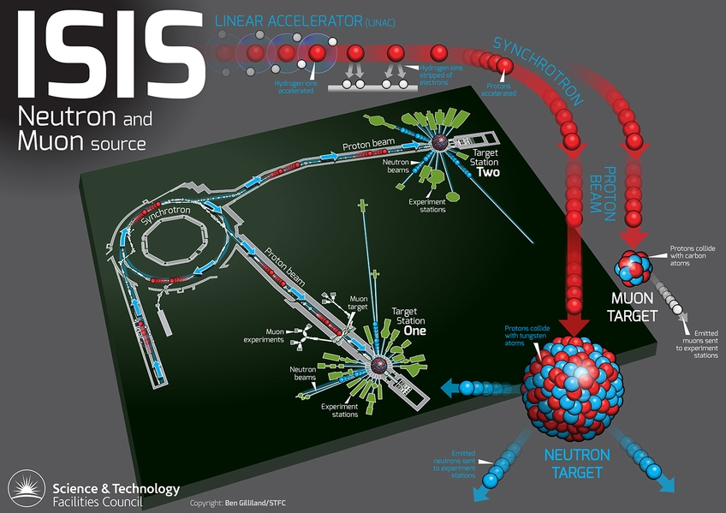

Slide 7
Neutrons
Uncharged, subatomic particles found in atomic nuclei
v=2.2 km/s at RT
Wave-particle duality, λ = 0.18 nm at RT
Spallation (ISIS)
800MeV accelerator driven source
16n/collision and 20Mev/n
Pulsed and broad energy

Slide 8
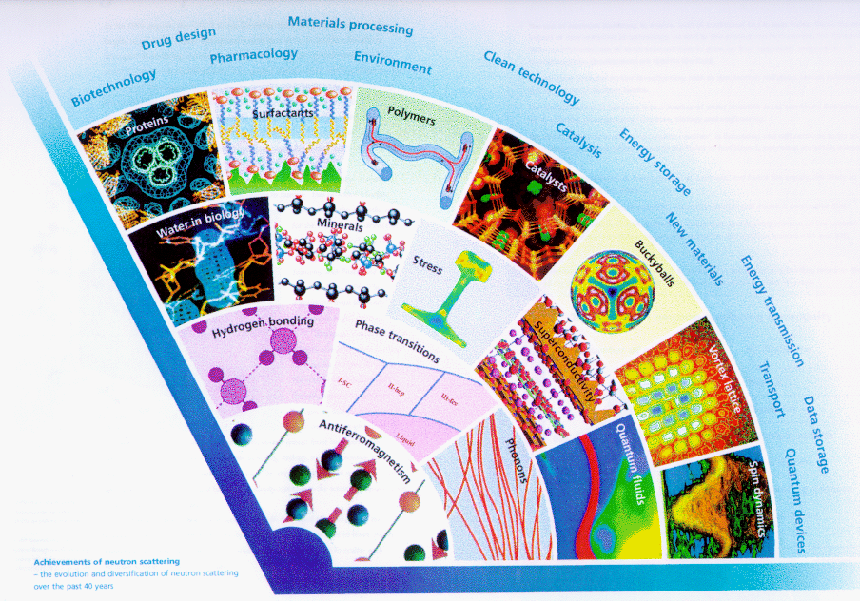
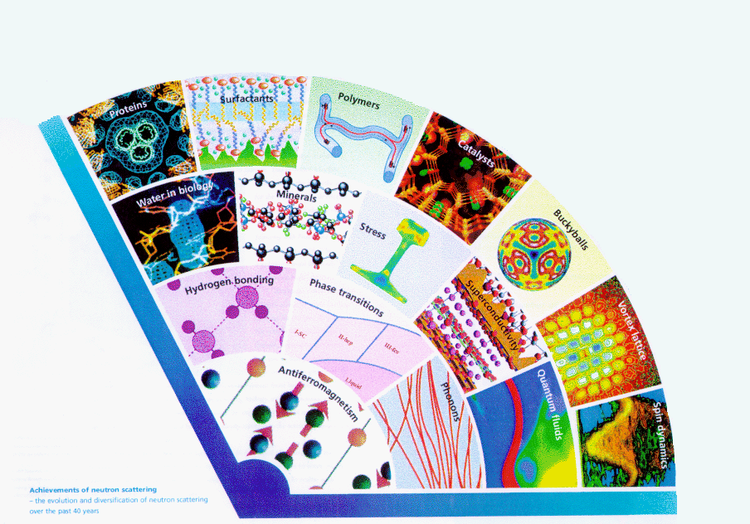
No One Experiment
Soft
multidisciplinary
condensed matter science
2000
1990
1990
1980
1980
1970
1970
1960
1960
Hard

Slide 9
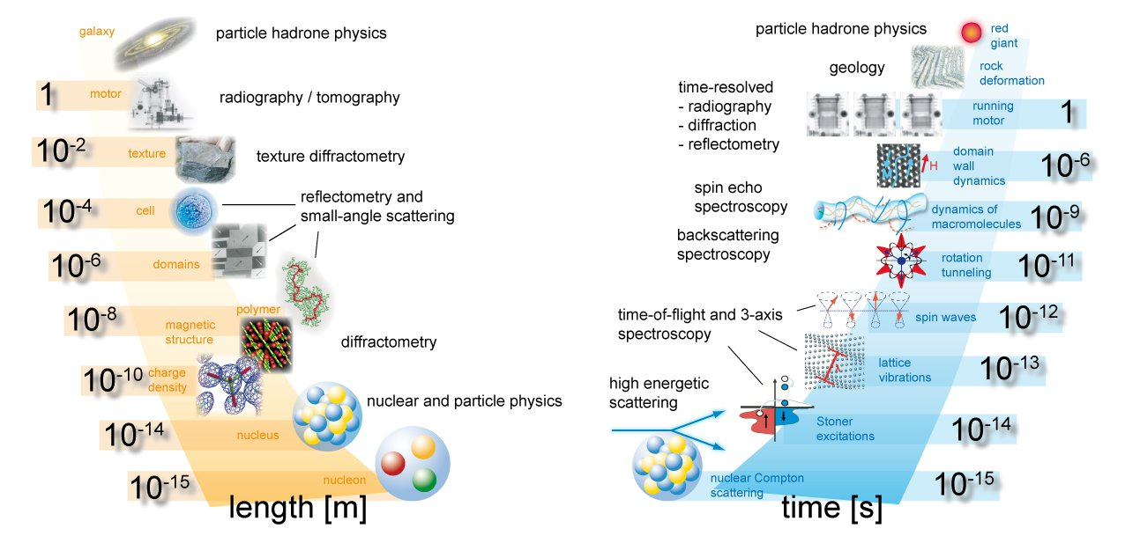
Time and Length Scales

Slide 10

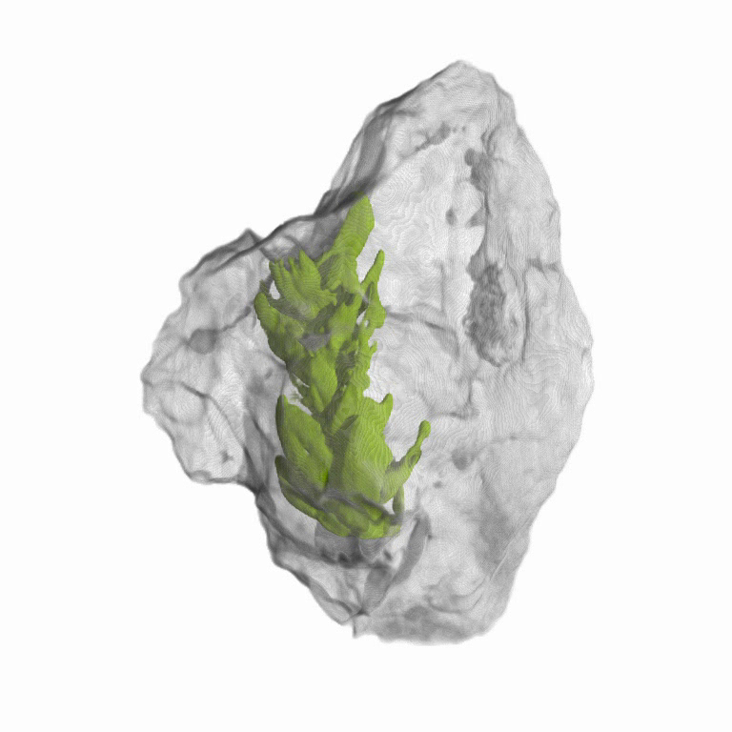
Neutrons
Neutrons are a neutral particle
are highly penetrating
can be used as non-destructive probes,
can be used to study samples in extreme environments

Slide 11
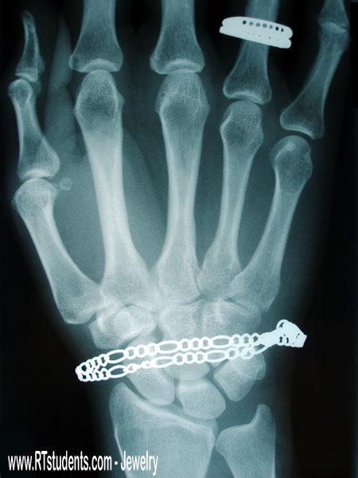
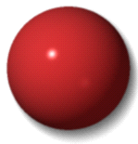
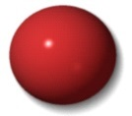












Neutrons
Neutrons interact with Nuclei
are sensitive to light atoms, particularly hydrogen
can exploit isotopic substitution, especially H/D
‘see‘ materials differently to X-rays, complementary
H
Li
Li
C
O
O
S
S
Mn
Mn
Zr
Zr
Cs
Cs
X
X
-
-
rays
rays
neutrons
neutrons

Slide 12
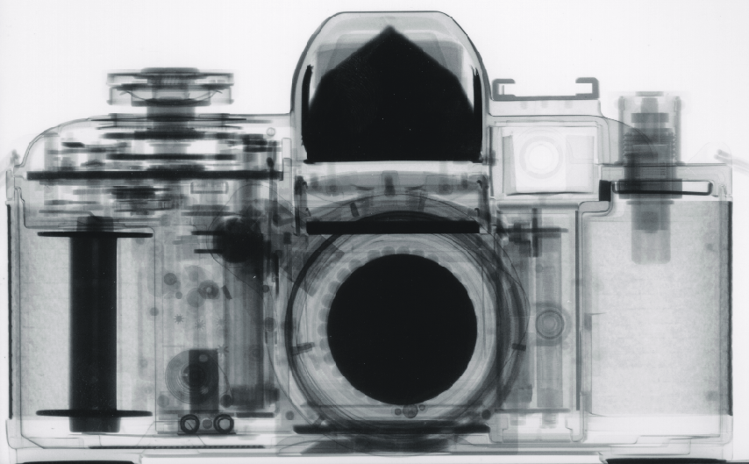

Neutrons
Neutrons interact with Nuclei
are sensitive to light atoms, particularly hydrogen
can exploit isotopic substitution, especially H/D
‘see‘ materials differently to X-rays, complementary
H
Li
Li
C
O
O
S
S
Mn
Mn
Zr
Zr
Cs
Cs
X
X
-
-
rays
rays
neutrons
neutrons

Slide 13
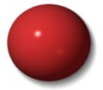

Neutrons
Neutrons interact with Nuclei
are sensitive to light atoms, particularly hydrogen
can exploit isotopic substitution, especially H/D
‘see‘ materials differently to X-rays, complementary
Li
Li
C
O
O
S
S
Mn
Mn
Zr
Zr
Cs
H
D
Cs
000
Nuclear Interaction Changes
X
X
-
-
rays
rays
neutrons
neutrons
Chemistry Remains the Same

Slide 14
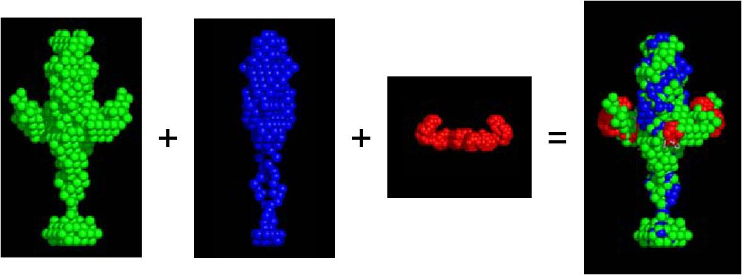
Neutrons
Neutrons interact with Nuclei
are sensitive to light atoms, particularly hydrogen
can exploit isotopic substitution, especially H/D
‘see‘ materials differently to X-rays, complementary
Li
Li
C
O
O
S
S
Mn
Mn
Zr
Zr
Cs
H
D
Cs
000
Nuclear Interaction Changes
X
X
-
-
rays
rays
neutrons
neutrons

Slide 15
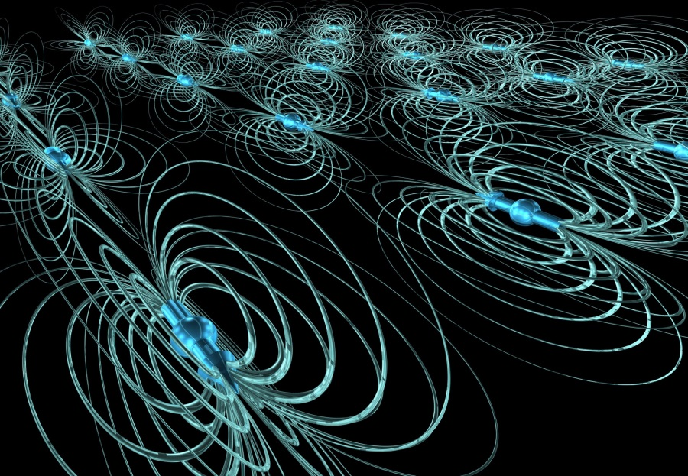
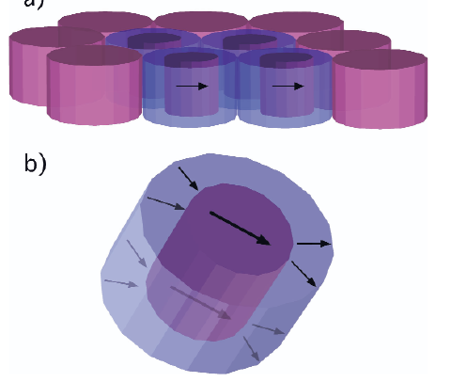
Neutrons
Neutrons have magnetic moment and spin
study microscopic magnetic structures
study magnetic fluctuations , and
develop magnetic materials
formed into polarised beams,
study nuclear (atomic) orientation, and
separate coherent from incoherent scattering

Slide 16
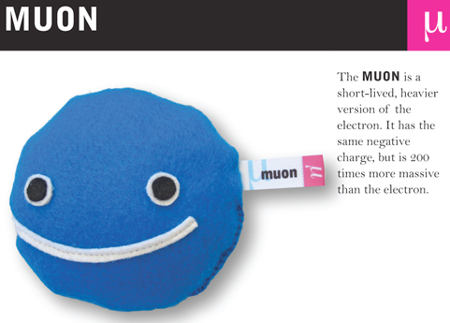
Muons are fundamental,
charged particles with:
spin 1/2
magnetic moment 3.2 x proton
mass 0.11 x proton
lifetime 2.2 µs: decay into a positron
(and a couple of neutrinos)
Muonium: positive muon + electron -
hydrogen atom analogue
Muon and muonium behaviour can be observed via the technique of µSR . . .
muon spin rotation, relaxation and resonance

Slide 17
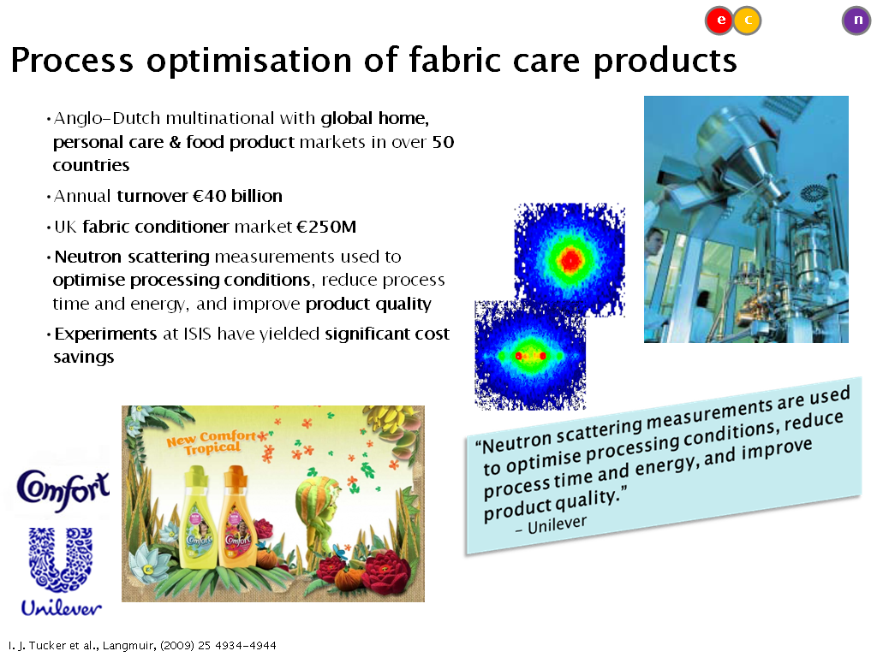
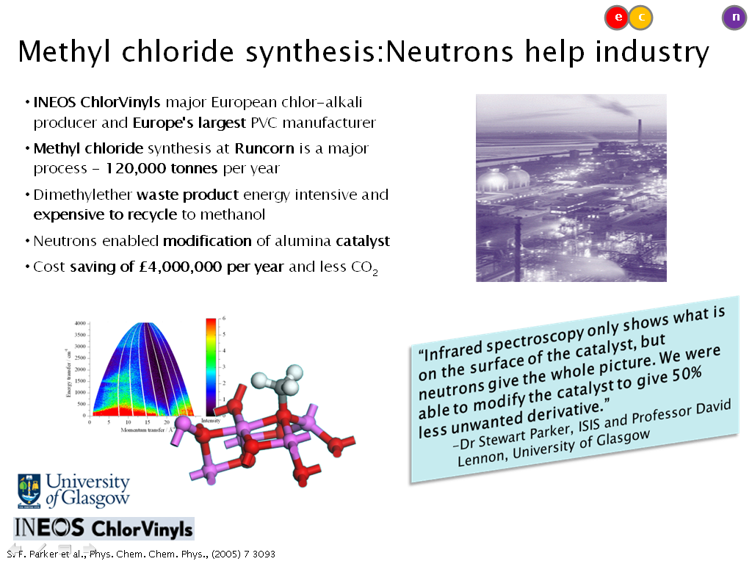
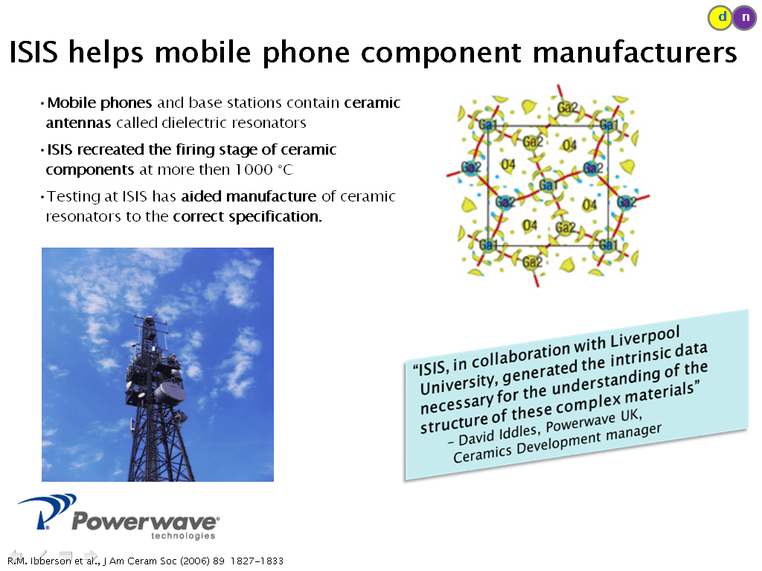
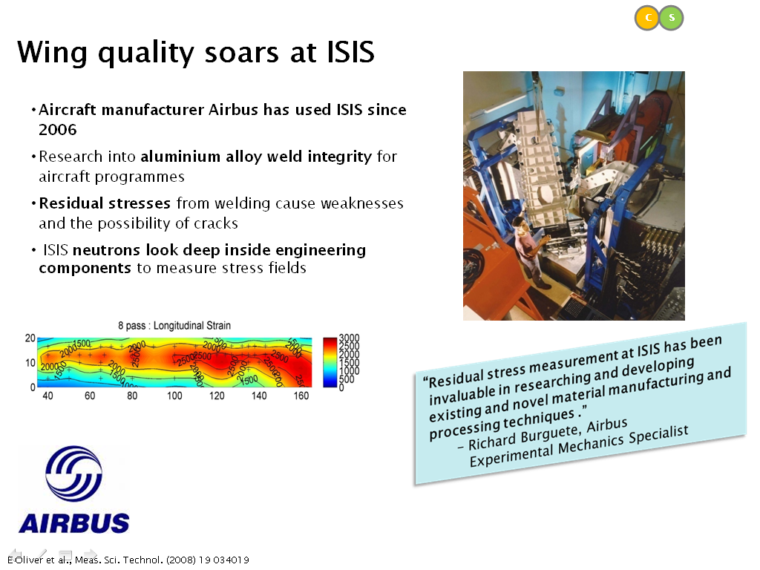

Slide 18
