Slide 1
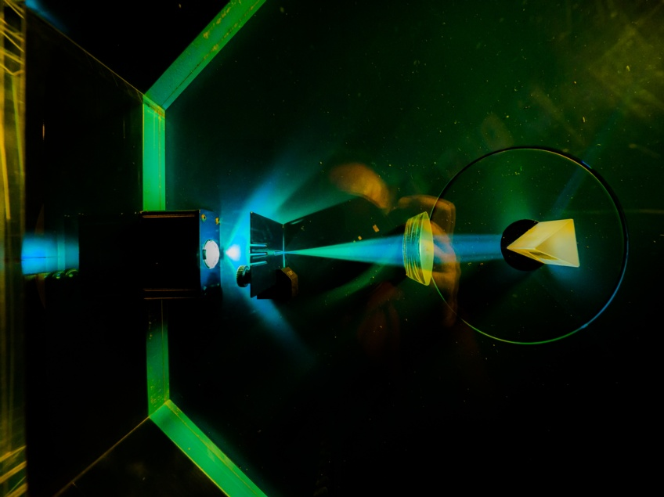



Notes:
To edit the background image, select ‘Format’ from the PowerPoint menu and ‘Slide Background’ from the drop-down menu. Within the new list of options that appears on the right of the screen, select the ‘File’ button under ‘Insert picture from’ and select your image from your file browser. Please remove or amend the image credit if you are using a different image to the one provided.

Slide 2



Detector Hub
Matt Roberts
Sooraj Pradeep
ESDG
Notes:
The abstract pattern can be removed or repositioned if required. Be careful to ‘Send to Back’ so that it does not obscure any important information.

Slide 3
Hexitec 2x6
Hexitec
Mhz
BabyD
XiDyn
RDP
Detector Hub

Slide 4
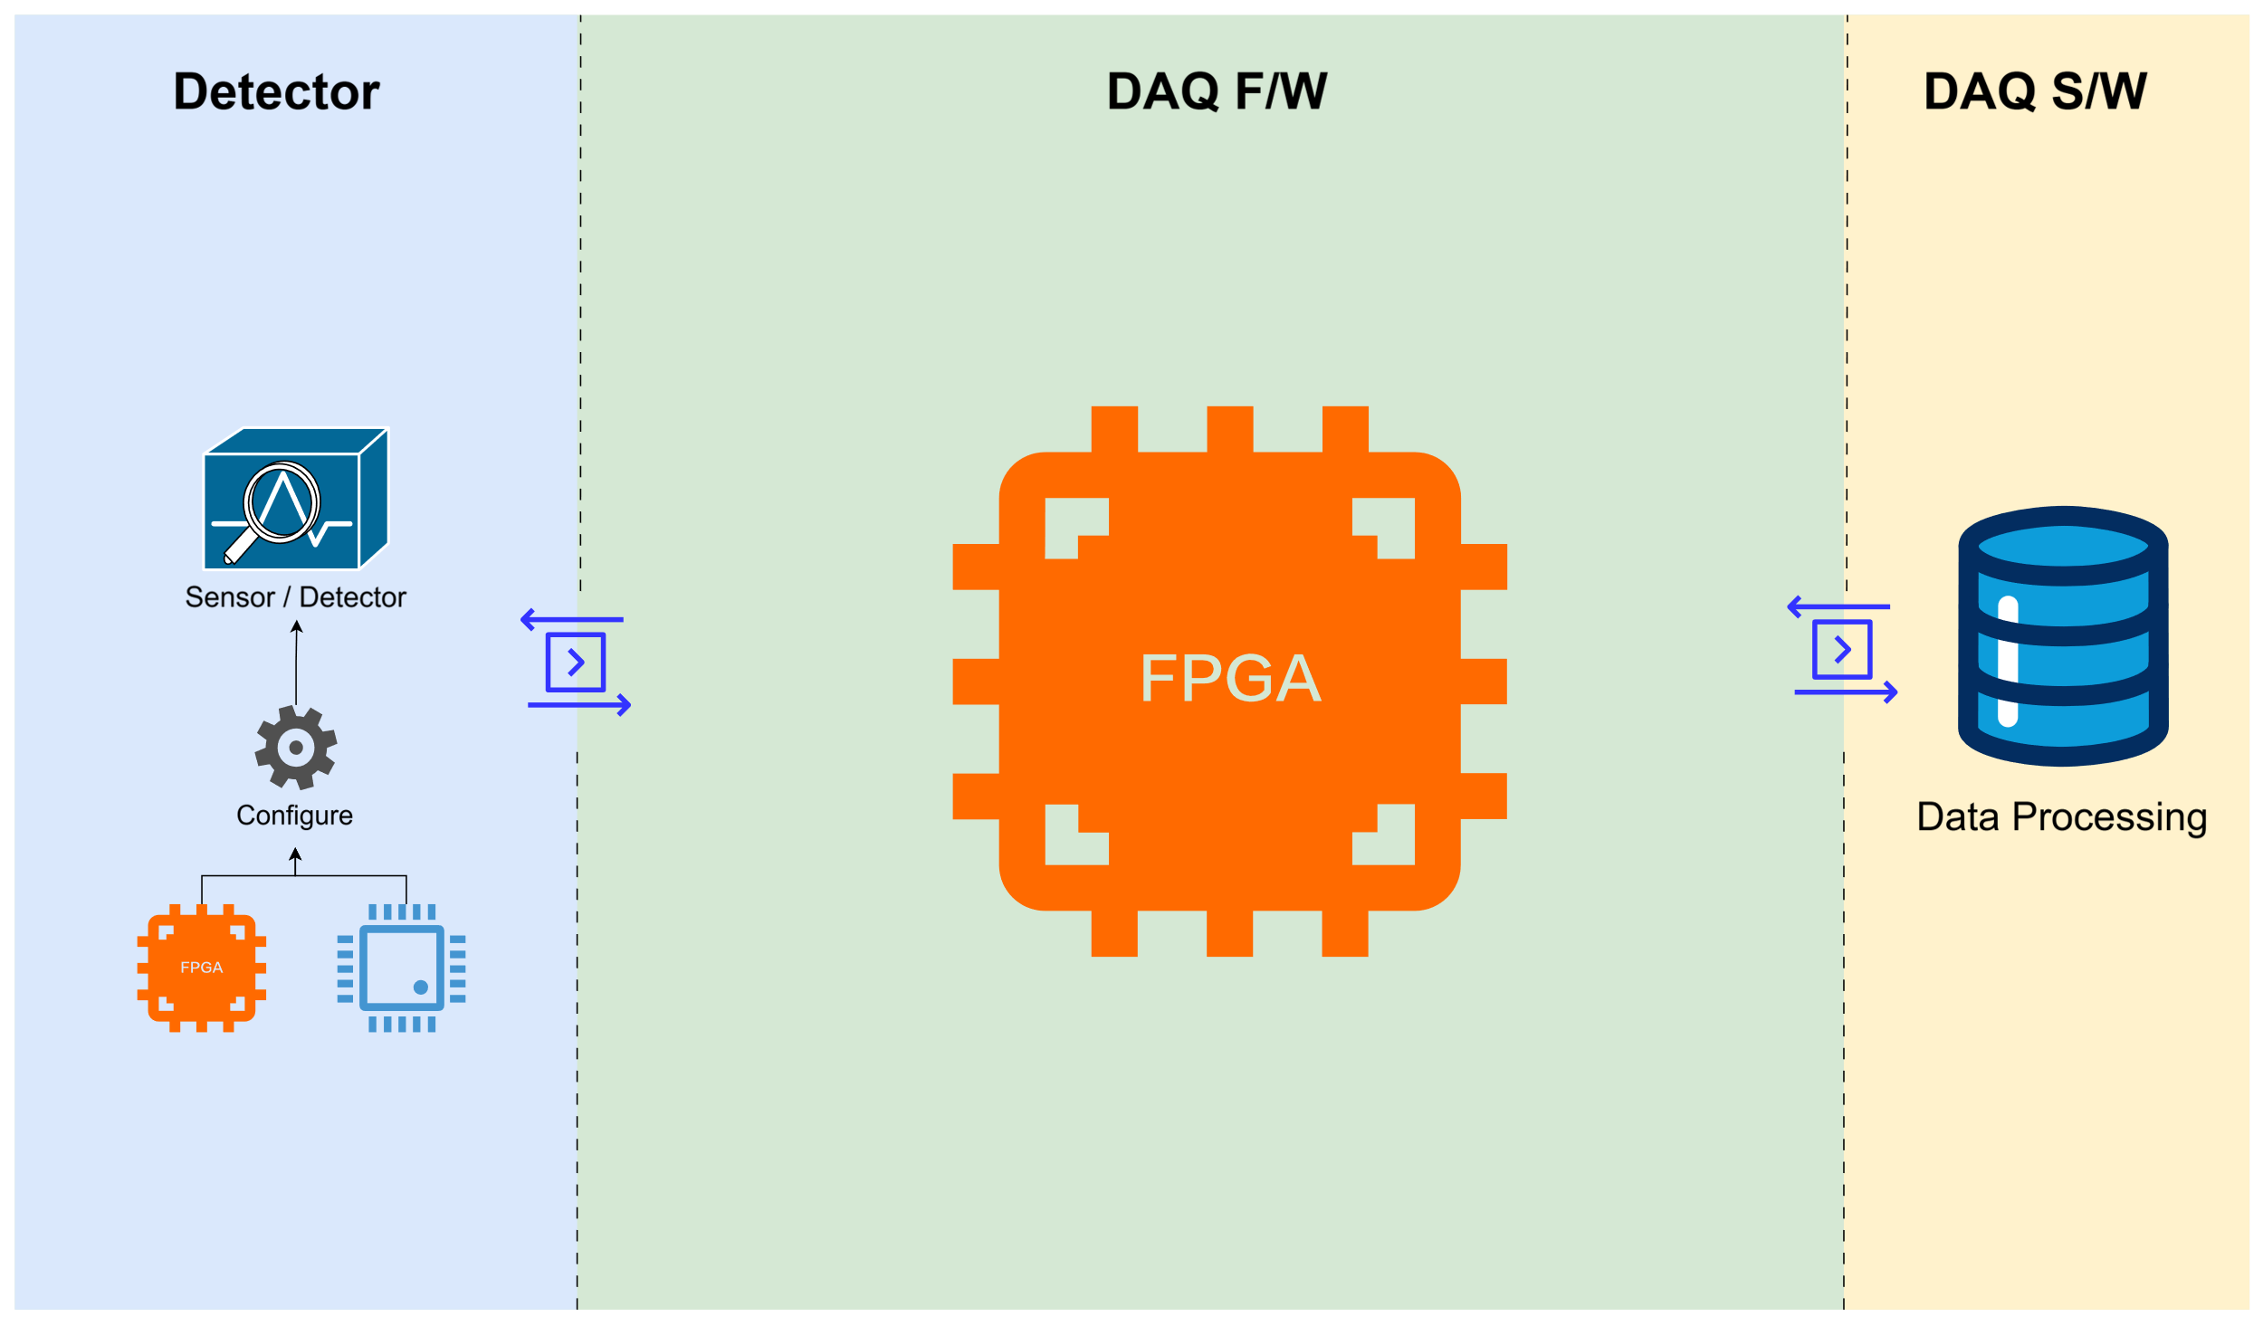
Detector Hub

Slide 5
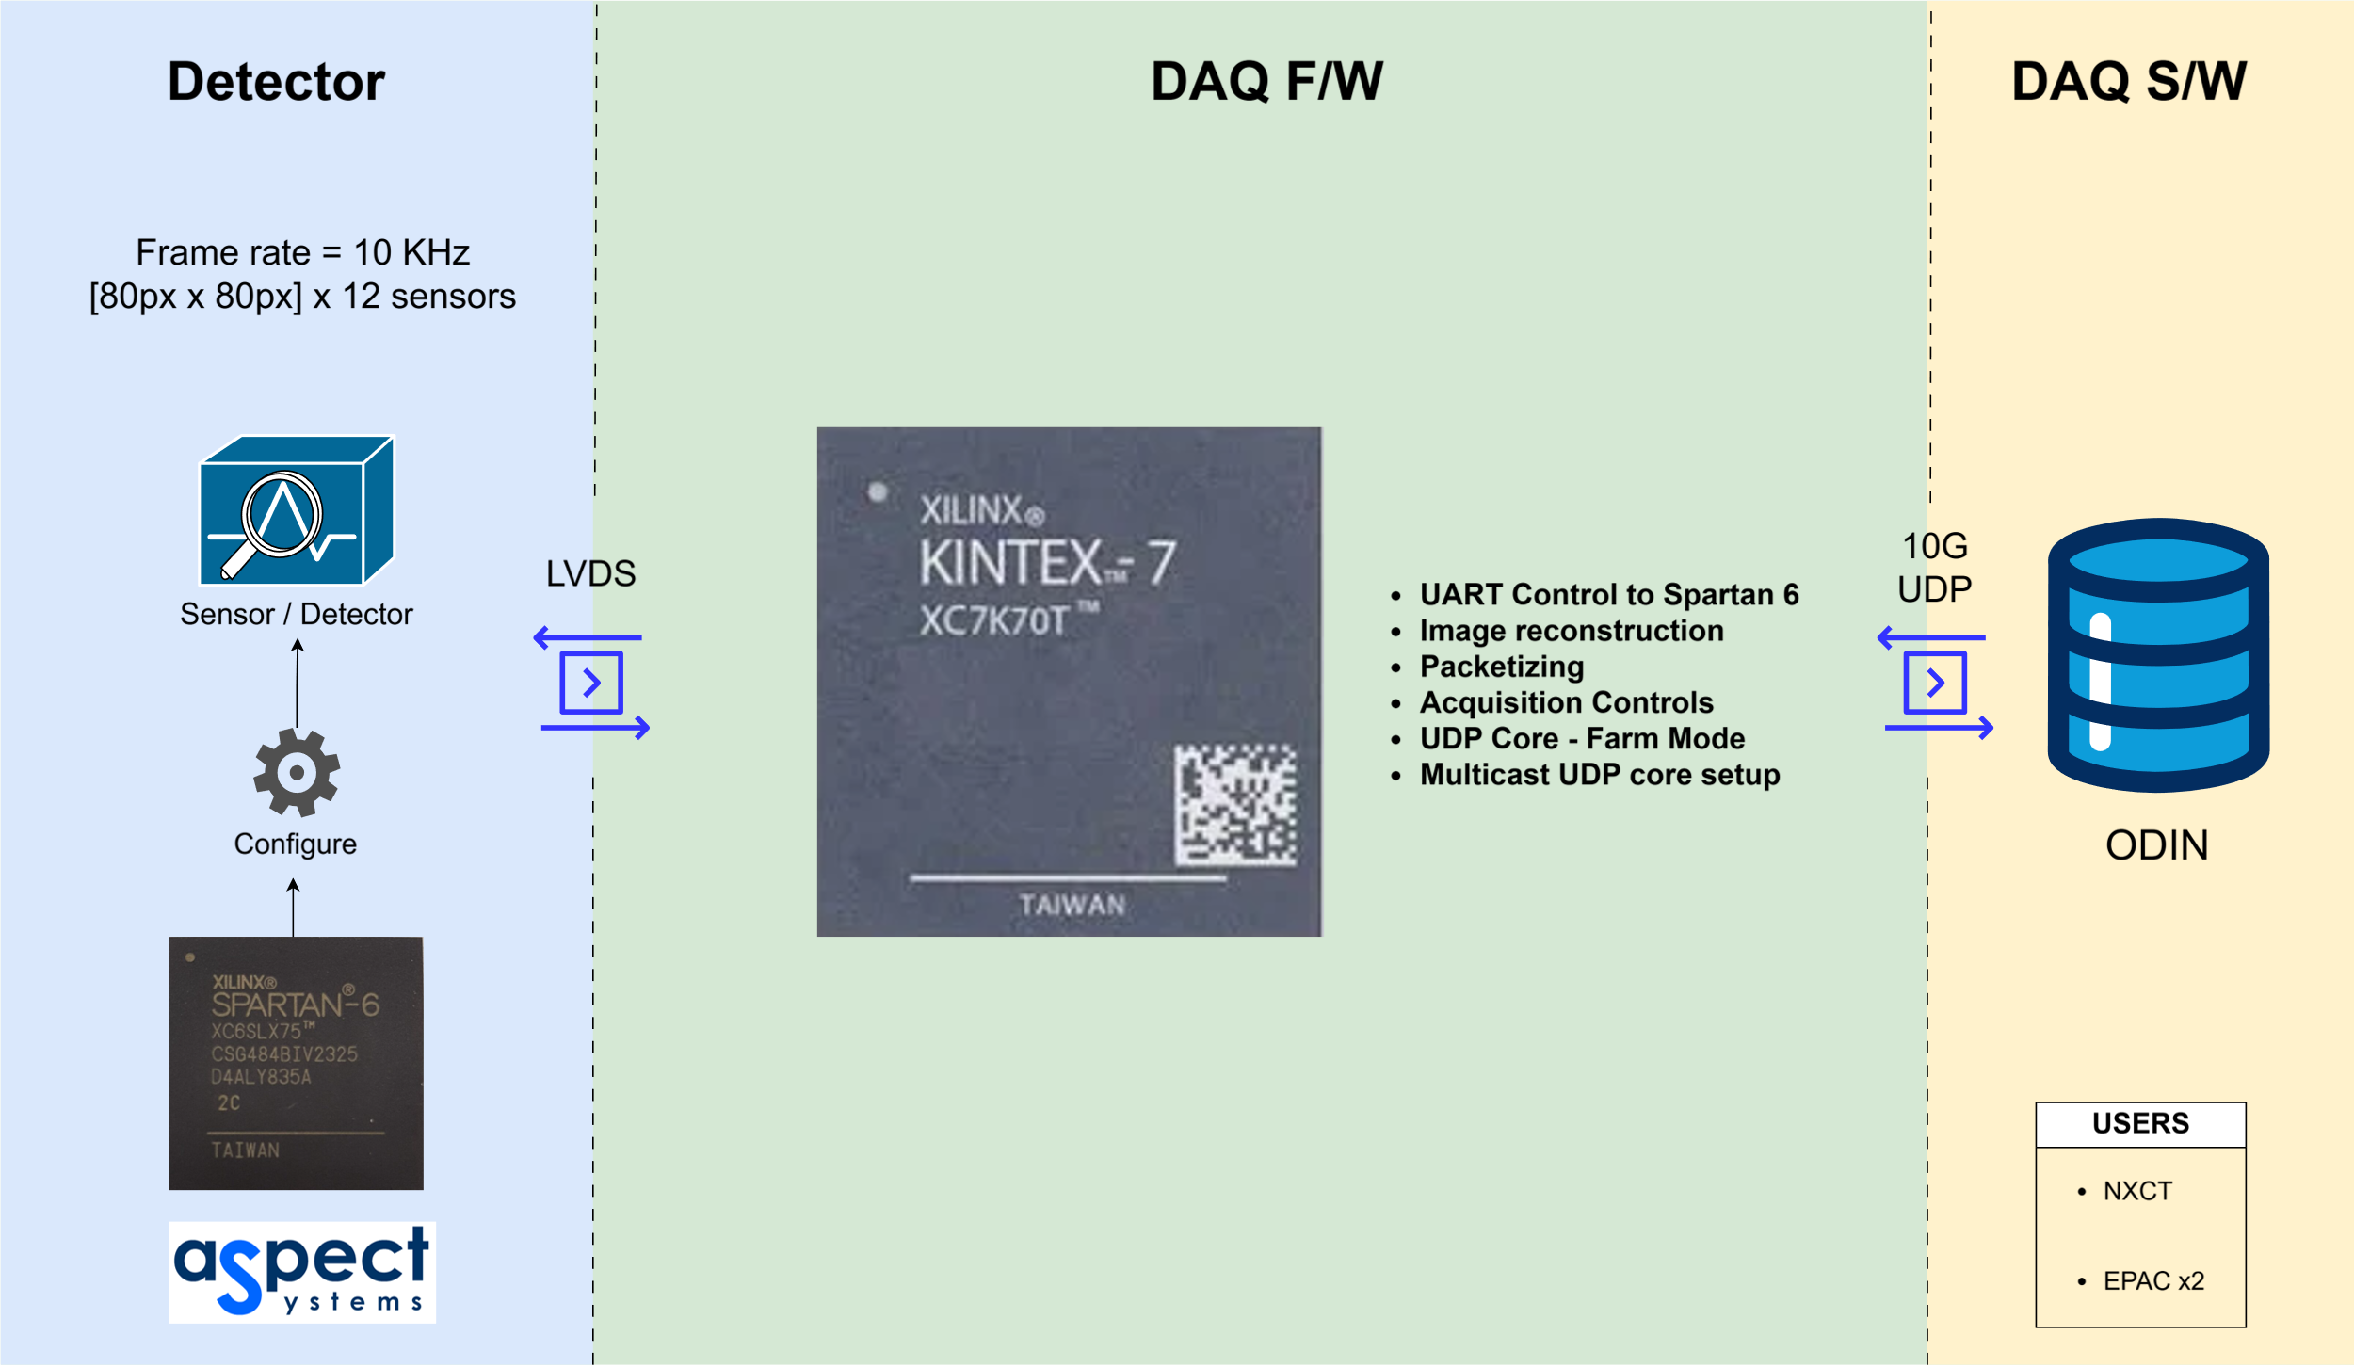
Hexitec 2x6

Slide 6
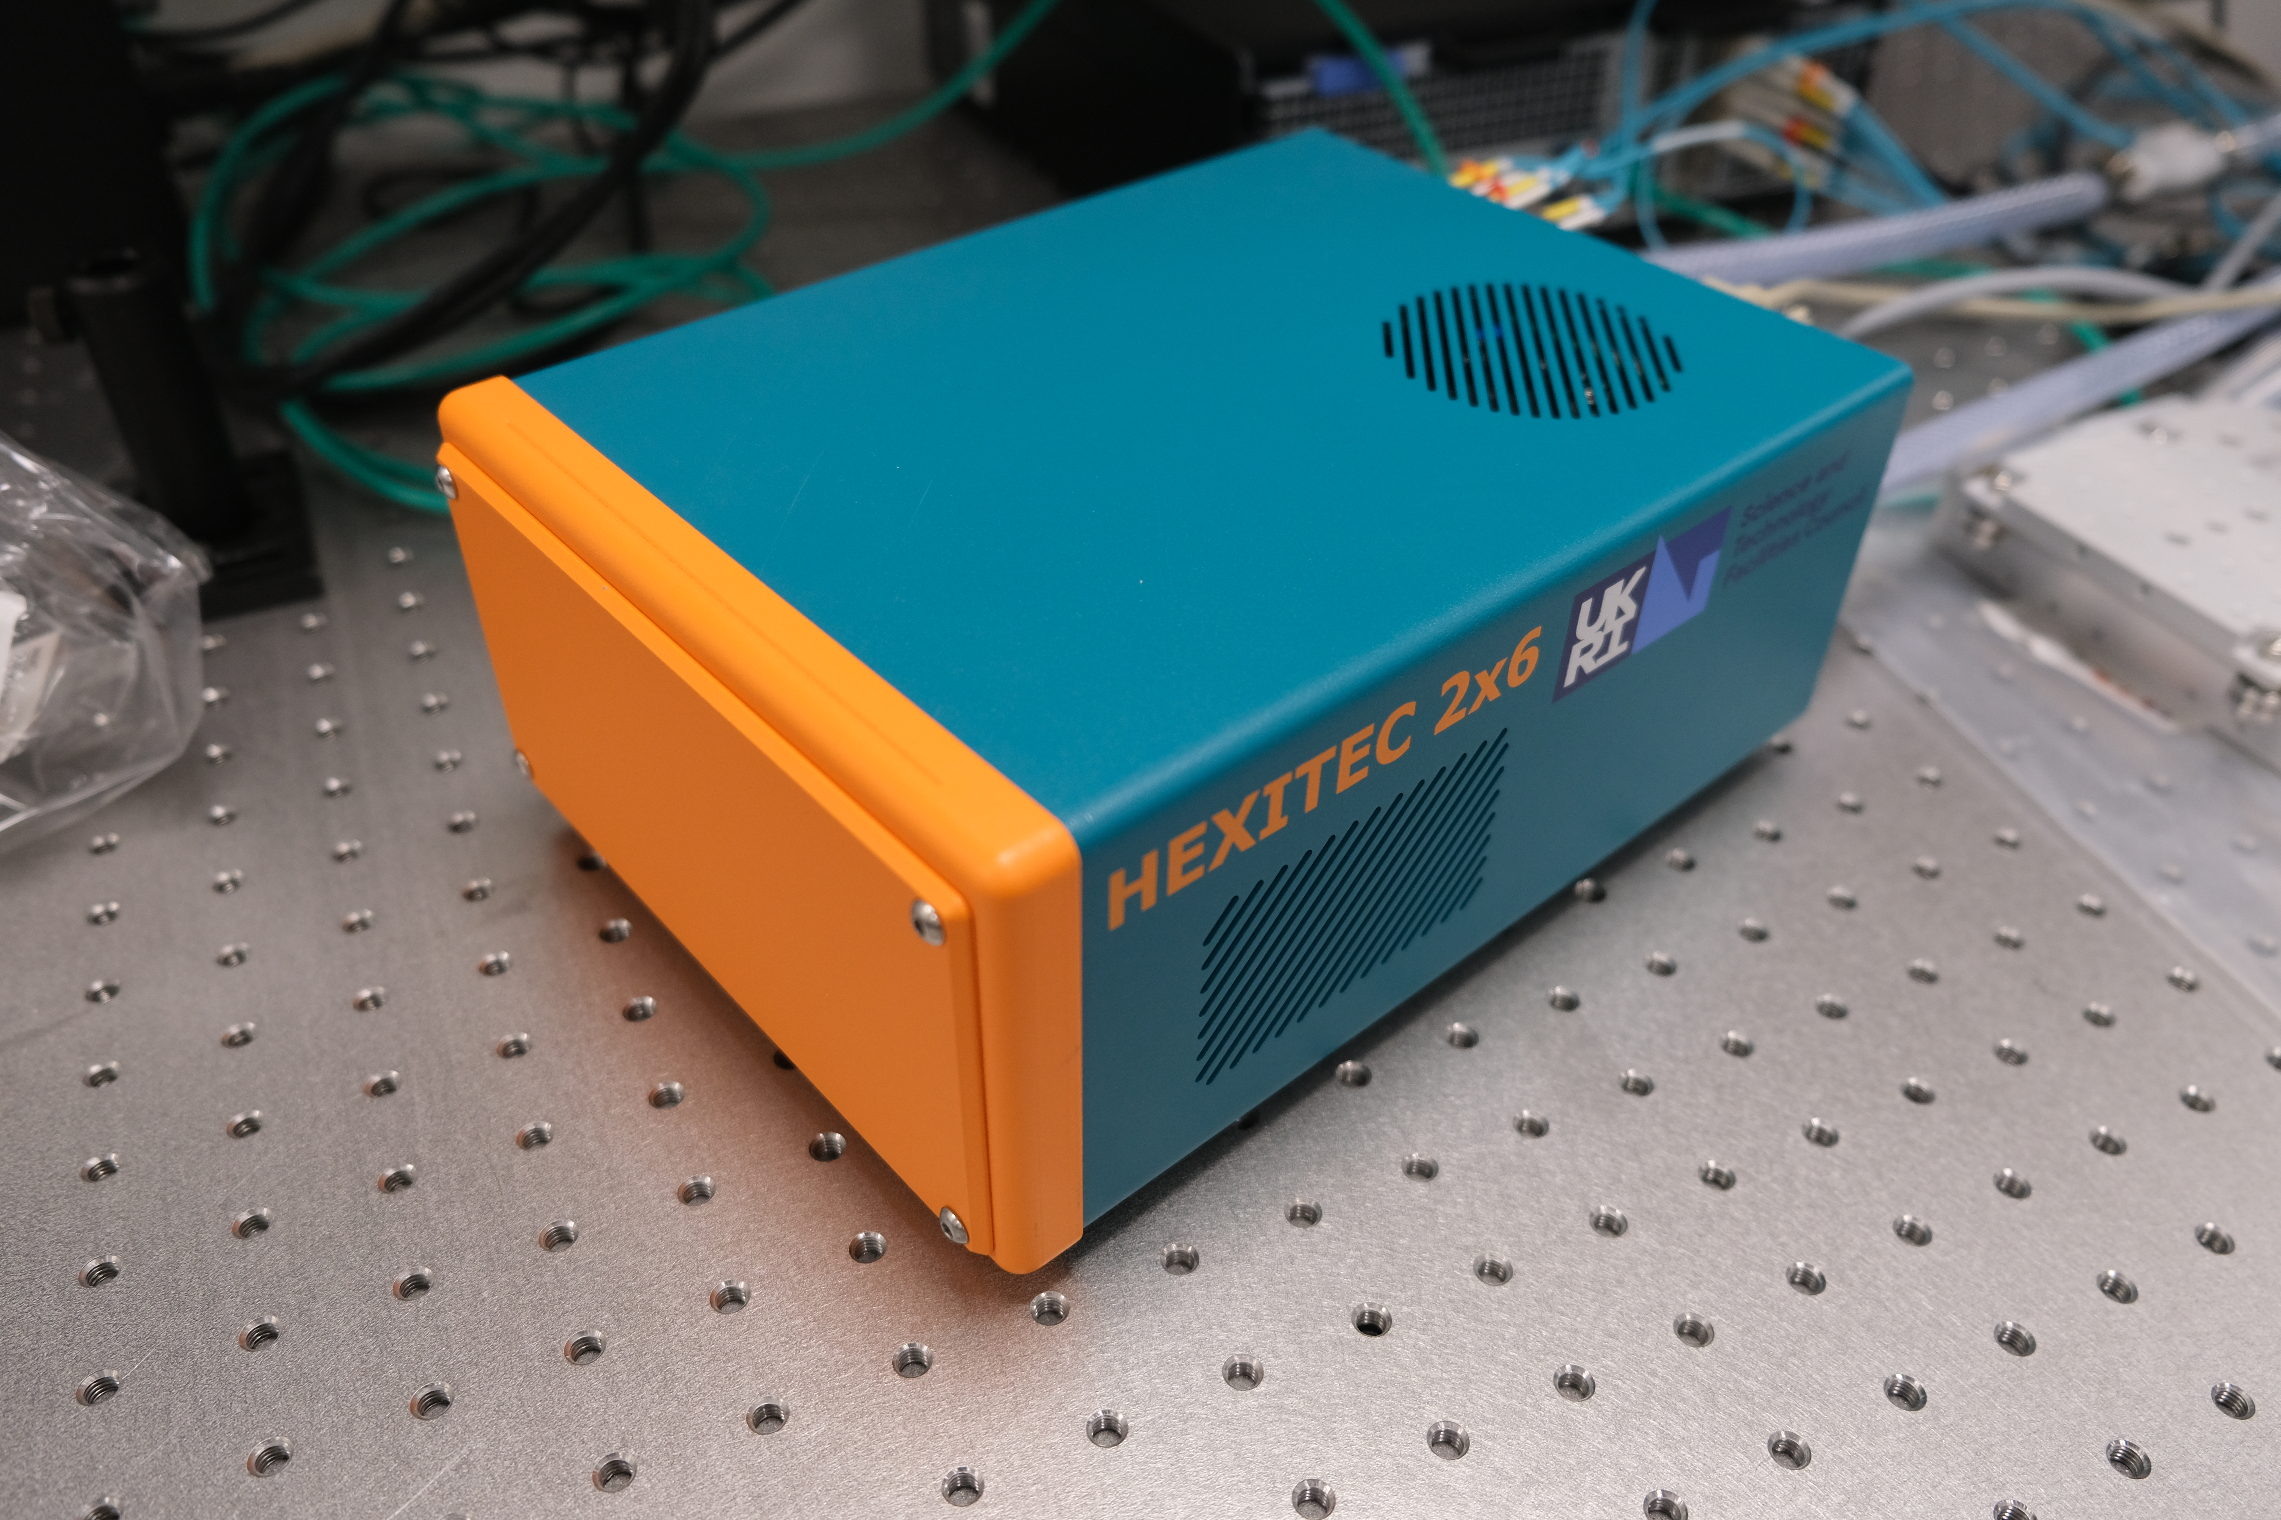
Hexitec 2x6

Slide 7
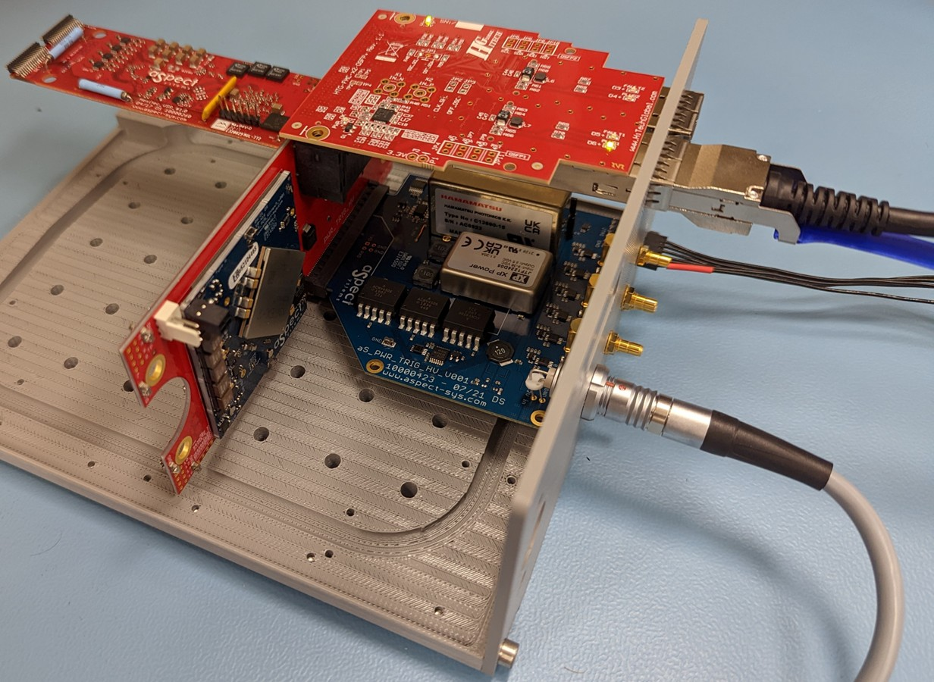
Hexitec 2x6

Slide 8
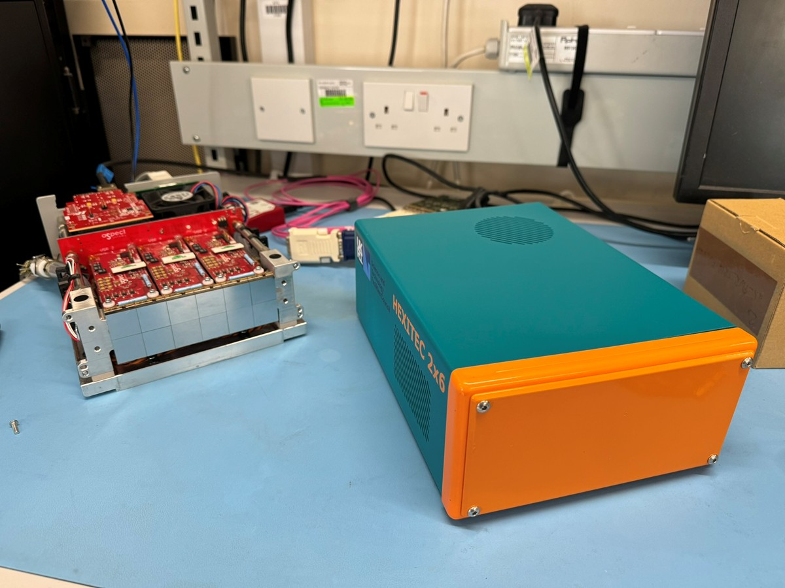
Hexitec 2x6

Slide 9
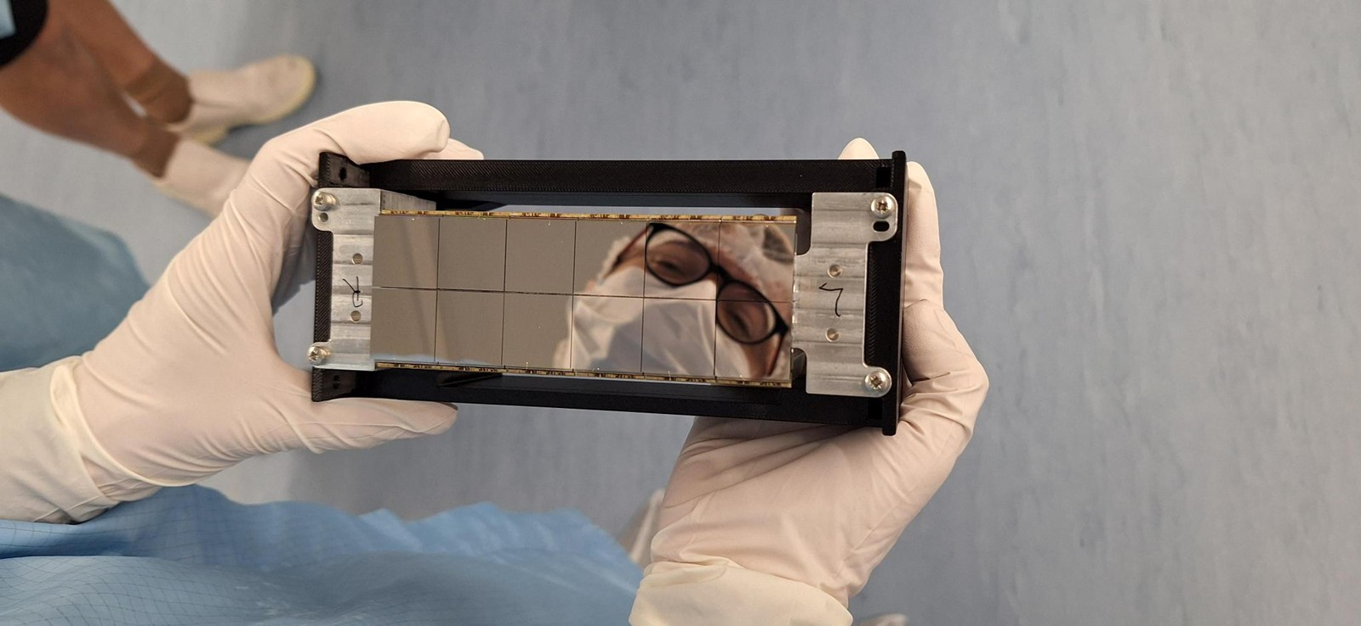
Hexitec 2x6

Slide 10
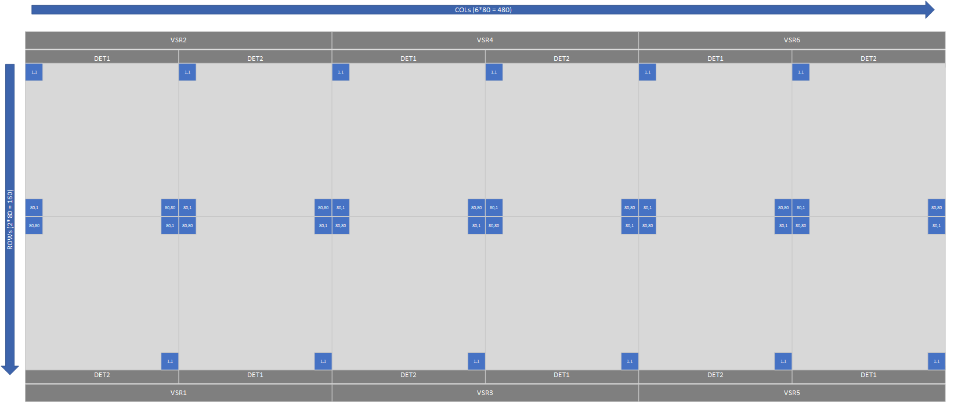
Hexitec 2x6

Slide 11
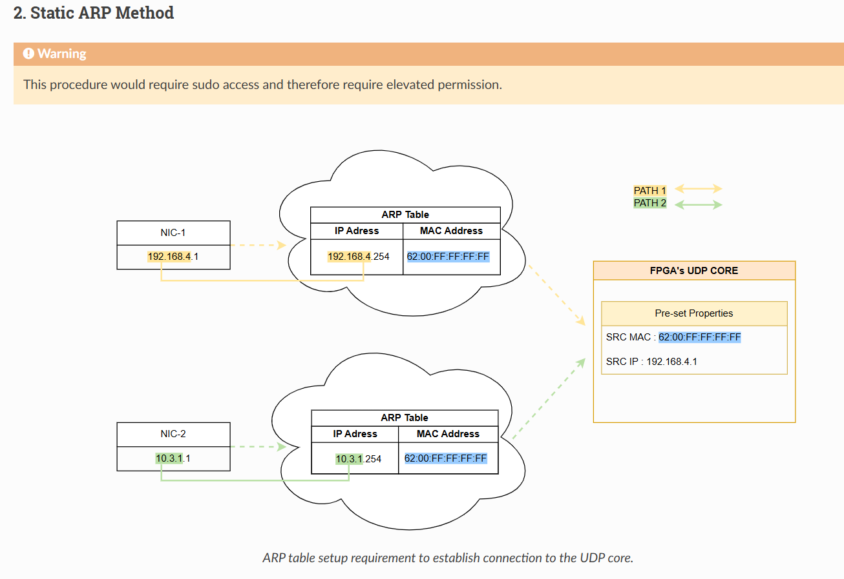
Doc URL: link

Slide 12
Doc URL: link

Slide 13
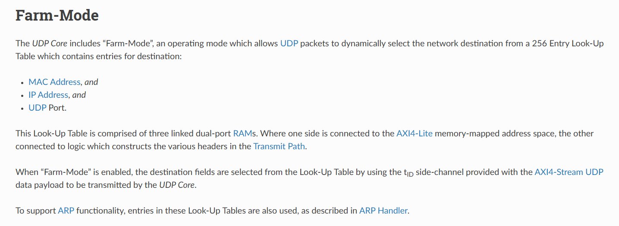
Hexitec 2x6
Doc URL: link

Slide 14
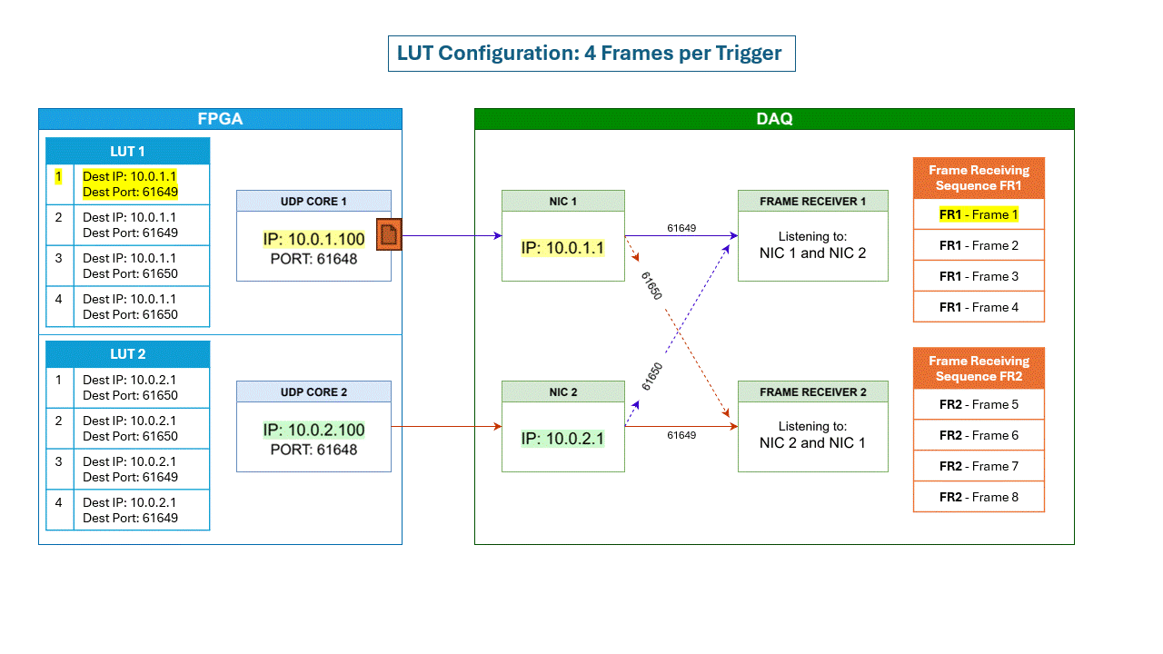
Hexitec 2x6

Slide 15
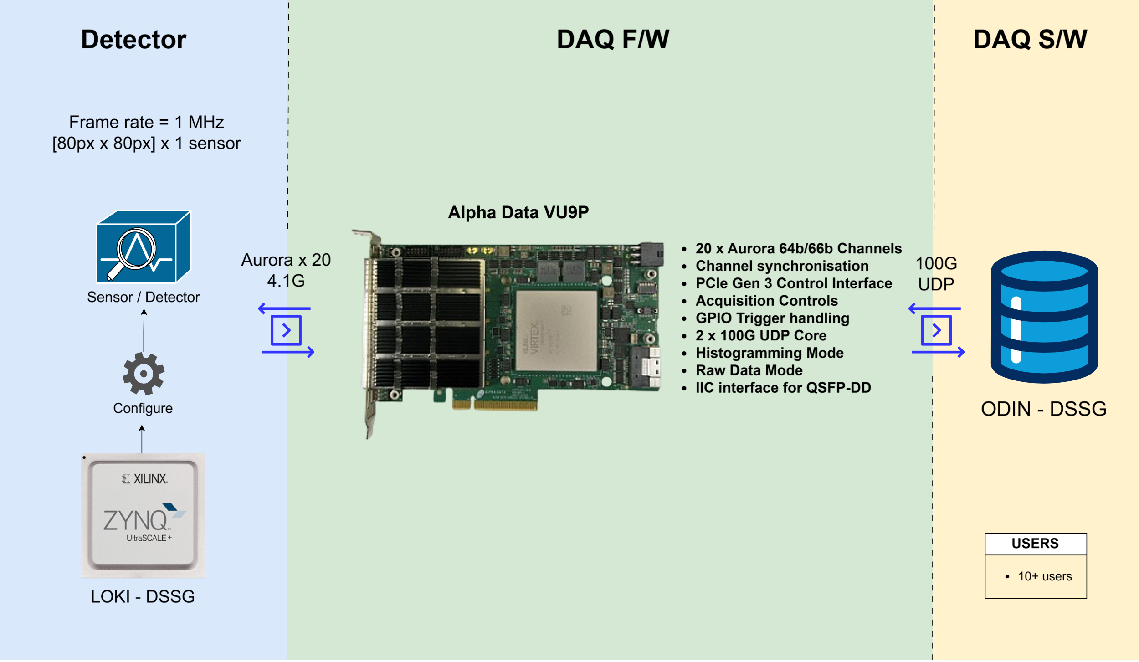
Hexitec MegaHertz

Slide 16
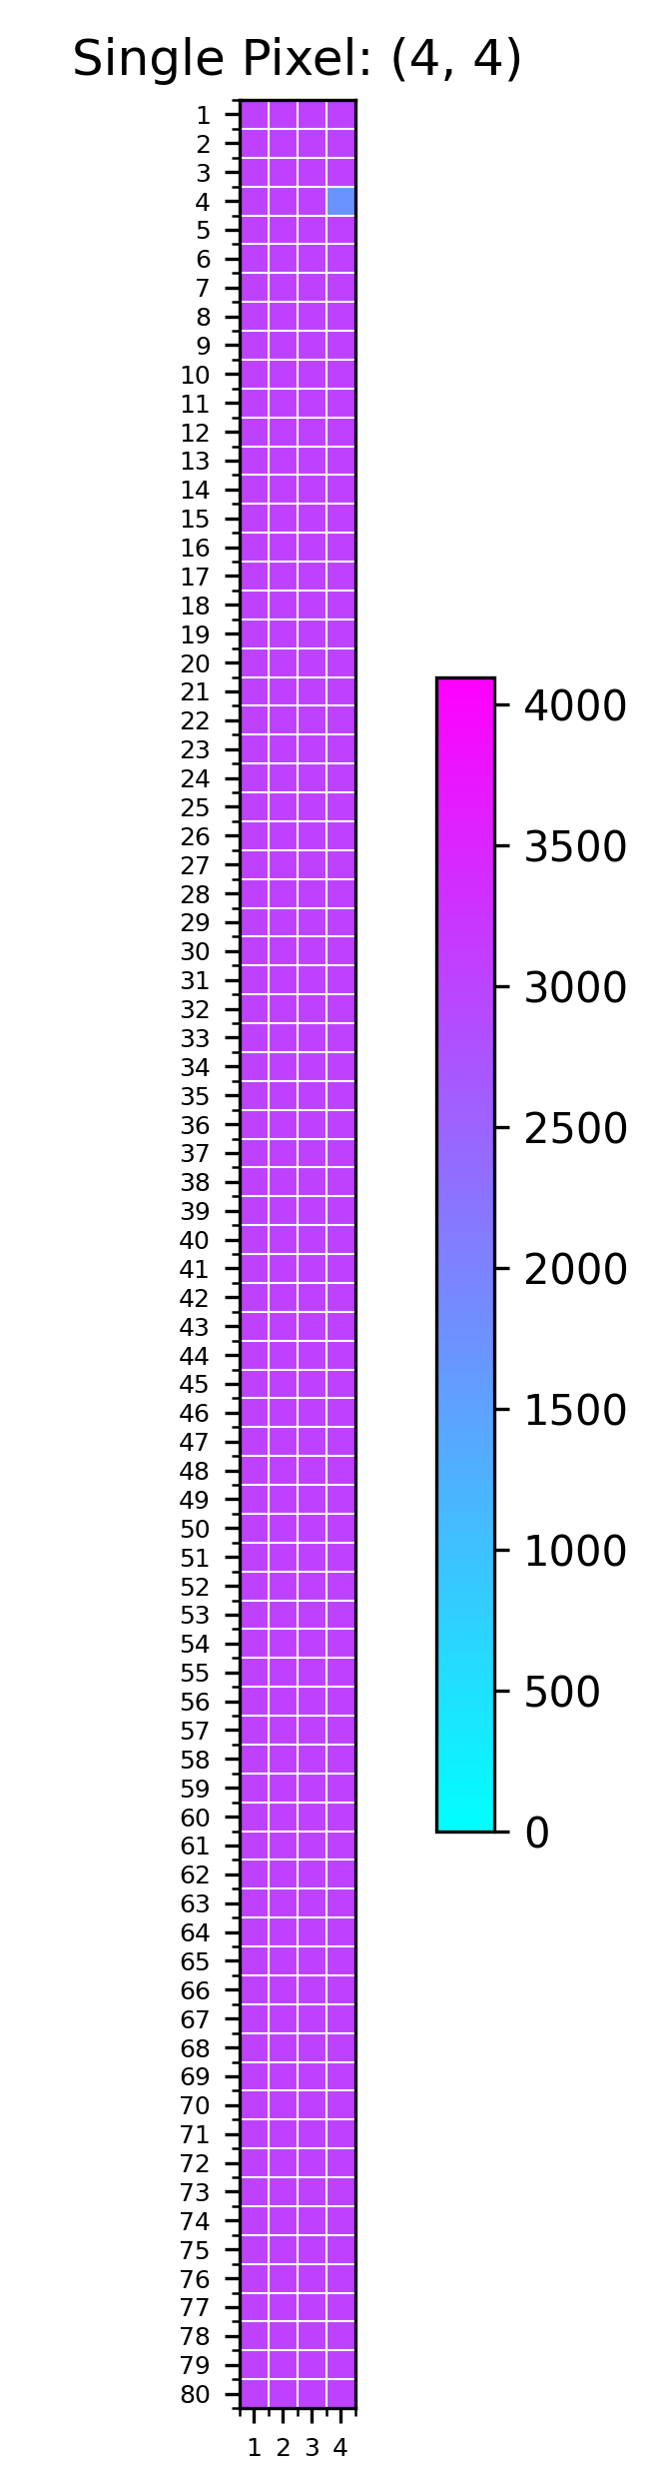


Hexitec MegaHertz

Slide 17
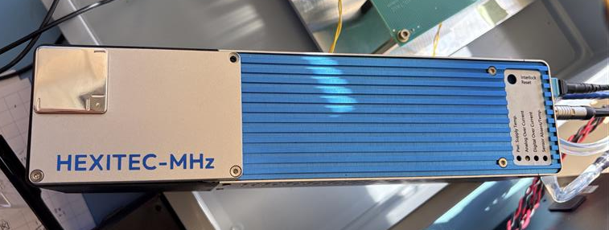
Hexitec MegaHertz

Slide 18
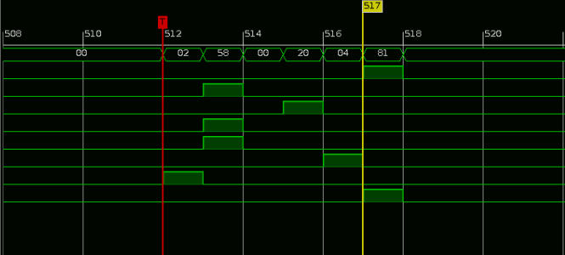
Hexitec MegaHertz

Slide 19
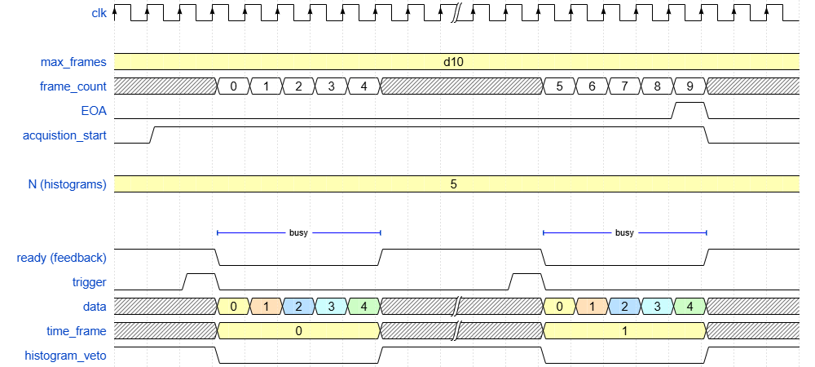
Hexitec MegaHertz
Step Scan Mode

Slide 20
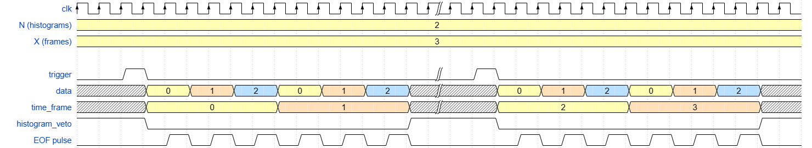
Hexitec MegaHertz
Burst Mode

Slide 21
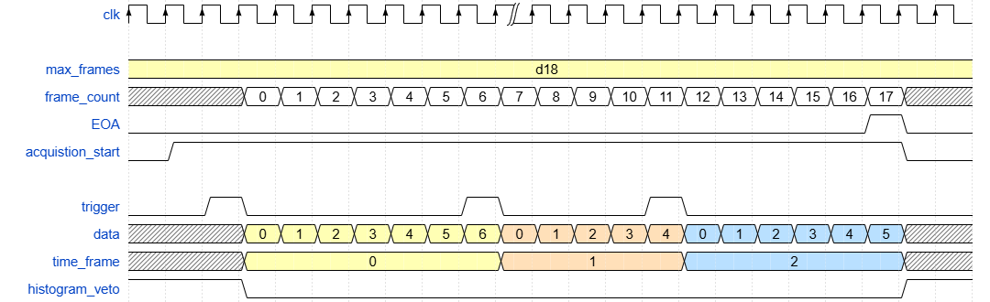
Hexitec MegaHertz
Continuous Mode

Slide 22
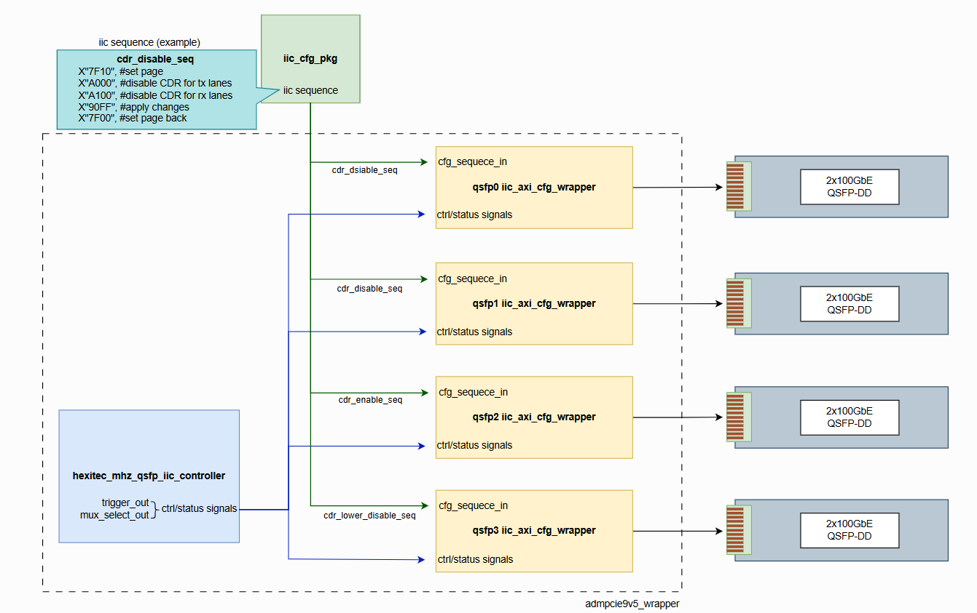
Hexitec MegaHertz

Slide 23
Hexitec MegaHertz

Slide 24
Hexitec MegaHertz

Slide 25
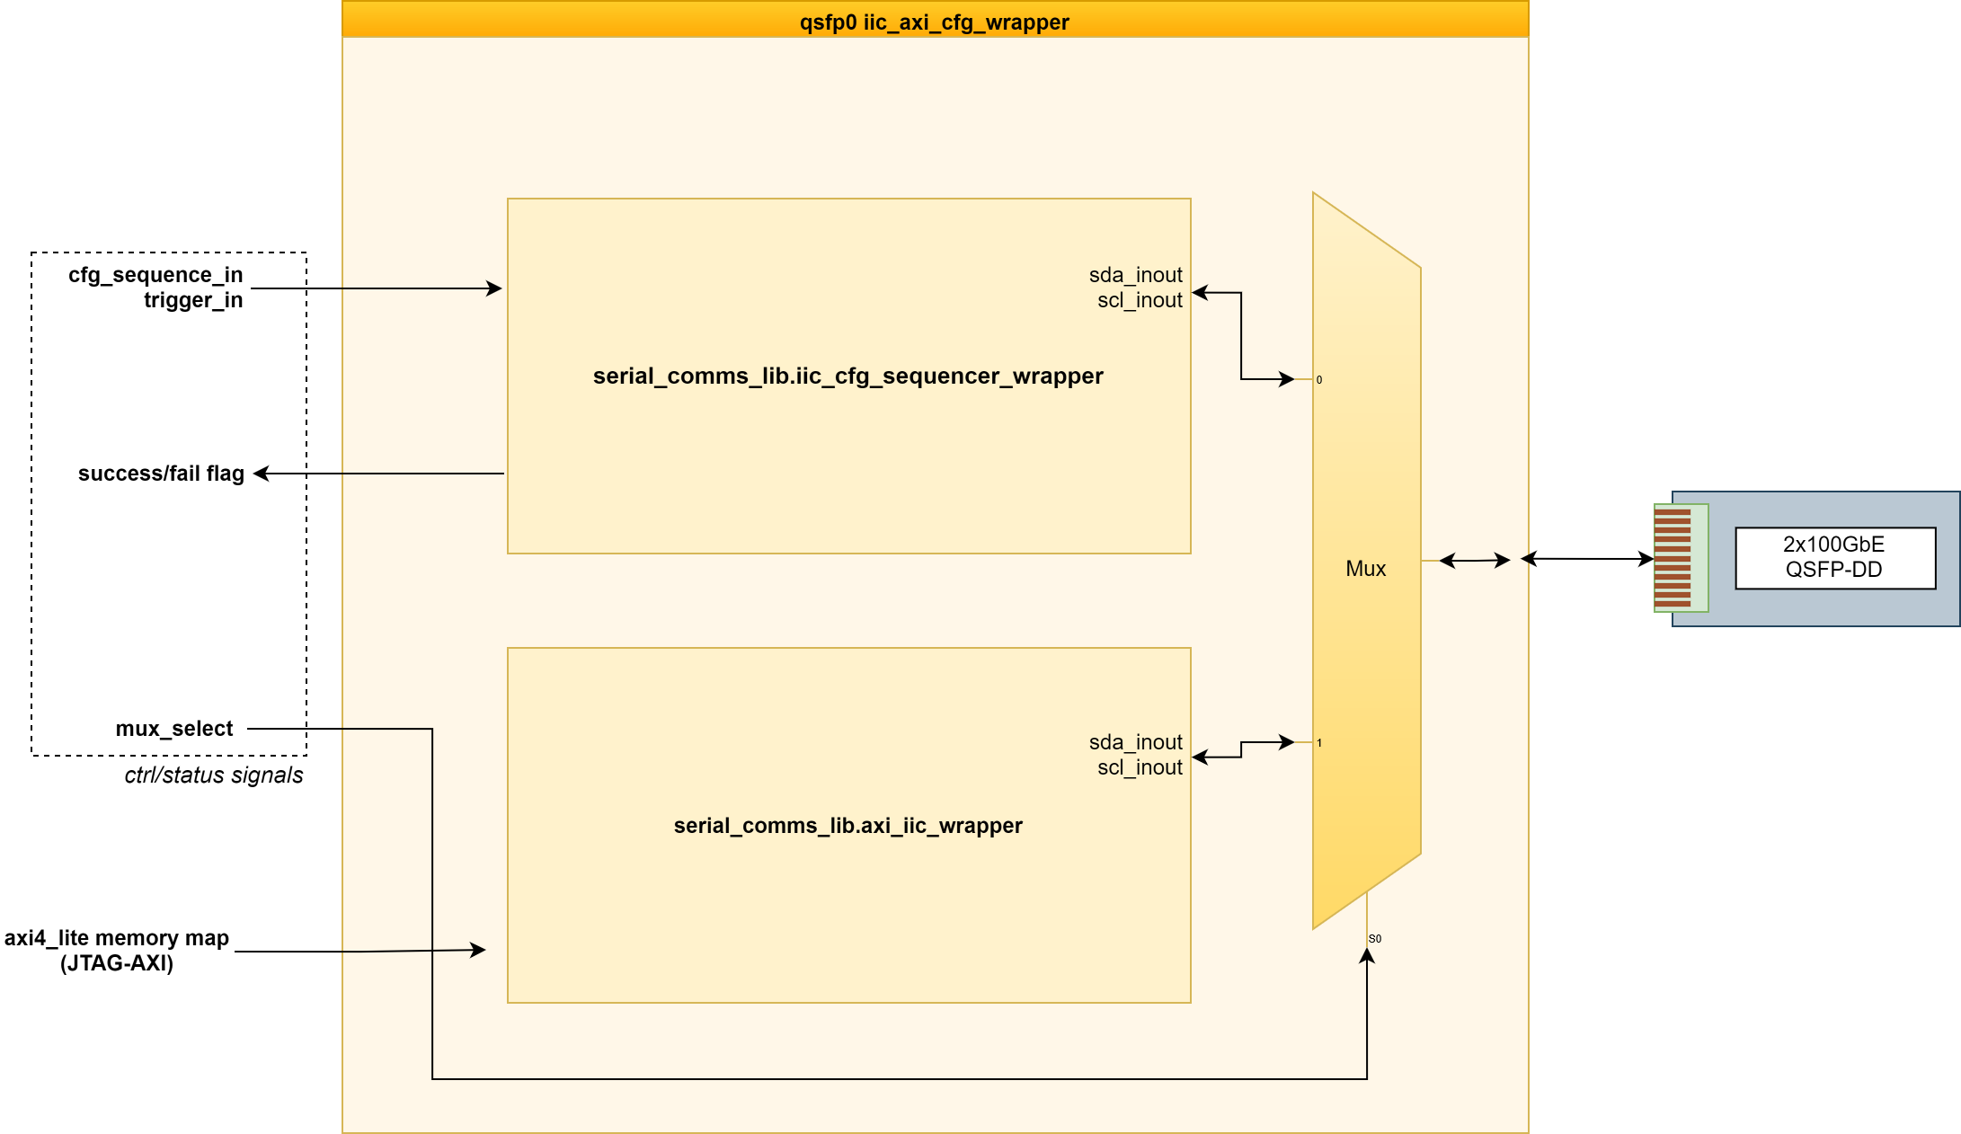
Hexitec MegaHertz

Slide 26
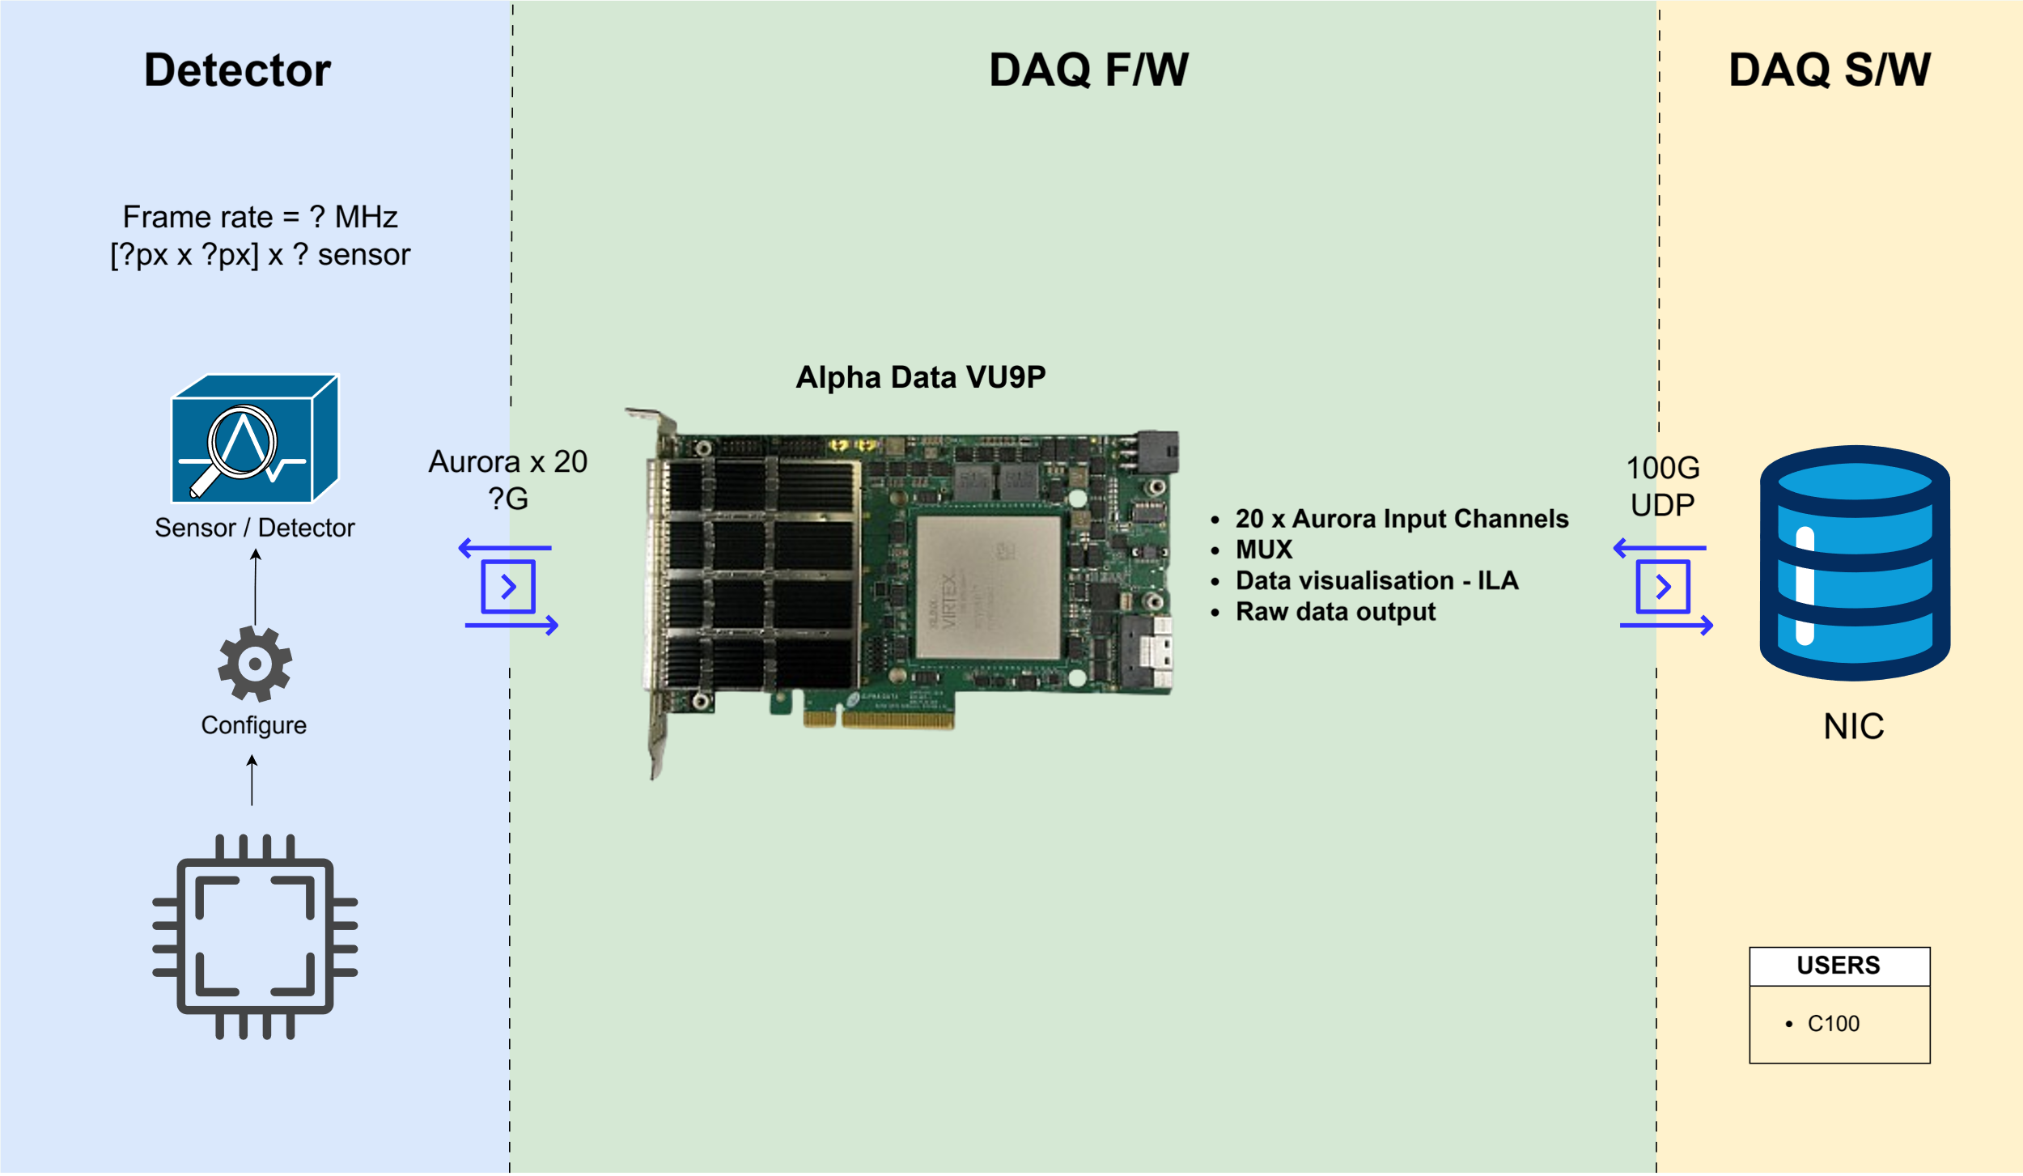
Raw Data Processor

Slide 27
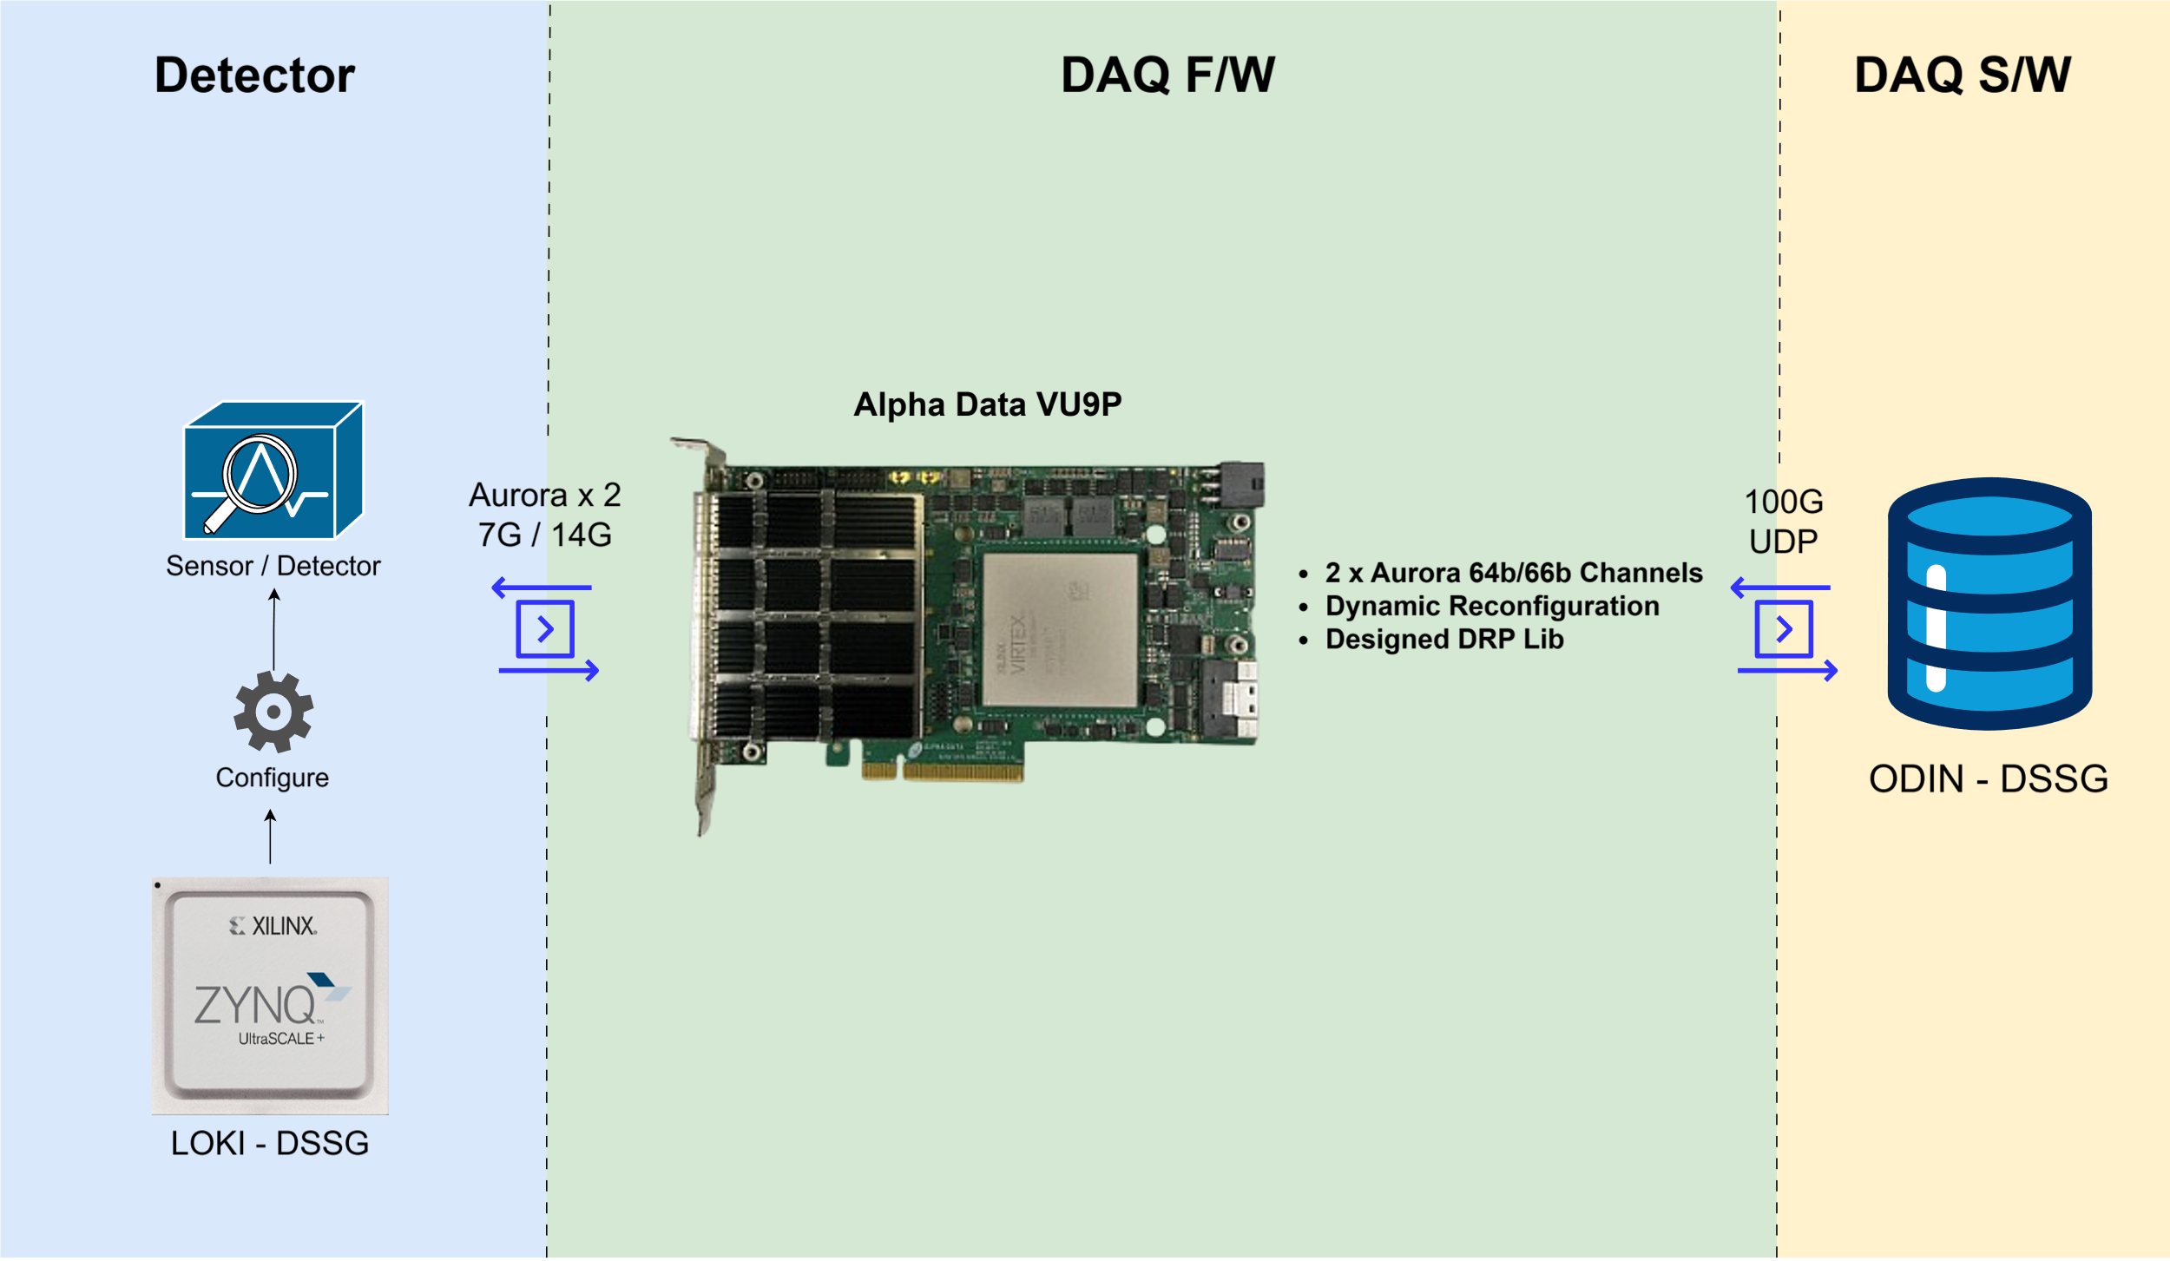
BabyD

Slide 28
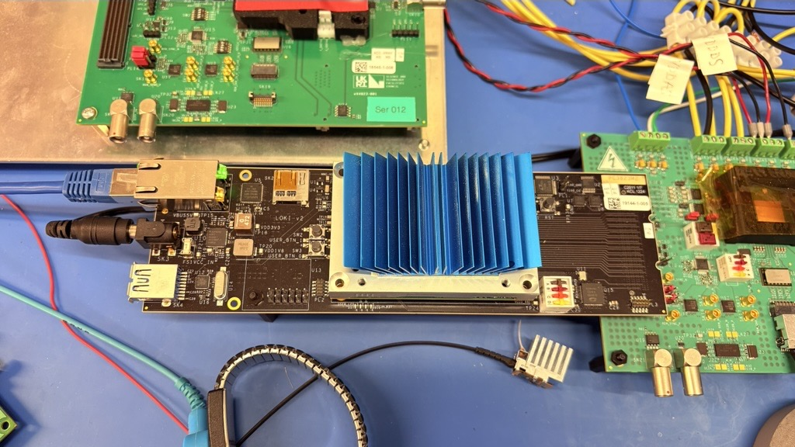
BabyD

Slide 29
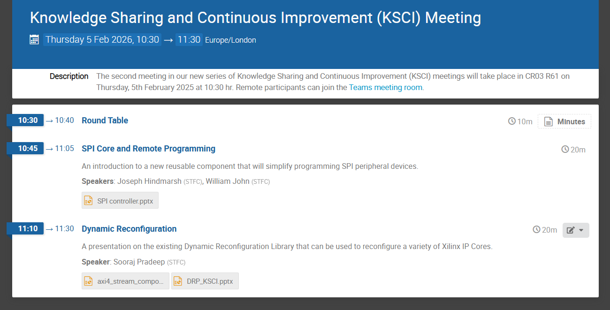
DRP Lib
Recording

Slide 30
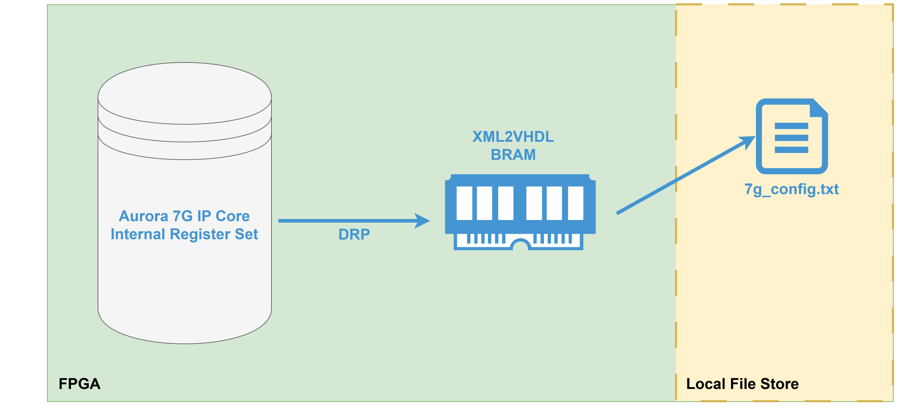
DRP Lib

Slide 31
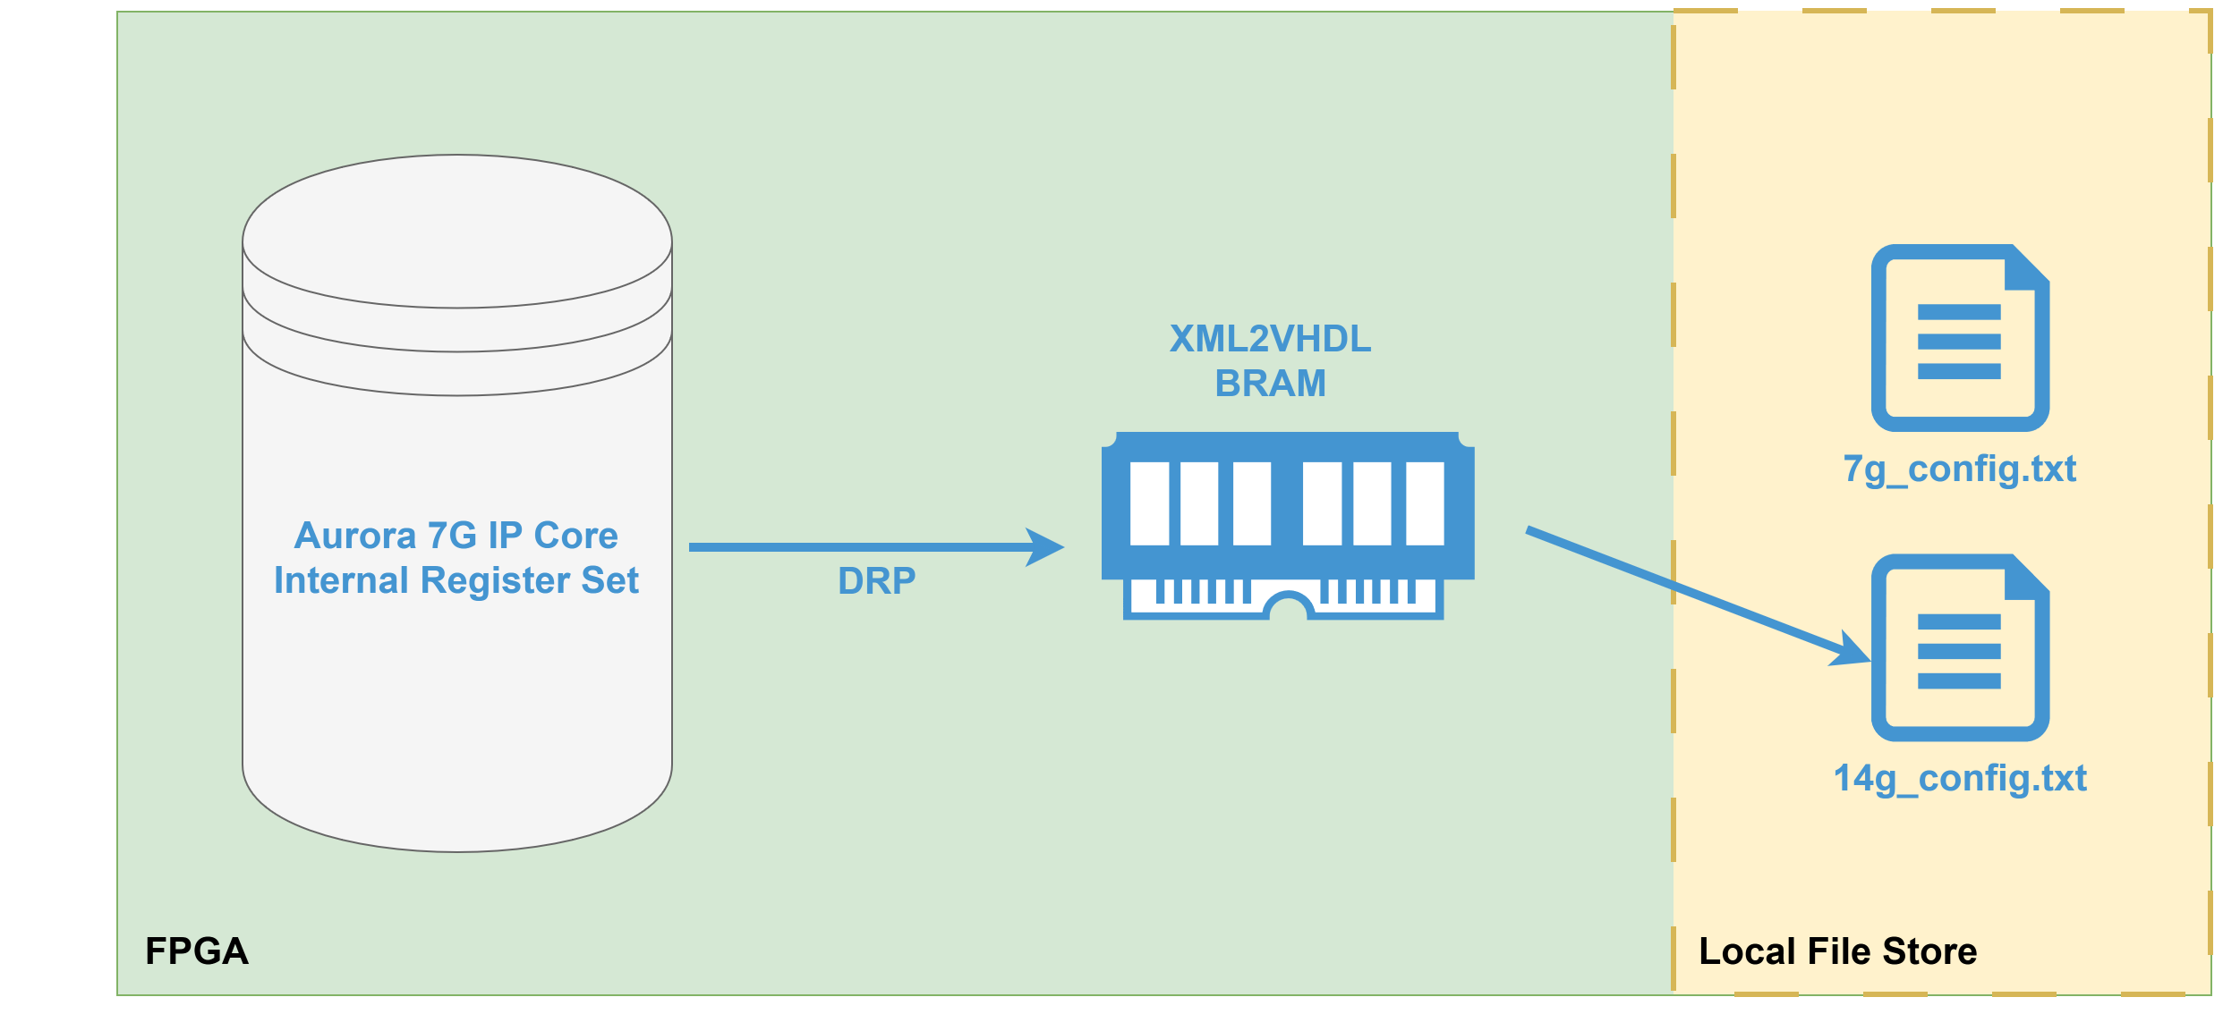
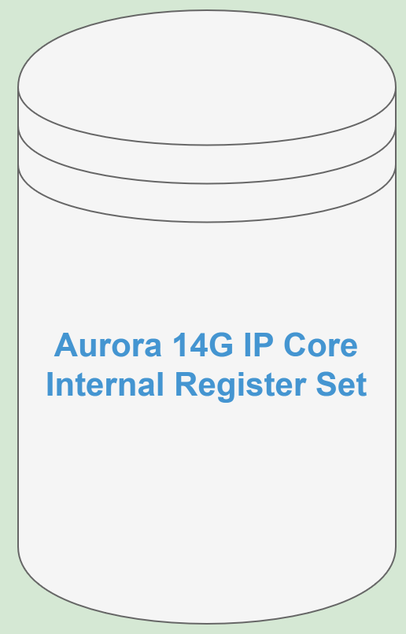
DRP Lib

Slide 32
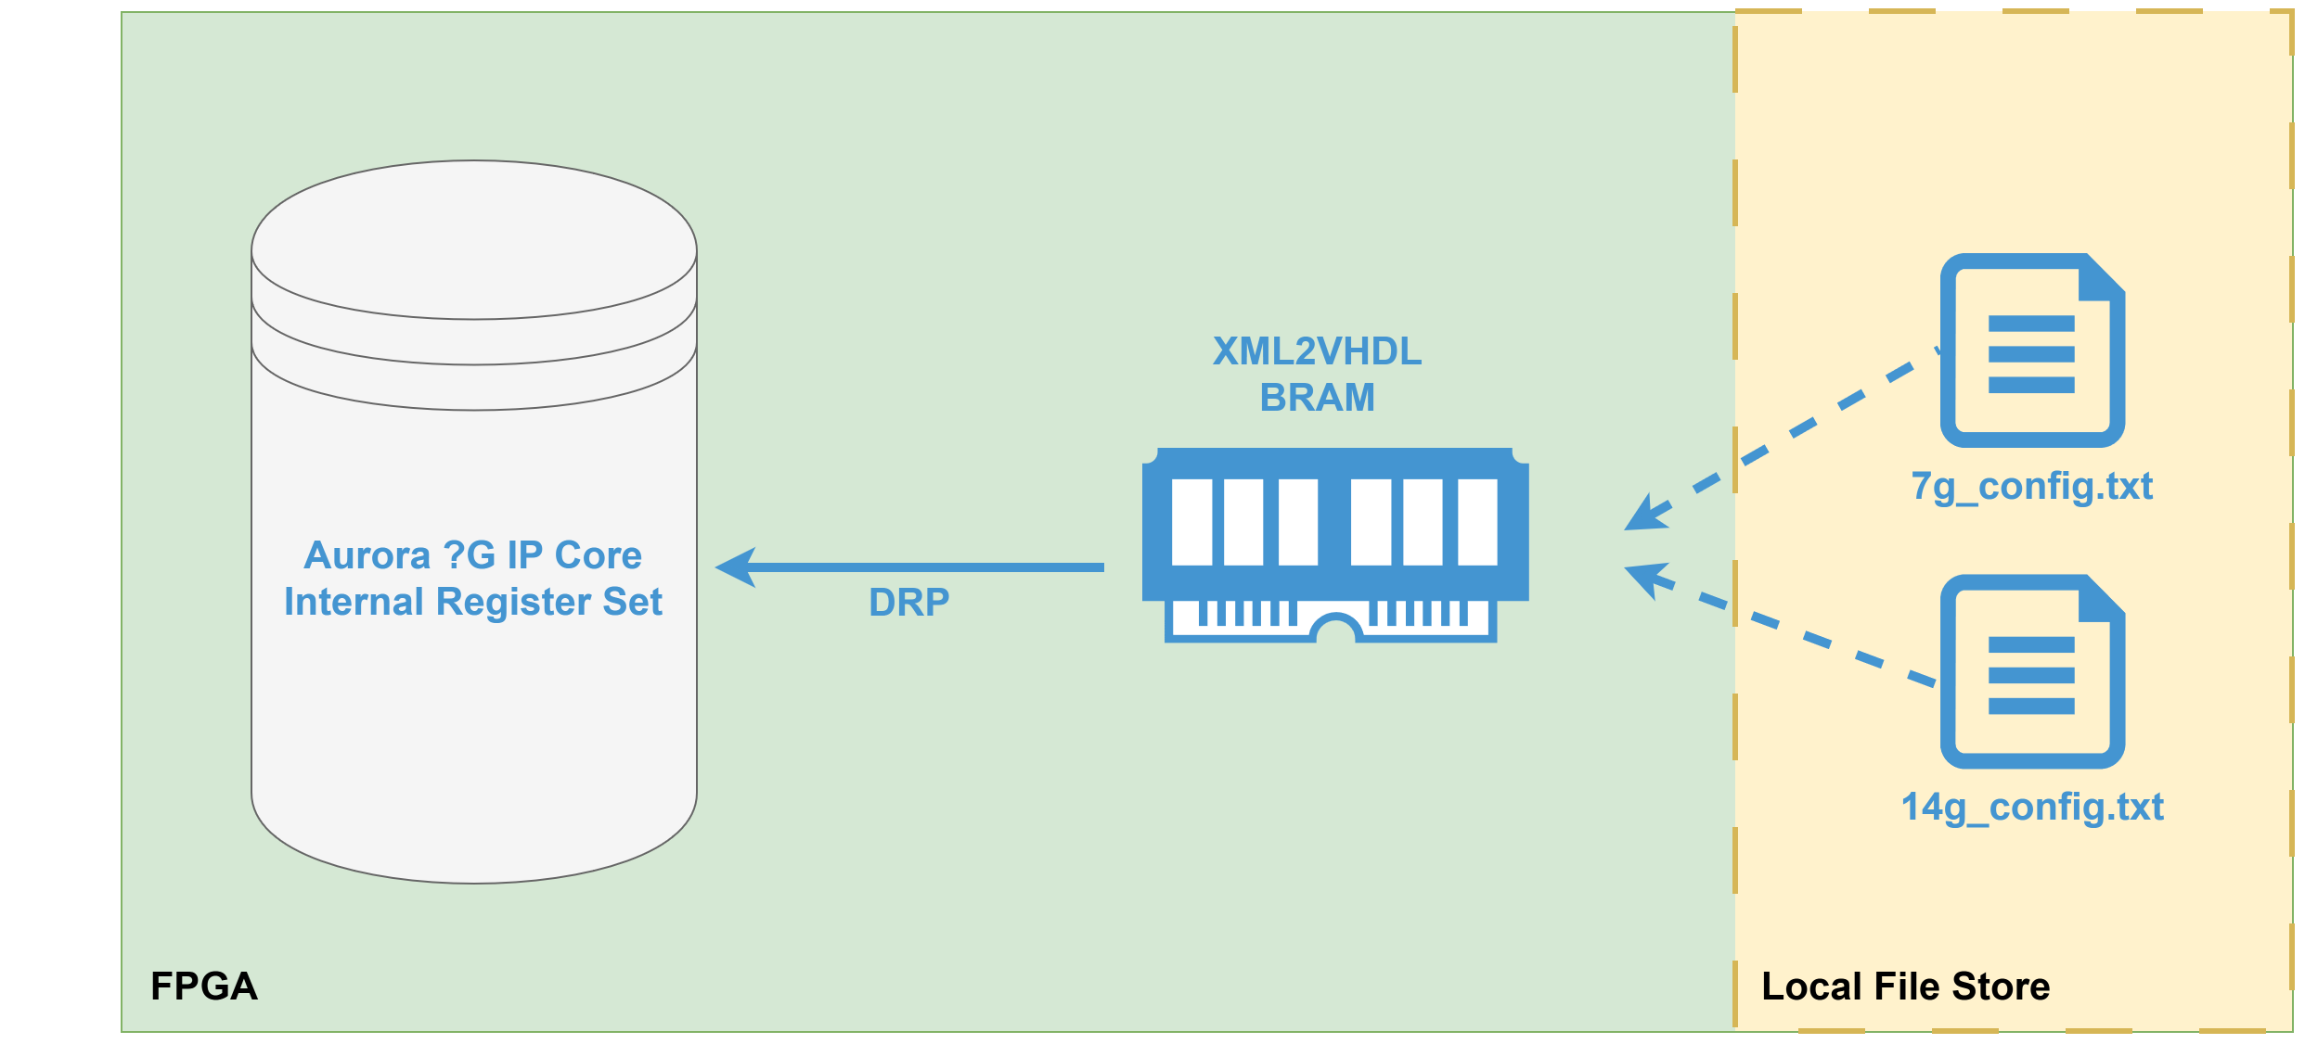
DRP Lib

Slide 33

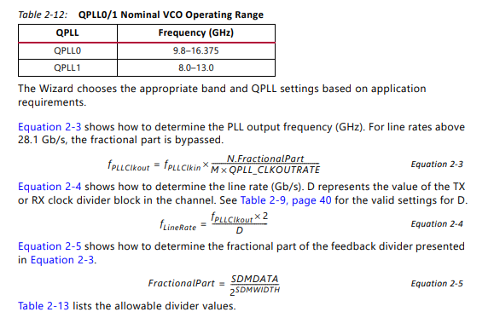
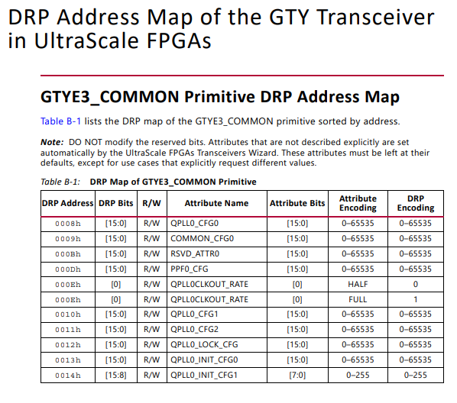
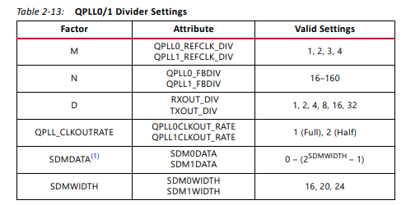
DRP Lib

Slide 34
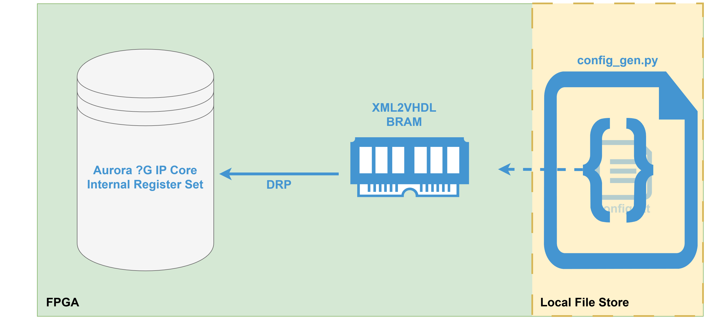
DRP Lib

Slide 35
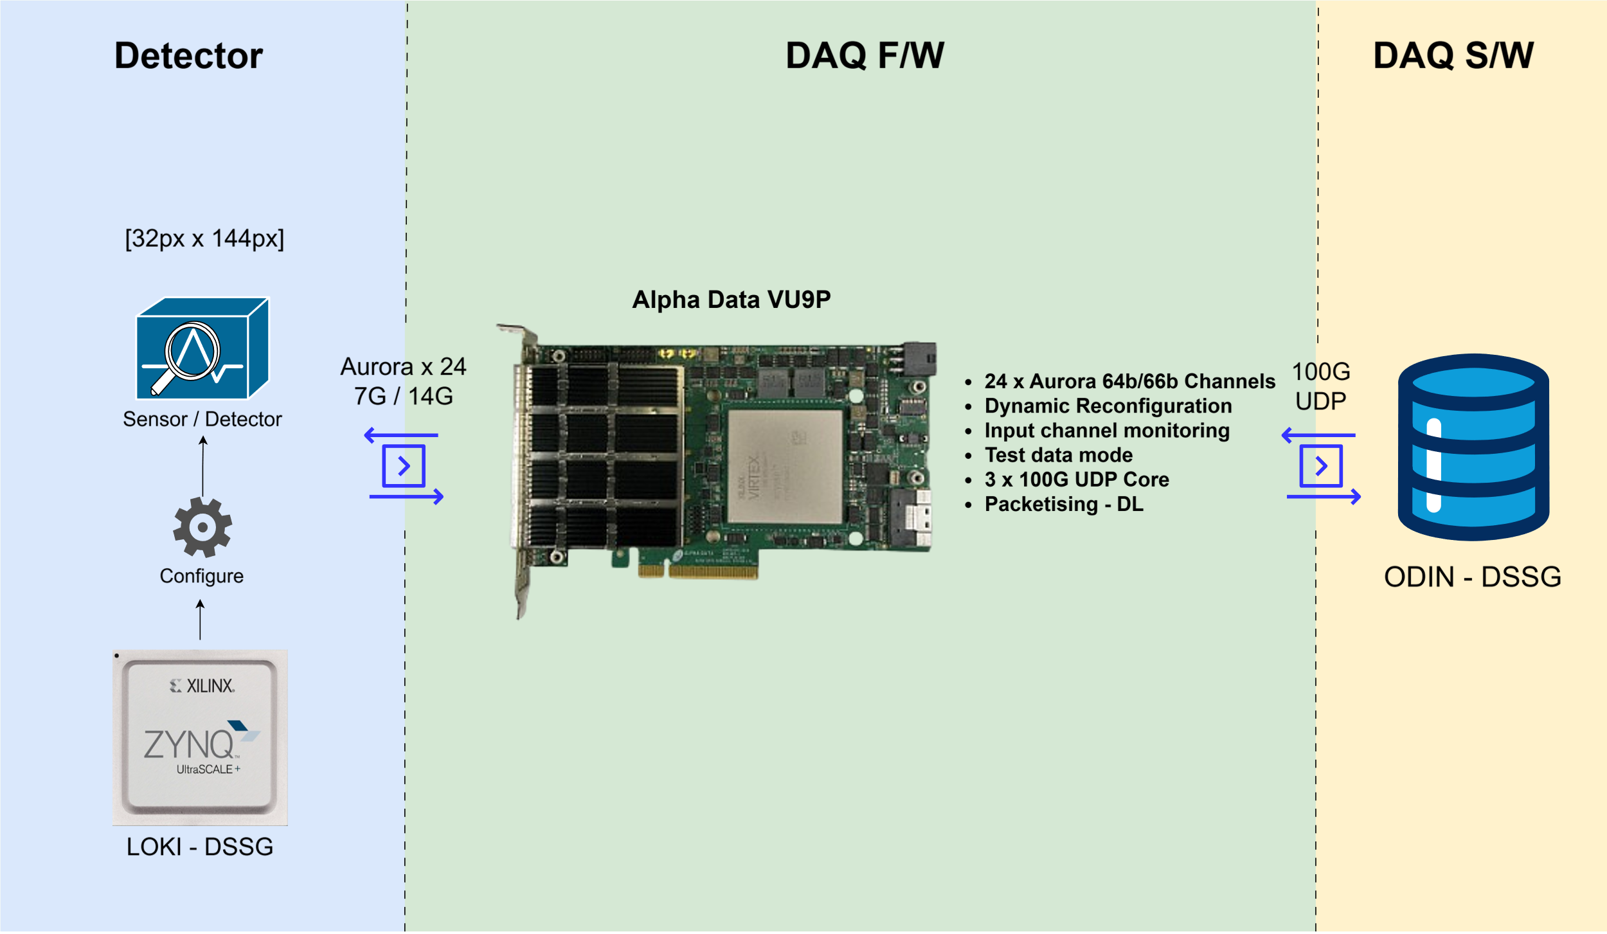
XiDyn

Slide 36
XiDyn

Slide 37
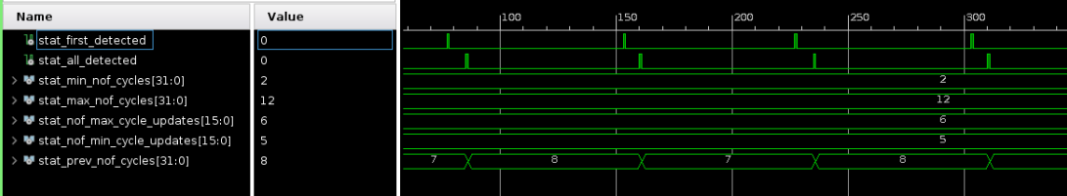
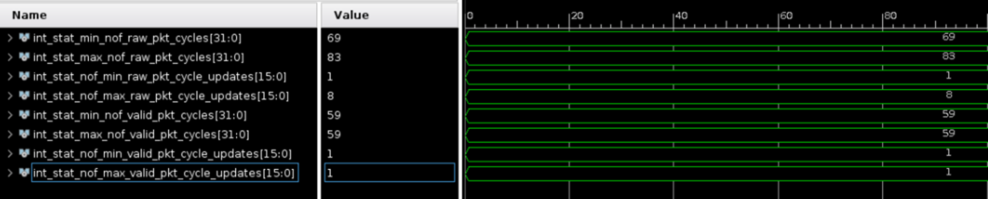
XiDyn

Slide 38




technologysi.stfc.ac.uk
@STFC_Matters
Science and Technology Facilities Council
Science and Technology Facilities Council
Notes:
The abstract pattern can be removed or repositioned if required. Be careful to ‘Send to Back’ so that it does not obscure any important information.

