Slide 1
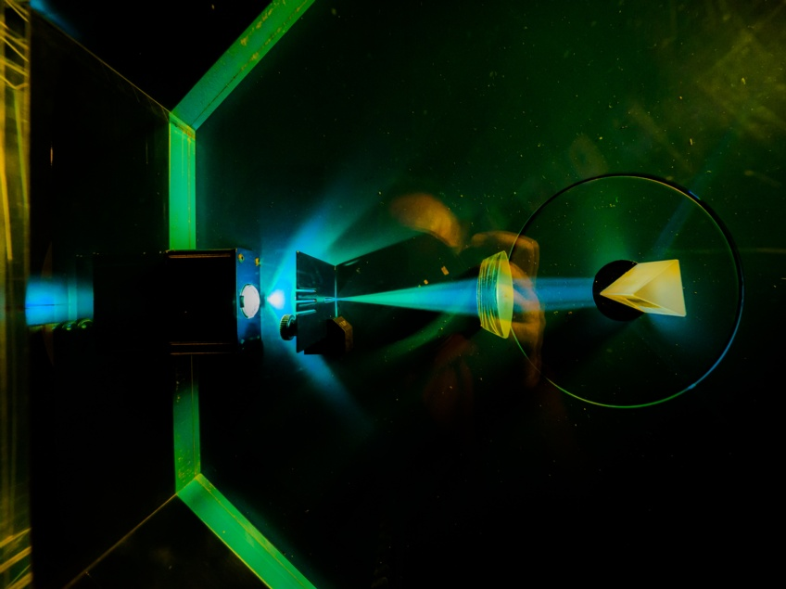


Electronic System Design Group Management Update
Group Meeting, 26 March 2026
CR03 & Zoom
Image © STFC Alan Ford
Notes:
To edit the background image, select ‘Format’ from the PowerPoint menu and ‘Slide Background’ from the drop-down menu. Within the new list of options that appears on the right of the screen, select the ‘File’ button under ‘Insert picture from’ and select your image from your file browser. Please remove or amend the image credit if you are using a different image to the one provided.

Slide 2
Fire Alarm!
A reminder: the fire alarm in this room will be tested at some point in this meeting
For which, apologies
You may remain seated

Slide 3
Overview
Projects ‘26–27
APRs
Staff, OTL, Capital Purchases
The Transformation Roadshow
Dates of next meetings

Slide 4
Projects 2026–27, Projection
ATLAS funding halved
SKA bidding for extension beyond 2026
New Opportunities
Involved in 3 CfI bids
Image Processing
EMP (Machine Learning)
Quantum Computing
Chilbolton radar correlation
Buckets & IS8…
We will find useful work for any effort unfunded
Notes:
Numbers from
H:\ESDG_business\EffortProfiles\2026-27\EffortProfile_Projection_2026-27_d1
Which is embedded

Slide 5
APRs
Deadline = 1st April end of May
For writing up 2025–27 & setting goals for 2026–27
I’ll book SLM appointments mid–late April
Divisional review on 13th May (→ Department review on 11 June)
Goals
Aim for ≥3
Can be added to & adjusted as year progresses
Recommend 1 ongoing goal = job description
Guidance on Fusion process available here

Slide 6
Group Organisation & Staff Changes
Ian Brawn
Ronnie Brumfitt
Joseph Hindmarsh
Weiming Qian
Kelvin Gascoyne
John Holden
Simon Moorby
Zhen Ha Ng
Geoffrey Betts
Matt Roberts
Chad Silk
Joshua Davies
Mohamed Siyad
Dave Templeman
Piers Coode
Jack Day
Martin Torbet
John Coughlan
Adam Barcock
Sooraj Pradeep
Hajira Bazaz
Berk Bilgin
Peter Furey-Duffin
Lucie Sharpe
William John
Saeed Taghavi
Changes
New Graduate Recruit
Willis Chiu will start in September

Slide 7
OTL
All done for the FY
Thank you!

Slide 8
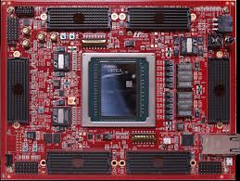
Capital Purchases
HTG-960 dev board
Xilinx Ultrascale+ VU19P
High-density FMC
+ various FMC cards
$50k
Await delivery
Remaining TD funds uncertain spent
So no other purchases this FY
https://www.hitechglobal.com/Boards/VirtexUltraScale+_VU19P_Board.htm

Slide 9

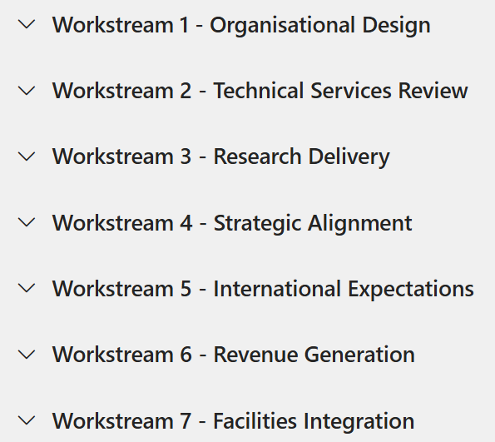
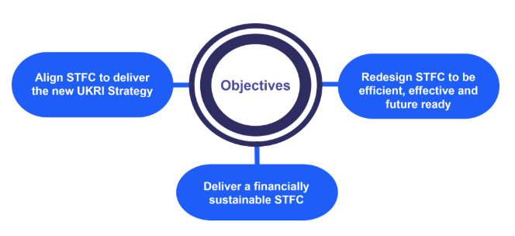
Transformation Roadshow
The STFC Transformation Roadshow visited RAL 18 March
= Engineering & Technology
“Why are we in this position?”
“What does this mean for me?”
— Not intended to answer these questions; more an information-gathering exercise

Slide 10
Meetings This Year
Meeting | Date | Start Time | Location
ESDG Group Meeting | Thursday 26 February | 10:15 am | CR03
ESDG Group Meeting | Thursday 26 March | 10:30 am | CR03
DED Forum | Wednesday 1 April | 10:00 am | Visitor Centre
ESDG Group Meeting | Thursday 30 April | 10:30 am | CR03
ESDG Group Meeting | Thursday 28 May | 10:30 am | CR03
ESDG Group Meeting | Thursday 25 June | 10:30 am | CR03
ESDG Group Meeting | Thursday 30 July | 10:30 am | CR12
ESDG Group Meeting | Thursday 27 August | 10:30 am | CR12
ESDG Group Meeting | Thursday 24 September | 10:30 am | CR12
ESDG Group Meeting | Thursday 26 October | 10:30 am | CR12
ESDG Group Meeting | Thursday 26 November | 10:30 am | CR12
Christmas Party | TBA
Room change

Slide 11






AOB
technologysi.stfc.ac.uk
@STFC_matters
Science and Technology Facilities Council
Science and Technology Facilities Council
Notes:
The abstract pattern can be removed or repositioned if required. Be careful to ‘Send to Back’ so that it does not obscure any important information.

Slide 12
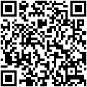
SHE: Who’s Representing YOU?
Good Health and Safety (H&S) management relies on the support and commitment of all staff to make our workplaces safe.
TU Health and Safety Reps represent all staff, not just TU members.
If you have any H&S concerns that you think are not being properly dealt with, please contact any of these reps; your input will be treated in the strictest confidence.
Representative | UNION | Contact extension/e-mail
Rutherford Appleton Laboratory (RAL)
Charles Ballard | Prospect | 7721 / charles.ballard@stfc.ac.uk
Joel Kurati | Prospect | 5156 / joel-stephen-prabhakar.kurati@stfc.ac.uk
Michael Hirsch | Prospect | 7145 / michael.hirsch@stfc.ac.uk
Andrew Seville | Prospect | 5689 / andrew.seville@stfc.ac.uk
Stephen Bell | Prospect | 5416 / stephen.bell@stfc.ac.uk
David McGarry | Prospect | 4453 / dave.mcGarry@stfc.ac.uk
Adrian Coveney | Prospect | 6516 /adrian.coveney@stfc.ac.uk
Further detail can be obtained from your local SHE Group
Issued July 2025

Slide 13
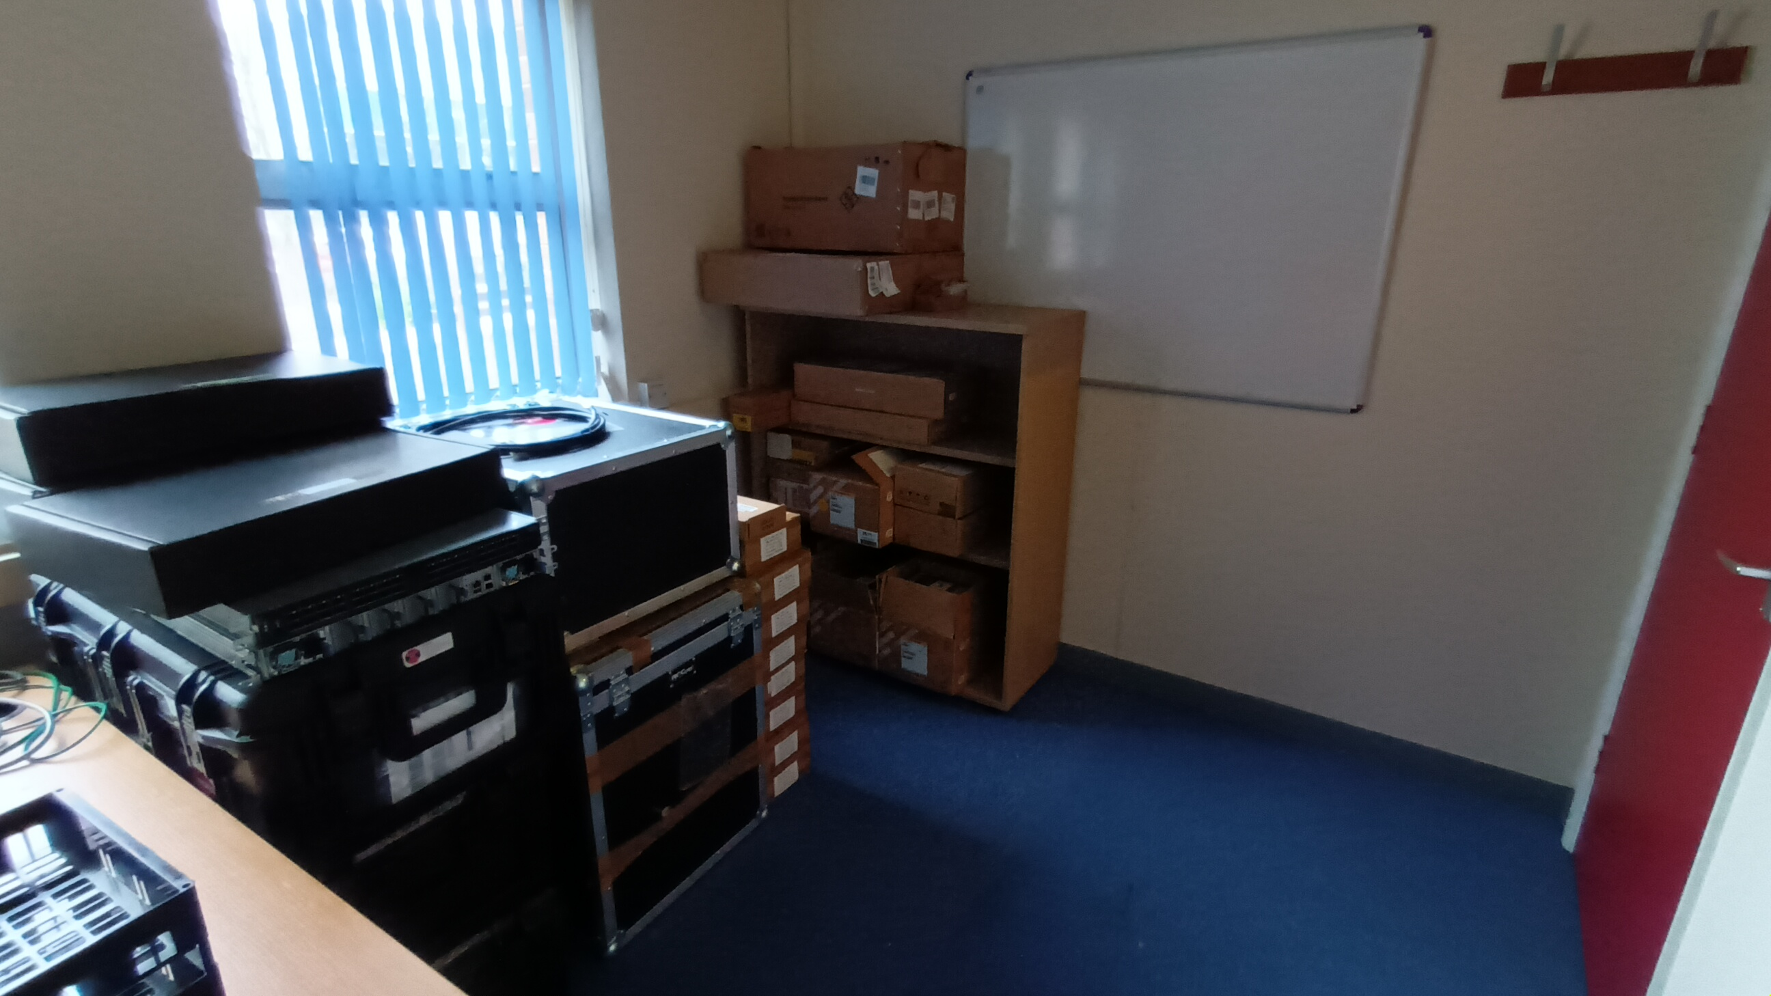
ESDG Accommodation in R66
Storage office: R66, G07
Shelves finally arrived

