Slide 1
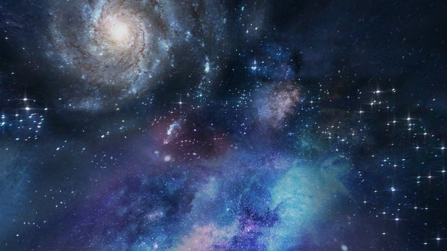
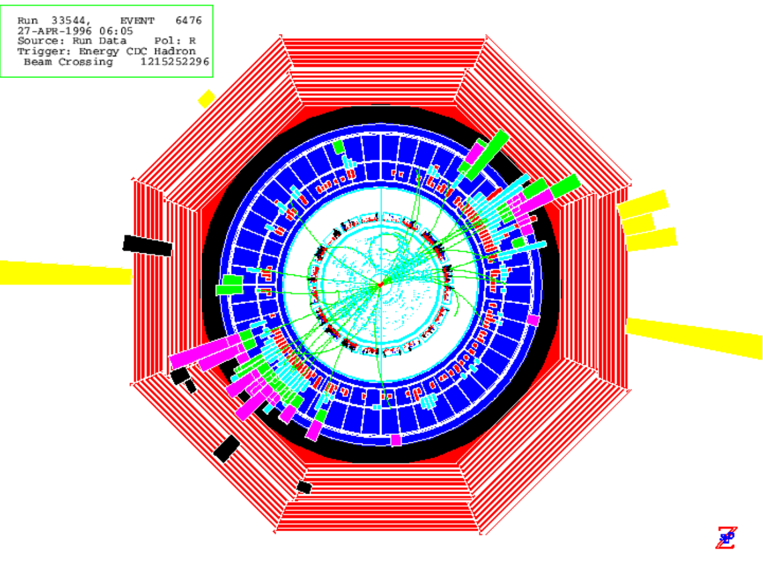
Unification? It’s Only a Matter of Time
David Jackson
May 6th, 2026
Rutherford Appleton Lab, PPD Seminar

Slide 2
The Nature of Unification
1
Simple, Unique, Minimal Assumptions for some
basic Entity, Concept and/or Maths Structure
as Foundation for…
Standard Model: Multiplet Structure of Leptons and Quarks under
Lorentz x Gauge symmetries, with masses and couplings
2
[Understand Higgs and Neutrino Sectors]
3
Quantum + Gravity: Framework uniformly valid on ALL scales
Amalgamating Quantum Theory with General Relativity
[Measurement Problem…, Black Hole Singularities]
4
Cosmology: Large Scale Observations associated with
Dark Matter, Dark Energy and Early Universe
[Modifications to $Λ$CDM to address tensions]
5
Big picture, ‘Before the Big Bang’, Origins in General

Slide 3

Outline
1
Simple, Unique, Minimal Assumptions:
Time, rather than Matter or Space, as the Basic Entity
in the Mathematical Form of ‘Generalised Proper Time’
Standard Model:
2
Direct Link with Groups E₆ and E₇ and SM-like multiplet properties,
and connections with the Higgs and Neutrino Sectors
3
Quantum + Gravity:
Construction of 4D spacetime from local temporal elements
as basis for ‘Quantum Gravity’ addressing known issues
4
Cosmology:
Candidates for Dark Matter and Dark Energy, with differences
from $Λ$CDM, and Early Universe Structure Formation
5
Big picture, ‘Before the Big Bang’:
‘Origins of Time’?... Summary

Slide 4
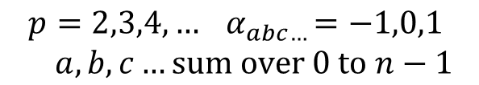
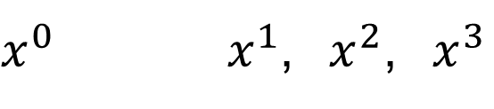


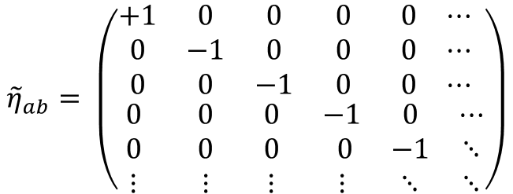


Historical Run-up: Relations between Space, Time and Matter
Classical Physics
Absolute Time 3D Space
Matter
${x^{0} { x}^{1}\text{,} x}^{2}$,${ x}^{3}$
particles
Special Relativity
4D Spacetime
Proper Time
Matter
${\left(∆s\right)}^{2}={\left(∆x^{0}\right)}^{2}−{\left(∆x^{1}\right)}^{2}$ ${− \left(∆x^{2}\right)}^{2}−{\left(∆x^{3}\right)}^{2}$
particles, fields
General Relativity
$$Lorentz Symmetry$$
Local Proper Time 4D Spacetime
Matter
${\left(δs\right)}^{2}={\left(δx^{0}\right)}^{2}−{\left(δx^{1}\right)}^{2}$ ${− \left(δx^{2}\right)}^{2}−{\left(δx^{3}\right)}^{2}$
particles, fields
Extra Space Dimensions
Matter
Augmented nD Spacetime form
${\left(δs\right)}^{2}={\left(δx^{0}\right)}^{2}−{\left(δx^{1}\right)}^{2}$ ${− \left(δx^{2}\right)}^{2}−{\left(δx^{3}\right)}^{2}$ $−{ \left(δx^{4}\right)}^{2}…$
$$Symmetry {SO}^{+}\left(1,n−1\right)⊃Lorentz$$
Generalised Proper Time
$$(δs)^{2}={\tilde{η}}_{ab}δx^{a}δx^{b}$$
$$a,b, sum over 0 to n−1$$
$${\tilde{η}}_{ab}= \left(\begin{matrix}\begin{matrix}+1 & 0 & 0 \\ 0 & −1 & 0 \\ 0 & 0 & −1\end{matrix} & \begin{matrix}0 & 0 & ⋯ \\ 0 & 0 & ⋯ \\ 0 & 0 & ⋯\end{matrix} \\ \begin{matrix}0 & 0 & 0 \\ 0 & 0 & 0 \\ ⋮ & ⋮ & ⋮\end{matrix} & \begin{matrix}−1 & 0 & ⋯ \\ 0 & −1 & ⋱ \\ ⋮ & ⋱ & ⋱\end{matrix}\end{matrix}\right)$$
$$(δs)^{p}=α_{abc…}δx^{a}δx^{b}δx^{c}.. .$$
$$p=2,3,4,…{ α}_{abc…}=−1,0,1$$
$$a,b,c…sum over 0 to n−1$$

Slide 5


Historical Run-up: Relations between Space, Time and Matter
Classical Physics
Absolute Time 3D Space
Matter
${x^{0} { x}^{1}\text{,} x}^{2}$,${ x}^{3}$
particles
Special Relativity
4D Spacetime
Proper Time
Matter
${\left(∆s\right)}^{2}={\left(∆x^{0}\right)}^{2}−{\left(∆x^{1}\right)}^{2}$ ${− \left(∆x^{2}\right)}^{2}−{\left(∆x^{3}\right)}^{2}$
particles, fields
General Relativity
$$Lorentz Symmetry$$
Local Proper Time 4D Spacetime
Matter
${\left(δs\right)}^{2}={\left(δx^{0}\right)}^{2}−{\left(δx^{1}\right)}^{2}$ ${− \left(δx^{2}\right)}^{2}−{\left(δx^{3}\right)}^{2}$
particles, fields
Extra Space Dimensions
Matter
Augmented nD Spacetime form
${\left(δs\right)}^{2}={\left(δx^{0}\right)}^{2}−{\left(δx^{1}\right)}^{2}$ ${− \left(δx^{2}\right)}^{2}−{\left(δx^{3}\right)}^{2}$ $−{ \left(δx^{4}\right)}^{2}…$
$$Symmetry {SO}^{+}\left(1,n−1\right)⊃Lorentz$$
Generalised Proper Time
Basis for 4D Spacetime
Basis for Matter
$$(δs)^{p}=α_{abc…}δx^{a}δx^{b}δx^{c}.. .$$
$$=\left({\text{h}}_{ab}δx^{a}δx^{b}\right)×{\left(δx…\right)}^{p−2}+ {\left(δx…\right)}^{p}$$
$$Symmetry \hat{G} ⊃ Lorentz$$
$$× Gauge$$
External x Internal Symmetry for Physics

Slide 6
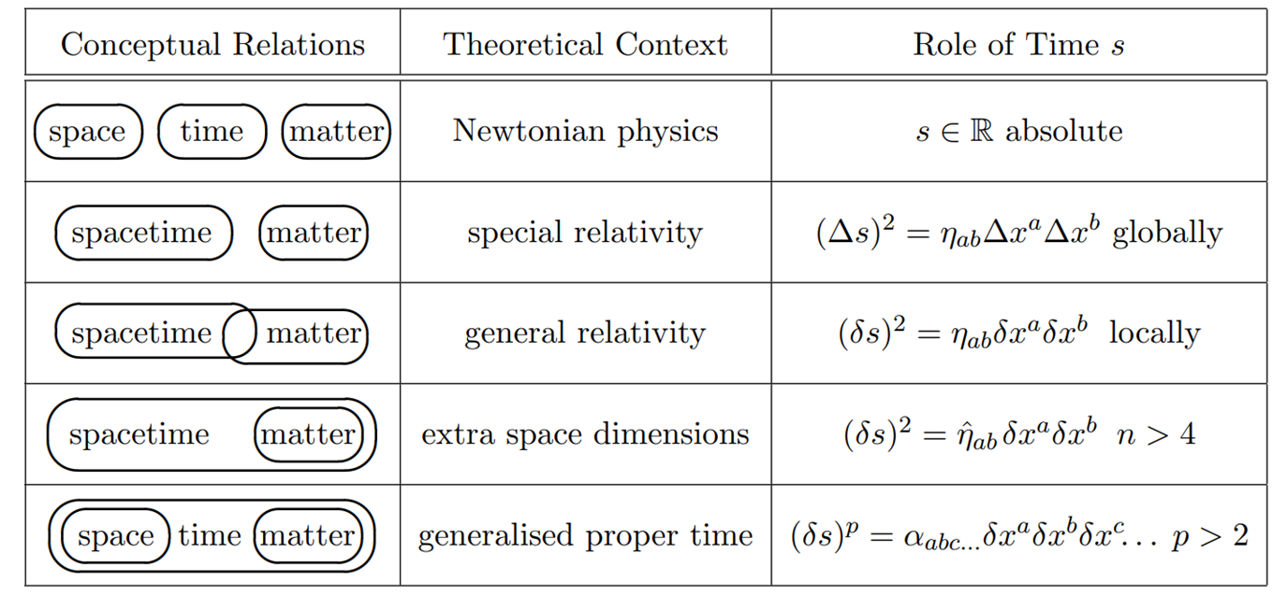

Historical Run-up: Relations between Space, Time and Matter
Classical Physics
Special Relativity
General Relativity
Extra Space Dimensions
Generalised Proper Time
$$(δs)^{p}=α_{abc…}δx^{a}δx^{b}δx^{c}.. .$$
Generalised proper time is a natural further step along this trajectory
Re-examine basic motivation: cf. ESD do not need a quadratic form for matter!
Basis in time is: simpler,
more direct
more unique,
more conservative,
more unifying,
Represents the simplest possible unifying relation between Space, Time, Matter

Slide 7
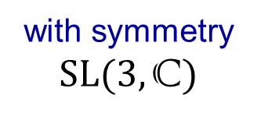

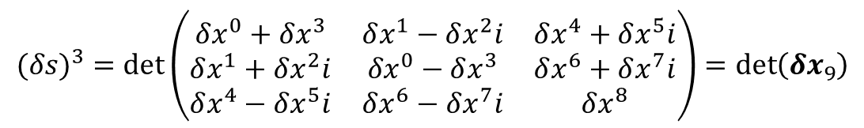
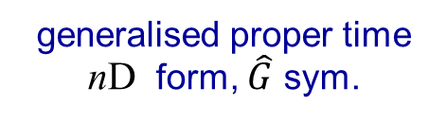


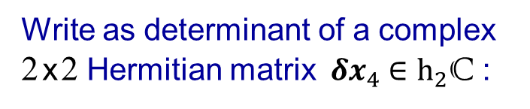

$$(δs)^{p}=α_{abc…}δx^{a}δx^{b}δx^{c}.. .$$
Write as determinant of a complex 2 x 2 Hermitian matrix ${ δx}_{4} ∈h_{2}\text{C}$ :
from:
$$(δs)^{2}=\left(δx^{0}\right)2−\left(δx^{1}\right)2−\left(δx^{2}\right)2−\left(δx^{3}\right)2$$
$$=\det\left(\begin{matrix}δx^{0}+δx^{3} & δx^{1}−δx^{2}i \\ δx^{1}+δx^{2}i & {δx}^{0}−δx^{3}\end{matrix}\right)=\det\left({δx}_{4}\right)$$
with Lorentz group ${SO}^{+}(1,3)$ $→$ $SL(2,\text{C})$ symmetry
$$2×2→3×3$$
$$\text{matrix}$$
Extend to determinant of a 3 x 3 matrix ${ δx}_{9} ∈h_{3}\text{C}$ :
$$(δs)^{3}=\det\left(\begin{matrix}δx^{0}+δx^{3} & δx^{1}−δx^{2}i & δx^{4}+δx^{5}i \\ δx^{1}+δx^{2}i & {δx}^{0}−δx^{3} & δx^{6}+δx^{7}i \\ δx^{4}−δx^{5}i & δx^{6}−δx^{7}i & δx^{8}\end{matrix}\right)=\det\left({δx}_{9}\right)$$
with symmetry $SL(3,\text{C})$
$$=\det\left(\begin{matrix}δx^{0}+δx^{3} & δx^{1}−δx^{2}i \\ δx^{1}+δx^{2}i & {δx}^{0}−δx^{3}\end{matrix}\right)δx^{8} + {\left(δx…\right)}^{3}$$
As an example of:
$$(δs)^{p}=α_{abc…}δx^{a}δx^{b}δx^{c}.. .=\left({\text{h}}_{ab}δx^{a}δx^{b}\right)×{\left(δx…\right)}^{p−2}+ {\left(δx…\right)}^{p}$$
generalised proper time nD form, $\hat{G}$ sym.
basis for 4D spacetime
basis for matter

Slide 8
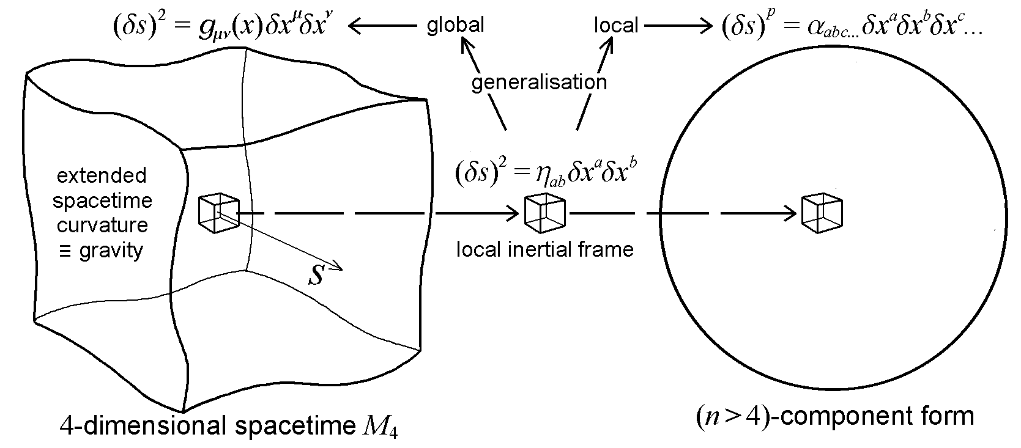
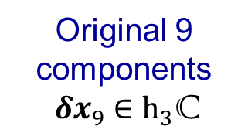
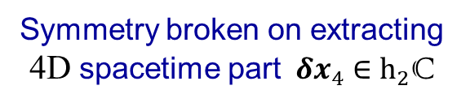










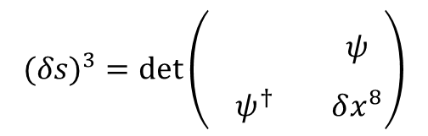

$$(δs)^{p}=α_{abc…}δx^{a}δx^{b}δx^{c}.. .$$
Write as determinant of a complex 2 x 2 Hermitian matrix ${ δx}_{4} ∈h_{2}\text{C}$ :
from:
$$(δs)^{2}=\left(δx^{0}\right)2−\left(δx^{1}\right)2−\left(δx^{2}\right)2−\left(δx^{3}\right)2$$
$$=\det\left(\begin{matrix}δx^{0}+δx^{3} & δx^{1}−δx^{2}i \\ δx^{1}+δx^{2}i & {δx}^{0}−δx^{3}\end{matrix}\right)=\det\left({δx}_{4}\right)$$
with Lorentz group ${SO}^{+}(1,3)$ $→$ $SL(2,\text{C})$ symmetry
$$2×2→3×3$$
$$\text{matrix}$$
Extend to determinant of a 3 x 3 matrix ${ δx}_{9} ∈h_{3}\text{C}$ :
$$(δs)^{3}=\det\left(\begin{matrix}δx^{0}+δx^{3} & δx^{1}−δx^{2}i & δx^{4}+δx^{5}i \\ δx^{1}+δx^{2}i & {δx}^{0}−δx^{3} & δx^{6}+δx^{7}i \\ δx^{4}−δx^{5}i & δx^{6}−δx^{7}i & δx^{8}\end{matrix}\right)=\det\left({δx}_{9}\right)$$
with symmetry $SL(3,\text{C})$
$$(δs)^{3}=\det\left(\begin{matrix}\begin{matrix} & \\ & \end{matrix} & ψ \\ ψ^{†} & δx^{8}\end{matrix}\right)$$
$${ δx}_{4}$$
$$ψ$$
$$δx^{8}$$
external $×$ internal
$${ δx}_{9}$$
‘Small piece of the SM’
$${ δx}_{4}$$
$SL\left(3,\text{C}\right) →$ $SL(2,\text{C})$ $× U(1)$
Original 9 components ${ δx}_{9} ∈h_{3}\text{C}$
4$ψ \text{Weyl} \text{spinor} 1$
Basis for matter
$$→$$
1$δx^{8} \text{scalar}$ $0$
4${ δx}_{4} \text{vector} 0$
Symmetry broken on extracting 4D spacetime part ${ δx}_{4} ∈h_{2}\text{C}$

Slide 9

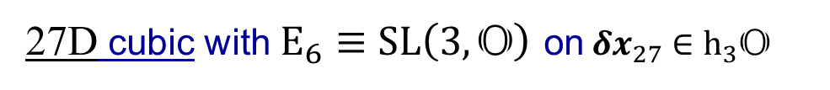
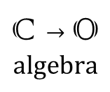
$$(δs)^{p}=α_{abc…}δx^{a}δx^{b}δx^{c}.. .$$
Write as determinant of a complex 2 x 2 Hermitian matrix ${ δx}_{4} ∈h_{2}\text{C}$ :
from:
$$(δs)^{2}=\left(δx^{0}\right)2−\left(δx^{1}\right)2−\left(δx^{2}\right)2−\left(δx^{3}\right)2$$
$$=\det\left(\begin{matrix}δx^{0}+δx^{3} & δx^{1}−δx^{2}i \\ δx^{1}+δx^{2}i & {δx}^{0}−δx^{3}\end{matrix}\right)=\det\left({δx}_{4}\right)$$
with Lorentz group ${SO}^{+}(1,3)$ $→$ $SL(2,\text{C})$ symmetry
$$2×2→3×3$$
$$\text{matrix}$$
Extend to determinant of a 3 x 3 matrix ${ δx}_{9} ∈h_{3}\text{C}$ :
$$(δs)^{3}=\det\left(\begin{matrix}δx^{0}+δx^{3} & δx^{1}−δx^{2}i & δx^{4}+δx^{5}i \\ δx^{1}+δx^{2}i & {δx}^{0}−δx^{3} & δx^{6}+δx^{7}i \\ δx^{4}−δx^{5}i & δx^{6}−δx^{7}i & δx^{8}\end{matrix}\right)=\det\left({δx}_{9}\right)$$
with symmetry $SL(3,\text{C})$
$$\text{C}→\text{O}$$
$$\text{algebra}$$
27D cubic with $E_{6}≡$ $SL\left(3,\text{O}\right)$on${ δx}_{27} ∈h_{3}\text{O}$
The Octonions $𝕆$are generalisation of the complex numbers $ℂ$ with 7 imaginary units
Quaternion:
Complex:
Octonion:
Real norm: $\left|a\right|$ defined by: ${\left|a\right|}^{2}=a\overline{a}$ and inverse: $a^{−1}=\frac{\overline{a}}{{\left|a\right|}^{2}}$ for any $a∈𝕆$
with: $\left|ab\right|=\left|a\right|\left|b\right|$ for any $a,b∈𝕆 ⇒ \text{describe} \text{symmetry} \text{transformations}$
however: $\left(ab\right)c≠a(bc)$ for many$a,b,c∈𝕆 ⇒ \text{non}\text{−}\text{associative} \text{algebra}$
Can still construct $SL\left(3,\text{O}\right)$actions on $h_{3}\text{O} \text{(}\text{with} (δs)^{3}=\det\left({δx}_{27}\right)\text{invariant}\text{) }$

Slide 10

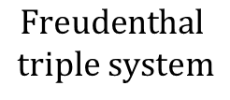
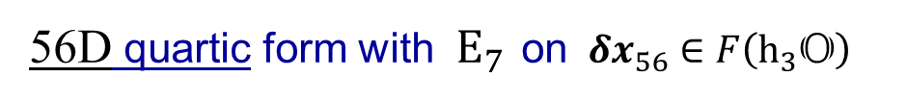

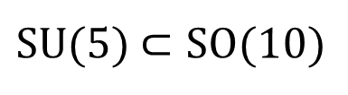

$$(δs)^{p}=α_{abc…}δx^{a}δx^{b}δx^{c}.. .$$
Write as determinant of a complex 2 x 2 Hermitian matrix ${ δx}_{4} ∈h_{2}\text{C}$ :
from:
$$(δs)^{2}=\left(δx^{0}\right)2−\left(δx^{1}\right)2−\left(δx^{2}\right)2−\left(δx^{3}\right)2$$
$$=\det\left(\begin{matrix}δx^{0}+δx^{3} & δx^{1}−δx^{2}i \\ δx^{1}+δx^{2}i & {δx}^{0}−δx^{3}\end{matrix}\right)=\det\left({δx}_{4}\right)$$
with Lorentz group ${SO}^{+}(1,3)$ $→$ $SL(2,\text{C})$ symmetry
$$2×2→3×3$$
$$\text{matrix}$$
Extend to determinant of a 3 x 3 matrix ${ δx}_{9} ∈h_{3}\text{C}$ :
$$(δs)^{3}=\det\left(\begin{matrix}δx^{0}+δx^{3} & δx^{1}−δx^{2}i & δx^{4}+δx^{5}i \\ δx^{1}+δx^{2}i & {δx}^{0}−δx^{3} & δx^{6}+δx^{7}i \\ δx^{4}−δx^{5}i & δx^{6}−δx^{7}i & δx^{8}\end{matrix}\right)=\det\left({δx}_{9}\right)$$
with symmetry $SL(3,\text{C})$
$$\text{C}→\text{O}$$
$$\text{algebra}$$
27D cubic with $E_{6}≡$ $SL\left(3,\text{O}\right)$on${ δx}_{27} ∈h_{3}\text{O}$
$$(δs)^{4}=q\left({δx}_{56}\right)$$
56D quartic form with$E_{7 }$on ${ δx}_{56} ∈F\left(h_{3}\text{O}\right)$
$$\text{Freudenthal}$$
$$\text{triple} \text{system}$$
Generalised proper time, directly connects with Exceptional Lie Groups
Since 1970s: ‘Grand Unified Theory’, for internal gauge symmetry only
$SU$(5) $⊂SO(10)$
$⊂E_{6}⊂E_{7}$ $⊂E_{8}$
Sequence of unifying groups:
Well-known connections with SM structure
(largest exceptional Lie group)
(as also for the Octonions $\text{O}$)

Slide 11
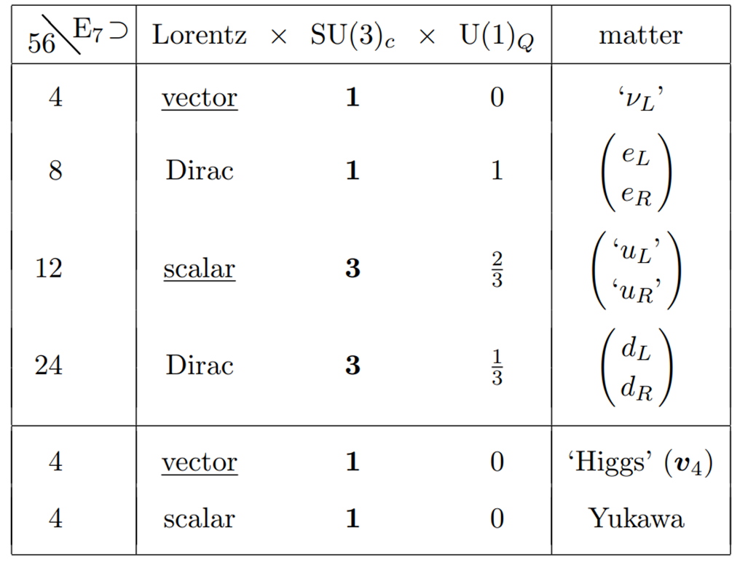








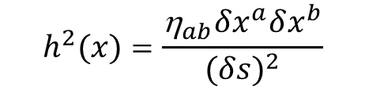
full $E_{7 }$symmetry of
For all physics in 4D spacetime
$$(δs)^{4}=q\left({δx}_{56}\right)$$
$${δx}_{56}$$
broken to external $×$ internal form:
$${δx}_{4}$$
$$SL(2,\text{C})$$
Rich in SM properties:
Lorentz spinor structures
Colour SU(3)_{c} singlets and triplets
Electromagnetic U(1)_{Q} fractional charges
elements of Electroweak theory (incl. L-R asym.)
$$h^{2}(x)=\frac{{\text{h}}_{ab}δx^{a}δx^{b}}{(δs)^{2}}$$
$${δx}_{4}$$
$${δx}_{4}$$
Norm ~ SM scalar Higgs
If treat as GUT (drop Lorentz factor):
While incomplete, and with discrepancies seen as underlined, uncover significant structures of SM, far more directly and closely to than with ESD, and little redundancy.
${ E}_{7 }⊃ {SU\left(3\right)}_{c}×{\text{‘}SU\left(2\right)}_{L}$ $×{U\left(1\right)}_{Y}\text{’}$
breaks to the above…
${ E}_{7 }⊃ {SU\left(3\right)}_{c}$ $×{U\left(1\right)}_{Q}$
…by action on ${δx}_{4}$ ‘Higgs’

Slide 12
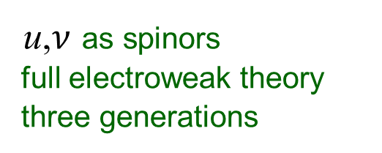

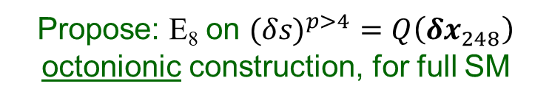
For all physics in 4D spacetime full $E_{7 }$symmetry of broken to external $×$ internal form:
$$(δs)^{4}=q\left({δx}_{56}\right)$$
$${δx}_{56}$$
$${δx}_{4}$$
Rich in SM properties:
Lorentz spinor structures
Colour SU(3)_{c} singlets and triplets
Electromagnetic U(1)_{Q} fractional charges
elements of Electroweak theory (incl. L-R asym.)
$$h^{2}(x)=\frac{{\text{h}}_{ab}δx^{a}δx^{b}}{(δs)^{2}}$$
$${δx}_{4}$$
$${δx}_{4}$$
Norm ~ SM scalar Higgs
While incomplete, and with discrepancies seen as underlined, uncover significant structures of SM, far more directly and closely to than with ESD, and little redundancy.
Still needed
u,$ν$ as spinors
full electroweak theory
three generations
Propose: E₈ on $(δs)^{p>4}=Q\left({δx}_{248}\right)$ octonionic construction, for full SM

Slide 13
Three comments on the status of Standard Model identification:
1) The $E_{7}$ stage does not give exactly one SM generation
No such thing as a single pristine isolated ‘generation of the Standard Model’ in nature. Significant mismatch between weak / mass eigenstate, in both quark and lepton sectors, as associated with mixing between the three generations of the SM, which is ‘one thing’.
Extracting something from full $E_{8}$, expect a bit ragged at the edges (as for $E_{6}$ and $E_{7}$)
2) Known that $E_{8}$ does not quite work for SM
Standard breaking 248 rep. $E_{8}⊃$ Lorentz x SU(3) x SU(2) x U(1) does NOT give SM.
Standard analysis of Lie Groups${{{ E}_{6}\text{,}E}_{7}\text{,} E}_{8 }$ built upon 4 group theory axioms:
$$Closure: g_{1}∙g_{2}∈G for all g_{1},g_{2}∈G$$
$$Identity: e∙g_{1}=g_{1} for all g_{1}∈G$$
$$Inverse: g_{1}^{−1}∙g_{1}=e for all g_{1}∈G$$
$$Associativity: {\left(g_{1}∙g_{2}\right)∙g_{3}=g}_{1}∙\left(g_{2}∙g_{3}\right) for all g_{1},g_{2},g_{3}∈G$$
Here symmetry, for GPT, more fundamental than standard group structure and axioms
In particular can describe symmetries based on octonions which are non-associative.
that is: $\left(ab\right)c≠a(bc)$ for many$a,b,c∈𝕆 ⇒ \text{non}\text{−}\text{associative} \text{algebra}$
Lie groups and representations based on $ℂ$ maths. $𝕆$ can give non-standard reps.
3) Coleman-Mandula Theorem?
Symmetry for All Physics is Lorentz x Gauge

Slide 14












Is the theory predictive?
First prediction of the theory is that an ‘$𝕆$-based $E_{8}$’ symmetry of GPT should exist, a ‘mathematical puzzle’ to complete the three generation SM multiplet structure
DJJ, `Time, E₈, and the Standard Model’, arXiv:1709.03877
For Beyond-SM physics will likely need $E_{6}$ $→E_{7}→$ $E_{8}$ symmetry on full form of GPT
Possibility of new gauge symmetry or states identified in full symmetry breaking.
Already for $E_{7}$ have basis for L-R asymmetry, as particularly marked in neutrino sector:
E₆ on $(δs)^{3}=det\left({δx}_{27}\right)$
4D spacetime external ${δx}_{4}$
$27$ representation
$$ν≡h$$
E₇ on $(δs)^{4}=q\left({δx}_{56}\right)$
$$ν_{L}$$
$$h$$
$27$ and $\overline{27}$
(L and R)
?
E₈ on $(δs)^{8}=Q\left({δx}_{248}\right)$
‘ ’
$ν_{L }$ $ν_{L }$ $ν_{L }$
${h }_{ }$ $ν_{R }$ $ν_{R }$
$\sim$ ($27$ and $\overline{27}$) $×3$
Strong hint that ‘Higgs’ ${δx}_{4}$ may be a composite of ‘right-handed neutrino’ components.
Accounting for the very different empirical properties of left and right-handed neutrinos
DJJ, ‘GPT as a Unifying Basis for Models with Two Right-Handed Neutrinos’, arXiv:1905.12419
…all of above is for local Standard Model⁺ properties, what about Gravity?

Slide 15
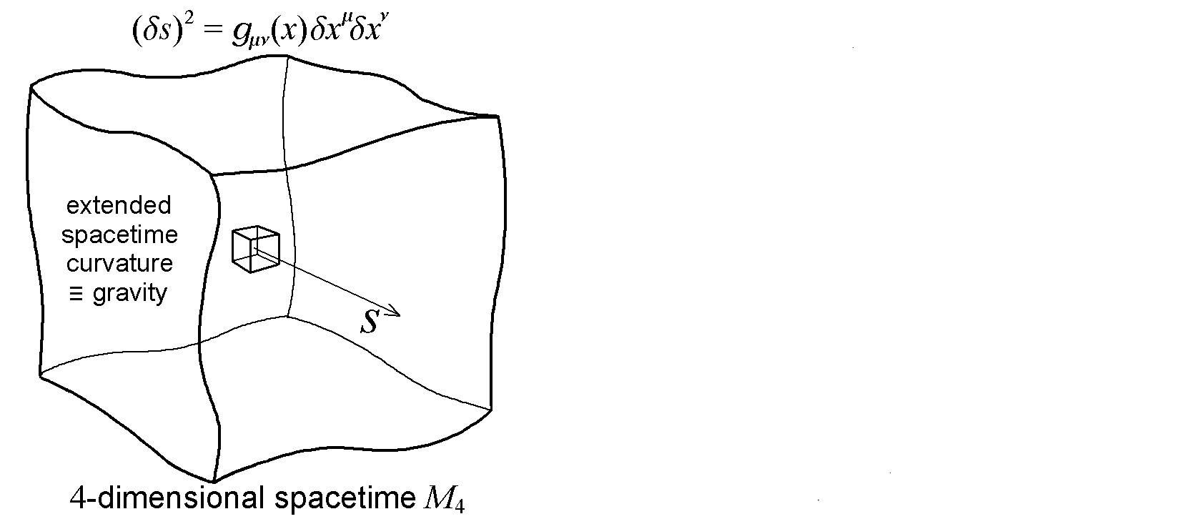
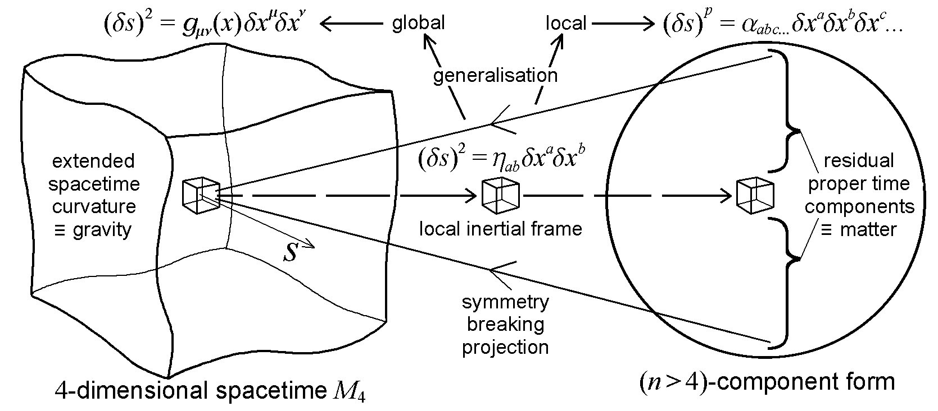
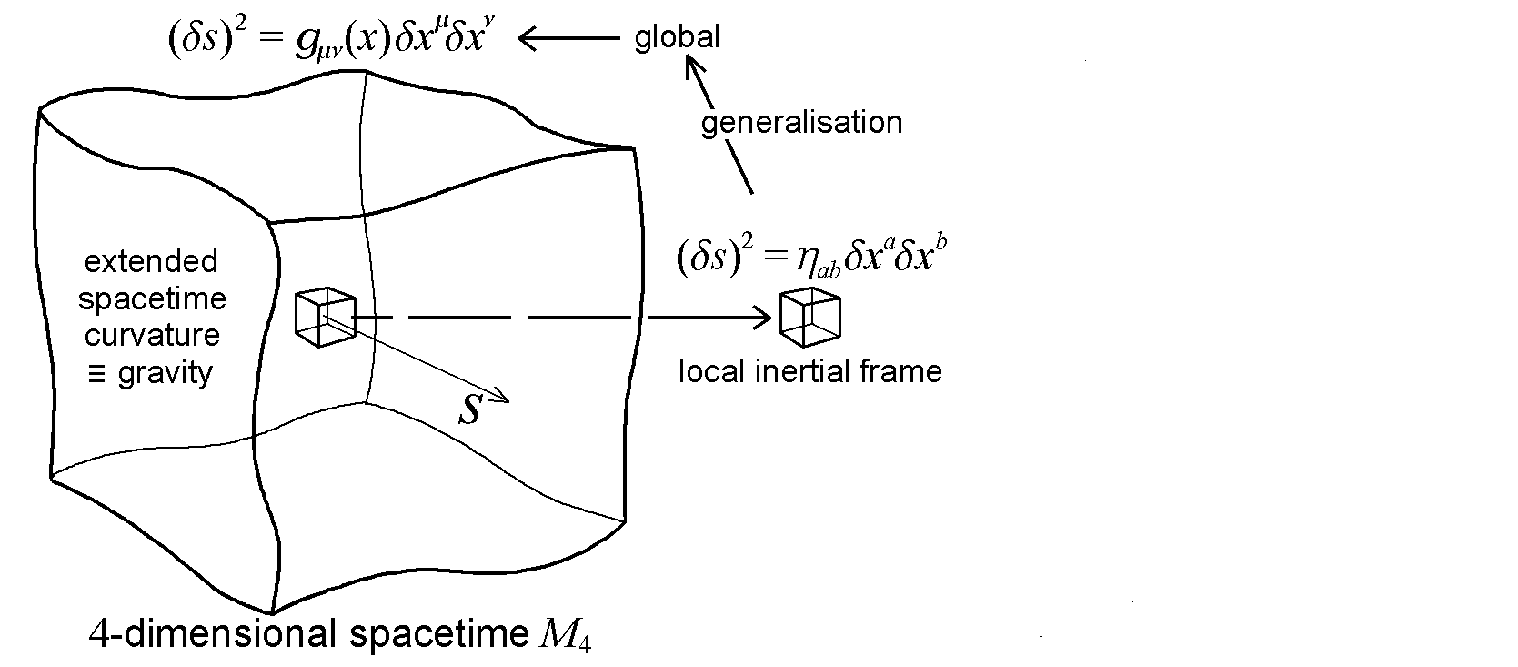

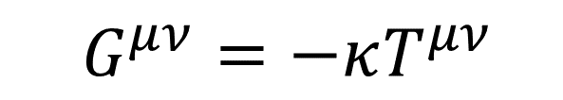







Complementary metric generalisations, but invariance of proper time central
$$\hat{G}$$
$$\hat{G}$$
$$\hat{G}$$
$$⊃$$
Lorentz
with symmetry $\hat{G}{ SO}^{+}(1,3)$
with symmetry $\hat{G}{ SO}^{+}(1,3)$
with symmetry $\hat{G}{ SO}^{+}(1,3)$
$$∪$$
$$∪$$
General Relativity
$$∪$$
Generalised Proper Time
MARBLE
$G^{μν}=−κT^{μν}$
W_{O}^{O}D
Aim of Unified Field Theory to incorporate the ‘wood’ into an augmented GR
Progression from 1D time $s$ to 4D spacetime $(δs)^{2}$ to nD space-time-matter $(δs)^{p}$ form
Extend from 4D spacetime to incorporate matter, not more space,
hence can drop quadratic assumption and generalise (n > 4 and p > 2)

Slide 16
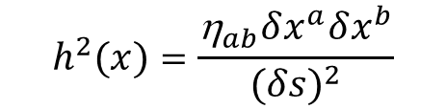

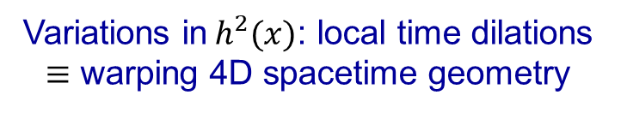
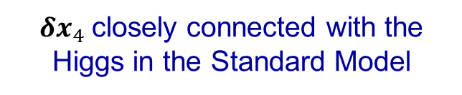



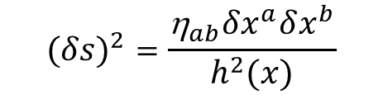
Complementary metric generalisations, but invariance of proper time central
$$\hat{G}$$
$$\hat{G}$$
$$\hat{G}$$
$$\hat{G}$$
$$⊃$$
Lorentz
${δx}_{4}$closely connected with the Higgs in the Standard Model
with symmetry $\hat{G}{ SO}^{+}(1,3)$
with symmetry $\hat{G}{ SO}^{+}(1,3)$
effective metric function:
perturb from flat:
with symmetry $\hat{G}{ SO}^{+}(1,3)$
$$∪$$
$$∪$$
$$∪$$
$(δs)^{2}=$ ${\text{g}}_{ab}(x)δx^{a}δx^{b}$
${\text{g}}_{ab}\left(x\right)=$ $\frac{{\text{h}}_{ab}}{h^{2}(x)}$
with scalar field:
Variations in${ h}^{2}(x)$: local time dilations $≡$ warping 4D spacetime geometry
$$h^{2}(x)=\frac{{\text{h}}_{ab}δx^{a}δx^{b}}{(δs)^{2}}$$
$$(δs)^{2}=\frac{{\text{h}}_{ab}δx^{a}δx^{b}}{h^{2}(x)}$$
project 4D spacetime part

Slide 17
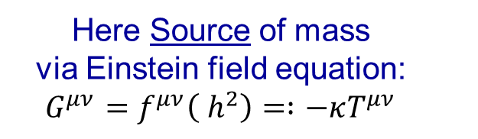

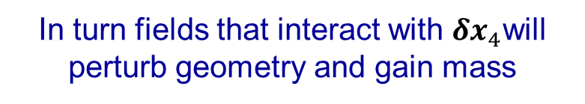
Complementary metric generalisations, but invariance of proper time central
$$\hat{G}$$
$$\hat{G}$$
$$\hat{G}$$
$$\hat{G}$$
$$⊃$$
Lorentz
${δx}_{4}$closely connected with the Higgs in the Standard Model
with symmetry $\hat{G}{ SO}^{+}(1,3)$
with symmetry $\hat{G}{ SO}^{+}(1,3)$
effective metric function:
perturb from flat:
with symmetry $\hat{G}{ SO}^{+}(1,3)$
$$∪$$
$$∪$$
$$∪$$
$(δs)^{2}=$ ${\text{g}}_{ab}(x)δx^{a}δx^{b}$
${\text{g}}_{ab}\left(x\right)=$ $\frac{{\text{h}}_{ab}}{h^{2}(x)}$
Here Source of mass via Einstein field equation: $G^{μν}=f^{μν}\left({ h}^{2}\right)=∶−κT^{μν}$
Variations in${ h}^{2}(x)$: local time dilations $≡$ warping 4D spacetime geometry
$→$
In turn fields that interact with ${δx}_{4}$will perturb geometry and gain mass
Connects mass in General Relativity with that in the Standard Model

Slide 18
The theory based on Generalised Proper Time fits very well with General Relativity
However, in starting with GPT, with time the basic entity, how to build GR framework?

Slide 19





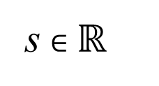




Can express $δs∈ℝ$ as:
$$δs = δx^{1}+δx^{2}$$
These intervals ‘fit together’ composing the ‘real line’ $ℝ$
s $∈ℝ$
[$+ +$ ]
Can express $δs∈ℝ$ as:
$→$
$$(δs)^{2}=\left(δx^{0}\right)2−\left(δx^{1}\right)2−\left(δx^{2}\right)2−\left(δx^{3}\right)2$$
$\left\{δx^{0},δx^{1},δx^{2},δx^{3}\right\}$ $∈ℝ^{4}$
with:
This arithmetic substructure has an implicit geometric interpretation as form of 3D space itself
$$δx^{2}$$
$$δx^{1,2,3}$$
$$δs$$
$$δx^{0}$$
$$δx^{1}$$
$$δx^{3}$$
full quadratic form describes a local 4D spacetime element

Slide 20
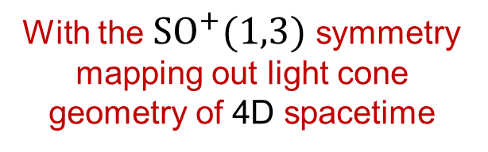
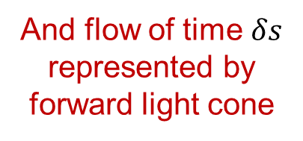
Can express $δs∈ℝ$ as:
$$δs = δx^{1}+δx^{2}$$
These intervals ‘fit together’ composing the ‘real line’ $ℝ$
s $∈ℝ$
[$+ +$ ]
Can express $δs∈ℝ$ as:
$$(δs)^{2}=\left(δx^{0}\right)2−\left(δx^{1}\right)2−\left(δx^{2}\right)2−\left(δx^{3}\right)2$$
$\left\{δx^{0},δx^{1},δx^{2},δx^{3}\right\}$ $∈ℝ^{4}$
with:
With the ${SO}^{+}(1,3)$ symmetry mapping out light cone geometry of 4D spacetime
$$δx^{1,2,3}$$
(passive coord. transformations)
$$δs$$
past
And flow of time $δs$ represented by forward light cone
$$δx^{0}$$
future
light cone
(active hyperbolic rotations)
full quadratic form describes a local 4D spacetime element
Causal order of time represented
20

Slide 21







Can express $δs∈ℝ$ as:
$$δs = δx^{1}+δx^{2}$$
These intervals ‘fit together’ composing the ‘real line’ $ℝ$
s $∈ℝ$
[$+ +$ ]
Can express $δs∈ℝ$ as:
$$(δs)^{2}=\left(δx^{0}\right)2−\left(δx^{1}\right)2−\left(δx^{2}\right)2−\left(δx^{3}\right)2$$
These quadratic elements ‘fit together’ composing extended patch of $ℝ^{4 }\text{:}$
$$δx^{1,2,3}$$
$$δs$$
$$δx^{0}$$
$$δx^{1,2,3}$$
$$δs$$
$$δx^{1,2,3}$$
$$δs$$
$$δx^{0}$$
$$δx^{0}$$
$ℝ^{4}$

Slide 22





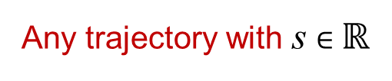




Can express $δs∈ℝ$ as:
$$δs = δx^{1}+δx^{2}$$
These intervals ‘fit together’ composing the ‘real line’ $ℝ$
s $∈ℝ$
[$+ +$ ]
Can express $δs∈ℝ$ as:
$$(δs)^{2}=\left(δx^{0}\right)2−\left(δx^{1}\right)2−\left(δx^{2}\right)2−\left(δx^{3}\right)2$$
These quadratic elements ‘fit together’ composing extended patch of $ℝ^{4 }\text{:}$
causal relations
Construction taken to the spacetime continuum limit
$$δx^{1,2,3}$$
$$δs$$
$$δx^{1,2,3}$$
$$δs$$
$$δx^{0}$$
Arithmetic substructure of time accommodates the Geometric form through which it propagates
$$δx^{0}$$
$$δx^{1,2,3}$$
$$δs$$
‘events’
$$δx^{0}$$
Any trajectory with s $∈ℝ$
$ℝ^{4}$
has above local quadratic form

Slide 23
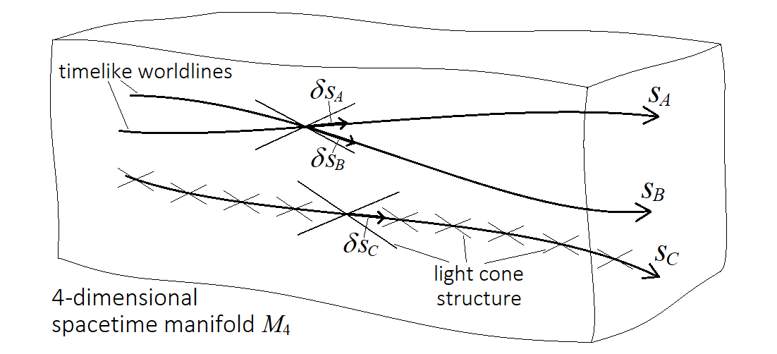
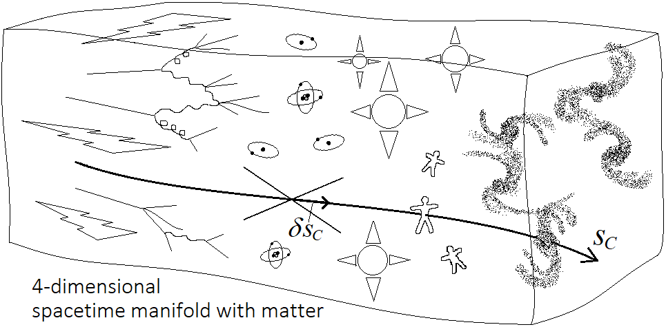
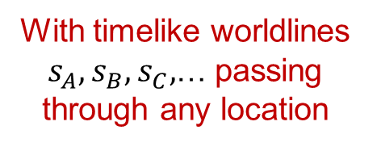
Via elements
$$(δs)^{2}={\text{h}}_{ab}δx^{a}δx^{b}=\left(δx^{0}\right)2−\left(δx^{1}\right)2−\left(δx^{2}\right)2−\left(δx^{3}\right)2$$
can construct a continuous extended 4-dimensional spacetime manifold:
With timelike worldlines $s_{A},s_{B},s_{C},$… passing through any location
(as elements within full temporal structure)
Via
$$(δs)^{p}=α_{abc…}δx^{a}δx^{b}δx^{c}.. .$$
$$=\left({\text{h}}_{ab}δx^{a}δx^{b}\right)×{\left(δx…\right)}^{p−2}+ {\left(δx…\right)}^{p}$$
direct arithmetic generalisation of proper time,
fill out matter content
Construct full 4D spacetime block containing everywhere a flow of time underlying matter evolution dynamics
With direct connection to Standard Model of PP
Generalised proper time as basis for 4D spacetime and its matter content

Slide 24

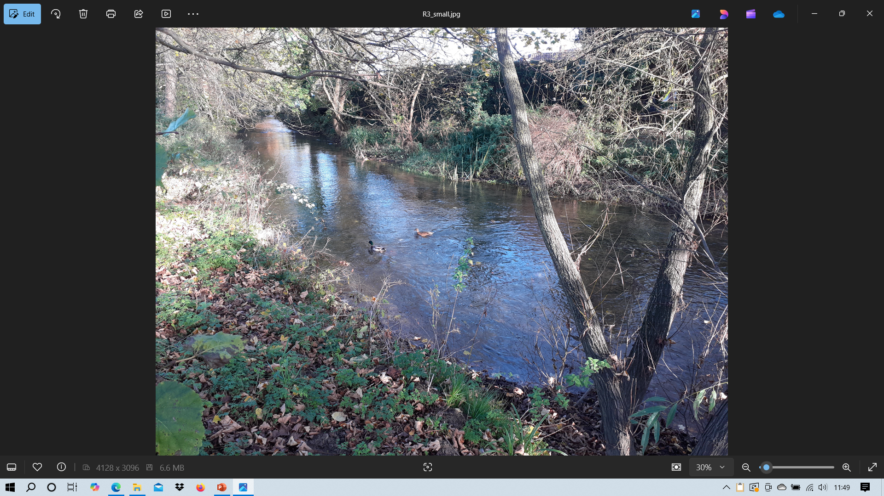
Analogy with river: fixed geological bed and banks containing everywhere a flow of water
4D block - as associated with general relativity
dynamic - as associated with quantum theory
Basis for unifying GR+QM framework
Construct full 4D spacetime block containing everywhere a flow of time underlying matter evolution dynamics
With direct connection to Standard Model of PP
Generalised proper time as basis for 4D spacetime and its matter content

Slide 25














4D spacetime of general relativity
Theories with extra dimensions of space:
Here from local 4D form generalise proper time:
$$(δs)^{2}={\text{g}}_{μν}(x)δx^{μ}δx^{ν}$$
Construct Higher-dimensional global spacetime
$${\text{e}\text{ach} α}_{abc…}∈\{−1, 0,+1\}$$
$$p>2$$
$$n>4$$
$$(δs)^{p}=α_{abc…}δx^{a}δx^{b}δx^{c}.. .$$
$$(δs)^{2}={\text{h}}_{ab}δx^{a}δx^{b}$$
$$\text{Lorentz}$$
$${\tilde{g}}_{μν}\left(x\right)$$
in (n>4)D
For particle physics, interested in local particle interactions and local symmetry properties
Local inertial reference frame
$$\hat{G}$$
Indirect
Direct
Break symmetry on extracting 4D spacetime
Then compactify the extra dimensions as basis for matter
$$G⊂\hat{G}$$
$$\text{Lorentz} ×$$
residual components basis for matter fields in 4D spacetime
Internal gauge symmetry
4D spacetime
$G^{μν}=f^{μν}\left(ψ,A\right)$
$$=∶−κT^{μν}$$
$→$
4D Geometry depends on residual components

Slide 26
4D spacetime of general relativity
Theories with extra dimensions of space:
Here from local 4D form generalise proper time:
$$(δs)^{2}={\text{g}}_{μν}(x)δx^{μ}δx^{ν}$$
Construct Higher-dimensional global spacetime
$${\text{e}\text{ach} α}_{abc…}∈\{−1, 0,+1\}$$
$$p>2$$
$$n>4$$
$$(δs)^{p}=α_{abc…}δx^{a}δx^{b}δx^{c}.. .$$
$$(δs)^{2}={\text{h}}_{ab}δx^{a}δx^{b}$$
$$\text{Lorentz}$$
$${\tilde{g}}_{μν}\left(x\right)$$
in (n>4)D
DJJ, `Quantum Gravity from the Composition of Spacetime Constructed through Generalised Proper Time’, arXiv:2010.02703
Local inertial reference frame
$$\hat{G}$$
Begin with global nD spacetime
Basic structure of matter~SM at local level
from which compactify to 4D spacetime
from which build extended 4D spacetime
typically vast ambiguity in matter types
vast degeneracy in matter contributions
‘landscape problem’ in string theory
provides basis of QM indeterminacy
A ‘bad’ form of non-uniqueness
$G^{μν}=f^{μν}\left(ψ,A\right)$
$$=∶−κT^{μν}$$
A ‘good’ form of non-uniqueness

Slide 27
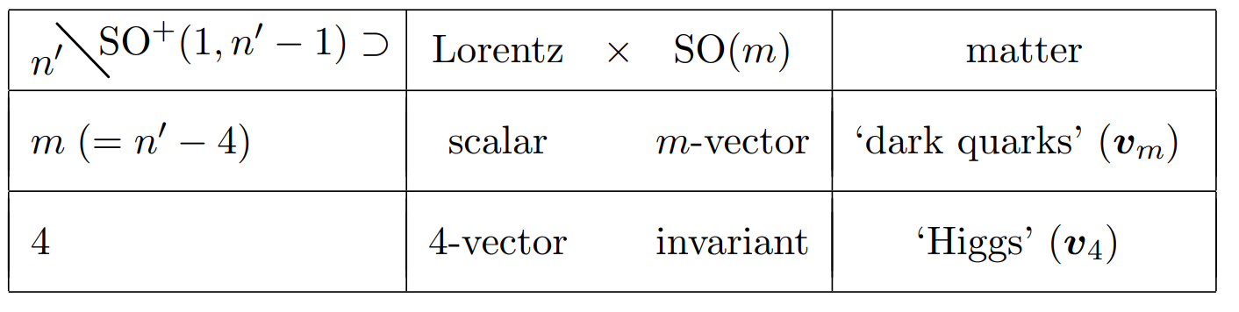
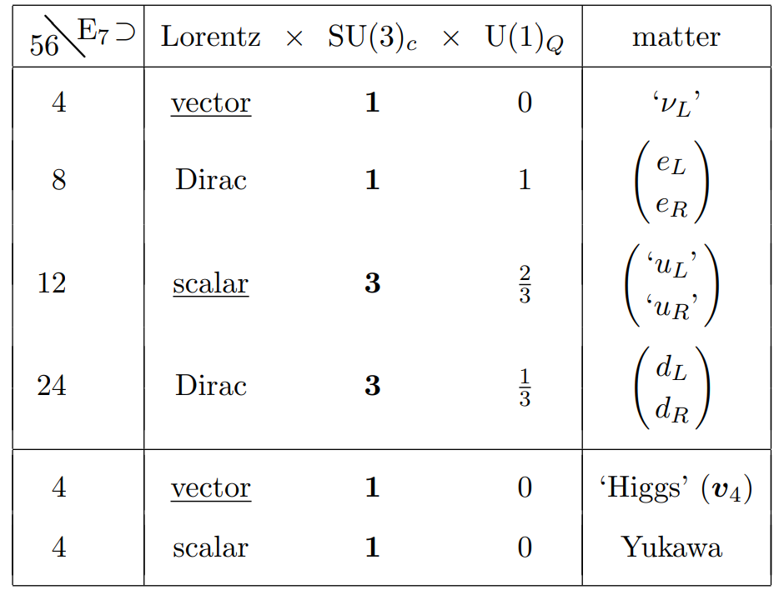













Extra space dimensions
From local 4D level
Generalised proper time
$$(δs)^{2}={\text{h}}_{ab}δx^{a}δx^{b}$$
$$\tilde{η}=diag(1,−1,−1,. . . ,−1)$$
$${\text{e}\text{ach} α}_{abc…}∈\{−1, 0,+1\}$$
and
$$n>4$$
$$a,b=0,.. .,n−1; n>4$$
$$p>2$$
$$(δs)^{2}={\tilde{\text{h}}}_{ab}δx^{a}δx^{b}$$
$$(δs)^{p}=α_{abc…}δx^{a}δx^{b}δx^{c}.. .$$
$(δs)^{2}=\left(δx^{0}\right)2−\left(δx^{1}\right)2.. .−\left(δx^{n−1}\right)2$
$(δs)^{4}=q\left({δx}_{56}\right)$ 56D quartic form
full ${SO}^{+}\left(1,n−1\right)$ symmetry
full $E_{7}\left(𝕆\right)$ symmetry
broken:
broken:
?
$${δx}_{m}$$
$${δx}_{4}$$
$${δx}_{4}$$
SO(m) internal symmetry and scalar matter field, in parallel with, but ‘hidden’ from, the SM sector.
‘hidden QCD’, compact non-Abelian gauge group generate ‘dark glueball/hadron/pion’-type states
$${δx}_{4}$$
Candidate for Self-Interacting Dark Matter
Standard Model structures directly

Slide 28

Extra space dimensions
From local 4D level
Generalised proper time
$$(δs)^{2}={\text{h}}_{ab}δx^{a}δx^{b}$$
$$\tilde{η}=diag(1,−1,−1,. . . ,−1)$$
$${\text{e}\text{ach} α}_{abc…}∈\{−1, 0,+1\}$$
and
$$n>4$$
$$a,b=0,.. .,n−1; n>4$$
$$p>2$$
$$(δs)^{2}={\tilde{η}}_{ab}δx^{a}δx^{b}$$
$$(δs)^{p}=α_{abc…}δx^{a}δx^{b}δx^{c}.. .$$
But how many ways are there to ‘generalise proper time’? And what might they imply for the ‘dark sector’?
$(δs)^{4}=q\left({δx}_{56}\right)$ 56D quartic form
full $E_{7}\left(𝕆\right)$ symmetry
broken:
Full gravitational interaction between DM and SM sectors via common 4D spacetime root
As typical for dark QCD, may be no other interaction with visible matter. (although may be a ‘Higgs portal’?)
$${δx}_{4}$$
Candidate for Self-Interacting Dark Matter
Standard Model structures directly

Slide 29
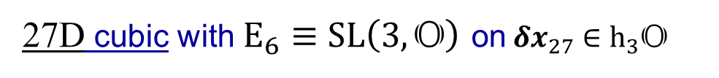
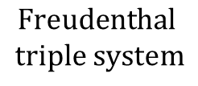


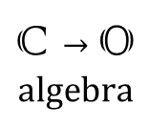
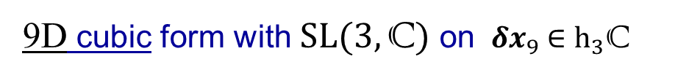
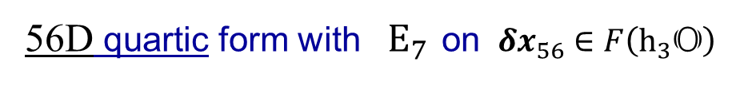



4D quad. form with $SL(2,\text{C})$ on ${ δx}_{4} ∈h_{2}\text{C}$
$(δs)^{2}$ $=\det\left({δx}_{4}\right)$
$$2×2→3×3$$
$$\text{matrix}$$
$$(δs)^{3}=\det\left({δx}_{9}\right)$$
9D cubic form with $SL(3,\text{C})$ on ${ δx}_{9} ∈h_{3}\text{C}$
$$\text{C}→\text{O}$$
$$\text{algebra}$$
27D cubic with $E_{6}≡$ $SL\left(3,\text{O}\right)$on${ δx}_{27} ∈h_{3}\text{O}$
$$(δs)^{4}=q\left({δx}_{56}\right)$$
56D quartic form with$E_{7 }$on ${ δx}_{56} ∈F\left(h_{3}\text{O}\right)$
$$\text{Freudenthal}$$
$$\text{triple} \text{system}$$
A unique sequence of maths structures
$$(δs)^{p}=α_{abc…}δx^{a}δx^{b}δx^{c}.. .$$
full $E_{7}\left(𝕆\right)$ symmetry
broken:
$${δx}_{4}$$
Standard Model structures directly

Slide 30








4D quad. form with $SL(2,\text{C})$ on ${ δx}_{4} ∈h_{2}\text{C}$
$(δs)^{2}$ $=\det\left({δx}_{4}\right)$
$$2×2→3×3$$
$$\text{matrix}$$
$$(δs)^{3}=\det\left({δx}_{9}\right)$$
9D cubic form with $SL(3,\text{C})$ on ${ δx}_{9} ∈h_{3}\text{C}$
$$3×3→4×4$$
$$\text{matrix}$$
$$(δs)^{4}=\det\left({δx}_{16}\right)$$
16D 4th order form, $SL(4,\text{C})$ on${ δx}_{16}∈h_{4}\text{C}$
$$4×4→p×p$$
$$\text{matrix}$$
$$(δs)^{p}=\det\left({δx}_{p2}\right)$$
p²D p^{th} order form, $SL(p,\text{C})$ on${ δx}_{p2}∈h_{p}\text{C}$
Alternative sequence of maths structures
Also fully consistent with generalised proper time
$$(δs)^{p}=α_{abc…}δx^{a}δx^{b}δx^{c}.. .$$
full $E_{7}\left(𝕆\right)$ symmetry
broken:
full$SL\left(p,\text{C}\right)$symmetry broken:
Symmetry breaking yields gauge interactions independent of visible Standard Model sector.
$${δx}_{4}$$
What are the properties of this contribution to the dark sector?
Standard Model structures directly

Slide 31






$$(δs)^{p}=\det\left({δx}_{p2}\right)$$
p²D p^{th} order form, $SL(p,\text{C})$ on${ δx}_{p2}∈h_{p}\text{C}$
$$p×p \text{matrix}$$
Independent gauge sector,
Non-compact gauge group $SL(k,\text{C})_{D}$
only (classical) gravitational interaction with SM (i.e. dark)
$A_{+}$positive and $A_{−}$ negative K.E. states
cf. phantom dark energy?
create out of vacuum:
Negative Kinetic Energy scalars
+ve K.E. SM states
arXiv:9908168 arXiv:1708.06981

Slide 32








$$(δs)^{p}=\det\left({δx}_{p2}\right)$$
p²D p^{th} order form, $SL(p,\text{C})$ on${ δx}_{p2}∈h_{p}\text{C}$
$$p×p \text{matrix}$$
Raging vacuum sea of $A_{±}$ states can be gravitationally completely benign
energy density:
$${ρ_{V}=ρ}_{A_{+}}+ρ_{A_{−}}=0$$
pressure:
$${p_{V}=p}_{A_{+}}+p_{A_{−}}=0$$
‘matter fields’ $M_{+}$asymmetrically perturb the equation of state:${ p}_{V} =w_{V}ρ_{V}$
$⇒$ parameter $w_{V}=−1\text{, }\text{with}{ ρ}_{V}=−p_{V}>0$
GR vacuum, with very small $Λ>0$
stable equilibrium vacuum state

Slide 33




General suitability as a dark energy candidate
driving large scale accelerating expansion of the universe
macroscopically: ~uniform in space and time
equation of state,${ w}_{V}=−1$
$$M_{+}$$
Created out of the vacuum:
with $A_{−}$ part as source of negative pressure${ p}_{V}<0$
Contributions ${AM}_{+},$ and $A_{−}$ can largely cancel leaving ultra-low net${ ρ}_{V} >0$
(cf. ‘QCD quark-gluon plasma’ is ${\sim 10}^{44}$ $×$ too large)
(QFT vacuum energy density is ${\sim 10}^{120}×$ too large)
Having a source of negative kinetic energy from $A_{−}$ part is analogous to models
of ‘phantom dark energy’, but here only classical GR with SM, hence stable
Indeed, no? particle or gauge interactions with the visible sector, hence dark
While such a non-compact non-Abelian sector could be proposed as a model
…here such a candidate for dark energy has basis in a fundamental theory
(visible SM branch itself from theory of generalised proper time)
DJJ, `Generalised Local Extra Dimensions as a Basis
for the Elementary Structure of Matter’, arXiv:2209.06162
(with a dark matter candidate also identified in the dark sector)

Slide 34






Role of this dark energy source in very early universe ‘inflationary phase’:
${{ ρ}_{V}⋙0, p}_{V}⋘0 \text{and}{ p}_{V}=w_{V}ρ_{V} \text{with} w_{V}=−1$
2dF Galaxy Survey Map
$$M_{+}$$
$$A_{−}$$
$$A_{+}$$
Very early dark energy fluctuations preceding ‘phase transition’ to dark matter states may leave observable imprint in cosmic wall/web/void structures
H. Yamamoto LPHEP85
cf. ‘Cosmological Collider’
and ‘Cosmological Bootstrap’
arXiv:1811.00024 arXiv:2203.08121

Slide 35



Heisenberg’s Box, ‘Theory, Criticism and a Philosophy’
1968 lecture, reprinted in ‘From a Life of Physics’ 1989
“When you try too much for rigorous mathematical methods, you fix your attention on those points which are not important from the physics’ point…”
“…one should always have the whole picture in mind
before one tries to fix a theory in mathematics…”

Slide 36



For a 21st century Unified Theory would like:
Quantum with Gravity
QFT calculations
QM measurement
Standard Model
dark matter
Higgs
dark energy
neutrinos
early universe
Conceptual foundation
Big Picture
Unification based upon Generalised Proper Time connects with all of these

Slide 37
‘Gestalt shift’ in worldview
Obviously can’t construct a theory accounting for complex physical world simply from ‘time’ alone
Obvious ‘time’ provides a natural unifying basis for physical theory since everything ‘happens in time’
Main Obstacle
‘It can scarcely be denied that the supreme goal of all theory is to make the irreducible basic elements as simple and as few as possible without having to surrender the adequate representation of a single datum of experience’
‘Everything should be made as simple as possible, but not simpler’
Much quoted, as paraphrased from:
Einstein, ‘On the Method of Theoretical Physics’ (1933 lecture)
The trick is then to see how it is possible to construct a theory just from time

Slide 38
A barrier to making this change of perspective may be the common representation of time as a one-dimensional line in space (or in spacetime)
s
However, nothing we know of in the physical world corresponds to a purely 1D vanishingly thin line in space or worldline in spacetime - that is not what time is
Rather, taking time to be a real continuum $s∈ℝ$ says nothing explicit about any relation to spatial extension or properties (does not imply a ‘line’ in space)
(Like listening to the flow of music in a dark place)
The real numbers $ℝ$ have basic arithmetic properties of ‘$±$’ and ‘$×÷$’ operations
Time as continuum expressed by $ℝ$ $⇒$ time itself has these intrinsic properties

Slide 39



The real numbers $ℝ$ have basic arithmetic properties of ‘$±$’ and ‘$×÷$’ operations
Time as continuum expressed by $ℝ$ $⇒$ time itself has these intrinsic properties
Can express $δs∈ℝ$ as:
$δs = δx^{1}+δx^{2}+$ $δx^{3}…$
The intervals $δs∈ℝ$ ‘fit together’ composing the real continuum $ℝ$
s $∈ℝ$
[$+ +$ ]
Can express $δs∈ℝ$ as:
$$(δs)^{2}=\left(δx^{0}\right)2−\left(δx^{1}\right)2−\left(δx^{2}\right)2−\left(δx^{3}\right)2$$
$\left\{δx^{0},δx^{1},δx^{2},δx^{3}\right\}$ $∈ℝ^{4}$
form of space itself identified through an arithmetic substructure of time
with:
$$δx^{2}$$
has geometric interpretation:
$$δx^{1,2,3}$$
$$δs$$
past
$$δx^{1}$$
$$δx^{0}$$
$$δx^{3}$$
future
full quadratic form describes a local 4D spacetime element with a causal light cone structure
light cone

Slide 40










The real numbers $ℝ$ have basic arithmetic properties of ‘$±$’ and ‘$×÷$’ operations
Time as continuum expressed by $ℝ$ $⇒$ time itself has these intrinsic properties
Can express $δs∈ℝ$ as:
$δs = δx^{1}+δx^{2}+$ $δx^{3}…$
The intervals $δs∈ℝ$ ‘fit together’ composing the real continuum $ℝ$
s $∈ℝ$
Can express $δs∈ℝ$ as:
$$(δs)^{2}=\left(δx^{0}\right)2−\left(δx^{1}\right)2−\left(δx^{2}\right)2−\left(δx^{3}\right)2$$
$δs = δx^{1}±δx^{2}±$ $δx^{3}±δx^{4}±…$
These quadratic elements ‘fit together’ composing extended patch of $ℝ^{4 }\text{:}$
causal relations
$$δx^{1,2,3}$$
$$δs$$
construction of spacetime continuum with no residual discrete structure
$$δx^{1,2,3}$$
$$δs$$
$$δx^{0}$$
$$δx^{0}$$
$$δx^{1,2,3}$$
$$δs$$
local 4D light cone, inertial reference frame at any location
$$δx^{0}$$
$ℝ^{4}$
Arithmetic substructure of time contains the Geometric form in which it flows

Slide 41


$→$
Via elements
$$(δs)^{2}={\text{h}}_{ab}δx^{a}δx^{b}=\left(δx^{0}\right)2−\left(δx^{1}\right)2−\left(δx^{2}\right)2−\left(δx^{3}\right)2$$
can construct a continuous extended 4-dimensional spacetime manifold:
Wholly temporal structure with timelike worldlines $s_{A},s_{B},s_{C},$…
Via
$$(δs)^{p}=α_{abc…}δx^{a}δx^{b}δx^{c}.. .$$
$$=\left({\text{h}}_{ab}δx^{a}δx^{b}\right)×{\left(δx…\right)}^{p−2}+ {\left(δx…\right)}^{p}$$
direct arithmetic generalisation of proper time,
fill out matter content

Slide 42








Via elements
$$(δs)^{2}={\text{h}}_{ab}δx^{a}δx^{b}=\left(δx^{0}\right)2−\left(δx^{1}\right)2−\left(δx^{2}\right)2−\left(δx^{3}\right)2$$
can construct a continuous extended 4-dimensional spacetime manifold:
Change in perspective from ‘time something in world’ to ‘the world something in time’
Dynamic+Block of GR Local degeneracy basis for Quantum+Gravity
$G^{μν}=f^{μν}\left(ψ,A\right)$ $=∶−κT^{μν}$
Via
$$(δs)^{p}=α_{abc…}δx^{a}δx^{b}δx^{c}.. .$$
$$=\left({\text{h}}_{ab}δx^{a}δx^{b}\right)×{\left(δx…\right)}^{p−2}+ {\left(δx…\right)}^{p}$$
direct arithmetic generalisation of proper time,
direct arithmetic generalisation of proper time,
fill out matter content
fill out matter content
Standard Model
$$(δs)^{4}=q\left(F(h_{3}𝕆)\right)$$
$$(δs)^{2}={\hat{\text{h}}}_{ab}δx^{a}δx^{b}$$
$E_{7}$ sym. $⇒E_{8}\left(𝕆\right)$
${SO}^{+}\left(1,n−1\right)$ sym. $n>4$
Unifying picture: All based upon ‘one simple equation’: Generalised Proper Time, as basis for 4D spacetime and its matter content
GPT over 4D spacetime
Maths rules
Dark Sectors
$$(δs)^{p}=\det\left(h_{p}ℂ\right)$$
$$p×p \text{matrix}$$
$SL(p,ℂ)$ sym. $p>3$

Slide 43
Unification in One Dimension (Feb 16, 2016)
A Novel Approach to Extra Dimensions (Mar 2, 2016)
Construction of a Kaluza-Klein type Theory from One Dimension (Sep 5, 2016)
Time, E₈​, and the Standard Model (Sep 6, 2017)
The Structure of Matter in Spacetime from the Substructure of Time (Feb 22, 2018)
From Unified Field Theory to the Standard Model and Beyond (Sep 12, 2018)
Generalised Proper Time as a Unifying Basis for Models with Two Right-Handed Neutrinos (May 27, 2019)
Octonions in Particle Physics through Structures of Generalised Proper Time (Sep 2, 2019)
Quantum Gravity from the Composition of Spacetime Constructed through Generalised Proper Time
(Aug 28, 2020)
Unification through Generalised Proper Time: The Short Story (Oct 28, 2020)
The Dark Sector and the Standard Model from a Local Generalisation of Extra Dimensions (Sep 30, 2021)
Unification through Generalised Proper Time: The Elementary Construction of the Theory (Nov 24, 2021)
The Dark Energy Sector of Generalised Proper Time (May 19, 2022)
Generalised Local Extra Dimensions as a Basis for the Elementary Structure of Matter (Aug 25, 2022)
Generalised Proper Time and the Universal Bootstrap (Aug 8, 2023)
Unification by Generalising Proper Time Beyond the Extra Spatial Dimensions Paradigm (Jun 27, 2025)

