Slide 1
RF Linear accelerators
L6: Gradient limits: Breakdown
Prof Graeme Burt
Lancaster University

Slide 2
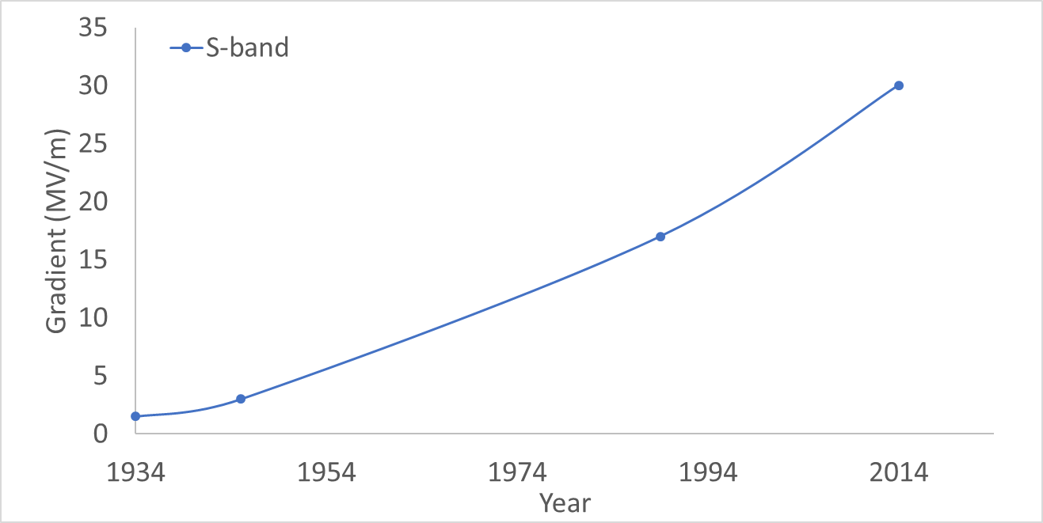
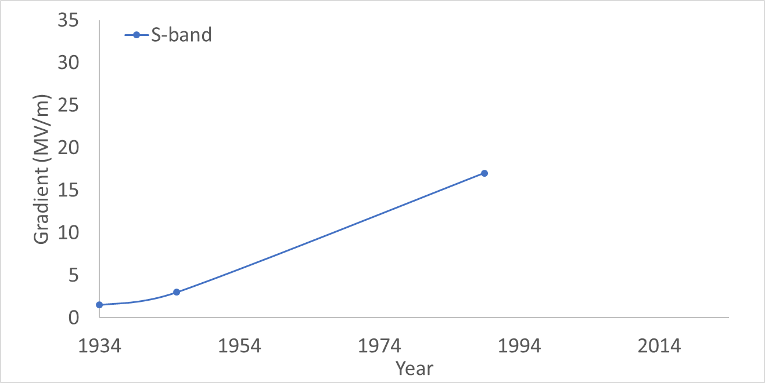
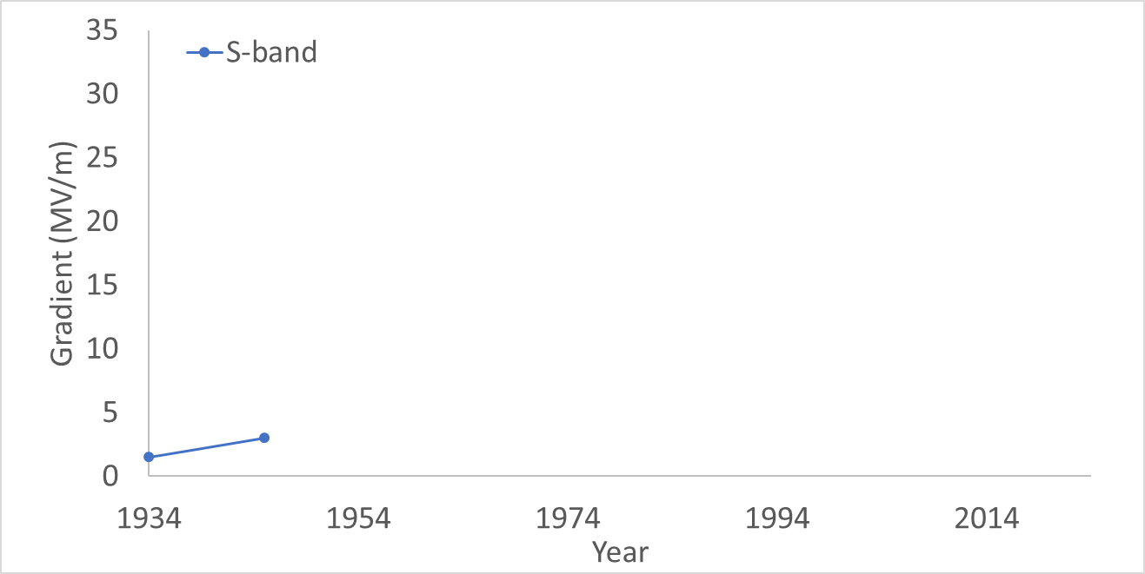
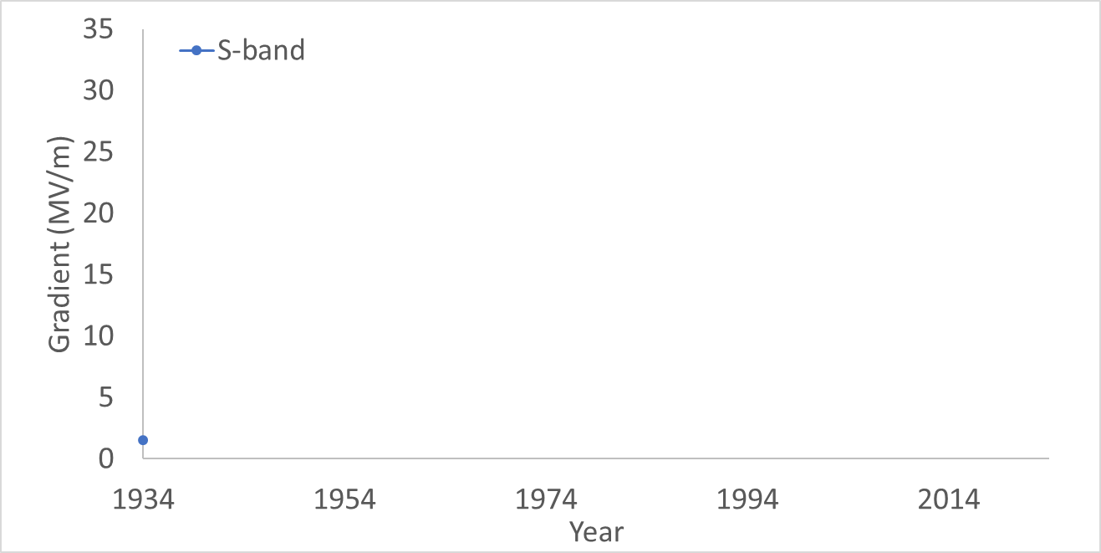
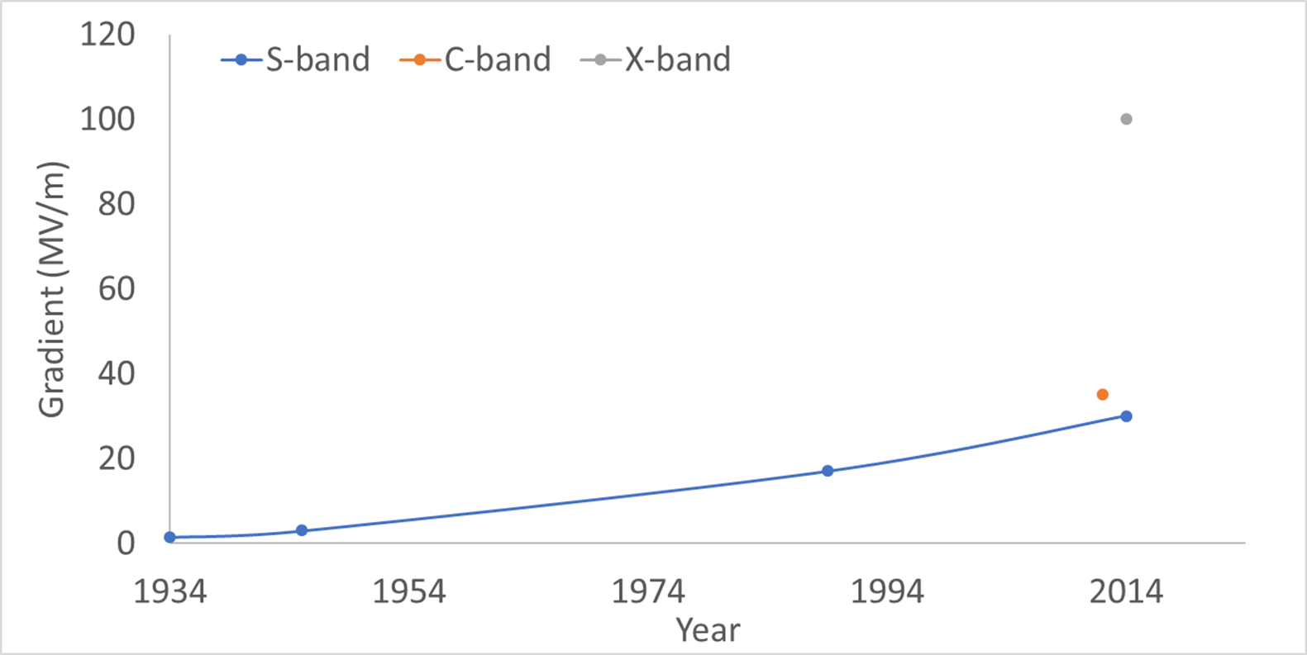
History of RF gradients
Modern 3 GHz accelerators similar to the SLC have settled to a limit of around 30 MV/m
Moving to higher frequencies have allowed higher gradients with C-band (6 GHz) around 35-40 MV/m and X-band (12 GHz) at 65-100 MV/m depending on duty cycle
The Stanford linear accelerator moved to higher frequencies and yet higher powers to achieve 17 MV/m helped by the faster velocity of electrons compared to ions
The first large scale linac was developed by Sloan and Lawrence using 30 drift tube linacs, giving 1.26 MV in 1.1 m, just over 1 MV/m
The development of RaDAR during the 2nd world war had produced high power RF sources, allowing the Alvarez linac to more than double the gradient of the Sloan linac reaching 32 MeV in 12 meters

Slide 3
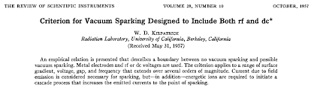
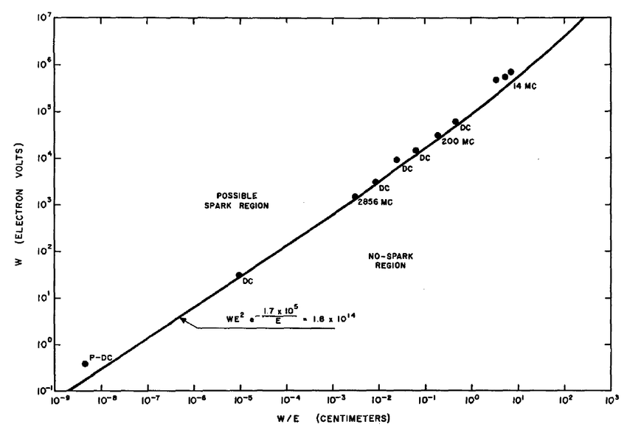

Kilpatrick Limits
The limit for the maximum operating gradient is often breakdown, where a plasma forms on the cavity surface
In the 1950’s W. Kilpatrick created an empirical formula for the peak surface electric field a linac could operate at based on experiments at SLAC
The field strength increases with frequency.
Kilpatrick limit is now regularly exceeded but it’s a useful yard-stick
The maximum field strength also varies with pulse length as t^{-0.25}

Slide 4
Field Enhancement
The start of breakdown is believed to be field emission. However, the field needed to get an appreciable current and hence heating is in the range of GV/m way beyond what we observe
The surface of an accelerating structure will have a number of imperfections at the surface caused by grain boundaries, scratches, bumps etc.
As the surface is an equipotential the electric fields at these small imperfections can be greatly enhanced.
In some cases, the field can be increase by a factor of several hundred.
E_{local}=β E₀
2b
h

Slide 5
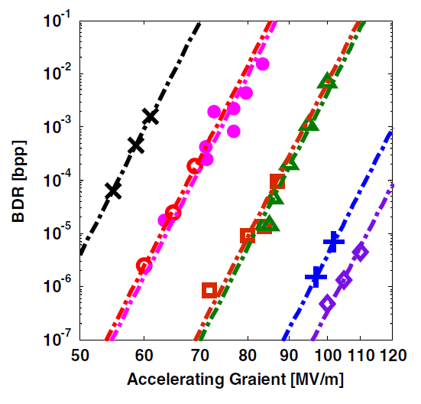
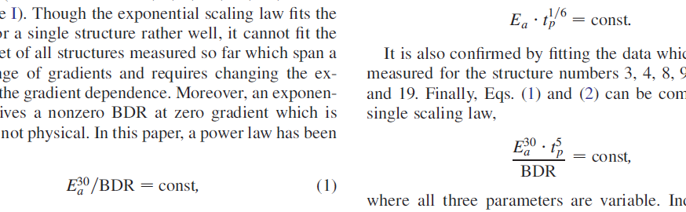
Breakdown Rate
The structure could statistically breakdown at any field but it becomes more likely at higher fields
It is often convenient to discuss the breakdown rate (BDR), given as the number of breakdowns/pulse per unit length..
From observation
The constant is dependant on geometry, material and history of the structure

Slide 6
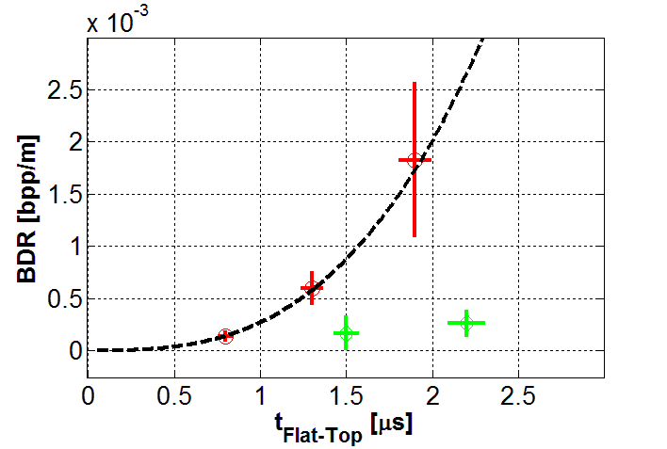
BDR Vs pulse length
It takes breakdown time to start so it is also dependant on pulse length.
nominal
pulse
length
double
pulse
length
half
pulse
length
E₀=58 MV/m
If pulse length goes down by 20 the field almost doubles.

Slide 7
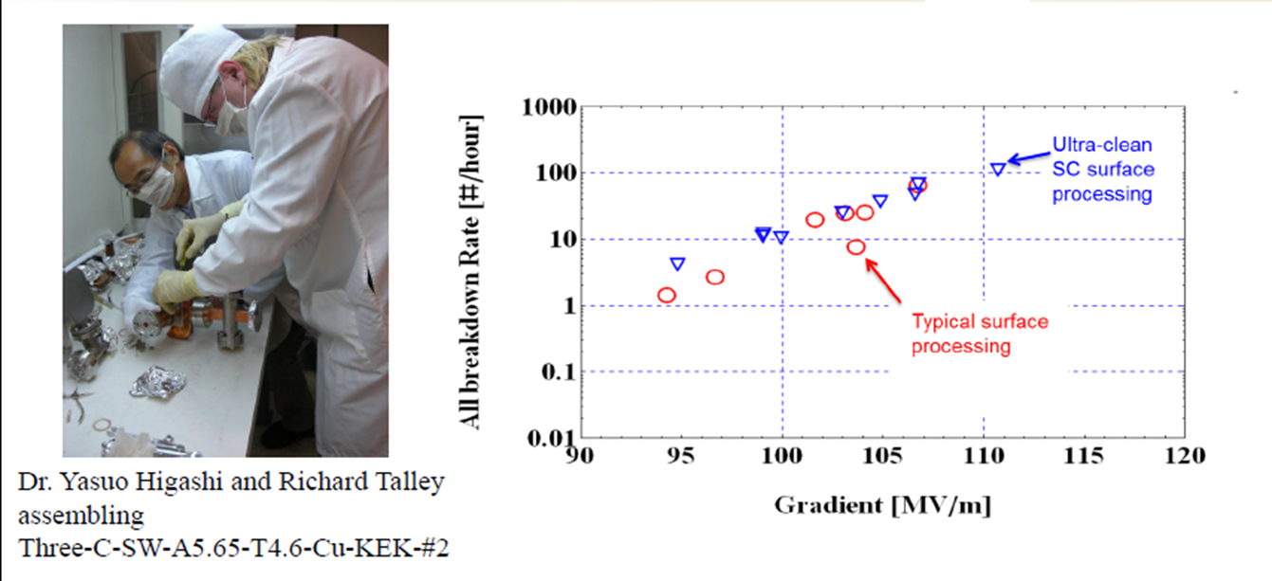
What causes the whiskers?
Generally thought breakdown is initiated by field emission on whiskers enhancing the field but where do they come from?
Machining defects? Not observed beforehand
Dust and dirt? Cleanroom construction reduces conditioning time but not ultimate gradient
Lattice defects under electric stress?
Micro-cracking due to heating?
Damage from breakdown, multipactor etc?

Slide 8
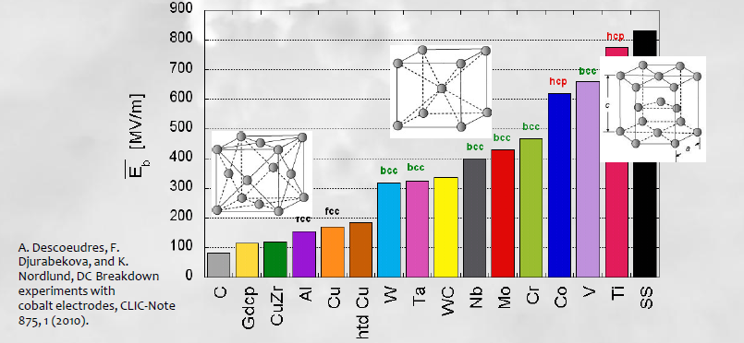
Breakdown field vs Material
DC Breakdown strength is correlated with crystal structure. This would suggest the dominant cause is dislocations.
The stress can come from pulsed heating or the electric field itself.

Slide 9
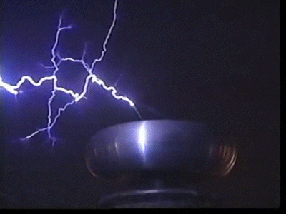
Vacuum Breakdown
Breakdown occurs when a plasma discharge is generated in the cavity.
The stress model suggests the Lorentz force on the cavity surface creates defects from voids in the bulk near the surface.
The stress of the electric field on a defect creates an emitter tip
This causes extensive heating and evaporation via field emission
The vapor is then ionised by field emission.
This melts a crater into the cavity surface
This is the major limitation to gradient in most pulsed RF cavities and can permanently damage the structure.

Slide 10
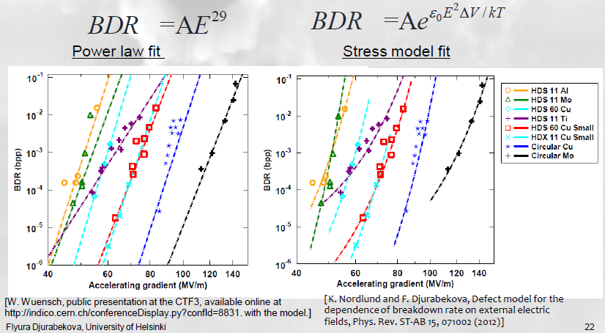
Curve fitting

Slide 11
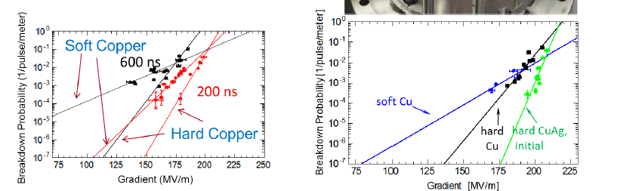
Copper Alloys
We were already aware that DC breakdown was related to crystal structure
Studies have been performed on different alloys of copper, hard or soft to find if the BDR was affected
Hard alloys tended to withstand higher surface field

Slide 12
Cryogenic Copper
The stress model gives a temperature dependence of the BDR, hence SLAC did a pioneering experiment to measure the BDR of a copper linac at low temperature
It was found that there was a significant increase in allowed peak surface electric field at a given BDR at 45 K compared to room temperature
SLAC have now measured acceleration of a beam at 150 MV/m in prototype cryomodule

Slide 13
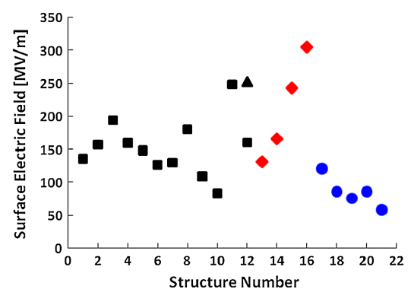
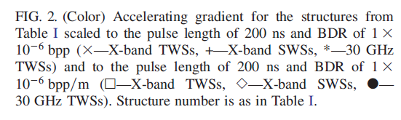
Peak surface Electric field
You would expect that for RF the breakdown electric field on the surface would be constant for all copper cavities.
The plot below from CERN would suggest otherwise hence electric field might not be the full story.
From W. Weunch

Slide 14
Pulsed Heating
The power deposited is
And the temperature on the surface is
ρ is density, κ is thermal conductivity and c_{e} is specific heat
Pulsed RF however has problems due to heat diffusion effects.
Over short timescales (<10ms) the heat doesn’t diffuse far enough into the material to reach the water cooling. This means that all the heat is deposited in a small volume with no cooling.
Cyclic heating can lead to surface damage if the temperature rise creates thermal stress (~40 K) .

Slide 15
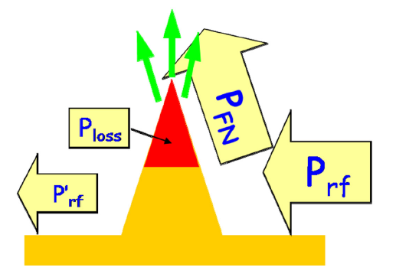
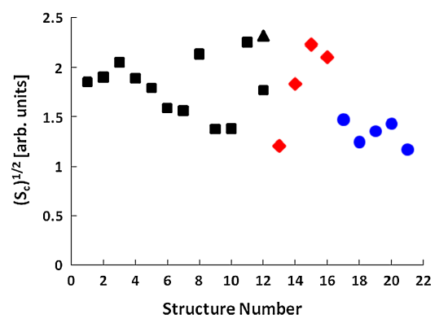

Power Flow model
Another recent theory suggests that the breakdown rate depends on the maximum poynting flux near the surface.
This is because the RF power is often larger than the field emitted power.
This is mainly based on fitting the data to lots of different cavities.
CERN have created a modified poynting vector to account for the fit to SW and TW cavities.
Relates to local power flow near the breakdown site.
It can be seen that all structure breakdown at roughly Sc= 2 MW/mm² at 1 μs pulse

Slide 16
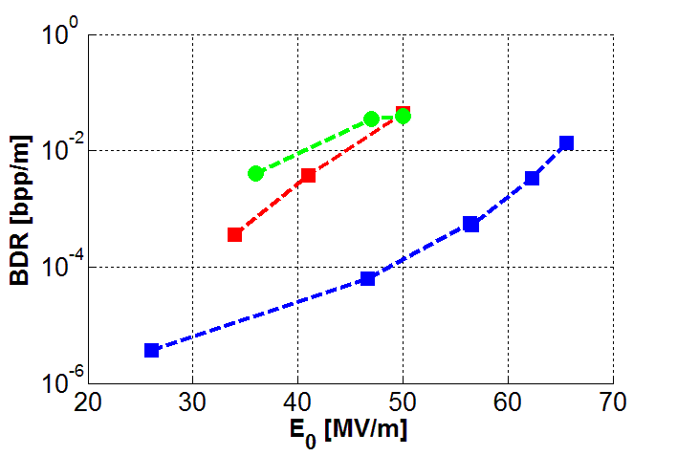
RF Conditioning
As a cavity is often manufactured with a number of nucleation sites for breakdown it is necessary to condition the cavity.
This consists of a number of semi-controlled RF breakdowns, caused by increasing the RF power or pulse length very slowly over a number of days/hours.
This causes vaporisation of the nucleation sites (sharp points) just above the breakdown threshold causing a minimum amount of damage.
Winter’10
Fall’11
Winter’12
In theory this should allow the structure to be conditioned to any gradient but in practice every structure has a maximum field at which processing fails to be effective.
This is likely to be due to the production of secondary nucleation sites after melting the primary sites.
S. Verdú-Andrés et al, High-power test results of a 3 GHz single-cell cavity,
arXiv:1206.1930v2

Slide 17

Dark Current Trapping
When we looked at beam dynamics we saw that we could inject a low energy bunch in a beta=v/c=1 structure and it could be accelerated to the speed of light and arrive on crest.
If we have field emitted electrons in the structure these could also be capture and can travel with the main beam.
The gradient at which this occurs is given by

Slide 18
Maximum Gradient Limits
All the limiting factors scale differently with frequency.
They also mostly vary with pulse length which is frequency dependant.
The limiting factor tends to be different from cavity to cavity.

Slide 19
Multipactor
Multipactor is a resonant electron instability where an electron striking the surface with a given energy generates statistically more than one secondary particle.
If the secondaries are returned to the surface at the same rf phase and energy as the primary then an exponential growth in electrons will occur. These electrons can absorb all additional RF power from the cavity keeping the cavity from increasing it’s voltage.

Slide 20


Slide 21
Parallel Plate Multipactor
One of the most common type of multipactor is two-point multipactor that occurs between two metallic plates.
The RF fields accelerate the particle across the gap. The RF fields reverese every half period so the electron motion is resonant if it take (n+1/2) periods to traverse the gap
a.c. electric field
across gap or in
waveguide
Notes:
A discharge is the passage of a conduction current (i.e. not a displacement current) through a medium that does not normally have any charge carriers.

Slide 22
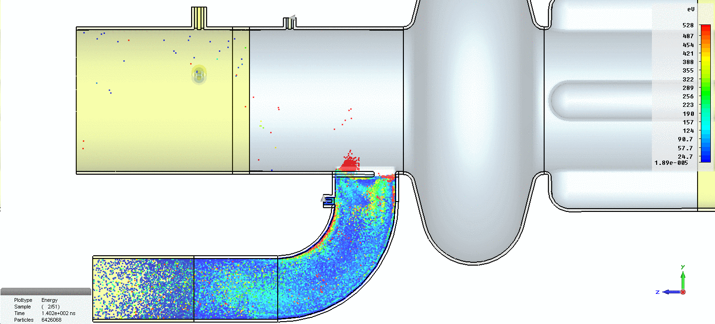
DLS coupler Multipactor

Slide 23
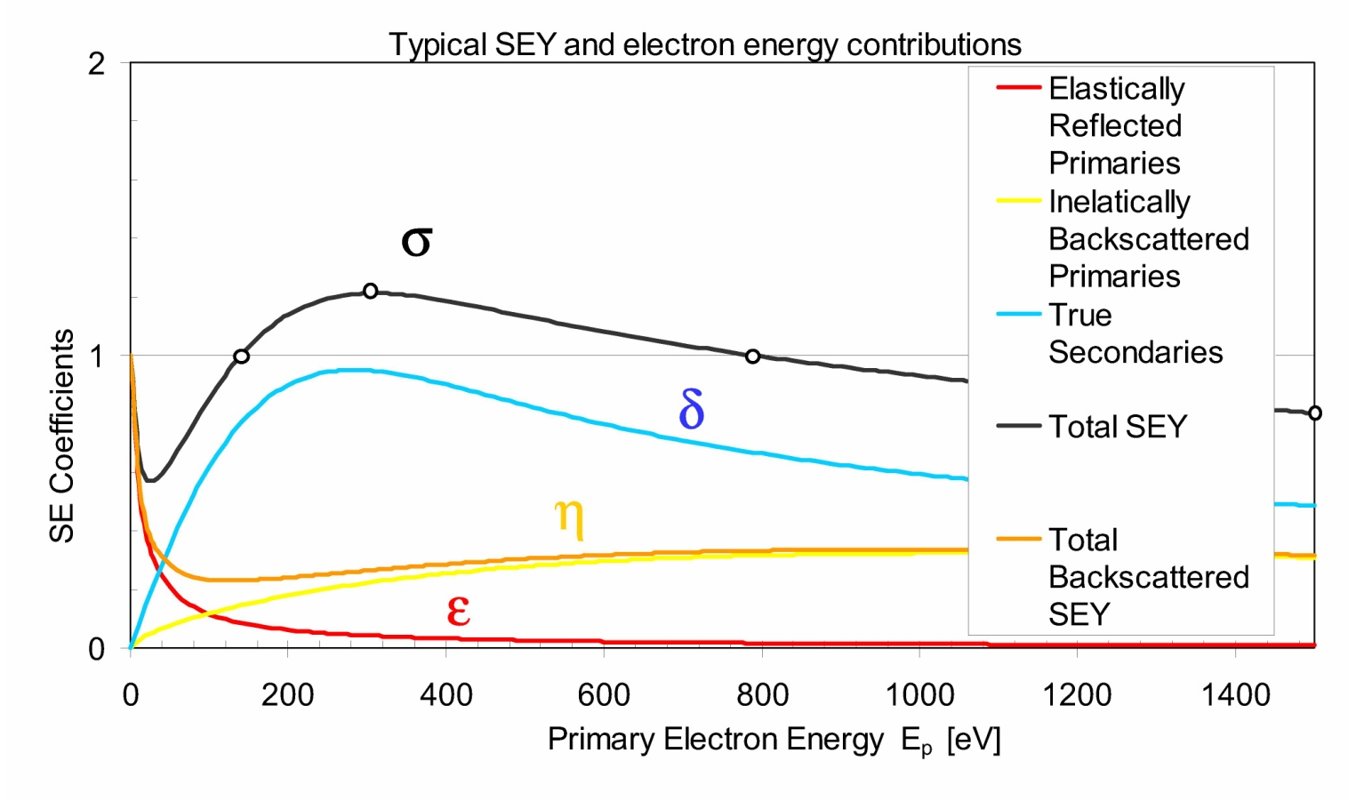
Secondary Electron Yield
Secondary Emission Yield
For multipactor to occur each electron striking the surface must generate more than one secondary on average.
The ratio of primary to secondary electrons is given by the secondary emission yield (SEY).
SEY is strongly dependant on impact energy and only gives an SEY>1 for a finite range of low energies

Slide 24
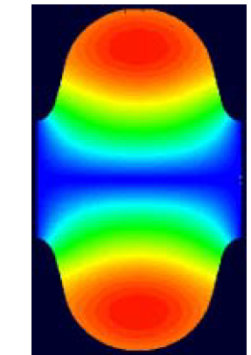
Multipactor in Cavities
Two point multipactor can also occur in pillbox and elliptical cavities.
The electron trajectories are bent by the RF magnetic field to form semi-circles.
In pillbox cavities trajectories are resonant if the cyclotron conditions are met
Multipactor will occur if the electric field accelerates the electrons to energies between ~50-500 eV depending on the material.
In elliptical cavities the resonant condition varies with radius as smaller arcs are required causing any resonant trajectories to break up, preventing multipactor.
Electron trajectory

Slide 25
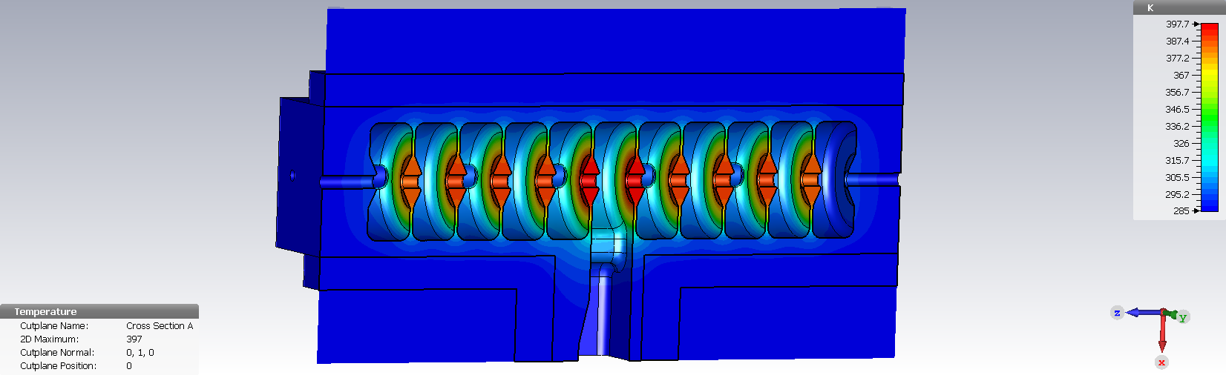
Average Heating Limits
In normal conducting cavities, the RF deposits large amounts of power as heat in the cavity walls.
This heat is removed by flushing cooling water through special copper cooling channels in the cavity. The faster the water flows (and the cooler), the more heat is removed.
For CW cavities, the cavity temperature reaches steady state when the water cooling removes as much power as is deposited in the RF structure.

Slide 26
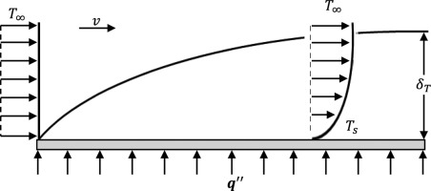

Water cooling
Temperature rise of water
kW = Flow rate (litres/second) x Specific heat capacity of fluid (Water is 4.182 kJ/kg) x ɗT
Mass follow rate is
But there is also a temperature difference between the water and the walls of the cooling pipes as the water velocity is slow near the walls causing a boundary layer to form
Finally we get a temperature gradient in the copper due to conduction
This cannot be reduced by water flow
$$ΔT=\frac{\dot{Q}/L}{πDh}$$
Where h is the heat transfer coefficient based of fluid dynamics and D is the pipe diameter

Slide 27
Cavity temperature with distance
Temperature
Thermal conductivity, given by dT=Q’ κ L/A
Iris is thin so has a large gradient
T_{iris}
Boundary layer temperature gradient, the same in all pipes/cells. Can be corrected with water temperature
T_{pipe}
T_{wall}
Increase in water body temperature, increases along the pipe causing temperature gradients and differential thermal expansion
T_{water}
T_{outer}
Position

Slide 28
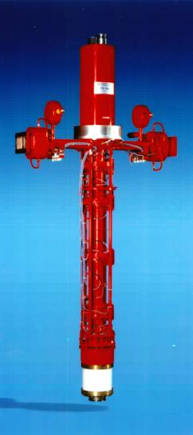
Power Limits (Klystrons)
Many linacs are actually limited by RF power.
The highest power klystrons are around 50 MW pulsed (200 ns) or 1 MW CW, this is enough to meet the current maximum operating gradients.
We can store the energy from longer pulses and release then in a short timescale creating higher powers. This is known as pulse compression and can double or quadruple the peak power (to 200 MW)
If we overcome the gradient limits we may well be limited by the maximum power we can deliver which scales as E²
Even if higher power klystrons could be obtained we may still be limited by the power limits of RF components like windows, splitters and loads.

