Slide 1

RF Linear accelerators L4: Longitudinal and Transverse Dynamics in Linacs
Prof Graeme Burt
Lancaster University
( some elements from Wangler, RF Linear accelerators, S. Henderson UPSAS and M. Vrentinar Linear Accelerators CERN Accelerator School)

Slide 2
Synchronous particle
Imagine we have a series of gaps. The phase change between two gaps when the beam arrives is given by
Where ϕ_{a} is the phase advance, (the phase difference between adjacent coupled cavities)
Hence the distance between cells should be
In a linac we choose a synchronous phase φ_{s} and design the lengths so that the synchronous particle sees the desired phase (not always constant)

Slide 3
Energy errors
If a particle has a higher velocity than the synchronous particle it will see a phase error in the next cell, due to its faster velocity, of
Where N = ϕ_{a}/2π + i, where i is an integer.
Using the relationship between energy and velocity
Where W is the beam energy. We obtain the phase error for an energy error instead

Slide 4
Phase errors
A phase error will also cause a variation in the particle energy as it will see a different accelerating voltage.
These equations can be stated as differential equations if we replace the discrete gaps with a continuous action along s (beam direction)

Slide 5
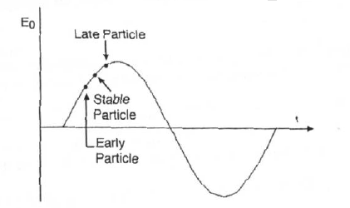
Longitudinal Focussing
Longitudinal focussing occurs if late particles see a higher acceleration and hence gain a higher velocity.
Early particles must then see less acceleration.
This creates particles who are off momentum or phase oscillating around the stable particle

Slide 6
For small acceleration
Differentiating the phase equation and substituting in the energy equation we obtain
Integrating this with respect to s yields
Using ds=dφ/φ’ and multiplying by φ’ we get

Slide 7
Potential well
Integrating all this wrt phi yields
Hamiltonian
Kinetic energy
Potential energy
φ_{s}=0
By plotting the potential energy we can see a potential well is formed around φ_{s.}
As the Hamiltonian is constant as a particle moves in phase it looses kinetic energy, only particles with enough kinetic energy to overcome the potential well are able to escape, and those confined have stable trajectories.
φ_{s}=60

Slide 8
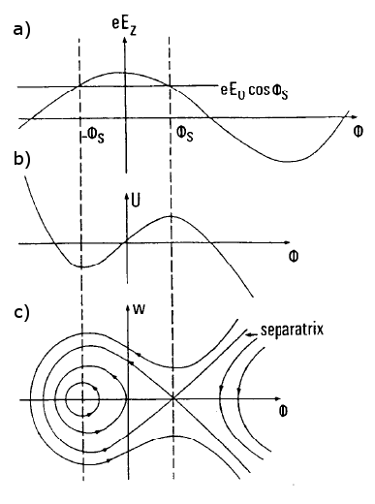
Seperatrix
Just like circular dynamics a seperatrix is formed.
Maximum energy difference is
You would not wish to operate at φ_{s}=0 as you would lose any off momentum particles.

Slide 9
Phase width
The phase width are the two solutions where w=0.
One solution is φ₁=-φ_{s}.
The other, φ₂, is given by
The phase acceptance is typically from –φ_{s} to 2φ_{s} for small φ_{s} and at φ_{s}=90 degree covers all phase space.
Again clearly you would not wish to operate with φ_{s}=0

Slide 10
Harmonic Oscillation
Going back to the phase equations
For φ-φ_{s} is small

Slide 11
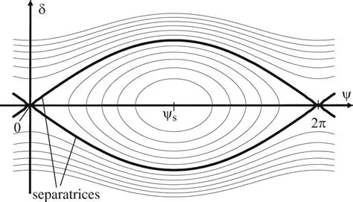
Harmonic oscillation
This gives the equation for simple harmonic motion
With frequency
Note as the beam becomes relativistic the frequency goes to zero as gamma increases to the power 3.
The particle follow elliptical trajectories given by
where
and

Slide 12
High energy linacs
As β tends to 1 the variation of phase with energy tends to zero and hence particles no longer oscillate in a stable orbit. All particles with β~1 are trapped/frozen in phase and are only lost through transverse effects or if they are decelerated to lower β.

Slide 13
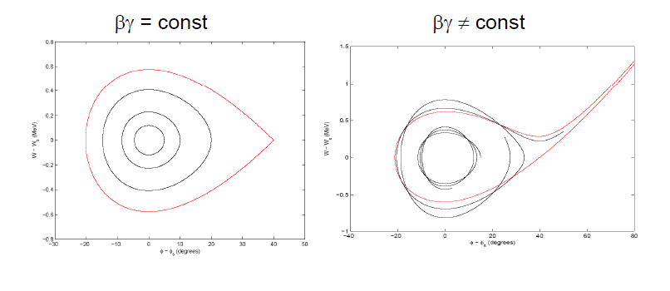
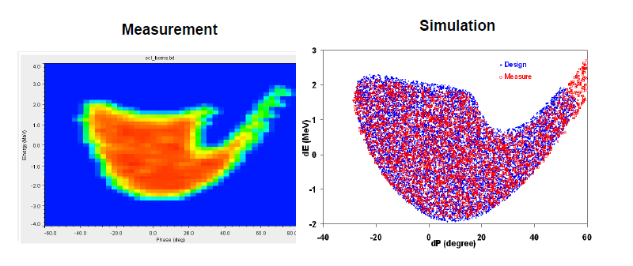
Larger acceleration
Real accelerators are more complicated as the acceleration isn’t small and the velocity isn’t constant
The acceptance of a real machine looks like a golf-club.
SNS acceptance from Y, Shang

Slide 14
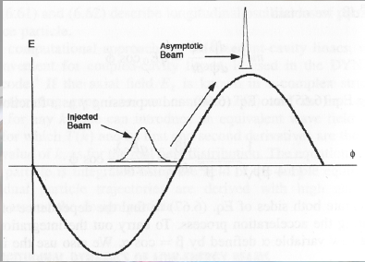
Capture
It is sometimes useful to inject lower energy electrons into v=c linac. In this case as the velocity is initially slower its phase will slip.
If we can inject at the correct phase we can design so the phase slips so that it reaches the desired phase at v=c
The phase motion is described by
Solving these gives
Note there is a minimum gradient E0 for this to work

Slide 15
Transverse Dynamics

Slide 16
RF defocussing
Maxwell’s equations (Amperes and Guass’ laws) give a transverse field (E_{r} and B_{φ}) due to the change in E_{z}.
E_{z}
E_{r}/r

Slide 17
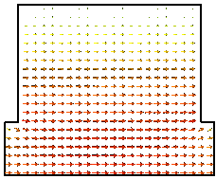
Rf defocussing
The transverse force can be given by
If the velocity change over the gap are small then
Giving
This gives a time dependant and a DC term
Defocus
Symmetric first cell
cathode
Focus

Slide 18
Momentum
If we integrate to and from the region where the field goes to zero then the total spacial derivative term goes to zero.
The momentum is inversely proportional to γ² hence this mainly dominates at low energy as the magnetic field cancels the electric field

Slide 19
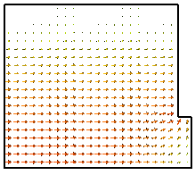
RF Guns
Asymmetric first cell with short at z=0
Defocus
Defocusing
cathode
In RF guns the field doesn’t decay to zero, it has an abrupt change in Ez, this means there is no focussing force as the surface charge on the metal walls allows Ez to change abruptly without giving rise to a focussing radial field.
This means RF gun have a net defocussing field from the electrostatic term.
You could design it to decay but then you have low fields on the cathode which causes space charge blow-up. Emmittance is minimised for the former case with focusing.

Slide 20
Velocity change
If the velocity changes across the gap then the electrostatic term no longer cancels
Let us consider a hypothetical case where the longitudinal field abruptly tends to zero at the edges of the gap +/– g/2.
Hence
-

Slide 21
Velocity Change
Normally r₁>r₂ β₂>β₁ so the net effect for on crest is focussing.
However for low energy bunches a negative φ is normally chosen for longitudinal bunching so the field could be focussing or defocussing.
In addition the bunch normally spends longer in the low focusing (low energy) end than the defocusing (high energy) end of the cavity.

Slide 22
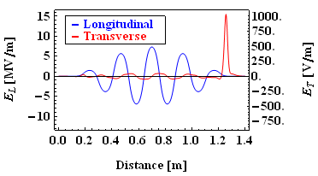
Coupler kicks
The coupler on a cavity can also lead to a deflection to the beam, this is due to two reasons
The coupler breaks the cavity symmetry causing the electrical centre to shift. This is proportional to the accelerating voltage.
There is a field associated with the coupler that has a transverse electric field. This kick is dependant on the incoming and outgoing waves on the coupler.
The effect can be avoided by using two couplers so that the kick from each cancels.

Slide 23
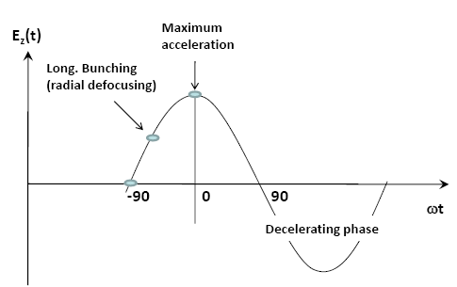
RF bunching and focusing
Solenoids are unacceptable for compact applications. Hence RF focusing from the linac structure is used
Radial focusing
(long. Debunching)
Initially the DC bunch see’s all phases, bunching phases are captured
The captured bunch then is accelerated moving towards the peak acceleration
The bunch is then moved to a radially focussing phase until the linac exit which unfortunately starts to debunch the beam.

Slide 24
Particle motion
If we approximate the focussing and defocussing impulses as a smooth average effective force we obtain a smoothed equation of motion.
Where k_{l0} is the longitudinal wavenumber defined in the previous section.
Note it is proportional to gamma and the RF frequency
This means at low energies we must use lower frequencies

Slide 25
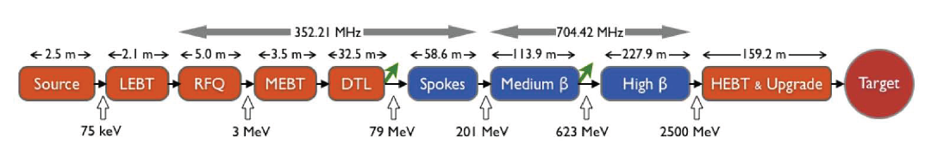
RF focussing in proton drivers
In proton/ion machines the beam remains below β=1 for most of the machine.
This means the beam is more susceptible to focussing and bunching forces.
It is normal to use a phase that gives bunching but defocusing and use quadropoles to compensate for the defocusing.
As defocusing is frequency dependant it is normal to use a low frequency at the start and step up the frequency at one (for protons) or two (heavy ions) points up to higher frequencies at the end of the linac.

Slide 26
Space charge defocussing
Large numbers of particles per bunch ( ~10¹⁰ ).
Coulomb repulsion between particles (space charge) plays an important role.
But space charge forces ~ 1/γ² disappear at relativistic velocity
Space charge appears to the 1st order as a defocussing quadrupole in both planes so can be corrected with quadrupole doublet/triplet etc.
Force on a particle inside a long bunch with density n(r) traveling at velocity v:
B
E

Slide 27
Quadrupoles
We need to have a net focusing force to compensate for the space charge and RF defocusing.
Where G is the quad magnetic field gradient
At higher energy space charge and RF defocusing is much smaller as quadrupole focussing drops off with gamma slower (squared) than the defocusing terms (cubed).
At high energy the quadrupoles still needed to compensate for wakefields and coupler kicks.

Slide 28
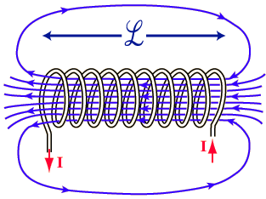
Solenoids
At the entrance to the solenoid the particles see the B_{r} component of the fringing fields which cause then to have an azimuthal velocity component
The B_{z} field in the solenoid centre crossed with this velocity provides a radial focussing force. The fringing fields at the exit remove the azimuthal velocity.
Large B fields are required so they are quite inefficient so are not used at high energy.
The wavenumber for a solenoid is
At low energy it is better to have something which focuses in both planes at once. This can be achieved with a solenoid.

Slide 29
Transverse beam equilibrium in linacs
The equilibrium between external focusing force and internal defocusing forces defines the frequency of beam oscillations.
Oscillations are characterized in terms of phase advance per focusing period σ_{t} or phase advance per unit length k_{t}.
Ph. advance = Ext. quad focusing - RF defocusing - space charge
q=charge
G=quad gradient
l=length foc. element
f=bunch form factor
r₀=bunch radius
λ=wavelength
…
Approximate expression valid for:
F0D0 lattice, smooth focusing approximation, space charge of a uniform 3D ellipsoidal bunch.
A “low-energy” linac is dominated by space charge and RF defocusing forces !!
Phase advance per period must stay in reasonable limits (30-80 deg), phase advance per unit length must be continuous (smooth variations) → at low β, we need a strong focusing term to compensate for the defocusing, but the limited space limits the achievable G and l → needs to use short focusing periods N βλ.
Note that the RF defocusing term ∝f sets a higher limit to the basic linac frequency (whereas for shunt impedance considerations we should aim to the highest possible frequency, Z ∝√f) .
29

Slide 30
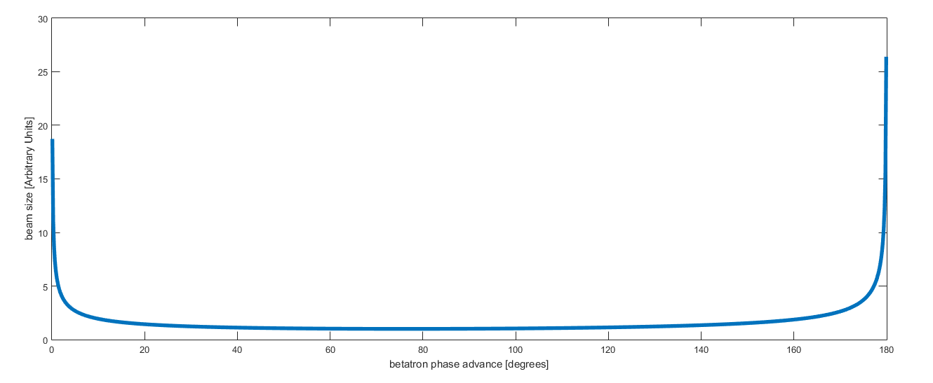
Focusing periods
Need to keep the phase advance in the good range, with a constant phase advance per unit length → The length of the focusing periods has to change along the linac, going gradually from short periods in the initial part to longer periods at high energy.
For Protons - βλ in the DTL, 4-10βλ at higher energy (>40 MeV).
For Electrons -focusing periods up to several meters
If your focussing period is too long, your average beam size is too large (beam size in a periodic lattice scales as sqrt(L))
If the length is too short then the quadrupoles can't provide enough focussing for the beam to remain stable.
Beam size
Beatatron phase advance (deg)
Notes:
Beta 7% at 3 MeV

Slide 31
High-intensity protons –Linac4
Transverse (x) r.m.s. beam envelope along Linac4
Example: beam dynamics design for Linac4@CERN.
High intensity protons (60 mA bunch current, duty cycle could go up to 5%), 3 - 160 MeV

