Slide 1


RF Linear accelerators
L1: Introduction: Coupled cavity linacs
Prof Graeme Burt
Lancaster University

Slide 2
Multi-cell structures
It is simpler to drive multiple cavities (cells) with a single RF source. This requires the separation between cells to be adjusted to achieve the correct phasing of cavities to achieve maximum acceleration.
Once β~1 all cavities are a half wavelength apart,

Slide 3
Synchronous particle
Imagine we have a series of gaps. The phase change between two gaps when the beam arrives is given by
Where ϕ_{a} is the phase advance, (the phase difference between adjacent coupled cavities)
Hence the distance between cells should be
In a linac we choose a synchronous phase φ_{s} and design the lengths so that the synchronous particle sees the desired phase (not always constant)

Slide 4
Low beta electron synchronism
For electron guns and industrial/medical linacs the electrons are injected at a beta less than one and are accelerated to beta=1 in the first cell.
However at X-band (9-13 GHz) the gaps are small hence the first few cells are non-relativistic, hence

Slide 5
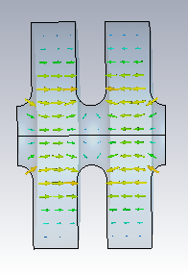

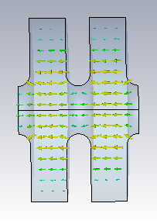
Cell-to-cell coupling
Kirchoff’s voltage law:
V_{c}= IZ = (I₁-I₂) Z = 0
k
I₁
I₂
k
I₁
I₂
V_{c}= IZ = (I₁+I₂) Z = 2I₁Z
If we move two resonators close to each other they become capacitively coupled. The potential drop across this capacitor is dependant on the phase difference between the resonators.
This results in a different resonant frequency.

Slide 6
T-network
A periodic array of impedances of the form below, is called a T-network
Kirchoffs law gives
and has the solution
Z_{n-1}
Z_{n}
Z_{n+1}
Y_{n-1}
Y_{n}
Y_{n+1}

Slide 7
Electric coupling
We can couple via an inductance (Y=1/ωL₂) or a capacitance (Y=ωC₂) depending on where we place our coupling slots. Lets start with capacitive
If we set
And insert into the T-network equation we obtain
Which gives

Slide 8
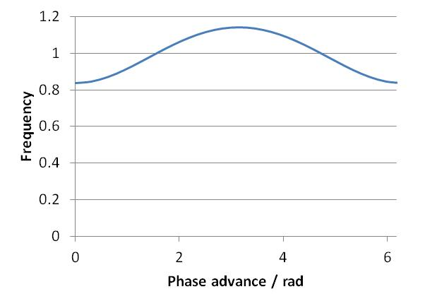
Electric coupling
If we set
We obtain for k<<1
Hence when k<<1, k can be found by

Slide 9
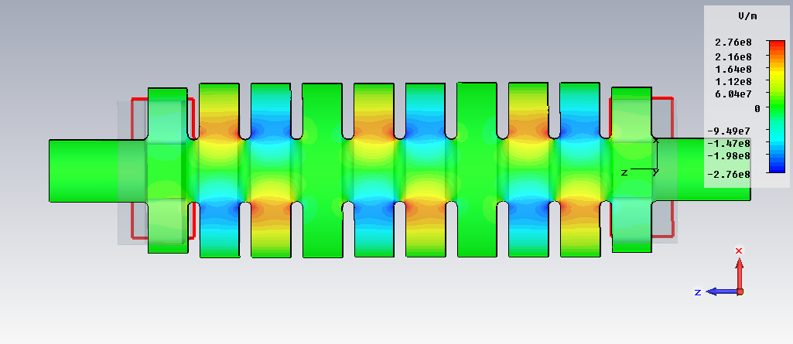
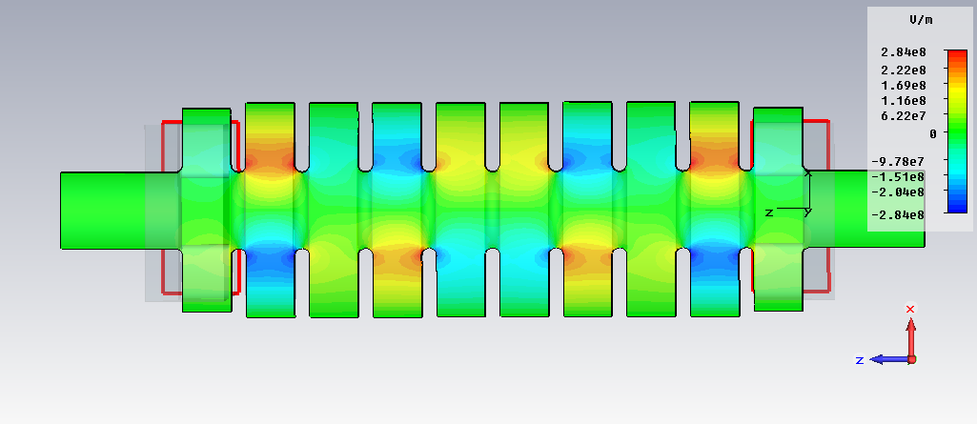
Phase advance
Phase advance is the phase difference between adjacent cells.
In standing wave cavities this means that all cells have different amplitudes (except in 0 or pi phase advances).
In the pi/2 mode every 2nd cell is empty.
Amplitude is given by
A=sin(nϕ_{a})cos(ωt)
where n is the cell number
pi/3 mode deflecting cavity
2pi/3 mode deflecting cavity

Slide 10
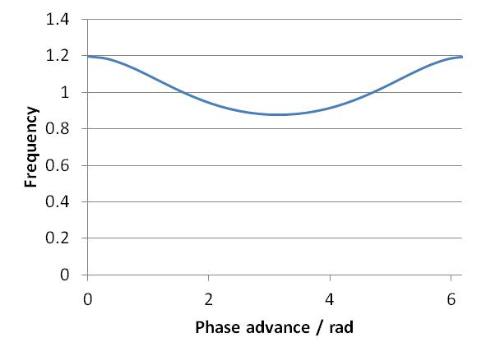
Magnetic coupling
If we follow the same procedure for an inductive coupling we obtain
where
Hence when k<<1,
k can again be found by

Slide 11
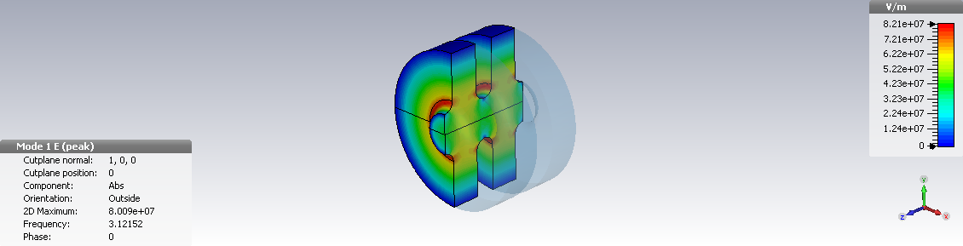
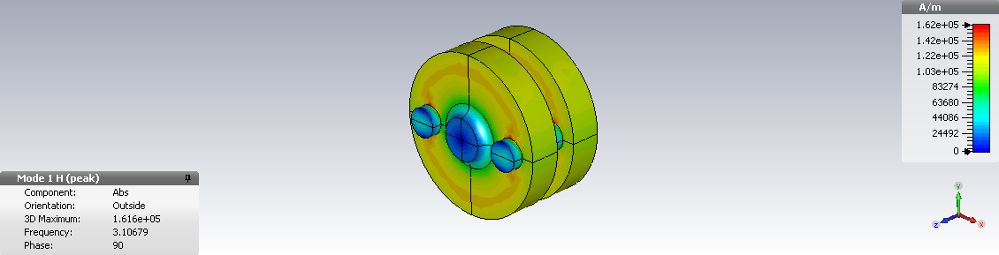
Coupling Cells
If we wish capacitive coupling we couple through the beam tubes. This needs a large aperture which often results in higher peak fields and a lower shunt impedance.
If we want magnetic coupling we need to cut coupling slots in the cavity walls near the peak magnetic field on the equator. This allows strong coupling without affecting the fields.

Slide 12
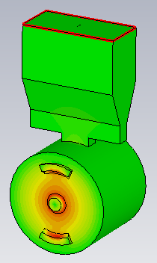
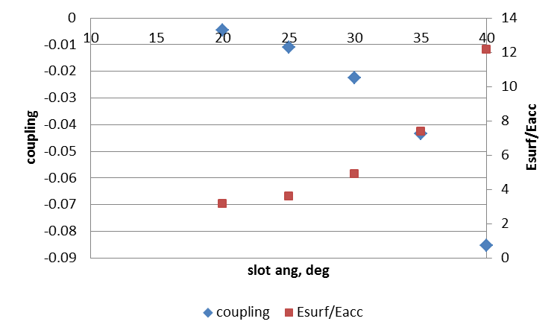
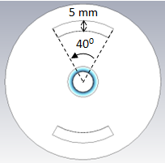
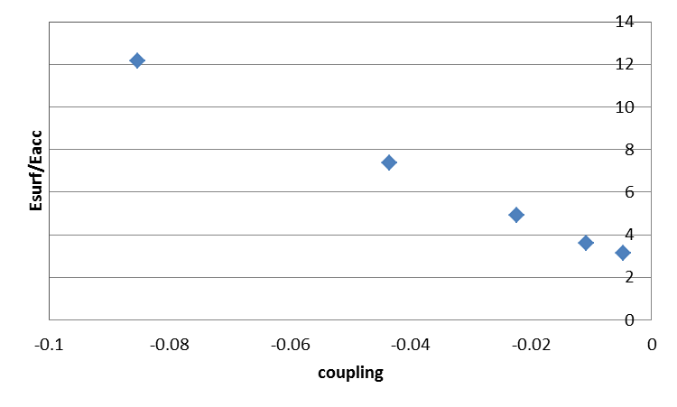
Slot coupling
Coupling=(fpi-f0)*2/(fpi+f0)
Each point is at 3 GHz
The electric field comes from coupling to the TE11 mode in the slot.
Sensitivity to manufacturing errors is proportional to the coupling

Slide 13
Three cell cavity example
We can set up Kirchoff’s law as a matrix and solve for the eigenvalues, x, which is a normalised current
We get three eigenmodes of the system
q=0,1 and 2 (ϕ_{a} = 0, π/2, π)

Slide 14
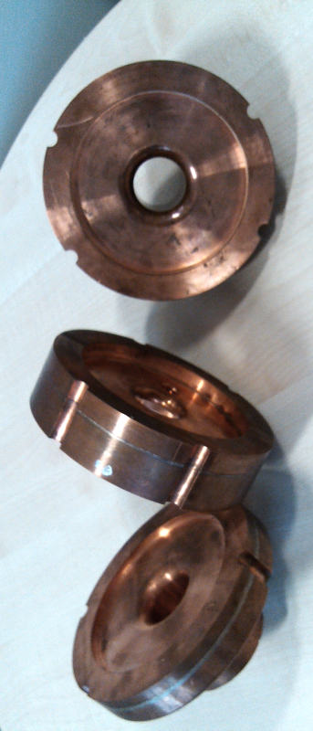
Manufacturing tolerances
Normal Uni machine shop 100 μm
Good machine shop in a Uni 50 μm
Precision manufacturing 15 μm
Diamond tipped lathes 5 μm
This is related to frequency errors by
Hence the proportional frequency error is proportional to frequency. This is the main limit on going to higher frequency linacs.

Slide 15
Perturbation theory
We can study the effects of frequency errors by applying perturbation theory. δω₁ is the frequency error of the mid cell and δω₀ is the error of the end cells
The effects are that a new eigenvector is created containing corrections from mixing from all the unperturbed eigenvectors.

Slide 16
Fields stability
It can be seen that the amplitude in the π mode varies as
While the π/2 mode varies as
It can be seen in both cases the perturbation is inversely proportional to k so strong coupling is desired.
Also that the π/2 mode is more stable than the π mode by a factor of (normally 10-100 times smaller error)

Slide 17
Power-flow phase shift
So far we have not included cavity losses or power coupling.
If we add a generator on one side and add resistance to the circuit we can investigate the effects. We implement these in the form Ae^{jφ}
The π mode has a phase droop and the π/2 mode has an amplitude droop
Mode | Amplitude | Phase
0 | 1
π/2 | 1/kQ
π | -1
Cell 2
Mode | Amplitude | Phase
0 | 1
π/2 | -1 +2/(kQ)² | 0
π | 1
Cell 3

Slide 18
π/2 mode stability
Why is a π/2 mode so stable
Each mode in the passband contributes a small error term to the excitation of any one particular mode when there are frequency errors. Having a larger mode spacing, by increasing k, reduces this error term.
For the π/2 mode the error terms for the higher frequency modes almost exactly cancels the contributions from the lower frequency modes.
For this reason most long standing wave structures work in the π/2 mode.

Slide 19
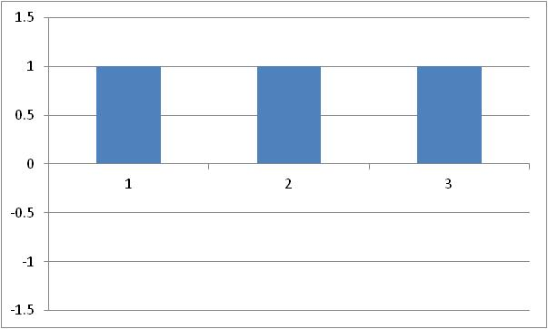
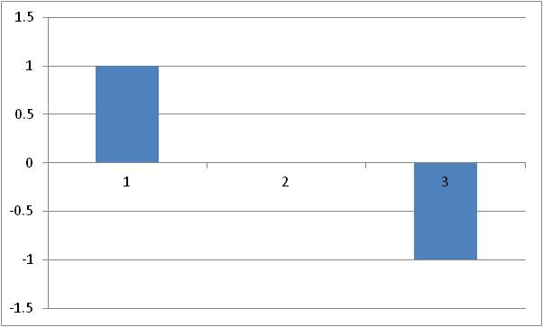
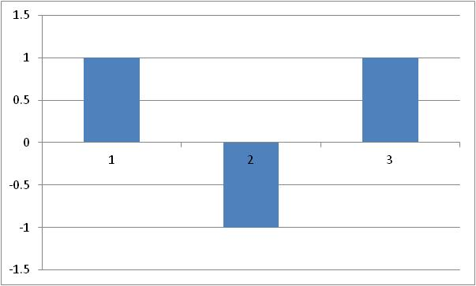
Field profiles
0 mode
π/2 mode
π mode
The 0 and π modes have field in every cell, hence every cell contributes to the acceleration.
However in order to meet synchronism conditions the 0 mode and the transit time factor a zero mode needs long drift tubes which makes lowers the average accelerating gradient as the beam is not accelerated in the drift tubes.
The π/2 mode has the middle cell empty hence only the two end cells will contribute to acceleration
For these reasons the π mode gives the highest accelerating gradient.

Slide 20
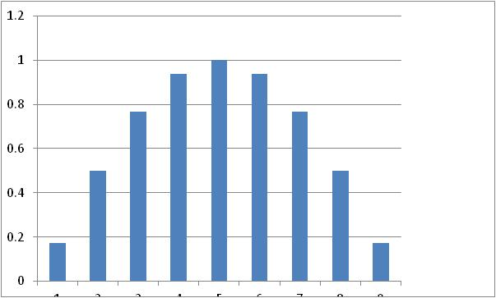
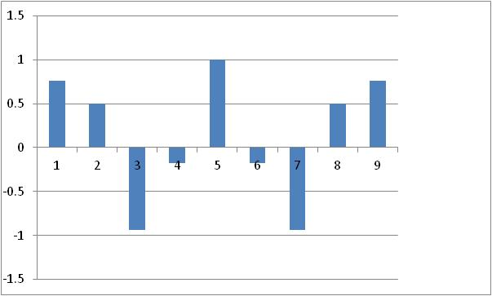
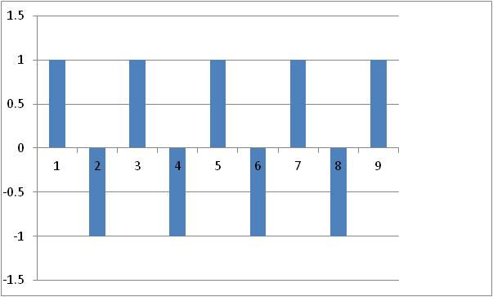
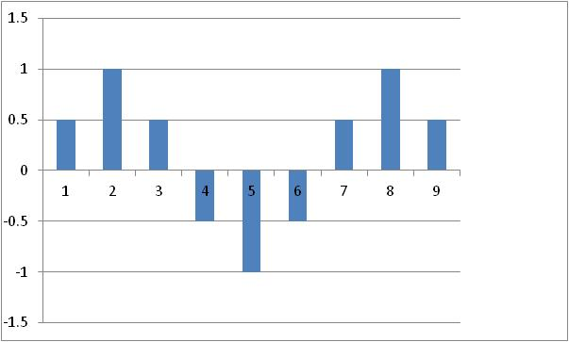
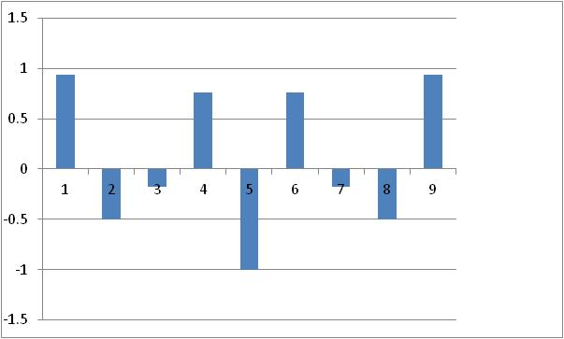
Longer structures
If we have N cells in a cavity we get N eigenmodes (q=1-N). If we adjust the end capacitance to give field flatness. The frequencies and amplitudes are given by
9 cell cavity with ω_{π/2}=1 and k=0.1
n=3
n=7
n=1
n=5
n=9

Slide 21
π mode errors
For an N cell cavity in the pi mode the power-flow phase shift between the first and last cell is
This means k can be chosen to limit the phase shift.
The amplitude stability is given by
Where Δω is the frequency shift due to manufacturing errors. In this case we can use a lower k but our machining will cost more (ie HEP machines), or have a larger k and have looser tolerances (ie medical linacs)

Slide 22
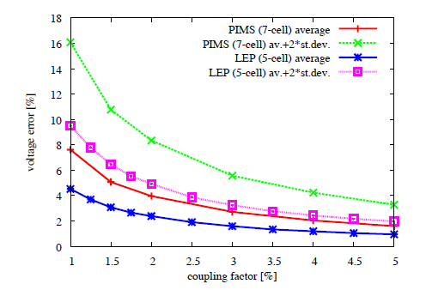
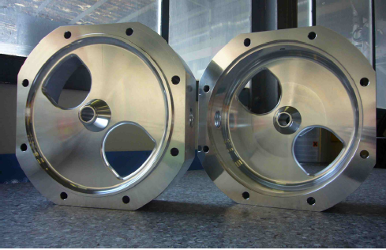
Example: Linac4 PIMS
Based on standard manufacturing errors of 25 kHz the voltage error as a function of coupling can be calculated.
For an error of 11% in shunt impedance the coupling factor was chosen to be 5%.
Other effects are expected to further reduce the shunt impedance such as surface roughness and the effect of the coupler

Slide 23
Effect of cell errors on amplitude
Below is an example of the effect of end cell frequency errors in a pi mode structure fed from the central cell.
This leads to early onset of breakdown in the central cell limiting gradient.

Slide 24
π/2 mode structures
As we have seen π/2 modes are more tolerant to frequency errors (due to manufacturing tolerances) than π mode structures.
We can adjust the cell length to make the π/2 mode synchronous using
But the mode still has a low efficiency as every 2nd cell is unfilled
high shunt impedance
π-mode
high field stability
π/2-mode

Slide 25
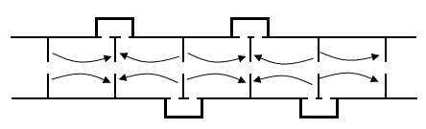
Side coupled or bi-periodic cavity
We can improve the shunt impedance by making the coupling and accelerating cells have different geometries for π/2 mode structures.
Side coupled structures move the coupling cells off axis
Bi-periodic cavities use very short coupling cells
high shunt impedance
π-mode
high field stability
π/2-mode
π/2-mode
Side coupled
both !
π/2-mode
bi-periodic
both !
Beam sees a π-mode→ high acceleration
RF sees a π/2-mode field→ highly stable
L

Slide 26
On-axis coupled infinitely periodic BPC
Structure
Dispersion relation
ω_{c}
ω_{c}
ω_{a}
ω_{a}
ω_{a}
k=coupling constant between acc and coup cells
ω_{a}=natural freq. of acc. cell
ω_{c}=natural freq. of coup. cell
ω_{m}= frequency of mode m
2N coupling cells
2N+1 accelarating cells
If we use a bi-periodic structre the benefits of the π/2 mode are only received if the frequency of both accelerating and coupling cells are the same.
If they are different we just get a weakly coupled π mode which is worse than a normal π mode
Dispersion diagram contains a stop band at π/2 of width δω=ω_{a}−ω_{c}

Slide 27
π/2 modes errors
For a cavity with 2n+1 cells with the coupler located in cell m the field amplitudes in the accelerating cells are given by
Where Δω is the frequency difference between the coupling and accelerating cells. The first term is the power-flow droop and the 2nd is the power-flow phase shift.
As the error is proportional to (m2-n2) it is often best to locate the coupler in the centre of the structure
And the field in the coupling cells are given by

Slide 28
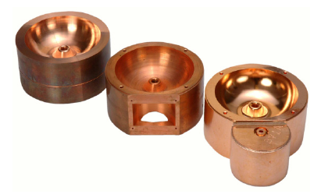
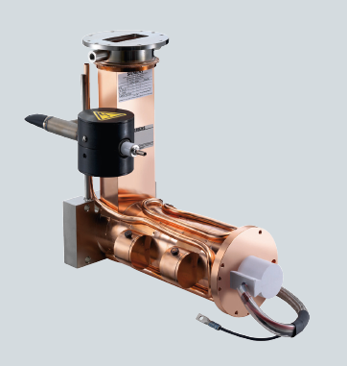
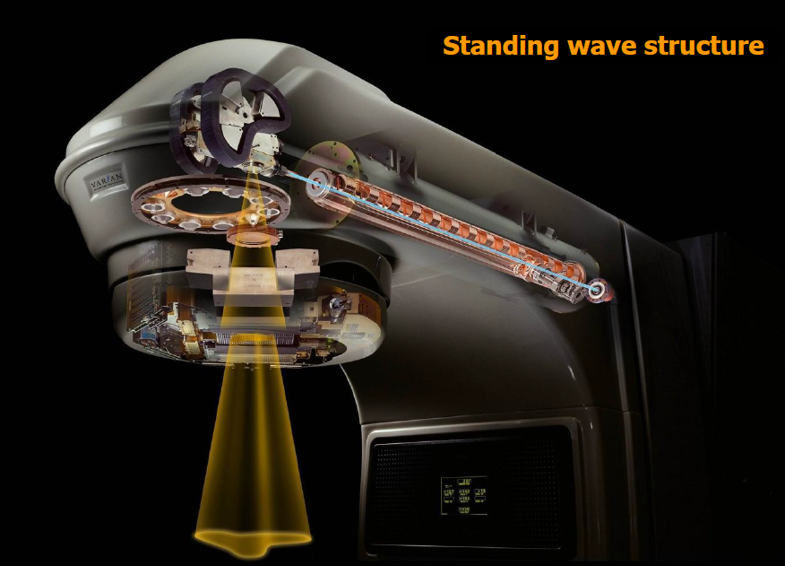
Example: Industrial & medical side-coupled linac
SAMEER structure
Siemens 6 MeV SILAC
Mass produced commercial cavities need to be manufactured cheaply
Ie side-coupled pi/2
Varian Clinac

