Slide 1


An update on pySpinW
Duc Le
ISIS-PSI Software workshop 2026.03.17
Notes:
The abstract pattern can be removed or repositioned if required. Be careful to ‘Send to Back’ so that it does not obscure any important information.

Slide 2

– Overview
Simulates spin wave spectra in crystalline solids
Used to fit inelastic neutron scattering (INS) data to get exchange interactions.
Exchange interactions determine the physical properties of (quantum) magnets:
  Verifies if the material is a quantum spin liquid
  Classifies model system within a theoretical phase diagram, e.g. for frustrated magnets.
  Important for theoretical descriptions of high temperature superconductors.
  Input for micromagnetic simulations of magnonic / spintronic devices.
Project (Nov 2024 – Nov 2026) is to translate code from Matlab to Python

Slide 3
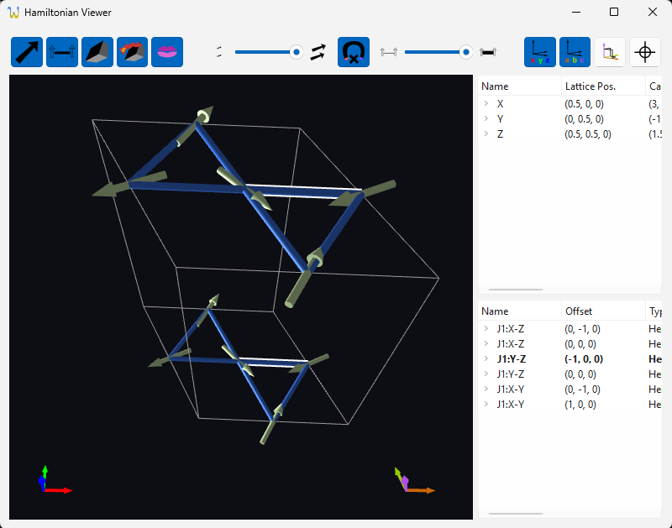
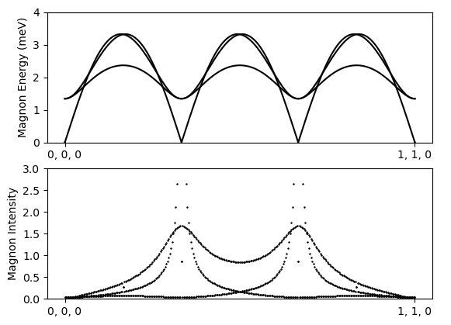
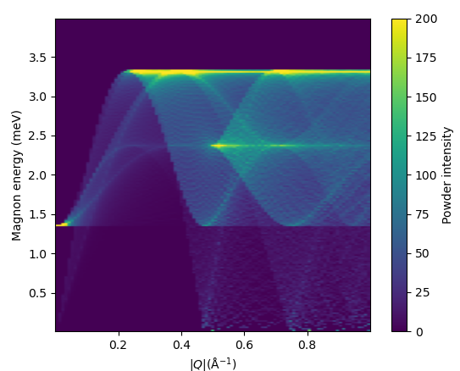
– Current status
Currently at the minimum viable product (MVP) stage:
  Major Matlab functionality implemented
  Calculations agree with Matlab
Python version has GUI (not in Matlab)
Calculations is not as performant (~30% slower)
Fitting not yet implemented.

Slide 4
– Future plans
Plan to release beta in mid-April (after Easter).
Plan to teach a data analysis workshop at FRM-II using PySpinW.
Continue with friendly user testing ready for full release in Summer.

Slide 5




isis.stfc.ac.uk
@ISISNeutronMuon
STFC
Notes:
The abstract pattern can be removed or repositioned if required. Be careful to ‘Send to Back’ so that it does not obscure any important information.

