Slide 1
State of muon data reduction and analysis STFC-PSI workshop 17/03/26
Dr Franz Lang

Slide 2
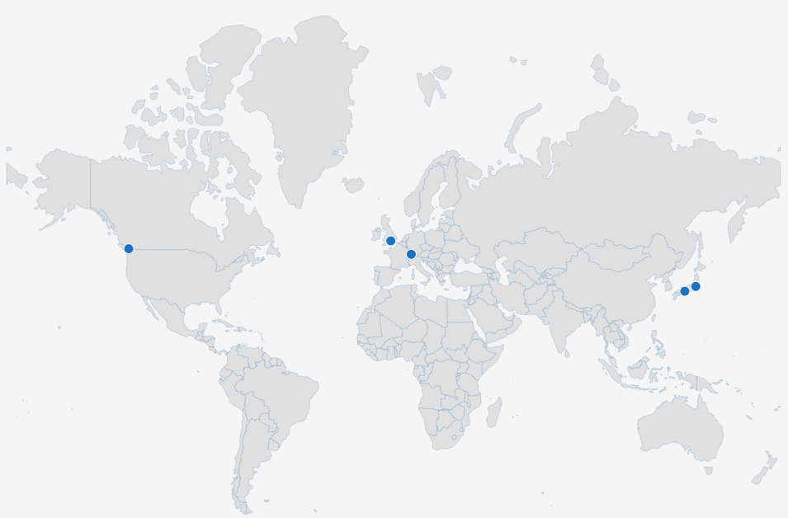
TRIUMF, Vancouver, CAN
ISIS, Didcot, UK
CSNS(!) & CIDS(?), CHN
J-PARC, Tsukuba, JPN
PSI, Villigen, CHF
MuSIC, Osaka, JPN
RAON(?), KOR
https://muonsources.org/muon-centres/

Slide 3
Heterogeneity – data formats and software
TRIUMF
MUD (MuSR Universal Data format)
musrfit (PSI)
msrfit (TU München + Triumf)
PSI
PSI-BIN (portable binary format)
MusrROOT (open file format)
any2many file format converter
musrfit
J-PARC, MuSIC
no information on their websites, or links dead
MUD?
ISIS
NeXus, fully HDF5 since 2025(?)
WiMDA
Mantid
NOTE:
only muon spin relaxation/rotation on left
negative muons not included in here
Eva, mudirac are valuable tools for potential collaboration opportunities
computational/simulation tools
DFT+mu, mufinder, etc
Aiida-lab, muon-galaxy
muspinsim, Quantum, etc

Slide 4
The challenge(s) for data reduction for muon spin relaxation/rotation
WiMDA
(mostly) single developer (Francis Pratt)
Delphi: developers scarce, Windows-only natively, GUI-only
cannot currently support as no Delphi developers available
research software maintenance fund application unsuccessful
musrfit
(mostly) single developer (Andreas Suter)
C++ and ROOT framework, only Unix(-like) OS natively
proprietary scripting language for input files
musredit GUI
Mantid
data reduction tool for ISIS Neutrons and Muons
difficult to serve neutron and muon workflows in same framework
muon data reduction typically small, expectation that analysis should be part of the software
does not support developments for muons since Q4 2024
large project, can take long for changes to be merged in
Moving to Event mode
ISIS: across all muon instruments, SuperMuSR first
PSI: tracking detectors

