Slide 1
AI-Driven Accelerator Control
Alexander Brynes | UKRI-STFC, ASTeC
On behalf of the ASTeC-ISIS Virtual Accelerator team
17th March 2026
Alexander Brynes | Senior Accelerator Physicist UKRI STFC Daresbury Laboratory alexander.brynes@stfc.ac.uk

Slide 2
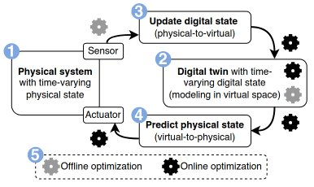
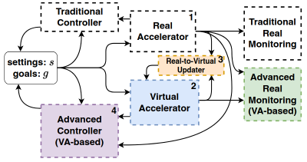
Digital Twin Structure: How and Why
Why do we need an accelerator digital twin?
How can we realize a digital twin?
Digital Twin Requirements
A wide range of factors influence the properties of beams in accelerators
A digital twin can be used for:
Predictive maintenance;
Anomaly detection;
Virtual diagnostics;
Automated tuning
Generate a virtual copy of the physical accelerator
Use a configurable simulation model to:
Read machine status
Model beam evolution
Write simulated outputs to virtual accelerator
Reproduce the physical machine state – as close as possible
Integrate seamlessly with the real control system
Modularity – to allow swapping out of modules
Configurable – to apply to multiple accelerators
Figures from Twinac paper, arXiv.2507.24093

Slide 3
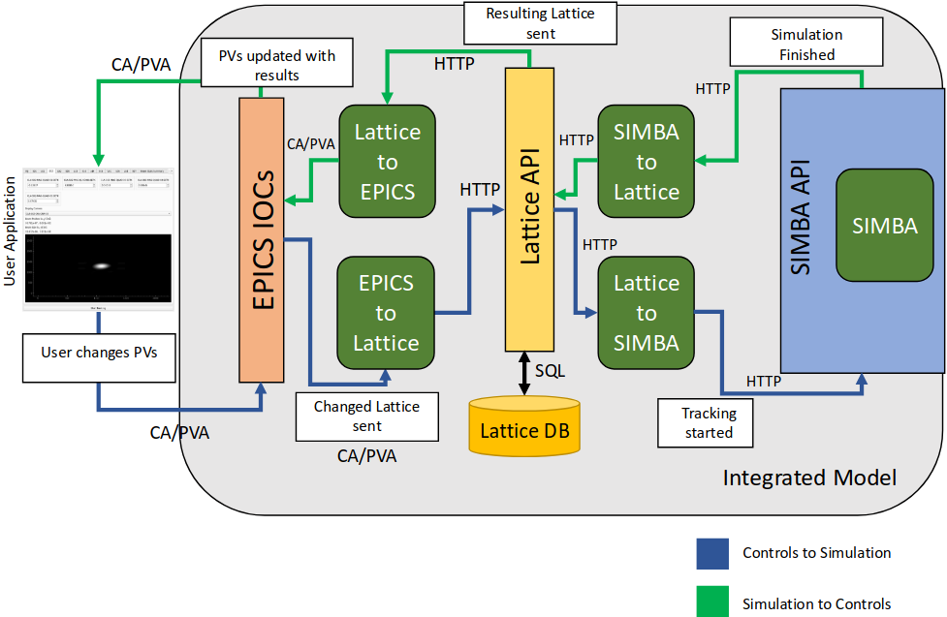
Digital Twin Architecture
Accelerator Lattice
The ground source of truth about the accelerator, containing:
Element definitions
Control system information
Based on LAURA format
Virtual Accelerator
Generated procedurally based on the lattice
Sends signals to update simulation model when changes are made
Simulation Model
Lattice Database
Can use particle tracking codes or AI models
Updates virtual control system with simulation outputs
Based on SIMBA package
Each run is associated with a UUID and saved to a database
To be used for model training

Slide 4
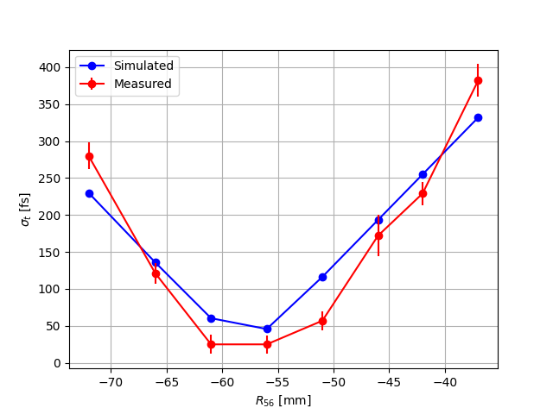
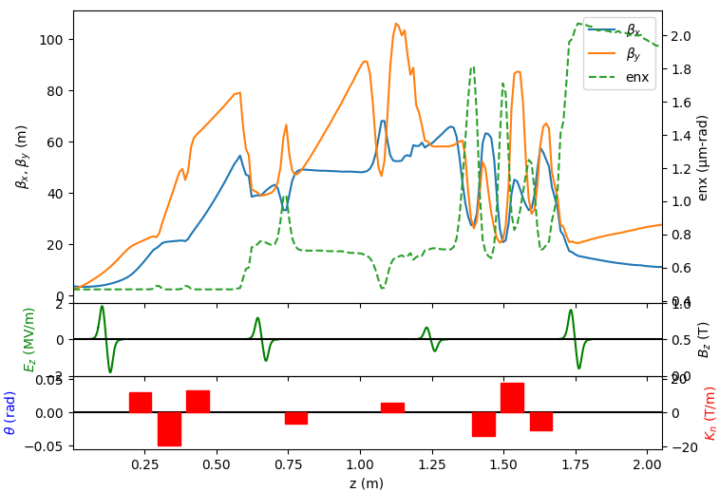
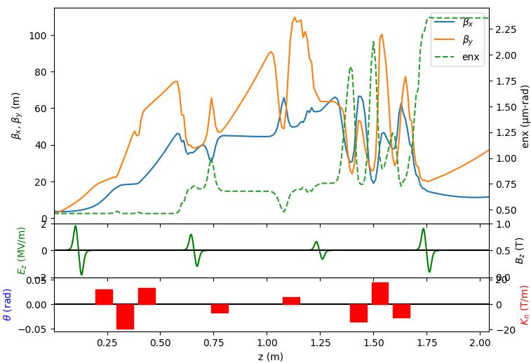
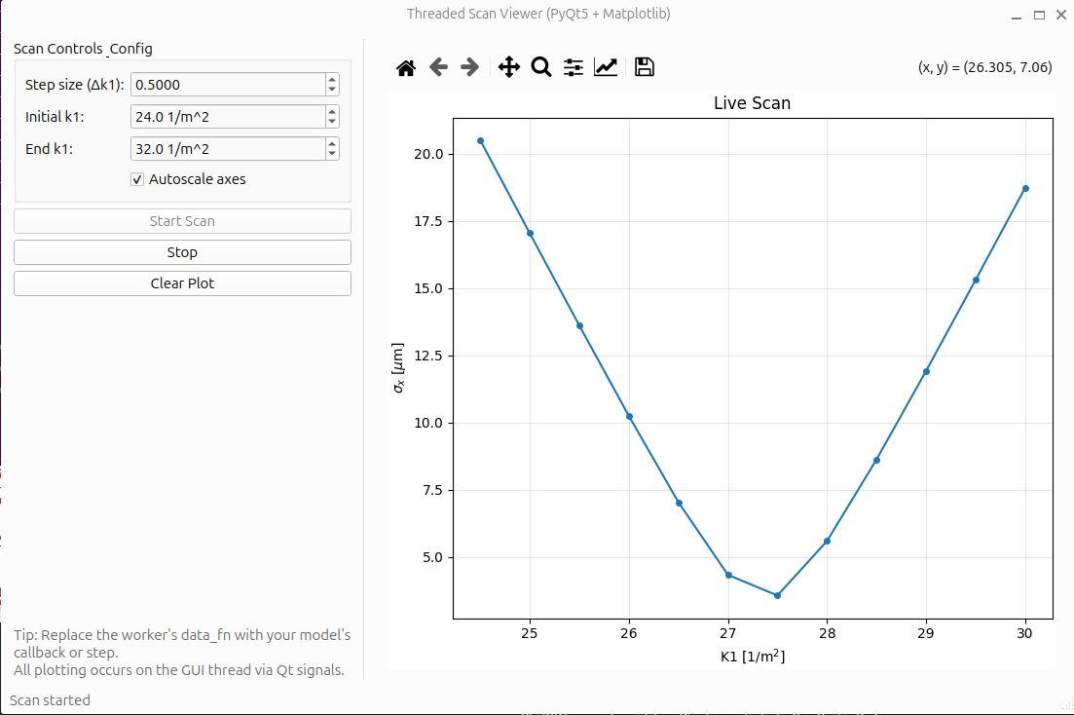
Deployment
Model Matching on CLARA
Real and virtual bunch length measurements in CLARA
Initial comparisons between real and virtual measurements taken on the CLARA accelerator are promising
Future model training will be based on results from the digital twin
Prototype measurement apps have been successfully deployed
ML Model Deployment and Training at ISIS
Conventional tracking codes and ML models can be used interchangeably in the digital twin
The lattice database can also be used for training models
Virtual Commissioning of LCLS-II
LCLS-II is under construction
Prototyping of virtual measurements can greatly expedite the commissioning process
ISIS MEBT tracking in the digital twin: ASTRA (left) and ML model (right)
Future Work
This architecture can be applied to any accelerator
Could be extended to cover user stations, photon transport, etc.
Virtual emittance measurement for LCLS-II

