Slide 1
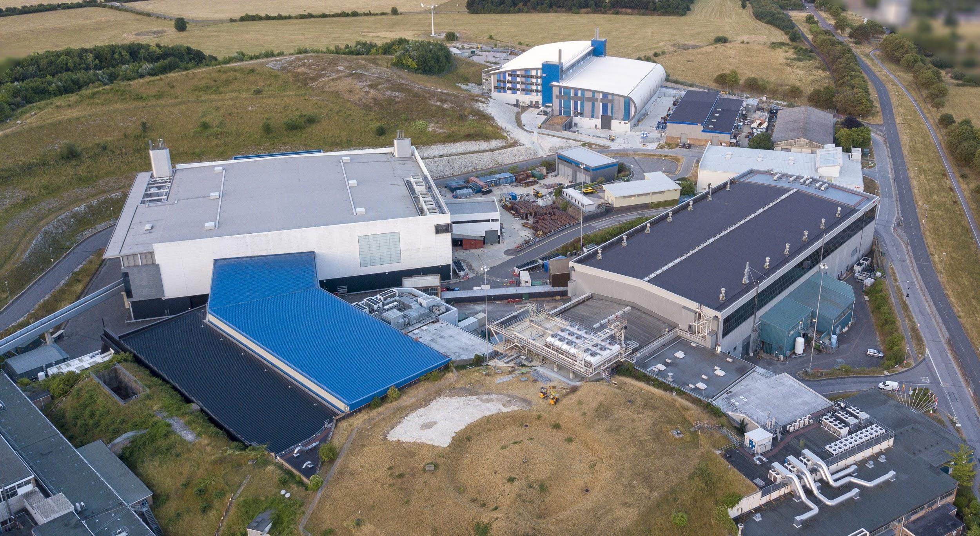


Notes:
To edit the background image, select ‘Format’ from the PowerPoint menu and ‘Slide Background’ from the drop-down menu. Within the new list of options that appears on the right of the screen, select the ‘File’ button under ‘Insert picture from’ and select your image from your file browser. Please remove or amend the image credit if you are using a different image to the one provided.

Slide 2

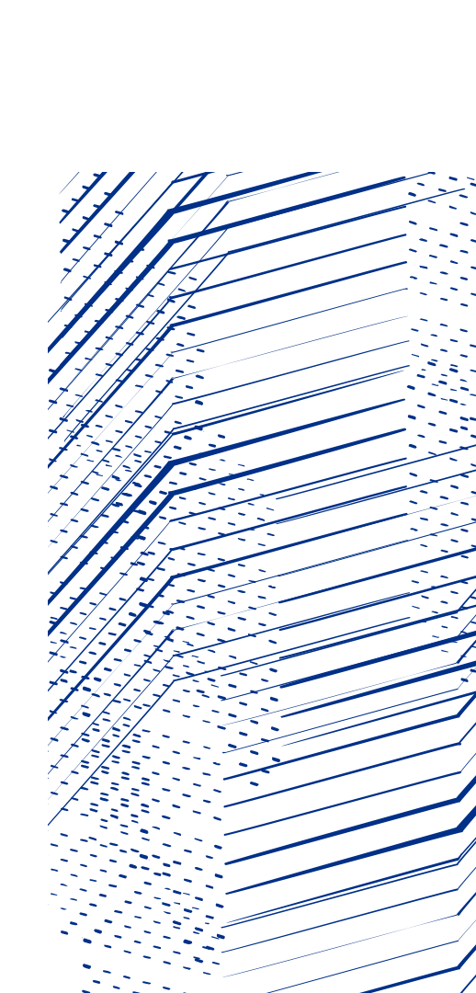

Texture Analysis in Mantid for ISIS and PSI
Dr Andy Bridger
Notes:
The abstract pattern can be removed or repositioned if required. Be careful to ‘Send to Back’ so that it does not obscure any important information.

Slide 3
Introduction
I will talk about the collaboration between ISIS and PSI on the texture analysis data reduction work I have been doing.
I will start by, hopefully very briefly, outlining what we do for texture analysis to motivate the following section.
I will then cover these reasons why I think this experiment is good for cross-facility software collaboration.
Noting here the main reason for collaboration that doesn’t fit into the narrative that follows is sharing of expertise!

Slide 4
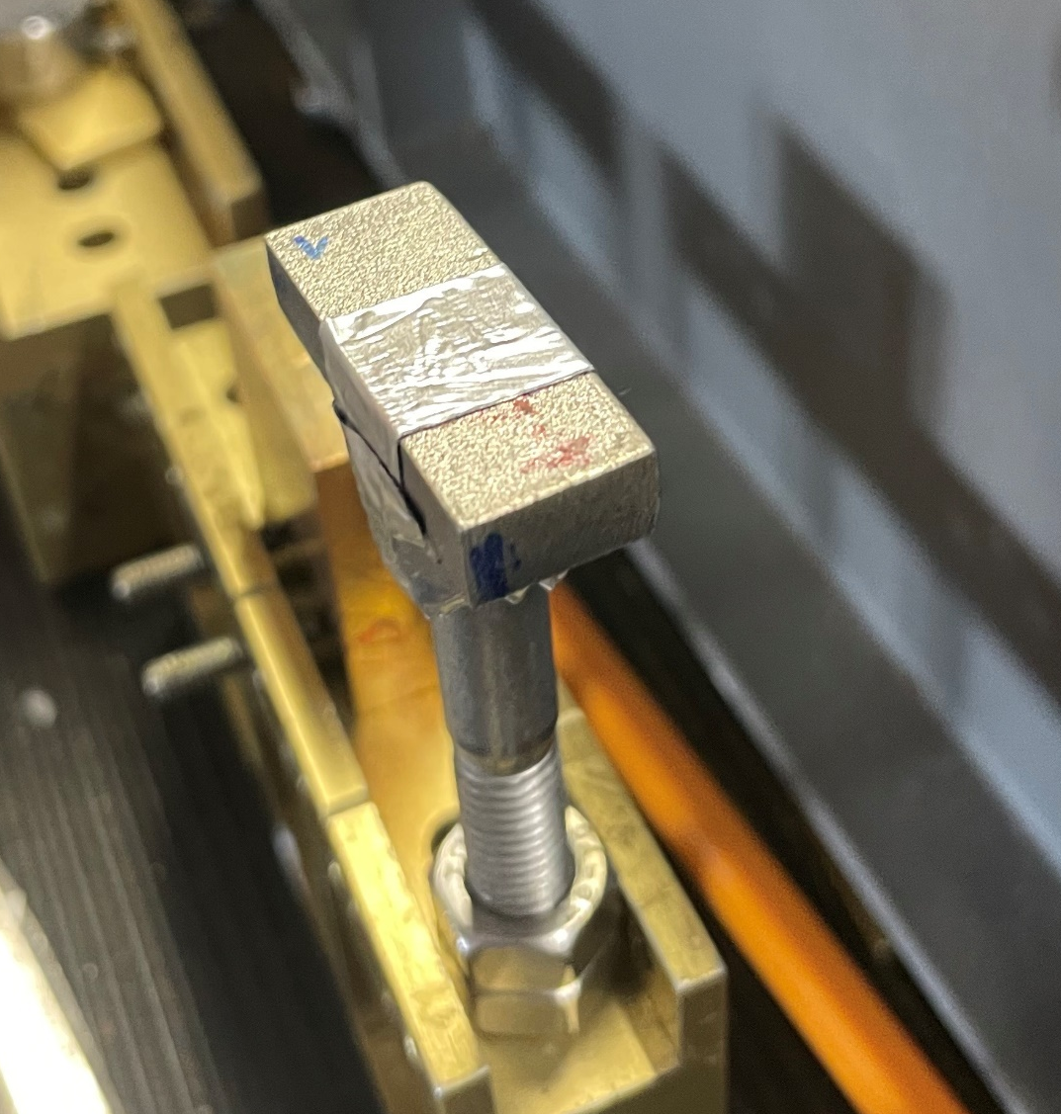
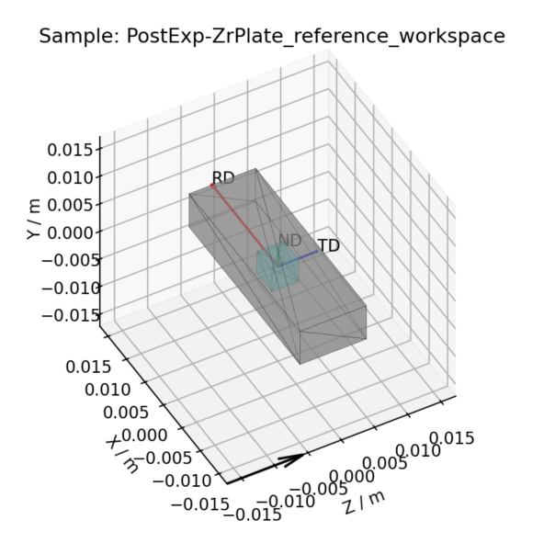
Brief Introduction to Texture
Fundamentally, you have a thing. You want to know how the crystal structure is orientated in that thing
ND
RD
TD

Slide 5
Brief Introduction to Texture
For a given experimental geometry, kd –ki = K, we know we will see intensity in a diffraction pattern, for a specific hkl plane, when experimental diffraction vector is aligned with the plane normal (i.e. K = Q_{hkl})
Incident beam, ki
Q_{hkl}
K
-ki
Diffracted beam, kd
Notes:
You’ll get a diffraction signal from a crystal if it is orientated in a very specific way relative to the K vector (which is defined by your beam source and detectors)

Slide 6
Brief Introduction to Texture
So by taking experimental data with our sample in different orientations, we can probe different K vectors relative to our sample axes
ND
Incident beam, ki
RD
K
TD
Diffracted beam, kd

Slide 7
Brief Introduction to Texture
Sample rotated, now K is aligned along ND
Incident beam, ki
ND
K
RD
TD
Diffracted beam, kd

Slide 8
Brief Introduction to Texture
And so by looking at the intensity of the corresponding hkl peaks, we can tell how the crystals are orientated relative these sample directions
ND
Intensity
RD
K
TD
(region of spectra corresponding to Q_{hkl} reflection)

Slide 9
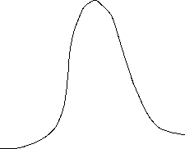
Brief Introduction to Texture
ND
Intensity
K
RD
(region of spectra corresponding to Q_{hkl} reflection)
TD

Slide 10
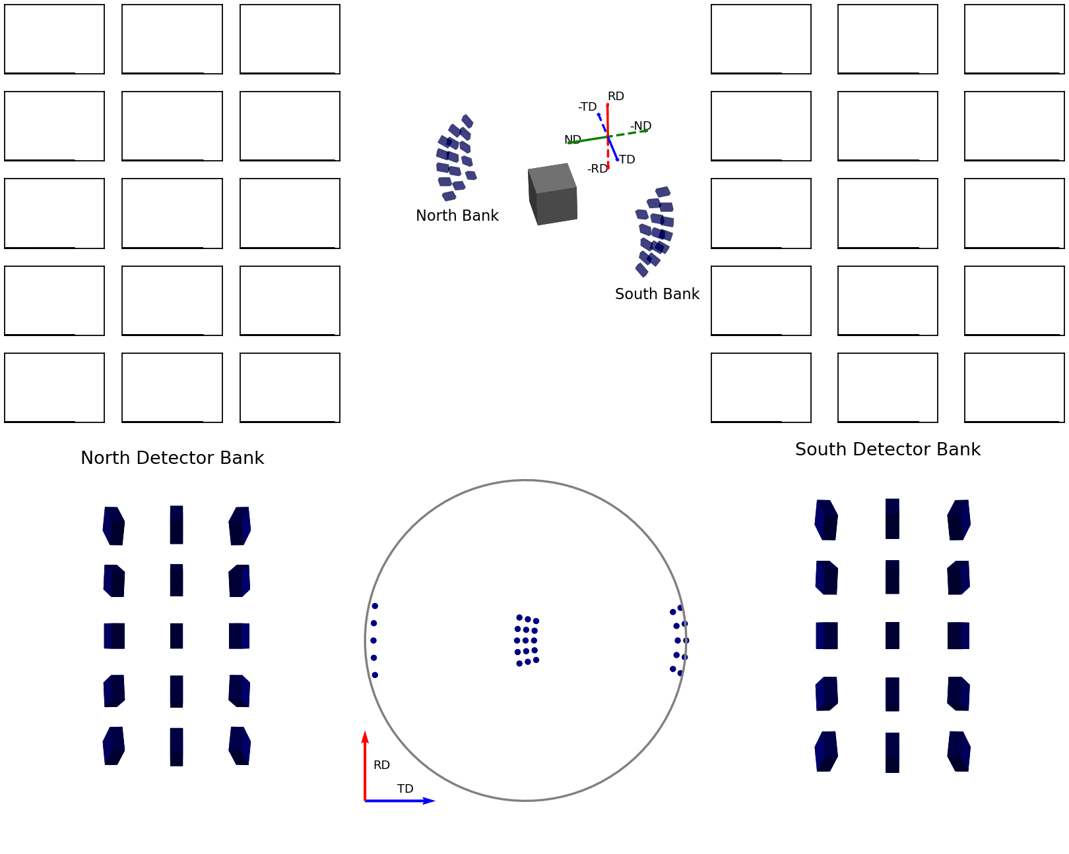
Brief Introduction to Texture
For a single experimental run, depending on which detectors we use to create each diffraction pattern, we can sample different K vectors at once

Slide 11
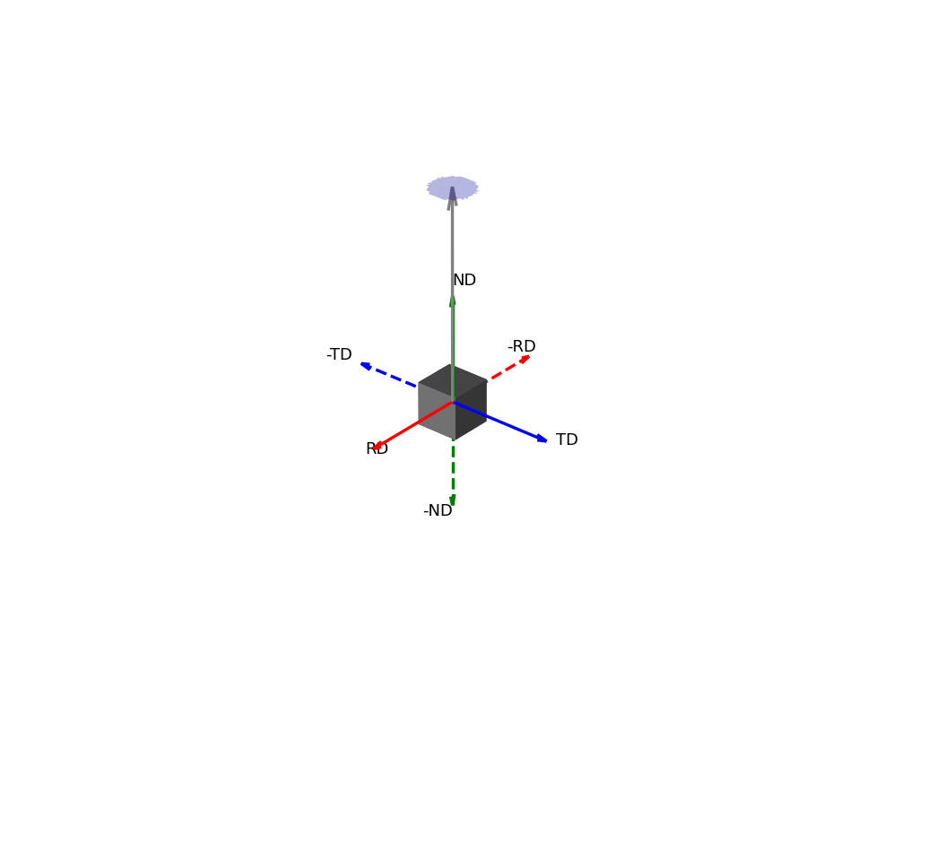
How do Texture Experiments Work?
In the extreme case, where you sample all possible K vectors, you could get a value for the diffracted intensity in all directions
Which can be shown as intensities on the surface of a sphere

Slide 12
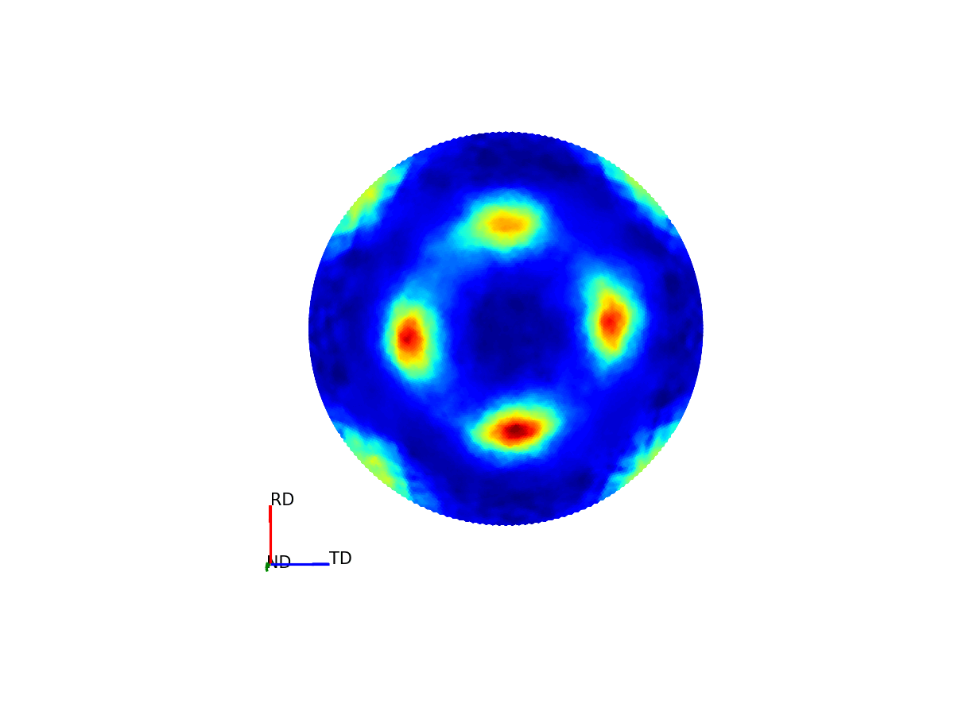
What is a pole figure?
To make these pole figures more useable, it is typical to project this 3D sphere down into a 2D image (much like how maps act as a 2D version of globes)

Slide 13
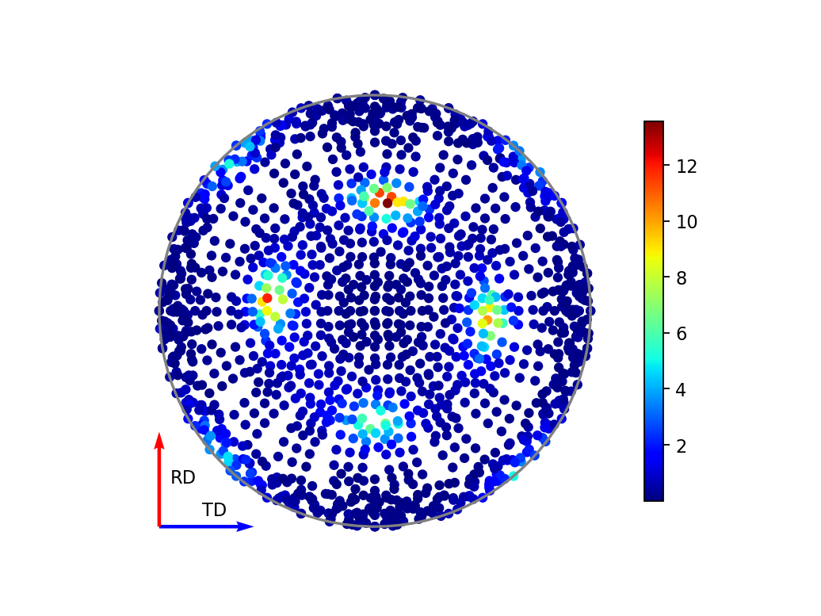
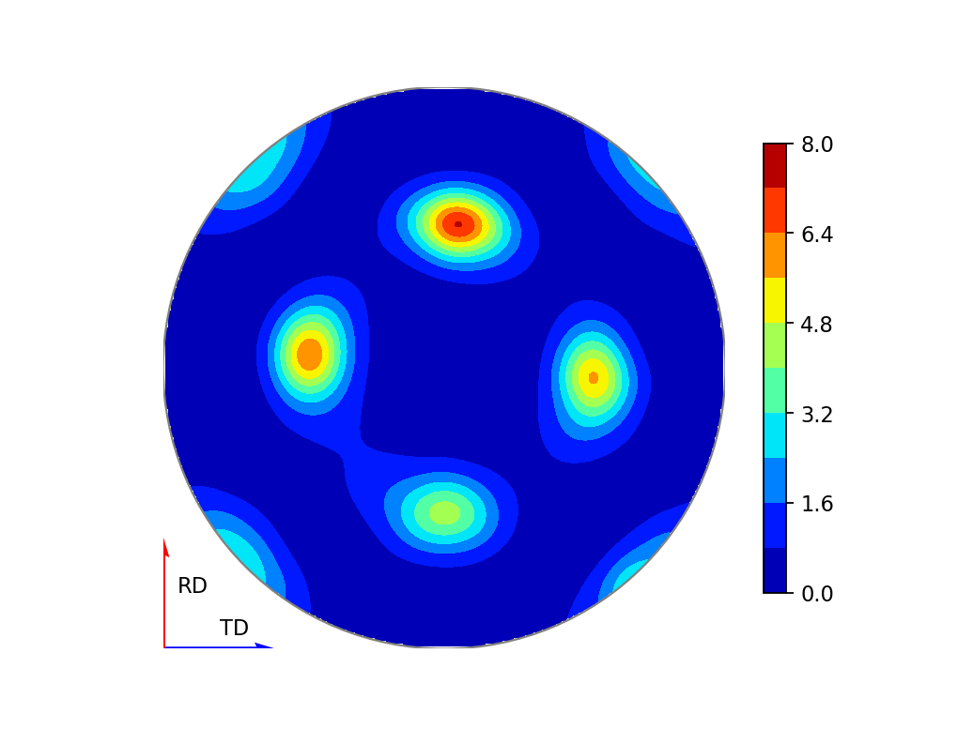
What is a pole figure?
Practically, you cannot collect data at every point on the sphere, so you end up only collected a discrete set of points, but these can still be projected into the 2D pole figure in exactly the same way
Experimental Pole Figure
(individual detector scatter plot)
Experimental Pole Figure
(interpolated contour plot)

Slide 14
Why collaborate?
The result of the texture analysis we want to do: produce these pole figures which contain information on the intensity of a given diffraction peak in some particular orientation relative to the sample axes
A lot of this work is actually pretty instrument agnositic!

Slide 15
Why collaborate?
For a given point we need to know:
What is the K vector being sampled? (orientation of the incident and diffracted beam for the spectrum associated with this point)
What is the orientation of this vector relative to the sample axes? (how is the sample orientated for this run)
What is the intensity of the hkl peak in this diffraction pattern?

Slide 16
Why collaborate?
What is the K vector being sampled? (orientation of the incident and diffracted beam for the diffraction spectrum associated with this point)
We need an understanding of the instrument and detector geometries – Instrument Dependent but not something that changes very often!

Slide 17
Why collaborate?
What is the orientation of this K vector relative to the sample axes? (how is the sample orientated for this run)
We need an understanding of sample geometry for different experimental runs and coordinate transformations to get K vectors relative to sample reference frame. This is almost entirely instrument agnostic

Slide 18
Why collaborate?
What is the intensity of the target peak in this diffraction pattern?
We need to be able to access a diffraction pattern (potentially instrument agnostic, may or may not be straightforward depending on the instrument)
Ideally, correct the patterns for all orientation-dependent variations coming from non-texture effects like attenuation, detector efficiencies, flux dependence etc. (will be technically instrument dependent but a lot of the machinery for individual steps can be reused, pipelines are then set)
Fit the peak intensity in the patterns (instrument dependent peak shapes, but similarly a lot of reusable machinery and set pipelines)

Slide 19
Why collaborate?
Lots of the work is reusable, especially when you do this in Mantid, which already has a lot of capabilities written in a way that they can be used across different instruments

Slide 20
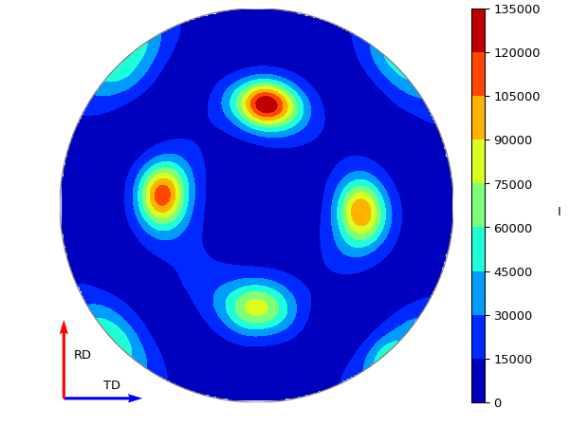
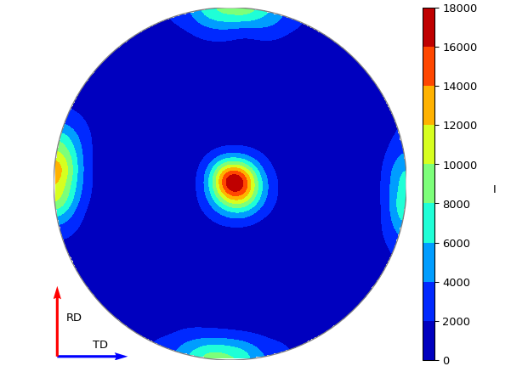
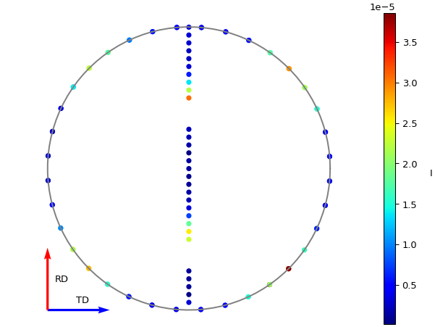
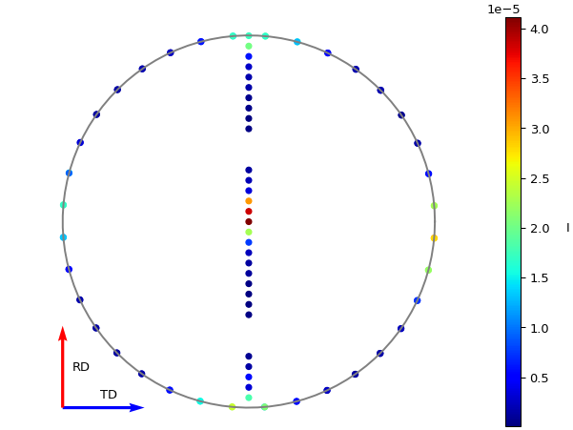
Example
ENGINX
POLDI

Slide 21
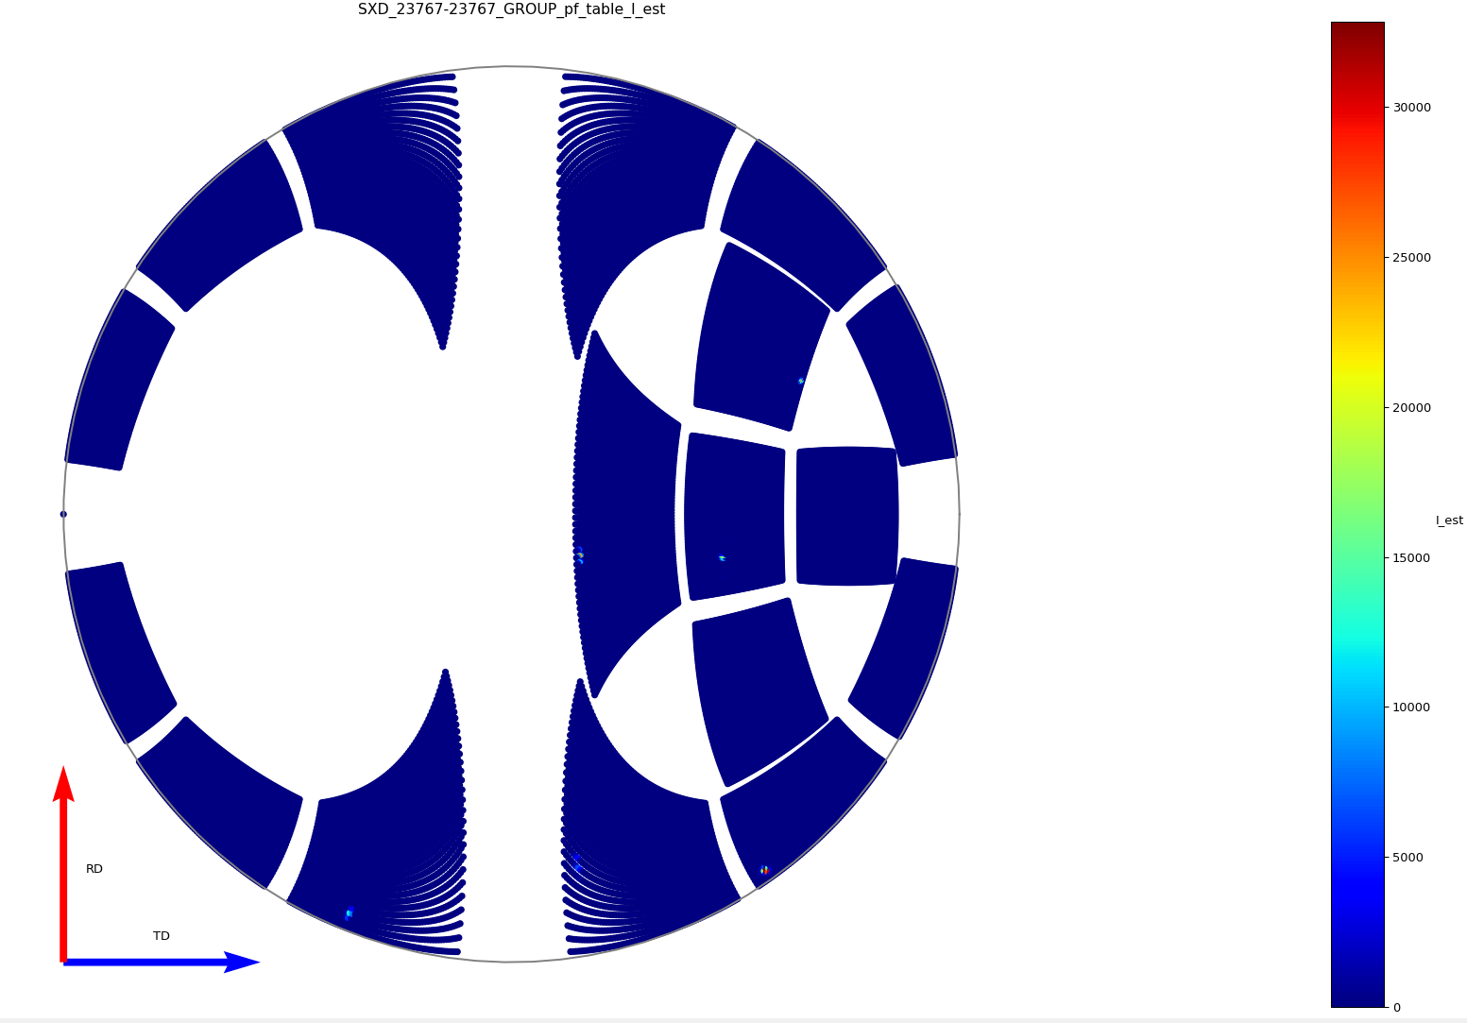
Example
Can be fairly trivial to set up for new instruments. This only required tweaking the existing user scripts

Slide 22
Why collaborate?
The scope for my project is for this to be comprehensively implemented for ENGINX and IMAT at ISIS and POLDI at PSI
Why not try and use it for more? (GEM at ISIS, DMC at PSI?)
Are there other opportunities to take this approach and collaborate on software for some other experimental setups?

Slide 23

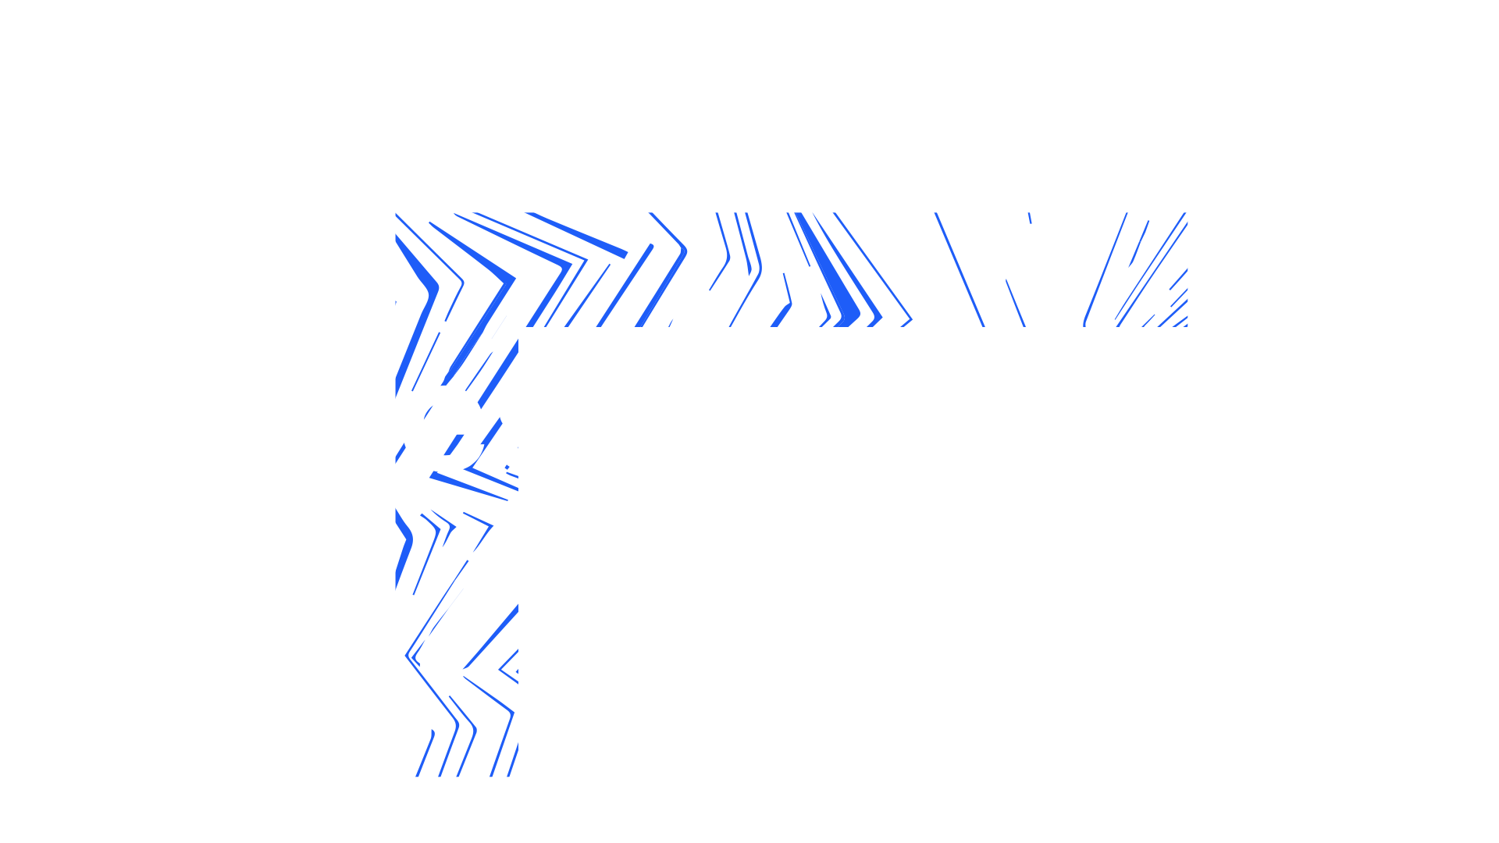

Notes:
The abstract pattern can be removed or repositioned if required. Be careful to ‘Send to Back’ so that it does not obscure any important information.

Slide 24




isis.stfc.ac.uk
STFC
Notes:
The abstract pattern can be removed or repositioned if required. Be careful to ‘Send to Back’ so that it does not obscure any important information.

