Slide 1
ISIS Data
Martyn Gigg – ISIS Computing Division
STFC-PSI Collaboration Meeting
17/03/2026

Slide 2
Outline: Two Topics
Operational Analytics
MNeuData: Next-generation beamline data pipeline

Slide 3

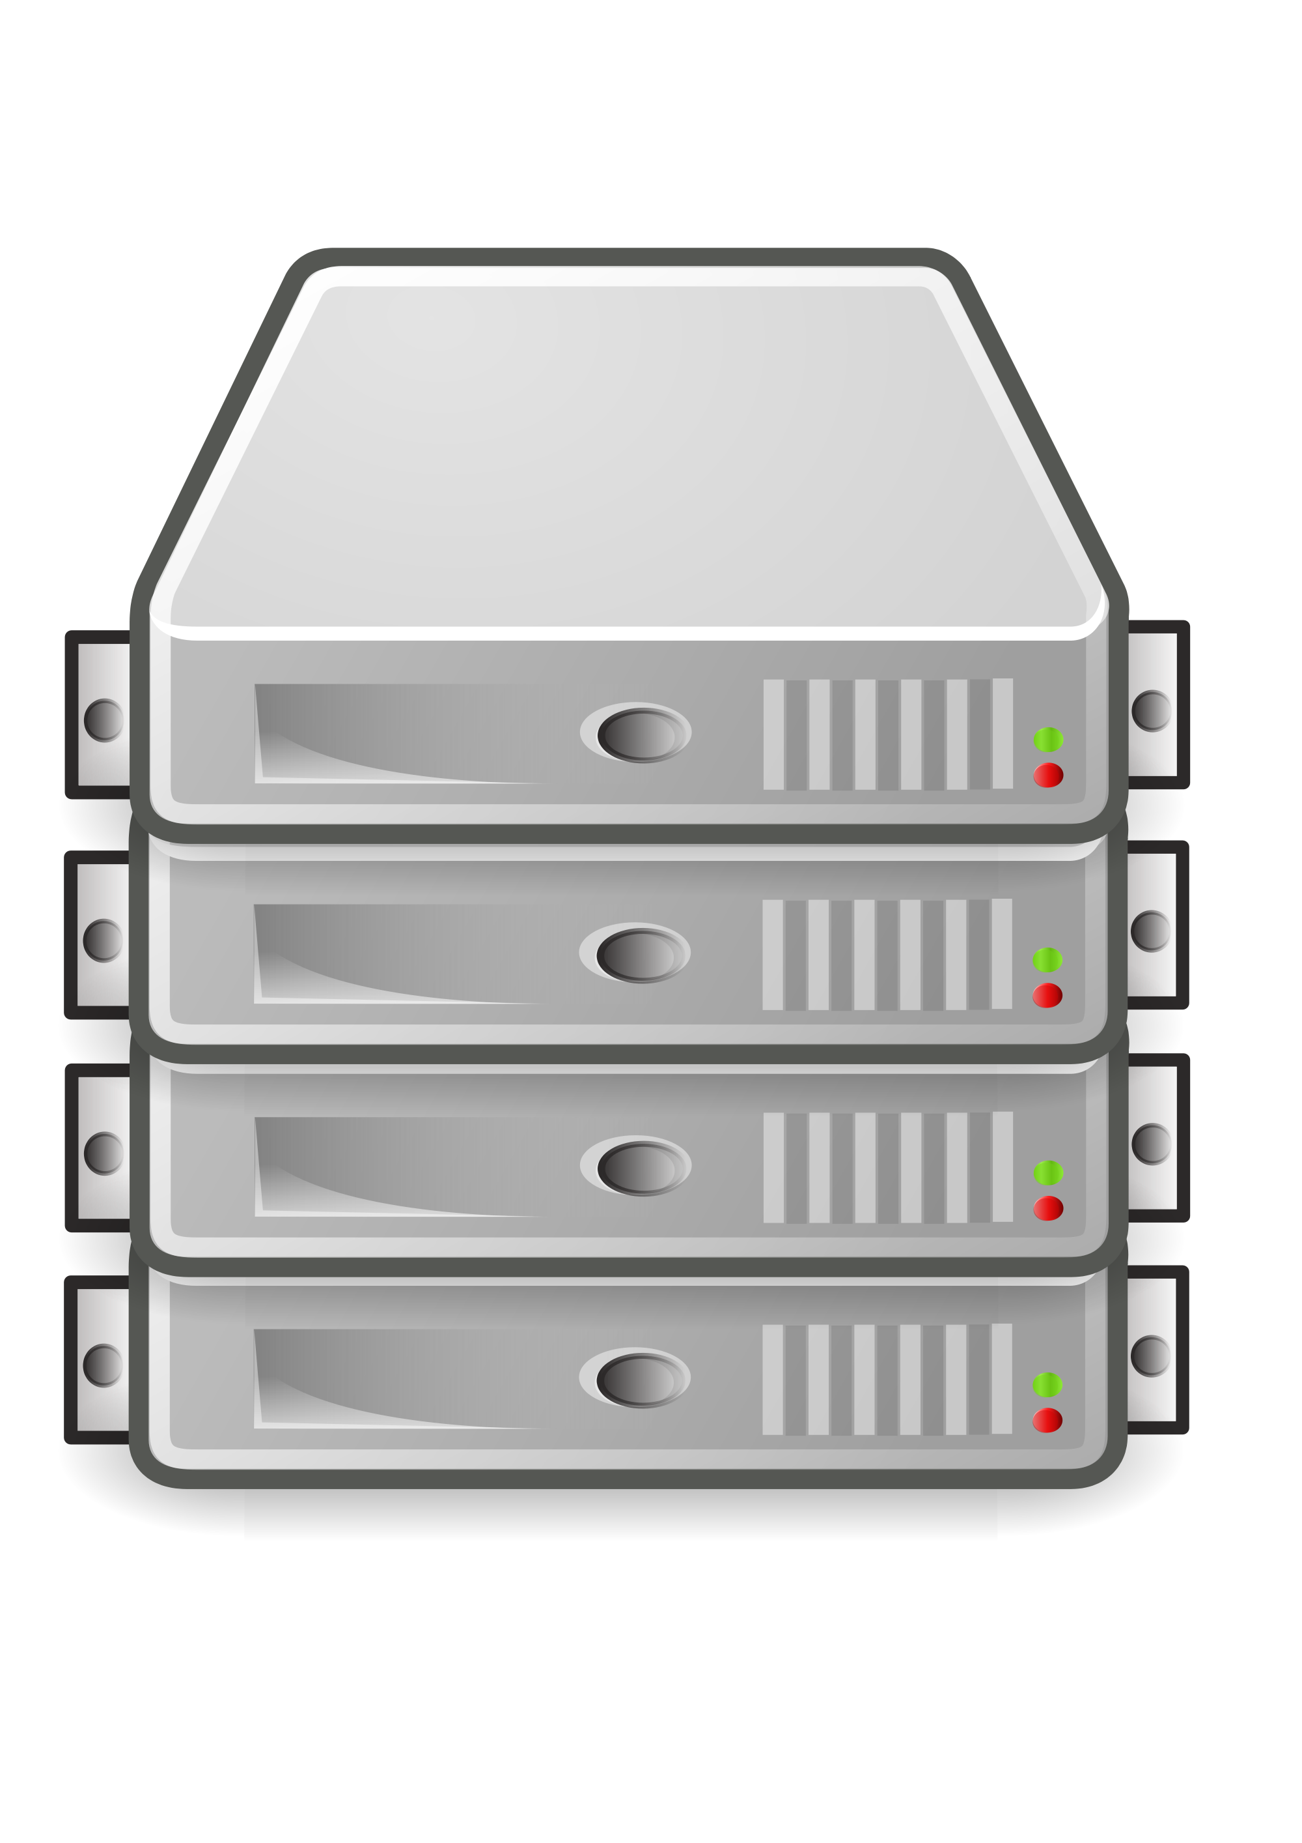

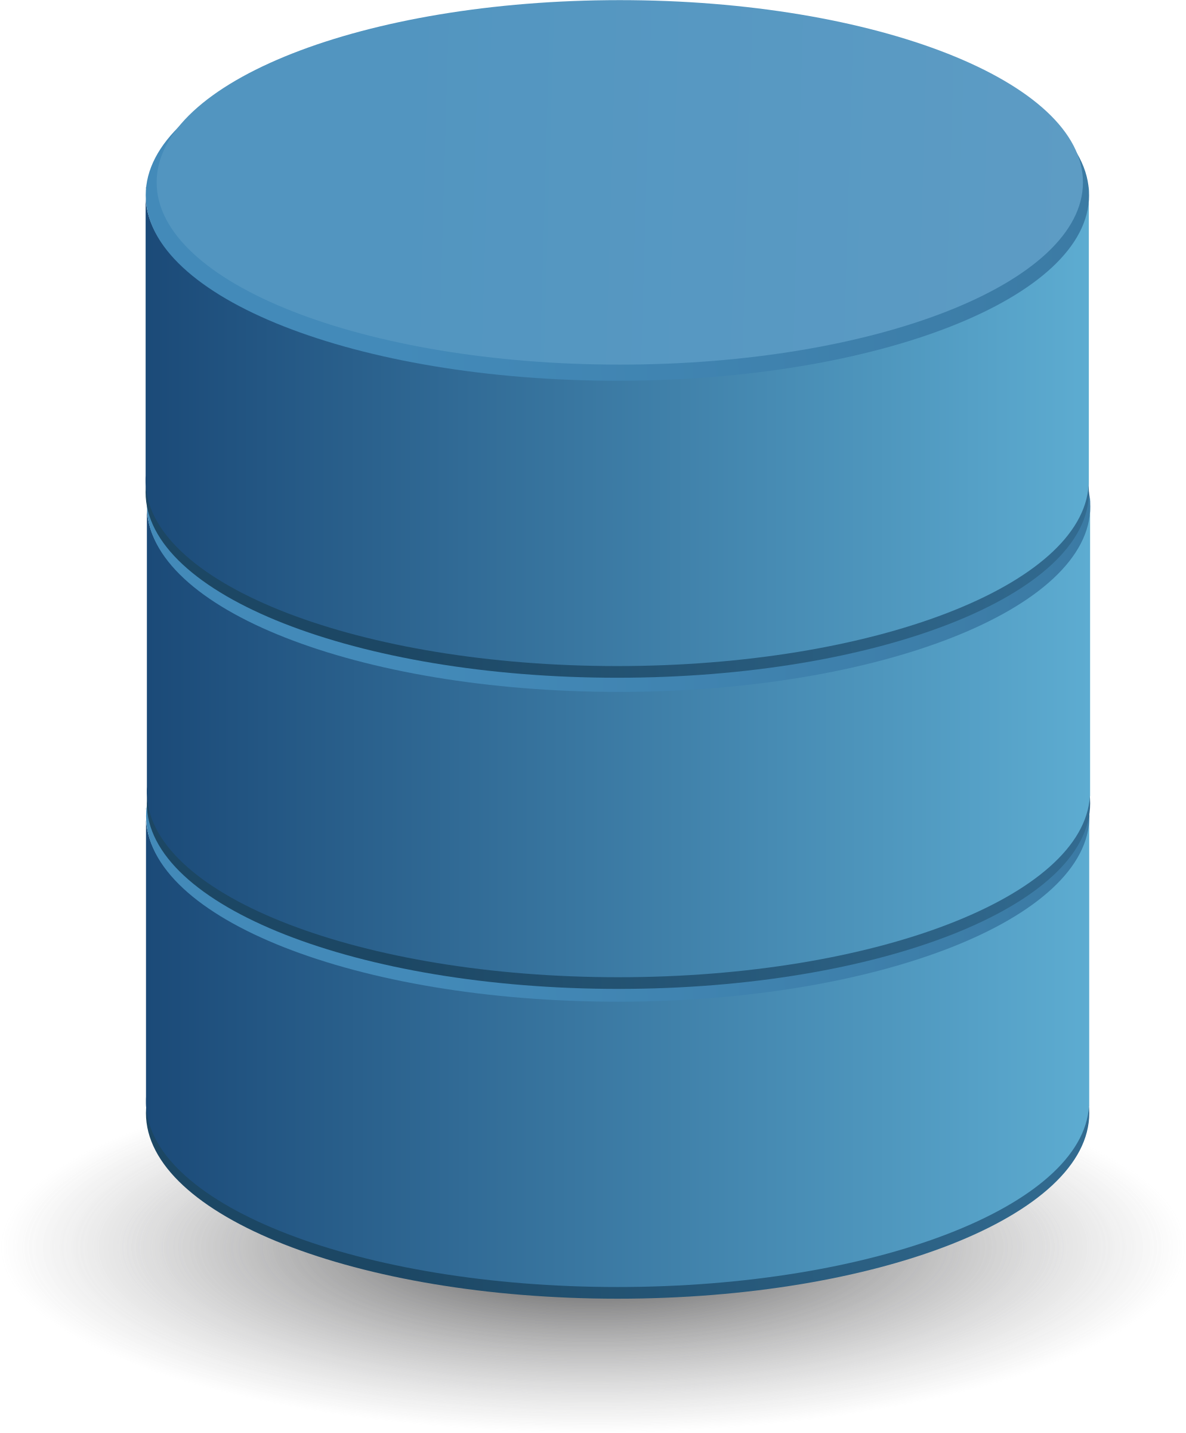


Plenty of data sources (TBs of data)
EPICS
Vista
Excel
Influx/Grafana Dashboards
Pheobus
Opralog
Operational Analytics
DWS Live Viewer
CMMS
Crew logs
Diagnostics
Plant ops
…
Control system channels
Beam simulations
Machine physics
…
Images by unknown author. Licensed under CC BY-NC
Notes:
Plenty of data
Each system supporting the operation in its own area and doing that well.
What about when we want to ask cross-cutting questions?

Slide 4
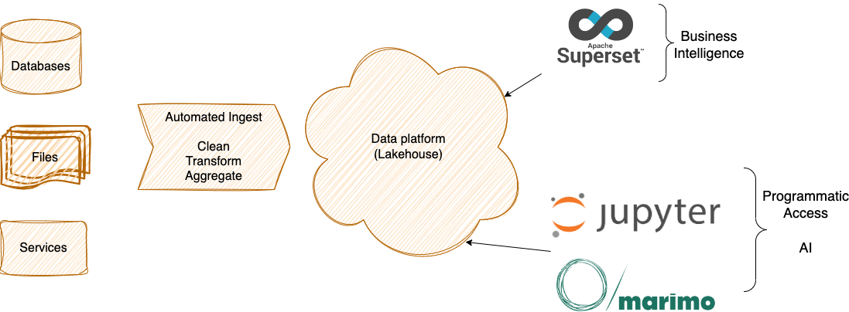
Apache Iceberg-based Data Platform
“Enable seamless access to up-to-date, cleaned & pre-processed data”

Slide 5


Slide 6

Concept
... review, define and implement transformative change in the instrument data ecosystem; data generation, pipelines and architecture.
Events time-tagged
(GPS Timing Source)
A streaming, event-based world.
Facility
(PPP, Δt…)
Run file generation
Filtering Tools
(Data & Diagnostics)
Detectors
(n, µ, traces…)
Data broker
& related data infrastructure
Data reduction/analysis
Motion Control
(xyz, robot …)
Live
Visualisation Tools
(Data & Diagnostics)
Sample Environment
(T, Laser, RF…)
Any data producer !
Long-term storage

Slide 7
Thank you

