Slide 1
Nuclear data in the UK, an update
Nuclear Physics Forum 2026
Luigi Capponi
Not protectively marked

Slide 2
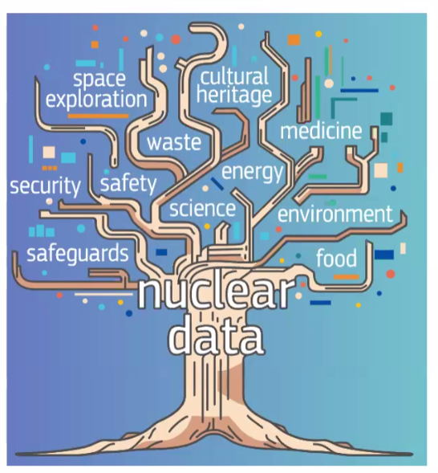
Nuclear data: the root of many nuclear applications
Computational modelling is dependent on data that describes the physical parameters of nuclides and their nuclear reactions
Based on experimental measurements; tens of thousands of measurements have been made experimentally throughout the years to determine such physics data
Processed through the nuclear data lifecycle and international collaborative projects these have been used to build nuclear data libraries.
OFFICIAL:Commercial
Image from A.Plompen, JEFF meeting

Slide 3


Slide 4
Some points from the UKNSF
The United Kingdom Nuclear Science Forum (UKNSF) meets twice per year to discuss items and issues of importance to UK nuclear data users, and to review nuclear data for applications in the UK nuclear industry.
It works as a link between industry, academia, and the international nuclear data bank
The PLANET DFA is a fantastic opportunity to upskill UK graduates in nuclear data sourcing, processing, and applications.
UKNNL is proposing a workshop to form the next generation of UK nuclear data experts and evaluators. This should be a combined effort between the UK institutions interested in nuclear data.
The AWE should kick off soon its nuclear data centre of excellence, that should provide the needed wind to the nuclear data sails.
The US has joined the NEA databank community. This means that software like MCNP and SCALES could be distributed through the NEA in the future.
Some exciting work in nuclear theory applied to nuclear data modelling.
There is a common call from the US and Europe for better nuclear data on graphite structural damage and thermal neutron scattering law.

Slide 5
Few additional updates
UKNNL is involved with CEA in updating the fission yield section of the JEFF libraries using the new experimental results, for example fission yield studies from Lohengrin instrument at ILL (check D. O’Donnell presentation yesterday).
UKNNL are hosting in support of DESNZ CSA, a first workshop that will explore nuclear science challenge needs for Quantum Computing. There is a general interest in applying advanced computational techniques and machine learning to nuclear data. This can be an especially useful tool for evaluators.

Slide 6
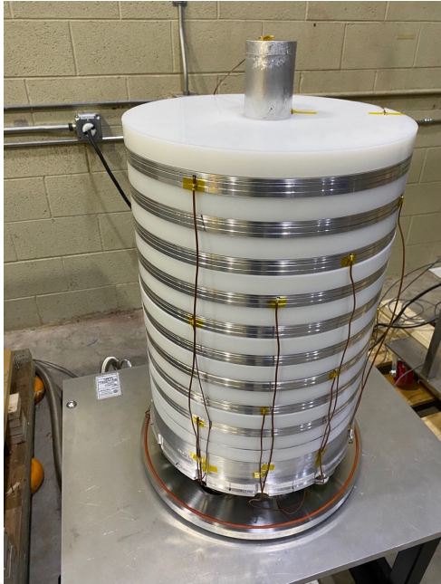
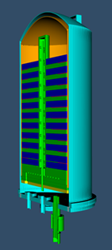
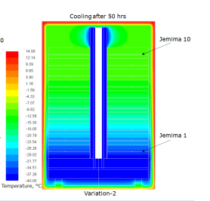


Low Temperature Critical Benchmark Experiment
UKNNL are collaborating with Lawrence Livermore National Lab to complete a world‑first low temperature critical experiment (IER-479), UKNNL input lead by Alfie O’Neill
This will be used to validate criticality safety codes and nuclear data temperatures down to ‑40°C; required to demonstrate compliance with IAEA Transport Regulations
Consists of a stack of HEU plates, with varying thicknesses of polyethylene moderator, aiming for different neutron energy spectrum configurations.
UKNNL provided thermal modelling to aid the experimental design, and will be an Independent Reviewer on the ICSBEP Benchmark Evaluation
The design used novel TSL data generated by North Carolina State
Experiment is due to take place in October 2026
Notes:
Images are:
ICSBEP handbook cover where the evaluation will be published
CAD Model of Fuel Stack inside vacuum chamber – experiment is run at very low vacuum to prevent condensation / ice formation as this would have unknown thickness and location.
Screenshot of thermal modelling showing temperature model after 50 hours of cooling – an interesting aspect is that we use liquid coolant to reach this temperature and we want a uniform distribution, but we have poor thermal conduct and all the polyethylene layers are good insulators. We also want to drain this coolant before taking the experiment critical to remove uncertainties on the coolant material spec and how much is present within the configuration.
Photo of the main fuel stack, this is from surrogate thermal testing, so uses aluminium instead of HEU plates, and you can see some of the thermocouples wired up.

Slide 7
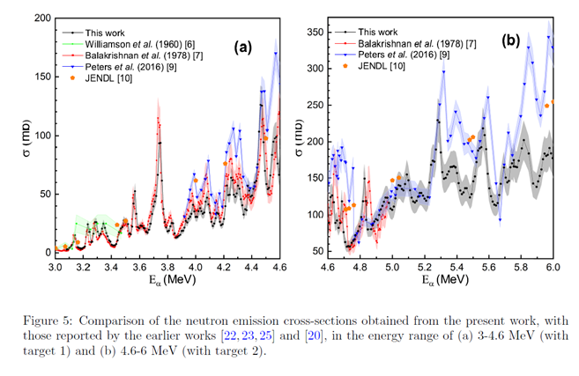
A typical nuclear data workflow, the ¹⁹F(α,n) cross section
A cross-section measurement was performed at Bucharest by a collaboration including NPL.
They found some big discrepancies with the literature values.
They came to UKNNL asking, what is the impact of the new cross section?
In short, we have no idea….
Then, we are planning a simulation work of a molten salt reactor (to have plenty of ¹⁹F).
We will use the old and the new cross sections to try to quantify the difference in the neutron economy of the reactor.
This is challenging as implies taking into consideration also secondary and tertiary emissions.

Slide 8
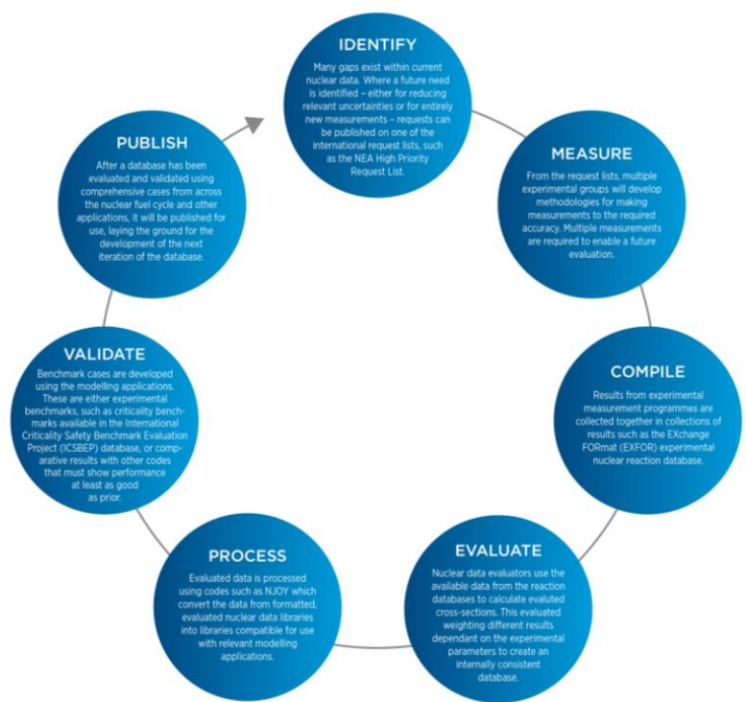
Summary
Nuclear data are the root of reactor and nuclear reaction modelling
There is an expected renaissance of nuclear data in UK
There is a general need of forming people and fund nuclear data studies
UKNNL is a strong player in the field and involved in many nuclear data related activities
If you want to know more, check the NEA Nuclear Data High Priority Request List (HPRL) or consider joining the UKNSF

Slide 9
Thank you

