Slide 1
Next Generation TAS for Decays and Reactions
Dr. Matthew Williams
STFC Ernest Rutherford Fellow

Slide 2
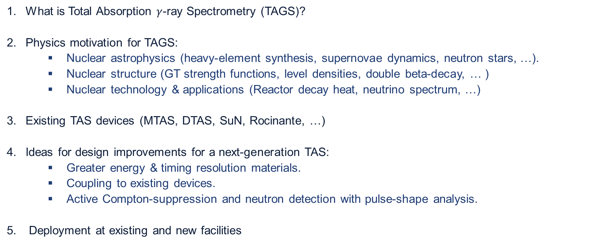
Outline
What is Total Absorption $γ$-ray Spectrometry (TAGS)?
Physics motivation for TAGS:
  Nuclear astrophysics (heavy-element synthesis, supernovae dynamics, neutron stars, …).
  Nuclear structure (GT strength functions, level densities, double beta-decay, … )
  Nuclear technology & applications (Reactor decay heat, neutrino spectrum, …)
Existing TAS devices (MTAS, DTAS, SuN, Rocinante, …)
Ideas for design improvements for a next-generation TAS:
  Greater energy & timing resolution materials.
  Coupling to existing devices.
  Active Compton-suppression and neutron detection with pulse-shape analysis.
Deployment at existing and new facilities

Slide 3
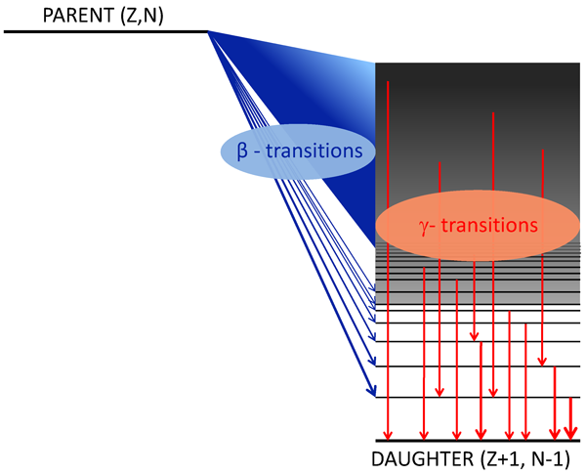
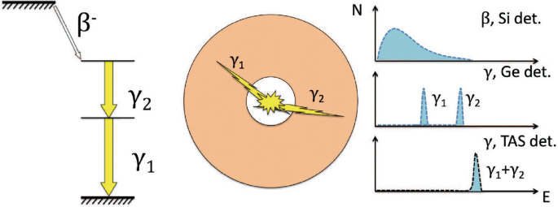
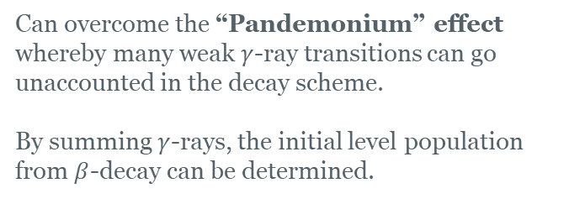
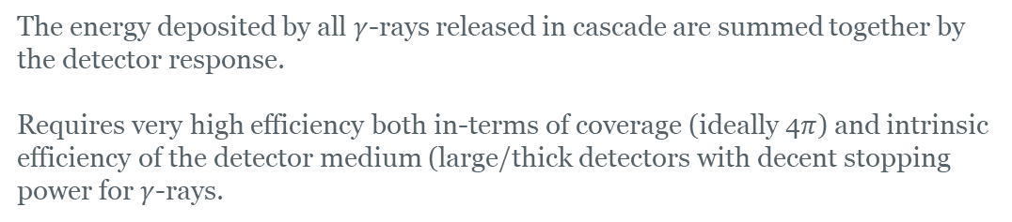
Total Absorption $γ$-ray Spectroscopy
The energy deposited by all $γ$-rays released in cascade are summed together by the detector response.
Requires very high efficiency both in-terms of coverage (ideally 4$π$) and intrinsic efficiency of the detector medium (large/thick detectors with decent stopping power for $γ$-rays.
Can overcome the “Pandemonium” effect whereby many weak $γ$-ray transitions can go unaccounted in the decay scheme.
By summing $γ$-rays, the initial level population from $β$-decay can be determined.
Note: this is a very simplified picture for an ideal detector. In reality, interpretation of TAGS spectra requires careful treatment of the response function, possible contamination, neutron interactions etc…
(fertile ground for leveraging new AI/ ML tools).
A. Algora, et al., Eur. Phys. J. A 57, 85 (2021).

Slide 4
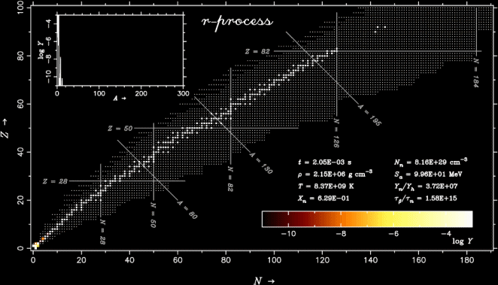
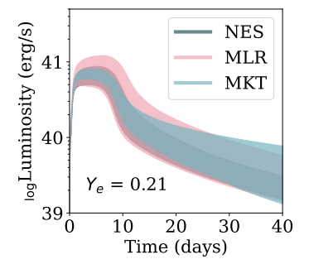
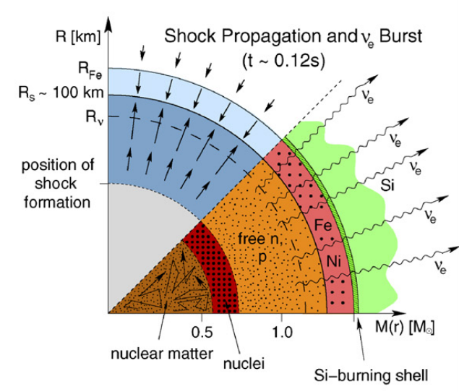
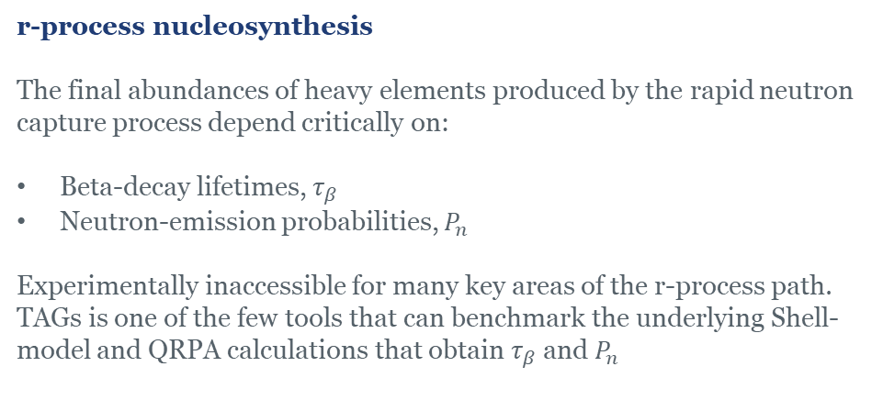
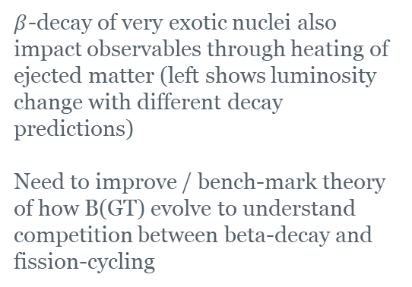
Nuclear Astrophysics
r-process nucleosynthesis
The final abundances of heavy elements produced by the rapid neutron capture process depend critically on:
Beta-decay lifetimes, $τ_{β}$
Neutron-emission probabilities, $P_{n}$
Experimentally inaccessible for many key areas of the r-process path. TAGs is one of the few tools that can benchmark the underlying Shell-model and QRPA calculations that obtain $τ_{β}$ and $P_{n}$
Nuclear heating in Astrophysical Environments
Core-collapse supernovae dynamics
$β$-decay of very exotic nuclei also impact observables through heating of ejected matter (left shows luminosity change with different decay predictions)
Need to improve / bench-mark theory of how B(GT) evolve to understand competition between beta-decay and fission-cycling
Supernovae dynamics in the immediate lead-up and aftermath of the core-bounce are highly sensitive to weak interaction rates.
Typically bench-marked by charge exchange reactions. But these data are experimentally challenging for radioactive nuclei.

Slide 5
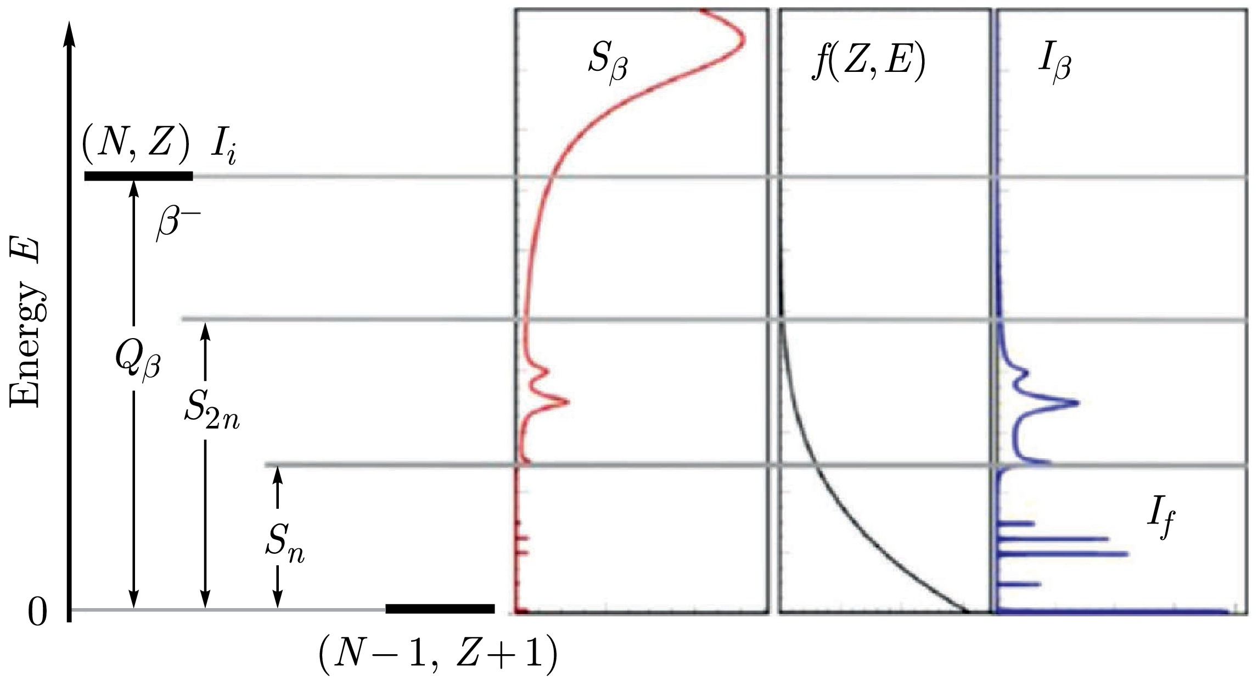
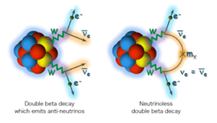
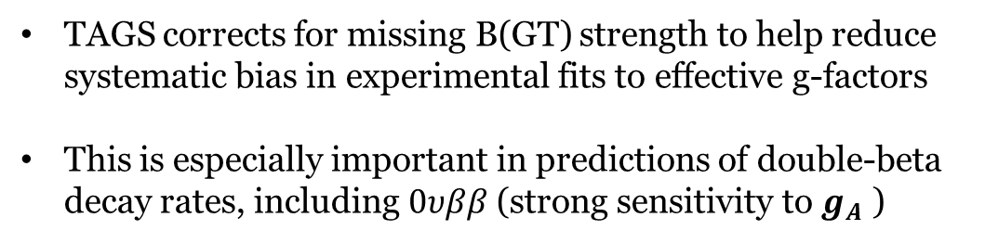

Nuclear Structure & Theory
TAGS is one of the best tools to obtain the true beta-decay strength function.
Probe of nuclear deformation and shape co-existence since B(GT) strength in the daughter is characteristic of the shape of the parent.
Tests of shell model and QRPA calculations (help to predict properties in inaccessible regions of nuclear chart). Link to theory expertise in the UK (Esra & Paul).
$g_{A}$ quenching and double-$β$ decay.
TAGS corrects for missing B(GT) strength to help reduce systematic bias in experimental fits to effective g-factors
This is especially important in predictions of double-beta decay rates, including $0υββ$ (strong sensitivity to $g_{A}$ )
J. Suhonen, Frontiers in Physics 5, 55 (2017).

Slide 6
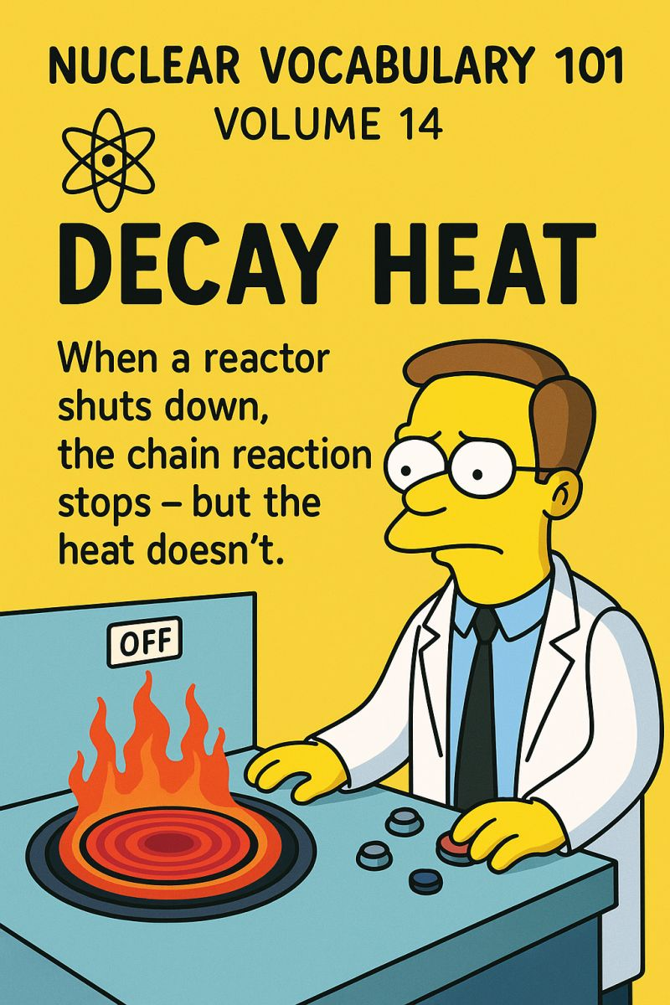

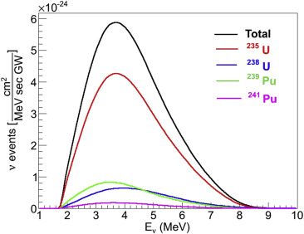
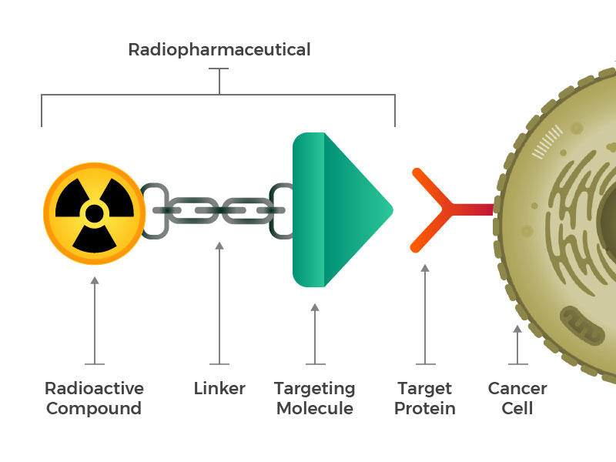
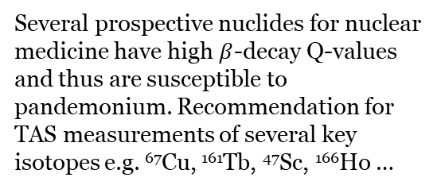
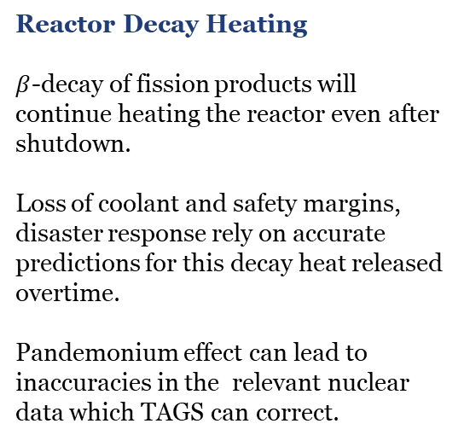
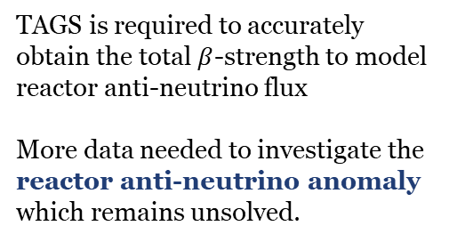

Nuclear Applications, Security & Technology
Reactor Decay Heating
$β$-decay of fission products will continue heating the reactor even after shutdown.
Loss of coolant and safety margins, disaster response rely on accurate predictions for this decay heat released overtime.
Pandemonium effect can lead to inaccuracies in the relevant nuclear data which TAGS can correct.
Reactor anti-neutrino spectrum
$β$-strength of nucleus, $i$
Phase-space factor
TAGS is required to accurately obtain the total $β$-strength to model reactor anti-neutrino flux
More data needed to investigate the reactor anti-neutrino anomaly which remains unsolved.
Radiopharmaceutical Dosimetry
Nuclear Data Impact
TAGS data feeds into several sets of nuclear data libraries (ENDF, ENSDF) and represents a good test of the completeness of these libraries with impact on decay heat libraries, reactor simulation models, new reactor design.
Several prospective nuclides for nuclear medicine have high $β$-decay Q-values and thus are susceptible to pandemonium. Recommendation for TAS measurements of several key isotopes e.g. ⁶⁷Cu, ¹⁶¹Tb, ⁴⁷Sc, ¹⁶⁶Ho …

Slide 7
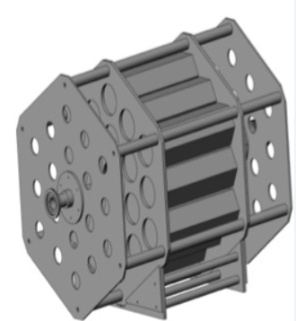
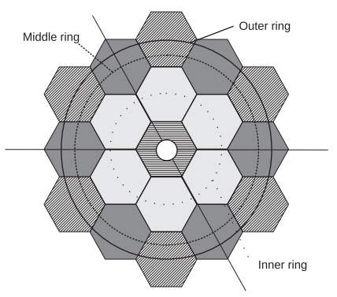
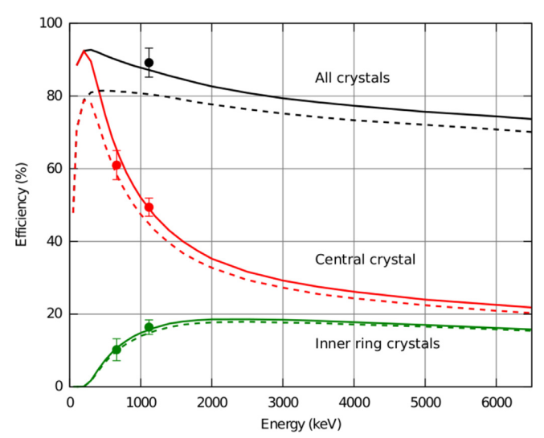
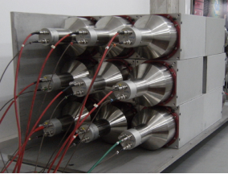
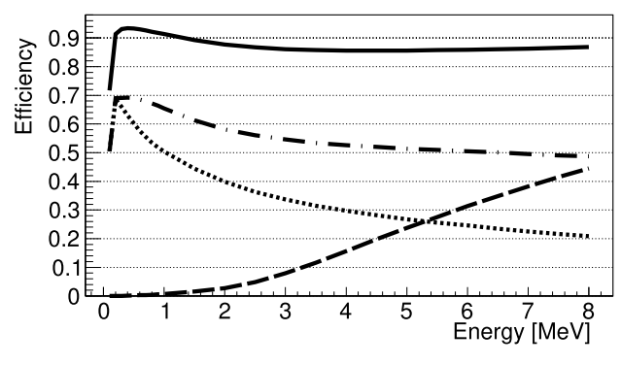
Existing TAS devices: Modular NaI arrays
Modular Total Absorption Spectrometer (MTAS)
(ORNL now at FRIB)
1 Ton of active NaI detector
Arranged in hexagonal modules in honeycomb configuration.
Selected Publications:
A. Fijałkowska et al. (2017). "Impact of Modular Total Absorption Spectrometer Measurements of β Decay of Fission Products on the Decay Heat and Reactor ν̄_{e} Flux Calculation." PRL 119, 052503.
B. C. Rasco et al. (2022). "Deciphering ⁹⁸Nb 𝛽 decay with the Modular Total Absorption Spectrometer at ORNL” PRC
Decay Total Absorption Spectrometer (DTAS)
(Part of DESPEC at GSI)
18 NaI detectors in a box configuration
Lower efficiency than MTAS
Selected Publications
V. Guadilla et al. (2019). "Total absorption γ-ray spectroscopy of the β-delayed neutron emitters ¹³⁷I and ⁹⁵Rb." PRC 100, 024311.
V. Guadilla et al. (2017). "Study of the β decay of ¹⁰⁰Tc with Total Absorption γ-Ray Spectroscopy." PRC 96, 014319.

Slide 8
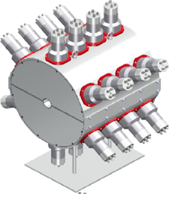
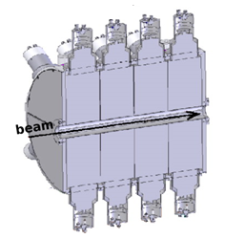
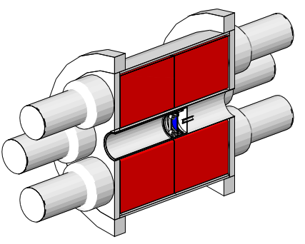
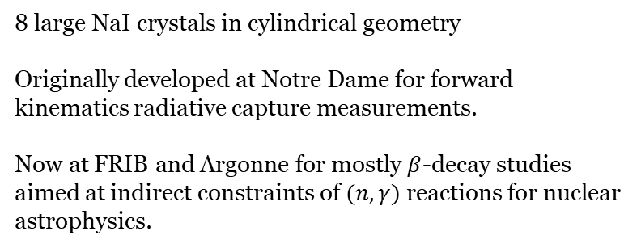
Other TAS devices
Summing NaI detector (SuN)
Valencia-Surrey Total Absorption Spectrometer (Rocinante)
12 BaF detectors in cylindrical configuration. (BaF2 gives a reduced neutron sensitivity)
Operated at GANIL and Jyvaskyla
Rocinante Publications:
[1] J.L. Tain, et al., “Enhanced γ-Ray Emission from Neutron Unbound States Populated in β Decay” PRL 115, 062502 (2015).
[2] A.-A. Zakari-Issoufou, et al., “Total Absorption Spectroscopy Study of ⁹²Rb Decay: A Major Contributor to Reactor Antineutrino Spectrum Shape”, PRL 115, 102503 (2015).
[3] S. Rice, et al., “Total absorption spectroscopy study of the 𝛽 decay of ⁸⁶Br and ⁹¹Rb” Phys. Rev. C 96, 014320 (2017).
8 large NaI crystals in cylindrical geometry
Originally developed at Notre Dame for forward kinematics radiative capture measurements.
Now at FRIB and Argonne for mostly $β$-decay studies aimed at indirect constraints of $(n,γ)$ reactions for nuclear astrophysics.
SuN Publications:
[1] S. Uthayakumaar, et al. “Constraining the astrophysical 𝑖 process: The 87Kr⁢(𝑛,𝛾)⁢88Kr reaction rate” Phys. Rev. C 113, 065801 (2026)
[2] A. Spyrou, et al., “First Study of the 139Ba⁢(𝑛,𝛾)⁢140Ba Reaction to Constrain the Conditions for the Astrophysical 𝑖 Process” Phys. Rev. Lett. 132, 202701 (2024)

Slide 9
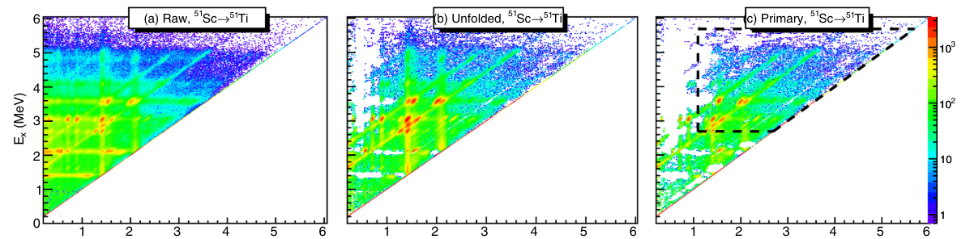
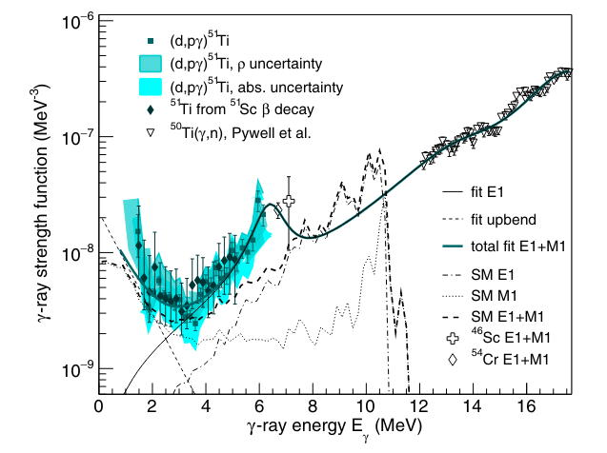
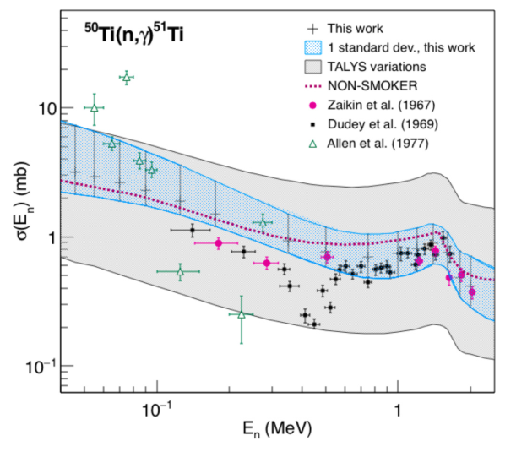
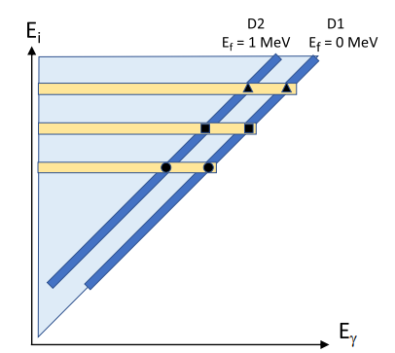
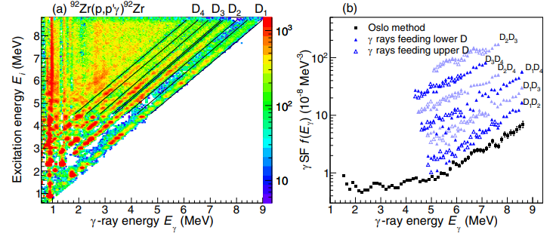

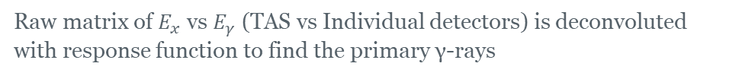
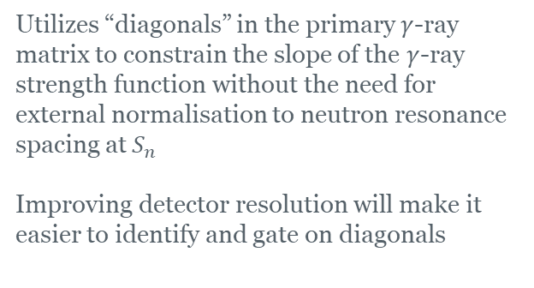
Constraints on $(n,γ)$ reaction rates from TAS data
β-Oslo Method
Raw matrix of $E_{x}$ vs $E_{γ}$ (TAS vs Individual detectors) is deconvoluted with response function to find the primary γ-rays
The primary γ-ray matrix can then be combined with ancillary information on the NLD to constrain the γSF and then $σ_{(n,γ)}$
“Shape” Method
Utilizes “diagonals” in the primary $γ$-ray matrix to constrain the slope of the $γ$-ray strength function without the need for external normalisation to neutron resonance spacing at $S_{n}$
Improving detector resolution will make it easier to identify and gate on diagonals
S.N. Liddick, et al., PRL 116, 242502 (2016)
S.N. Liddick, et al., PRC 100, 024624 (2019)
M. Wiedeking, et al., PRC 104, 014311 (2021)

Slide 10
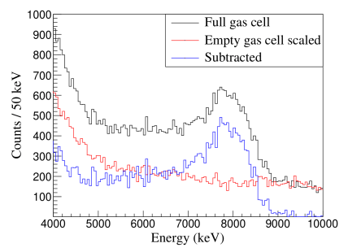
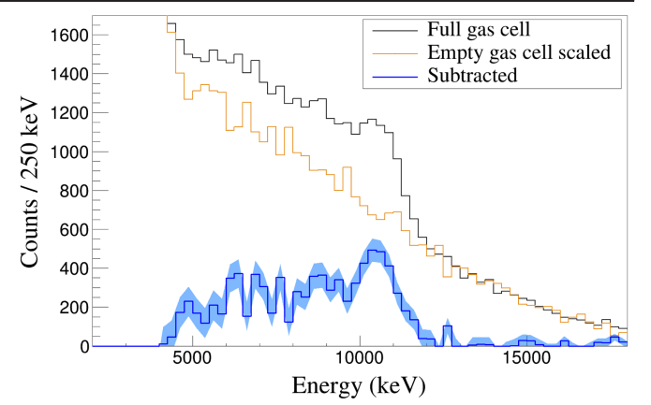
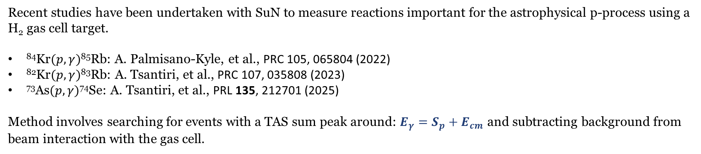
Measurements of radiative capture reactions with TAGS
Recent studies have been undertaken with SuN to measure reactions important for the astrophysical p-process using a H₂ gas cell target.
⁸⁴Kr$(p,γ)$⁸⁵Rb: A. Palmisano-Kyle, et al., PRC 105, 065804 (2022)
⁸²Kr$(p,γ)$⁸³Rb: A. Tsantiri, et al., PRC 107, 035808 (2023)
⁷³As$(p,γ)$⁷⁴Se: A. Tsantiri, et al., PRL 135, 212701 (2025)
Method involves searching for events with a TAS sum peak around: $E_{γ}=S_{p}+E_{cm}$ and subtracting background from beam interaction with the gas cell.
While effective for stable or long-lived beams, this technique is strongly limited by background likely from a combination of reactions on the target foil and room-background.

Slide 11
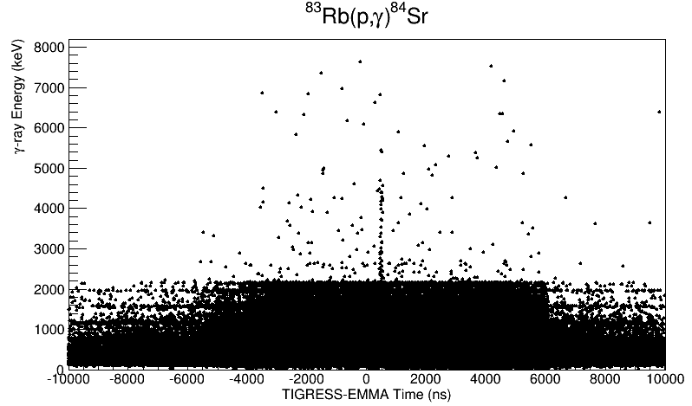
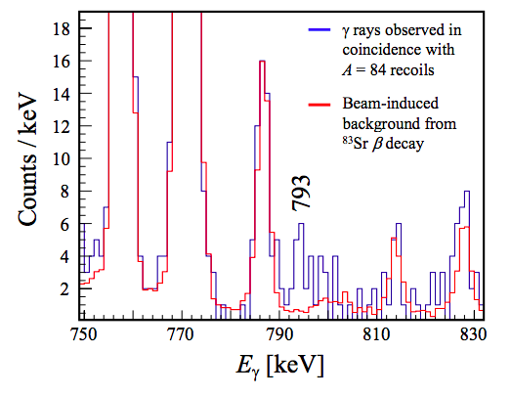
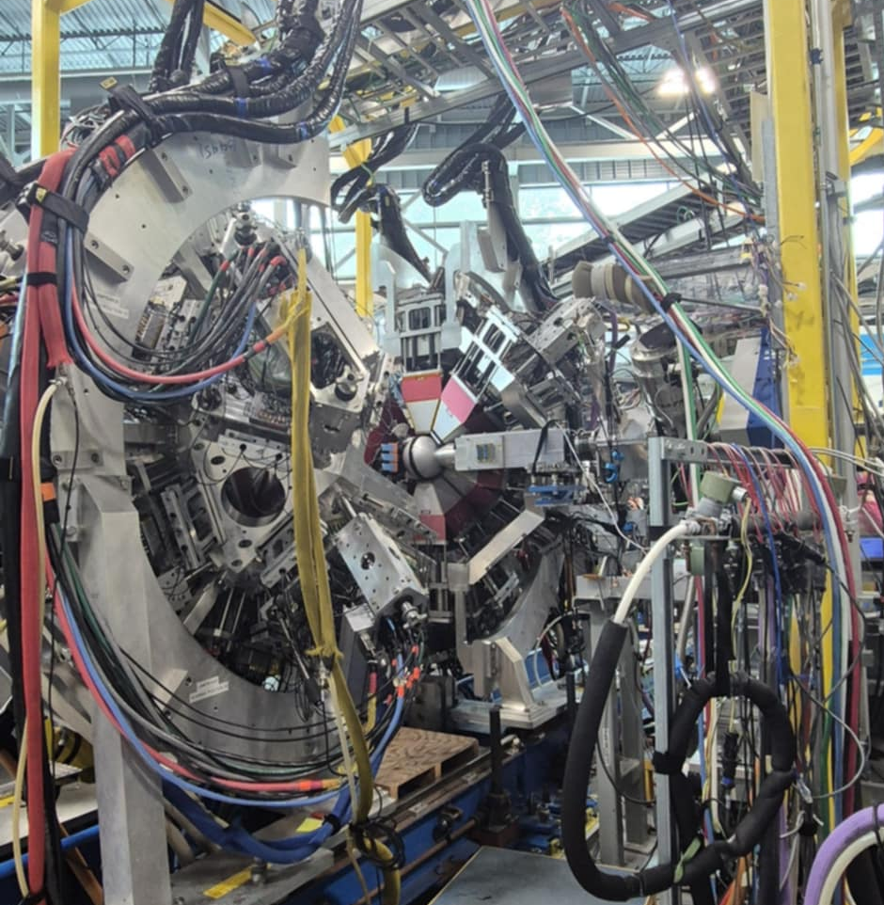
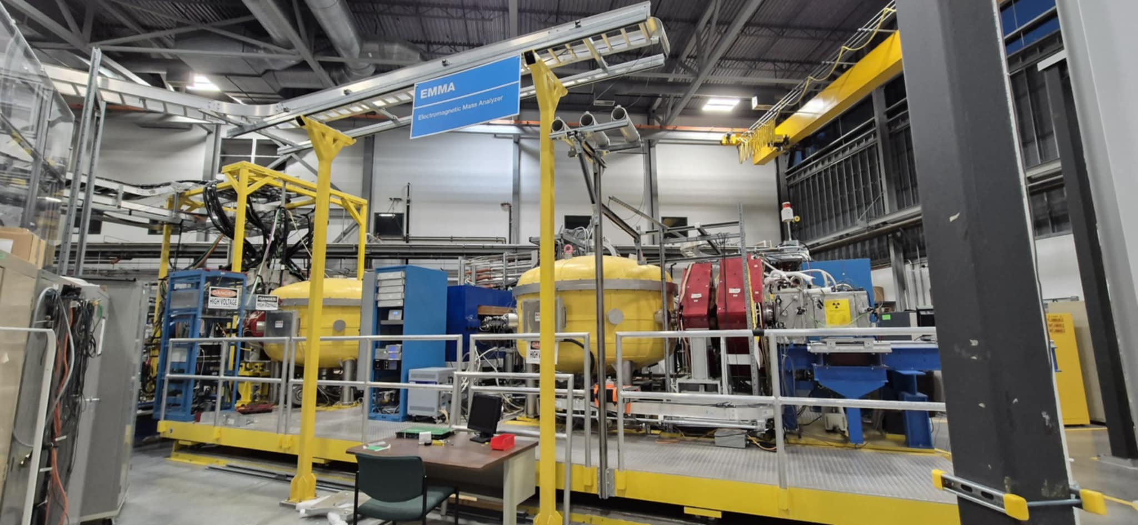
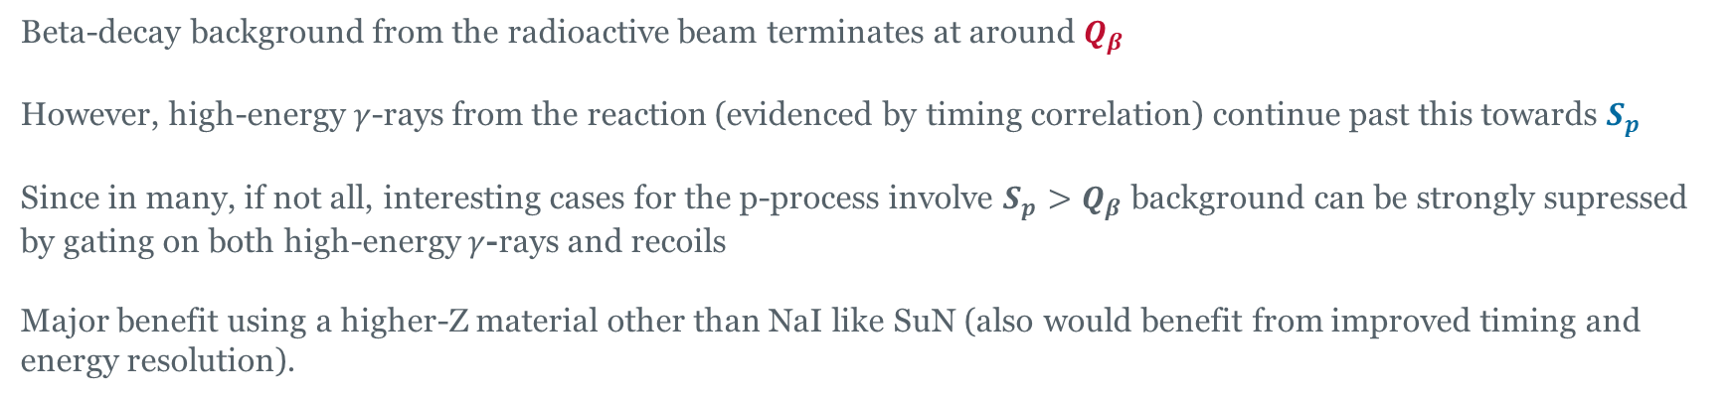
Combining TAS with recoil separation
Can background for RIB measurements be overcome by combining with recoil separation?
Beta-decay background from the radioactive beam terminates at around $Q_{β}$
However, high-energy $γ$-rays from the reaction (evidenced by timing correlation) continue past this towards $S_{p}$
Since in many, if not all, interesting cases for the p-process involve $S_{p}>Q_{β}$ background can be strongly supressed by gating on both high-energy $γ$-rays and recoils
Major benefit using a higher-Z material other than NaI like SuN (also would benefit from improved timing and energy resolution).

Slide 12
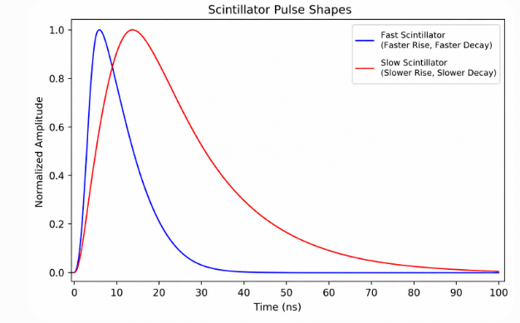
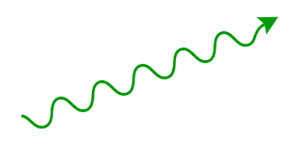
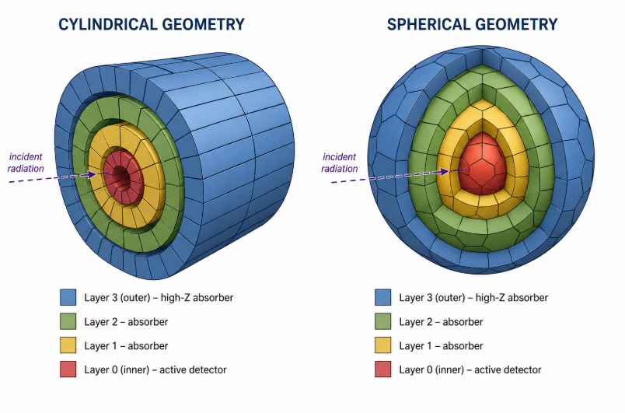
Desing Improvements for a Next-Generation Device
More options are now available for detector materials the improve on both efficiency (proxy from density), resolution (times and energy) and light yield
Utilize Digital Electronics and PSA for Active Compton suppression
Material | Density (g/cm3) | Energy resolution @ 662 keV (%) | Rise Time (ns) | Decay Time (ns) | Light Yield (ph/MeV)
NaI(Tl) | 3.67 | 6 to 7 | ~30 | 230 | ~38k
CsI(Tl) | 4.51 | 6 to 8 | 20 to 30 | 1000 | ~54k
BGO | 7.13 | 9 to 12 | ~5 | 300 | ~8k
LYSO:Ce | 7.10 | 7 to 10 | ~0.1 to 0.5 | 40 | ~32k
LSO:Ce | 7.40 | 8 to 10 | ~0.1 to 0.5 | 40 | ~30k
LaBr3(Ce) | 5.29 | 2.6 to 3.0 | <1 | 16 | ~63k
CeBr3 | 5.10 | 3.8 to 4.5 | ~1 | 17 | ~60k
GAGG:Ce | 6.63 | 4.5 to 6 | ~5 to 10 | 90 | ~50k
PMT
Possible geometries*
Geometries having a polar symmetry are needed in order to perform Doppler-corrections for in-beam experiments. Nested design to help veto background.
SuN has been upgraded with added CeBr3. Rocinante with LaBr3
*For illustrative purposes only!

Slide 13
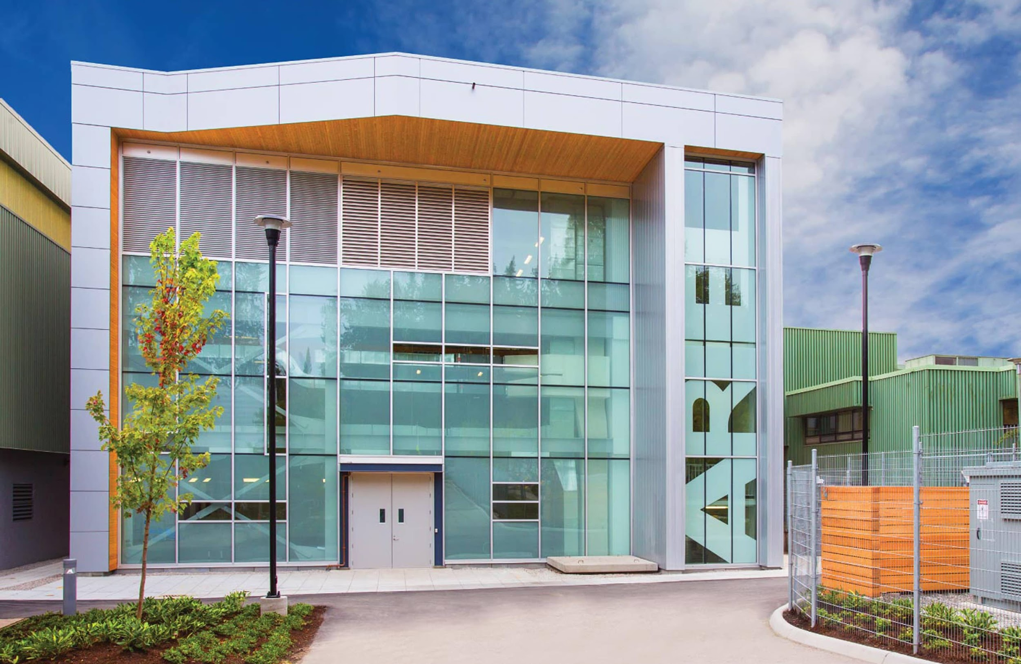
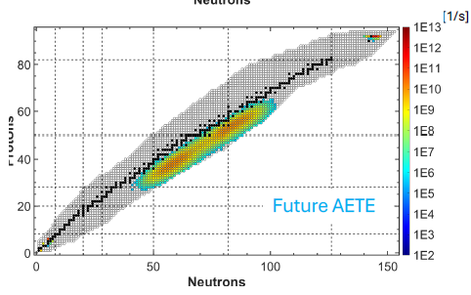
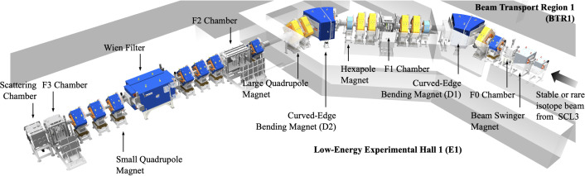
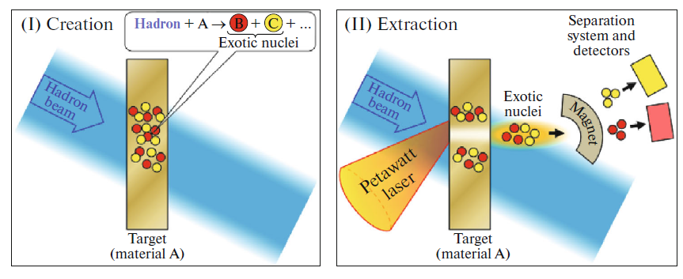

Where would such a device go?
A mobile facility to take advantage of opportunities for both decay and in-beam studies.
ISOL facilities like ISOLDE and TRIUMF would be good candidates for astrophysical reaction studies. Neither currently have segmented TAS devices installed long-term.
A program at TRIUMF focusing on neutron-rich nuclei close to fission peaks would greatly benefit from ARIEL.
The new RAON facility (open for international users next year) will also offer unique opportunities. Initially with stable beam fragmentation with KoBRA separator, then with radioactive beam fragmentation.
A Future UK Facility?
Cross-over with muon-induced induced reactions at ISIS (RAL) – Talk by Jack Henderson
Radioactive ion beam production at a UK laser facility, e.g. EPAC at RAL?

Slide 14
Summary / Discussion
TAS-enabled measurements provide important insights into nuclear astrophysics and nuclear structure, increasingly supported by new methods and techniques.
Most current TAS devices use NaI, but new commercially-available materials could greatly benefit a new device with improved stopping power, timing and energy resolution.
How could a new higher-resolution TAS device benefit your physics programs?
What design characteristics are most important for your science case and what detector systems could a new TAS be combined with to improve scientific output?
Should the roadmap be revisited to emphasize links between fundamental and more applied-focused UKRI missions: clean energy, security, NHS fit for future…
Path forward: Concept design and simulations needed. Currently working with a masters’ student, but could be expedited with a small-project fund including PDRA support. Work with existing European collaboration on TAGS. Explore potential ERC grant avenues as well as PPRP. Is there a Bucket 2 grant line to be exploited?
Unfortunately, small project funds are relatively uncommon in nuclear physics.
How can we better support ideas for new devices/programmes?

