Slide 1
ALICE 3 status and plans
Birmingham, Liverpool, Derby, and Daresbury
David Evans, The University of Birmingham
6th-7th July 2026
NP Community Meeting, Glasgow

Slide 2
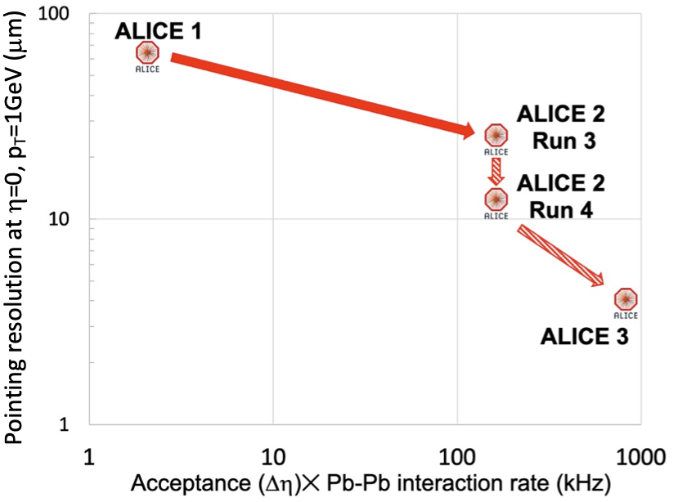
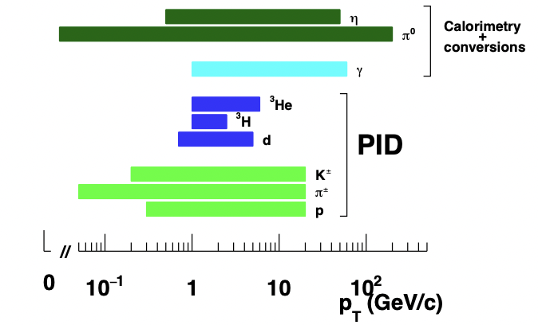
ALICE upgrades strategy
Large steps in pointing precision and “effective acceptance”
+
Keep/strengthen ALICE unique reach in particle identification

Slide 3
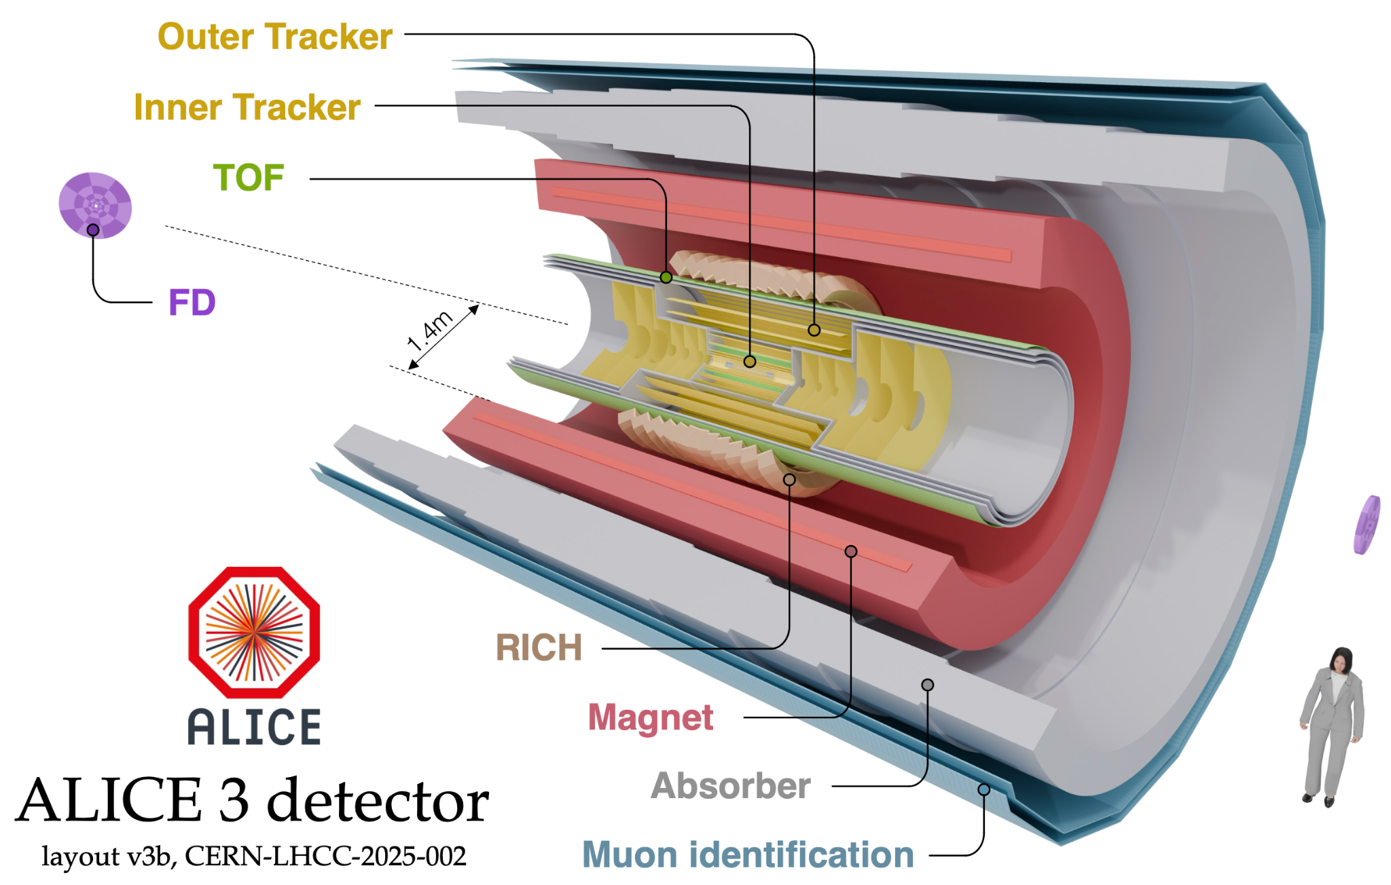
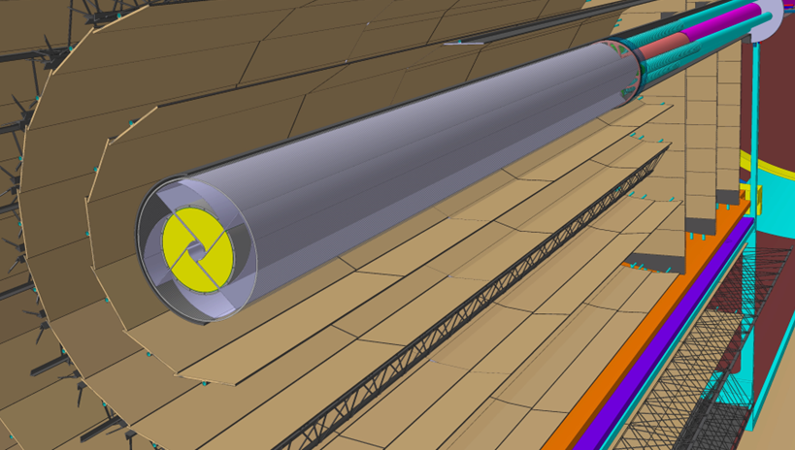
ALICE 3 detector
➠ Novel and innovative detector concept
Compact and lightweight all-silicon tracker
Retractable vertex detector (inner R = 0.5 cm)
Extensive particle identification
Large acceptance
Superconducting magnet (2 T)
Continuous read-out and online processing
⌀ 1 cm
Letter of Intent: CERN-LHCC-2022-009
Scoping Document: CERN-LHCC-2025-002

Slide 4
Unique ALICE 3 physics goals
Access to temperature as function of time
  high-precision di-electron mass spectra, p_{T} dependence, elliptic flow
Understanding thermalisation in the QGP
  direct access to charm diffusion: D-Dbar azimuthal correlations
  degree of thermalisation of beauty: high-precision beauty measurements
  approach to chemical equilibrium: multi-charm hadrons
Fundamental aspects of the QCD phase transition
  net-baryon and net-charm fluctuations
  mechanism of chiral symmetry restoration in the QGP: di-electron mass spectrum
Laboratory for hadron physics
  hadron-hadron interaction potentials
  explore nature of exotic hadrons (tetraquarks)
Also summarised in Scoping Document (CERN-LHCC-2025-002 p9) and endorsed in LHCC report:
“ALICE 3 is a unique detector at the LHC in terms of having a low material budget, a few-micron pointing resolution, a large acceptance in eta, and hadron, electron and muon identification.”
“The LHCC recognises that the different scoping options presented would enable a compelling and unique heavy ion physics programme in Run 5.”
Notes:
mention phases of collision
some example measurements
much more to be done

Slide 5
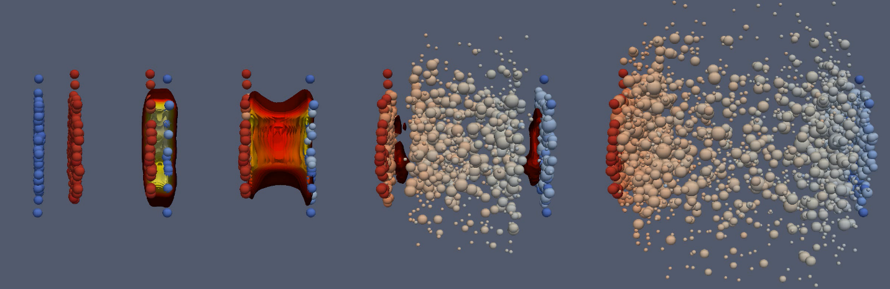
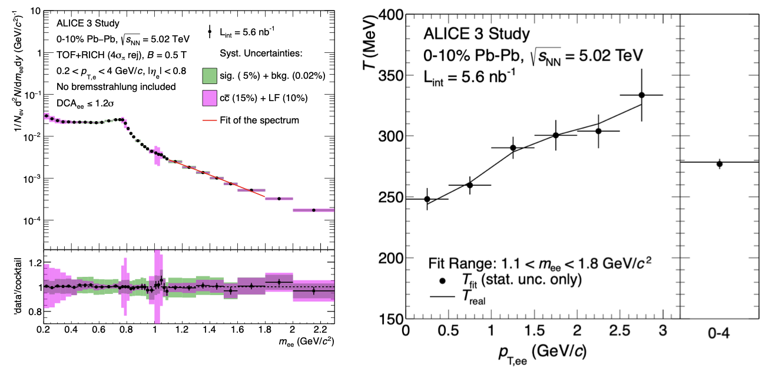
Unique ALICE 3 physics goals
Access to temperature as function of time
  high-precision di-electron mass spectra, p_{T} dependence, elliptic flow
Understanding thermalisation in the QGP
  direct access to charm diffusion: D-Dbar azimuthal correlations
  degree of thermalisation of beauty: high-precision beauty measurements
  approach to chemical equilibrium: multi-charm hadrons
Fundamental aspects of the QCD phase transition
  net-baryon and net-charm fluctuations
  mechanism of chiral symmetry restoration in the QGP: di-electron mass spectrum
Laboratory for hadron physics
  hadron-hadron interaction potentials
  explore nature of exotic hadrons (tetraquarks)
electromagnetic radiation (virtual photons → e⁺e⁻)
e⁻
e⁻
e⁻
e⁺
e⁺
e⁺
~1 fm/c ~10 fm/c time
ALICE 3 LoI, CERN-LHCC-2022-009
time
temperature
Time dependence of temperature only accessible with ALICE 3
Notes:
mention phases of collision
some example measurements
much more to be done

Slide 6
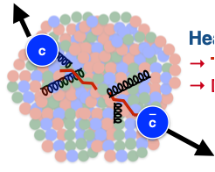
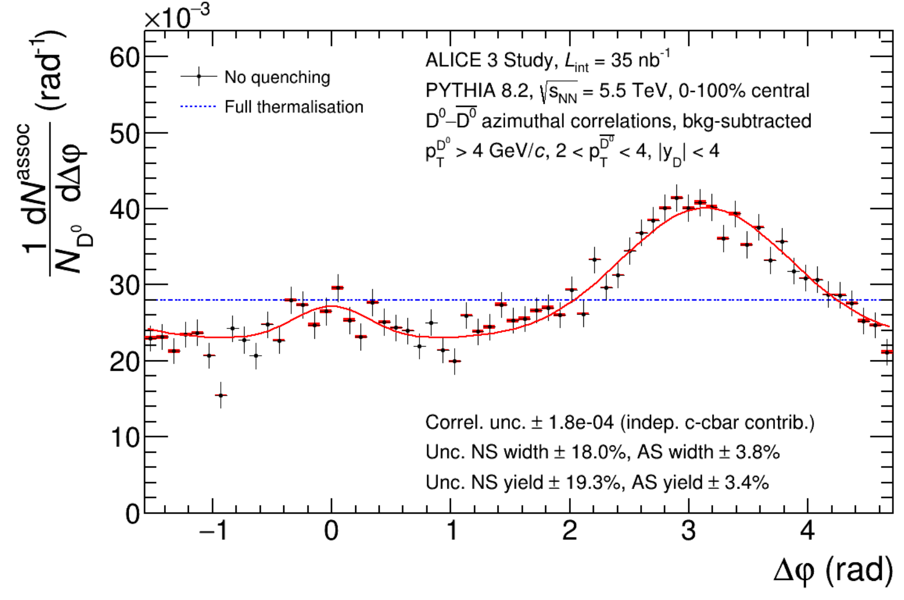
Unique ALICE 3 physics goals
Access to temperature as function of time
  high-precision di-electron mass spectra, p_{T} dependence, elliptic flow
Understanding thermalisation in the QGP
  direct access to charm diffusion: D-Dbar azimuthal correlations
  degree of thermalisation of beauty: high-precision beauty measurements
  approach to chemical equilibrium: multi-charm hadrons
Fundamental aspects of the QCD phase transition
  net-baryon and net-charm fluctuations
  mechanism of chiral symmetry restoration in the QGP: di-electron mass spectrum
Laboratory for hadron physics
  hadron-hadron interaction potentials
  explore nature of exotic hadrons (tetraquarks)
c
c
ALICE 3 LoI, CERN-LHCC-2022-009
Charm pair azimuthal correlation
Back-to-back correlation
Notes:
mention phases of collision
some example measurements
much more to be done

Slide 7
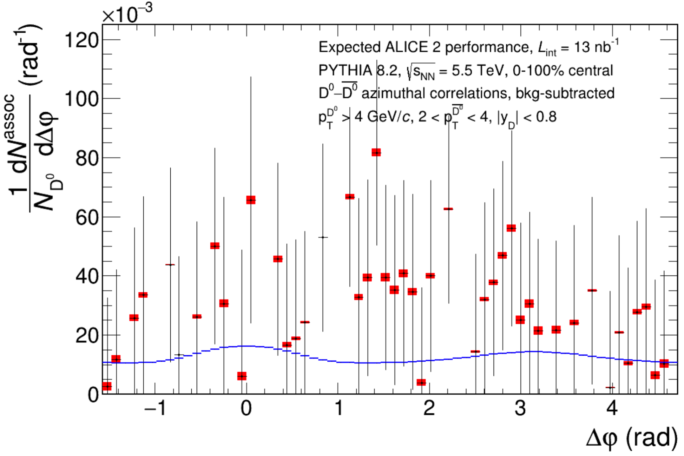
Unique ALICE 3 physics goals
Access to temperature as function of time
  high-precision di-electron mass spectra, p_{T} dependence, elliptic flow
Understanding thermalisation in the QGP
  direct access to charm diffusion: D-Dbar azimuthal correlations
  degree of thermalisation of beauty: high-precision beauty measurements
  approach to chemical equilibrium: multi-charm hadrons
Fundamental aspects of the QCD phase transition
  net-baryon and net-charm fluctuations
  mechanism of chiral symmetry restoration in the QGP: di-electron mass spectrum
Laboratory for hadron physics
  hadron-hadron interaction potentials
  explore nature of exotic hadrons (tetraquarks)
~1 fm/c ~10 fm/c time
ALICE 3 LoI, CERN-LHCC-2022-009
Charm pair azimuthal correlation
Not accessible without ALICE 3
Notes:
mention phases of collision
some example measurements
much more to be done

Slide 8
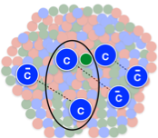
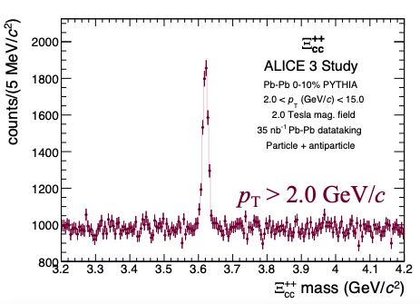
Unique ALICE 3 physics goals
Access to temperature as function of time
  high-precision di-electron mass spectra, p_{T} dependence, elliptic flow
Understanding thermalisation in the QGP
  direct access to charm diffusion: D-Dbar azimuthal correlations
  degree of thermalisation of beauty: high-precision beauty measurements
  approach to chemical equilibrium: multi-charm hadrons
Fundamental aspects of the QCD phase transition
  net-baryon and net-charm fluctuations
  mechanism of chiral symmetry restoration in the QGP: di-electron mass spectrum
Laboratory for hadron physics
  hadron-hadron interaction potentials
  explore nature of exotic hadrons (tetraquarks)
𝚵_{cc}
~1 fm/c ~10 fm/c time
ALICE 3 LoI, CERN-LHCC-2022-009
Only accessible with ALICE 3
x100 enhancement in Pb-Pb wrt pp
Notes:
mention phases of collision
some example measurements
much more to be done

Slide 9
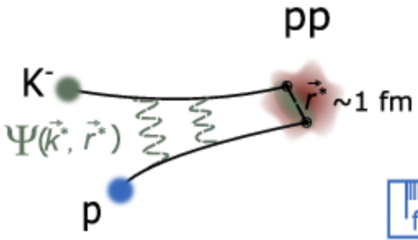
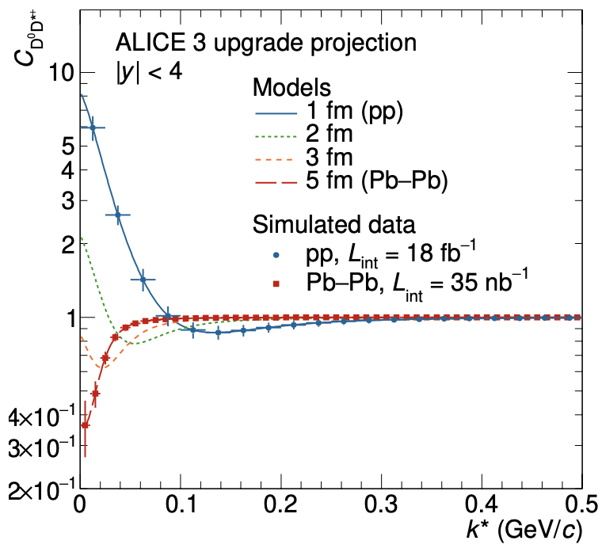
Unique ALICE 3 physics goals
Access to temperature as function of time
  high-precision di-electron mass spectra, p_{T} dependence, elliptic flow
Understanding thermalisation in the QGP
  direct access to charm diffusion: D-Dbar azimuthal correlations
  degree of thermalisation of beauty: high-precision beauty measurements
  approach to chemical equilibrium: multi-charm hadrons
Fundamental aspects of the QCD phase transition
  net-baryon and net-charm fluctuations
  mechanism of chiral symmetry restoration in the QGP: di-electron mass spectrum
Laboratory for hadron physics
  hadron-hadron interaction potentials
  explore nature of exotic hadrons (tetraquarks)
D
D*
~1 fm/c ~10 fm/c time
ALICE 3 LoI, CERN-LHCC-2022-009
Charm pair strong interaction
Only accessible with ALICE 3
Notes:
mention phases of collision
some example measurements
much more to be done

Slide 10

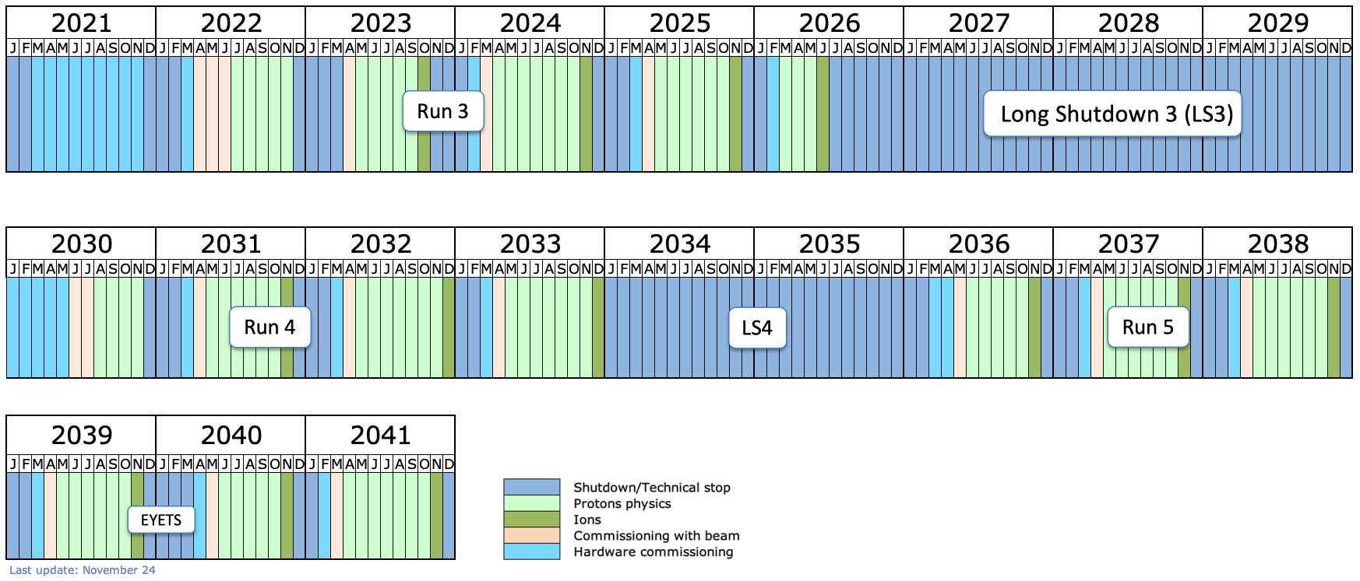

ALICE and ALICE 3 high level timeline
CG end
ALICE Data taking
Next CG end
ALICE Data taking
Assembly
@CERN
ALICE 3 Installation
ALICE 3 Data taking
ALICE 3 Data taking

Slide 11
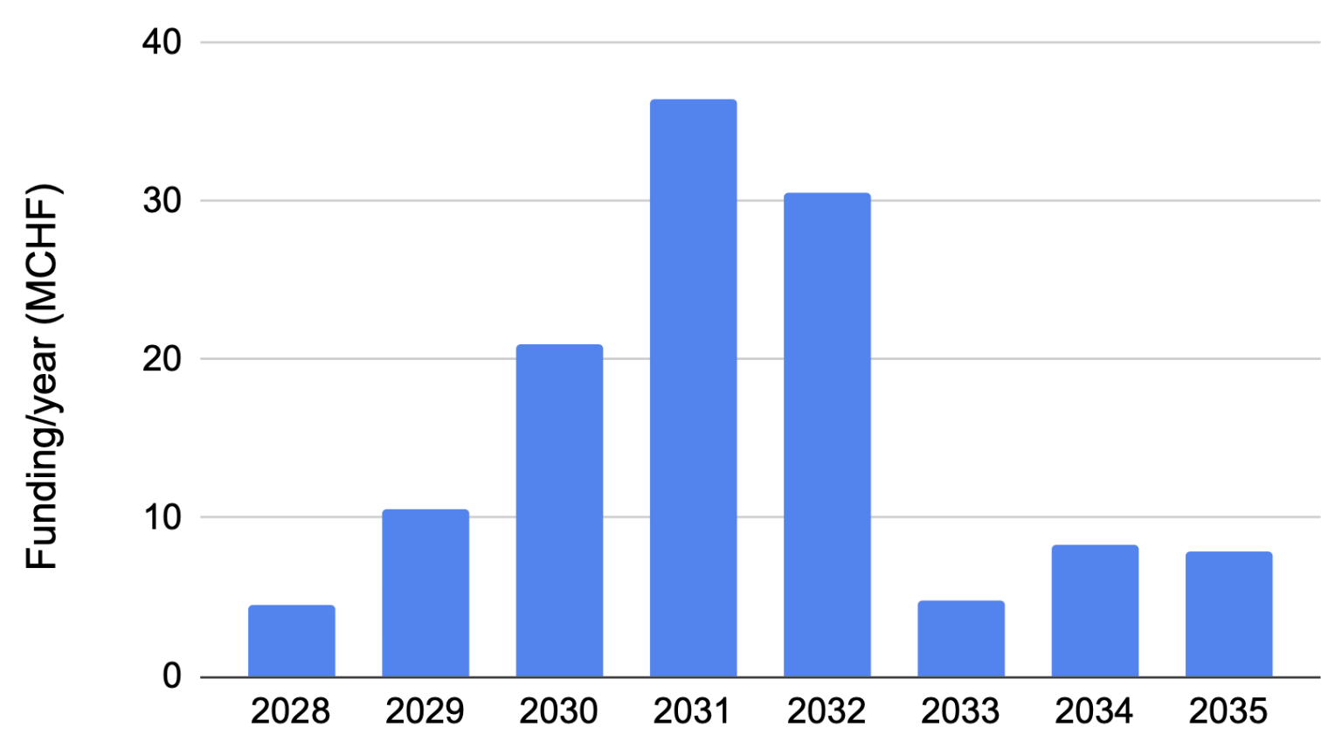
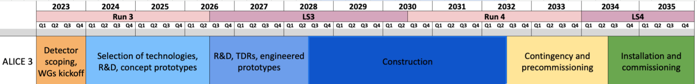
Spending profile and schedule
Projected profile of expenses, including Common Items and Magnet
Peak of spending in 2030-32

Slide 12
Proposed UK Contribution
The UK team would like to contribute to ALICE3 to maintain the UK’s influence in this exciting project.
Our proposal matches our pro-rata common fund and capital contribution but also include manpower, travel etc.
The proposed project cost is £6 million over five years from approx. 2028. The breakdown is:
Central Timing Processor (distributes precision timing to all sub-detectors and calibration triggers)
  £1,790k (assuming current engineers are partially funded on the CG (to maintain ALICE in Run 4)
Contribution to MAPS silicon pixel tracker – Liverpool / Darebury
  £4,215k (more staff effort required than for CTP)

