Slide 1
Recent activities at the RIBF
Frank Browne (with thanks to Marina, Shunji, and Chen)

Slide 2
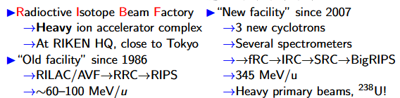
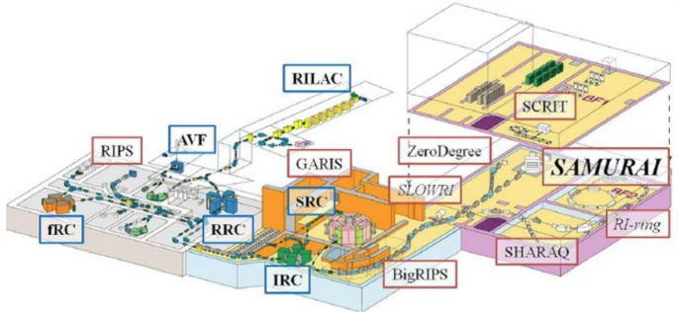
RIBF & talk overview
I will briefly report on latest developments of primary beams
Focus on:
  In-beam gamma-ray spectroscopy
  Decay & mass studies
  Reactions and unbound systems
Highlight UK involvement with logos of institutes
  Sorry if I forgot yours!
  Only UK logos shown for clarity, obviously huge input from abroad!

Slide 3

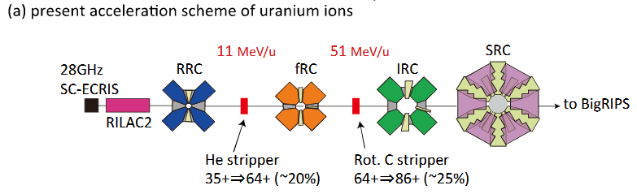
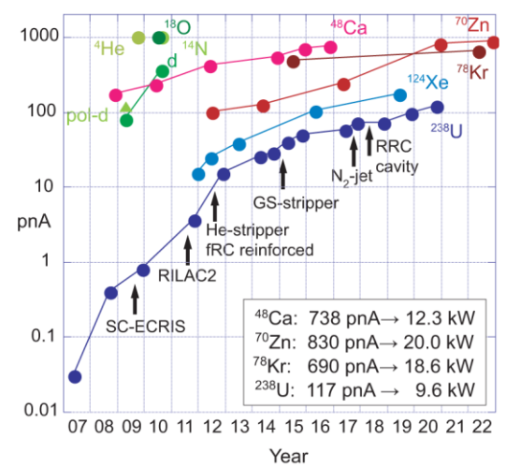
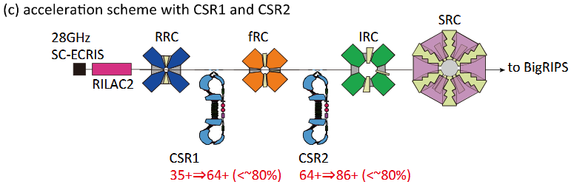
RIBF upgrade program
SRC requires 86+ charge state of U-238
✓

Slide 4

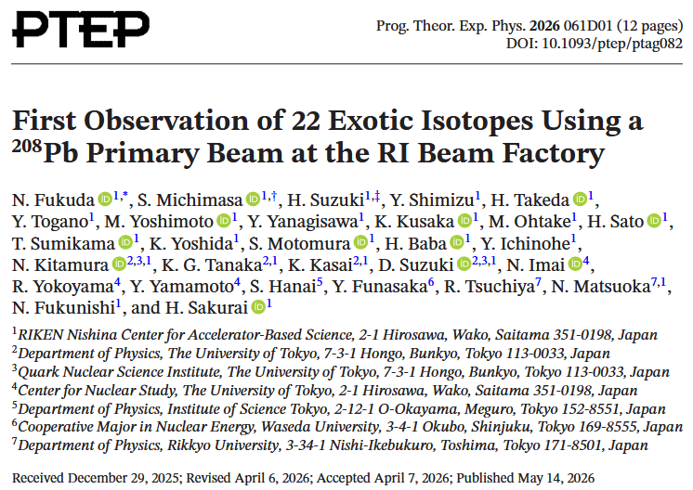
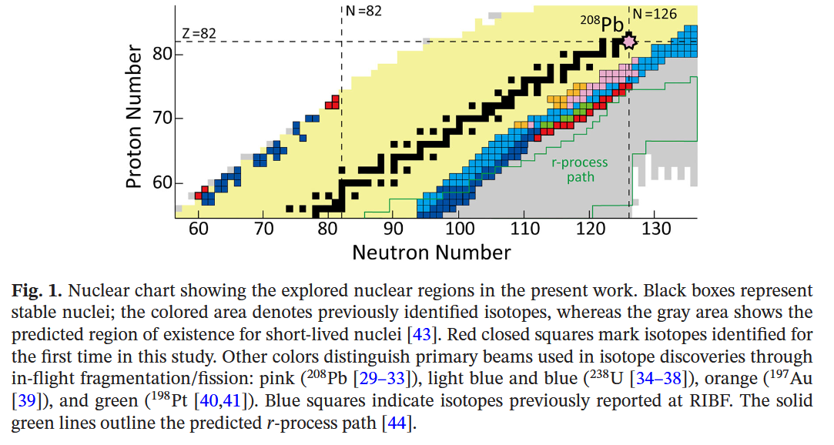
New Pb-208 primary beam! ~100 pnA

Slide 5


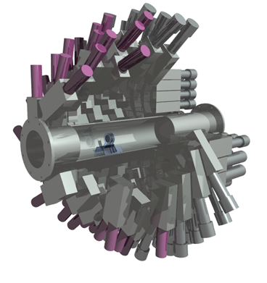
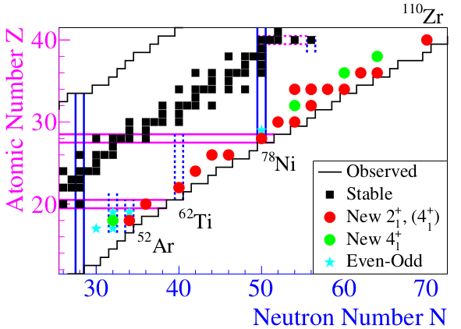



In-beam gamma-ray spectroscopy conducted at the RIBF
Typically uses DALI2+
  NaI array of around 220 crystals
  High efficiency, moderate energy resolution
  Ideal for low multiplicity
SEASTAR project
  Thick LH2 target coupled to DALI
    High luminosity aimed at most exotic first spectroscopy
  Large acceptances of ZD/SAMURAI mean lots of side channels
HICARI project
  Mixed array of HPGe detectors
  Exploring high-resolution gamma-ray spectroscopy at RIBF
  UK-led proposals
    R. Taniuchi, 78Ni
    S. Paschalis, M. Petri:
    F. Browne
    Zs. Podolyak

Slide 6


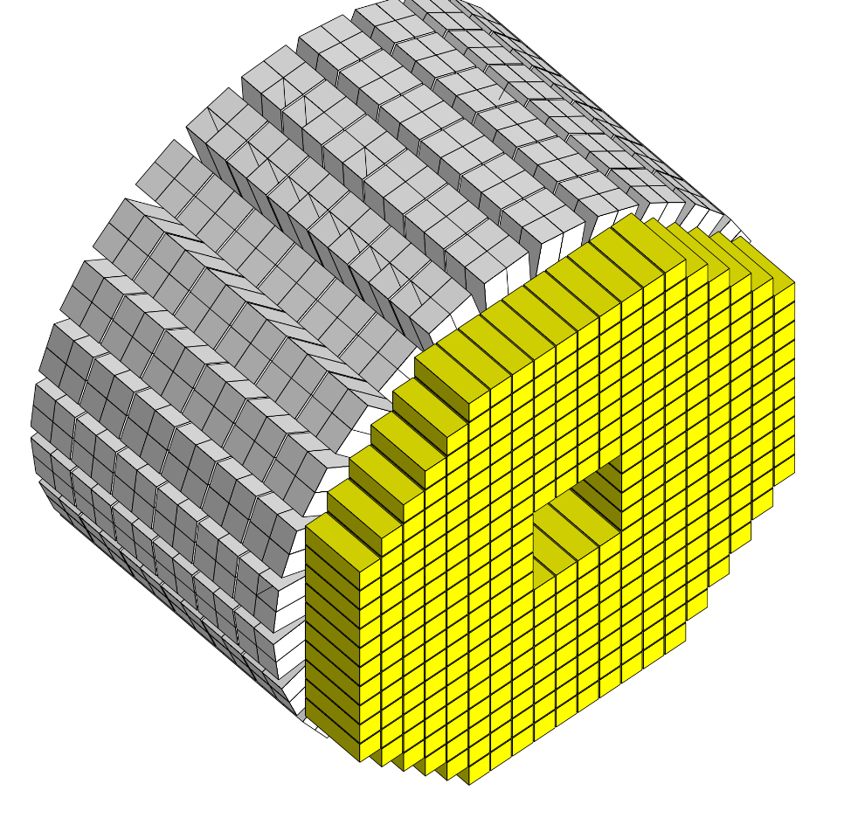




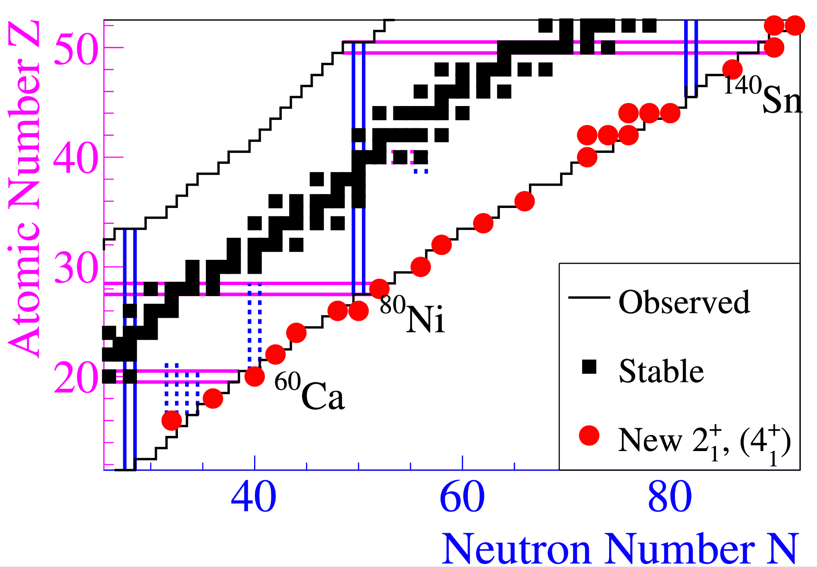
overall improvement in sensitivity of x5
HYPATIA
384 HR-GaGG 25x25x100mm³
→ superior Stopping power
624 CeBr₃ 3x3x8cm³, 2x2 common Al housing
→ Energy & Time performance
2030
The New Frontier
01
higher efficiency
from 35% to 53%
02
better energy resolution
from 10% to ≤5%
03
superior Peak-to-Total (P/T)
from 0.5 to ≥0.7
04
superior time resolution
from several ns to ≤1ns
05
flexible array geometry
2pμA ²³⁸U, 345 MeV/u, 30 days of beam time

Slide 7
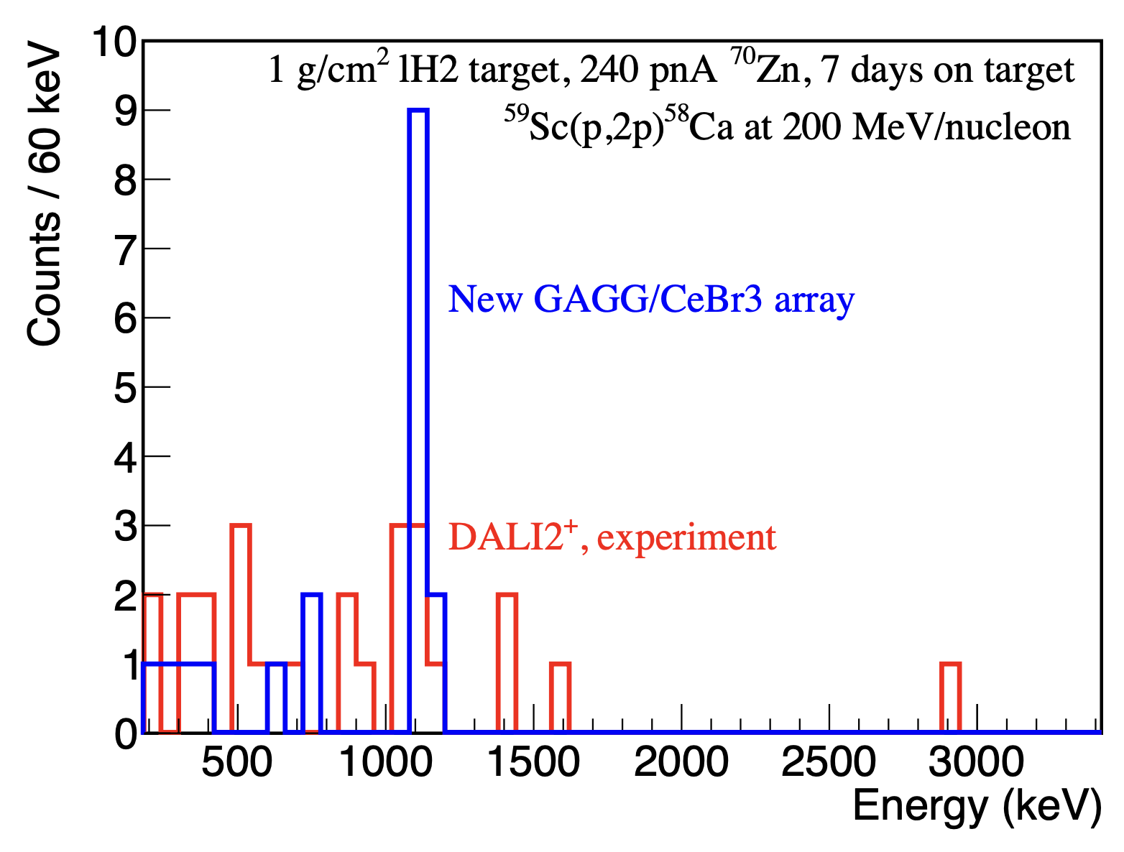
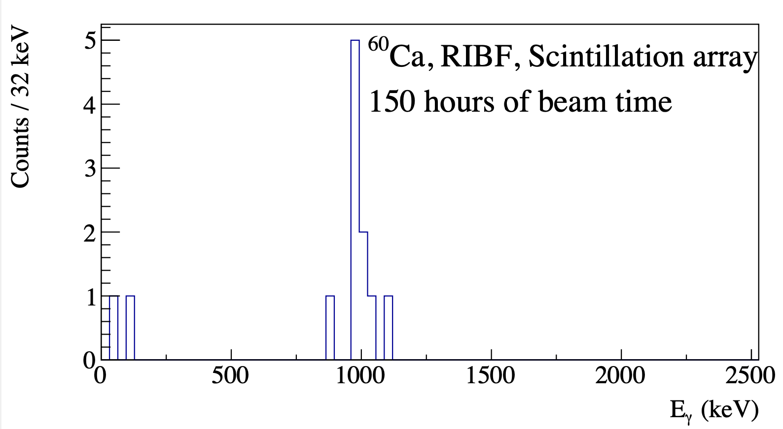
DALI2⁺
HYPATIA
226 large NaI(Tl)
384 HR-GaGG 25x25x100mm³
→ superior Stopping power
624 CeBr₃ 3x3x8cm³, 2x2 common Al housing
→ Energy & Time performance
2023
2030
SEASTAR
The New Frontier
2pμA ²³⁸U, 345 MeV/u

Slide 8
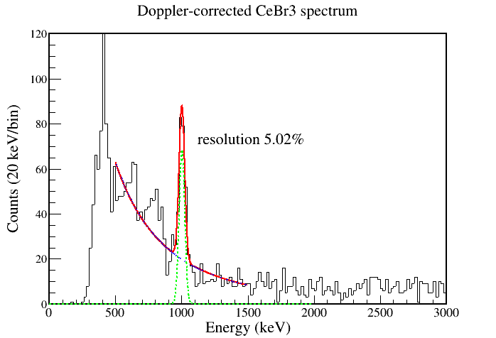

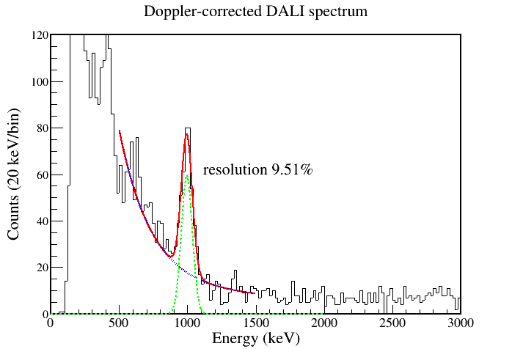
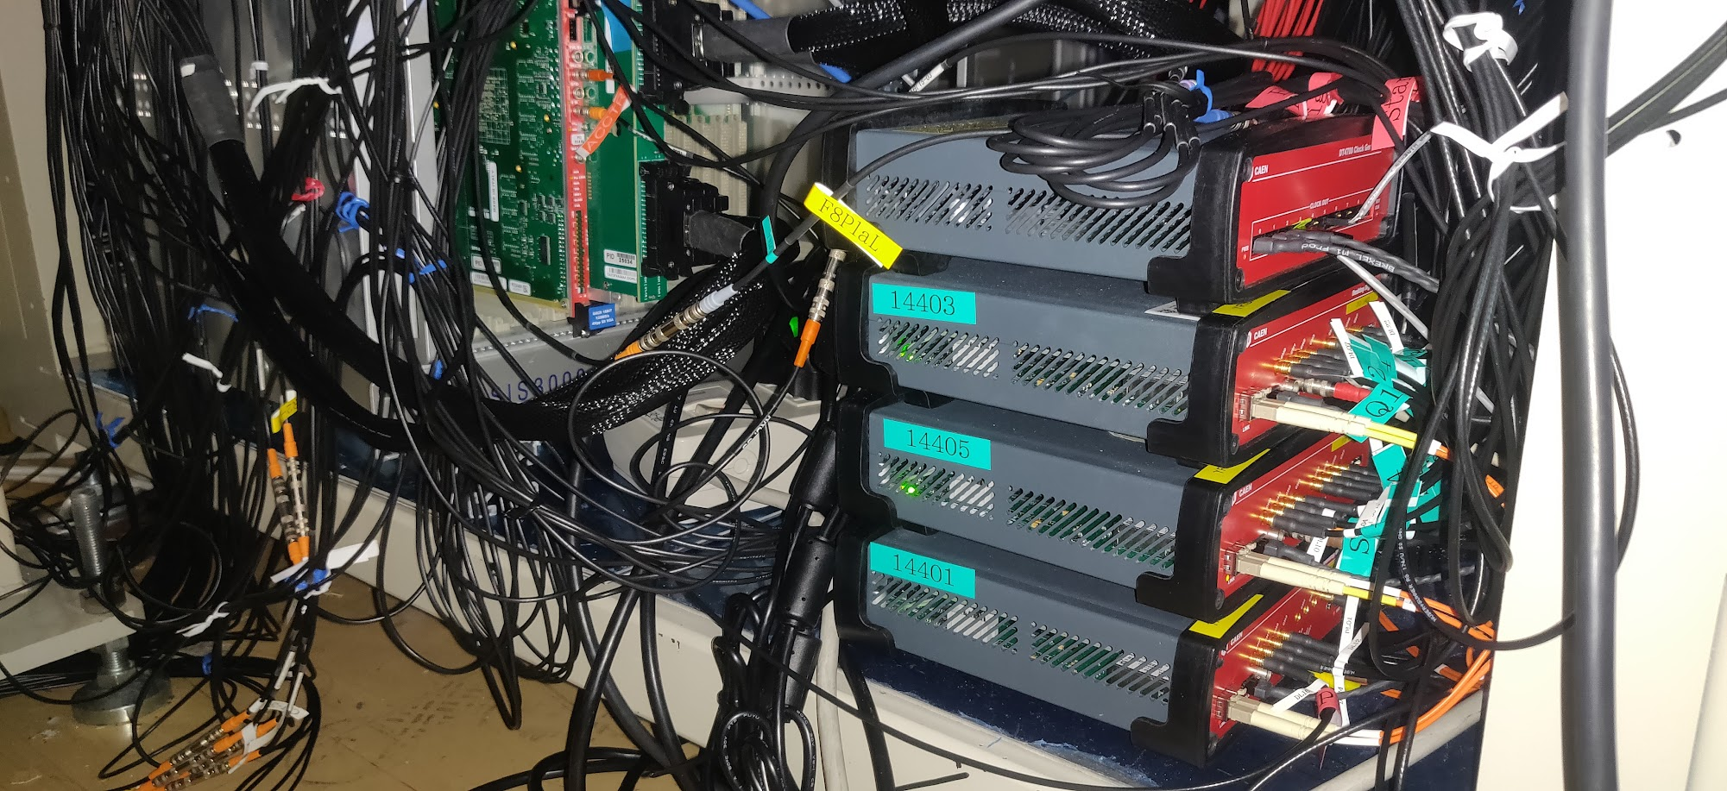
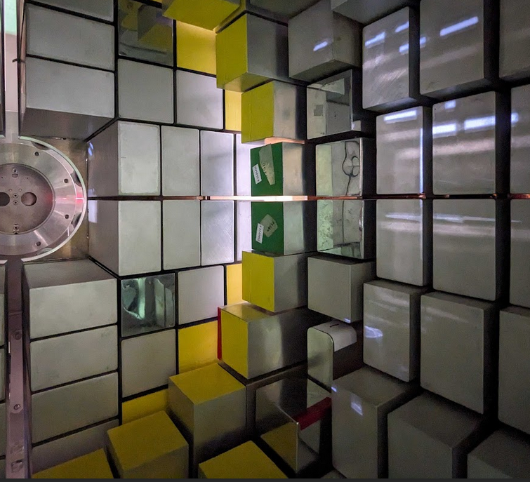
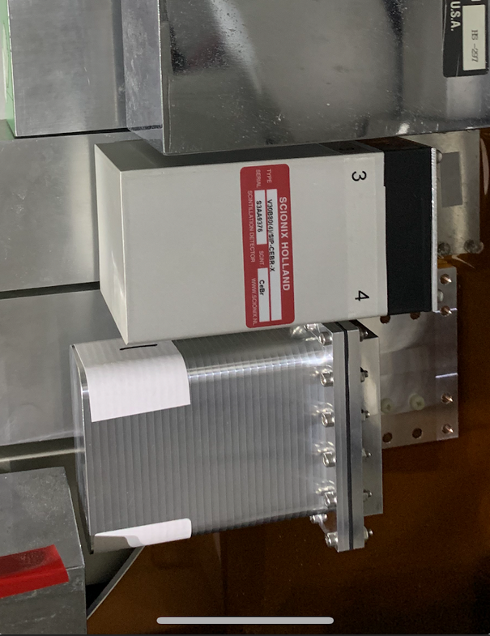
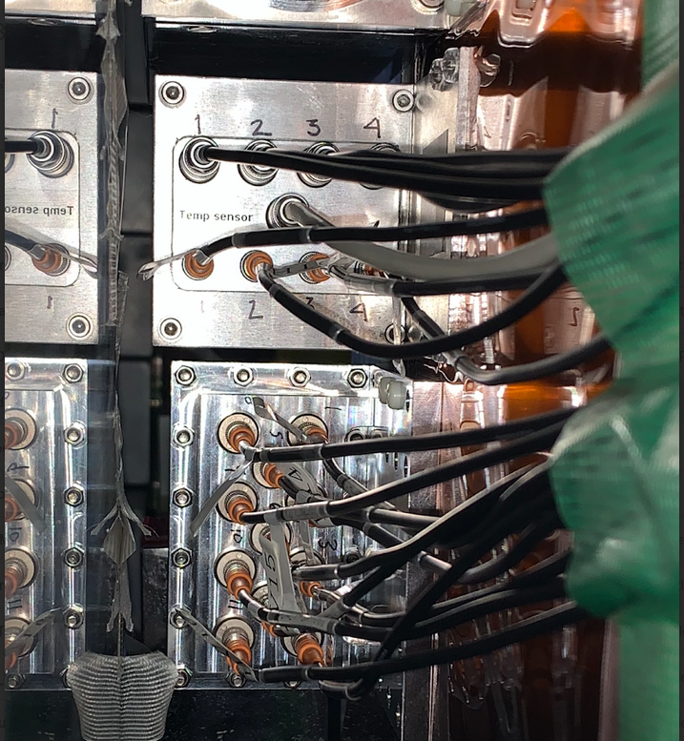
pyDAQ
Doppler-corrected ⁵⁰Ca spectra following a one-neutron removal from ⁵¹Ca
Scionix Module
pyDAQ @
RIKEN RIBF
York Module

Slide 9

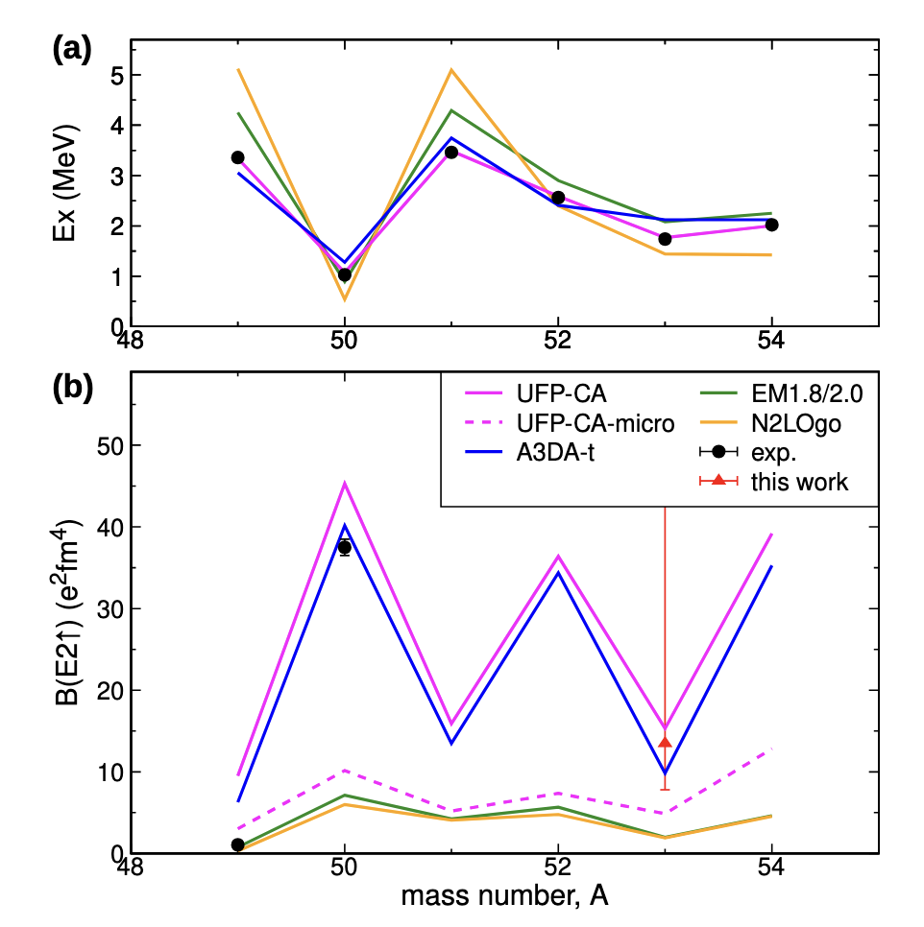
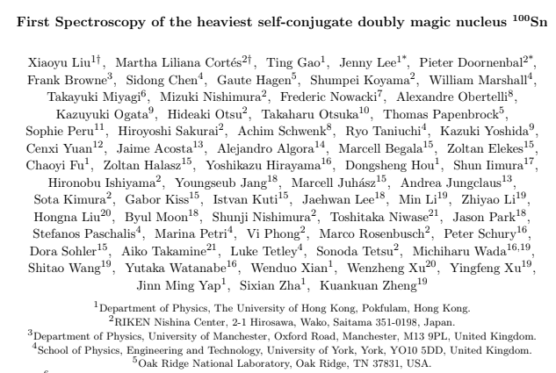
A couple of recent high-profile SUNFLOWER experiments
New RIBF experiment led by S. Chen, M. Petri (UYork) and K. Wimmer (Cologne)
Grade-S PAC approved, Coulomb excitation of ⁵⁰⁻⁵⁴Ca
DALI + HYPATIA
⁴⁹Ca: D. Montanari et al. Phys. Lett. B 697 (2011) 288
⁵⁰Ca: J. J. Valiente-Dobón et al. Phys. Rev. Lett. 102 (2009) 242502
⁵³Ca: S. Chen, M. Petri et al., in preparation (2026)
⁵⁰⁻⁵⁴Ca: T. Gao, S. Chen, M. Petri et al., under analysis

Slide 10


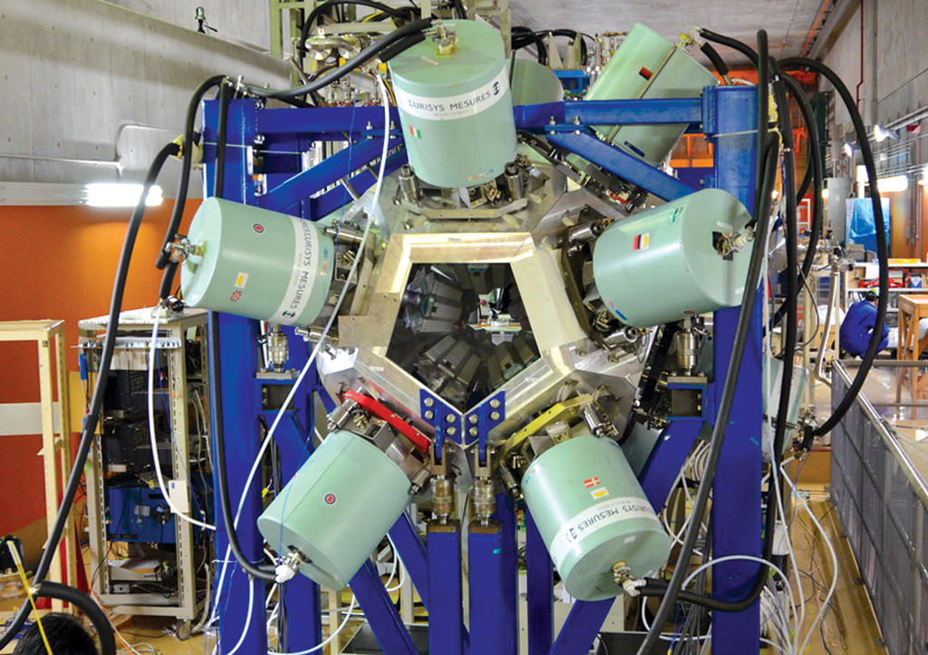
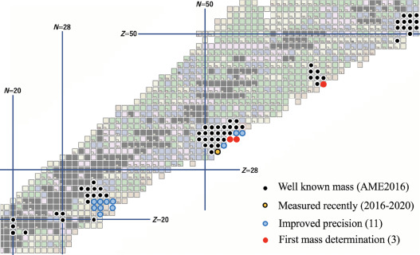

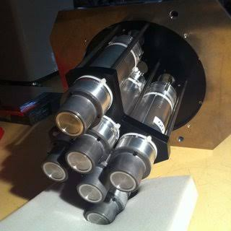
F11 – Decay and masses
EURICA from ~2011-2016
  Large program of decay studies across nuclear chart
    Structure and astrophysics questions addressed
  First fast-timing measurements from fragmentation beams
MR-TOF recently added, capable of “symbiotic” measurements

Slide 11
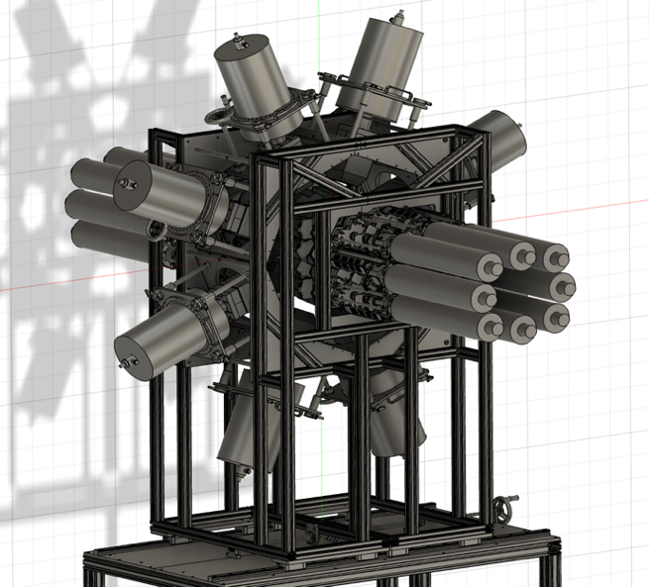
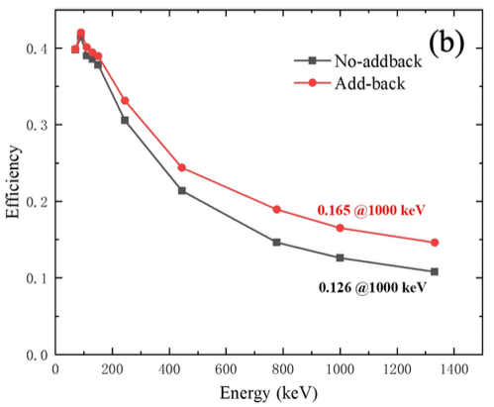
DEGAS
ASGARD
IMP Clovers
C2URIE Project ( Post EURICA: 2027 〜 )
RIBF256 (D.Brugnara) ... ¹⁰⁰Sn (6-days)
RIBF265 (A.Gottardo) ... ¹⁷⁸⁻¹⁸⁶Pb, ¹⁸⁸⁻¹⁹⁰Po (7-days)
RIBF266 (V.Phong) ... ¹⁴⁰Sn (6-days)
γ-ray detection efficiency
10 % → 20 %@ 1MeV
Full Digital Electronics
for beta & gamma detectors!
⁷⁸Kr ... 690 pnA ( x 20 )
¹²⁴Xe ... 173 pnA ( x 7 )
²³⁸U ... 70 ~ 100 pnA ( x 15)
⁷⁰Zn ... 500 ~ 826 pnA
²⁰⁸Pb ... ( ~100 pnA ) ... New!

Slide 12


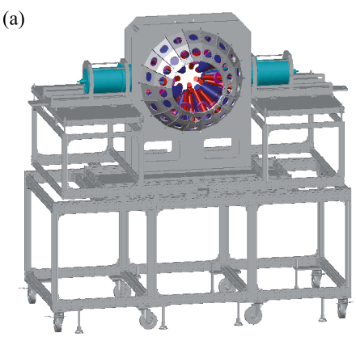
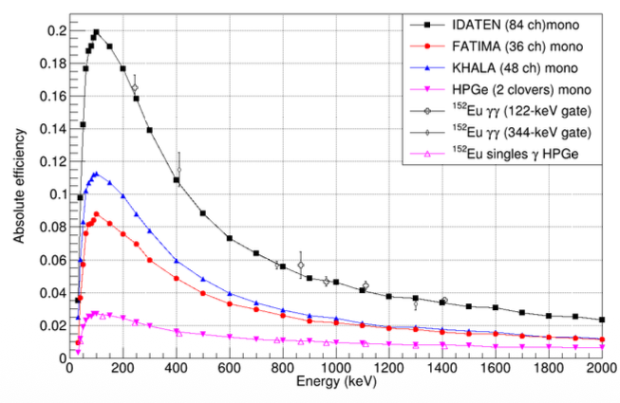
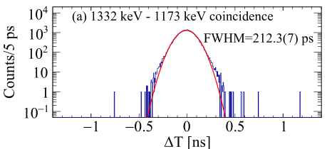
Fast Timing Decay Project
82 LaBr3(Ce) γ-detectors
FATIMA (36) + KHALA (46)
(UK) (Korea)
²³⁸U beam
RIBF230 (7-days) ... ¹²⁸Pd N=82 (Watanabe)
RIBF232 (3-days) ... ⁶⁴V (B.Olaizola)
RIF215R1 (3.5-days) ... 136In (R. Lozeva)
RIBF218R1 (4.5-days) ... Z=40, N=60 (T. Bhattacharjee)
RIBF291R1 (5.5-days) ... 214Pb, 226Po (A.I. Morales)
RIBF220R1 (4.5-days) ... 79Cu (E.Sahin)
¹²⁴Xe beam
RIBF229 (3.5-days) ... ¹⁰⁰Sn (A.Blazehv)
RIBF222R1 (5.5-days) ... N=Z below ¹⁰⁰Sn (J.Park)
RIBF239 (4.5-days) ... ⁸²Nb, ⁸⁶Tc (B.Moon)
B.Moon et al.,
NIM A 1084, 171239 (2026)

Slide 13
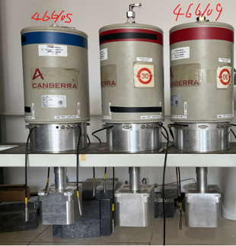
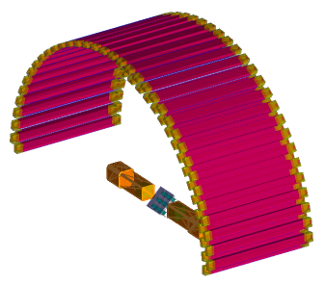
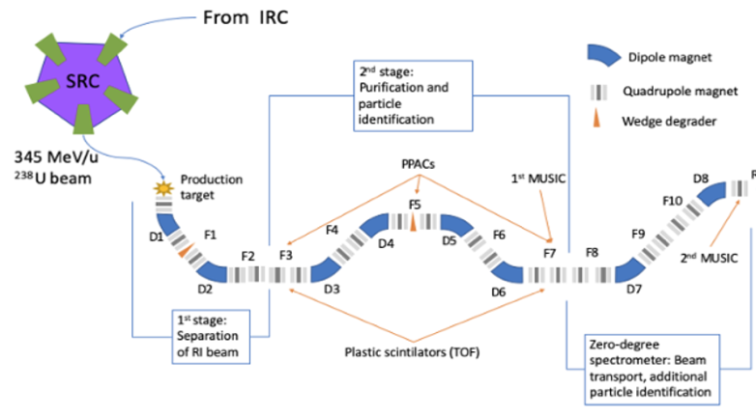
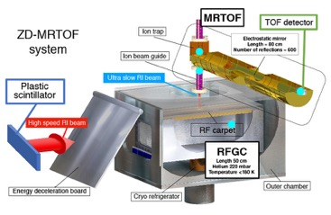

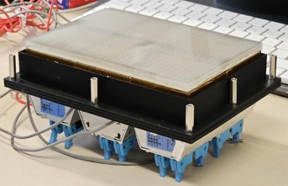
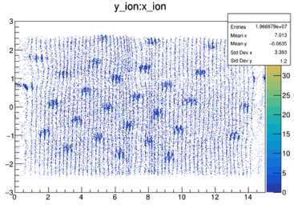
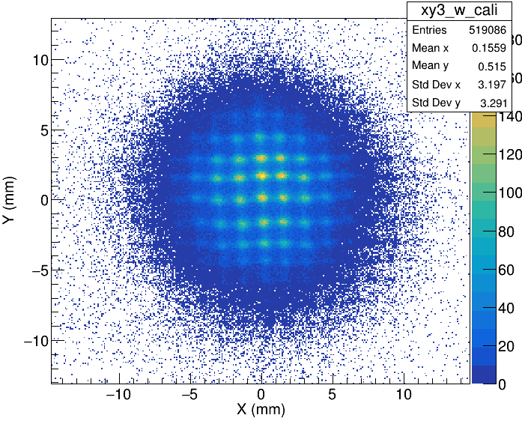
γ-ray detectors
- LaBr3(Ce) KHALA
- Clover Ge
ZD-ADS Project with ZD-MRTOF
Neutron TOF
(TOFU)
HpGe, LaBr₃
Gas-cell
ZD-MRTOF
Mass messurement
Position-sensitive Scintillator GARi
Commissioning Experiment (Parasitic Mode) in 2024
(Masked) ion hit pattern
Beta hit pattern (⁹⁰Sr source)
◯ Q.B.Zeng et al., PRL 135, 232501 (2025)
  New β-decay half-lives by GARi
◯ C.Y. Fu et al., PRL accepted.
  New mass ⁵⁰Ar

Slide 14
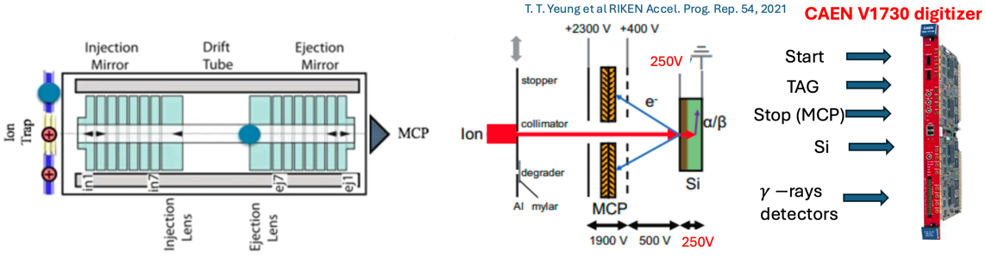

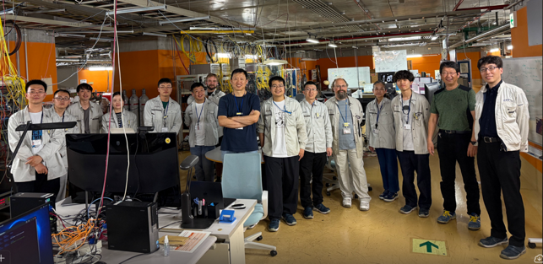
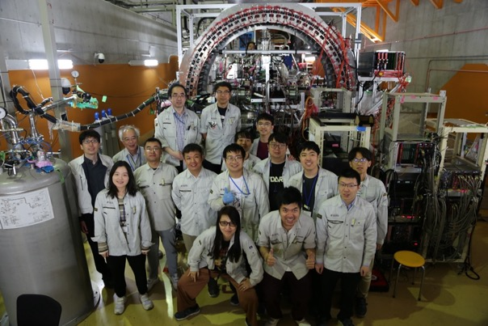
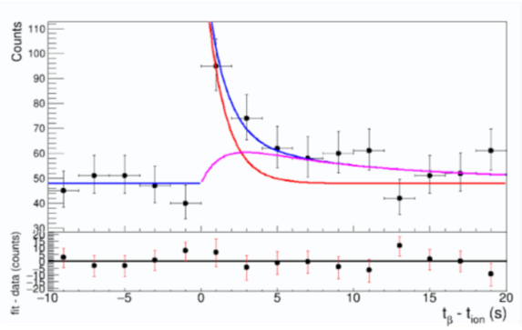
Decay Spectroscopy of Long-Lived Isomers with ZD-MRTOF
ZD-MRTOF Mass Resolving Power : > 600 k
beta counter: PIPS
Energy threshold: < 20 keV
Efficiency: ~ 50 %
Mass Gated β-decay
RI’s decay curve
Decay Spectroscopy of long-lived isomeric states !
→ Impact study of isomers in r-process nucleosynthesis

Slide 15

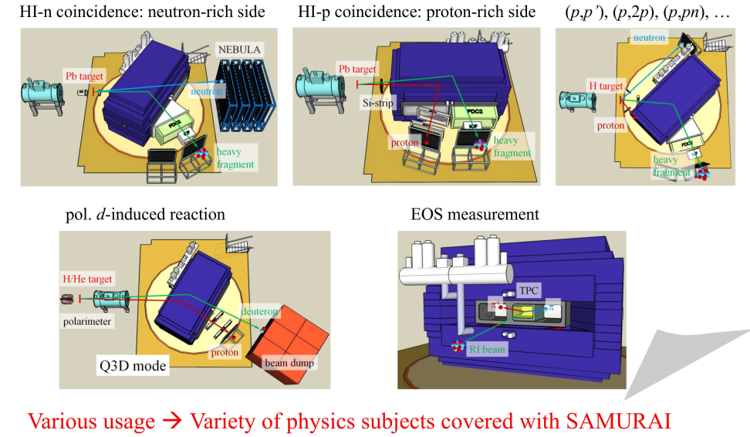
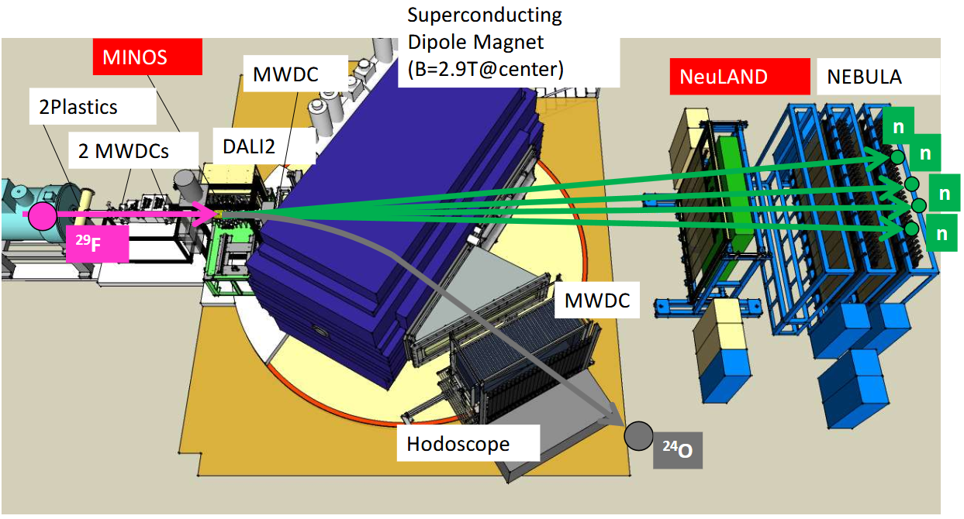
Versatile apparatus
  Equation of state: Sπrit
  (p,2p), (p,pn), etc
Unbound systems
Invariant and missing-mass spectroscopy
Multi-particle spectroscopy
Many detector sub-systems
Large overlap and collaboration
with R3B
  Lots of the same infrastructure shared

Slide 16
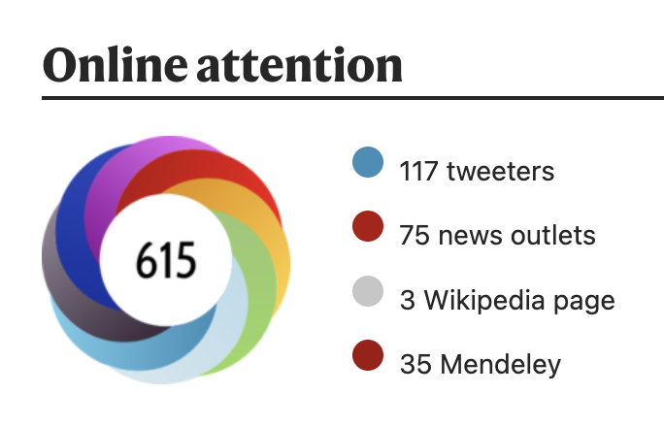
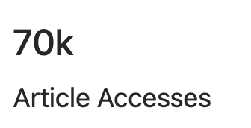
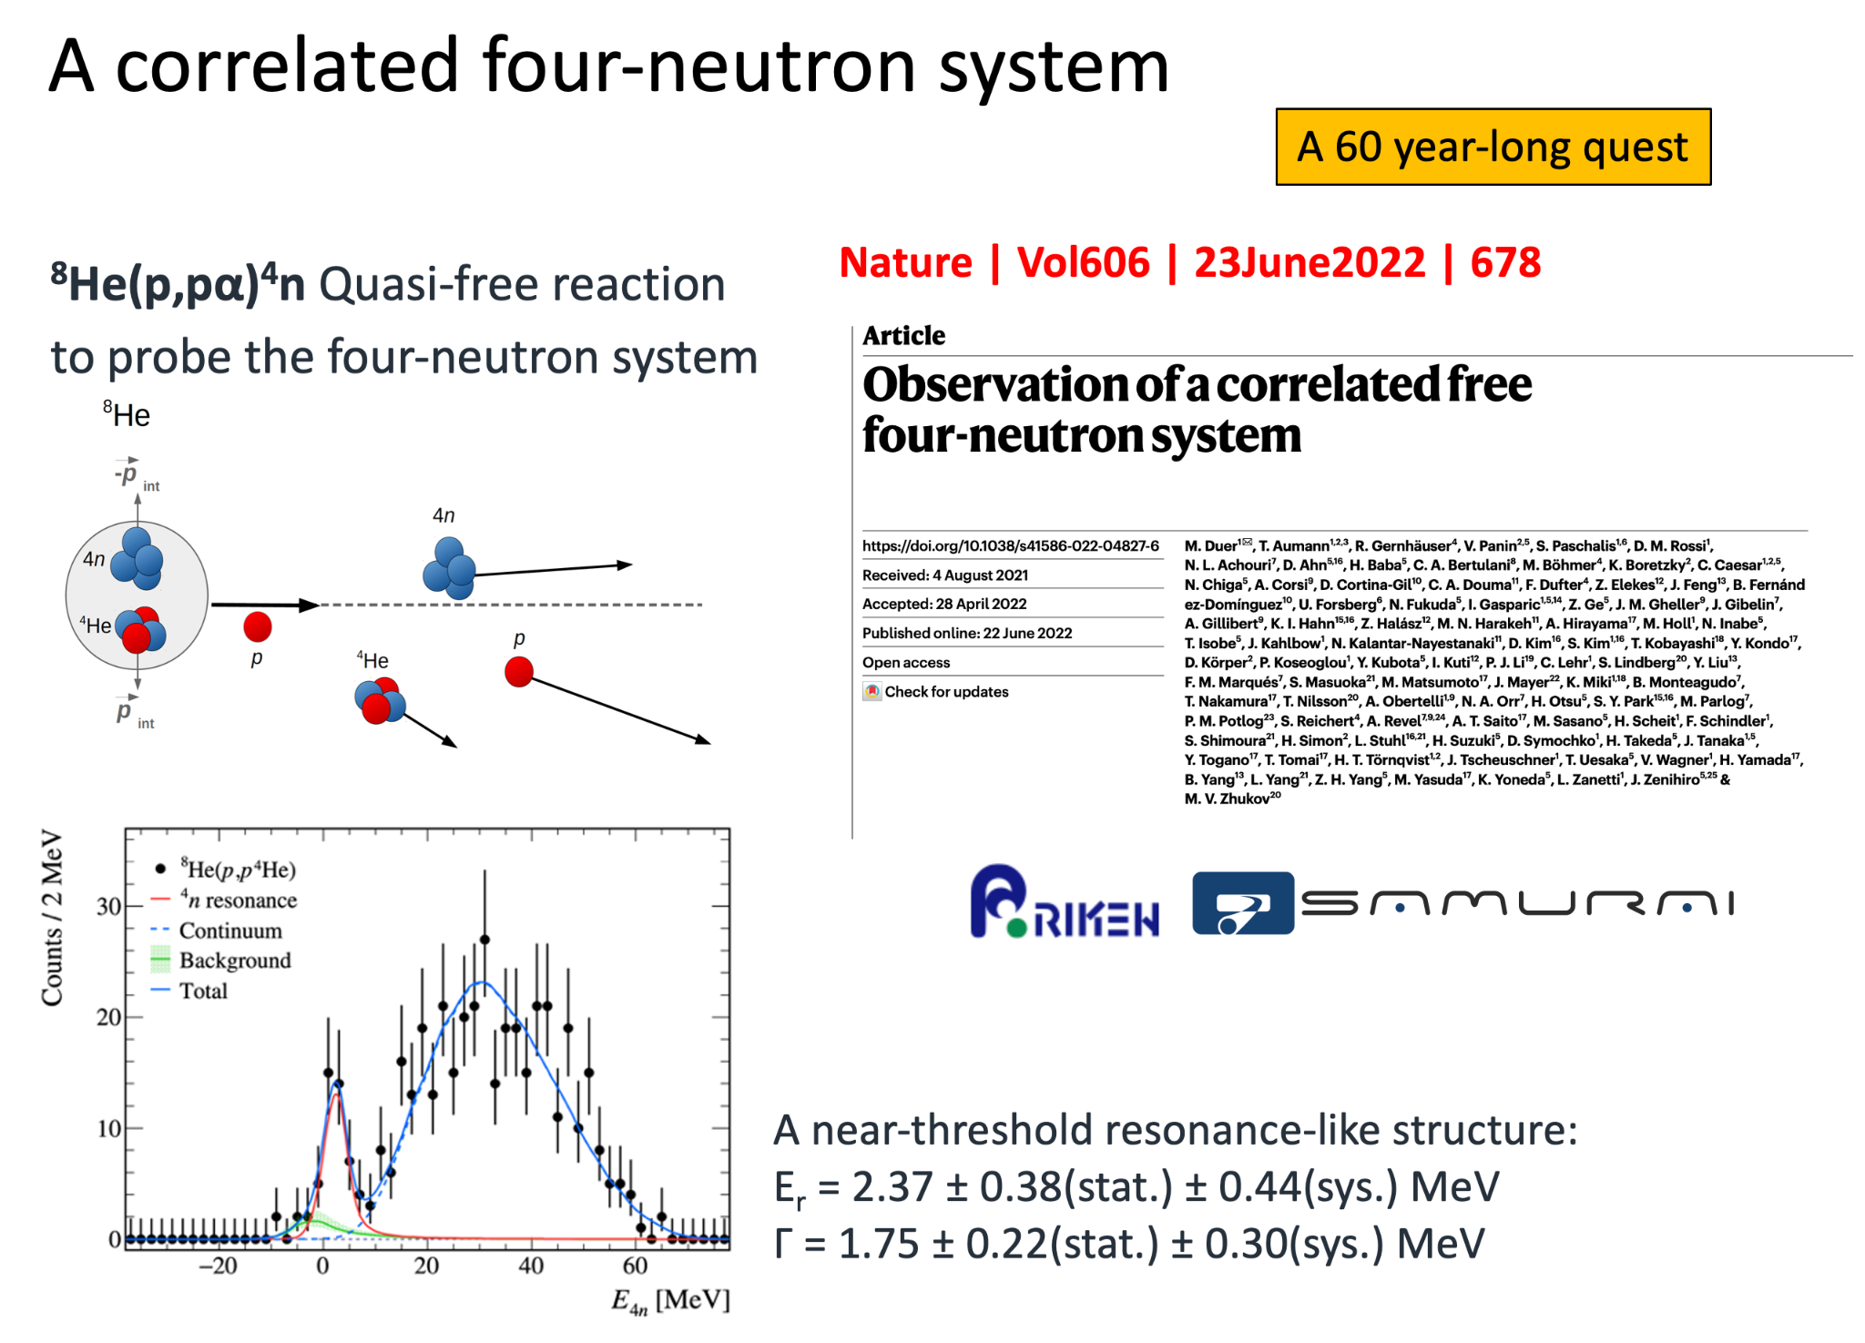
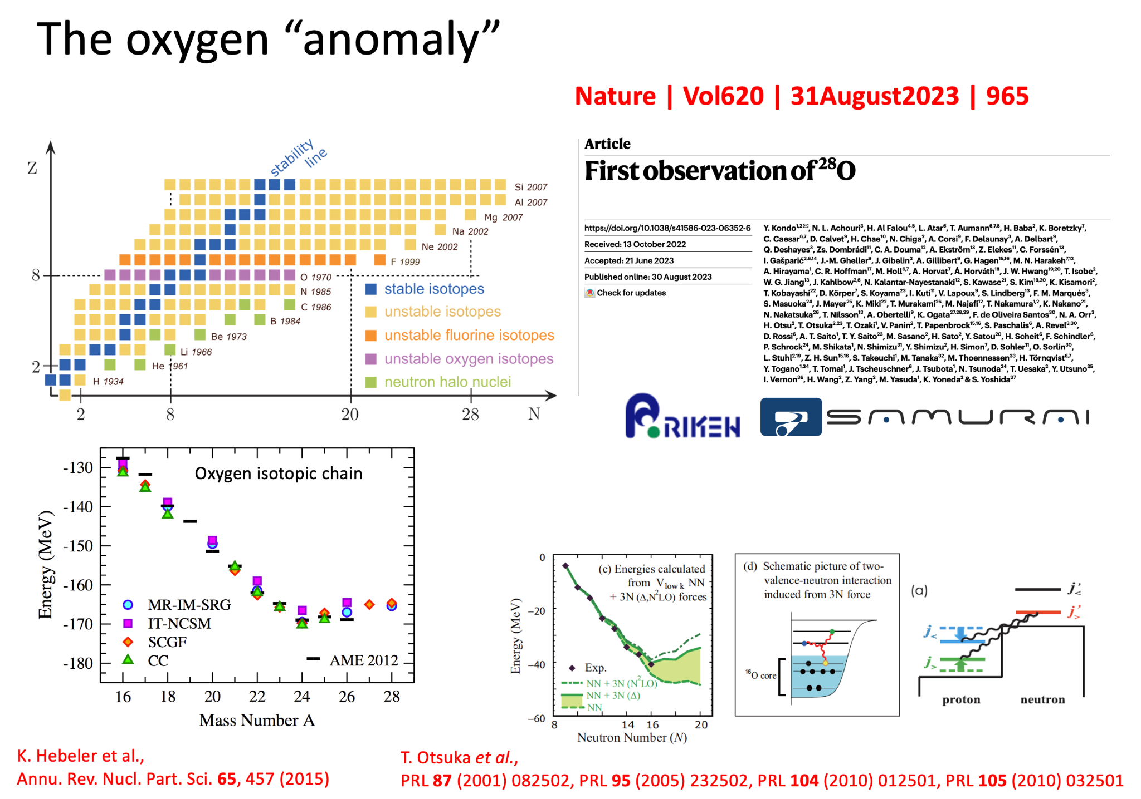
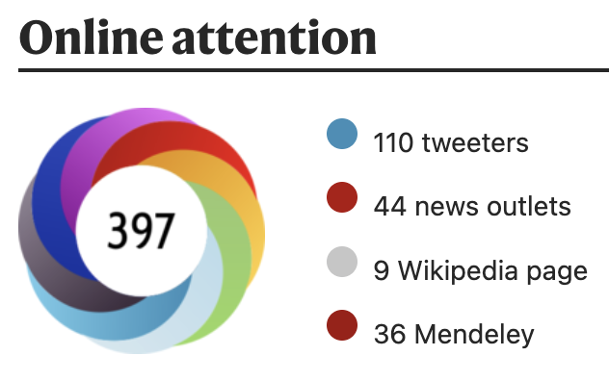
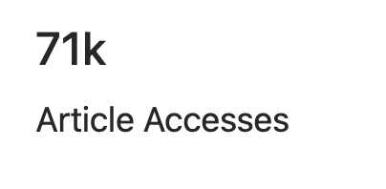
RIBF: frontier facility for the study of exotic nuclei
S. Paschalis (U. York) spokesperson.

Slide 17

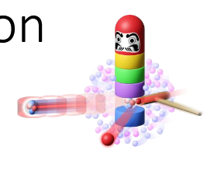
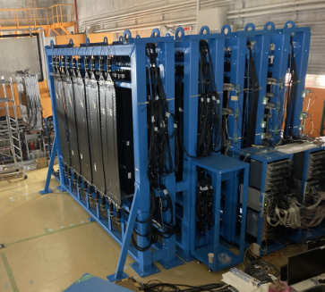



NEBULA Plus
Detector systems aimed at multi-neutron spectroscopy
Up to 6n aimed for (NEOLITH)
Biggest challenge is cross-talk
Project to investigate clustering in nuclei
Need to tag on different knockout products
S. Paschalis (U. York) an international coordinator of reaction channels
HIME
Theoretical inputs important for weakly-bound systems (deuteron/nucleon pairs)
  RCNP (K. Yoshida)/Kyushu (K. Ogata)
  Collaborators of UManchester

Slide 18

Summary
Significant UK involvement at the RIBF
  Material and creative leadership
RIBF upgrade will increase beam intensities by factors
New detector systems already in use
Combination of detectors and beam intensities create opportunities for both discovery and more detailed studies
Many detectors presented are precursors to FAIR…
Many other updates that I’m not so au-fait with!
  Keep an eye out for KISS1.5!

Slide 19
Backup slides

Slide 20

HYPATIA Collaboration landscape - now
Project partners:
York, Daresbury, UWS, NPL, UK
RIKEN, KEK, RCNP, CNS, Tokyo Tech, Japan
ATOMKI, Hungary
HKU, BNU, Beihang U, HIAF China
CENS, South Korea
TUDa, Cologne, Germany
LPC, IJCLab, France
CSIC, Spain

Slide 21





n-rich Ca isotopic chain
B. Alex Brown, Physics 2022, 4(2), 525-547
A. Magilligan et al., PRC 104 (2021) L051302
(sub-)shell closure at N = 16, 20, 28, 32, 34
T. Otsuka et al., Rev. Mod. Physics 92, 015002 (2020)
Chen et al., PLB 843 (2023) 138025
The influence of the gds orbitals above the pf shell is critical for the location of the dripline;
UFP-CA Hamiltonian: ⁶⁰Ca is likely doubly magic at a level similar to ⁶⁸Ni
A3DA-t interaction: Ca dripline at N = 50
Nature 498, 346-349 (2013)

Slide 22


Electromagnetic strength beyond N=28
HiCARI (High-resolution Cluster Array at the RIBF)
Hybrid HPGe array:
  6 x Miniball cluster
  4 x SuperClover cluster
  1 x Gretina Quad cluster
  1 x Gretina P3 cluster
Chen, Petri et al., in preparation (2026)

