Slide 1

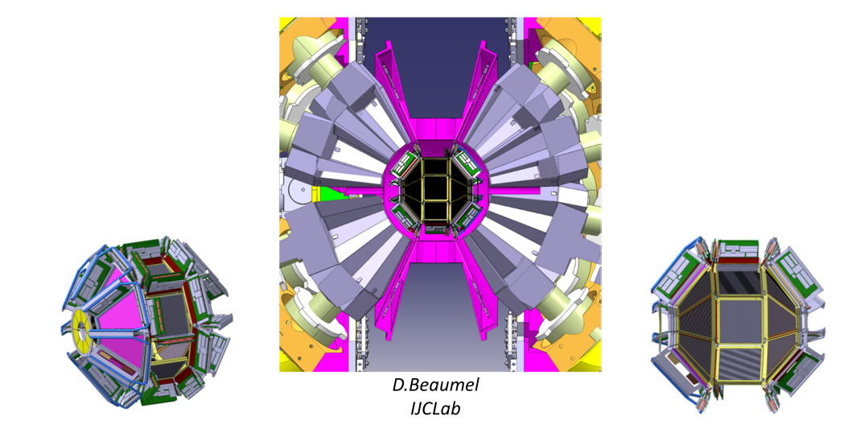
VAMOS
GANIL/SPIRAL1 2028-2029
FRANCE--ITALY--UK--SPAIN

Slide 2
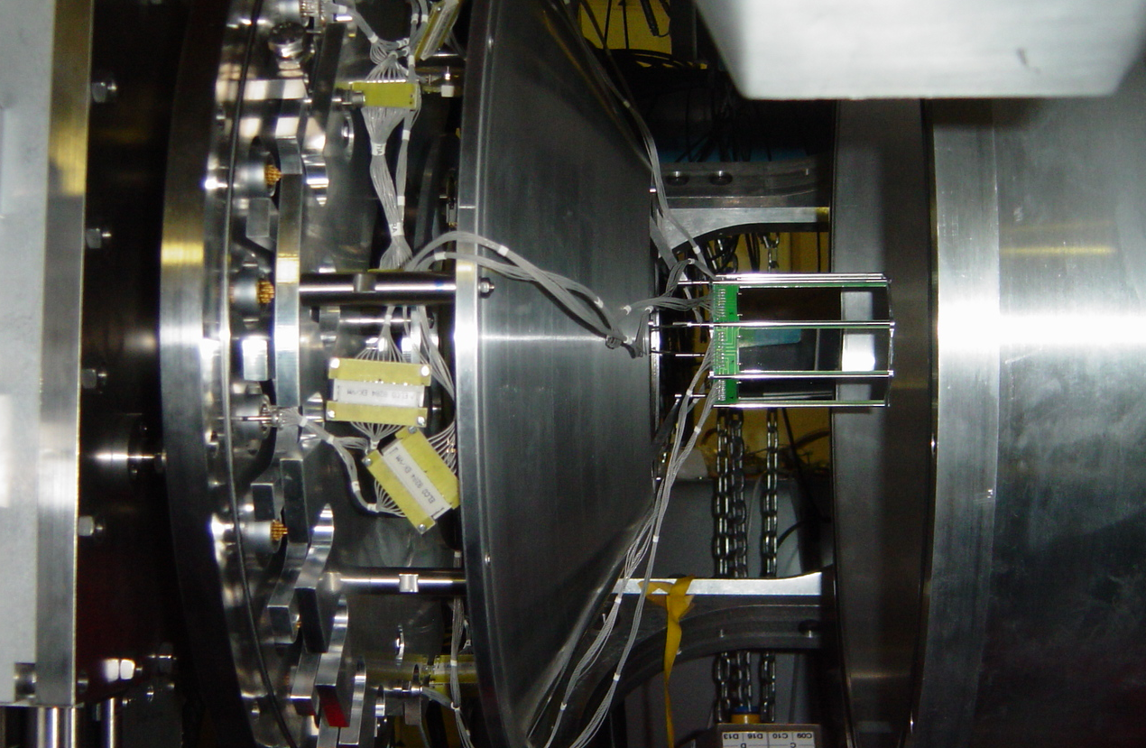
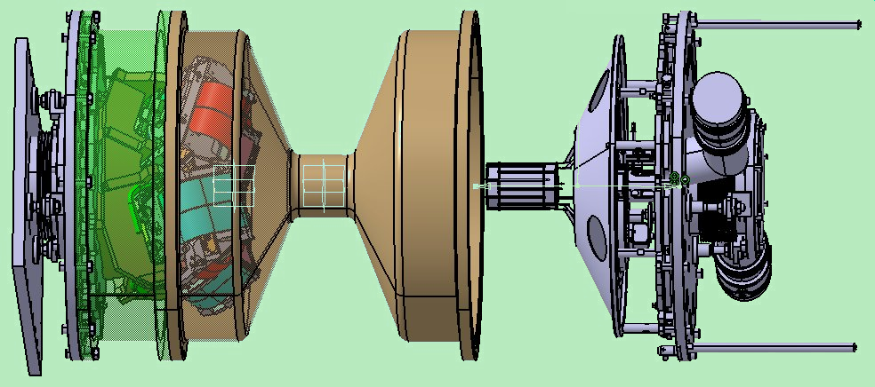

2003
MUGAST 2010-2025
GANIL
EXOGAM
VAMOS
SPIRAL1/LISE
GANIL
EXOGAM
VAMOS
SPIRAL1/LISE
GANIL
AGATA
VAMOS
SPIRAL1++
EUROPEAN
RE-ACCELERATED

Slide 3

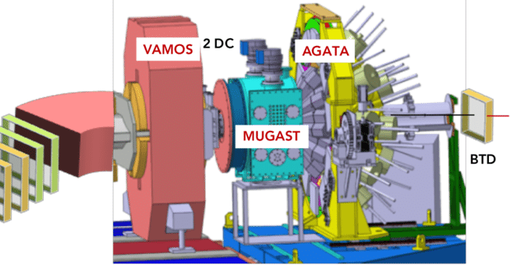
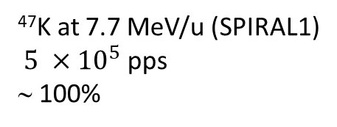
2019-2021
Beam:
Intensity:
Purity:
⁴⁷K at 7.7 MeV/u (SPIRAL1)
$5 ×{10}^{5}$ pps
∼ 100%
(d,p) and (d,t)
Charlie Paxman
Surrey, GANIL

Slide 4
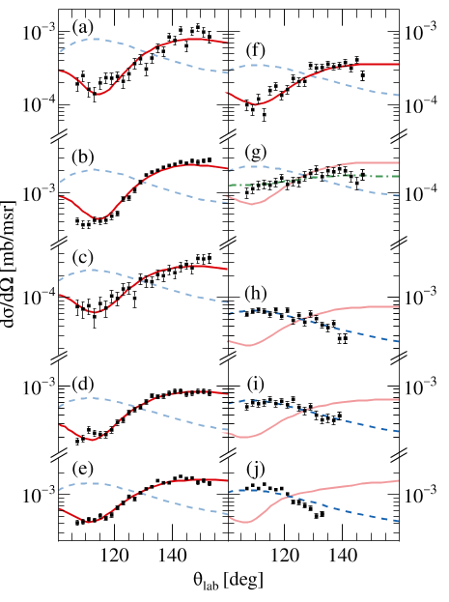
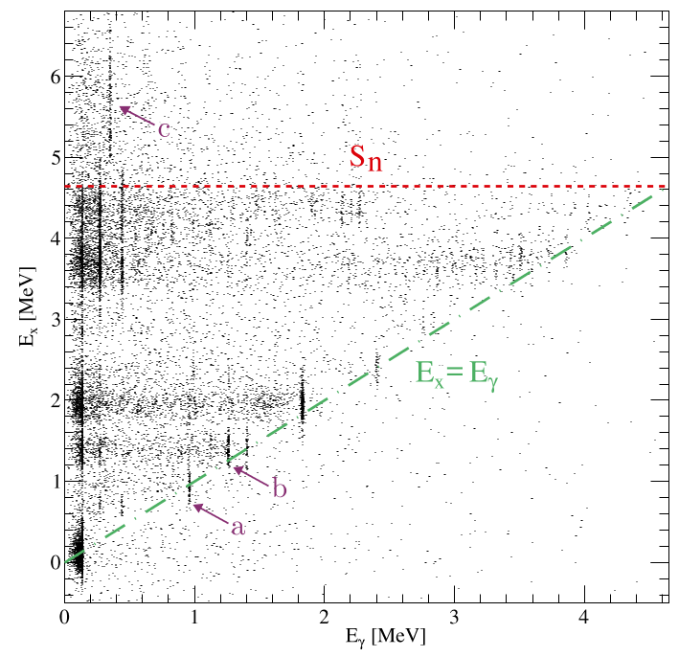
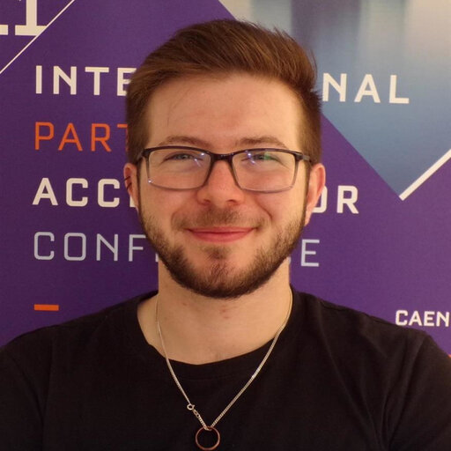
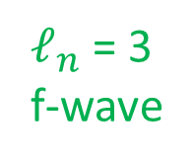

⁴⁷K (d,pγ) ⁴⁸K
$ℓ_{n}$ = 3
f-wave
$ℓ_{n}$ = 1
p-wave
C. J. Paxman et al., Phys. Rev. Lett. 134, 162504 (2025)
C. J. Paxman et al., Phys. Rev. C, for the (d,t), with referee
CHARLIE
PAXMAN

Slide 5
STEERING COMMITTEE
MANAGEMENT BOARD
ELECTED BY
STEERING
COMMITTEE
CHAIR OF
GRIT STEERING
COMMITTEE
CHAIR OF
MANAGEMENT
BOARD
PROJECT MANAGER
APPOINTED BY
STEERING COMMITTEE
EX
OFFICIO
MEMBERS
NOMINATED BY
NATIONAL AGENCIES
TECHNICAL
COORDINATOR
WITH DEPUTY
WORKING PARTY LEADERS
WORKING PARTIES
COLLABORATION COUNCIL
INDIVIDUAL CAMPAIGN
ELECTED BY COLLABORATION
COUNCIL
GRIT
LOCAL CAMPAIGN
MANAGER
GRIT
PROJECT
SPOKESPERSON
APPOINTED BY MANAGEMENT
BOARD
ELECTED BY COLLABORATION
COUNCIL
GRIT
PHYSICS CAMPAIGN
SPOKESPERSON
REPRESENTATIVES
OF EACH
COLLABORATING
INSTITUTION
PHYSICS
COLLABORATORS
WORKING WITH OTHER
LOCAL PROJECT MANAGERS

Slide 6
STEERING COMMITTEE
MANAGEMENT BOARD
CHAIR
WILTON CATFORD
CHAIR OF
MANAGEMENT
BOARD
PROJECT MANAGER
ADRIEN MATTA
DANIELE MENGONI
EX
OFFICIO
MEMBERS
NOMINATED BY
NATIONAL AGENCIES
TECHNICAL
COORDINATOR
WITH DEPUTY
WORKING PARTY LEADERS
WORKING PARTIES
COLLABORATION COUNCIL
INDIVIDUAL CAMPAIGN
TO BE ELECTED BY COLLABORATION
COUNCIL
LOCAL CAMPAIGN
MANAGER
MARLENE ASSIÉ
GRIT
PROJECT
SPOKESPERSON
TO BE ELECTED BY COLLABORATION
COUNCIL
GRIT
PHYSICS CAMPAIGN
SPOKESPERSON
FOR THE UK:
SURREY (JH)
YORK (CD)
DARESBURY (ML)
PHYSICS
COLLABORATORS
WORKING WITH OTHER
LOCAL PROJECT MANAGERS

Slide 7
VAMOS
GANIL/SPIRAL1 2028-2029
FRANCE--ITALY--UK--SPAIN

