Slide 1


Activities and future plans at JYFL, Jyväskylä
Paul Campbell
Nuclear Physics Group, The University of Manchester

Slide 2
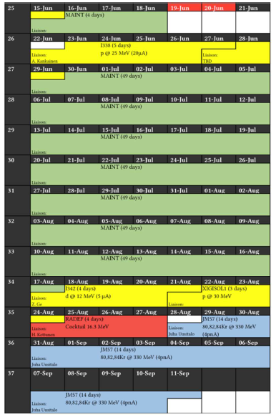

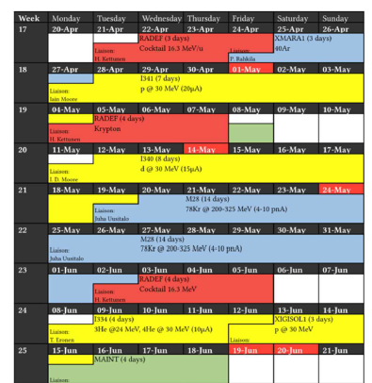
Beam time schedule
29/04/26 – 11/09/26
Extended “maintenance” period 15/06 – 17/08

Slide 3

Previously…

Slide 4
The JYFL accelerator laboratory
Priorities:
Renovation(s)
MARA-LEB
MCC-30 (next year)
New Tandetron + neutron line, C-linac gone, Pelletron to go

Slide 5
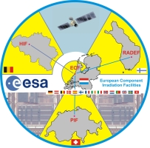
Radiation effects and irradiation services
  Irradiation of components with heavy ion beams to simulate radiation effects in space
  ESA External Component Irradiation Facility
  Cocktail beams 10, 16 and 22 MeV/u
  Proton beams from 0.4 – 55 MeV
  Also, possibility for electron, gamma, neutron
  Typically, 25% of main cyclotron usage
  RADNEXT IA
  RADMEP European Master (ERASMUS+)
  Membrane production (Porsche cayenne headlights, other filters…)

Slide 6
JYFL goals, next year and beyond…
Major redevelopment of K130 Target Hall in 2026.
New 3 MV platform (Tandetron) – arriving early November and acceptance tests before 2027.
Neutron irradiation facility (new).
Relocation of RADEF facility.
Completion of MARA-LEB facility.
Ongoing discussions with company for production of ²¹¹At for TAT.
Aim to (re)commission the K=30 MeV machine. Offering parallel operations.
Continued international collaboration at facilities including ISOLDE, FAIR, GANIL…

Slide 7
Developments (UK)

Slide 8
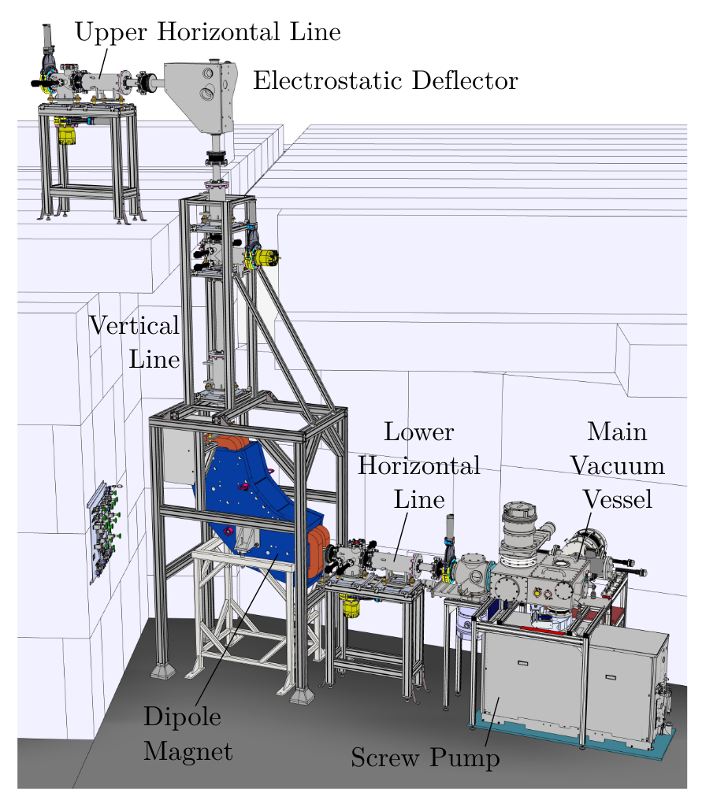
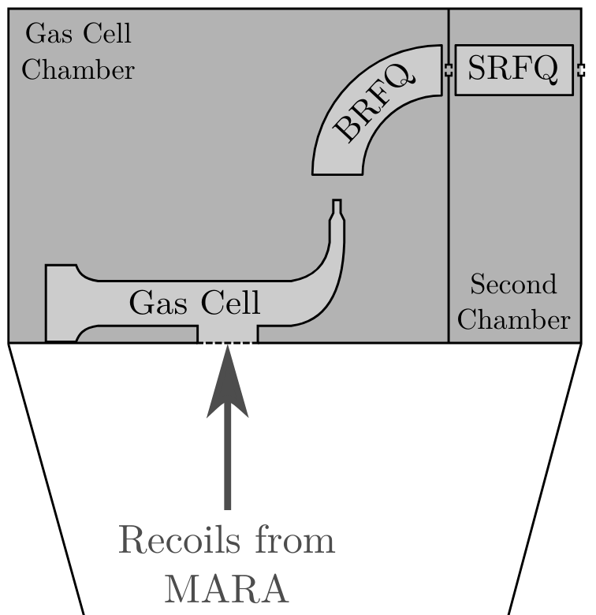
MARA-LEB?
• Gas stopper, laser ionisation, mass separator for the MARA separator
Notes:
Why isthis region interesting?
Cross the N = 28, testing magicity, confirmation of this sharp change in charge radii (deformation).
In the Fe and Co chain there exists a proton-emitting isomer in 53mCo, with it’s mirror nuclei in 53mFe, providing a measure 53mFe will give insight for predicted moments of the much less produced 53mCo.
Improved sensitivity in the neutron deficient case will provide the required sensitivity to push to the n-rich side, where a maxium of deformation has been measured towards the N = 40 island of inversion in the Fe chain.

Slide 9
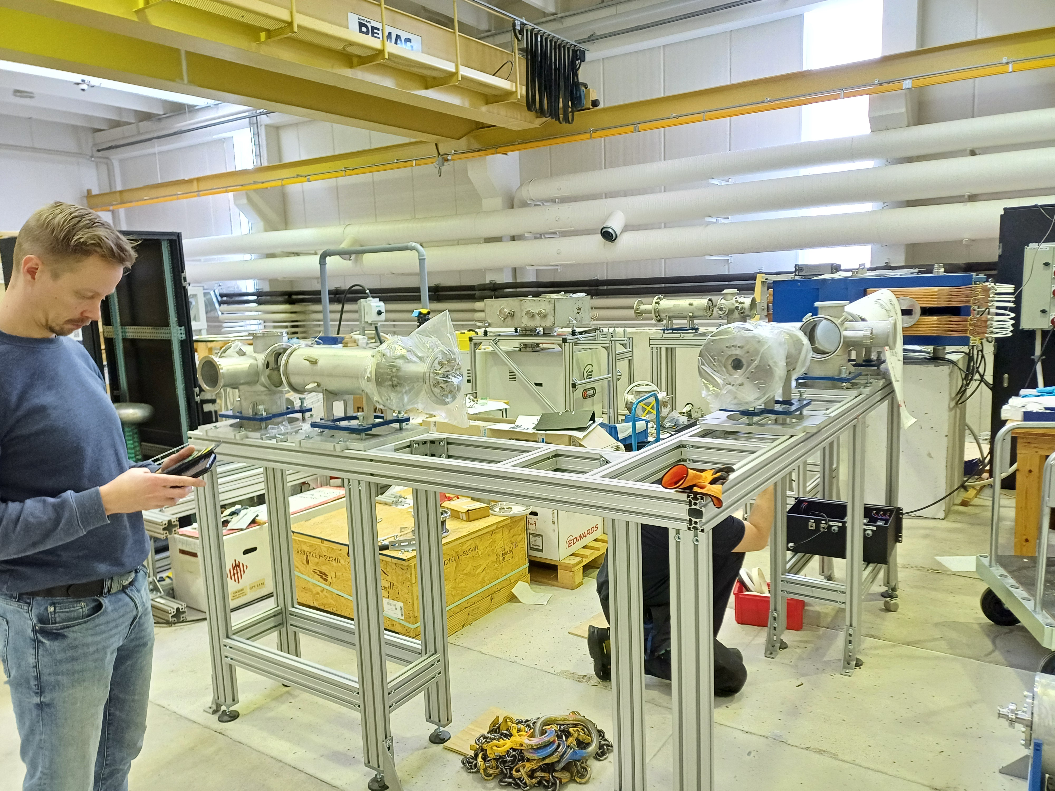
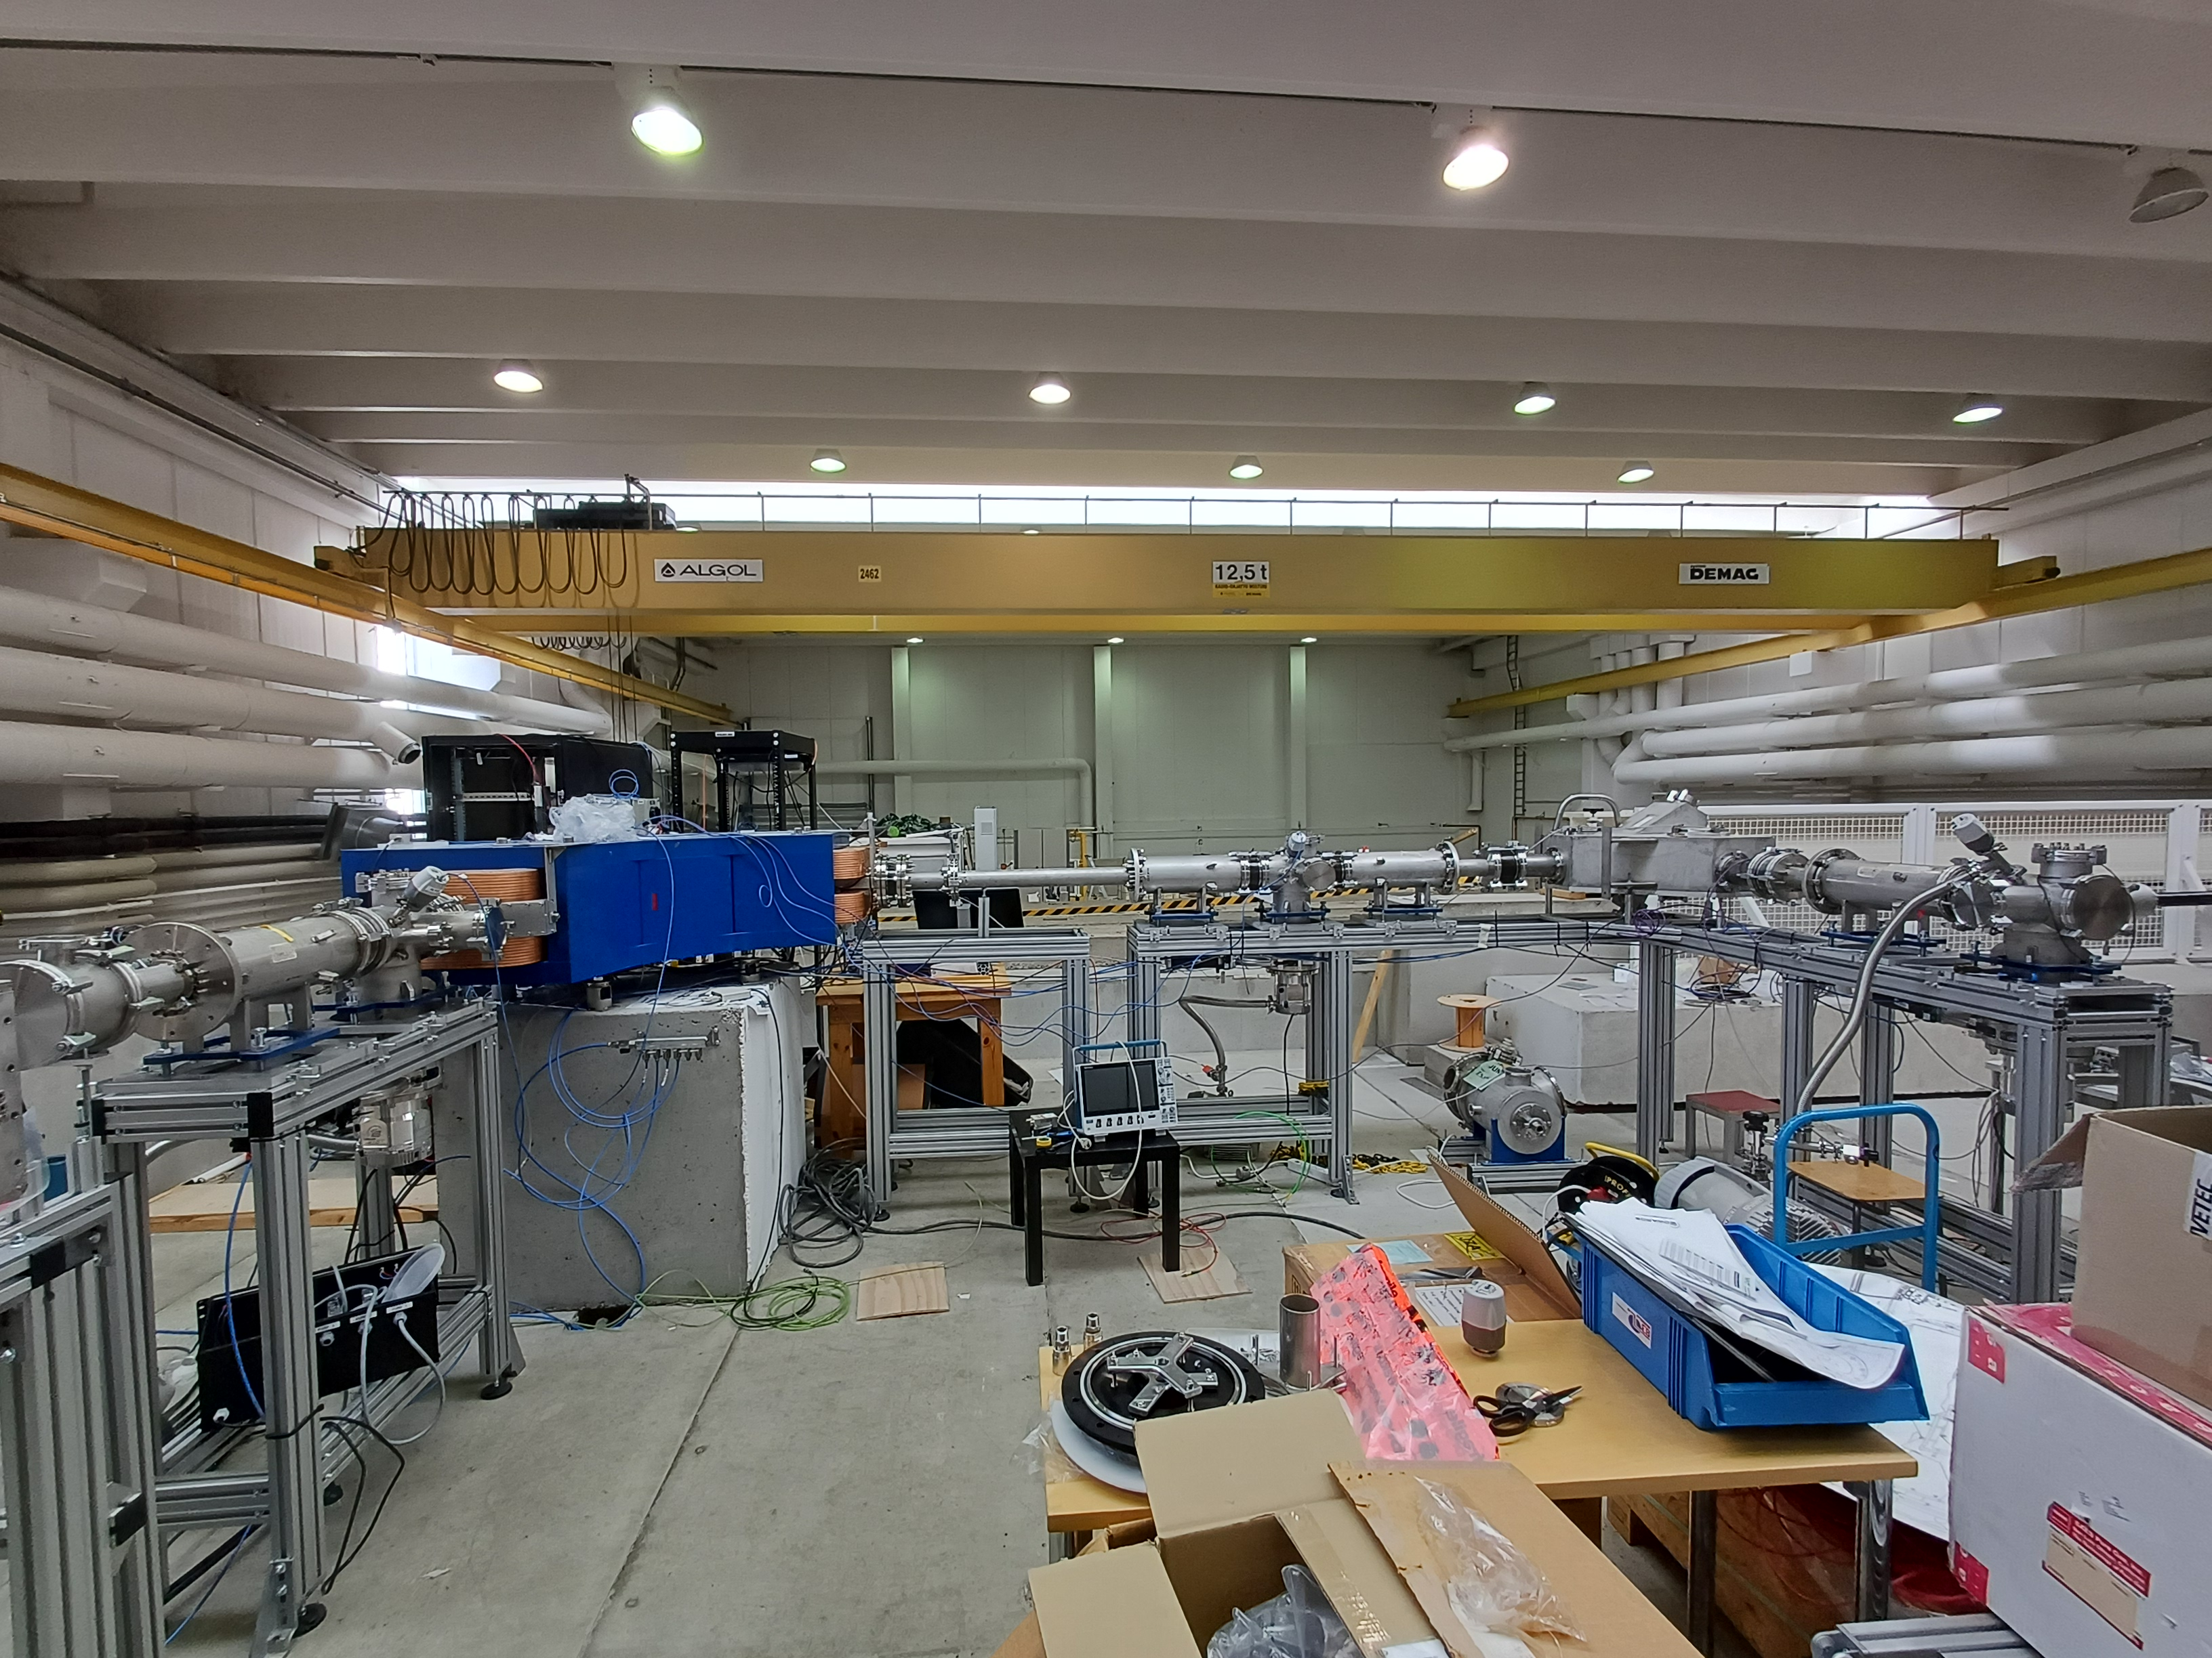
MARA-LEB
• Offline assembly almost complete. Individual beam line sections tested.
• The ion guides constructed. Ion source mounted and tested in the chamber.
• LEB lasers tested at IGISOL and fully operational.
• Tape station design ongoing at Daresbury (led by Kalle Auranen).
Notes:
Why isthis region interesting?
Cross the N = 28, testing magicity, confirmation of this sharp change in charge radii (deformation).
In the Fe and Co chain there exists a proton-emitting isomer in 53mCo, with it’s mirror nuclei in 53mFe, providing a measure 53mFe will give insight for predicted moments of the much less produced 53mCo.
Improved sensitivity in the neutron deficient case will provide the required sensitivity to push to the n-rich side, where a maxium of deformation has been measured towards the N = 40 island of inversion in the Fe chain.

Slide 10
Gamma / electron activity
• JM57 Highly Deformed Bands in Europium Isotopes and Identification of New Excited States, C. Sullivan, D. Joss, E. Paul (14 days)
• JM64 Systematic investigation of Auger electron emission multiplicities for Auger Electron Therapy, Jacob Heery, Jack Henderson, Panu Ruotsalainen (11 days)
• JR169 Onset of deformation in light Ra isotopes - 204Ra, J. Henderson, P. Rahkila, S. Freeman (10 days)
• JR174 Evolution of octupole correlations in 226U, James Keatings, John F Smith, Paul Greenlees (14 days)
• M29 Exploring the role of neutrons in proton emission from odd-odd nuclei, Adam McCarter, Robert Page (14 days)
• R73 Observing Nuclear Excitation by Electron Capture - Charge State Measurements of 83Kr, John Fuller, David Jenkins, Jack Henderson (5 days)
• S31 Search for excited 0+ states and E0 transitions in 194Po nucleus using the SAGE spectrometer at MARA, Janne Pakarinen, Andrew Briscoe (10 days)
• S32 Probing the E0 transitions in 187Pb using the SAGE spectrometer, Janne Pakarinen, Philippos Papadakis (14 days)
Notes:
Why isthis region interesting?
Cross the N = 28, testing magicity, confirmation of this sharp change in charge radii (deformation).
In the Fe and Co chain there exists a proton-emitting isomer in 53mCo, with it’s mirror nuclei in 53mFe, providing a measure 53mFe will give insight for predicted moments of the much less produced 53mCo.
Improved sensitivity in the neutron deficient case will provide the required sensitivity to push to the n-rich side, where a maxium of deformation has been measured towards the N = 40 island of inversion in the Fe chain.

Slide 11
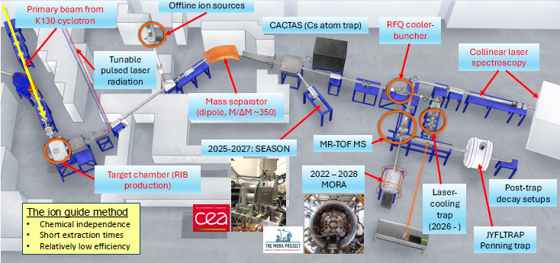
Meanwhile, at the IGISOL facility:
Notes:
Why isthis region interesting?
Cross the N = 28, testing magicity, confirmation of this sharp change in charge radii (deformation).
In the Fe and Co chain there exists a proton-emitting isomer in 53mCo, with it’s mirror nuclei in 53mFe, providing a measure 53mFe will give insight for predicted moments of the much less produced 53mCo.
Improved sensitivity in the neutron deficient case will provide the required sensitivity to push to the n-rich side, where a maxium of deformation has been measured towards the N = 40 island of inversion in the Fe chain.

Slide 12
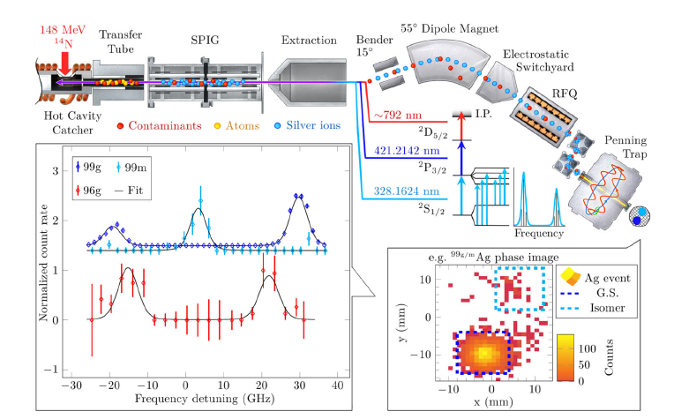
Non-IG “IGISOL activities”
Worldwide great effort on measuring the charge radius of proton-emitters…
Notes:
Why isthis region interesting?
Cross the N = 28, testing magicity, confirmation of this sharp change in charge radii (deformation).
In the Fe and Co chain there exists a proton-emitting isomer in 53mCo, with it’s mirror nuclei in 53mFe, providing a measure 53mFe will give insight for predicted moments of the much less produced 53mCo.
Improved sensitivity in the neutron deficient case will provide the required sensitivity to push to the n-rich side, where a maxium of deformation has been measured towards the N = 40 island of inversion in the Fe chain.

Slide 13

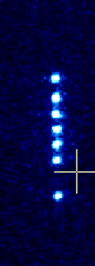
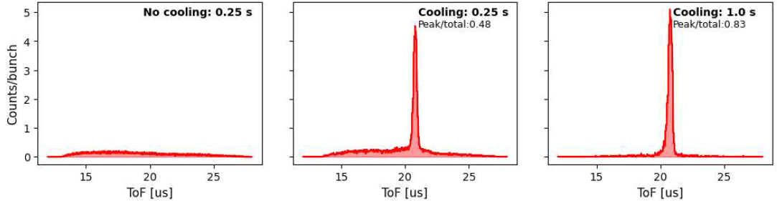
Laser cooling to mK
As ions cool, Δv and Δx shrink, and therefore the ToF.
Temperature? Hard to infer, until:
²P_{1/2}
1092 nm
422 nm
²D_{3/2}
²S_{1/2}
Ramped laser frequency

Slide 14
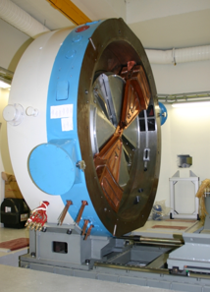
General:
Pressures on beam time more acute than ever (additionally so given LS3 and SPIRAL2 status)
Still the case that the K130 delivers protons or deuterons for (over) one-third of its on-target hours
Productivity (UK and others) however higher than ever…

Slide 15
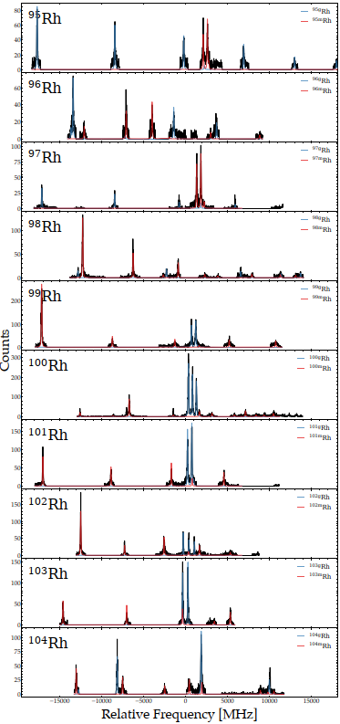
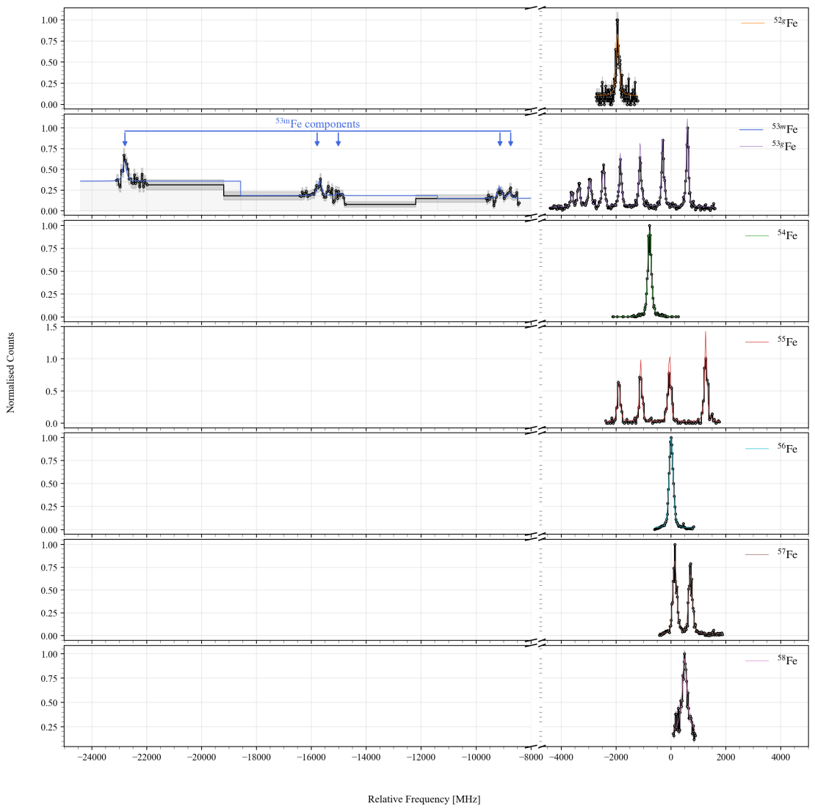
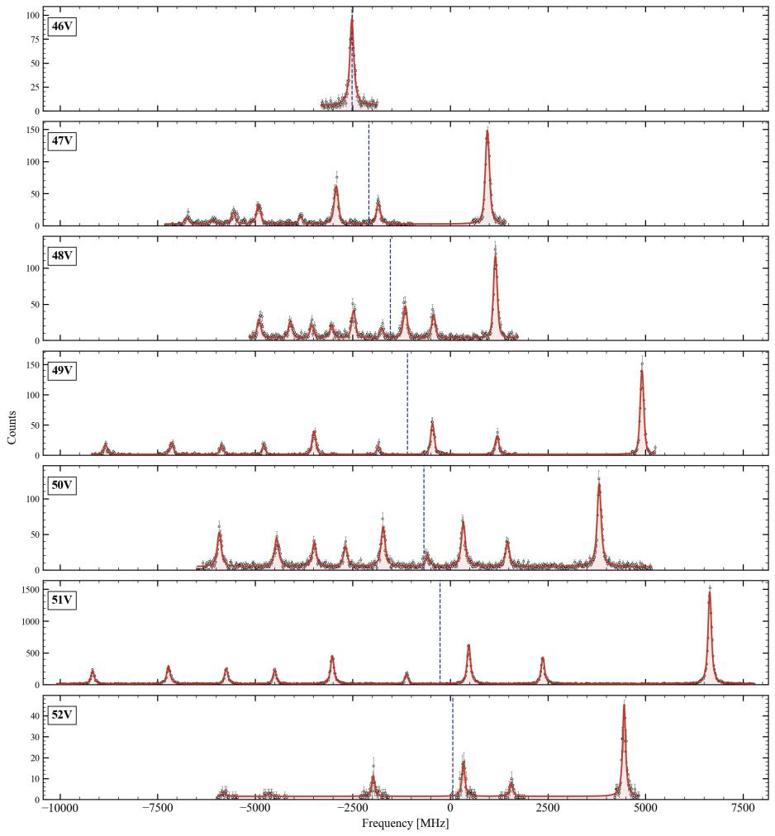
Highly productive… (IGISOL-laser to appear)

Slide 16
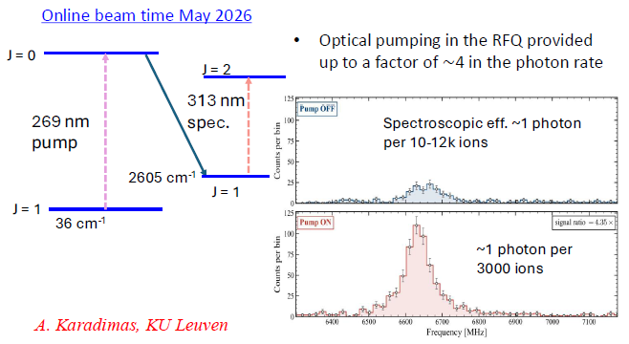
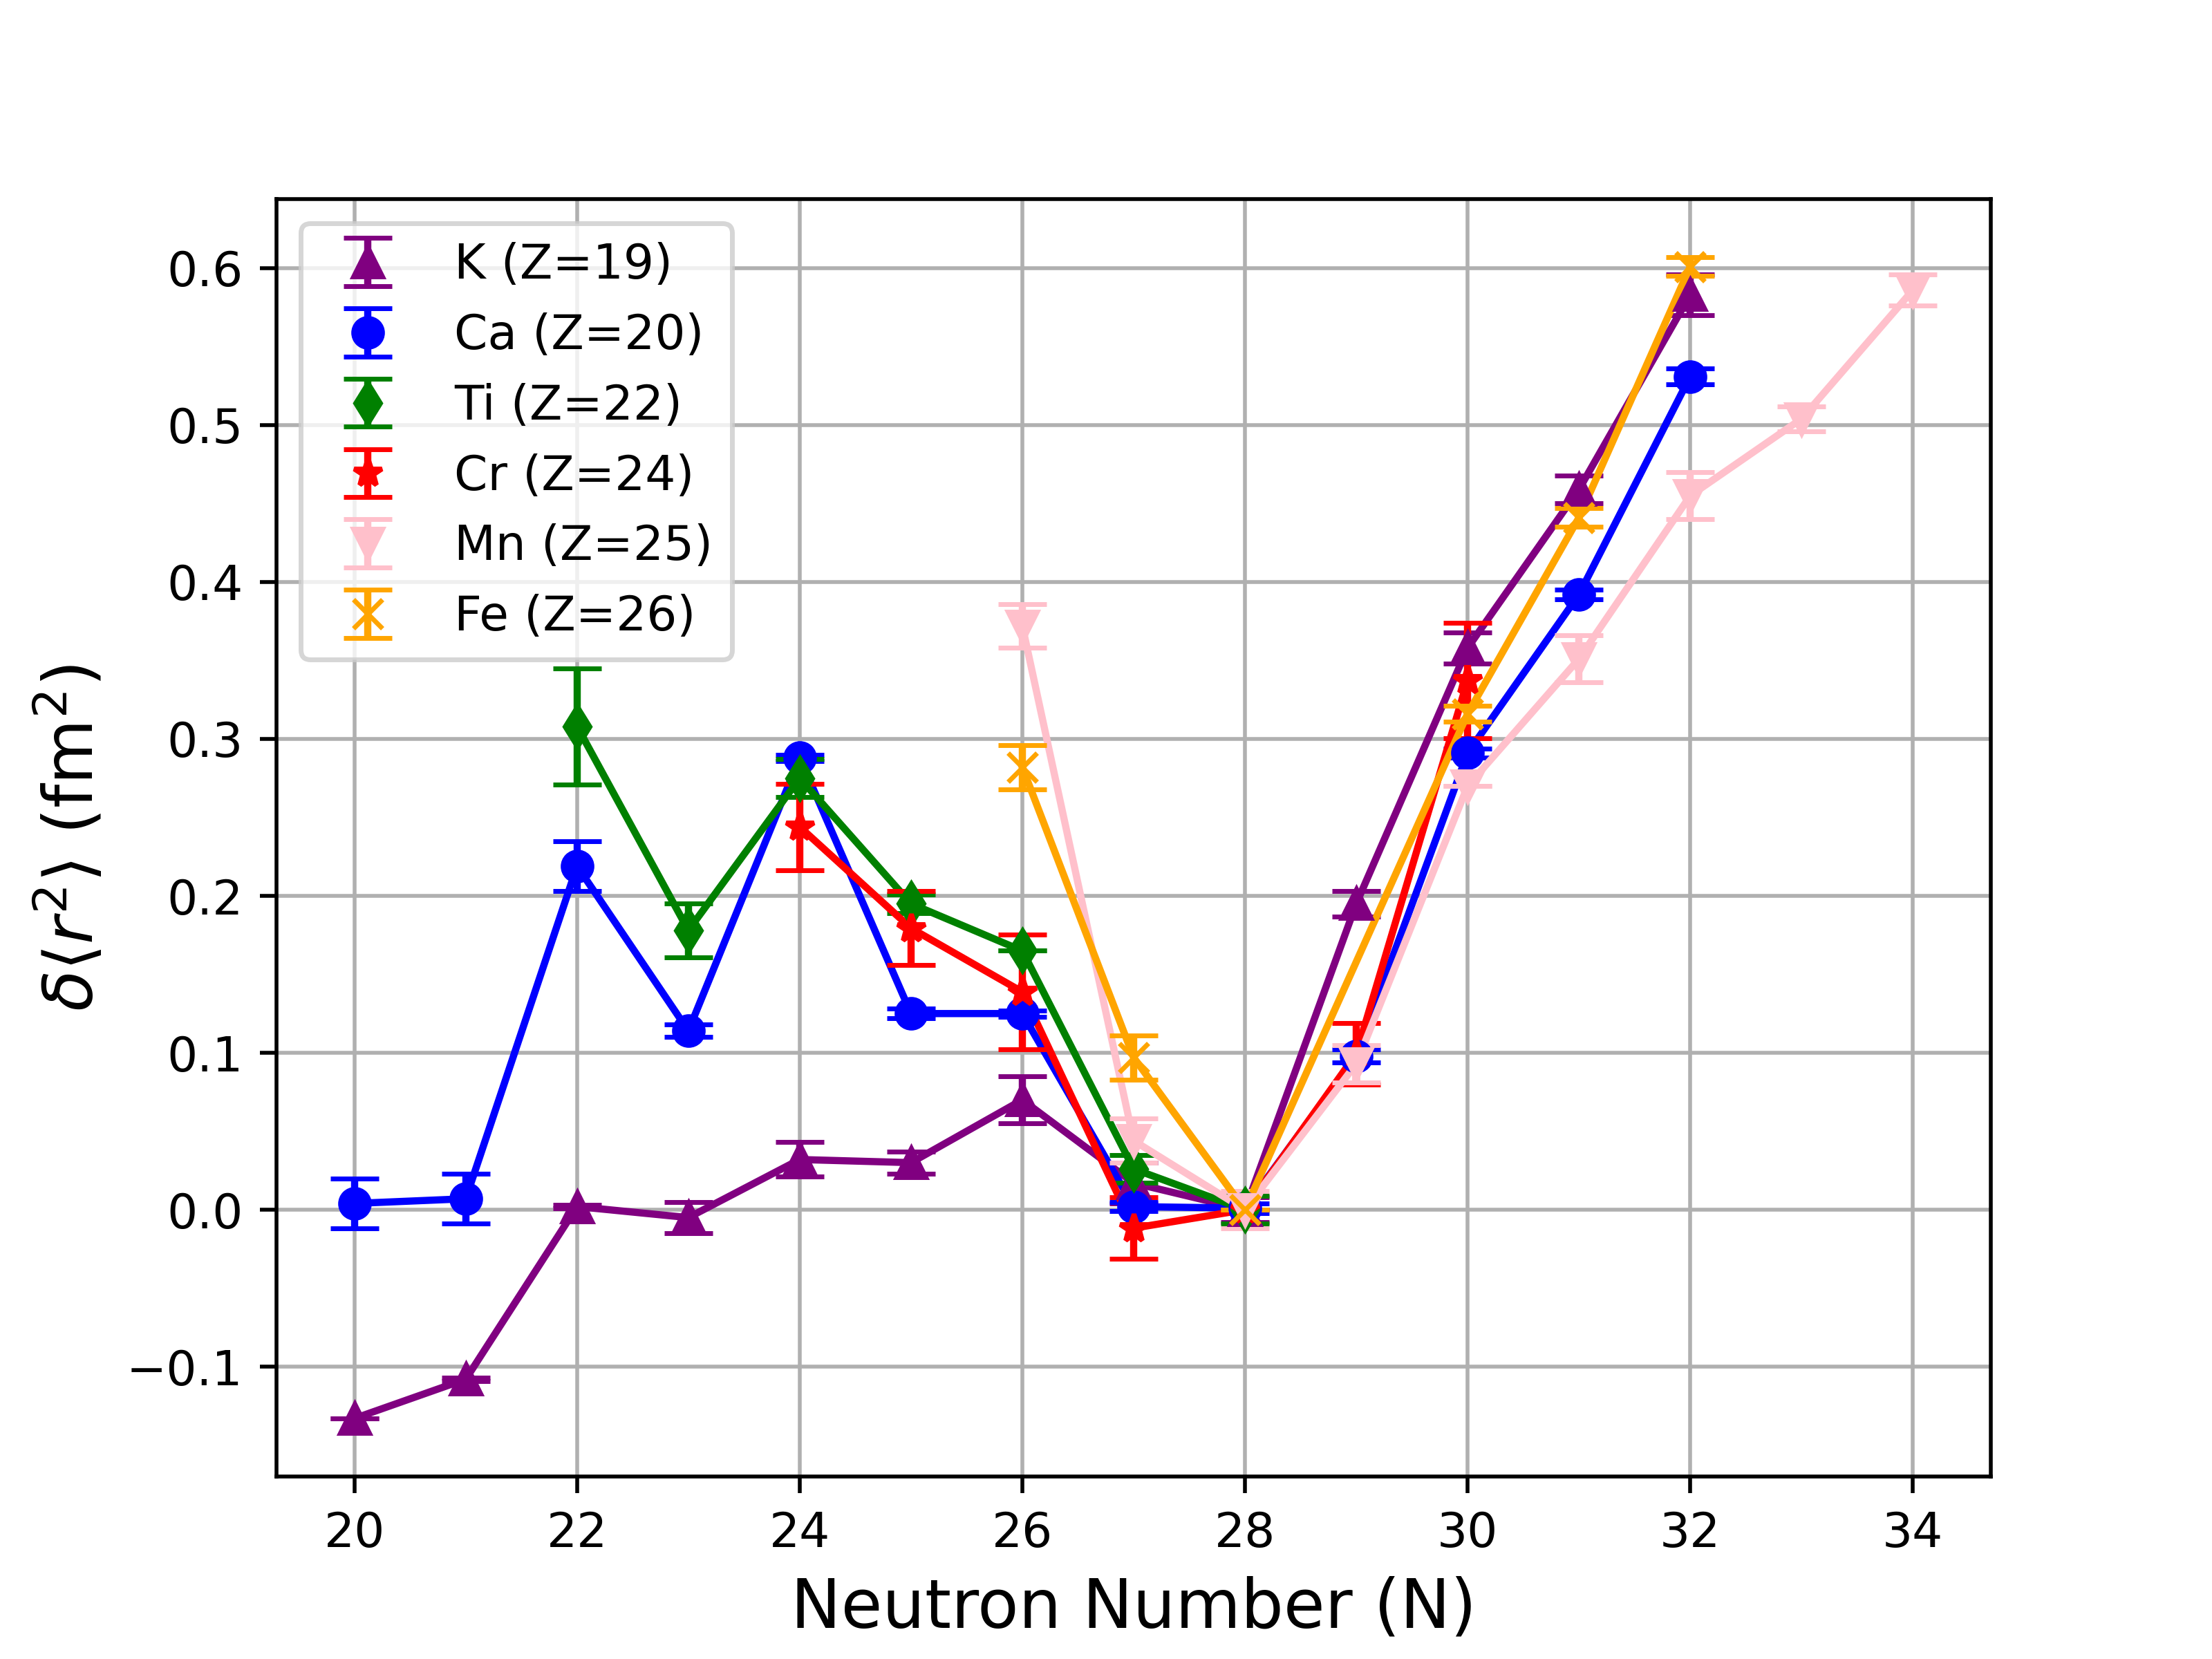

Highly productive…
Vanadium 1+ ion
3d4 5D 0 0.000
1 36.1017
2 106.6421
3 208.7901
4 339.1256

Slide 17
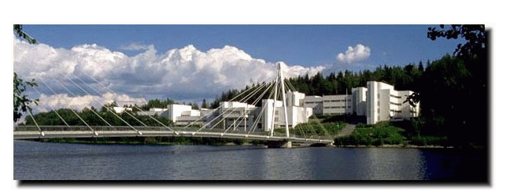
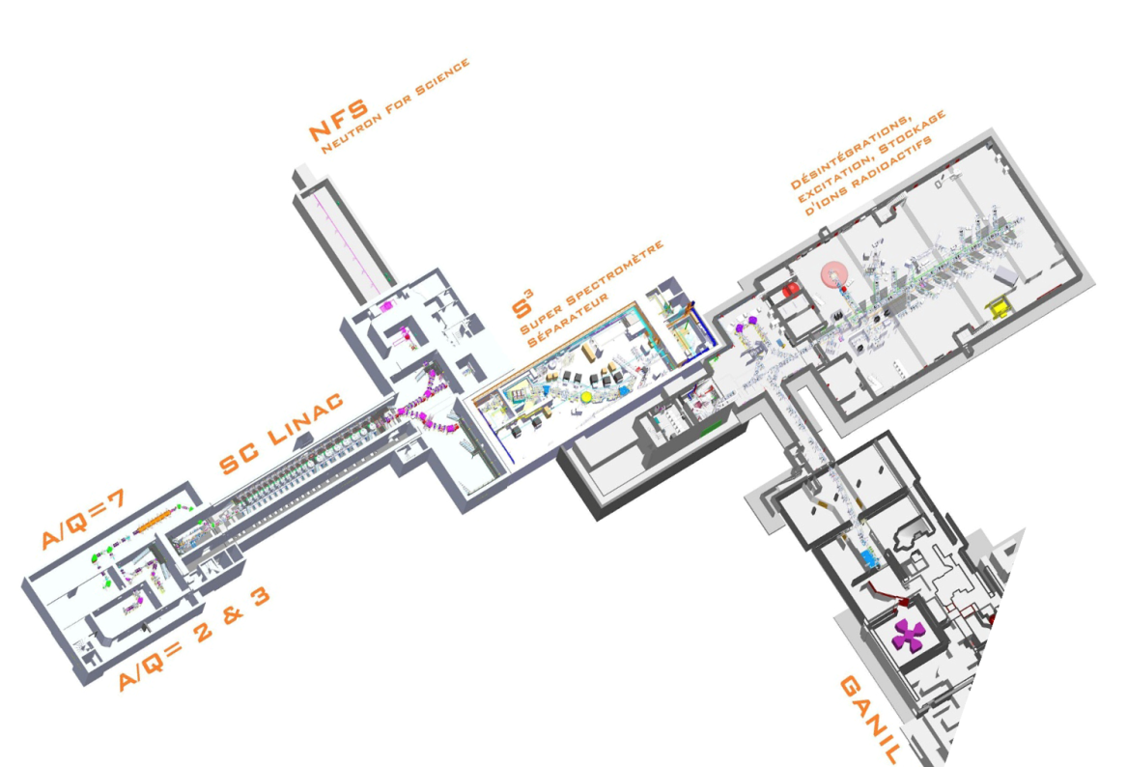



For the future…
“Continued international collaboration at facilities including ISOLDE, FAIR, GANIL…”

Slide 18
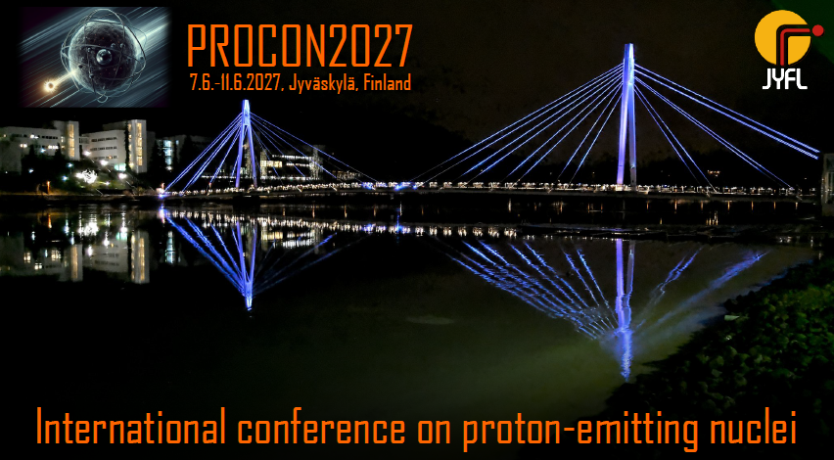
Next year…

