Slide 1

The UK in ALICE at the CERN LHC
Birmingham, Liverpool, Derby, and Daresbury Lab
David Evans
The University of Birmingham
NP Community Meeting
Glasgow 6th – 7th July 2026

Slide 2
ALICE Physics
Study of Hot QCD
Study strongly interacting matter at extreme energy densities over large volumes and long time-scales.
Study the nature of quark confinement.
Study the physics of the Quark-Gluon Plasma (QCD under extreme conditions).
Exotics, light anti-nuclei, gluon saturation, etc.

Slide 3
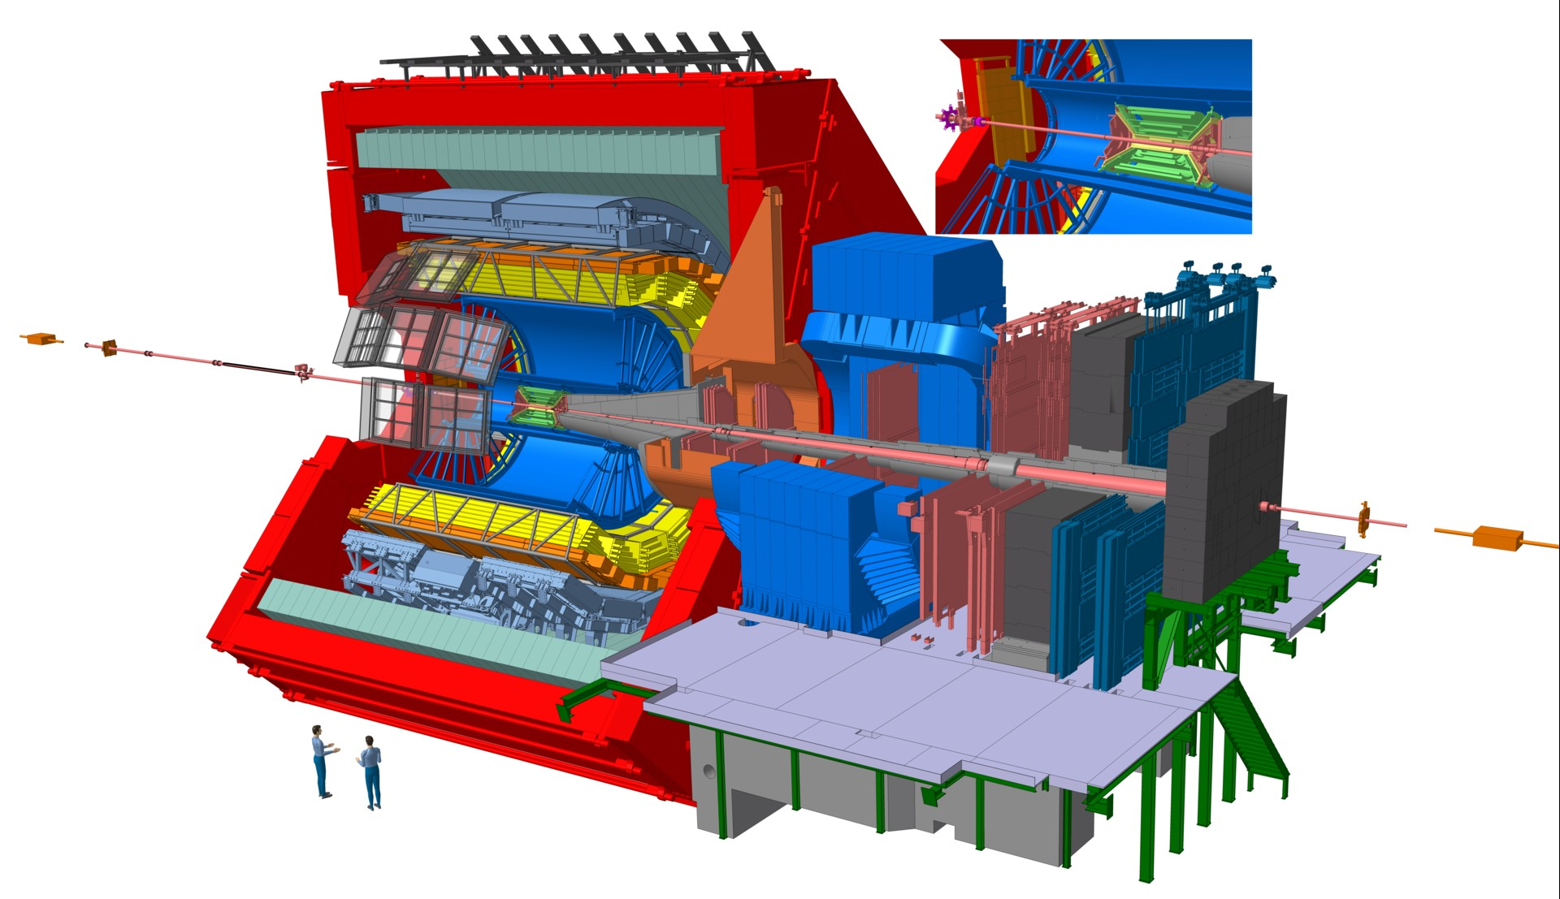
ALICE Detector
16 x 16 x 25 metre 10,000 tonne detector
UK responsible for:
The trigger system
A Large part of the Si pixel Inner Tracking System
Some of the software upgrades

Slide 4
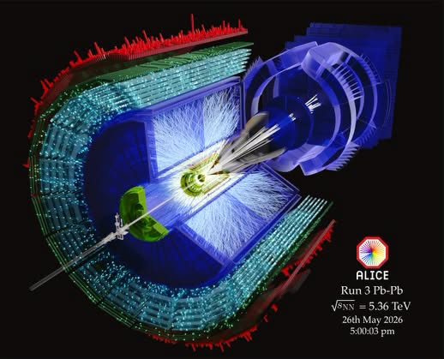
Collision Systems
Pb-Pb to create hot dense system and Quark-Gluon Plasma (QGP).
p-p as baseline QCD but lots of physics in its own right.
p-PB as baseline for nuclear effects
Lighter ions to bridge the gap between Pb-Pb and p-p systems.

Slide 5
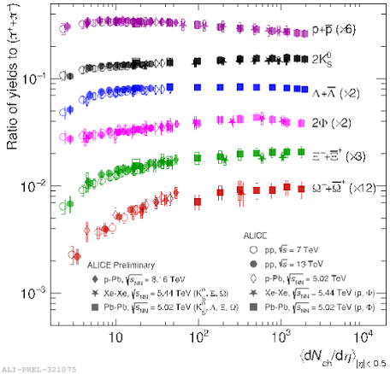
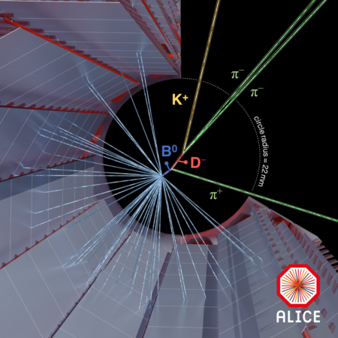
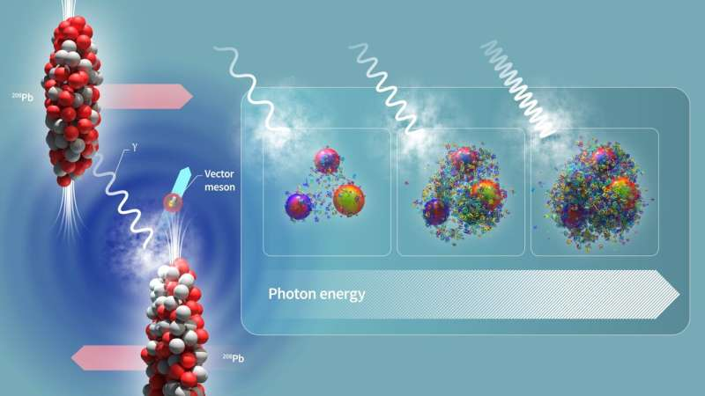
Sample of UK Physics Interests
Heavy flavour: probably the best probe of the QGP.
UPC – probing gluon saturation at low x
Strangeness production and QGP-like behaviour in small systems

Slide 6
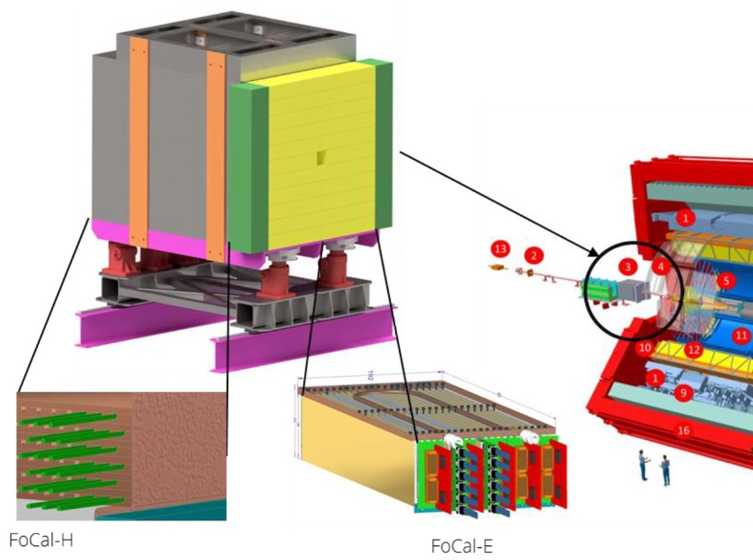
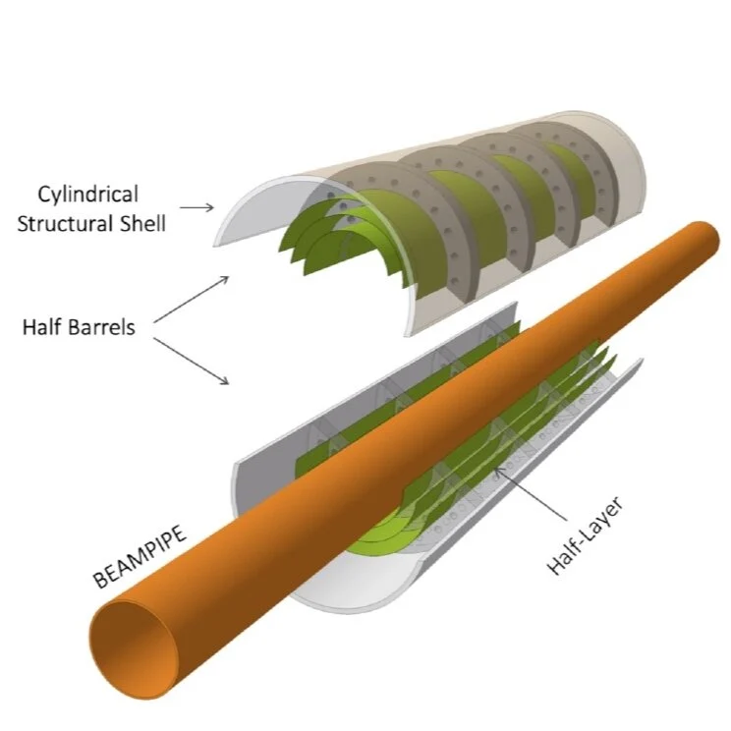
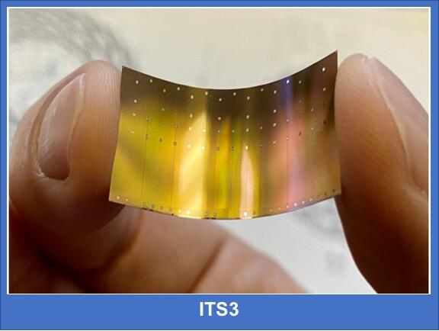
Near Future – Run 4 (from 2030)
ITS3 – bendable Si MAPS pixel technology.
Superb vertexing for heavy flavour and rare decays
FoCal - access to gluon densities in Pb down x<10⁻⁵ and search for saturation regime of QCD

Slide 7
ALICE Summary
UK ALICE group is making a large contribution to the experiment.
Management level
  Management Board
  Technical Board
Physics analysis
  PAG convenors, Editorial Board, Collaboration Board
Detector Level
  Trigger Project Leader & large part of ITS detector
53 Billion Pb-Pb collisions in Run 3 – a new era of discovery.
Next Steps: Preparing for upcoming installations, including the Forward Calorimeter (FoCal) and all-silicon ITS3 trackers for future LHC runs. Plus, a lot of data analysis.

