Slide 1



Jefferson Laboratory
Hadron and Nuclear Physics
Universities of Glasgow and York

Slide 2
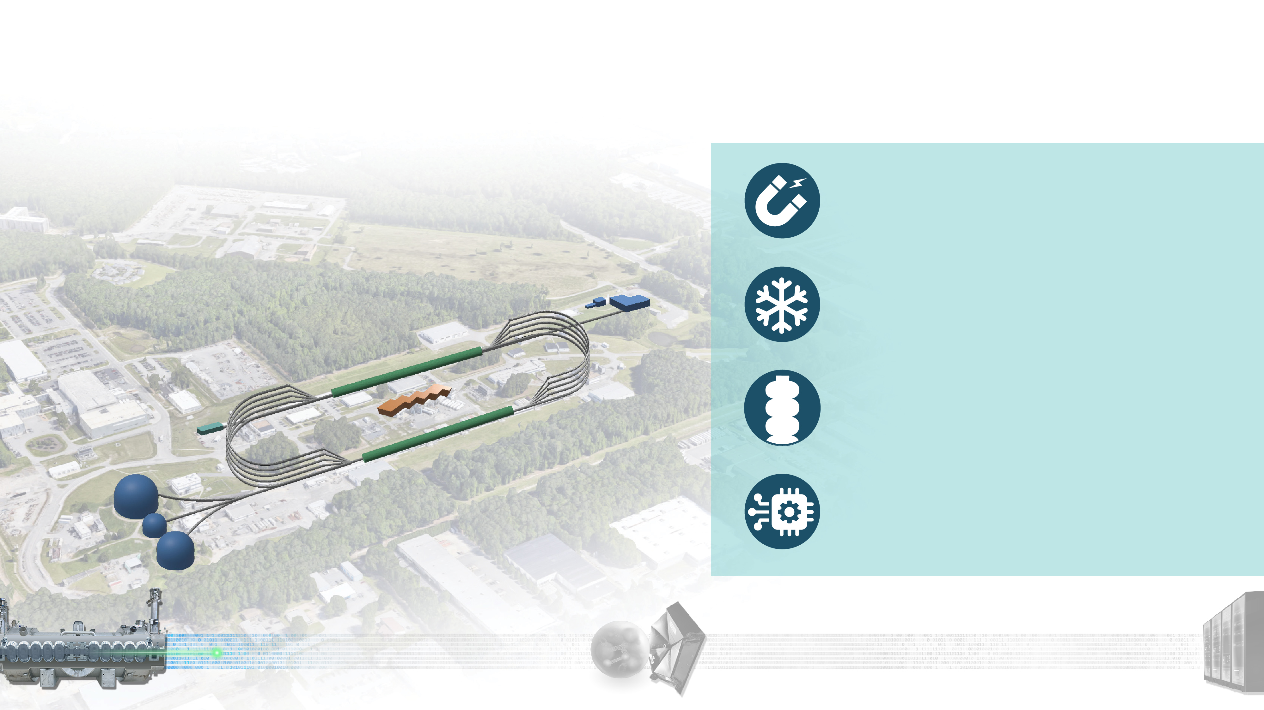







Our Discovery Machine:
Advancing Nuclear Physics Research
The Continuous Electron Beam Accelerator Facility is the highest throughput research accelerator in the world.
The Continuous Electron Beam Accelerator Facility (CEBAF) superconducting machine, is unique in the world – the only high-energy accelerator for nuclear physics for the next several years (RHIC, CERN LS3, 2026-30).
Half-million accelerator control points
monitored by AI, improving operation & reliability (86.7% in 2025).
Largest pair of 2 Kelvin cryogenics refrigerators in the world, unique capabilities for the DOE complex.
12 GeV electron beams at up 10³⁹ electrons/second/cm², making it the highest luminosity electron accelerator in the world.
We use polarized beams and targets.
Supporting LRP priorities for the user communities in NP.
2

Slide 3
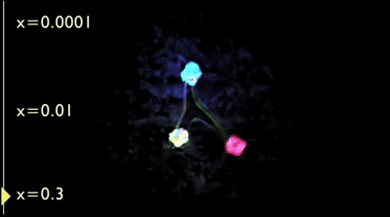

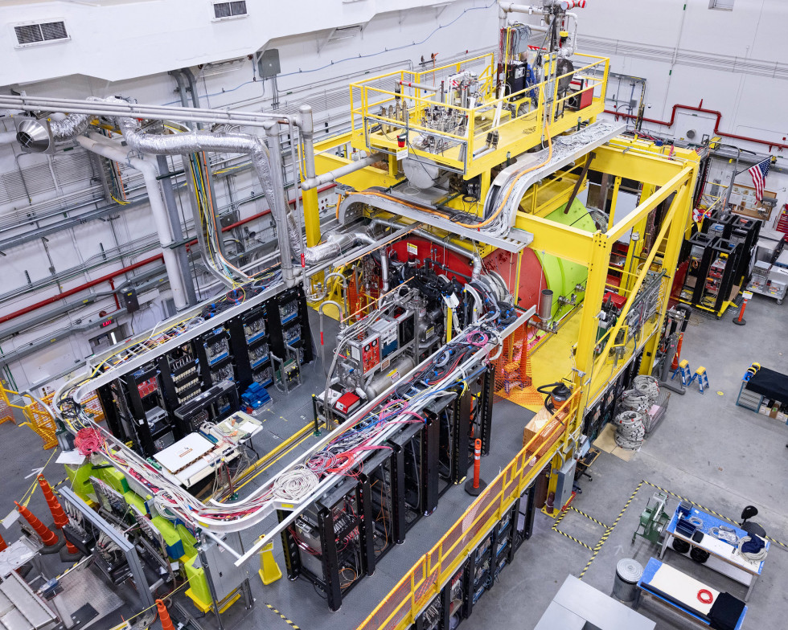
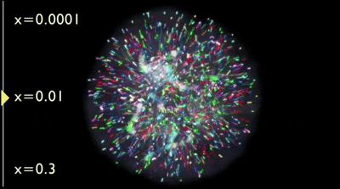
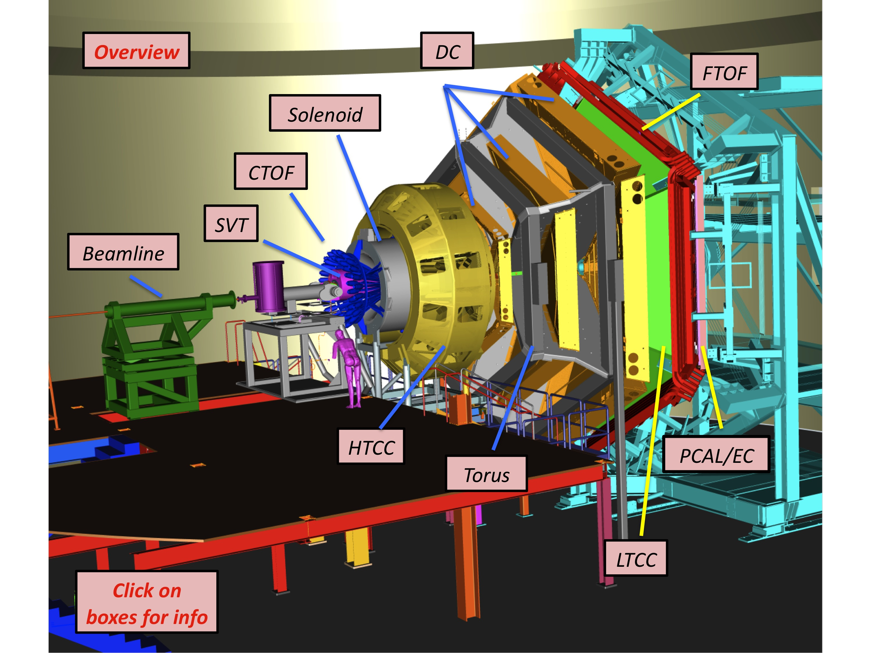
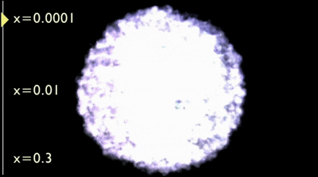
Future : Smarter Particle Accelerators & Nuclear Physics
nucleon visualization at different Bjorken x values
Experimental Nuclear Physics (NP) seeks to understand the internal structure and dynamics of nucleons
Large detectors with high sensor density produce increasingly larger datasets (O(10) PB/yr for a single experiment) which are needed to search for increasingly rare reactions
Workflows that match large datasets with large compute and advanced analysis techniques enable faster, more efficient insight to the science
Accelerator operation with high intensity, precision, and reliability is required to obtain clean signals for next-gen subatomic discovery
https://www.jlab.org/news/releases/pioneering-nuclear-glue-frontier-0
https://www.bnl.gov/rhic/sphenix.php
General Visualizations of a Nucleon

Slide 4
3D Partonic Imaging : Hadron Femtography
Deeply Virtual Compton Scattering
Timelike Compton Scattering
Deeply Virtual Meson Production
Light Meson Structure
Gluonic Gravitational Form Factors (J/ψ Production)
Properties of Hadrons : Spectroscopy and Structure
Exotic Hadron Spectroscopy
Strange Spectroscopy
Transverse Hadron Structure
Hadronic Form Factors
Nuclear Physics
Short-Range Correlations (SRC)
Electrons for Neutrinos (e4nu)
Color Transparency

Slide 5
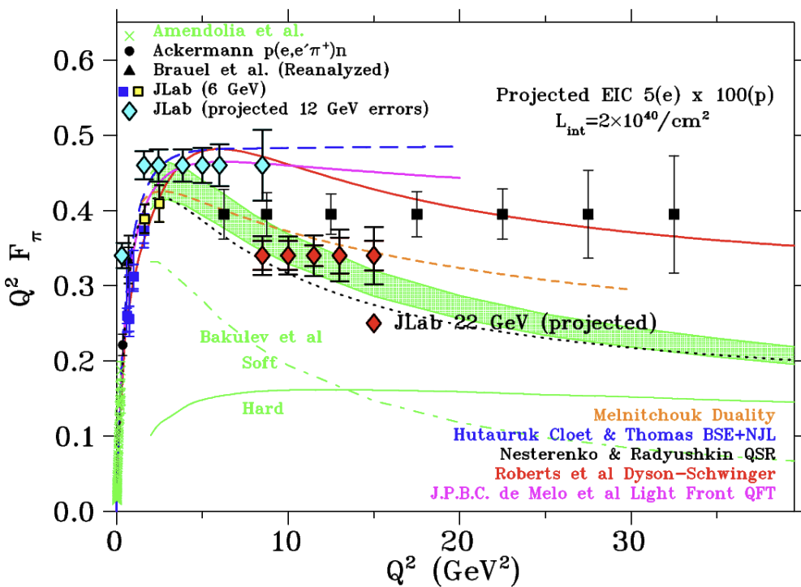
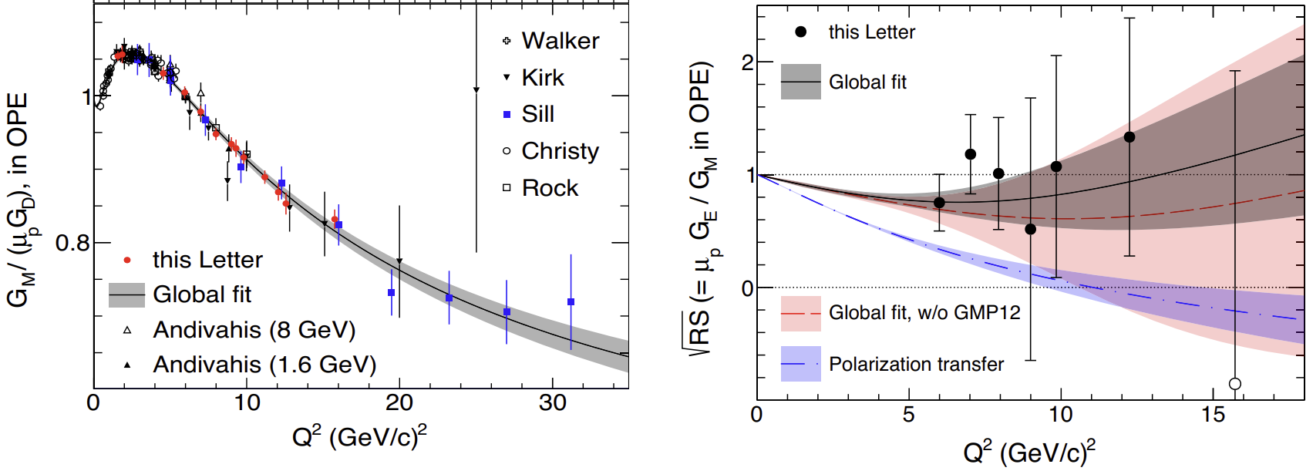
Halls A/C - High Resolution Magnetic Spectrometers, BIGBITE
Precision Nucleon Form Factors
The Strange Form Factor of the Proton
Reaction Mechanisms via GPDs
Wide-Angle Compton Scattering (WACS)
Meson Structure
Detailed measurements of two photon exchange
via nucleon form factors
Pion (and soon kaon) form factor experiments

Slide 6
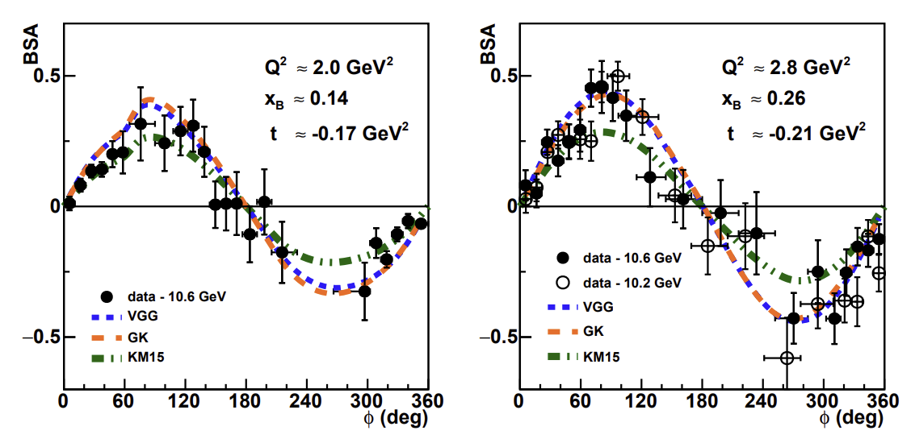
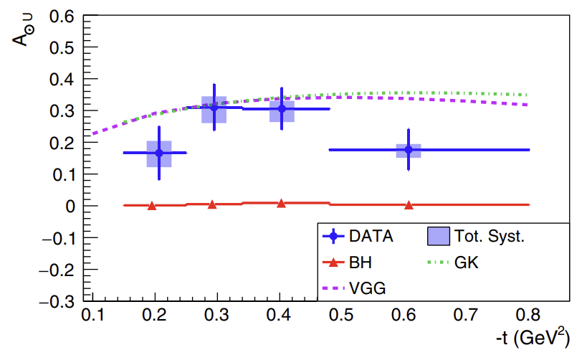
Hall B : CLAS12 Large Angle Spectrometer
3D Quark Tomography via Deeply Virtual Compton Scattering
Timelike Compton Scattering
Deeply Virtual Meson Production
Hadron Transition Form Factors
Gluonic Form Factors and Mass Radius Mapping
Lepton-Nucleus Benchmarking for Neutrino Oscillations
High-Density Short-Range Correlations
Color Transparency and the Quark-Hadron Transition
First polarisation observables in DVCS for GPDs
First polarisation observables in TCS for GPDs

Slide 7
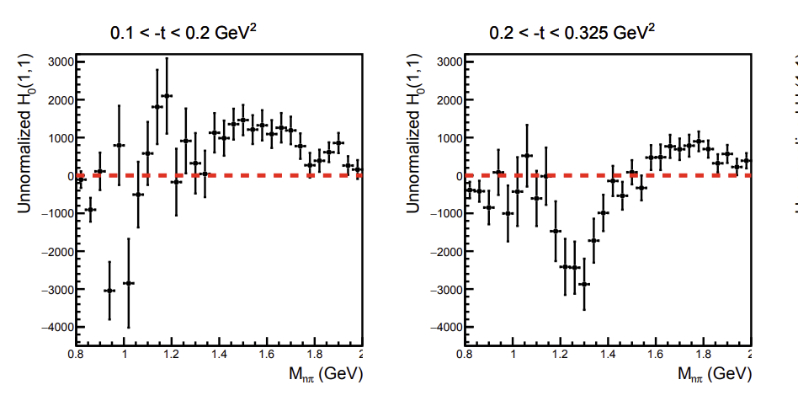
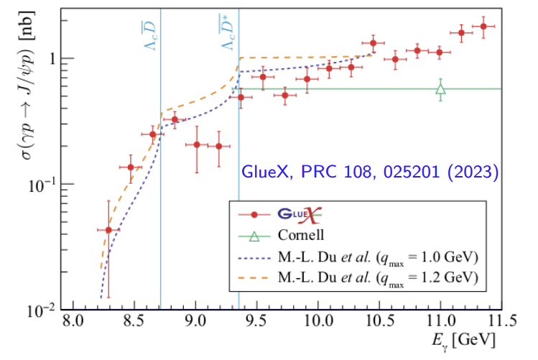
Hall D : Hermetic GlueX Spectrometer / Calorimeter
Exotic Meson Spectroscopy (GlueX)
Precision Hyperon Weak Decays (Elliptical GlueX)
Gluonic Structure and the EMC Effect in Nuclei (Nuclear GlueX)
J/ψ and Charmonium Production (GlueX III)
First Exotic hybrid signals in Photoproduction
Only exotics contribute to these Spherical harmonics
Largest statistics and coverage for J/ψ photoproduction

Slide 8
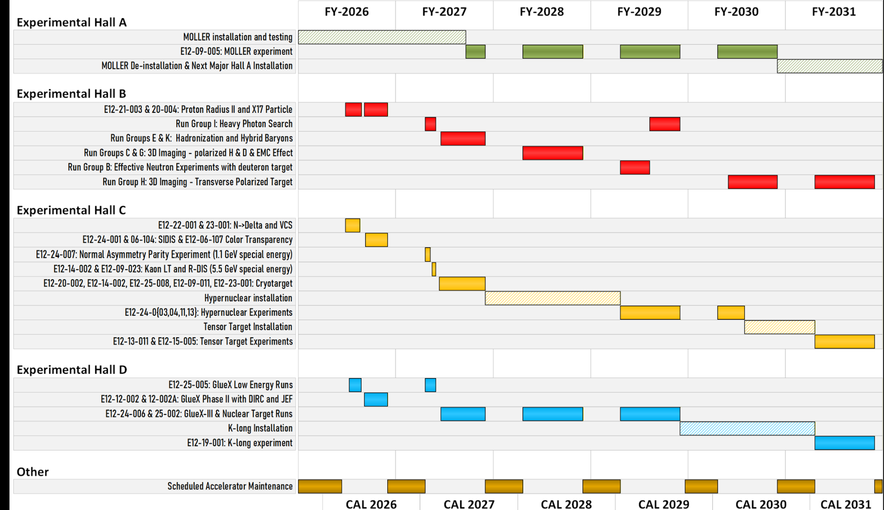
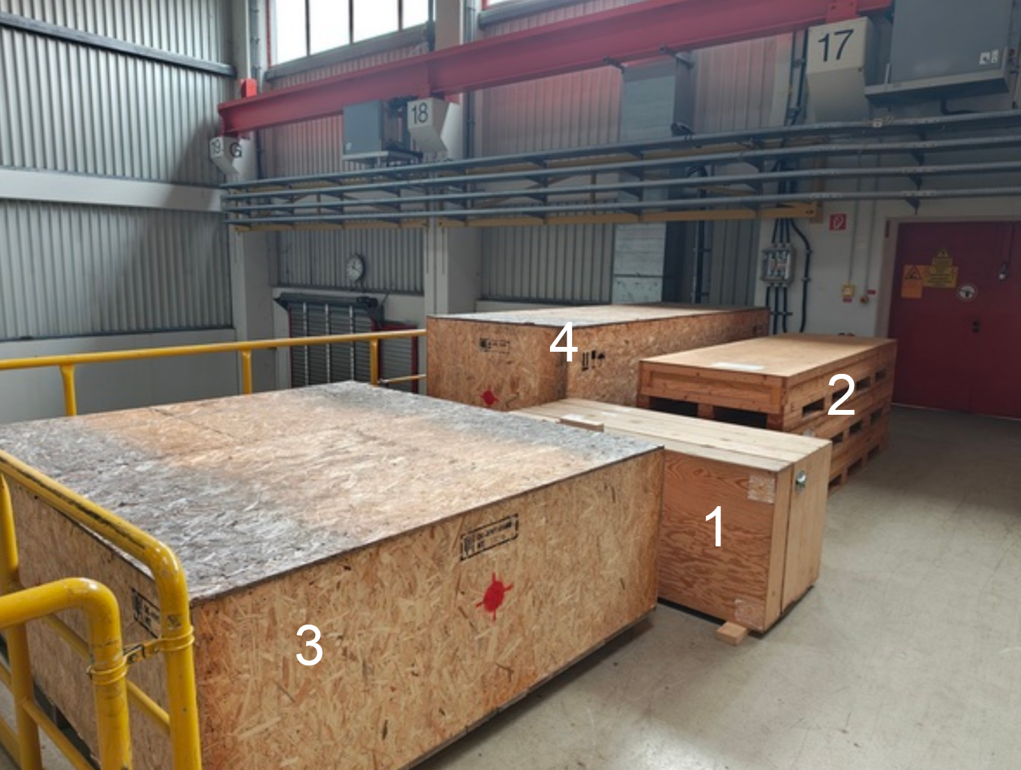
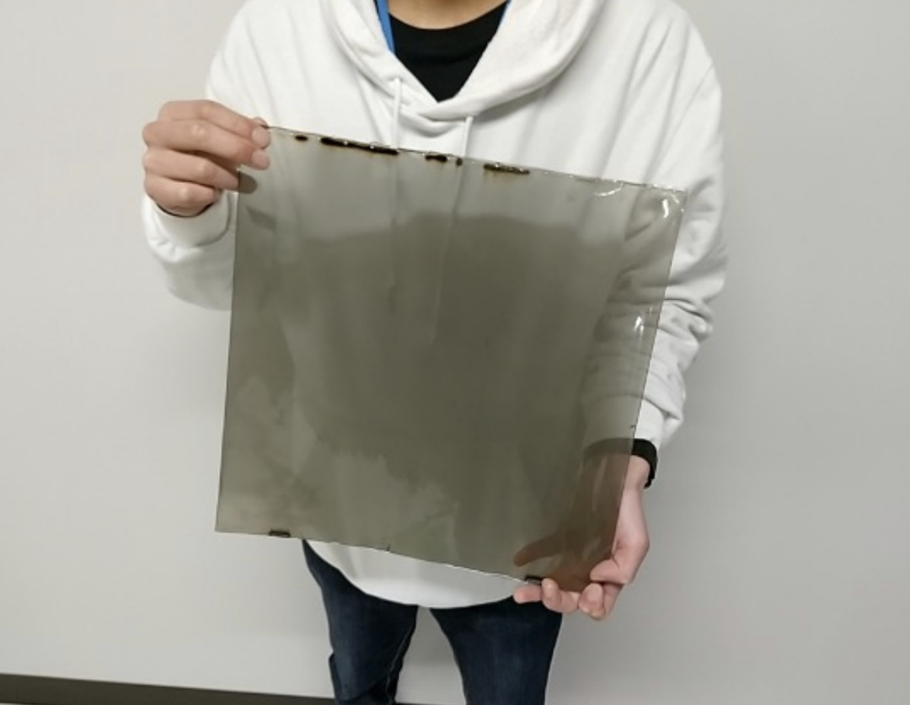
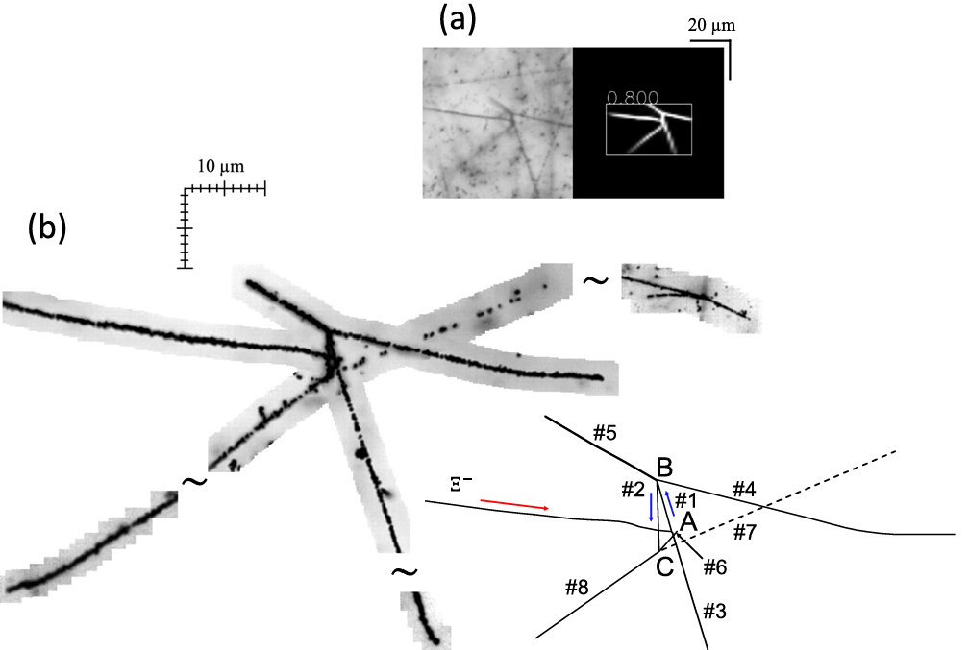
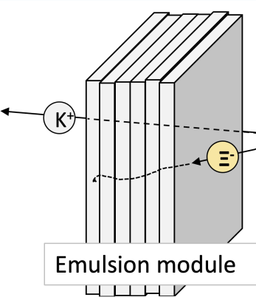
Hall D : K-Long Facility
Strange Baryon Spectroscopy
Equipment for the Flux monitor
  UoY responsibility, to be shipped from Juelich
  took 26 months to sign all contracts Sweden-Germany-UK-USA
  First new KLF equipment
Successful intermediate readiness review (Summer 2025)
Final readiness review (Summer 2027)
New proposal UoY-RIKEN – Hypernuclear station at KLF
(PAC on 07.07.2026)

Slide 9
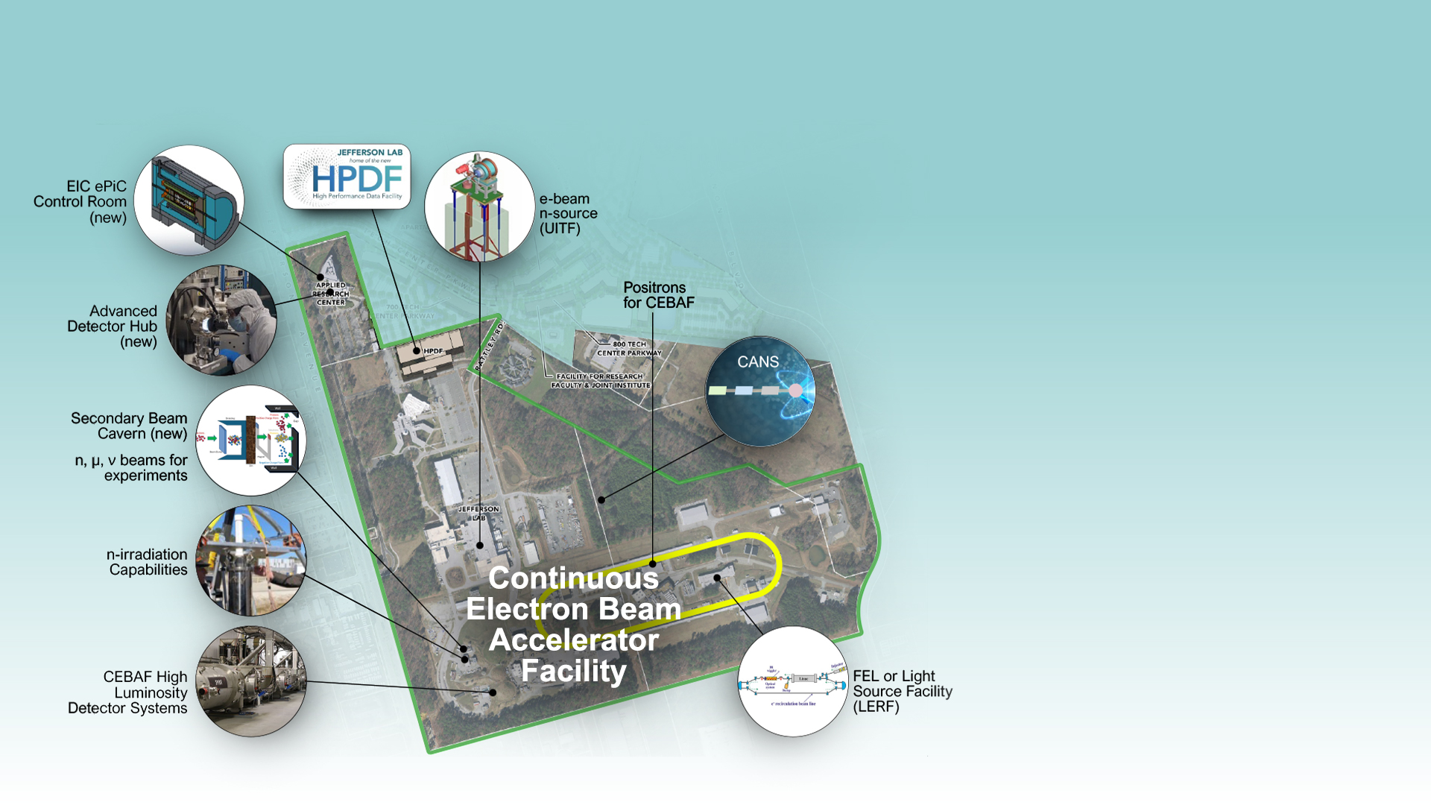
Jefferson Lab: 10/20-Year Outlook
Continuation of CEBAF Nuclear Physics Program
Growing to a multi-program laboratory
Future expansions proposed over the next 20 years supported by:
  working with the scientific
  user community for buy
  in on priorities
  We are planning community-oriented strategy planning exercises, for CEBAF and other sectors
    CEBAF 2037 and beyond
    Beam Dump opportunities
    22 GeV ? Positron beams ?
    FEL, n-sources…
9

