Slide 1
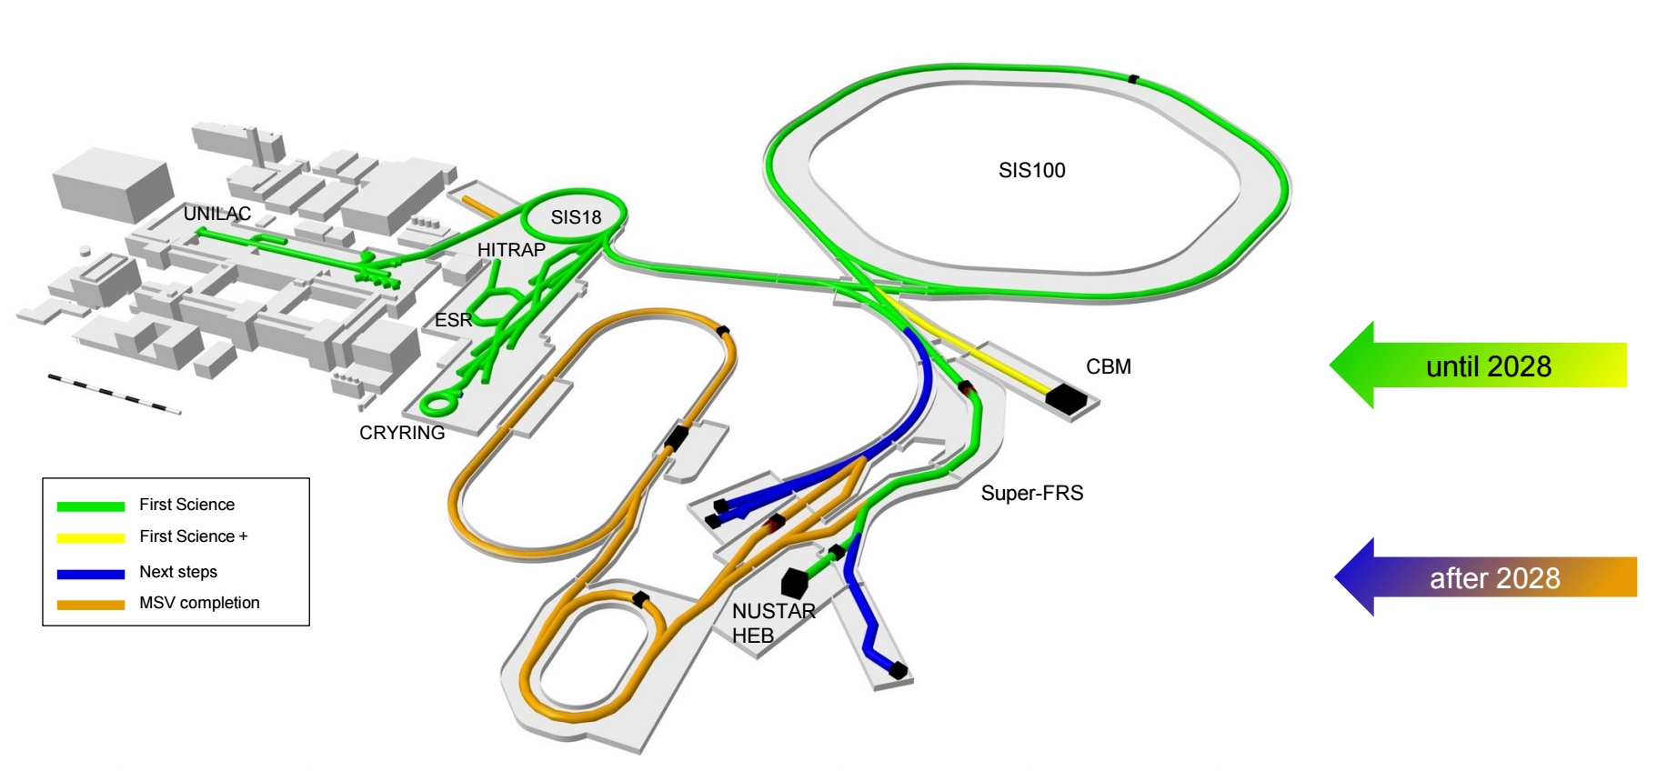
GSI/FAIR

Slide 2
UK contributions
University of Brighton,
University of Edinburgh,
University of Liverpool,
University of Manchester,
University of Surrey,
University of West of Scotland,
University of York,
STFC Daresbury Laboratories
Target Recoil Detector for R3B
LYCCA for HISPEC
AIDA and FATIMA LaBr3(Ce) array
for DESPEC
CARME Si array for CRYRING
UK is associate member: committing to contributing 0.5% share of the commissioning and operations costs until three years after the start of operations

Slide 3


NUSTAR >640 members (449 with PhD) (without Russia)
NUSTAR spokesperson: Podolyak
R³B
HISPEC/ DESPEC
Super-FRS
EC
219
Petri
MATS
237
ILIMA
48
185
SHE
67
Herzberg
LaSpec
43
Cheal
74
Status: Sep 28, 2025
>640 NUSTAR members
(incl. students, engineers)
EXL dormant
Reactions in rings incorporated into ILIMA
> 1000 listed “interested” scientists
> 640 registered members
(incl. students, etc.)
~ 449 senior members
(PhD holders w/o Russia)
> 140 institutes from 35 countries
Notes:
=RUNDEN(WURZEL(B5/PI());2)

Slide 4

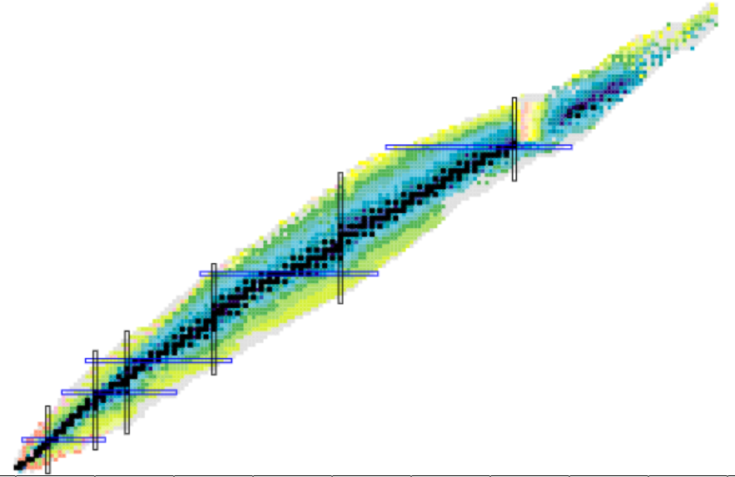
2021-25: 54 FAIR-0 exps.+tests
Superheavies (mass, laser spectroscopy, structure/isomerism, chemistry) 8
Nuclei at the extremes
Nature of the nuclear force
Rare phenomena
Fission/isomers 3
N~Z 2 exps.
Octupole collectivity 2
Two-photon decay 2
r-process 6
(N=126; masses, lifetimes, structure)
Shape effects 3
(prolate/oblate/triaxial/coexistence)
Drip-line phenomena 5
K-isomers
Short-range correlations 2
Symmetry energy 3
Neutron skin 1
Hypernuclei, mesic nuclei 3
Heavy beams are
essential for NUSTAR

Slide 5
NUSTAR >640 members (449 with PhD) (without Russia)
NUSTAR spokesperson: Podolyak
R³B
HISPEC/ DESPEC
Super-FRS
EC
219
Petri
MATS
237
ILIMA
48
185
SHE
67
Herzberg
LaSpec
43
Cheal
74
Status: Sep 28, 2025
>640 NUSTAR members
(incl. students, engineers)
EXL dormant
Reactions in rings incorporated into ILIMA
> 1000 listed “interested” scientists
> 640 registered members
(incl. students, etc.)
~ 449 senior members
(PhD holders w/o Russia)
> 140 institutes from 35 countries
Notes:
=RUNDEN(WURZEL(B5/PI());2)

Slide 6
Publications 2021-2025
 |  | Nature family; PRL | PLB | PRC/PRA | NIM | Other | PhD diss. | Total
R3B | 2021-25 | 6 | 3 | 11 | 4 | 24 | 16 | 64
HISPEC/DESPEC | 2021-25 | 3 | 9 | 7 | 7 | 19 | 6 | 51
SuperFRS-EC | 2021-25 | 3 | 3 | 6 | 17 | 23 | 2 | 54
ILIMA | 2021-25 | 5 | 0 | 4 | 1 | 12 | 0 | 22
SHE | 2021-24 | 11 | 5 | 20 | 12 | 65 | 6 | 119
LASPEC/MATS | 2021-25 | 4 | 0 | 1 | 1 | 3 | 0 | 9
NUSTAR | 2025 | 8 | 2 | 13 | 5 | 33 | 11 | 72
 | 2024 | 7 | 5 | 3 | 5 | 30 | 13 | 63
 | 2023 | 6 | 5 | 5 | 14 | 35 | 4 | 69
 | 2022 | 6 | 4 | 16 | 10 | 31 | 0 | 67
 | 2021 | 5 | 4 | 12 | 8 | 17 | 2 | 48
NUSTAR | 2021-25 | 32 | 20 | 49 | 42 | 146 | 30 | 319
NUSTAR database
(based on GSI repository:
https://repository.gsi.de/)
Publication report sent to JSC
on 6 April 2026
247 publications / 25 min. talk
= 10/min.
=> some highlights

Slide 7
A New Island of Asymmetric Fission
P. Morfouace et al. Nature 641, 339 (2025)
DOI 10.1038/s41586-025-08882-7
Results
First set of charge distribution across a wide range of exotic fissioning systems.
Experimental evidence of strong proton-shell stabilization at Z=36
Z_{H} = 54 (Xe)
Z_{L} = 36 (Kr)
Unlike the actinides, the asymmetric fission in the neutron deficient sub-lead region is driven by shell effect in the light fragment.

Slide 8

Phase-0 experiments @ R3B
Commisioning
S444
2019
S473
Constraining energy-density functionals
and the density-dependence of the symmetry energy
S454
Astrophysical reaction rate of ¹²C(α,γ)¹⁶O via Coulomb dissociation of ¹⁶O
2020
S444
Nuclear interaction cross sections of ¹²C and ¹²⁰Sn
Structure of neutron-rich Ca isotopes
S467
S455
Fision with RI-beams using SOFIA @ R3B
Coulomb dissociation of ¹⁶O into ¹²C and ⁴He
S494
2021
S515
Total charge-changing, neutron-removal and Coulomb-excitation cross sections for ^{124,128,132,134}Sn
Multi-neutron correlations in drip-line nuclei
S509
2022
2023
S522
First characterization of Short-Range Correlations in exotic nuclei
Test of proton-tracking detectors @ COSY
Test
2024
Test
Test of HYDRA prototype inside GLAD
Commisioning of upgraded R3B detectors
S118
S091
Probing SRC correlations in nuclei via
(p,pd) QFS reactions
S122
2025
  ASY-EOSII experiment @ R3B
G249
Structure of Z=9 isotopes close to neutron drip-line

Slide 9

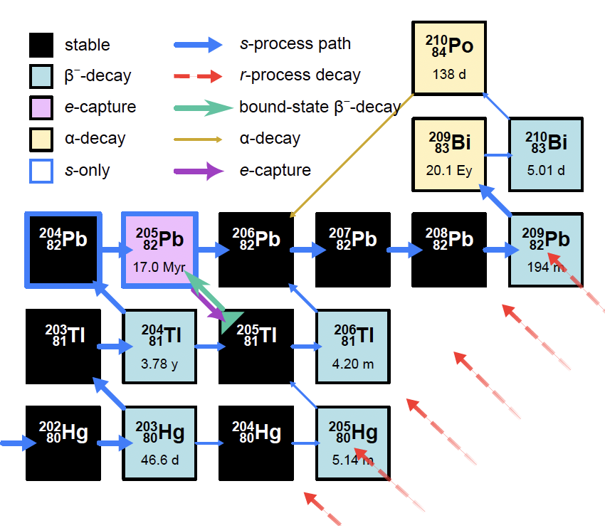
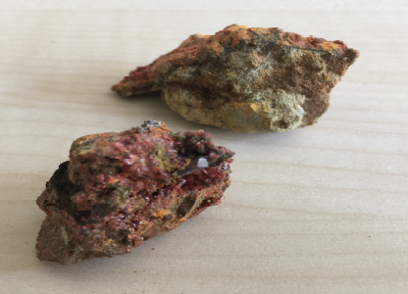
Bound-State Beta Decay of ²⁰⁵Tl⁸¹⁺
²⁰⁵Tl: Stable in neutral atoms
Radioactive in bare ions
Cosmochronometer of the s-process
Rare processes
Neutrino energy threshold 53 keV!
LOREX project: new solar neutrino detector

Slide 10

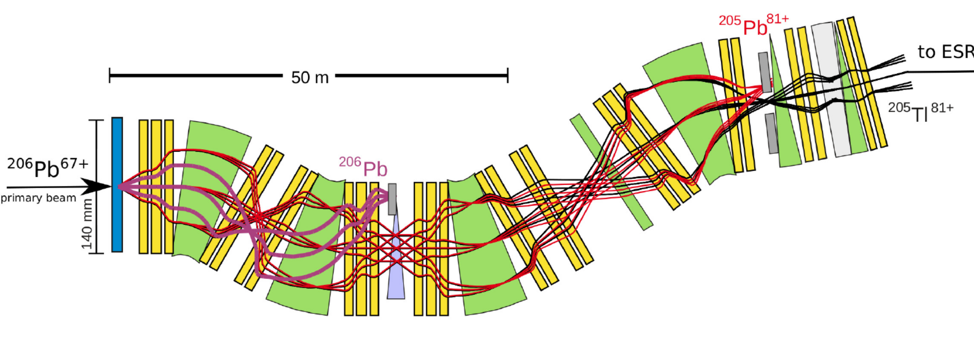
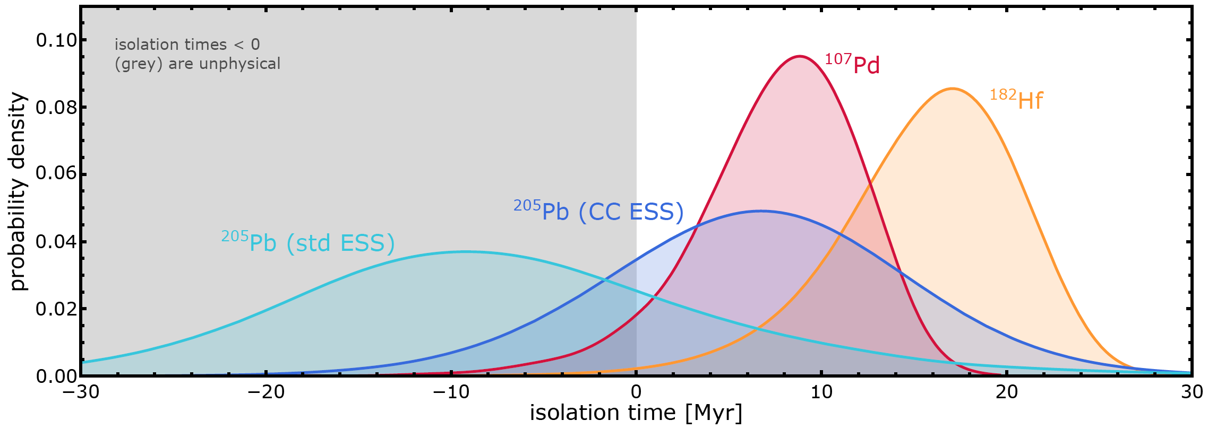
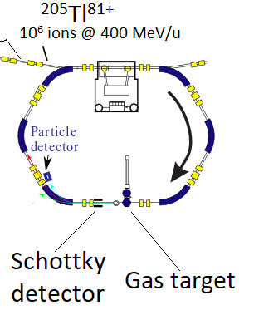

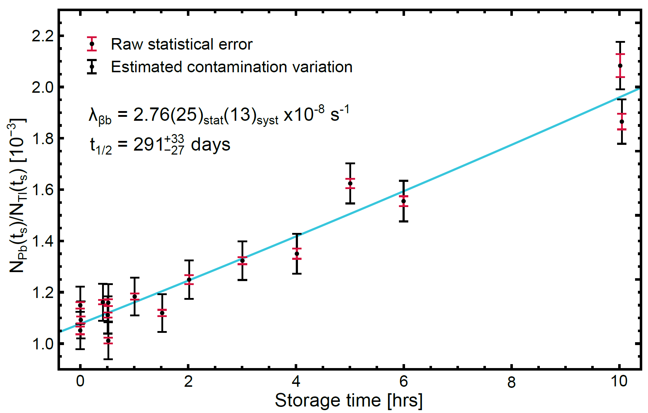





Bound state beta decay of ²⁰⁵Tl⁸¹⁺
Accepted in
Combined with meteoritic data, new ²⁰⁵Pb and ²⁰⁵Tl decay rates in plasmas, and astrophysical simulations, the isolation time of the solar matter from the last synthesis of ²⁰⁵Pb is for the first time positive!
G. Leckenby et al., Nature 635, 321 (2024)
Combined with new neutrino capture rates, the new ²⁰⁵Tl decay constant sets precise constraints on the production of ²⁰⁵Pb by solar pp neutrinos, and thus for the LOREX project aiming at measuring ²⁰⁵Pb in lorandite minerals
T_{1/2}^{the} =122 days
T_{1/2}^{exp}=291 days
ESR:
Storage times of up to 10 hours
R. S. Sidhu et al., Phys. Rev. Lett. 133, 232701 (2024)
Rare processes
Notes:
205Tl is stable as atom but decays if all bound electrons are removed
The decay rate is significantly different from theoretical predictions
205Tl-205Pb pair has the lowest Q-value for capturing solar neutrinos. 205Tl has therefore been a candidate for solar pp neutrino detector. LOREX is the project to determine the number of 205Pb atoms created by solar neutrinos in 3.2 My old lorandite mineral
Decay of 205Pb and back-decay of 205Tl determine the termination of slow neutron capture process in AGB stars. With new 205Tl rate, the production of 205Pb can be constrained. The origin of the solar system can be determined as well.

Slide 11
Bound-state beta decay of ²⁰⁵Tl⁸¹⁺
Accepted in
Combined with meteoritic data, new ²⁰⁵Pb and ²⁰⁵Tl decay rates in plasmas, and astrophysical simulations, the isolation time of the solar matter from the last synthesis of ²⁰⁵Pb is for the first time positive!
G. Leckenby et al., Nature (2024) in print
Combined with new neutrino capture rates, the new ²⁰⁵Tl decay constant sets precise constraints on the production of ²⁰⁵Pb by solar pp neutrinos, and thus for the LOREX project aiming at measuring ²⁰⁵Pb in lorandite minerals
T_{1/2}^{the} =122 days
T_{1/2}^{exp}=291 days
ESR:
Storage times of up to 10 hours
R. S. Sidhu et al., Phys. Rev. Lett. (2024) in print
Notes:
205Tl is stable as atom but decays if all bound electrons are removed
The decay rate is significantly different from theoretical predictions
205Tl-205Pb pair has the lowest Q-value for capturing solar neutrinos. 205Tl has therefore been a candidate for solar pp neutrino detector. LOREX is the project to determine the number of 205Pb atoms created by solar neutrinos in 3.2 My old lorandite mineral
Decay of 205Pb and back-decay of 205Tl determine the termination of slow neutron capture process in AGB stars. With new 205Tl rate, the production of 205Pb can be constrained. The origin of the solar system can be determined as well.

Slide 12
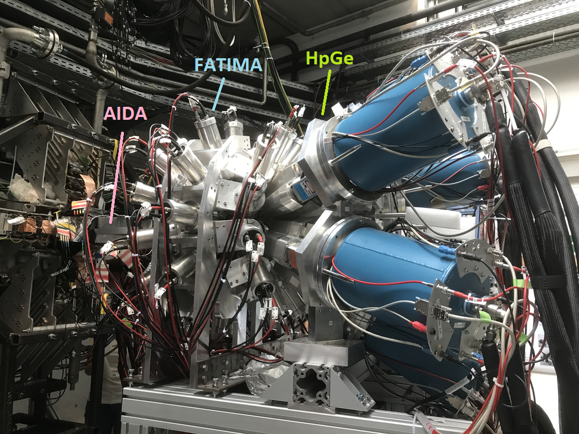
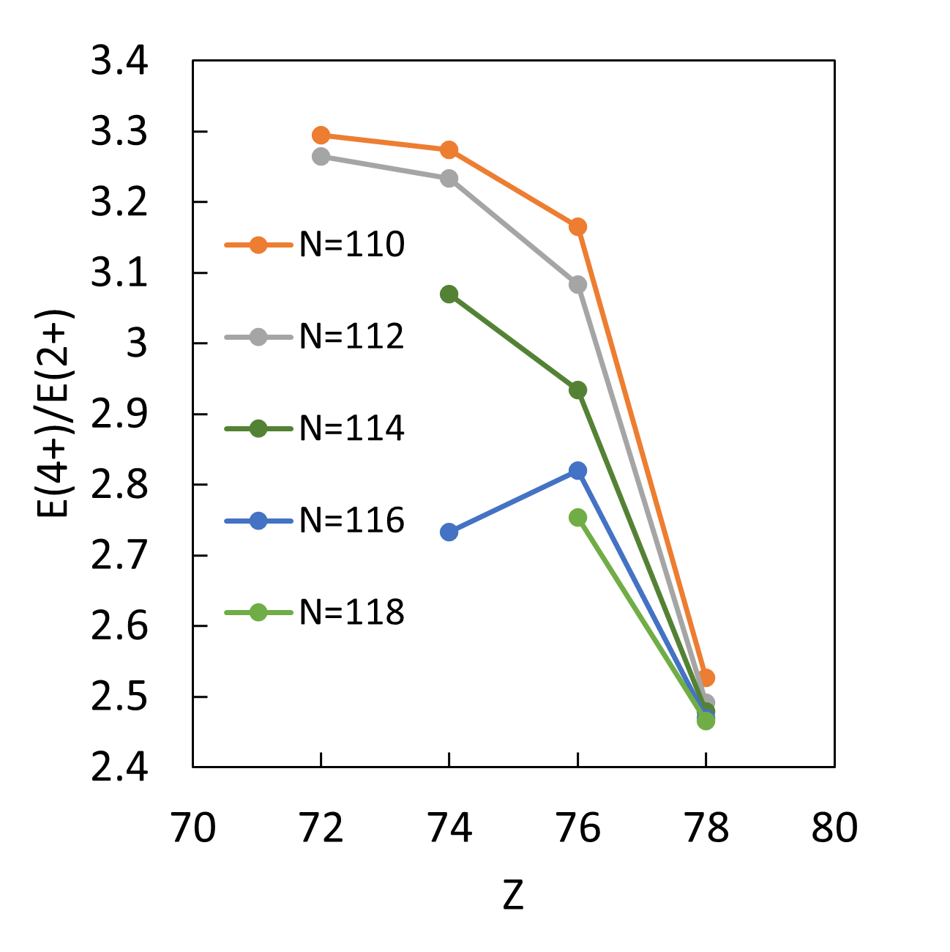
FATIMA result:
Prolate-oblate shape transition at ¹⁹⁰W₁₁₆
Hybrid array for fast-timing
measurements
EDF-IBM approach
E. Sahin et al., Phys. Lett. B 857, 138976 (2024)

Slide 13
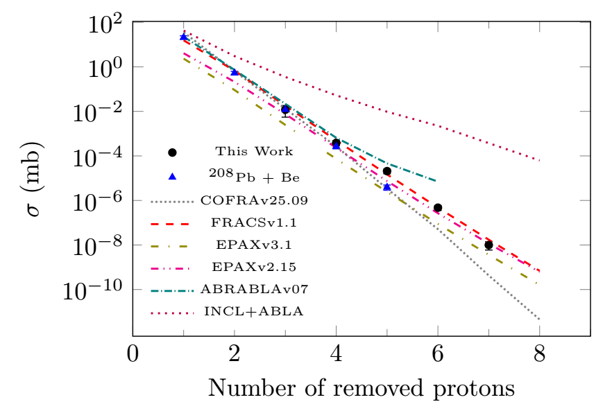
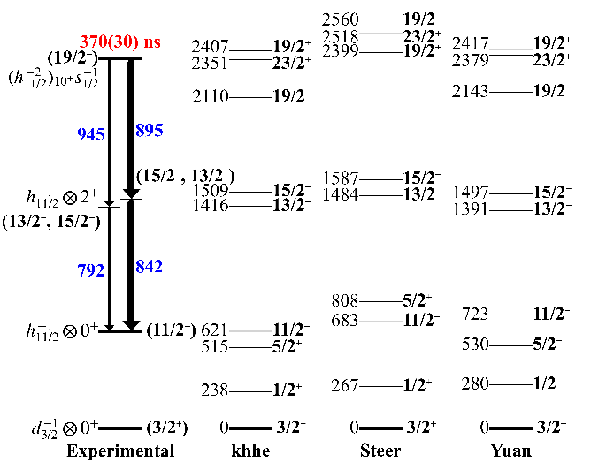
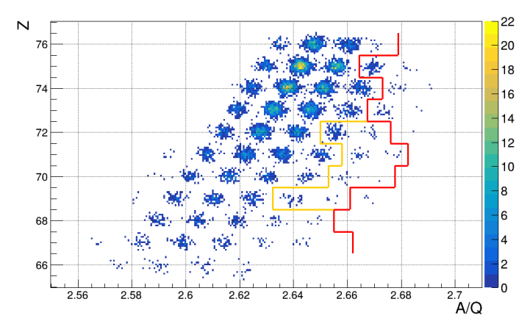
The most neutron-rich N=126 nuclei
²⁰³Ir
²⁰¹Re
S. Pietri et al., Phys. Lett. B ; S.K. Singh et al., Phys. Rev. C; G. Bartam et al., Phys. Lett. B

Slide 14
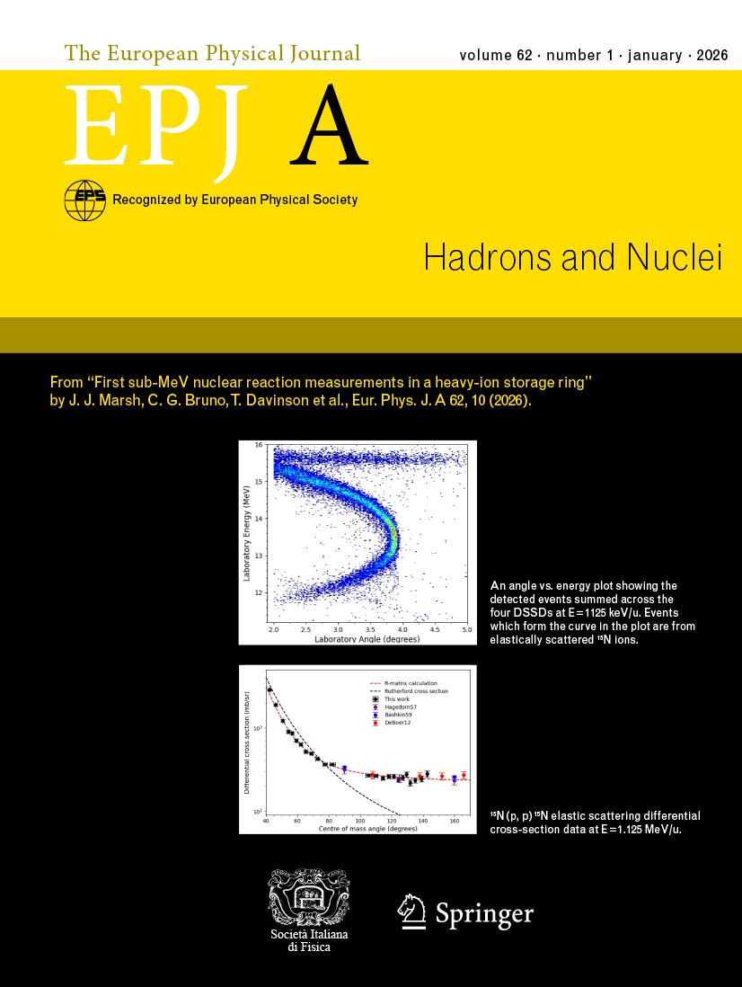
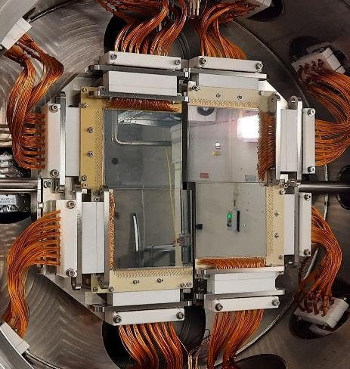
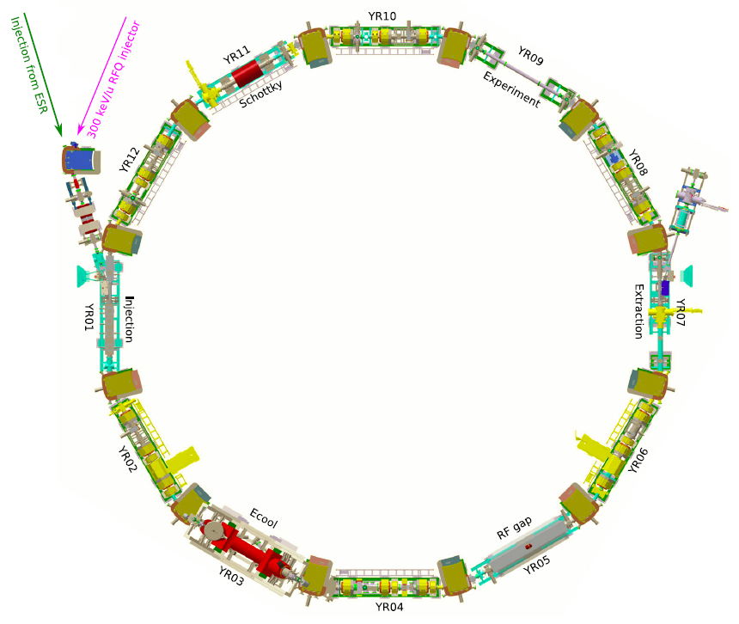


CARME: First ever nuclear reaction studied with a heavy-ion storage ring at sub-MeV energies
J.J. Marsh et. al EPJ A 62, 10 (2026)
¹⁵N(p,p) and ¹⁵N(p,α) at the CRYRING
  at 0.426 MeV/u
¹⁵N injected from the local MINIS source
CARME @ CRYRING
(CRYRING Array for Reaction MEasurements)
CARME at CRYRING
PI Carlo Bruno
ERC Starting Grant “ELDAR”

Slide 15
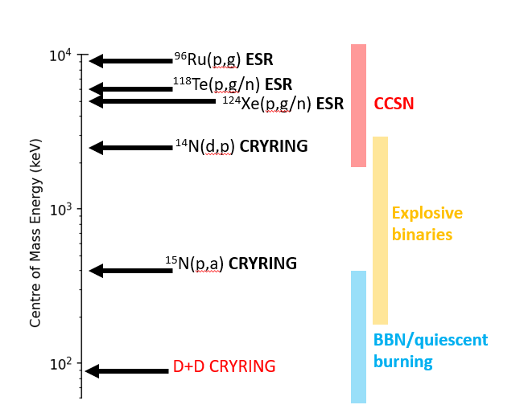
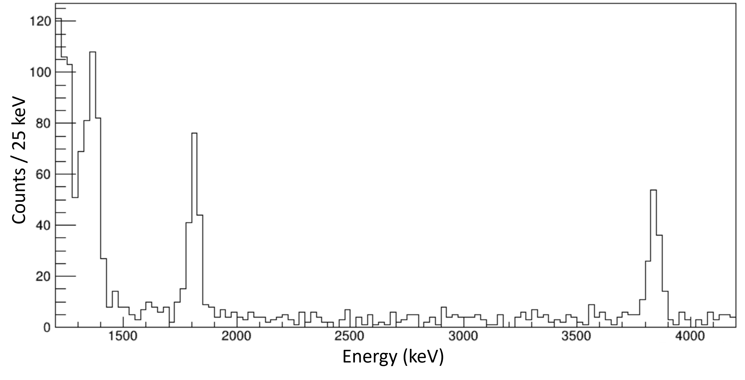



CARME@CRYRING – recent successes
2025: Measured the most important reaction in Big Bang Nucleosynthesis: D+D. We reached 90 keV/u, most significant energy during the Big Bang. By far lowest energy reached at rings. Analysis in progress!
(PI: CG Bruno, UoEdi)
Ebeam = 90 keV/u
$${}_{}^{3}{He}$$
$${}_{}^{3}H$$
$$p$$
PRELIMINARY

Slide 16
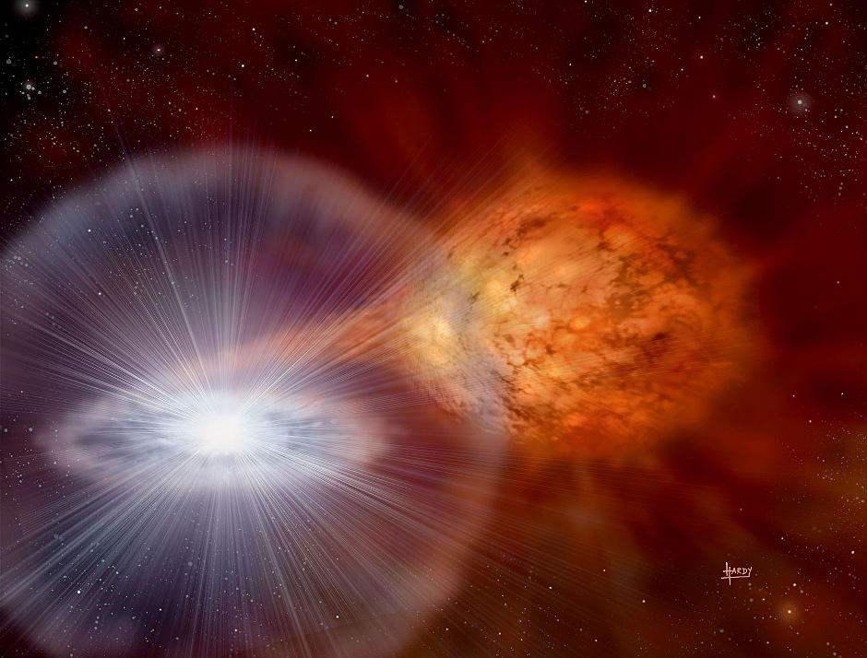
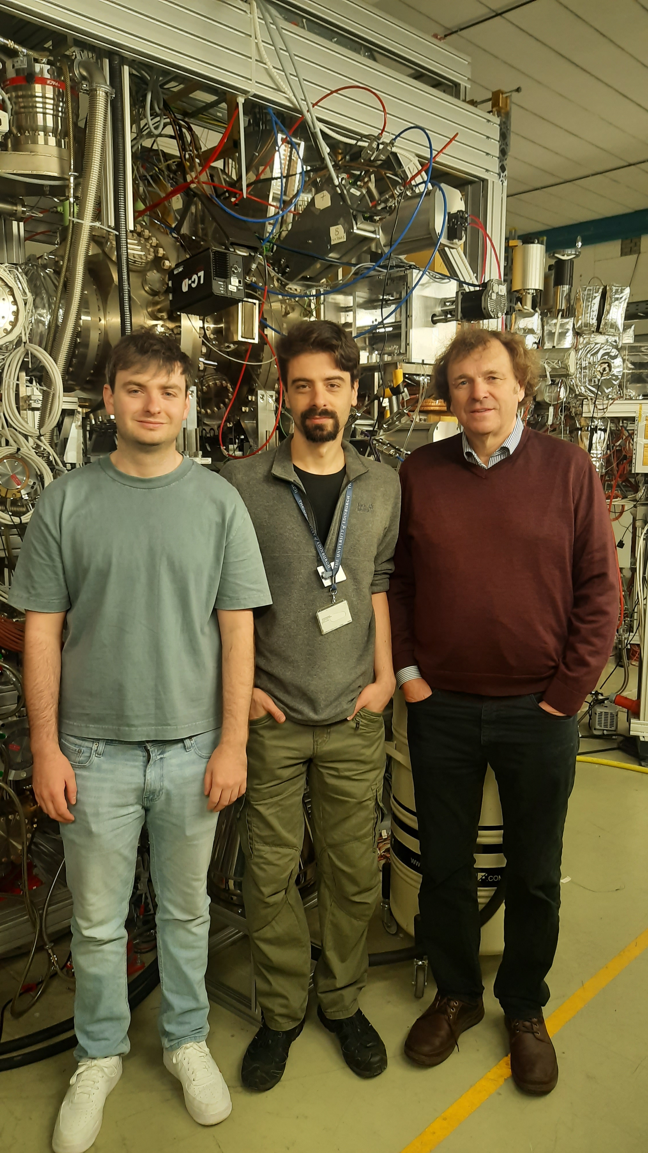
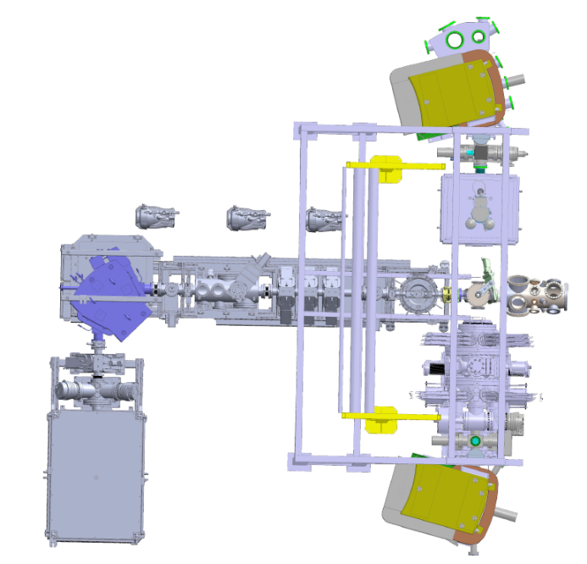
CARME@CRYRING – future plans
November 2026: Two proposals accepted (Edinburgh PIs) investigating the ¹⁹F abundance in the universe, and a key reaction in X-ray bursters.
2027+: More studies planned with stable beams, including a re-run of D+D to reach 1-2% overall uncertainty, as well as electron screening studies using beam-on-beam collisions, and more!
2030+?: First radioactive beam reactions at CRYRING.
Revolving ions
FISIC ion source
Transverse ion beam

Slide 17
GSI/FAIR

Slide 18
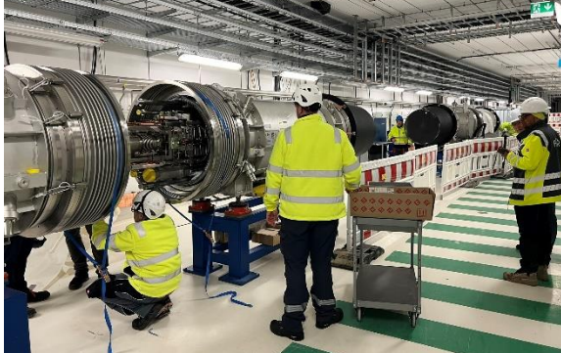
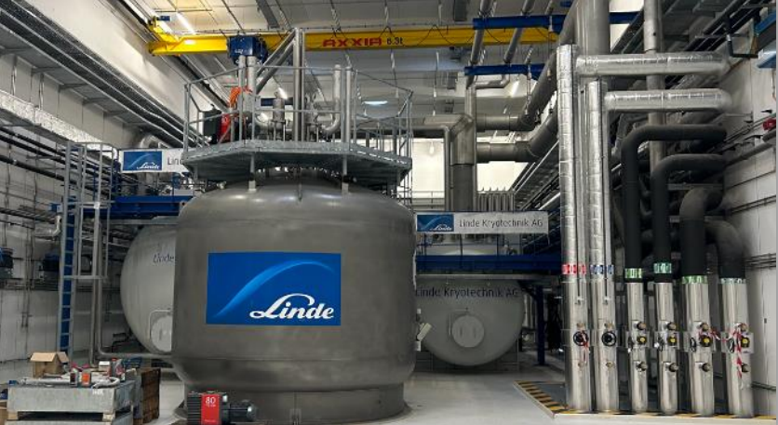
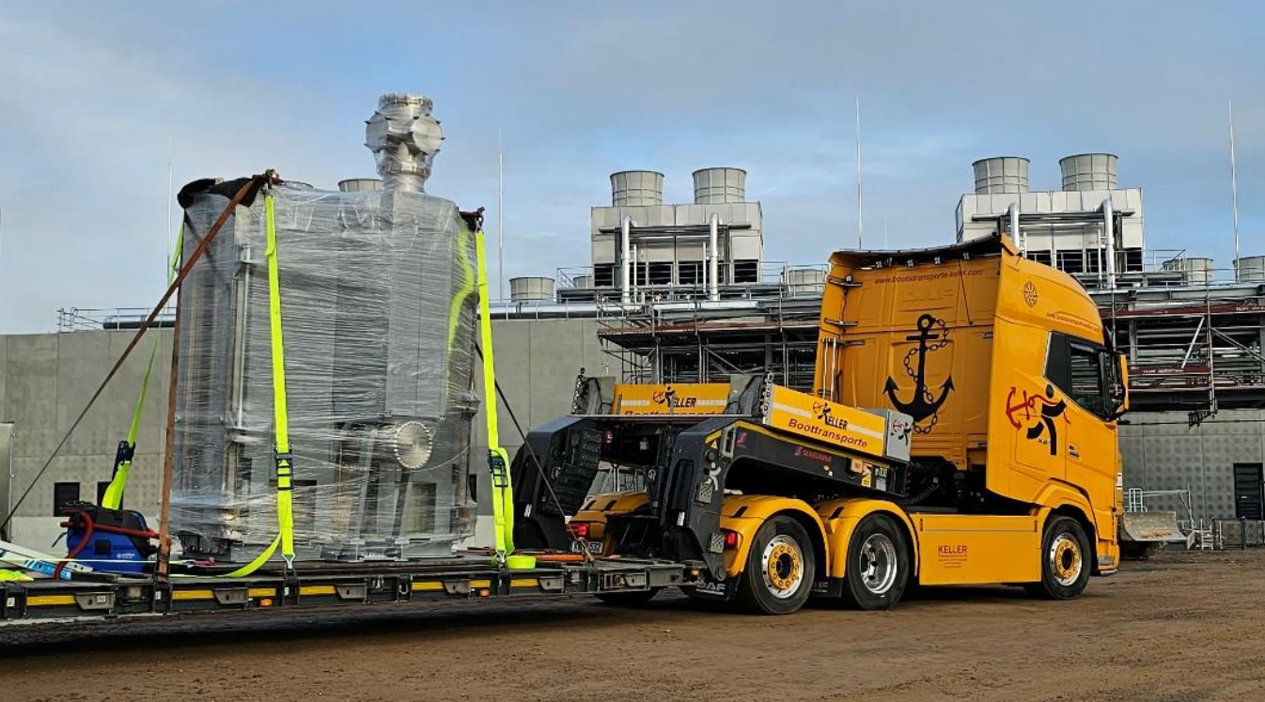
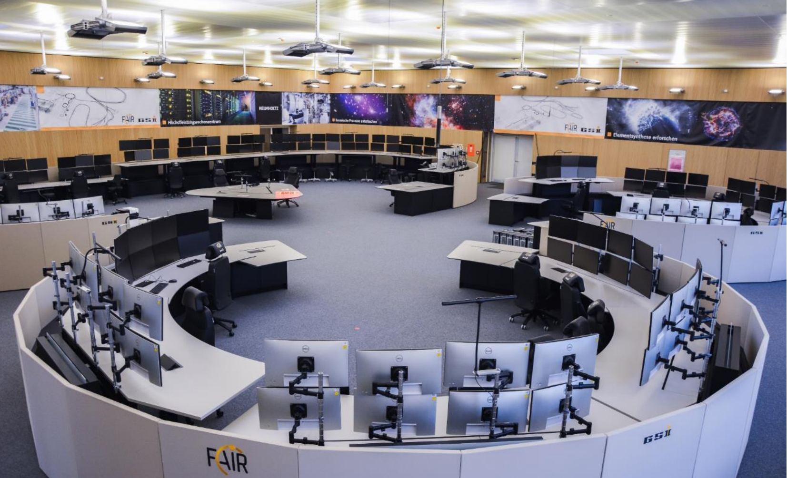
cryogenics
SIS-100
SuperFRS target chamber
New control room

Slide 19
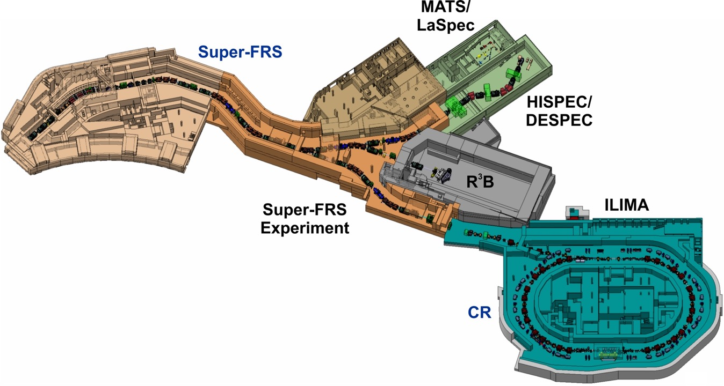
NUSTAR: experiment locations
FS++
Low-energy branch
-needs infrastructure
-serves:
Super-FRS EC,
HISPEC/DESPEC,
MATS,
LASPEC
-physics workshop:
1 October 2025
FHF1
FHF2
FMF2
Early and first science:
Mainly FHF2 and FHF1
Only R3B, HISPEC/DESPEC, Super-FRS EC

Slide 20
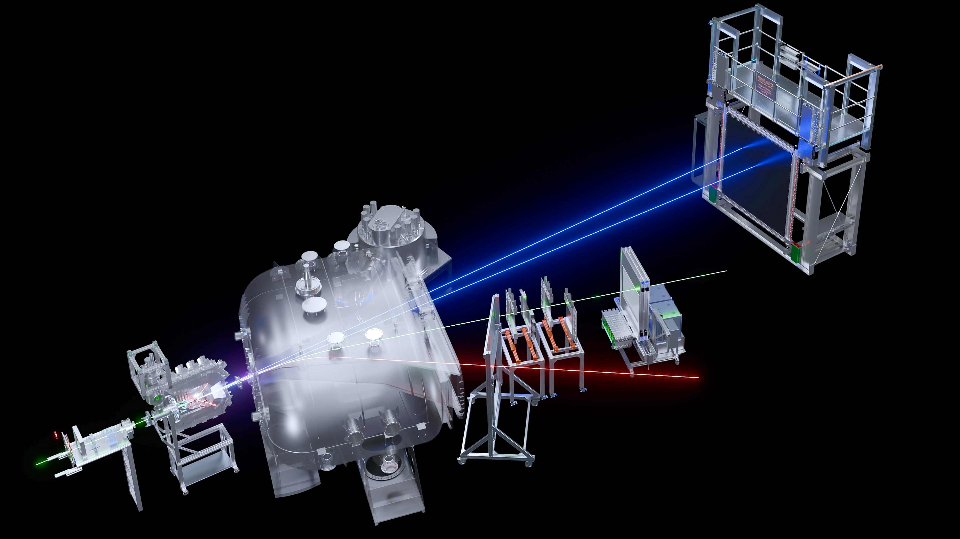

NeuLAND
International collaboration with over 200 members
Structure of rare isotopes
Density-dependence of the nuclear symmetry energy
NN-correlations, clustering
Fission of p/n-deficient nuclei
Nuclear astrophysics
Hypernuclei
Open quantum systems, multi-neutrons
Neutrons
TOFD
GLAD
Fibers
Heavy ions
CALIFA
+ LH2 target
𝛾, p, n, …
\
Light ions
Tracking
detectors
RI beam
RPC

Slide 21
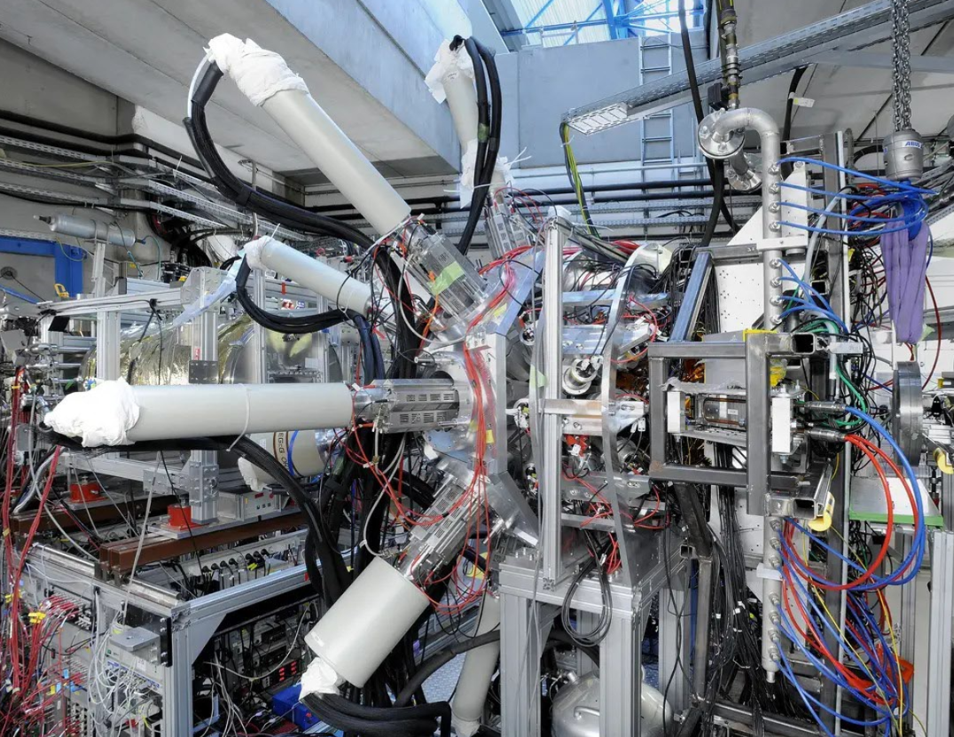
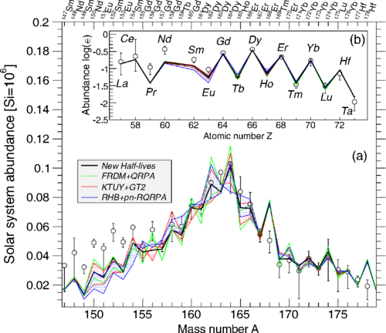
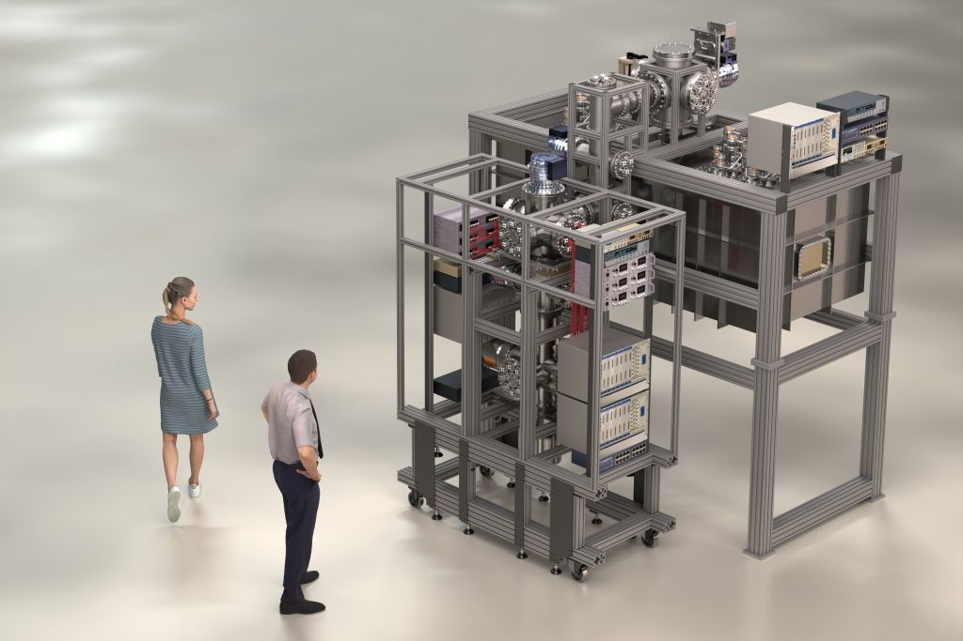
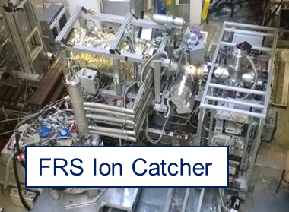
Physics in the SuperFRS tunnel
As shown at JSC Oct. 2024
Production of exotic neutron-rich isotopes
Measurement of their beta-decay lifetimes
Measurement of their masses
Astro impact, based on theory
Decay setup
SuperFRS Ion Catcher
Notes:
New ion catcher is being built, commissioning at FRS is not planned; off-line commissioning planned for mid 2027

Slide 22
CARME@CRYRING – future plans
November 2026: Two proposals accepted (Edinburgh PIs) investigating the ¹⁹F abundance in the universe, and a key reaction in X-ray bursters.
2027+: More studies planned with stable beams, including a re-run of D+D to reach 1-2% overall uncertainty, as well as electron screening studies using beam-on-beam collisions, and more!
2030+?: First radioactive beam reactions at CRYRING.
Revolving ions
FISIC ion source
Transverse ion beam

Slide 23
After the fire of 05/02/2026
Full GSI/FAIR capabilities with UNILAC as a high-intensity short-pulse machine and HELIAC for long-pulse operation within Q4/2030 (2032)
Heavy ion beams (up to Xe or heavier) for an intermediate science program latest Q4/2028 until Q4/2030
Beams for commissioning the FAIR machines and detectors (min. ¹²C) in Q4/2027

Slide 24
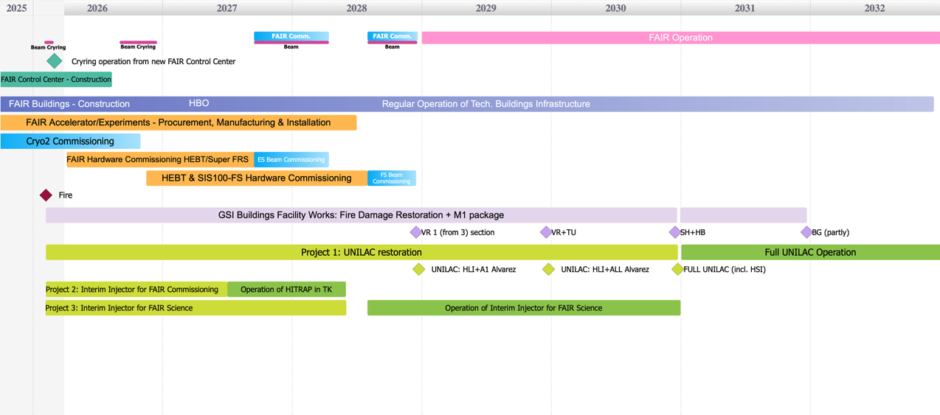
Integrated Campus Schedule
including the additional GSI activities resulting from the Fire-Incident on the 5th of February 2026
FAIR project
new GSI fire damage restoration projects
other
GSI ACC
big projects
Project: Alvarez 2.0 for UNILAC (excluding the installation phase)
ready for installation
Project part1: SIBAF (HELIAC Front-End + CM1)
part 2: HELIAC full setup (incl. CM2 & CM3)
ready for full operation

Slide 25
Commissioning beamtime 2027
min. ¹²C-beam at low intensity (1E7-1E8/spill, ¹²C⁵⁺ up to 1,5GeV/u)
(PARTIH I HITRAP in transfer channel)
Main focus: technical commissioning with beam of FAIR HEBT (beam transport lines) and Super-FRS
Beam parameters not sufficient for a competitive user beamtime, focus is on detector tests and individual experiments (e.g. BIO)

Slide 26
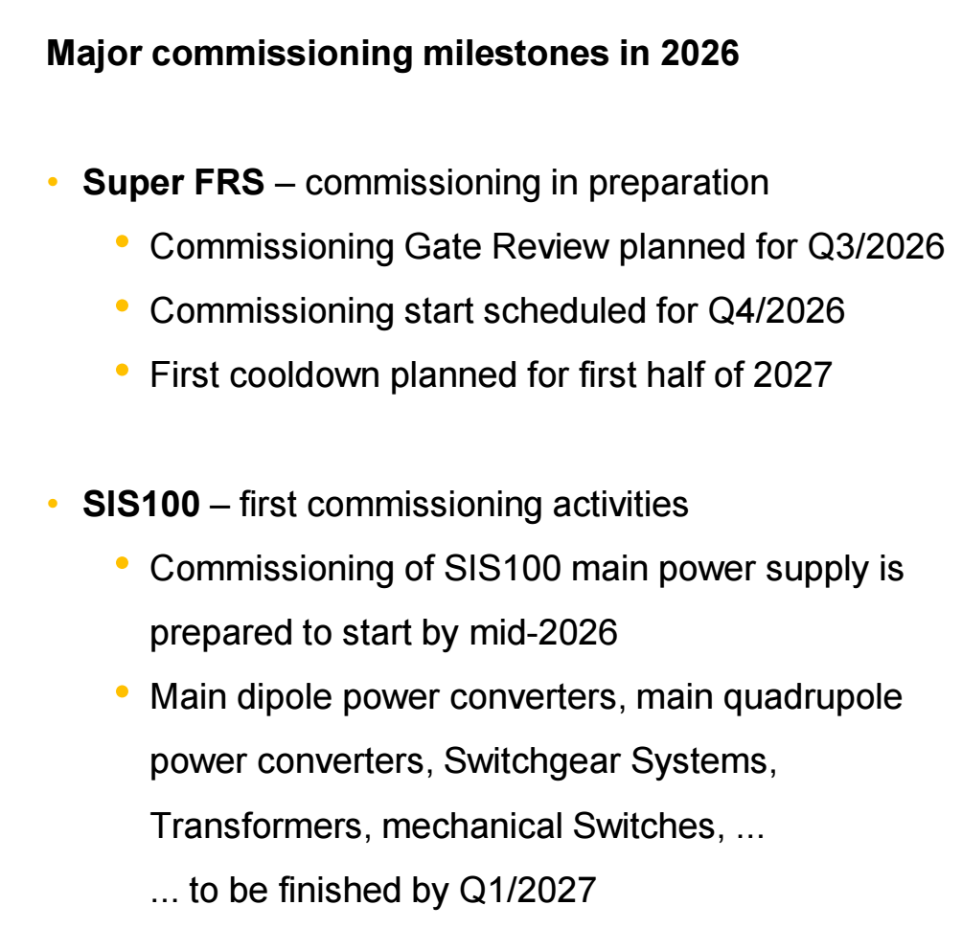

Slide 27
Further commissioning and intermediate science 2028-2030
min. Xe-beam at medium intensity (InterLAC)
SIS100 commissioning
Super-FRS, CBM and NUSTAR detector commissioning
Adapted FAIR28 science program for all communities
  First measurements with light and medium heavy beams at CBM
  Galactic cosmic ray simulator at 10GeV/u (bio physics)
  Adapted NUSTAR FS program with focus on R3B
  …
On a critical path are the experiments requiring UNILAC long-pulse operation as well as ion beams in Exp. Hall, like SHE and Materials Research

Slide 28
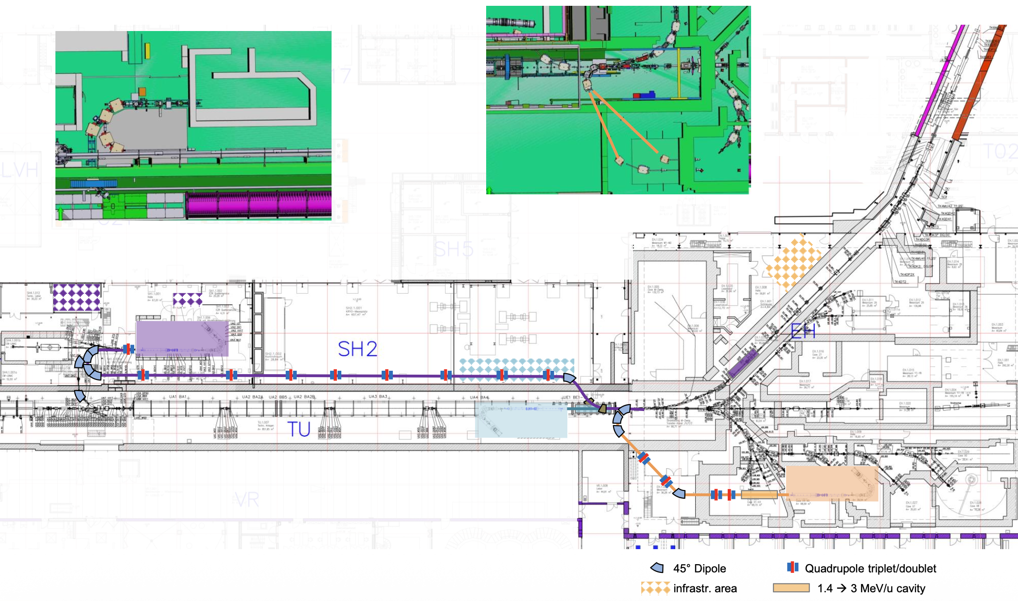
InterLAC – location opportunities
Courtesy of Gregor Loisch

Slide 29
Beamtime expectation
Commissioning and user beamtime / days
User beamtime / days
90
180
180
180
200
200
200
2027
2028
2029
2030
2031
2032
2033
HITRAP I PARTIH p – min. C beams, low intensity
InterLAC p - min. Xe beams, medium intensity
UNILAC p – U beams, high intensity (only short pulse operation)
UNILAC + HELIAC full operation

Slide 30
NUSTAR >640 members (449 with PhD) (without Russia)
NUSTAR spokesperson: Podolyak
R³B
HISPEC/ DESPEC
Super-FRS
EC
219
Petri
MATS
237
ILIMA
48
185
SHE
67
Herzberg
LaSpec
43
Cheal
74
Status: Sep 28, 2025
>640 NUSTAR members
(incl. students, engineers)
EXL dormant
Reactions in rings incorporated into ILIMA
> 1000 listed “interested” scientists
> 640 registered members
(incl. students, etc.)
~ 449 senior members
(PhD holders w/o Russia)
> 140 institutes from 35 countries
Notes:
=RUNDEN(WURZEL(B5/PI());2)

Slide 31
NUSTAR >640 members (449 with PhD) (without Russia)
NUSTAR spokesperson: Podolyak
R³B
HISPEC/ DESPEC
Super-FRS
EC
219
Petri
MATS
237
ILIMA
48
185
SHE
67
Herzberg
LaSpec
43
Cheal
74
Status: Sep 28, 2025
>640 NUSTAR members
(incl. students, engineers)
EXL dormant
Reactions in rings incorporated into ILIMA
> 1000 listed “interested” scientists
> 640 registered members
(incl. students, etc.)
~ 449 senior members
(PhD holders w/o Russia)
> 140 institutes from 35 countries
Notes:
=RUNDEN(WURZEL(B5/PI());2)

Slide 32
UK contributions
University of Brighton,
University of Edinburgh,
University of Liverpool,
University of Manchester,
University of Surrey,
University of West of Scotland,
University of York,
STFC Daresbury Laboratories
Target Recoil Detector for R3B
LYCCA for HISPEC
AIDA and FATIMA LaBr3(Ce) array
for DESPEC
CARME Si array for CRYRING
UK is associate member: committing to contributing 0.5% share of the commissioning and operations costs until three years after the start of operations

Slide 33
Evolution of the FAIR membership status when construction is complete
I asked STFC

Slide 34
The UK contributes to NUSTAR/FAIR by providing equipment
DESPEC: AIDA Si implantation and decay detector,
FATIMA LaBr3(Ce) fast-timing array,
(DTAS mechanics)
HISPEC: LYCCA array (to track and identify reaction products)
R3B: Si target-recoil tracker for the identification and characterisation
(CARME Si array in CRYRING is not considered to be part of NUSTAR)
The UK is associate member
The UK pays 0.5% of the (commissioning and) running costs
This needs to be renegotiated years after the start of operations (2029), by 2032.

Slide 35
DSIT (Department for Science, Innovation and Technology) are the official signatories to the convention that signed us up to FAIR, which STFC manages.
STFC will be looking to the UK nuclear physics community for their recommendation of how they would like to continue (or not) to be involved with FAIR, noting that this will be subject to budget availability.

Slide 36
The FAIR subscription did have a proforma that went into the prioritisation process but, since it was not possible to withdraw before the end of this spending review, it was not considered as part any cost reduction in this prioritisation process.
The FAIR subscription has now moved into the international partition, so will not be directly tensioned against other items in the NP core budget. However, the international partition is no long ring-fenced and has financial pressures so when the renegotiation happens we will need a strong case of the interest and demand from the NP community to stay involved - it can not be assumed that we will continue if there is not a case to be made.

Slide 37
International subscriptions
CERN # £160 million
European Molecular Biology Laboratory (EMBL)
European Southern Observatory (ESO)
European Spallation Source (ESS)
European Synchrotron Radiation Facility (ESRF)
European XFEL (Eu-XFEL)
Facility for Antiproton and Ion Research (FAIR) #
Institute Laue-Langevin (ILL) #
Square Kilometre Array Observatory (SKAO)
# has nuclear
https://www.ukri.org/what-we-do/creating-world-class-research-and-innovation-infrastructure/international-subscriptions/
https://www.ukri.org/who-we-are/stfc/facilities/why-is-the-uk-involved-in-cern/

Slide 38
How important is FAIR to the community?
need to be answered within the next couple of years
full associate aspiring
members member member

