Slide 1

ISOLDE Update
UK Nuclear Physics Community Meeting
6th July 2026
Kara M. Lynch
UK rep on the ISOLDE Collaboration Committee (ISCC)

Slide 2




UK at ISOLDE
ISOLDE: ISOL radioactive ion beam facility at CERN
10 UK institutions listed in ISOLDE MoU
  UK involvement via STFC Consolidated Grant and external grants
  Currently 3 UK instrument spokespersons: ISS, IDS and CRIS
  UK capital investment: ISCOOL, ISS, IDS, MINIBALL and CRIS
UK science interests: nuclear physics, BSM physics, medical isotopes etc.

Slide 3
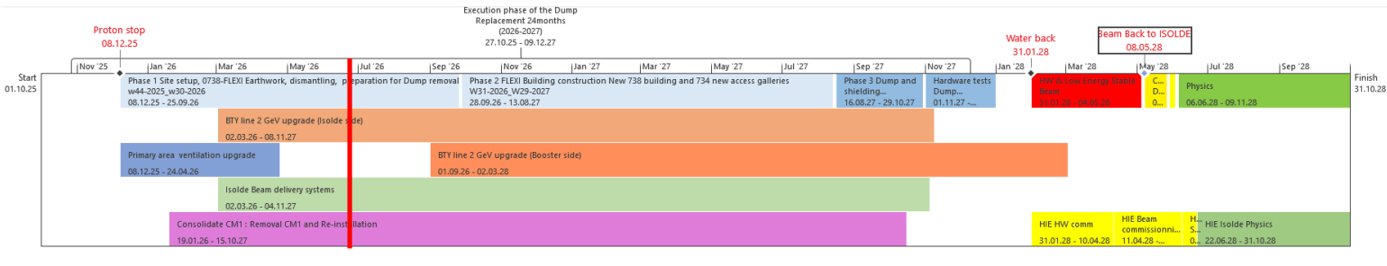
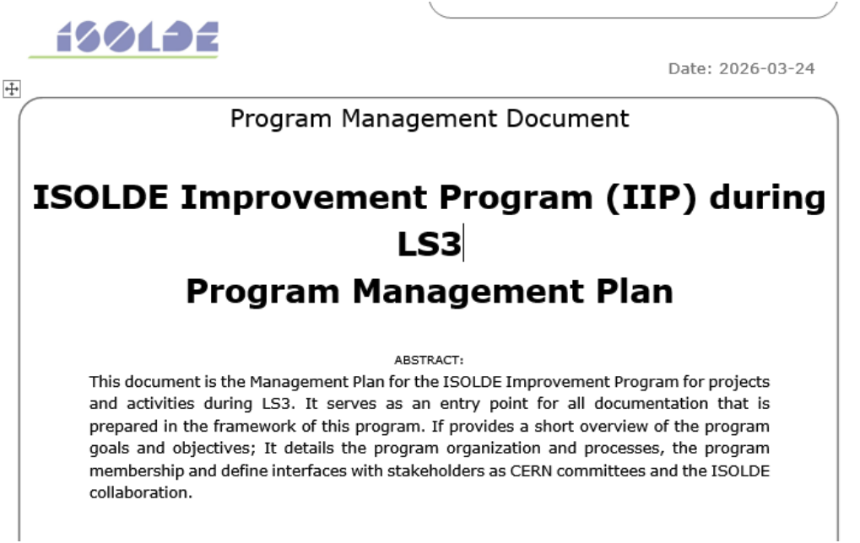
LS3 and ISOLDE Improvements Program
CERN entered Long Shutdown 3 (LS3) on 29th June 2026
  ISOLDE started LS3 earlier in December 2025
ISOLDE Improvements Programme is underway:
  Primary areas ventilation and fire safety upgrade
    Extending B.197 with new HVAC equipment
  Proton beam line (PSB to ISOLDE) upgrade
    Proton energy from 1.4 GeV to 2 GeV
  ISOLDE beam dumps replacement
    New beam dumps and shielding building
  ISOLDE beam delivery systems upgrade
    ISCOOL hardware/diagnostics
    Consolidation of beam instrumentation
  HIE-ISOLDE cryomodule refurbishment

Slide 4
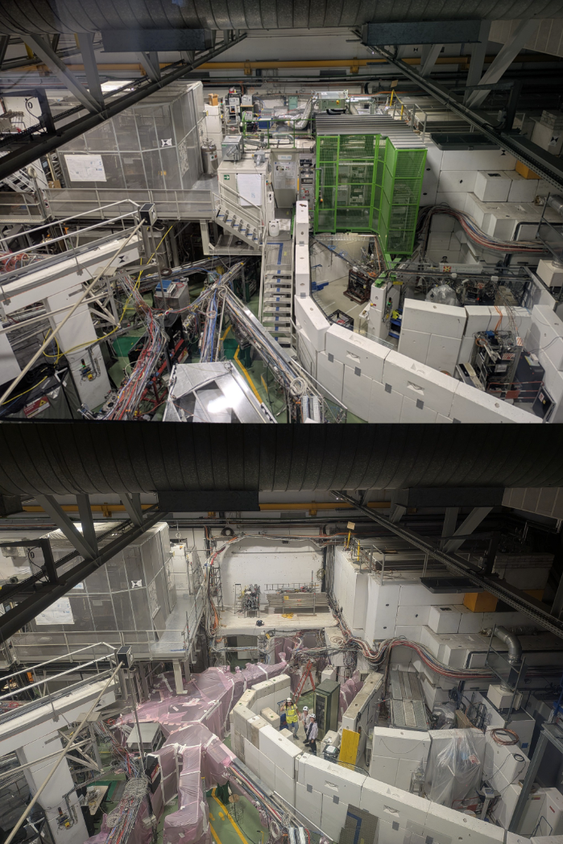
Then and now…
Before LS3…
Last week…
New RILIS laser cabin / ISCOOL platform
New ISOLTRAP platform
New CRIS/COLLAPS laser cabins/platform
Protons back to ISOLDE on 8th May 2028
More info: https://ep-news.web.cern.ch/content/isolde-improvement-programme

Slide 5
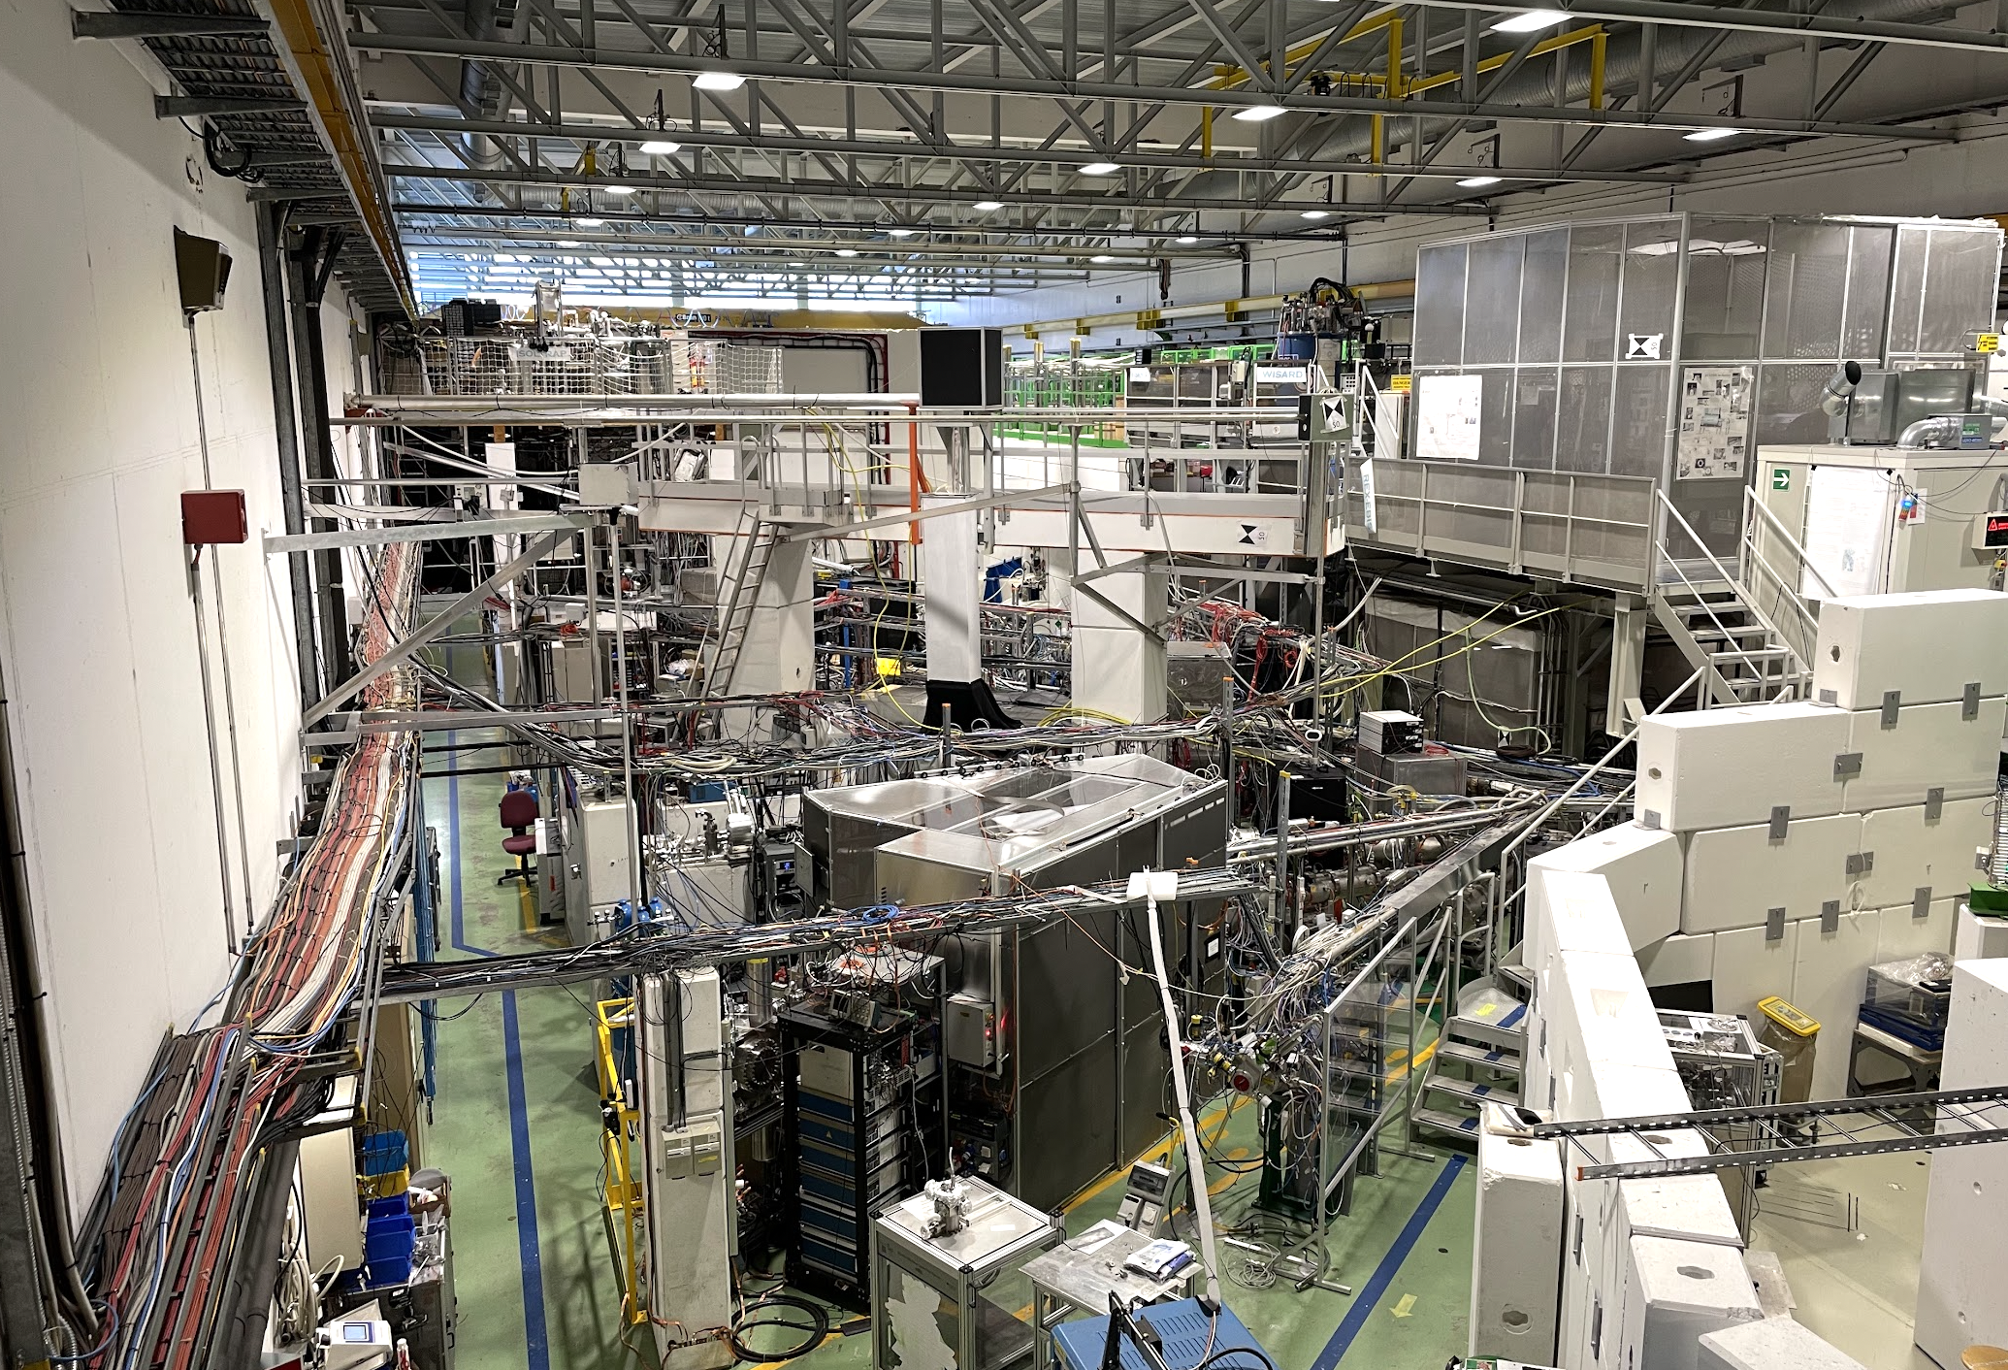
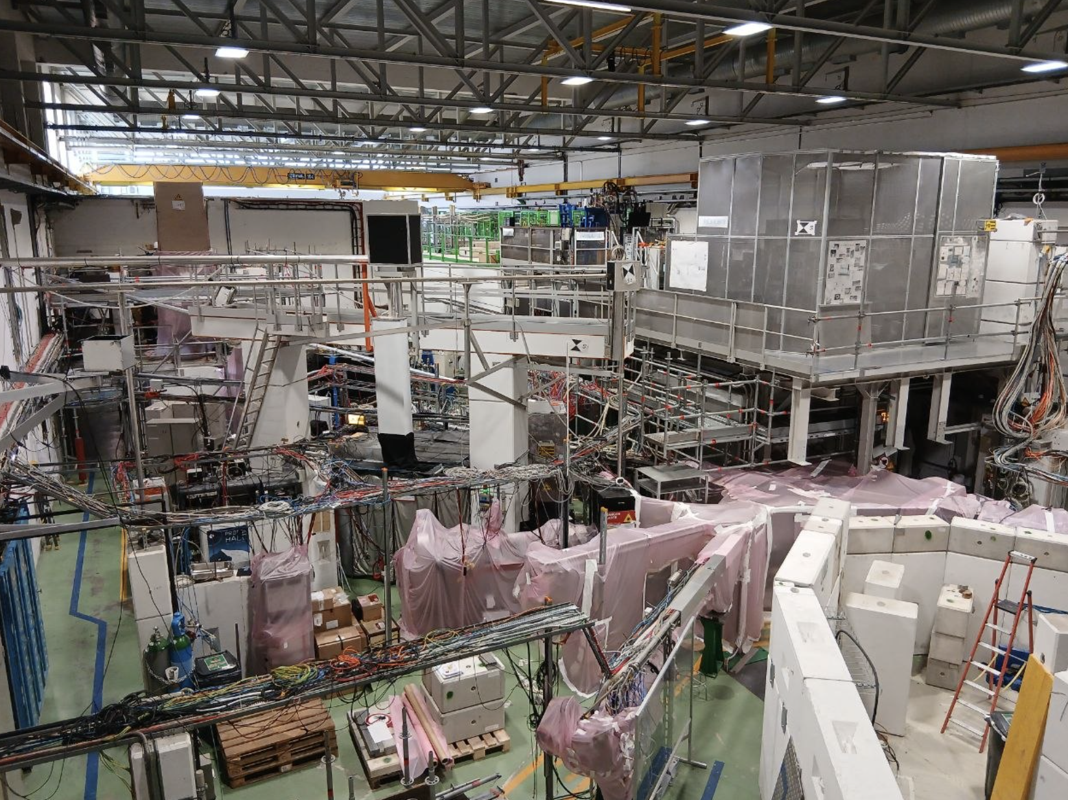
Then and now…
2024…
Last week…
New RILIS laser cabin / ISCOOL platform
New ISOLTRAP platform
New CRIS/COLLAPS laser cabins/platform
Protons back to ISOLDE on 8th May 2028
More info: https://ep-news.web.cern.ch/content/isolde-improvement-programme

Slide 6
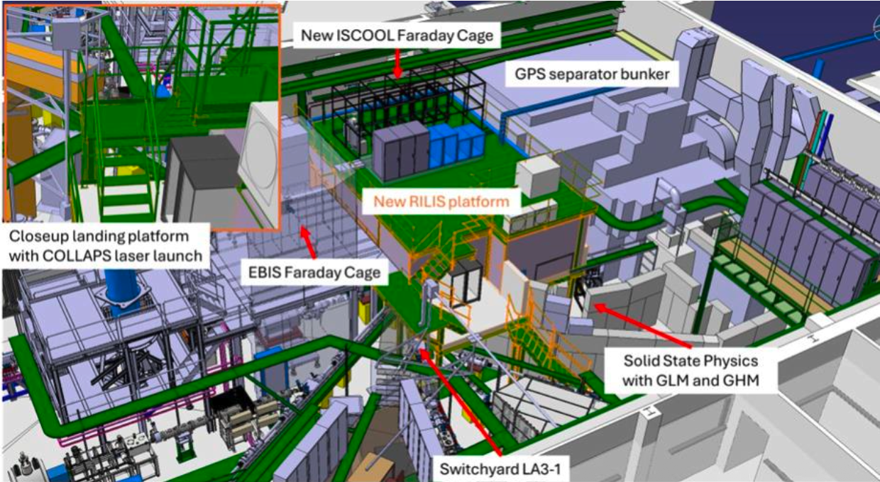
Post-LS3 configuration

Slide 7
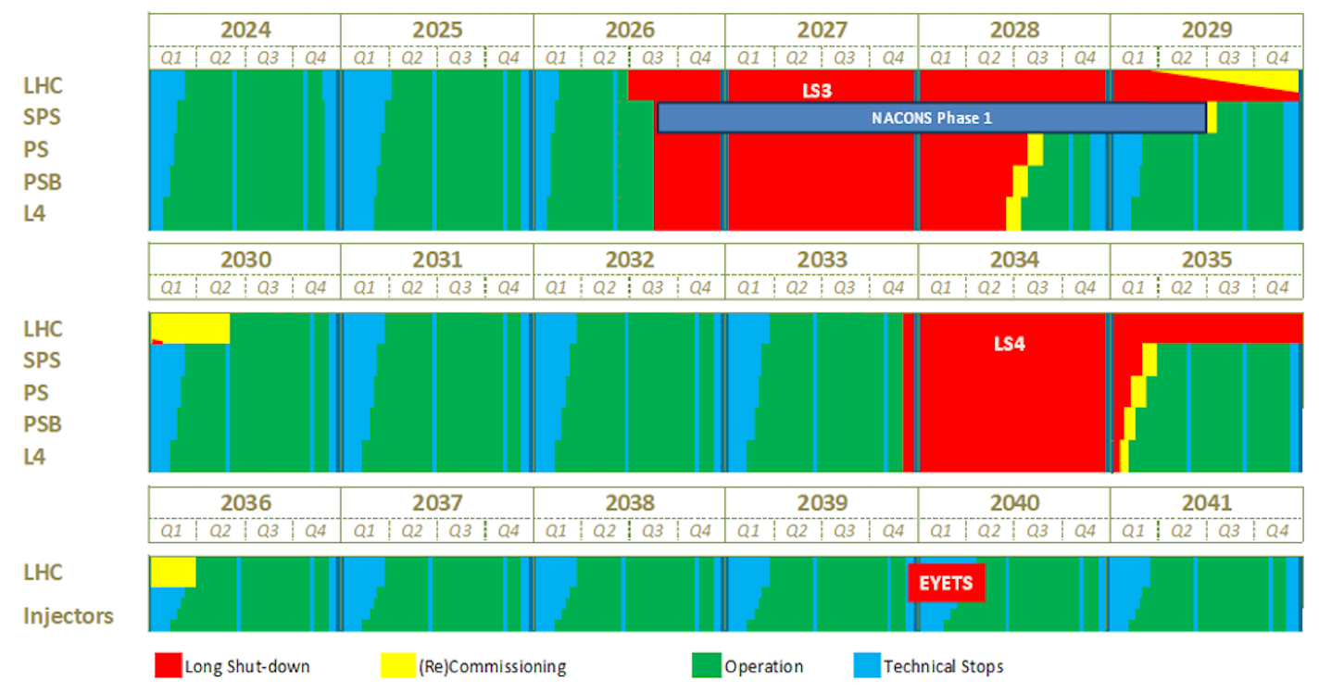
CERN Roadmap for Non-Collider Physics
Plans for a 20-year roadmap for Non-Collider Physics (NCP) programme at CERN
  Marcus Brugger is leading a task force to establish a ‘science driven, community inclusive, and infrastructure / resource constrained holistic 20 yr roadmap’
  More info on the Roadmap: https://indico.cern.ch/event/1696414/
Scope: Covering existing experiments/facilities and possible future ones
  PS East-Area, AD/ELENA, nToF, ISOLDE, SPS North-Area, auxiliary LHC experiments, neutrino related…
INTC has opened a call for Expressions of Interest for programmes at ISOLDE
  Driven by physics themes, rather than specific instruments
Expressions of Interest (10 pages) to cover:
  Scientific motivation and impact
  Research programme
  Timeline and resources
    Run 4 (2028-2033)
    LS4 / Run 5 (2034-2041)
    Beyond (2041-2046)

Slide 8
Procedure for preparing the Roadmap
INTC opened call for Expression of Interest (EOI)
  Submission deadline: 7th October 2026
INTC: 4-5th November 2026
  Fully devoted to Non-Collider Physics Roadmap preparation
  4th Nov (open session): EOIs in-person oral presentations
  5th Nov (closed session): first EOIs evaluation based on initial technical reviews
INTC: 10-11th February 2027
  More in-depth assessment of EOIs
    Prioritise as "must have” (Top), "should / could” (High), "relevant" (Medium)
    Create a consolidated programme for ISOLDE by early 2027
  Resume discussion on regular proposal submissions (ISOLDE and n_TOF)
Deadline for Roadmap ~ March 2027
People encouraged to contact INTC Chair and Secretary (Silvia Leoni, Hanne Heylen) and ISOLDE Group Leader (Luis Fraille) early to ensure alignment with the call

Slide 9
More info from Silvia, Luis and Hanne
EOIs to be a starting point for drafting a ‘challenging scientific roadmap’
  Justify upgrades to existing experimental programs and development of new instrumentation (with indicative budget)
  Timeline of short, medium and long-term projects
Looking for EOIs around physics themes rather than from existing collaborations / instruments
  e.g. ‘what are the most important scientific questions for the next 10–20 years related to nuclear reactions / nuclear structure etc.’
Luis will reach out to trigger working groups which will guide this exercise
  They will ensure there is a coherent approach to the contribution
EOIs will be reviewed by the INTC but used by the Roadmap taskforce
  Suggested to aim the document for a wider physicist audience
The process is still being developed so more information should be coming in due course

Slide 10

Other ISOLDE news…
Inaugural ISOLDE Ph.D. Prize 2026 now open for nominations
  Awarded annually for the best Ph.D. thesis in nuclear physics based on ISOLDE data
  Ph.D. viva between 1st August 2025 – 31st July 2026
  Deadline: 31st August 2026
EPJ Plus - Focus Point on ISOLDE: Exploring the Frontiers of Physics with Radioactive Ion Beams
  Accepting original papers, including reviews, research, technical articles, future plans, upgrades etc.
  Submission deadline: 30th September 2026

Slide 11
Further information
Please reach out for anything ISOLDE-related
kara.lynch@manchester.ac.uk

Slide 12
Preparing input for the Roadmap
From Luis: A preliminary (non-exhaustive!) list of ideas:
  Storage ring for short-lived isotopes at MeV/u for reactions with cooled and stored radioactive ion beams
  Radioactive molecules for fundamental symmetry violation studies, EDMs... (FunSy collaboration)
  Superconducting recoil-separator for reaction products from reactions with HIE-ISOLDE
  Decay spectroscopy of trap-purified radioactive ions
  Increased energy of the HIE-ISOLDE accelerator for improved sensitivity of transfer and other reactions
  Nuclear structure and applications with laser and reaction polarized beams
  PUMA: antiprotons to study the neutron-to-proton ratio at the surface of exotic nuclei
  Solid state physics and applications, synergies with other techniques
  Biophysics opportunities
  Highly charged ions for nuclear structure, QED tests and more
  New opportunities with bunched beams at the HIE-ISOLDE accelerator
  Beam dump and other irradiation facilities at ISOLDE
  Nuclear astrophysics research with radioactive targets
  Precision studies to search for BSM physics with exotic radioactive decays
  The ^{229m}Th nuclear clock at ISOLDE
  Nuclear structure input to the ion collision programme at CERN

